Slide 1
SCEP sensitivity Estimation

Slide 2
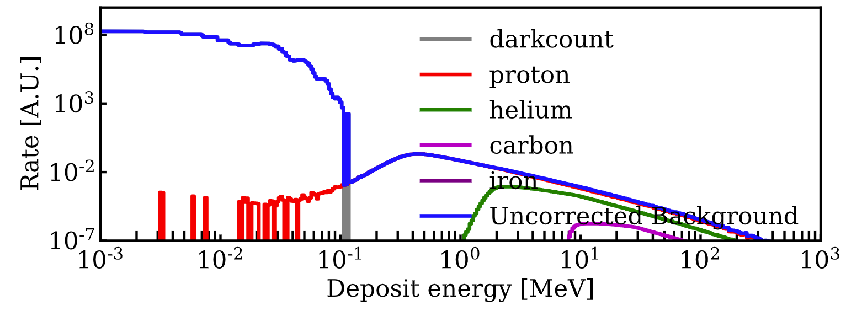
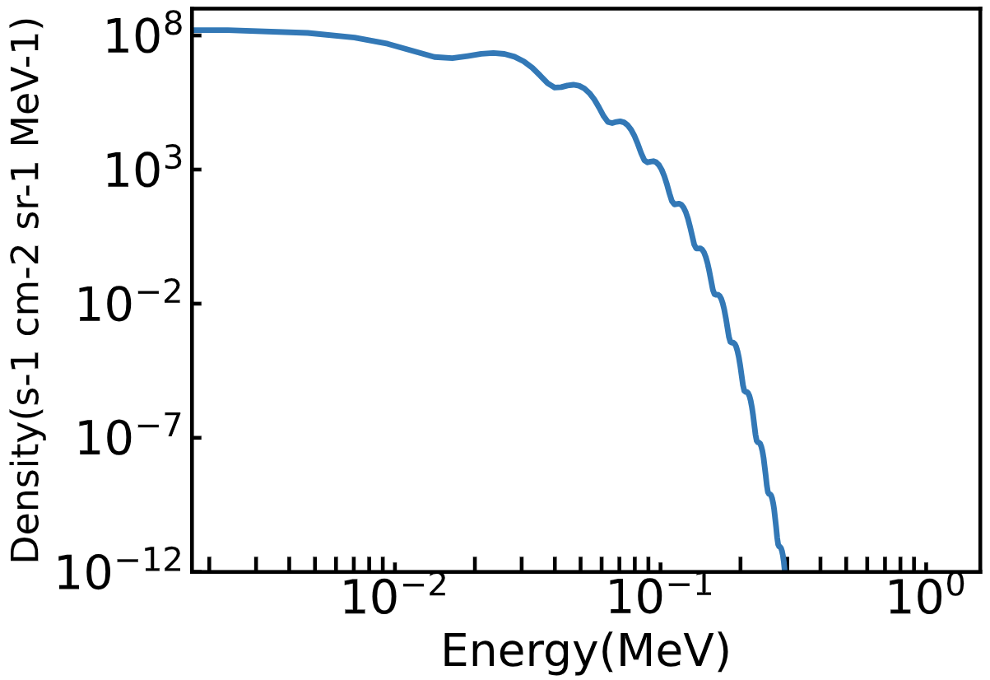
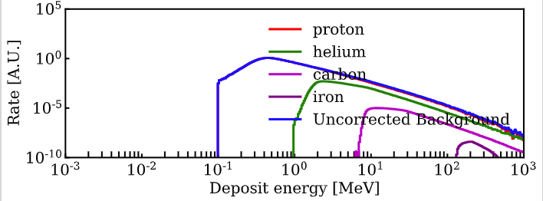
Dark count barely do not contribute to the final spectrum
Get random samples from Dark count spectrum
Dark count events will be cut by energy threshold and then contribute to single panel spectrum

Slide 3
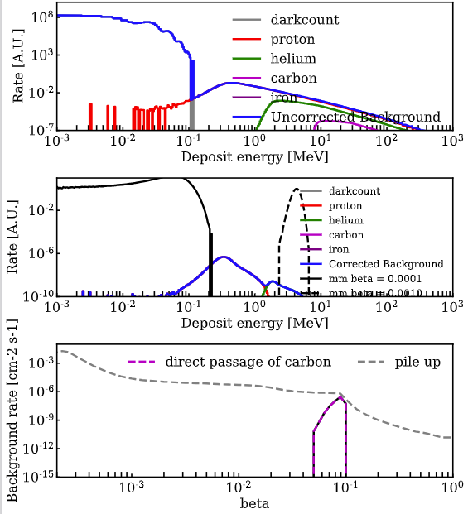
PS background spectrum and the coincidence rate with MMs
On Earth
In Space

Slide 4
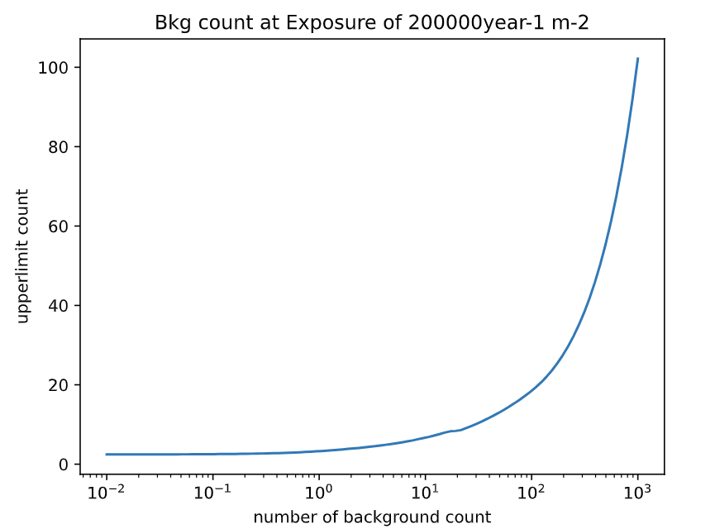
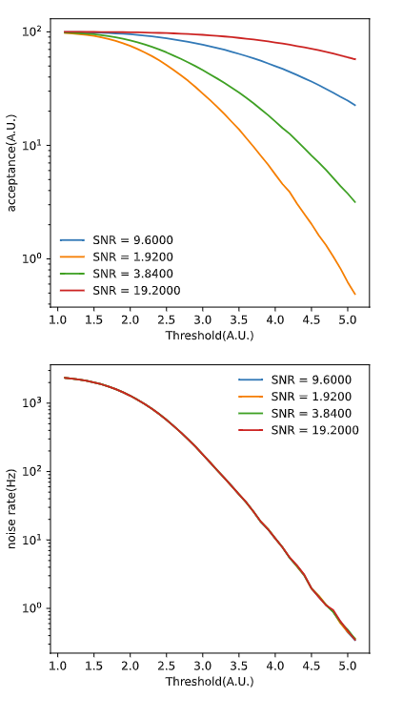
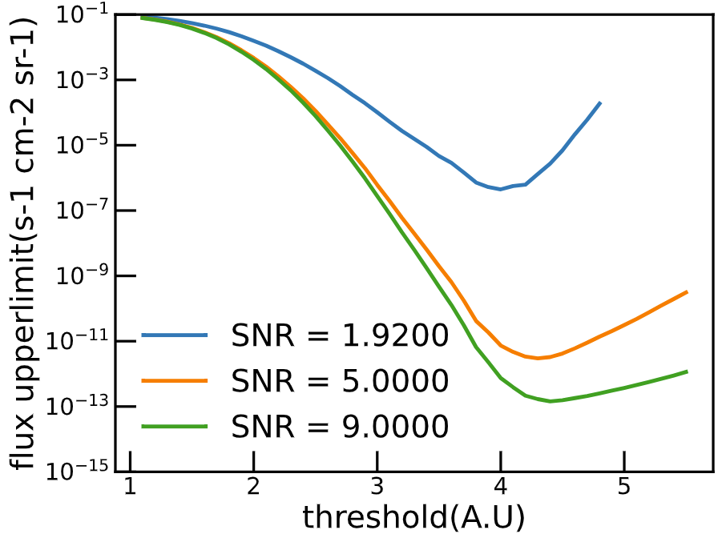
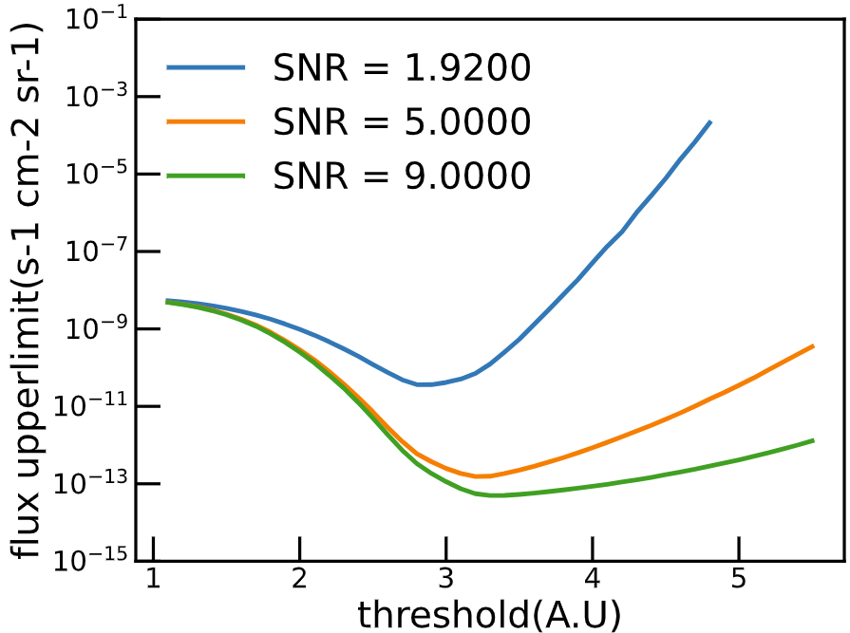
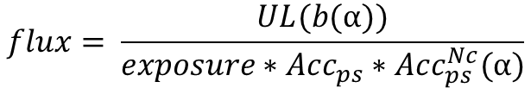
Coils’ Trigger Threshold Optimization
Upper limit calculated by Feldman Cousins Algorithm
Example:
Exposure 2000 year-1 m-2；
N coil = 5,
CI = 90%
$$flux= \frac{UL(b(α))}{exposure∗Acc_{ps}∗Acc_{ps}^{Nc}(α)}$$
β =1e-5
β =1e-3
For every exposure and every β, find the optimized value of α

Slide 5
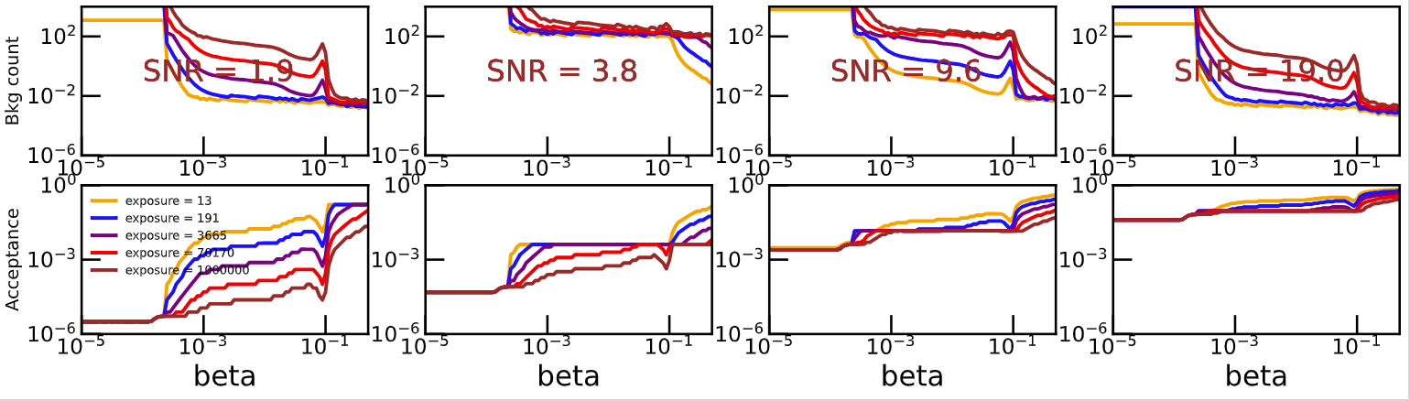
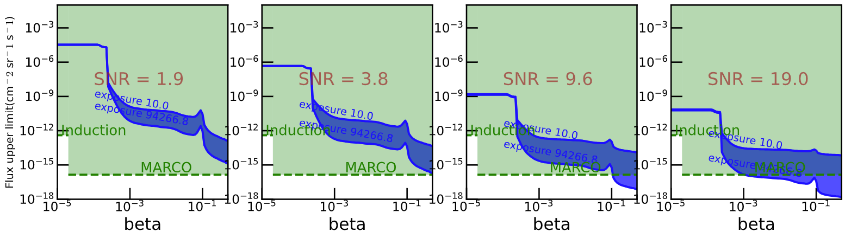
In Space N = 2

Slide 6
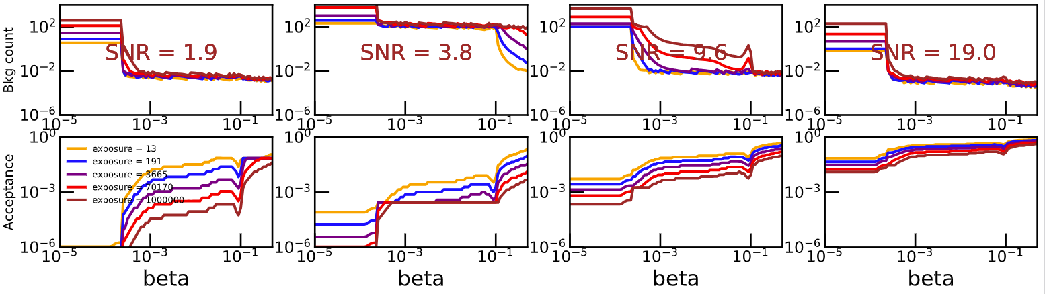
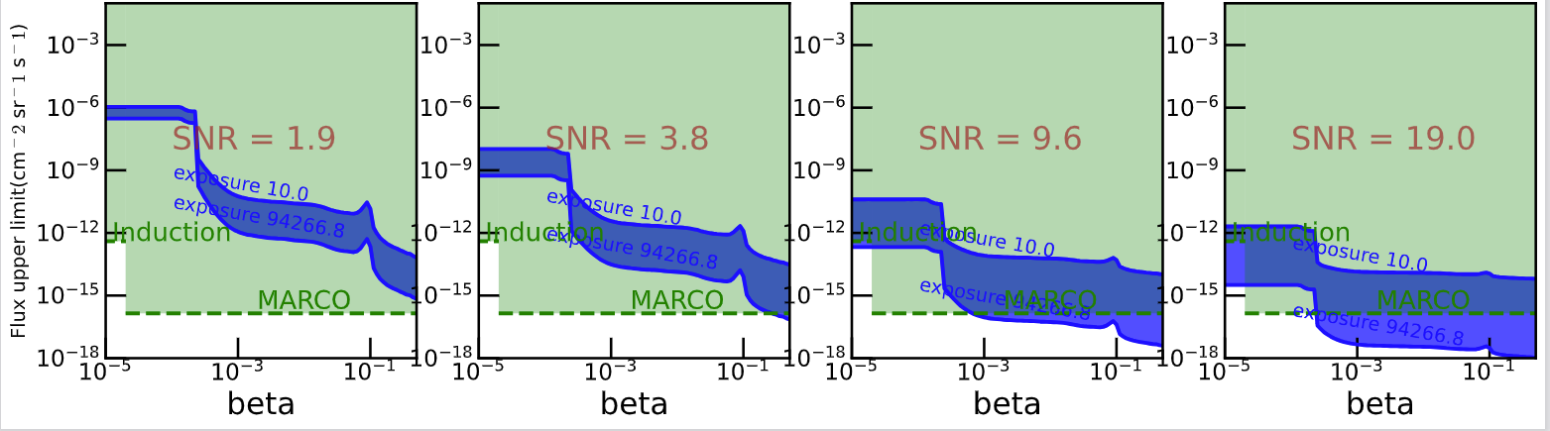
In Space N = 3

Slide 7
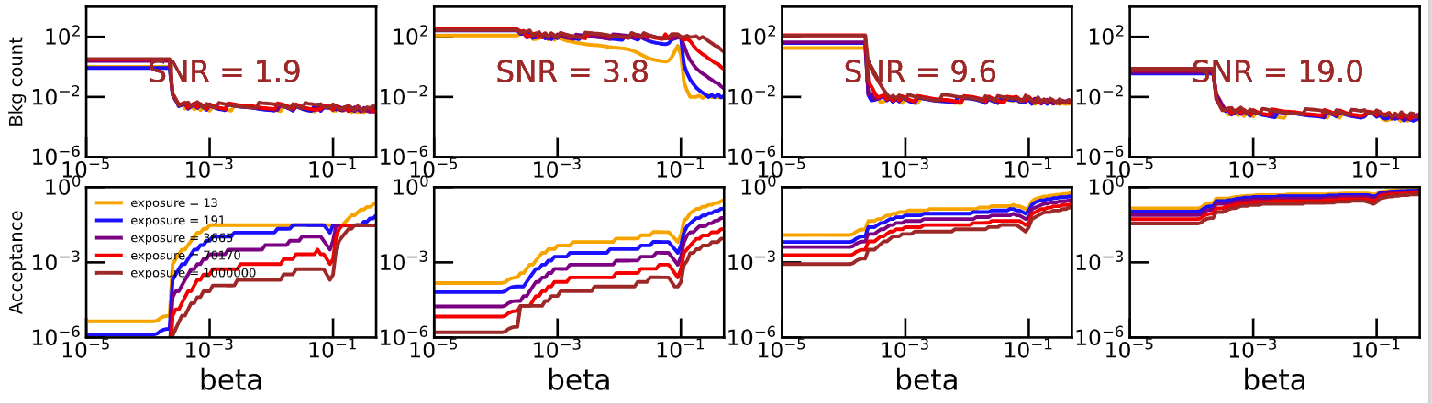
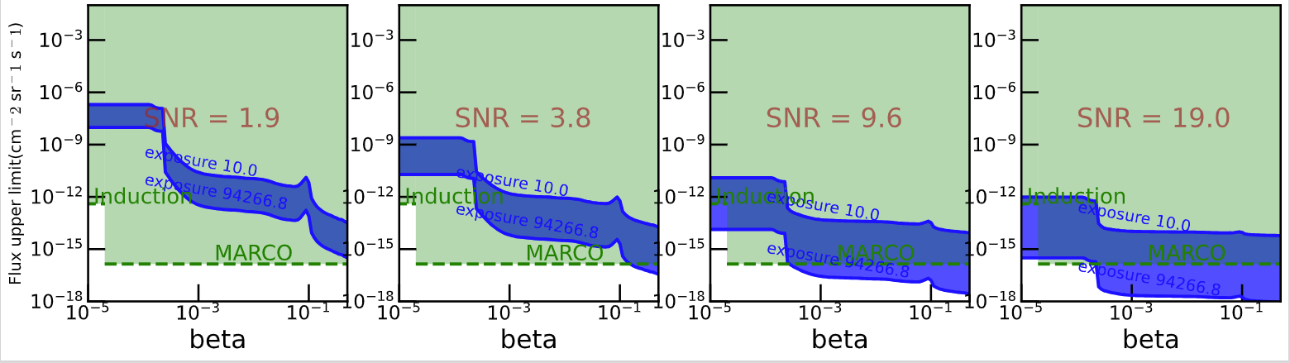
In Space N = 4

Slide 8
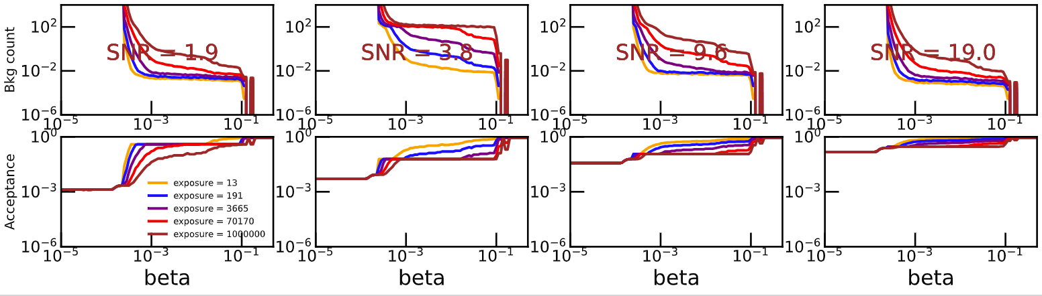
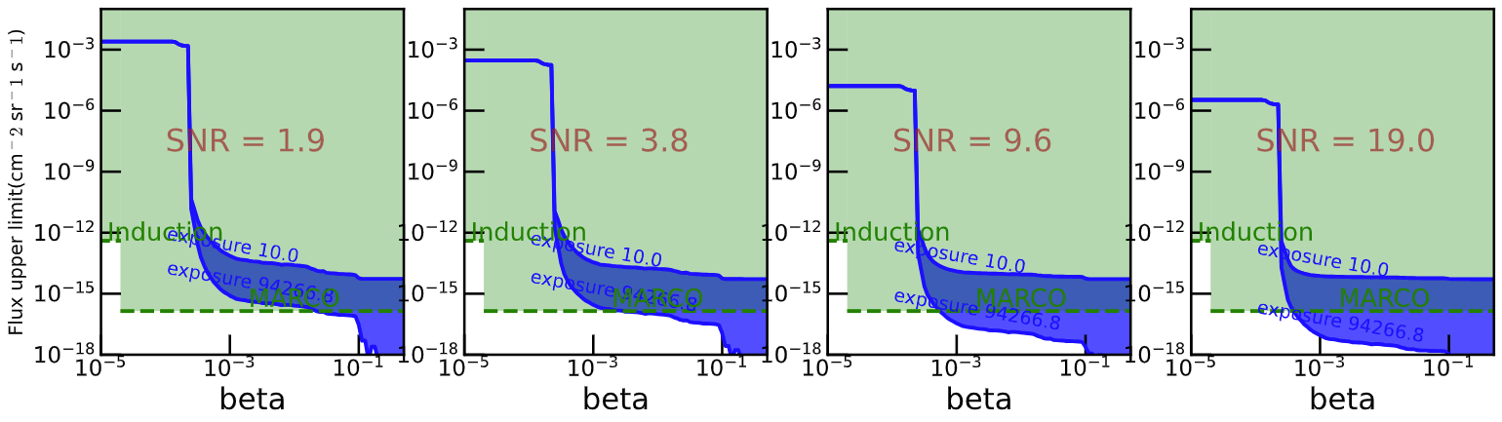
At sea level N = 1

Slide 9
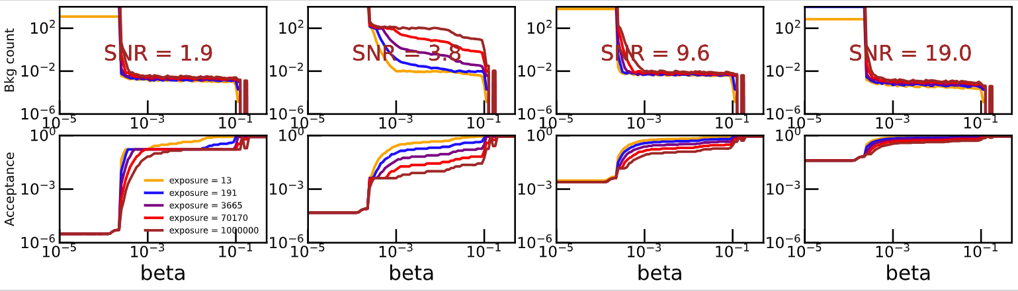
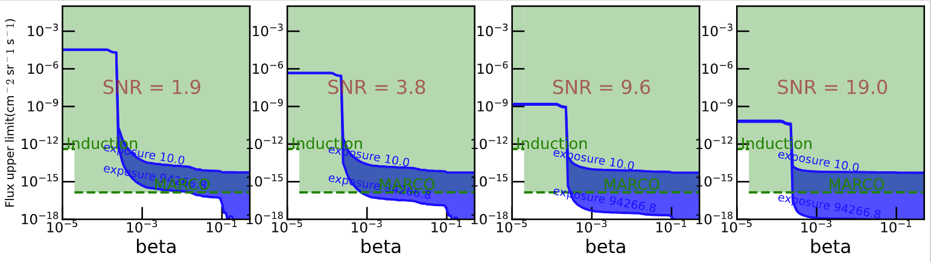
At sea level N = 2

Slide 10
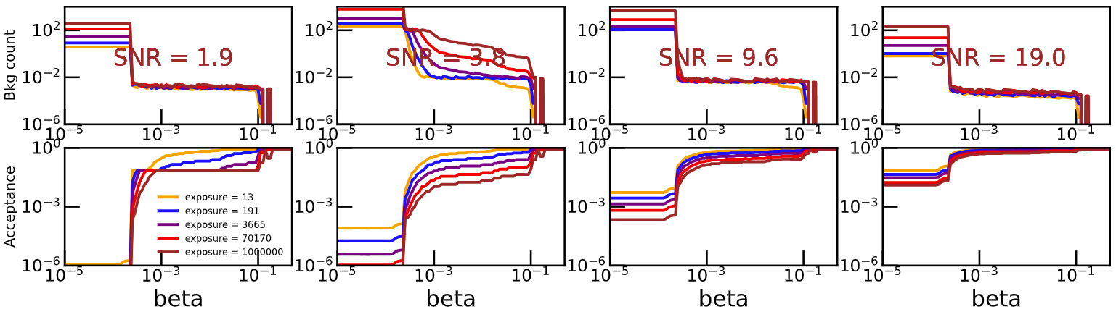
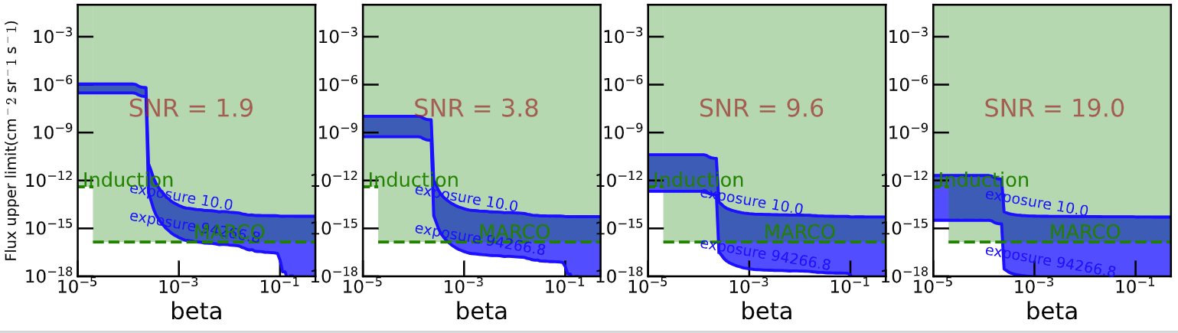
At sea level N = 3

Slide 11
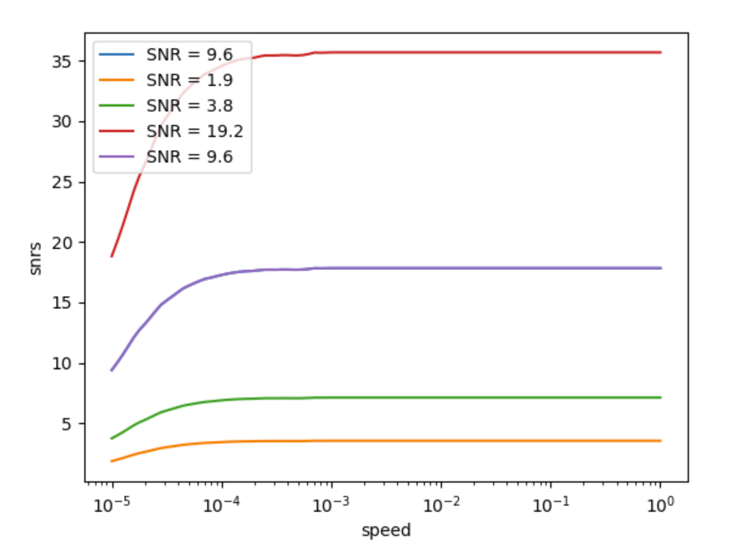
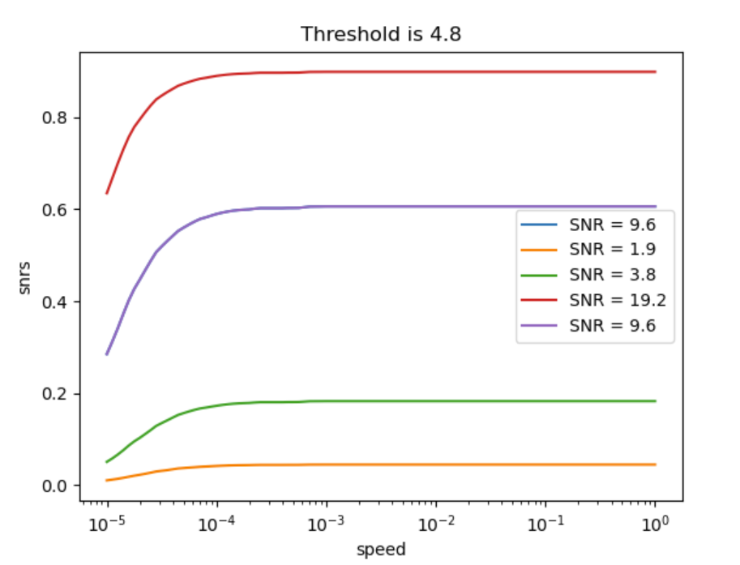
考虑SNR~speed 修正
基于V2线圈SNR~speed的模拟结果

Slide 12
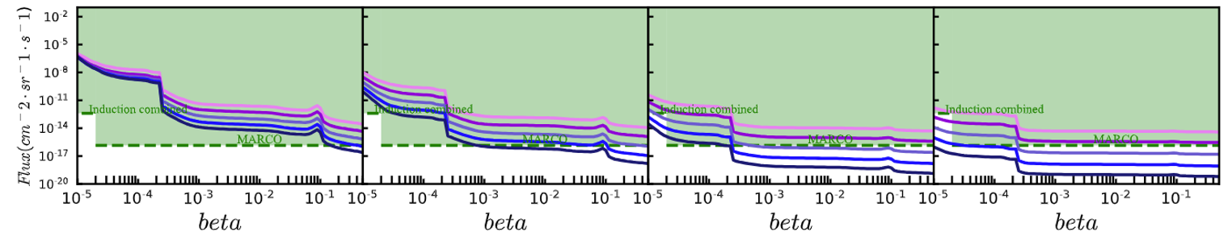
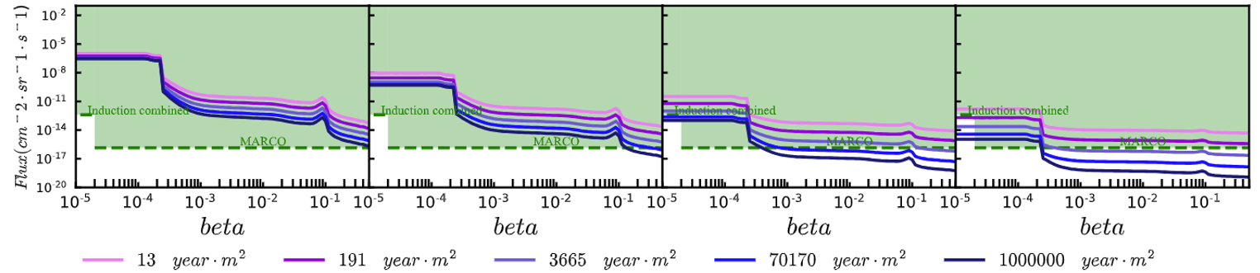
修正后
修正前

Slide 13
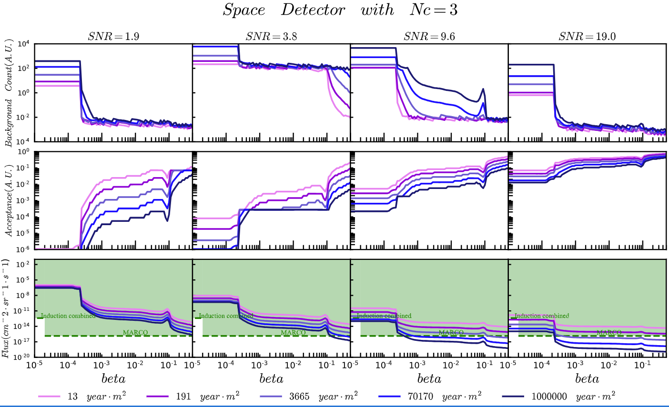
修正前details

Slide 14
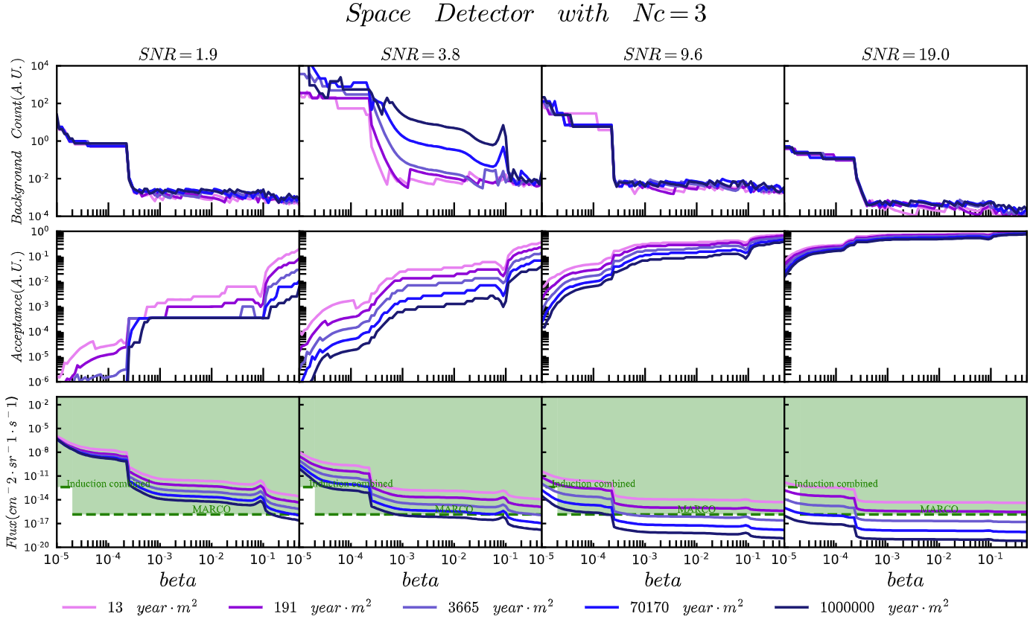
修正后details

