Slide 1
GW170817 limits on Axion-like Particles
Yongchao Zhang （张永超） Southeast University
Higgs Potential 2024, Hefei Dec 22, 2024
mainly based on PRL132(2024)101003
in collaboration with P. S. B. Dev, J.-F. Fortin, S. P. Harris & K. Sinha

Slide 2
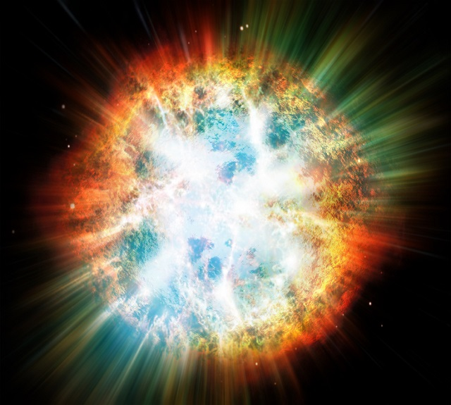
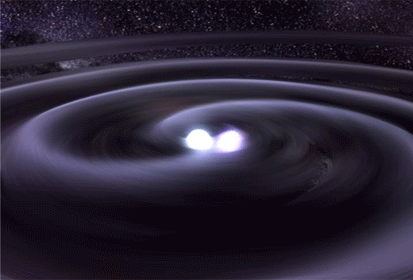
Multi-messenger astrophysics
SN1987A
Neutron Star merger
Stars | Photons | Neutrinos | GWs
Supernovae | √ | √ | predicted
Neutron Star mergers | √ | predicted | √

Slide 3
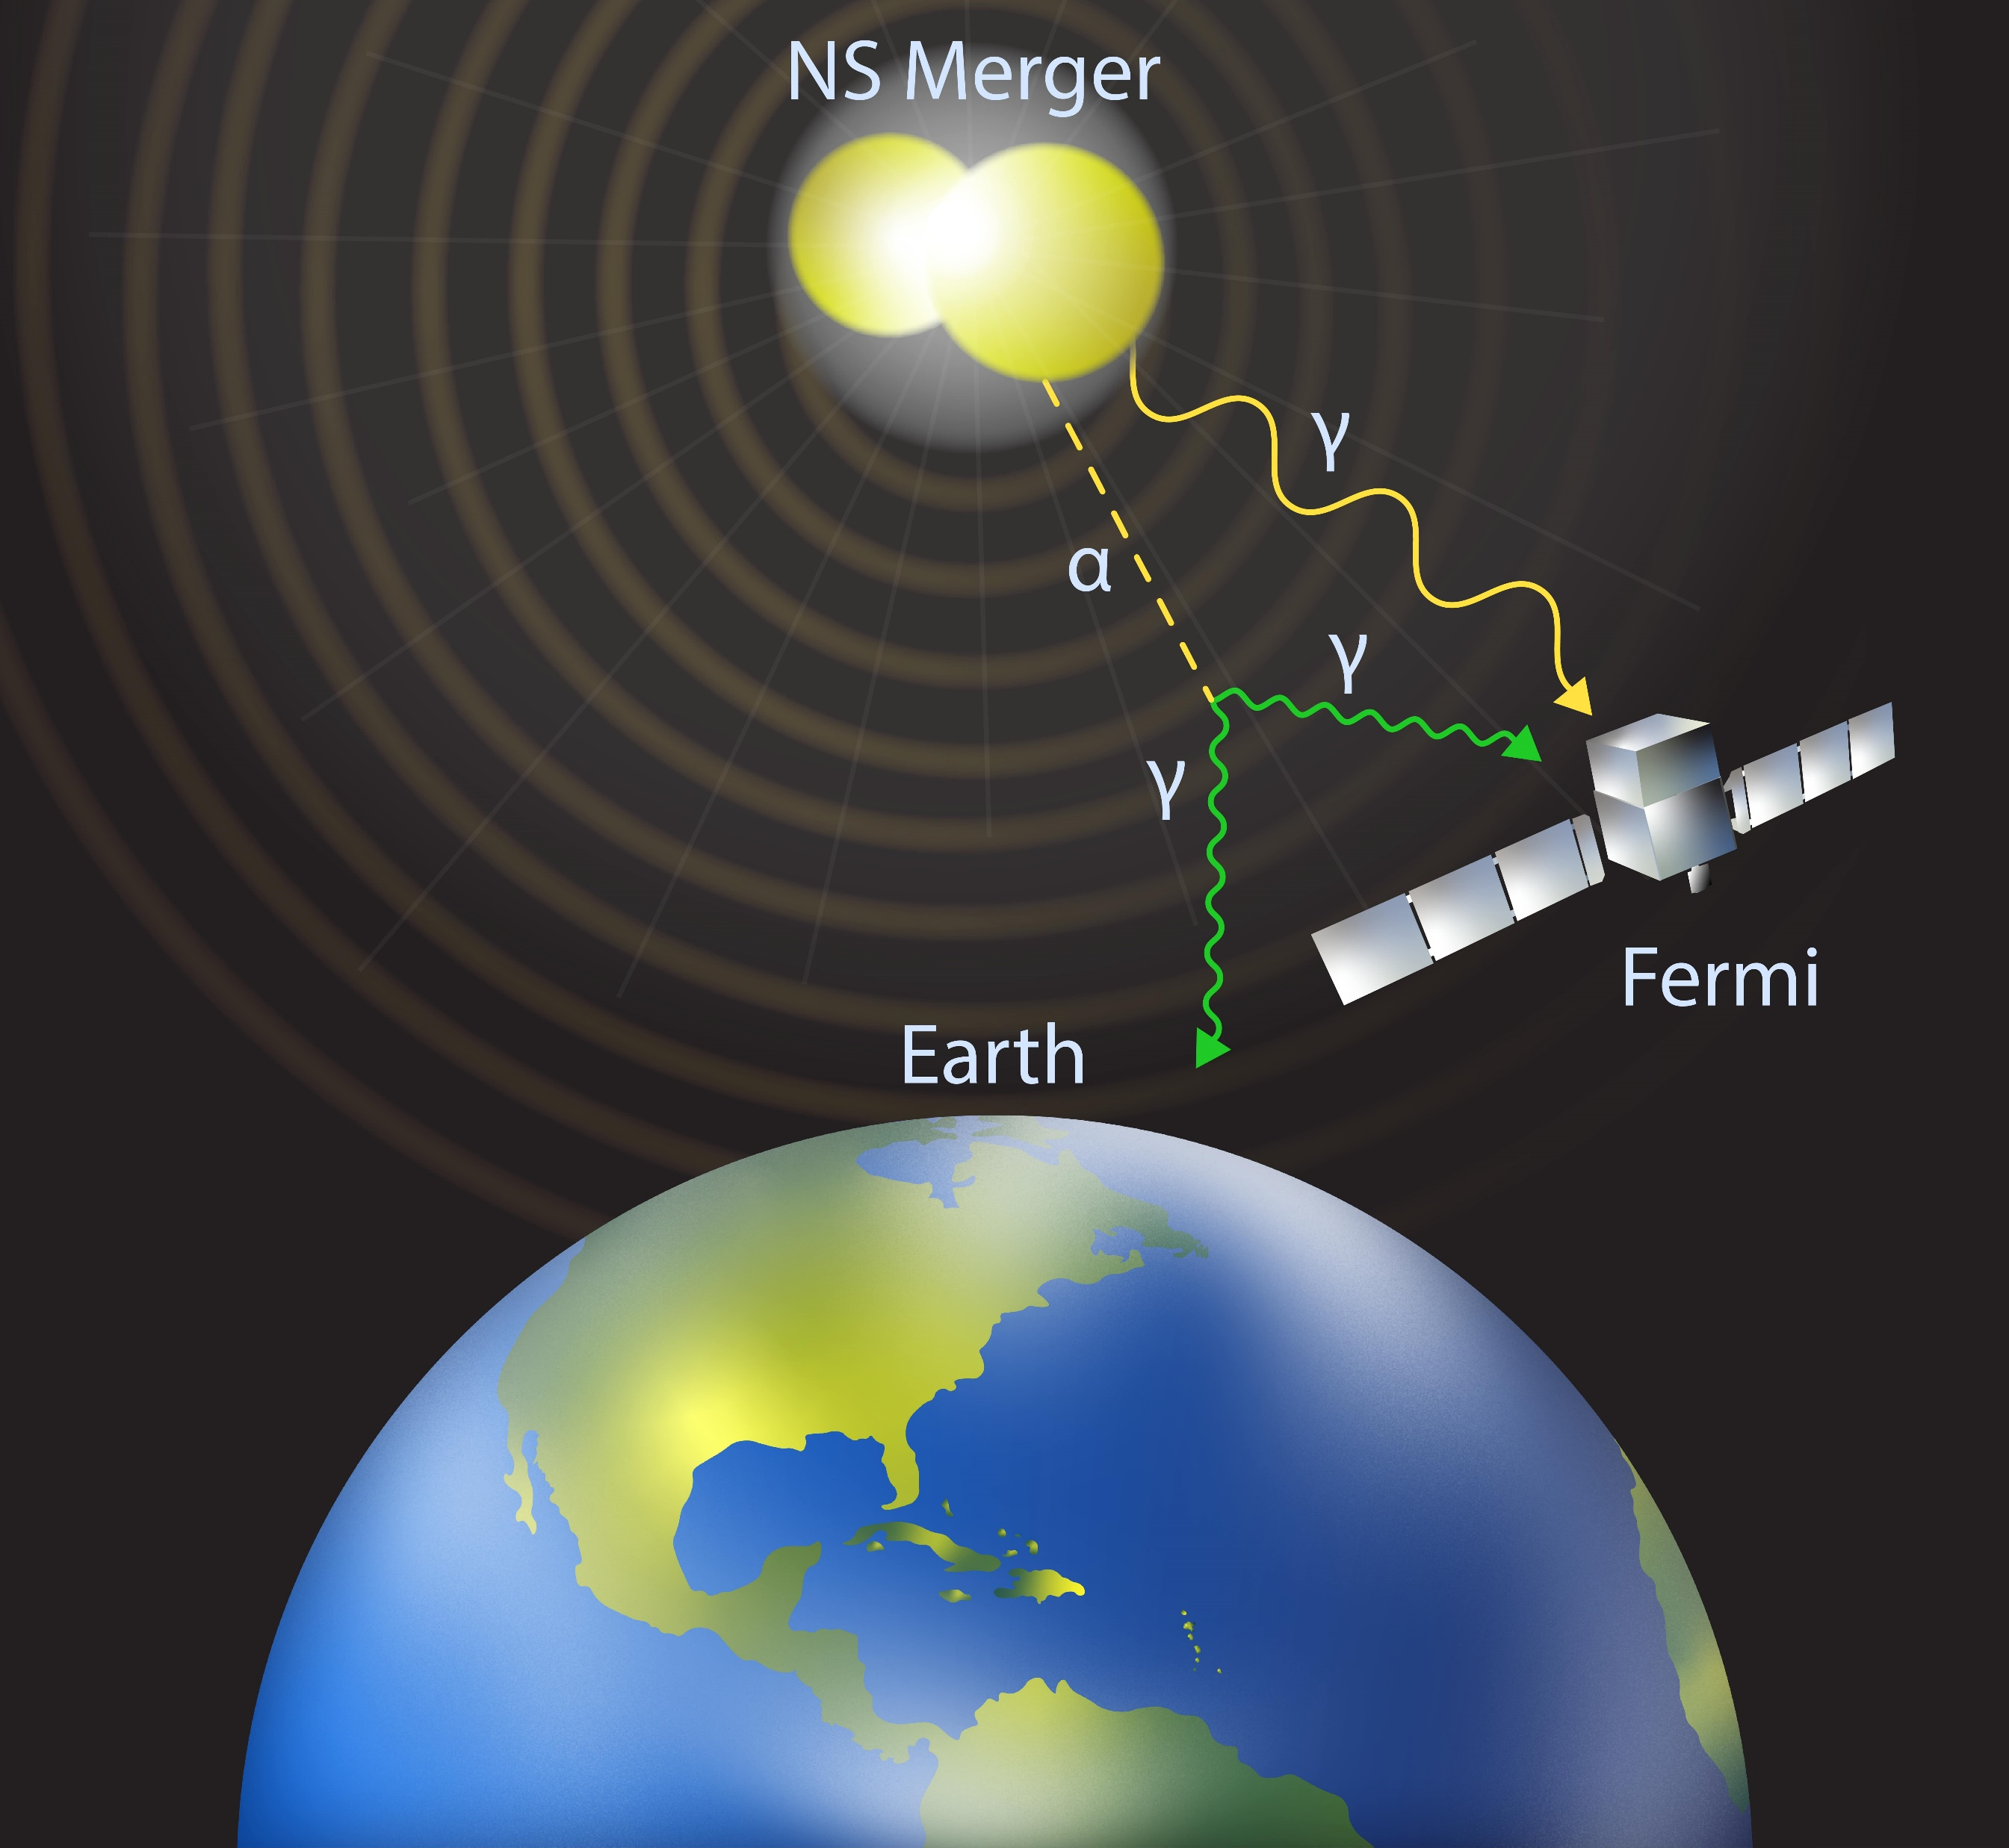
NS merger → ALPs → photons
GWs

Slide 4
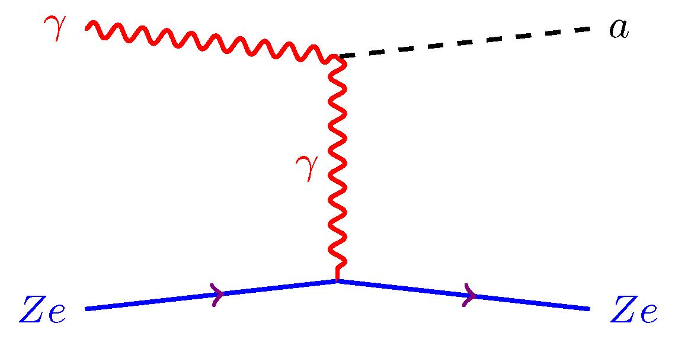
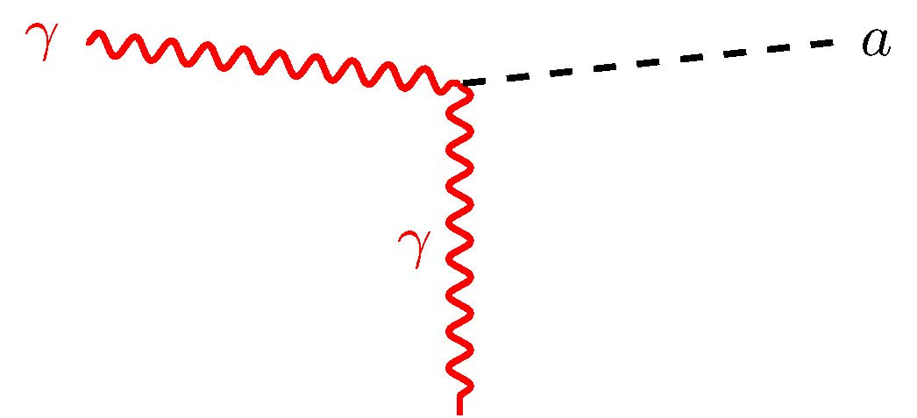
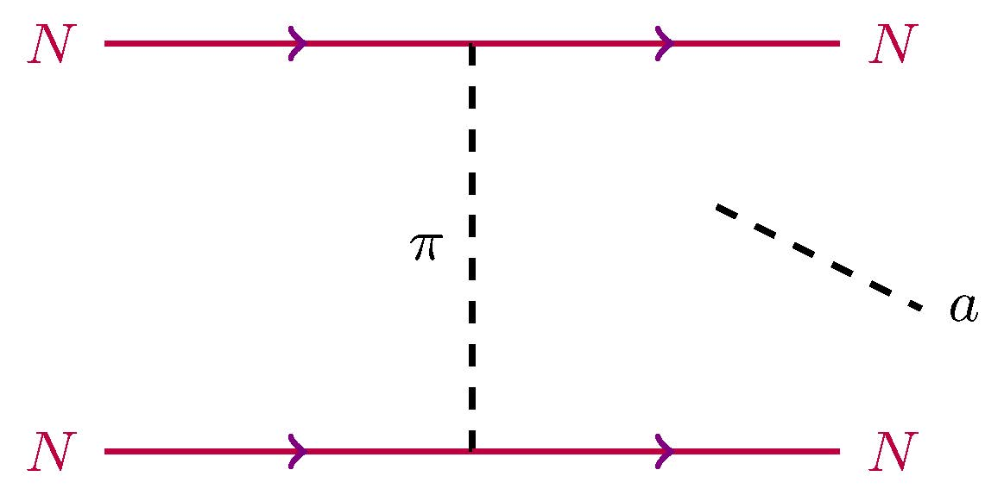
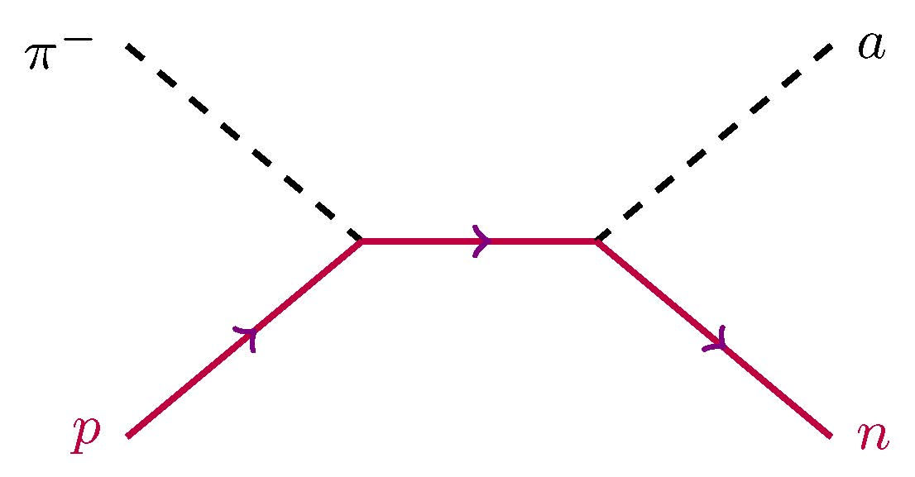
ALP couplings & processes
To photons:
Primakoff
coalescence
To nucleons
Nucleon bremsstrahlung
pion-axion conversion
Turner, PRD45(1992)1066; Raffelt & Seckel, PRD52(1995)1780;
Carenza, Fore, Giannotti, Mirizzi & Reddy, PRL126(2021)071102
Notes:
https://indico.ibs.re.kr/event/445/contributions/2690/attachments/3053/3305/Pres_PCarenza_IBSICTP.pdf

Slide 5
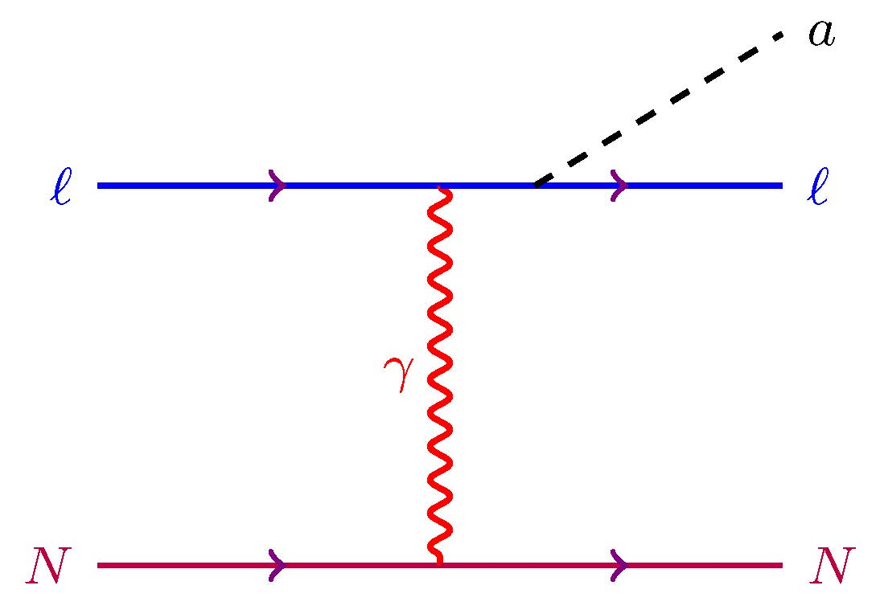
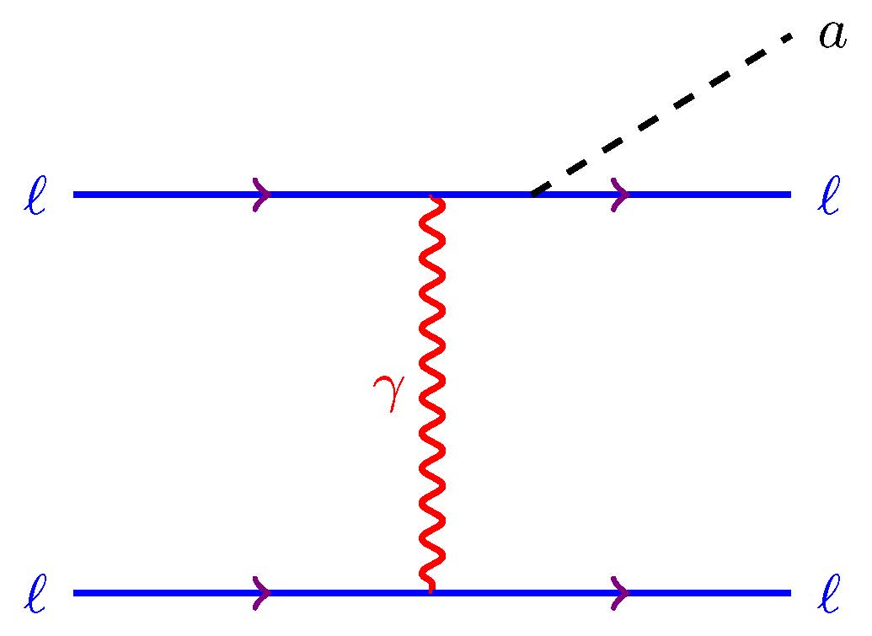
ALP couplings & processes
To electrons/muons
$ℓ−N$ bremsstrahlung
$ℓ−ℓ$ bremsstrahlung
Notes:
https://indico.ibs.re.kr/event/445/contributions/2690/attachments/3053/3305/Pres_PCarenza_IBSICTP.pdf

Slide 6
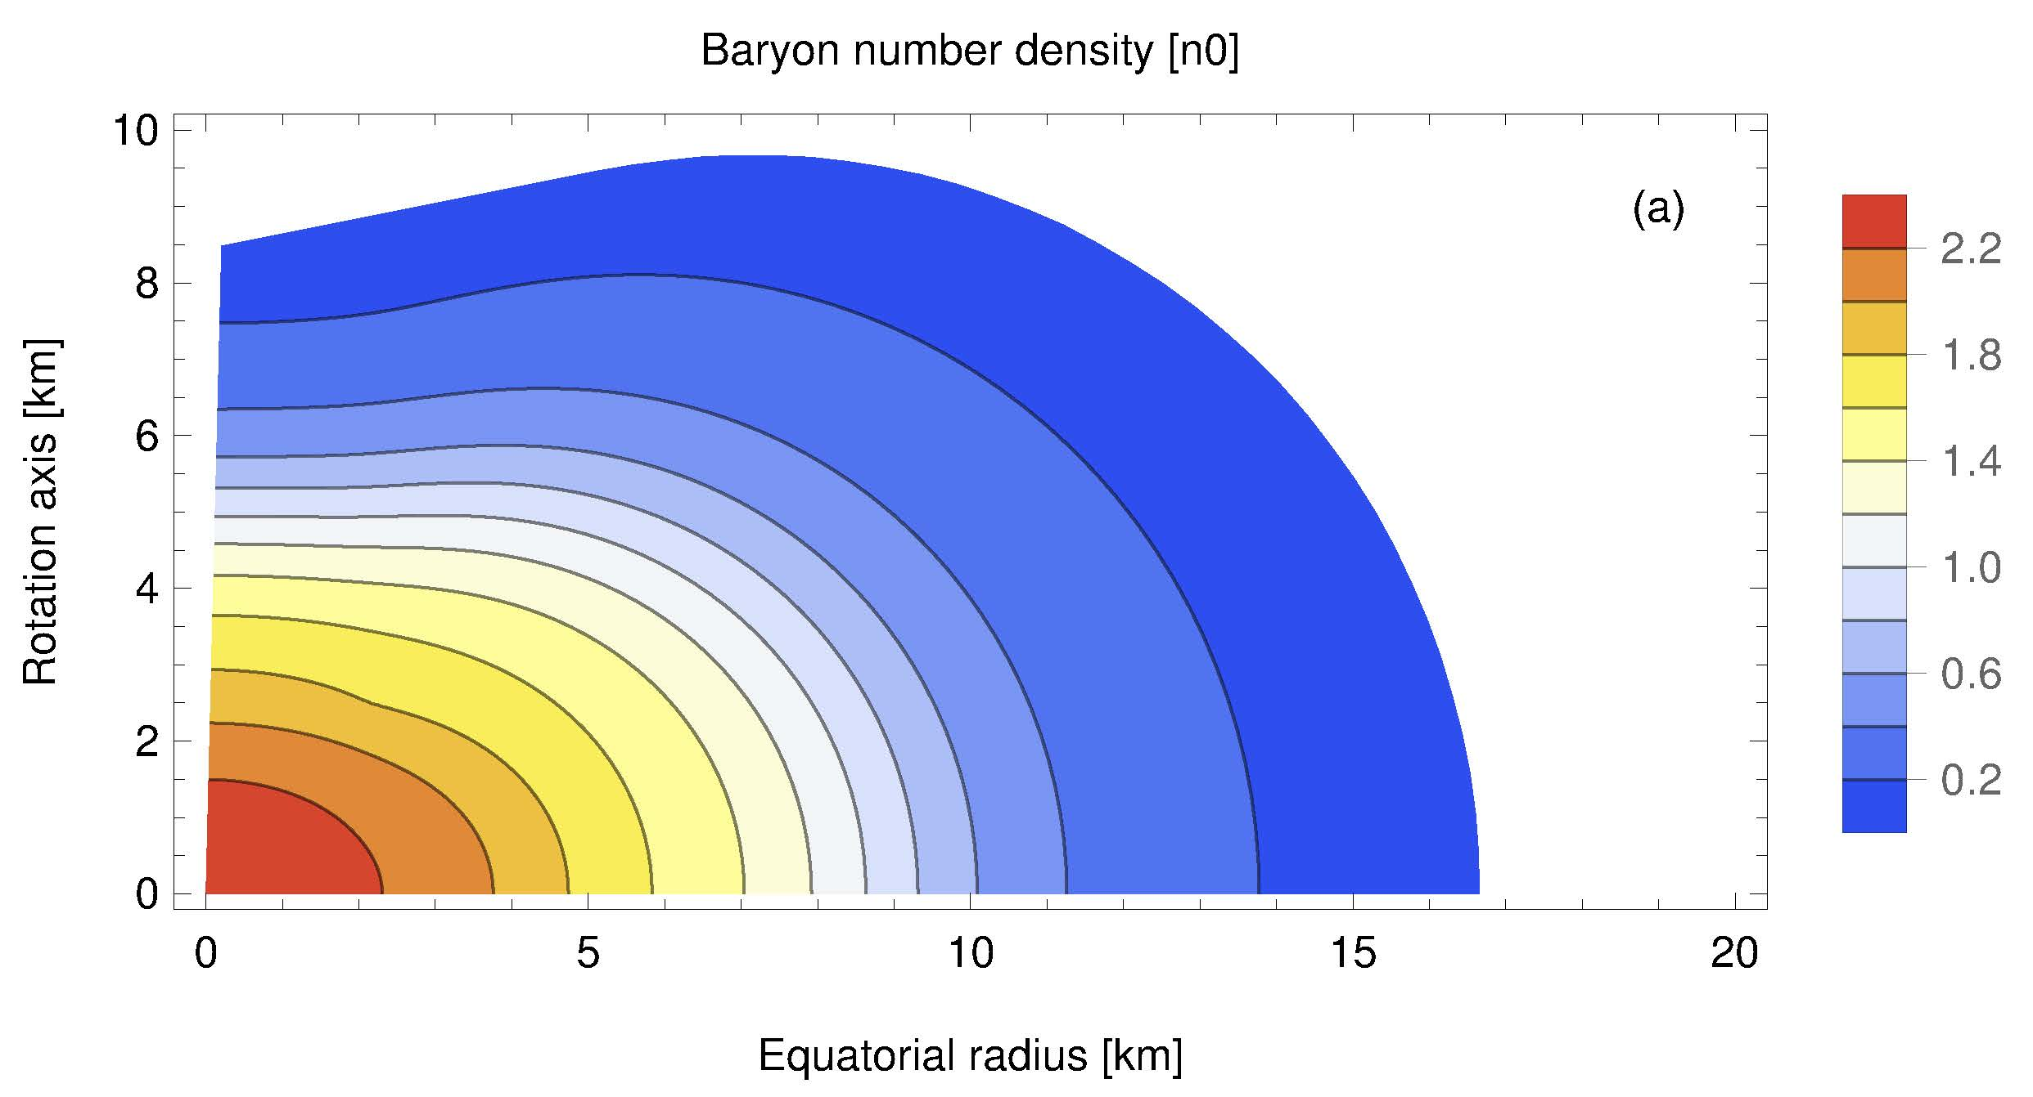
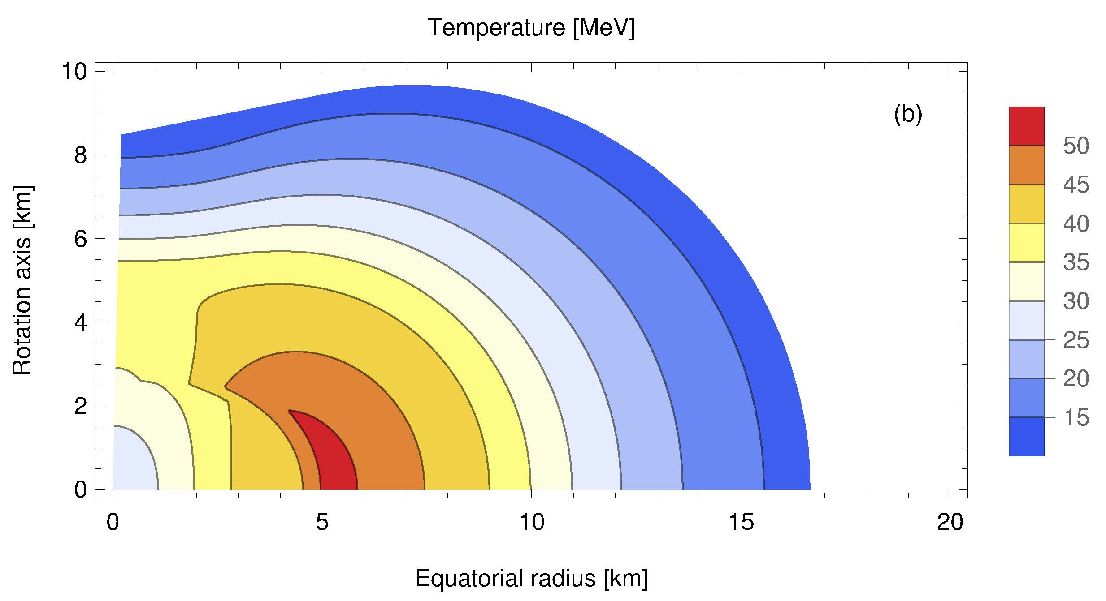
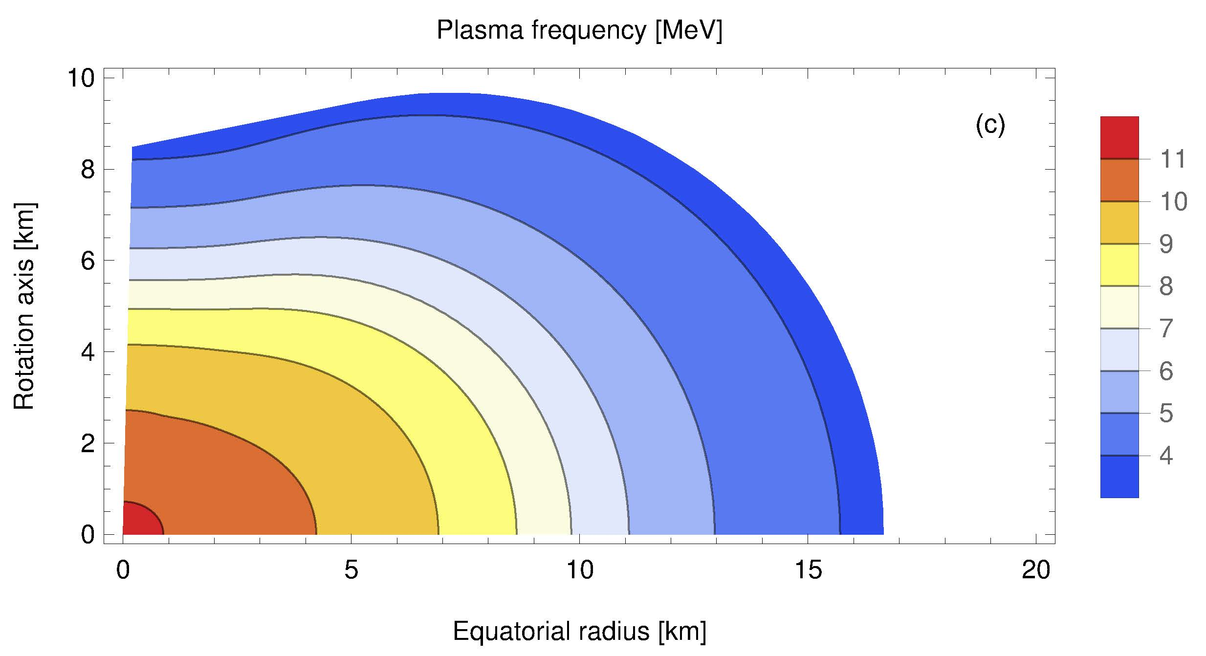
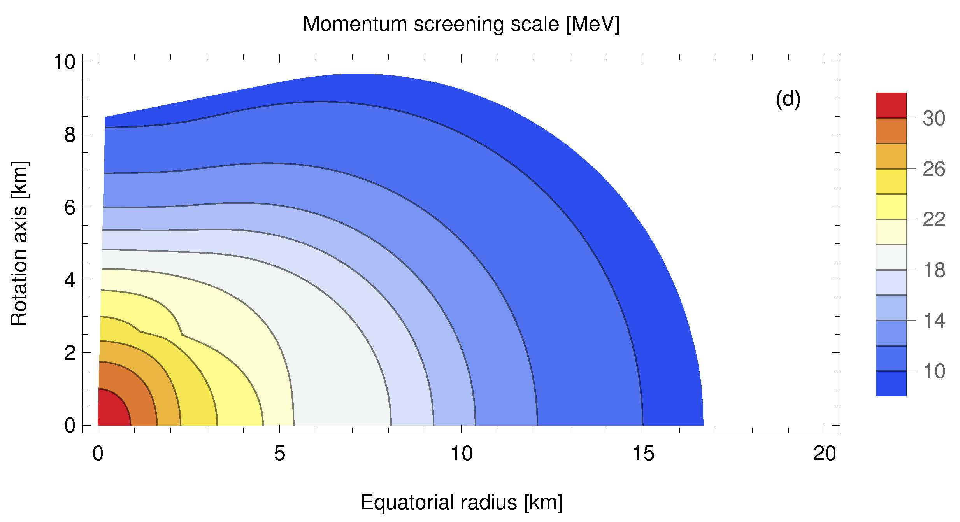
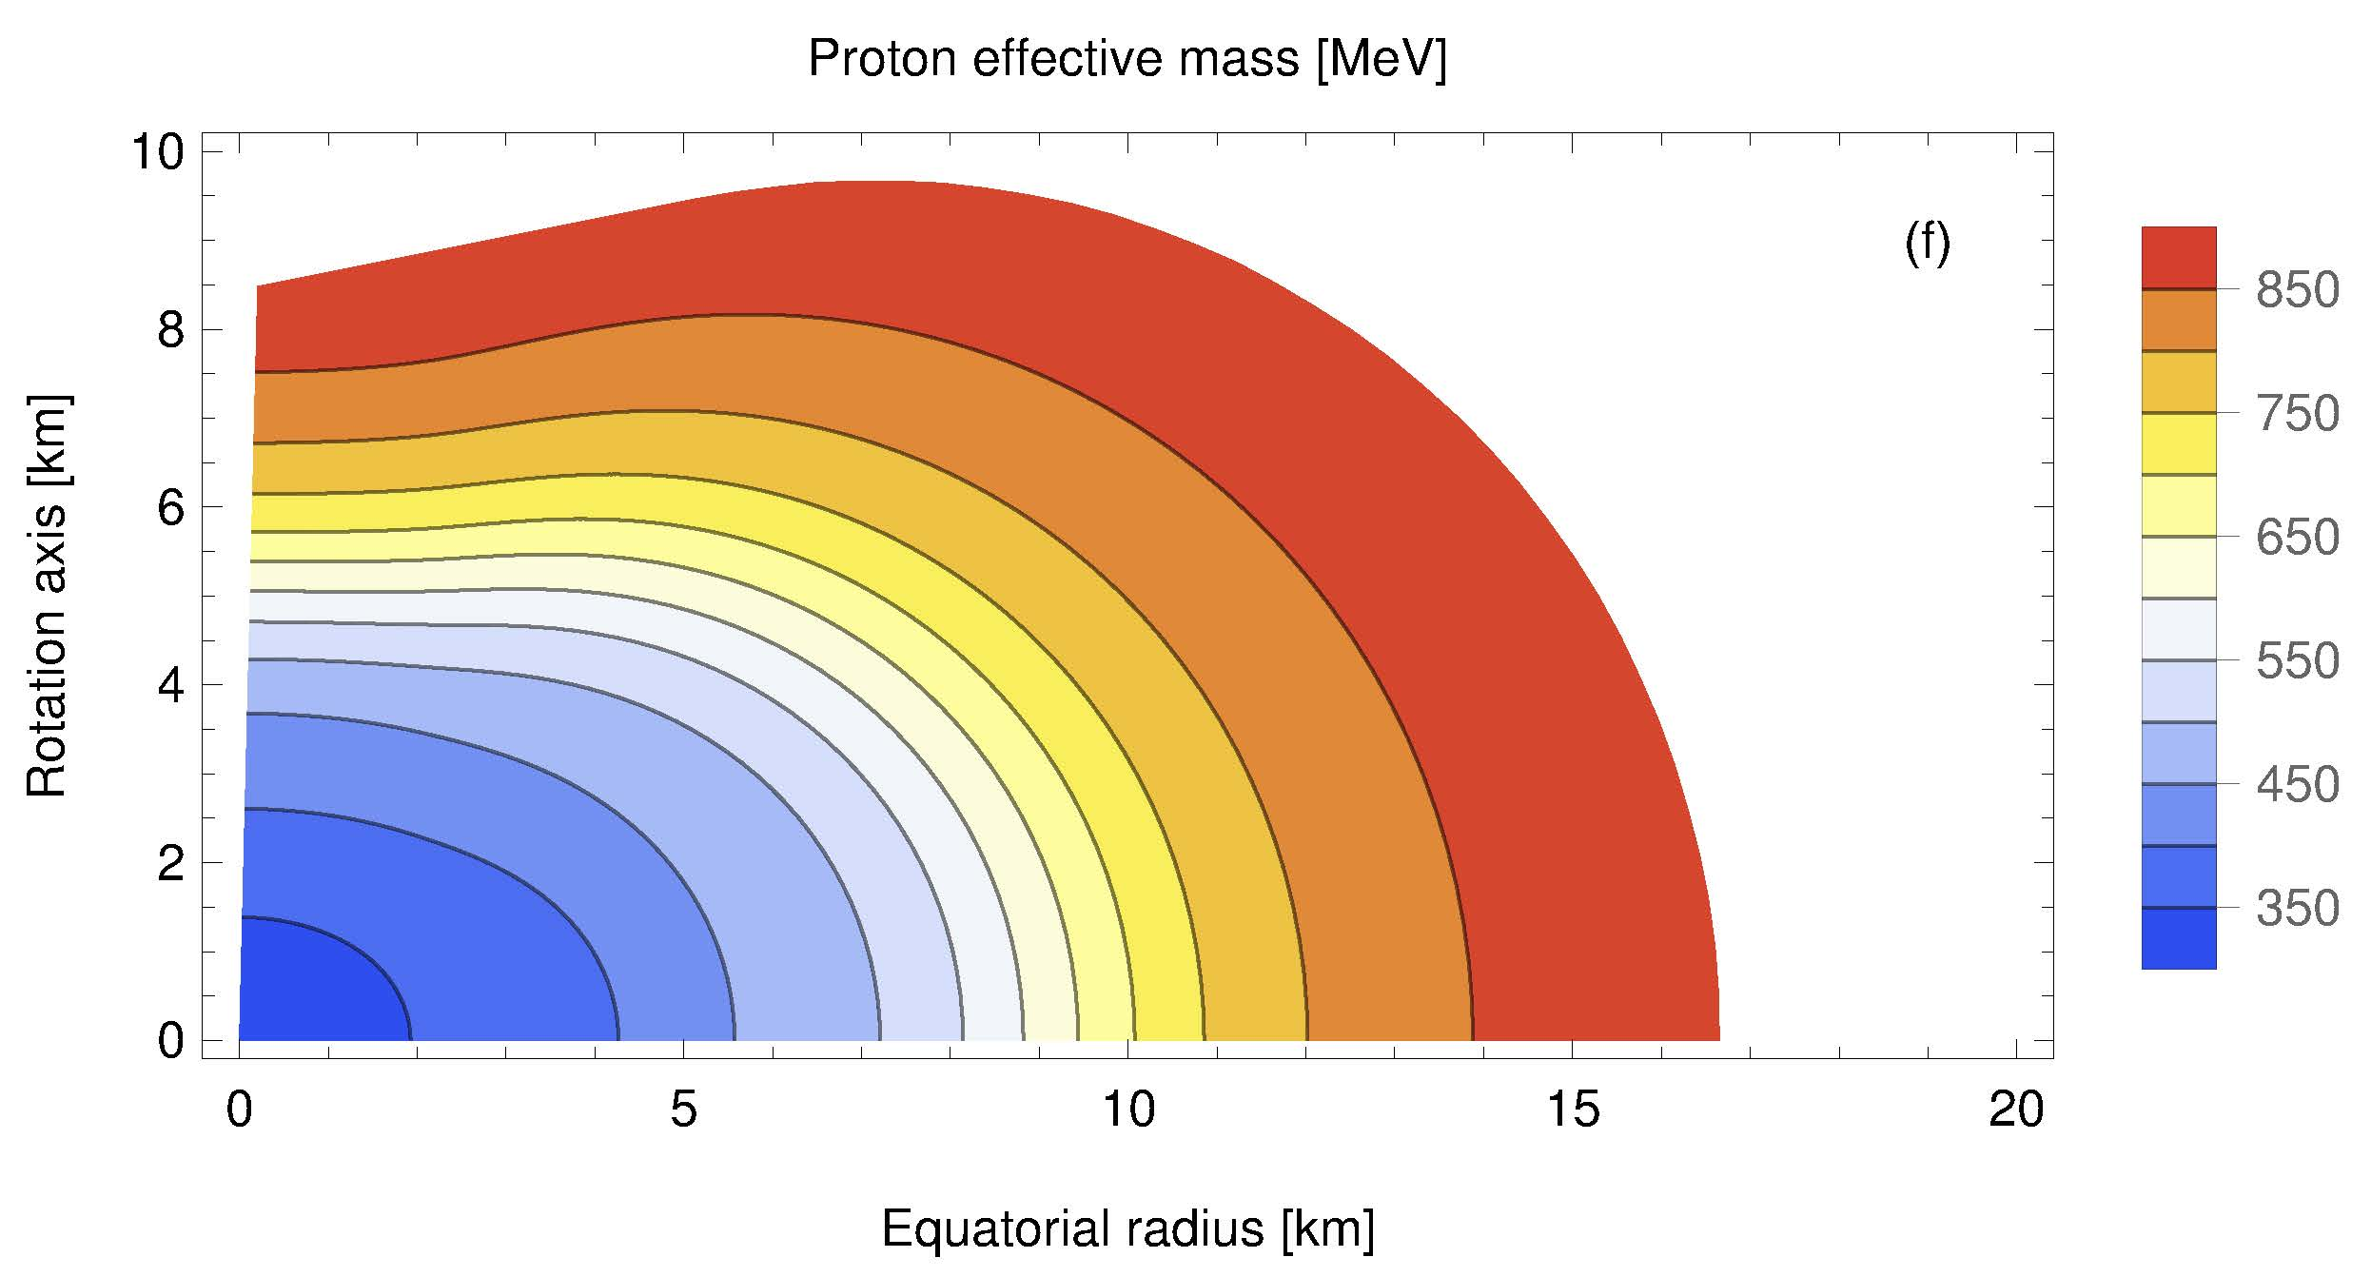
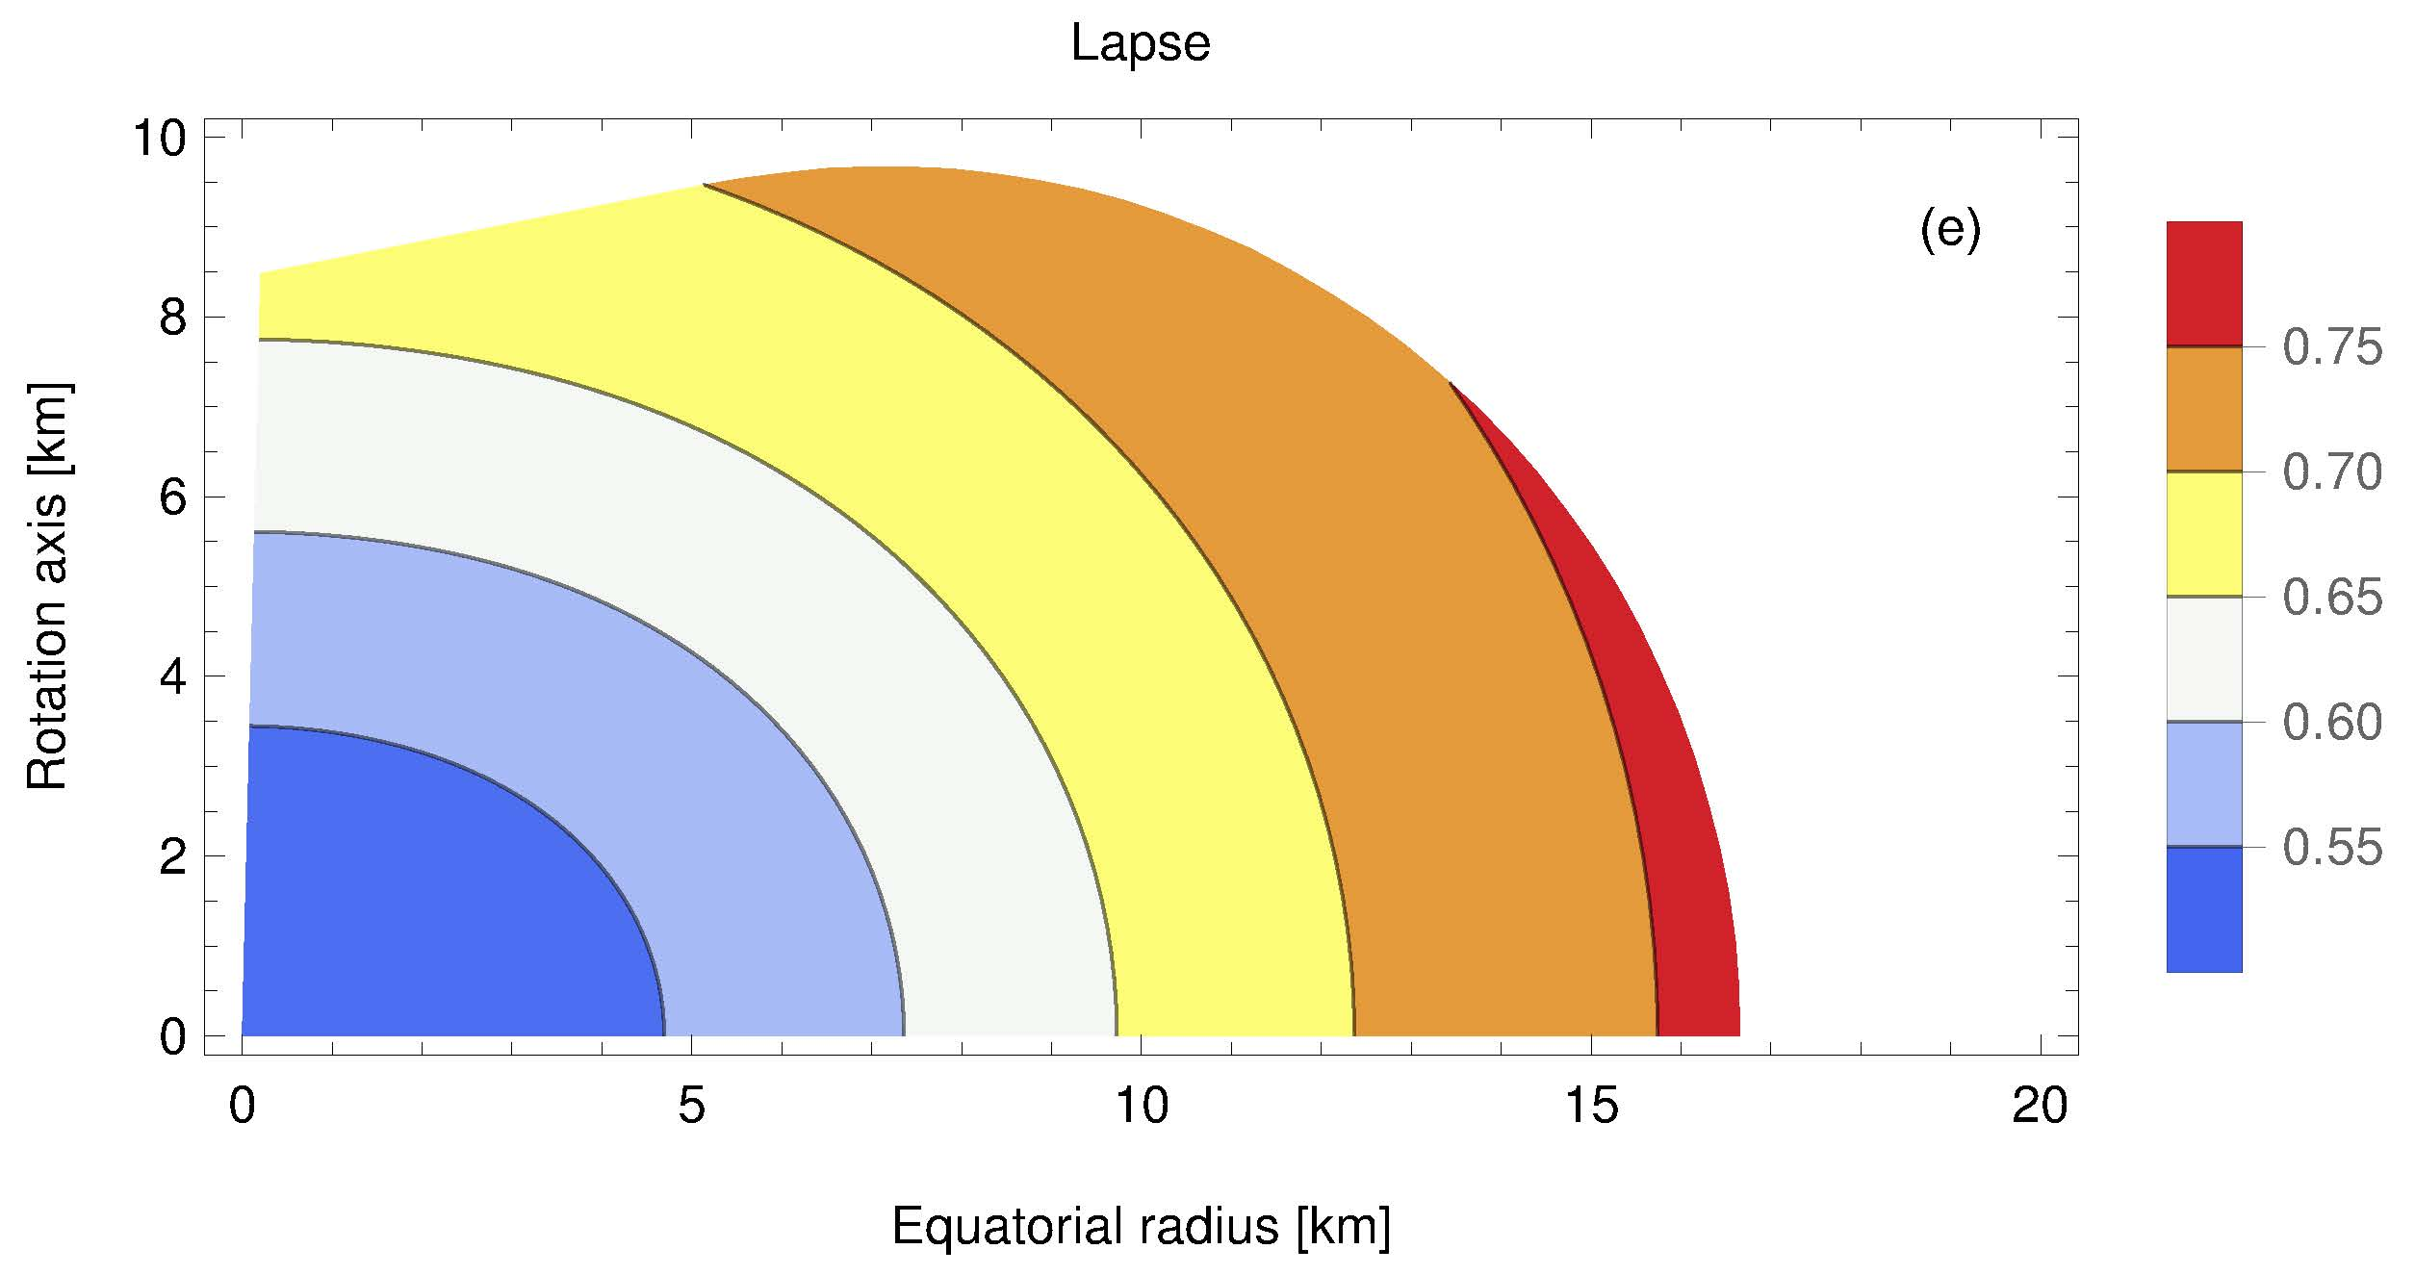

Slide 7
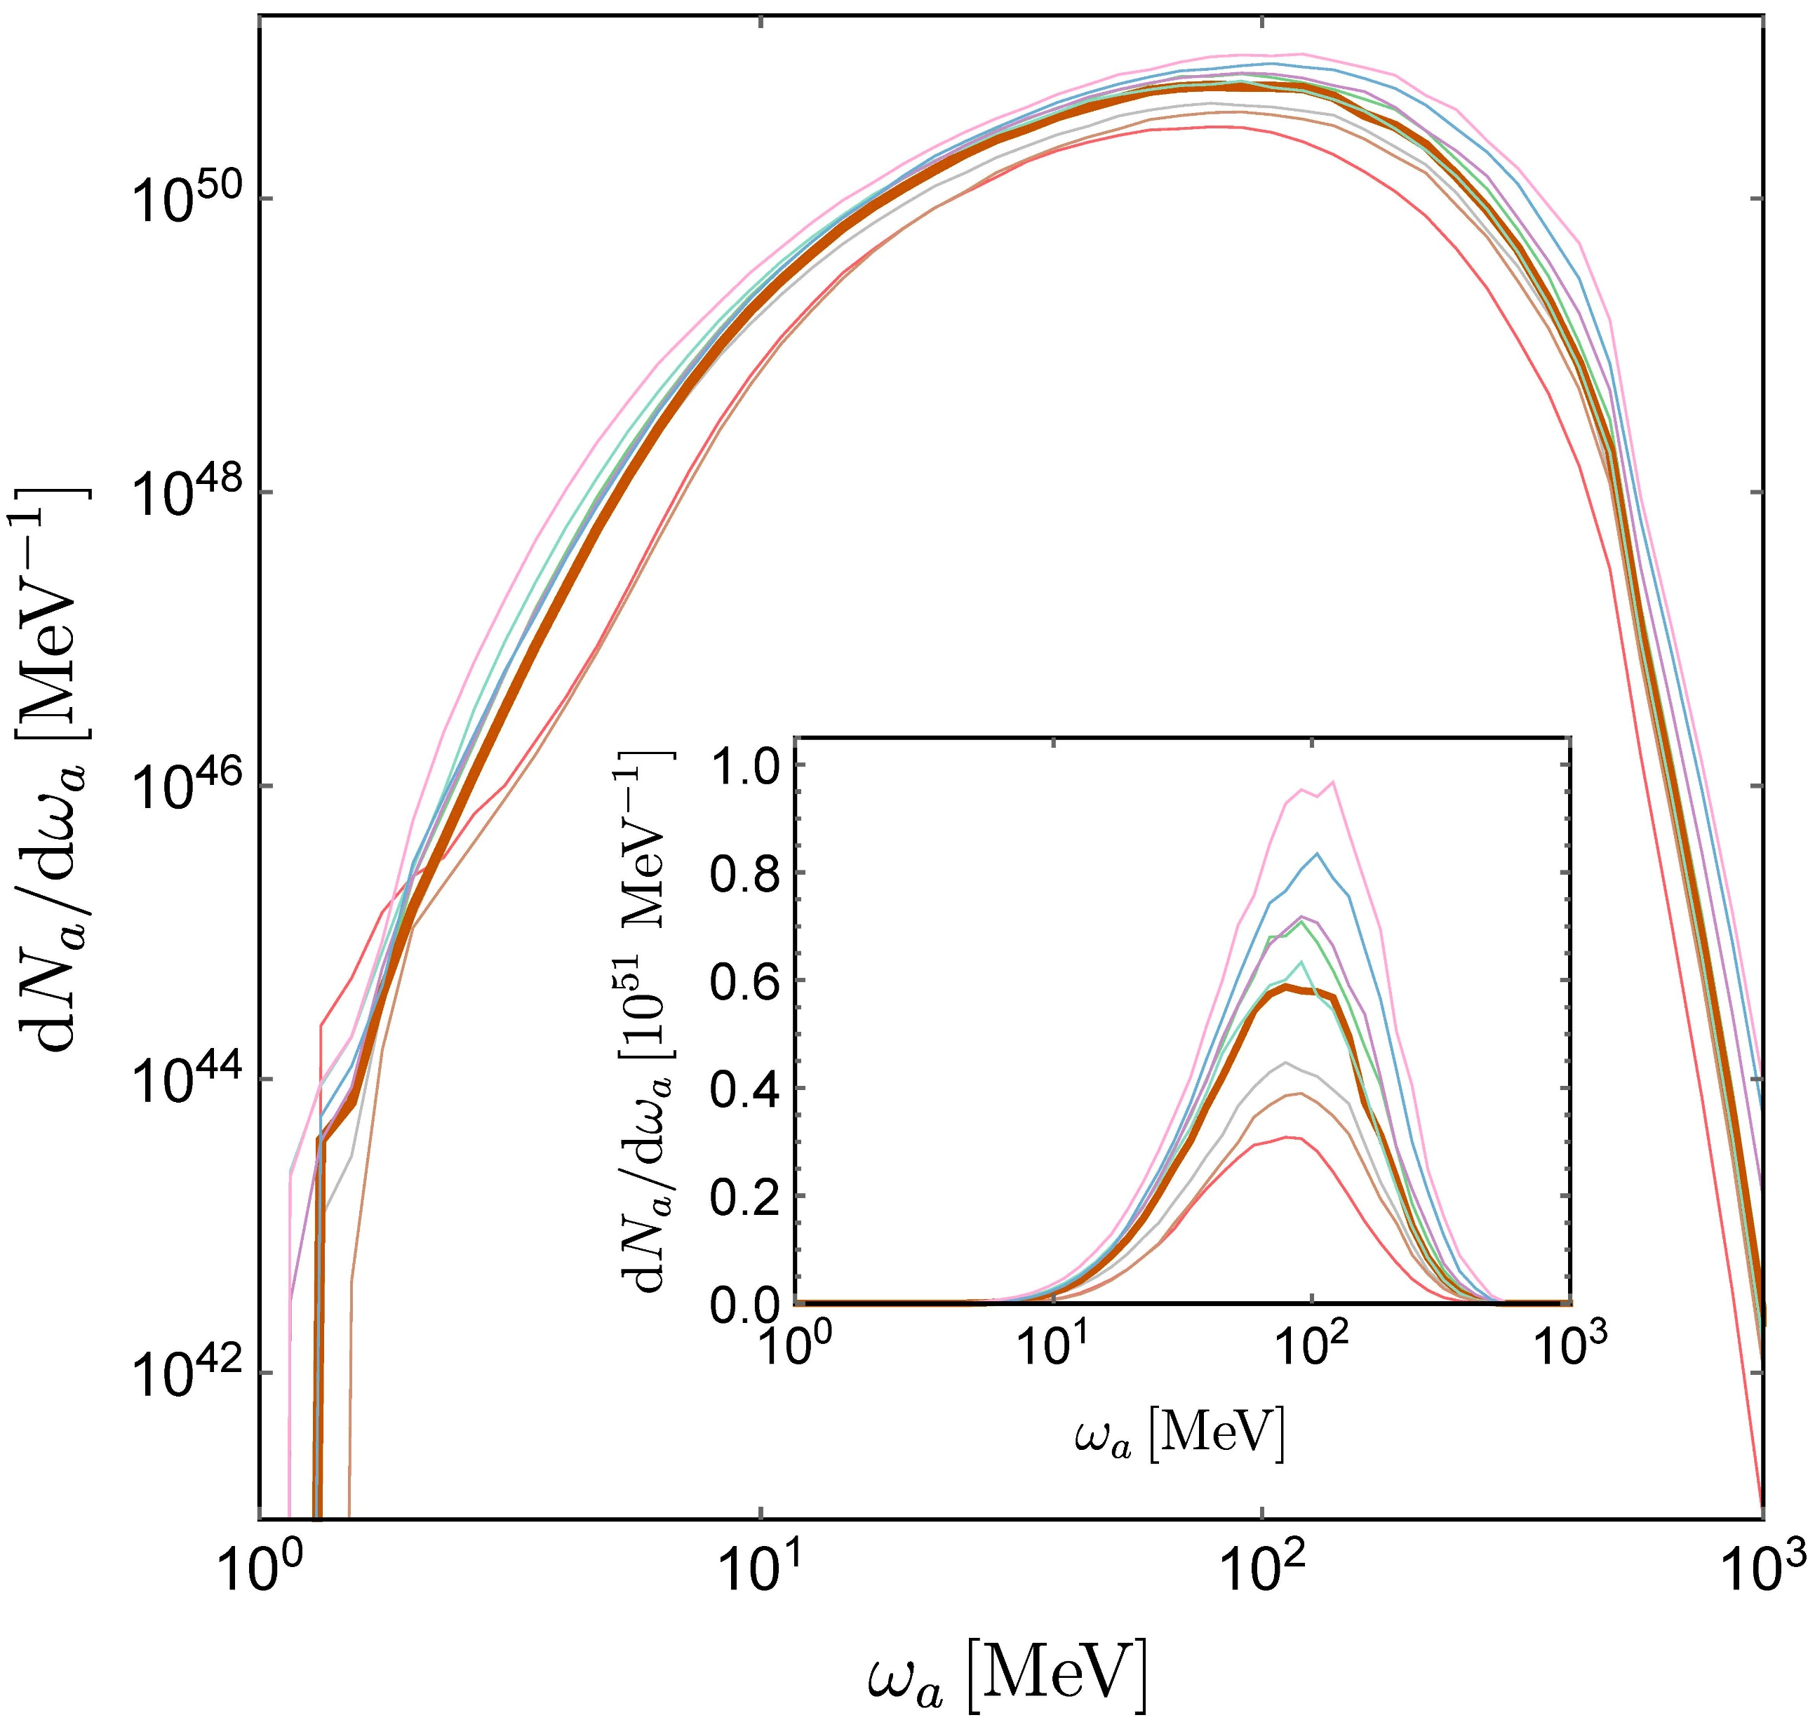
ALP spectra: NS profiles
Assuming ALP coupling only to photons.
NS profiles from Camelio, Dietrich, Rosswog & Haskell, PRD 103(2021)063014
ALP emission duration of 1 second (duration of GW emission).
Our analysis based on the bold orange curve (not extreme profiles).
Notes:
Gravitational trapping NOT considered in this calculation.

Slide 8
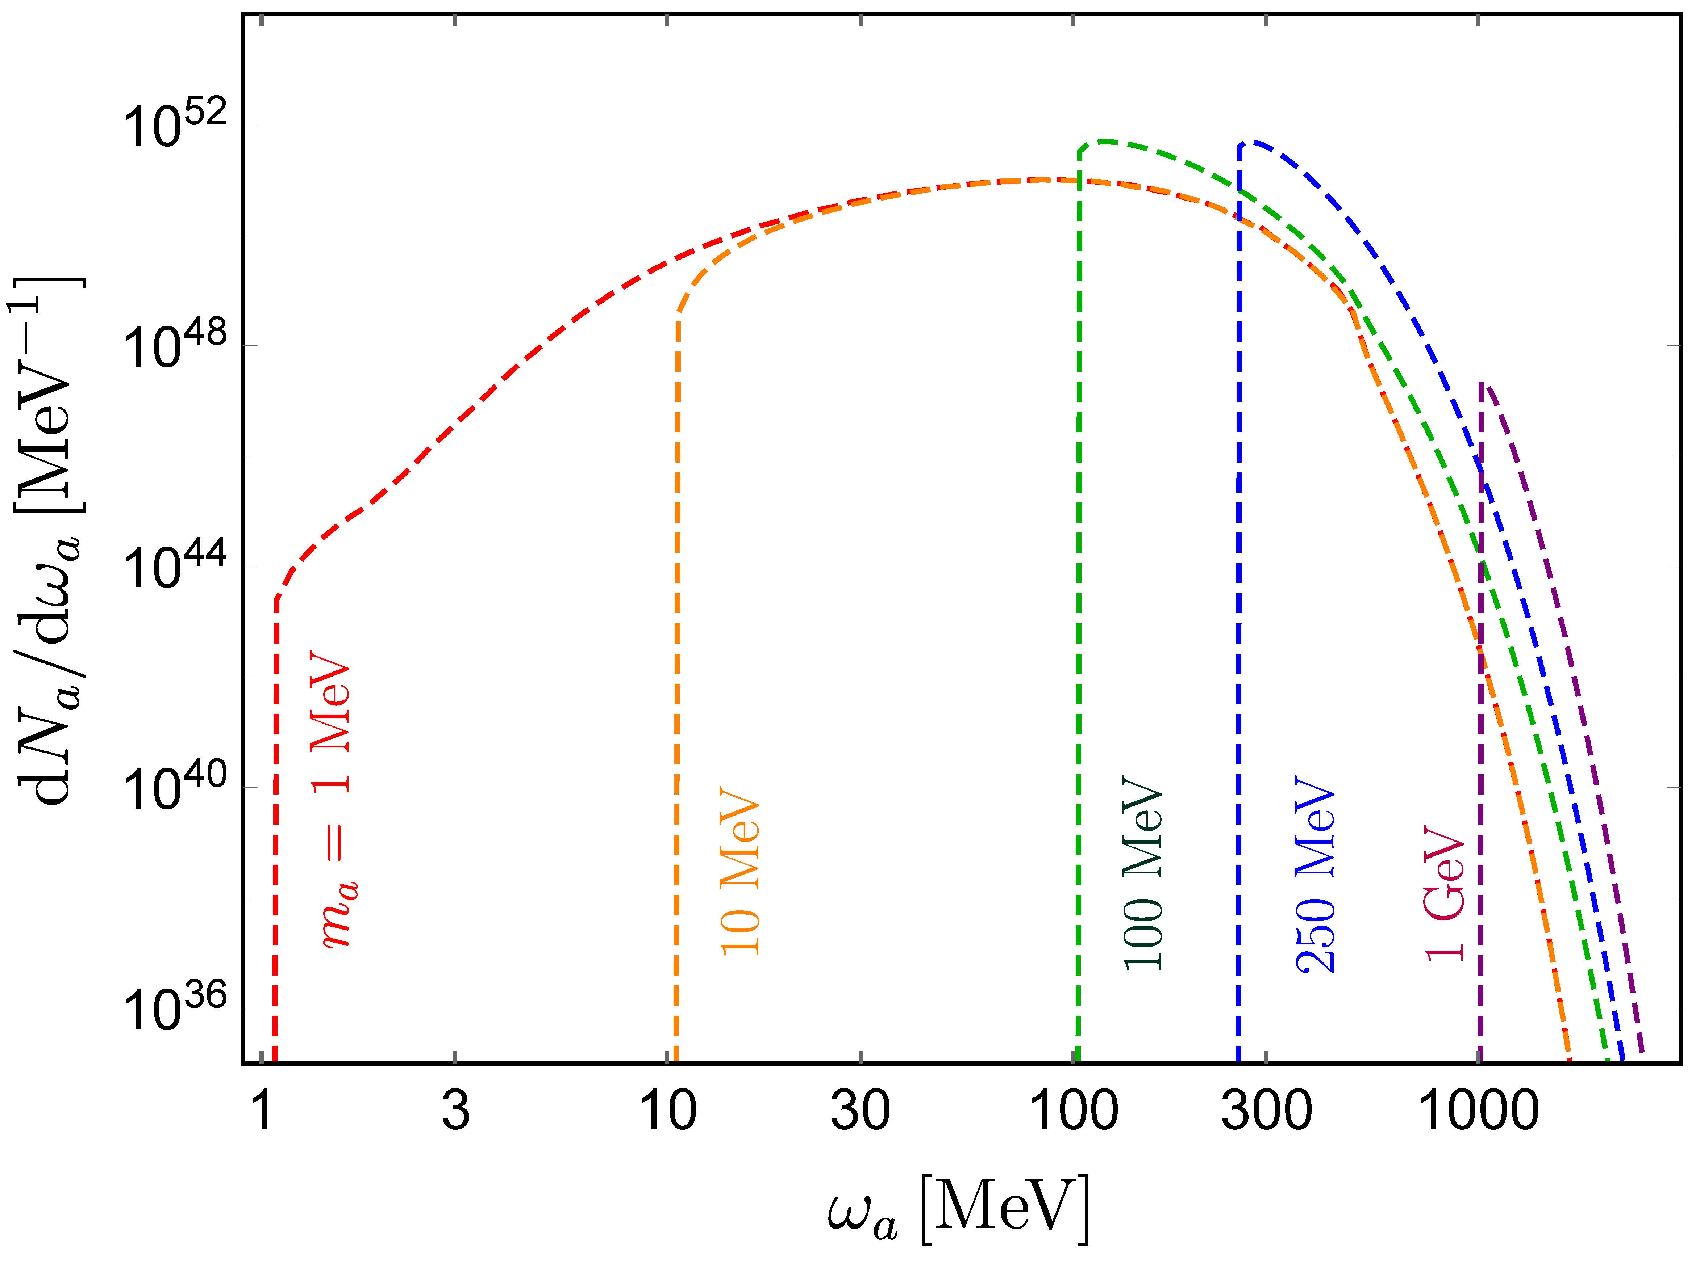
ALP spectra

Slide 9
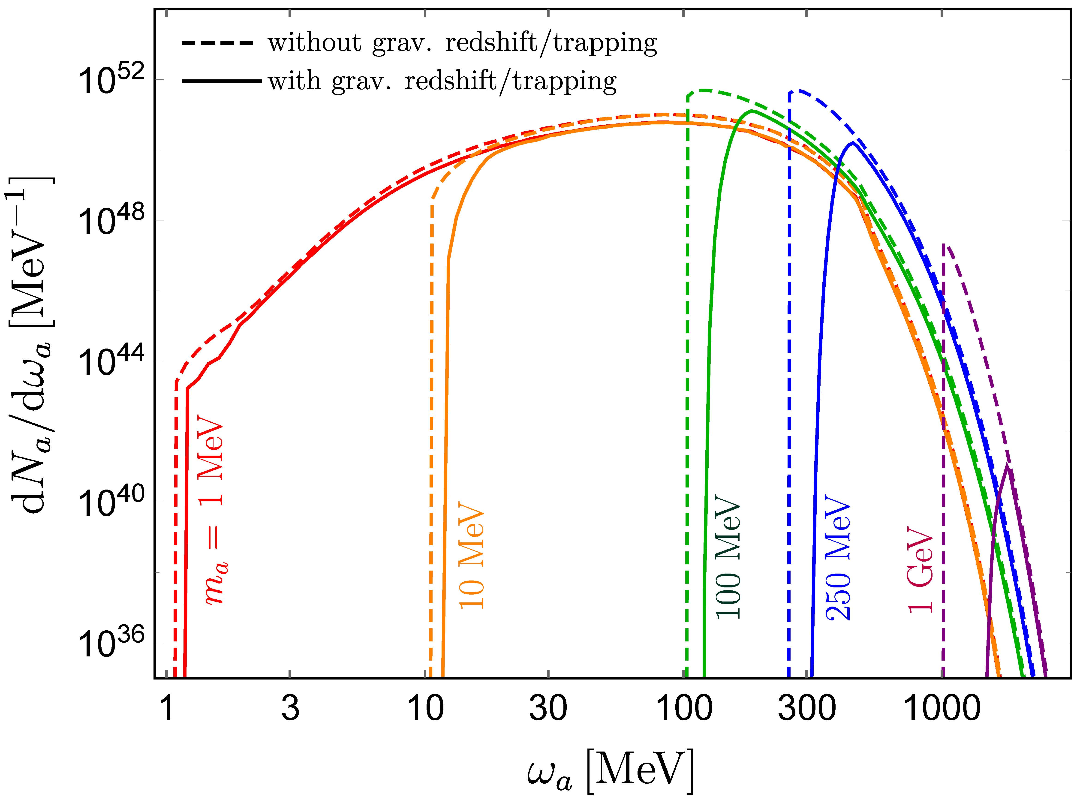
ALP spectra: gravitational trapping
Effectively, there is lower cutoff on the momentum of ALP.
More important for heavy ALP.
Gravitational trapping effect for spernovae: Lucente, Carenza, Fischer, Giannotti & Mirizzi, JCAP12(2020) 008

Slide 10
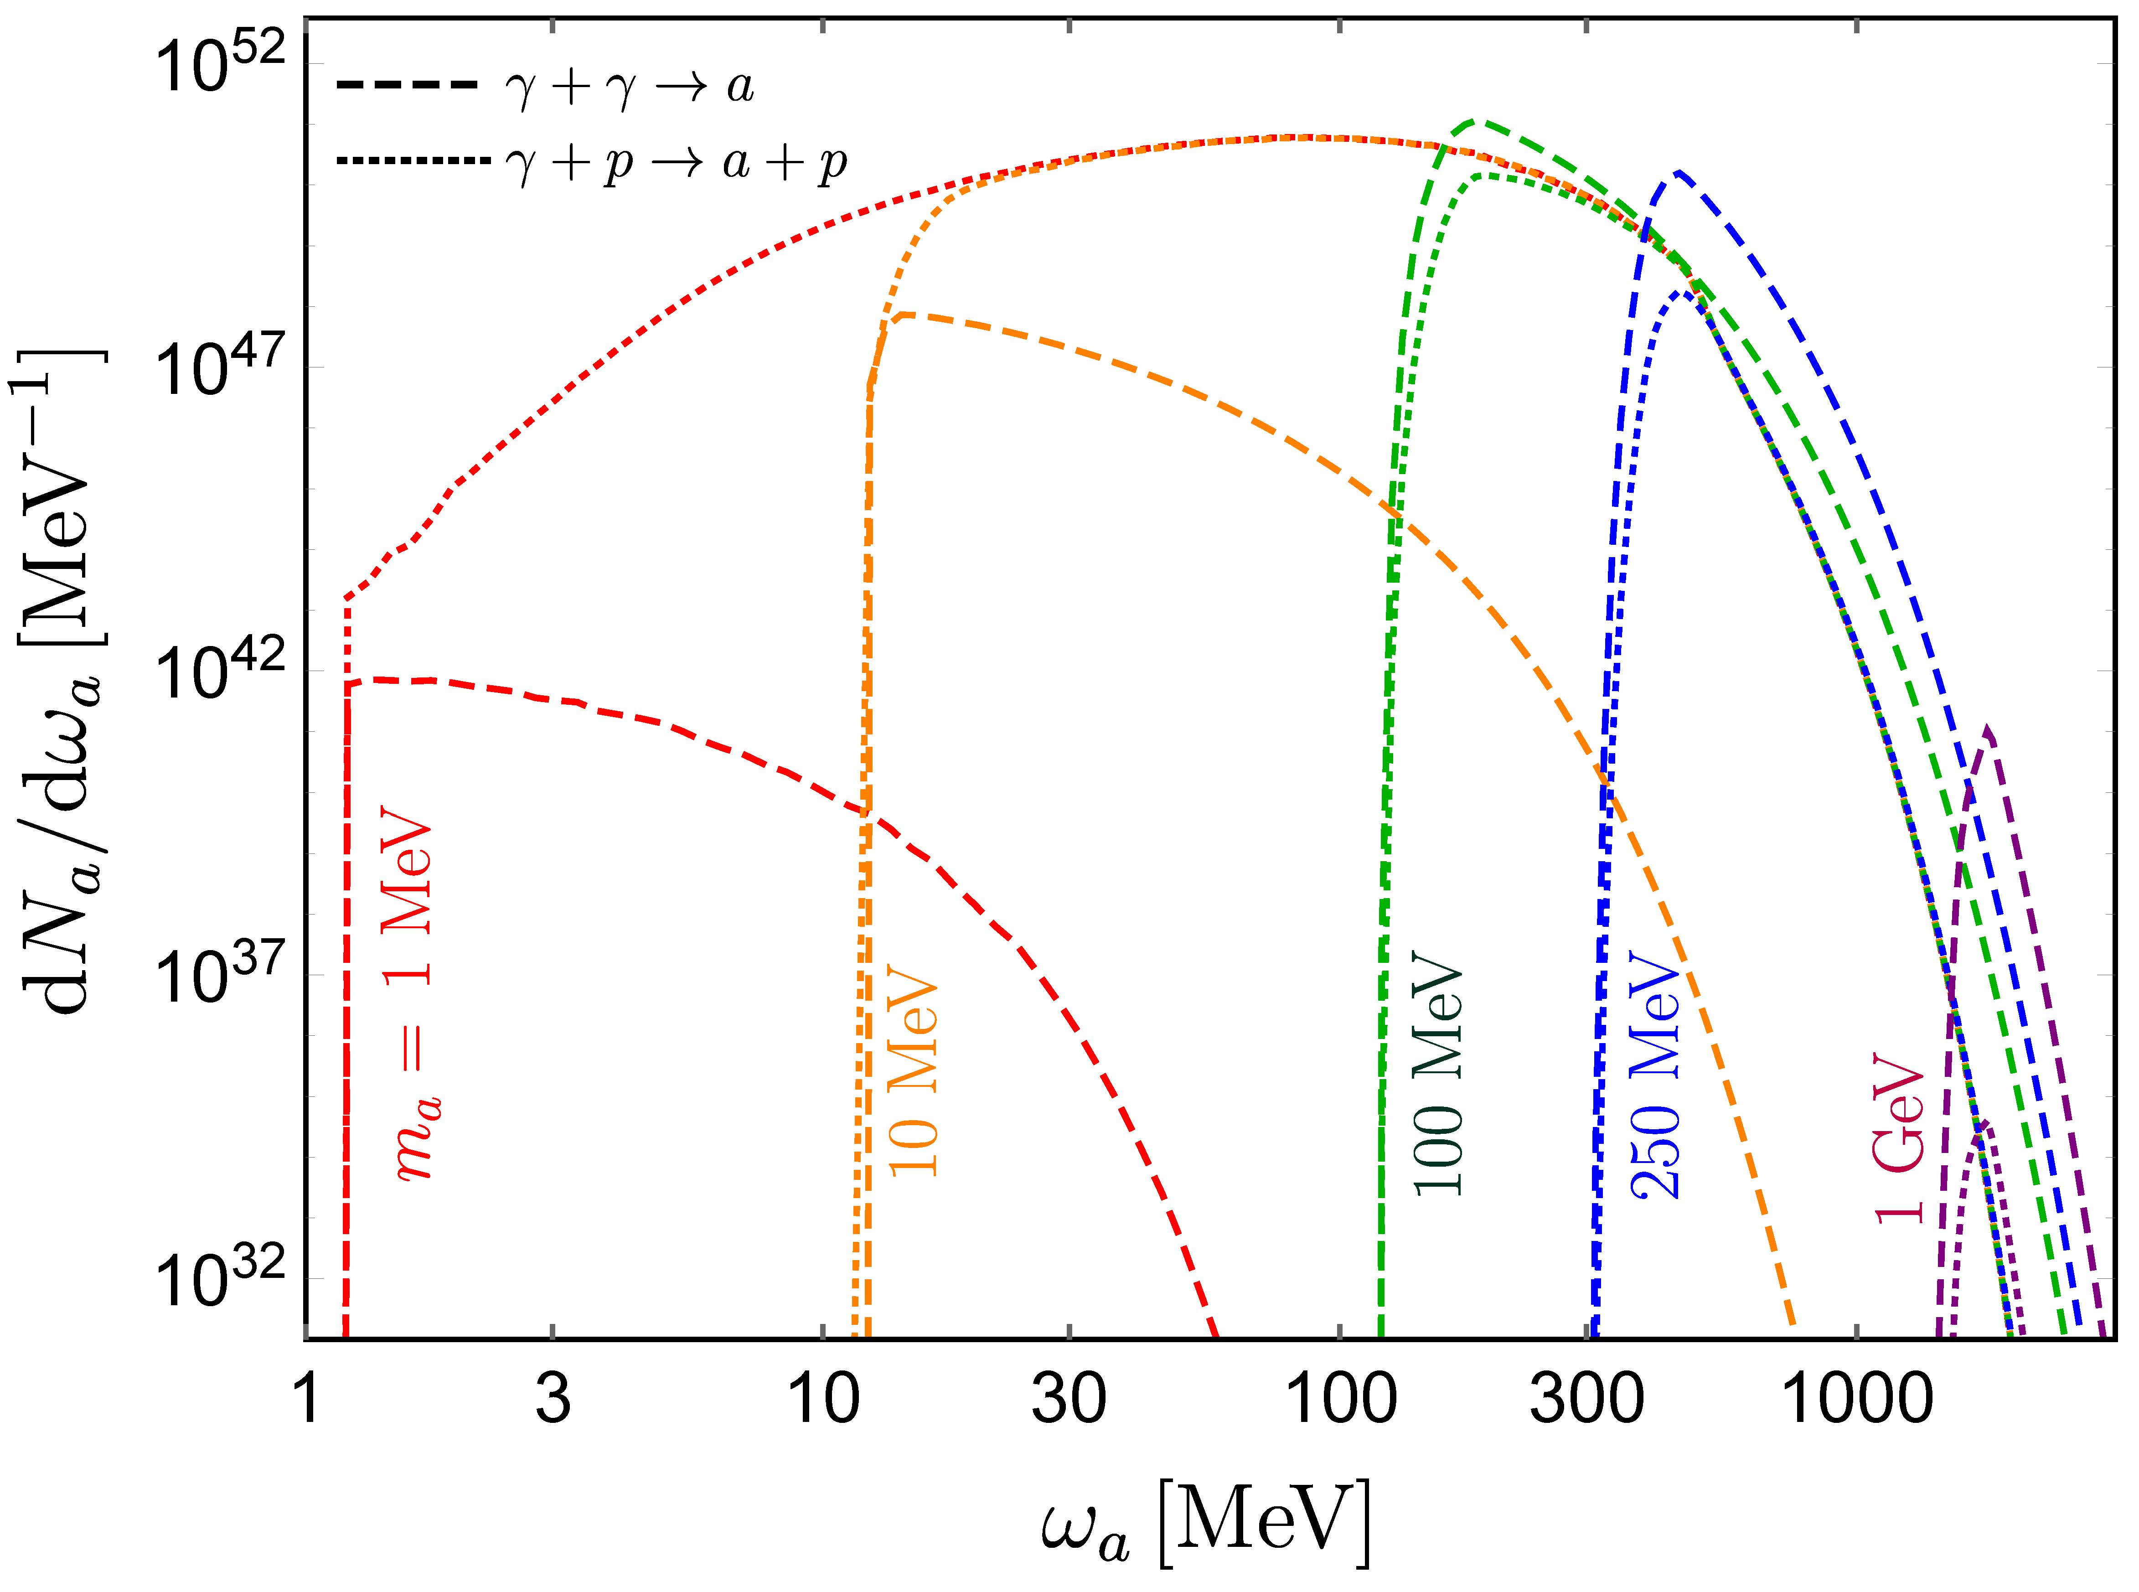
ALP spectra: Primakoff vs coalescence
Caputo, Janka, Raffelt & Vitagliano, PRL128(2022)221103
For light ALP $m_{a}≲100$ MeV, Primakoff process is more important.
For heavy ALP $m_{a}≳100$ MeV, coalescence process is more important.

Slide 11
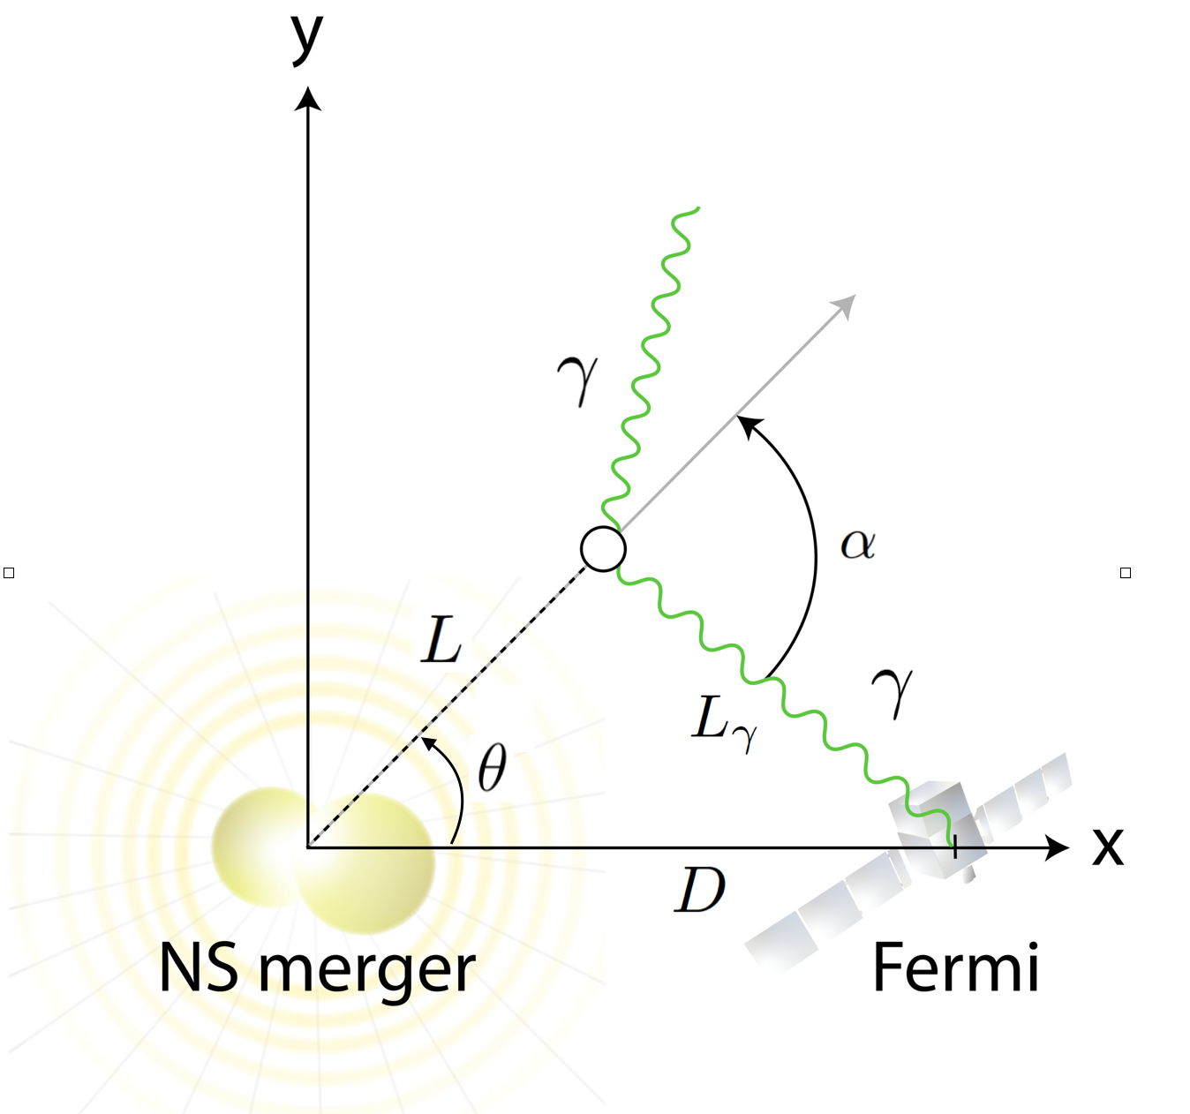
ALP decay: geometry
Jaeckel, Malta & Redondo, PRD98(2018)055032 Ferreira, Marsh & Muller, JCAP11(2022)057

Slide 12
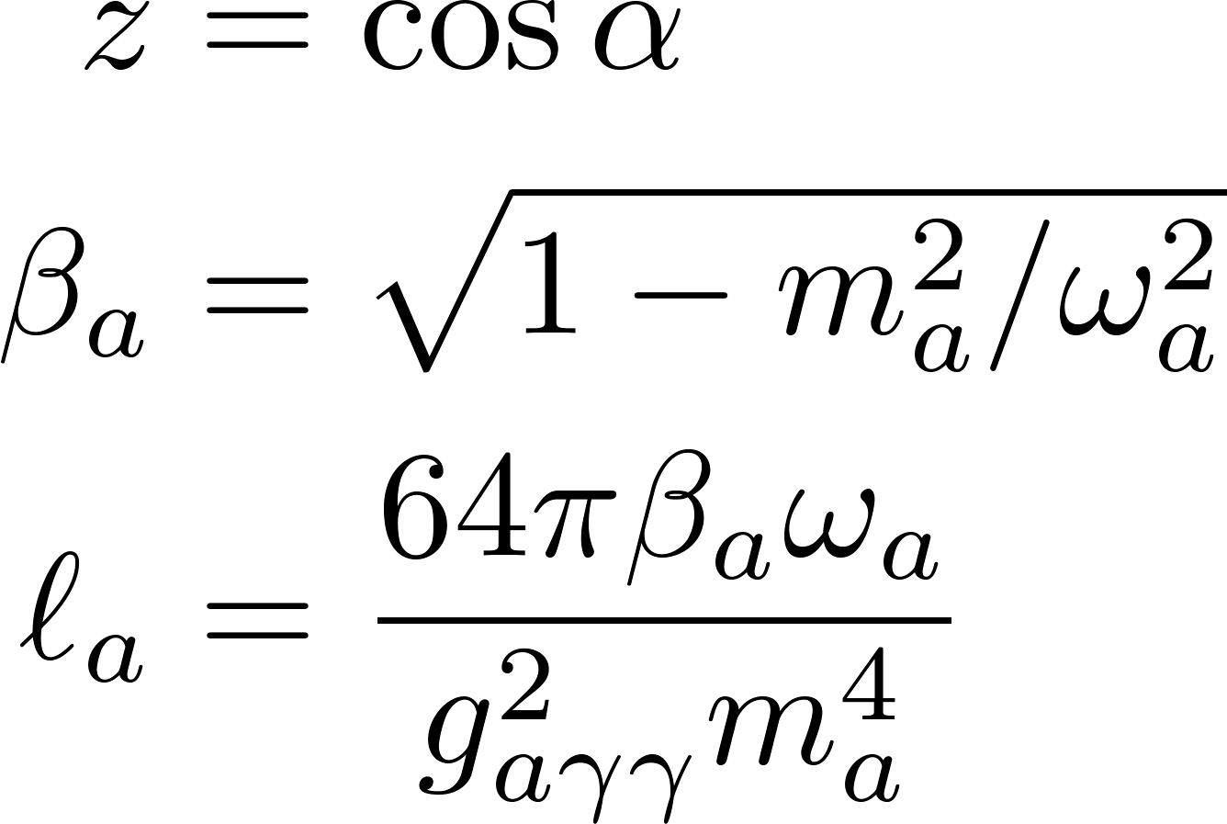
Photon spectra
Jaeckel, Malta & Redondo, PRD98(2018)055032 Ferreira, Marsh & Muller, JCAP11(2022)057
Photon spectrum from the ALP spectrum

Slide 13
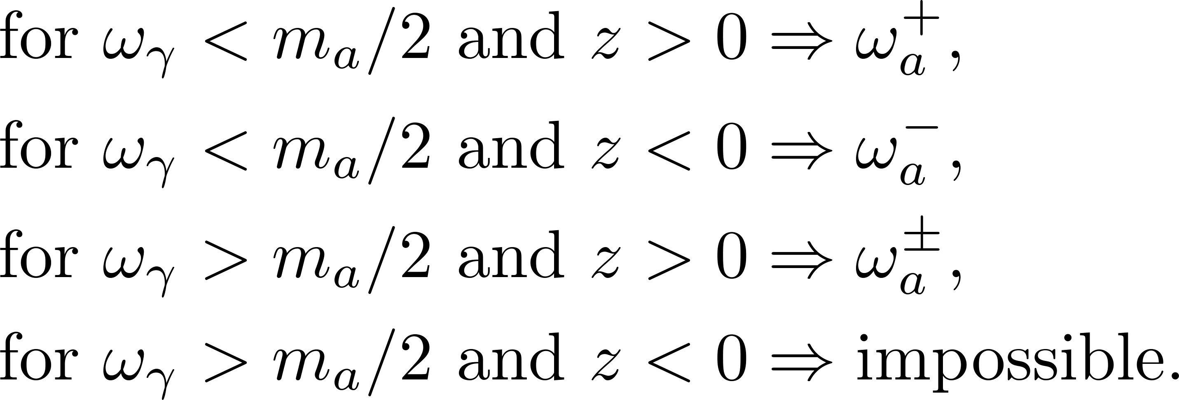
Jacobian: summing up two solutions
Two solutions for $ω_{γ}$ and $𝓏$ in ALP decay

Slide 14
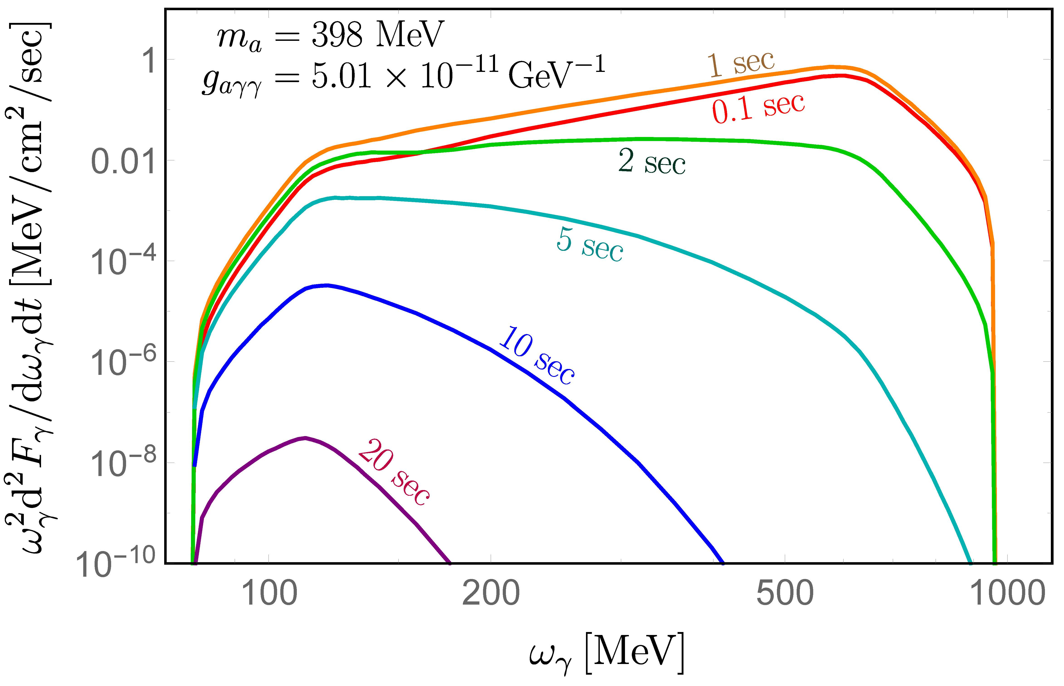
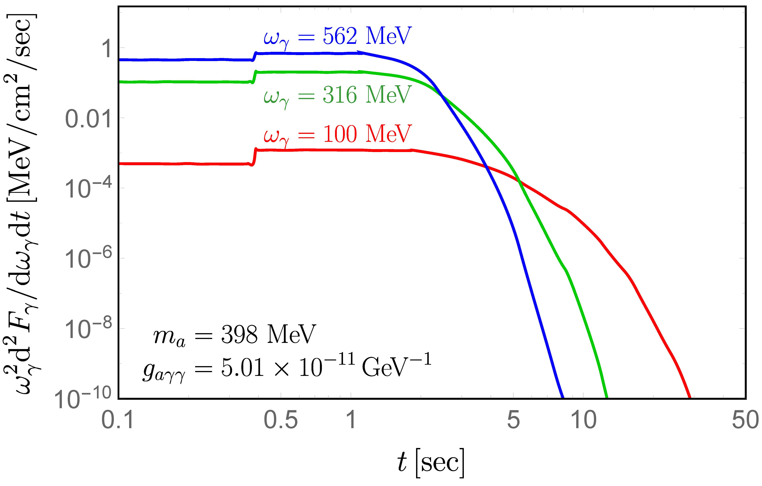
Photon spectra: example 1
ALP is relatively shorter-lived.

Slide 15
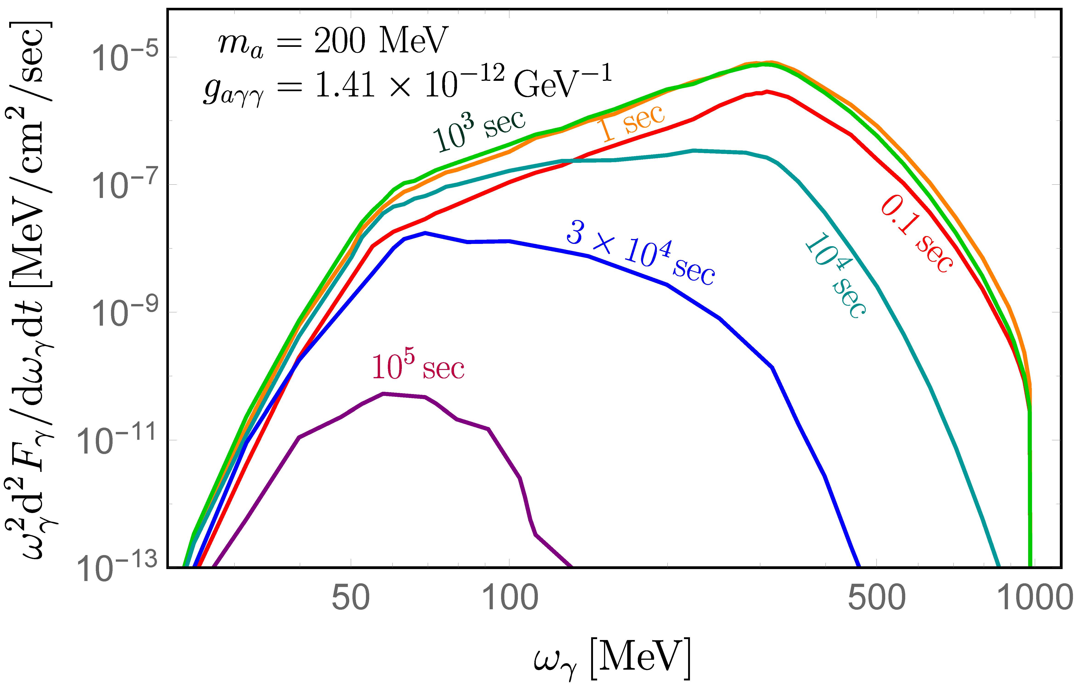
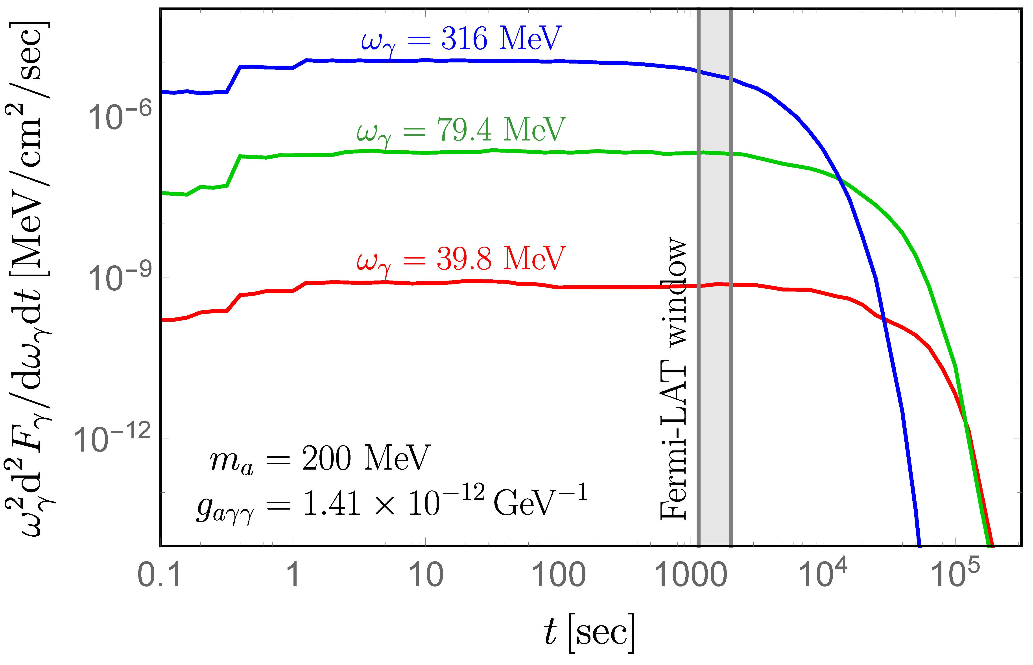
Photon spectra: example 2
ALP is relatively longer-lived.

Slide 16
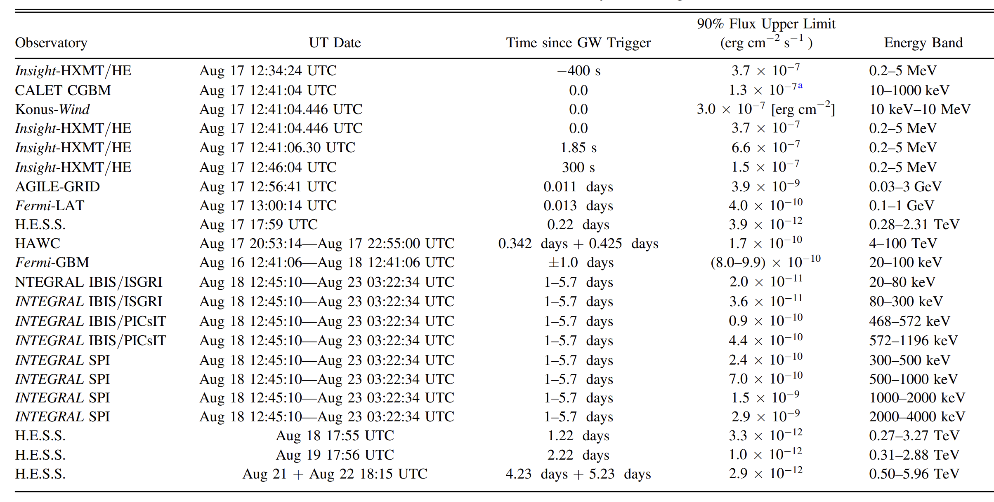
$γ$-ray limits
Astrophys.J.Lett. 848 (2017) 2, L12

Slide 17
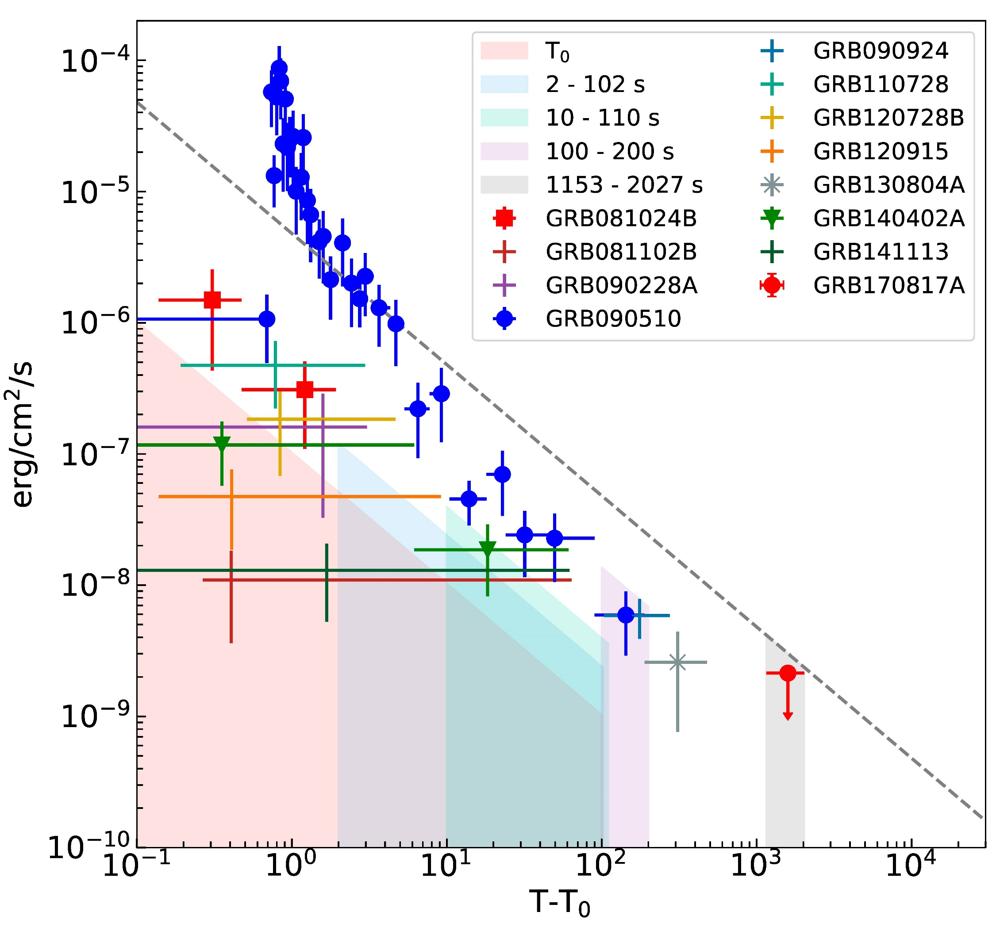
Fermi-LAT limit on GRB
Fermi-LAT, 1710.05450
Fermi-LAT looked for GW170817 associated short GRBs.
Energy range: 100 MeV – 1 GeV
Time period: t_{GW} + 1153 s → t_{GW} + 2027 s
Limit: 4.5×10⁻¹⁰ erg/cm²/sec

Slide 18
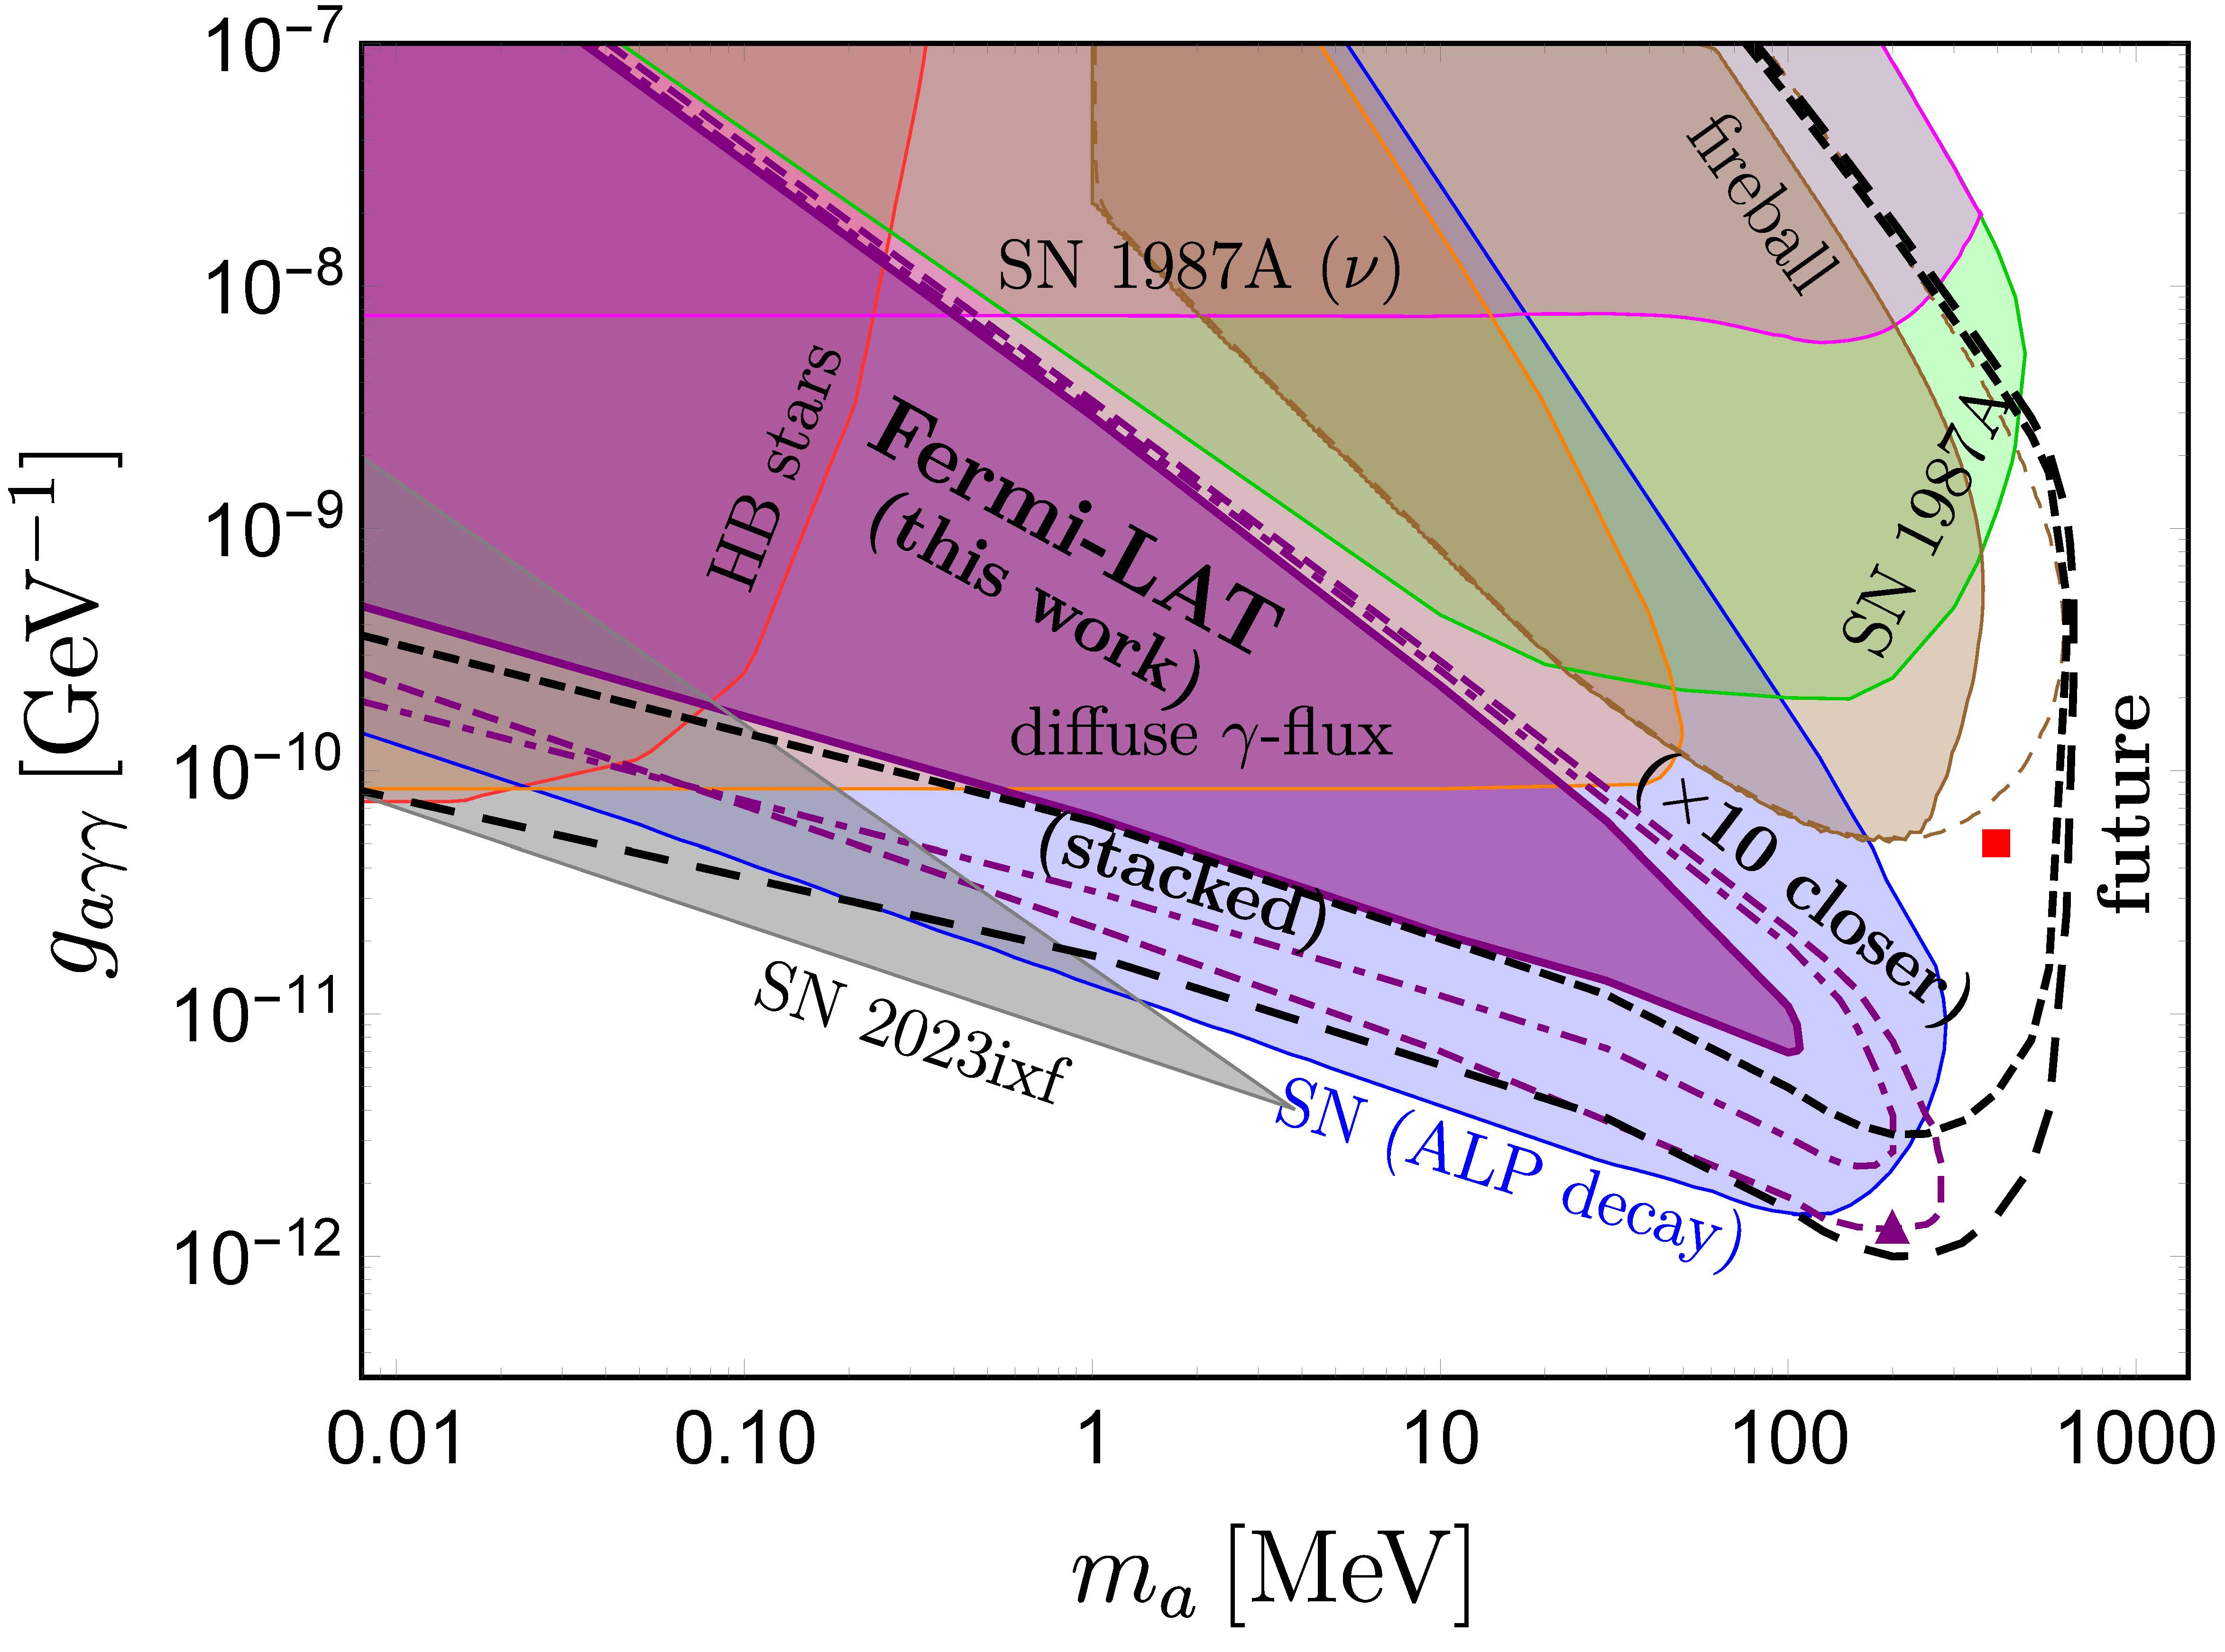
NS merger limits on ALP
LESNe
SN decay limit Jaeckel, Malta & Redondo, PRD98(2018)055032; Hoof & Schulz, JCAP03(2023) 054 Fireball region & limit
Diamond, Fiorillo, Marques-Tavares, Tamborra & Vitagliano, PRL132(2024)101004 Future prospects AMEGO-X [2208.04990], e-ASTROGAM [1711.01265], PANGU [1407.0710], AdEPT [1311.2059], APT [PoS ICRC2021(2021)655], GAMMA-400 [Phys.Atom.Nucl.80(2017)1141], GECCO [2112.07190]

Slide 19
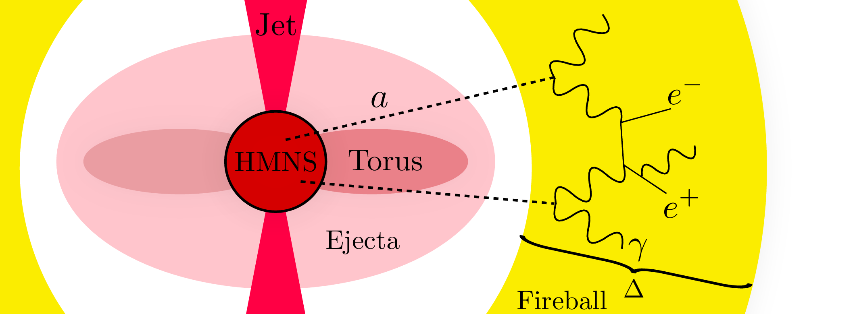
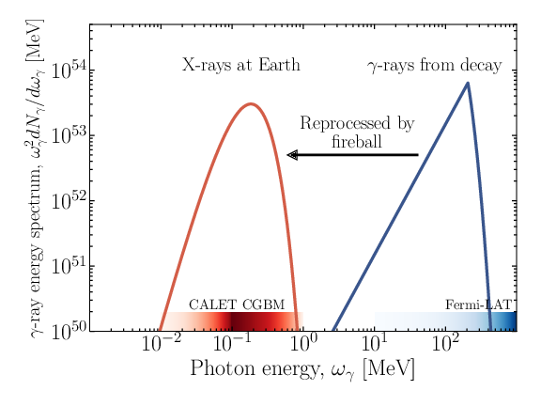
Fireball in supernovae & NS mergers
Diamond, Fiorillo,
Marques-Tavares & Vitagliano ’23;
Diamond, Fiorillo,
Marques-Tavares,
Tamborra & Vitagliano,
PRL132(2024)101004

Slide 20
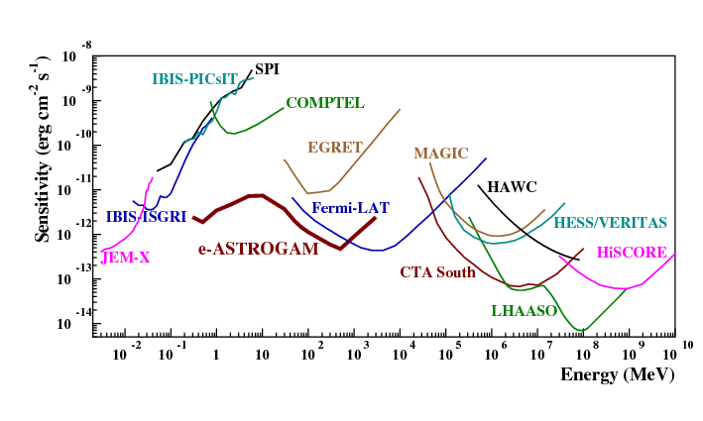
Future 𝛾-ray prospects
1711.01265

Slide 21
Some thoughts and progress
NS mergers limits on a light (photonic) scalar 𝘚 (e.g. originating from left-right symmetric model) 𝘚 → 𝛾𝛾 and/or 𝘚 → mesons/𝜇⁺𝜇⁻ →𝛾𝛾
White Dwarf merger limits on ALPs: less promising with respect to NS mergers photons from ALP decays in the back direction?

Slide 22
Conclusion
NS mergers can be used to set limits on light particles, e.g. axion/ALP, from observations of multimessenger signals.
NS merger & supernova limits are largely complementary to each other (& also other limits).
In the future, we can do better!
Thank you！

Slide 23
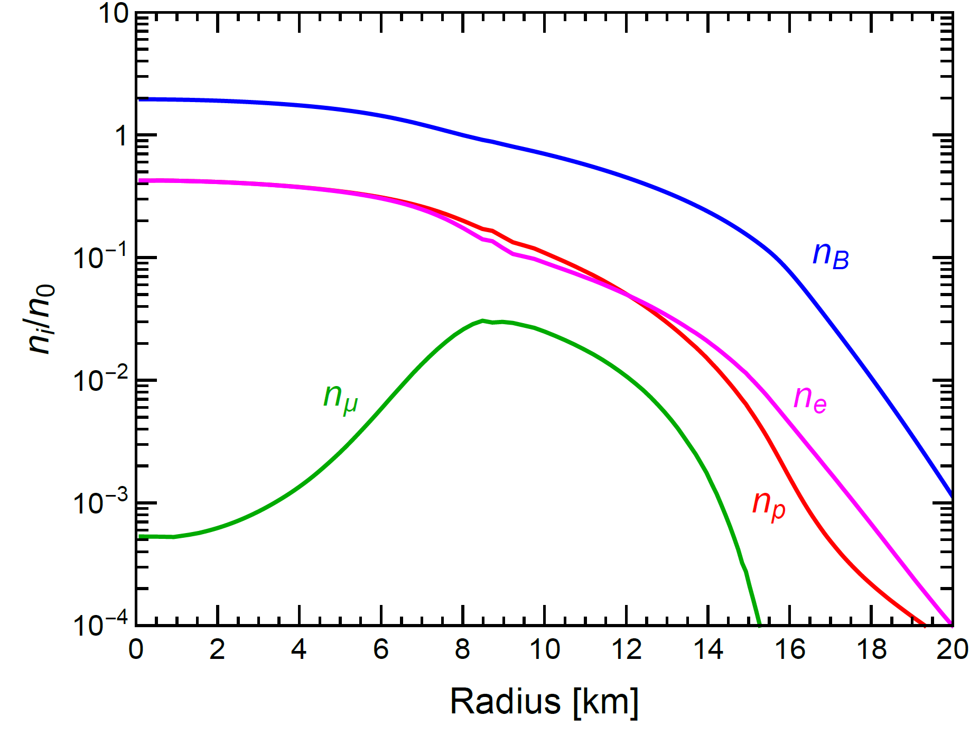
Muons in NSs & supernovae
Energies of photons and neutrinos can reach well beyond 100 MeV in a newly born NS:
Muonizing (building up net muon-lepton number) in the star by emitting more ${\overline{ν}}_{μ}$ than $ν_{μ}$.
Bollig, Janka, Lohs, Martinez-Pinedo, Horowitz & Melson, PRL119(2017)242702; Bollig, DeRocco, Graham & Janka, PRL125(2020)051104; Croon, Elor, Leane & McDermott, JHEP01(2021)107;
Fischer, Guo, Martinez-Pinedo, Liebendorfer & Mezzacappa, PRD102(2020)123001

