Slide 1
Implementation of MicroTCA Based
Low-level RF Systems
2024.09.18

Slide 2
1
2
Introduction
MTCA.4 LLRF
System Hardware
CONTENT
3
4
FPGA Framework & Software Implementation
Summary

Slide 3
LLRF Introduction
01

Slide 4
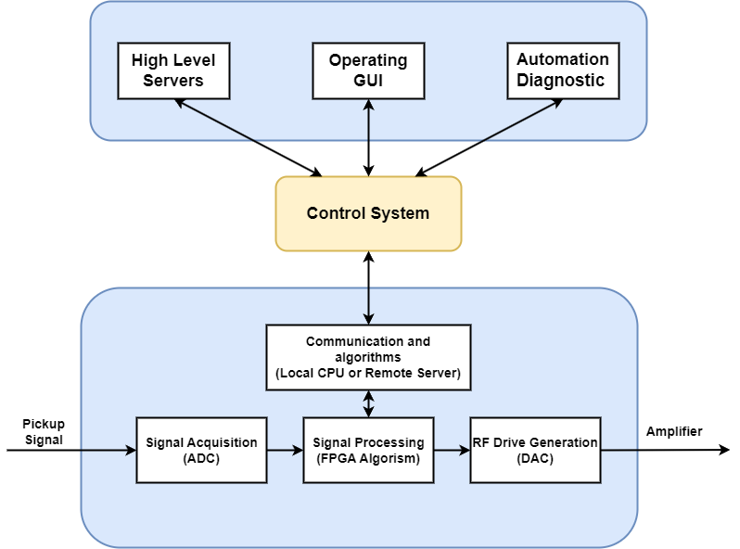
LLRF System
Low Level Radio Frequency
Regulates the amplitude and the phase of the accelerating voltage inside a RF cavity is essential to ensure the stable operation of charged particle accelerator
Basic requirements:
Cavity Field Control (RF loops)
Cavity Resonance Control (frequency loops)
Additional requirements:
High speed data acquisition
Built-in system diagnosis
Automation commission
Exception handling procedures

Slide 5
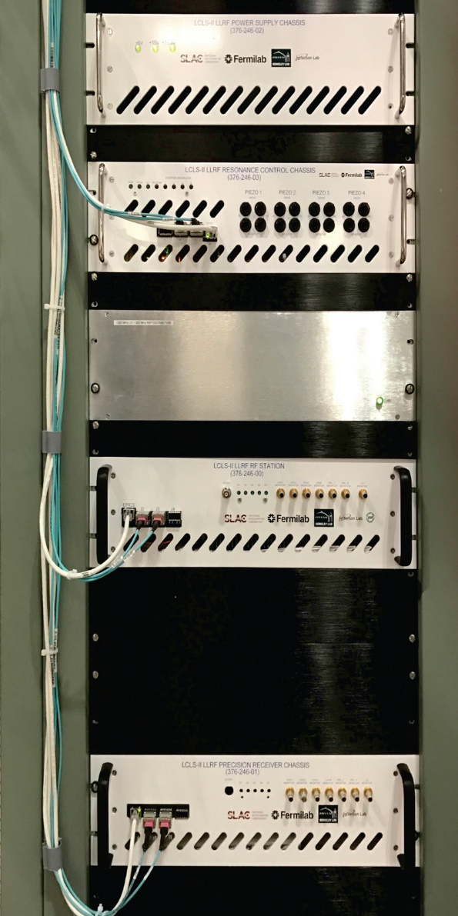
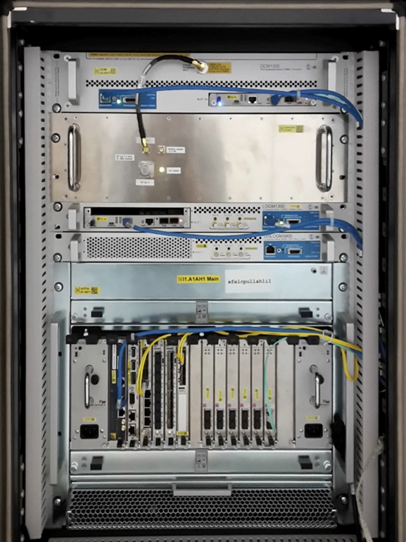
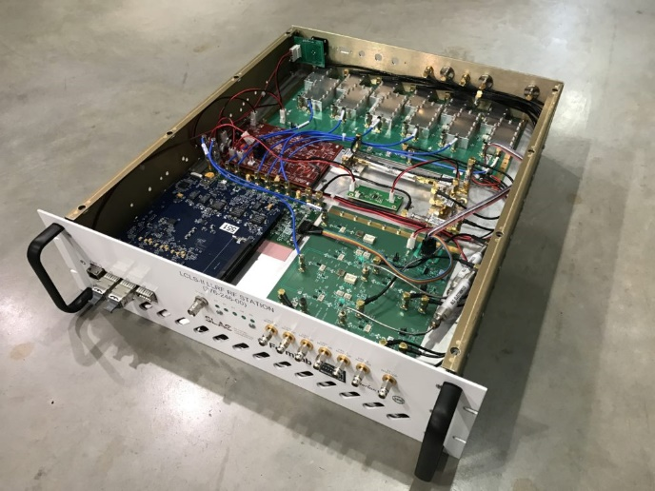
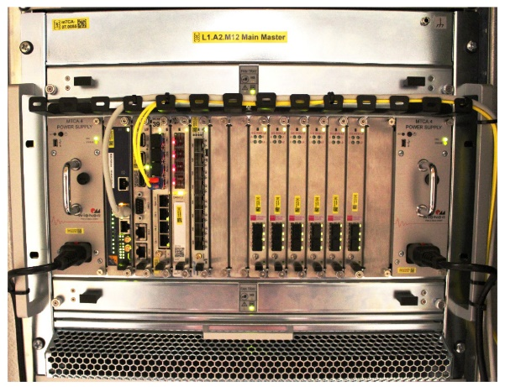
Digital LLRF System Types
“Pizza box”
19-inch modules
Individually developed and built hardware
Crate-based systems
Of-the-shelf components
Highly modularity and scalability
LLRF Testing at the FNAL CMTS
MicroTCA LLRF at the XFEL

Slide 6
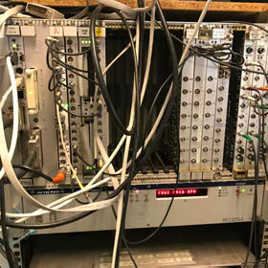
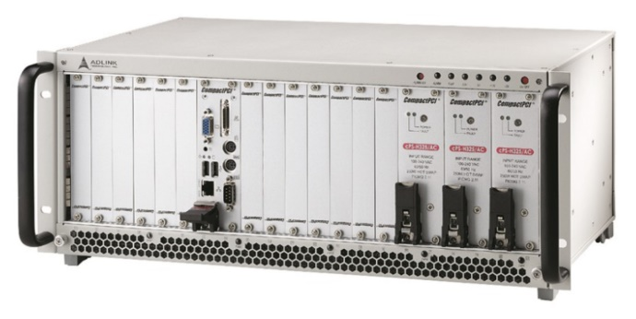
Motivation for MicroTCA.4
Limitations of VME/CPCI/PXI:
Low bus bandwidth
Lack of support for serial fabrics
Insufficient intelligent control support
Requirements in the High-Energy Physics
High data rate
Scalable modular system
Shelf management and monitoring
Redundancy
Hot swap capability
Evolved from ATCA/MTCA
Modern, high-speed data transfer
Redundant fans/power supply
Intelligent platform management
Excellent signal quality
Internal clock & trigger distribution

Slide 7
MTCA.4 LLRF
System Hardware
03

Slide 8
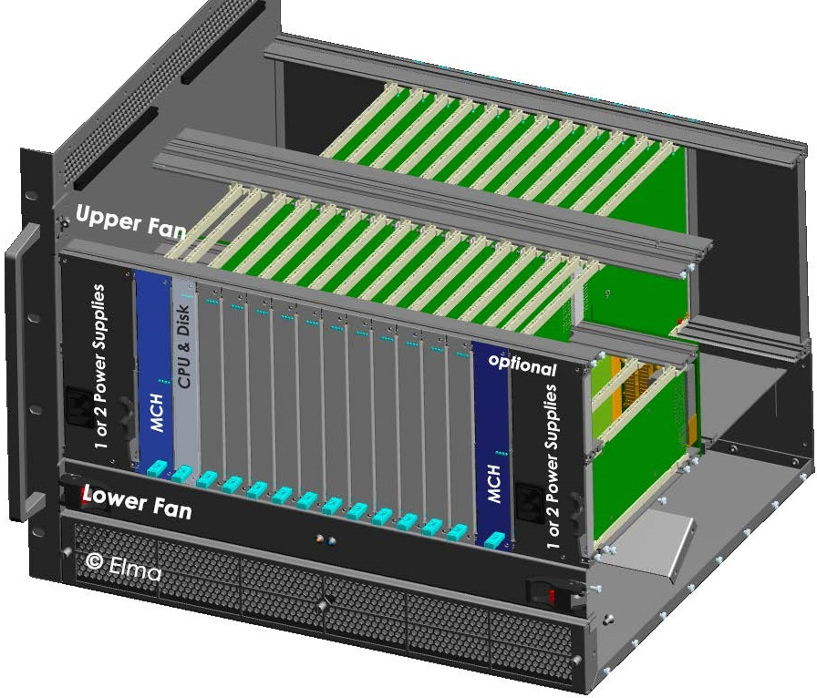
MTCA.4 LLRF: Overview
ADC, DAC, FPGA
Mostly COTS
RTM
Boards
RF interface, I/O extension
In-house development or COTS
AMC
Boards
Power Supply
MicroTCA Carrier Hub
Processor
Board
Redundant
PSU & MCH

Slide 9
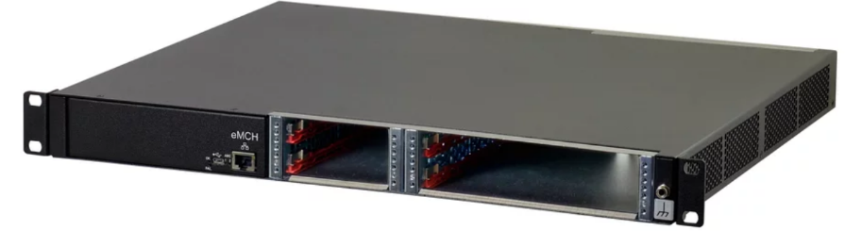
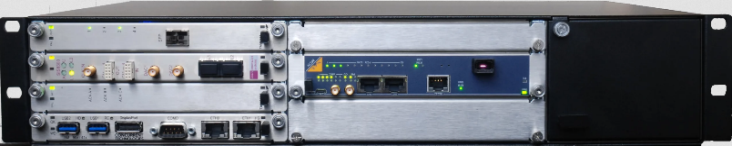
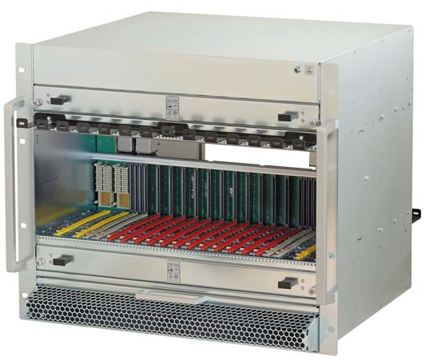
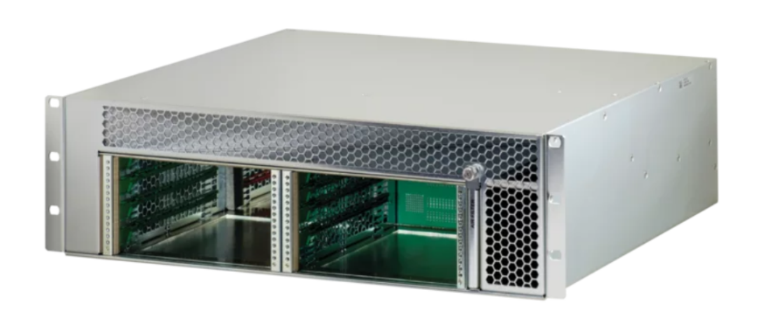
Chassis selection
1U Chassis
• Integrated eMCH
• 2-slot Double Mid-Size AMC w/ RTM
• 2-slot Single Mid-Size AMC
• Integrated PSU
2U Chassis
• 5-slot Double Mid-Size AMC w/ RTM
• 1-slot Double Full-size AMC
• 1-slot Double Full-size MCH w/ RTM
• 1 Double Full-size PM
3U Chassis
• 4-slot Double Mid-Size AMC w/ RTM
• 1-slot Double Mid-size AMC
• 1-slot Double Full-size MCH
• 2 Double Full-size PM
9U Chassis
• 12-slot Double Mid-Size AMC
slots w/ RTM
• 2-slot Double Full-size MCH w/ RTM
• 4 Double Full-size PM

Slide 10
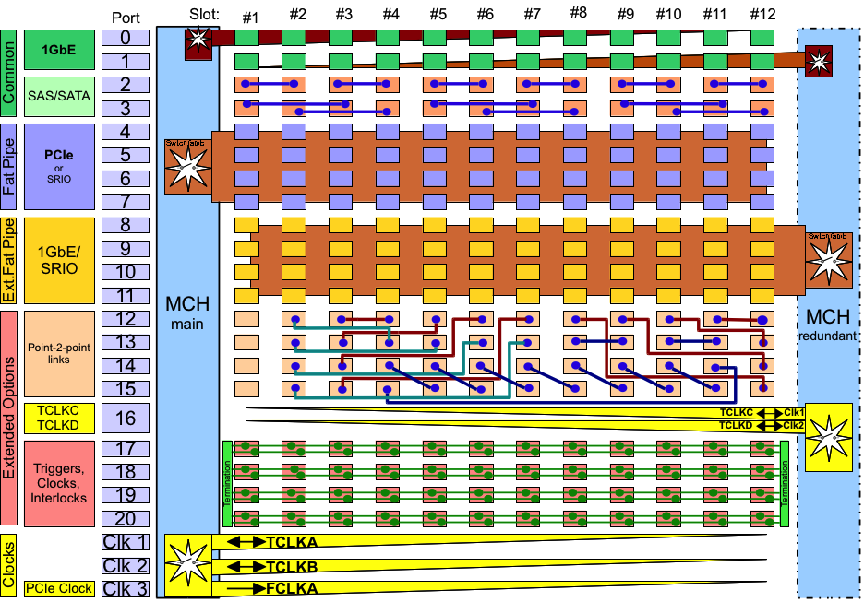
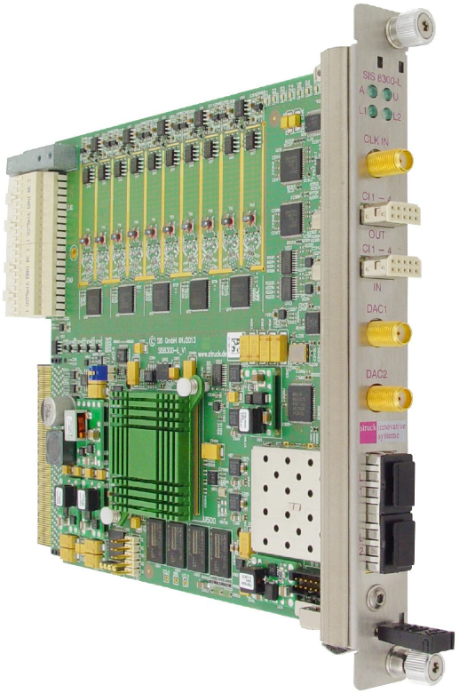
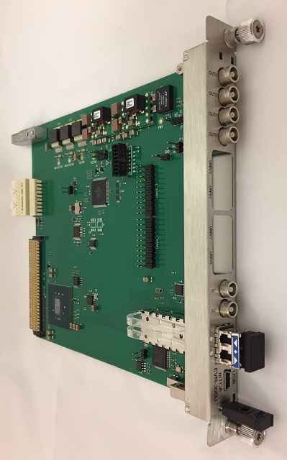
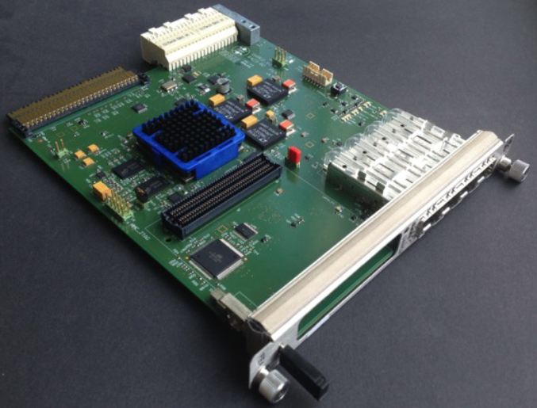
Backplane Connections
MLVDS
Shared between all slots
Triggers, interlocks, clocks, ...
Usually one transmitter and multiple receivers
Example: interlock and trigger interconnect between digitizer, EVR or interlock board
Timing
Trigger
MPS Interlock
mTCA-EVR-300U
SIS8300L2
DAMC2

Slide 11
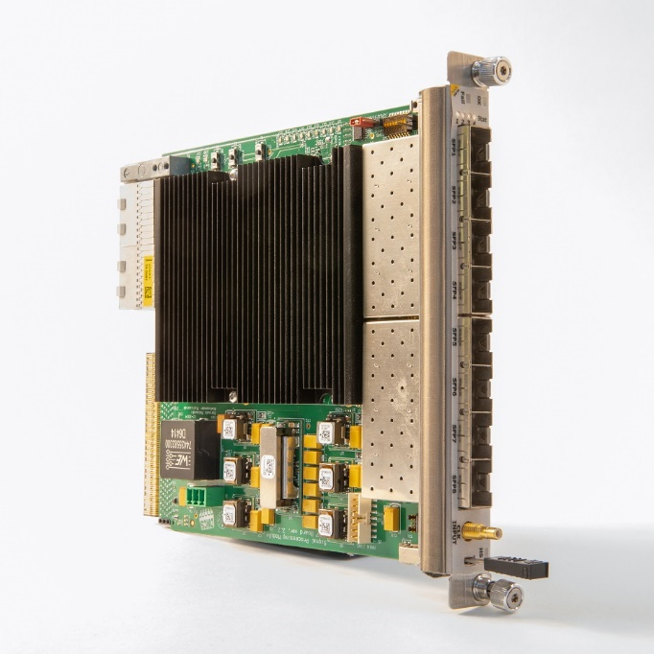
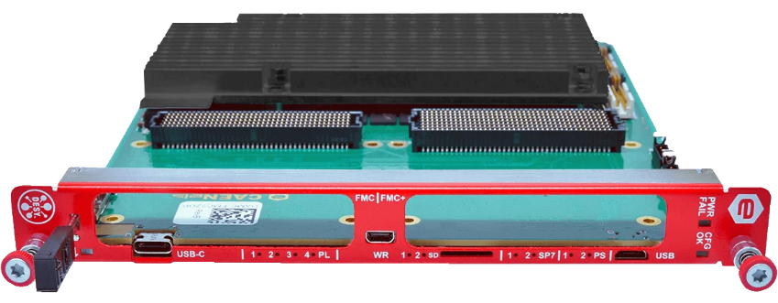
Backplane Connections
Point-to-point links
Direct communication between boards, used for data aggregation
Protocol selection up to application: Aurora, 8b/10b, (10)G Ethernet
Example: Data exchange between master-slave digitizer for multi-cavity LLRF control, superconducting cavity with resonance controller
Data
Processing
Cavity
Tunning
Processing Board
Digitizer
FMC Carrier

Slide 12
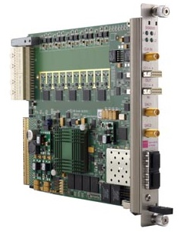
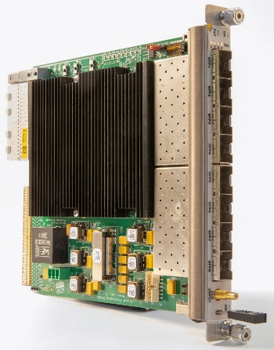
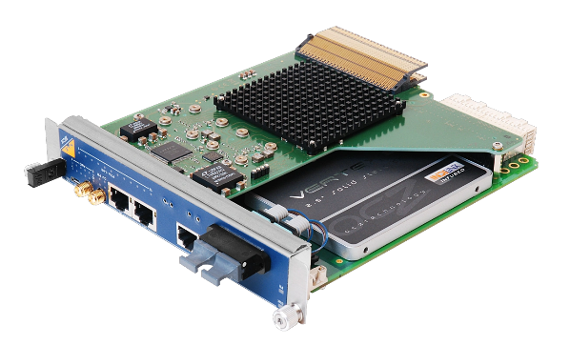
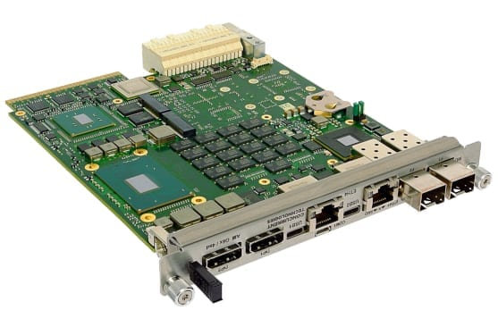
Backplane Connections
Gigabit Ethernet
1000BASE-KX
TX and RX diff pair at 1.25 Gbps
Examples: Ethernet interface of Zynq-based boards, UDP transceiver on FPGA
PCI Express
Gen 3 (8 GT/s), x4 (x8 in special crates) choice for many apps
Native support for PCI Express 5.0 in the future
Other protocols available (SRIO, 10/40Gb Ethernet )
PCIe Switch
ETH Switch

Slide 13


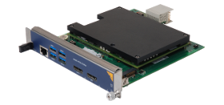

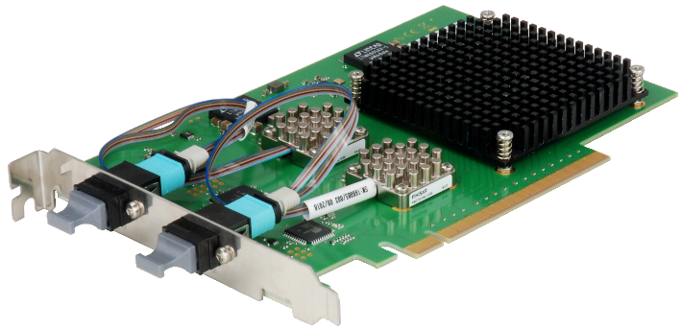
Computing Module
CPU module inside of crate
Processor performance limited by 80 W per slot power limit
Easy to operate and maintain
PCIe interface card for operation in PCs / servers
Optical PCIe Gen3 x8/x16 uplink
Obtaining higher computing and storage performance at a lower cost
optical uplink
PCIe interface card
NAT-PHYS80 MCH

Slide 14
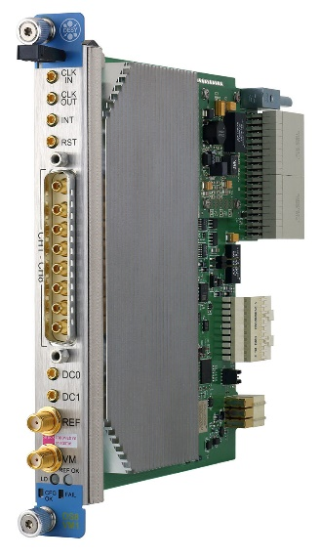
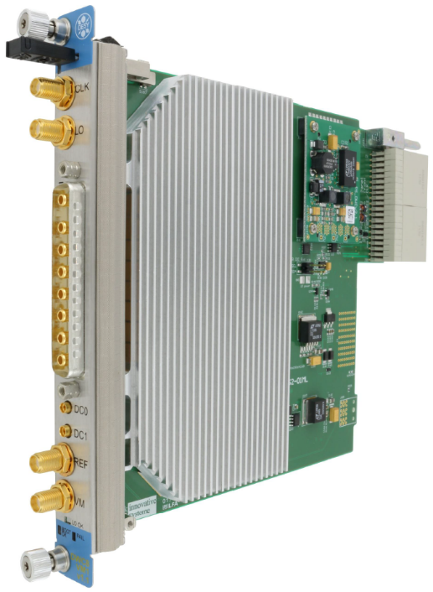
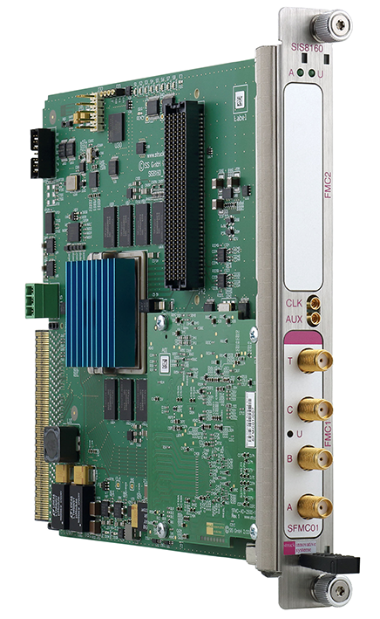

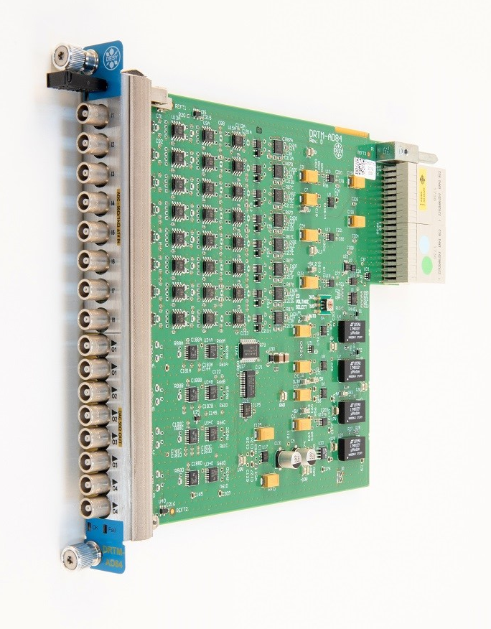
AMC & RTM Selection
Many AMCs and RTMs available on the market, LLRF system needs to make appropriate choices based on the system architecture and operating frequency band

Slide 15
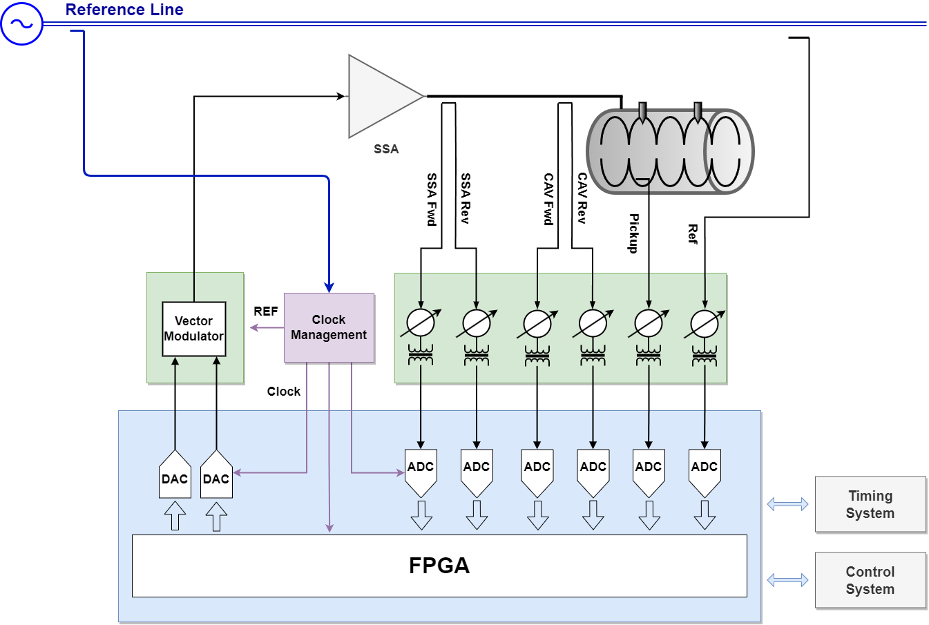
Direct Sampling Schemes with RTM
Latest generation of RF sampling ADCs digitize signals at frequency up to several GHz, which makes it possible to sample RF signal directly
Direct-sampling architecture provides flexibility and simplification for LLRF
Direct Sampling RTM
DC to 400 MHz DS front-end
AMC Digitizer
10 channel 125MHz/16Bit digitizer

Slide 16
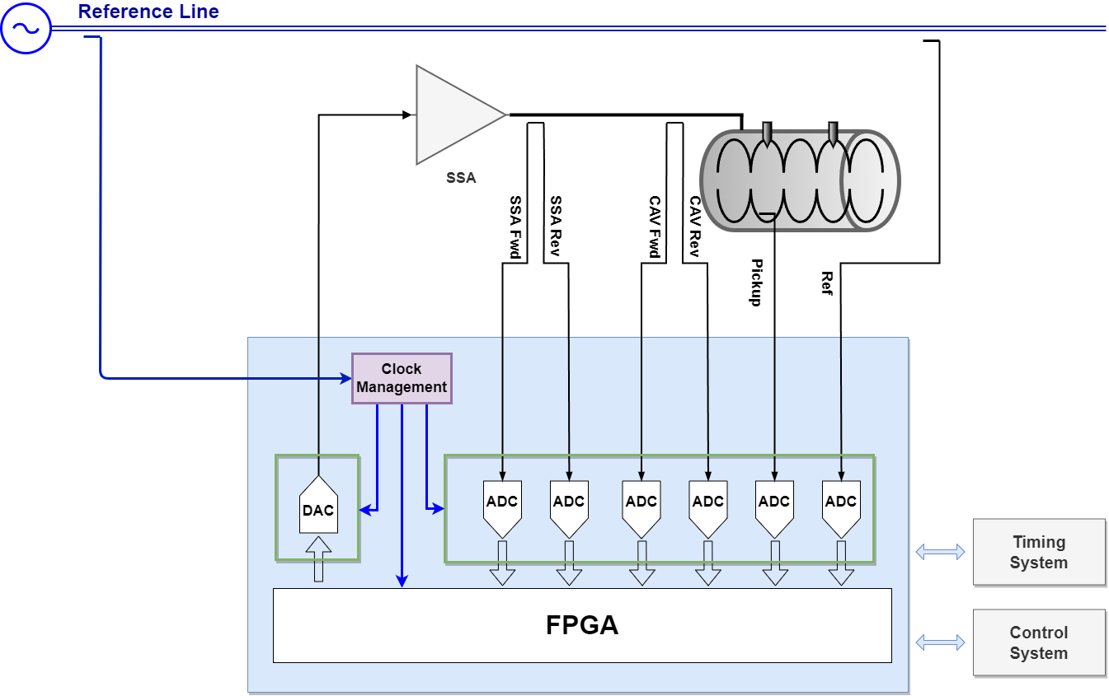
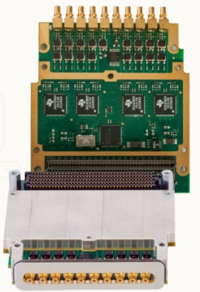
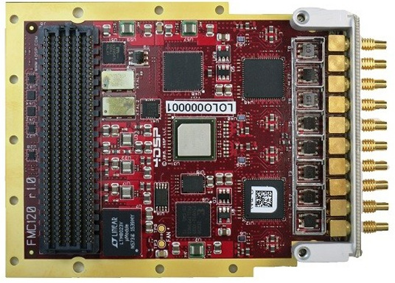
Direct Sampling Schemes with AMC Carrier
High frequency analog signal transfer over Zone3 can leads to crosstalk between the differential channels
Get rid of Zone 3 analog bandwidth limitations using carrier + FMC
Many COTS components for GSPS ADC and DAC
Carrier AMC
Dual HPC FMC Carrier
FMC Card

Slide 17
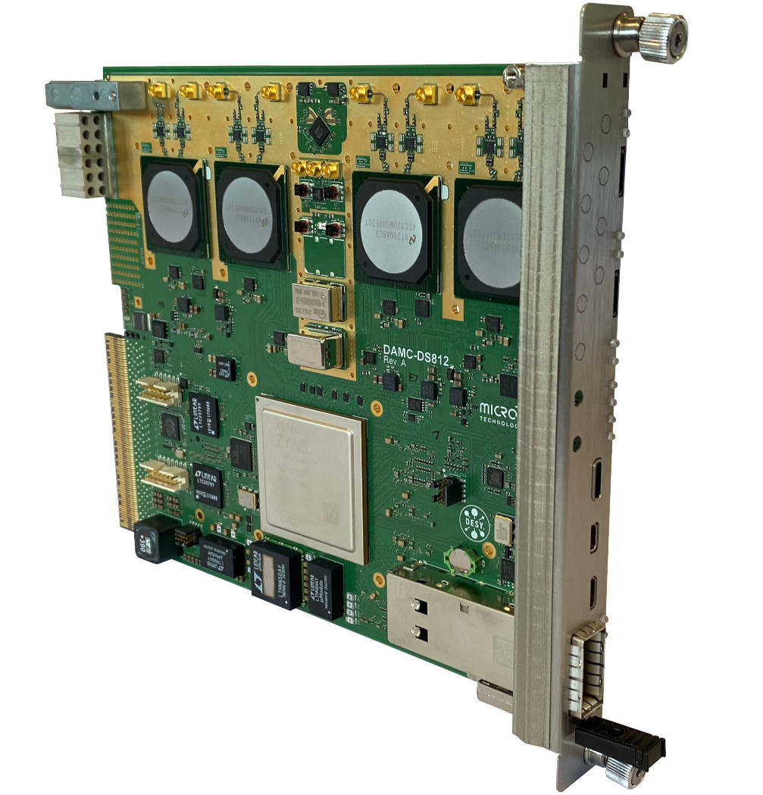
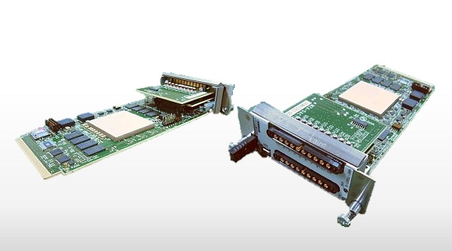
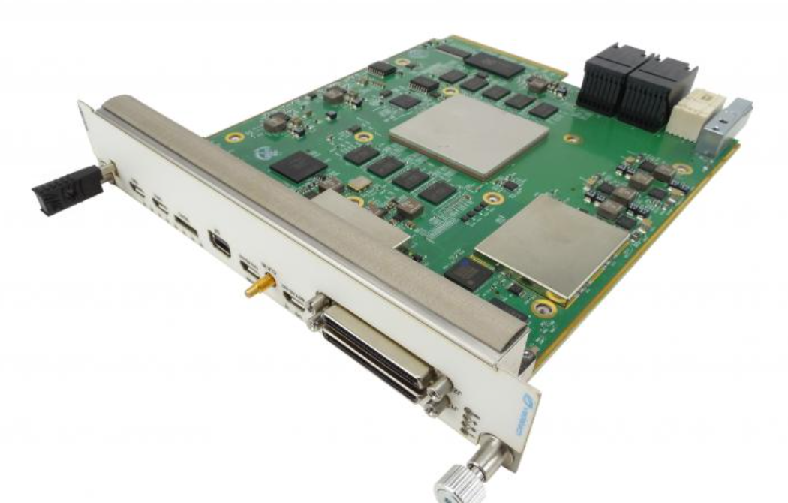
Other Direct Sampling Schemes
High sampling rate digitizer using single-ended analog RTM connection (Class RF1.0)
Zynq RF-SoC digitizer: highly integrated, more flexible, lower latency
DAMC-DS812ZUP
8 channels, 800 MSPS, 12 bit digitizer
MMC-TRX02-B RF-SoC
12bit, Sampling: 4GSPS, Bandwidth: 4GHz, Channels: 8ch
AMC576 RF-SoC
16 ADC (12-bit @ 2 GSPS) and 16 DAC (14-bit @ 6.4 GSPS)

Slide 18
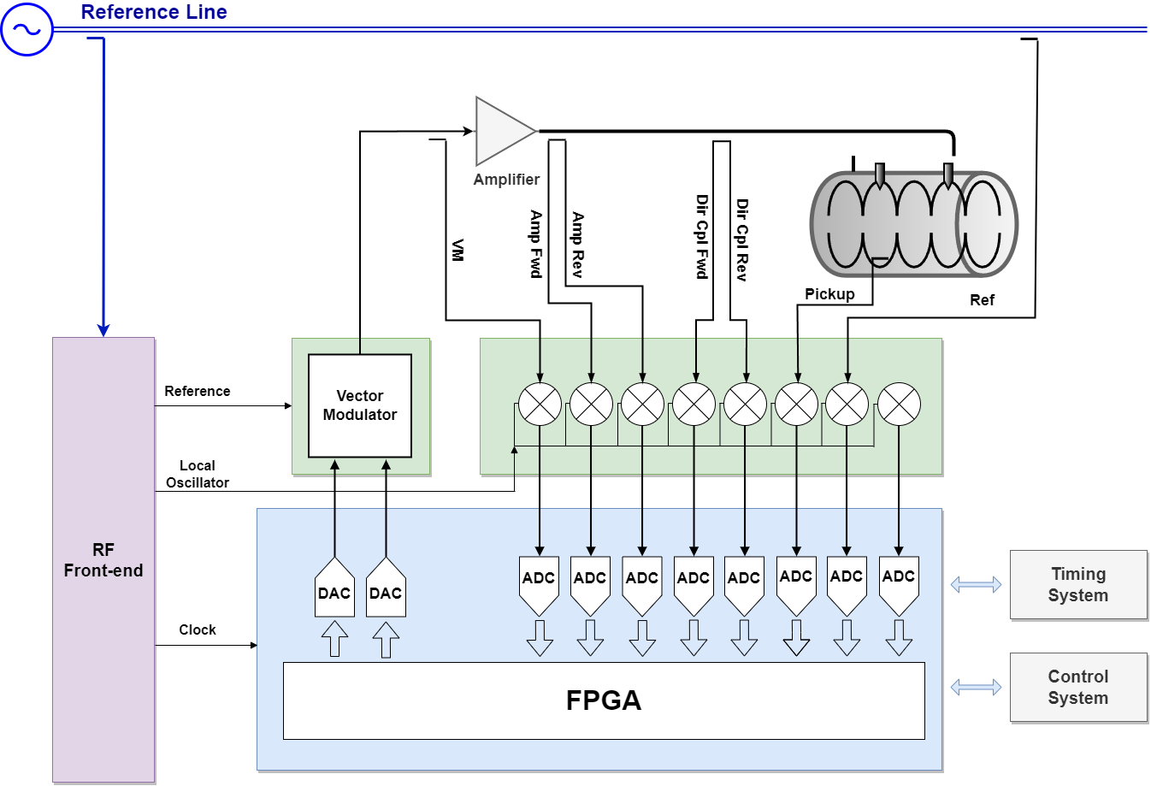


Down-conversion Schemes
For L, S, C band LLRF, RF signal is typically down-converted in RTM front-end
For higher frequency (X-band) LLRF, conversion between X, S or C out of crate may required
RTM Front-end
500MHz to 6GHz Down/VM converter
LO & Clock
Generator
AMC Digitizer
10 channel 125MHz/16Bit digitizer

Slide 19
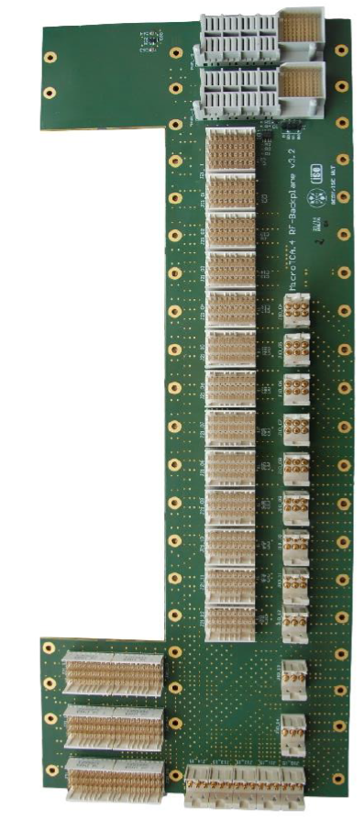
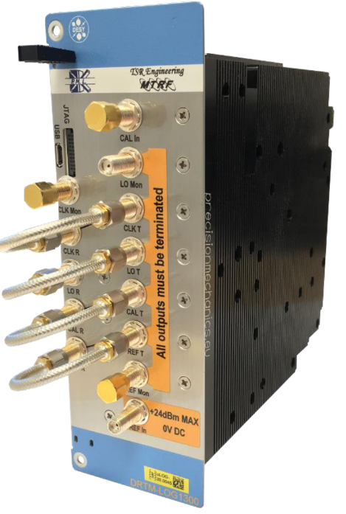
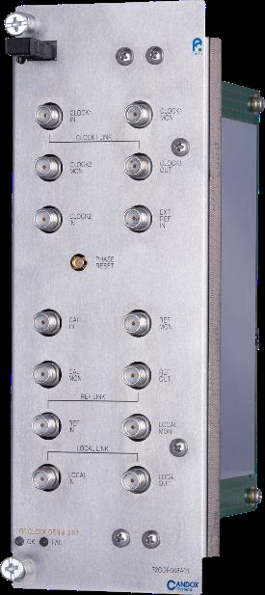
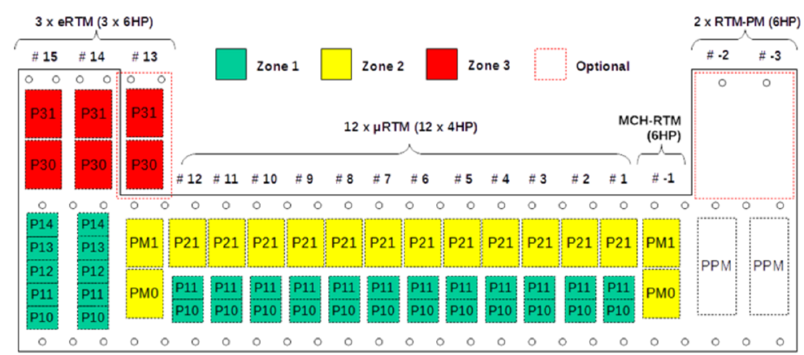
Down-conversion Schemes with RF Backplane
RF backplane introduced in MicroTCA 4.1
Extra slots for RF/clock signal generation and distribution modules, Supports up to 3 extended RTMs (RTMs without AMC)
Up to 2 power supply RTMs with low-noise, separated, analog, bipolar power distribution
RF signal distribution over backplane, eliminates RF coaxial cable, more compact system, improves reliability
DRTM-LOG1300
eRTM-508MHz
Candox Systems, Inc.

Slide 20
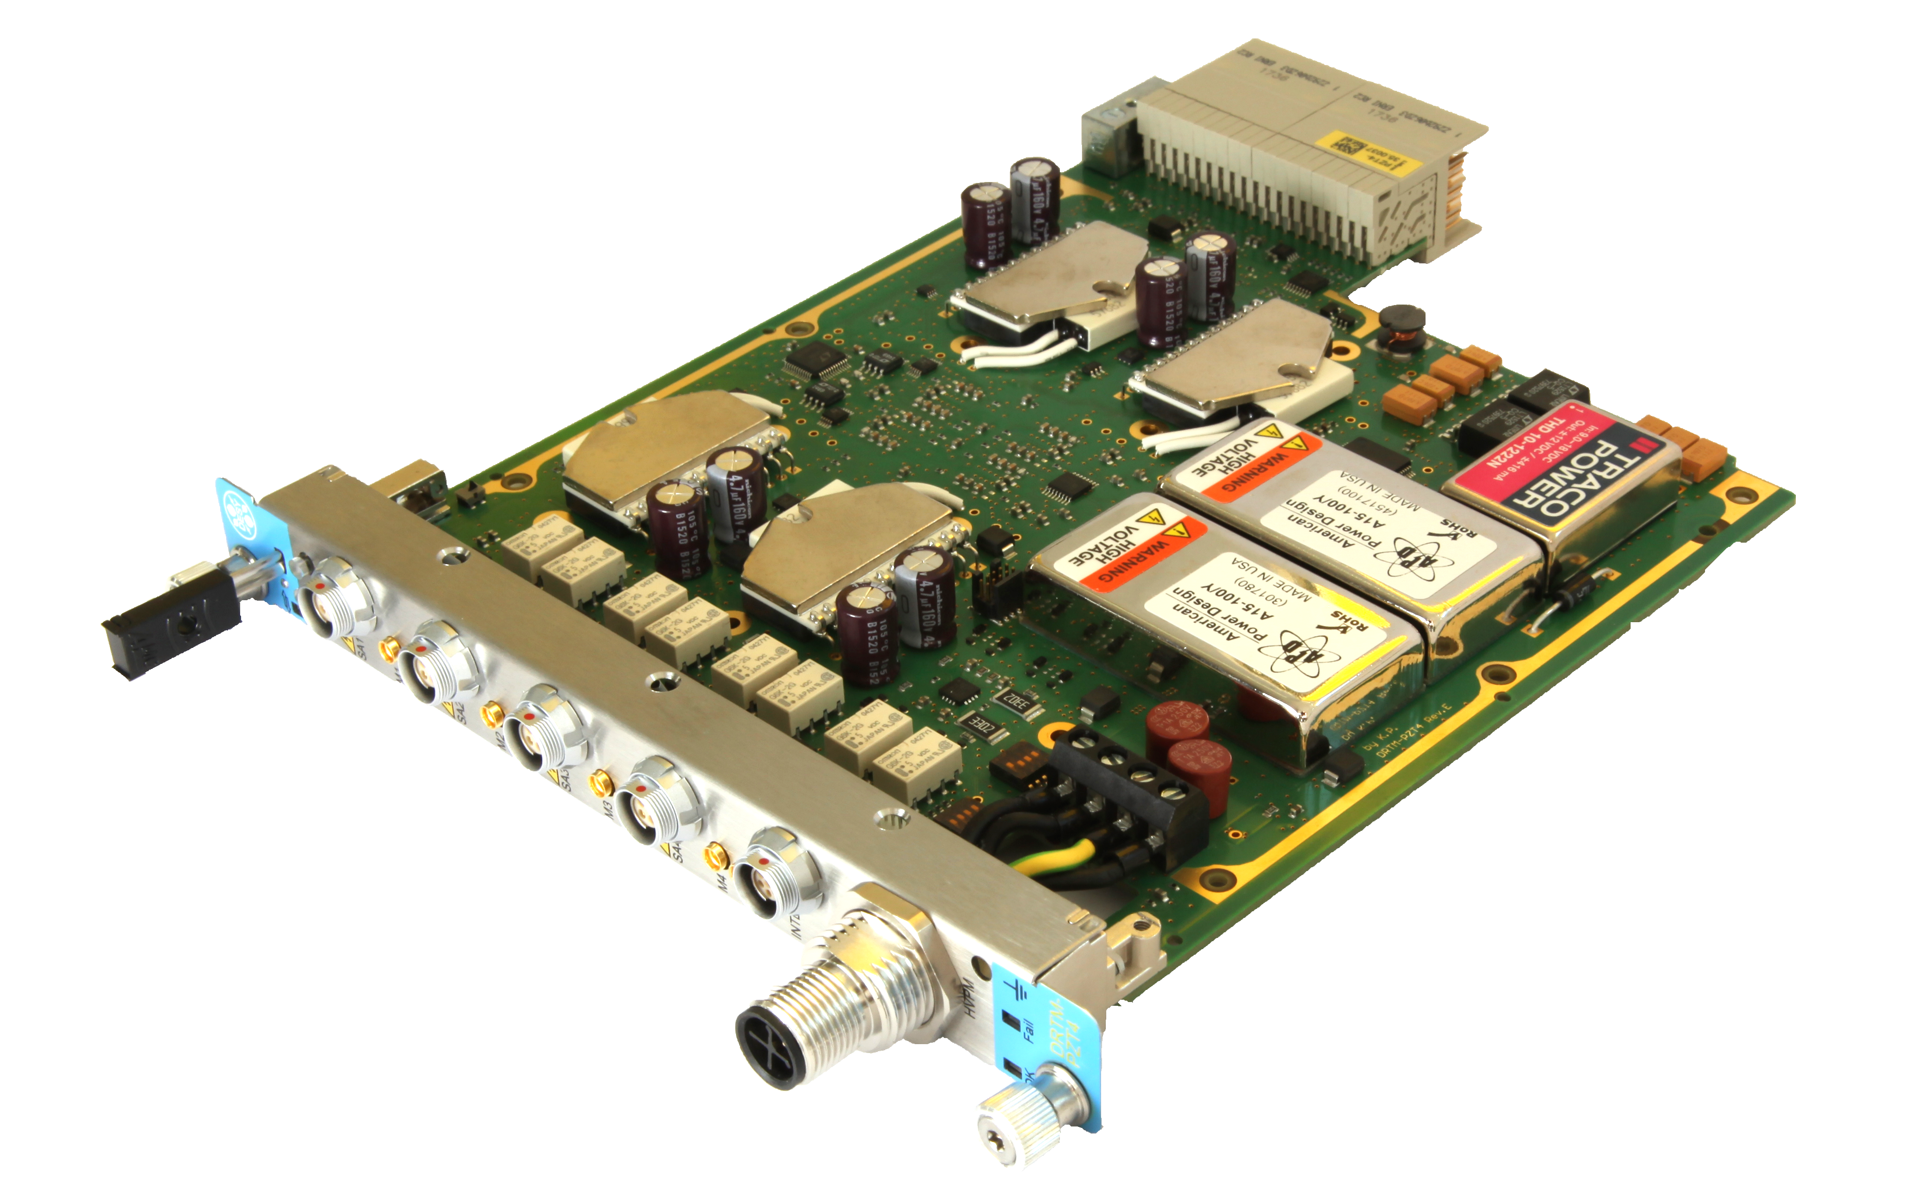
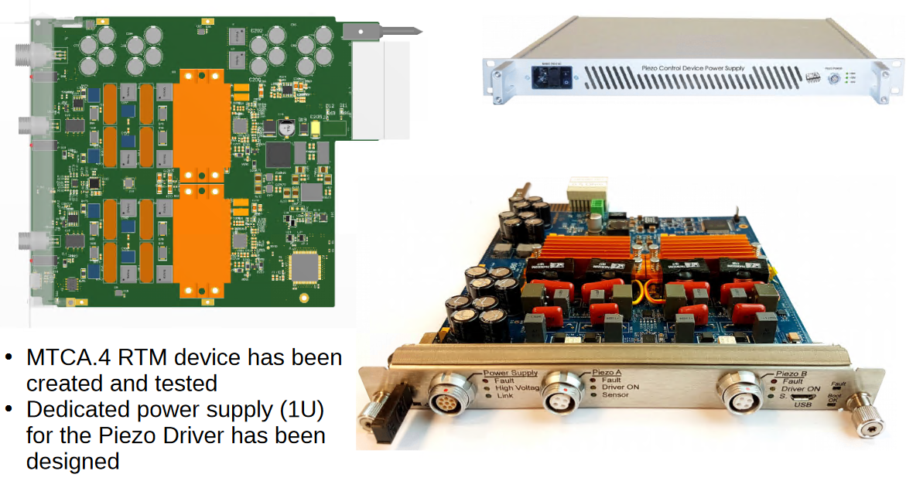
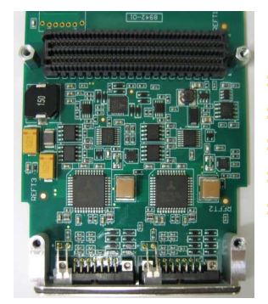
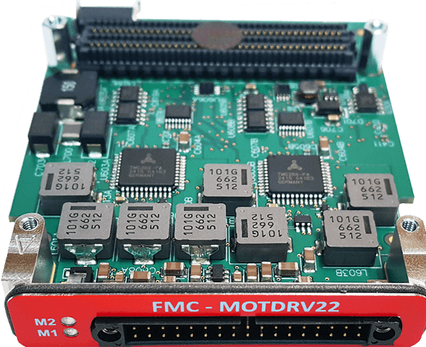
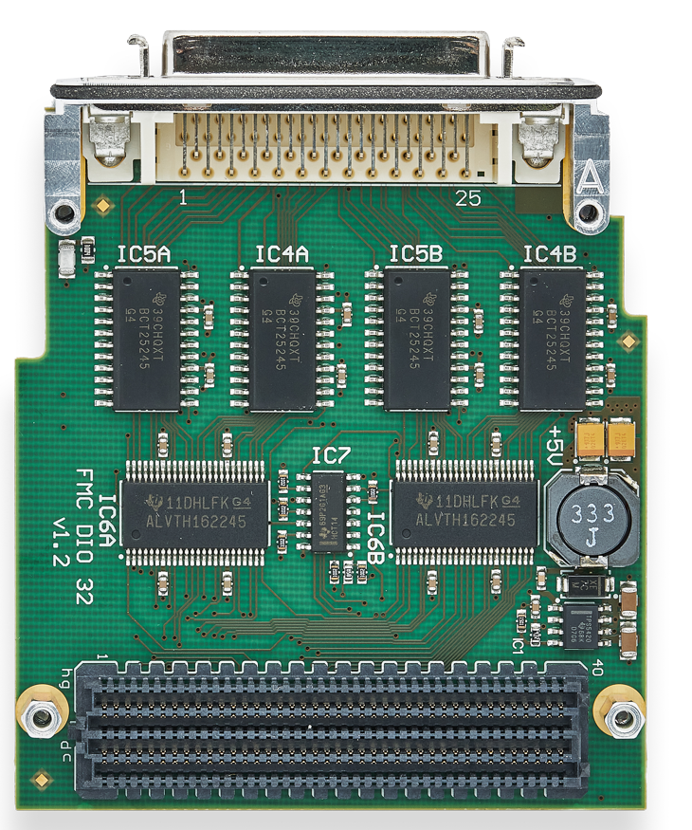
Cavity Tuning
Piezo RTM
DRTM-PZT4
2 independent channels operation(0 to +200V)
Operation as an actuator or a sensor
Motor control

Slide 21
FPGA Framework and Software Implementation
03

Slide 22
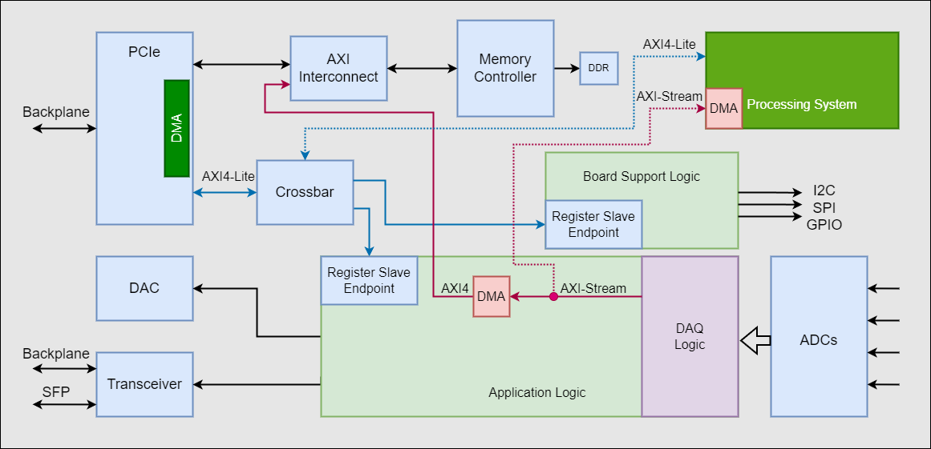
FPGA Framework
BSP
PCIe、DMA、DDR, configuration of peripherals on the board (clocks, I/O buffers, ADCs, DACs, etc.)
APP
User specific algorithms（LLRF control , DAQ logic, etc. ）
DAQ Requirements:
Multi-channel
Pulse/continuous mode
Cross clock domain
Timestamp
Down sampling
Configurable data width
Interrupt
…

Slide 23
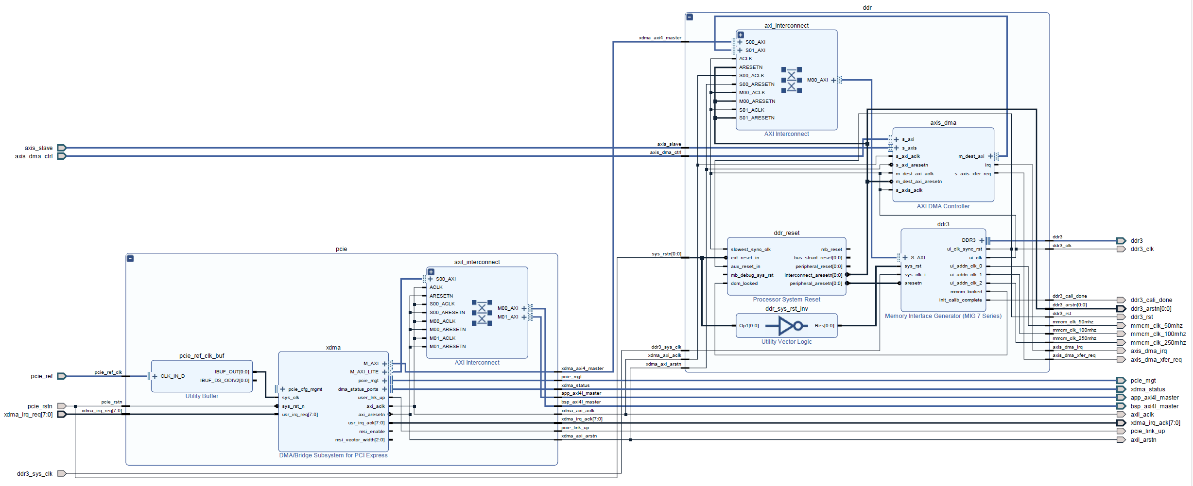
Typical PCIe block design
Xilinx XDMA is provided as an option to transfer data between the FPGA and the instance's CPU memory
Open-source driver
Easy to install and use, and does not require driver development expertise to use
Support multiple channels per FPGA for high performance
DMA (S2MM)
DAQ Stream Input
XDMA
MIG
Register Access

Slide 24
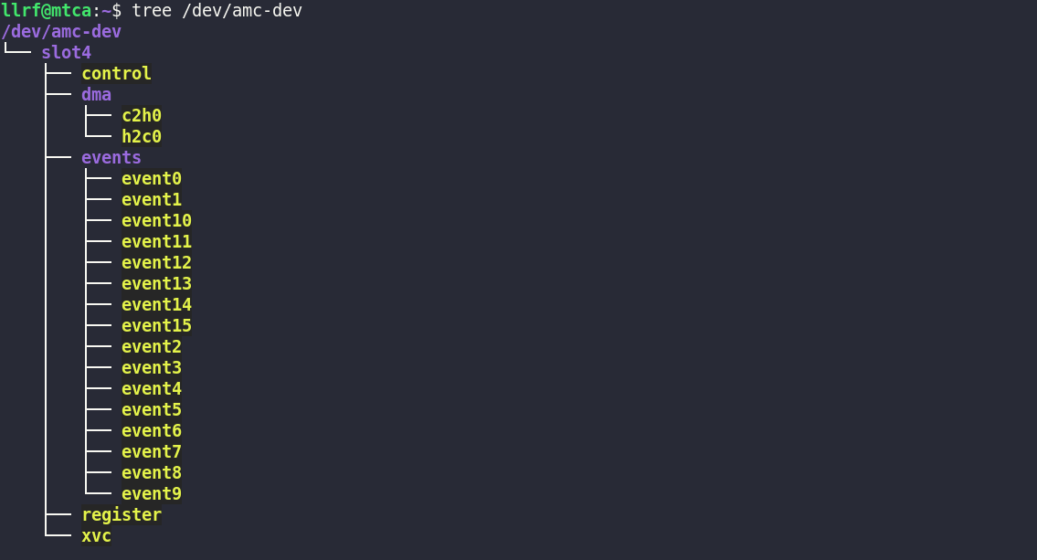
XDMA Device Driver
Official Driver:
https://github.com/Xilinx/dma_ip_drivers
Driver Customization:
Board startup configuration support
Crate slot mapping
Driver installation script
Udev rules and dkms support for the Xilinx XDMA driver，example：
https://github.com/MicroTCA-Tech-Lab/xdma-metapackage
User space character device structure :
C2H: AXI4 port (DMA from device)
H2C: AXI4 port (DMA to device)
Register: AXI4-Lite port

Slide 25
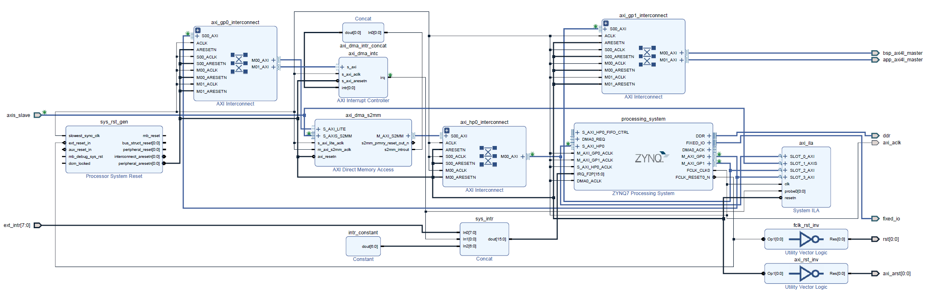
Typical processing system block design
Typically involves integrating a Processing System IP with DMA, peripherals, memory, or programmable logic in a block design environment
Capable of implementing an embedded EPICS IOC for control and data access via Ethernet
Interrupt Controller
Register Access
DAQ Stream Input
PS
AXI DMA

Slide 26
User Space Driver
Linux kernel driver for the general purpose DMA
Xilinx provides "DMA proxy" kernel driver
https://www.xilinx.com/video/soc/linux-dma-from-user-space.html
https://github.com/Xilinx-Wiki-Projects/software-prototypes/tree/master/linux-user-space-dma
The drivers use the Linux DMA Engine subsystem and provide the ability for user to write their own Linux driver which uses the Xilinx driver in kernel space through the DMA Engine subsystem
Other open source driver:
A zero-copy, high-bandwidth Linux driver and user space interface library for Xilinx's AXI DMA and VDMA IP blocks:
https://github.com/bperez77/xilinx_axidma
Linux Driver for the Zynq FPGA DMA engine
https://github.com/bmartini/zynq-xdma

Slide 27
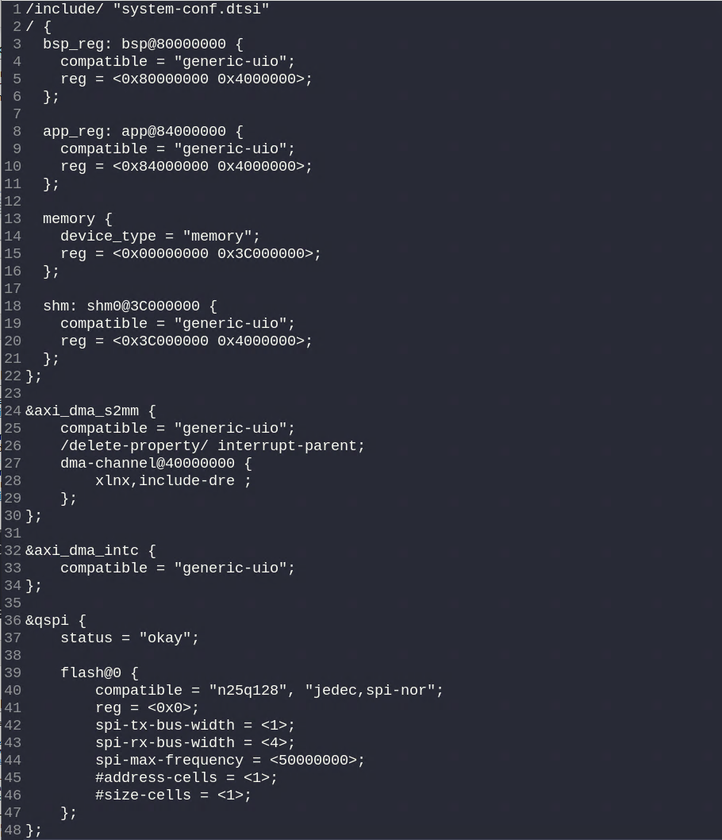


User Space Driver
User space application/driver through the UIO framework
Add the UIO driver to the kernel
Setup IP core in the device tree to use the UIO driver
Develop API to access IP cores via UIO device
Add access to memory:
  reserved memory region in device tree
  u-dma-buf kernel driver: https://github.com/ikwzm/udmabuf
Control AXI DMA engine read from/write to memory space
Example: libudmaio from MTCA Tech Lab
https://github.com/MicroTCA-Tech-Lab/libudmaio
Simplify the use of the Xilinx AXI DMA controller when used in S2MM (Stream to Memory-Mapped) mode
Over PCIe with xdma driver
From ARM over the Userspace I/O
S2MM for example
Clear IRQs (S2MM_DMASR)
Set config (S2MM_DMACR)
Set Dst mem address (S2MM_DA)
Set length (S2MM_LENGTH)
Register Interface
DMA Controller

Slide 28



EPICS Integration
Build EPICS application
Develop device support using XDMA API or user space API
  Board initialization / configuration
  Wrapper for register r/w and DMA r/w
Re-write db record (ai/ao, li/lo, waveform, interrupt…) using device support
Develop complete EPICS IOC and OPI

Slide 29
Summary
04

Slide 30
Summary
MicroTCA is widely used in accelerators because it offers high performance, modular design, cost-effectiveness and reliability. It also provides quick deployment and is supported by a wide community
A relatively standardized MicroTCA.4 LLRF architecture has now been formed. Simplify system development, enables hardware reusability, reduces redundant development, and reduce costs
Xilinx provides a variety of mature IP cores, along with numerous open-source drivers and software, making high-speed data transmission very easy.

Slide 31
Thank you for your attention!

