Slide 1
Challenges and Opportunities in Charm from Lattice QCD
A personal perspective
Wei Wang
6th Workshop on Future Tau Charm Facilities

Slide 2
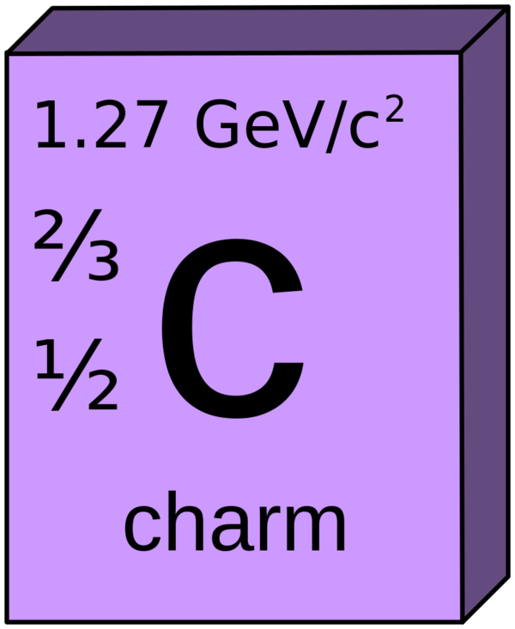
What we know about charm?
1. The charm quark is not heavy, not light:
$$m_{c}\sim 1.3 GeV$$
2. The strong coupling is strong:
$$α_{s}\left(m_{c}\right)\sim 0.3$$
3. There is almost no CPV in charm
ΔA_{CP}=A(K⁻K⁺)−A(𝜋⁻𝜋⁺)=(−1.54±0.29)×10⁻³
LHCb, PRL 122, 211803 (2019)

Slide 3
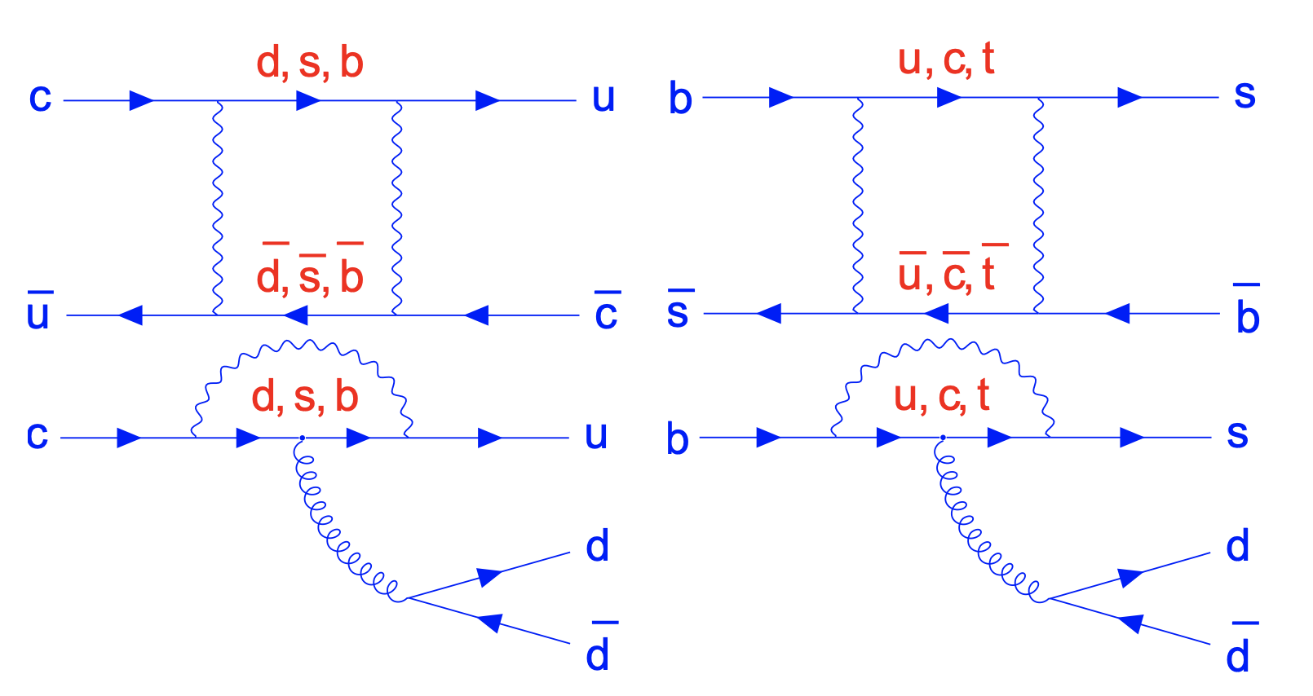
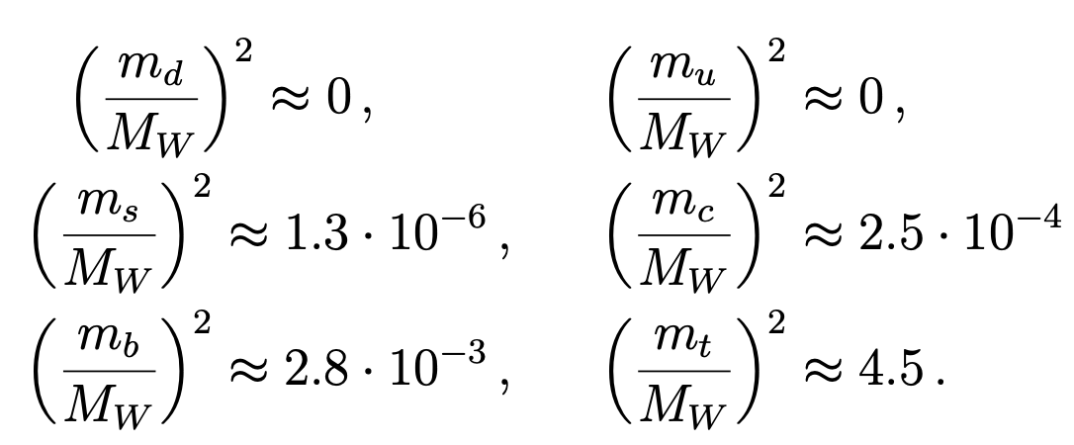
What we know about charm?
4. GIM cancellations in charm sector:
Lenz, Wilkinson, Ann.Rev.Nucl.Part.Sci. 71 (2021) 59-85

Slide 4
What we can learn from charm?
$${|V}_{ud}|=0.97367±0.00032$$
| $V_{us}|=0.22431 ±0.00085$
$${|V}_{ub}|=0.00382±0.00020$$
First row:
$$\left(\begin{matrix}{ V}_{ud} & { V}_{us} & { V}_{ub} \\ { V}_{cd} & { V}_{cs} & { V}_{cb} \\ { V}_{td} & { V}_{ts} & { V}_{tb}\end{matrix}\right)$$
$${10}^{−3}/{10}^{−4}accuracy$$
${{ |V}_{ud}|}^{2}+{{ |V}_{us}|}^{2}$+ ${{ |V}_{ub}|}^{2}=0.9983±0.001$
$${|V}_{cd}|=0.221±0.004$$
| $V_{cs}|=0.975±0.006$
$${|V}_{cb}|=0.0411±0.0012$$
Second row:
$${10}^{−2} accuracy$$
${{ |V}_{cd}|}^{2}+{{ |V}_{cs}|}^{2}$+ ${{ |V}_{cb}|}^{2}=1.0012±0.014$
High precision determination of the second row provide strong tests of CKM unitarity, but this has to answered together with theoretical understanding!

Slide 5
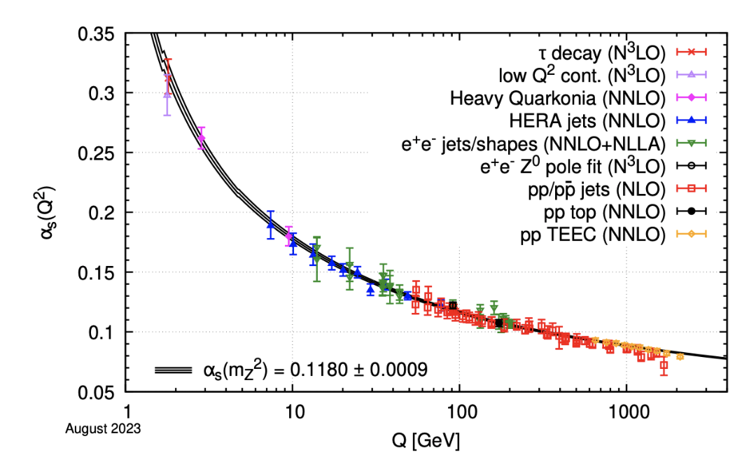
Theoretical Tools for Charm
HQE: fair, but factorization is bad
Models: quark model, rescattering: accuracy is low
QCD sum rules: systematics is hard to estimate
Flavor SU(3) symmetry: 20%
Lattice QCD:
Notes:
5

Slide 6
Lattice QCD
Discretizations
Configurations
Simulations
Notes:
6

Slide 7
Challenges from Lattice QCD
Difficult to study on lattice QCD:
Nonleptonic decays
Semi-leptonic decays into a scalar meson
D-Dbar mixing
…

Slide 8
Challenges with Opportunities
Mass: Hai-Yang Du, et.al, 2408.03548;
Decay Constant: Yu Meng, et.al, Phys.Rev.D 109 (2024) 7, 074511; Hai-Yang Du, et.al, 2408.03548v2; Dong-Hao Li, et.al, Chin.Phys.C 48 (2024) 12, 123104; Lei-Yi Li, et.al, in preparation.
Transition form factors: Qi-An Zhang, et.al, Chin.Phys.C 46 (2022) 1, 011002; Yu-Meng, et.al, Phys.Rev.D 110 (2024) 7, 074510
Lifetime:
LCDAs: Xue-Ying Han, et.al, 2410.18654
Inclusive decay rates:

Slide 9
Challenges with Opportunities
Mass: Hai-Yang Du, et.al, 2408.03548;
Decay Constant: Yu Meng, et.al, Phys.Rev.D 109 (2024) 7, 074511; Hai-Yang Du, et.al, 2408.03548v2; Dong-Hao Li, et.al, Chin.Phys.C 48 (2024) 12, 123104; Lei-Yi Li, et.al, in preparation.
Transition form factors: Qi-An Zhang, et.al, Chin.Phys.C 46 (2022) 1, 011002; Yu-Meng, et.al, Phys.Rev.D 110 (2024) 7, 074510
Lifetime:
LCDAs: Xue-Ying Han, et.al, 2410.18654
Inclusive decay rates:

Slide 10
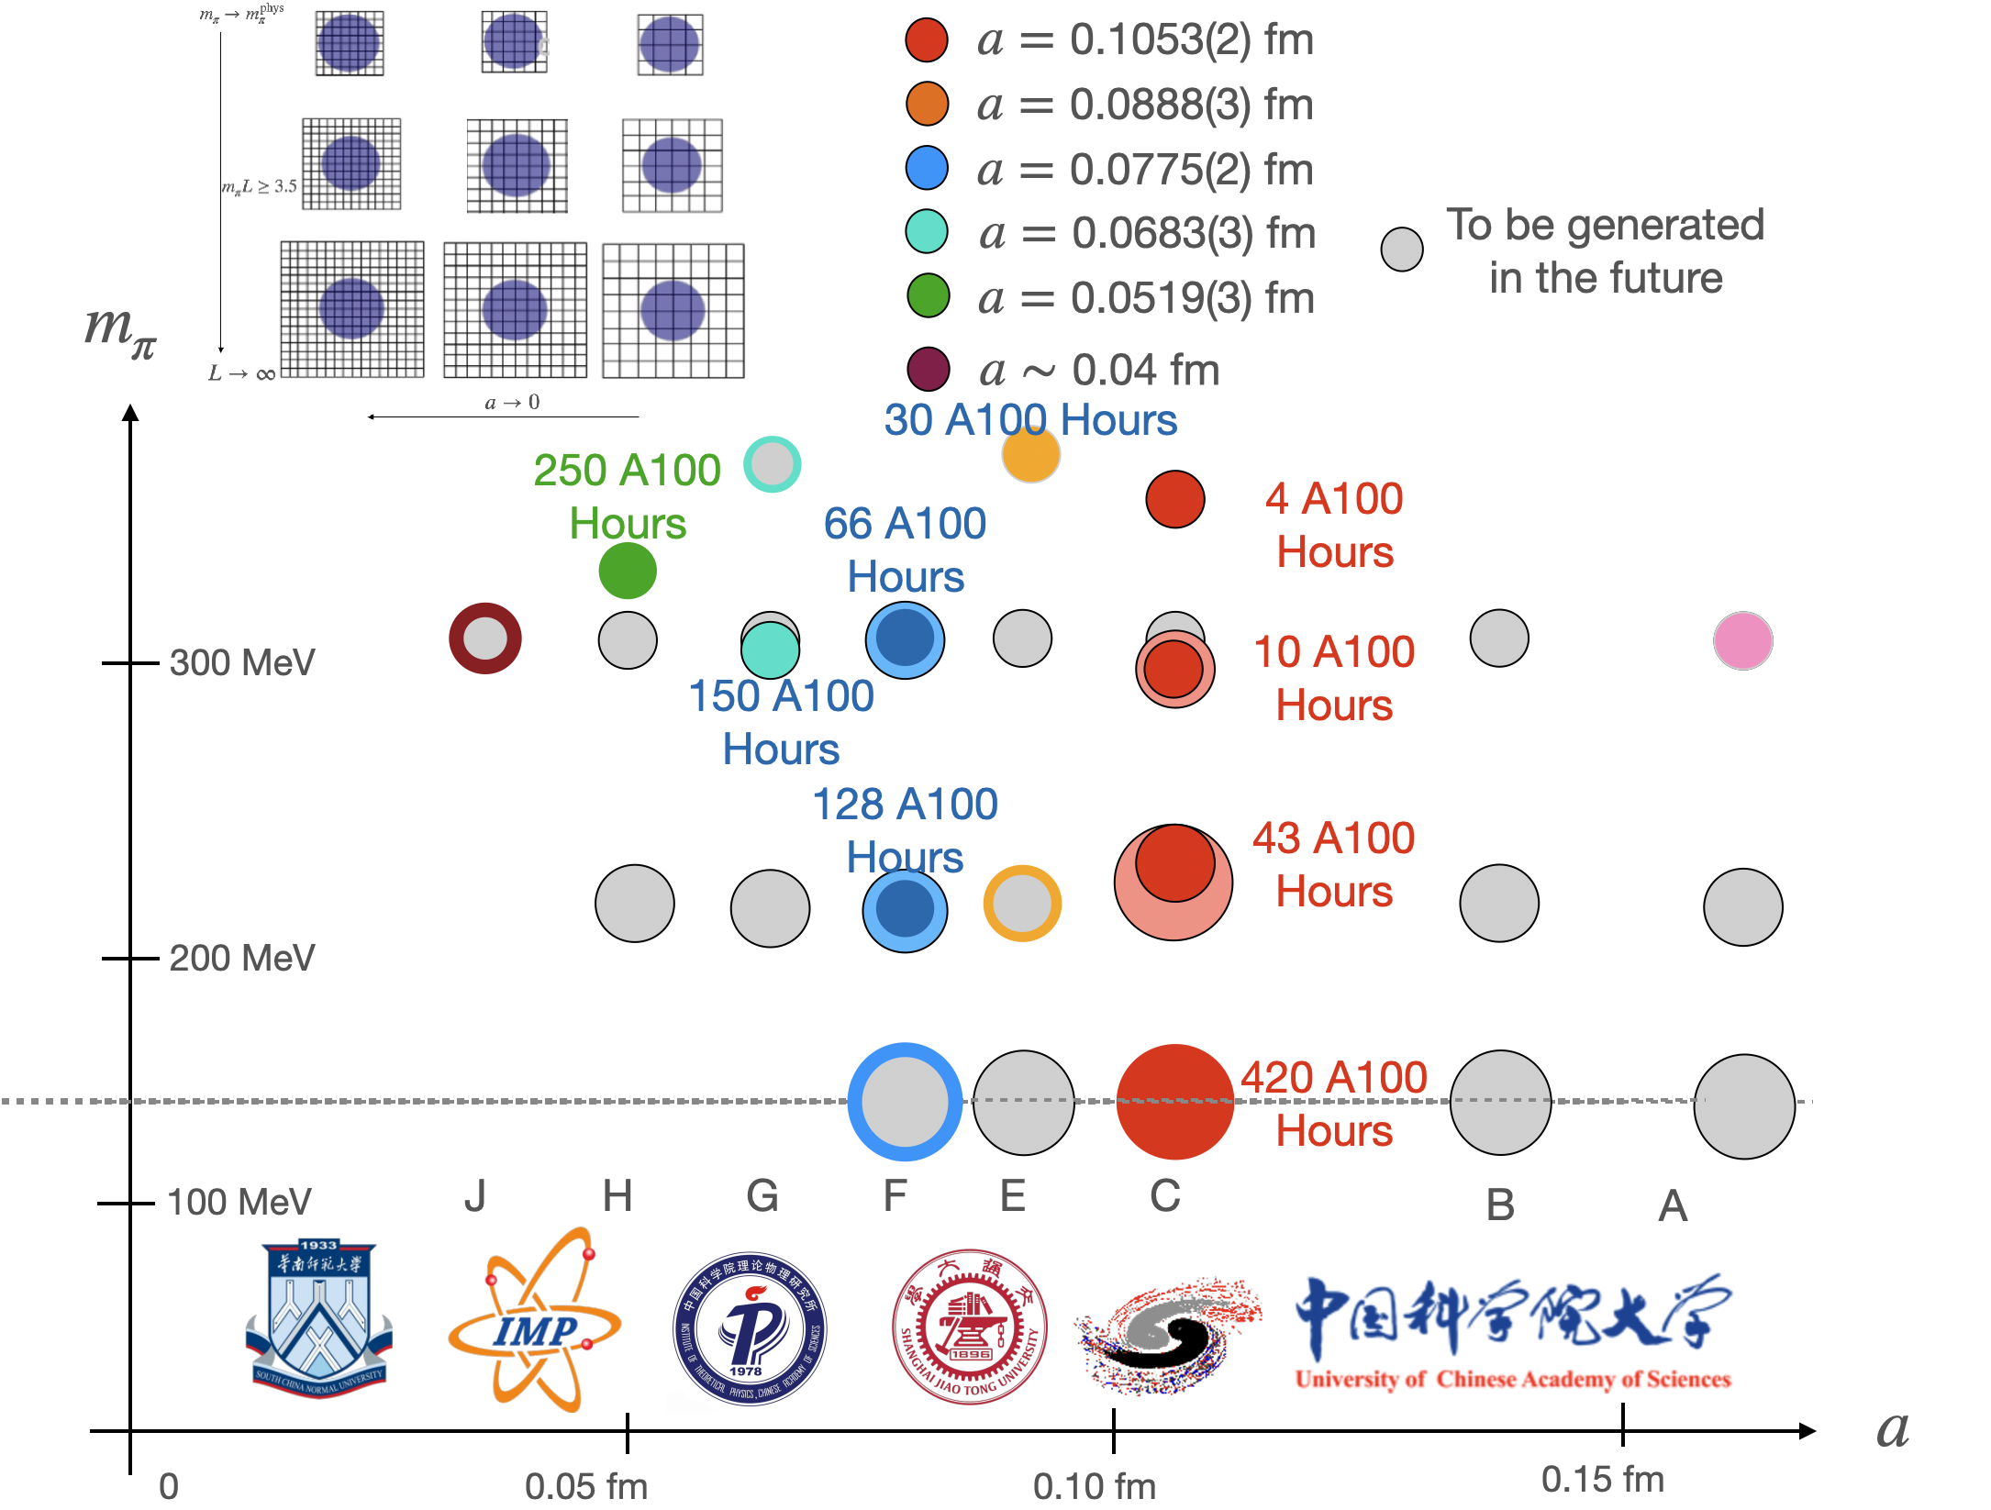
New Lattice QCD configurations
10
Hu, et.al., PRD 109, 054507 (2024)

Slide 11
Challenges and Opportunities
Recent Form factors on Lattice QCD
Process | $$a[fm]$$ | $m_{π}$[MeV] | Reference
$$Λ_{c}→Λ$$ | 0.08，0.11 | 140-360 | S.Meinel, 1611.09696/PRL 2017
$$Λ_{c}→Λ(1520)$$ | 0.08，0.11 | 300-430 | S.Meinel, G. Rendon 2107.13140/PRD 2022; 2107.13084/PRD 2022
$$Λ_{c}→n$$ | 0.08，0.11 | 230-360 | S. Meinel, 1712.05783/PRD 2018
$Ξ_{c}$ $→$ $Ξ$ | 0.08，0.108 | 290, 300 | Q.A. Zhang, et.al, 2103.07064/CPC 2022
$$Λ_{c}→Λ$$ | 0.1555 | 550 | H. Bahtiyar 2107.13909/Turk.J.Phys. 2021
Notes:
11

Slide 12
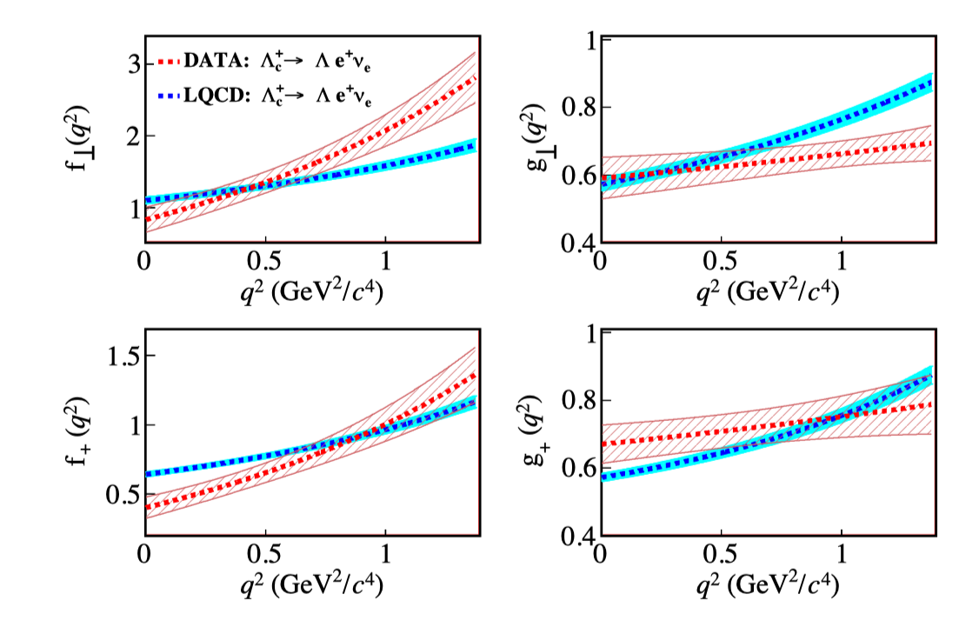
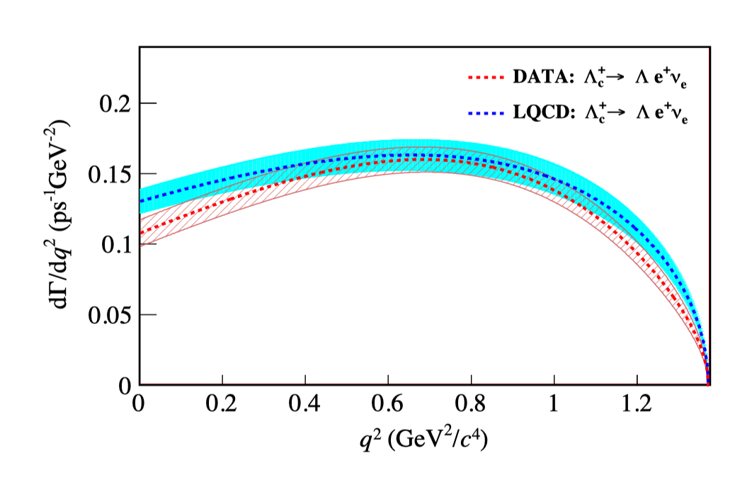
Challenges and Opportunities
12
$Λ_{c}→Λ$
no clear difference is observed within uncertainties for the resulting differential decay rate
the dependences of measured FFs show different kinematic behavior compared to those predicted from LQCD calculations.
BESIII: 2207.14149
LQCD: S. Meinel, PRL118, 082001 (2017)

Slide 13
Challenges and Opportunities
13
$Ξ_{c} → Ξ$ based on 2 lattices
Qi-An Zhang, et.al, Chin.Phys.C 46 (2022) 1, 011002

Slide 14
Challenges and Opportunities
14
$Ξ_{c} → Ξ$ based on 2 lattices
Qi-An Zhang, et.al, Chin.Phys.C 46 (2022) 1, 011002

Slide 15
Challenges and Opportunities
15
$Ξ_{c} → Ξ$ based on 2 lattices
Qi-An Zhang, et.al, Chin.Phys.C 46 (2022) 1, 011002

Slide 16
Challenges and Opportunities
16
Large SU(3) breaking in $Ξ_{c}$ $→$ $Ξ$
1. PDG/PTEP 083C01 2020
2. Belle, 2103.06496/PRL 2021
3. ALICE, 2105.05187/PRL 2021
4. S. Meinel, 1611.09696/PRL 2017
5. Q.A.Zhang, et.al., 2103.07064/CPC 2022
Based on two lattices
F. Huang, et.al, 2110.04179/PLB 2021
Large SU(3) breaking, but difficult to understand from LQCD with two lattices (need more explorations)

Slide 17
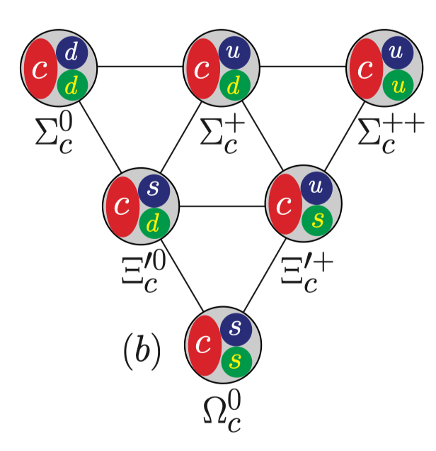
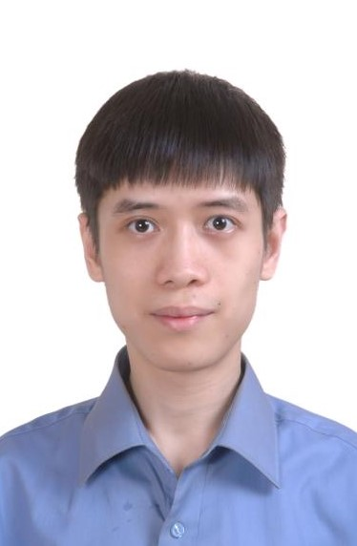
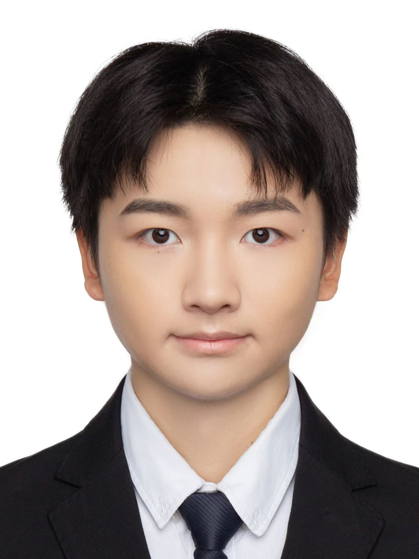
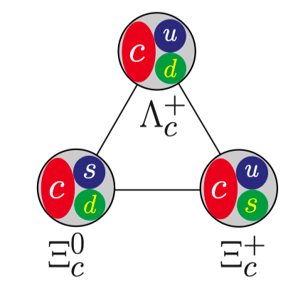
Challenges and Opportunities
17
Lei-Yi Li
Jie Ran
Yu Gu,
Jun Hua
Fanrong Xu
Yibo Yang
Qi-An Zhang
A number of decay form factors are yet to be explored with full sets of lattices!

Slide 18
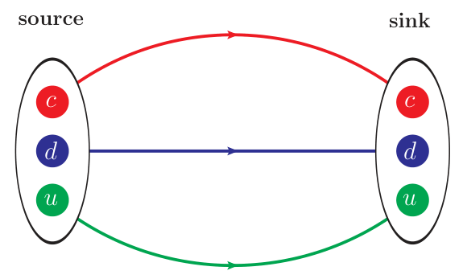
Challenges and Opportunities
18
$$Λ_{c}^{+}(udc)$$
$O_{Λ_{c}^{+}}^{(P)}=ε_{ijk}$($u_{i}^{T}$C$γ_{5}d_{j}$)$c_{k}$
$O_{Λ_{c}^{+}}^{(S)}=ε_{ijk}$($u_{i}^{T}$C$d_{j}$) $γ_{5}c_{k}$
$O_{Λ_{c}^{+}}^{(A)}=ε_{ijk}$($u_{i}^{T}$C$γ_{5}γ_{μ}d_{j}$) $γ^{μ}c_{k}$
$$Σ_{c}^{+}(udc)$$
$O_{Σ_{c}^{+}}^{(V)}=ε_{ijk}$($u_{i}^{T}$C$γ_{μ}d_{j}$) $γ^{μ}γ_{5}c_{k}$
$O_{Σ_{c}^{+}}^{(T)}=ε_{ijk}$($u_{i}^{T}$C$σ_{μν}d_{j}$)$σ^{μν}γ_{5}c_{k}$
$$Ξ_{c}(usc/dsc)$$
$$O_{Ξ_{c}}^{(V)}=ε_{ijk}\text{(}s_{i}^{T}\text{C}γ_{μ}c_{j}\text{)} γ^{μ}γ_{5}q_{k}$$
$O_{Ξ_{c}}=2βO_{Ξ_{c}}^{(S)}$+2$βO_{Ξ_{c}}^{(P)}+…$
$$Ω_{c}^{0}(ssc)$$
$O_{Ω_{c}^{0}}^{(V)}=ε_{ijk}$($s_{i}^{T}$C$γ_{μ}s_{j}$) $γ^{μ}γ_{5}c_{k}$
Lei-Yi Li
Jie Ran
Starting with decay constant (more appropriately pole residue)

Slide 19
Summary
Charm on the Lattice are full of challenges and opportunities.
Transition Form factors under progress:
$Λ_{c}→Λ、Ξ_{c}$ $→$ $Ξ、Ω_{c}$ $→Ω$
$Ξ_{cc}?$
Lifetime of charmed hadrons:
$D^{0},D^{+}$
Charmed Baryons
We hope to have a close discussions with experimentalists.
Thank you for your attention.

Slide 20
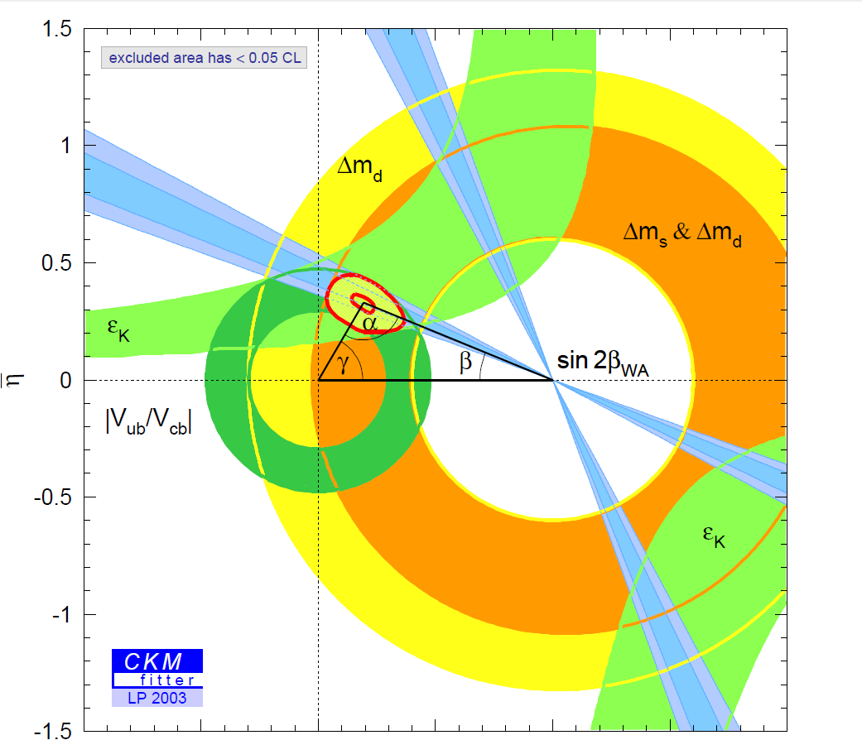
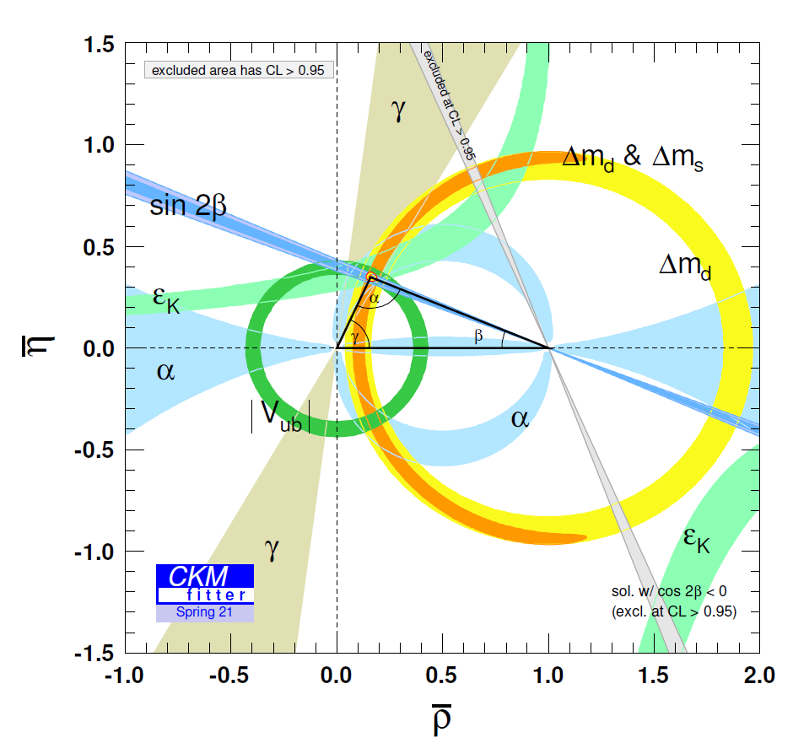
Charm
Precisely testing standard model
Study on CP violation
Time-dependent CP violation in B meson decays, [Babar& Belle 2001]
Direct CP violation in B meson decays, [Babar& Belle 2004]
Direct CP violation in D meson decays, [LHCb 2019]
Indirect search for new physics
Notes:
20

Slide 21
Challenges and Opportunities
Leptonic/Radiative Decays: $η_{c}→2γ$, $D→γlν$
Semileptonic decay form factors
Lifetime of charmed hadrons

Slide 22
What we can learn from charm?
Vcs/Vcd: precision compared to Vud/Vus
CP of SM?
NP?
This has to be answered together with theoretical understanding!

Slide 23
Lattice QCD
Notes:
23

Slide 24
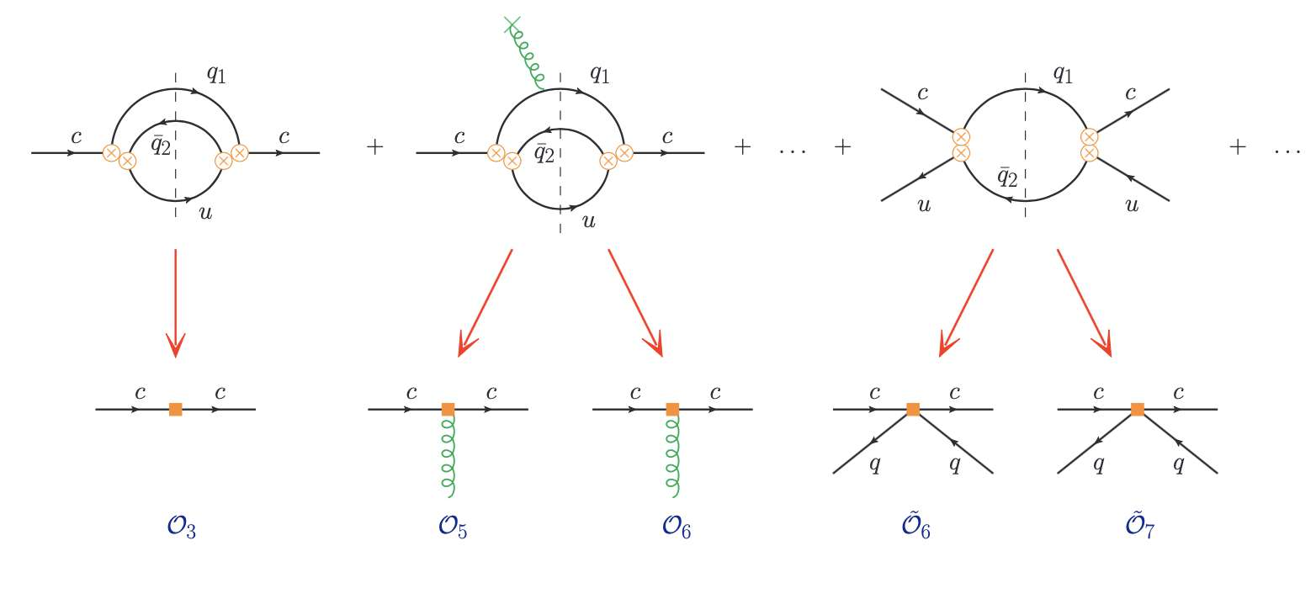
Challenges and Opportunities
24
Lifetime of charmed hadrons are described by OPE

Slide 25
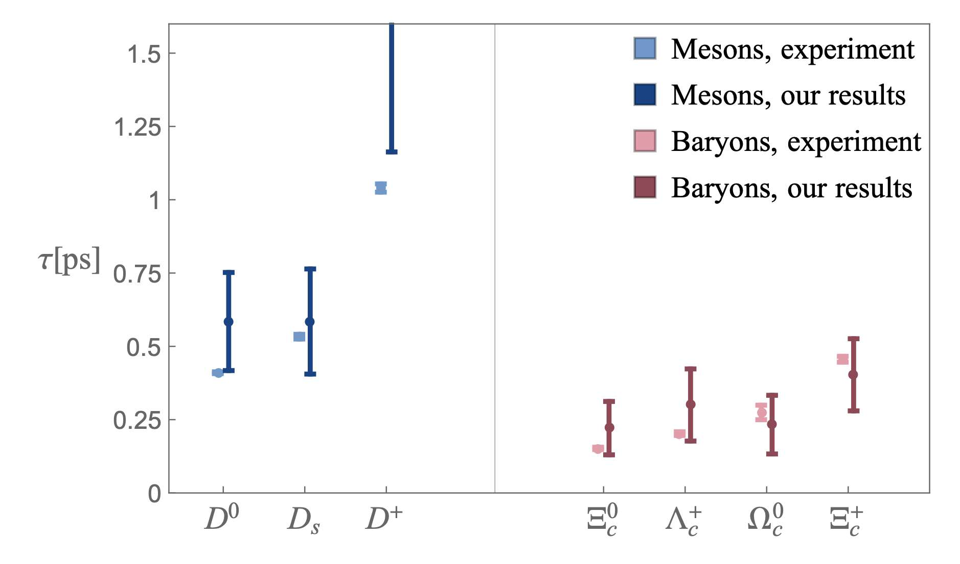
Challenges and Opportunities
25
Gratrex,Melić,Nišandžić,2204.11935

Slide 26
Challenges and Opportunities
26
From Alexander Lenz

Slide 27
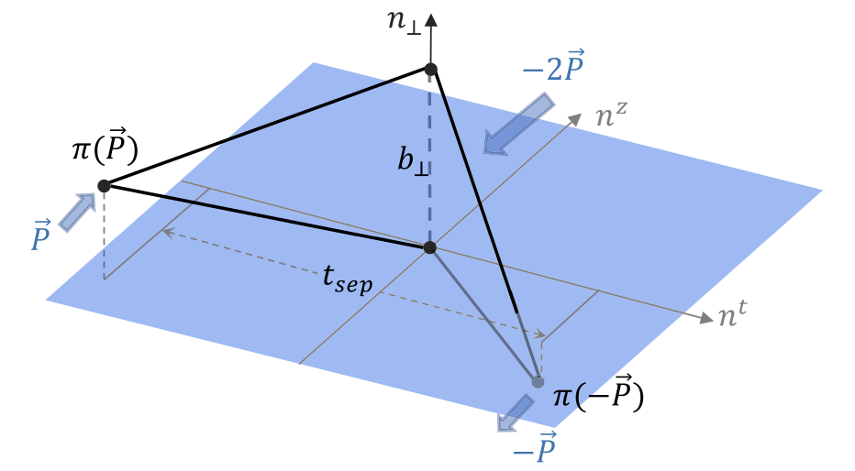
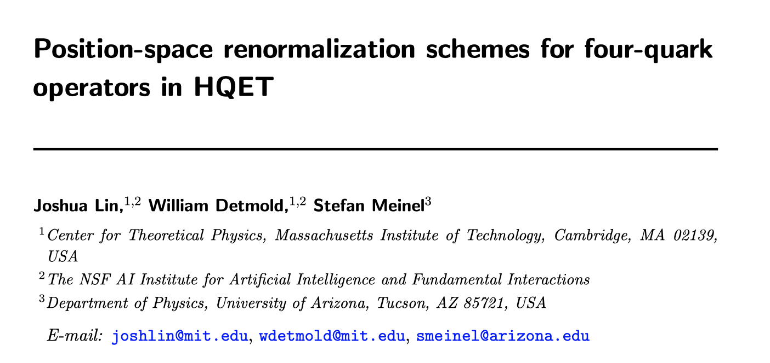
Challenges and Opportunities
27
Zhang, et.al. (LPC) PRL125,192001(2020)
Lin, Detmonld, Meinel, 2404.16191v1

Slide 28
Challenges and Opportunities
28
in units of fs (${10}^{−15}$ s)
 | $$τ(Ξ_{c}^{+})$$ | $$τ(Λ_{c}^{+})$$ | $$τ(Ξ_{c}^{0})$$ | $$τ(Ω_{c}^{0})$$
PDG (’04 ~ ’18) | 442 ± 26 | 200 ± 6 | ${112}_{−10}^{+13}$ | 69 ± 12
LHCb (’18) |  |  |  | 268 ± 26
LHCb (’19) | 457 ± 6 | 203.5 ± 2.2 | 154.5 ± 2.6
PDG (’20) | 456 ± 5 | 202.4 ± 3.1 | 153 ± 6 | 268 ± 26
LHCb (’21) |  |  | 148.0 ± 3.2 | 276.5 ± 14.1
PDG (’22,’23) | 453 ± 5 | 201.5 ± 2.7 | 151.9 ± 2.4 | 268 ± 26
Belle II (’22) |  | 203.20 ± 1.18 |  | 243 ± 49
World Ave (’23) | 453 ± 5 | 202.9 ± 1.1 | 150.5 ± 1.9 | 272.6 ± 12.0
From Hai-Yang Cheng
LHCb (’21) & Belle (’22) data were not taken into account by PDG (’23)
$τ(Ω_{c}^{0})$ obtained by LHCb (’18) from semileptonic $Ω_{b}^{−}$ decays is nearly four times larger. It has been confirmed by LHCb (’21) using promptly produced $Ω_{c}^{0}$ baryons
$τ\left(Ξ_{c}^{+}\right)>τ\left(Λ_{c}^{+}\right)>τ\left(Ξ_{c}^{0}\right)>τ\left(Ω_{c}^{0}\right)$ before 2018
$τ\left(Ξ_{c}^{+}\right)>τ\left(Ω_{c}^{0}\right)>τ\left(Λ_{c}^{+}\right)>τ\left(Ξ_{c}^{0}\right)$ after 2018
$τ(Ξ_{c}^{0})$ becomes 3.3σ larger due to new measurements from LHCb (’19, ’21)

