Slide 1
The RF Techniques of STCF
Yelong Wei
on behalf of Ring RF system
2024.11.20

Slide 2
Outline
1 Background & Introduction
2 Technique Route
3 TM020-mode Cavity Design
4 Summary

Slide 3
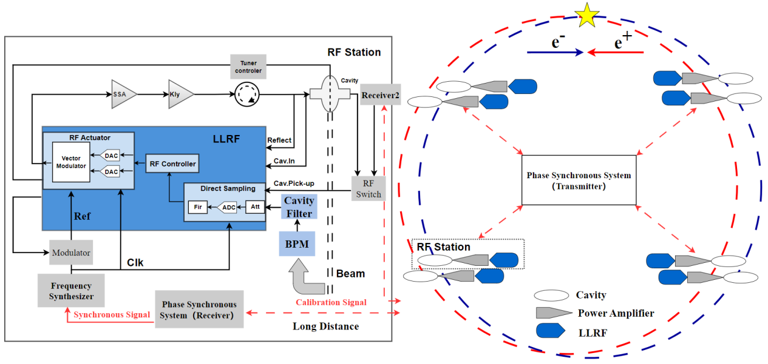
STCF Ring RF System
Super Tau-Charm Facility Ring RF system
RF Cavities
RF Power Source
Low-level RF System
RF system
One of the most serious issue is that large beam currents to excite fast-growing longitudinal coupled-bunch instabilities (CBI) caused by the accelerating mode of detuned RF cavities which is needed to compensate for the reactive component of beam-loading.
The other issue is to minimize the cavity higher-order mode (HOM) impedances which drive strong longitudinal and transverse CBI and bring the induced HOM power.

Slide 4
STCF Collider Ring
 | Values
Beam Energy [GeV] | 1.0 | 1.5 | 2.0 | 3.5
Circumference [m] | 865.398
Revolution frequency [kHz] | 346.42
RF Frequency [MHz] | 499.7
Harmonic Number | 1442
Number of Bunches | 692
Beam Current [A] | 1.5 | 2 | 1.7 | 2
Momentum Compaction Factor | 13.04×10⁻⁴ | 13.65×10⁻⁴ | 13.86×10⁻⁴ | 14.14×10⁻⁴
Energy Loss per Turn [keV] | 105.9 | 265.9 | 541 | 1477
Beam SR Power [kW] | 159 | 452 | 1082 | 2954
RF Voltage [MV] | 1 | 2 | 3 | 6
Synchronous phase [°] | 174 | 172 | 170 | 166
Considering damping ring has a low beam current, so the RF system can be developed for both damping and collider ring.
Key parameters for RF systems：
Frequency: 499.7 MHz ；
Single collider ring provides a voltage of 6 MV and a beam power of 3 MW

Slide 5
Outline
1 Background & Introduction
2 Technique Route
3 TM020-mode Cavity Design
4 Summary

Slide 6
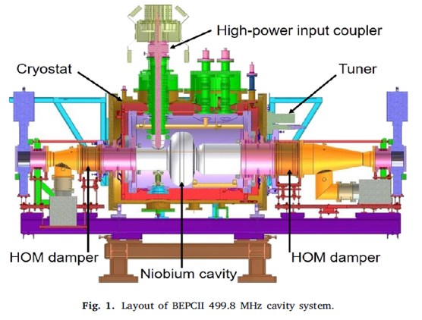
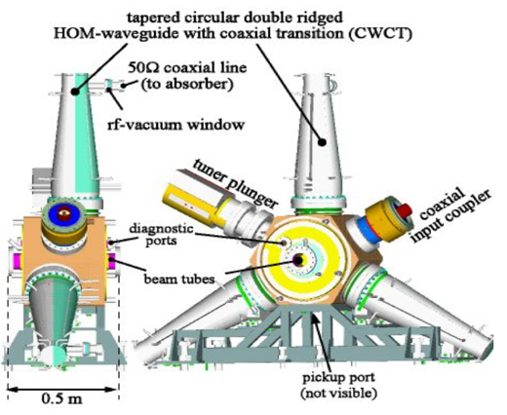
Superconducting VS Normal-conducting
 | Superconducting cavity [SC] | Normal-conducting cavity [NC]
HOM damping | Simple | Complicated
Accelerating Voltage | High（~2.0MV） | Low（~0.5MV）
Module Length | Long（3-3.5 meter） | Short（~0.5 meter）
Robust | Complicated for Commissioning | Easy for Commissioning
Maintenance | Cryogenic system requires special attention | Easy
Economic | High construction budget | Low construction budget
3.5m
0.5m
[1]T. Huang, W. Pan, G. Wang，et al., The development of the 499.8MHz superconducting cavity system for BEPCII. Nucl. Instrum.Methods Phys. Res. Sect. A 1013, 165649 (2021).
[2]E. Weihreter, F. Marhauser, HOM damped cavities for high brilliance synchrotron light sources, in: Brilliant Light in Life and Material Sciences, Springer, Dordrecht, 2007, pp. 413–42

Slide 7
RF Systems for Different Colliders
NC is more advantageous in terms of easy maintenance, running robust, low construction budget.
Colliders | Cavity Types
PEP-II | NC（20 NC for electron ring, 6 NC for positron ring） | Closed-off at 1998
BEPCII | SC（1 SC for each ring） | Commissioning
SuperKEKB | SC+NC（8 NC and 8 SC for electron ring，32 NC for positron ring） | Commissioning
BINP-SCTF | NC（3 NC for each ring） | Under Design

Slide 8
STCF Ring RF System
SC is disadvantageous due to relative lower accelerating voltage required
NC RF systems are chosen as a candidate for our STCF collider rings。
 | KEKB SC | BEPCII SC | ARES NC(KEKB) | TM020 NC | PEP-II NC | BESSY-II NC
Beam power [kW] | 3000 | 3000 | 3000 | 3000 | 3000 | 3000
Voltage [kV] | 6000 | 6000 | 6000 | 6000 | 6000 | 6000
Number of cavities | 10 | 20 | 10 | 12 | 15 | 30
Voltage per cavity [kV] | 600 | 300 | 600 | 500 | 400 | 200
Shunt impedance per cavity –circuit Ω | 46.5E9 | 46.5E9 | 8.625E5 | 2.85E6 | 3.5E6 | 3.4E6
Unloaded quality factor | 1E9 | 1E9 | 1.15E5 | 6.0E4 | 3E4 | 2.96E4
Power poss per cavity [kW] | 0.00387 | 0.00097 | 209 | 44 | 23 | 6
Beam power per cavity [kW] | 300 | 150 | 300 | 250 | 200 | 100
Input power per cavity [kW] | 300 | 150 | 509 | 294 | 223 | 106
Detuning frequency per cavity [kHz] | 75 | 150 | 12 | 92 | 283 | 557

Slide 9
Different NC Cavities Worldwide
 | f₀ [MHz] | R_{a} [MΩ] | R/Q [Ω] | Q0 | Voltage per cavity [kV] | Input power per cavity
KEK-PF | 509 | 7.68 | 174.5 | 44,000 | ＜500 | ＜ 150 kW
KEK-ARES | 509 | 1.725 | 15 | 115000 | < 850 | 750 kW = 150 kW+600 kW
PEP-II | 476 | 7.6 | 234.6 | 32,400 | ＜850 | 320 kW = 70 kW+250 kW
BESSY-II | 500 | 6.8 | 229.7 | 29,600 | ＜500 | ＜ 150 kW
KEK-RIKEN TM020 | 509 | 6.8 | 113 | 60,000 | ＜800 | > 200 kW
KEK-PF does not heavily damping HOMs
BESSY-II and PEP-II strongly damping HOMs，but with complicated mechanical design
ARES comprises of storage, coupling and accelerating cavities，but with complicated mechanical design
TM020 are advantageous in terms of compact and simple HOM damping
TM020 has a low R/Q，which is beneficial for suppressing CBI caused by accelerating mode

Slide 10
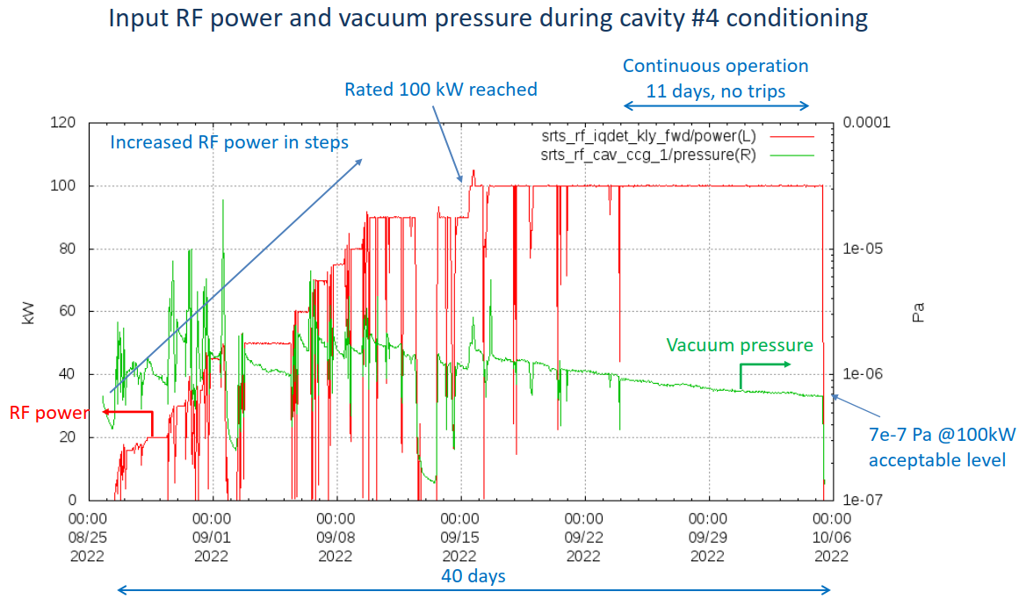
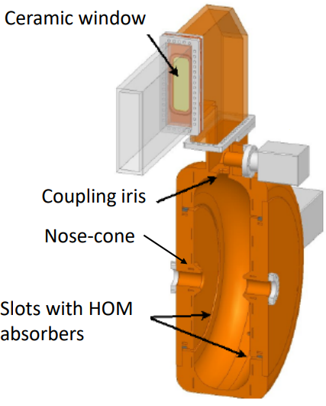
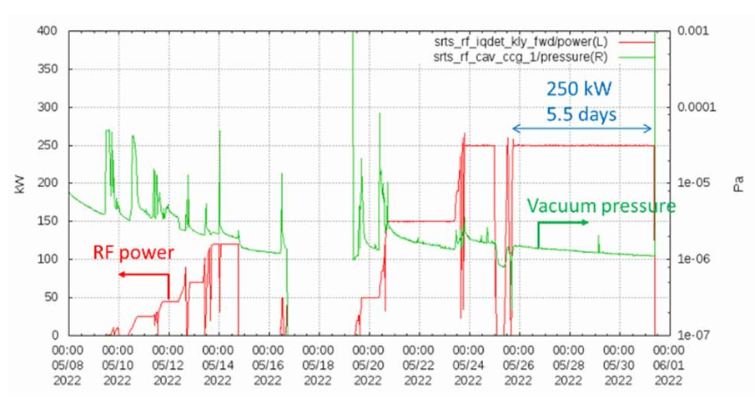
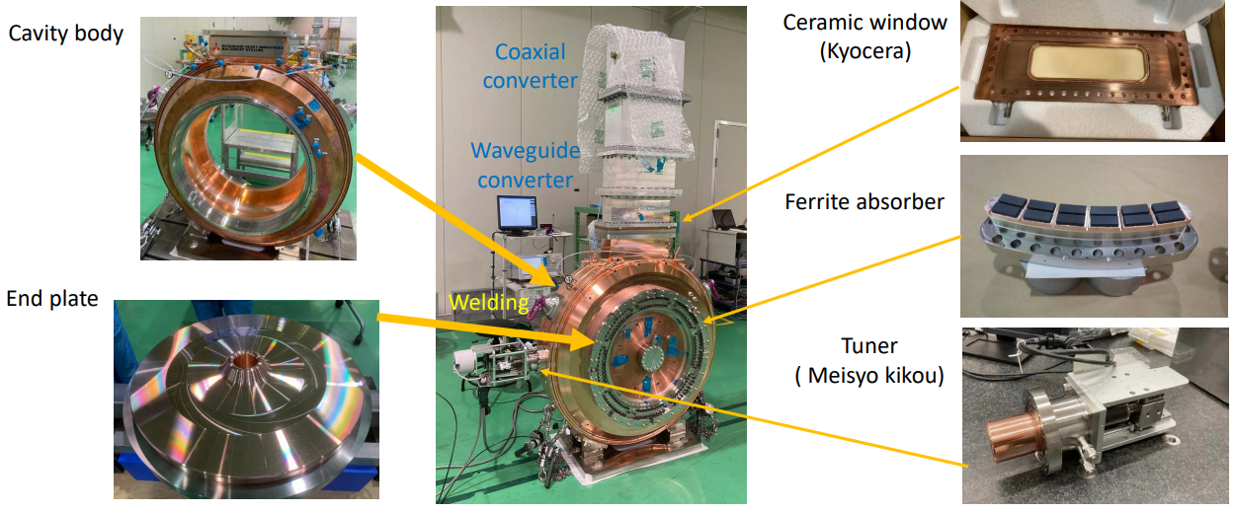
TM020-mode NC Cavity from KEK and RIKEN
RF Parameters
Working mode | TM020
Working frequency | 509 MHz
Unloaded quality factor$Q_{0}$ | 60000
Shunt impedance$R_{s}$ | 6.8 MΩ
Voltage per cavity | 825 kV
Power per cavity | 100 kW（no beam） 210 kW（400 mA）

Slide 11
Technique Route Selected for STCF
 | KEKB SC | BEPCII SC | ARES NC(KEKB设计) | TM020 NC | PEP-II NC | BESSY-II NC
Beam power [kW] | 3000 | 3000 | 3000 | 3000 | 3000 | 3000
Voltage [kV] | 6000 | 6000 | 6000 | 6000 | 6000 | 6000
Number of cavities | 10 | 20 | 10 | 12 | 15 | 30
Voltage per cavity [kV] | 600 | 300 | 600 | 500 | 400 | 200
Shunt impedance per cavity –circuit Ω | 46.5E9 | 46.5E9 | 8.625E5 | 2.85E6 | 3.5E6 | 3.4E6
Unloaded quality factor | 1E9 | 1E9 | 1.15E5 | 6.0E4 | 3E4 | 2.96E4
Power poss per cavity [kW] | 0.00387 | 0.00097 | 209 | 44 | 23 | 6
Beam power per cavity [kW] | 300 | 150 | 300 | 250 | 200 | 100
Input power per cavity [kW] | 300 | 150 | 509 | 294 | 223 | 106
Detuning frequency per cavity [kHz] | 75 | 150 | 12 | 92 | 283 | 557

Slide 12
Outline
1 Background & Introduction
2 Technique Route
3 TM020-mode Cavity Design
4 Summary

Slide 13
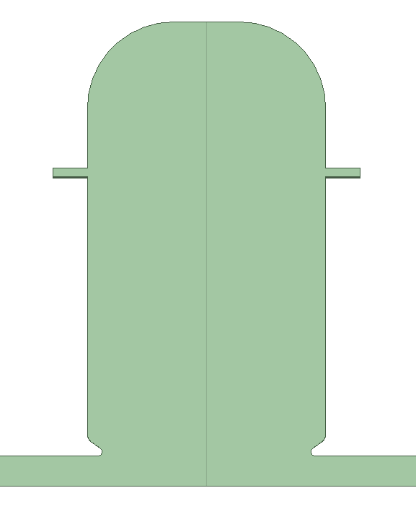
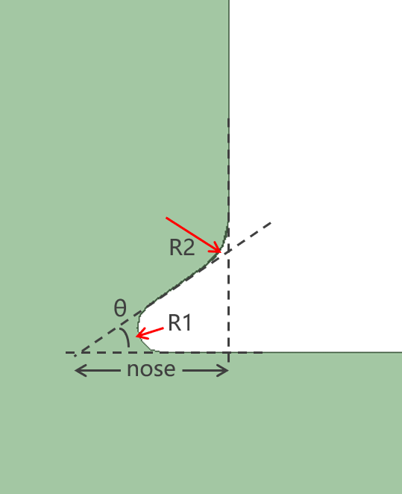
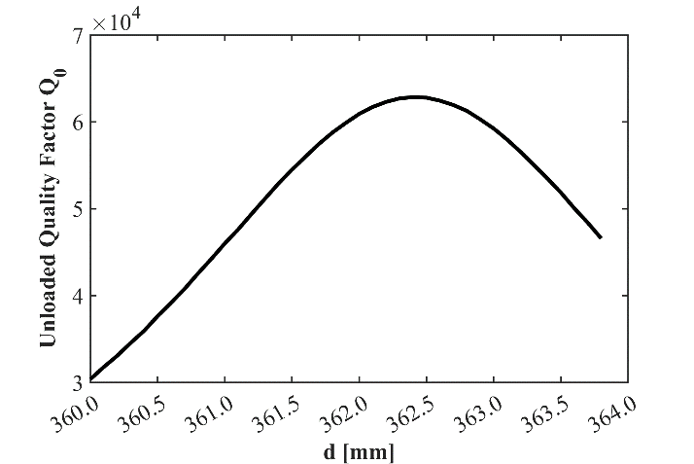
Cavity Geometry
Location d

Slide 14
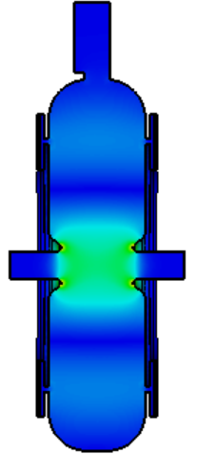
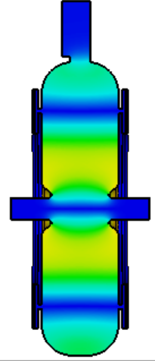
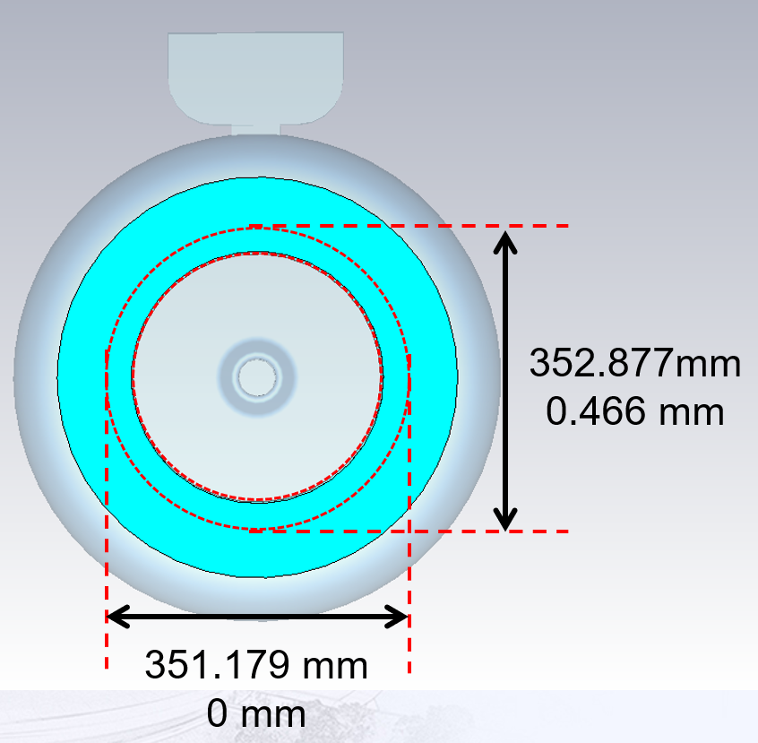
Optimized TM020-mode cavity
RF parameters
Working mode | TM020
Frequency [MHz] | 499.7
R/Q [Ω] | 109
Unloaded quality factor | 61500
$${E_{p}}/{E_{acc}}$$ | 3.79
${B_{p}}/{E_{acc}}$ [mA/V] | 3.17
Electric fields
Magnetic fields

Slide 15
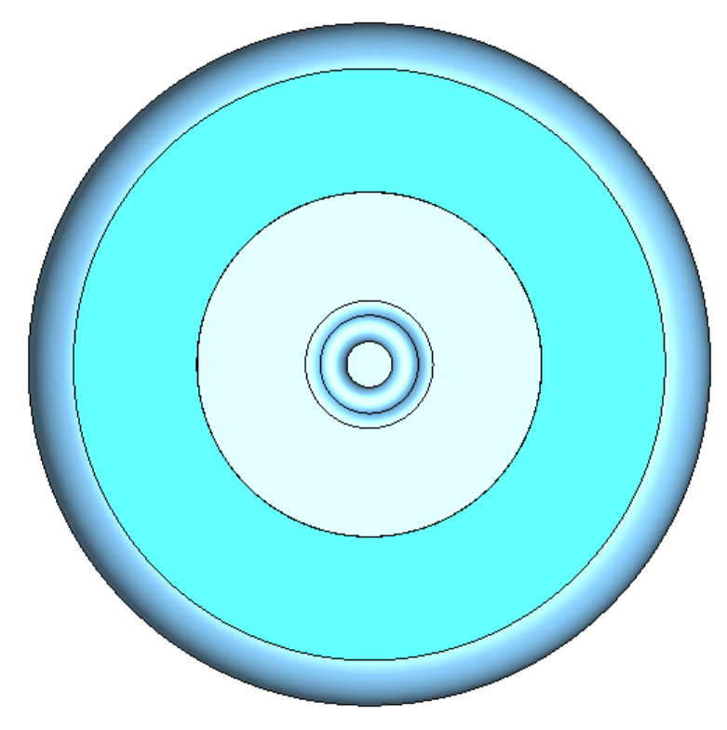
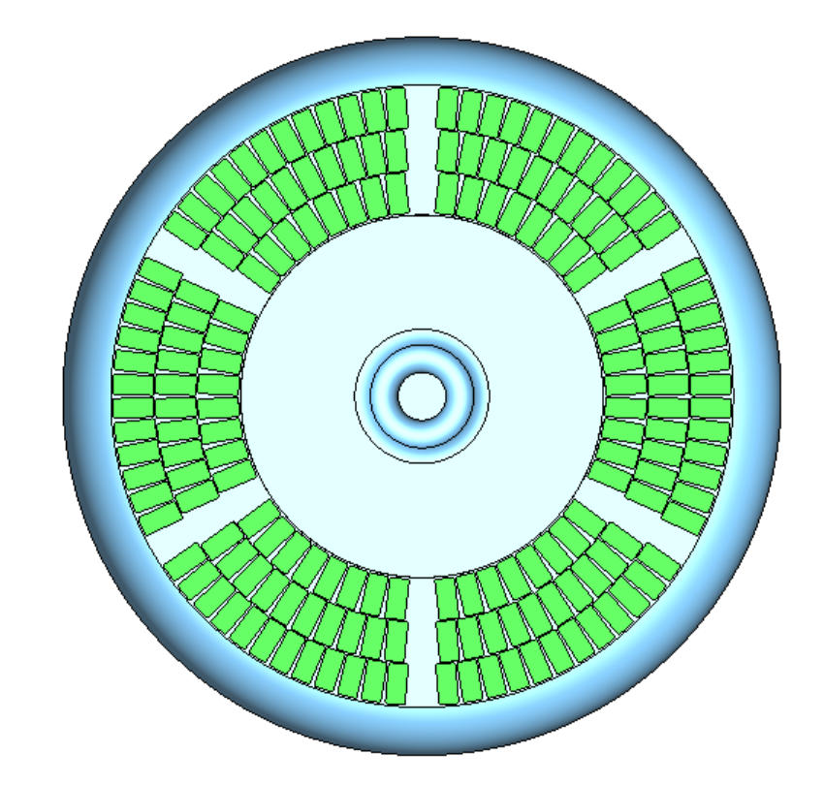
HOM damping-Transverse modes
Simulated dampers
Realistic dampers

Slide 16
HOM damping-Longitudinal modes
Simulated dampers
Realistic dampers
Mode | Frequency(GHz) | Rz(Ω)
TM021 | 0.76637 | 344.36
TM031 | 0.98353 | 581.11
TM033 | 1.88010 | 406.97

Slide 17
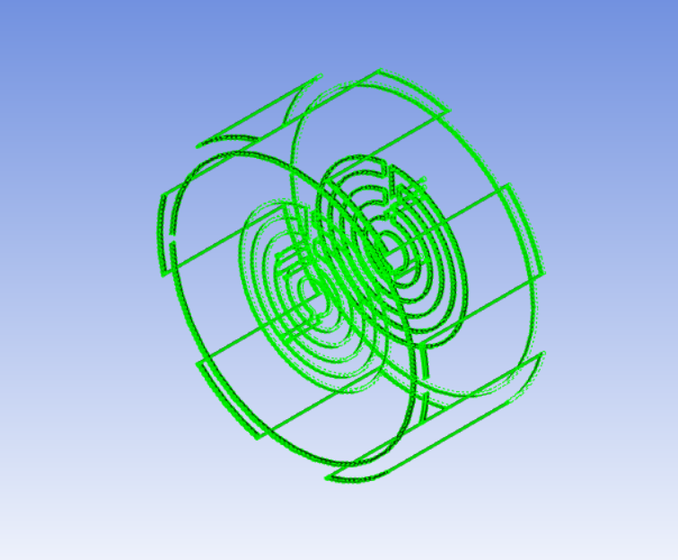
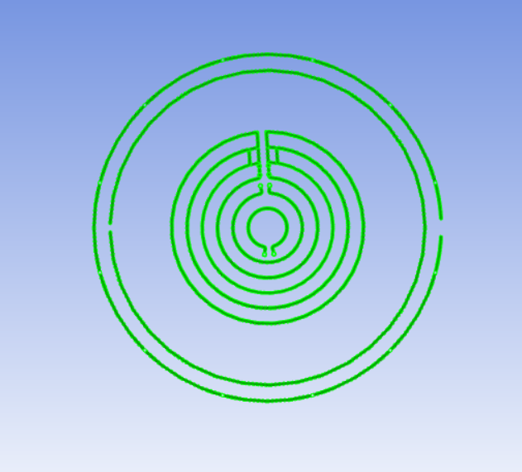
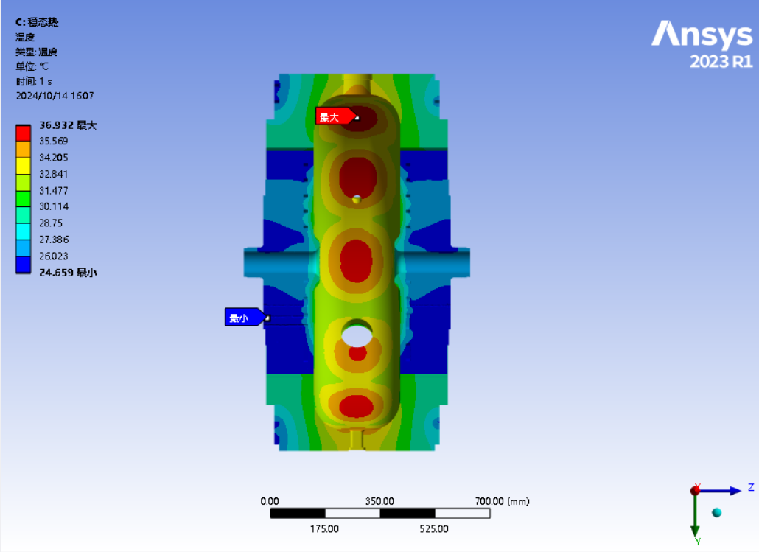
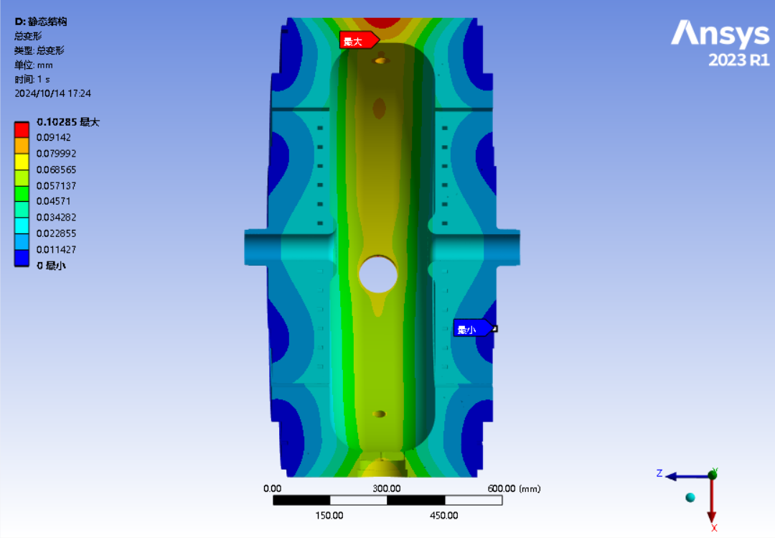
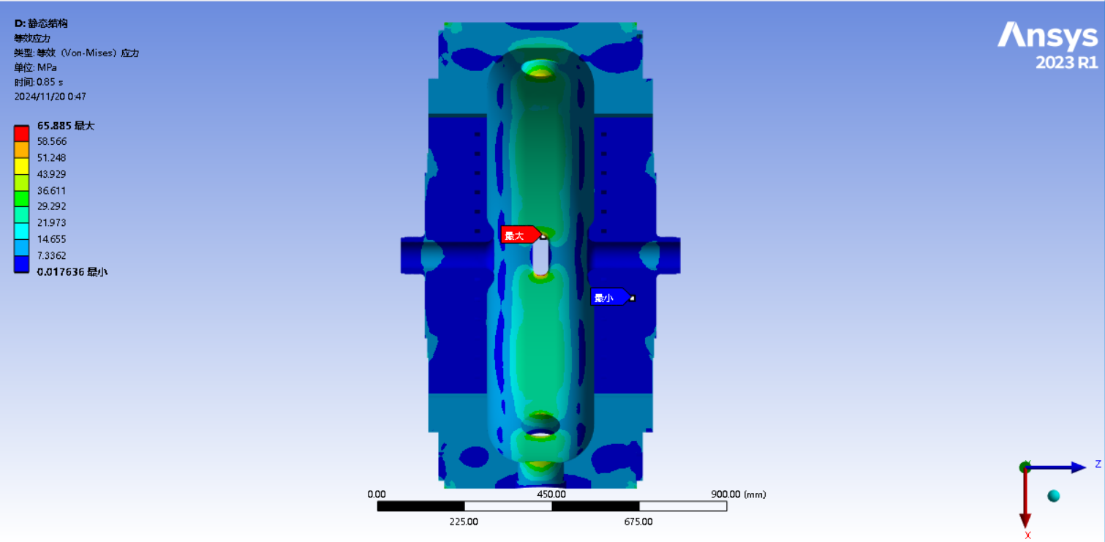
Thermal Analysis for Cavity
Cooling system
Including pumping vacuum
Pumping vacuum has little effect
50 kW power dissipation on the cavity surface
Max stress：Coupling port，65.885 MPa
Max deformation：Equator outer，0.10285mm
Frequency shift：-100.8KHz
Temperature
Deformation
Stress

Slide 18
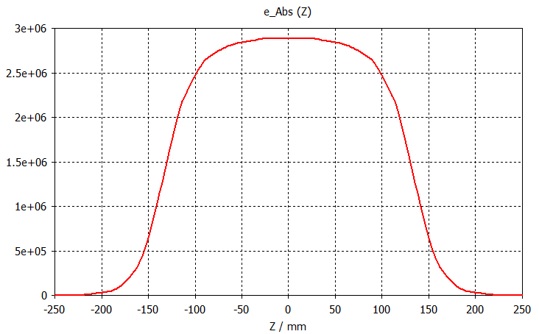
Input Power Coupler
Design Target
499.7 MHz TM020-mode cavity
Waveguide-type input coupler，online tuning。
Working frequency | 499.7 MHz
Type | Waveguide type
Power capacity | CW 200 kW
Design coupling factor | 1.0
Coupling factor | 1~8
Coupling type | Magnetic Coupling
Vacuum leakage rate | <1e-10 mbar·l/s
Ultimate vacuum | <5e-7 Pa
Mode | Frequency | Q0
TM020 | 499.70 MHz | 61500
Electric fields
On-axis electric fields

Slide 19
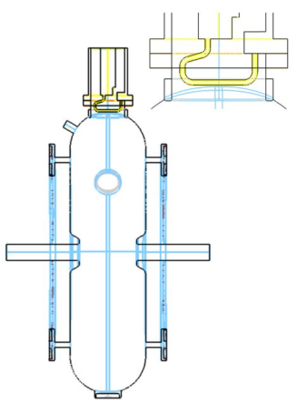
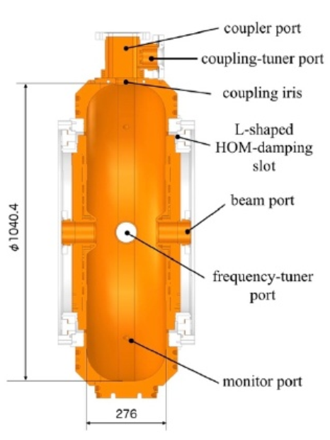
Two types of input coupler
Coupler types
Coaxial type：
Complicated
Fixed coupling factor, have large reflections for different beam currents
Waveguide type：
Simple geometry
Variable online tuning for different beam currents
High construction budget。
After comparisons, we choose waveguide type input coupler

Slide 20
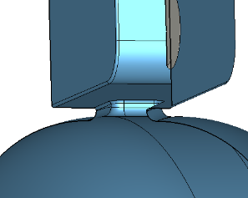
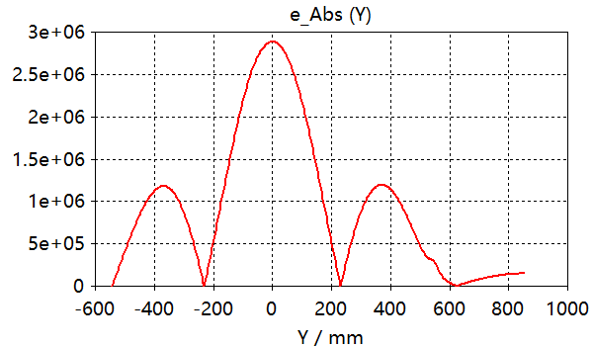
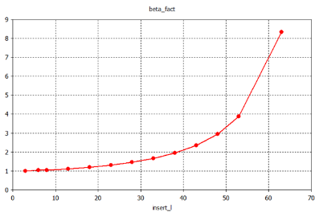
RF Design
Coupling port
Increasing the fillets to minimize the magnetic fields
Tuning range：Tuner insertion depth 3~63mm→0.9975~8
Frequency shift：-0.1564MHz
58kW→748kV
Coupling port
垂直耦合口方向Electric fields distribution
Coupling factor as a function of insertion depth of Tuner

Slide 21
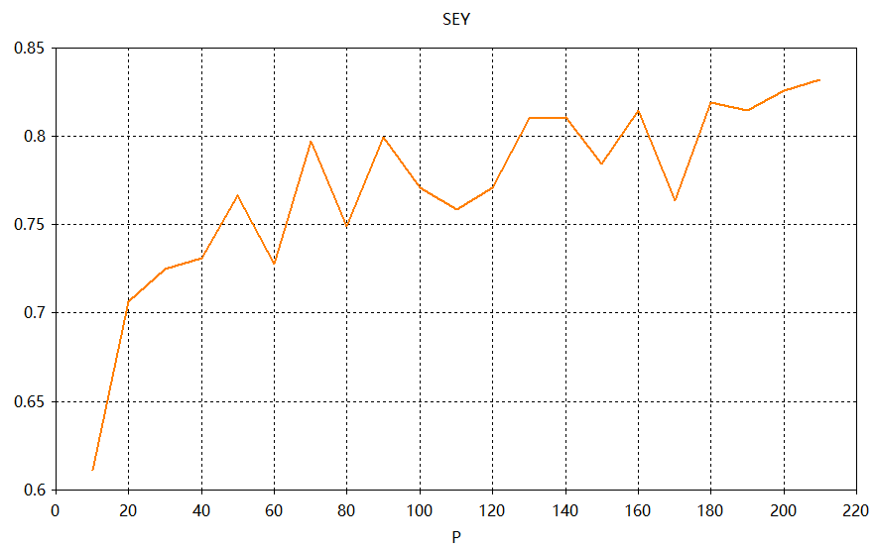
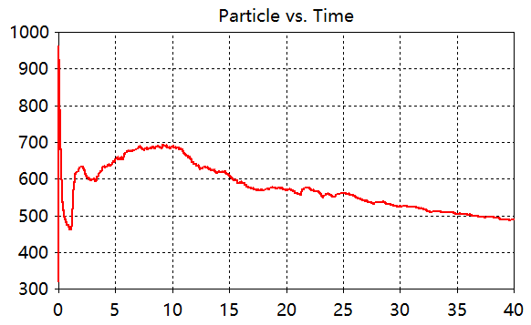
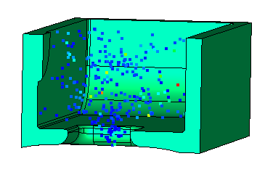
MP for Coupling Port
MP for coupling port only：
No oscillating，the number of particles decreases with time
For an input power：0~200kW，No MP occur
Input power （kW）
Particles distribution at 10kW@40ns
At 200kW，the number of paticles decreases with time
SEY

Slide 22
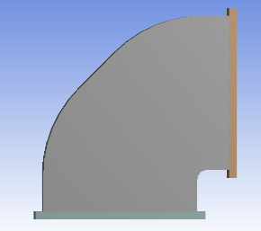
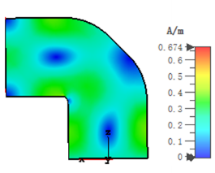
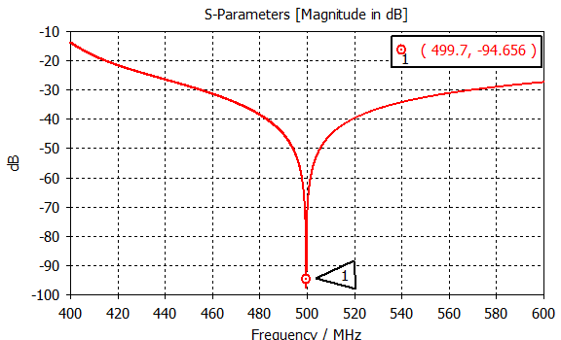
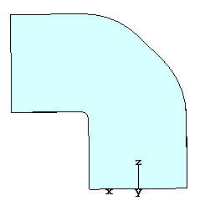
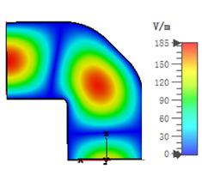
Bending Waveguide RF Design
Bending waveguide
90° bending waveguide for connection between port and
ceramic windows
S11：499.7MHz@-94.656dB
Low electromagnetic fields，low BDR
Mechanical modelling
EM fields
Optimized S11

Slide 23
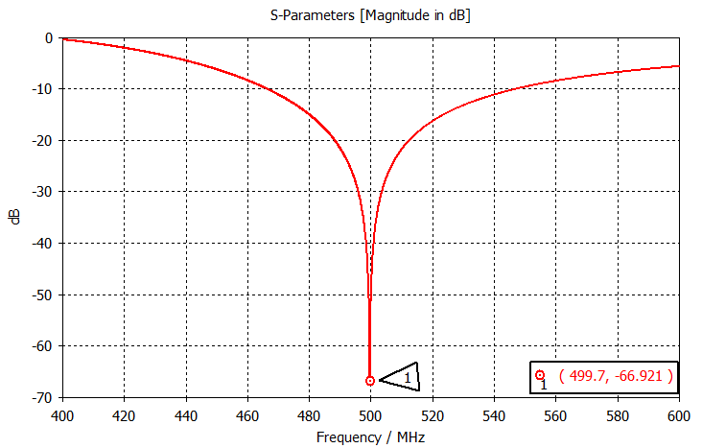
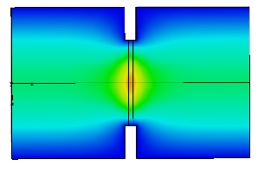
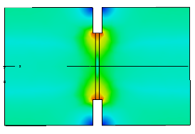
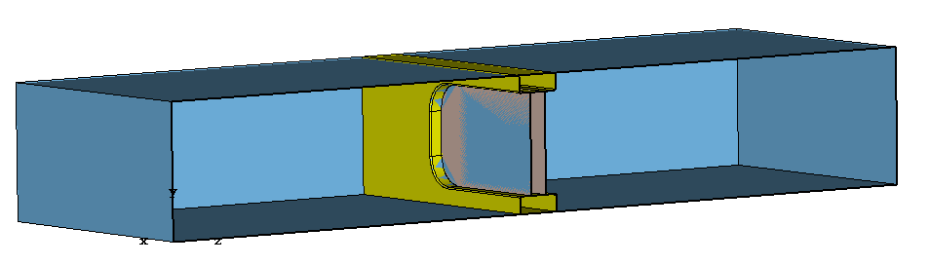
RF Design for Ceramic Window
Ceramic Window
99.5% Ceramic Window：aluminium oxide
Low loss tangent，low temperature，low BDR
No difficulty in welding，there are some existing experience
S11：499.7MHz@-66.921dB
WR1800 waveguide
Optimized S11
Ceramic window geometry
Electric fields
Magnetic fields

Slide 24
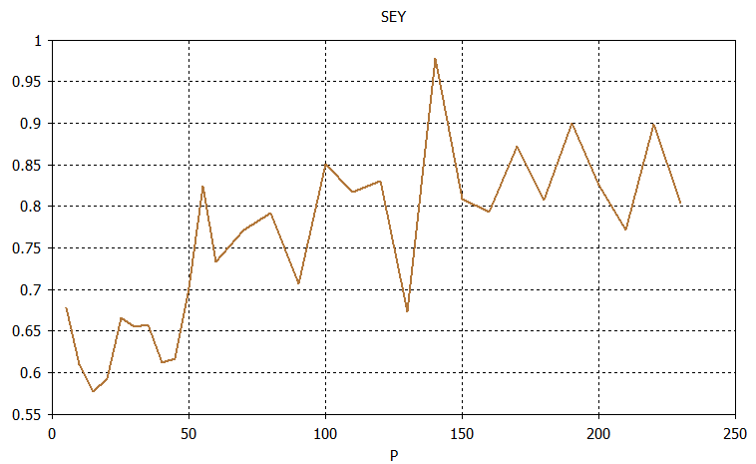
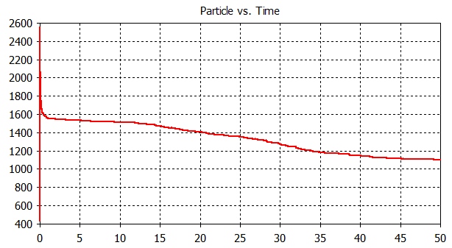
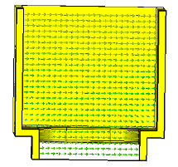
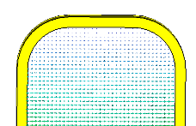
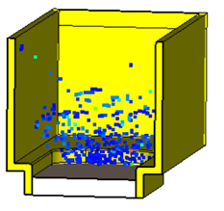
MP for Ceramic Window
MP is a key issue for ceramic window。
At an input power of 0~200kW，SEY<1，No MP occur
SEY
Input power （kW）
SEY
Electric Fields at 230kW
Input power of 230kW
At 230kW, the number of particles decreases with time

Slide 25
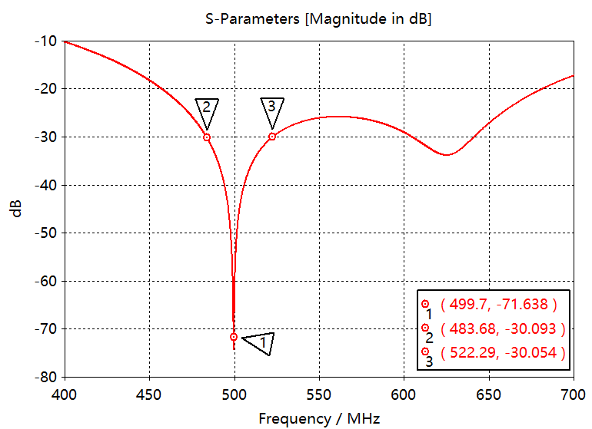
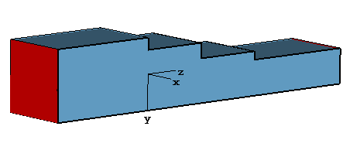
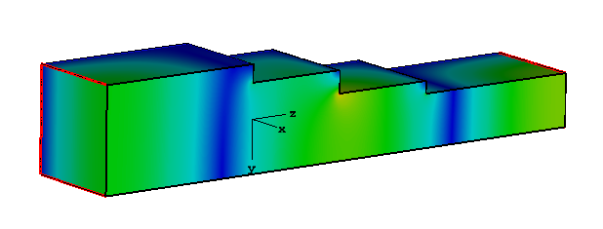
RF Design for Stepped Waveguides
WR1800 to HFWR1800 converter
Stepped waveguides：
Material：Aluminum alloy
Bandwidths：S11：499.7MHz@-71.638dB, -30dB@38.61MHz
Input power = 200kW，Emax<0.1 MV/m, much lower than breakdown
Modelling and electric fields
Optimized S11

Slide 26
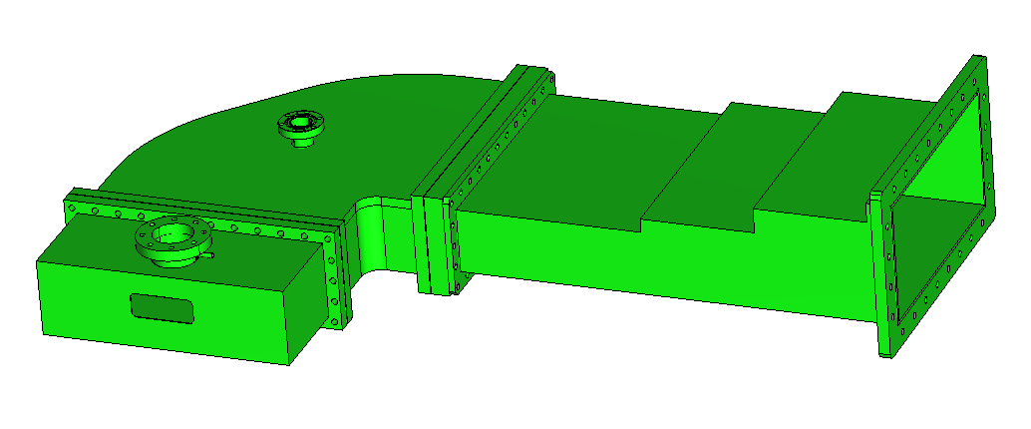
Final Input coupler connected with WR1800 waveguides

Slide 27
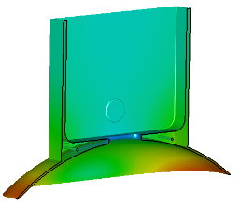
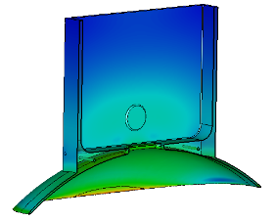
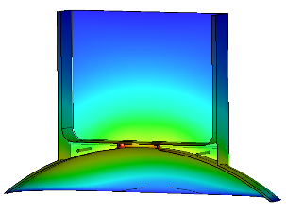
Thermal Analysis for Coupling Port
Coupling Port
Conditions：Using Four-way water cooling surrounds the coupling port
Position at Short edge for coupling port，Max Temperature： 39.9℃
Max thermal stress：12MPa
Max thermal deformation ：0.0181mm
Each cooling has a flow velocity 10L/min，pressure ≥0.4MPa
CW 200kW thermal distribution
Deformation
Stress

Slide 28
Thermal Analysis for Waveguides
Bending and Stepped waveguides
No wind required
Stepped waveguide：CW 200kW，Max Tem 10.48℃
Bending waveguide：
Deformation results from the pumping vacuum
Deformation positions at waveguide wide edge
Finally we choose a waveguide with a thickness of 15mm*10mm
Max deformation 0.2mm，Max stress 71.22MPa，meet the requirements
应力
变形
机械及抽真空时，弯波导变形及应力随波导宽边厚度变化
CW 200kW temperature
CW 200kW Temperature
CW 200 kW deformation
CW 200kW stress

Slide 29
Thermal Analysis for Ceramic Window
Ceramic purity
Cooling enough：
97% max Temperature: 76.28℃，99.5% max temperature: 47.348℃
After comparisons, 99.5% Ceramic is chosen for our window
97%（Left）及99.5%（Right）Volume Loss
97% thermal
99.5% thermal

Slide 30
Thermal analysis
Cooling system: 6 L/min surrounding the ceramic window
Max deformation: 0.019175mm
Max stress: 41.593Mpa
Meet the requirements
Stress for copper and ceramic window
Modelling
Deformation and stress

Slide 31
Mechanical Design for Whole Module
2946mm
2491.5mm
739mm

Slide 32
Summary & Outlook
We have chosen a NC 499.7MHz TM020-mode cavity with strong HOM damping for our STCF collider rings; further optimizations are required on heavily damping to meet the requirement of 2 A, 3.5 GeV.
RF design and preliminary mechanical design on this TM020-mode cavity have been completed；
The fabrication is planned to be completed by the end of 2025.

