Slide 1
Longitudinal polarization spin flips for measurement of the mixing angle
E.V. Bedarev, A.E. Bondar, I.A. Koop, A.V. Otboev, Yu.M. Shatunov,
BINP SB RAS
Speaker: Egor Bedarev
BINP SB RAS, Lab. 11
E-mail: E.V.Bedarev@inp.nsk.su

Slide 2
Plan
Standard Model Electro-Weak sector checking with SCTF
Longitudinal polarization flipping procedure and it’s spin dynamics
Simulation results
Conclusion

Slide 3
Standard Model Electro-Weak sector checking with SCTF
Spin physics program at SCTF
Weinberg's “running” Weak Angle
Total cross-section of $e^{+}e^{−}→q\overline{q}$ on poles
Systematic errors sources
Frequent flipping of longitudinal polarization

Slide 4
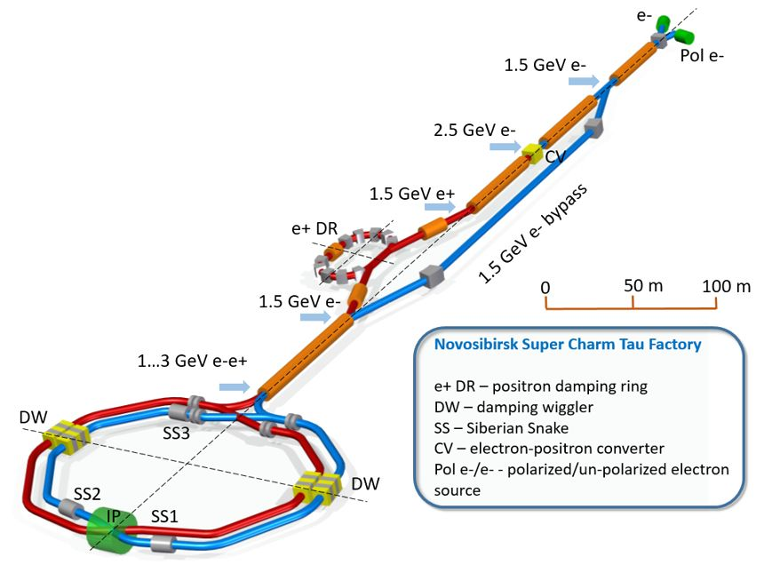
Spin physics program at SCTF
The main goal of the experiments with the Super Charm-Tau Factory (SCTF) is to study the processes of electron-positron annihilation in $c\text{−}τ$ region with high luminosity: $2E=2÷6$ GeV in c.m. and $L \sim {10}^{35}$ ${cm}^{−2}s^{−1}$.
Variant with longitudinal polarized e-
Longitudinal polarization in IP (3 Siberian snakes)
Rich spin physics program (EW, strong sector):
Measuring ${Sin}^{2}(θ_{W})$ with $J/ψ$ decays (SM testing)
Nucleon polarization near threshold ($N\overline{N}$, bound states)
Polarization effects in $τ$ physics (EDM, CP-violation)
$$⋯$$

Slide 5
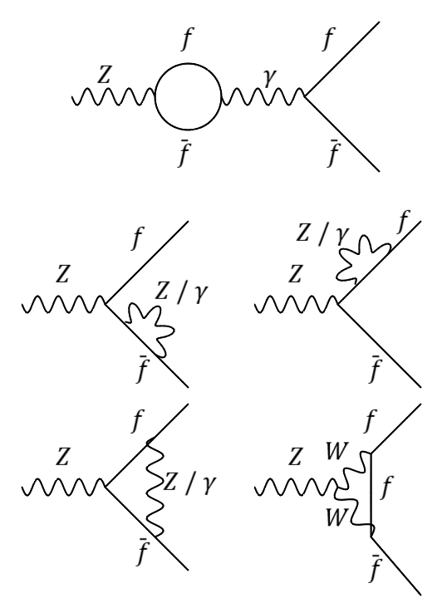
Weinberg's “running” Weak Angle
1. Electroweak theory parameter (Weinberg-Salam-Glashow):
$${A_{μ}= B_{μ}\operatorname{Cos}\left(θ_{W}\right)+V_{μ}^{3}Sin⁡(θ_{W}) \atop Z_{μ}=−B_{μ}\operatorname{Sin}\left(θ_{W}\right)+V_{μ}^{3}Cos⁡(θ_{W})}$$
$θ_{W}$ $−$ mixing angle.
2. $v_{f}$ current ($Z−f$ coupling):
$$v_{f}^{Z}=T_{f}−2Q_{f}{Sin}^{2}θ_{W}^{eff}$$
$T_{f}$- third isospin component, $Q_{f}$ - electric charge. (Neutral currents)
3. Physical “running" angle ($Q=2E$):
$${Sin}^{2}θ_{W}^{eff}=k(Q^{2}){{Sin}^{2}θ_{W}(m_{Z})}_{\overline{MS}}$$
${{Sin}^{2}θ_{W}(m_{Z})}_{\overline{MS}}$ - the value on $Z$-pole in Minimal subtraction scheme (MS), $k(Q^{2})$- the electro-weak form-factor. Absorbed diagrams by $k\left(Q^{2}\right)$ due to $Z−γ$ interference:

Slide 6
Total cross-section of $e^{+}e^{−}→q\overline{q}$ on poles
1. Left-right asymmetry of $σ(e^{+}e^{−}→q\overline{q})$ (Standard Model):
$A_{LR}=\frac{σ_{+}−σ_{−}}{σ_{+}+σ_{−}}=\frac{3−8{Sin}^{2}θ_{eff}^{c}}{{16Sin}^{2}θ_{eff}^{c}(1−{Sin}^{2}θ_{eff}^{c})}{\left(\frac{m_{J/ψ}}{m_{Z}}\right)}^{2}ζ$,
$σ_{±}−$ total cross-section corresponding to $J/ψ(1S)$ with positive and negative longitudinal polarization of e- bunch, ${Sin}^{2}θ_{eff}^{c}$ – value of sin square at energy of pole, $m_{J/ψ}−$ resonance mass, $m_{Z}−$ $Z$-boson mass, $ζ$ $−$ average polarization degree of e- bunch.
2. Estimation for $A_{LR}(ζ=1)$ in one-loop order, using “Pinch Technique” (give same result as $\overline{MS}$):
$A_{LR}^{J/ψ(1S)}≈4.4⋅{10}^{−4}$ (${Sin}^{2}θ_{eff}^{c}=0.2362$)

Slide 7
Systematic errors sources
Inequivalence of $ζ_{±}$
Dependence of the beam lifetime on the square of the degree of polarization
Dependence of cross-sections on energy $δ=∆γ/γ$: $Γ_{J/ψ}\sim 93$ keV
The presence of $e^{+}$ polarization
Estimation of uncertainty (A.E. Bondar previous FTCF-2024, January):
$d(sin^{2}θ_{W})\sim 2∙{10}^{−4}$ for $J/ψ$ ($T_{tot}\sim 1$ year, $d(ζ)/ζ\sim {10}^{−3}$, $dA_{LR}\sim {10}^{−6}$)
VS
On $Z$-pole LEP/SLAC $d(sin^{2}θ_{W})\sim 6∙{10}^{−4}$

Slide 8
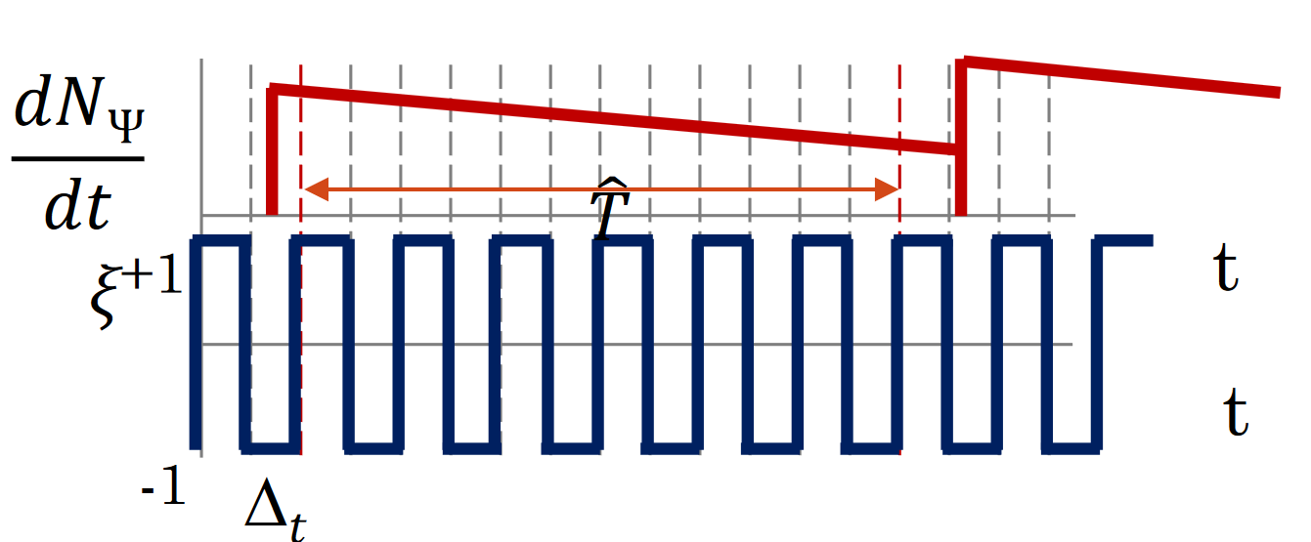
Frequent flipping of longitudinal polarization
“Spin Gymnastics” and random polarization sign of $e^{−}$ bunch:
${δA}_{LR}^{Syst} \sim \frac{δσ_{B}^{Syst}}{σ_{B}}\frac{1}{\sqrt{n_{B}T_{tot}/\hat{T}}}\frac{∆_{t}}{\hat{T}}=\frac{δσ_{B}^{Syst}}{σ_{B}}A$,
where $n_{B}−$ number of bunches, $T_{tot}$ $−$ total time of data acquisition, $\hat{T}−$ time of data acquisition for one bunch, $∆_{t}−$ time between flips.
Required polarization losing during spin-flip $∆ζ/ζ\sim {10}^{−3}$
$n_{B}=300$, $T_{tot}={10}^{7}$ s, $\hat{T}=$ 300 s, $∆_{t}=$ 5 s:
$A≈5.3∙{10}^{−6}$
($C$-$τ$ factory)

Slide 9
Longitudinal polarization flipping procedure and it’s spin dynamics
Adiabatic spin-flip specific for SCTF
Organization of longitudinal polarization in IP
Adiabatic crossing of spin resonance
The influence of the “mirror” harmonic and synchrotron modulations
RF-flipper calculations
Position optimization for RF-flipper
Parameters of RF-flipper. Field integral
Parameters of RF-flipper. Resonant circuit

Slide 10
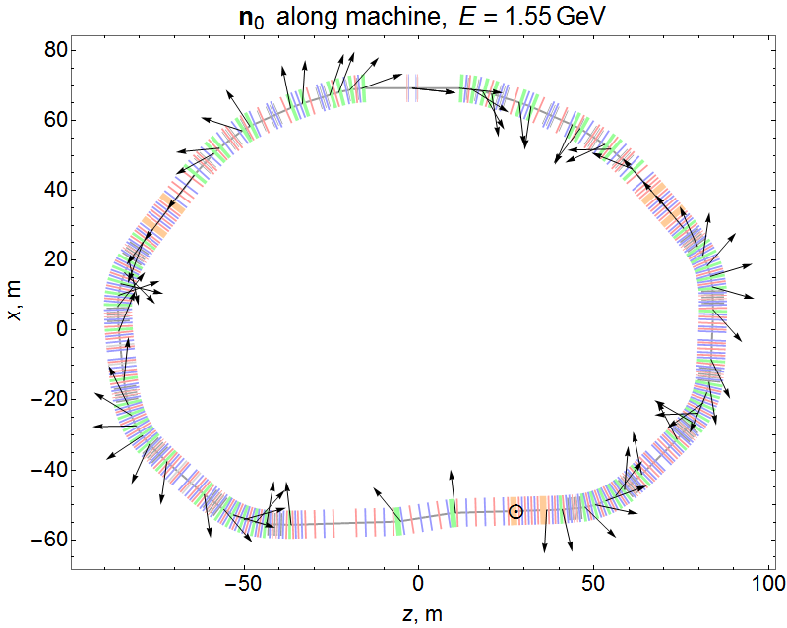
Organization of longitudinal polarization in IP
1
1 – Electron ring SCTF
2 – Interaction point IP
3 – Siberian snakes (Snake1 has rotation $φ=π+Δφ$).
4 – Spin RF-rotator (shifted on $Δθ$)
Black arrows indicate the evolution of the equilibrium degree of polarization along the ring without RF-rotator.
Spin frequency
$$ν=\frac{1}{2} \text{(}\text{without} \text{RF}\text{−}\text{rotator}\text{)}$$
$$ν=\frac{1}{2}+∆ν \text{(}\text{with} \text{RF}\text{−}\text{rotator}\text{)}$$
2
IP
Snake 1
Before flip
Snake 3
After flip
$Δθ$
4
3
Snake 2

Slide 11
Adiabatic crossing of spin resonance
$$α=arctg(\frac{\left|w_{k}\right|}{ε})$$
Isolated resonance approximation:
$$\frac{d\vec{ζ}}{dθ}=\left[\vec{h}×\vec{ζ}\right]$$
$\vec{h}=ε\vec{n_{0}}+\vec{w} −$ cone axis,
$\vec{ζ}=\frac{\vec{S}}{S} −$ degree of polarization,
$ε= ν−ν_{f}$ $−$ resonance detuning
($ν_{f}$ $−$ RF-rotator frequency),
$\vec{w}$ $−$ amplitude of resonant harmonic.
$$\vec{n_{0}}$$
$$\vec{ε}$$
$$\vec{ε}$$
$$α$$
$$\vec{h}$$
$$\vec{ζ}$$
$$\vec{l_{2r}}$$
$$\vec{w}$$
$$\vec{l_{1r}}$$

Slide 12
Adiabatic crossing of spin resonance (continue)
$$α=arctg(\frac{\left|w_{k}\right|}{ε})$$
Froissart-Stora formula (resonance crossing):
$ζ_{z}\left(+∞\right)=ζ_{z}\left(−∞\right)(−1+2e^{−2J})$,
where $J=\frac{π^{2}{\left|w_{k}\right|}^{2}}{2\left|ε^{′}\right|}$, here $ε^{′}$ - speed of detune change in terms of turn numbers.
In case of adiabatic crossing:
$J≫1$ and $ζ_{z}\left(−∞\right)=+$1 $→ζ_{z}\left(+∞\right)=−$1
The vector $\vec{ζ}$ follows the $\vec{h}$axis, which leads to a change in the sign of the equilibrium degree of polarization according to the Froissart-Stora prediction.
$$\vec{n_{0}}$$
$$\vec{ε}$$
$$α$$
$$\vec{h}$$
$$\vec{ζ}$$
$$\vec{l_{2p}}$$
$$\vec{w}$$
$$\vec{l_{1p}}$$

Slide 13
The influence of the “mirror” harmonic
The presence of a “mirror” $w_{k+1}$ ($\left|w_{k}\right|=\left|w_{k+1}\right|$) leads to a violation of the resonance isolation condition ($ν=0.5=ν_{f}$ и $1−ν=0.5=ν_{f}$), which means violation of the adiabatic condition.
In this regard, it is necessary to perform frequency tuning $Δν$ from $ν=\frac{1}{2}$, which results to the small vertical component of spin at IP:
$$\vec{n_{0}}\left(0\right)=\frac{1}{\sin\left(πν\right)}(0,−\sin\left(\frac{φ}{2}\right), −cos⁡(\frac{φ}{2})sin⁡(\frac{πν_{0}}{3}))\text{,}$$
$ν_{0}=γG$ – spin rotation frequency around the vertical axis, $G$ – G-factor of particle, $γ$ – gamma factor. For $Δν={−5⋅10}^{−3}$, $E=1.55$ GeV:
${n_{0}}_{z}=0.0095$ and ${n_{0}}_{y}=0\text{.99995}$

Slide 14
The influence of synchrotron modulations on the adiabatic flip
Taking synchrotron oscillations into account ($ε=\overline{ε}+σcos(Ψ_{γ})$):
$$\left|w_{km}\right|=\left|w_{k}\right|∙J_{m}\left(\frac{σ}{ _{ν_{s}}}\right)$$
$J_{m} −$ Bessel function $m$-s order, $ν_{s} −$ synchrotron oscillation frequency, $σ −$ amplitude of modulation.
Without snakes
$$σ=ν_{0}{\left(\frac{Δγ}{γ}\right)}_{0}$$
With snakes
$$σ=\frac{\cos\left(\frac{πν_{0}}{3}\right)\sin\left(\frac{φ}{2}\right)\left(2π+φ\right)−\frac{2π}{3}cos\left(\frac{φ}{2}\right)sin⁡(\frac{πν_{0}}{3})ν_{0}}{2π\sqrt{1−\cos^{2}(\frac{φ}{2})\cos^{2}(\frac{πν_{0}}{3})}}{\left(\frac{Δγ}{γ}\right)}_{0}$$

Slide 15
The influence of synchrotron modulations on the adiabatic flip
Taking synchrotron oscillations into account ($ε=\overline{ε}+σcos(Ψ_{γ})$):
$$\left|w_{km}\right|=\left|w_{k}\right|∙J_{m}\left(\frac{σ}{ _{ν_{s}}}\right)$$
$J_{m} −$ Bessel function $m$-s order, $ν_{s} −$ synchrotron oscillation frequency, $σ −$ amplitude of modulation.
In the 3-snake scheme:
$σ≈−1.9∙{10}^{−3}$
with ${\left(\frac{Δγ}{γ}\right)}_{0}=1.56∙{10}^{−3}$, $ν=0.48$ ($∆φ=−0.147$). For $m=0$, $ν_{s}=1.17∙{10}^{−2}$ have:
$\left|w_{km}\right|=9.93∙{10}^{−5}$ ($\left|w_{k}\right|={10}^{−4}$, weakening on $0.007\%$)

Slide 16
Position optimization for RF-flipper
From one-turn matrix:
$\vec{n_{0}}(θ^{∗})=\frac{i}{2sin⁡(πν)}Sp(\vec{σ}U)$,
where $U −$ one-turn matrix, $\vec{σ} −$ vector of sigma matrices, $ν−$ generalized spin frequency.
In our case (in terms of $Δθ$):
$$\vec{n_{0}}\left(Δθ\right)=\frac{1}{sin⁡(πν)}(−sin⁡(\frac{φ}{2})sin⁡(ν_{0}(Δθ−\frac{π}{3})),−\sin\left(\frac{φ}{2}\right)cos⁡(ν_{0}(\frac{π}{3}−Δθ)), cos⁡(\frac{φ}{2})sin⁡(\frac{πν_{0}}{3}))$$
So, condition for $Δθ$:
$Δθ=\frac{π}{2ν_{0}}+\frac{π}{3}$ in our case $Δθ=1.49$

Slide 17
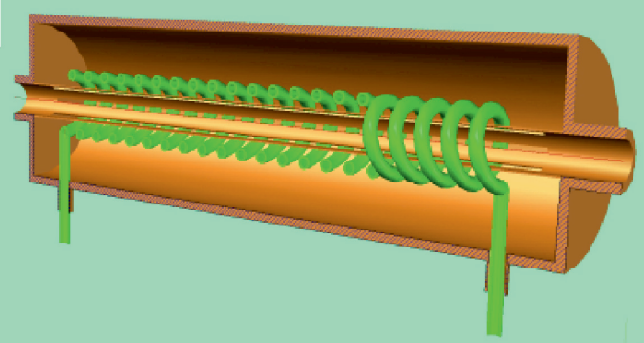
Parameters of RF-flipper
2
The necessary field integral defined by $\left|w_{k}\right|$:
$$w_{k}=−i\frac{(G+1)H_{y_{0}}θ_{0}}{4π\left\langle H_{z}\right\rangle }$$
For $J/ψ$-meson energy to get adiabatic parameter $J≫1$:
$$H_{y_{0}}l=\text{0.0}\text{0}\text{65} \text{T}⋅\text{m}$$
for $w_{k}={\text{10}}^{−\text{4}}$ (from simulation).
1
3
1 – Cylindrical vacuum case, 2 – RF-solenoid coil, 3 – Copper liner with several longitudinal slits-cuts.

Slide 18
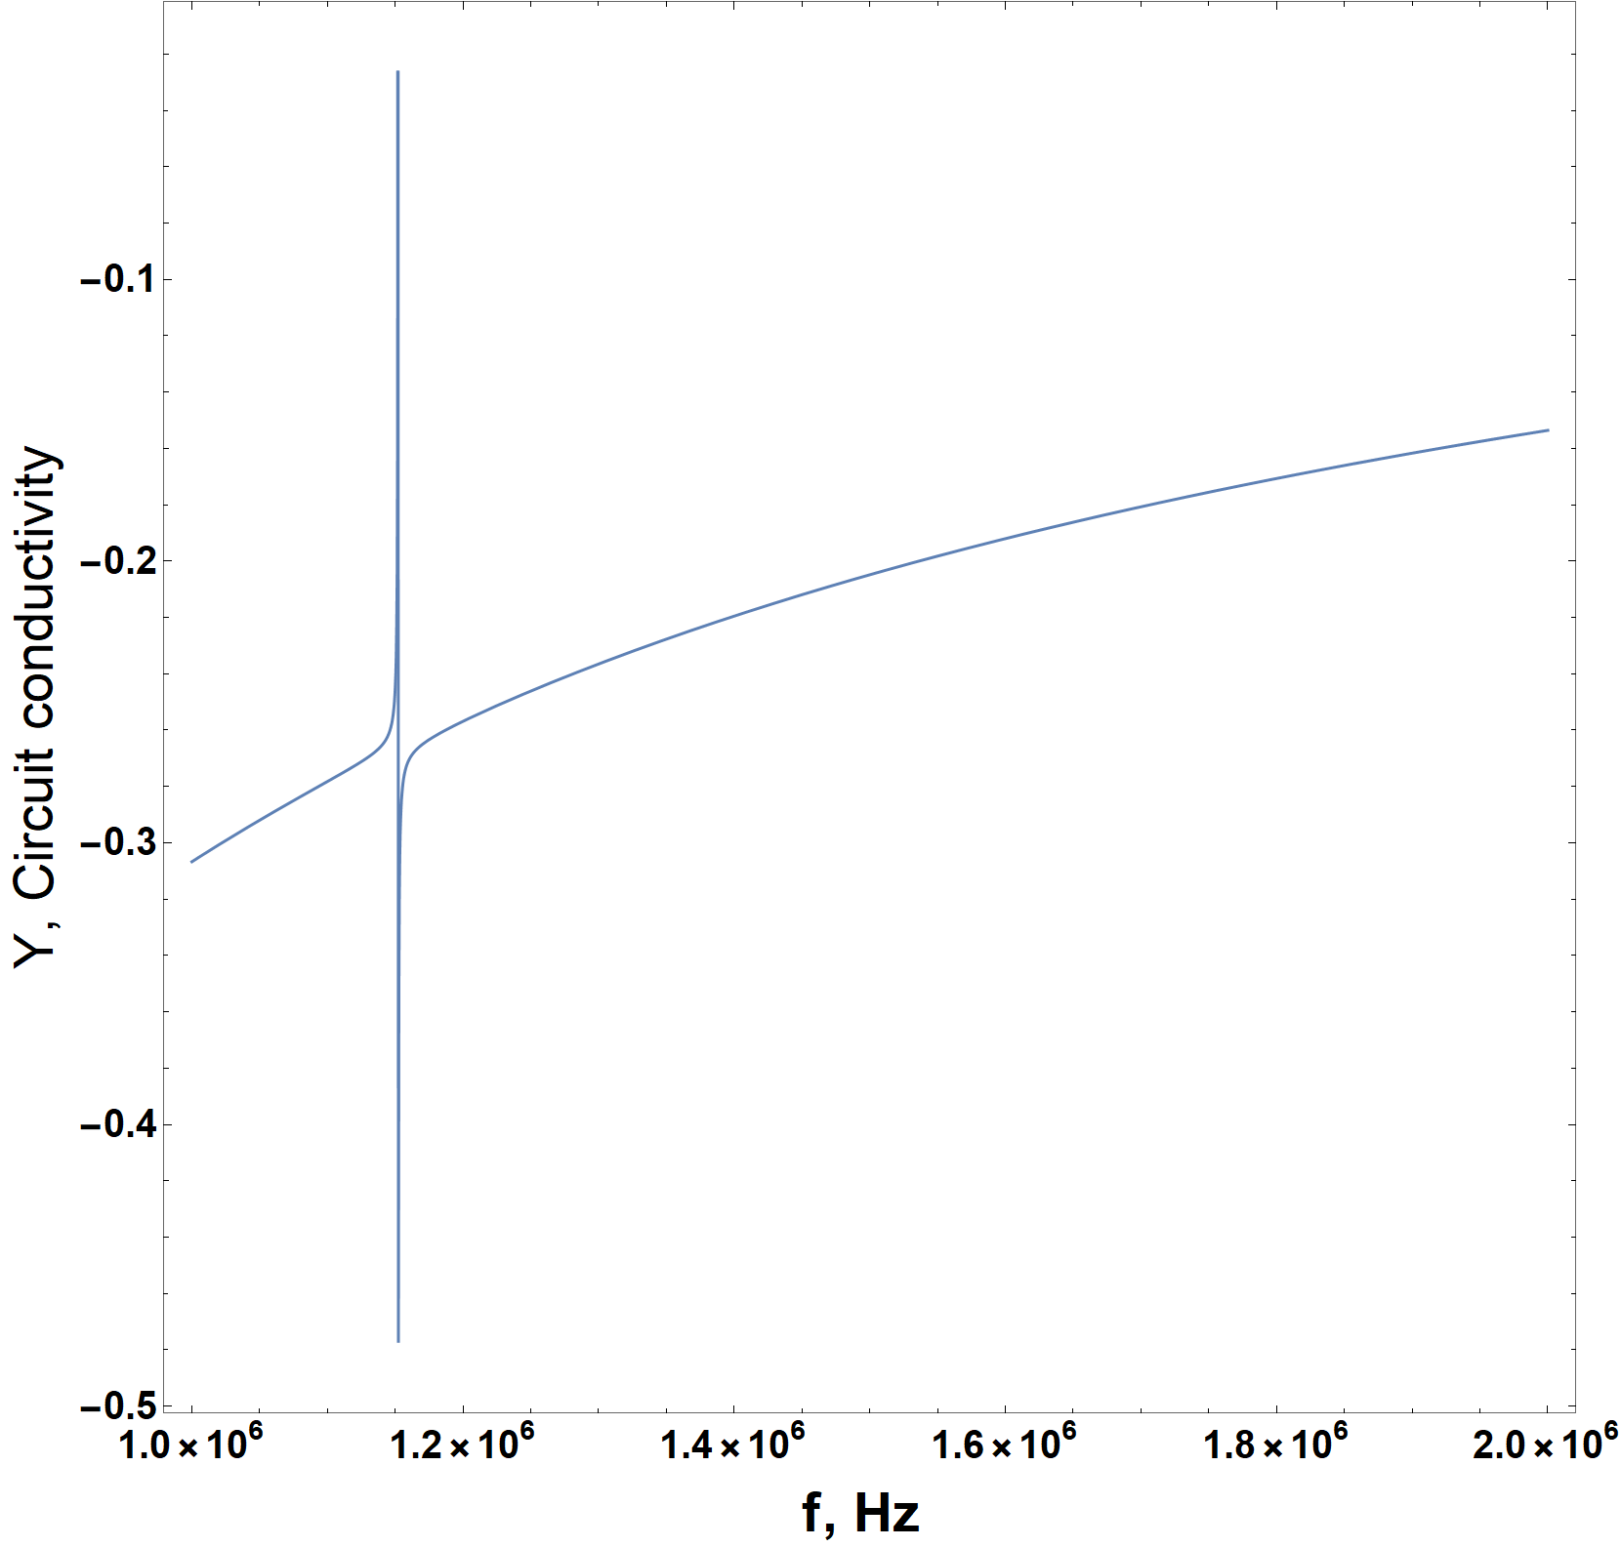
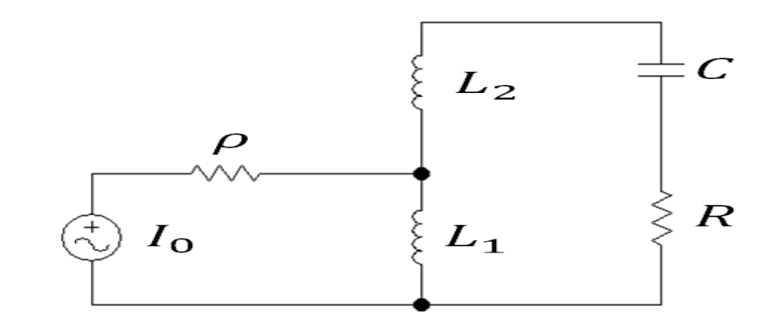
Parameters of RF-flipper
Simplified scheme of the resonant circuit.
$L_{1}$, $L_{2}$ - Transmission and solenoid inductance, $R$, $C$ - heat loss resistance and parasitic capacitance, $ρ$ - the wave resistance of the feeder

Slide 19
Simulation results

Slide 20
Simulating of synchrotron motion
Rotation of vector $\vec{ψ}=(φ,δ)$:
$$\vec{ψ}(n)=\left(\begin{matrix}Cos\left(2πν_{s}n\right) & Sin\left(2πν_{s}n\right) \\ −Sin\left(2πν_{s}n\right) & Cos\left(2πν_{s}n\right)\end{matrix}\right)e^{−n/N_{γ}}\vec{ψ}\left(0\right)\text{,}$$
$n−$ turn number, $ν_{s} −$ synchrotron oscillation frequency, $N_{γ}$ - characteristic decay time in terms of turn numbers.
Quantum fluctuations of synchrotron oscillations:
$σ_{noise}=\frac{2σ_{δ}}{\sqrt{N_{γ}}}$,
$σ_{δ}$ – the value of the asymptotic root-mean-square energy spread in the beam ($δ_{0}=\sqrt{2}σ_{δ}$). For $N_{γ}=$25839 ($W_{0}≈$60 keV), $σ_{δ}=$1.1$⋅{\text{10}}^{−3}$
$$σ_{noise}=1.37⋅{10}^{−5}$$

Slide 21
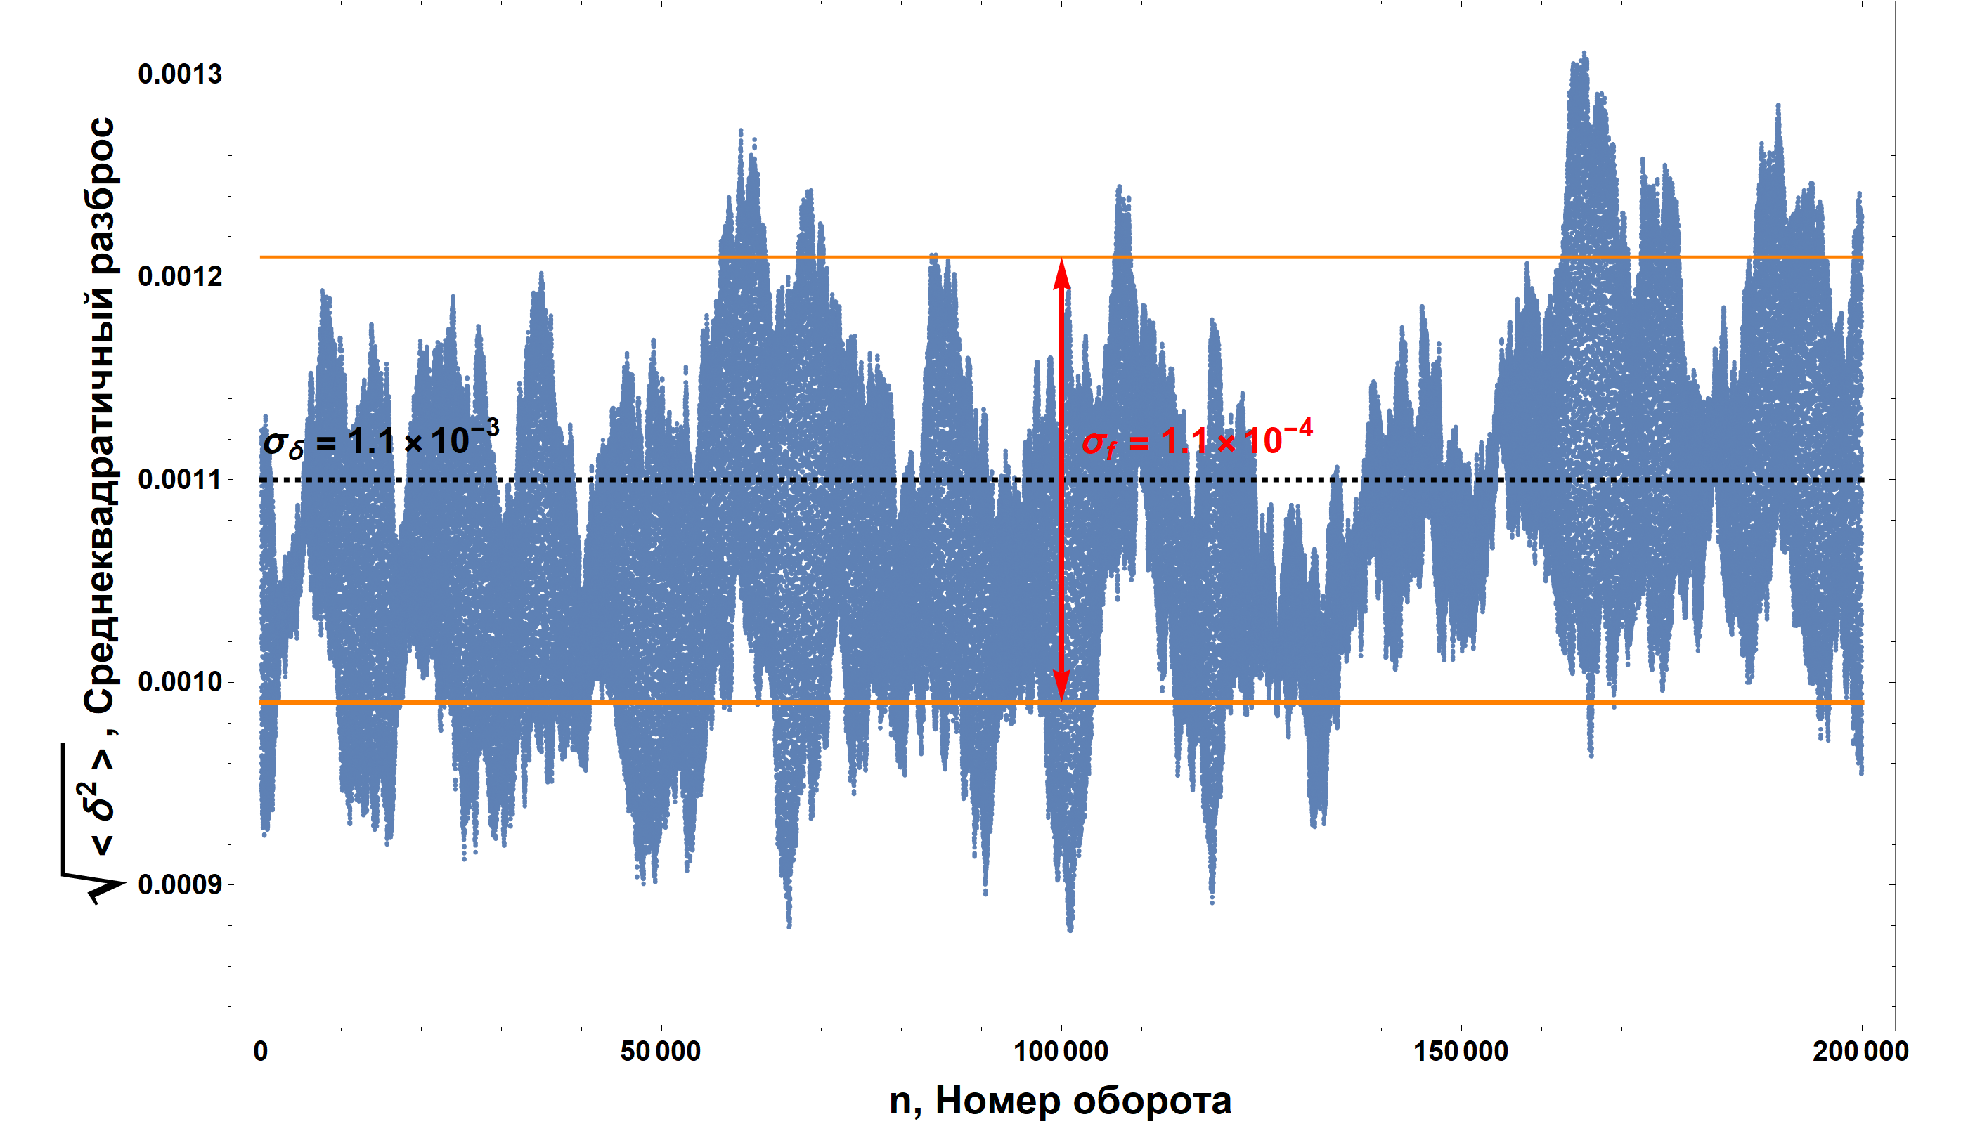
Root mean square energy spread in the ansemble
RMS
Turn number

Slide 22
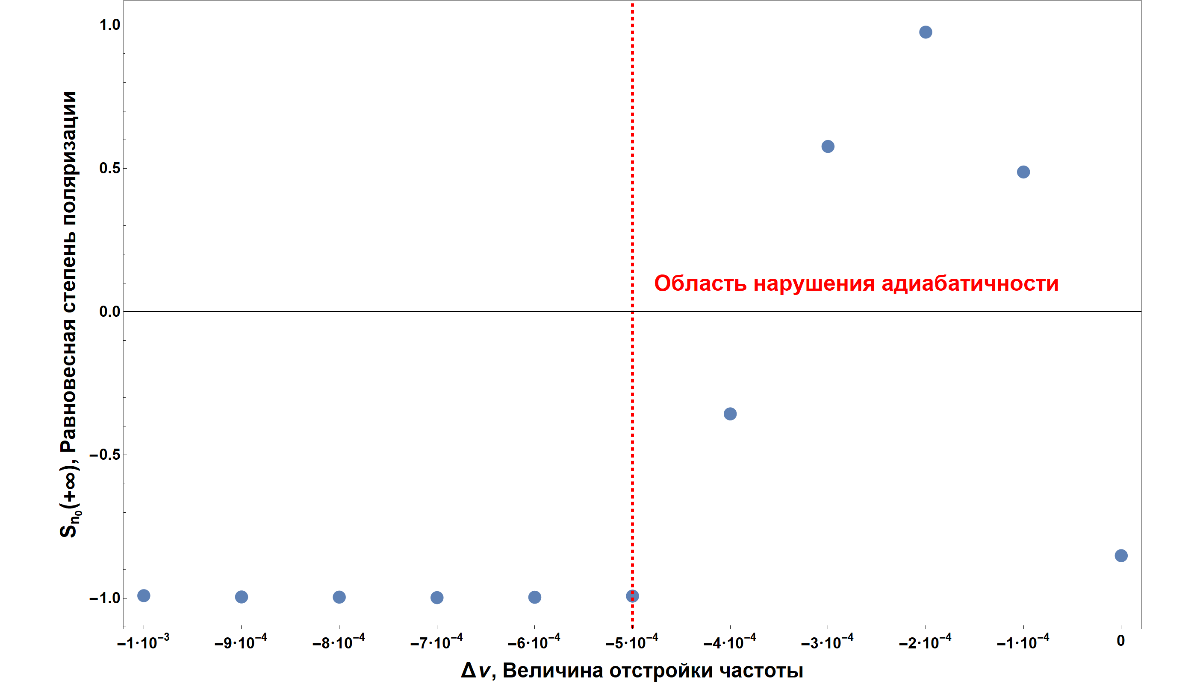
The influence of the “mirror” harmonic. Spin flip
Equilibrium polarization
Adiabaticity violation zone
Detune

Slide 23
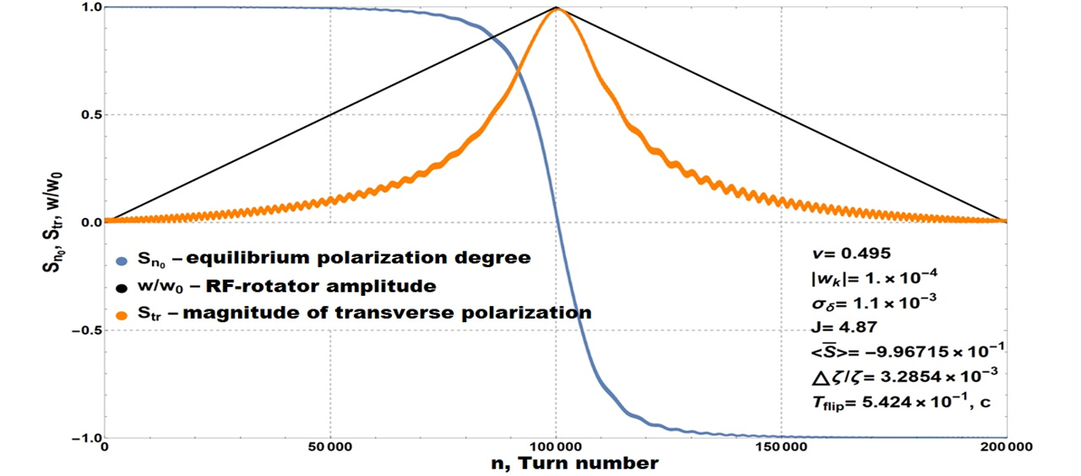
Simulation of "spin gymnastics"

Slide 24
Conclusion
Total
Estimation for $A_{LR}^{J/ψ(1S)}$ using “Pinch Technique” in one-loop order is performed.
In the case of the SCTF, the simulation results give a positive result for using the scheme with three Siberian Snakes for such an experiment.
Analysis of “mirror” harmonic, synchrotron motion is carried out.
Plans:
Calculations of the spin coherence time in resonance zone, as well as the derivation of an analytical formula for the weakening of polarization after a flip in case of variable $w_{k}$.
Betatron motion implementation.

Slide 25
Simulating of synchrotron oscillations
Ultrarelativistic case and $qω_{0}τ≪1$:
$$\left\{\begin{aligned}\frac{dI_{γ}}{dt}=−4ζ_{E}I_{γ}{Cos}^{2}Ψ_{γ} \\ \frac{dΨ_{γ}}{dt}=Ω_{s}+2ζ_{E}CosΨ_{γ}SinΨ_{γ}\end{aligned}\right.\text{,}$$
$I_{γ}$ – action variable, $Ψ_{γ}$ – angle variable, $ζ_{E}$ – synchrotron oscillation decrement, $Ω_{s}=ν_{s}ω_{0}$ – synchrotron oscillation frequency, $ω_{0}$ – particle turn frequency.

Slide 26
Simulating of synchrotron oscillations
Solution of the system:
$$\left\{\begin{aligned}I_{γ}=A\left(\frac{1}{1−ε^{2}}−\frac{ε}{\sqrt{1−ε^{2}}}Sin({{2Ψ}_{γ}}_{0}\sqrt{1−ε^{2}})+\frac{ε^{2}}{1−ε^{2}}Cos({{2Ψ}_{γ}}_{0}\sqrt{1−ε^{2}})\right)e^{−2ε{Ψ_{γ}}_{0}} \\ {Ψ_{γ}}_{0}=\frac{1}{\sqrt{1−ε^{2}}}Arctg\left(\frac{tg\left(Ψ_{γ}\right)+ε}{\sqrt{1−ε^{2}}}\right) \end{aligned}\right.$$
where ${Ψ_{γ}}_{0}$ – angle variable without dumping, $ε=ζ_{E}/Ω_{s}<1$ – ratio of the decrement of synchrotron oscillations to the synchrotron frequency, $A$ – constant determined by the initial conditions.
SCTF case $ε≪1$:
$$\left\{\begin{aligned}δ=δ_{0}Cos{Ψ_{γ}}_{0}e^{−ζ_{E}t} \\ φ=δ_{0}Sin{Ψ_{γ}}_{0}e^{−ζ_{E}t}\end{aligned}\right.$$
$ε\sim 5.27⋅{10}^{−4}$ ($E=\text{1.55}$ GeV, $ν_{s}=\text{1.17}⋅{\text{10}}^{−2}$, $τ_{E}=ζ_{E}^{−1}≈\text{69.77}$ $ms$, $T_{0}=2π/ω_{0}=\text{2.7}$ $μs$).

Slide 27
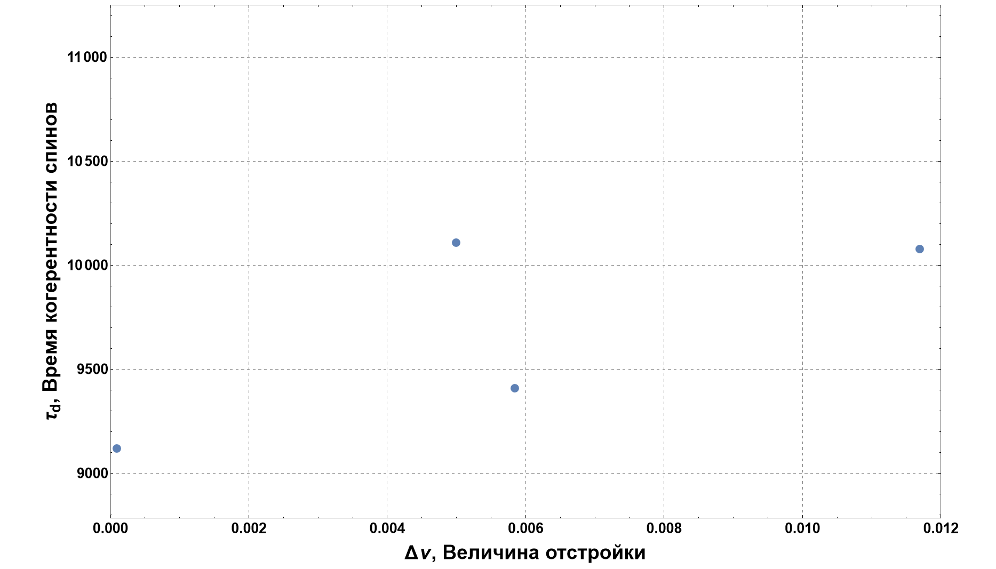
The influence of the “mirror” harmonic. Radiation spin life time

