Slide 1
Touschek lifetime at SCTF
Mr. Mikhail Skamarokha
Junior researcher
Budker Institute of Nuclear Physics, Novosibirsk, Russia
November 19th 2024
Notes:
Im Mikhail, Junior Researcher ad Budker institute of nuclear physics
Today Im going to talk with you about my work regarding SCTF and touschek lifetime

Slide 2
Contents
Touschek lifetime calculation
Simulation of Touschek scattering using Elegant (APS, M.Borland)
Optimization of local momentum acceptance (LMA) to increase Touschek lifetime using “MOGA for rings” routine (Elegant, run on cluster)
Impact of orbit error on dynamic aperture and LMA/Touschek lifetime – short study
Notes:
These are the main topics of my presentation that I hope to cover
Probably most of the things I’m going to show you are already familiar to you, some or all methods shown in this presentation you might use in your work already.
In the beginning I will talk about the simulations of touschek scattering that I ran for our SCTF lattice using elegant code and touschek_scatter function
After that I’m going to show you how I succeded in optimizing dynamic aperture and LMA using MOGA optimizer for rings on the example of lattice that is similar to SCTF
Lastly I will show you how dynamic aperture and touchek lifetime changes when we introduce orbit error to our SCTF lattice caused by the transverse displacement of quadrupole lenses

Slide 3
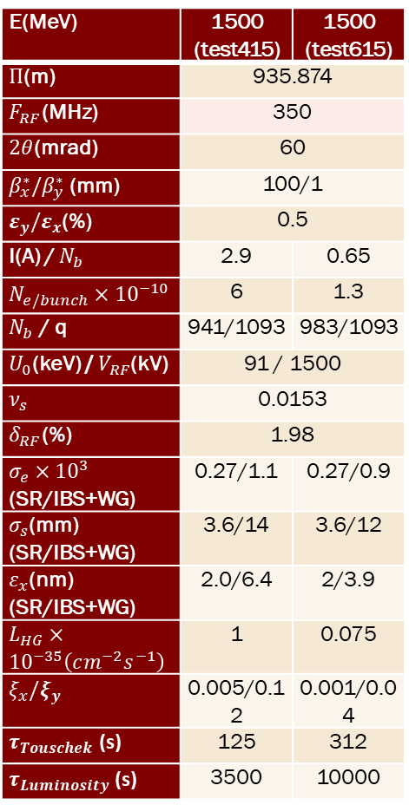
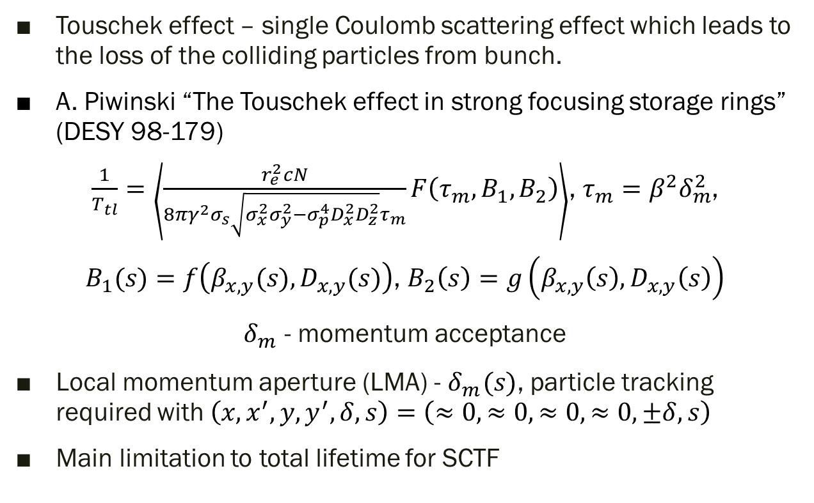
Introduction
E(MeV) | 1500 (test415) | 1500 (test615)
$Π$(m) | 935.874
$F_{RF}$(MHz) | 350
$2θ$(mrad) | 60
$β_{x}^{∗}/β_{y}^{∗}$ (mm) | 100/1
$ε_{y}/ε_{x}$(%) | 0.5
I(A) / $N_{b}$ | 2.9 | 0.65
$N_{e/bunch}×{10}^{−10}$ | 6 | 1.3
$N_{b}$ / q | 941/1093 | 983/1093
$U_{0}$(keV) / $V_{RF}$(kV) | 91 / 1500
$ν_{s}$ | 0.0153
$δ_{RF}$(%) | 1.98
$σ_{e}×{10}^{3}$ (SR/IBS+WG) | 0.27/1.1 | 0.27/0.9
$σ_{s}$(mm) (SR/IBS+WG) | 3.6/14 | 3.6/12
$ε_{x}$(nm) (SR/IBS+WG) | 2.0/6.4 | 2/3.9
$L_{HG}×{10}^{−35}\left(cm^{−2}s^{−1}\right)$ | 1 | 0.075
$ξ_{x}/ξ_{y}$ | 0.005/0.12 | 0.001/0.04
$τ_{Touschek}$ (s) | 125 | 312
$τ_{Luminosity}$ (s) | 3500 | 10000
Touschek effect – single Coulomb scattering effect which leads to the loss of the colliding particles from bunch.
A. Piwinski “The Touschek effect in strong focusing storage rings” (DESY 98-179)
$\frac{1}{T_{tl}}=\left\langle \frac{r_{e}^{2}cN}{8πγ^{2}σ_{s}\sqrt{σ_{x}^{2}σ_{y}^{2}−σ_{p}^{4}D_{x}^{2}D_{z}^{2}}τ_{m}}F\left(τ_{m},B_{1},B_{2}\right)\right\rangle$, $τ_{m}=β^{2}δ_{m}^{2}$,
$B_{1}(s)=f\left(β_{x,y}(s),D_{x,y}(s)\right)$, $B_{2}\left(s\right)=g\left(β_{x,y}\left(s\right),D_{x,y}\left(s\right)\right)$
$δ_{m}^{}$ - momentum acceptance
Local momentum aperture (LMA) - $δ_{m}^{}(s)$, particle tracking required with $\left(x,x^{′},y,y^{′},δ,s\right)=\left(≈0,≈0,≈0,≈0,±δ,s\right)$
Main limitation to total lifetime for SCTF

Slide 4
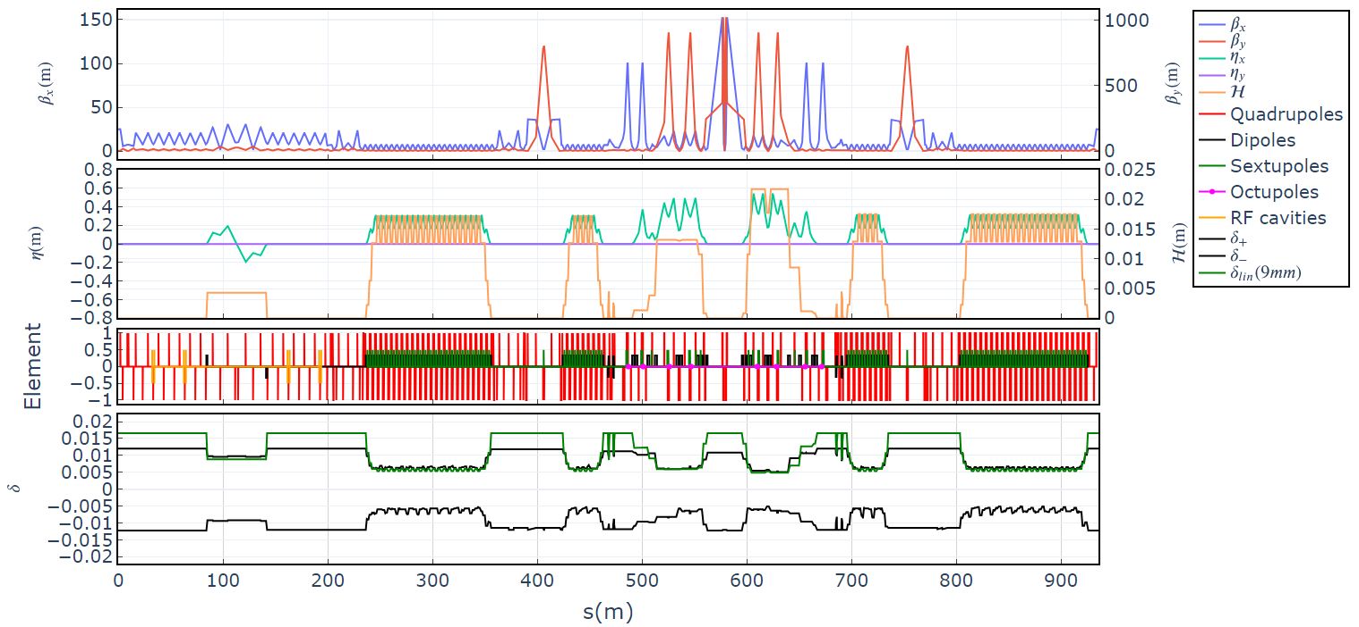

Optical functions and LMA of SCTF (ctau v68)
$$δ\left(s\right)=\frac{R}{η\left(s\right)+\sqrt{ℋ\left(s\right)β\left(s\right)}}$$

Slide 5
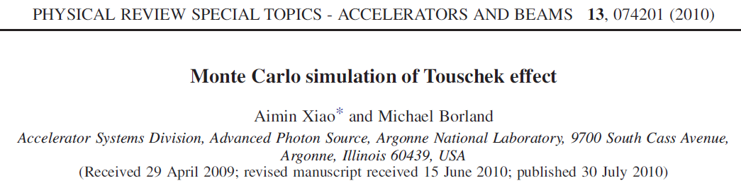
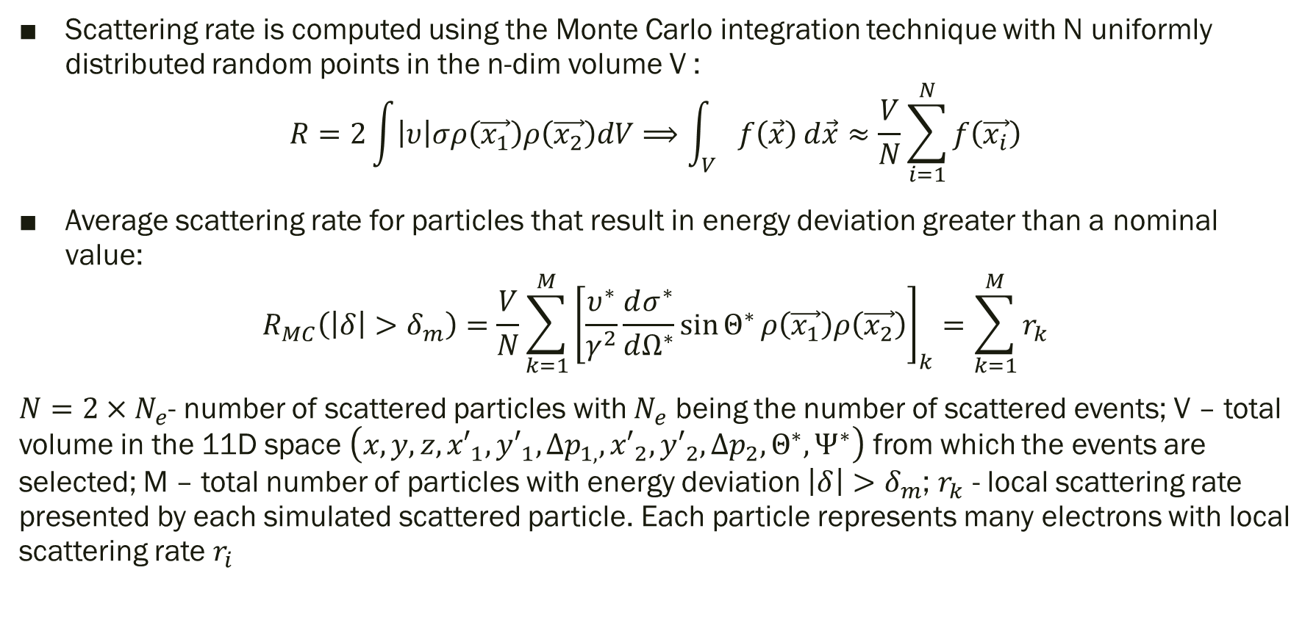
Scattering rate is computed using the Monte Carlo integration technique with N uniformly distributed random points in the n-dim volume V :
$$R=2\int{\left|υ\right|σρ\left(\vec{x_{1}}\right)ρ\left(\vec{x_{2}}\right)dV}⟹\int_{V}{f\left(\vec{x}\right)ⅆ\vec{x}≈\frac{V}{N}\sum_{i=1}^{N}{f\left(\vec{x_{i}}\right)}}$$
Average scattering rate for particles that result in energy deviation greater than a nominal value:
$$R_{MC}\left(\left|δ\right|>δ_{m}\right)=\frac{V}{N}\sum_{k=1}^{M}{{\left[\frac{υ^{∗}}{γ^{2}}\frac{dσ^{∗}}{dΩ^{∗}}\sin{Θ^{∗}}ρ\left(\vec{x_{1}}\right)ρ\left(\vec{x_{2}}\right)\right]}_{k}}=\sum_{k=1}^{M}{r_{k}}$$
$N=2×N_{e}$- number of scattered particles with $N_{e}$ being the number of scattered events; V – total volume in the 11D space $\left(x,y,z,{x′}_{1},{y′}_{1},{∆p}_{1,},{x′}_{2},{y′}_{2},{∆p}_{2},Θ^{∗},Ψ^{∗}\right)$ from which the events are selected; M – total number of particles with energy deviation $\left|δ\right|>δ_{m}$; $r_{k}$ - local scattering rate presented by each simulated scattered particle. Each particle represents many electrons with local scattering rate $r_{i}$
Notes:
As you all well know one of the limitations to beam lifetime is caused by Touschek effect.
Creators of elegant program, that as I heard you are using as well, have implemented Monte Carlo integration technique to calculate touschek scattering rate. Scattering rate divided by number of particles in bunch is reversed touschek lifetime.
Average scattering rate for particles that result in energy deviation greater than momentum acceptance or some nominal value is Rmc. In this equation N is the number of scattered particles, Ne is the number of scattering events. So one scattering event involve two particles. V is total volume in 11 dim space from which events are selected. M is particles with energy deviation bigger than nominal. Rk is local scattering rate presented by each simulated scattered particle.

Slide 6
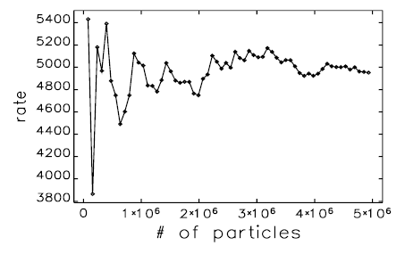
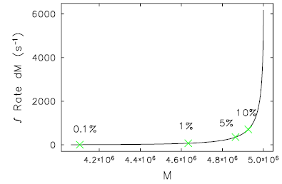
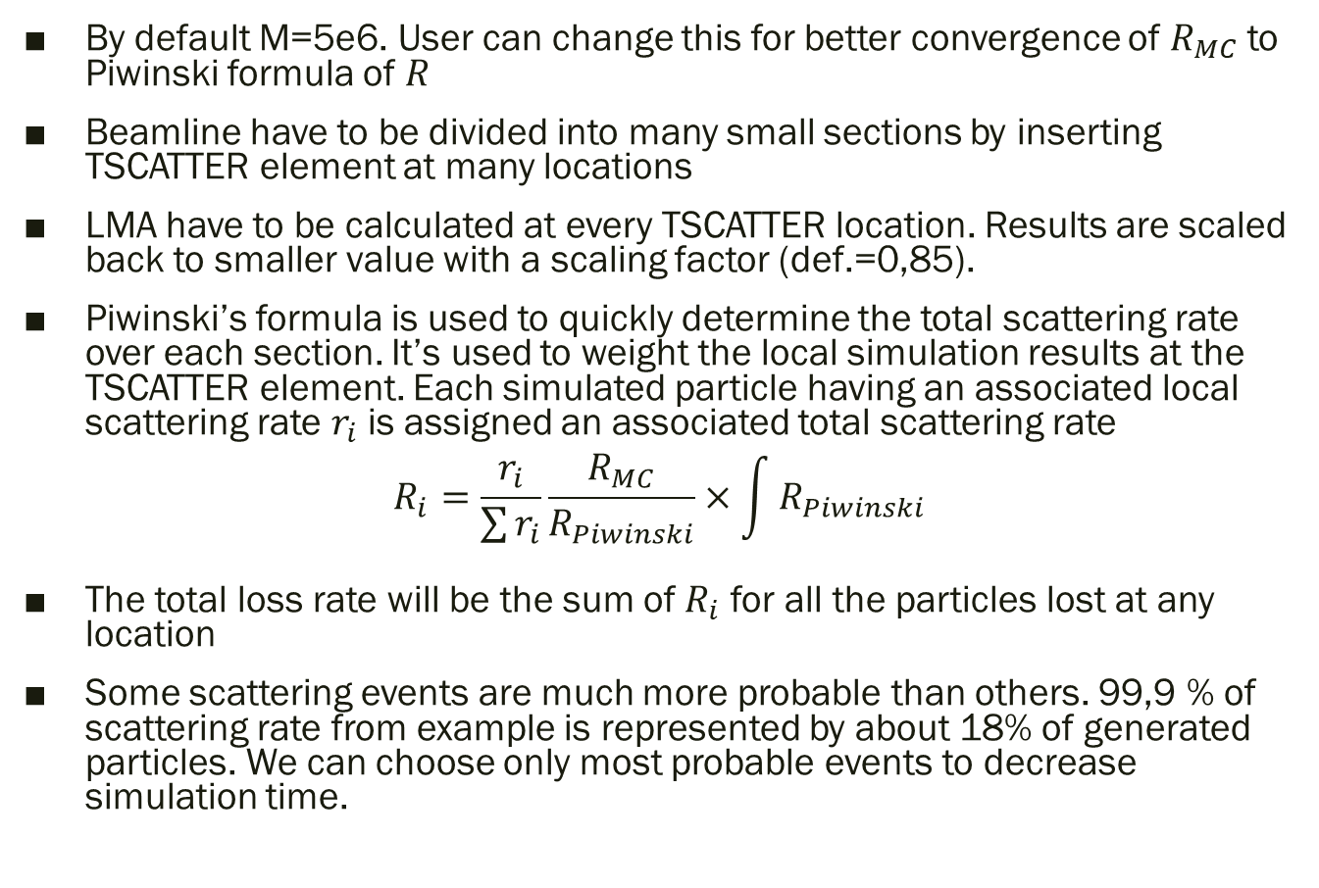
Steps of Touschek scattering simulation in elegant
By default M=5e6. User can change this for better convergence of $R_{MC}$ to Piwinski formula of $R$
Beamline have to be divided into many small sections by inserting TSCATTER element at many locations
LMA have to be calculated at every TSCATTER location. Results are scaled back to smaller value with a scaling factor (def.=0,85).
Piwinski’s formula is used to quickly determine the total scattering rate over each section. It’s used to weight the local simulation results at the TSCATTER element. Each simulated particle having an associated local scattering rate $r_{i}$ is assigned an associated total scattering rate
$$R_{i}=\frac{r_{i}}{\sum{r_{i}}}\frac{R_{MC}}{R_{Piwinski}}×\int{R_{Piwinski}}$$
The total loss rate will be the sum of $R_{i}$ for all the particles lost at any location
Some scattering events are much more probable than others. 99,9 % of scattering rate from example is represented by about 18% of generated particles. We can choose only most probable events to decrease simulation time.
Notes:
By default M is 5e6, user can change that to achieve better convergence of Rmc to R defined by known Piwinski formula. You may see from this plot over here that the more particles we use in our simulation, the better convergence we get, the rate on the plot approaches the constant value as the number of particles increases
User has to divide lattice into small sections by inserting TSCATTER elements at many locations. Between these elements local scattering events are simulated and local scattering rate is calculated
Local momentum aperture at every TSCATTER element is calculated using momentum aperture command. Results are scaled back with a scaling factor – default is 0,85. It’s done to ensure that we won’t underestimate scattering rate by not looking at particles close to momentum acceptance values that might get lost.
Piwinski’s formula is used to quickly determine the local scattering rate over each section. It’s used to weight the local simulation results at the TSCATTER element. Each simulated particle having an associated local scattering rate ri is assigned an associated total scattering rate Ri
The total loss rate will be the sum of Ri for all the particles lost at any location
And now you are probably thinking that 5 million particles scattered in every magnet and tracked requires a lot of CPU time and you are right. That’s why we can sort particles by how much they contribute to scattering rate and use for tracking only those scattering events that contribute to scattering rate the most. You can see that 99,9 % of scattering particles in this example is represented by about 18% of generated electrons. So we don’t have to track 5e6 times number of segments particles

Slide 7
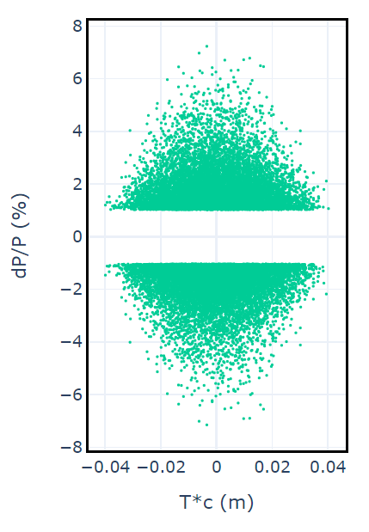
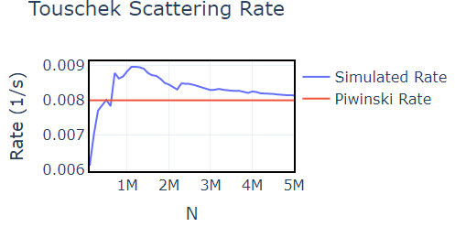
Setting up simulation of Touschek scattering in SCTF
Lattice version ctau68-2022.10.08-19.03.53_1.0crab-1.5GeV
Parameters – Test415 and Test615 (CRAB=1, IBS ON, RF ON, SR ON)
807 TSCATTER elements in lattice
4096 turns
5e6 of simulated particles in MC simulation, 0,05 – ignored portion of scattering rate in tracking
Scale – 0,85 of LMA
Notes:
For simulation I used lattice version with turned on crab sextupoles and considered intra beam scattering. Parameters were chosen by Anton to insure luminosity of 1e35. Energy is 1,5 GeV, lifetime calculated with piwinski formula is 125 seconds. For simulation I have inserted 807 TSCATTER elements and used default values of simulated particles and scale for momentum aperture.

Slide 8
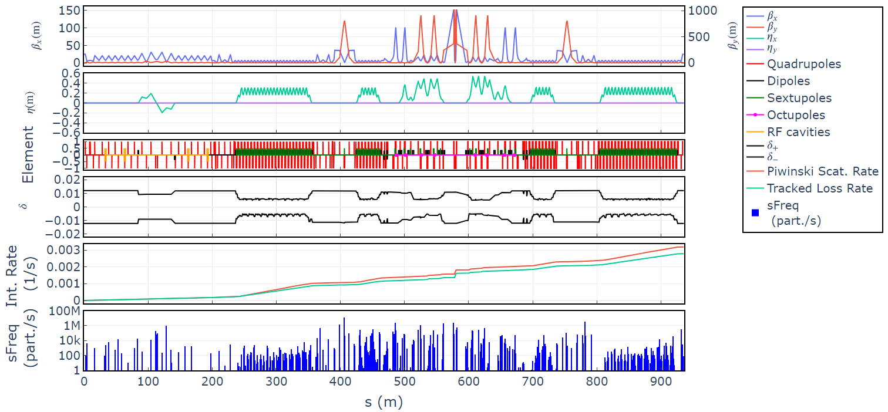
Touschek scattering simulation results
 | Ctau68 Test415 | Ctau68 Test615
Calculated lifetime (s) | 128 | 314
Simulated lifetime (s) | 141 | 359
Notes:
On this slide you can see the results of the simulation but for different set of parameters. I have included this slide mostly because of the graph in the bottom – here you can see local loss rate. The sum of bins in the histogram is reversed lifetime.

Slide 9
Optimization of SCTF (ctau v.68) LMA
MOGA optimizer for rings (M. Borland, V. Sajaev, L. Emery, A. Xiao – Multi-objective direct optimization of dynamic acceptance and lifetime for potential upgrades of the APS)
Cluster with geneticOptimizer and elegant programs is required
For efficiency – places for LMA search are chosen to be the places where H invariant value vary – entrance and exit of every dipole.
Variables for optimizer – octupole and sextupole strengths (crab-sextupoles excluded) – elements in -I pairs have same variable
Notes:
Now that I have shown you touschek scattering simulation method and results I can move to the next topic – optimization of LMA and dynamic aperture.
Optimization of LMA is needed to increase the touschek lifetime.
Elegant developers have created a tool, a routine, for LMA and dynamic aperture optimization called MOGA for rings. At the base of routine is multi-objective genetic algorithm. To use the routine the user must have access to cluster with geneticOptimizer program and elegant.
I can’t show the result of optimization for SCTF yet, but I can show it for similar machine we call Super Phi
Variables for MOGA in our case are strengths of sextupole and octupole lenses. We don’t change strength of crab sextupole. Strengths of lenses that organized in –I pairs has one variable per pair.
For efficiency I have chosen to search for LMA at the places where H inv (or dispersion invariant) changes it’s value – as it happens, LMA is limited at the places where H invariant has nonzero values.

Slide 10
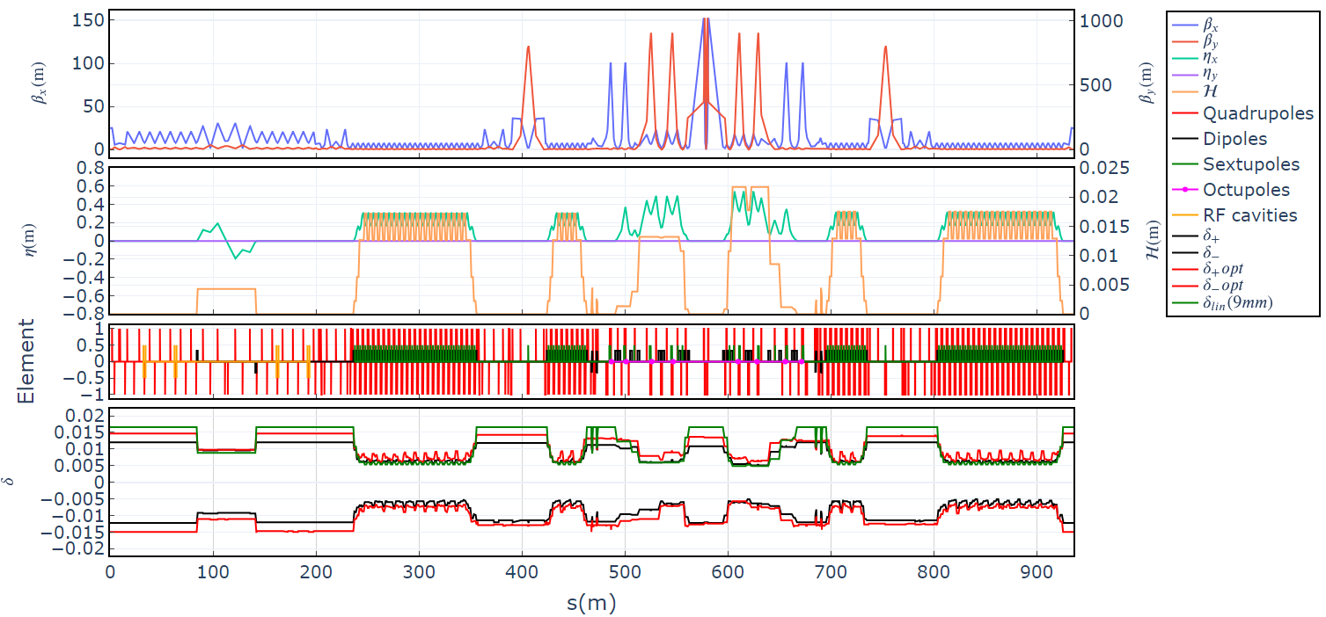
Optimization results for SCTF (ctau v68): optimized LMA
Tl_start = 145 sec
Tl_opt = 218 sec (+50%!!!)
Notes:
On this slide you can see optical functions of super phi.
Fourth graph represents H inv variation along the azimuth. You can see that limitation of momentum acceptance on fifth graph is in the plases of nonzero H inv. LMA drawn with black line represents LMA of lattice with base sextupole and octupole strengths. Red line represents optimized LMA.
Lifetime was optimized from 2044 seconds to 2537 seconds (25% up).
I expect to obtain similar result for SCTF

Slide 11
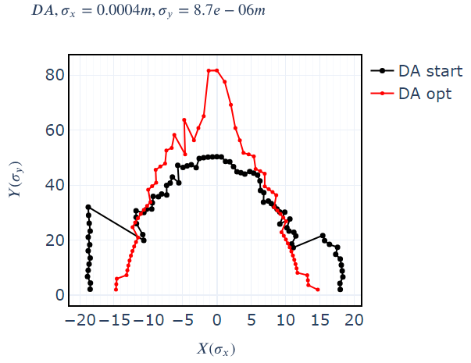
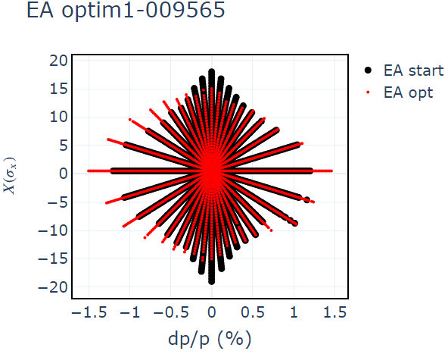
SCTF (ctau v68):
MA and DA optimization results
Notes:
After running the optimization routine for about a week on cluster, I ‘ve got about 10000 configurations. You can see them on first graph. Red dot represents the base configuration for test 415 parameters. Y axis shows touschek lifetime and x axis shows area of on momentum DA. The best solutions are in the upper right area of the graph. Second graph shows the comparison of energy aperture in injection section before and after optimization. It slightly decreased in momentum but increased in horizontal plane. Third graph shows that on momentum dynamic aperture has increased

Slide 12
LMA optimization summary
LMA optimization gave 50% Touschek lifetime increase
LMA is increased at the expense of DA
High number of variables required for optimization, works better for synchrotron light sources
Optimization is time consuming
X vs dP/P area optimization is faster
Beam-beam simulations show beam blowup in IP which suggest incorrect use of variables (sextupole and octupole strengths) for optimization or a need of additional constrain for optimization

Slide 13
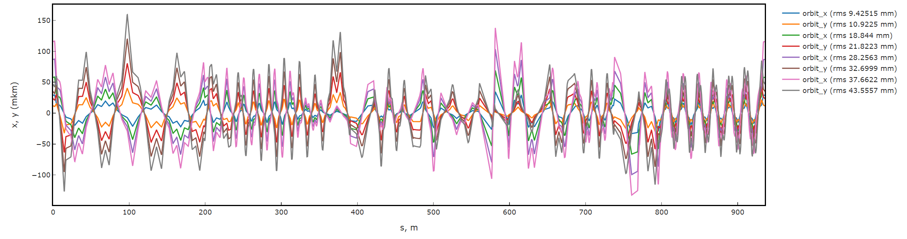
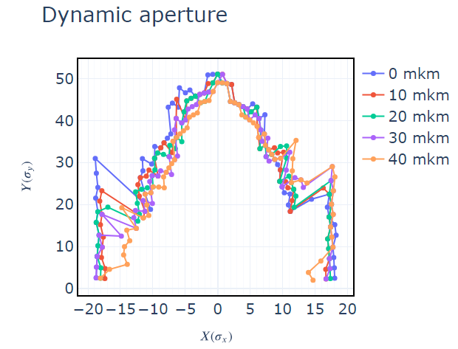
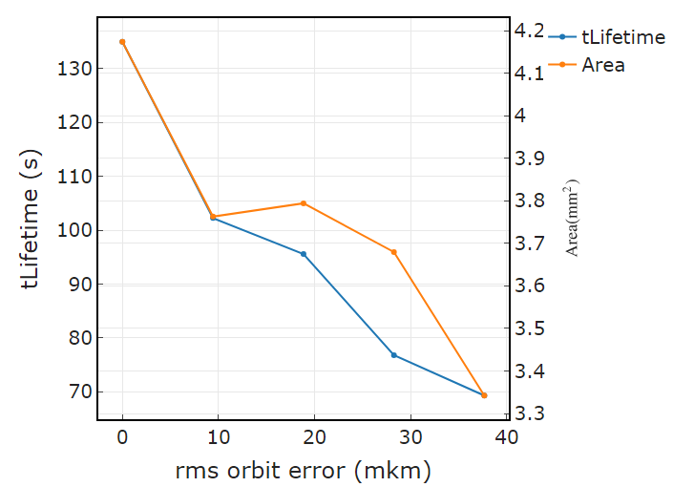
DA and Touschek lifetime with orbit error in SCTF
test
Notes:
We wanted to see how DA and lifetime would change if we introduced quadrupole displacements to lattice. On first graph you can see x and y orbit errors along the azimuth for rms values of 10, 20, 30 and 40 mkm.
Errors were generated by random number generator for the same seed.
On plots below we can see the change in dynamic aperture in comparison to the ideal case. And final graph shows how the lifetime and DA area changes with rms orbit error.
Lifetime is decreased by 50 % when we have around 40 mks orbit error, DA area is decreased by 30 %

Slide 14
Thank you

Slide 15
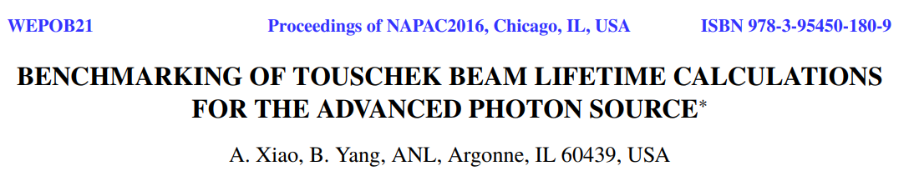
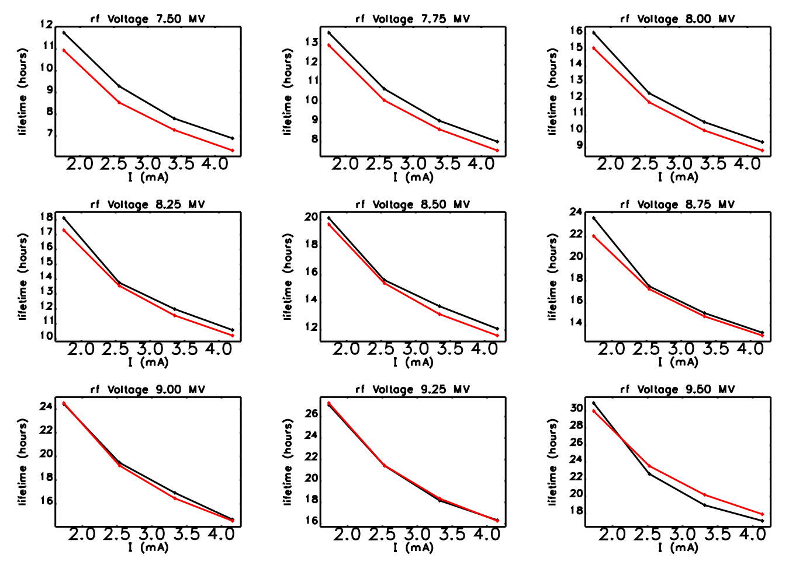
Spare slide

