Slide 1
Super Tau-Charm Facility
Conceptual Design of the STCF Detector Superconducting Solenoid Magnet
Presenter: Zhang Xiao Tao
Date: 21st Nov 2024

Slide 2
Contents of STCF Detector Superconducting Solenoid Magnet
Draft timeline of Detector Superconducting Solenoid Magnet Design
Physical Requirements and Magnetic Field Design
Research and Development of Superconducting Coil
Research and Development of Cryostat
Research and Development of Quench Protection Circuit
Summary and Future Work
Detector Superconducting Solenoid Magnet

Slide 3
1. Draft timeline of Detector Superconducting Magnet Design
Detector Superconducting Solenoid Magnet team aligned @Aug.30th.2024
CY
CY
STCF Detector Mechanical Design Seminar
DSSM
Prepare the project proposal_ Solenoid
Zhang Xiaotao
Prepare the project proposal _ Cryogenics
He Chongchao
Optimization yoke poletip
Zhang Xiaotao
Prepare the report for the FTCF workshop in November
Zhang Xiaotao
Lesson learn the relevant chapters of BES III, STCF CDR, CMS TDR.
DSSM
Prepare the STCF DSSM TDR
DSSM
Prepare the STCF Cryogenics TDR
DSSM
Project pre research_ Superconducting Cable
Zhang Xiaotao/LP
Study of coil cooling
Chen Zibo
Project pre research_ Suspension
Liu Ping/ZXT
Project pre research_ Quench protection and detection circuit
Zhang Guoqing/ZXT
Project pre research_ Cable joint and mapping device
Zhang Xiaotao/LP
Today
Phase II
Phase I
Phase II

Slide 4
2. Physical Requirements and Magnetic Field Design - Comparison of Main Parameters of Superconducting Magnets for ATLAS, CMS, BES III, and STCF Detectors
Name | Parameters | ATLAS | CMS | BESIII | STCF
Cryostat | Inner radius /m | 1.15 | 2.97 | 1.38 | 1.45
 | Outer radius /m | 1.35 | 3.80 | 1.70 | 1.85
 | Length /m | 2.40 | 13.00 | 3.91 | 4.76
Superconducting coil | Nominal diameter/m | 2.46 | 4 layers | 2.95 | 3.10
 | Length /m | 5.30 | 12.48 | 3.52 | 4.00
Conductor size/mm*mm |  | 4.25*30 | 22.3*72 | 3.7*20 | 4.67*15
Electrical performance | Central magnetic field strength /T | 2.00 | 4.00 | 1.00 | 1.00
 | Nominal current /A | 7600 | 19500 | 3150 | 3820
 | Inductance /H | 1.35 | 14.15 | 2.10 | 1.69
 | Energy storage /MJ | 39.00 | 2700.00 | 9.50 | 12.30
 | Cold mass/t | 5.70 | 234.00 | 3.60 | 4.80
Detector Superconducting Solenoid Magnet

Slide 5
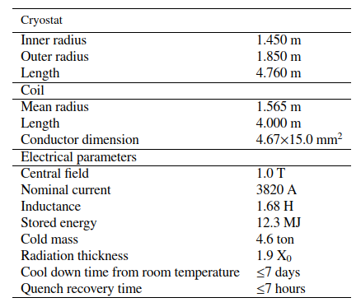
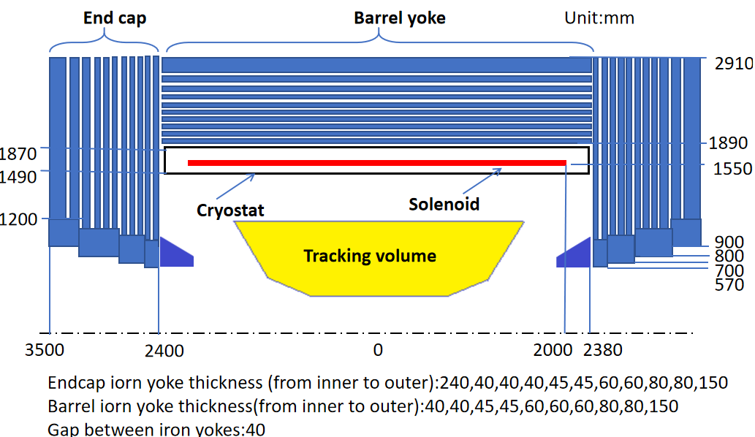
2. Physical Requirements and Magnetic Field Design - Physical modeling and boundary conditions
Physical Requirements:
Design value of the central magnetic field : 1.0 T
Uniformity in the tracking volume ≤ 2%
Magnetic field measurement accuracy ≤ 0.3%
Axial leakage magnetic flux ≤ 50Gs@5.1m
Boundary Condition
End Yoke plates layer: 40, 40, 40, 45, 45, 60, 60, 60, 80, 80, 150 mm respectively
Barrel Yoke layer: 40, 40, 45, 45, 60, 60, 60, 80, 80, 150 mm respectively
Yoke octagon innner diameter: 3700 mm
Yoke total length: 7000 mm
Detector Superconducting Solenoid Magnet
Main parameters of the STCF detector superconducting magnet

Slide 6
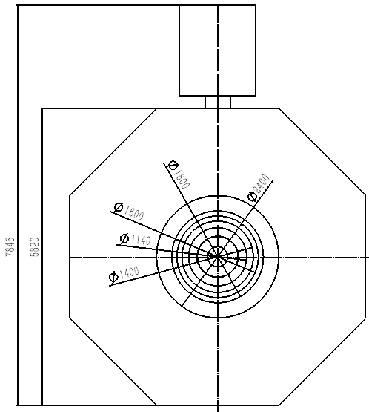
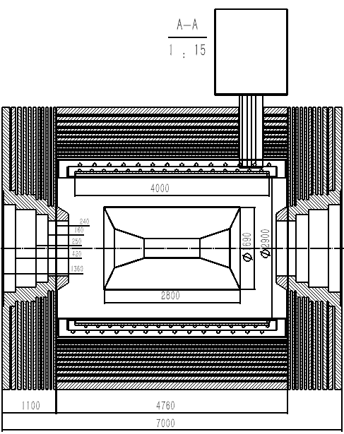
2. Physical Requirements and Magnetic Field Design - Yoke prototype
Main parameters of the STCF detector
STCF superconducting magnet flux distribution
Detector Superconducting Solenoid Magnet

Slide 7
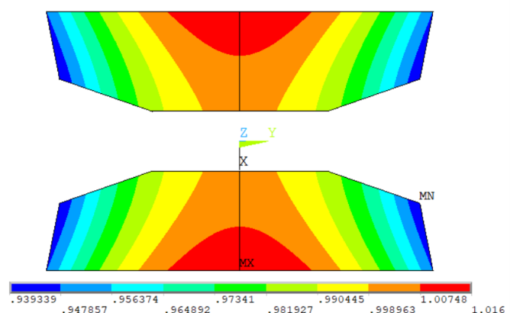
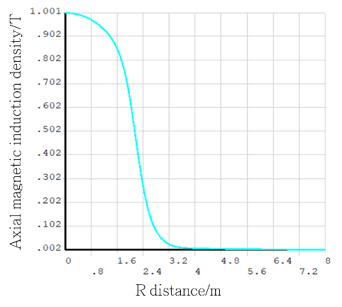
2. Physical Requirements and Magnetic Field Design - Electromagnetic field finite element simulation results (Further optimization required)
STCF detector superconducting magnetic field distribution at tracking area
Distribution of magnetic field along the centerline
The uniformity and magnetic field distribution need further optimization to meet the requirements
Detector Superconducting Solenoid Magnet

Slide 8
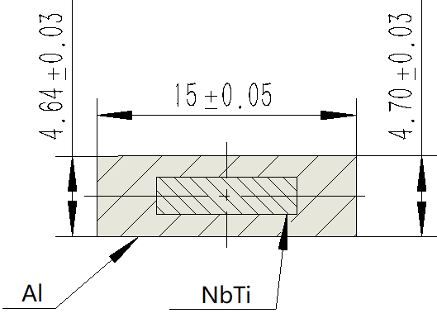
3. Research and Development of Superconducting Coil - Superconductor, layout structure and parameters of superconducting coil
Conductor paraments
Conductor paraments
rated current | 3820 A
critical current at 4.2 k & 2 T | ≥15000 A
condutor length | 9.15 km
cable dimension | 4.67 mm *15 mm
Rutherford cable paraments
number of strands | 16
cable transposition pitch | 100±5 mm
Cu : NbTi | ~1:1
NbTi filament diameter | 30±5 μm
numbe of filaments | ≥600
n value@2T | ≥35
aluminum stabilizer paraments
RRR@0t,4.2K | ≥500
Yield strength@4.2k | ≥60MPa
Crosssection ratio of aluminum | >80%
Cross-sectional view of the superconductor for the STCF detector magnet
He cooling pipe
5083 Aluminum Support Cylinder
Superconductor cable
1000 RRR Aluminum Strip
Conceptual structure layout of the solenoid
Detector Superconducting Solenoid Magnet

Slide 9
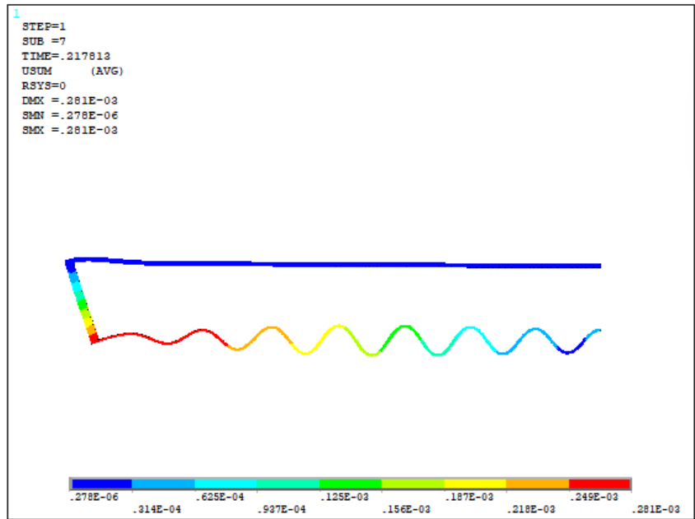
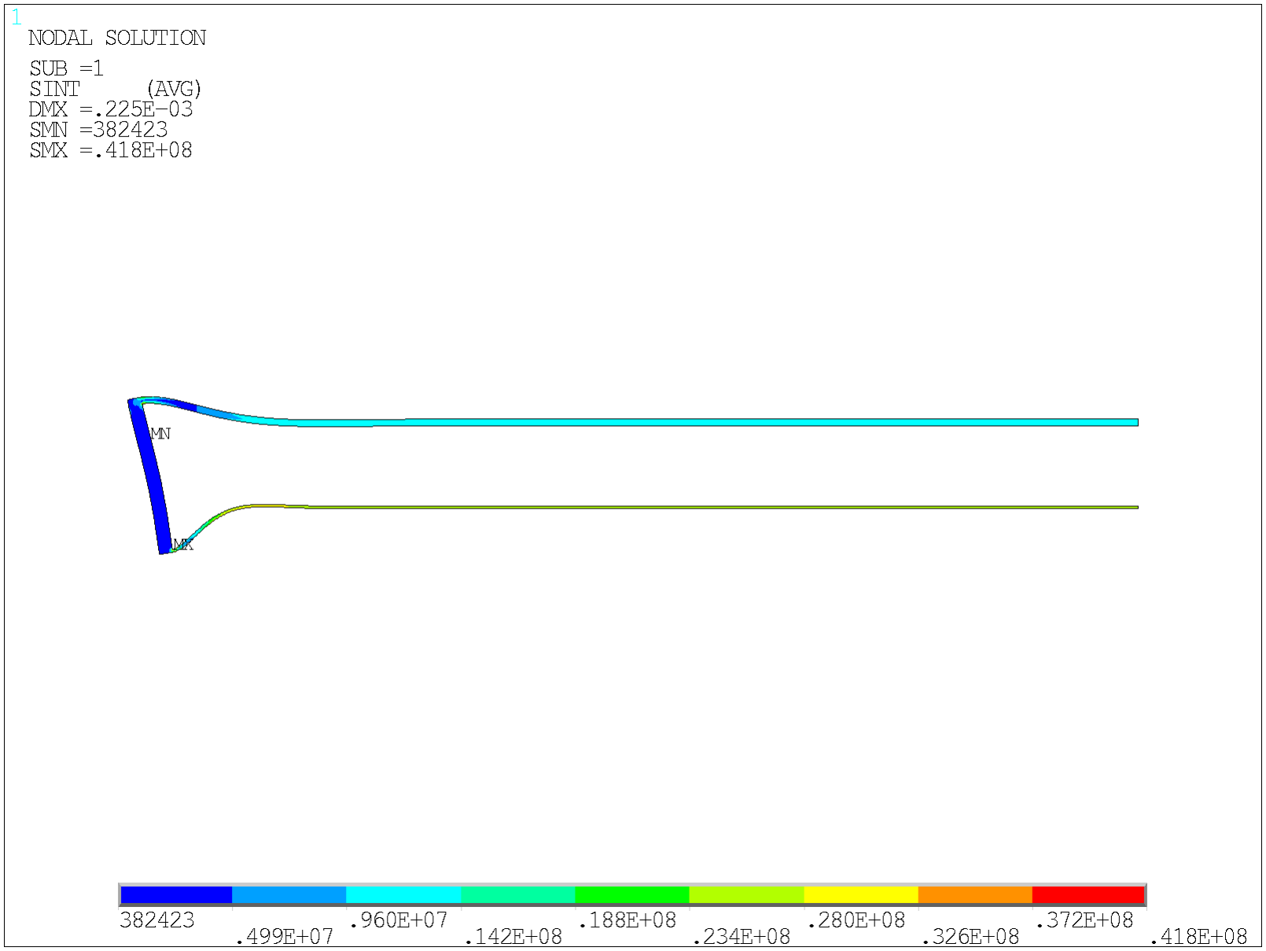
4. Research and Development of Cryostat - FEA simulation of preliminary design cryostat
Cryostat dimension
Name | Parameter
Inner radius | 1.49m
Outer radius | 1.88m
Length | 4.76m
Inner cylinder thickness | 6mm
Outer cylinder thickness | 16mm
End plate thickness | 32mm
Buckling analysisl（2D 1/2 Model）
Conclusion: By simulating the buckling analysis of a cryostat using two FEA softwares, the selected dimensions can fully meet the design requirements.
Detector Superconducting Solenoid Magnet

Slide 10
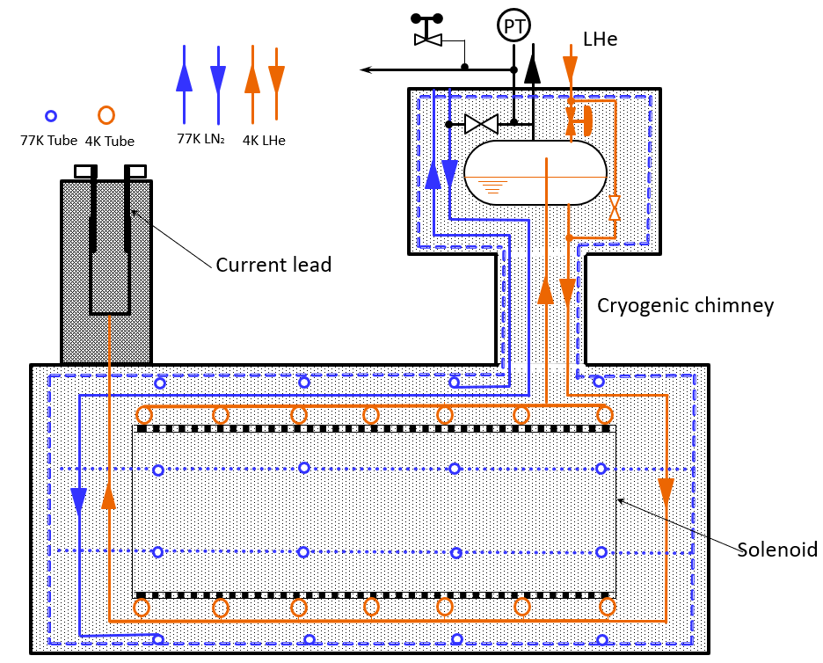
4. Research and Development of Cryostat - STCF detector cryogenics sketch map and heat load estimation
Heat load estimation
Items of Heat Load | 77 K | 4.5 K
Caused by the support rods in cryostat | 26.527 W | 1.038 W
Caused by the radiation in cryostat | 73.801 W | 3.236 W
Caused by the current leads | —— | 7.920 W + 0.421 g/s
Caused by the radiation in chimney & SP | 10.025 W | 0.407 W
Caused by the support rods in chimney & SP | 3.900 W | 0.022 W
Caused by the bayonet and valves in SP | 46.000 W | 13.000 W
Caused by the measuring wires | 5.311 W | 0.831 W
Total | 165.5 W | 26.46 W + 0.421g/s
Adopted heat load（×1.5） | 248 W | 39.7 W + 0.63 g/s
STCF detector cryogenics sketch map
Preliminary plan: The 4.5K cold mass is cooled using thermosiphon liquid helium, while the 77K shield is cooled using forced flow liquid nitrogen.
Detector Superconducting Solenoid Magnet

Slide 11
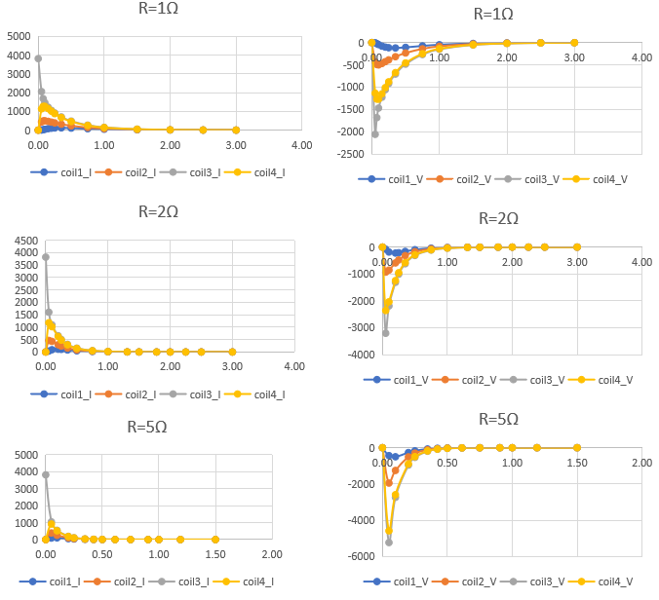
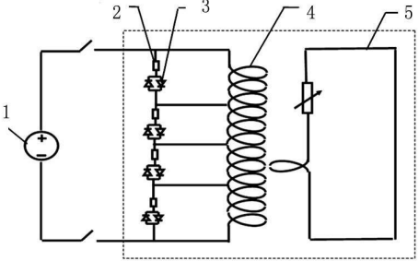
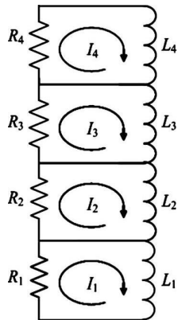
5. Research and Development of Quench Protection Circuit - Multi-sectioned quench process circuit(Further discussion)
1- Power supply; 2-Cold resistor; 3-Cold diode; 4- Coil; 5-Hoop cylinder
Schematic of multi-sectioned quench process circuit
Conclusion: The external resistance of quench is inversely proportional to the current decay time and inversely proportional to the induced potential.

Slide 12
6. Summary and Future Work - Future work plan
Research and development of superconductor
FEA simulation of two different cooling methods (forced cooling and thermosiphon)
Optimization of the yoke poletip, including the field shape of the magnetic field uniformity in the tracking volume area
Thermal leakage analysis of suspension
Design and numerical calculation of quenching protection circuit

Slide 13
Thank you for your attention

Slide 14
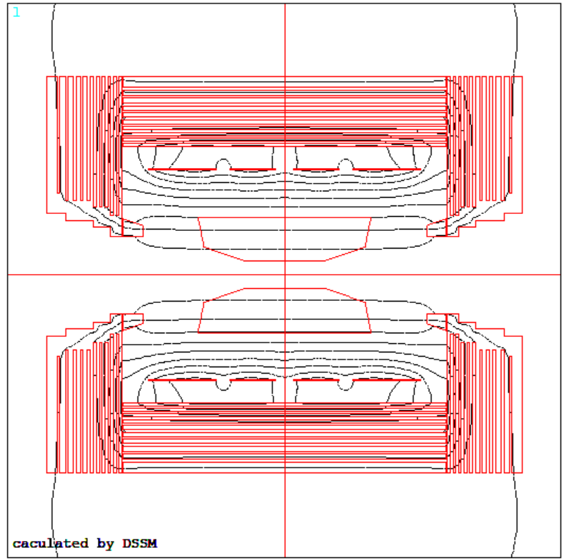
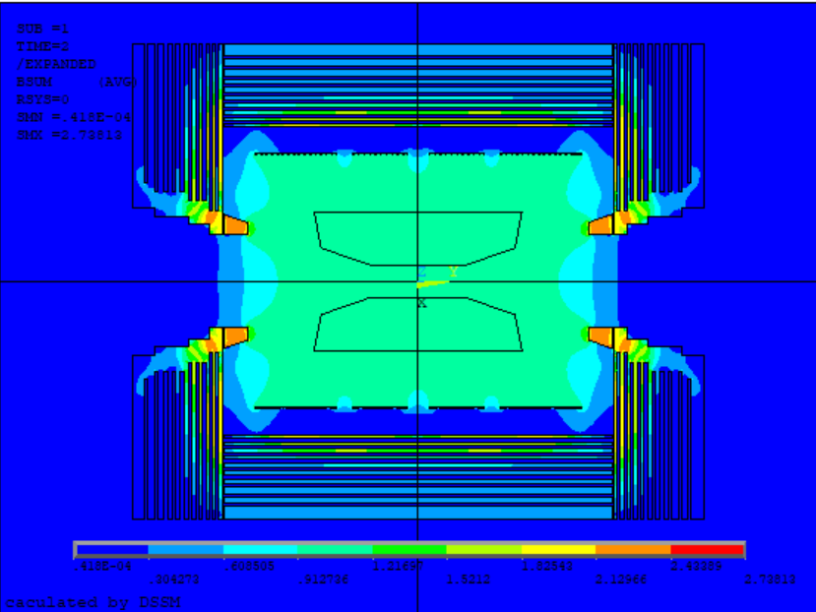
Backup information

Slide 15
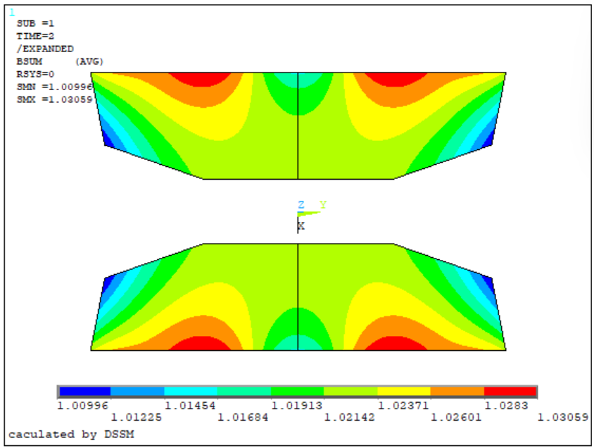
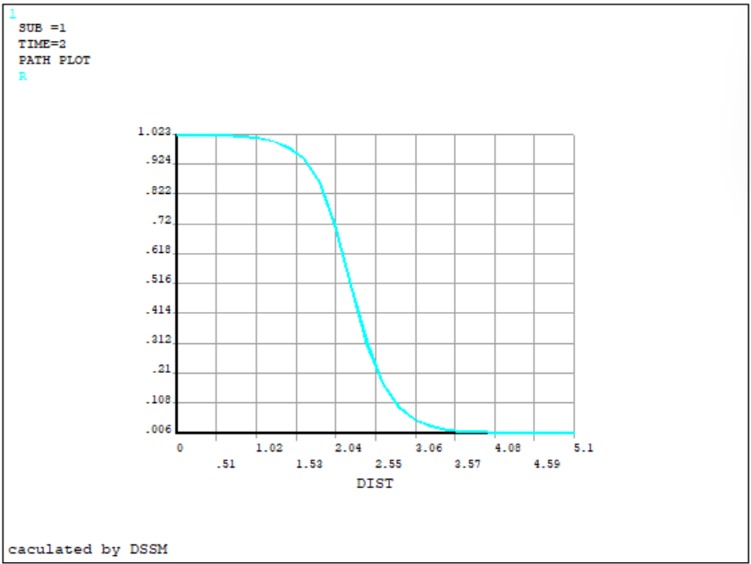
Backup information

Slide 16
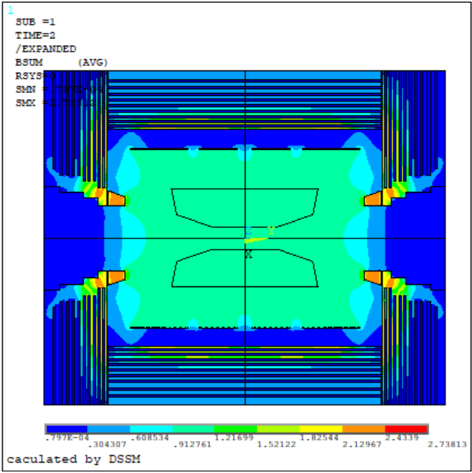
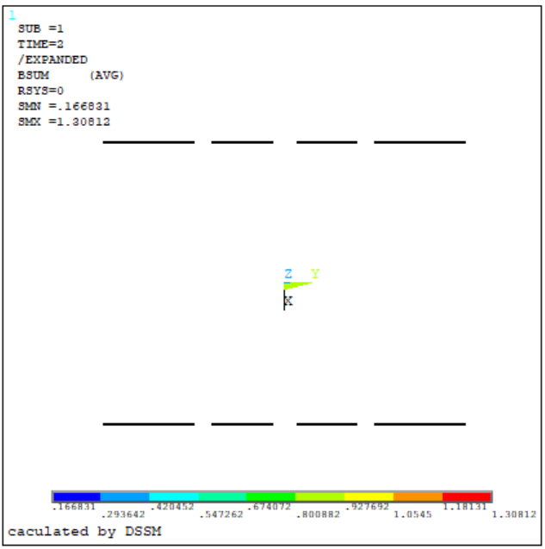
Backup information

