Slide 1
STCF barrel PID detector R&D progress
Speaker: Anqi Wang
On behalf of RICH Group
University of Science and Technology of China
University of Chinese Academy of Sciences
2024.11.20
Notes:
Good morning, everyone! I am honor to present the presentation : the progress of the STCF barrel particle identification detector. My name is Anqi Wang, on behalf of STCF RICH group.

Slide 2
Outline
Physical requirements for STCF PIDB
Study of RICH detector
Readout electronics design
Conclusions
Notes:
My presentation consists of 4 parts. Physical requirements for STCF PIDB,study of RICH detector and the readout electronics design. And then the conclusions are given.

Slide 3
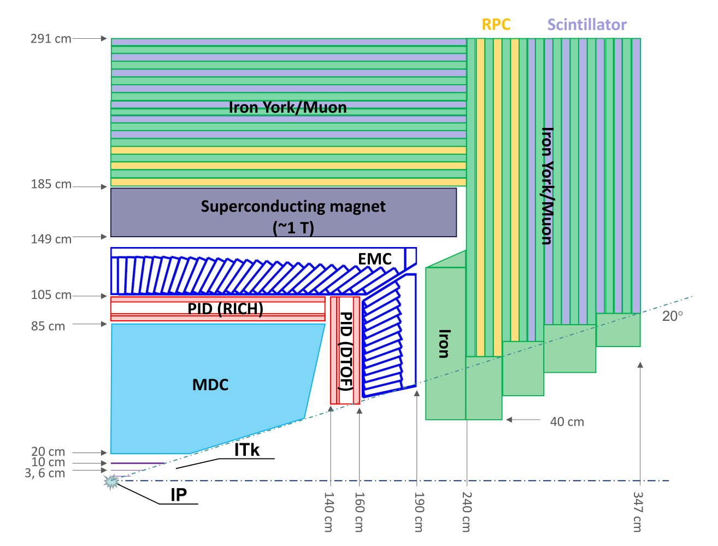
PIDB Detector
Expansion plan after the BESIII facility
Center-of-mass energy extend to 2~7 GeV, luminosity up to 100 times (0.5~1× 10³⁵ cm⁻² s⁻¹)
High event, background rate large dynamic range vs high PID ratio
PID detector on barrel:
Ring Imaging Cherenkov Detector(RICH)with C₆F₁₄ radiator, reflective CsI photocathode, photon detector base on THGEM and Micromegas.
Notes:
Super Tau-charm facility is an expansion plan after the BESIlI facility. It is designed to operate in a center-of-mass energy range from 2 to 7 giga electron-volt with a peak luminosity of zero point five times ten to the power of thirty five (one 0.5 x 10^35 cm-2s-1) or higher. Such a high luminosity will allow the STCF to produce much more data samples. However, it also pose the challenge of high event rate and high background rate. Moreover, considering of the space limit, the Ring Imaging Cherenkov Detector detector is chosen as the barrel part of the particle identification detector. The RICH detector consists of C 6 F_14 (Perfluorohexane) as the radiator, reflective Csl(cesium iodide) as the photocathode, and the photon detector is THGEM combined with Micromegas.

Slide 4
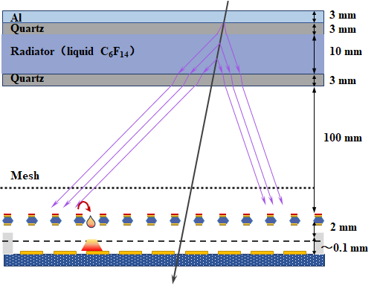
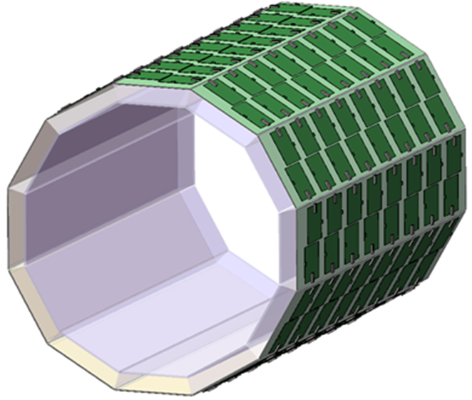
Technical Specification
Covered area:13 m²
Thickness < 200 mm
Material budget < 0.3X₀
Accumulated charge < 2 μC/cm² @ 10 year
K/π > 3σ @ 2.0 GeV/c
MPGD : High gain(~10⁵), low IBF(~10⁻³)
RICH detector based on THGEM + Micromegas
Conceptual design of STCF-RICH system
Notes:
The RICH detector needs to cover an area of 13 square meters. In order to leave space for the calorimeter and achieve a low material budget of less than 0.30X0,the thickness should be less than 200 millimeters. The accumulated charge over 10 years is about 2 micro coulomb per square centimeters. The precise measurement of the collision fragmentation function requires a Tt/K separation larger than 3 sigma up to 2.0 GeV. The micro pattern gas detector used for the RICH detector needs to achieve a high gain of about one hundred thousand and low ion backflow of less than one thousandth. The pixel size is 5 millimeters by 5 millimeters.

Slide 5
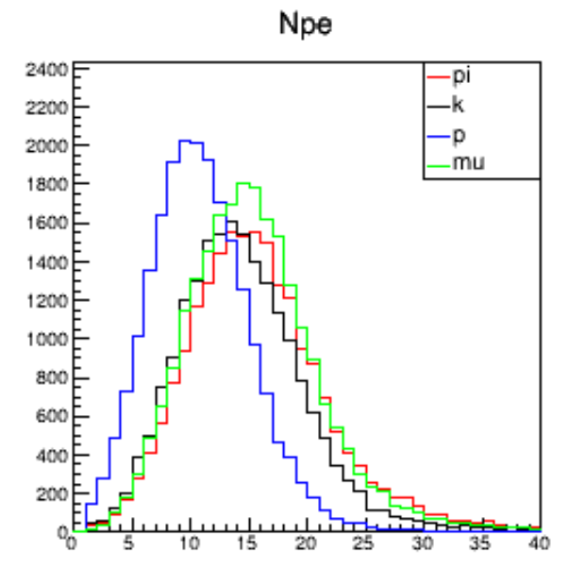
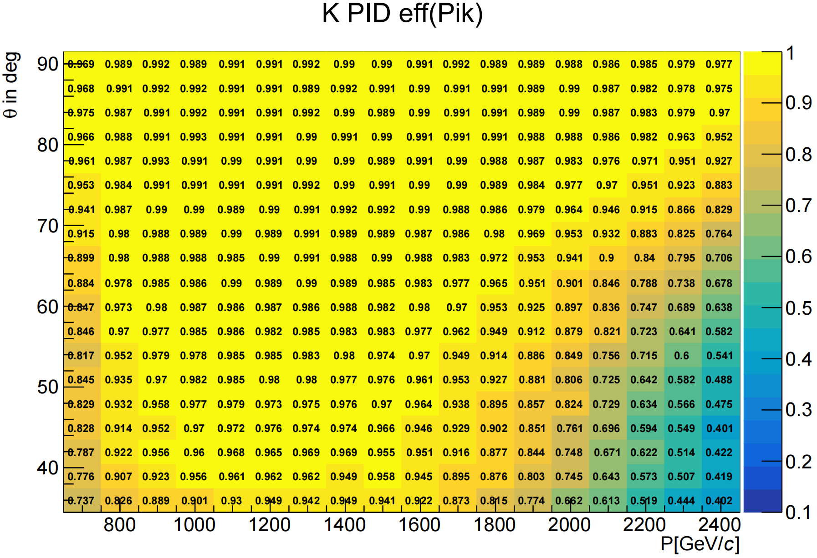
RICH performance in simulation
We conducted a full simulation under the OSCAR framework.
Using real-time PDF algorithms, considering the material effects of the inner detector
Scanning different momentum/angle of π/K, simulating the incidence of single track
  → P ∈ (0.2 GeV/c, 2.4 GeV/c)
  → θ ∈ (36°, 90°), φ randomly sampled 0°~ 360°
Notes:
Under the OSCAR framework, we have conducted a full simulation of the detector, simultaneously employing real-time PDF generation algorithms, and taking into account the material effects of the inner detectors. In the simulation, we scanned π and K at varying moment and angles, and the simulation of single-track incidence produced the right diagram, which can meet the performance requirements of the CDR. Specific details will be displayed in the software report.

Slide 6
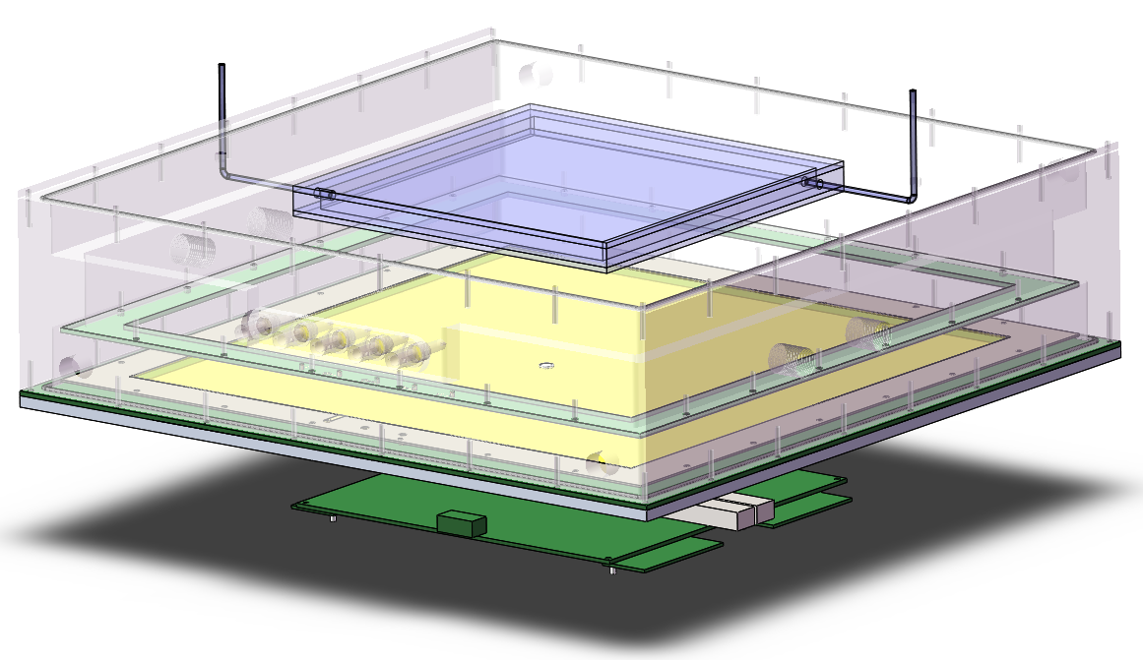
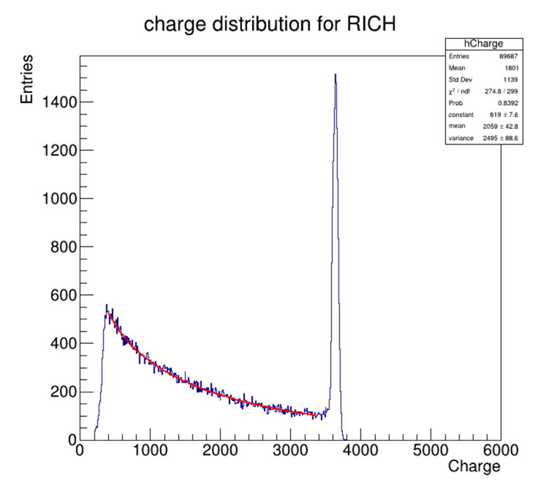
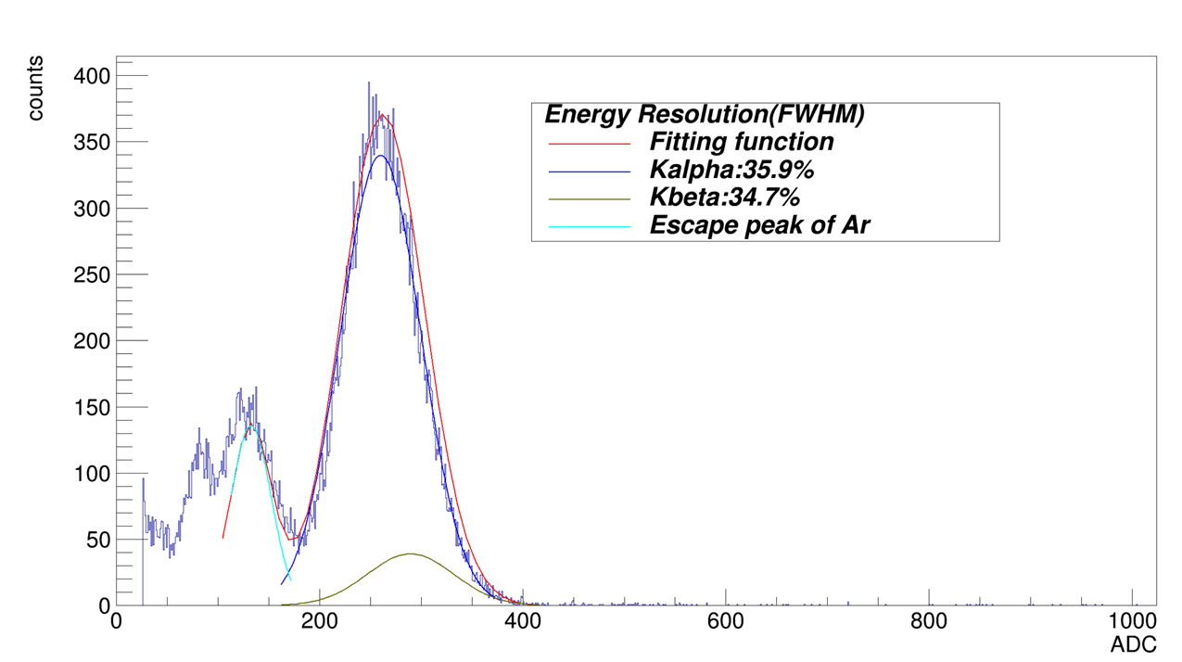
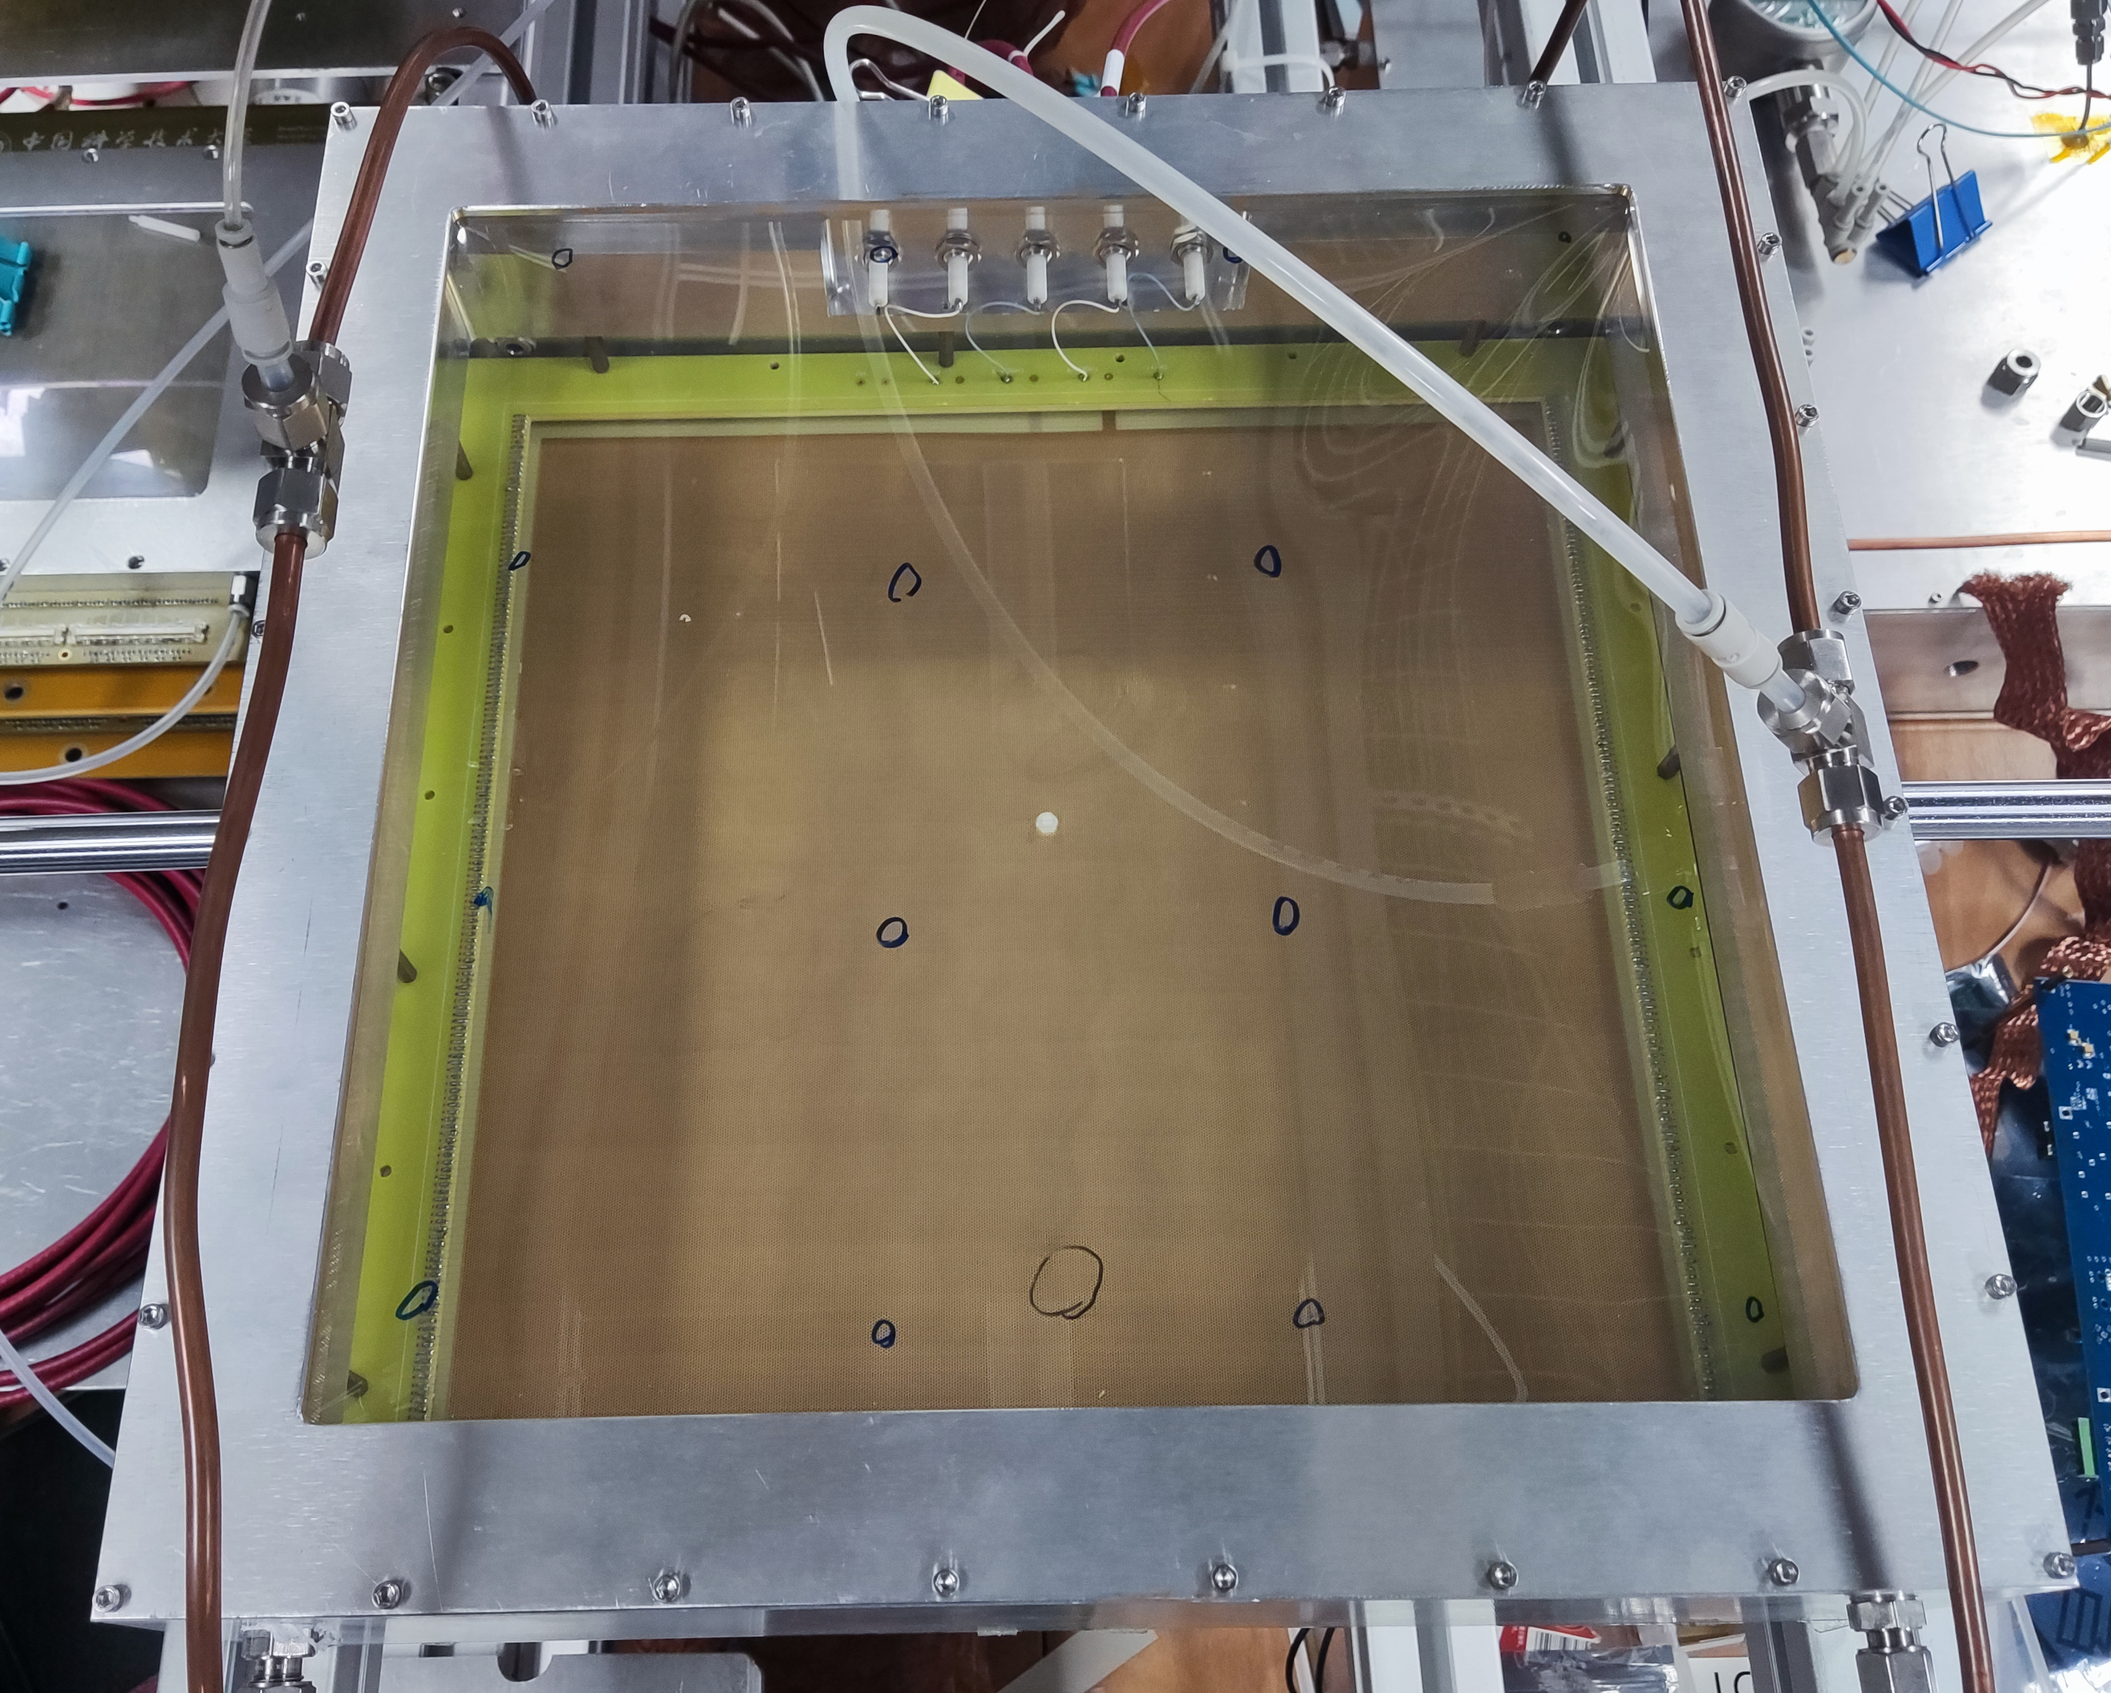
Test of RICH prototype
We have completed the fabrication of the large-scale RICH prototype.
Detection area is 320mm × 320mm.
⁵⁵Fe source testing was conducted.
  The gain can reach 10^5, meeting the requirement for single-photon detection.
Single-photon detection was achieved through the candle experiment.
V_MM = 540V
V_transmission = 480V@3mm
V_THGEM = 900V
Notes:
In order to validate the feasibility of the plan, we have manufactured a large-scale prototype with an effective detection area of 320mm by 320mm. We tested this prototype with an Fe55(iron55) source and measured a gain of up to one hundred thousand , which meets the requirements for single-photon detection. Following this, we conducted test using candle light and successfully detected photon signals.

Slide 7
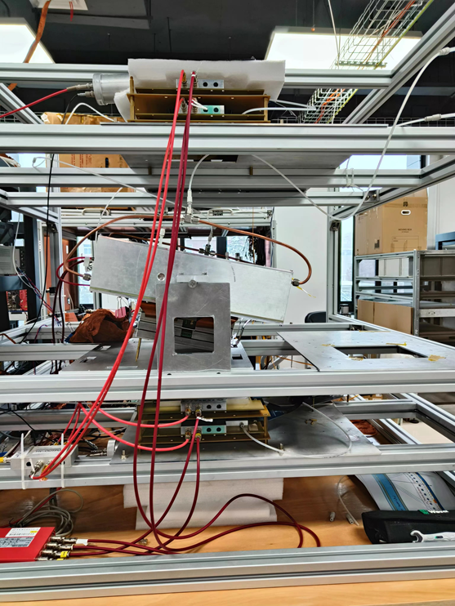
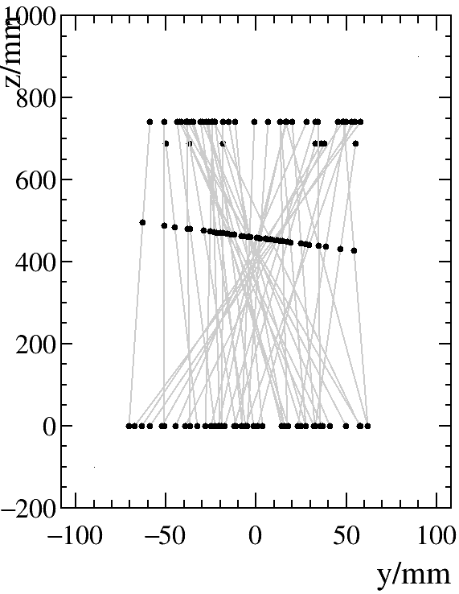
Cosmic ray testing
Trigger
Tracker 1, 2
Using C₆F₁₄ as a radiation source for cosmic ray testing.
RICH
T4
T3
741mm
RICH
Tracker 3, 4
Trigger
T1
160mm
Test setup
Notes:
Following the prototype, we constructed a cosmic ray testing system as shown in the figure, using C6F14(Perfluorohexane) as the Cherenkov radiator for testing. The testing system reconstructed the cosmic ray track information through the tracker, as shown in the left figure.

Slide 8
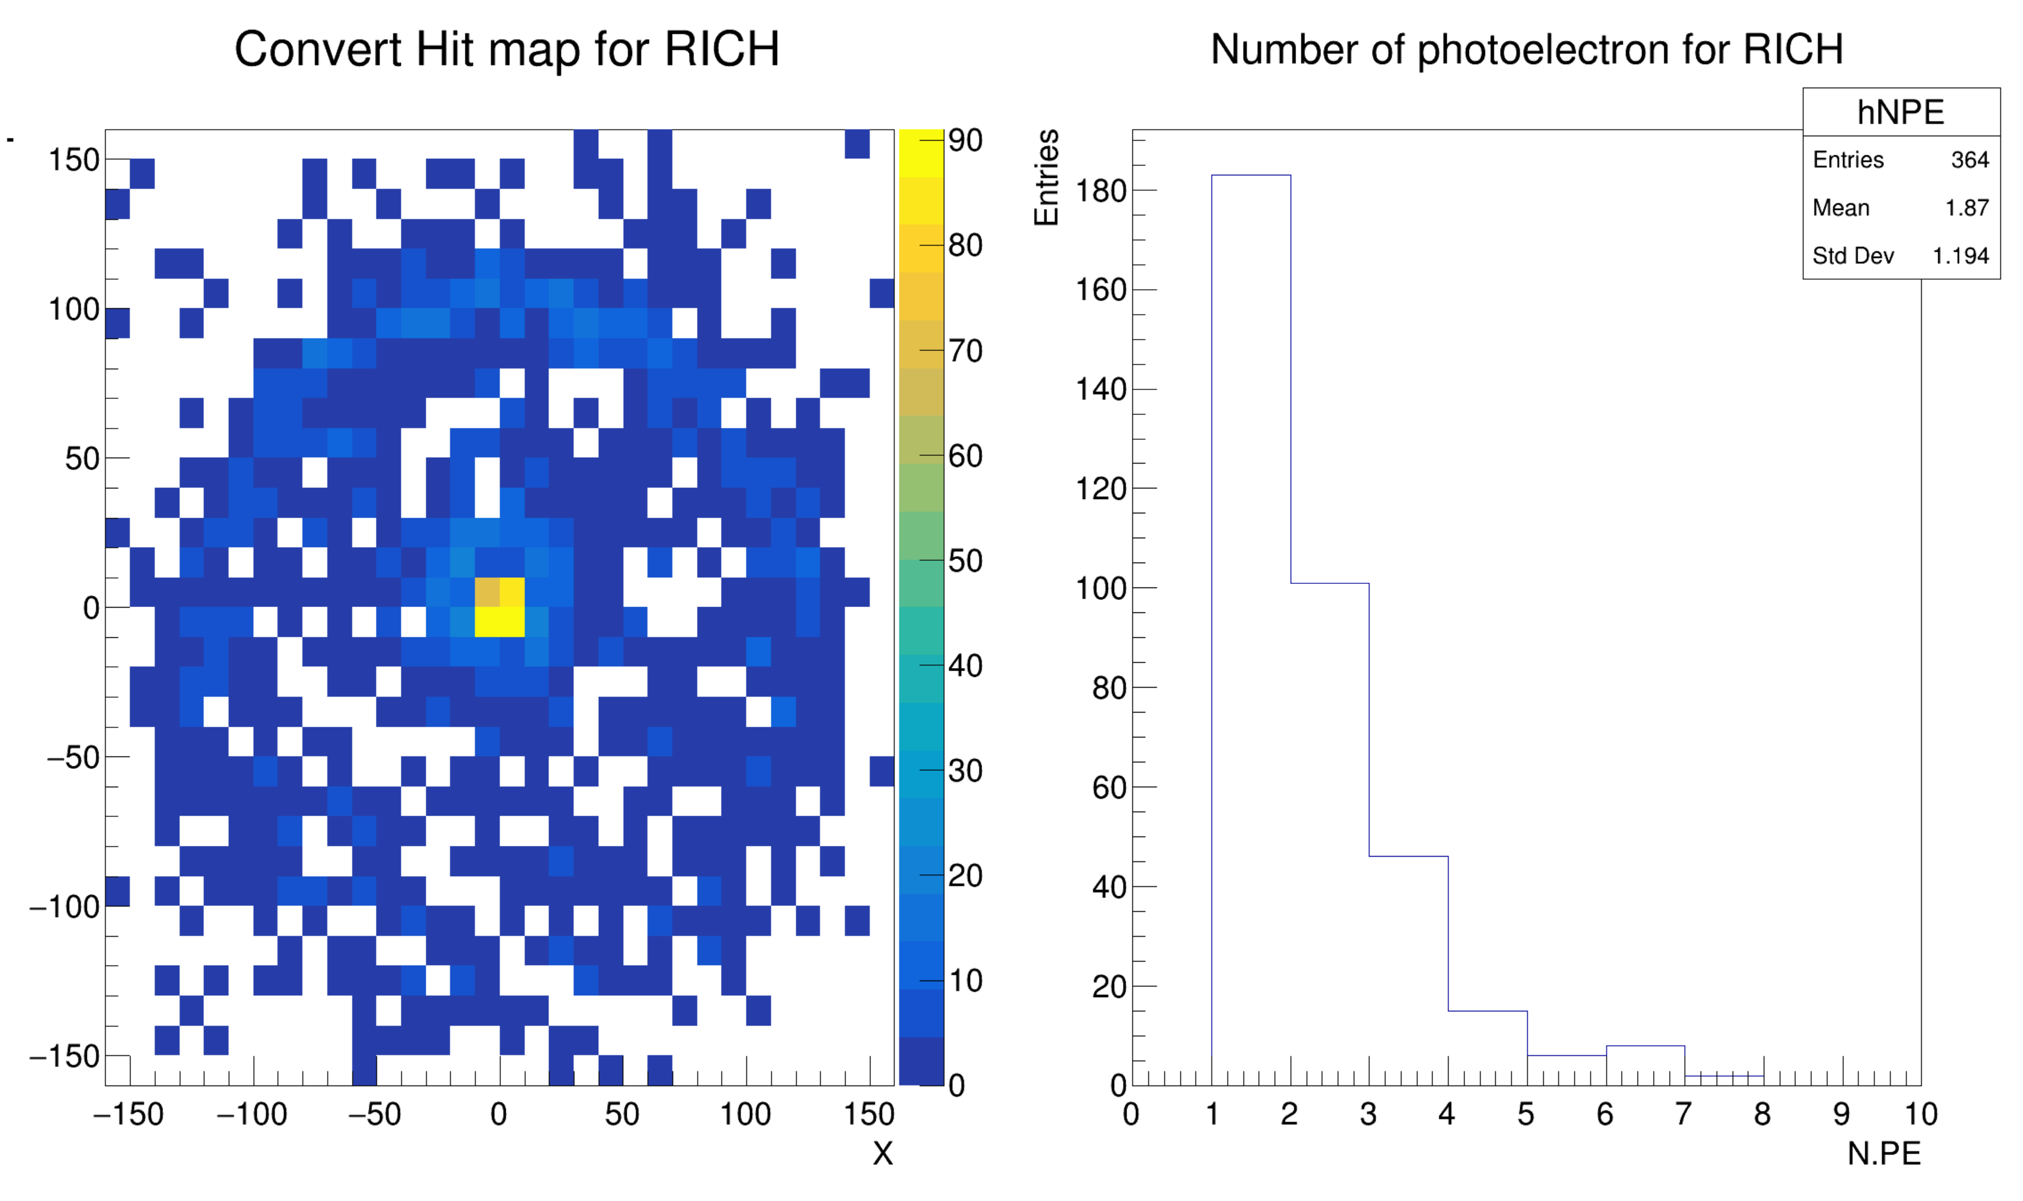
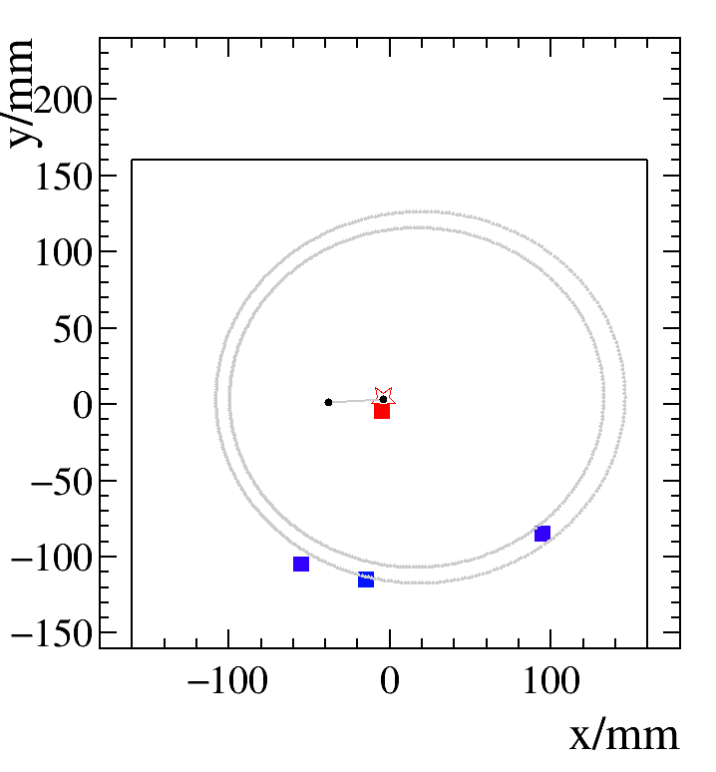
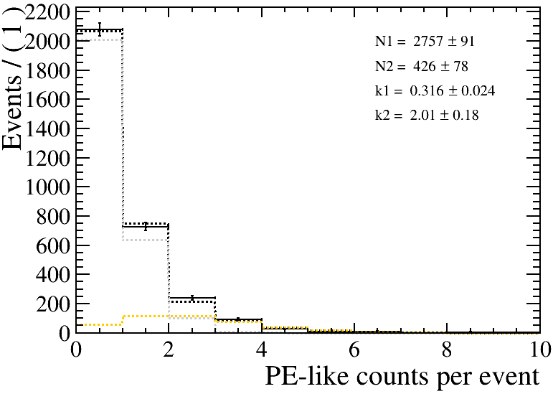
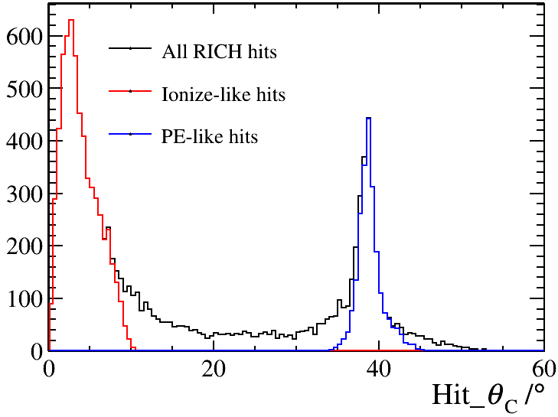
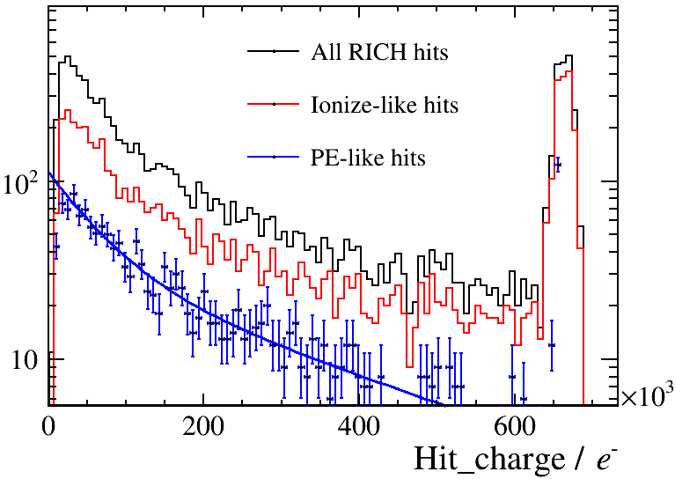

Cosmic ray experiment test results
Effective event count: 3711
Ionize-like hits: Distance from the expected ionization position < 18mm
PE-like hits: Distance from the expected photon position < 25mm
The average N_{p.e.} is 0.59
The distribution of $θ_{C}$
Energy spectrum
Notes:
In addition, the cosmic ray test collected some effective events . We can see the Cherenkov ring as show in this figure. Subsequently, for the signals on the RICH detection plane, we classified them into ionization-like points and photoelectron-like points based on their distance from the expected ionization point and the expected Cherenkov ring position, resulting in an average photon number of approximately 0.59 per event, which significantly differs from our previous simulation results

Slide 9
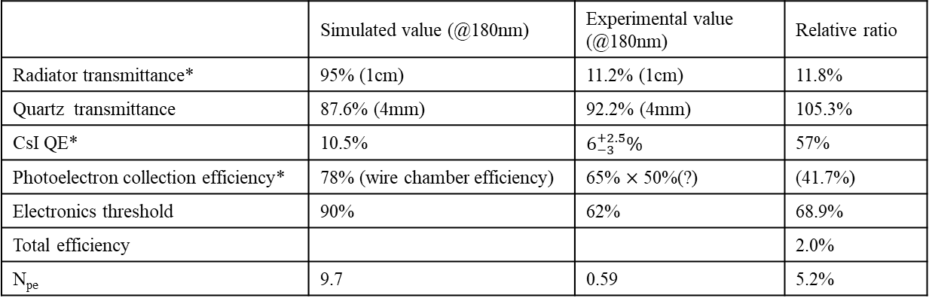
Experimental and Simulation Discrepancy Analysis
$Npe=Np×TranC6F14×Tranquartz×$ QE $×$ε_{eff} $×$ ε_{threshold}
 | Simulated value (@180nm) | Experimental value (@180nm) | Relative ratio
Radiator transmittance* | 95% (1cm) | 11.2% (1cm) | 11.8%
Quartz transmittance | 87.6% (4mm) | 92.2% (4mm) | 105.3%
CsI QE* | 10.5% | $6_{−3}^{+2.5}\%$ | 57%
Photoelectron collection efficiency* | 78% (wire chamber efficiency) | 65% $×$ 50%(?) | (41.7%)
Electronics threshold | 90% | 62% | 68.9%
Total efficiency |  |  | 2.0%
N_{pe} | 9.7 | 0.59 | 5.2%
Notes:
Thus, we plotted a table with both the simulated values and experimental measurements of parameters that could affect the number of photoelectrons. From this, we can identify the transmittance of the radiator, the quantum efficiency (QE) of CsI, and the efficiency of photoelectron collection as the main reasons for the reduction in the number of photoelectrons. Next, we will analyze the causes of these three factors and the current solutions available.

Slide 10
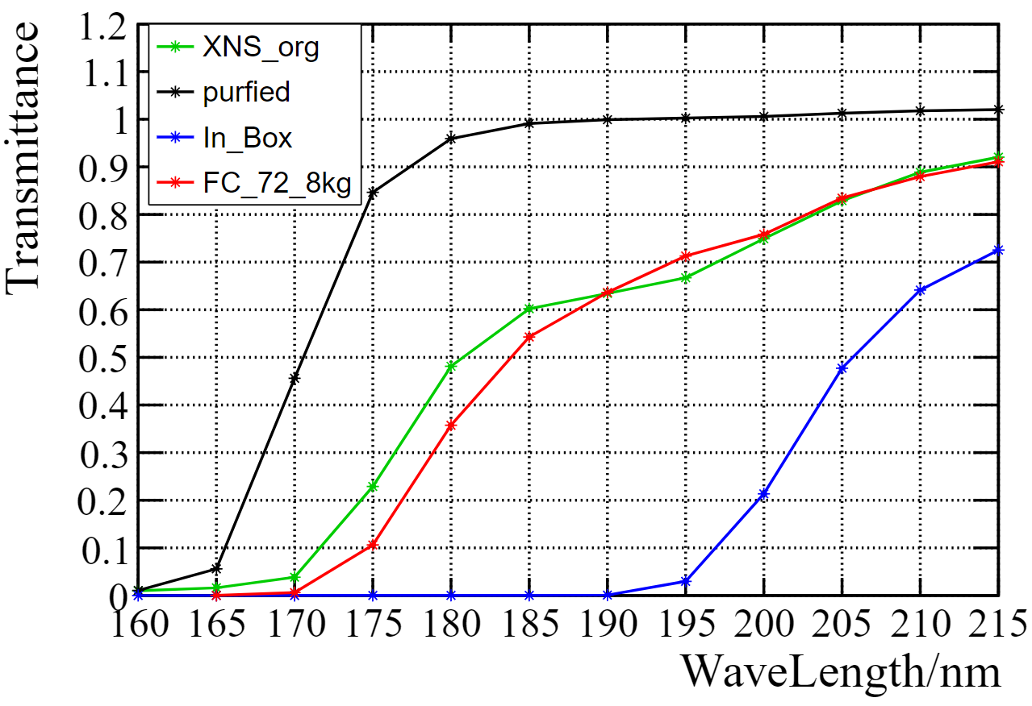
Radiator transmittance
$Npe=Np×TranC6F14×Tranquartz×$ QE $×$ε_{eff} $×$ ε_{threshold}
We already have some radiator with high transmittance.
  Request the manufacturer to produce a batch of radiator with the same quality.
Continuous purification during the next testing process.
  Perhaps it can solve the problem of deterioration.
After purified
Earlier radiator
New radiator
Extracted from this cosmic ray experiment
Notes:
Regarding the transmittance of the radiator, a noticeable decrease in transmittance occurred after we installed the radiator into the cosmic ray testing system, as shown by the blue line. The current situation is that we have a batch of good radiators, and we expect that they will achieve excellent transmittance after purification. Therefore, in the upcoming experiments, we will continue to perform cyclic purification of the radiators in hopes of resolving the issue of transmittance decline. At the same time, we are also communicating with the factory to produce more radiators of equal quality.

Slide 11
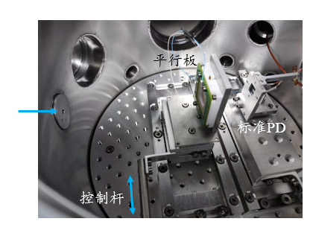
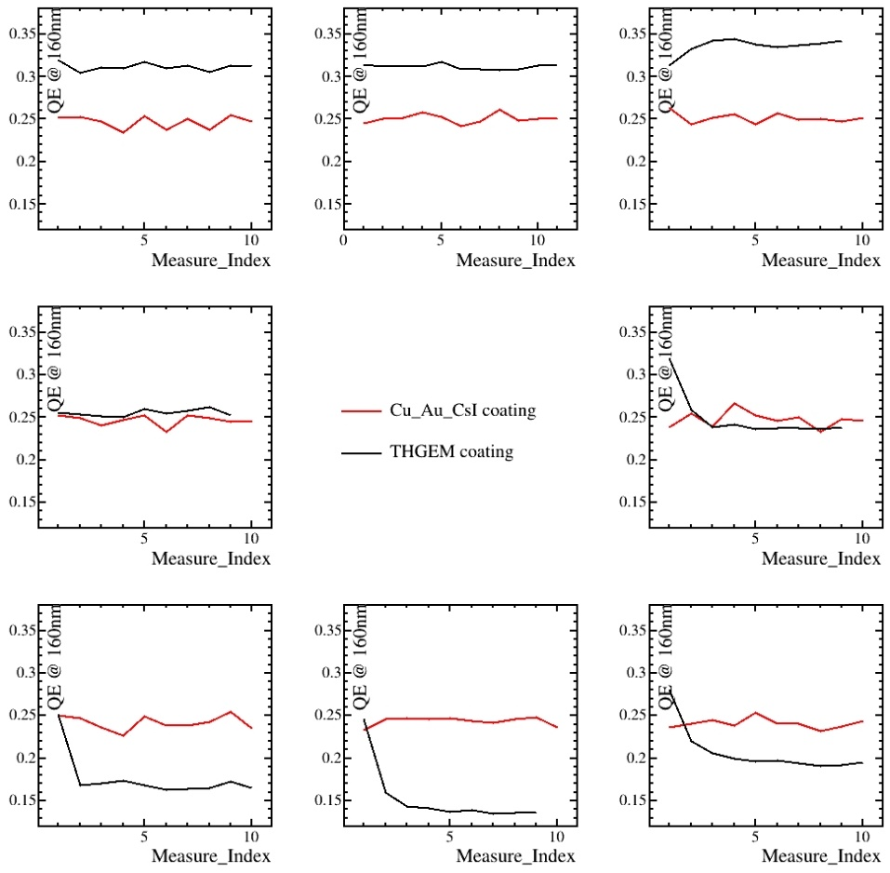
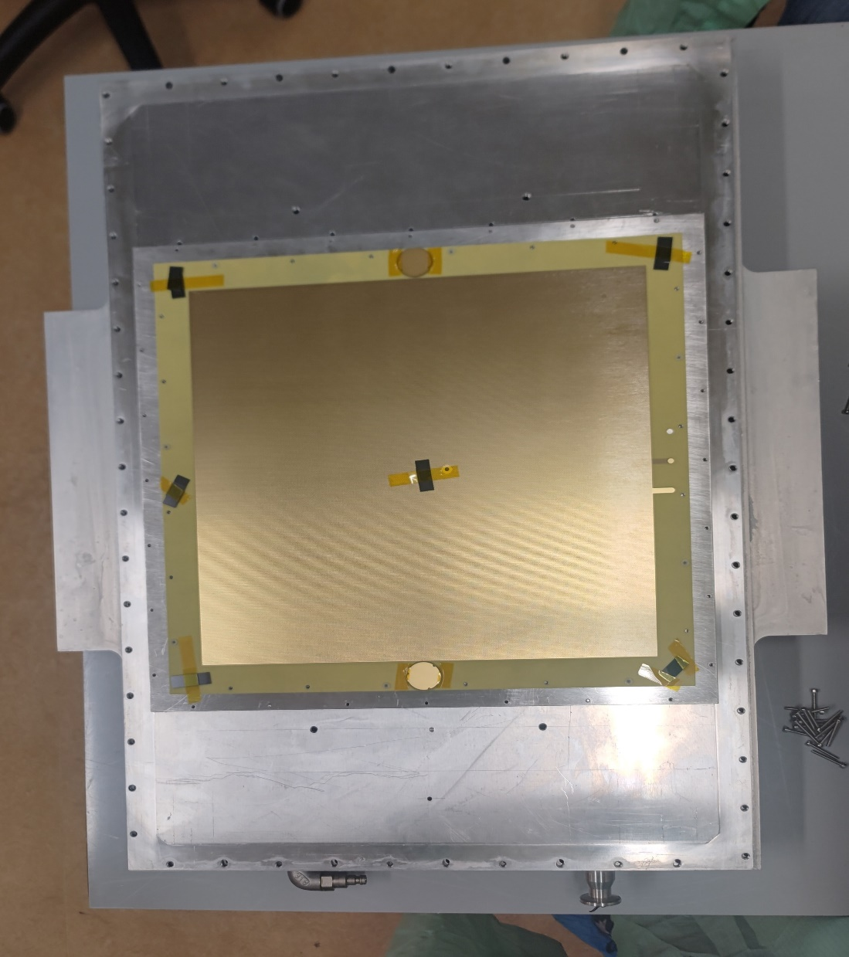

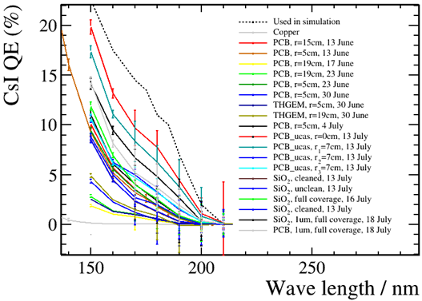
CsI QE
$Npe=Np×TranC6F14×Tranquartz×$ QE $×$ε_{eff} $×$ ε_{threshold}
Coating in CERN
Test in USTC
Test in CERN
Notes:
Then , regarding the QE of CsI, our previous coating measurement results have always been lower than the values mentioned in the simlution. We suspect that the PD used for testing the QE might be inaccurate, leading to incorrect measurements, or there might be issues with the coating machine and the coating process that result in a decrease in the QE of the photocathode. To verify the cause of the problem, we went to CERN to use their assistance in coating THGEMs.
The results from the CERN coating process, after accounting for the inherent open-hole rate of the THGEMs, are almost identical to their previous experimental results. Therefore, we anticipate that this will be a batch of excellent CsI coatings. Consequently, we will measure the QE of this small sample and compare it with our previous results to verify our PD. We will also use these newly coated THGEMs for the next cosmic ray test.

Slide 12
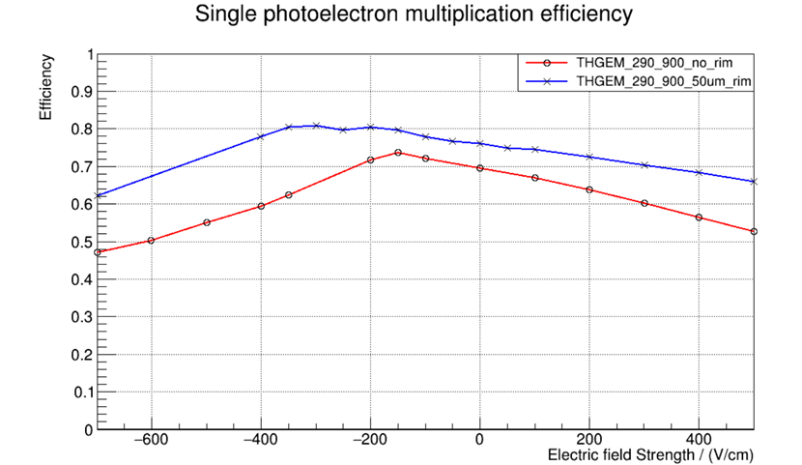
Photoelectron collection efficiency
$Npe=Np×TranC6F14×Tranquartz×$ QE $×$ε_{eff} $×$ ε_{threshold}
Collection efficiency & extraction efficiency both are important factor for THGEM
Extraction efficiency: electron From CsI to work Gas
  p.e. can be scattering back to CsI by gas molecule
Collection efficiency: electron From work Gas into THGEM hole
  Can be achieved to ~100% under certain circumstances
10.5%
80.4%
65%
Notes:
The last,Regarding the collection efficiency of photoelectrons, it consists of two parts: extraction efficiency and collection efficiency. Extraction efficiency refers to the efficiency with which electrons are extracted from CsI into the working gas, as photoelectrons may be scattered back into CsI by gas molecules. Collection efficiency refers to the efficiency with which electrons enter the holes of the THGEM from the gas. Simulations indicate that the combined efficiency of these two is relatively low, and there may not be much room for significant improvement.

Slide 13
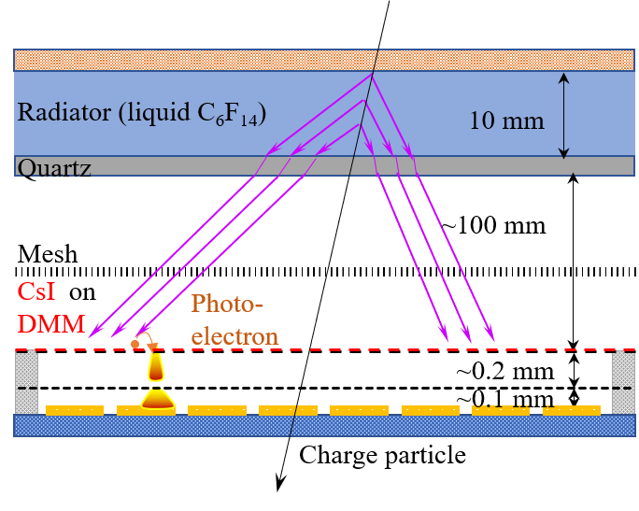
New photon detector : DMM
Advantages:
High gain: >10^6 for single electrons
Compact structure
Good time resolution: ~300ps
Low ion backflow: as low as 0.025%
Low out gas
RICH based on DMM
Notes:
Therefore, we are preparing to try a new type of photodetector to enhance the collection efficiency of photoelectrons. The novel photo-detector base on a double micro-mesh gaseous structure(DMM). This new detector aims to provide higher gain, better time resolution, and lower ion backflow. Also, it has advantages such as reducing the need for complex mechanical designs, and the stainless steel mesh does not release gases. So that, it is beneficial for the preparation and operation of CsI photocathode.

Slide 14
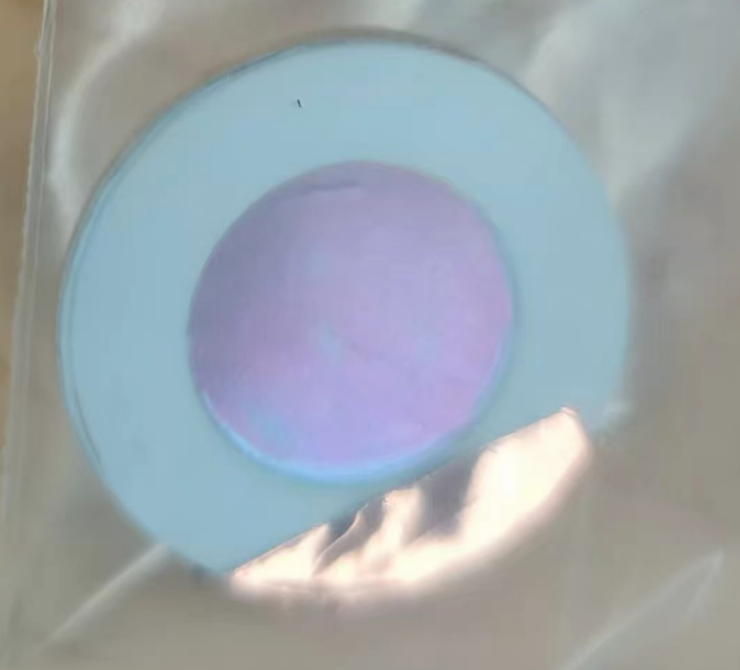
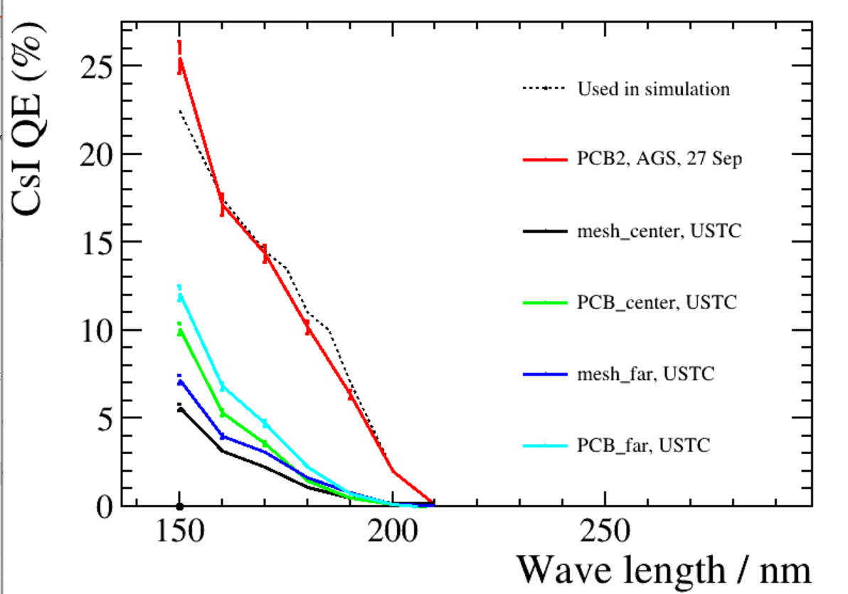
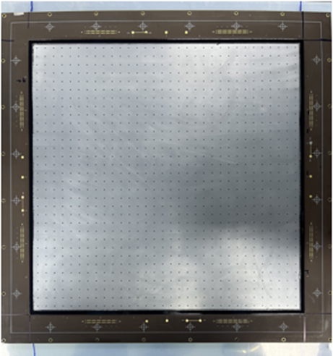
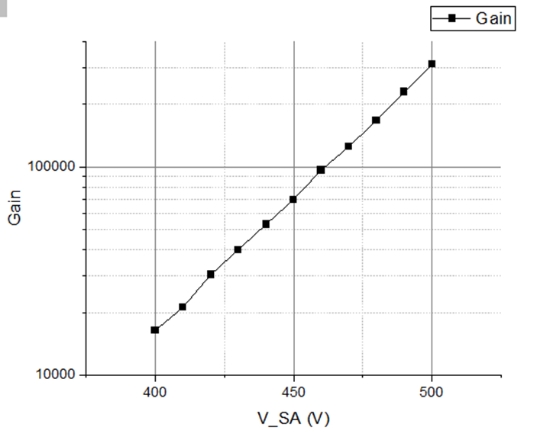
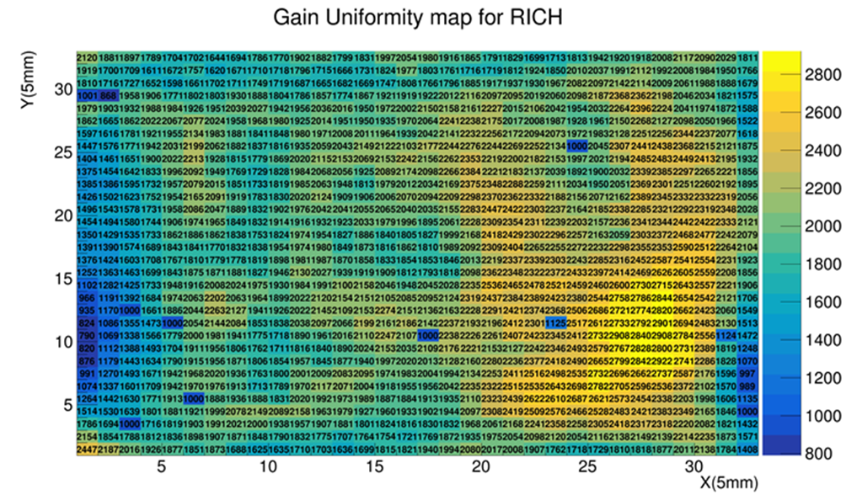
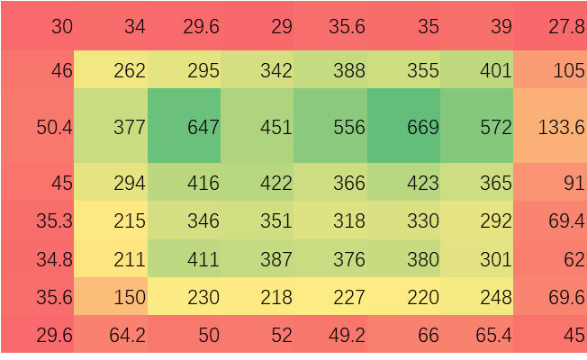
Study of DMM
A large-area DMM has been developed:
Gain > 3×10^5 (test with ⁵⁵Fe)
Gain uniformity (RMS/Mean) ~16.3%
CsI coating on stainless steel mesh
Change technology
Gain uniformity ~16.3%
Gain uniformity ~33.3%
Notes:
To verify the feasibility of the plan, we have developed a large-area double mesh Micromegas detector using a new technology. The tests show that it has good performance, with a gain that can reach three hundred thousand and the gain uniformity can reach 16.3%,it also solving the previous problem of lower gain in the edge areas. Furthermore, It is significant to investigate the substrates for making the CsI photocathodes with high quantum efficiency, good long-term stability and easy fabrication. Then, we done the study of CsI coated on the stainless steel mesh.

Slide 15
PIDB Readout Electronics
Parameters | Requirements
Charge measurement range | 48 fC
Equivalent noise charge (ENC) | 0.5 fC @ 20 pF
Time resolution | ≤1 ns @ 16 fC @ 20 pF
Total redout channels (non-coding) | 583,200
Maximum rate per channel | ~1.6 kHz
Notes:
Last ,in cosmic ray test, we used the AGET readout electronics, but its counting rate capability is only a few hundred hertz. Therefore, we are developing a new readout electronics, which is called ASIC. because of the high luminosity of STCF, The ASICs are required to achieve a counting rate of one thousand and six hundred Hz per channel.
In the prototype ASIC, we integrate 32 channels of analog processing circuits and analog-to-digital converters on a single chip.

Slide 16
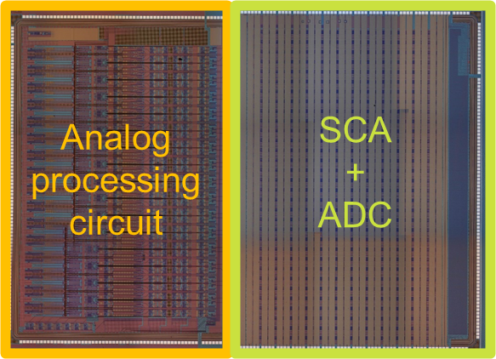
PIDB Readout Electronics
The prototype ASIC integrates 32 channels, including analog processing circuits, analog-to-digital conversion (ADC) circuits, and charge & time calculation circuit.
Preliminary test results meet the design requirements.
Photograph of the prototype ASIC
Output waveforms versus charge
Time resolution
versus input charge
@ 20 pF
ENC at discriminator input
versus input capacitance
Gain variation with input rate
Notes:
A series tests have been conducted after the prototype ASIC is fabricated. The right figure in the first column shows the output waveform versus input, with a gain of 15.2 codes per fento-coulomb and integral nonlinearity better than 0.92 percent. With an input capacitance of 20 picofarad, the ENC is better than 0.2 fento-coulomb. From sparse events to 15 kHz counting rates, the gain remains the same and the readout efficiency maintains 100 percent. And the time resolution is better than 1 nanosecond when the input charge is greater than 16 fento-coulomb with simple filter. These test results show that the prototype ASIC meets the design requirements. The next step will be to further study digital filtering to improve performance.

Slide 17
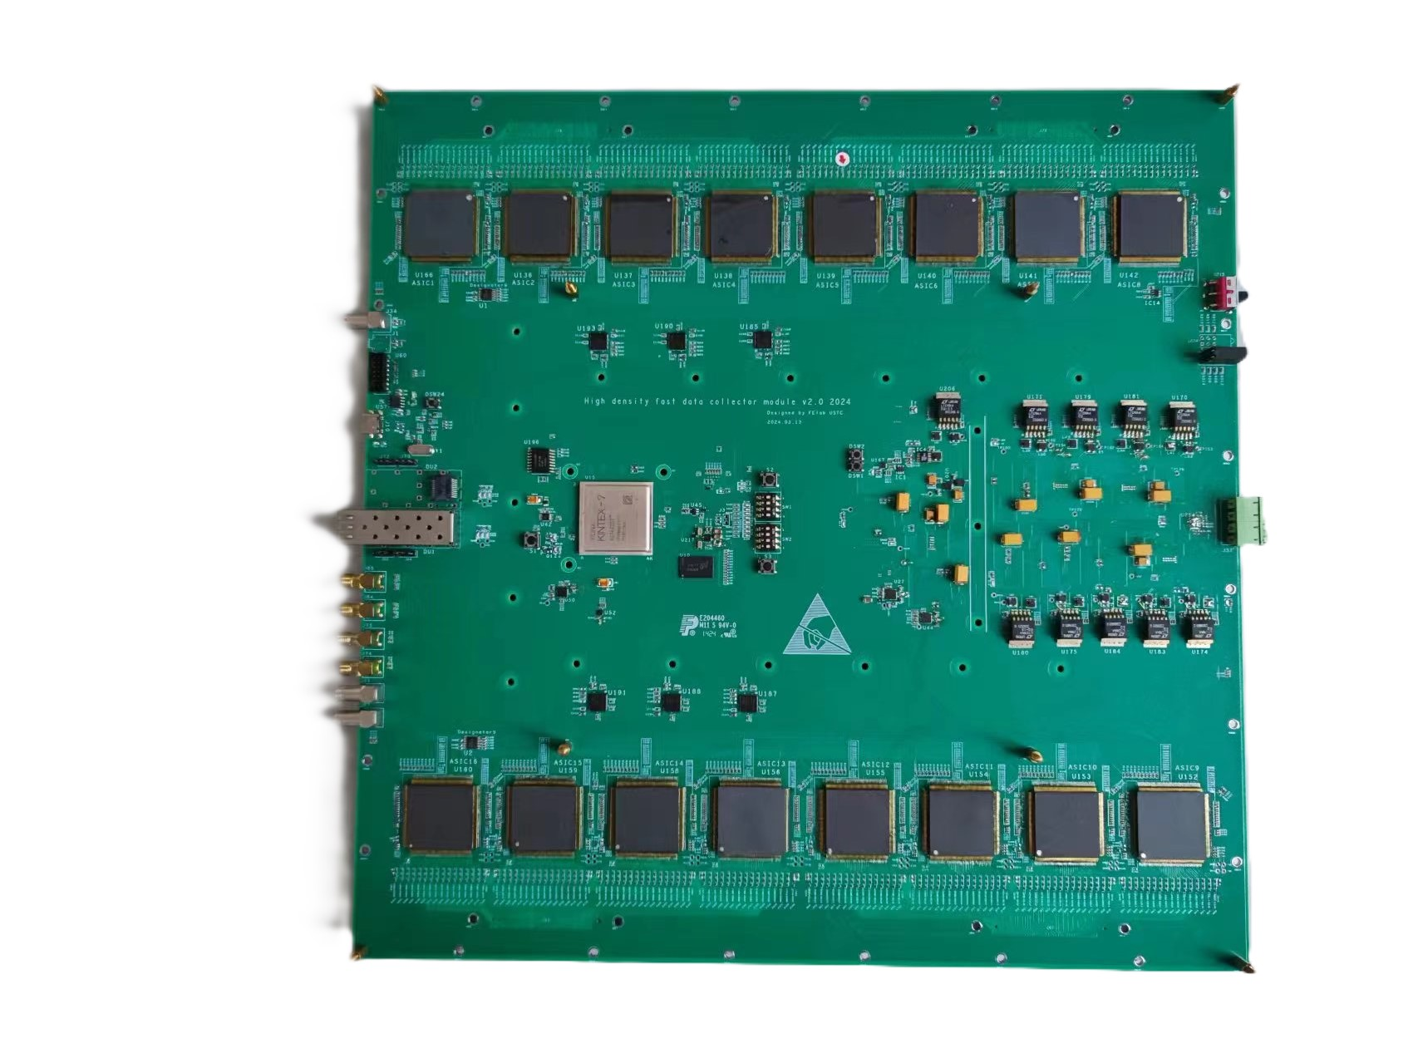
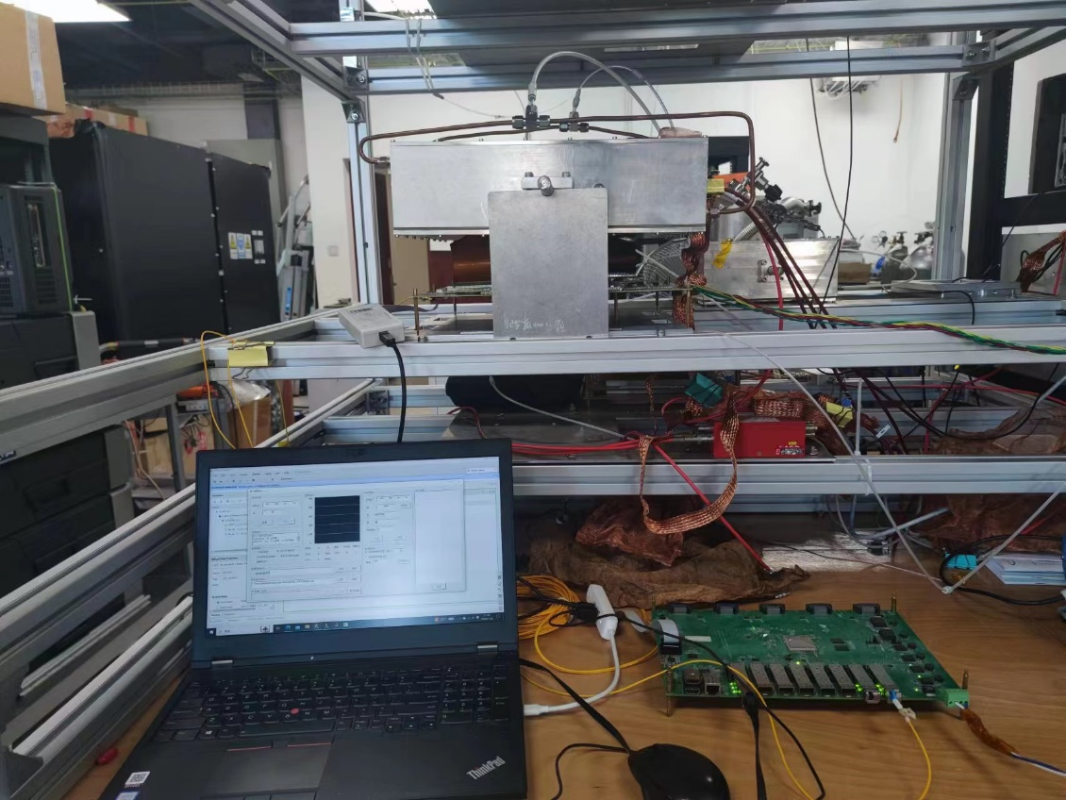
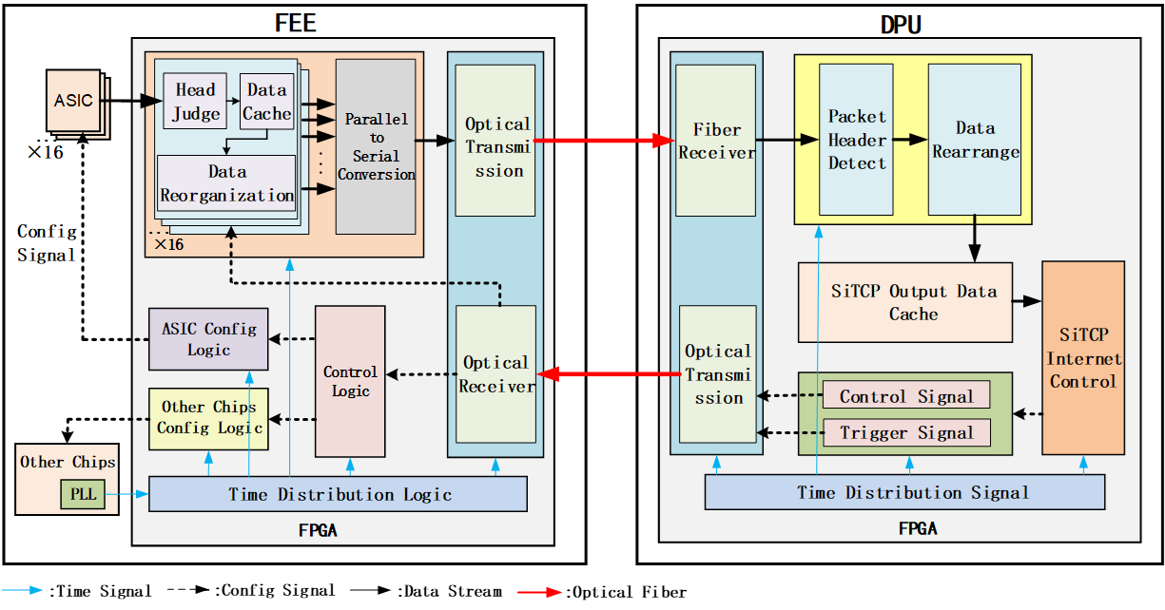
PIDB Readout Electronics
Based on the 32-channel prototype ASIC, a 512-channel FEE prototype was designed.
Functional verification test with ⁵⁵Fe are completed.
RICH & FEE
Photograph of the FEE prototype
PC
Data trans-
mission board
Test with ⁵⁵Fe
Notes:
We have also completed the prototype design of readout electronics based on this 32-channel prototype ASIC. A single board contains 16 prototype chips, achieving a readout of 512 channels. The functionalities of the readout electronics have been validated with the RICH detector prototype. And the hit position by the Xray from 55Fe can be clearly distinguished.

Slide 18
Conclusions
The development of RICH prototype based on THGEM combined with Micromegas has been achieved, and the Cherenkov radiation photon signals have been successfully tested.
We are exploring the feasibility of a novel photon detector based on a double micro-mesh gaseous structure (DMM).
Developed custom ASIC-based prototype readout electronics.
Notes:
In conclusion，。。。

