Slide 1

Precise measurement of total cross section of
$e^{+}e^{−}→$hadrons
FTCF2024
Guangzhou
November 18, 2024
Ivan Logashenko (BINP)

Slide 2
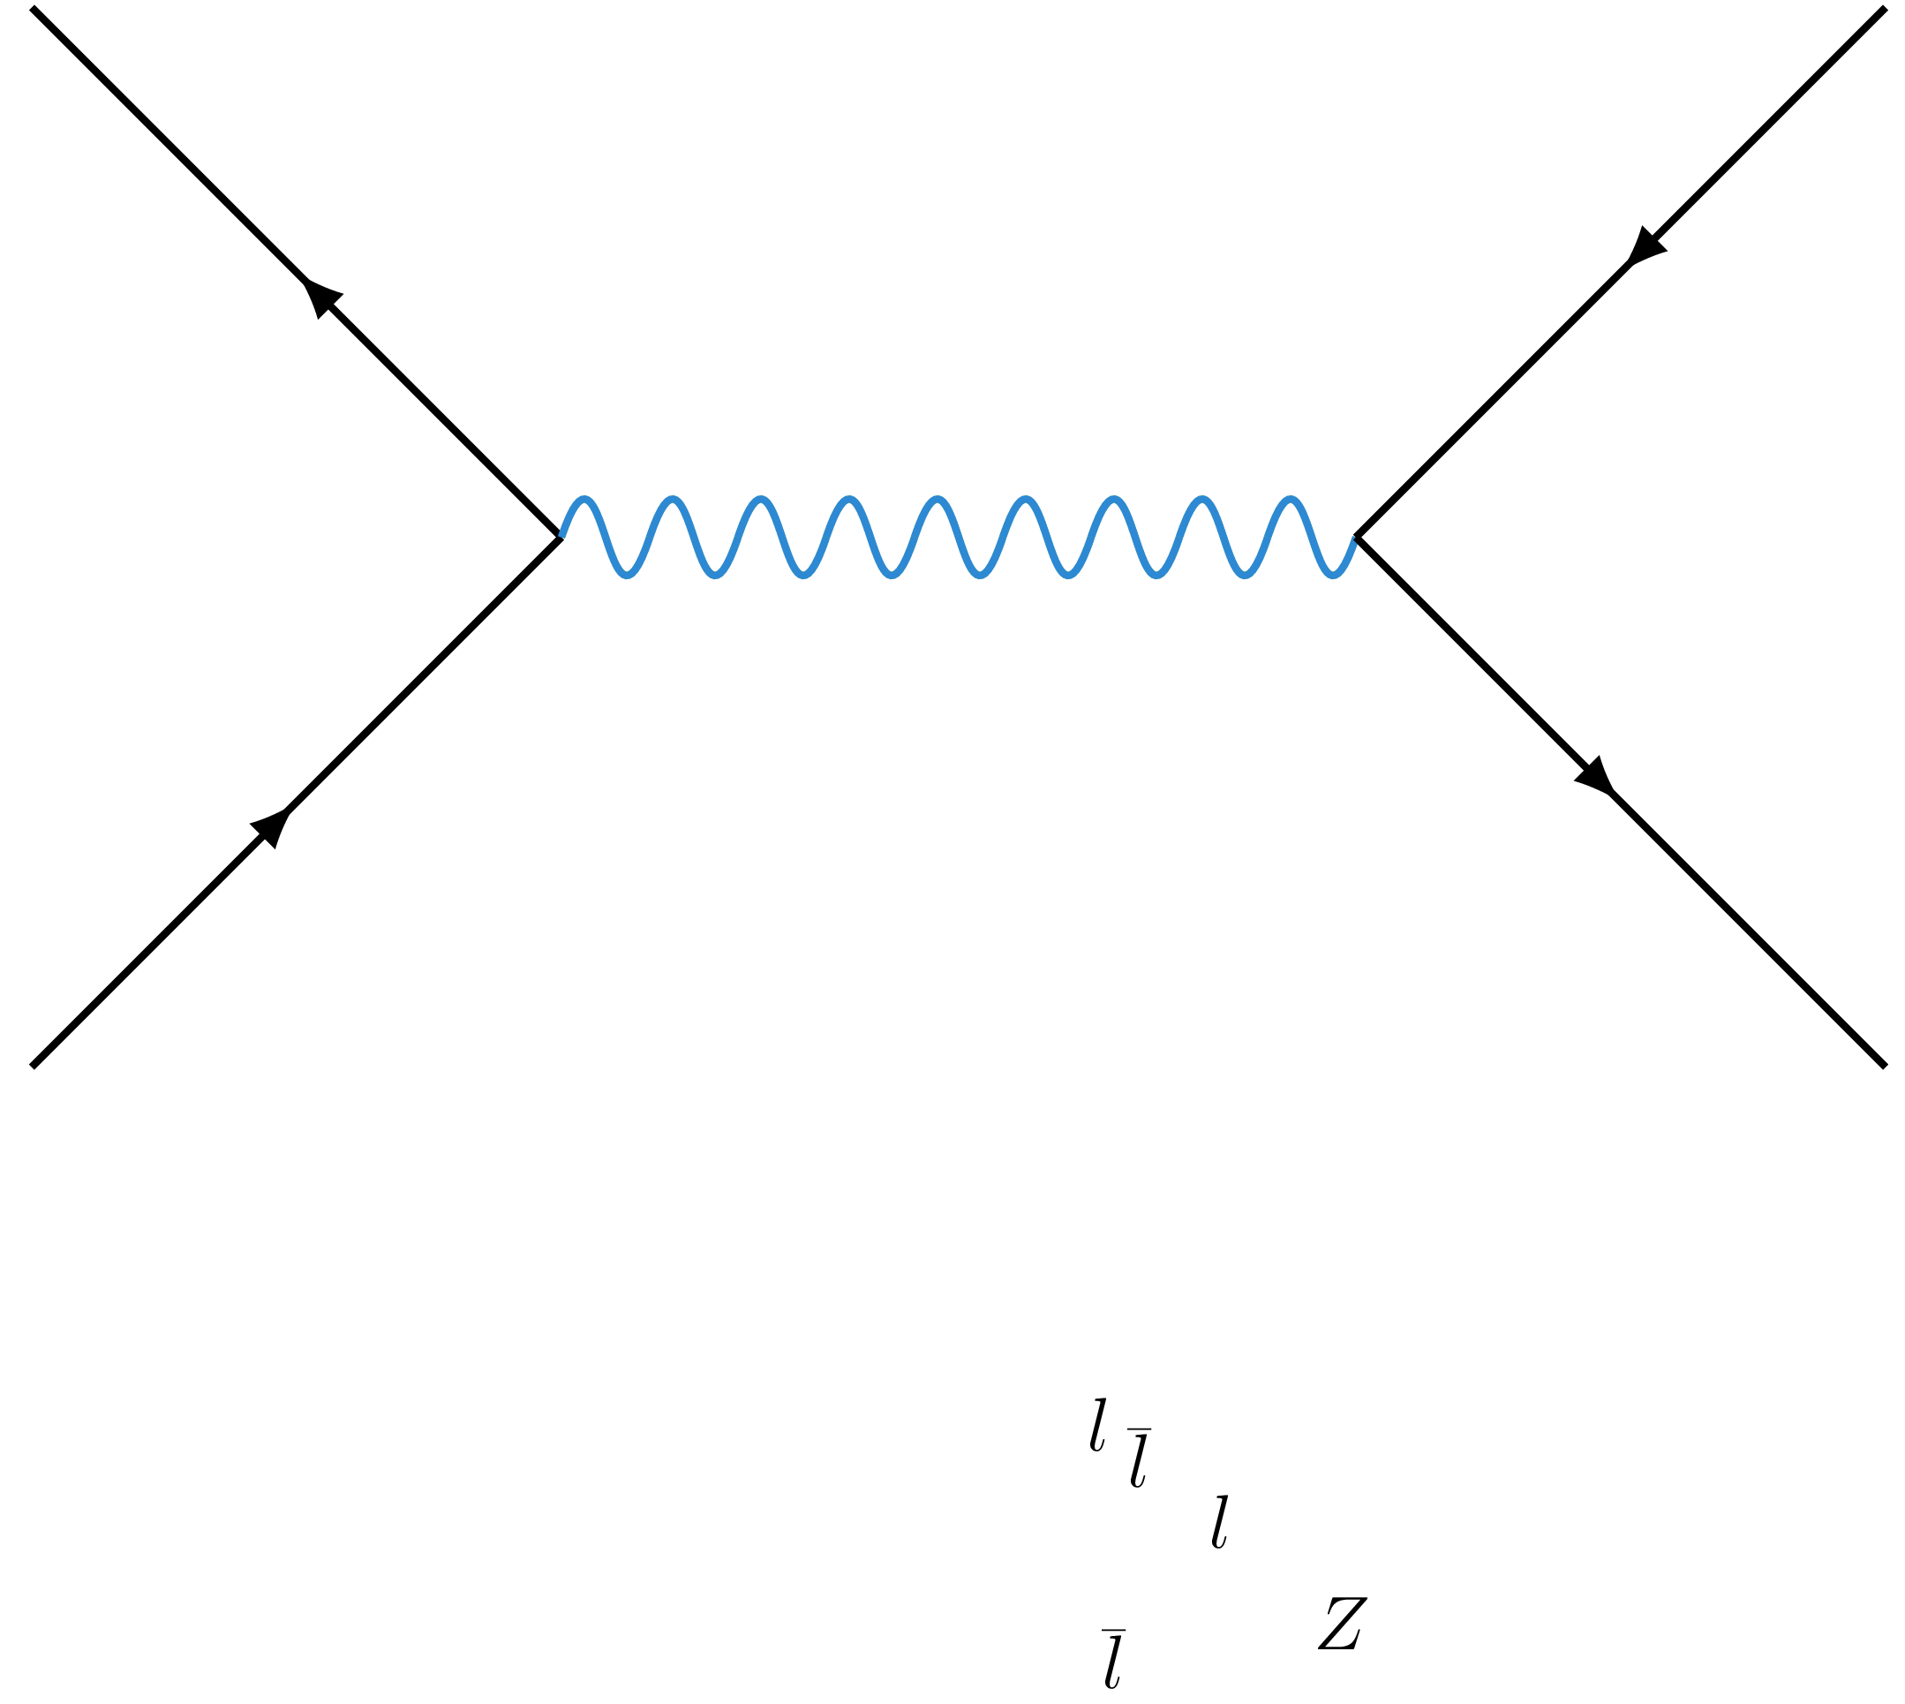
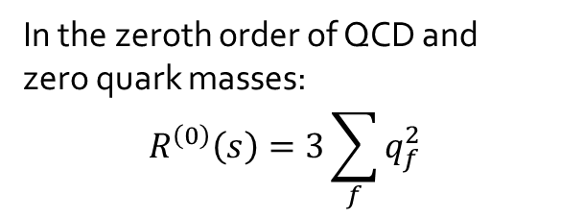


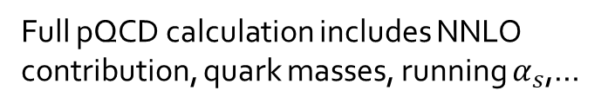


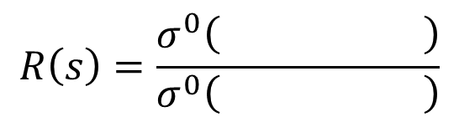

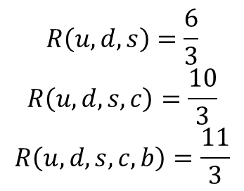
R(s)
$$R\left(s\right)=\frac{σ^{0}\left( \right)}{σ^{0}\left( \right)}$$
$$q\overline{q}$$
$$μ^{+}μ^{−}$$
In the zeroth order of QCD and zero quark masses:
$$R^{\left(0\right)}\left(s\right)=3\sum_{f}{q_{f}^{2}}$$
$D\overline{D}$ threshold
$$R\left(u,d,s\right)=\frac{6}{3}$$
$$R\left(u,d,s,c\right)=\frac{10}{3}$$
$$R\left(u,d,s,c,b\right)=\frac{11}{3}$$
$B\overline{B}$ threshold
Full pQCD calculation includes NNLO contribution, quark masses, running $α_{s}$,…
Important for $a_{μ}, α\left(M_{Z}^{2}\right),α_{s}\left(s\right),…$

Slide 3
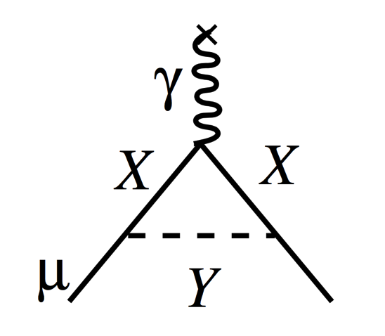
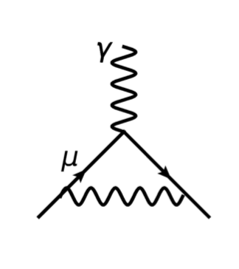



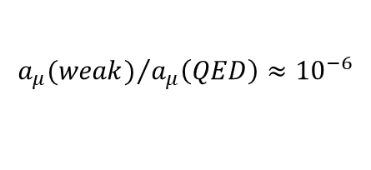
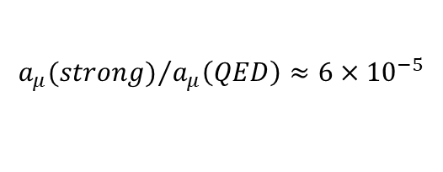
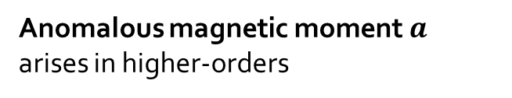
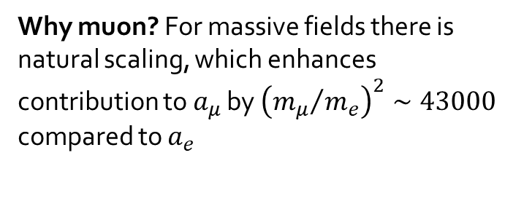

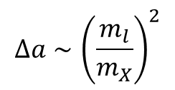
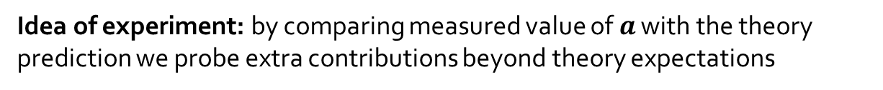
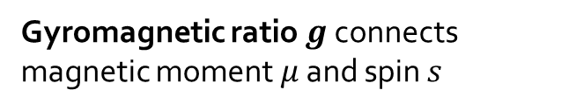


Muon (g-2): the basics
Gyromagnetic ratio $g$ connects magnetic moment $μ$ and spin $s$
$${\vec{μ}}_{S}=g\frac{e}{2m}\vec{S}$$
For point-like particle $g=2$
Anomalous magnetic moment $a$ arises in higher-orders
$$a=(g−2)/2$$
$a_{e}≈a_{μ}≈\frac{α}{2π}≈{10}^{−3}$ (QED dominated)
Idea of experiment: by comparing measured value of $a$ with the theory prediction we probe extra contributions beyond theory expectations
$${a_{μ}(strong)}/{a_{μ}\left(QED\right)≈6×{10}^{−5}}$$
$${a_{μ}(weak)}/{a_{μ}\left(QED\right)≈{10}^{−6}}$$
Why muon? For massive fields there is natural scaling, which enhances contribution to $a_{μ}$ by ${\left({m_{μ}}/{m_{e}}\right)}^{2}∼43000$ compared to $a_{e}$
$$Δa∼{\left(\frac{m_{l}}{m_{X}}\right)}^{2}$$
$$m_{l}$$
$$m_{X}$$

Slide 4
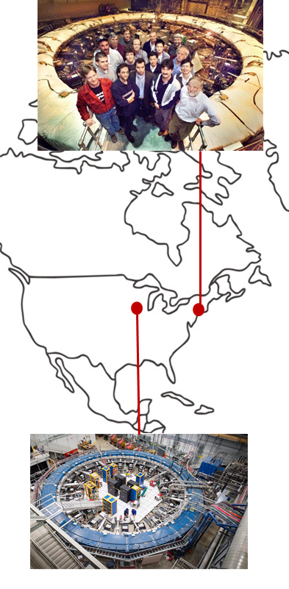
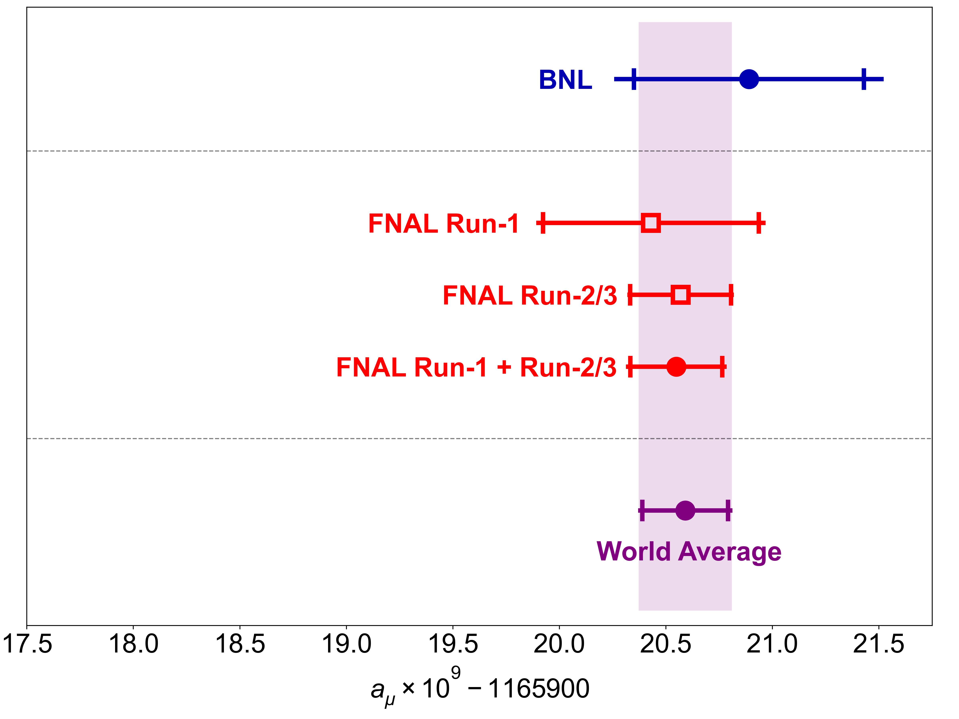
Muon G-2 2023 result
BNL 2006
2023 result
FNAL 2021, 2023
$$a_{μ}\left(Exp\right)=0.00 116 592 059\left(22\right) [190 ppb]$$

Slide 5
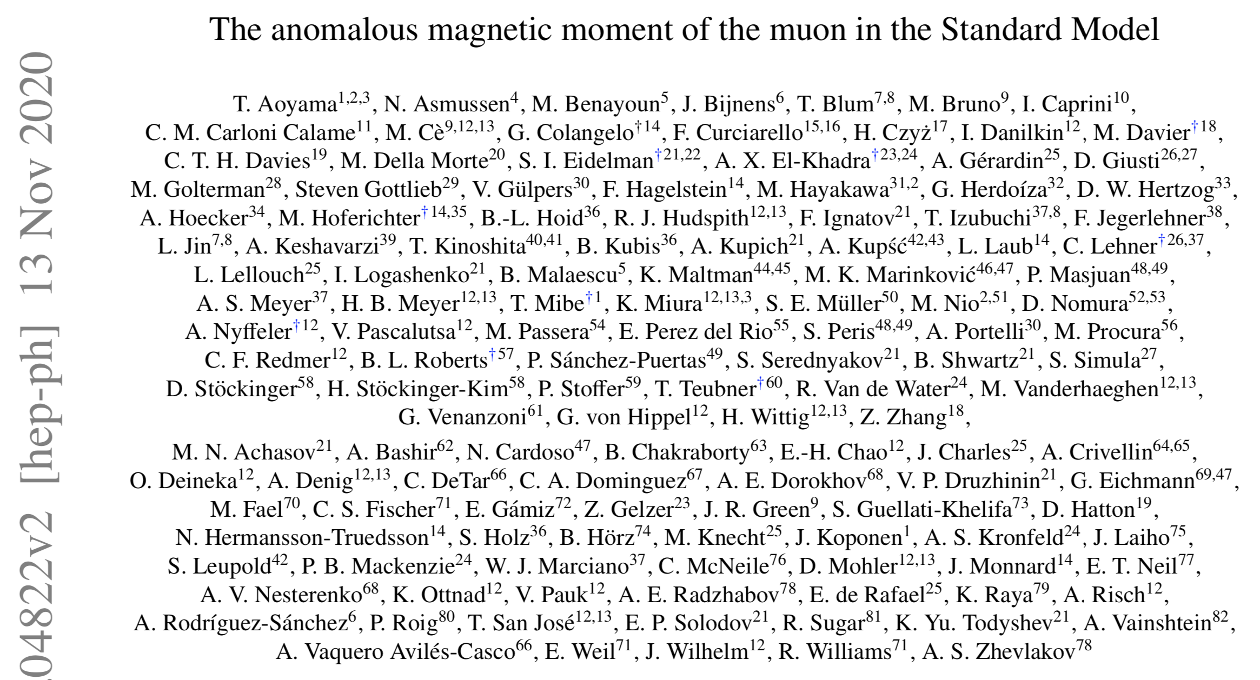
Experiment vs
SM prediction
Muon G-2 Theory Initiative
Consortium of >100 theorists
and experimental physicists
“White paper”, Phys.Rep. 887 (2020) 1-166
State-of-art @2020
WP2020

Slide 6
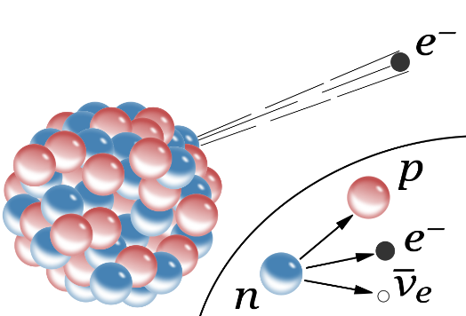
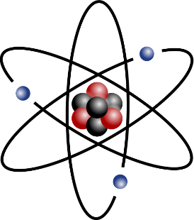
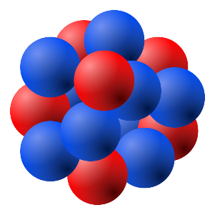


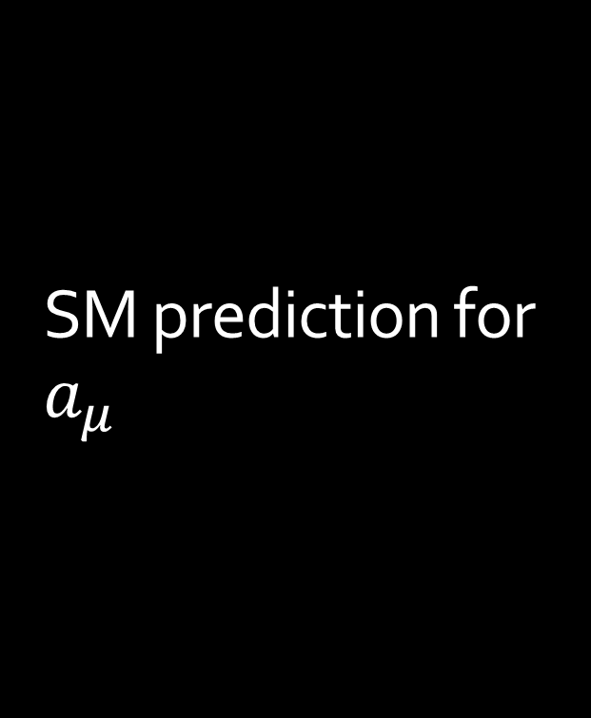
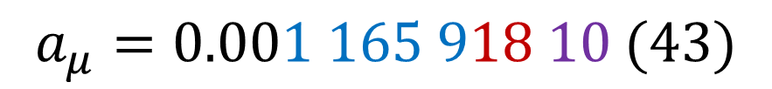

SM prediction for $a_{μ}$
Electromagnetic interactions
Strong interactions
Weak interactions
$$0.000 000 069 37 (43)$$
$$0.001 165 847 19 (0.1)$$
$$0.000 000 001 54 (1)$$
$$a_{μ}=0.001 165 918 10 (43)$$
The uncertainty is dominated by contribution of strong interactions

Slide 7
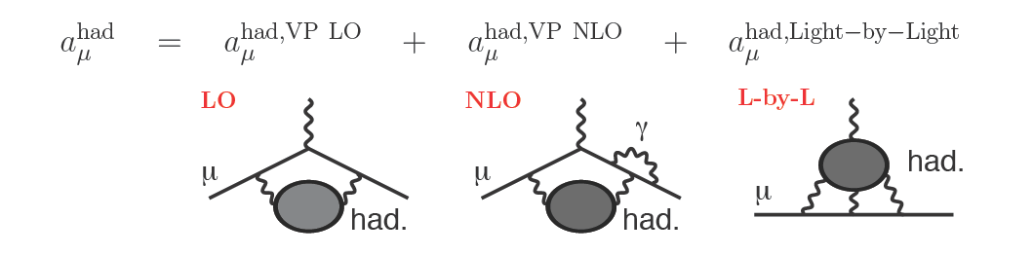

Hadronic contribution
Leading order
(LO)
Next-to-leading order
(NLO)
Light-by-light
(LBL)
$\left(6 931 ± 40\right)×{10}^{−11}$ $\left(−98.3 ± 0.7\right)×{10}^{−11}$ $\left(92 ±19\right)×{10}^{−11}$
WP(2020)
350 ppb (0.6%)
10 ppb
160 ppb
Underestimated!
Compare to experimental accuracy of 190 ppb

Slide 8






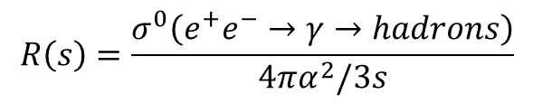
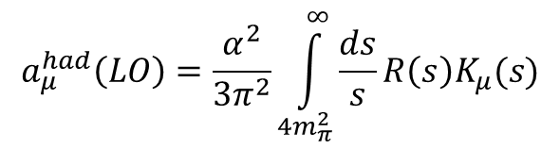
HVP: what do we need to measure
$$∝\frac{1}{q^{2}−s}$$
Dispersion relation:
$$a_{μ}^{had}(LO)$$
$$\frac{α}{π}K_{μ}(s)$$
Optical theorem:
$$Im Π^{′\left(s\right)}=\frac{s}{4πα}σ^{0}\left(e^{+}e^{−}→γ→hadrons+…\right)$$
This is what we need to measure
Lets put everything together:
$$a_{μ}^{had}\left(LO\right)=\frac{α^{2}}{3π^{2}}\int_{4m_{π}^{2}}^{∞}{\frac{ds}{s}R\left(s\right)K_{μ}(s)}$$
$$R\left(s\right)=\frac{σ^{0}\left(e^{+}e^{−}→γ→hadrons\right)}{4πα^{2}/3s}$$
$$σ^{0}\left(e^{+}e^{−}→μ^{+}μ^{−}\right)$$
$${s=\left(\text{c}\text{.}\text{m}\text{. }\text{energy}\right)}^{2}$$

Slide 9
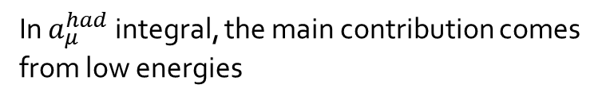
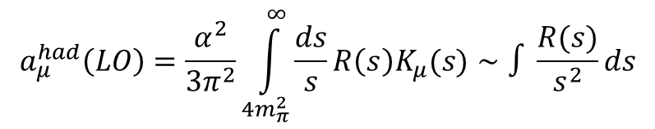

Contribution of various energies
$$\frac{3s}{m_{μ}^{2}}K_{μ}\left(s\right)$$
In $a_{μ}^{had}$ integral, the main contribution comes from low energies
$$a_{μ}^{had}\left(LO\right)=\frac{α^{2}}{3π^{2}}\int_{4m_{π}^{2}}^{∞}{\frac{ds}{s}R\left(s\right)K_{μ}(s)}∼∫\frac{R(s)}{s^{2}}ds$$
FJ(2017)
Contribution to the integral
Contribution to the error of integral

Slide 10
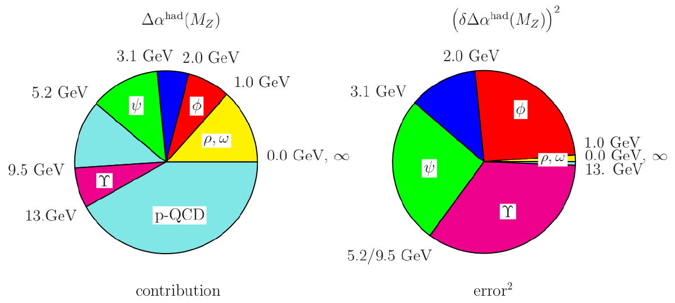
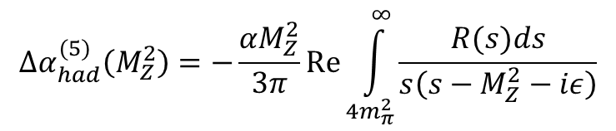

$$Δα_{had}^{\left(5\right)}\left(M_{Z}^{2}\right)$$
$${Δα}_{had}^{(5)}\left(M_{Z}^{2}\right)=−\frac{αM_{Z}^{2}}{3π}Re\int_{4m_{π}^{2}}^{∞}{\frac{R(s)ds}{s\left(s−M_{Z}^{2}−iε\right)}}$$
Important contribution to electroweak fit
Contribution to the integral
Contribution to the error of integral
A. Blondel et al., arXiv:1905.05078

Slide 11
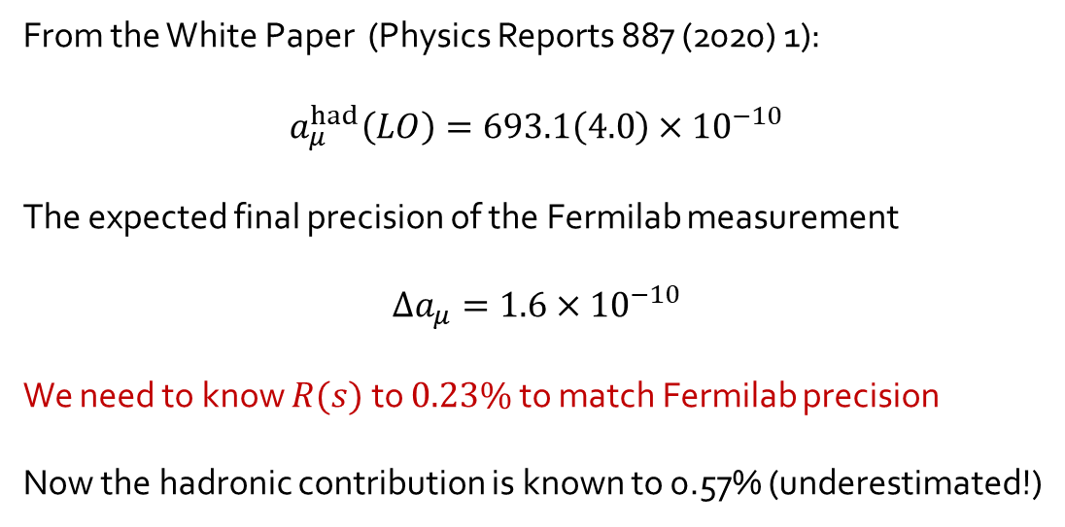
How well do we need to measure R(s)
From the White Paper (Physics Reports 887 (2020) 1):
$$a_{μ}^{had}\left(LO\right)=693.1\left(4.0\right)×{10}^{−10}$$
The expected final precision of the Fermilab measurement
$$Δa_{μ}=1.6×{10}^{−10}$$
We need to know $R(s)$ to $0.23\%$ to match Fermilab precision
Now the hadronic contribution is known to 0.57% (underestimated!)

Slide 12
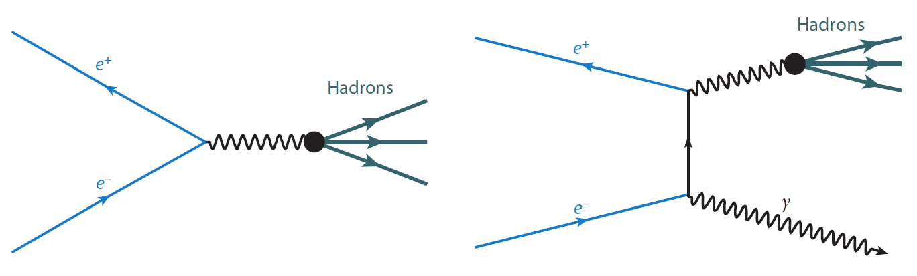
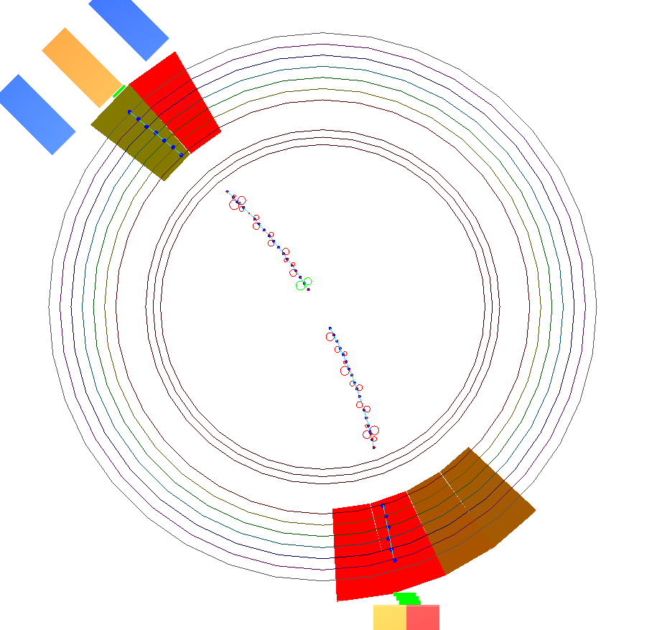
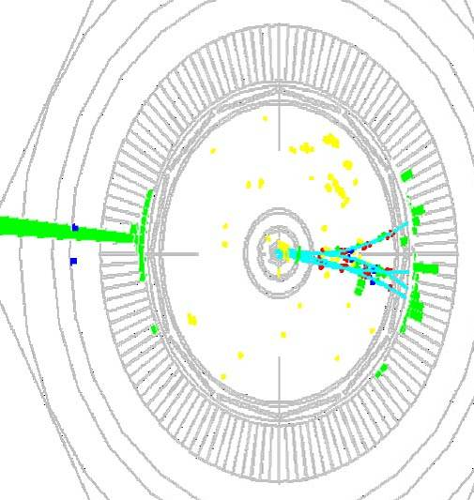

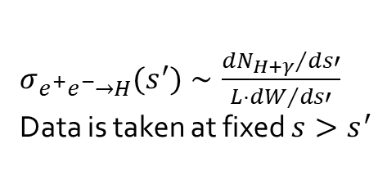
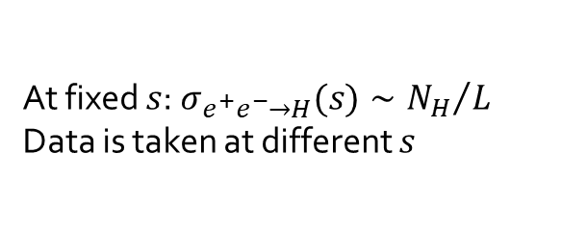
Measurement techniques:
Direct vs ISR
$$s′$$
Direct measurement (Energy scan)
ISR (Initial State Radiation)
$σ_{e^{+}e^{−}→H}(s^{′})∼\frac{{{dN}_{H+γ}}/{ds′}}{L⋅{dW}/{ds′}}$
Data is taken at fixed $s>s^{′}$
At fixed $s$: $σ_{e^{+}e^{−}→H}(s)∼{N_{H}}/L$
Data is taken at different $s$
VEPP-2M: CMD-2, SND
VEPP-2000: CMD-3, SND2k
KLOE, BABAR, BES-III, CLEO

Slide 13
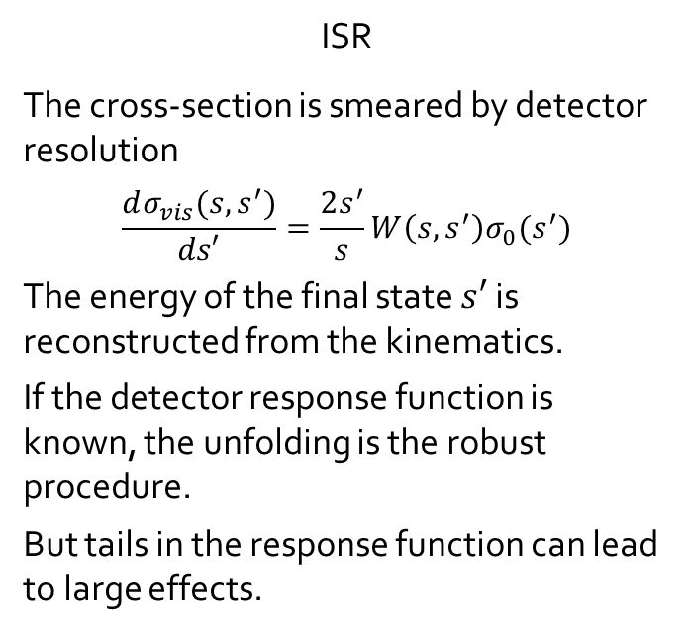
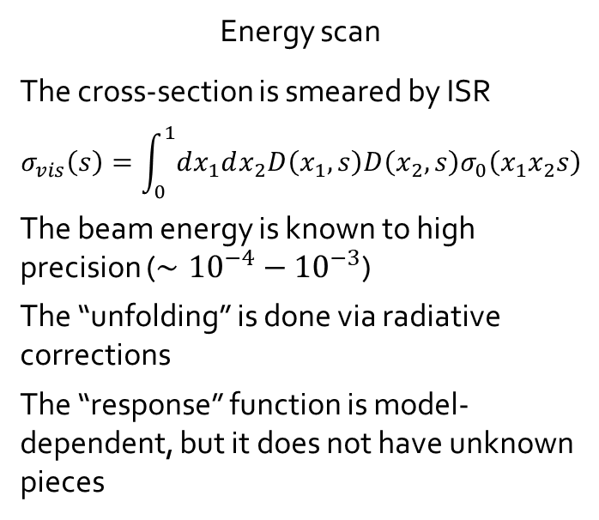
ISR vs energy scan
Energy scan analysis is generally simpler, but ISR measurements were done with superior detectors
Before VEPP-2000, ISR measurements had more statistics
In general, background is higher for ISR measurements
ISR approach allows for larger detector coverage and smaller model-dependence
In both approaches the visible cross-section is smeared and we need to unfold it:
Energy scan
The cross-section is smeared by ISR
$$σ_{vis}\left(s\right)=\int_{0}^{1}{dx_{1}dx_{2}D\left(x_{1},s\right)D\left(x_{2},s\right)σ_{0}\left(x_{1}x_{2}s\right)}$$
The beam energy is known to high precision ($∼{10}^{−4}−{10}^{−3}$)
The “unfolding” is done via radiative corrections
The “response” function is model-dependent, but it does not have unknown pieces
ISR
The cross-section is smeared by detector resolution
$$\frac{dσ_{vis}(s,s^{′})}{ds′}=\frac{2s^{′}}{s}W\left(s,s^{′}\right)σ_{0}(s^{′})$$
The energy of the final state $s′$ is reconstructed from the kinematics.
If the detector response function is known, the unfolding is the robust procedure.
But tails in the response function can lead to large effects.

Slide 14
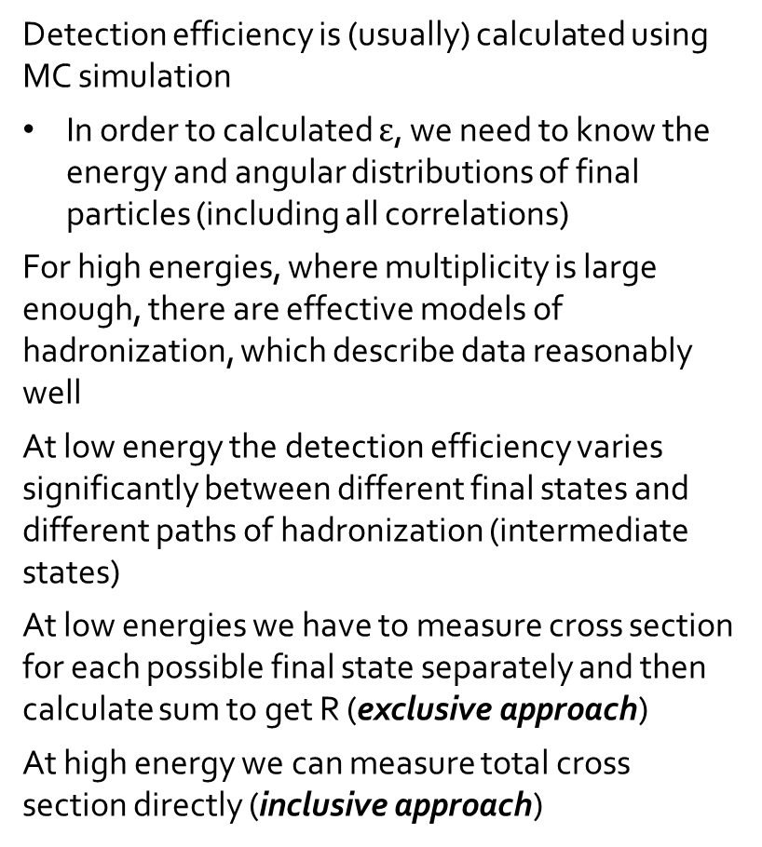
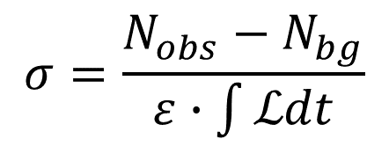
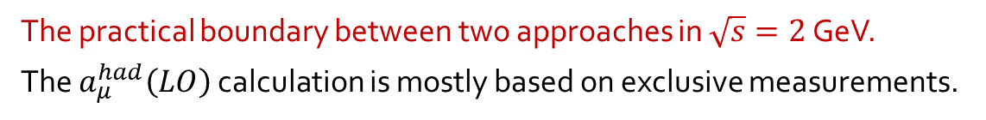
Exclusive vs inclusive measurement
Detection efficiency is (usually) calculated using MC simulation
In order to calculated $ε$, we need to know the energy and angular distributions of final particles (including all correlations)
For high energies, where multiplicity is large enough, there are effective models of hadronization, which describe data reasonably well
At low energy the detection efficiency varies significantly between different final states and different paths of hadronization (intermediate states)
At low energies we have to measure cross section for each possible final state separately and then calculate sum to get R (exclusive approach)
At high energy we can measure total cross section directly (inclusive approach)
$$σ=\frac{N_{obs}−N_{bg}}{ε∙\int{ℒdt}}$$
Final state
Intermediate states
The practical boundary between two approaches in $\sqrt{s}=2$ GeV.
The $a_{μ}^{had}\left(LO\right)$ calculation is mostly based on exclusive measurements.

Slide 15

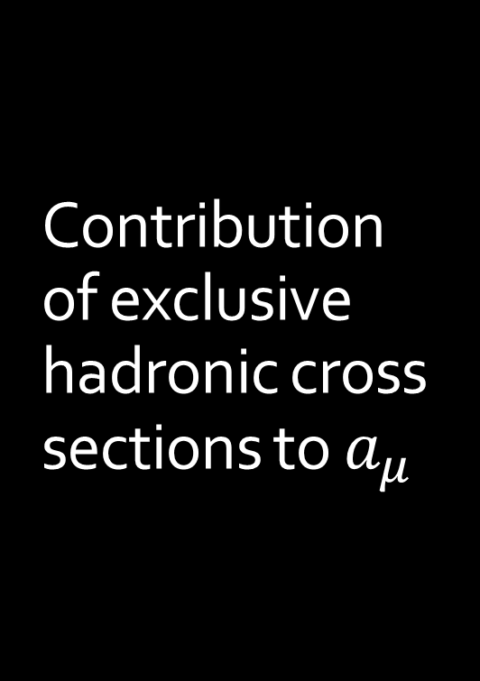
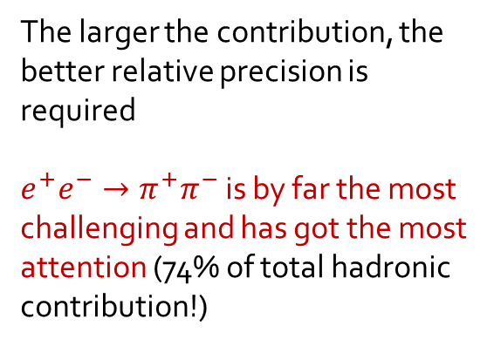
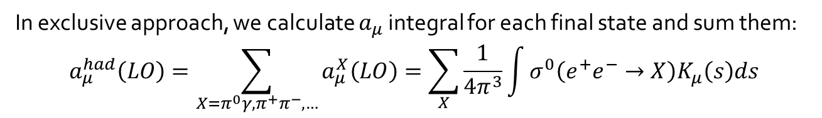
Contribution of exclusive hadronic cross sections to $a_{μ}$
In exclusive approach, we calculate $a_{μ}$ integral for each final state and sum them:
$$a_{μ}^{had}\left(LO\right)=\sum_{X=π^{0}γ,π^{+}π^{−},…}{a_{μ}^{X}\left(LO\right)=\sum_{X}{\frac{1}{4π^{3}}\int{σ^{0}\left(e^{+}e^{−}→X\right)K_{μ}\left(s\right)ds}}}$$
The larger the contribution, the better relative precision is required
$e^{+}e^{−}→π^{+}π^{−}$ is by far the most challenging and has got the most attention (74% of total hadronic contribution!)
All the rest
$$π^{+}π^{−}$$
From DHMZ’19

Slide 16
Where the measurements are done
BES (ISR@4GeV)
BES-III
KEDR
KEDR
Babar (ISR@10GeV)
Belle-II (ISR@10GeV)
VEPP-2000
Tau decays
VEPP-2M
KLOE (ISR)
Energy scan
ISR
Tau decays

Slide 17
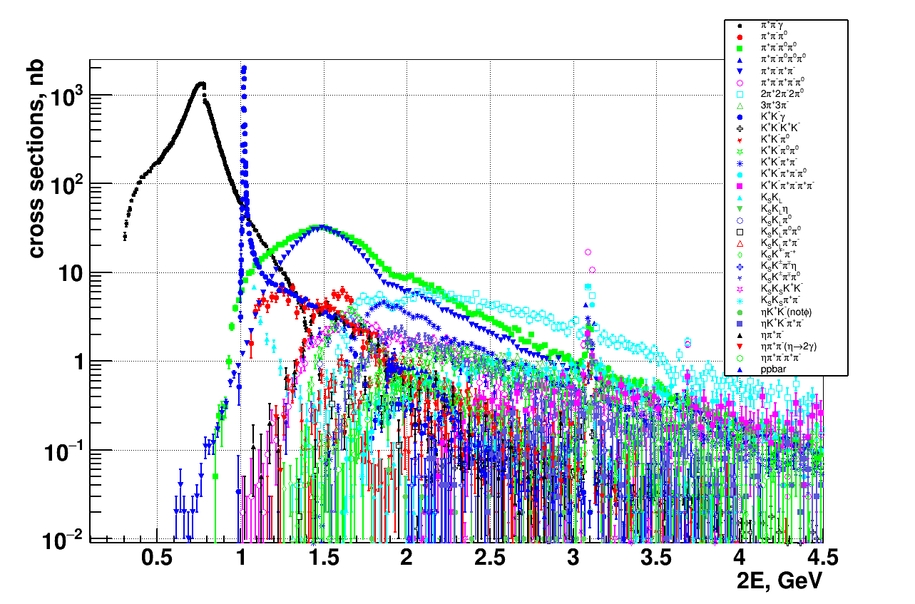


BABAR
$0.5−2\%$ syst.error
$4−15\%$ syst.error
BABAR measurements are mostly tagged

Slide 18
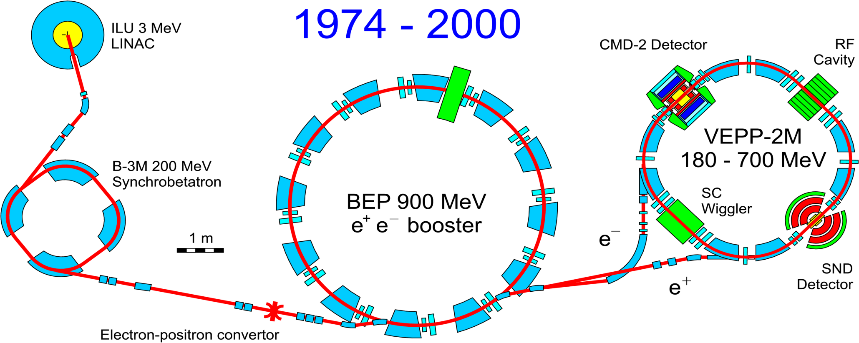
VEPP-2M (1993-2000)
Energy range: 0.36 – 1.4 GeV
Luminosity up to 5*10³⁰ 1/cm²s

Slide 19
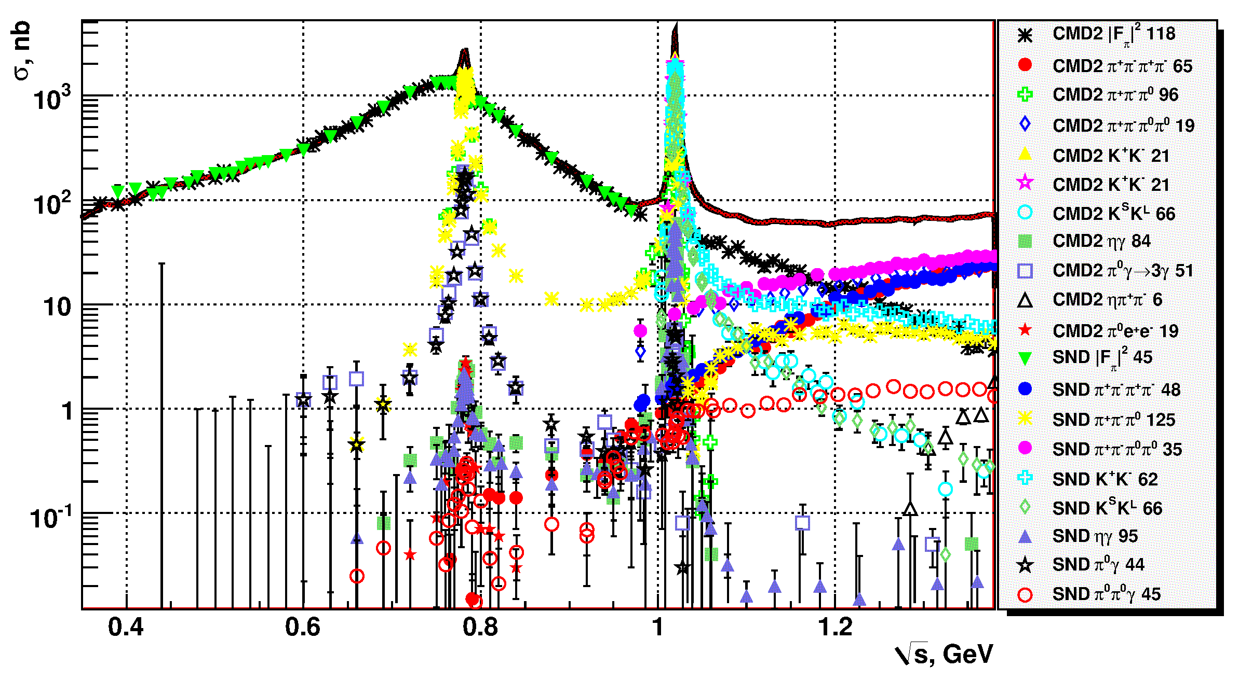
Overview of VEPP-2M measurements

Slide 20





VEPP-2000 (2011-)
250 m beamline
VEPP-2000
New injection complex
$$ρ,ω$$
$$φ$$
Data taking history
Collected integral by energy

Slide 21



Measurements at VEPP-2000
Final states under analysis at CMD-3
More final states compare to VEPP-2M
1-2 order of magnitude more data
The experiments are collecting data

Slide 22






Tensions in $e^{+}e^{−}→π^{+}π^{−}$ data
BABAR
CMD-2
10%
KLOE
There are few-% discrepancies between various sub-% measurements of $σ(e^{+}e^{−}→π^{+}π^{−})$
Unexplained
WP2020: scale factor for $Δa_{μ}(Had;LO)$
CMD-3 goal: new high statistics low systematics measurement of $σ(e^{+}e^{−}→π^{+}π^{−})$ via energy scan
$$a_{μ}^{had}\left(LO;2π, 0.6<\sqrt{s}<0.88 GeV\right)$$
2.5%
$$\frac{1}{4π^{3}}\int_{0.6}^{0.88}{σ^{0}\left(e^{+}e^{−}→π^{+}π^{−}\right)K_{μ}\left(s\right)ds}$$

Slide 23




CMD-3 measurement of
$$σ\left(e^{+}e^{−}→π^{+}π^{−}\right)$$
(2023)
Phys.Rev.Lett. 132 (2024) 23, 231903
Phys.Rev.D 109 (2024) 11, 112002
209 energy points

Slide 24


Comparison of CMD-3 to other measurements
CMD-3 is systematically above previous measurements by ~2-5%
10%
CMD-3

Slide 25


$a_{μ}(had;LO)$: the status
Discrepancies in data “blind” $a_{μ}(SM)$
It seems that existing measurements of $e^{+}e^{−}→π^{+}π^{−}$ underestimated systematic uncertainty (at least at some energy range)
CMD-3 simply exaggerated the problem, but it was there already

Slide 26


Features of CMD-3 measurement
World-largest statistics
  34 000 000 $e^{+}e^{−}→π^{+}π^{−}$
  3 700 000 $e^{+}e^{−}→μ^{+}μ^{−}$
  44 000 000 $e^{+}e^{−}→e^{+}e^{−}$
Many built-in cross checks
  3 methods for final states indentification
  2 methods for angle measurement
  Measurement of $σ\left(e^{+}e^{−}→μ^{+}μ^{−}\right)$
  Measurement of charge asymmetry
Very detailed study of potential systematics
Example of ${e^{+}e^{−}→π}^{+}π^{−}$ event

Slide 27

Statistical precision of CMD-3 data

Slide 28


At the beginning of 2023…
a_{μ}(SM) = 0.00116591810(43) → 368 ppb
→ 3.7σ
→ 3.3σ
BMW Lattice 2020
a_{μ}(Exp) - a_{μ}(SM) = 0.00000000251(59) → 4.2σ

Slide 29
Experiment vs
SM prediction
End of 2023
BMW Lattice 2020
WP2020
CMD-3 based
At the moment, the SM prediction for $a_{μ}$ is unclear (due to hadronic contribution)

Slide 30


Is there need for new measurements of hadronic cross sections?
There are significant efforts to understand the discrepancies and to obtain additional new $e^{+}e^{−}→H$ data:
SND has the same amount of data collected as CMD-3, analysis is in progress
BABAR is making reanalysis of old data using new approach (angular analysis)
BELLE-II plans to do ISR measurement of $e^{+}e^{−}→H$ cross sections
BES-III and KLOE perform analysis of additional data
In order to match FNAL, cross sections need to be measured to ~0.2%
Neither of existing experiment expect to reach such precision – need next generation experiments
Channel | Contribution, $⋅10^{10}$ (KNT19) | Relative accuracy, need (now)
$$π^{+}π^{−}$$ | 504.23(1.90) (0.4%) ??? | 0.23% (0.8%)
$$π^{+}π^{−}π^{0}$$ | 46.63(94) (2.0%) | 1.1% (1.5-3%)
$$π^{+}π^{−}π^{+}π^{−}$$ | 13.99(19) (1.4%) | 0.8% (2-3%)
$$π^{+}π^{−}π^{0}π^{0}$$ | 18.15(74) (4.0%) | 2.3% (5%)
$$K^{+}K^{−}$$ | 23.00(22) (1.0%) | 0.6% (2%)
$$K_{S}K_{L}$$ | 13.04(19) (1.5%) | 0.7% (2%)
$$a_{μ}(had;LO)$$ | 692.8(2.4) (0.35%) | 0.2%

Slide 31

Is there need for new measurements of hadronic cross sections?
Quest for next-generation experiments: reduce these error bars
Ultimate goal: Hadron data = Lattice QCD = MuONe
Large statistics Detector improvements
Improved MC generators for radiative corrections

Slide 32

Inclusive measurements
Inclusive measurements were systematically performed at $\sqrt{s}≳2$ GeV
Signal events: one or more hadrons in the final state + any number of extra particles
Cuts on multiplicity, sphericity,…
With or without particle identification
The analysis depends on the same ingredients as the exclusive measurement:
event selection, luminosity measurement, calculation of radiative corrections, evaluation of detector efficiency
Key difficulty: to properly model hadronic events for evaluation of efficiencies and radiative corrections. There are dedicated MC generators: JETSET, LUARLW
“Typical” good precision: $\frac{δR}{R}∼3\%$, best achieved $∼2\%$.
Important to have large detection efficiency (now $∼75\%)$

Slide 33

BES-II
PRL88(2002)101802
PLB677(2009)239
Major improvement!
BES-II performed detailed R(s) scan between 2 and 5 GeV
$3−5\%$ statistical error per point
$5−8\%$ systematical error
BES-III collected a lot of R(s) data, partly published

Slide 34

KEDR
KEDR detector
VEPP-4M collider
Beam energy range 0.925-5.3 GeV
Luminosity $∼4⋅{10}^{31} cm^{−2}s^{−1}$
Beam energy is determined to 20-30 keV (using Compton backscattering and resonance depolarization)

Slide 35


KEDR
KEDR performed detailed R(s) scan between 1.8 and 3.7 GeV
$2−3\%$ statistical error per point
$2−3\%$ systematical error
KEDR collected R(s) data between 4.7 and 7.0 GeV (17 points)

Slide 36


BES-III
BEPC-II collider covers c.m.energy
range from 2 to 5 GeV
“$cτ$-factory”

Slide 37

BES-III
Phys. Rev. Lett. 128, 062004 (2022)
Syst.error $≈1.6−2.8\%$, stat.error $<0.4\%$
Discrepency with pQCD and KEDR?

Slide 38
Is there agreement between inclusive and exclusive?

Slide 39

BES-III: expected soon

Slide 40

BES-III: expected soon

Slide 41

BES-III: inclusive R via ISR?

Slide 42

BES-III: inclusive R via ISR?

Slide 43

Final remarks
Measurement of R(s) remains very active field of research
It is required for number of precise tests, especially for (g-2) of muon
Precise measurement of R(s), both direct inclusive and ISR exclusive, will remain an important task for future charm-tau factory even in ~10 years
The huge statistics of the future experiments will be important for reduction of systematic errors:
  Detailed studies of detector efficiencies
  Detailed studies of radiative corrections (NNLO and beyond)
  Possibility to detect $γ$ through conversion
  …

Slide 44
Backup slides

Slide 45


Radiative corrections
Radiative processes
We want to measure $e^{+}e^{−}→H$, but these events are accompanied by similar events where photons are emitted by any of the particles.
Radiation of high-energy $γ$ is suppresses by $α$, but radiation of soft photons is enhanced.
Radiation changes both the cross-section and the kinematics of the final state:
And we have to calculate radiative corrections to the cross section of monitoring process as well
$$σ=\frac{N_{obs}−N_{bg}}{ε\left(δ\right)∙\left(1+δ\right)⋅\int{ℒdt}}$$
ISR
FSR
Initial
Final
state radiation

Slide 46





Vacuum polarization
$$σ^{0}(e^{+}e^{−}→γ→X)$$
$$σ(e^{+}e^{−}→γ^{∗}→X)$$
In $a_{μ}$ calculation
In experiment
In the calculation of $a_{μ}$, we assume the lowest order photon propagator $1/q^{2}$. But the real propagator includes higher order effects (loop corrections): $1/(q^{2}−Π\left(q^{2}\right))$. Therefore the measured cross section have to be corrected:
$$σ^{0}\left(e^{+}e^{−}→X\right)=σ\left(e^{+}e^{−}→X\right)×\frac{{\left|α(s)\right|}^{2}}{α^{2}}$$
The running fine structure constant is also calculated via dispersion relation based on R(s):
$$Δα_{had}\left(s\right)=−\frac{αs}{3π}\int_{0}^{∞}{\frac{R(s^{′})}{s^{′}(s−s^{′}−i0)}ds′}$$
Nice way to avoid this correction is to use $e^{+}e^{−}→μ^{+}μ^{−}$ for luminosity measurement
$$e^{+}e^{−}→X$$
$$e^{+}e^{−}→μ^{+}μ^{−}$$
$$e^{+}e^{−}→e^{+}e^{−}$$

Slide 47



MUonE @CERN
Dedicated experiment to measure hadronic contribution in t-channel.
Measured: angular distribution of $μe$ scattering; $4⋅{10}^{12}$ events!
Now: proof-of-concept data taking; final result after LHC LS3 (2029-)

