Slide 1
Geant4 simulation & Threshold Optimize

Slide 2
2. Detector Construction
1. Simulation & Analyze Construction
Al
type
Kinetic
x
y
z
px
py
pz
.mac文件能谱输入
Geant4
.root 文件
Python分析，绘图
3. Flux model : data from DAMPE & NASA
5cm
4. Physics List model: FTFP_BERT
Hadronic: elastic, inelastic, capture and fission processes.
EM:

Slide 3
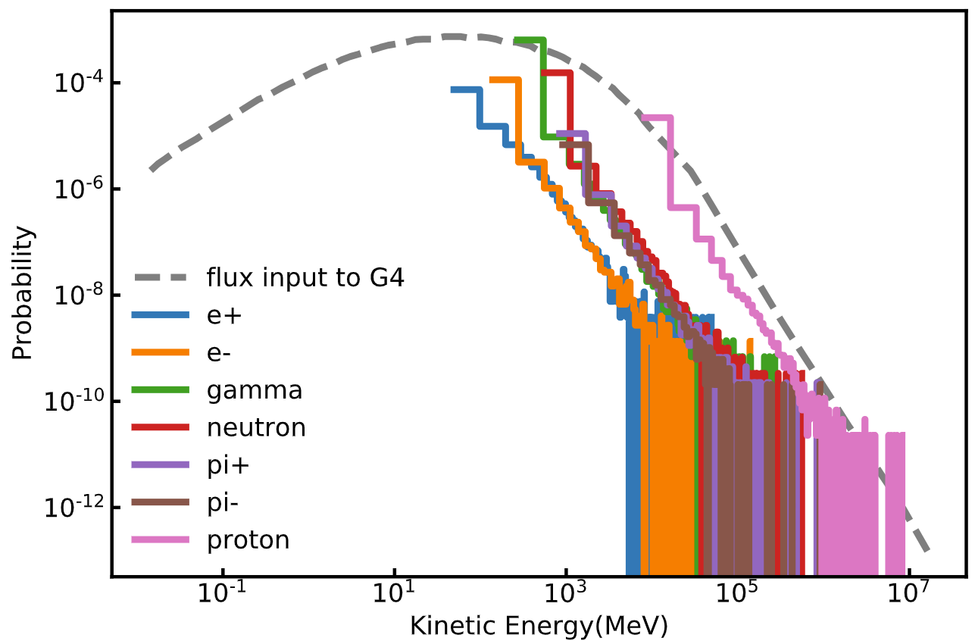
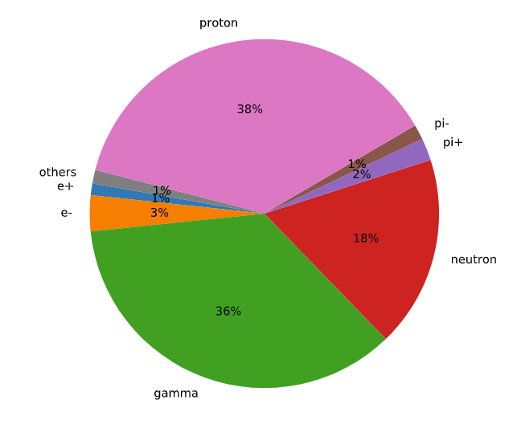
Test result
Input: Cosmic proton spectrum
To do:
Check Geant4 simulation in details
Look into the total cosmic flux result and summarize

Slide 4
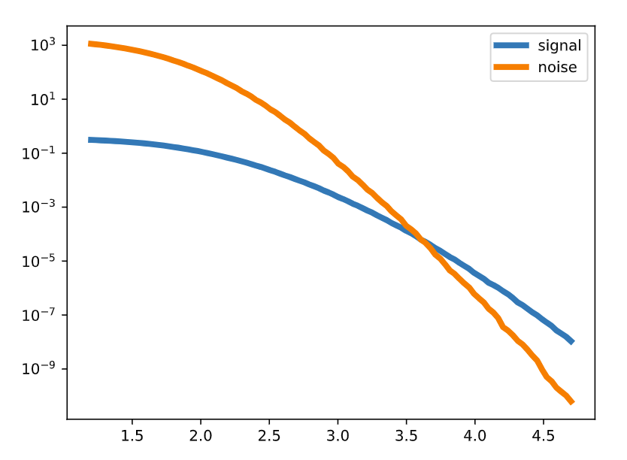
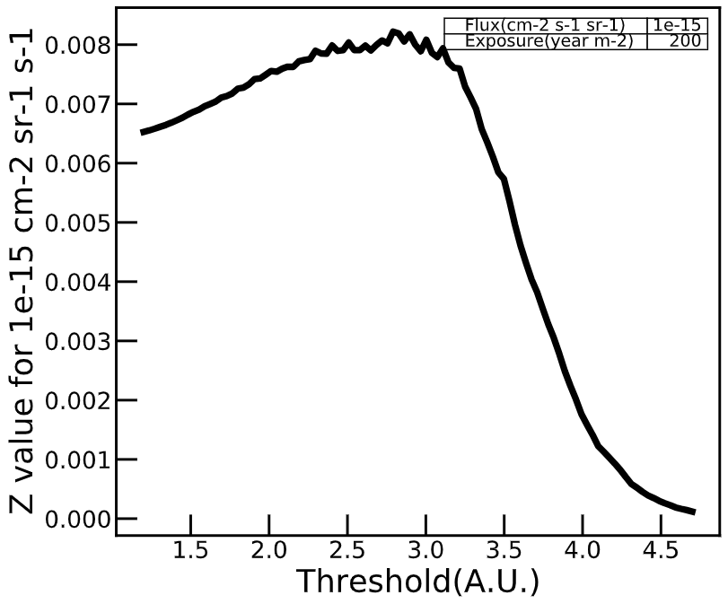

Threshold Optimize
Signal:
$$s=Flux∗Exposure∗A_{coil}^{N_{c}}∗A_{ps}$$
Background:
$$b=R_{ps}∗\frac{{\left(R_{coil}∆t\right)}^{N_{c}}}{N_{c}!}∗Exposure$$
Set $σ_{b}= \sqrt{b}$

Slide 5
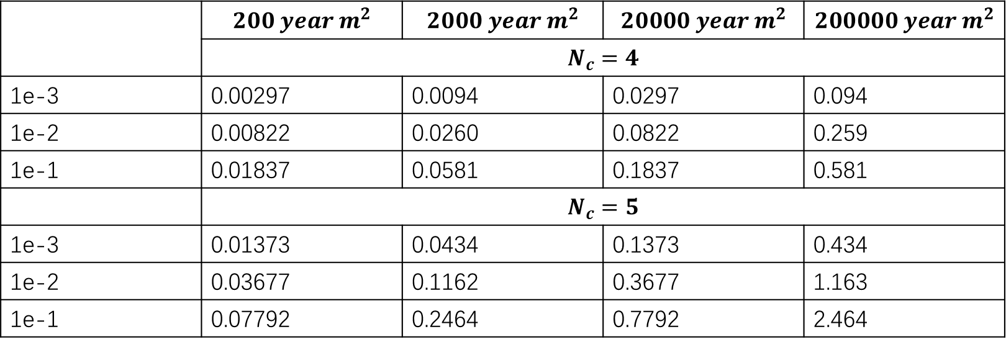
Threshold Optimize
Set $Flux=1e^{−15}s^{−1}cm^{−2}sr^{−1}$
 | $$200 year m^{2}$$ | $$2000 year m^{2}$$ | $$20000 year m^{2}$$ | $$200000 year m^{2}$$
 | $N_{c}=4$
1e-3 | 0.00297 | 0.0094 | 0.0297 | 0.094
1e-2 | 0.00822 | 0.0260 | 0.0822 | 0.259
1e-1 | 0.01837 | 0.0581 | 0.1837 | 0.581
 | $N_{c}=5$
1e-3 | 0.01373 | 0.0434 | 0.1373 | 0.434
1e-2 | 0.03677 | 0.1162 | 0.3677 | 1.163
1e-1 | 0.07792 | 0.2464 | 0.7792 | 2.464

Slide 6
