Slide 1

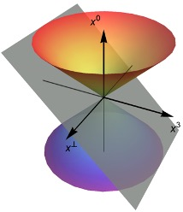
Higher-twist effects of protons with basis light-front quantization
Xingbo Zhao
Zhimin Zhu, Ziqi Zhang, Chandan Mondal and Siqi Xu
Institute of Modern Physics, Chinese Academy of Sciences
第二届核子三维结构研讨会暨第二届高扭度核子结构研讨会
2024年10月19日 @ 青岛

Slide 2
Outline
Motivations: higher-twist effects
Basis light-front quantization
Numerical results
GPDs
Transverse color Lorentz force
TMDs

Slide 3
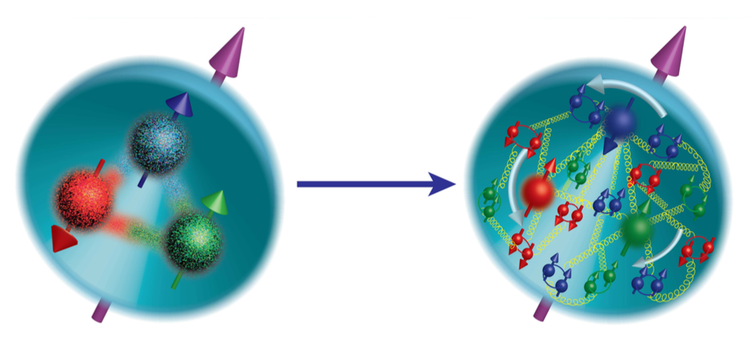
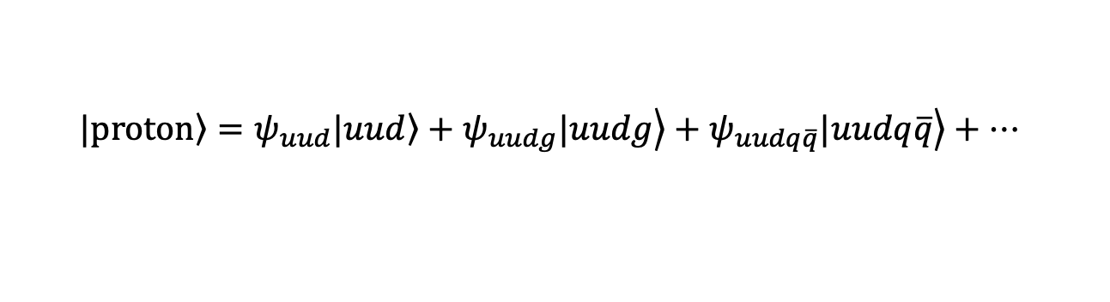
Proton structure
Proton is made of
  2 up quarks + 1 down quark
  + any number of quark-antiquark pairs
  + any number of gluons
valence quarks
sea quarks
Quark model
Parton model
Fock sector expansion
$$\left.|proton\right\rangle =ψ_{uud}\left.|uud\right\rangle +\left.ψ_{uudg}|uudg\right\rangle +\left.ψ_{uudq\overline{q}}|uudq\overline{q}\right\rangle +…$$
Many body system
Rich structure of proton

Slide 4


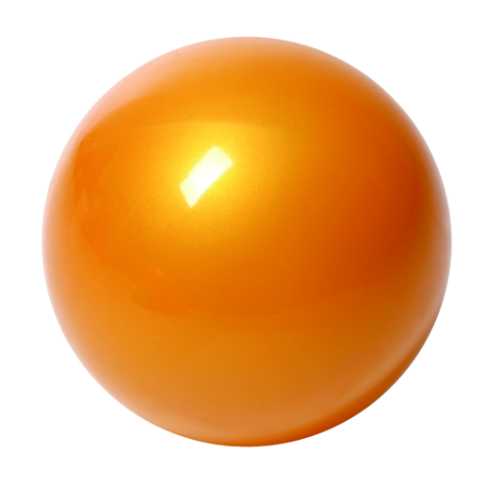



Parton distributions
  Parton Distribution Functions (PDFs): 1D long. momentum
  Generalized parton distributions (GPDs): 1D long. + 2D trans. position
  Transverse-momentum-dependent PDFs: 1D long. + 2D trans. momentum
$$b_{T}$$
$$GPD$$
$$TMD$$
Longitudinal + transverse position
Longitudinal + transverse momentum
electron
electron
photon
p
p’
p
X
h
Deeply virtual Compton scattering (DVCS)
Semi-inclusive Deep Inelastic Scattering (SIDIS)
DVCS/SIDIS processes: extract GPDs/TMDs

Slide 5
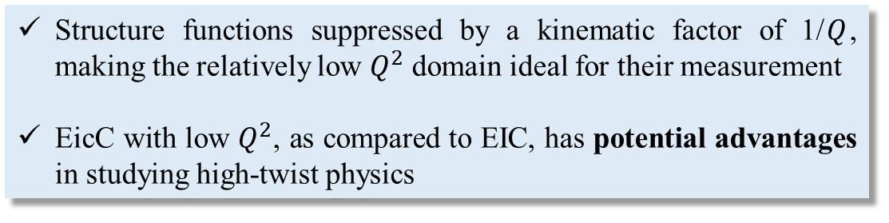
Higher-twist effects
Higher-twist distributions:
  Reflecting the physics of multi-parton correlations
Multi-parton distributions correspond to the interference of hadron wave functions between different Fock sectors
The physics of quark-gluon correlations:
  Transverse color Lorentz force [F. Aslan, et al. PRD 096021 (2019)]
  Spin-orbital correlation [C. Lorcé, PLB 735 (2014) 344–348]
  Partonic transverse AM [Y. Guo, et al. NPB 969 (2021) 115440]
  ……
Structure functions suppressed by a kinematic factor of 1/$Q$, making the relatively low $Q^{2}$ domain ideal for their measurement
EicC with low $Q^{2}$, as compared to EIC, has potential advantages in studying high-twist physics

Slide 6
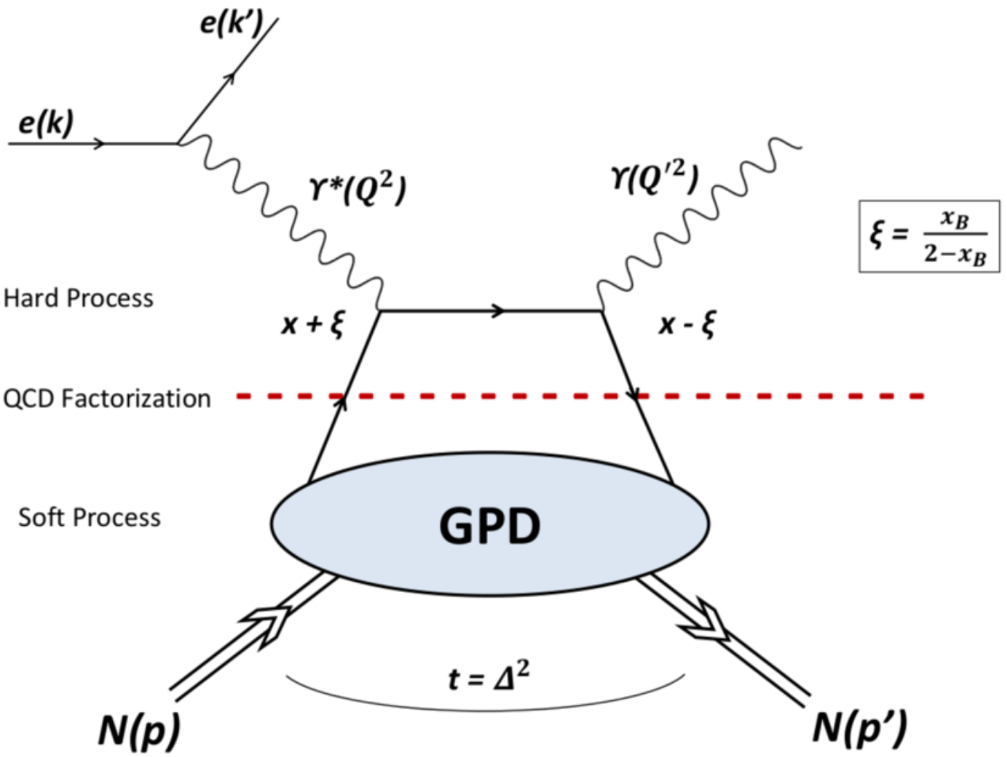
Generalized parton distribution functions
GPDs can be assessed through deeply virtual Compton scattering
Encode 3D spatial information
Contain information about spin and orbital angular momentum
Appear in DVCS / DVMP / TCS / DDVCS …

Slide 7
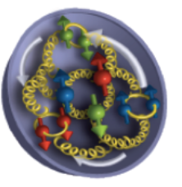
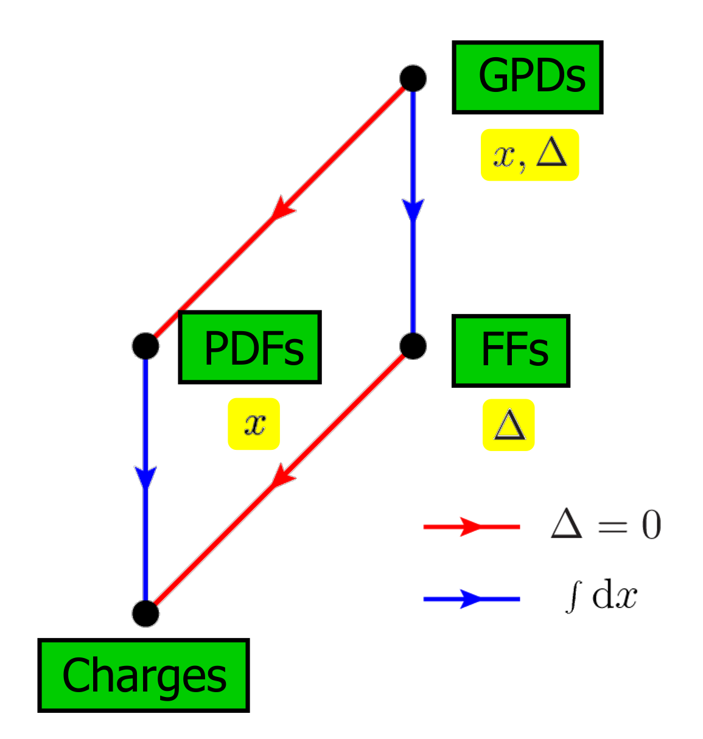
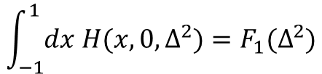
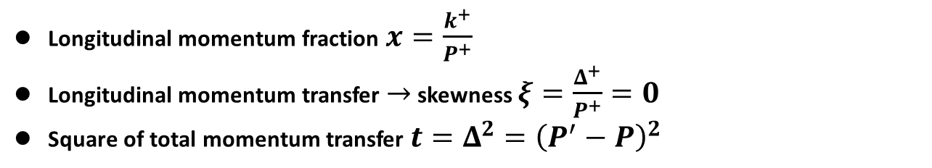


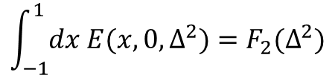
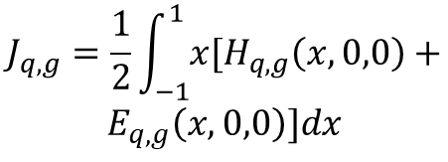
Generalized parton distribution functions
GPDs are functions of three variables:
Longitudinal momentum fraction $x=\frac{k^{+}}{P^{+}}$
Longitudinal momentum transfer $→$ skewness $ξ=\frac{Δ^{+}}{P^{+}}=0$
Square of total momentum transfer $t=Δ^{2}={\left(P^{′}−P\right)}^{2}$
GPDs relate to:
Parton distribution
Form factors
Total angular momentum
$$\int_{−1}^{1}{dx H(x,0,Δ^{2})}=F_{1}(Δ^{2})$$
$$H\left(x,0,0\right)=q(x)$$
$$J_{q,g}=\frac{1}{2}\int_{−1}^{1}{x[H_{q,g}\left(x,0,0\right)+}$$
$$E_{q,g}\left(x,0,0\right)]dx$$
$$\tilde{H}\left(x,0,0\right)=Δq(x)$$
$$\int_{−1}^{1}{dx E(x,0,Δ^{2})}=F_{2}(Δ^{2})$$

Slide 8
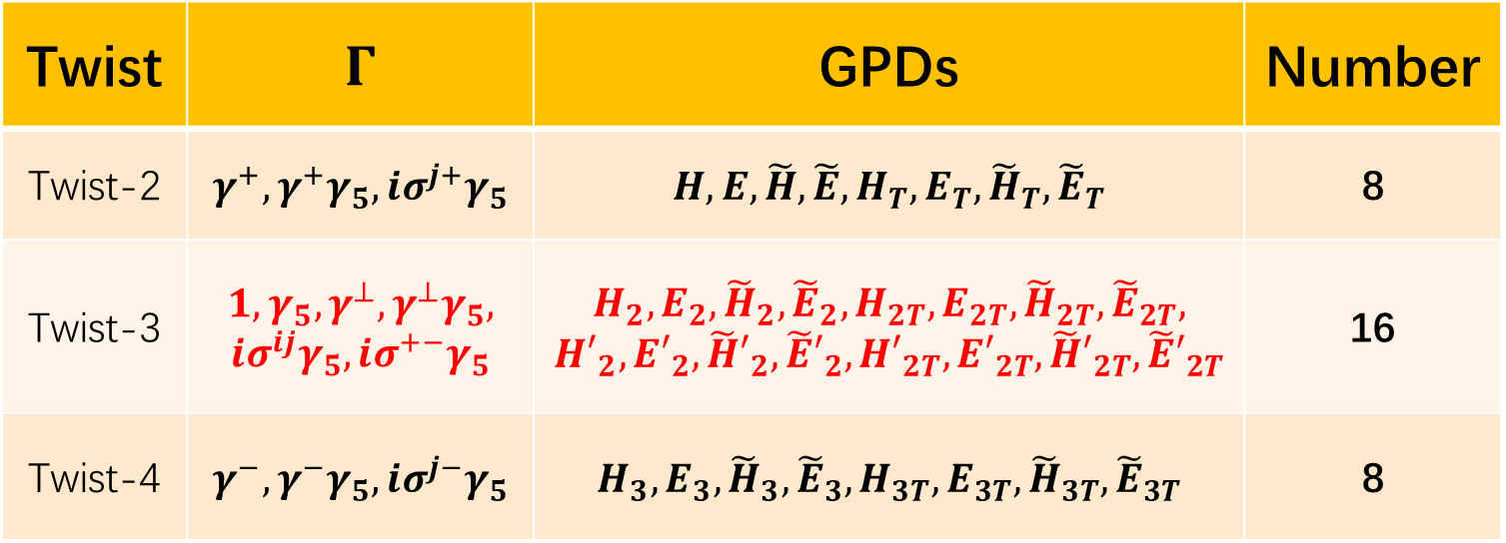
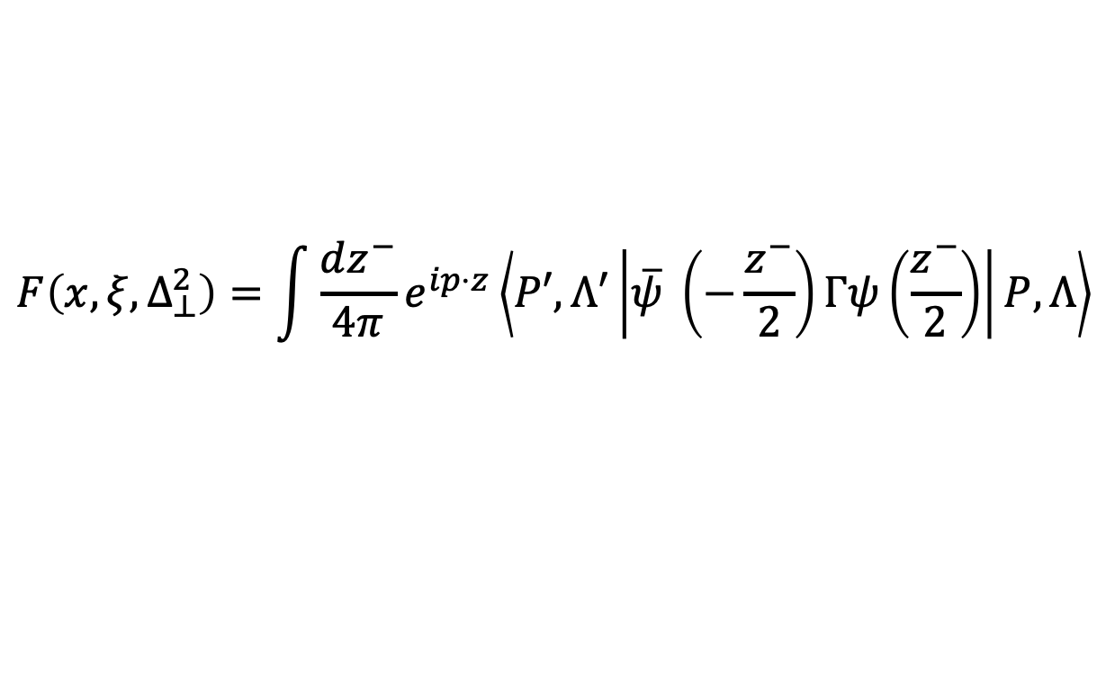

Generalized parton distribution functions
GPDs are defined by the following bi-local operator:
$$F\left(x,ξ,Δ_{⊥}^{2}\right)=\int{\frac{dz^{−}}{4π}}e^{ip⋅z}\left\langle P′,Λ′\left|\overline{ψ} \left(−\frac{z^{−}}{2}\right)Γψ\left(\frac{z^{−}}{2}\right)\right|P,Λ\right\rangle$$
$$z_{ }^{+}=0$$
Parameterization
[S. Meißner et.al, 2009]
Twist | $$Γ$$ | GPDs | Number
Twist-2 | $$γ^{+},γ^{+}γ_{5},iσ^{j+}γ_{5}$$ | $$H,E,\tilde{H},\tilde{E},H_{T},E_{T},{\tilde{H}}_{T},{\tilde{E}}_{T}$$ | 8
Twist-3 | $$1,γ_{5},γ^{⊥},γ^{⊥}γ_{5},$$ $$iσ^{ij}γ_{5},iσ^{+−}γ_{5}$$ | $$H_{2},E_{2},{\tilde{H}}_{2},{\tilde{E}}_{2},H_{2T},E_{2T},{\tilde{H}}_{2T},{\tilde{E}}_{2T},$$ $${H′}_{2},{E′}_{2},{\tilde{H}′}_{2},{\tilde{E}′}_{2},{H′}_{2T},{E′}_{2T},{\tilde{H}′}_{2T},{\tilde{E}′}_{2T}$$ | 16
Twist-4 | $$γ^{−},γ^{−}γ_{5},iσ^{j−}γ_{5}$$ | $$H_{3},E_{3},{\tilde{H}}_{3},{\tilde{E}}_{3},H_{3T},E_{3T},{\tilde{H}}_{3T},{\tilde{E}}_{3T}$$ | 8

Slide 9
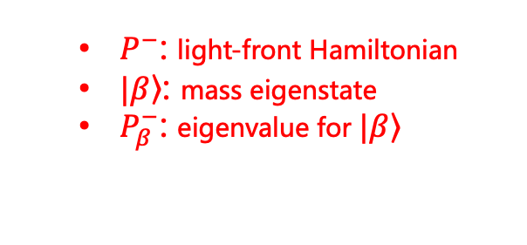
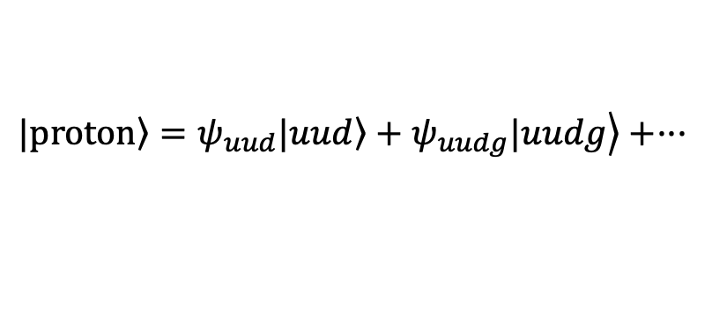
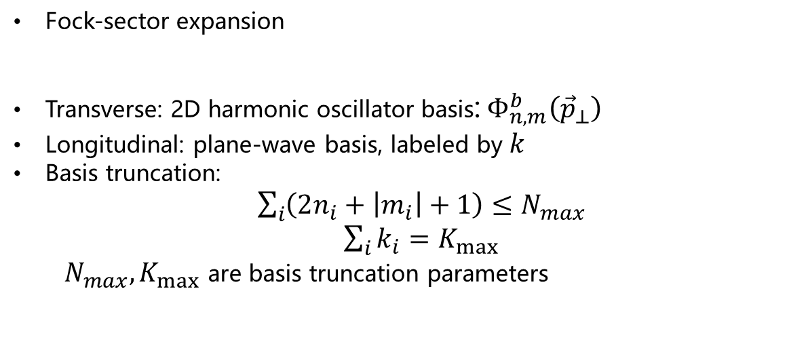
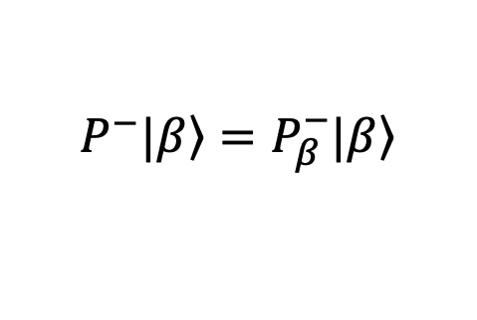
Basis light-front quantization (BLFQ)
Light-front Schrödinger equation
[Vary et al, 2008]
Eigenvalue problem
$$P^{−}|\left.β\right\rangle =P_{β}^{−}|\left.β\right\rangle$$
  $P^{−}$: light-front Hamiltonian
  $|\left.β\right\rangle$: mass eigenstate
  $P_{β}^{−}$: eigenvalue for $|\left.β\right\rangle$
Fock-sector expansion
Transverse: 2D harmonic oscillator basis:${ Φ}_{n,m}^{b}\left({\vec{p}}_{⊥}\right)$
Longitudinal: plane-wave basis, labeled by $k$
Basis truncation:
  $\sum_{i}{\left(2n_{i}+\left|m_{i}\right|+1\right)}≤N_{max}$
  $\sum_{i}{k_{i}}=K_{max}$
  $N_{max},K_{max}$ are basis truncation parameters
$$\left.|proton\right\rangle =ψ_{uud}\left.|uud\right\rangle +\left.ψ_{uudg}|uudg\right\rangle +···$$

Slide 10
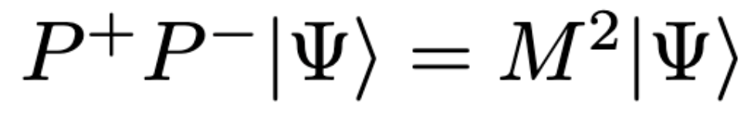
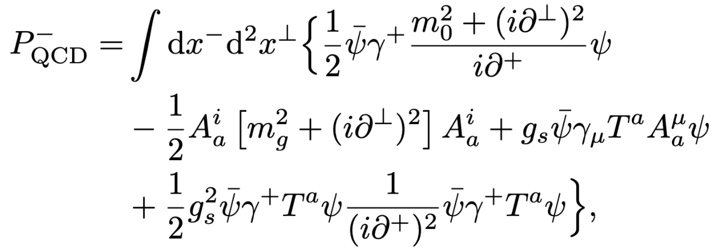




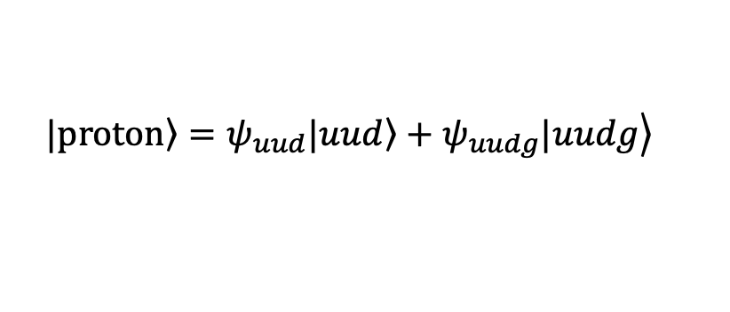
Proton with one dynamic gluon
$$\left.|proton\right\rangle =ψ_{uud}\left.|uud\right\rangle +\left.ψ_{uudg}|uudg\right\rangle$$
QCD Interaction:
[Siqi Xu et al, PRD 108 (2023) 9, 094002]
Confinement:
Parameters:
Truncation: N_{max}=9, K=16.5
HO parameters: b=0.7GeV, b_{inst}=3GeV
m_{u} | m_{d} | m_{g} | κ | m_{f} | g
0.31GeV | 0.25GeV | 0.50GeV | 0.54GeV | 1.80GeV | 2.40

Slide 11


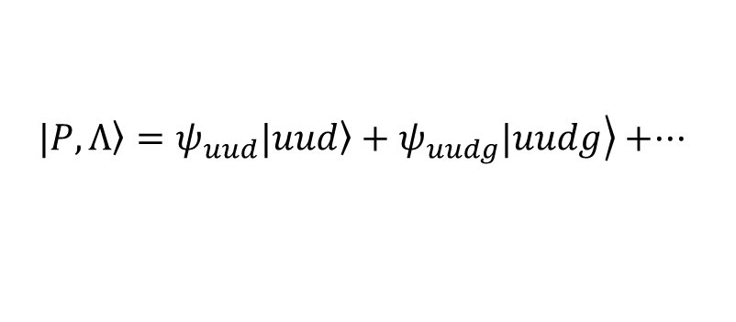







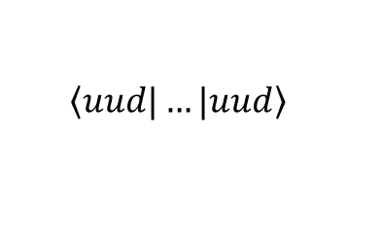

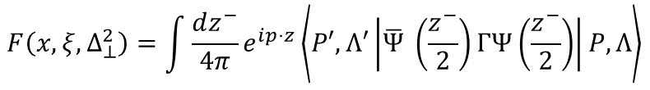
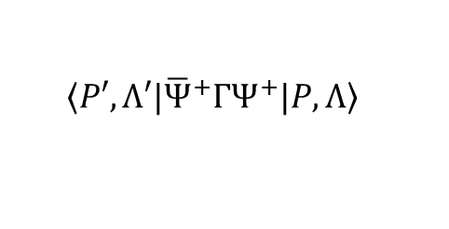
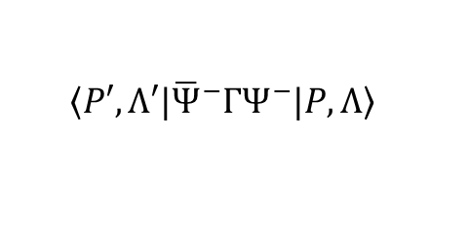
Quark GPDs from LFWFs
Quark correlator:
$$F\left(x,ξ,Δ_{⊥}^{2}\right)=\int{\frac{dz^{−}}{4π}}e^{ip⋅z}\left\langle P′,Λ′\left|\overline{Ψ} \left(\frac{z^{−}}{2}\right)ΓΨ\left(\frac{z^{−}}{2}\right)\right|P,Λ\right\rangle$$
$$z^{+}=0,z^{⊥}=0$$
Hadron states:
$$\left.|P,Λ\right\rangle =ψ_{uud}\left.|uud\right\rangle +\left.ψ_{uudg}|uudg\right\rangle +···$$
Light-front wave functions
Fermion field operator:
$Ψ^{+}$: free component
$$Ψ\left(x\right)=Ψ^{+}\left(x\right)+Ψ^{−}\left(x\right)$$
$Ψ^{−}$: constraint component
Overlap representation:
twist-2:
$$\left\langle P′,Λ′|\right.{\overline{Ψ}}^{+}ΓΨ^{+}\left.|P,Λ\right\rangle$$
$$\left\langle uud|\right.…\left.|uud\right\rangle$$
$$qqq$$
twist-3:
$$\left\langle P′,Λ′|\right.\left({\overline{Ψ}}^{+}ΓΨ^{−}+{\overline{Ψ}}^{−}ΓΨ^{+}\right)\left.|P,Λ\right\rangle =$$
$$\left\langle uudg|\right.…\left.|uudg\right\rangle$$
$$qqqg$$
$$\left\langle uudg|\right.…\left.|uud\right\rangle +h.c.$$
$$genuine$$
twist-4:
$$\left\langle P′,Λ′|\right.{\overline{Ψ}}^{−}ΓΨ^{−}\left.|P,Λ\right\rangle$$

Slide 12
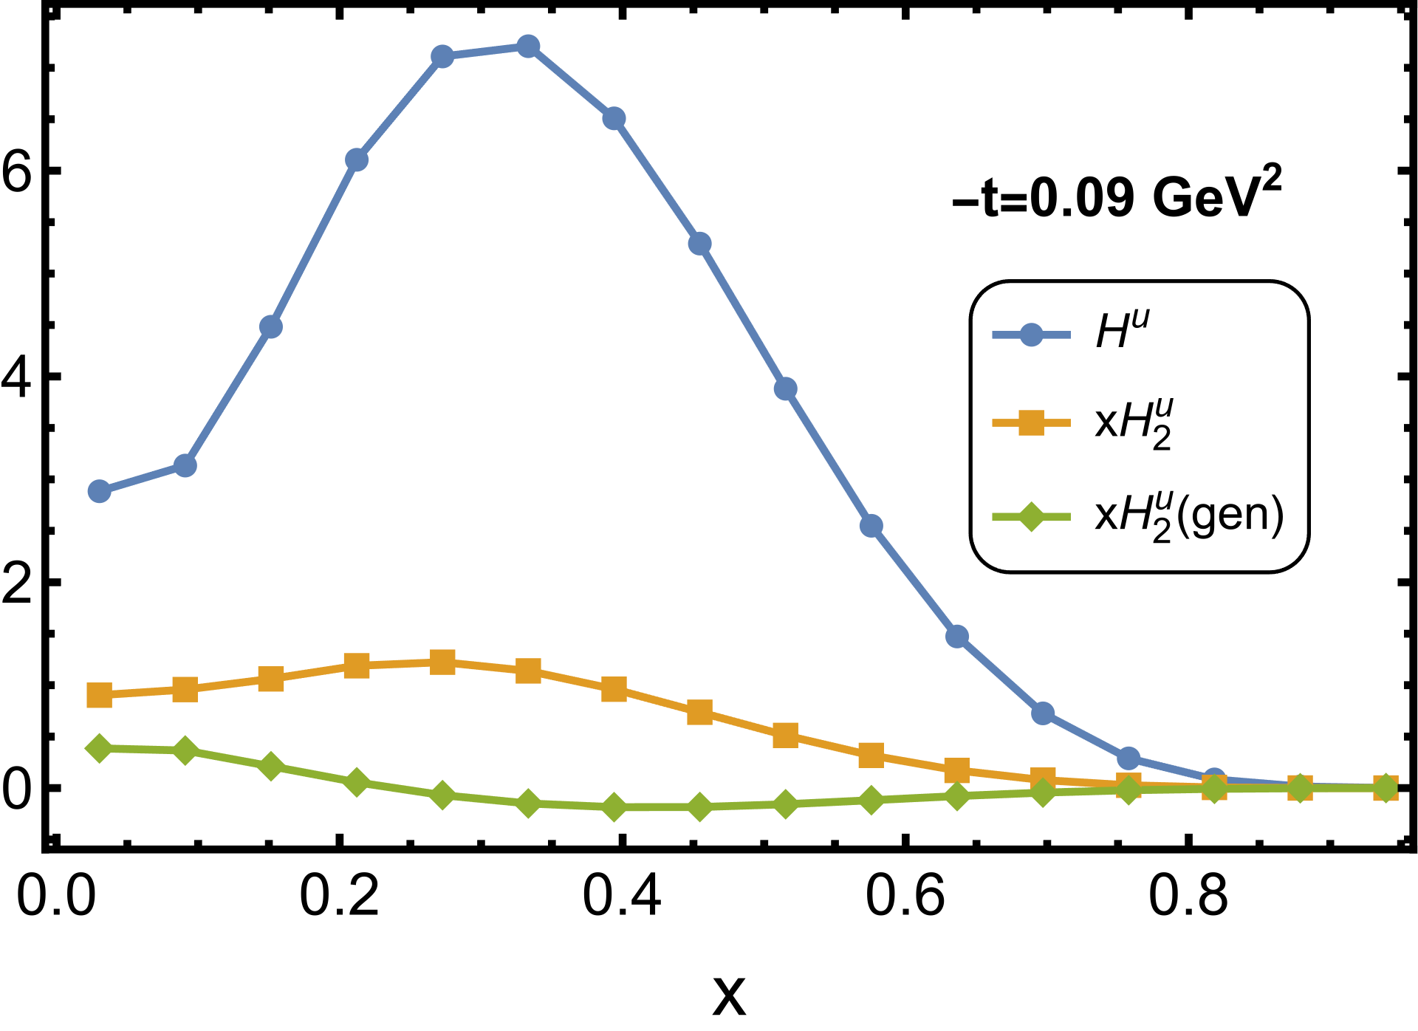
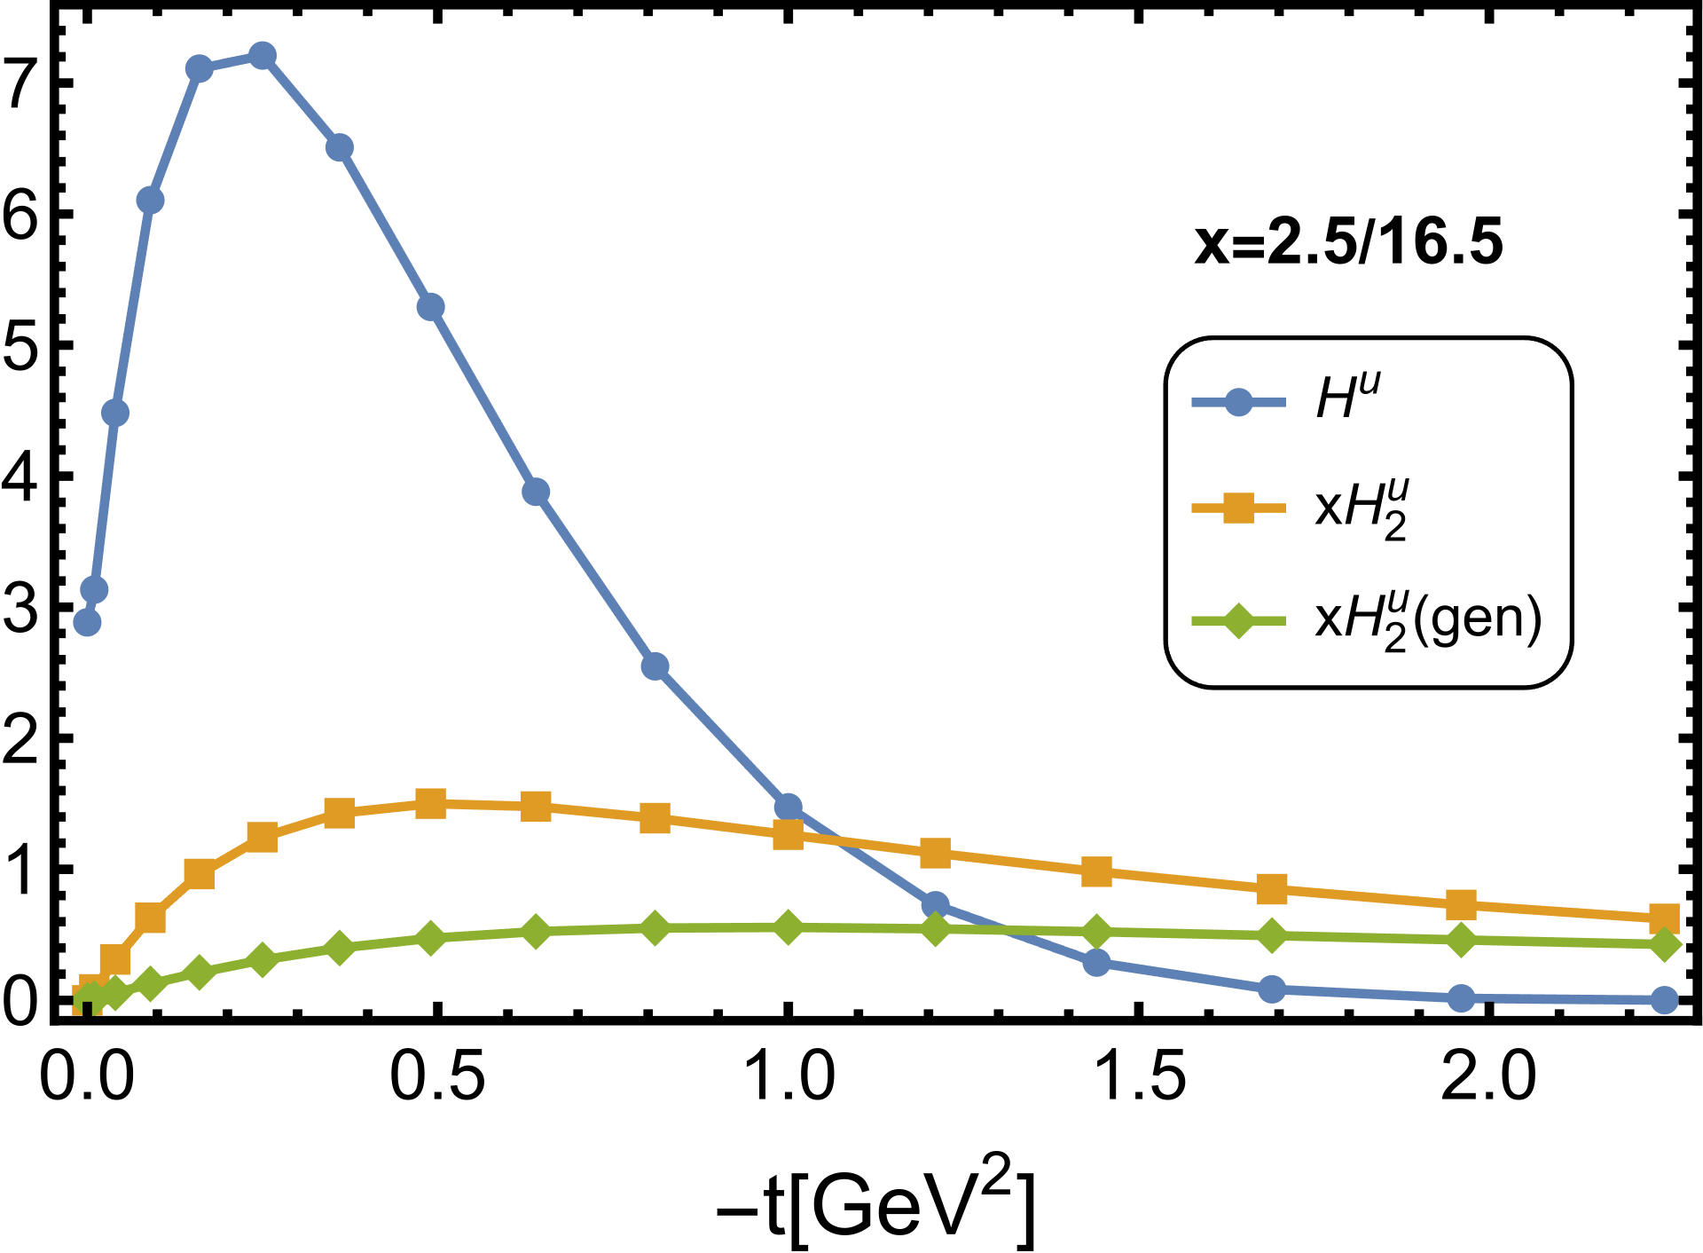

Twist-2 vs -3 GPDs
  [Ziqi Zhang, et.al., in preparation]
(tw-2)
(tw-3)
Twist-3 GPDs are comparable with twist-2 GPDs
Genuine contributions that contain q-g-q correlator are non-negligible

Slide 13
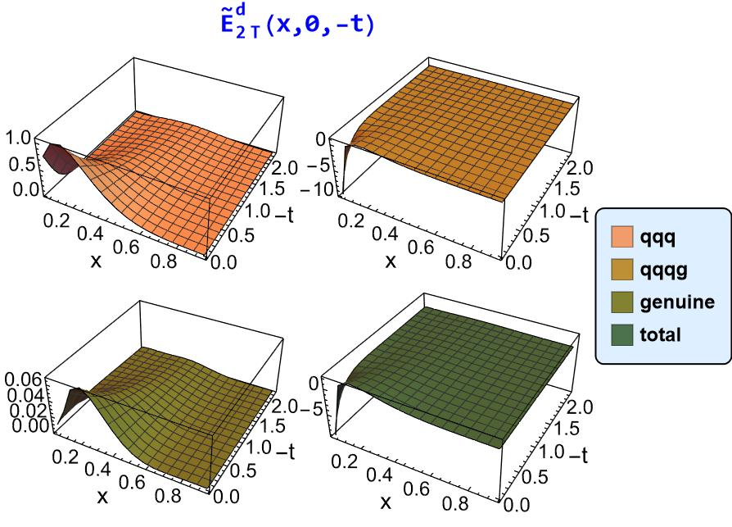
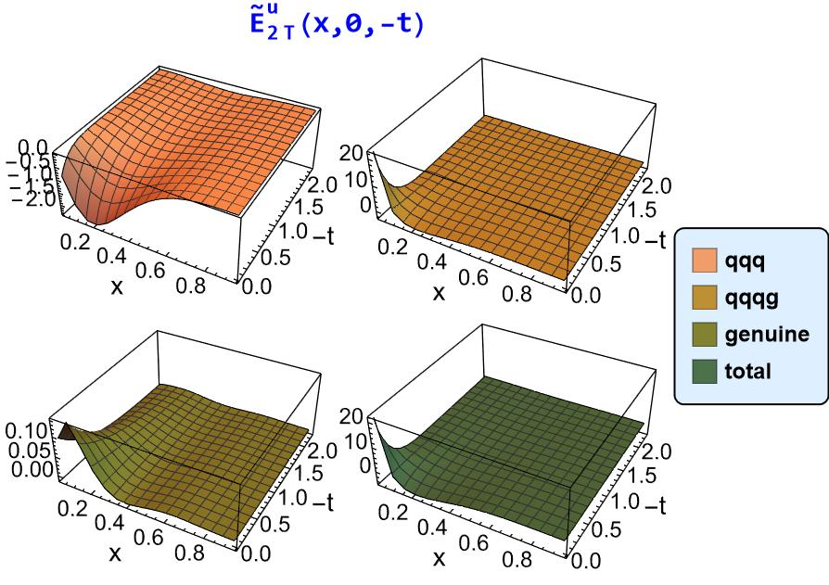

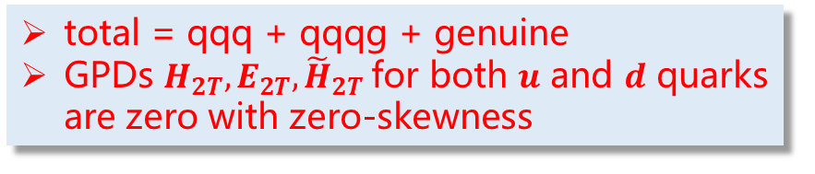
Twist-3 GPDs from BLFQ $(Γ=γ^{⊥})$
  [Ziqi Zhang, et.al., in preparation]
total = qqq + qqqg + genuine
GPDs $H_{2T}, E_{2T}, {\tilde{H}}_{2T}$for both 𝒖 and 𝒅 quarks are zero with zero-skewness

Slide 14
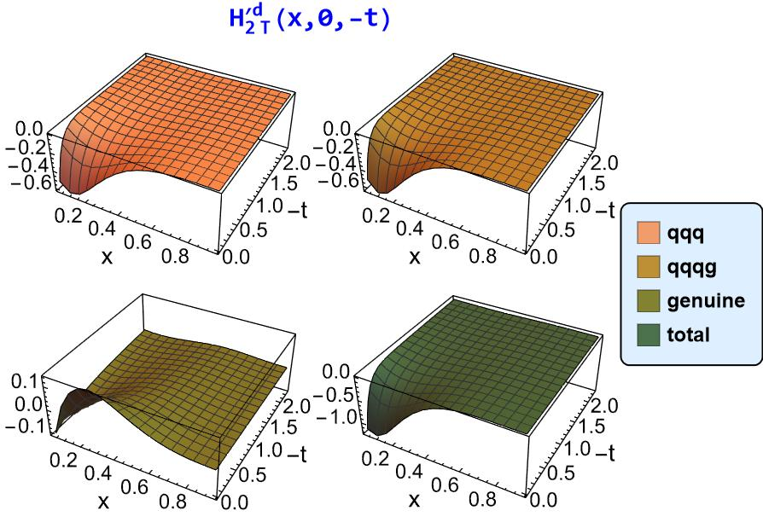
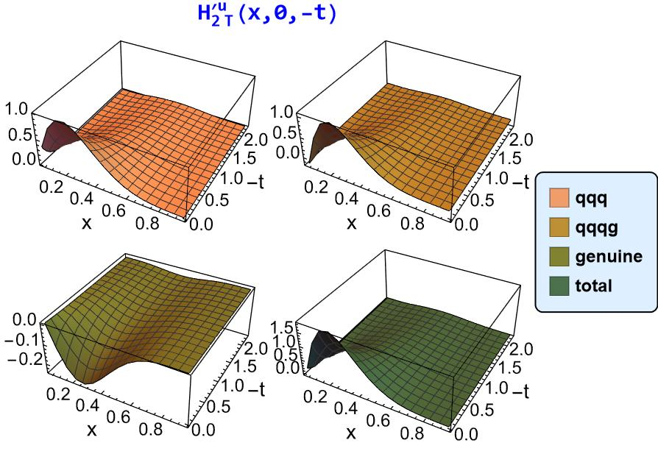
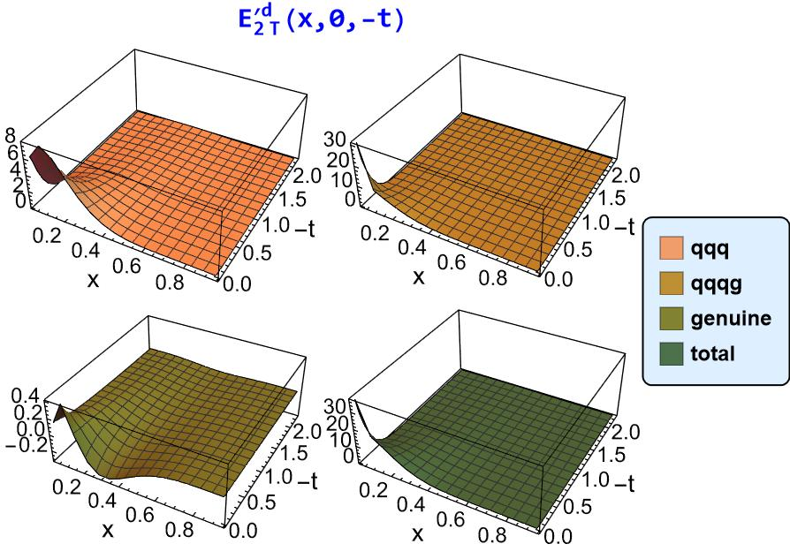
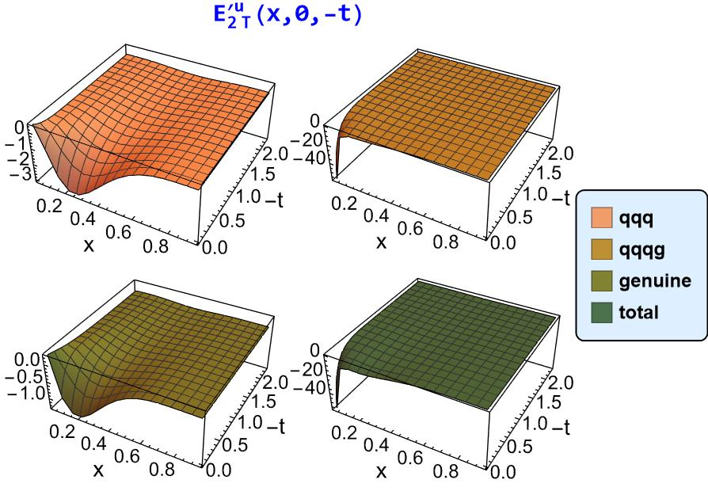

  [Ziqi Zhang, et.al., in preparation]
Twist-3 GPDs from BLFQ $(Γ=γ^{⊥}γ_{5})$

Slide 15
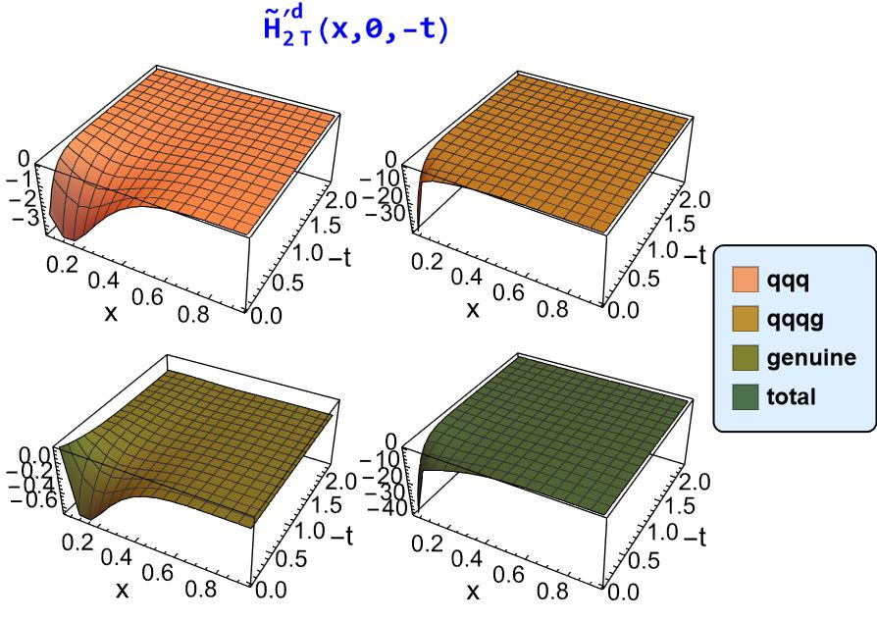
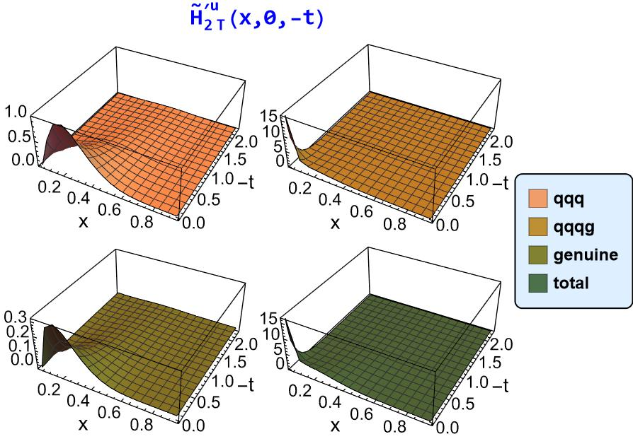
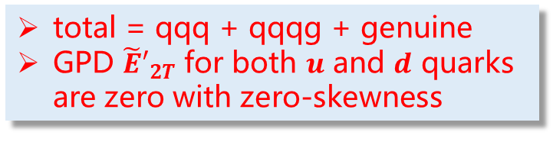
Twist-3 GPDs from BLFQ $(Γ=γ^{⊥}γ_{5})$
  [Ziqi Zhang, et.al., in preparation]
total = qqq + qqqg + genuine
GPD ${\tilde{E}′}_{2T}$ for both 𝒖 and 𝒅 quarks are zero with zero-skewness

Slide 16
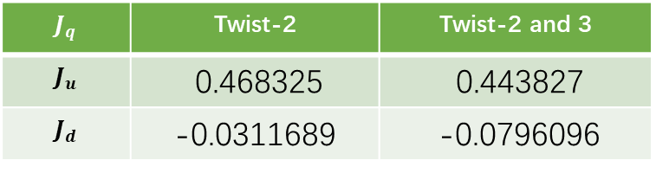
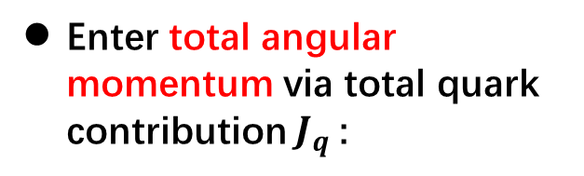
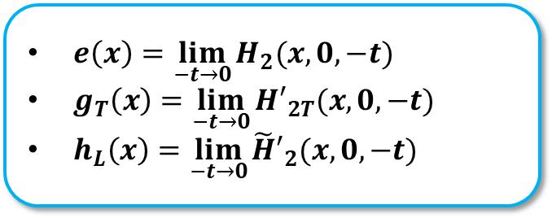
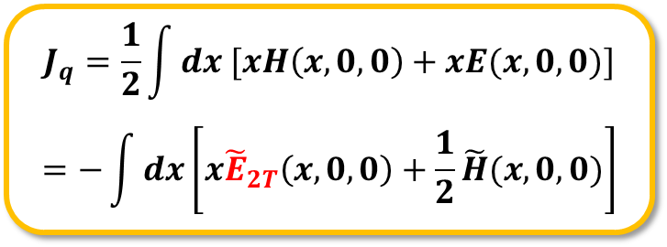
Properties of twist-3 GPDs
Twist-3 GPDs relate to the following things:
[Y. Guo et.al, 2021]
Obtain twist-3 PDFs by taking the forward limit:
Enter total angular momentum via total quark contribution $J_{q}$:
$e\left(x\right)=\lim_{−t→0}{H_{2}(x,0,−t)}$
$g_{T}\left(x\right)=\lim_{−t→0}{{H′}_{2T}(x,0,−t)}$
$h_{L}\left(x\right)=\lim_{−t→0}{{\tilde{H}′}_{2}(x,0,−t)}$
$$J_{q}=\frac{1}{2}\int{dx [xH\left(x,0,0\right)}+xE(x,0,0)]$$
$$=−\int{dx}\left[x{\tilde{E}}_{2T}\left(x,0,0\right)+\frac{1}{2}\tilde{H}(x,0,0)\right]$$
Relate to twist-3 Compton form factors
$$J_{q}$$ | Twist-2 | Twist-2 and 3
$$J_{u}$$ | 0.468325 | 0.443827
$$J_{d}$$ | -0.0311689 | -0.0796096

Slide 17
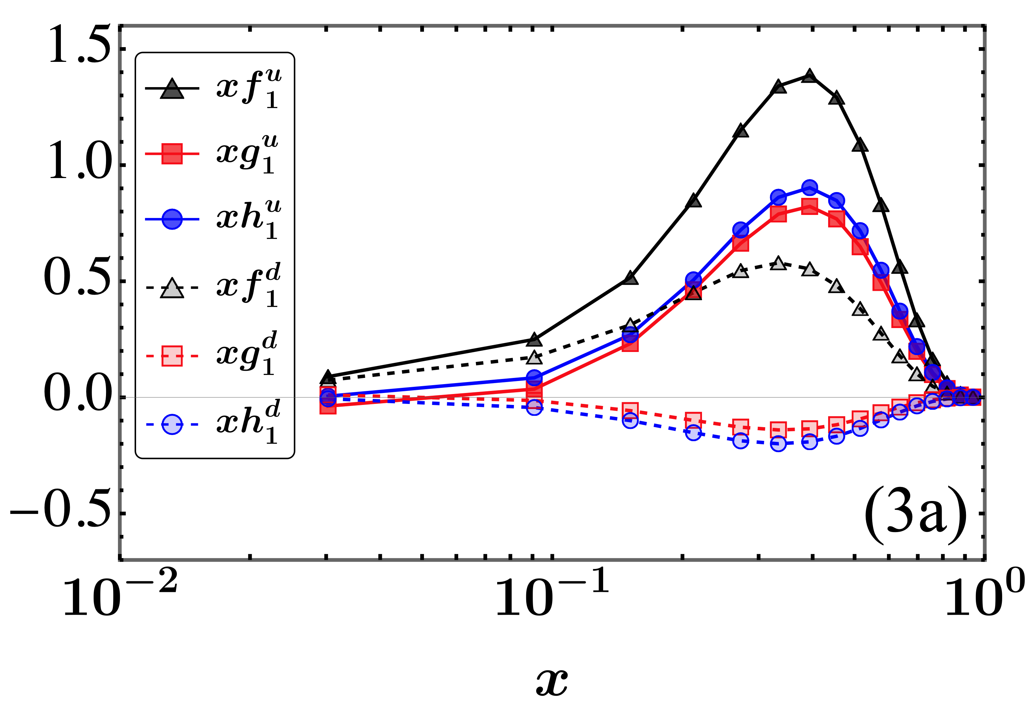
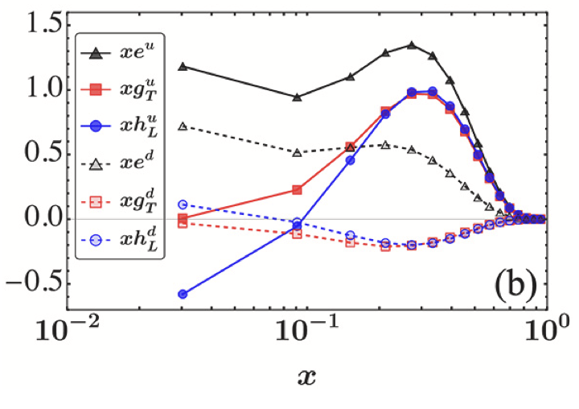

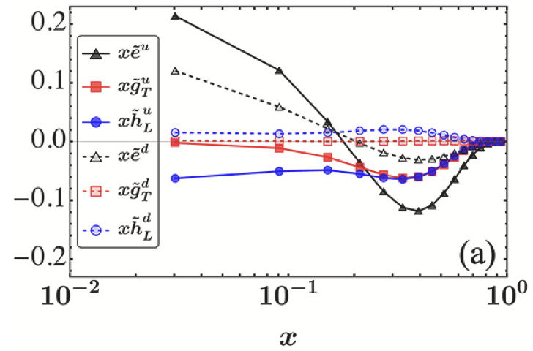
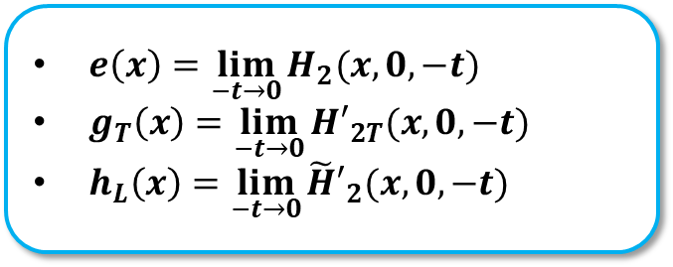
xPDFs from BLFQ
twist-2 xPDFs
twist-3 xPDFs
genuine twist-3 xPDFs
$e\left(x\right)=\lim_{−t→0}{H_{2}(x,0,−t)}$
$g_{T}\left(x\right)=\lim_{−t→0}{{H′}_{2T}(x,0,−t)}$
$h_{L}\left(x\right)=\lim_{−t→0}{{\tilde{H}′}_{2}(x,0,−t)}$
Twist-3 PDFs:
More concentrating in small x
Similar magnitude to twist-2 PDFs

Slide 18
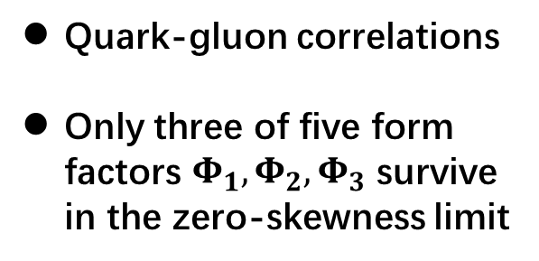


Transverse color Lorentz force
[M. Burkardt, PRD 88, 114502 (2013)]
Lorentz-force matrix element (higher-twist form factors) can be parametrized as:
[F. Aslan et.al, 2019]
$$−\sqrt{2}P^{+}F_{λ^{′}λ}^{j}\left(−t\right)=\left\langle p^{′},λ^{′}\left|\overline{q}\left(0\right)γ^{+}igG^{+j}\left(0\right)q\left(0\right)\right|p,λ\right\rangle =\overline{u}(p^{′},λ′)\left\{\frac{1}{M^{2}}\left[P^{+}Δ_{⊥}^{j}−P^{⊥}Δ^{+}\right]γ^{+}Φ_{1}\left(−t\right)+\frac{P^{+}}{M}iσ^{+j}Φ_{2}\left(−t\right)+\frac{1}{M^{3}}iσ^{+Δ}\left[P^{+}Δ_{⊥}^{j}Φ_{3}\left(−t\right)−P^{⊥}Δ^{+}Φ_{4}\left(−t\right)\right]+\frac{P^{+}Δ^{+}}{M^{3}}iσ^{jΔ}Φ_{5}\left(−t\right)\right\}u(p,λ)$$
Quark-gluon correlations
Only three of five form factors $Φ_{1},Φ_{2},Φ_{3}$ survive in the zero-skewness limit
Fourier transformation provides the force field distribution in impact parameter space
$$ℱ_{λ′λ}\left(b_{⊥}^{2}\right)=\int{\frac{d^{2}Δ_{⊥}}{{\left(2π\right)}^{2}}}e^{−ib⋅Δ}F_{λ′λ}(Δ_{⊥}^{2})$$

Slide 19






Twist-3 form factors
  [Ziqi Zhang, et.al., in preparation]
[Lattice QCD, arXiv:2408.03621]
Qualitive features agree with LQCD results
Energy scales of BLFQ and LQCD are different
BLFQ: d quark is comparable with u quark
LQCD: u quark strongly dominates d quark

Slide 20





Illustration of force field distributions
  [Ziqi Zhang, et.al., in preparation]
$$Φ_{1}^{u}(b^{2})$$
$$Φ_{1}^{d}(b^{2})$$
Arrows are 2D vectors with component 𝒋=𝒙,𝒚 taken from $ℱ_{λ^{′}λ}^{j}\left(b_{⊥}^{2}\right)$
This term contributes to unpolarized quark in an unpolarized nucleon

Slide 21




Illustration of force field distributions
  [Ziqi Zhang, et.al., in preparation]
Spin
$$Φ_{2}^{u}(b^{2})$$
$$Φ_{2}^{d}(b^{2})$$
This term contributes to unpolarized quark in a transversely polarized nucleon
Leads to spatial distribution of Sivers force

Slide 22




Illustration of force field distributions
Spin
  [Ziqi Zhang, et.al., in preparation]
$$Φ_{3}^{u}(b^{2})$$
$$Φ_{3}^{d}(b^{2})$$
This term contributes to unpolarized quark in a transversely polarized nucleon

Slide 23










Transverse color Lorentz force
Reduced local matrix element
$$d_{2}^{q}=−\frac{1}{2M{\left(P^{+}\right)}^{2}S^{x}}\left\langle P,S_{T}\left|\overline{q}\left(0\right)γ^{+}gG^{+y}\left(0\right)q\left(0\right)\right|P,S_{T}\right\rangle$$
Relates to average transverse color Lorentz force as a semiclassical interpretation acting on the struck quark in a DIS experiment:
$${F^{q,y}\left(0\right)=2MP^{+}S^{x}d}_{2}^{q}$$
[Lattice QCD, PRD 72, 054507 (2005)]
$$d_{2}^{d}=−0.0286$$
$$d_{2}^{d}=−0.011±0.010$$
$$d_{2}^{u}=0.0574$$
$$d_{2}^{u}=0.020±0.024$$
BLFQ results:
LQCD results:
The signs are consistent with LQCD
$$d_{2}^{p}=0.004(5)$$
$$d_{2}^{p}=0.0223$$
$$d_{2}^{n}=−0.0063$$
$$d_{2}^{n}=−0.001(3)$$

Slide 24
TMD-PDFs
  Parton Distribution Functions (PDFs): 1D longitudinal
  Transverse-momentum-dependent PDFs: 1D longitudinal + 2D transverse
Probability for finding a parton in a hadron with momentum fraction x and transverse momentum k_{T}
Longitudinal + transverse momentum
electron
h
h₁
h₂
h’
Semi-inclusive Deep Inelastic Scattering (SIDIS)
Drell-Yan process
SIDIS and Drell-Yan processes: extract TMDs

Slide 25




Semi-inclusive DIS
Factorization Theorem:
even angle: Twist-2
odd angle: Twist-3
……
kinematic analysis
[Bacchetta, et al, JHEP 02 (2007) 093]

Slide 26



Transverse-momentum-dependent PDFs
TMDs are defined by the following bi-local operator:
$$Φ\left(x,k_{⊥}^{ }\right)=\int{\frac{dz^{−}{d2z}^{⊥}}{2(2π)3}}e^{ip⋅z}\left\langle P,Λ′\left|\overline{ψ} \left(−\frac{z}{2}\right)Γψ\left(\frac{z}{2}\right)\right|P,Λ\right\rangle$$
$$z_{ }^{+}=0$$
Parameterization
[S. Meißner et.al, JHEP08(2009)056]
Twist | $$Γ$$ | TMDs | Number
Twist-2 | $$γ^{+},γ^{+}γ_{5},iσ^{j+}γ_{5}$$ | $f_{1},f_{1T}^{⊥}, g_{1L},g_{1T},h_{1T},h_{1L}^{⊥}$, $h_{1T}^{⊥},h_{1}^{⊥}$ | 8
Twist-3 | $$1,γ_{5},γ^{⊥},γ^{⊥}γ_{5},$$ $$iσ^{ij}γ_{5},iσ^{+−}γ_{5}$$ | $$e,e_{T}^{⊥},e_{L},e_{T},f_{ }^{⊥},f_{T}^{⊥},f_{L}^{⊥},f_{T}^{⊥},$$ $$g_{T},g_{L}^{⊥},g_{T}^{⊥},g^{⊥},h_{T}^{⊥},h,h_{L},h_{T}$$ | 16
Twist-4 | $$γ^{−},γ^{−}γ_{5},iσ^{j−}γ_{5}$$ | $$f_{3},f_{3T}^{⊥},g_{3L},g_{3T},h_{3T},h_{3L}^{⊥},h_{3T}^{⊥},h_{3}^{⊥}$$ | 8

Slide 27








Quark TMD-PDF from LFWFs
Quark correlator
Twist-2:
……
(averaging hadron spin S )
Twist-3:
……
Hadron states:
$$\left.|proton\right\rangle =ψ_{uud}\left.|uud\right\rangle +\left.ψ_{uudg}|uudg\right\rangle +···$$
Light-front wave functions
Overlap form of TMDs:
twist-2 TMD:
With projection operator
twist-3 TMD:
genuine twist-3 TMD:

Slide 28






Twist-2 vs -3 xTMDs
Twist-2:
Twist-3:
Genuine twist-3:
More concentrating in small x and k_{T}
Larger than twist-2 TMDs
Genuine parts are not small at small x
[Zhimin Zhu et al, PLB 855 (2024) 138829]

Slide 29
















in π⁺-produced SIDIS process at EicC
Structure functions after integrating over P_{h⊥} :
preliminary
Input:
PDFs: f₁(x), h₁(x) and g_{T}(x) from [PLB 855 (2024) 138829]
FF: D₁(z) from [PRD, 75, 114010, 2007]
Model quark-gluon-quark FF,
Kinematical region of EicC:
preliminary
Twist-3 DSA $A_{LT}^{\text{cos}\text{ϕ}\text{s}}$ is sizable
EicC has potential advantages in studying higher-twist spin asymmetries
Twist-2:
Twist-3:

Slide 30
Conclusion
Higher-twist GPDs/TMDs contain quark-gluon correlations, but are more complex
Investigated transverse color Lorentz force which can be extracted from the quark-gluon correlations
Twist-3 spin asymmetries are comparable with the twist-2 at EicC
Thank You !

