Slide 1
Pion and Kaon Fragmentation Functions
Hui-Yu Xing （邢惠瑜）
Supervisor: Prof. Craig D. Roberts
第二届核子三维结构研讨会（青岛）
October 18, 2024

Slide 2
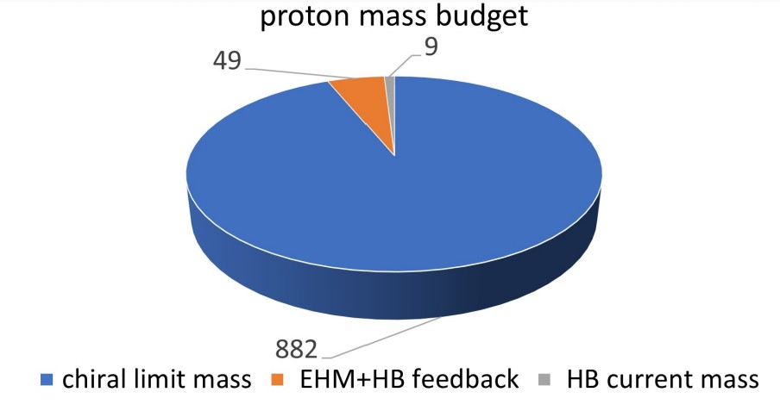
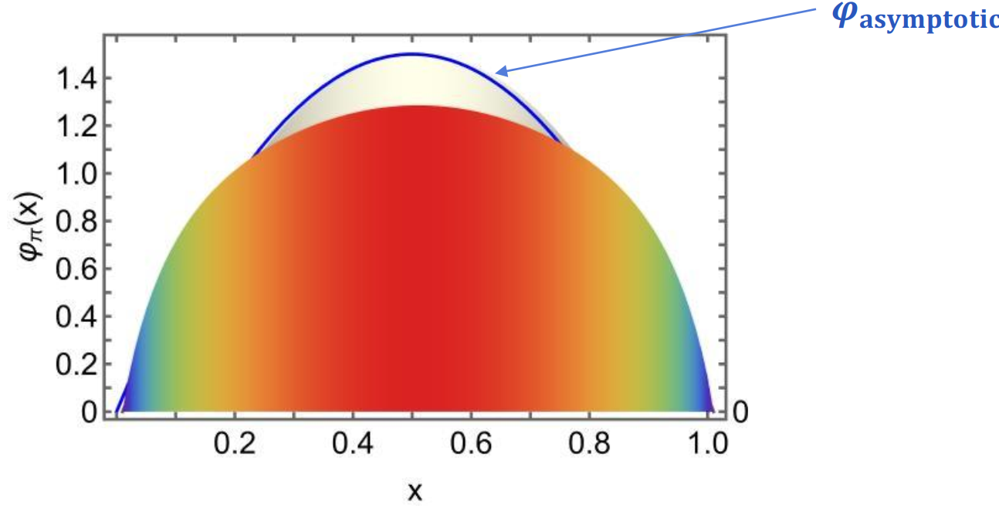
QCD: Emergent Phenomena
Craig D. Roberts, David G. Richards, Tanja Horn, Lei Chang
Prog. Part. Nucl. Phys. 120 (2021) 103883
Two fundamental phenomena in QCD
Emergent Hadron Mass (EHM)
Confinement
Proton mass budget
M_{A=N+Z} ≈ N*m_{n} + Z*m_{p}
Only 9 MeV/939 MeV is directly from Higgs
Evidently, there is another phenomenon in Nature that is extremely effective in producing mass:
Emergent Hadron Mass (EHM)
EHM are expressed in every strong interaction observables
EHM generates broadening in DF & DA
Hui-Yu Xing et al., Phys.Lett.B 849 (2024) 138462
Notes:
What we study is QCD, there are two…
In nature, almost all of the matter’s mass is the sum of the mass of its constitute part. The mass of an atom is the sum mass of the neutrons and protons. But when one considers a nucleon, things are different.
For a proton, a proton is nearly 1 GeV, only 9MeV is directly from the Higgs mechanism, which is the current mass of its constitute quarks….

Slide 3
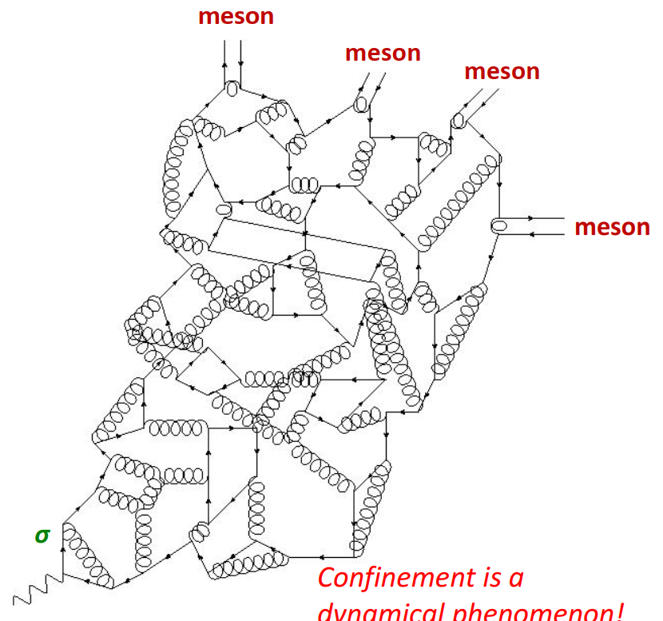
Fragmentation Function
High energy interaction often produce jets of energetic hadrons
- nearly parallel longitudinal momenta & relative small transverse momenta.
Such jets are normally understood to originate with gluon and quark partons
- produced in the initial collision
- Escape interaction region
- Driven by “confinement forces”, fragment into a shower of colourless hadrons
Hadronisation processes are described by fragmentation functions (FFs)
… probability densities:
– For instance, “$D_{u}^{π }\left(z,ζ\right) dz$ ” is probability that
interaction characterised by energy scale ζ
𝑢 quark escaping collision region produces a 𝜋⁺
giving up fraction 𝑧 of its pre-emission light-front momentum
Implicit connection with confinement
⇒ knowledge & understanding of FFs may reveal novel aspects of EHM and confinement
Notes:
The FF is…
Why FF is important/
The initial state is….final is… So this is the process of hadronization…and so that it is related with confinement.
Then, any high energy… whatever… all produce final hadrons… it can be applied in almost all….

Slide 4
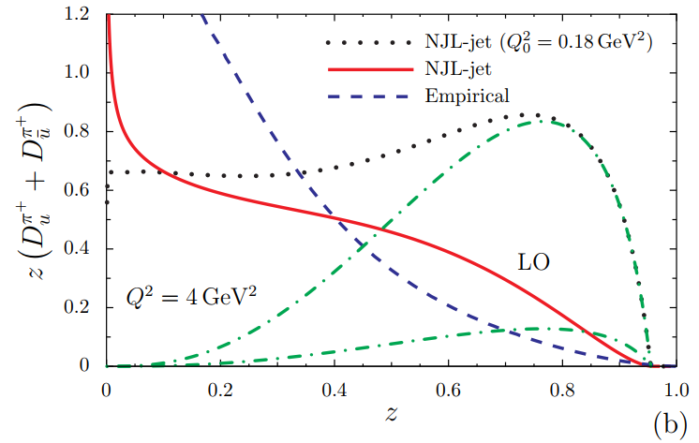
Current development
Experiment:
TASSO: 1982, JADE: 1985, TPC: 1988, OPAL: 1994, DELPHI: 1998, ALEPH: 2000, SLD: 2004,
Belle: 2013, BaBar: 2013, BESIII: 2023 ……
- Fragmentation functions
typically extracted in global fits to selections of hadron production data
e.g., 𝑒+𝑒− → ℎ + 𝑋 (“clean”) & SIDIS (convolution with distribution functions – DFs)
Fit:
HKNS: 2007, DSS: 2007, NNFF: 2017, JAM: 2021, MAPFF: 2022, LAXZ fit: 2024 ……
HKNS fit
- However, existing results have large uncertainties
Theory:
NJL
- Like DFs, FFs are nonperturbative objects
not calculable in perturbation theory
Almost a blank: example, NJL…
Hitherto, no realistic results & QCD prediction have been available
T. Ito et al., Phys. Rev. D 80 (2009) 074008.
Notes:
For FFs, such an imnportant quantities, there are many…People do many experiments to…
And there are also many other people to extract… using data…
However, for such an important… The theory is almost…
The only NJL disagree and is nt QCD….For now, no QCD prediction…
FFs are non-perturbative… can not be …

Slide 5
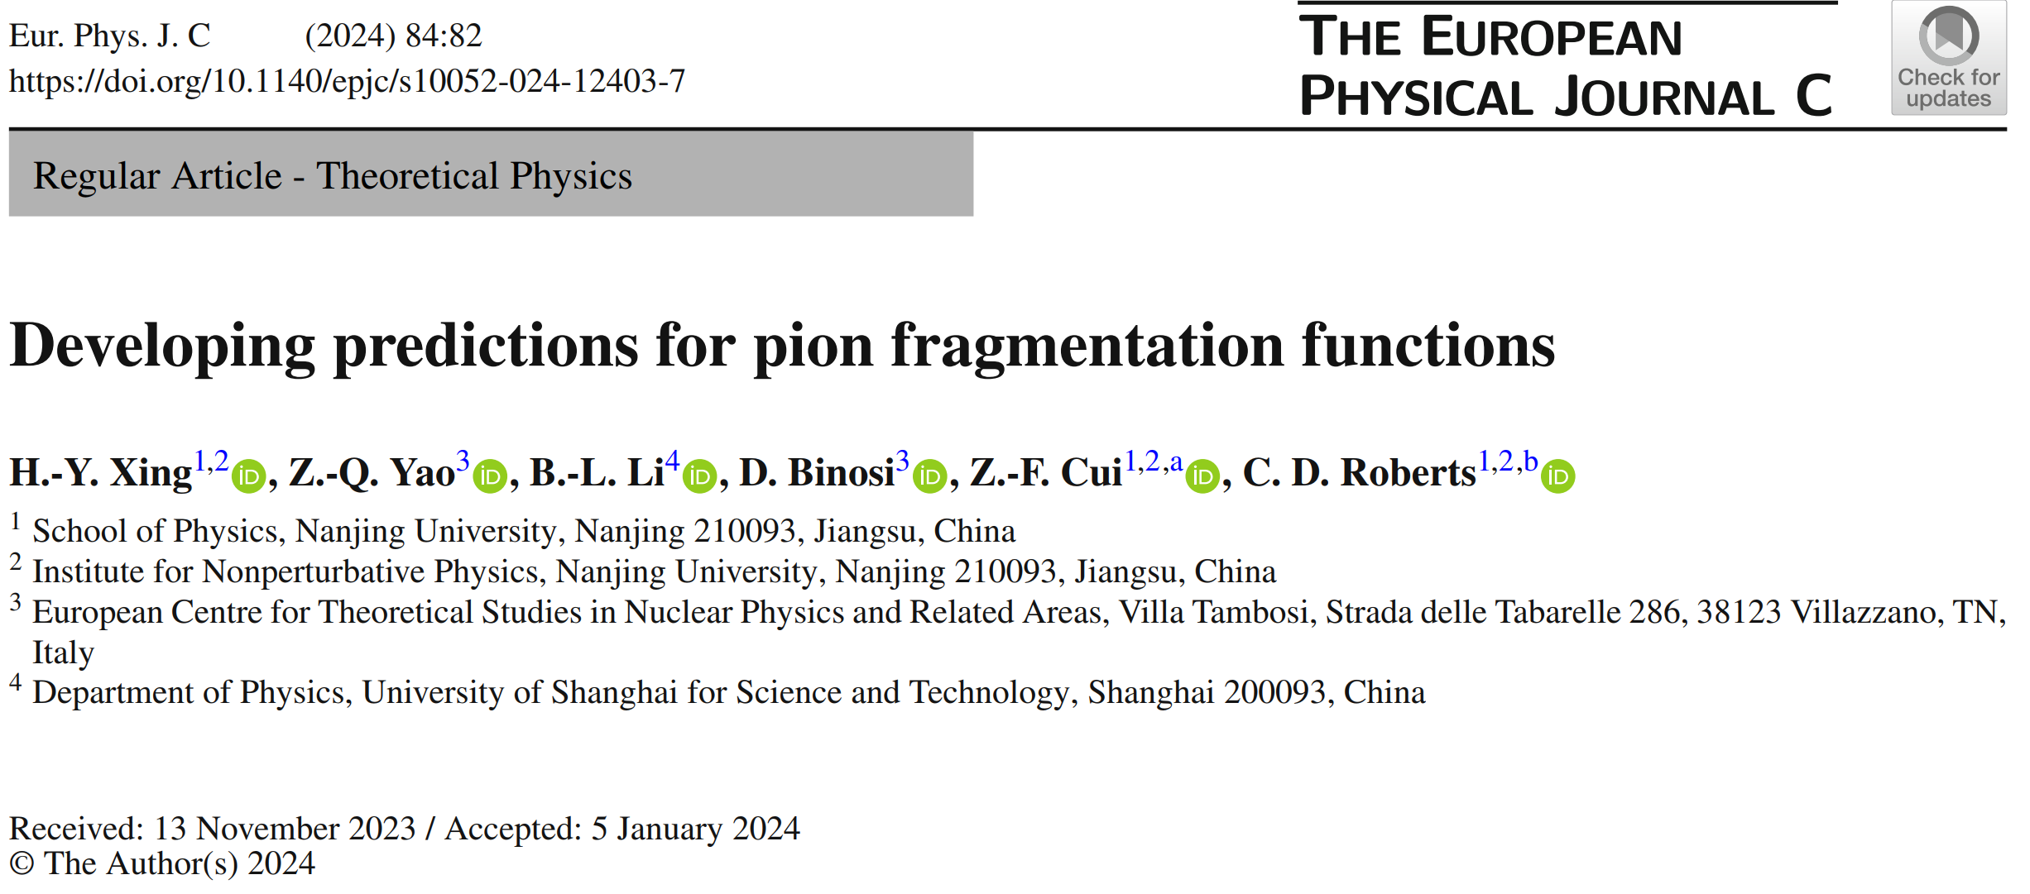
Fragmentation Function
Notes:
In this work, I will talk about the FFs, a way to link…

Slide 6
DLY relation and jet equation
Plausible path to calculation of FFs
$$h$$
$$h$$
$$\overline{h}$$
$$h$$
R. D. Field, R. P. Feynman, Phys. Rept. 81 (1982) 1–129.
$$u$$
$$u$$
Idea straightforward:
- Begin with knowledge of elementary FF…
- Then, the complete FF:
probability density for finding ℎ with mom-fraction 𝑧 in jet, obtained via the jet equation
DLY relation
S. D. Drell, D. J. Levy, T.-M. Yan, Phys. Rev. 187 (1969) 2159–2171.
FF DF
DLY relation means: Elementary FF may be viewed as timelike analogue of parton DF.
All manifestations of EHM in hadron are also expressed in the source function which drives fragmentation of p into h.
This information flows into the full fragmentation function via jet equation.
The seeds of confinement, as expressed in hadronization, are already to be found in the wave functions of the hadrons involved.
Notes:
OK, this is DLY.
And this is jet equation, it is a hadronization…This quantity in DLY is in fact the EFF, it corresponds to…The EFF can not be used to compare with…
This is the full FF, corresponding to, it describes the procsss… It can be used to compare…
There are deep physics in these two formula…
In our study, we finds the jet… this is our finding, and I will not talk about the details here…

Slide 7
DLY relation and QCD constrain
S. D. Drell, D. J. Levy, T.-M. Yan, Phys. Rev. 187 (1969) 2159–2171.
In QCD, DF:
$$x→1, q^{π}\left(x;ζ_{H}\right) ∝{(1−x) }^{2}$$
DLY relation ensure that the behavior of FF matches that of the related DF.
R. J. Holt, C. D. Roberts,
Rev. Mod. Phys. 82 (2010) 2991-3044.
$$x→1$$
$$⇒$$
$$d_{p}^{h}\left(z;ζ_{H}\right) ∝{(1−z) }^{2}$$
$$⇒$$
$$D_{p}^{h}\left(z;ζ_{H}\right)$$
A. Courtoy, P. M. Nadolsky,
Phys. Rev. D 103 (2021) 054029.
Evolution… any QCD-consistent FF satisfies, $γ\left(ζ\right)>0$
( these constraints are typically overlooked in phenomenological extractions of FFs. )
The QCD constrain on DF and FF leads a natural form for DF and FF.
satisfy the QCD constrain
symmetric under x ↔ 1-x
vanish at the endpoints
no divergence for FF
Notes:
Finally it’s the FF results. First we can see the firstmoment of FFs. The evolution is conserved under the evolution, and there is always a fraction stored in the gluon FFs. The first moment agree with the moment from HKNS fit.
Then, we see the results.The solid curve is… The dashed grey curve is… There is a qualitative … and quantitative…

Slide 8
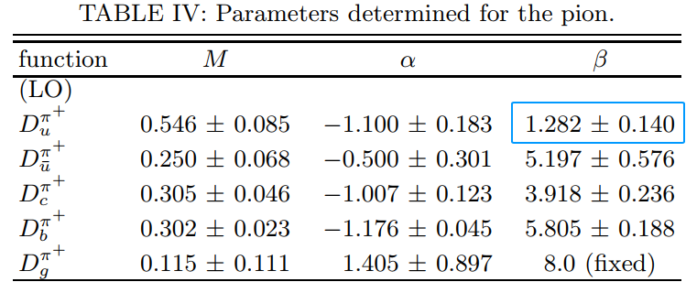
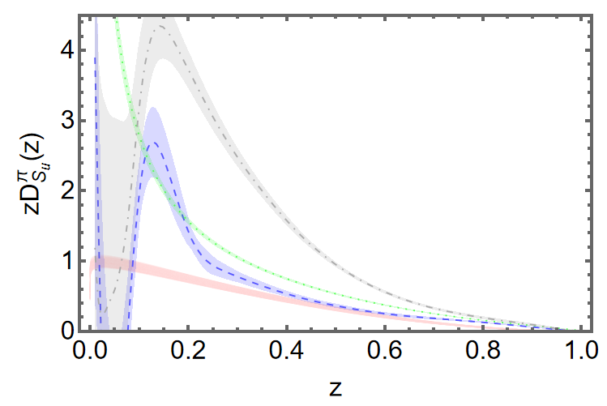
Current development: existing problems
QCD constrain: The QCD constrain is not satisfied by the model functions at initial scale.
D. de Florian et al. Phys. Rev. D 76, 074033 (2007)
M. Hirai et al. Phys. Rev. D 75, 094009 (2007)
Model dependent: using similar experimental data, the existing fits have completely different fitting results.
NNFF 2017
HKNS:
MAPFF 2022
Hard scattering kernel:
JAM 2021
LAXZ 2024
Notes:
Finally it’s the FF results. First we can see the firstmoment of FFs. The evolution is conserved under the evolution, and there is always a fraction stored in the gluon FFs. The first moment agree with the moment from HKNS fit.
Then, we see the results.The solid curve is… The dashed grey curve is… There is a qualitative … and quantitative…

Slide 9
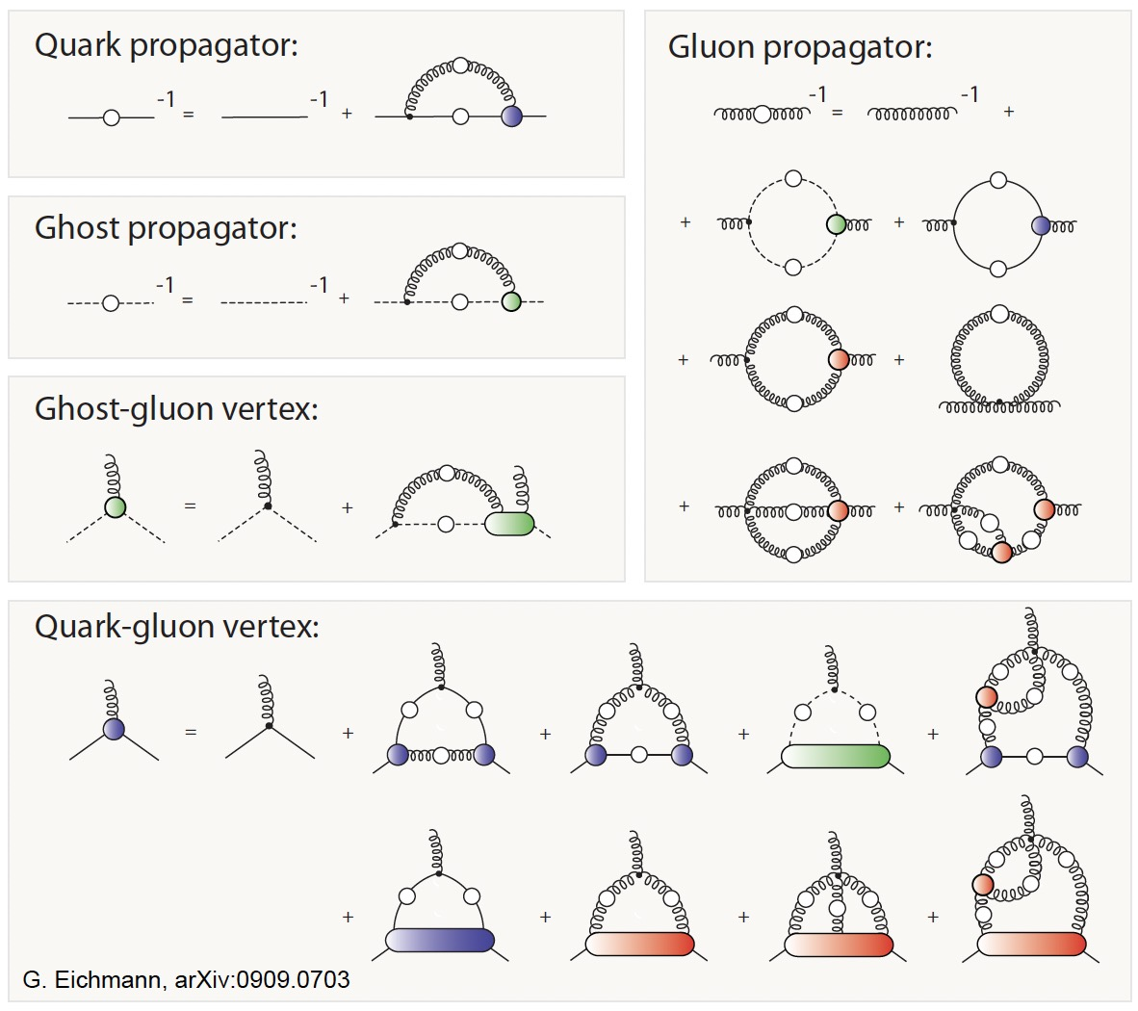
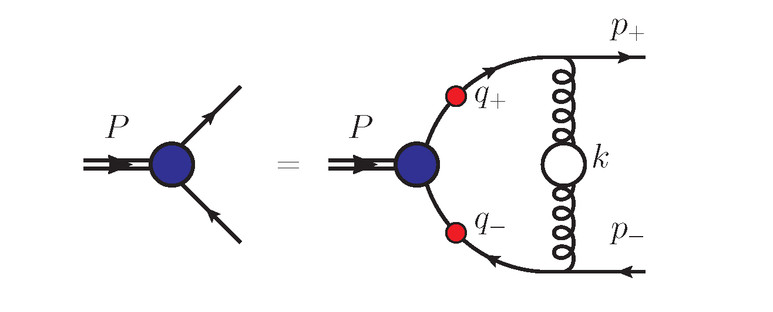
Dyson-Schwinger Equations
Continuum Schwinger function methods (CSMs)
Nonperturbative
Symmetry-preserving
Gap equation
Bethe-Salpeter equation
Notes:
The method we used is the DSEs, which is also known as the CSM.
There are two methods to solve QCD, the one is… the other is CSMs.
These are the Feynman diagram of these equations. It’s a nonperturbative method because these Schwinger functions are fully dressed, including infinite contributions…….
By using these important method, one can solve QCD and explain numerous hadron phenomenon in hadron physics.
Here I give some simple examples to introduce the CSMs…
In this way, the meson can be studied.
There are also Faddeev equation which can be used to study the baryon, but I will not talk about it today.

Slide 10
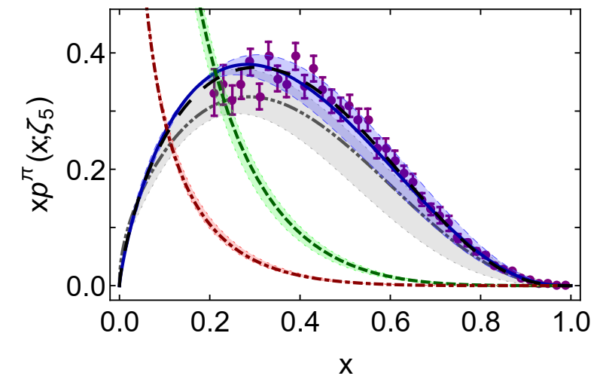
CSMs for DF and FF
Minghui Ding et al., Phys. Rev. D 101 (2020) 5, 054014
1. DF prediction obtained using
continuum Schwinger function methods
E615
LQCD DF
$$ρ=0.066$$
2. DLY relation gives elementary FF
3. Solve the jet equation to obtain complete FF
4. Evolve to obtain all pion FFs at phenomenology scale 𝜁 = 1GeV
Notes:
So starting with these diagrams, the Compton scattering, which can be used to calculate the DFs… Using CSMs, one can obtain DF, which agrees well with the data.
The using DLY…. Obtain the EFF , jet equation to obtain the full FF at hadron scale. Then it is the evolution to compare with the fit.

Slide 11
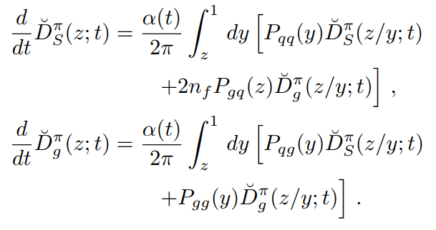
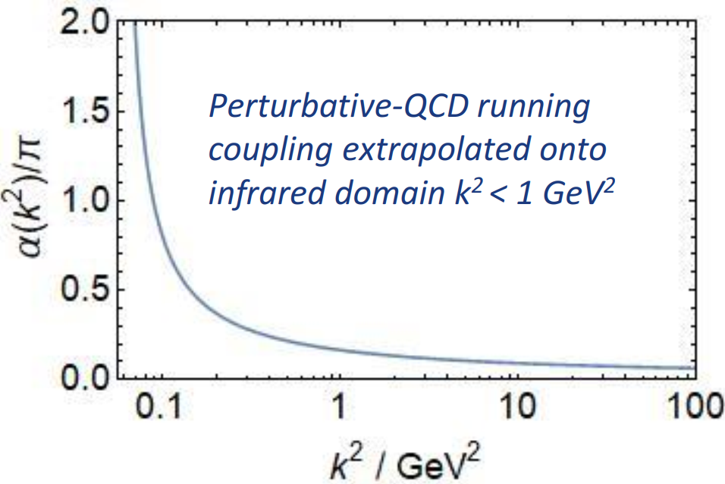
All-orders evolution
Suppose that two experiments are performed, with values ζ, ζ′, and these experiments enable extraction of D(z; ζ), D(z; ζ′).
How can one tell whether the results are consistent, viz. is there a mathematically precise connection between these two functions?
A practitioner develops a DF model that is supposed to be valid at an unspecified scale, the model DF reproduces some property or properties of the target distribution.

Slide 12
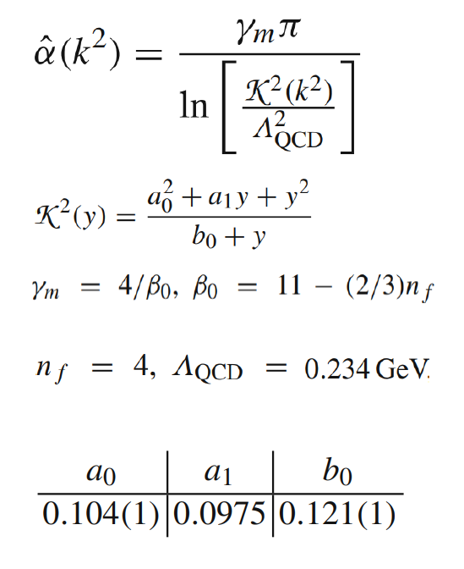
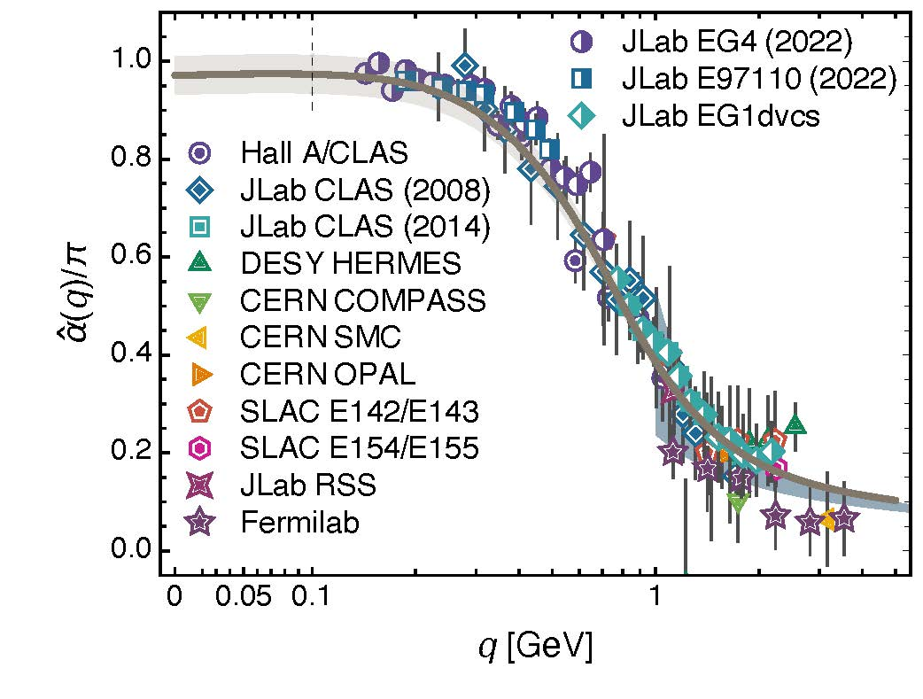
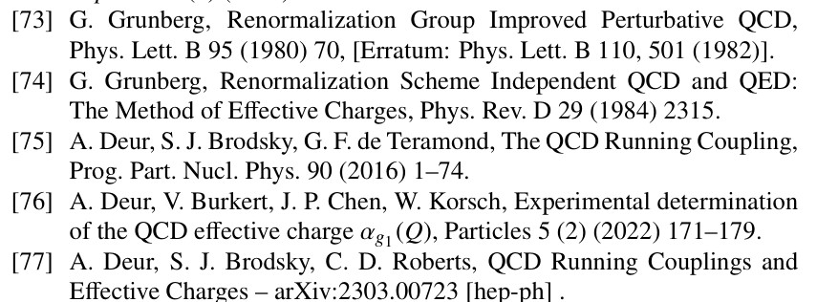
All-orders evolution
P1 There exists at least one effective charge, $α_{1ℓ}(k^{2})$, which, when used to integrate the leading-order perturbative evolution (DGLAP) equations, defines an evolution scheme for parton DFs that is all-orders exact.
CSM Process-Independent charge serves this purpose
P2 There is a scale, ζ_{H} < m_{N} , at which all properties of a given hadron are carried by its valence degrees-of-freedom.
The all orders evolution approach extends DGLAP evolution onto QCD’s nonperturbative domain .

Slide 13
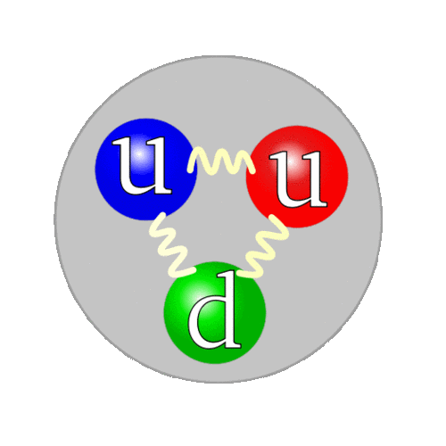
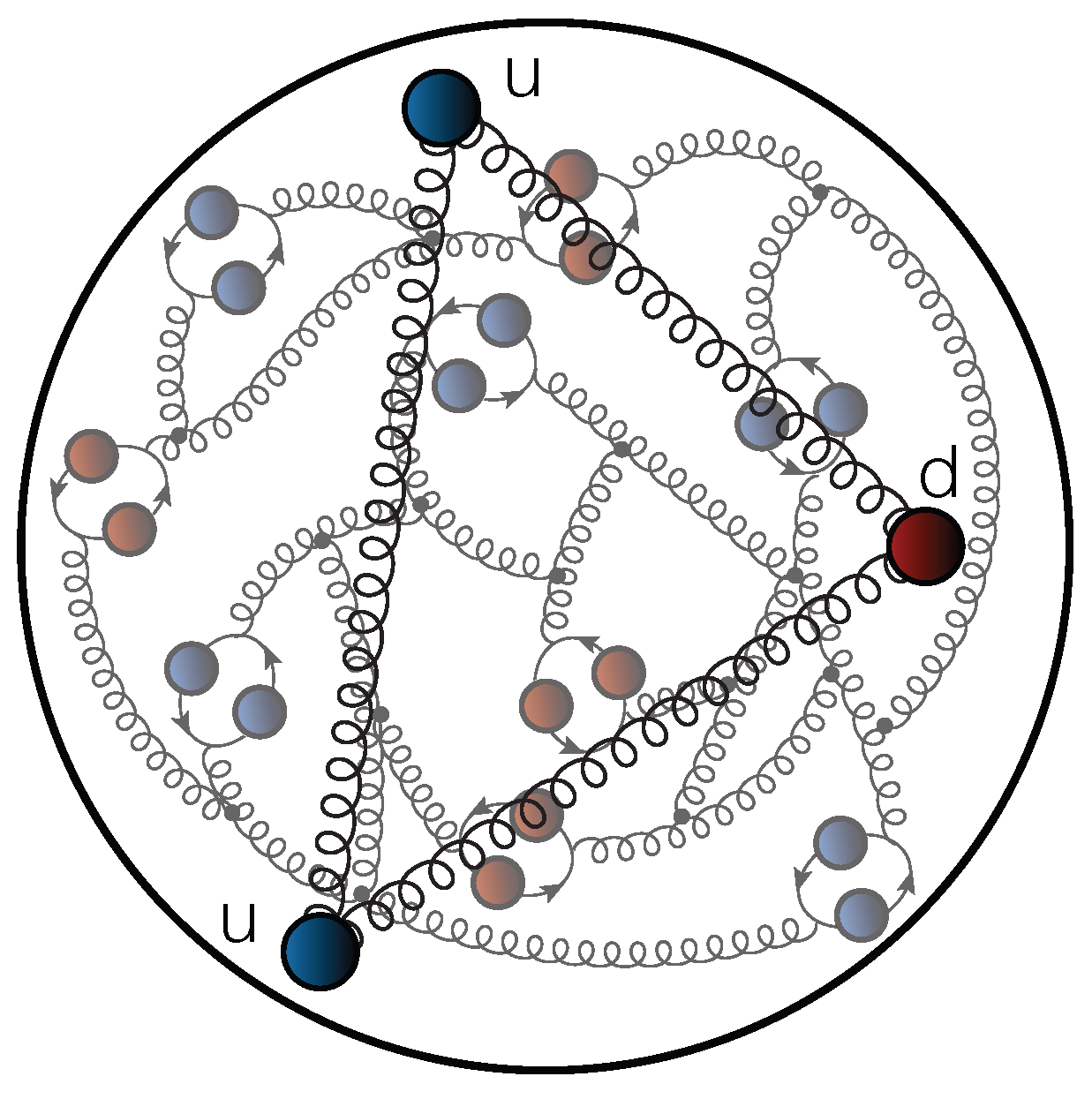
All-orders evolution: hadron scale
$$ζ_{H}$$
$${ζ>ζ}_{H}$$
Evolution
All properties of the hadron are carried by valence degrees of freedom.
Unveiling glue and sea d.o.f.
Notes:
What is hadron scale? At hadron scale, all properties of the hadron … They are fully-dressed valence quarks, we call them quasi-particles. After evolution to higher scale, it will unveal the glue and sea degrees of freedom. We call them partons

Slide 14
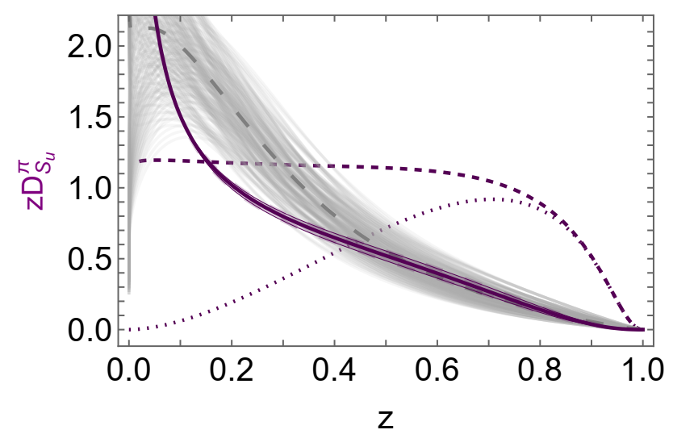
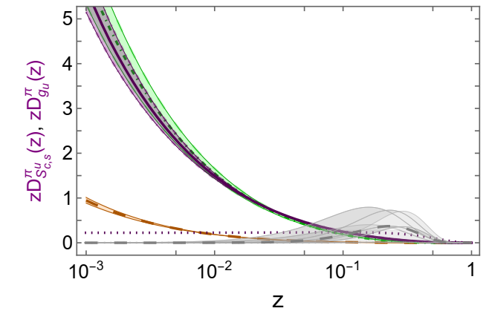
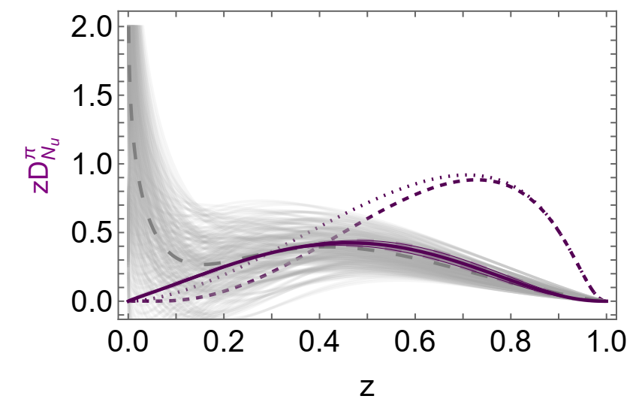
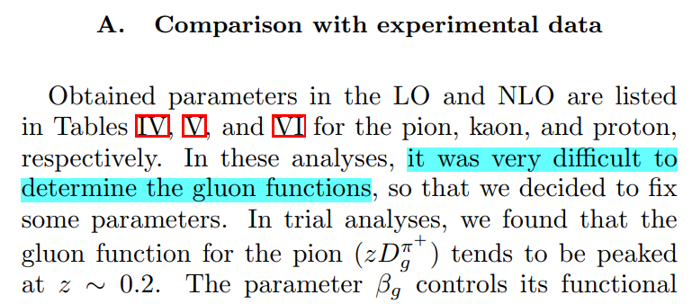
Pion FF Results
HKNS fit
s→π FF
CSM u→π FF
(after evolution)
gluon FF
c→π FF
HKNS fit: gluon FF
HKNS fit
CSM u→π FF
(after evolution)
M. Hirai et al., Phys. Rev. D 75 (2007) 094009
Notes:
We can also give prediction for s->pi, c->pi and gluon FFs. For the gluon FFs, the difference is very large, it is said in the paper, it is very difficult… This may be the reason.

Slide 15
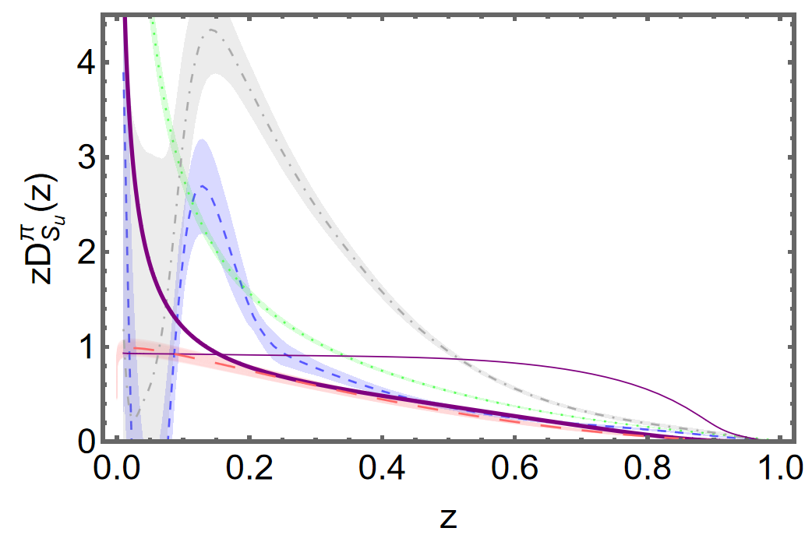
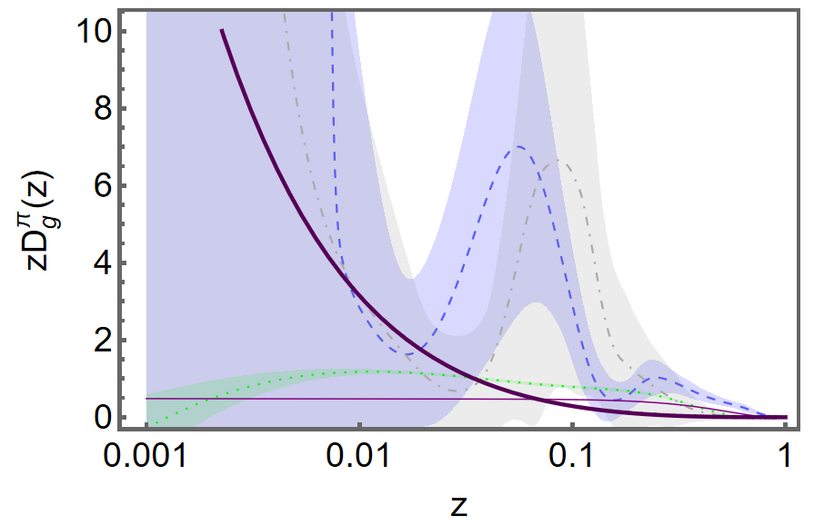
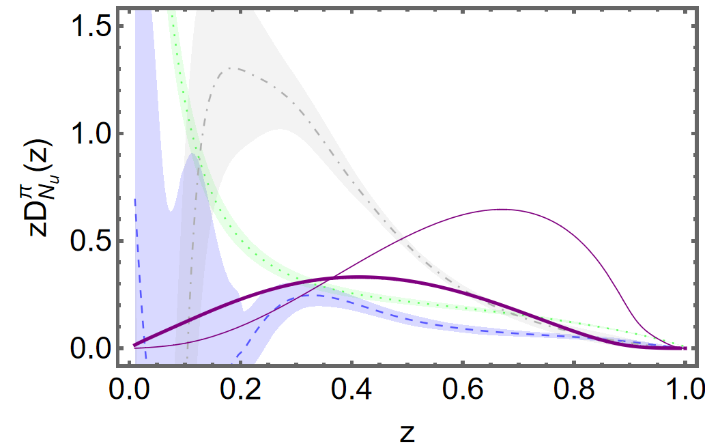
Pion FF Results
NNFF
NNFF
CSMs
CSMs
MAPFF
MAPFF
JAM
LAXZ 2024
ζ=1GeV
JAM
ζ=5GeV
s→π FF
NNFF
CSMs
gluon FF
MAPFF
JAM
c→π FF
HKNS fit: gluon FF
ζ=1GeV
ζ=1GeV
Notes:
Finally it’s the FF results. First we can see the firstmoment of FFs. The evolution is conserved under the evolution, and there is always a fraction stored in the gluon FFs. The first moment agree with the moment from HKNS fit.
Then, we see the results.The solid curve is… The dashed grey curve is… There is a qualitative … and quantitative…

Slide 16
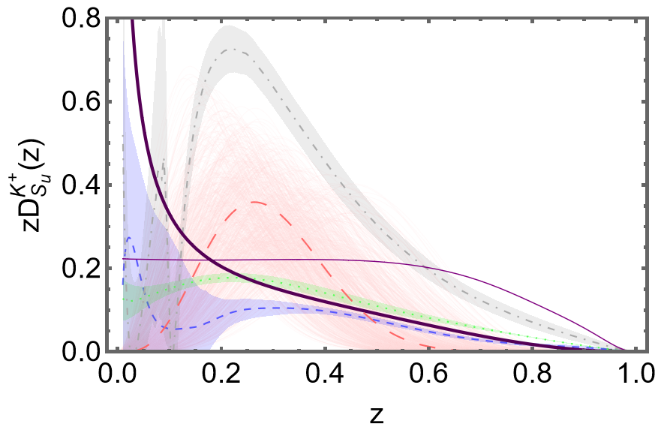
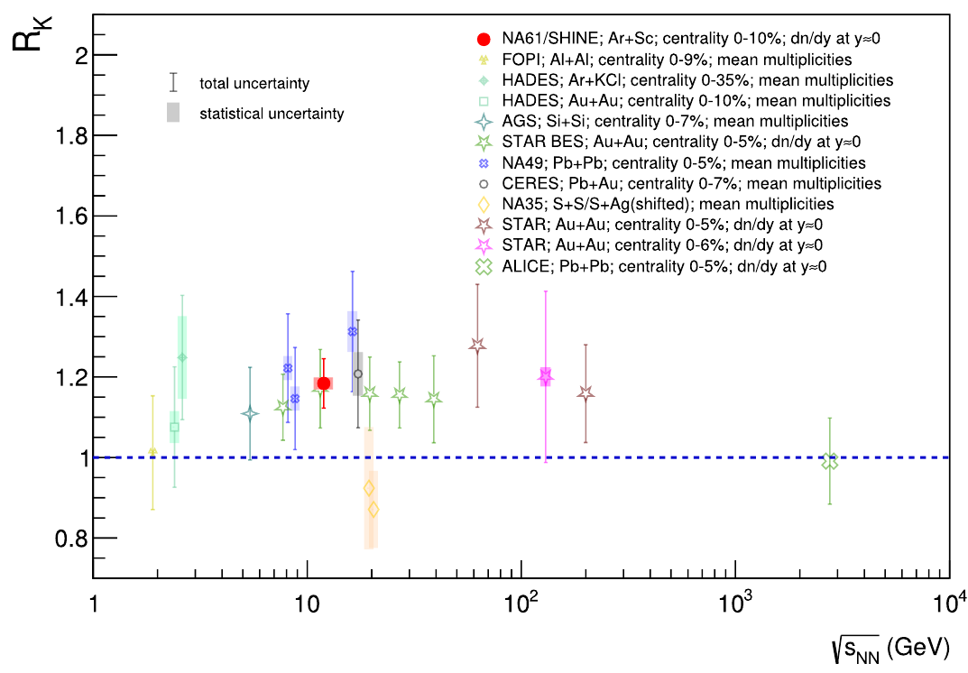
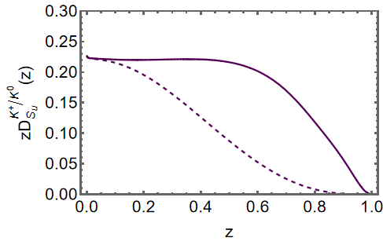
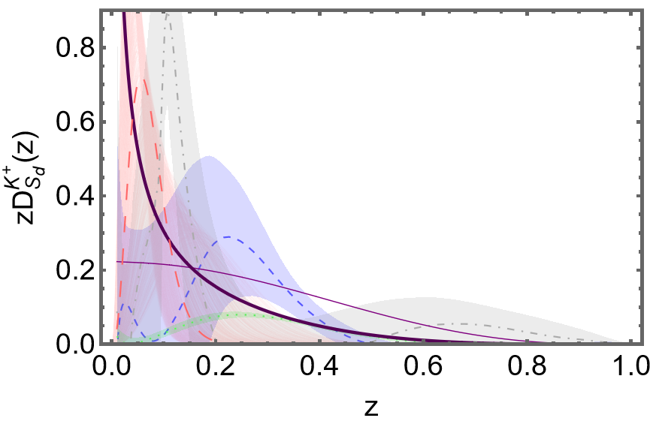
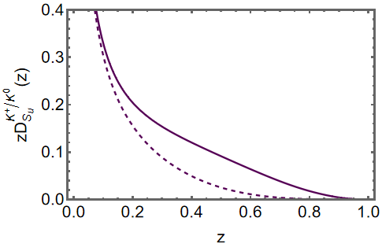
Kaon FF Results
Evidence for an excess of charged over neutral KK meson production in high-energy collisions of atomic nuclei,
The NA61/SHINE Collaboration, arXiv: 2312.06572
Asymmetry of charged and neutral kaon was found in the e⁺ e⁻ annihilation process and nucleus-nucleus scattering.
NNFF
CSMs
MAPFF
LAXZ
JAM
$$ζ=0.331GeV$$
LAXZ
CSMs
e⁺ e⁻ annihilation
MAPFF
$$ζ=1GeV$$
JAM
NNFF
nucleus-nucleus scattering
Notes:
Finally it’s the FF results. First we can see the firstmoment of FFs. The evolution is conserved under the evolution, and there is always a fraction stored in the gluon FFs. The first moment agree with the moment from HKNS fit.
Then, we see the results.The solid curve is… The dashed grey curve is… There is a qualitative … and quantitative…

Slide 17
Kaon FF Results
CSMs prediction for the 1th moment of pion FFs:
CSMs prediction for the 1th moment of kaon FFs:
Similar with DF, the momentum sum rule for FFs is satisfied.
 | $$\sum_{h}{{\left\langle \left.z\right\rangle \right.}_{u→h}}$$ | $$\sum_{h}{{\left\langle \left.z\right\rangle \right.}_{s→h}}$$
NNFF 1GeV | 1.62 | 1.68
NNFF 5GeV | 0.95 | 1
MAPFF 1GeV | 0.59 | 0.96
JAM 1GeV | 1.21 | 1.71
LAXZ 1GeV | 0.548 | 0.555
for q = u, s
h = π, K
Momentum is conserved under the evolution.
Notes:
Finally it’s the FF results. First we can see the firstmoment of FFs. The evolution is conserved under the evolution, and there is always a fraction stored in the gluon FFs. The first moment agree with the moment from HKNS fit.
Then, we see the results.The solid curve is… The dashed grey curve is… There is a qualitative … and quantitative…

Slide 18
Summary
These FFs are the first predictions of FFs in any approach with a traceable connection to QCD.
A unified treatment of the pion, kaon DFs and FFs was accomplished.
This work also gives insights into the link between two important phenomena in QCD: EHM and confinement.
Improve knowledge of FFs, give guidance for future data collection, data fit, and anticipated facilities.
PQCD constrain
momentum sum rule
Give the analyses of asymmetry of charged and neutral kaon
Thank you!
Notes:
A key test of the kernel is the GMOR, and we illustrated here that it is satisfied perfectly. So it is guaranteed that our constructed kernel preserve the symmetries.

