Slide 1
Proton parton distributions and proton spin
Yang Yu
Supervisor: Prof. Craig D. Roberts

Slide 2
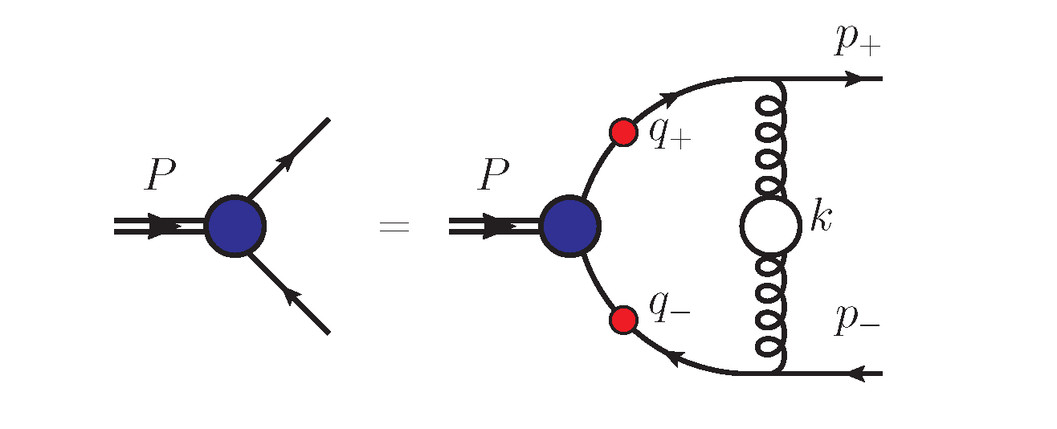
Dyson-Schwinger Equations (DSEs)
Gap equation
Continuum Schwinger function
method (CSM)
nonperturbative
symmetry-preserving
Bethe-Salpeter equation
Rainbow-Ladder truncation:
Contact interaction (CI):
Static approximation:
Faddeev equation
algebraic simplicity
transparency
no free parameter
Notes:
1. We briefly introduce the Dyson-Schwinger Equations. It is the nonperturbative and symmetry-preserving Continuum Schwinger function method. On the right side, we list the Dyson-Schwinger Equations of quark, diquark and baryon which correspond to the Gap equation, Bethe-Salpeter equation and Faddeev equation respectively.
2. Using a symmetry-preserving formulation of a vector × vector contact interaction (SCI) in which the gluon propagator is not depend on the relative momentum and treating the proton as a quark + interacting scalar and axial-vector diquark bound state, whose structure is obtained by solving a Poincaré-covariant Faddeev equation, we provide a comprehensive, coherent set of predictions for unpolarised and polarised proton parton distribution functions (DFs).
3. The merit of CI is that it is algebraic simplicity, transparency and with no free parameter.
4. We use the Rainbow-Ladder truncation to express the quark-gluon vertex and use the static approximation to express the exchange quark in Faddeev equation.

Slide 3
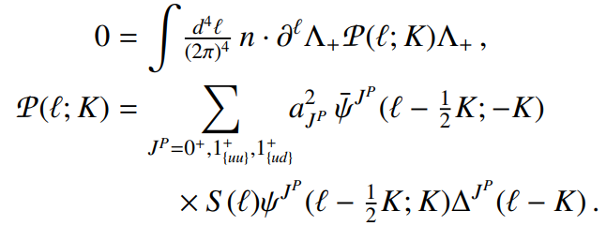
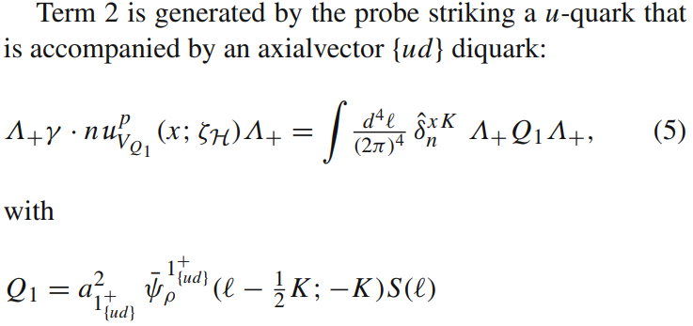
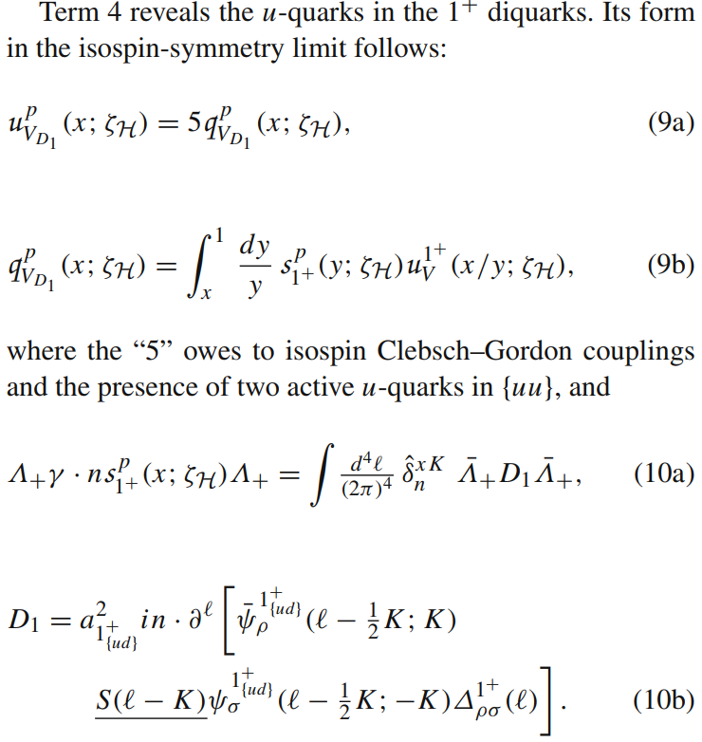
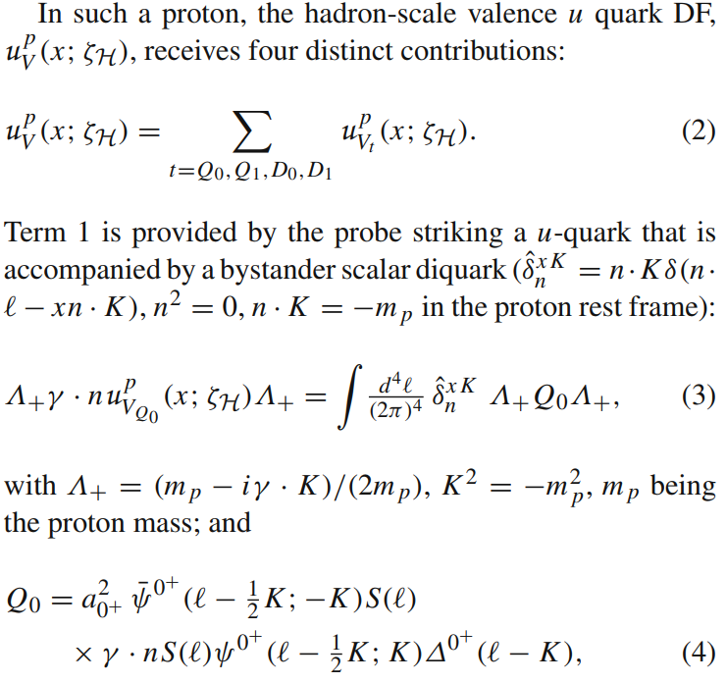
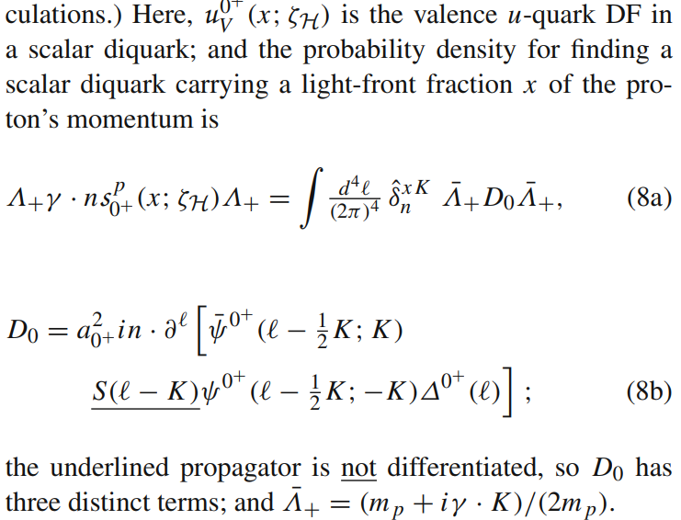
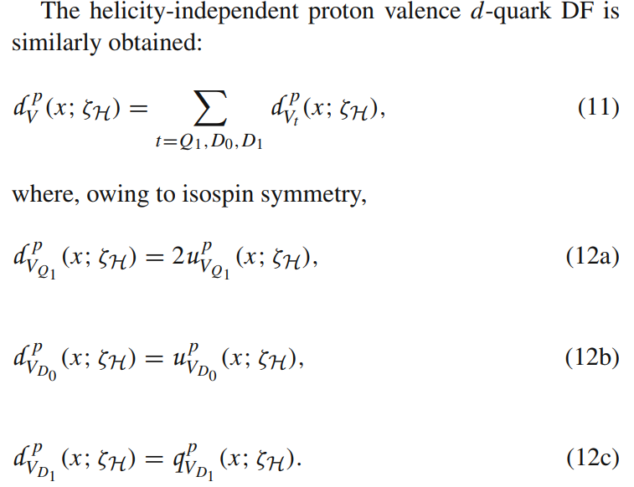
Helicity independent:
Notes:
夸克和对夸克模型下的质子束缚态可以由正则归一化的Faddeev振幅（1）式表示，其中我们考虑了标量和轴矢对夸克的贡献。质子部分子分布函数可以通过如下方式计算：我们以标量ud对夸克为例，质子中存在一个u夸克和标量ud对夸克，其中单独的u夸克携带质子动量分数的概率密度可以通过（3）式计算，而标量ud夸克对中的u夸克携带质子动量分数的概率密度可以通过（7）式的卷积进行计算，其中s0+是质子中的标量ud对夸克携带质子动量分数的概率密度，u0+是标量ud对夸克中u夸克携带ud对夸克动量分数的概率密度。在同位旋对称的情况下，标量ud夸克对中的d夸克携带质子动量分数的概率密度与标量ud夸克对中的u夸克携带质子动量分数的概率密度相同（12b）式。轴矢对夸克可以进行类似的讨论，由于时间限制我就不详细展开讲了。

Slide 4
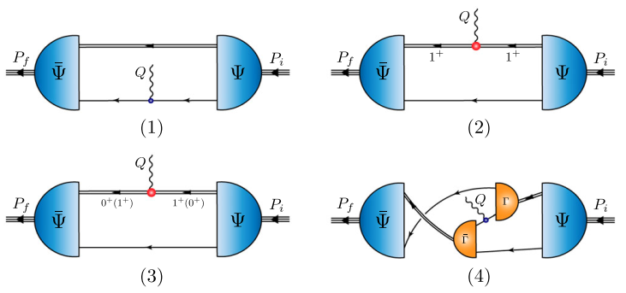
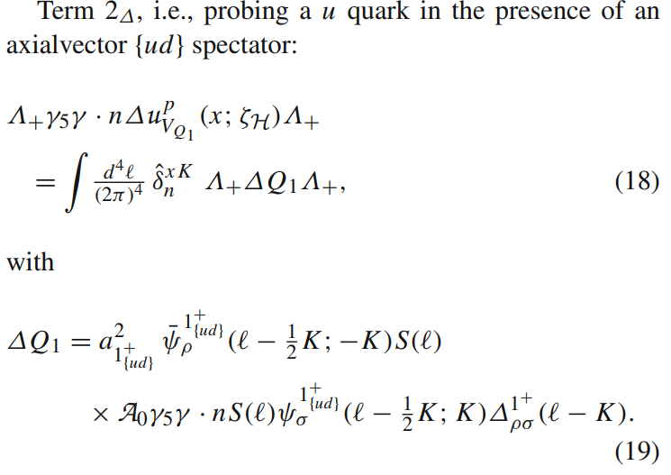
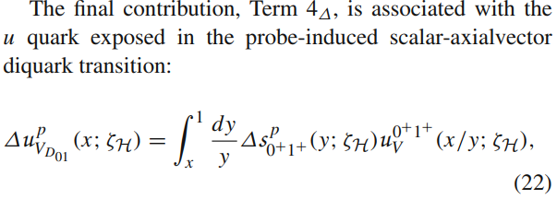
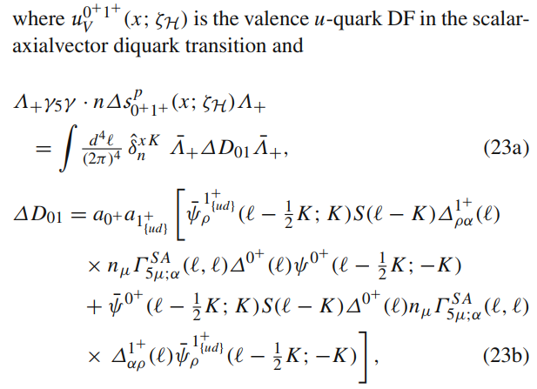
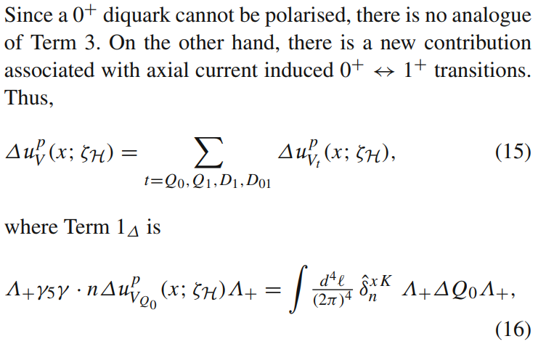
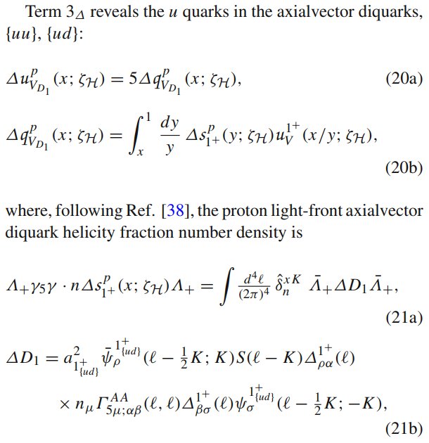
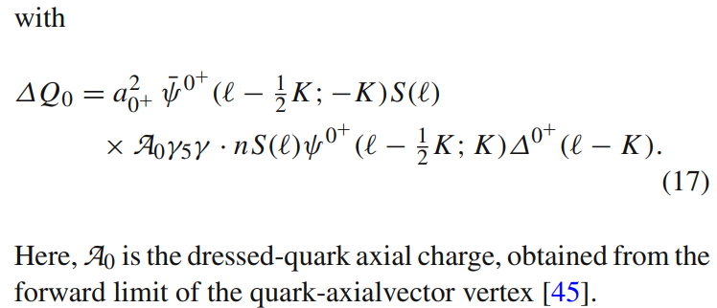
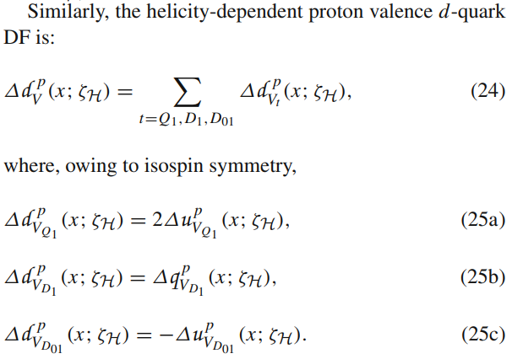
Helicity dependent:
Notes:
极化的质子部分子分布函数可以通过对称性保持的轴矢流进行计算。这里就不详细讲了。（由于标量对夸克自旋为0，所以没有探测ud对夸克的图。我们还需要加上标量ud对夸克到轴矢ud对夸克的图，并且由于我们采用了静态近似，所以没有探测转变夸克的图）。

Slide 5
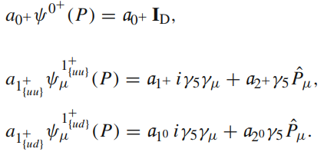
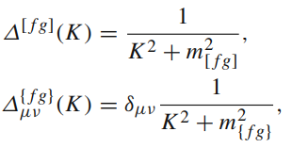
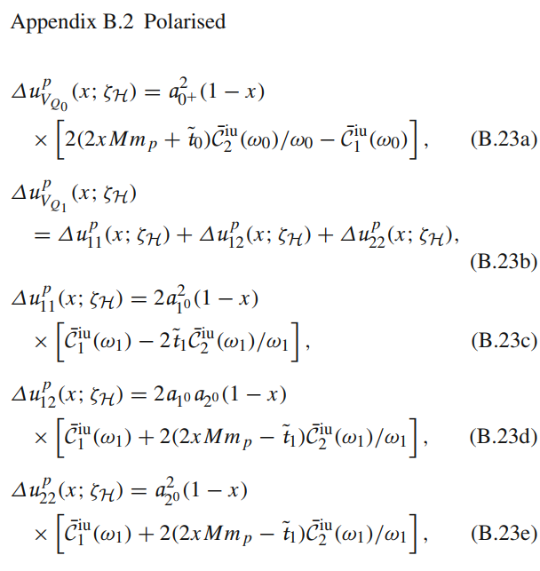
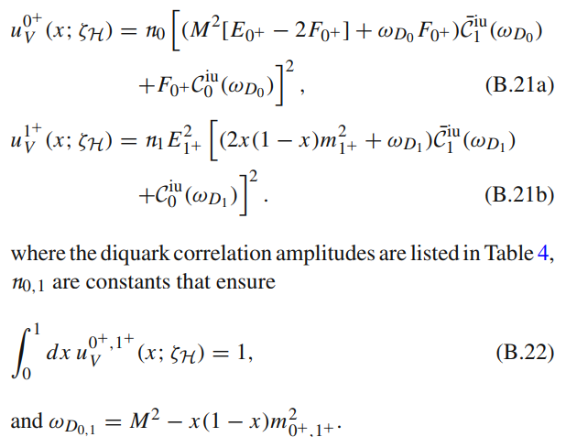
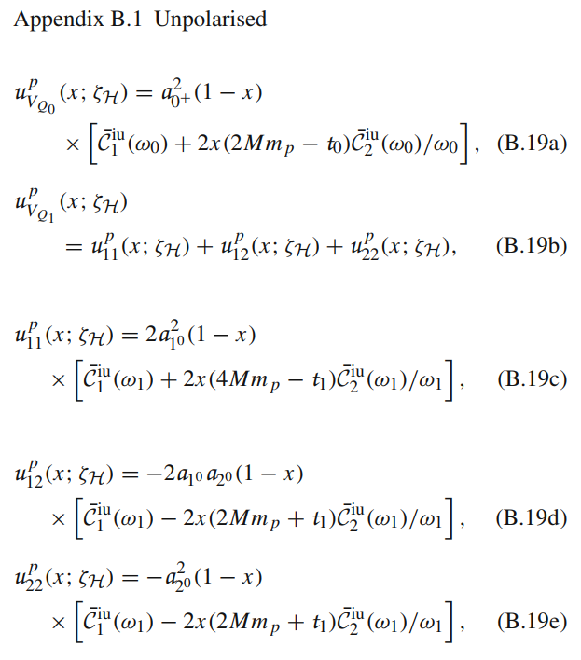
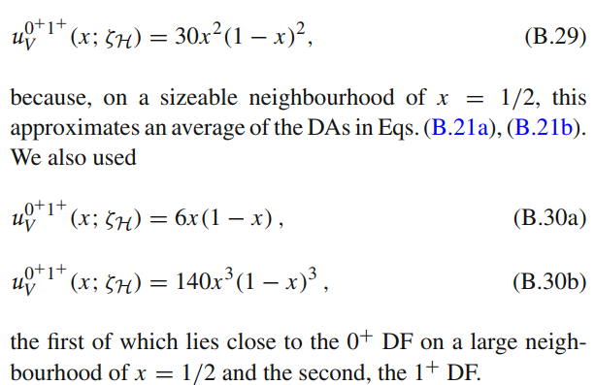
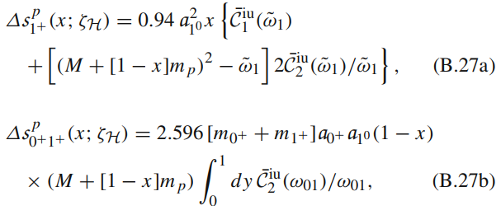
Notes:
极化的质子部分子分布函数可以通过对称性保持的轴矢流进行计算。这里就不详细讲了。（由于标量对夸克自旋为0，所以没有探测ud对夸克的图。我们还需要加上标量ud对夸克到轴矢ud对夸克的图，并且由于我们采用了静态近似，所以没有探测转变夸克的图）。

Slide 6
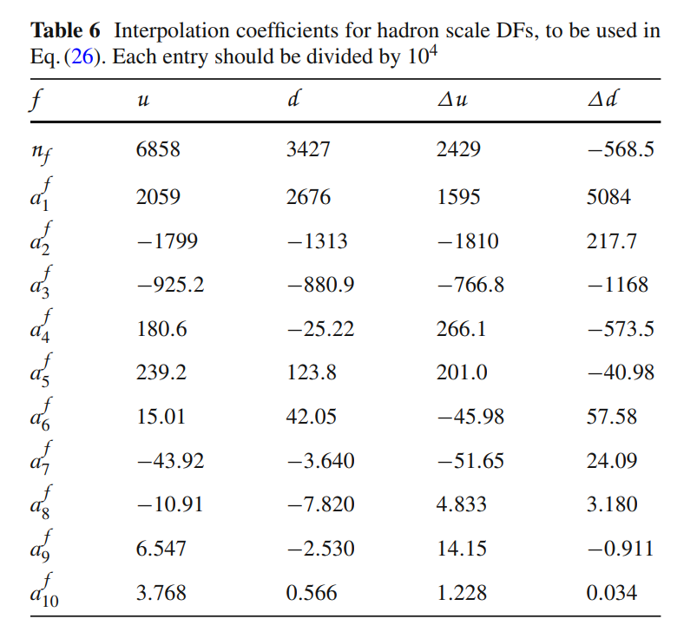
SCI results at the hadron scale
Hadron scale, $ζ_{H}$
Scale at which all properties of a given hadron are carried by valence degrees-of-freedom
vector current
axial-vector current
L. Chang et al, Phys. Lett. B 829 (2022) 137078.
P. Cheng et al, Phys. Rev. D 106 (2022) 054031.
The hadron-scale unpolarised and polarised proton parton distribution functions (DFs):
The hadron scale unpolarised and polarised valence-quark DFs exhibit the same power law behaviour in SCI calculations:
Large-x behaviour:
Small-x behaviour:
Contact interaction study of proton parton distributions, Yang Yu, Peng Cheng, Hui-Yu Xing, Fei Gao and Craig D. Roberts, Eur. Phys. J. C 84 (2024) 7, 739.
Notes:
We calculate the unpolarised and polarised proton parton distribution functions using symmetry-preserving vector and axial-vector currents respectively. The symmetry preserving currents can be found in this two references. The calculated DFs are reliably interpolated using the following Gegenbauer polynomials. The coefficients are listed in right Table.
Because time may not be enough, I just give the final results here. If you are interested in the details, please see this paper for reference.

Slide 7
QCD-kindred results at the hadron scale
QCD-kindred result (realistic interaction framework) is obtained using Schwinger functions that realistically express basic features of quantum chromodynamics (QCD).
Unpolarised proton parton DFs are reliably interpolated by a finite sum of Gegenbauer polynomials:
Polarised proton parton DFs are obtained from pQCD constraints:
L. Chang et al, Phys. Lett. B 829 (2022) 137078.
P. Cheng et al, Phys. Lett. B 844 (2023) 138074.
At low-x: there is no correlation between helicity of struck quark and that of parent proton
At high-x, polarized and unpolarized valence quark distributions possess the same power-law behaviour, viz.
$⇒$Polarized:unpolarized ratio of DFs must vanish
$\frac{Δq(x)}{q(x)}→0$ as $x→0$
Regge phenomenology:$Δq(x)∝\sqrt{x}q(x)$
M. M. Brisudova et al. Phys. Rev. D 61 (2000) 054013
$\frac{Δq(x)}{q(x)}→constant ≠0$ as $x→1$
C. Chen and C. D. Roberts, Eur. Phys. J. A 58 (2022) 10, 206.
Notes:
类QCD模型是一种动量依赖的参数化模型，对动量依赖的Schwinger函数进行参数化，能够模拟实际的QCD相互作用。
极化与非极化的部分子分布函数的比值在小x处趋于0，在大x处趋于常数。
Now I give a brief introduction of the QCD-kindred results before comparing with SCI results.
In large-ζ DF phenomenology, it is typically argued that there to is no correlation between the helicity of the struck quark and that of the parent proton, in which case the polarised:unpolarised ratio of DFs should vanish as x → 0.
The polarized proton DFs is normalized by the proton axial charge which value can be found in this paper.

Slide 8
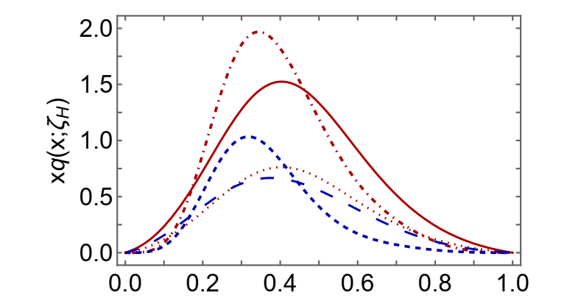
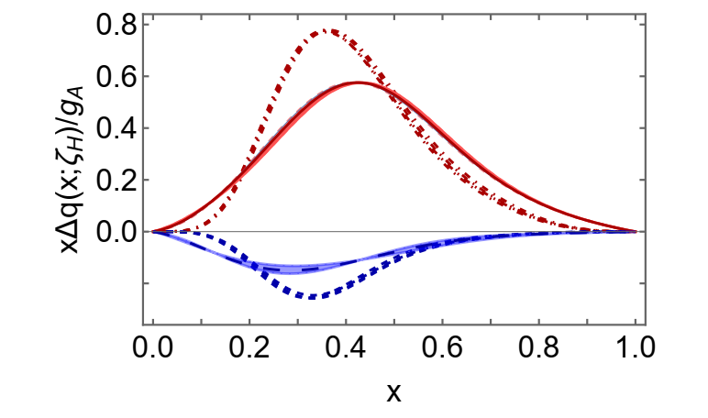
Comparison: SCI and QCD-kindred results at hadron scale
SCI results are dilated and possess markedly different endpoint behaviour. However, the momentum fraction lodged with each valence quark species is the same.
SCI and QCD-kindred predictions do not support helicity retention in hard scattering processes which requires a zero in . This is not seen in the SCI prediction.
Notes:
我们发现SCI的曲线比类QCD模型更宽，且有着完全不同的端点行为，但每味夸克携带的动量分数是一样的。
Now we can make a comparison between SCI and QCD-kindred results.
Hadron-scale polarised valence quark DFs are normalised by the respective value of the proton axial charge.
The u quark contributes a positive fraction of the proton spin whereas the d quark fraction is negative and one-third the size.
Helicity retention is the statement that the struck valence quark carries all proton spin (have the same helicity as the proton) at 𝑥 = 1. The positive polarised distribution dominate. The negative polarised distribution is suppressed by a relative factor (1-x)^2.
The breaking of helicity retention is due to the diquark correction in the proton wave function which presence violates the SU(4) symmetry in the proton wave function.

Slide 9
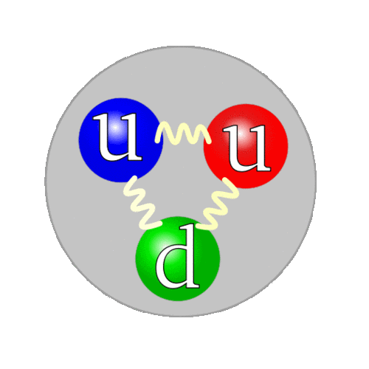
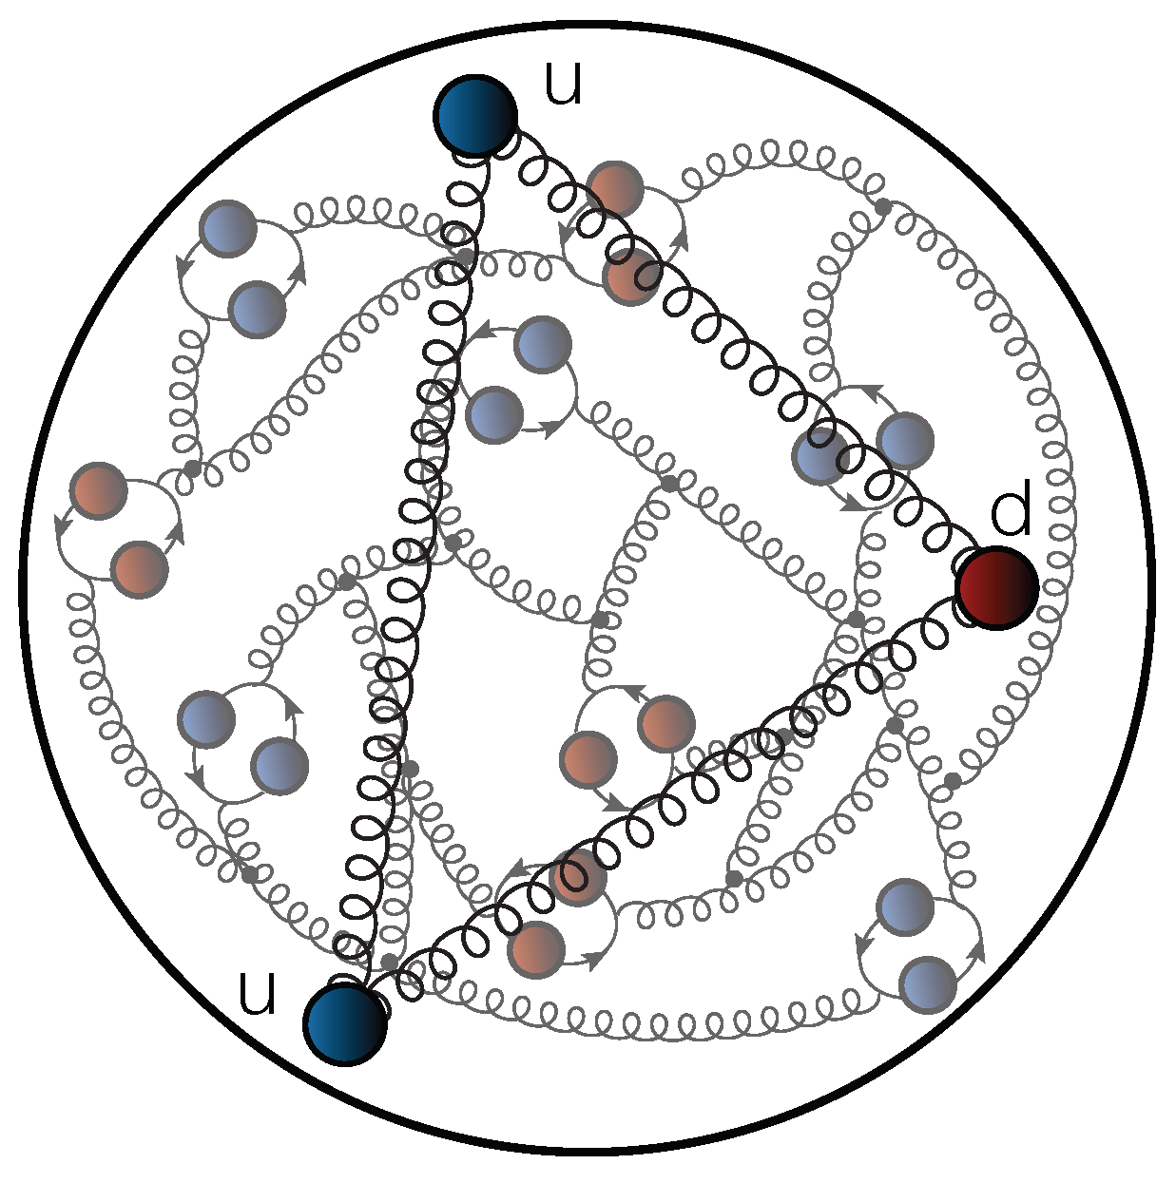
Distribution functions: evolved to Experiment Scales
$$ζ_{H}$$
$${ζ>ζ}_{H}$$
Evolution
(DGLAP equation)
Fully-dressed valence quarks
(quasiparticles)
Unveiling of glue and sea d.o.f.
(partons)
Notes:
At energy scale higher than hadron scale, the proton has glue and sea degrees of freedom.

Slide 10
Unpolarised proton valence-quark DFs
Completely different approaches (IQCD and CSMs) give agreement results for isovector distribution.
Isovector distribution of valence quark DFs is a poor discriminator between competing descriptions of proton structure.
Notes:
Isovector distribution of valence quark DFs is a poor discriminator between competing descriptions of proton structure(contact interaction and realistic interaction are the same).

Slide 11
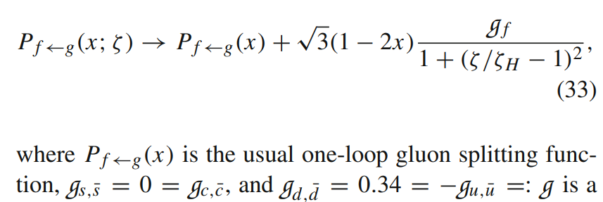
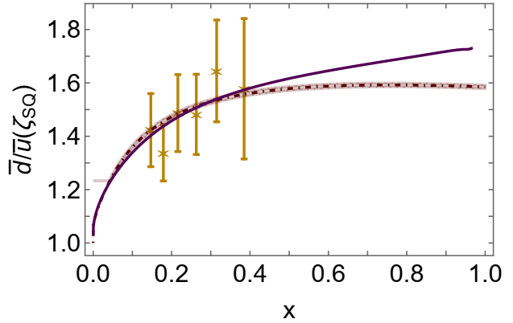
Asymmetry of antimatter in the proton
Proton = u + u + d
$⇒$ Pauli blocking: gluon splitting produces
$d+\overline{d}$ in preference to $u+\overline{u}$
Comparison with SeaQuest data
[J. Dove, et al., The asymmetry of antimatter in the proton, Nature 590 (7847) (2021) 561–565.]
On the domain of existing measurements, SCI and QCD-kindred results are indistinguishable and match the modern data. Even beyond that domain, the difference is modest.
This agreement supports that the Pauli blocking provides a viable explanation for the asymmetry of antimatter in the proton.
Notes:
(On this valence-quark domain, the contrasting large-x power-law behaviours has an influence.) Such insensitivity to details of the pointwise behaviour of the hadron-scale valence quark DFs suggests that Pauli blocking provides a viable explanation for the asymmetry of antimatter in the proton.

Slide 12
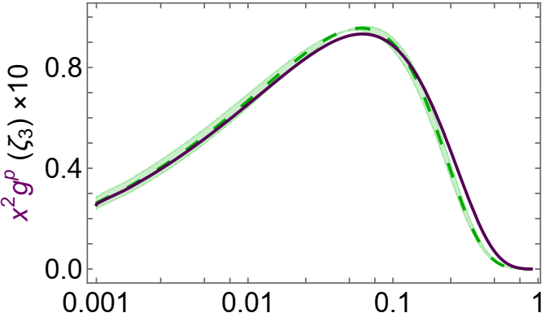
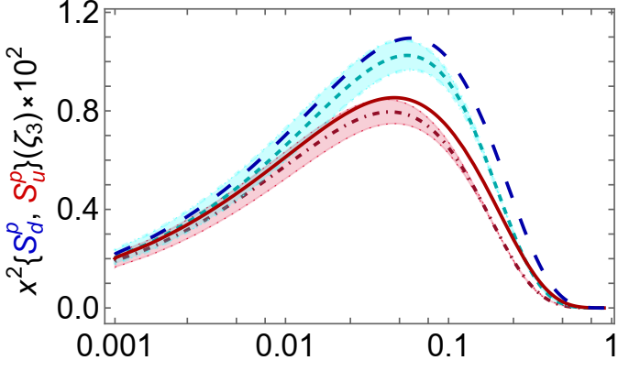
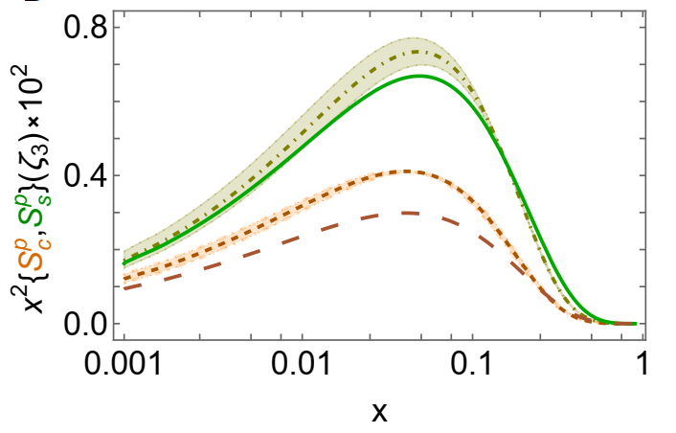
Unpolarised proton gluon and sea-quark DFs
We introduce thresholds at which heavier quarks begin to play a role in evolution. Multiply the glue → quark splitting function by the following factor:
Hence, there is a separation between flavours.
In comparison with the QCD-kindred predictions, the SCI results are larger and harder on the valence quark domain, smaller in magnitude on the complementary lower-x domain.
The heavier sea quark DFs are commensurate in size with those of the light-quark sea.
Both the SCI and QCD-kindred analyses predict a measurable charm quark momentum fraction in the proton without recourse to “intrinsic charm”.
Notes:
我们设置了每味夸克参与演化的阈值，因此每味夸克的曲线是不同的。
In sea DFs, the curves without uncertainty are the SCI results. They are larger and harder on the valence quark domain, smaller in magnitude on the complementary lower-x domain.
The band surrounding each QCD-kindred curve expresses the response to a ±5% variation in ζH.

Slide 13
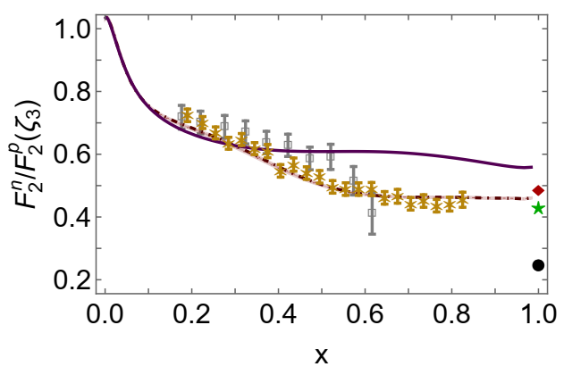
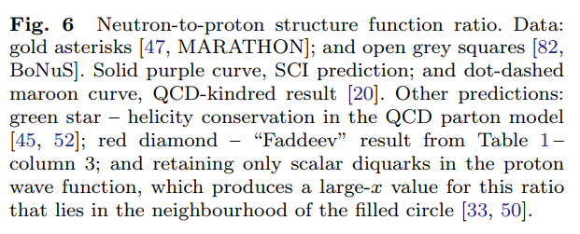
Neutron/Proton structure function ratio
Structure function ratio is clear window onto $d_{V}(x)/u_{V}(x)$
$U\left(x;ζ\right)=u\left(x;ζ\right)+\overline{u}\left(x;ζ\right)$, $D\left(x;ζ\right)=d\left(x;ζ\right)+\overline{d}\left(x;ζ\right)$
$Σ\left(x;ζ\right)=s\left(x;ζ\right)+\overline{s}\left(x;ζ\right)$+ $c\left(x;ζ\right)+\overline{c}\left(x;ζ\right)$
Comparison with MARATHON data
[D. Abrams, et al., Measurement of Nucleon $F_{2}^{n}/F_{2}^{p}$Structure Function Ratio by the Jefferson Lab MARATHON Tritium/Helium-3 Deep Inelastic Scattering Experiment – arXiv:2104.05850 [hep-ex], Phys. Rev. Lett. (2022) in press]
On sea quark dominance, SCI and QCD-kindred results agree with modern data.
On valence quark dominance, there are quantitative differences. The ratio on this domain is a useful discriminator between pictures of proton structure.
Sea quark dominance on x<0.2
Valence quark dominance on x>0.2

Slide 14
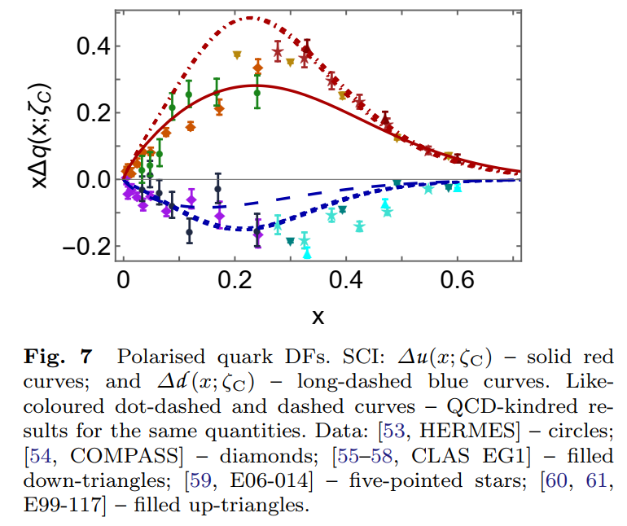
Polarised proton quark DFs
We employ a static approximation in treating the proton Faddeev equation and axial-vector current (no striking exchange-quark diagram), so${ g}_{A}$= $g_{A}^{u}$-$g_{A}^{d}$ is underestimated in SCI result.
The SCI results are semiquantitatively in agreement with available inferences from data.
Regarding the COMPASS results, lying on x ≲ 0.2, the collaboration’s extrapolations yield ${g_{A}^{d}=−0.34\left(5\right),g}_{A}^{u}=0.71\left(4\right)$. The SCI values are ${g_{A}^{d}=−0.23,g}_{A}^{u}=0.69$ and the QCD-kindred results are ${g_{A}^{d}=−0.30\left(1\right),g}_{A}^{u}=0.95\left(2\right)$.
Notes:
The collaboration’s extrapolations yield these values for proton axial charge. In SCI results, the value for u quark is equal to COMPASS value; the absolute value for d quark is less than COMPASS value. While in QCD-kindred results, the absolute value for d quark is equal to COMPASS value; the value for u quark is greater than COMPASS value.

Slide 15
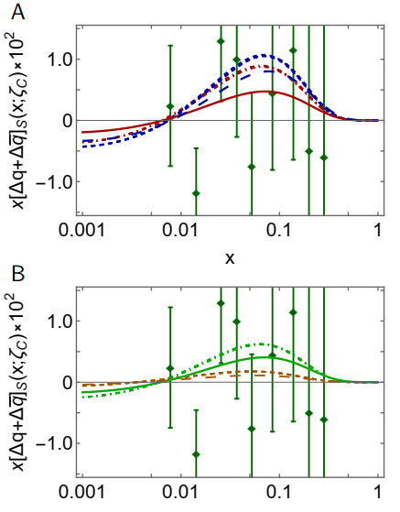
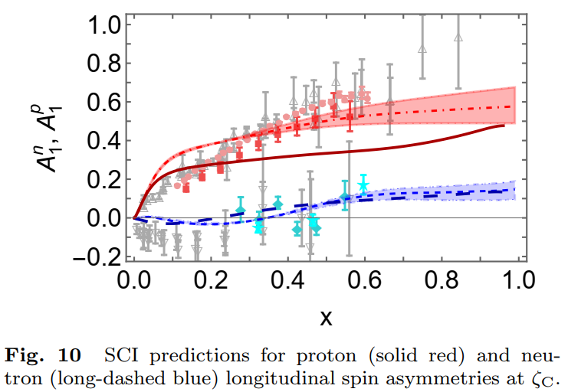
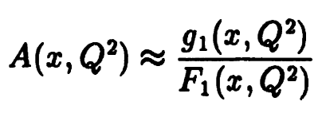
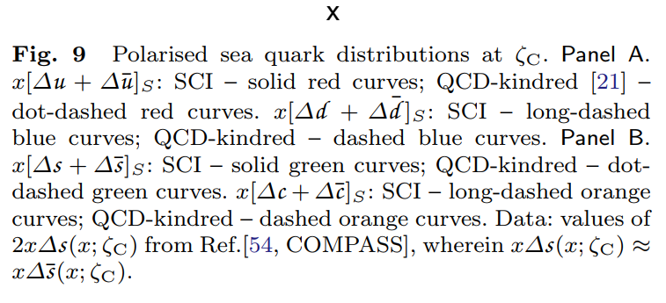
Polarised proton sea-quark DFs
Compared with QCD-kindred predictions, the SCI results are almost everywhere smaller in magnitude.
Extant phenomenological analyses of data deliver results that are typically of insufficient precision to distinguish between them.
Nucleon longitudinal spin asymmetries
Notes:
The solid red curve is the SCI prediction for proton. The long-dashed curve is the SCI prediction for neutron and it describe the data well. This is because the longitudinal spin asymmetry is the ratio of polarized and unpolarized proton DFs which have the same power-law behavior in SCI result.

Slide 16
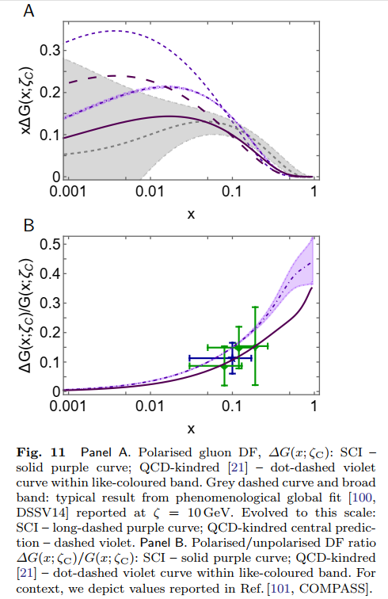
Polarised proton gluon DFs
Phenomenological DF fits of ∆$G\left(x\right)$ is very poorly constrained. Both SCI and QCD-kindred studies predict that the polarised proton gluon DF is positive and larger than phenomenological fits.
Parameter-free CSM prediction for ∆$G\left(x;ζ_{C}\right)$/ $G\left(x;ζ_{C}\right)$
compared with COMPASS data
C. Adolph, et al., Leading-order determination of the gluon polarization from semi-inclusive deep inelastic scattering data, Eur. Phys. J. C 77 (4) (2017) 209
e.g. average value over data window
${0.13}_{SCI}$ cf. $0.113±0.038±{0.036}_{COMPASS}$
The QCD-kindred value for this average is 0.167(3).
Notes:
SCI result compare well with COMPASS data.

Slide 17
Proton Spin Budget (SCI result)
Consider a light-front separation of the proton spin into contributions from quark and gluon spin and angular momenta:
$\frac{1}{2}=$ $\frac{1}{2}a_{0}+L_{q}\left(ζ\right)+ΔG$ $\left(ζ\right)+$ $L_{g}\left(ζ\right)$
At hadron scale:
$a_{0}$=0.45, $L_{q}\left(ζ_{H}\right)=0.27$
$ΔG$ $\left(ζ_{H}\right)=0, L_{g}\left(ζ_{H}\right)=0$
all proton spin is lodged with valence quark helicity and orbital angular momentum
Evolved to COMPASS scale
$a_{0}$=0.45, $L_{q}\left(ζ_{C}\right)=0.071, ΔG$ $\left(ζ_{C}\right)=0.91, L_{g}\left(ζ_{C}\right)=−0.71$
Combining CSM and lQCD results
quark helicity: $\left(56±13\right)\%$
glue:$≈40\%$
sign and magnitude of quark orbital angular momentum is uncertain
Notes:
Glue accounts for 40% of the proton spin. Valence quark helicity accounts for fifty-six plus(minus) thirteen percent proton spin.

Slide 18
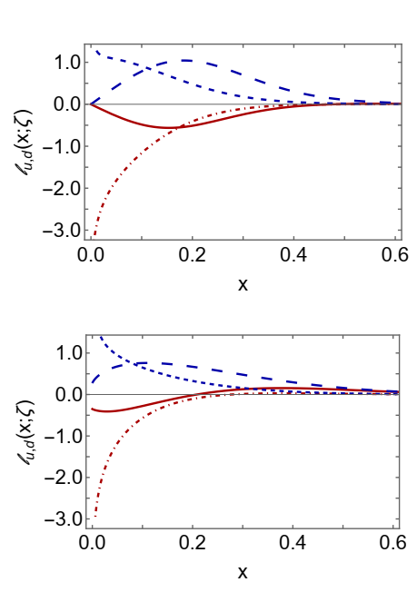
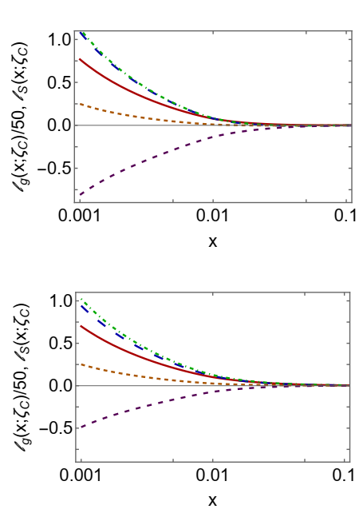
Orbital angular momenta (OAM) DFs
arXiv:2410.03966
We use a Wandzura-Wilczek (WW) approximation to estimate OAM distributions:
$$l_{f}\left(x\right)=x\int_{x}^{1}{dy\frac{1}{y^{2}}}\left[yf\left(y\right)−∆f(y)\right]$$
Under evolution, valence quark OAM is shifted to lower x and grow in magnitude. Sea and glue OAM are concentrated at low x.
Quark and gluon OAM also carry material fractions of the proton’s total spin, with OAM DF support concentrated at low values of parton light-front momentum fraction.
valence quark OAM
sea and glue OAM
Yang Yu and Craig D. Roberts, impressions of parton distribution functions, arXiv:2410.03966 .
Notes:
1. Valence quark OAM profiles are sensitive to details of proton structure.
2. Sea OAM DF is positive and glue OAM DF is negative.

Slide 19
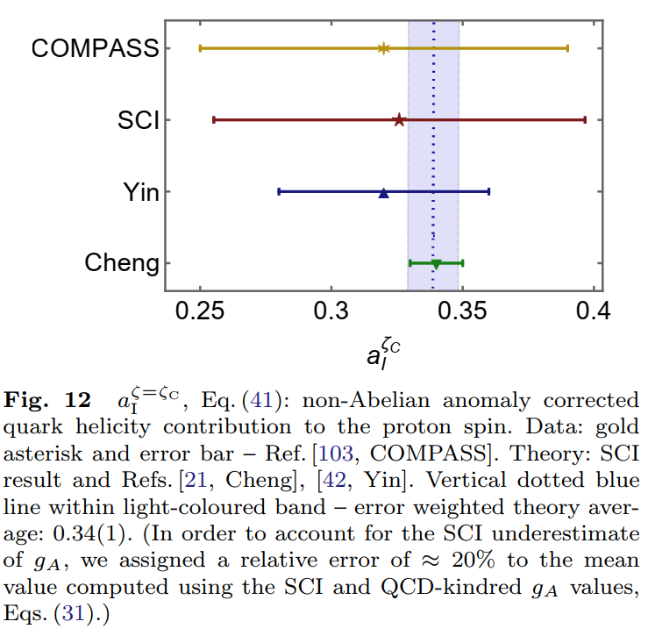
Proton Spin
$a_{0}=0.49g_{A}≈45\%$(SCI result) of proton spin
carried by valence quark
quasiparticle degrees of freedom at the hadron scale.
Under P1 evolution, this value is independent of scale.
However, measurements of the proton spin are sensitive to non-Abelian anomaly corrected combination $\left(n_{f}=4\right)$
SCI prediction: $a_{0}^{E}\left(ζ=\sqrt{3}GeV\right)=0.28$
QCD-kindred prediction: $a_{0}^{E}\left(ζ=\sqrt{3}GeV\right)=0.34(1)$
COMPASS: $a_{0}^{COMPASS}\left(ζ=\sqrt{3}GeV\right)=0.32(7)$
Contemporary CSM analyses deliver a viable solution of the proton spin crisis

Slide 20
Summary
Using a symmetry-preserving treatment of a vector × vector contact interaction (SCI), our calculations show that hadron scale unpolarised and polarised proton valence quark DFs have the same power law behavior.
The SCI and QCD-kindred predictions are qualitatively and semiquantitatively consistent, with neither supporting helicity retention in hard scattering processes.
With Pauli blocking expressed in a modification of the gluon splitting function, SCI DFs provide a straightforward explanation of the asymmetry of antimatter in the proton.
Regarding the unpolarised DF, both SCI and QCD-kindred analyses predict a measurable charm quark momentum fraction in the proton without recourse to “intrinsic charm” .
Quark and gluon OAM also carry material fractions of the proton’s total spin, with OAM DF support concentrated at low values of parton light-front momentum fraction.
Contemporary CSM analyses deliver a viable solution of the proton spin crisis.
Thankyou

Slide 21
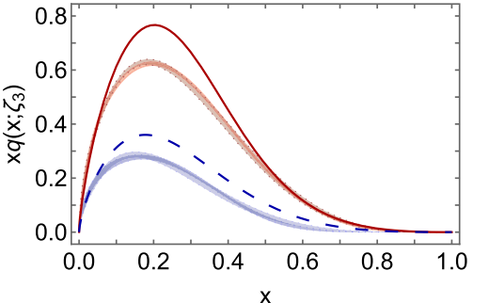
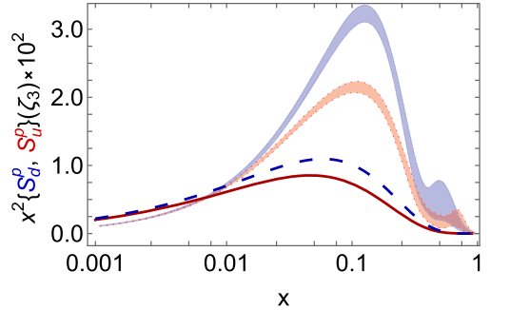
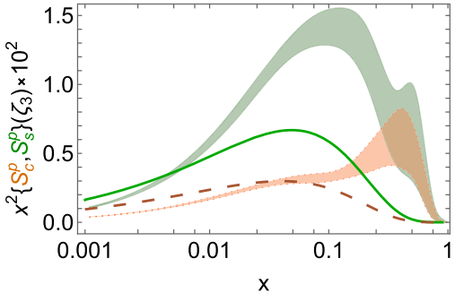
Comparison with NNPDF4.0 fits
Similarities:
In both cases, $u(x)≠2d(x)$; the maximum in $xu(x)$ is shifted to larger $x$ by roughly 15% than that in $xd(x)$. Existing CSM analyses attribute this shift to the existence of diquark correlations within the proton.
In both cases, the d quark sea DF is uniformly larger than that associated with u quarks, the s quark sea is next greatest in magnitude, and the c quark sea is smallest.

Slide 22
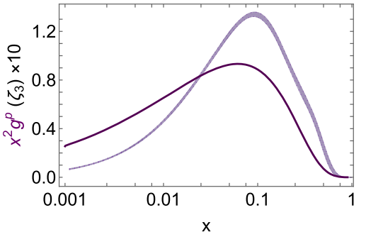
Comparison with NNPDF4.0 fits
Differences:
[1] Concerning pion parton distributions,
Z.-F. Cui et al, Eur. Phys. J. A 82 (2022) 1, 10.
The inferred proton DFs exhibit similar features with pion DFs [1,Fig.9]: the glue momentum fraction is practically identical with SCI prediction while momentum fractions with valence quarks are less than SCI predictions and this is compensated in the fits by locating additional momentum with the sea.
The sea quark DFs inferred from data typically possess more support than the SCI predictions and exhibit remarkable structure on the valence quark domain $x≥0.25$.
Soft gluon (next-to-leading logarithm threshold) resummation should be included before a detailed comparison of predictions and fits is possible, especially the pointwise behaviour.
Notes:
This is especially true of the sea DFs, which are not guaranteed to be monotonically decreasing. Remarkable structure (large uncertainties and “wiggles”) on valence quark domain is attribute to the scarcity of data on this domain.
The fitting outcomes are sensitive to the form of hard scattering kernel used.

Slide 23
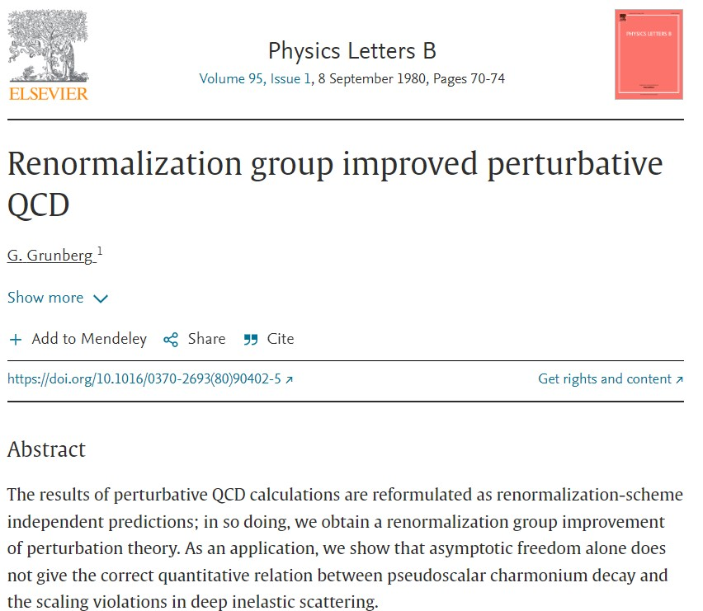
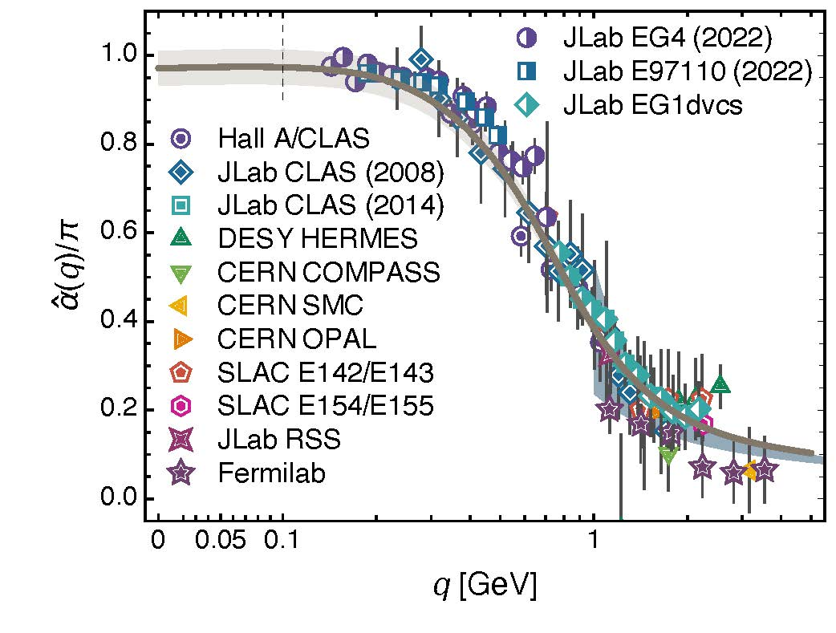
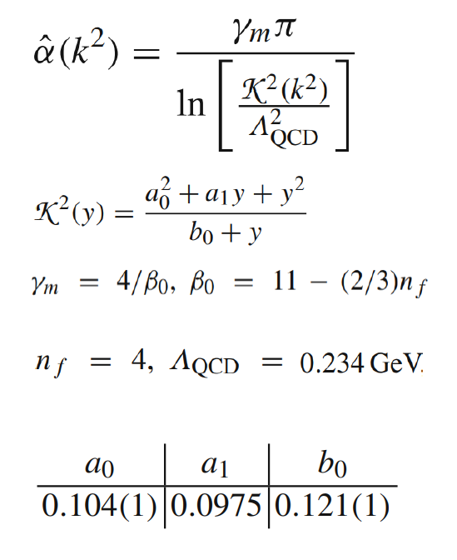
All-Orders Evolution of Parton Distributions: Principle, Practice, and Predictions
Pei-Lin Yin (尹佩林) et al., e-Print: 2306.03274 [hep-ph]
Chin. Phys. Lett. Express 40 (2023) 091201/1-8.
All-orders $ζ$-evolution
P1 – In the context of Refs. [73, 74], there exists at least one effective charge, $α_{1ℓ}(k^{2})$, which, when used to integrate the leading-order perturbative evolution (DGLAP) equations, defines an evolution scheme for parton DFs that is all-orders exact.
CSM Process-Independent charge serves this purpose
Notes:
至少存在一个有效荷，当被用来积分头阶的微扰DGLAP方程时，由此定义的演化方程是所有阶有效的。
CSM过程无关的有效荷可以被用来积分演化方程。

