Slide 1
Sivers and Collins Asymmetries
Studies and EicC Projection
Reporter：Hongxin Dong
Collaborators：Chunhua Zeng, Tianbo Liu, Peng Sun, Yuxiang Zhao
Report date ：2024.10.18

Slide 2
1
Introduction
Research Background
2
Theoretical formalism
Framework
Outlook
3
Numerical Result
CONTENTS
Result of global fit
4
Summary
Conclusions

Slide 3
1
Introduction
Research Background

Slide 4
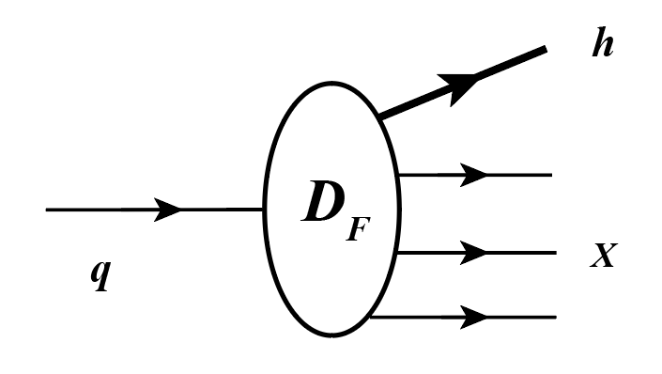
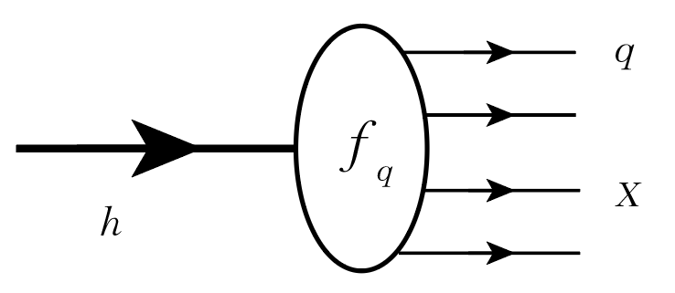
Introduction
Theoretical formalism
Numerical Result
Summary
Parton distribution functions & Fragmentation functions
PDFs
FFs
国内研究
$$h→q+X$$
$$q→h+X$$
a hadron $→$ a beam of partons
a quark $→$ a jet of hadrons
$f_{q}$ : number density of parton in the beam
$D_{F}$: number density of hadron in the jet induced by a parton
Deeply inelastic scattering (DIS)
Hadron production in $e^{+}e^{−}$ annihilation
SIDIS, Drell-Yan

Slide 5
Introduction
Theoretical formalism
Numerical Result
Summary
TMDs
TMD PDFs |  | Quark polarization
 |  | Unpolarized （U） | Longitudinally polarized(L) | Transversely polarized(T)
Nucleon polarization | U
 | L
 | T
Momentum fraction $x=\frac{k^{+}}{P^{+}}$
$f_{q}(x)$ : collinear PDF
$$f_{1}$$
$$h_{1}^{⊥}$$
$f_{q}(x,k_{⊥})$ : TMD PDF
Boer-Mulders
Unpolarized
$$g_{1L}$$
$$h_{1L}^{⊥}$$
Nucleon spin
8 leading twist TMD PDFs
Helicity
Longi-transversity
$$f_{1T}^{⊥}$$
$$g_{1T}$$
$$h_{1}^{ }$$
Parton spin
Trans-helicity
Transversity
Sivers
$$h_{1T}^{⊥}$$
Pretzelosity
TMD FFs |  | Quark polarization
 |  | Unpolarized （U） | Transversely polarized(T)
Hadron polarization | U
TMD FFs
$$D_{1}$$
$$H_{1}$$
Collins

Slide 6
2
Theoretical formalism
Framework

Slide 7
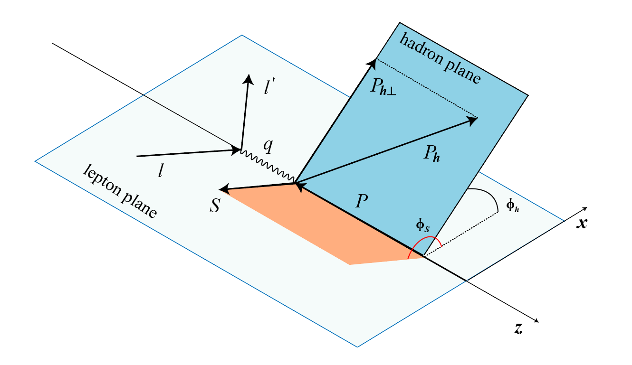
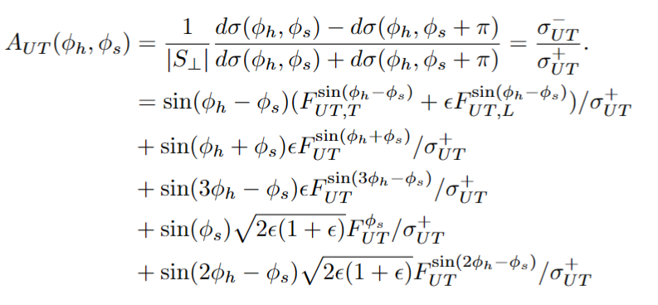
Introduction
Theoretical formalism
Numerical Result
Summary
SIDIS process
$$e\left(l\right)+N\left(P\right)→e\left(l^{′}\right)+h\left(P_{h}\right)+X$$
In the case target is transversely polarized and beam is unpolarized, we define a target single spin asymmetry as:
Sivers asymmetry
Collins asymmetry
$$εA_{UT}^{\sin\left(φ_{h}+φ_{s}\right)}=\frac{{ε F}_{UT}^{\sin\left(φ_{h}+φ_{s}\right)}}{F_{UU,T} }$$
$$h_{1}^{ }⊗H_{1}^{⊥}$$
Collins asymmetry :
transversity and Collins function
$$A_{UT,T}^{\sin\left(φ_{h}−φ_{s}\right)}=\frac{{ F}_{UT,T}^{\sin\left(φ_{h}−φ_{s}\right)}}{F_{UU,T} }$$
$$f_{1T}^{⊥}⊗D_{1}^{ }$$
Sivers asymmetry :
Sivers and unpolarized

Slide 8
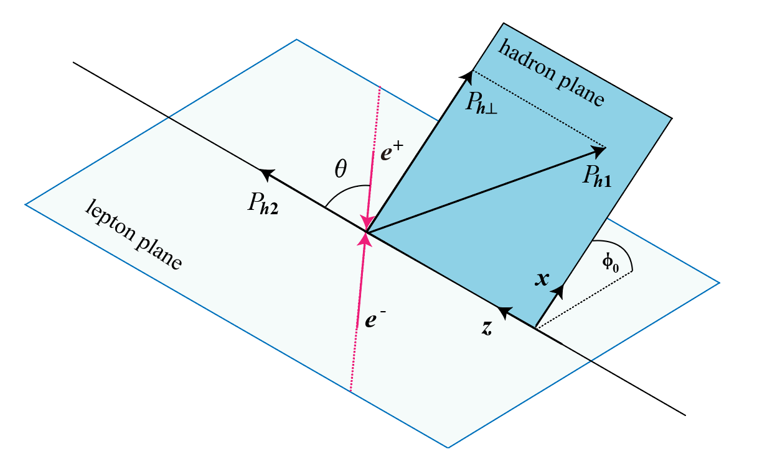
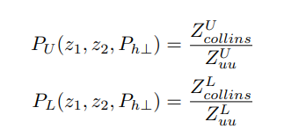
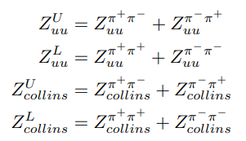
Introduction
Theoretical formalism
Numerical Result
Summary
SIA process
$$e^{+}+e^{−}→h_{1}+h_{2}+X$$
To eliminate false asymmetries, one consider the radio of unlike-sign ($R^{U}$) to like-sign ($R^{L}$) hadron pair production
For $ππ$ chancel
$$H_{1}^{⊥}⊗H_{1}^{⊥}$$
Collins function

Slide 9
3
Numerical Result
Result of global fit

Slide 10
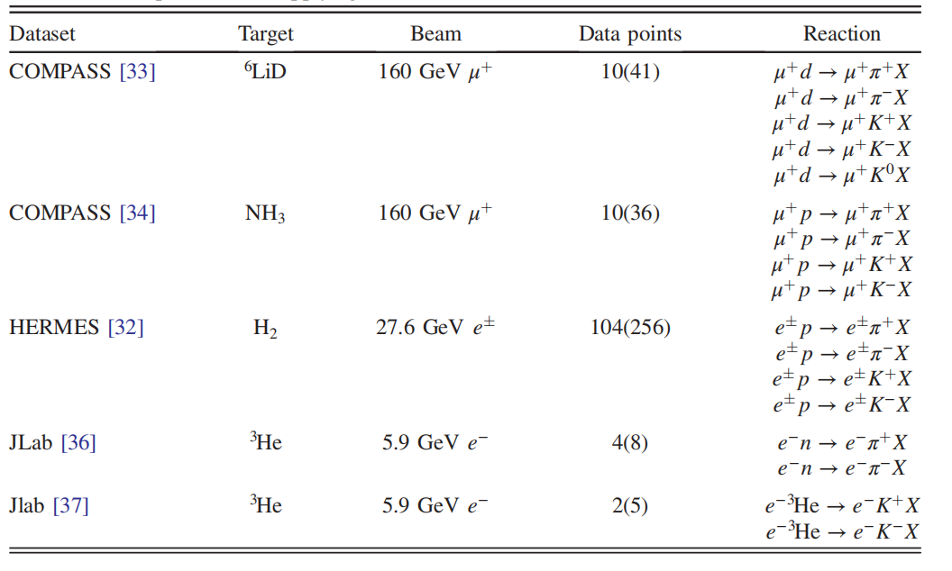
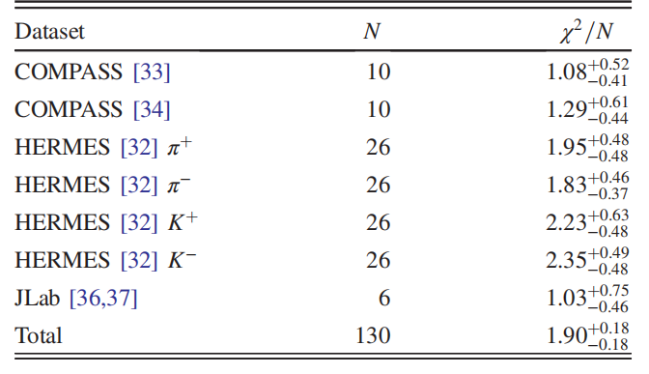
Introduction
Theoretical formalism
Numerical Result
Summary
Datasets for Sivers
$$δ=\frac{P_{h⊥}}{zQ}<0.5$$
world data
data uncertainty
SIDIS data:130
1000 replica
fit independently
1000 results
$$δ=\frac{P_{h⊥}}{zQ}<0.3$$
average and
standard deviation
EicC pseudodata:4983
TMDs
Sivers function

Slide 11
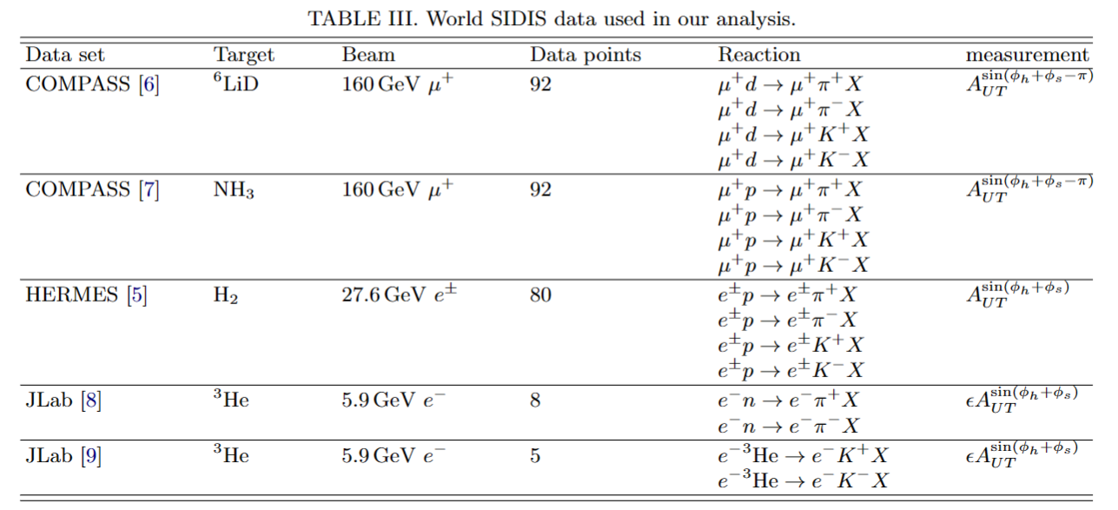
Introduction
Theoretical formalism
Numerical Result
Summary
Datasets for
transversity
world data
data uncertainty
SIDIS data:277
1000 replica
fit independently
1000 results
average and
standard deviation
SIA data:120
TMDs
Total world data:397
Collins function &
transversity function
EicC pseudodata:1347
$$δ=\frac{P_{h⊥}}{zQ}<0.3$$

Slide 12
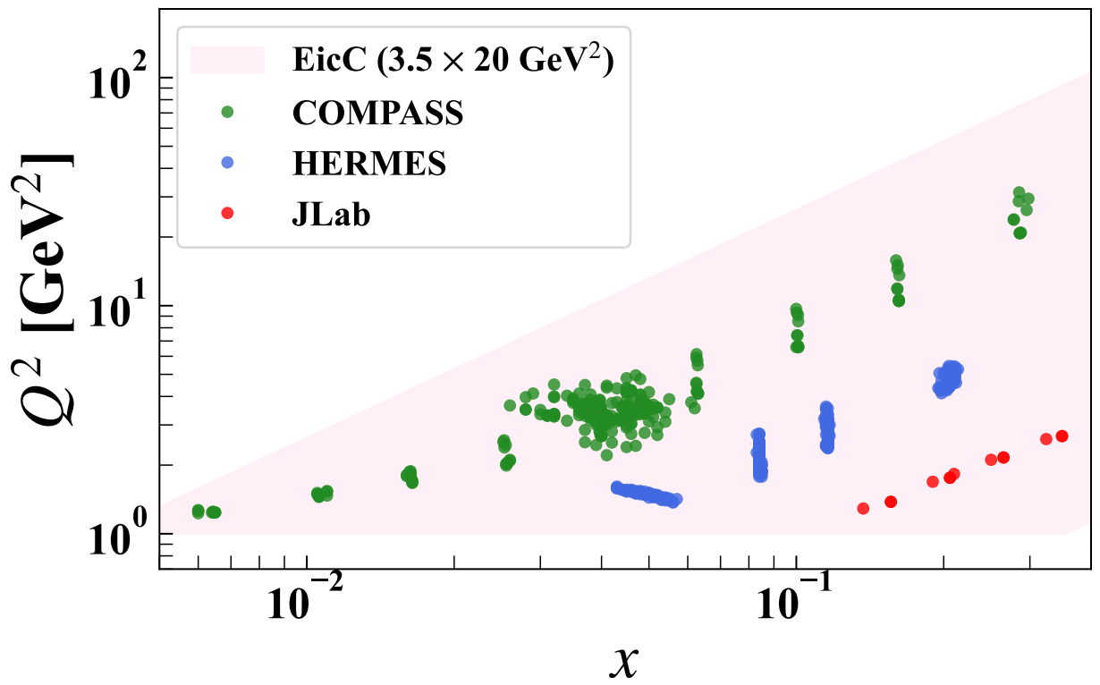
Introduction
Theoretical formalism
Numerical Result
Summary
Kinematic distribution of SIDIS Datasets

Slide 13
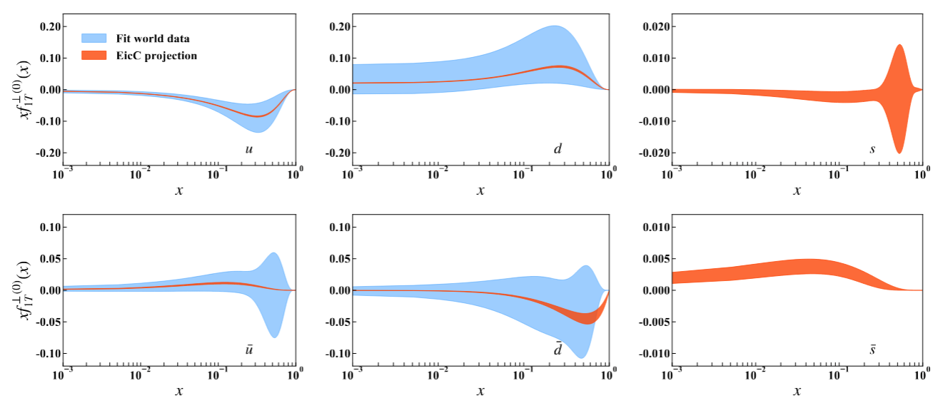
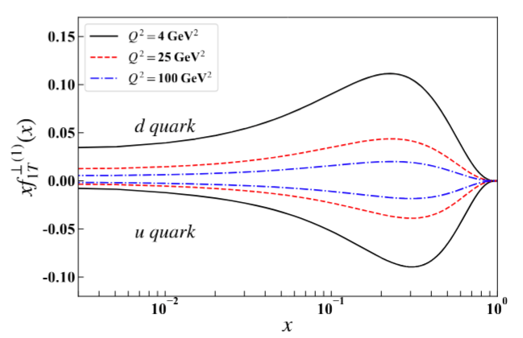
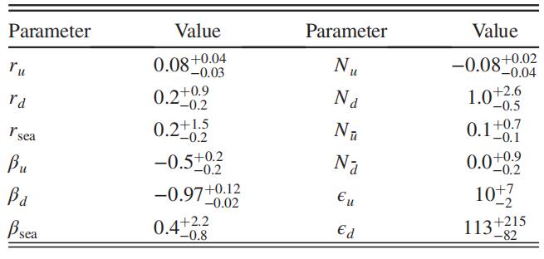
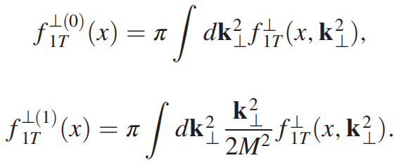
Introduction
Theoretical formalism
Numerical Result
Summary
Global fit & EicC pseudo data – Sivers function
$$f_{1T;q←p}^{⊥}\left(x,b\right)=\frac{N_{q}{\left(1−x\right)}^{α_{q}}x^{β_{q}}（1+ε_{q}x）\exp\left(−{r_{q}}_{ }b^{2}\right)}{n}$$

Slide 14
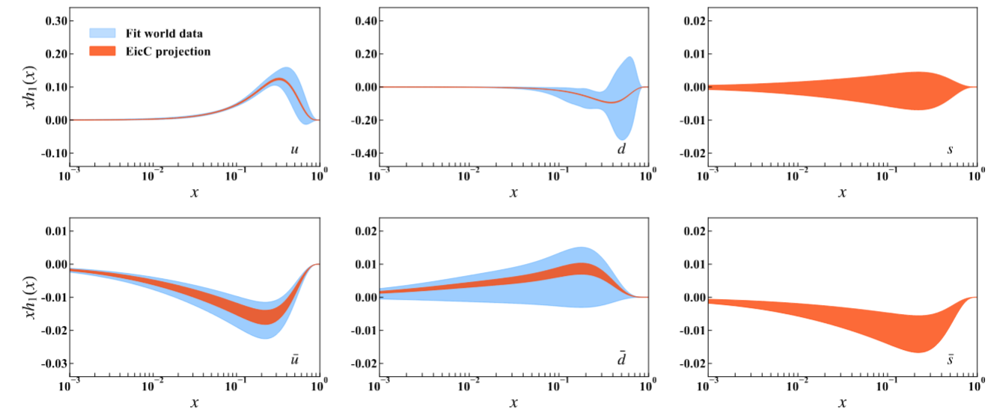
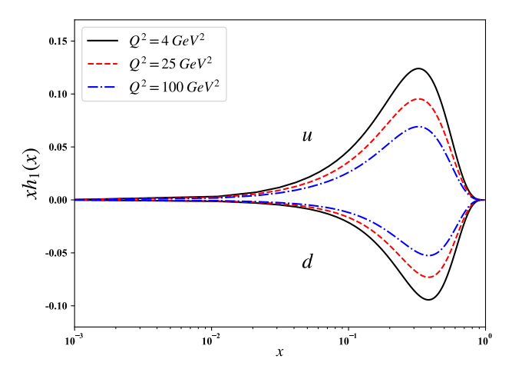
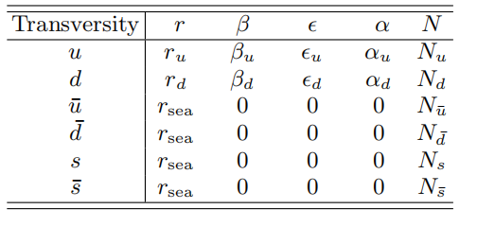
Introduction
Theoretical formalism
Numerical Result
Summary
Global fit & EicC pseudo data – transversity function
$$h_{1}^{u}\left(x,b\right)=\frac{N_{u}{\left(1−x\right)}^{α_{u}}x^{β_{u}}（1+ε_{u}x）\exp\left(−{r_{u}}_{ }b^{2}\right)}{n} f_{1}^{u}(x,Q_{0})$$
$$h_{1}^{\overline{u}}\left(x,b\right)=\frac{N_{\overline{u}}\exp\left(−{r_{ }}_{\overline{u}}{ b}^{2}\right)}{n} [f_{1}^{u}\left(x,Q_{0}\right)−f_{1}^{\overline{u}}\left(x,Q_{0}\right)]$$

Slide 15
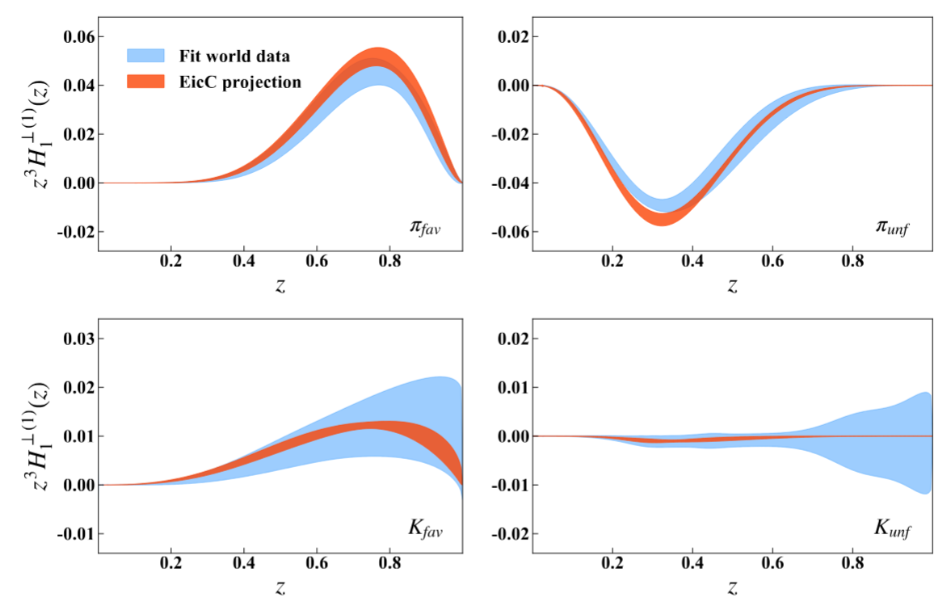
Introduction
Theoretical formalism
Numerical Result
Summary
Global fit & EicC pseudo data – Collins function
$$H_{1πfav}^{⊥(1)}(z,b)=\frac{1}{z^{2}}N_{f}^{π}{\left(1−z\right)}^{α_{f}^{π}}z^{β_{f}^{π}}D_{NP}(z,b)$$
$$D_{NP}(z,b)=exp[−\frac{η_{1f}^{π}z+η_{2f}^{π}\left(1−z\right)}{\sqrt{1+η_{3f}^{π}{\left(b/z\right)}^{2}}}\frac{b^{2}}{z^{2}}](1+η_{4f}^{π}\frac{b^{2}}{z^{2}})$$

Slide 16
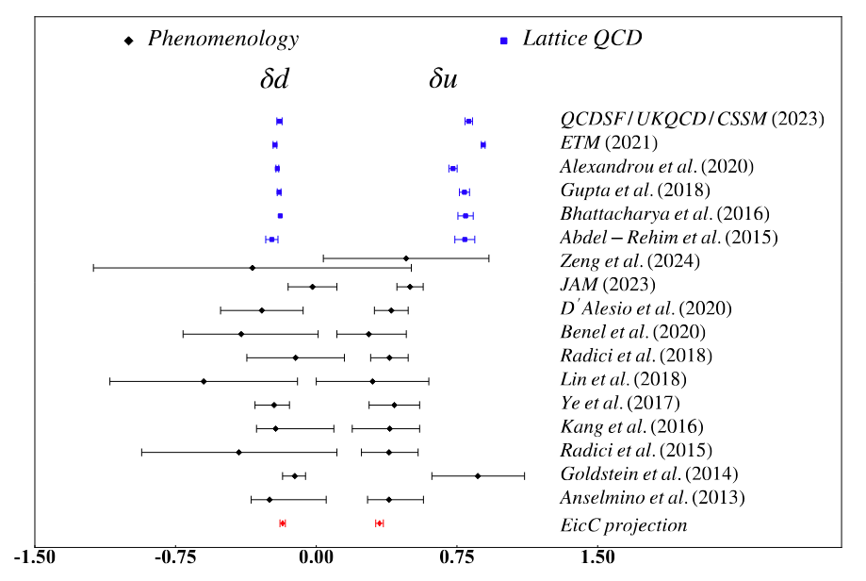
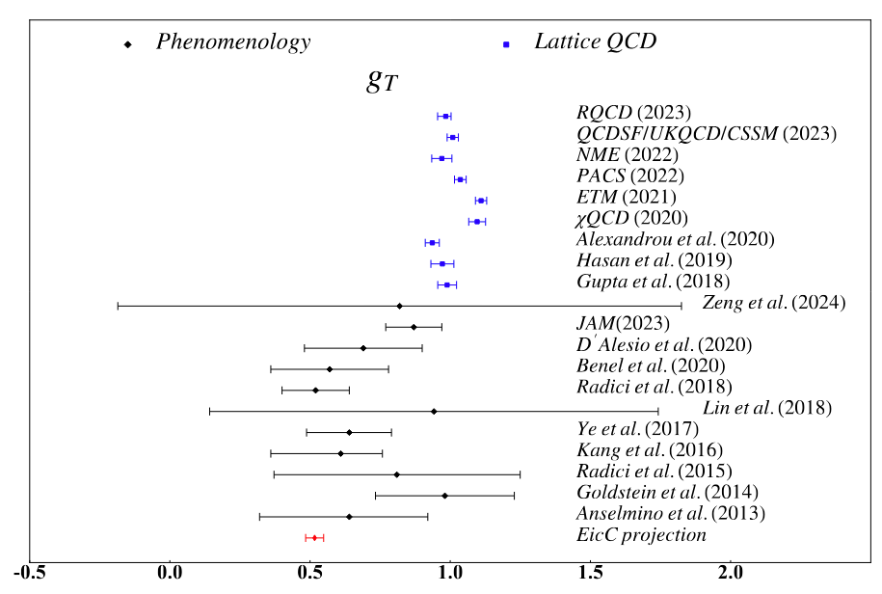
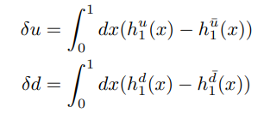
Introduction
Theoretical formalism
Numerical Result
Summary
Tensor charge

Slide 17
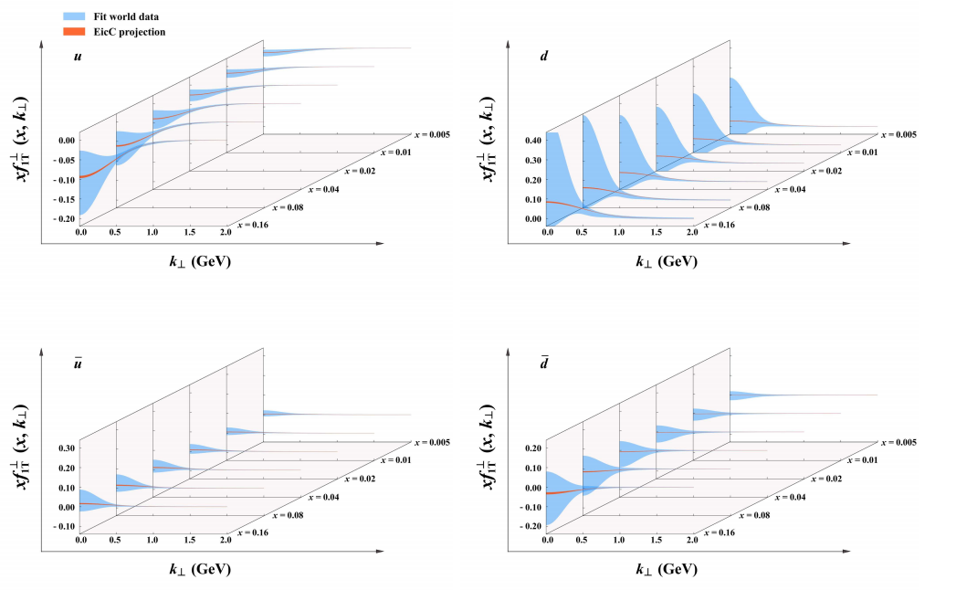
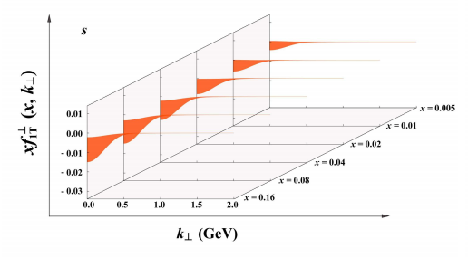
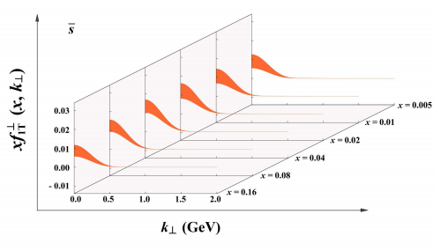
Introduction
Theoretical formalism
Numerical Result
Summary
Three-dimensional nucleon structures – Sivers function

Slide 18
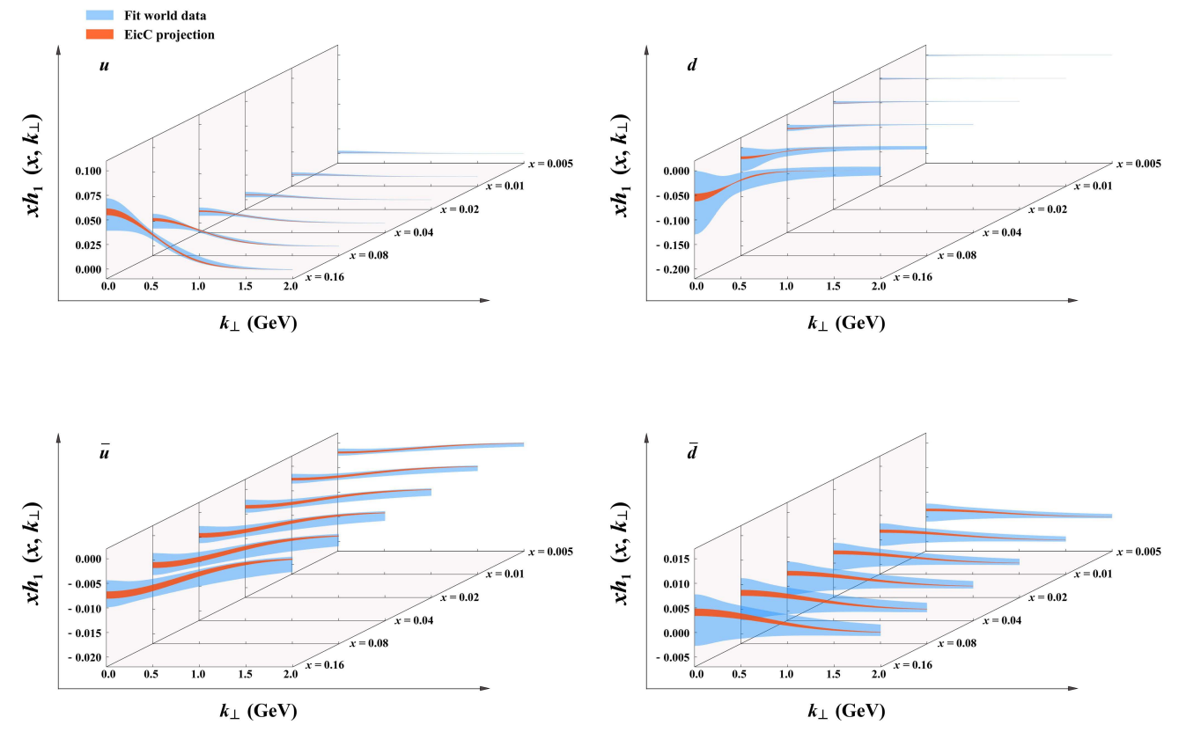
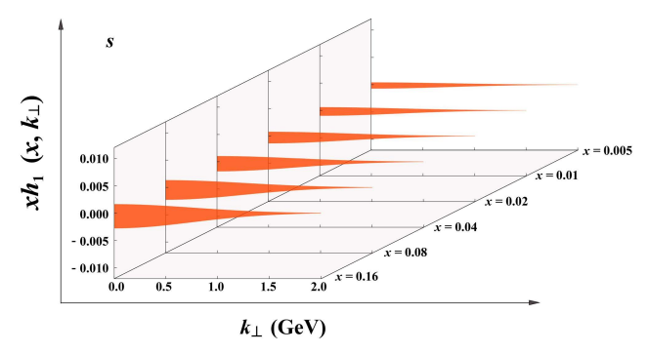
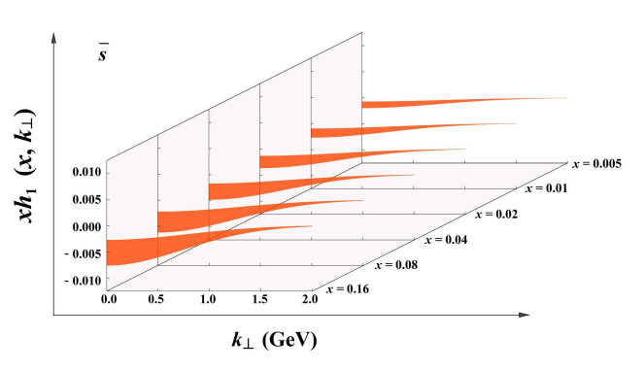
Introduction
Theoretical formalism
Numerical Result
Summary
Three-dimensional nucleon structures – transversity function

Slide 19
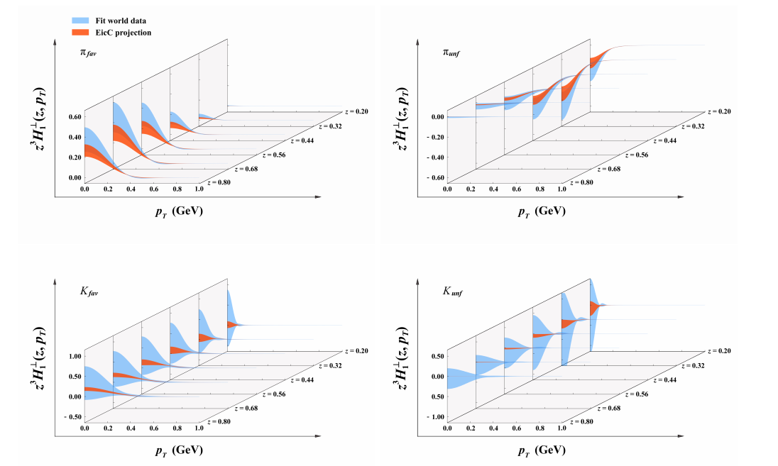
Introduction
Theoretical formalism
Numerical Result
Summary
Three-dimensional nucleon structures – Collins function

Slide 20
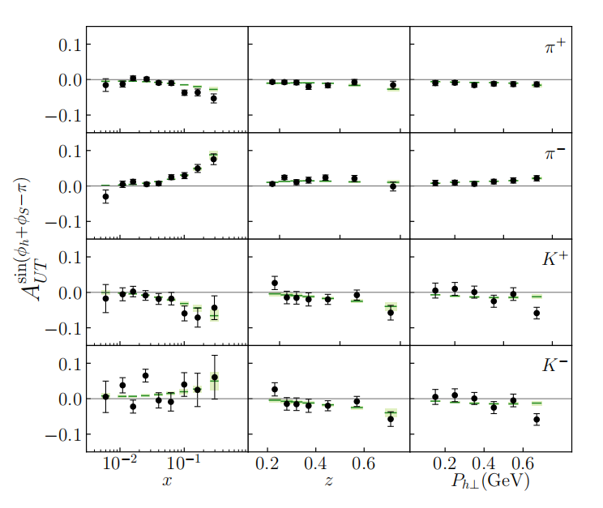
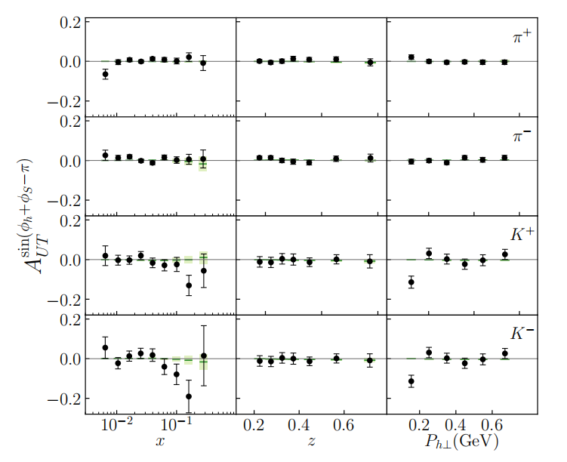
Introduction
Theoretical formalism
Numerical Result
Summary
Comparison with the world data
COMPASS data

Slide 21
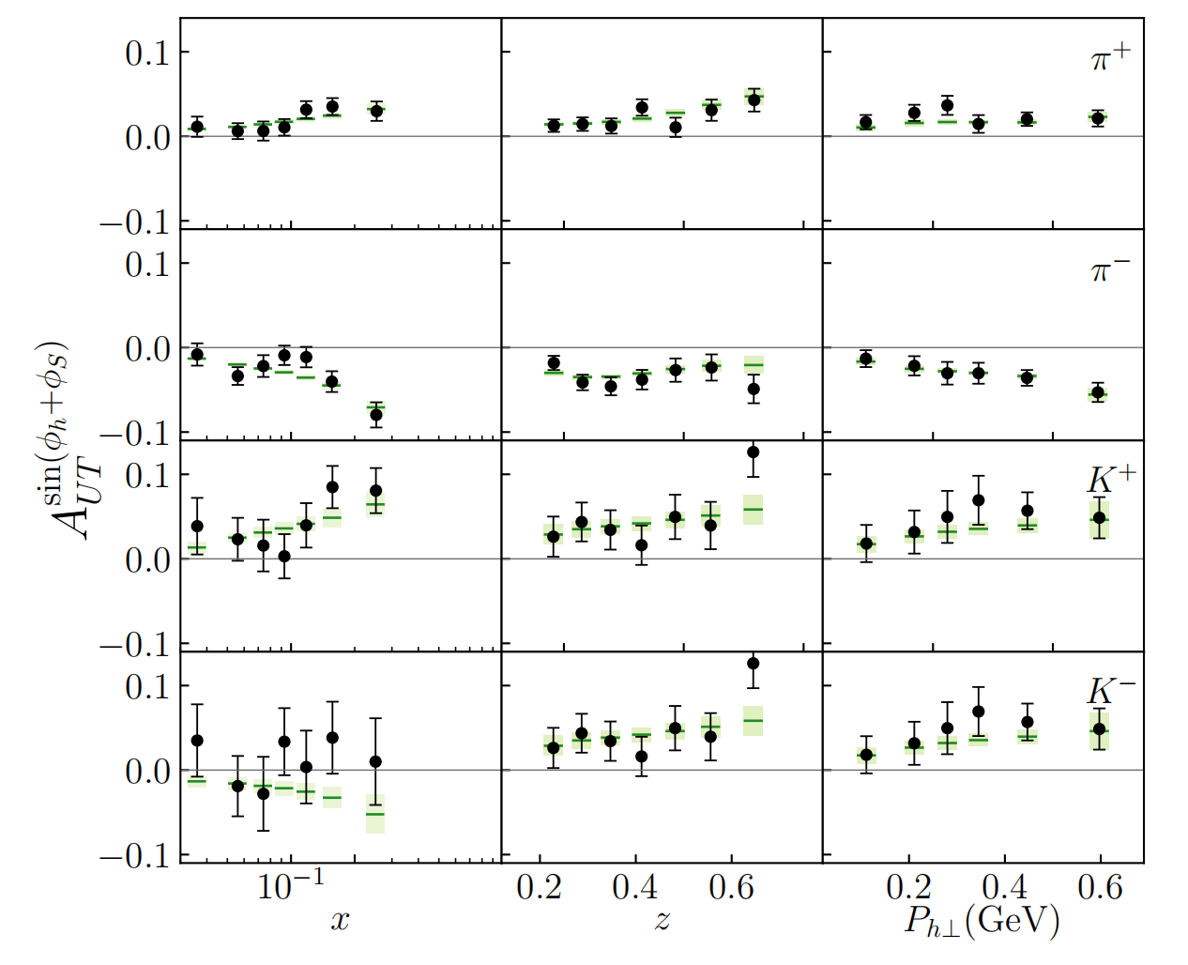
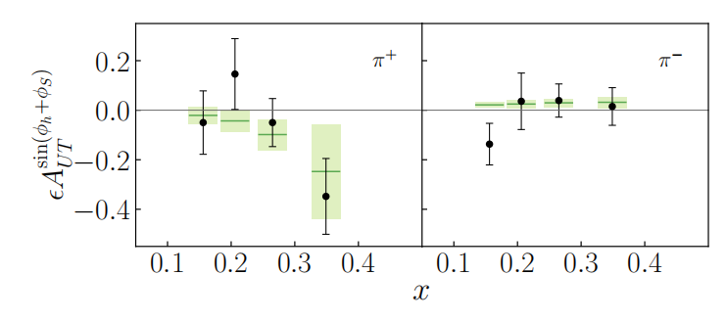
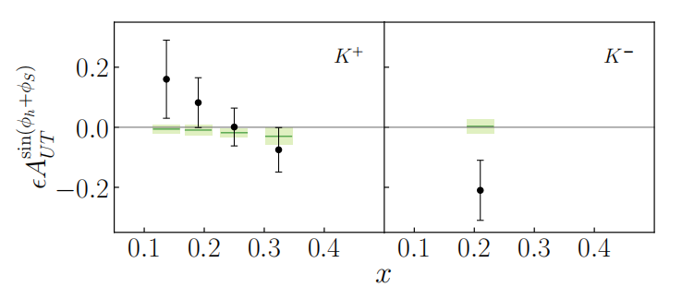
Introduction
Theoretical formalism
Numerical Result
Summary
Comparison with the world data
HERMES data
JLab data

Slide 22
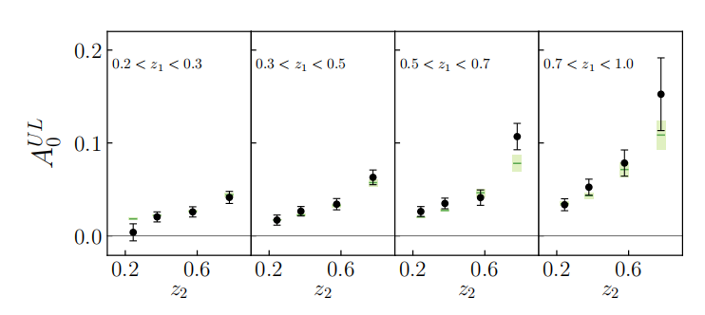
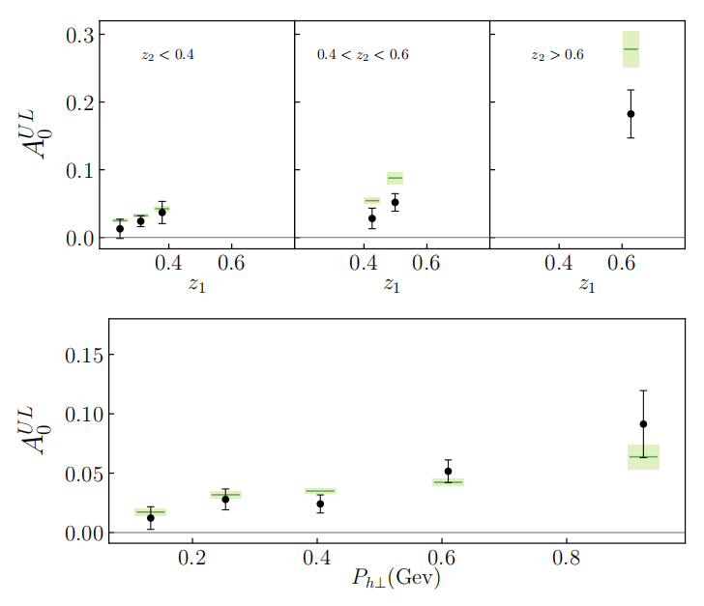
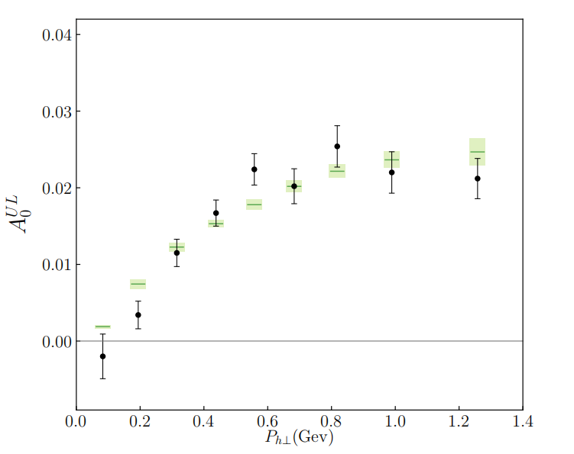
Introduction
Theoretical formalism
Numerical Result
Summary
Comparison with the world data
BELLE data
BESIII data
BABAR data

Slide 23
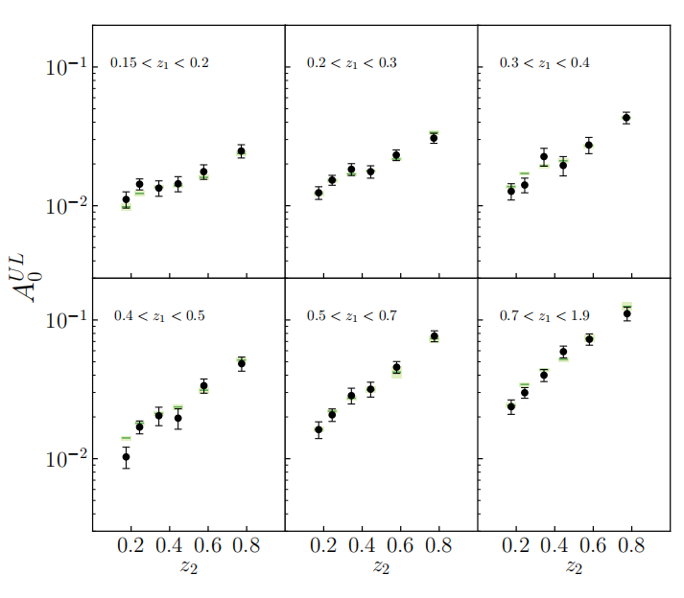
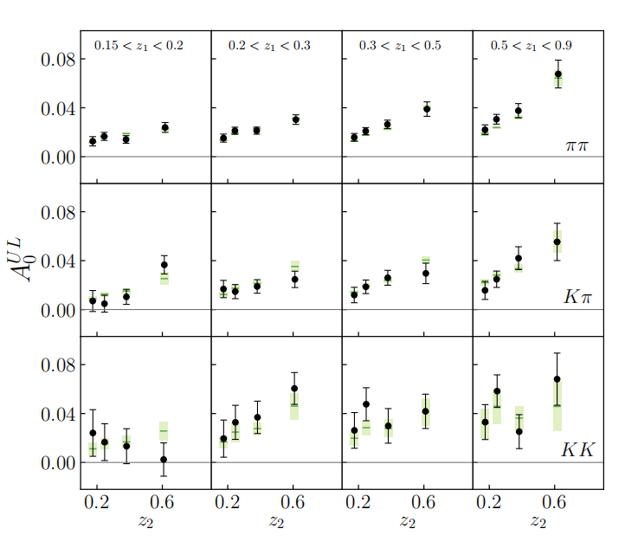
Introduction
Theoretical formalism
Numerical Result
Summary
Comparison with the world data
BABAR data

Slide 24
4
Summary
Conclusions

Slide 25
Introduction
Theoretical formalism
Numerical Result
Summary
Conclusions
1. In this study we used the QCD factorization to investigate the Sivers, transversity, Collins distribution with the evolution effect considered..
2. We find that the result of fitting world data for Sivers and transversity sea quarks distribution
and Collins function of Kaon distribution hints a significant uncertainty. We need EicC to
improve this situation.
3. With EicC pseudo-data, we can extracted the Sivers, transversity and Collins function at
high precision for various quark flavors.

Slide 26
THANKS FOR LISTENING
Reporter：Hongxin Dong
Collaborators：Chunhua Zeng, Tianbo Liu, Peng Sun, Yuxiang Zhao
Report date ：2024.10.18

