Slide 1

Higher-twist generalized parton distributions of the pion and kaon at zero skewness in the light-cone quark model
X. Luan and Z. Lu, Phys. Rev. D 110 (2024) no.7, 074022.
Xianyan Luan (栾晓燕)
School of Physics, Southeast University
10/19/2024
第二届核子三维结构研讨会暨第二届高扭度核子结构研讨会

Slide 2
Outline
Definition of the parton distributions
Definition of the generalized parton distributions (GPDs)
The twist-3 and twist-4 GPDs of light mesons
PDF Limit
Summary
10/19/2024 第二届核子三维结构研讨会暨第二届高扭度核子结构研讨会 1/20

Slide 3
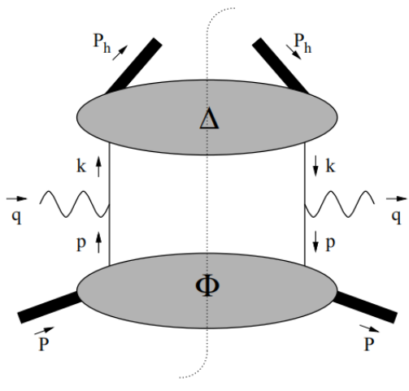
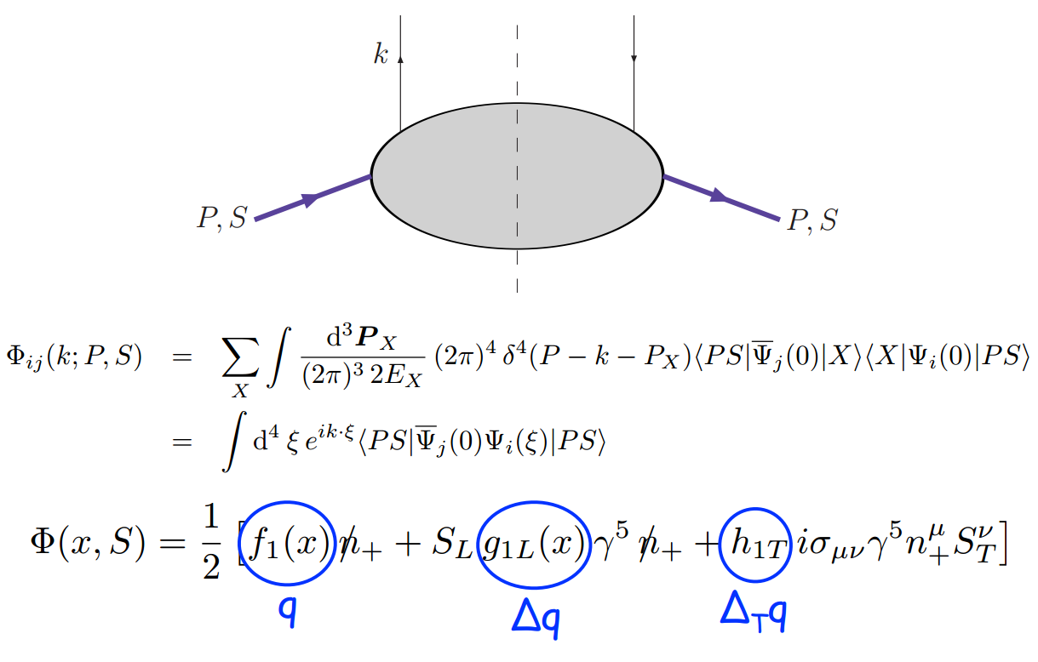
Definition of the parton distributions
QCD factorization theorem
At a specific energy scale, high-energy scattering process involving hadrons can be factorized into long-range and short-range parts.
Short-range: hard scattering subprocesses calculable by perturbative QCD.
Long-range: non-perturbative part, which can be parameterized as a set of universal quantities independent of specific processes, namely parton distribution functions and fragmentation functions.
quark-quark correlation function
10/19/2024 第二届核子三维结构研讨会暨第二届高扭度核子结构研讨会 2/20

Slide 4
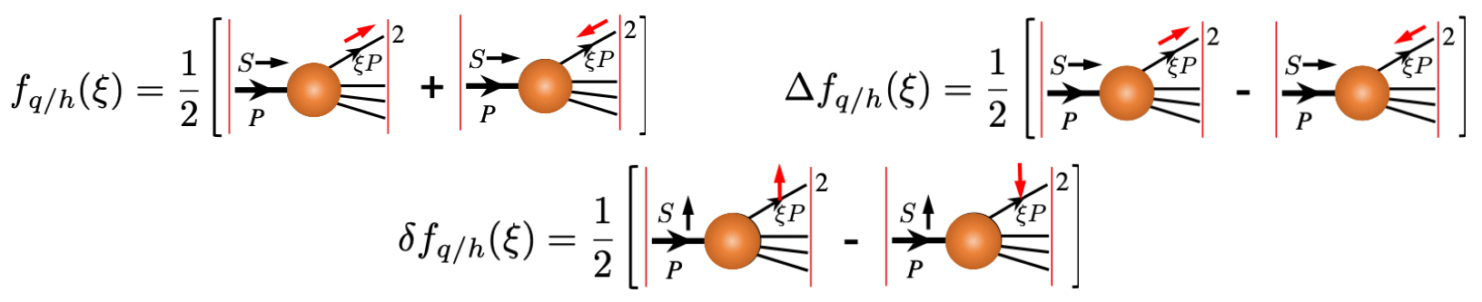
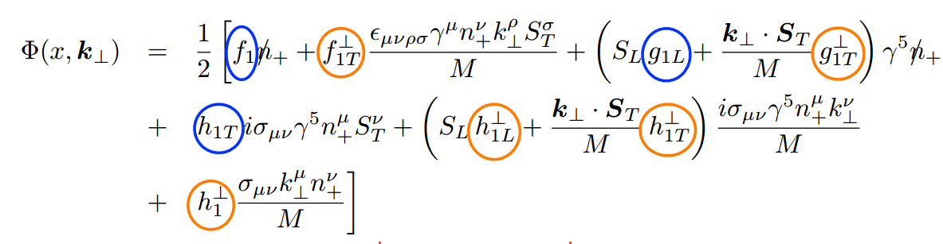
Definition of the parton distributions
quark-quark correlation function parameterization
One-dimensional parton distribution functions(PDFs)：
(Unpolarized)
(Longitudinally polarized)
Longitudinal motion only
(Transversely polarized)
Three-dimensional parton distribution functions(TMDs)：
Longitudinal + transverse motion
10/19/2024 第二届核子三维结构研讨会暨第二届高扭度核子结构研讨会 3/20

Slide 5
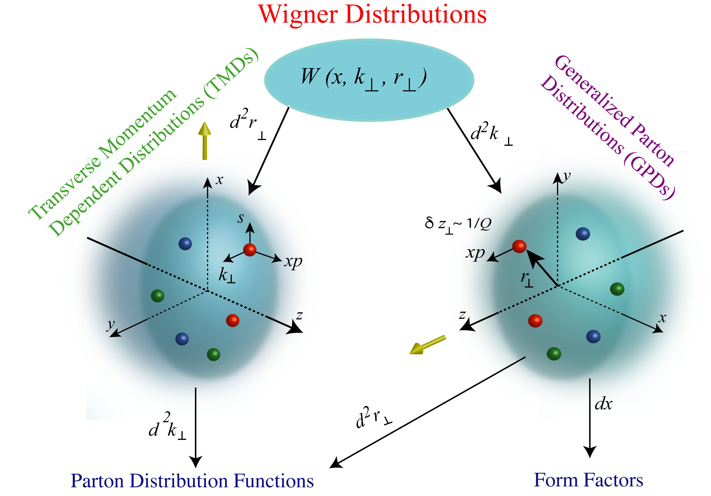
Definition of the parton distributions
Multidimensional parton distributions:
F.T. of GTMD
semi-inclusive:
SIDIS
Drell-Yan
e⁺e⁻ annihilation
exclusive:
DVCS
HEMP
10/19/2024 第二届核子三维结构研讨会暨第二届高扭度核子结构研讨会 4/20

Slide 6
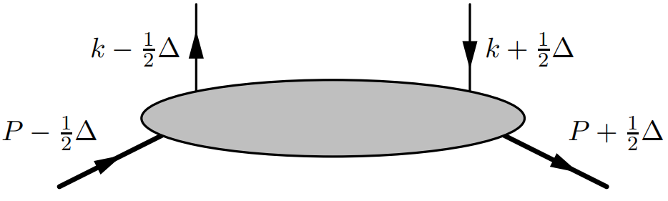
Definition of GPDs
Generalized parton correlation functions
spin-1/2 hardon
spin-0 hardon
The fully unintegrated, off-diagonal quark-quark correlator functions (GPCFs) contain the maximum amount of information about the partonic structure of hadrons.
GPCFs can be considered as mother distributions of GPDs and TMDs.
The correlator can be can expressed in the form of overlaps of the LCWFs.
Kinematics for GPCFs
10/19/2024 第二届核子三维结构研讨会暨第二届高扭度核子结构研讨会 5/20

Slide 7
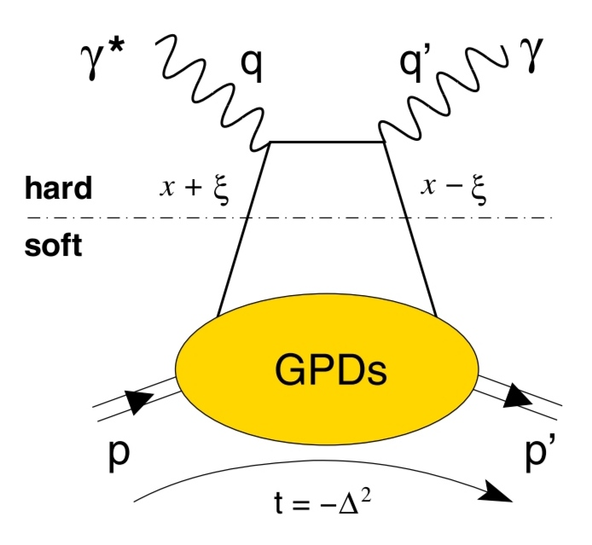
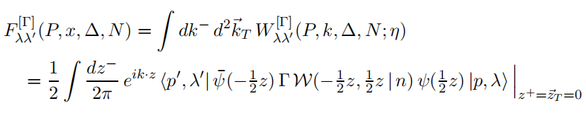
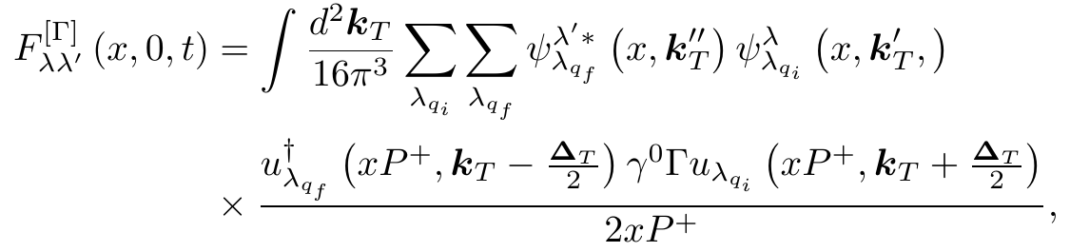
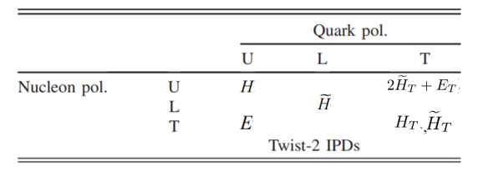
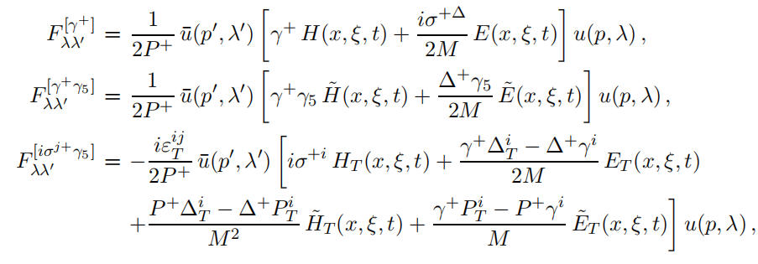
Definition of GPDs
GPD-limit (spin-1/2 hardon)
GPD correlator (spin-1/2 hardon)
The overlap representation for GPD correlator (spin-1/2 hardon)
Leadind-twist parameterization (spin-1/2 hardon)
8个领头扭度 GPDs，
4个chiral-even GPDs
4个chiral-odd GPDs
10/19/2024 第二届核子三维结构研讨会暨第二届高扭度核子结构研讨会 6/20

Slide 8
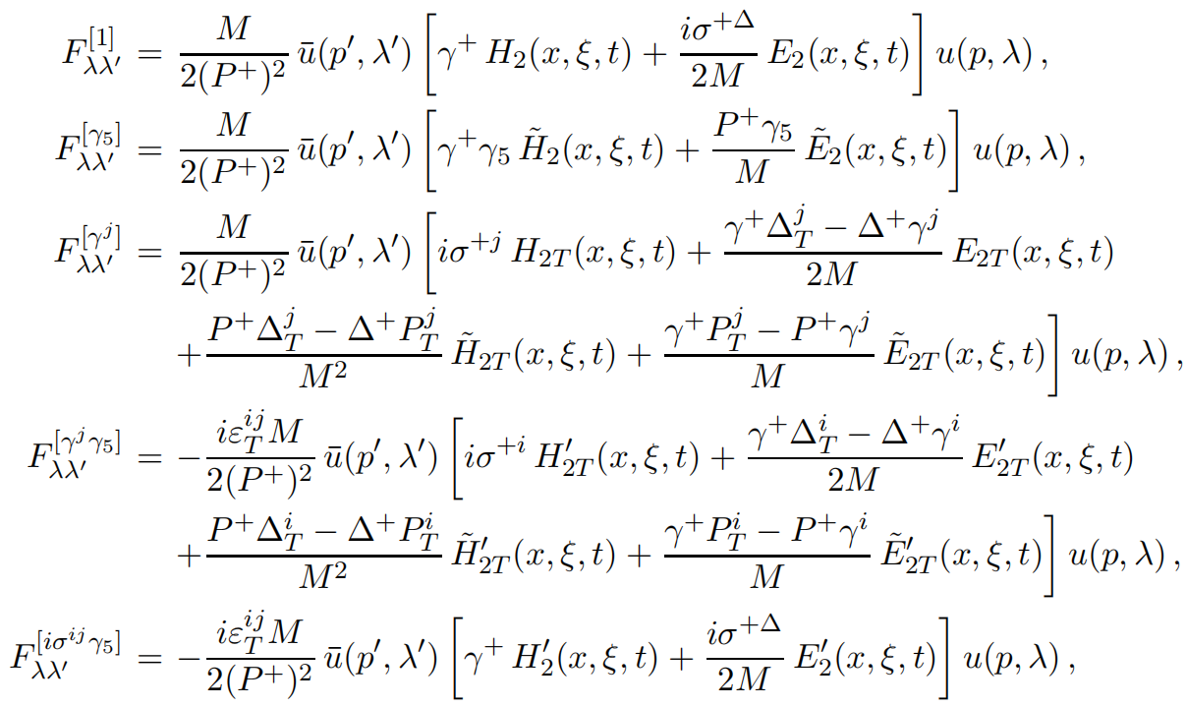
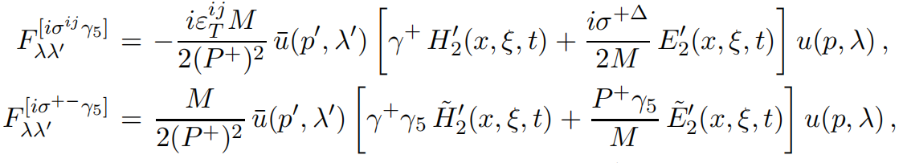
Definition of GPDs
twist-3 parameterization (spin-1/2 hardon)
10/19/2024 第二届核子三维结构研讨会暨第二届高扭度核子结构研讨会 7/20

Slide 9
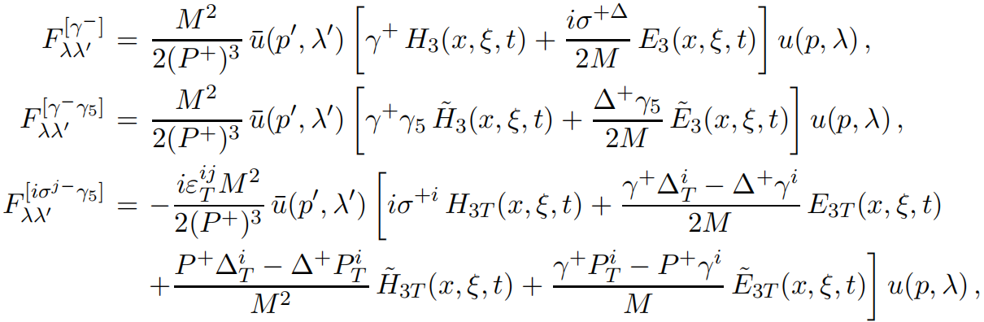
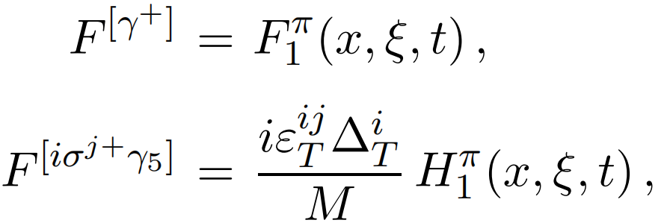
Definition of GPDs
twist-4 parameterization (spin-1/2 hardon)
GPD-limit (spin-0 hardon)
GPD correlator (spin-0 hardon)
Leadind-twist parameterization (spin-0 hardon)
10/19/2024 第二届核子三维结构研讨会暨第二届高扭度核子结构研讨会 8/20

Slide 10
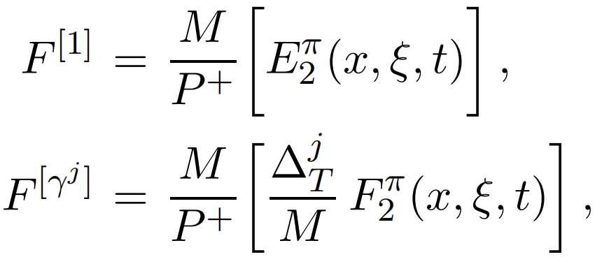
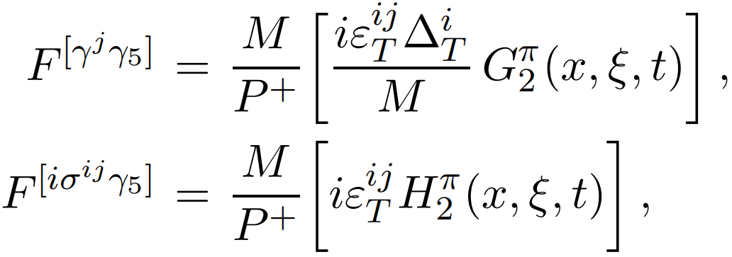
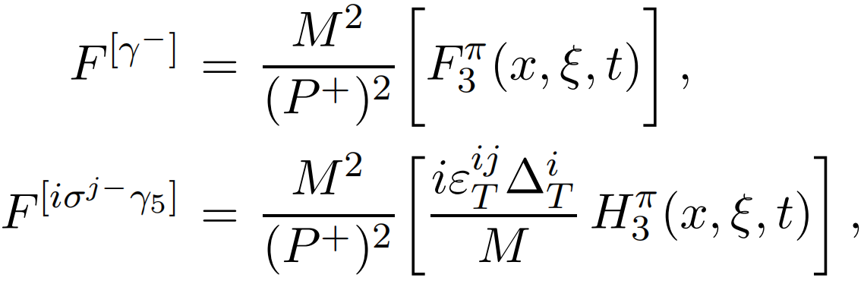
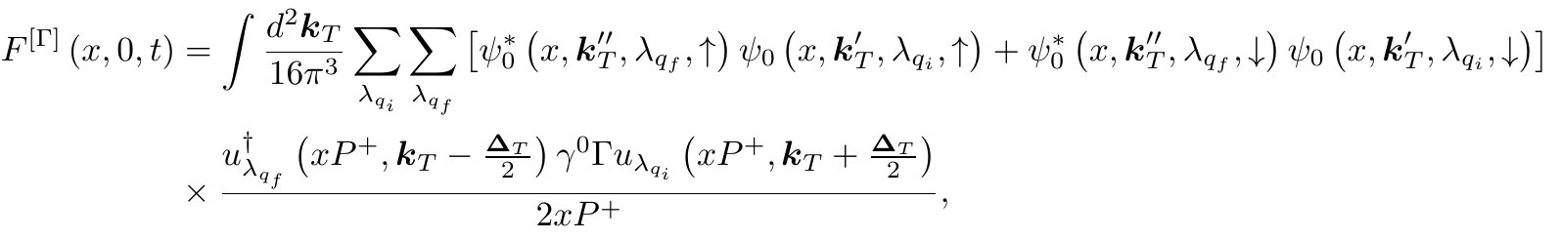



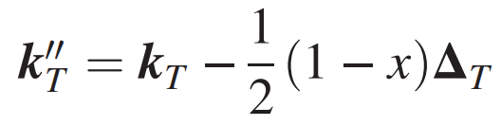
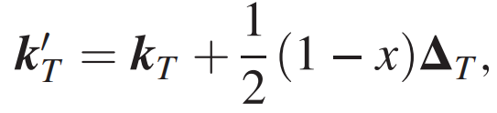
Definition of GPDs
twist-3 parameterization (spin-0 hardon)
twist-4 parameterization (spin-0 hardon)
The overlap representation for GPD correlator (spin-0 hardon)
where and represent the initial and final state of the quark helicity, respectively. The spinor product corresponds to the higher-twist Dirac matrices and encodes struck quark helicity combinations, and
are the transverse momenta for the final and initial struck quark q.
10/19/2024 第二届核子三维结构研讨会暨第二届高扭度核子结构研讨会 9/20

Slide 11
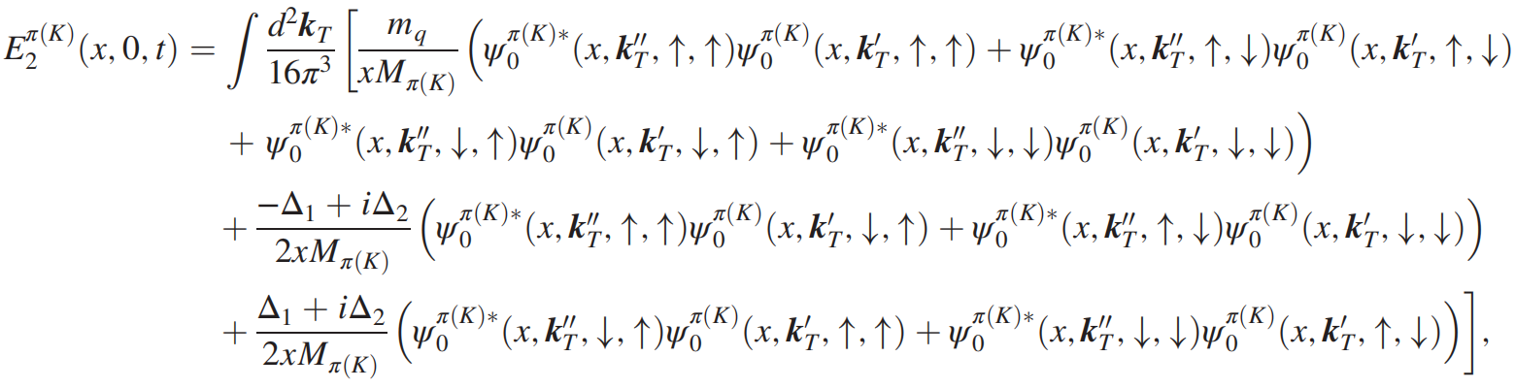
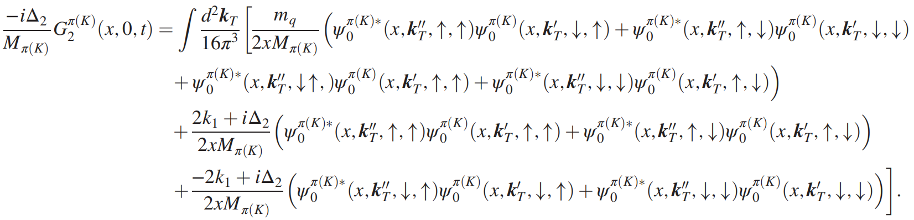
The twist-3 and twist-4 GPDs of light mesons
The overlap representation of the twist-3 GPDs for the pion and kaon in terms of the LCWFs can be expressed as
10/19/2024 第二届核子三维结构研讨会暨第二届高扭度核子结构研讨会 10/20

Slide 12
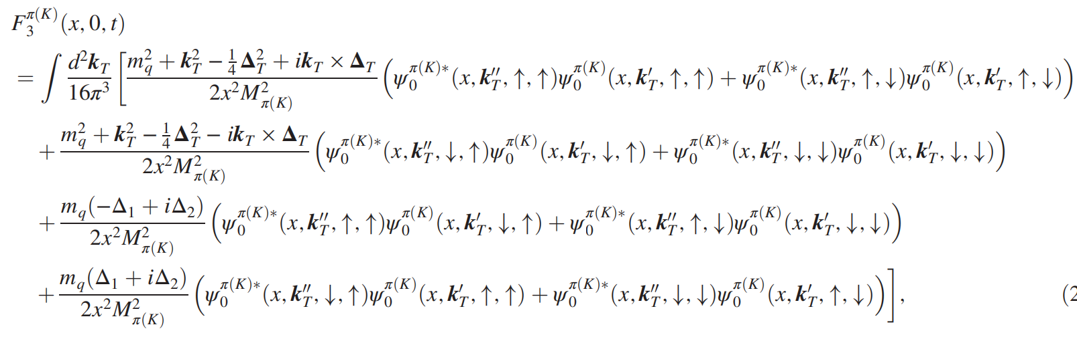
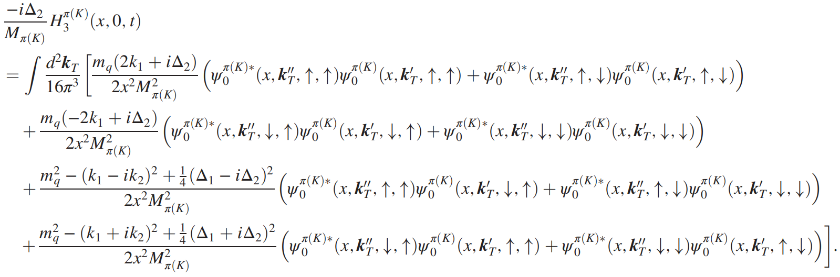
The twist-3 and twist-4 GPDs of light mesons
In the case of twist-4, the GPDs in the overlap representation can be expressed as
10/19/2024 第二届核子三维结构研讨会暨第二届高扭度核子结构研讨会 11/20

Slide 13
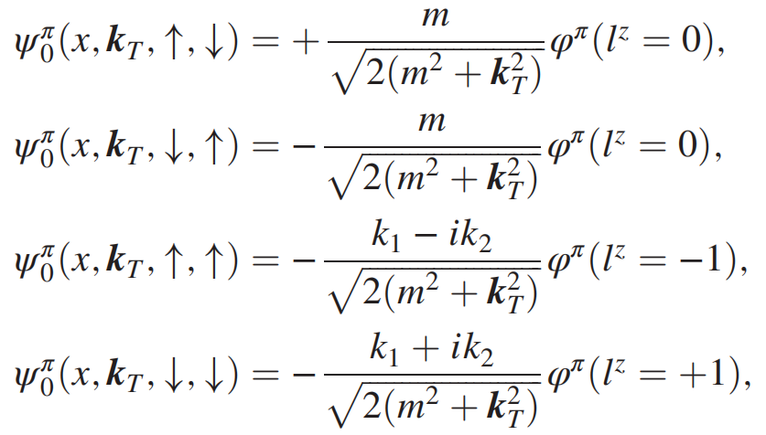
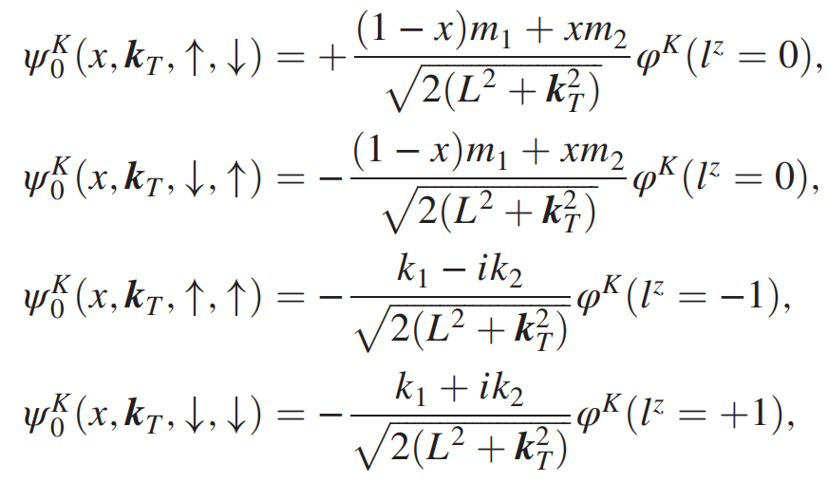
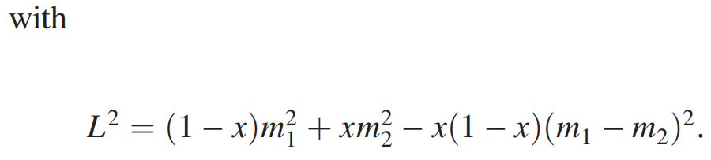
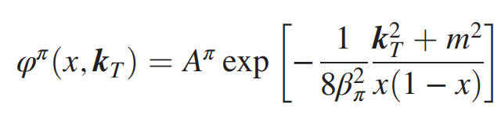
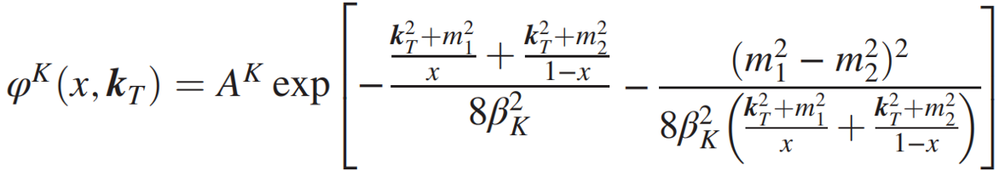
The twist-3 and twist-4 GPDs of light mesons
Light-cone wave fuctions of the pion and kaon
B. W. Xiao and B. Q. Ma, Phys. Rev. D 68, 034020 (2003).
W. Qian and B. Q. Ma, Phys. Rev. D 78, 074002 (2008).
S. Kaur and H. Dahiya, Phys. Rev. D 100, 074008 (2019).
10/19/2024 第二届核子三维结构研讨会暨第二届高扭度核子结构研讨会 12/20

Slide 14
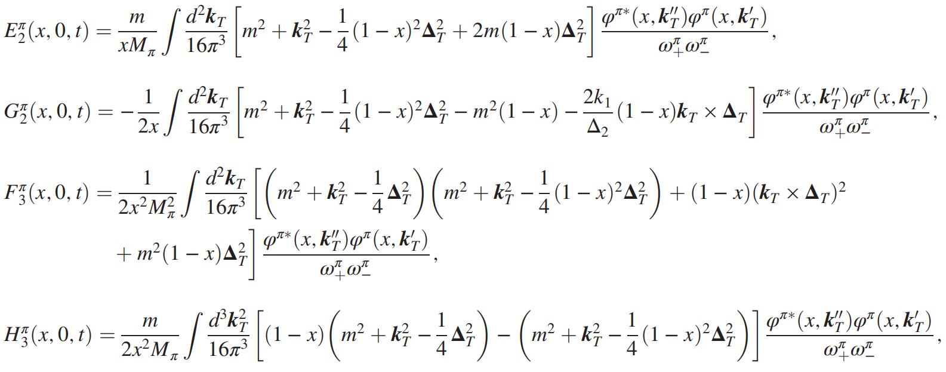
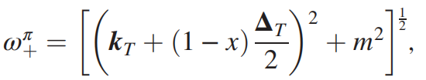
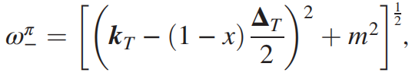
The twist-3 and twist-4 GPDs of light mesons
Using the LCWFs as well as the overlap representation, we obtain the analytic results for the twist-3 GPDs of the pion and kaon
where
10/19/2024 第二届核子三维结构研讨会暨第二届高扭度核子结构研讨会 13/20

Slide 15
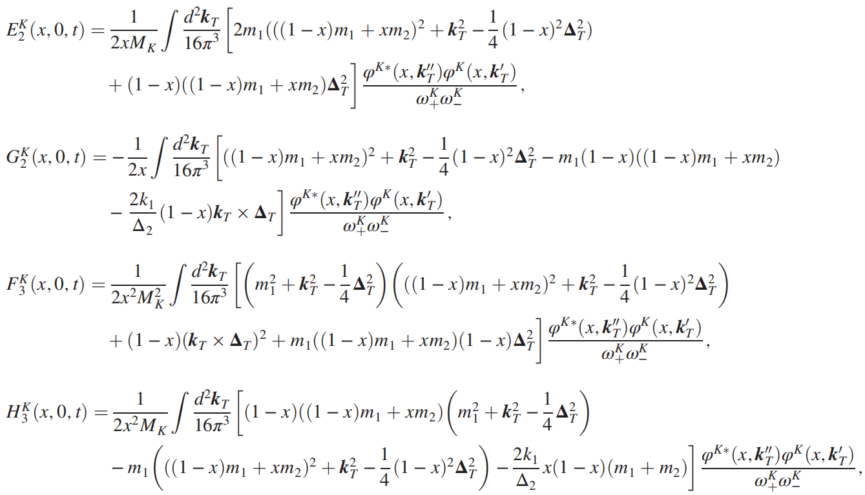
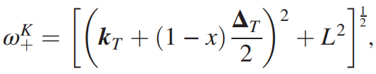
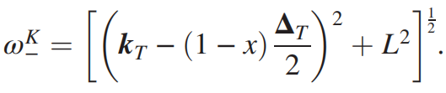
The twist-3 and twist-4 GPDs of light mesons
and twist-4 GPDs of the pion and kaon
where
10/19/2024 第二届核子三维结构研讨会暨第二届高扭度核子结构研讨会 14/20

Slide 16
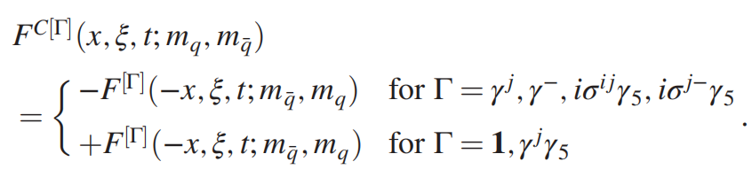
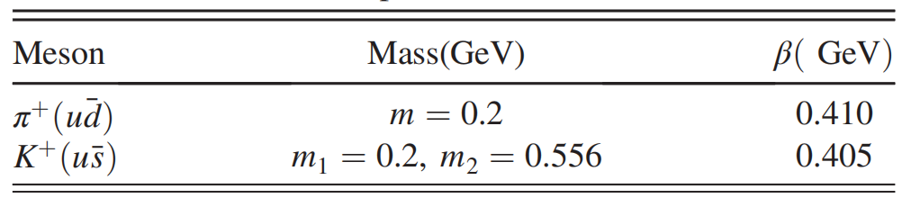
The twist-3 and twist-4 GPDs of light mesons
The antiquark distributions are defined by using the conjugate correlation function. For the spin-0 pseudoscalar mesons, the twist-3 and twist-4 GPDs of antiquark are related to the quark distributions as
Values of the parameters
W. Qian and B. Q. Ma, Phys. Rev. D 78, 074002 (2008).
10/19/2024 第二届核子三维结构研讨会暨第二届高扭度核子结构研讨会 15/20

Slide 17
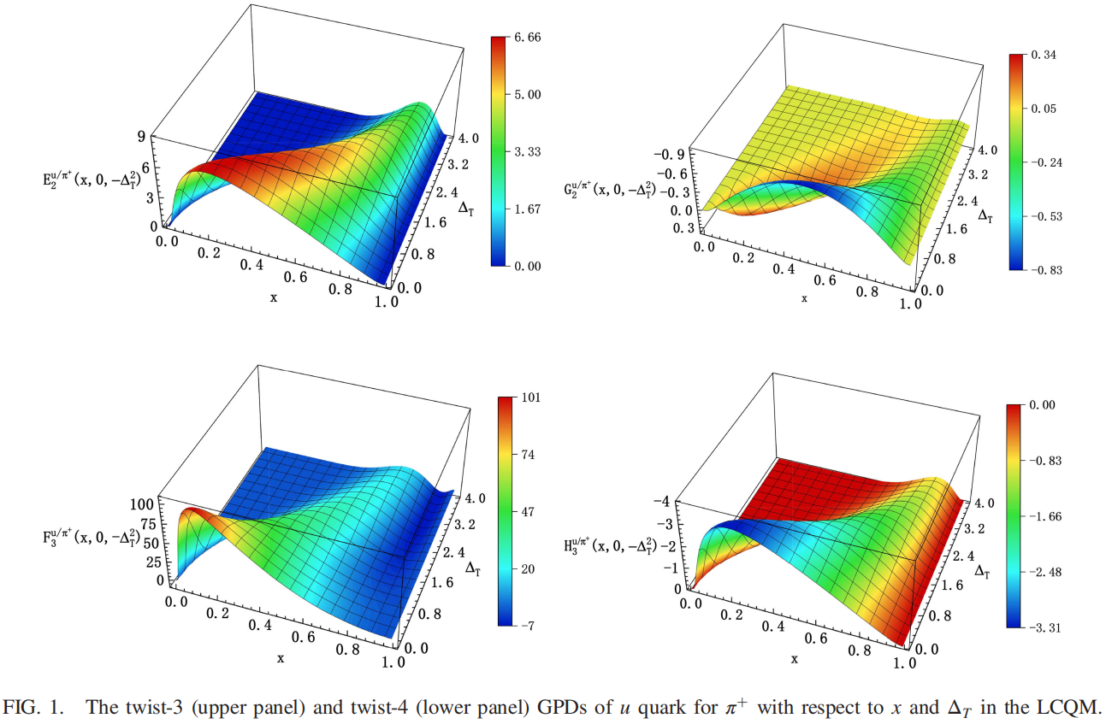
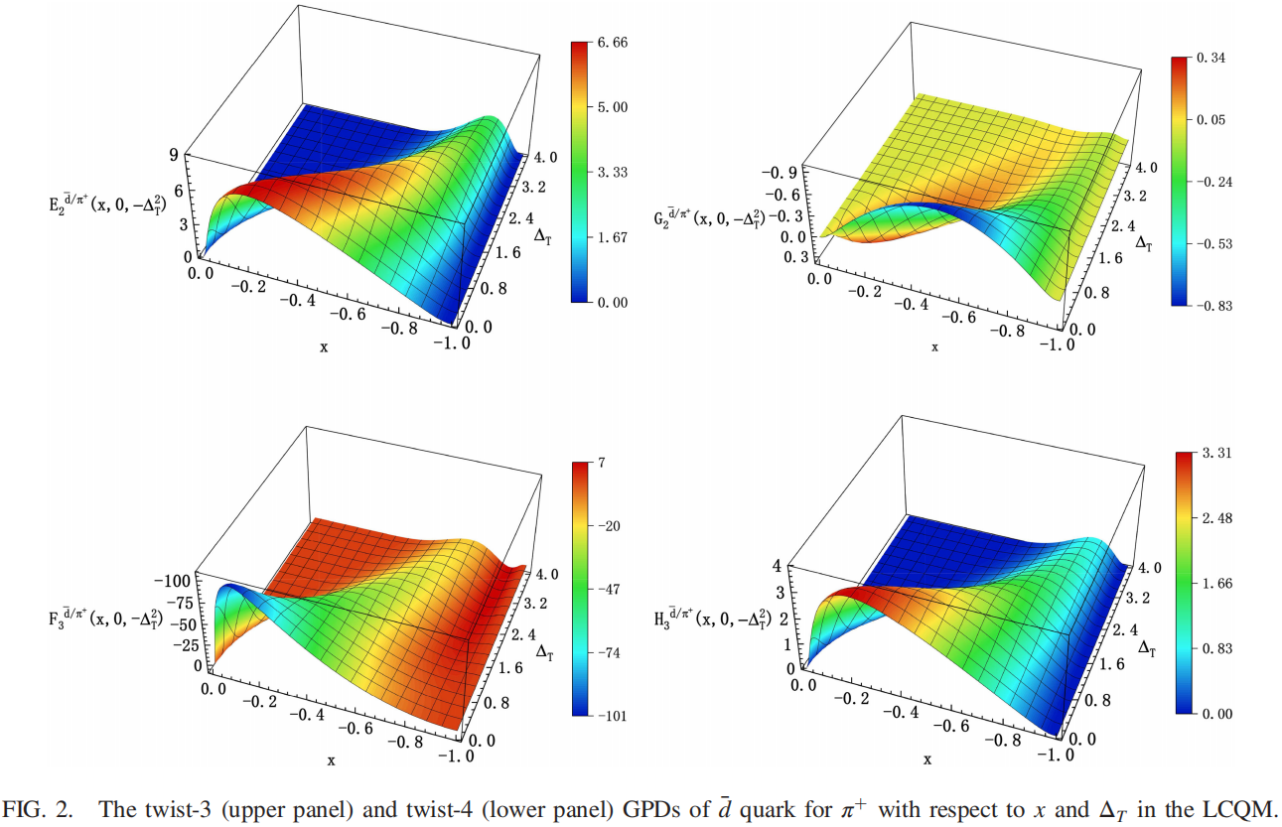
The twist-3 and twist-4 GPDs of light mesons
10/19/2024 第二届核子三维结构研讨会暨第二届高扭度核子结构研讨会 16/20

Slide 18
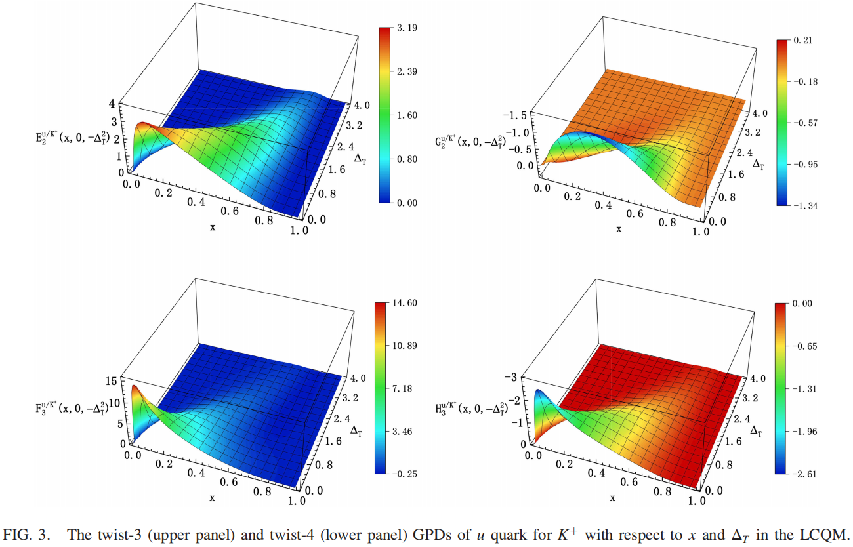
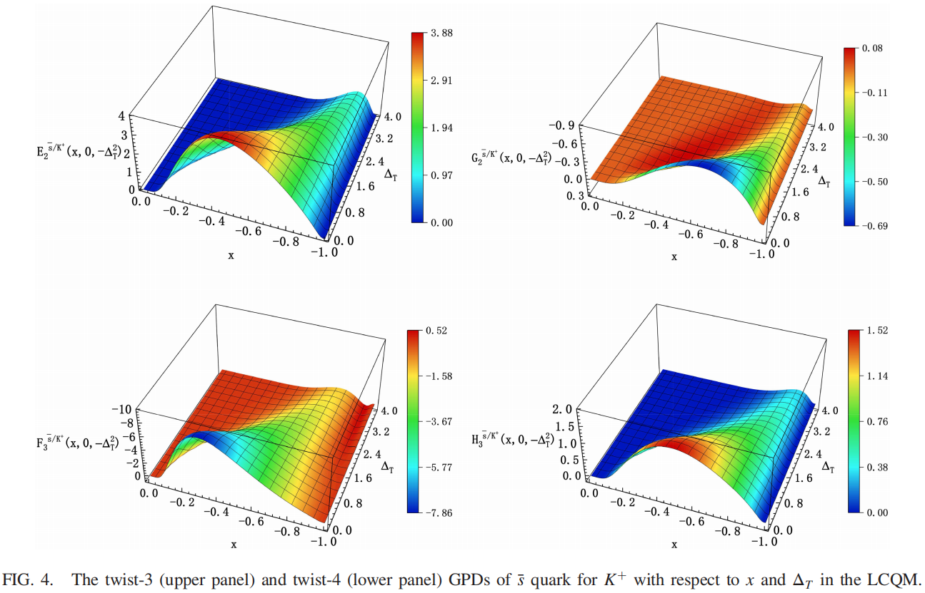
The twist-3 and twist-4 GPDs of light mesons
10/19/2024 第二届核子三维结构研讨会暨第二届高扭度核子结构研讨会 17/20

Slide 19
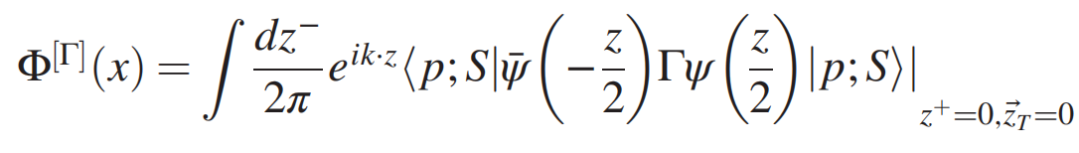
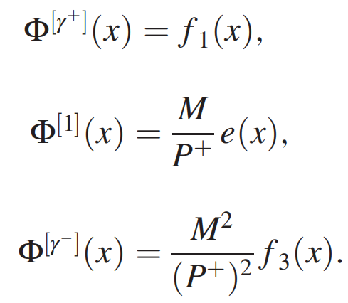
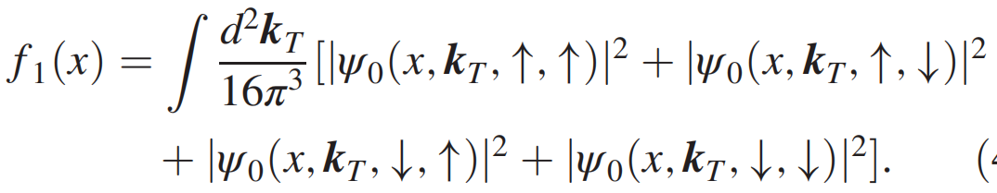
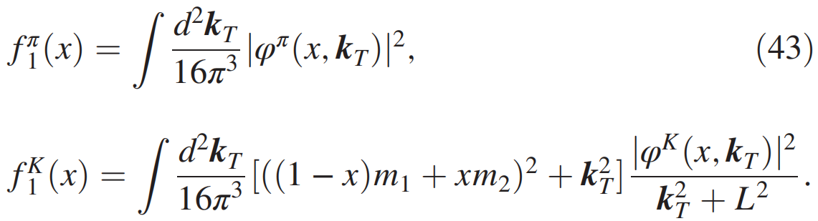
PDF Limit
For spin-0 pseudoscalar mesons, the PDFs are defined through the quark-quark correlation function
parameterization
Within the overlap representation in terms of LCWFs, the unpolarized PDF for the pion and kaon mesons can be calculated from
Using the LCWFs , we can obtain the valence quark unpolarized PDF of pion and kaon
10/19/2024 第二届核子三维结构研讨会暨第二届高扭度核子结构研讨会 18/20

Slide 20
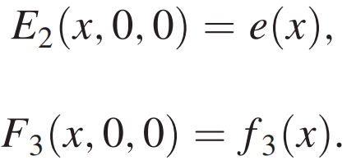
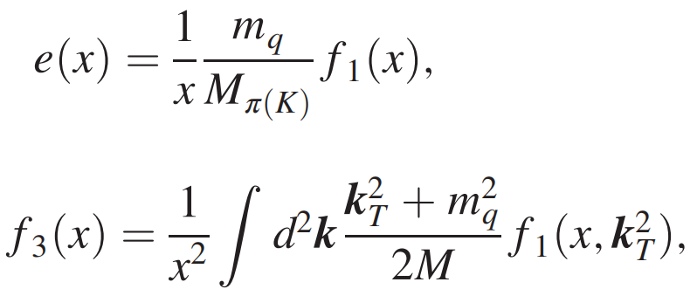
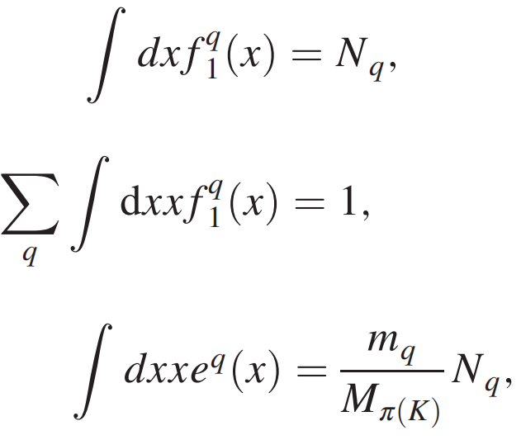
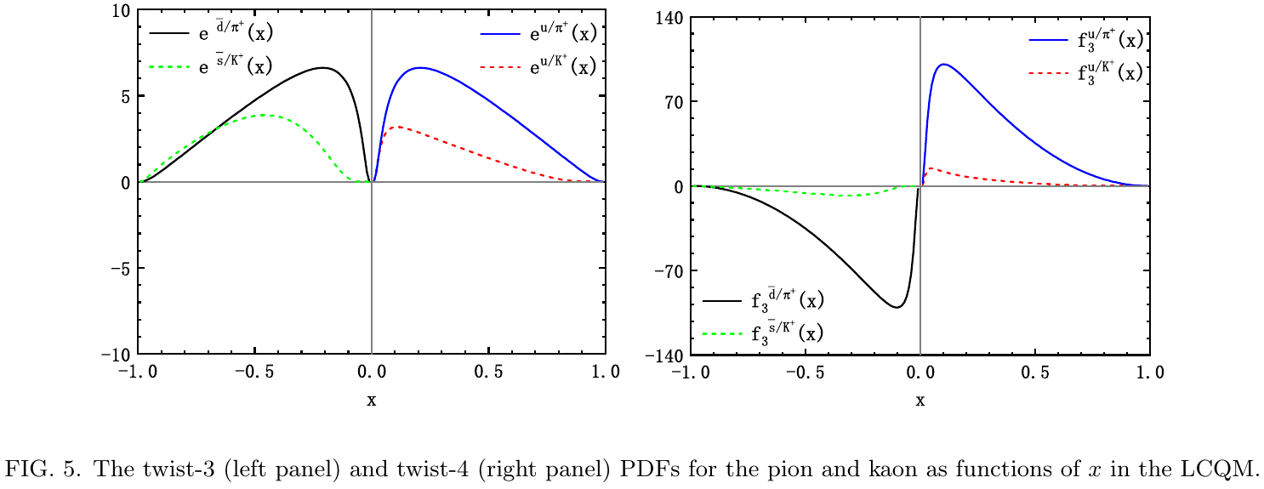
PDF Limit
In the forward limit, the twist-3 GPD and twist-4 GPD can reduce to their corresponding PDF
We can easily verify that our results satisfy the following relations
as well as the sum rules
10/19/2024 第二届核子三维结构研讨会暨第二届高扭度核子结构研讨会 19/20

Slide 21
Summary
We studied the twist-3 and twist-4 valence quark and antiquark GPDs of the pion and kaon at zero skewness using a light-cone quark model.
The higher-twist GPDs can be expressed as the overlaps of light-cone wave functions.
Using the overlap representation of LCWFs, we presented the analytic expressions of the twist-3 GPDs and twist-4 GPDs of pion and kaon.
The relations between the twist-3 PDF and twist-4 PDF and unpolarized PDF of the pion and kaon were verified by taking the forward limit.
We obtained the numerical results of the twist-3 and twist-4 GPDs as well as the twist-3 and twist-4 PDFs of the pion and the kaon.
These results may provide useful information on the 3-D structure of the pion and the kaon.
10/19/2024 第二届核子三维结构研讨会暨第二届高扭度核子结构研讨会 20/20

Slide 22
THANK YOU!
第二届核子三维结构研讨会暨第二届高扭度核子结构研讨会

