Slide 1
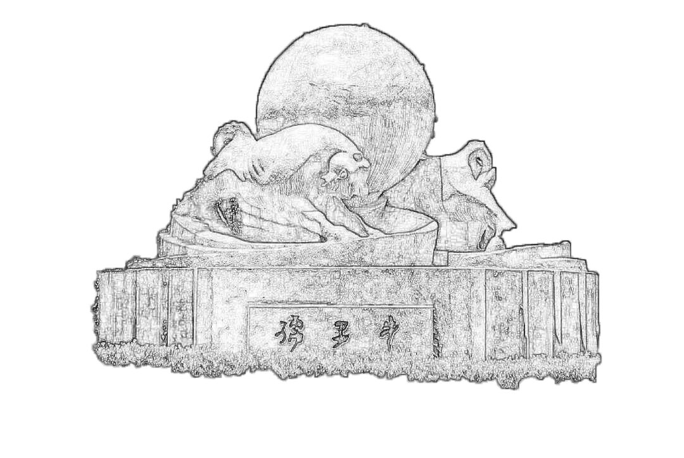
ECAL Digitization update
2023/05/13
Jiaxuan Wang

Slide 2
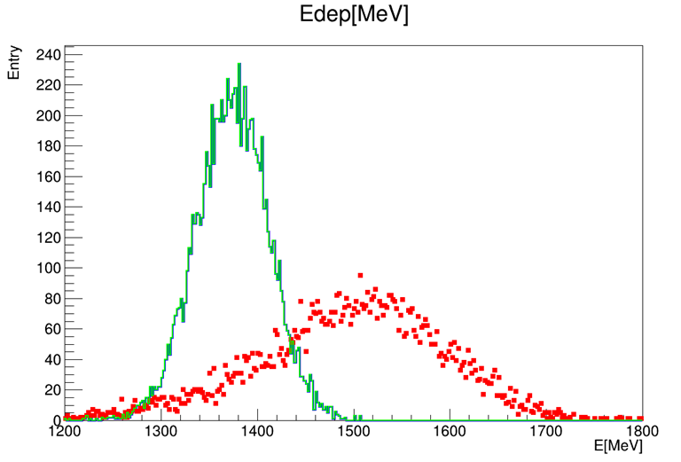
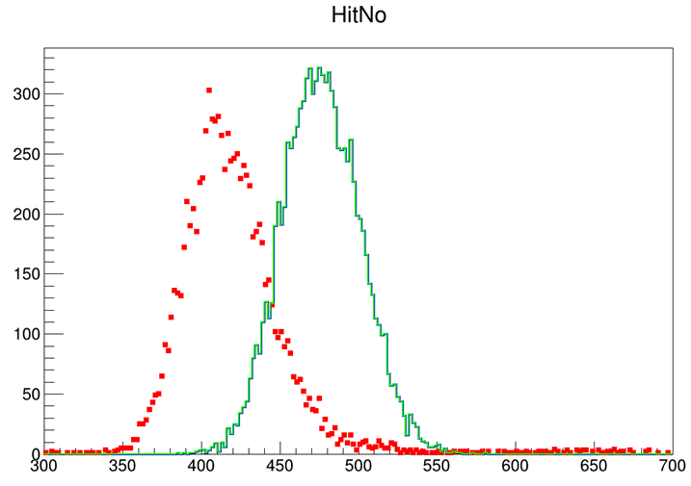
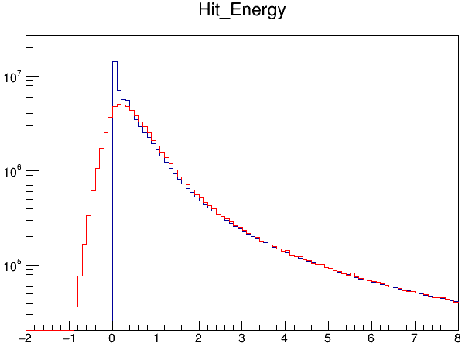
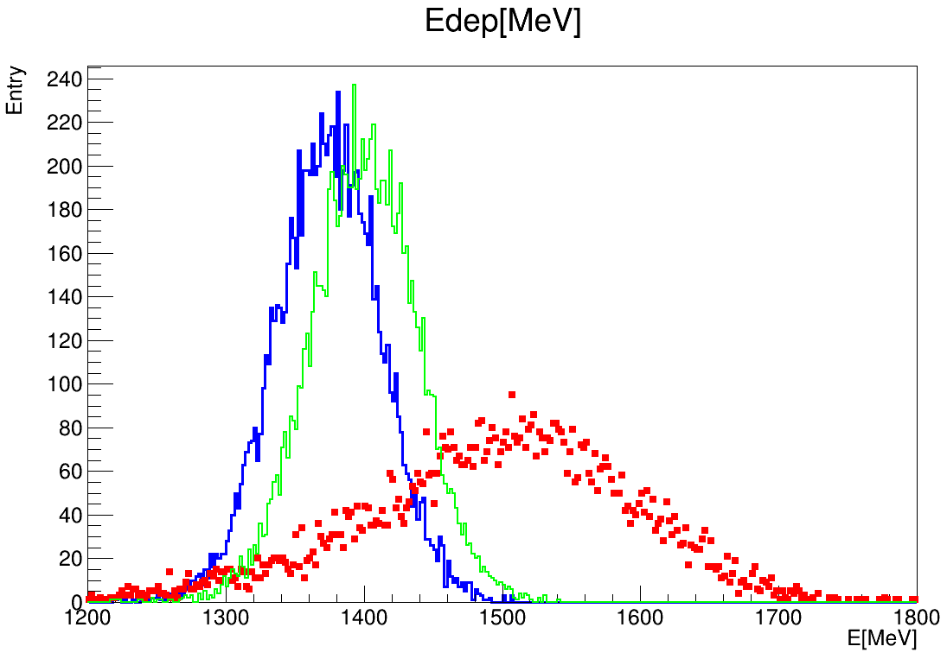
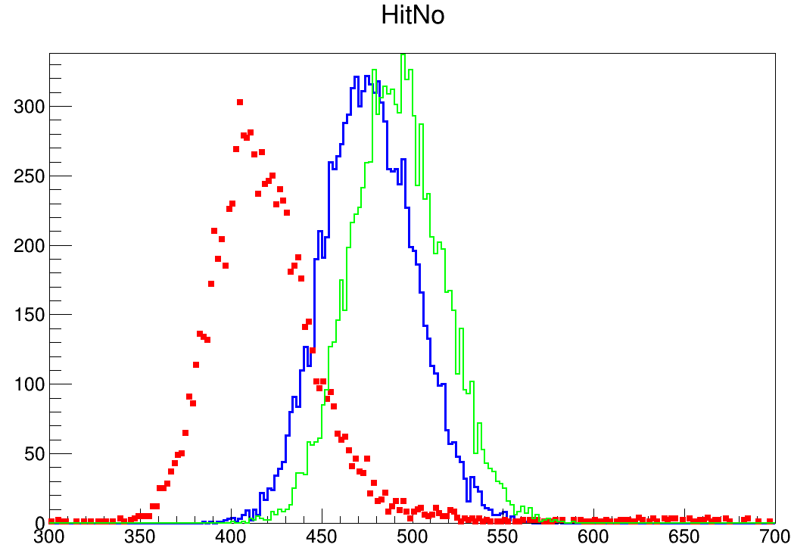
ADC smear
Threshold cut may lead to the increase of energy and hit number
Red: data
Blue: MC_truth
Green: MC_digi
Only ADC convert
Only ADC convert
ADC smear
ADC smear

Slide 3

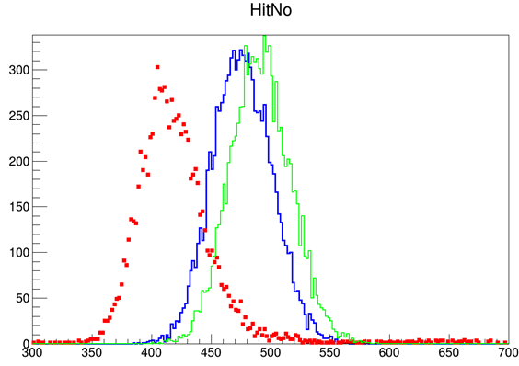
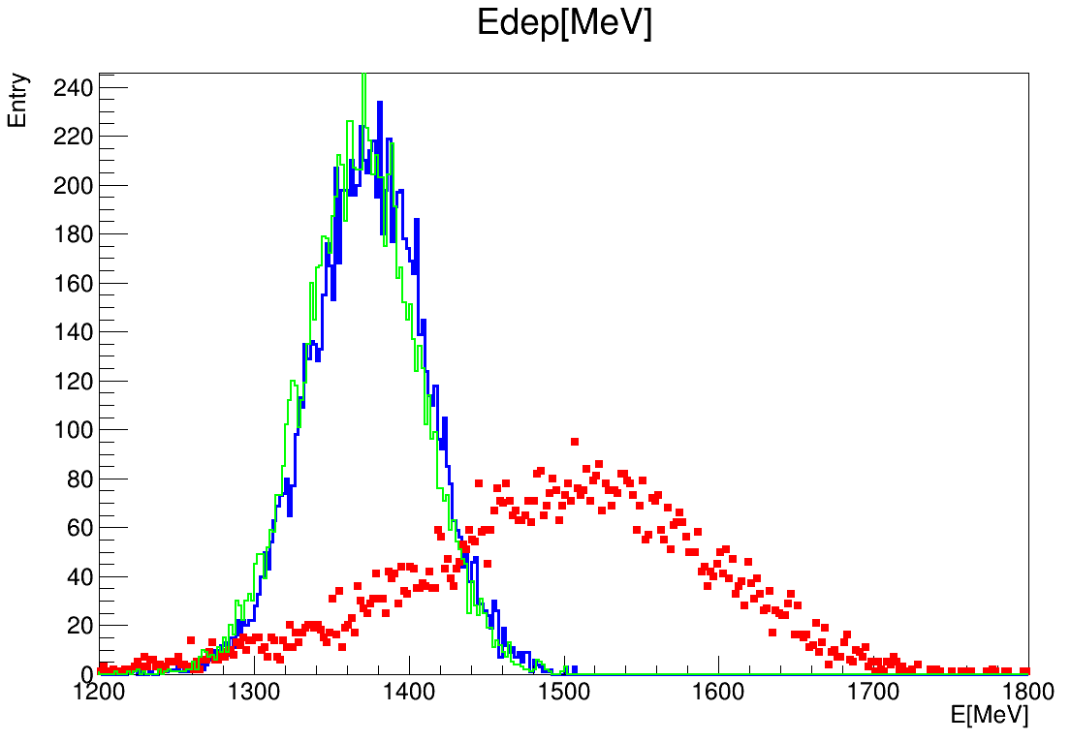
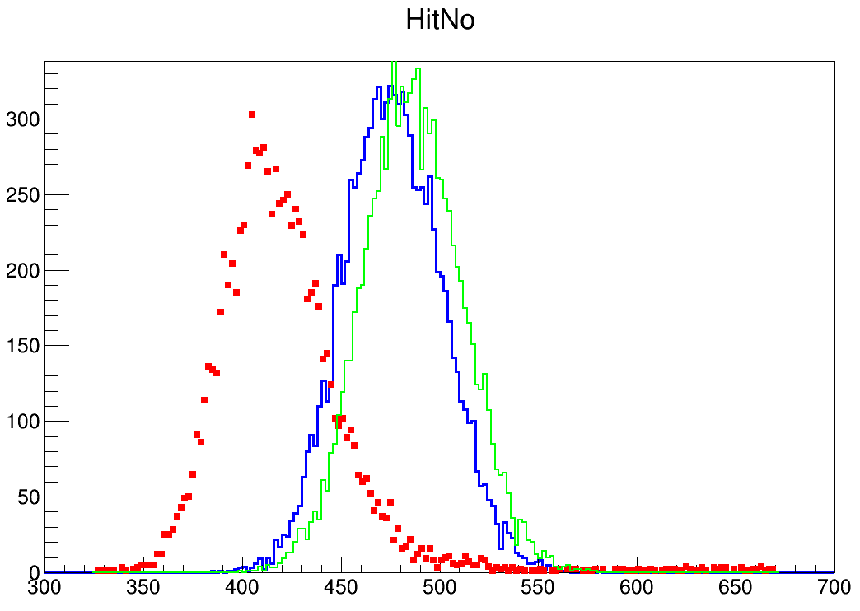
Saturation
ADC smear
ADC smear
Red: data
Blue: MC_truth
Green: MC_digi
Saturation
Saturation

Slide 4
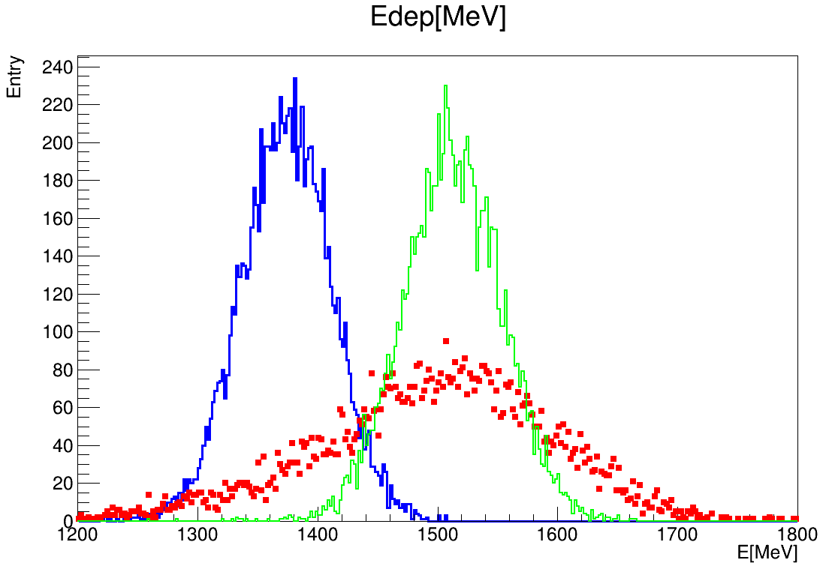
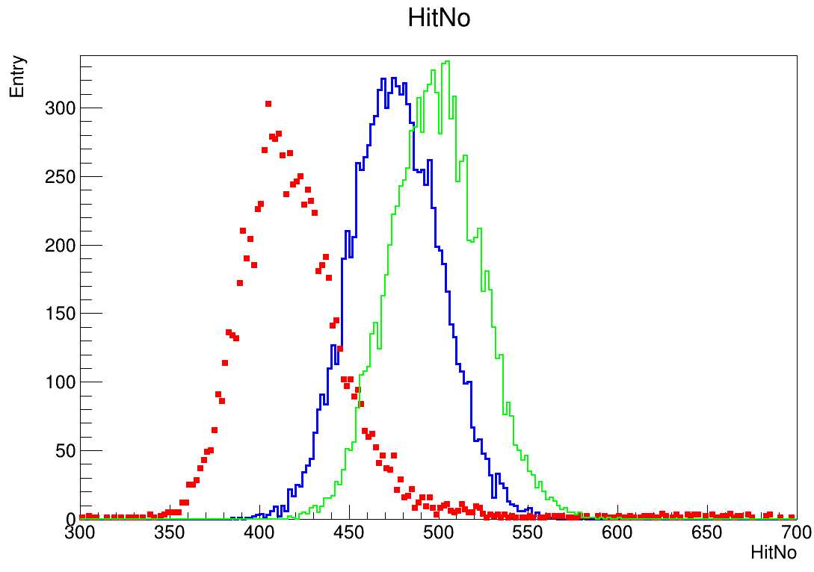
Saturation + crosstalk(0.1 0.15)
Saturation
Saturation
Red: data
Blue: MC_truth
Green: MC_digi
Saturation + crosstalk
Saturation + crosstalk

Slide 5
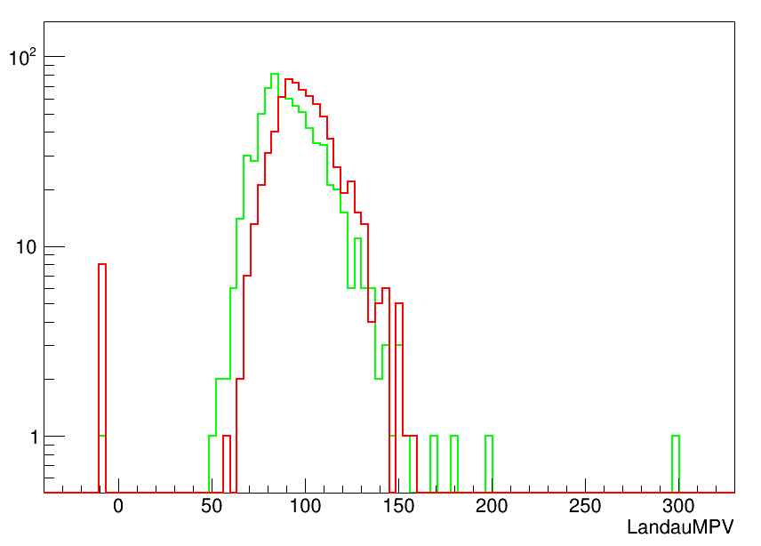
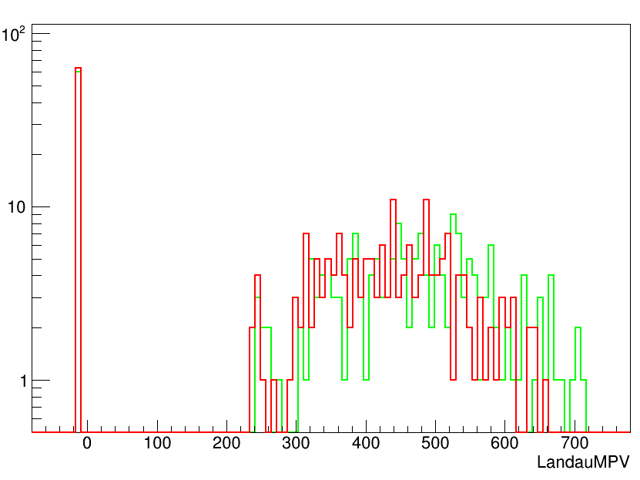
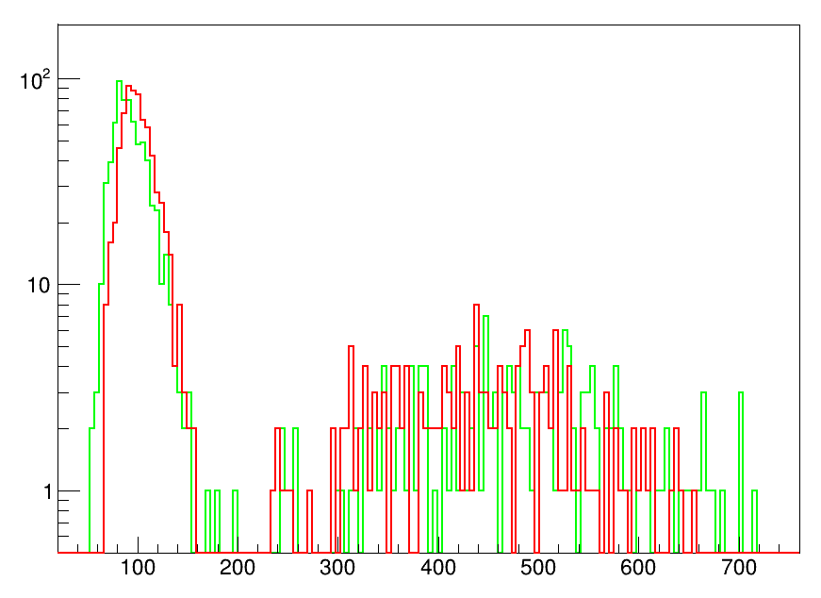
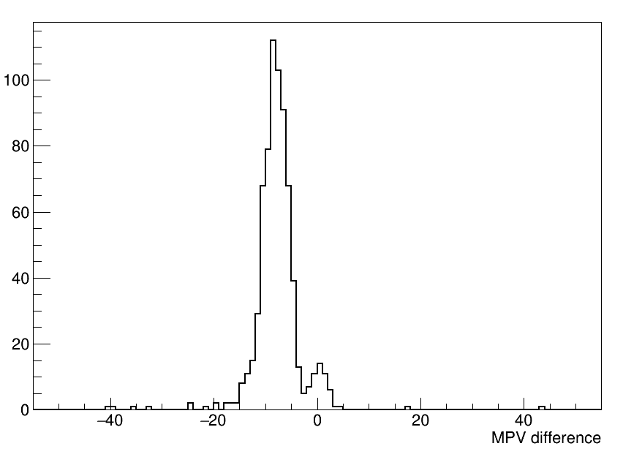
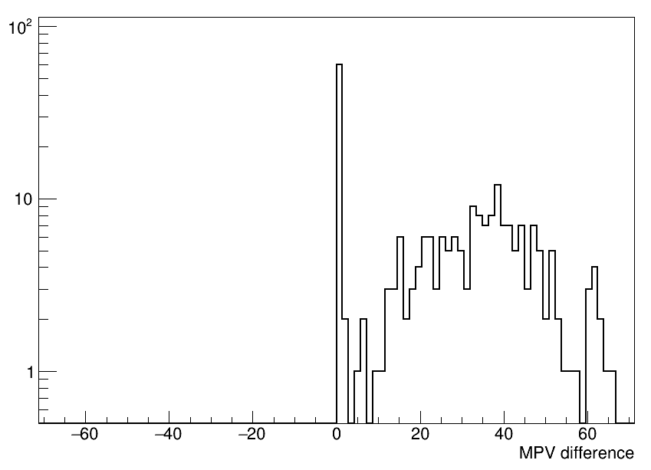
Muon MC Events check
100k 100GeV mu- MC events
  Beam : 50mm * 50mm
  2d Gaussian
Muon MC file digitization
Calibration: MIP fit
10um SiPM
15um SiPM
10um SiPM
15um SiPM
Red: data
Green: MC_digi

Slide 6
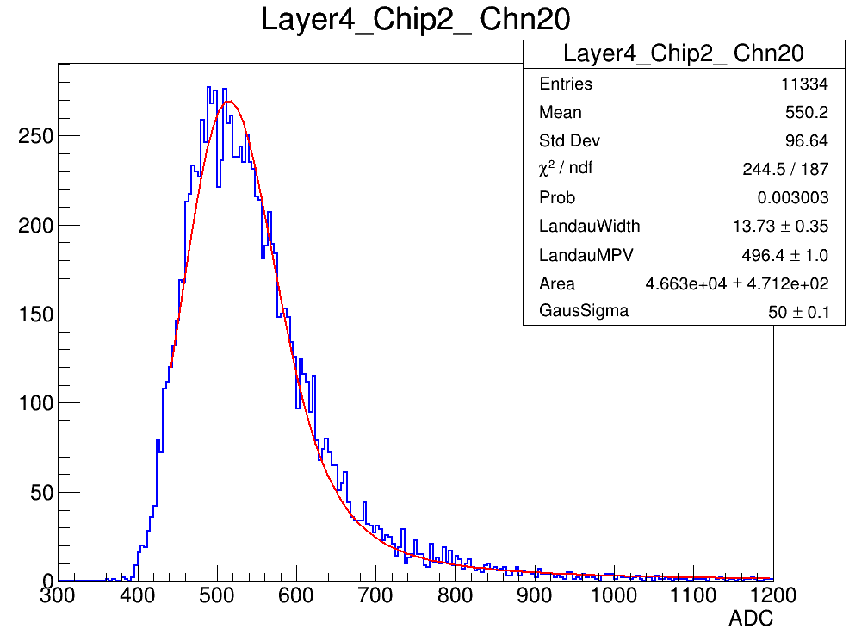
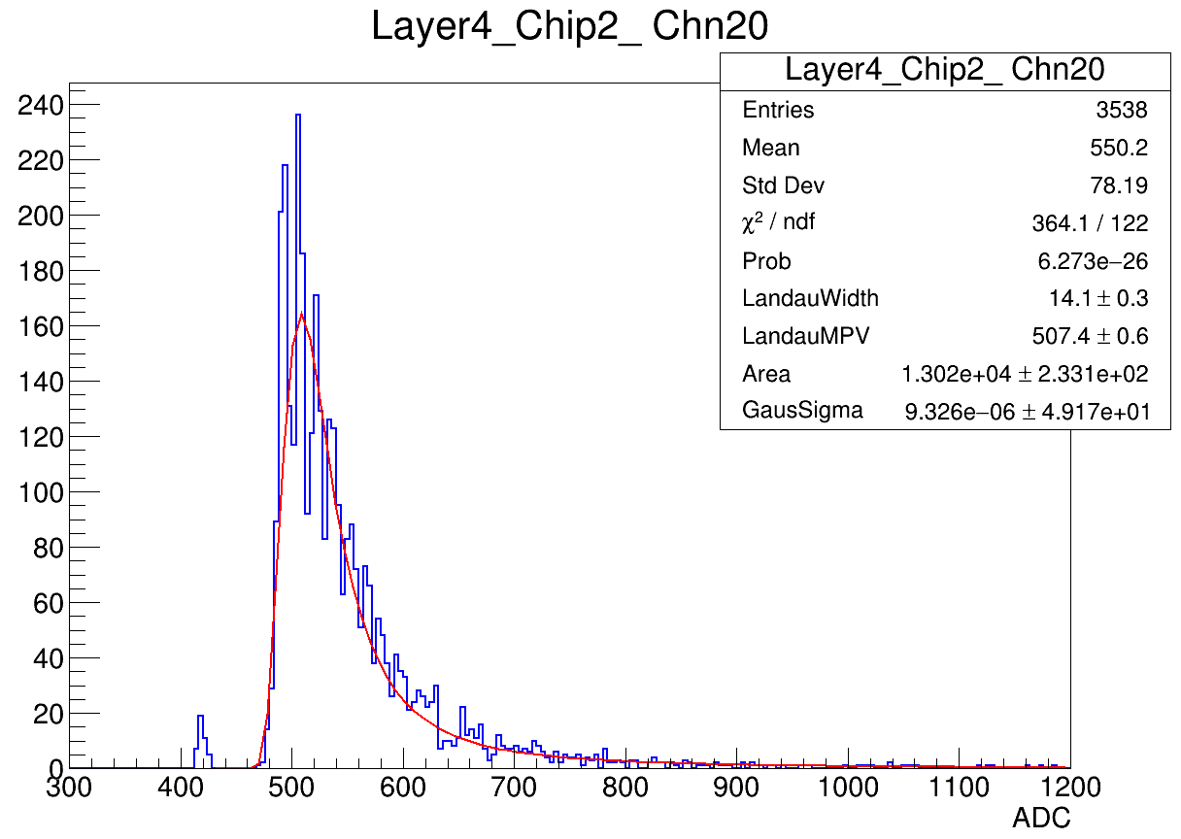
Muon MC Events check (10um)
10um SiPM
Digitization result much lower
Digitization
Data

Slide 7
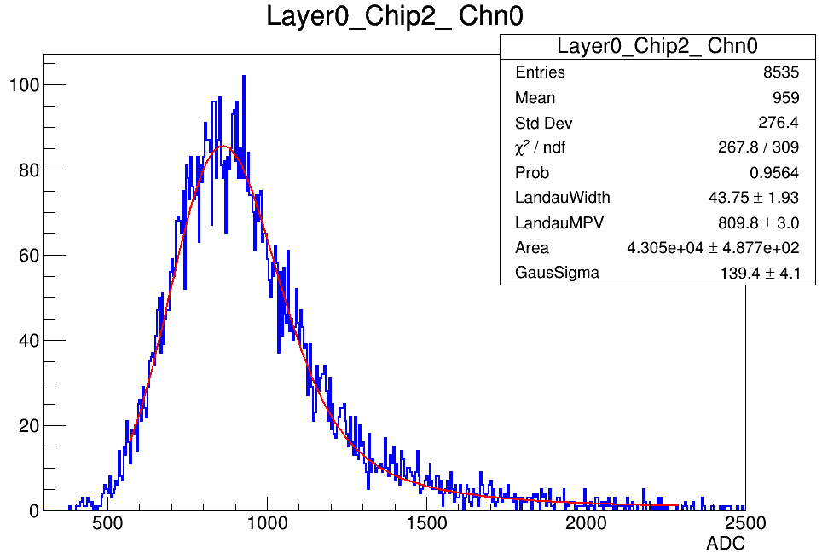
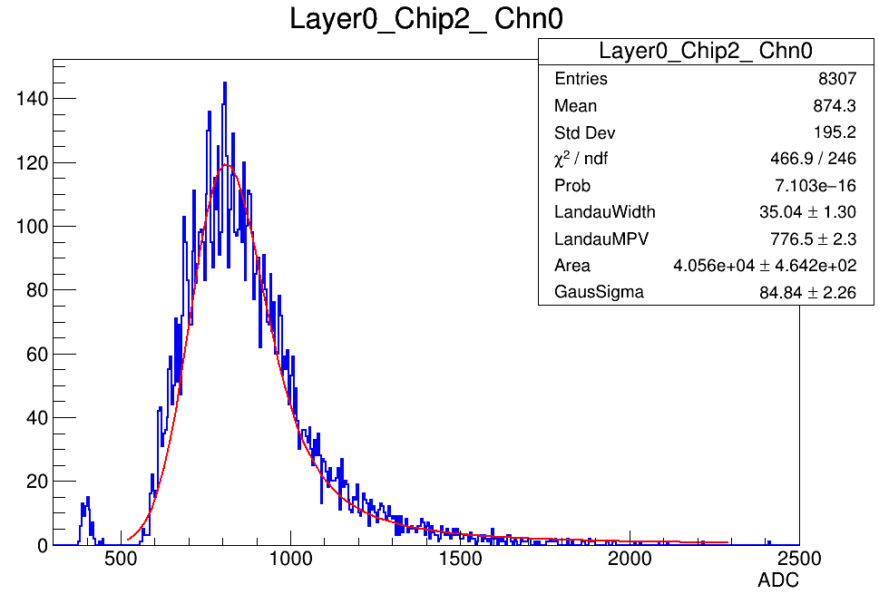
Muon MC Events check (15um)
15um SiPM
Digitization result much higher
Digitization
Data

