Slide 1
Scintillator ECAL Digitization update
2024/04/29
Jiaxuan Wang

Slide 2
Digitization
Overview
Beam size
From layer9 layer10
Format
Same with test beam data
Photon smear
SiPM
Model
ADC
Convert
E_Dep
N_photon
N_p.e.
ADC

Slide 3
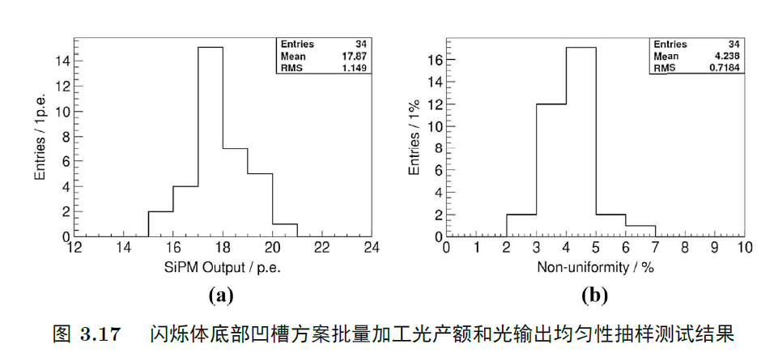
Digitization Step 1
Workflow
Input : MC truth hit energy
Output : N_photon
Process
N_photon
MIP_E : 0.305 MeV
SiPM gain (ADC/p.e.)
MIP MPV (ADC/MIP)
PDE
Non-uniformity of light output
~4.2%
Poisson Smear
$$N_{photon}=\frac{Hit_E∗MIP_MPV}{MIP_E∗SiPM_Gain∗PDE}$$

Slide 4
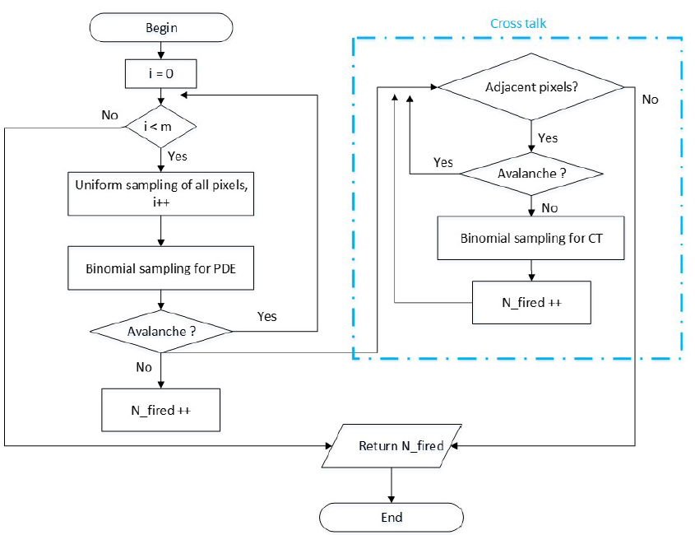
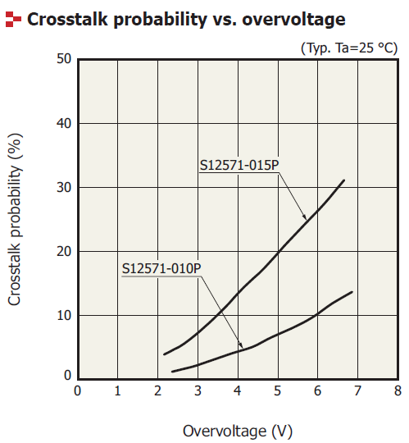
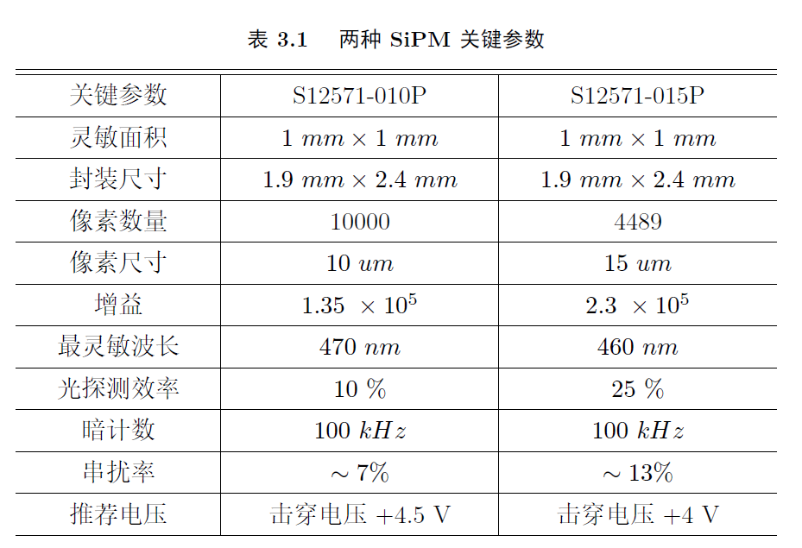
Digitization Step 2
Workflow
Input : N_photon
Output : N_p.e.
Process
Pixel placement : 10um-100*100, 15um-67*67
PDE : 10um-10% 15um-25%
Crosstalk : 10um-10% 15um-15%
Avalanche

Slide 5
Digitization Step 3
Workflow
Input : N_p.e.
Output : High-low gain mode ADC
Process
ADC && gaussian smear
ADC Mean = N_p.e.* SiPM Gain
ADC Sigma = 3 * sqrt(N_p.e.)?
High-low gain mode ADC
Pedestal fluctuation
High-low gain saturation
High gain saturation: high adc > switch point , let high adc =4000
Low gain saturation : low adc > 3000, let low adc = 3000

Slide 6
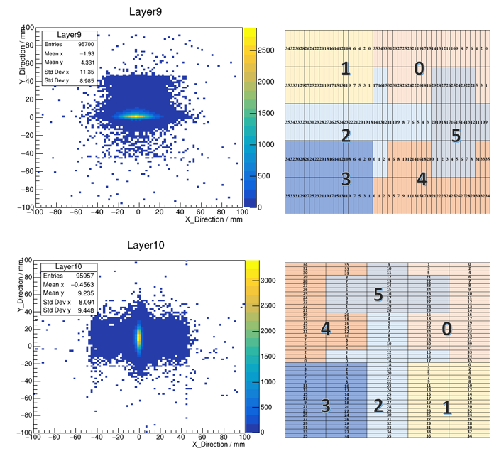
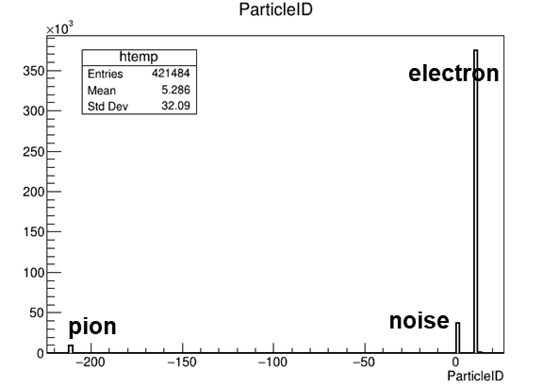
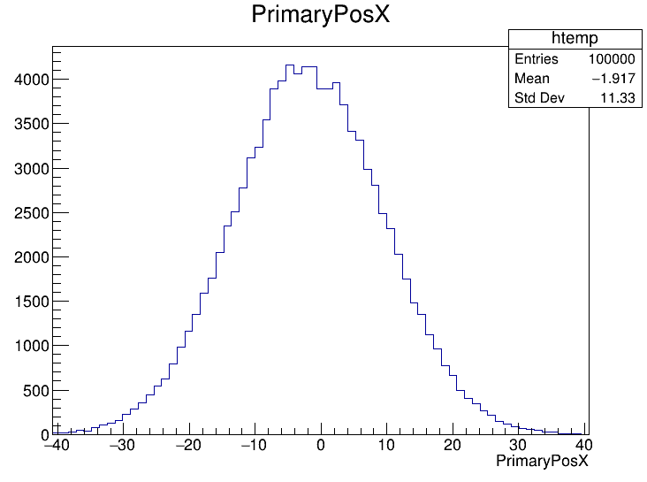
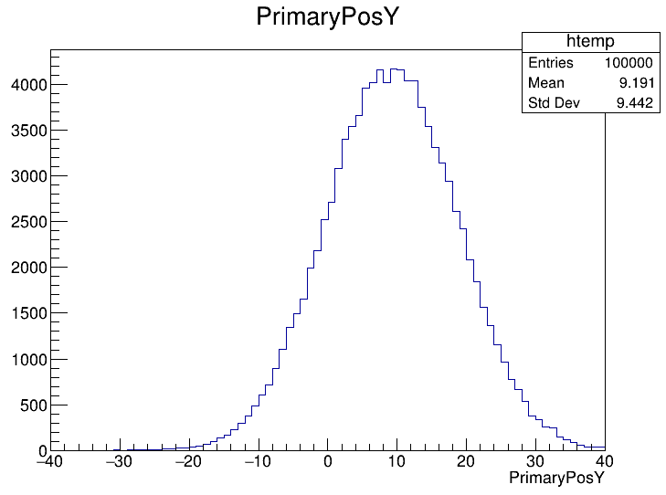
Energy reconstruction
Data sets
Data : ~100000 40GeV e-
MC : 100000 40GeV e-/pi-(97.5:2.5)
Restrictions
Hit cut
0.8 MIP cut
Dead channels cut
Event cut
50MeV && 100 hits cut

Slide 7
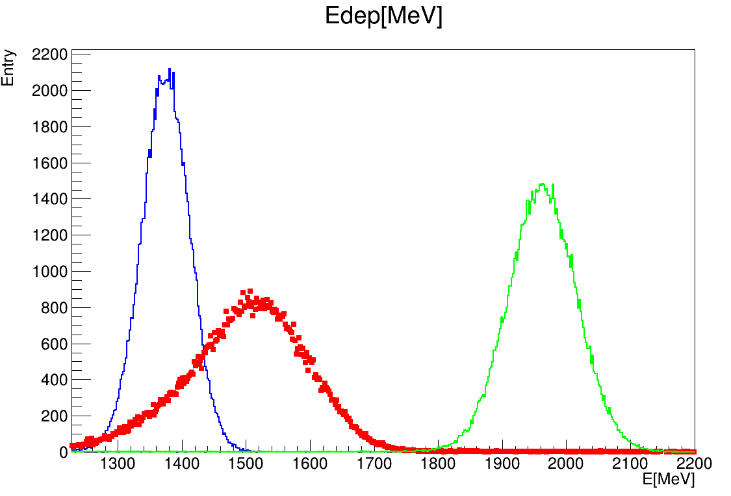
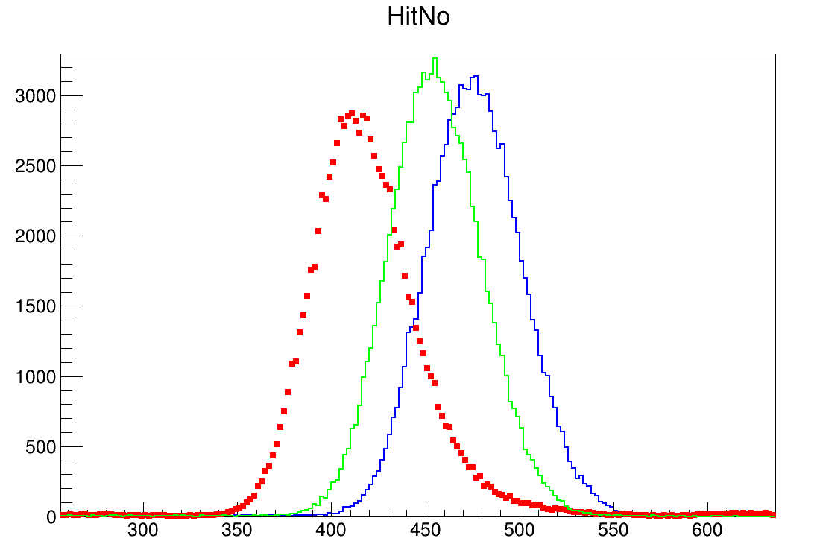
Comparison
Data: low hitNo but high deposited energy
Digitization:
Red: data
Blue: MC_truth
Green: MC_digi
Red: data
Blue: MC_truth
Green: MC_digi

Slide 8
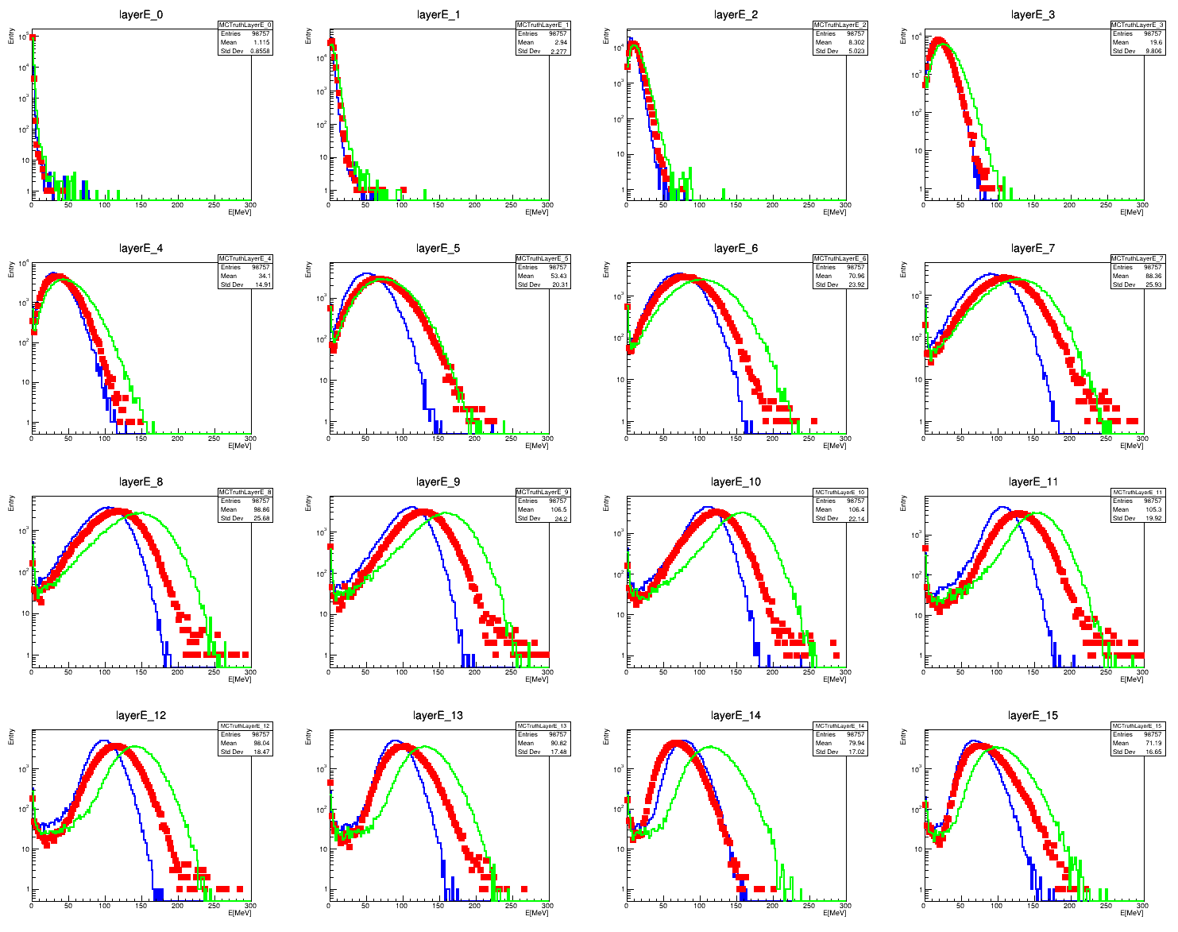
Layer energy deposition
First 16 layers

Slide 9
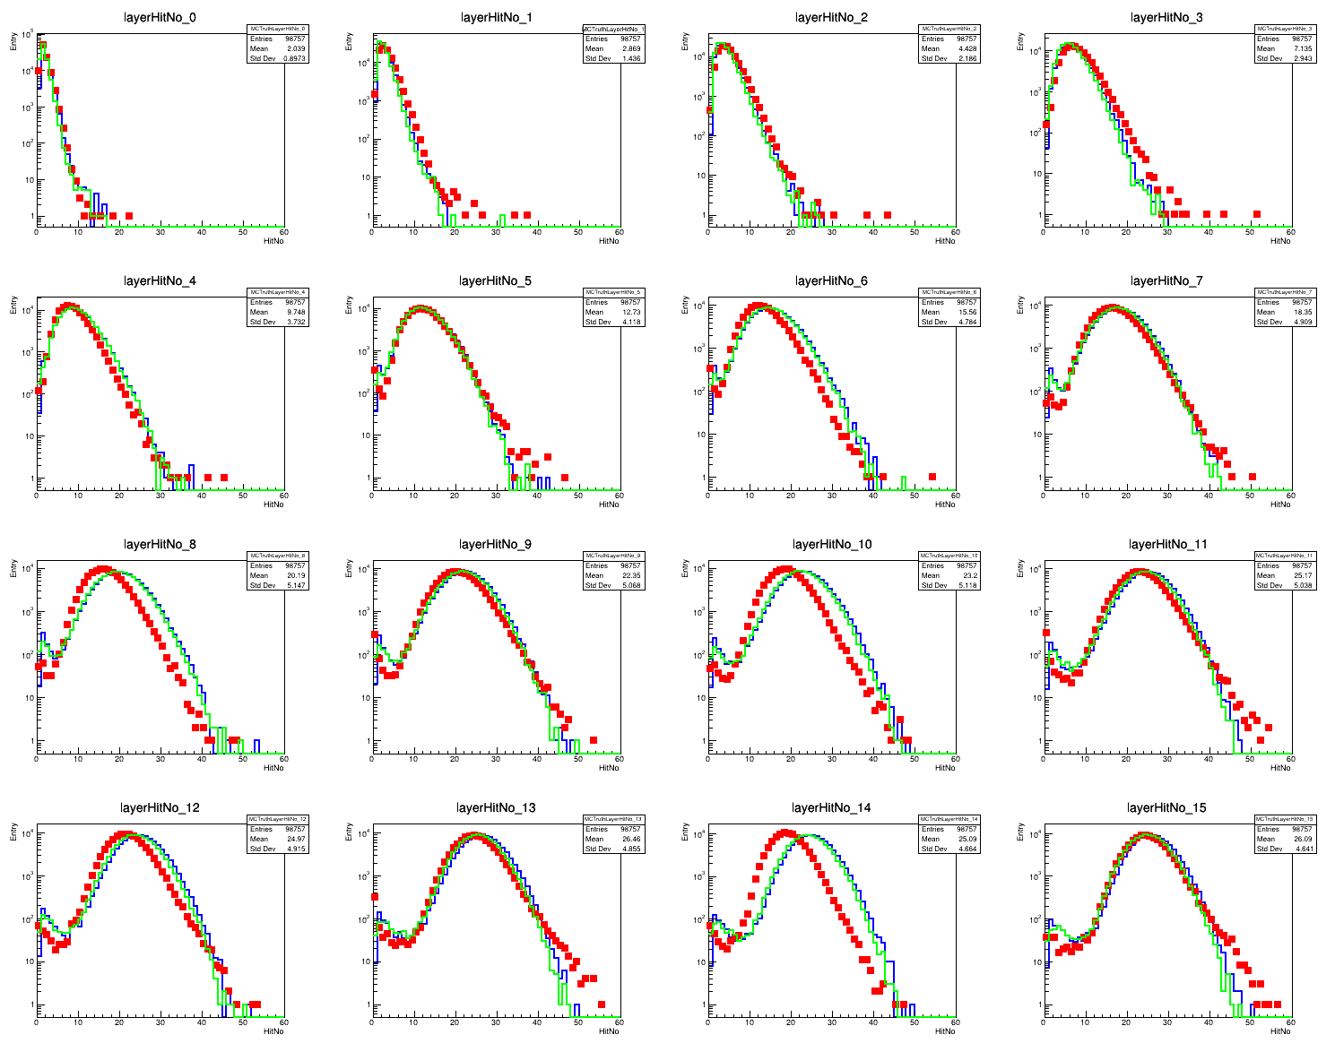
Layer hitNo
First 16 layers

Slide 10
Summary && Plan
Summary
Discrepancy between Data and MC
Plan
Adjust crosstalk
Detector material PCB
SiPM gain error
…

Slide 11
BACKUP

