Slide 1
Scintillator ECAL Digitization update
2024/04/15
Jiaxuan Wang

Slide 2
Digitization
Energy Deposition E_Dep
SiPM response N_PE
SiPM saturation correction N_PE_Saturation
ADC calibrated ADC
ADC ADC under HL mode
Energy reconstruction
0.5 MIP cut
Dead channel cut
50MeV && 100 hits cut

Slide 3
Digitization p.e
Input : MC truth hit energy
Output: photoelectron number
Process:
MIP energy : 0.305 MeV
SiPM gain (ADC/p.e.) and MIP spectrum MPV (ADC/MIP)
Poisson smear
Input : photoelectron number
Output: photoelectron number(after saturation correction)
Process:
SiPM type 10um-10000 15um-4489
Energy deposited in scintillator
Photon emission : $N_{photon}$
Of Poisson distribution
PDE : $N_{seed}$
SiPM saturation :$N_{fired}$
Exponential formula

Slide 4
Digitization
Input : photoelectron number(after saturation correction)
Output: calibrated ADC value
Process:
SiPM gain (ADC/p.e.)
Gaussian smear
ADC = p.e. * gain
Input : calibrated ADC value
Output: ADC high low gain ADC
Process:
Gaussian smear :
Mean : calibrated ADC / Hl-ratio + pedestal mean
Sigma : pedestal sigma
High-low switch point
High gain saturation: high adc > switch point , let highadc =4000
Low gain saturation : low adc > 3000, let lowadc = 3000
Calibrated ADC : p.e. * gain
Gain error : fit error
Single photoelectron spectrum Width : statistical error
ADC converted into high-low gain mode
ADC saturation

Slide 5
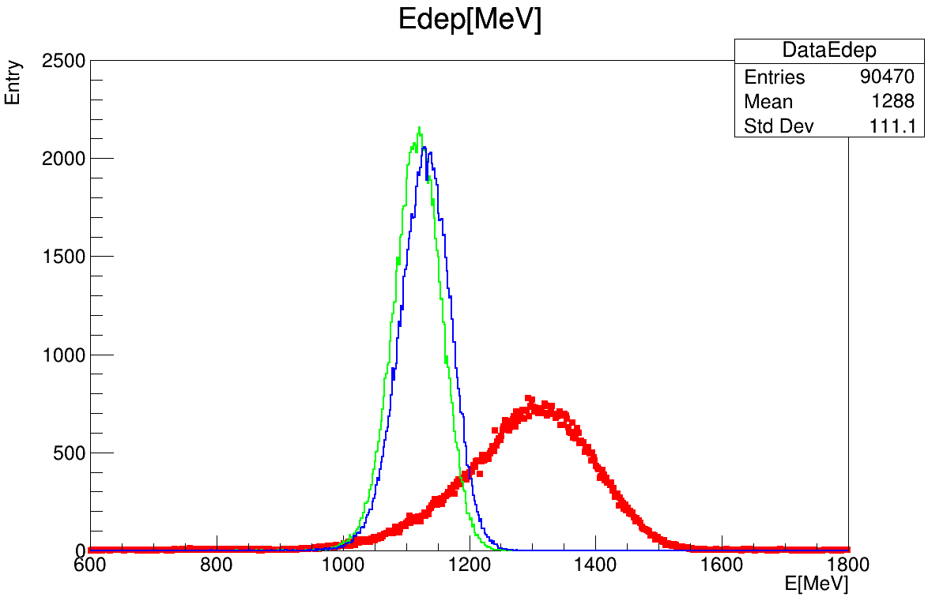
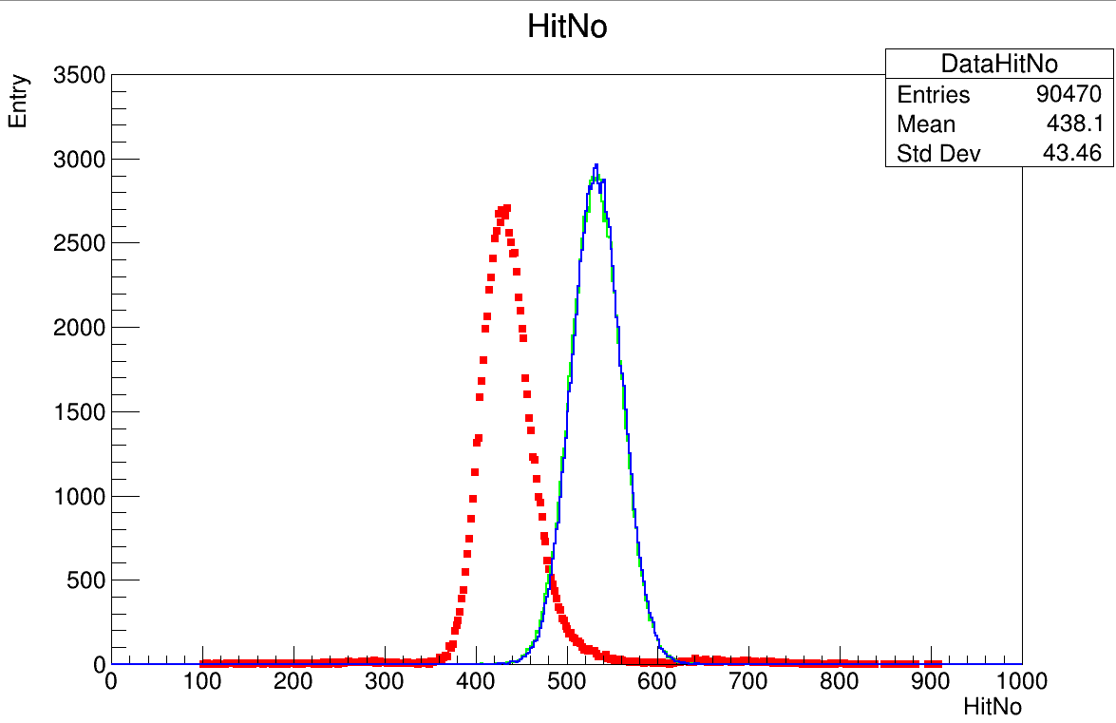
Comparison
Data with low hitNo but high deposited energy according to energy reconstruction
0.5MIP cut
Dead channel cut
50MeV and 100hits cut for 40GeV e- cut
Red: data
Blue: MC_truth
Green: MC_digi
Red: data
Blue: MC_truth
Green: MC_digi

Slide 6
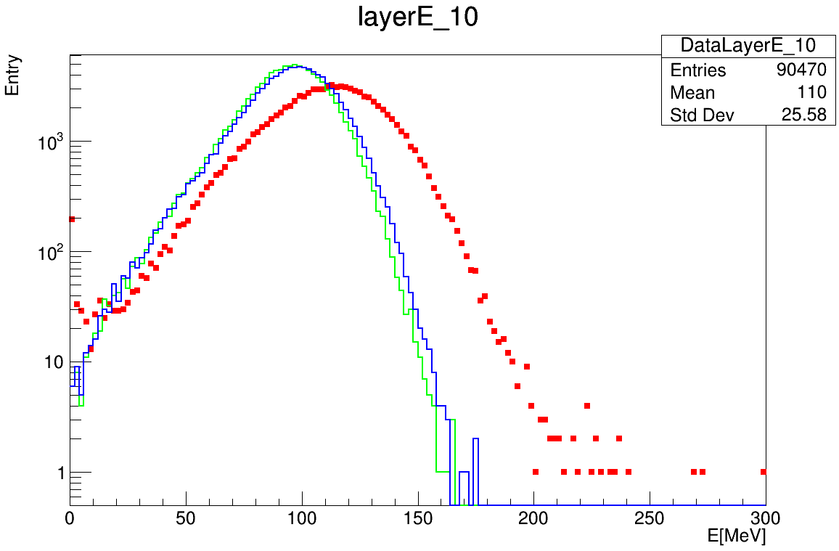
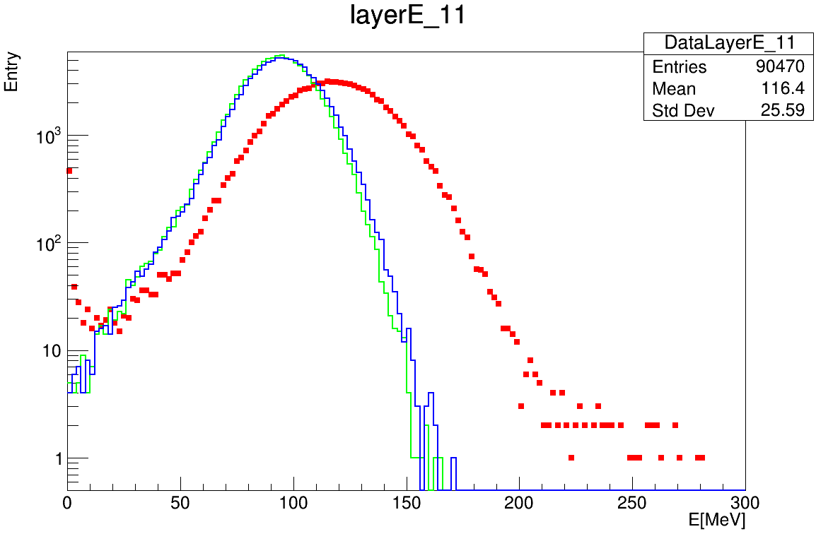
Layer energy deposition
Data with high energy
Red: data
Blue: MC_truth
Green: MC_digi
Red: data
Blue: MC_truth
Green: MC_digi

Slide 7
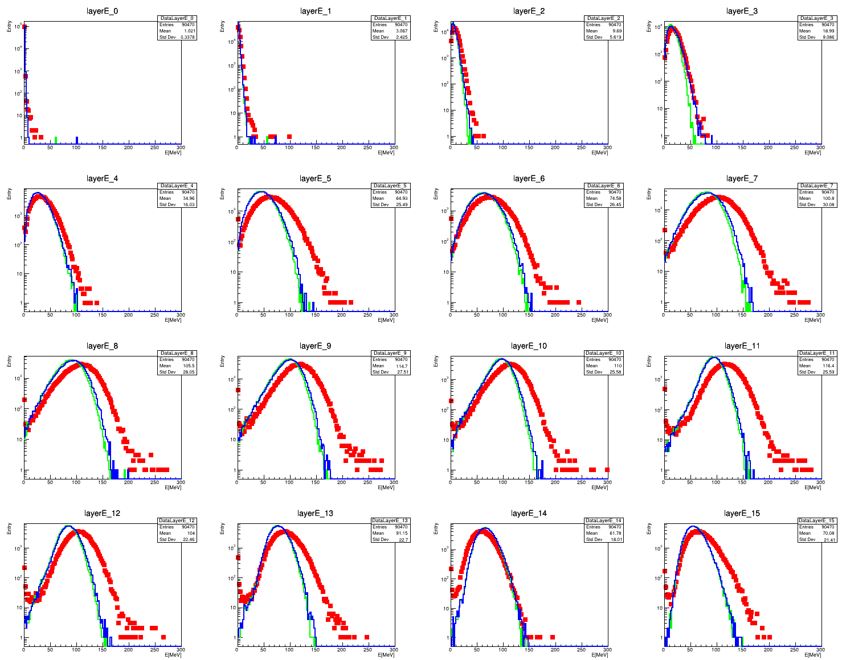
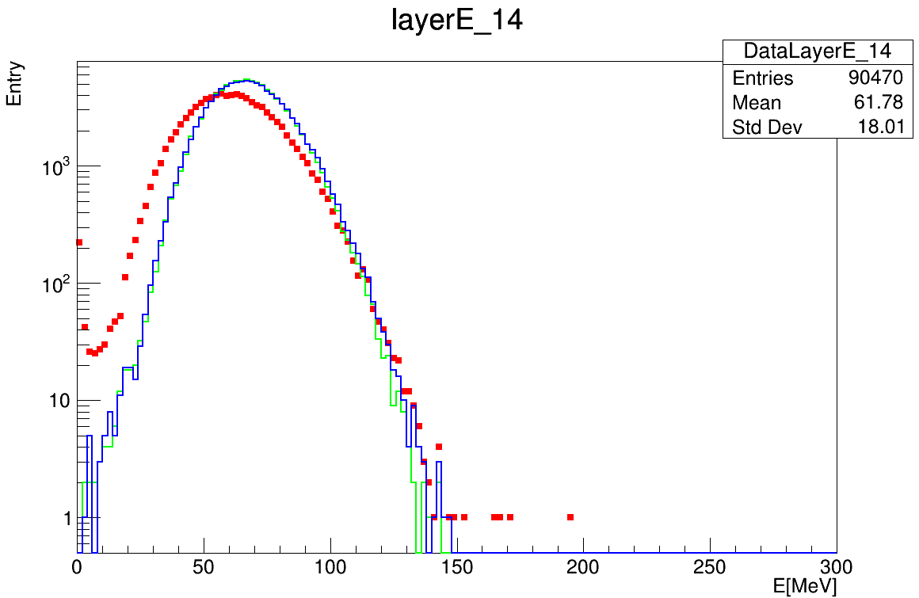
Layer energy deposition
First 16 layers
Layer 14 show different behavior
Red: data
Blue: MC_truth
Green: MC_digi

Slide 8
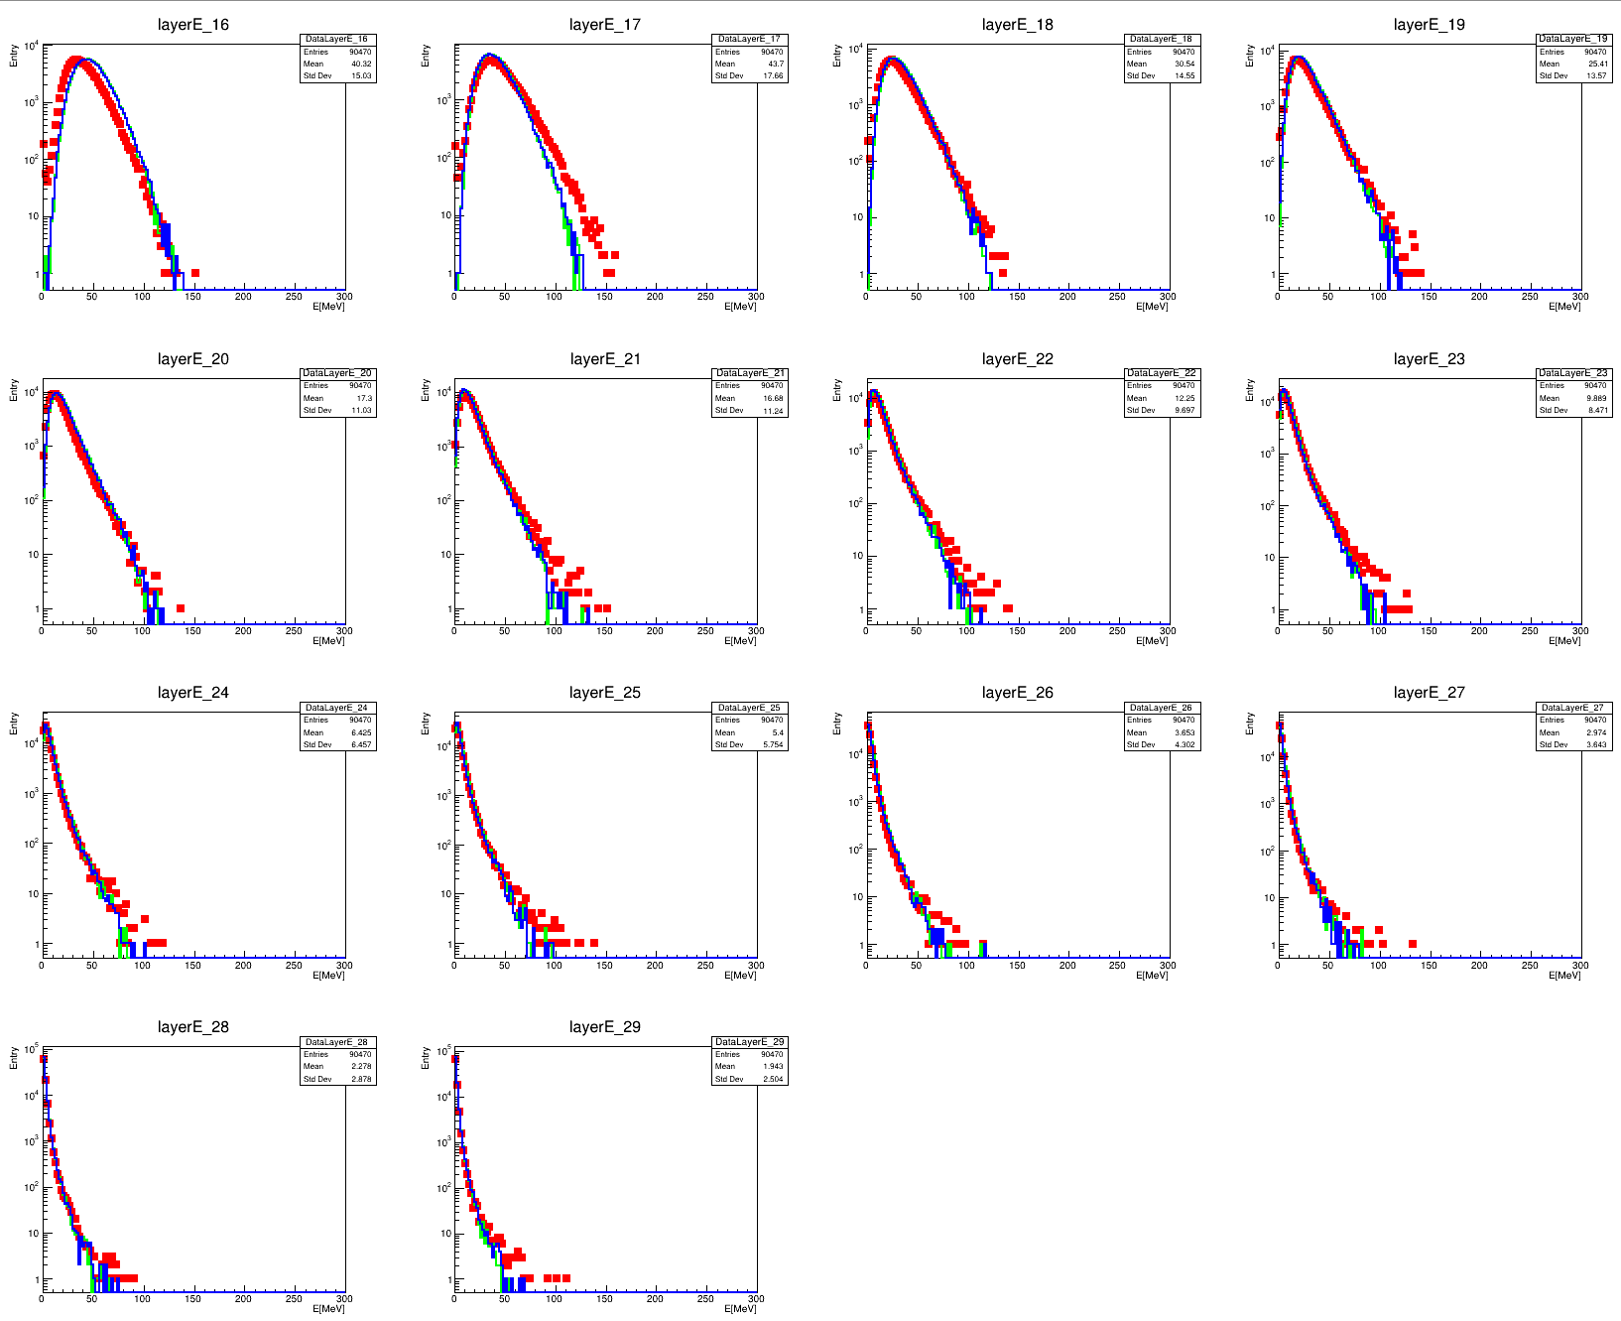
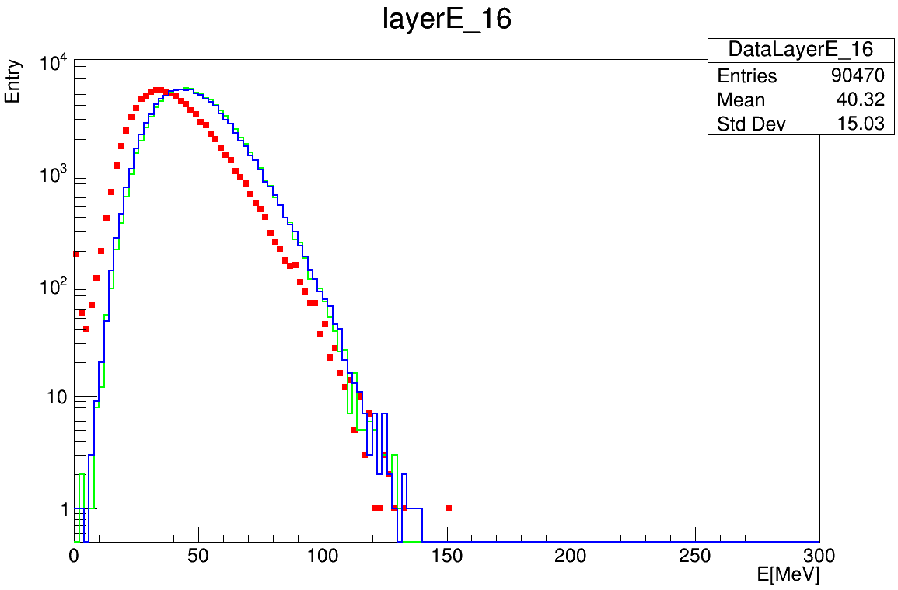
Layer energy deposition
Layer No.16-29
Layer 16 show different behavior
Red: data
Blue: MC_truth
Green: MC_digi

Slide 9
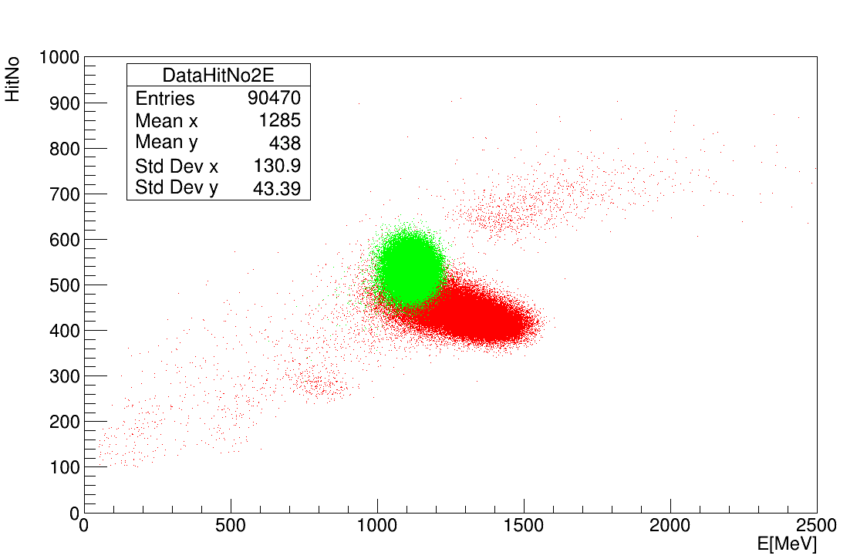
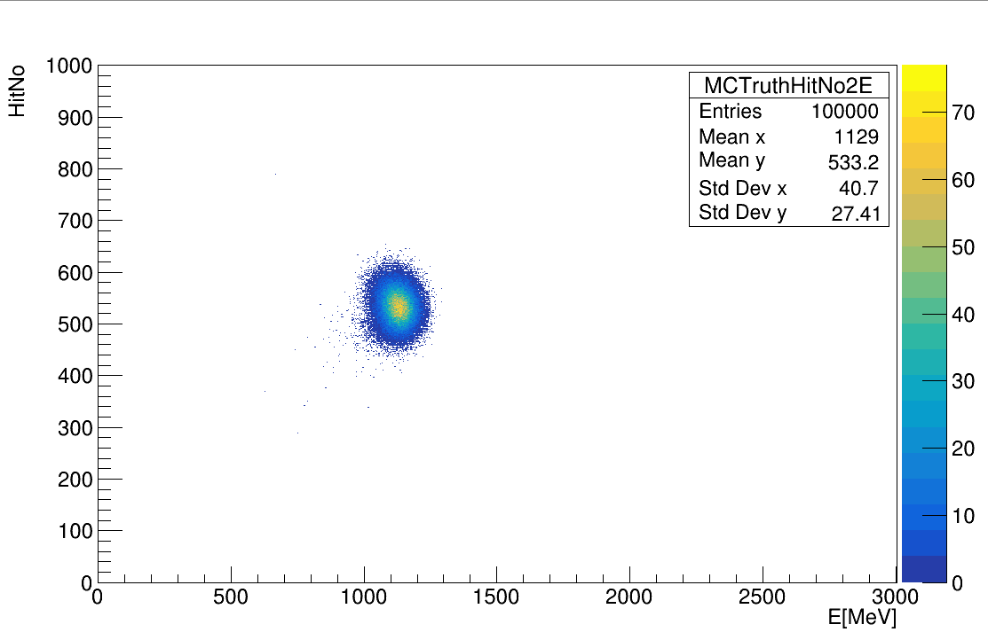
HitNo2Energy
Red: data
Green: MC_digi

Slide 10
Summary
Basic MC digitization process has been finished
MC digitization has little influence
Still need to improve
SiPM gain
Single photoelectron peak width
Noise model
Layer 14 && Layer 16 check

Slide 11
BACKUP

Slide 12
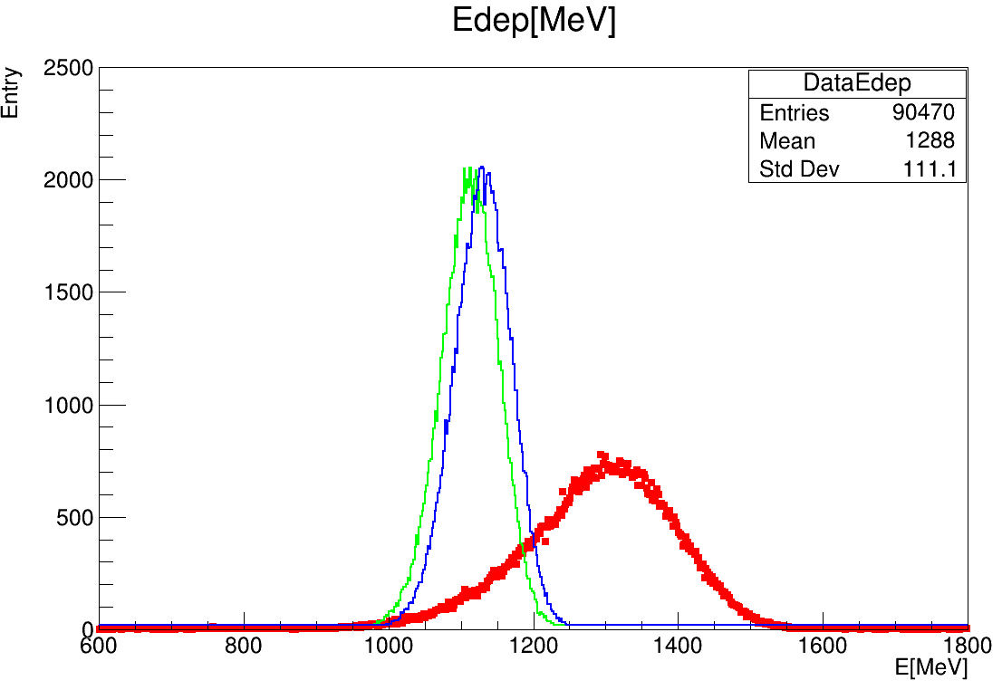
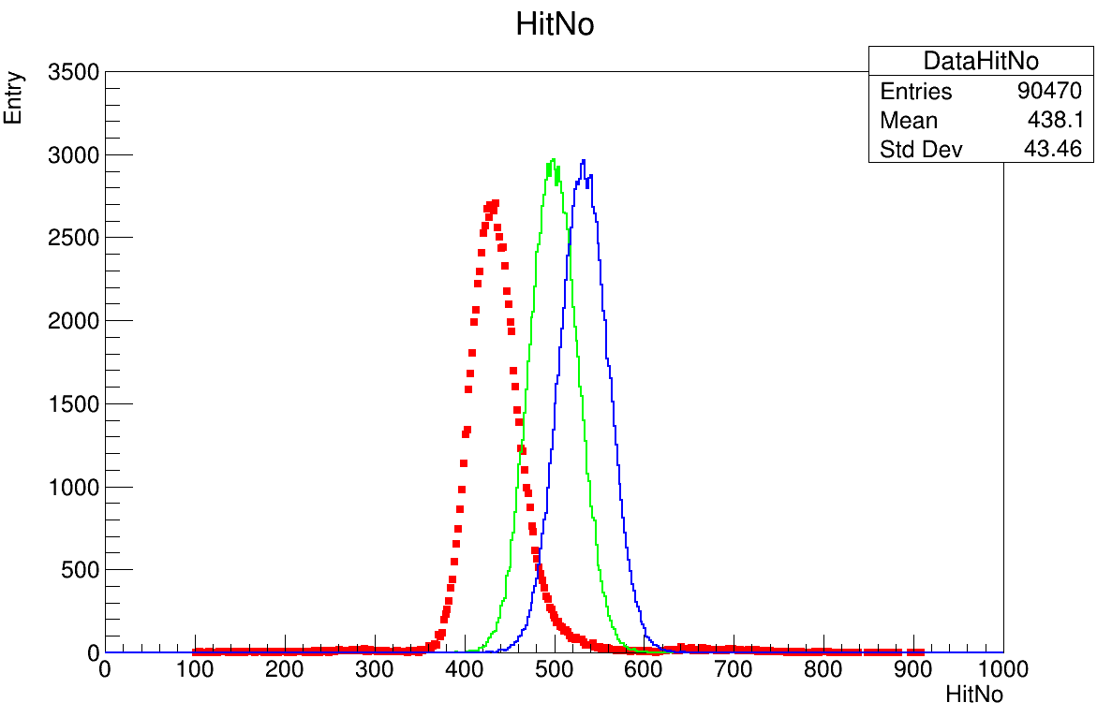
ADC saturation

Slide 13
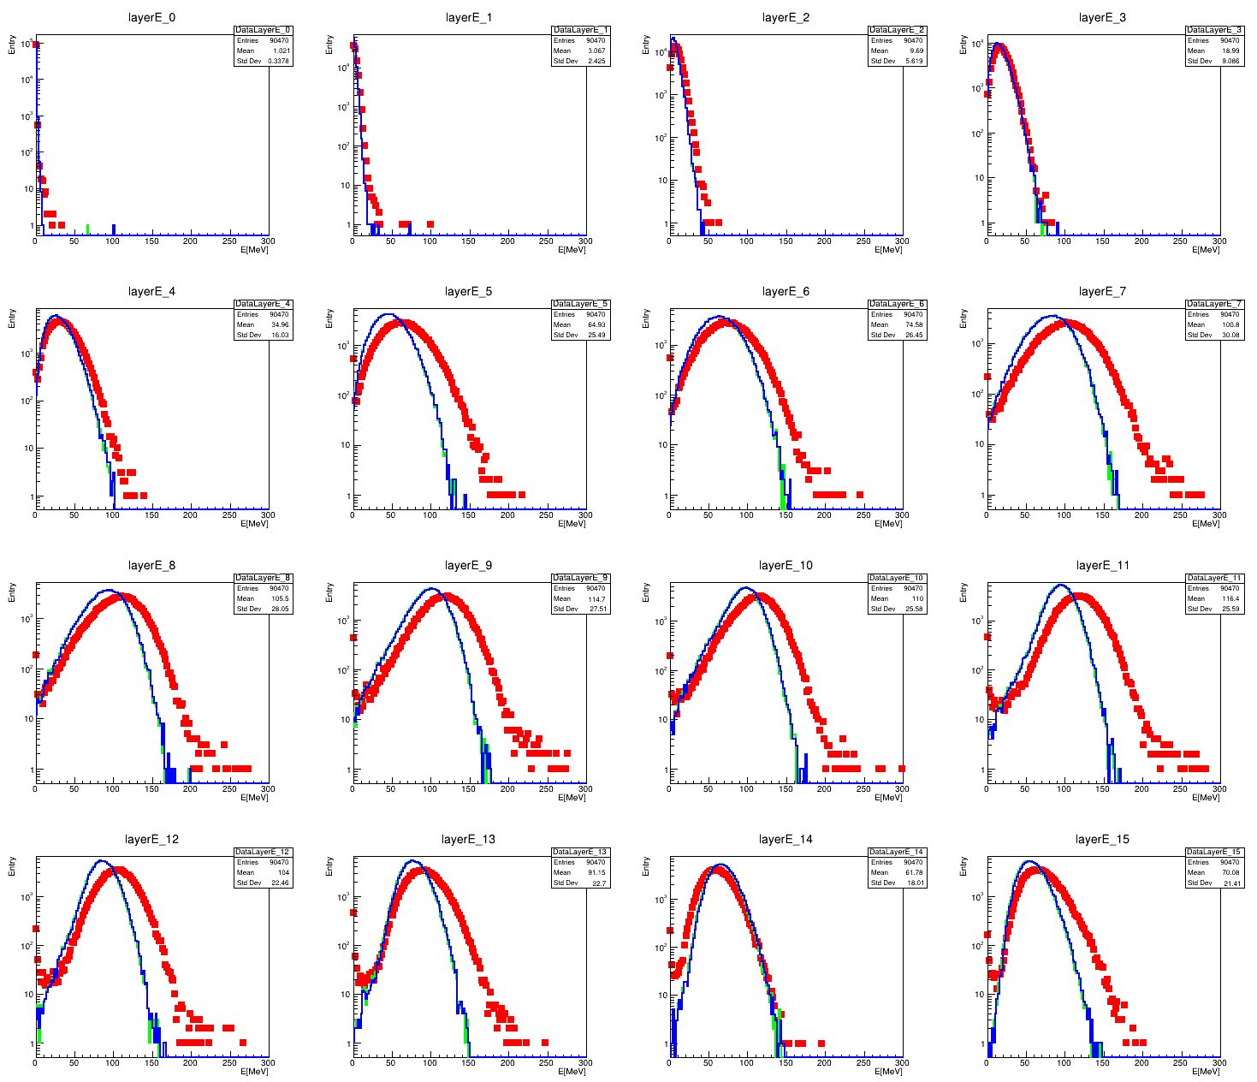
ADC saturation

Slide 14
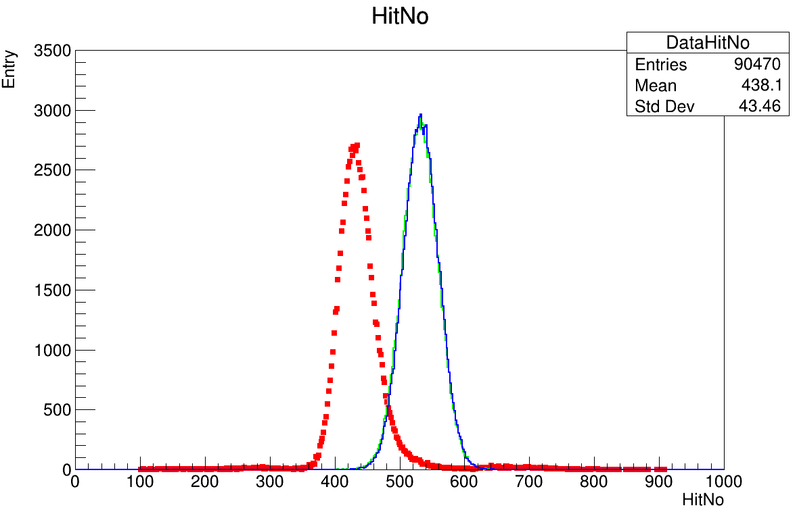
SiPM saturation

Slide 15
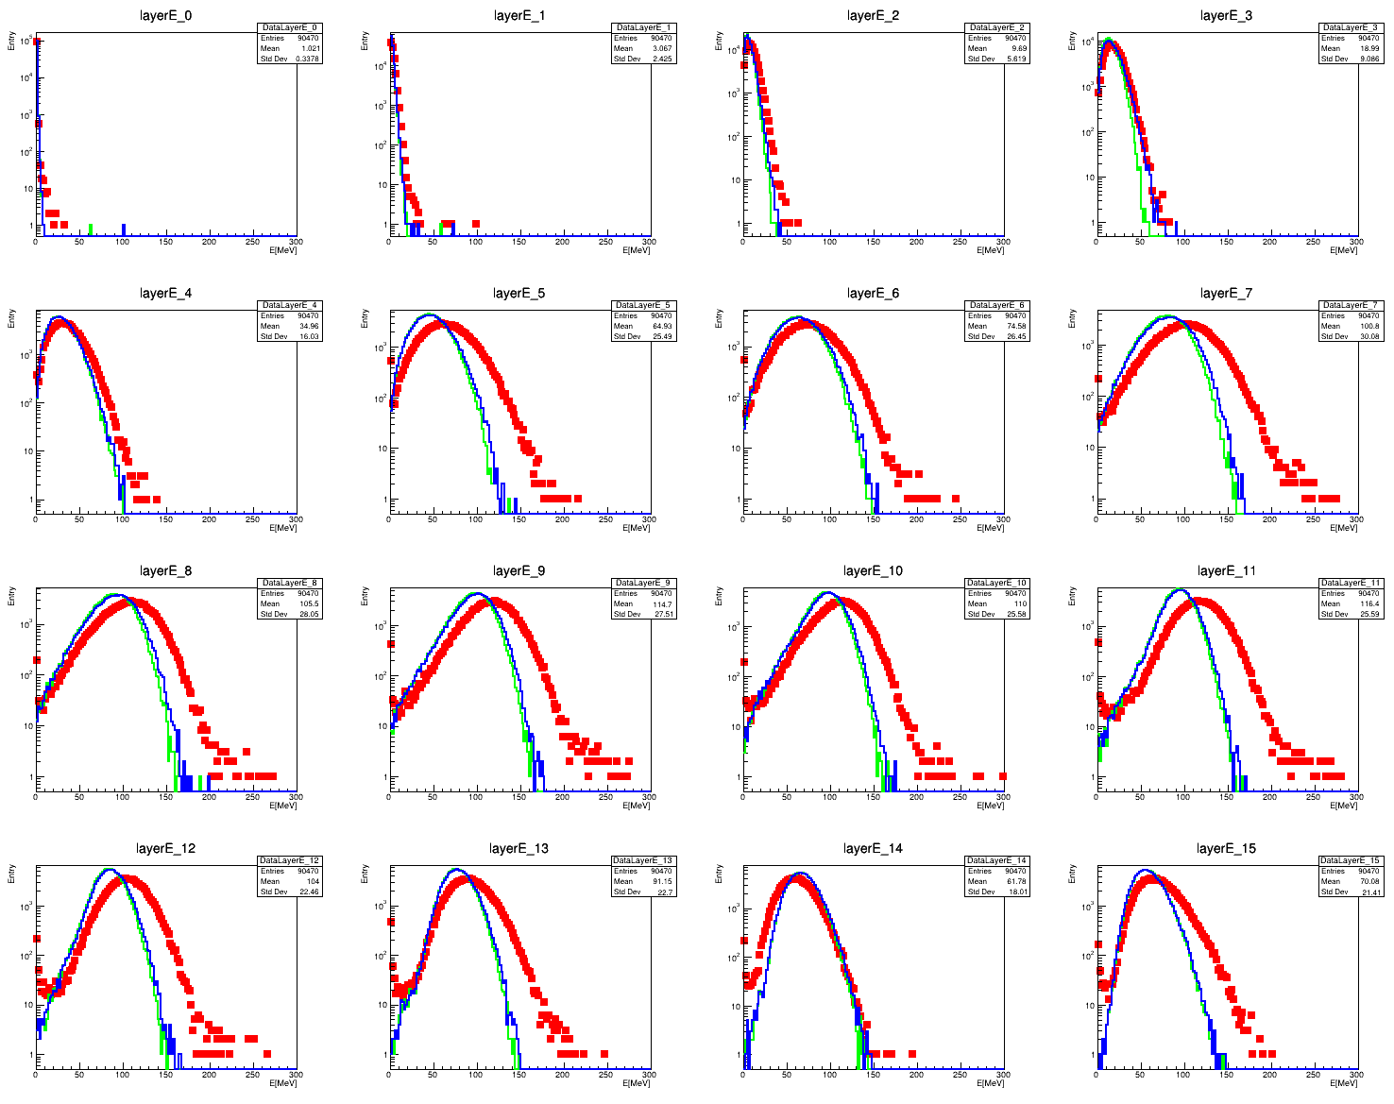
SiPM saturation

