Slide 1
Simulation setup
incident particle
based on baohua’s code
change the thickness of ESR to 65um, and material to 1.38g/cm^3 C10H8O4
add front trigger detector, thickness is variable
add copper in PCB
the thickness of Cu and PCB is variable
front trigger detector: polystyrene
gap: air, 1.5m
Absorber: steel: 2 mm
Scintillator: polystyrene: 3 mm
PCB: FR4(2.5mm)
Cu(0mm)
gap: air(4mm)
Absorber: steel: 18 mm

Slide 2
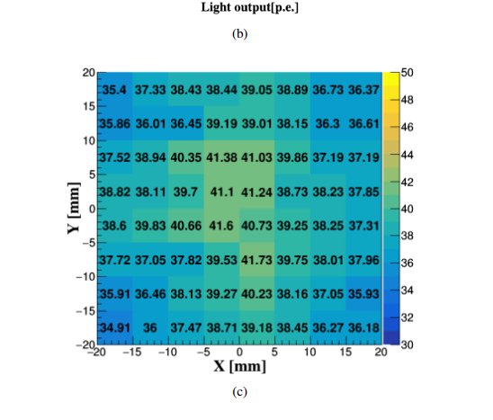
Digitization
4.8% gassian smear because non-uniformity of light output
energy to photon (poisson distribution)
photon to phoelectron (binomial distribution, PDE=0.32)
SiPM response model
gaussian smear with sigma
phoelectron to adc
gaussian smear (sigma of single phoelectron peak sqrt(n)*3)
adc to highgain and lowgain()

Slide 3
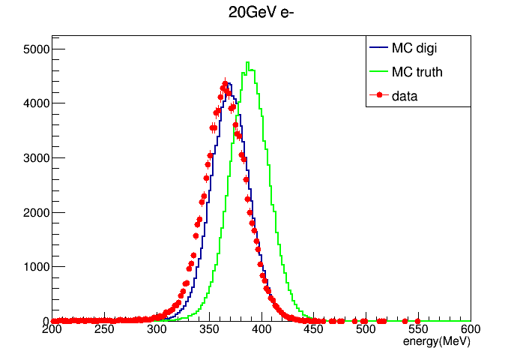
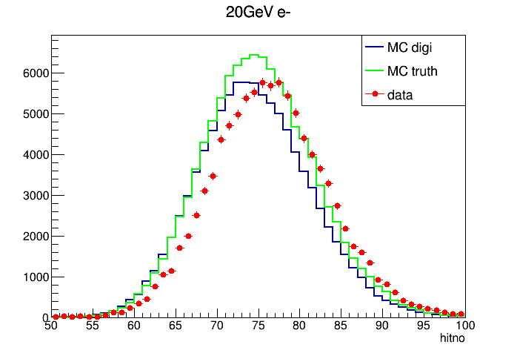
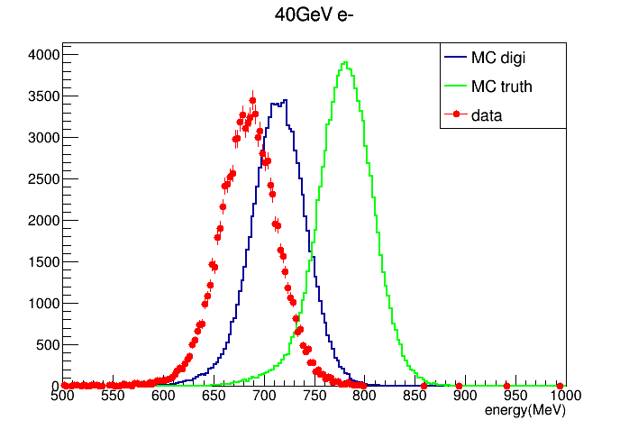
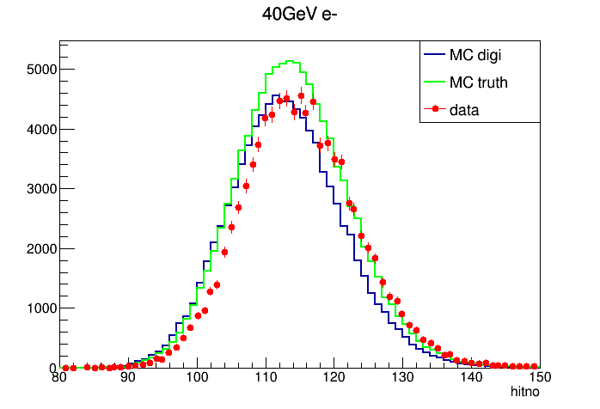
energy
hitno

Slide 4
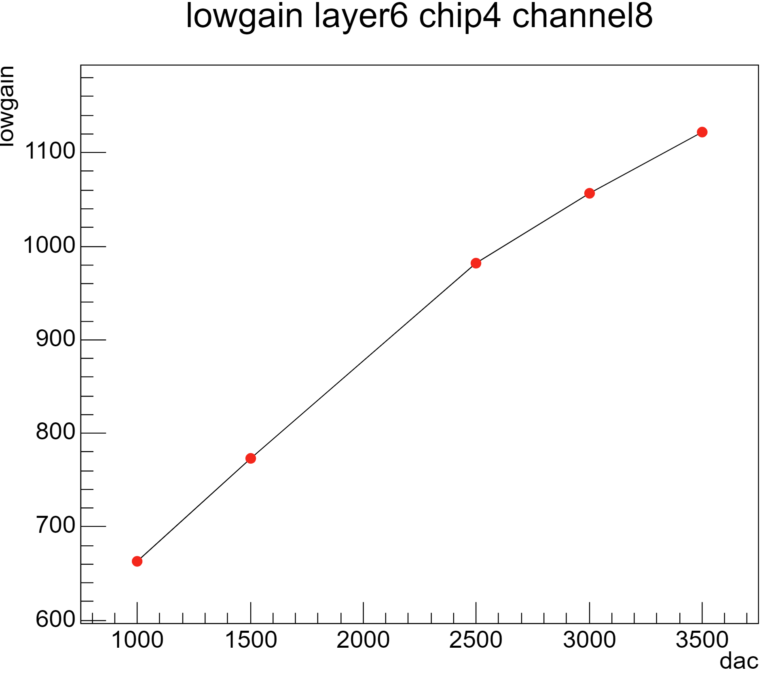
electronic calibration
obvious non-linearity of lowgain

