Slide 1
Phase Transitions in Soft Matter
Jamming, Glass Transition, and Rheology
Ning Xu
Department of Physics, CAS Key Laboratory of Soft Matter Chemistry & Hefei National Laboratory for Physical Sciences at the Microscale, University of Science and Technology of China

Slide 2
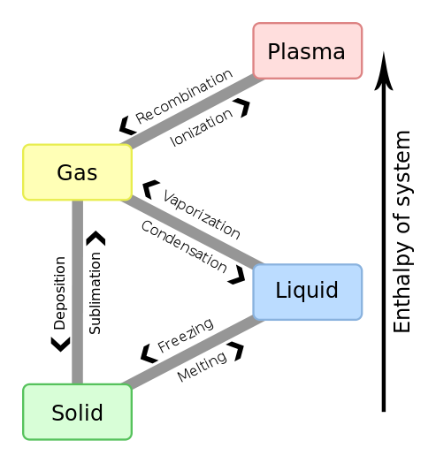
Phases of matter and phase transitions
Soft Matter ⎯ Fifth?
Matter between liquids and solids

Slide 3
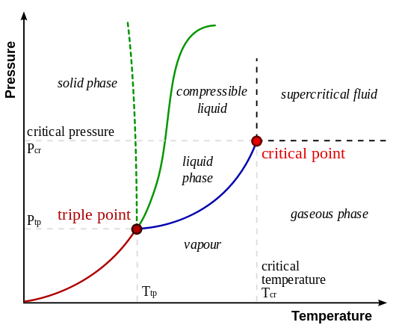
Phase diagram in T-P plane
water

Slide 4
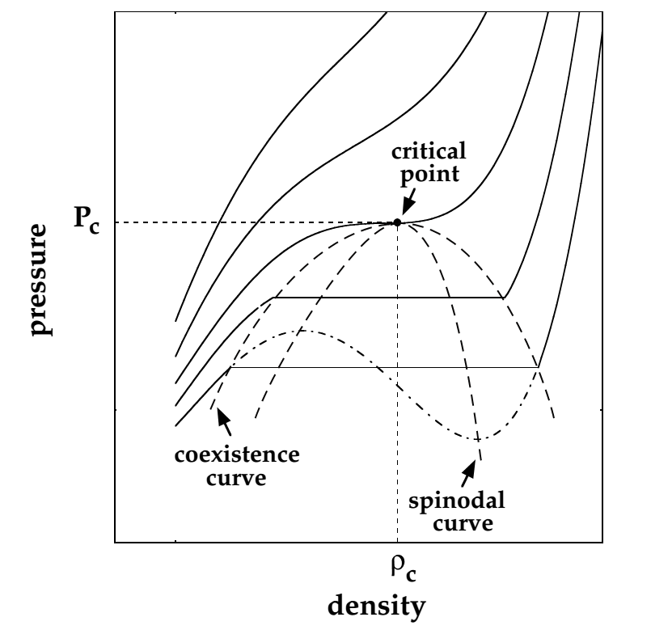


Phase diagram in P-ρ plane
Spinodal decomposition
metastable

Slide 5
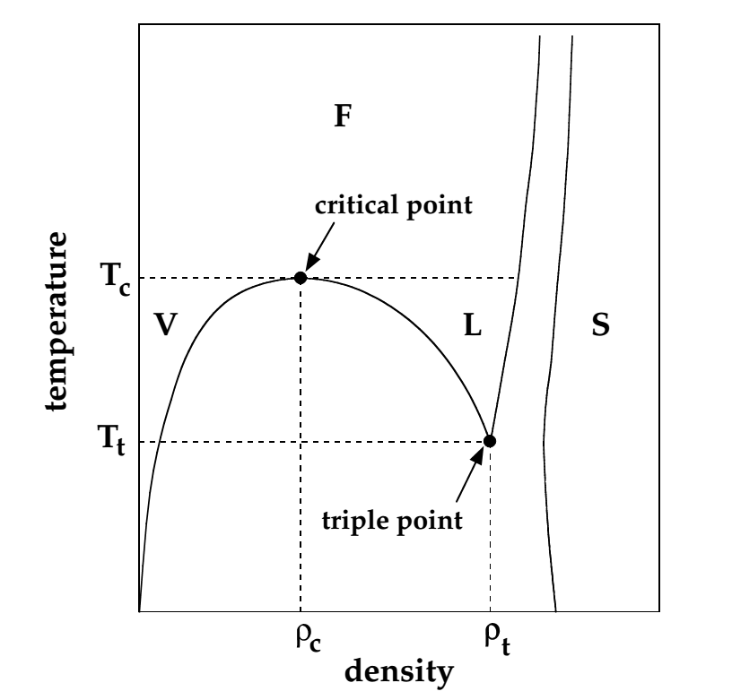
Phase diagram in T-ρ plane

Slide 6
Types of phase transitions
Take PV system as example (can be other systems)
First order transition
Discontinuous phase transition
T, P, chemical potential μ same
Entropy S discontinuous ⎯ latent heat
Second order transition (critical)
Continuous phase transition
T, P, μ, S same
No latent heat
Critical scaling
Order parameter ⎯ a quantity characterizing the order of a system

Slide 7
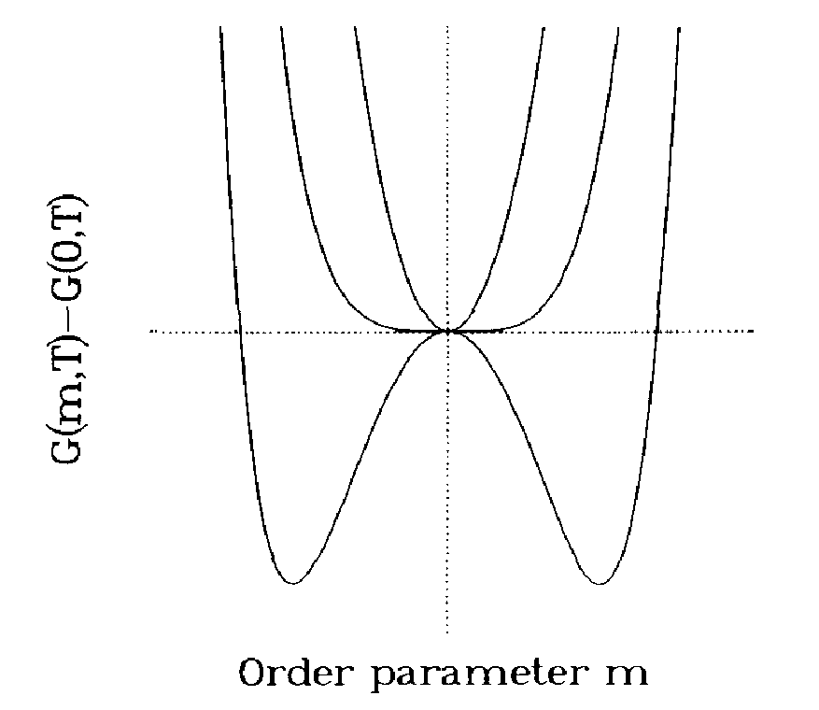
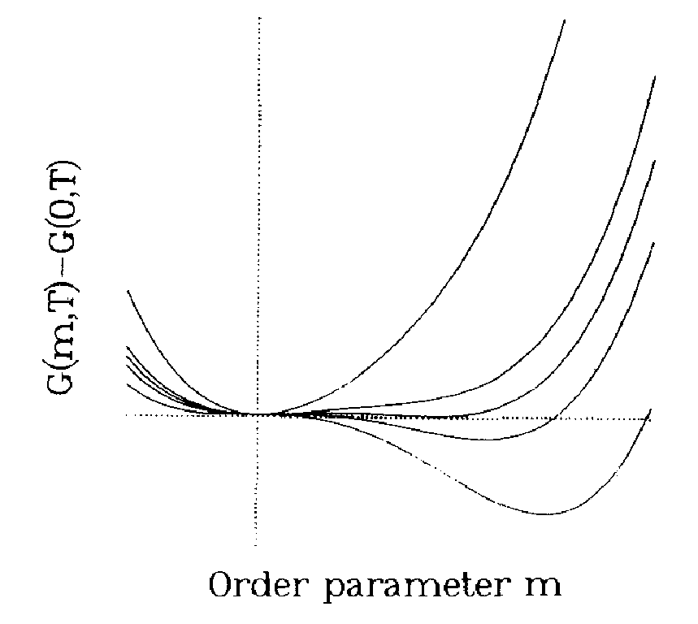
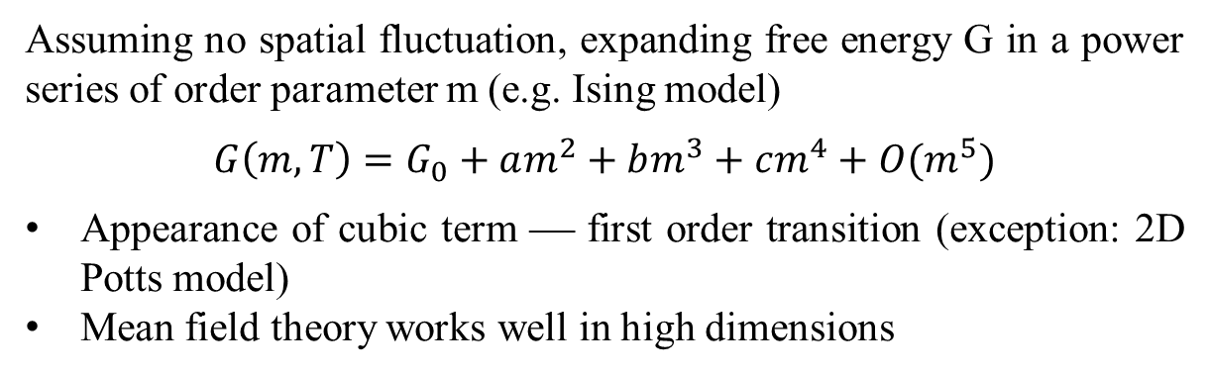
Mean field theory of phase transition
Assuming no spatial fluctuation, expanding free energy G in a power series of order parameter m (e.g. Ising model)
$$G\left(m,T\right)=G_{0}+am^{2}+bm^{3}+cm^{4}+O(m^{5})$$
Appearance of cubic term ⎯ first order transition (exception: 2D Potts model)
Mean field theory works well in high dimensions
b = 0
b ≠ 0

Slide 8
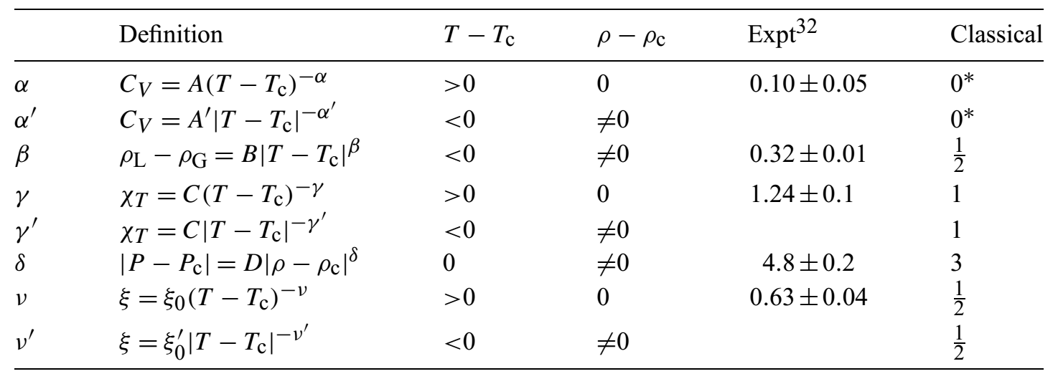
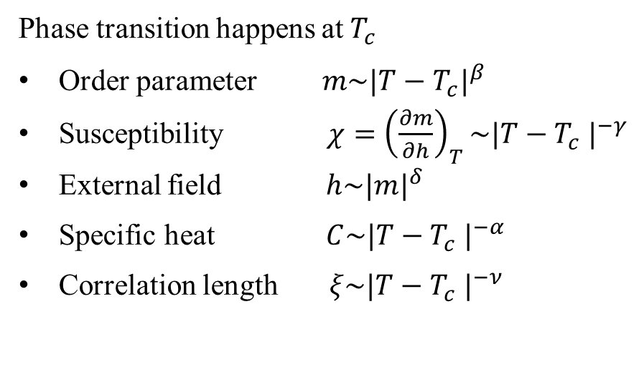


Critical scaling of critical phenomena
Phase transition happens at $T_{c}$
Order parameter $m\sim {|T−T_{c}|}^{β}$
Susceptibility $χ={\left(\frac{∂m}{∂h}\right)}_{T}\sim {|T−T_{c} |}^{−γ}$
External field $h\sim {|m|}^{δ}$
Specific heat $C\sim {|T−T_{c} |}^{−α}$
Correlation length $ξ\sim {|T−T_{c} |}^{−ν}$
$$α+2β+γ=2$$
$$β\left(δ−1\right)=γ$$

Slide 9

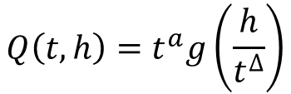


Characterizing critical phenomena
Scaling hypothesis
Finite size scaling
No true phase transition for finite systems with size L
$$Q\left(t,h\right)=t^{a}g\left(\frac{h}{t^{∆}}\right)$$
$$t=(T−T_{c})/T_{c}$$
Collapse curves measured at different external field $h$ in vicinity of $t=0$
$$T_{c}\left(L\right)=T_{c}+bL^{−1/ν}$$
$$L^{a/ν}Q\left(t,L\right)={\left(L^{1/ν}t\right)}^{a}f\left(L^{1/ν}t\right)$$
Collapse curves measured at different sizes in vicinity of $t=0$

Slide 10

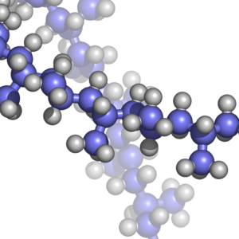
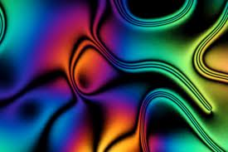
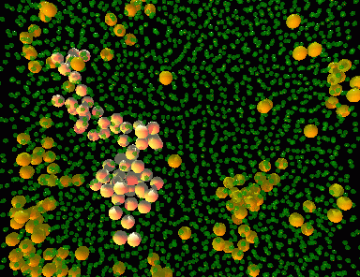

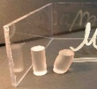
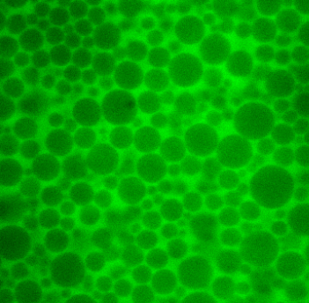
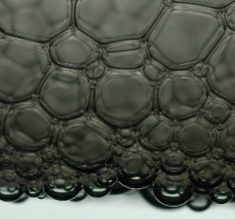
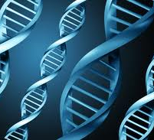
What is Soft Matter?
Major features:
Soft
weak interactions, large response to small perturbation
Room temperature
quantum effects negligible
Complicated components, structures, dynamics, and so on
fluctuations important
Pierre-Gilles de Gennes
The Nobel Prize in Physics 1991
Polymer
Liquid crystal
Colloid
Granular material
Glass
Emulsion
Foam
Biological material

Slide 11
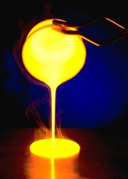
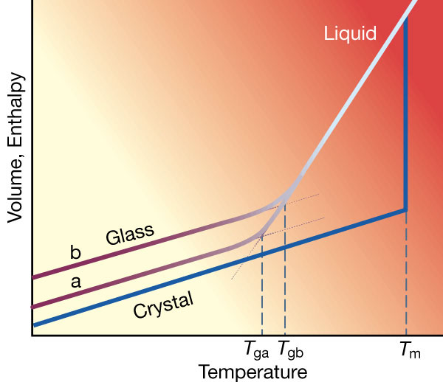
Glasses
Liquids are supercooled when quenched fast enough to bypass crystallization
Supercooled liquids turn into glasses (highly viscous liquids?) at low temperatures
P. G. Debenedetti and F. H. Stillinger, Nature 410, 259 (2001).

Slide 12
Glass transition ⎯ unusual phase transition
Liquid − disorder solid transition
No appearance of long range structural order
No latent heat ⎯ Not conventional first order transition
No apparent structural signature
No diverging two-point static length observed
⎯ Not conventional second order transition
What type of phase transition is the glass transition?
Thermodynamic, dynamical, or not a transition at all?

Slide 13
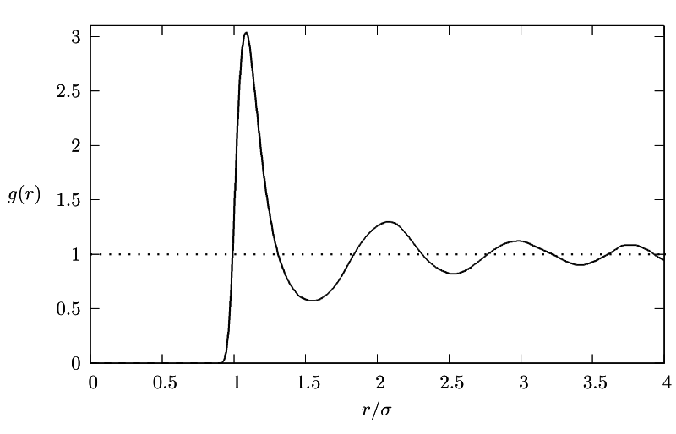
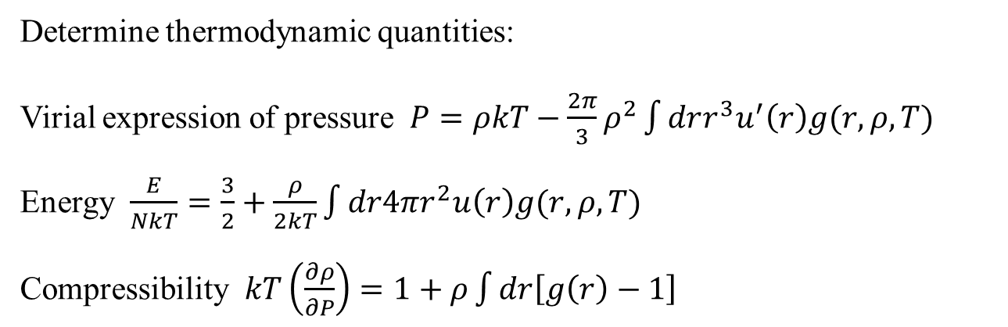

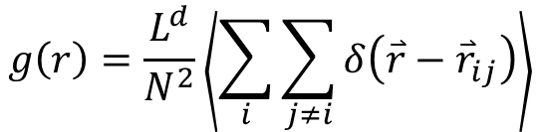
Characterizing structure
Radial distribution function $g(r)$
$$g\left(r\right)=\frac{L^{d}}{N^{2}}\left\langle \sum_{i}{\sum_{j≠i}{δ\left(\overset{⃑}{r}−{\overset{⃑}{r}}_{ij}\right)}}\right\rangle$$
Probability of finding particles r distance away
Determine thermodynamic quantities:
Virial expression of pressure $P=ρkT−\frac{2π}{3}ρ^{2}\int{drr^{3}u^{′}\left(r\right)g(r,ρ,T)}$
Energy $\frac{E}{NkT}=\frac{3}{2}+\frac{ρ}{2kT}\int{dr4πr^{2}u\left(r\right)g(r,ρ,T)}$
Compressibility $kT\left(\frac{∂ρ}{∂P}\right)=1+ρ\int{dr\left[g\left(r\right)−1\right]}$

Slide 14
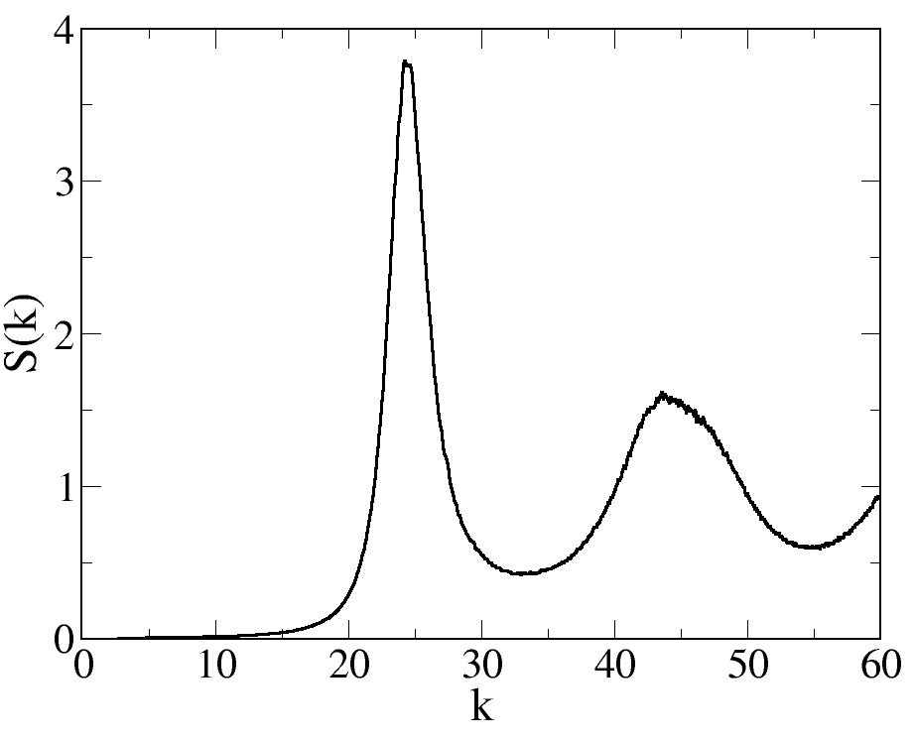
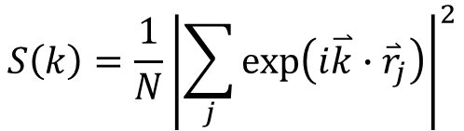
Characterizing structure
Static structure factor S(k)
$$S\left(k\right)=\frac{1}{N}{\left|\sum_{j}{\exp\left(i\overset{⃑}{k}∙{\overset{⃑}{r}}_{j}\right)}\right|}^{2}$$
S(k) and g(r) are related via Fourier transform
First peak at k = 2π/a, a is about inter-particle spacing
In liquids, S(0) proportional to isothermal compressibility

Slide 15
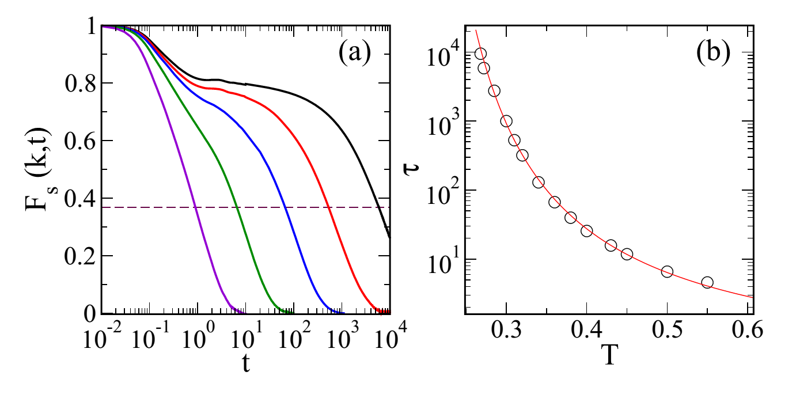
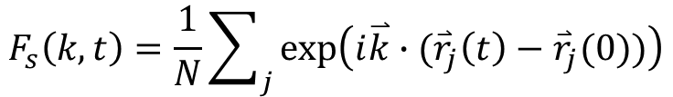


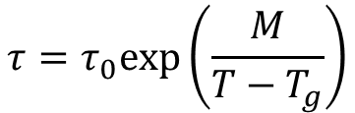
Two-step relaxation of supercooled liquids
β relaxation
$$τ$$
α relaxation
Intermediate scattering function
$$F_{s}\left(k,t\right)=\frac{1}{N}\sum_{j}{exp⁡\left(i\overset{⃑}{k}∙({\overset{⃑}{r}}_{j}\left(t\right)−{\overset{⃑}{r}}_{j}(0))\right)}$$
$$τ=τ_{0}exp\left(\frac{M}{T−T_{g}}\right)$$
Vogel-Fulcher function
Mode coupling function
$$τ=τ_{0}{\left(T−T_{g}\right)}^{−ν}$$

Slide 16
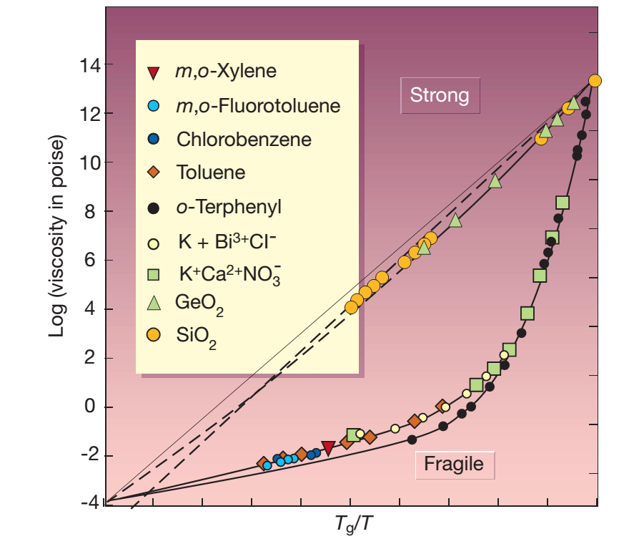
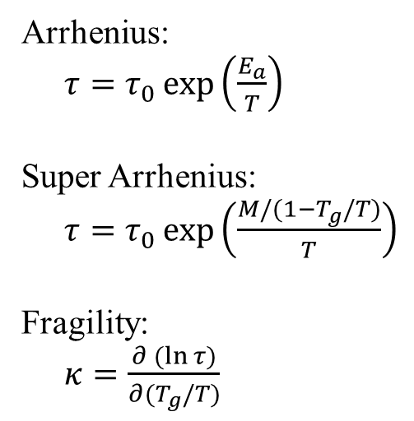
Glass fragility
Arrhenius:
$τ=τ_{0}\exp\left(\frac{E_{a}}{T}\right)$
Super Arrhenius:
$τ=τ_{0}\exp\left(\frac{M/(1−T_{g}/T)}{T}\right)$
Fragility:
$κ=\frac{∂(ln{τ)}}{∂{(T}_{g}/T)}$
Softer and denser systems are more fragile
L. Berthier and T. A. Witten, EPL 86, 10001 (2009).
J. Mattsson et al., Nature 462, 83 (2009).

Slide 17
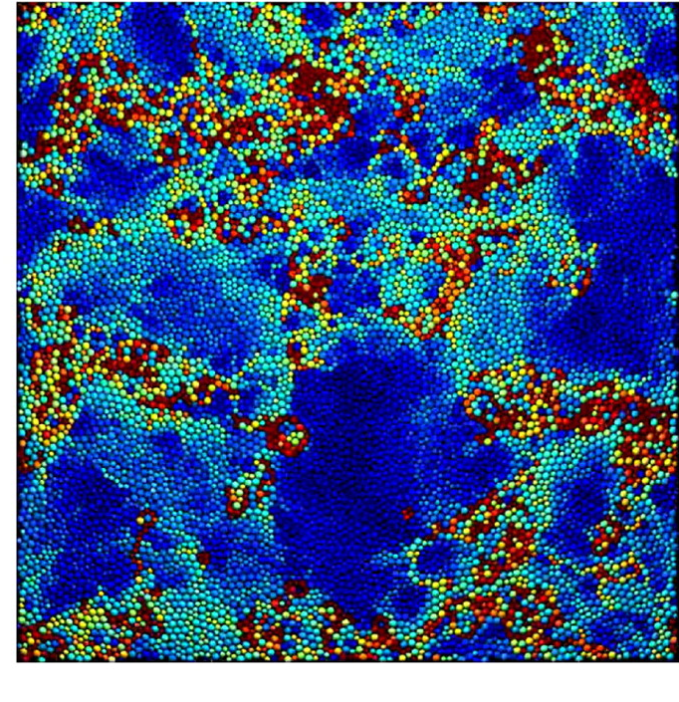
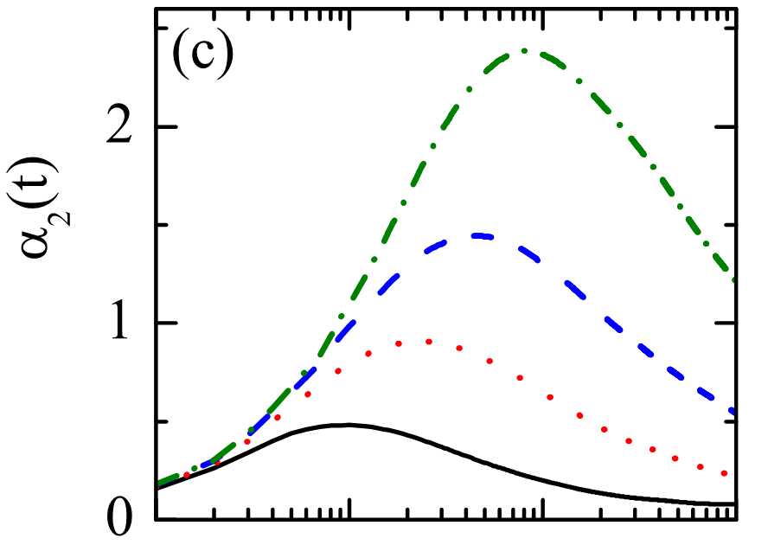
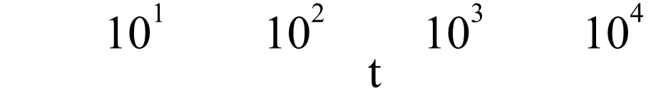
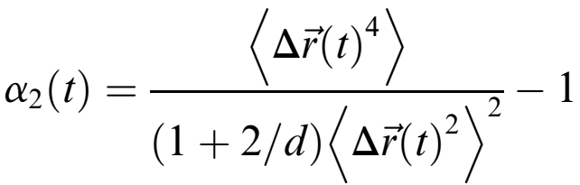
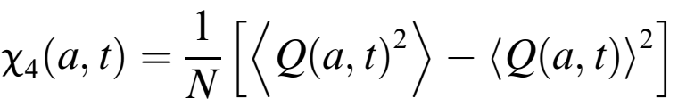

Dynamical heterogeneity of supercooled liquids
Non-Gaussian parameter
Four point dynamical susceptibility

Slide 18
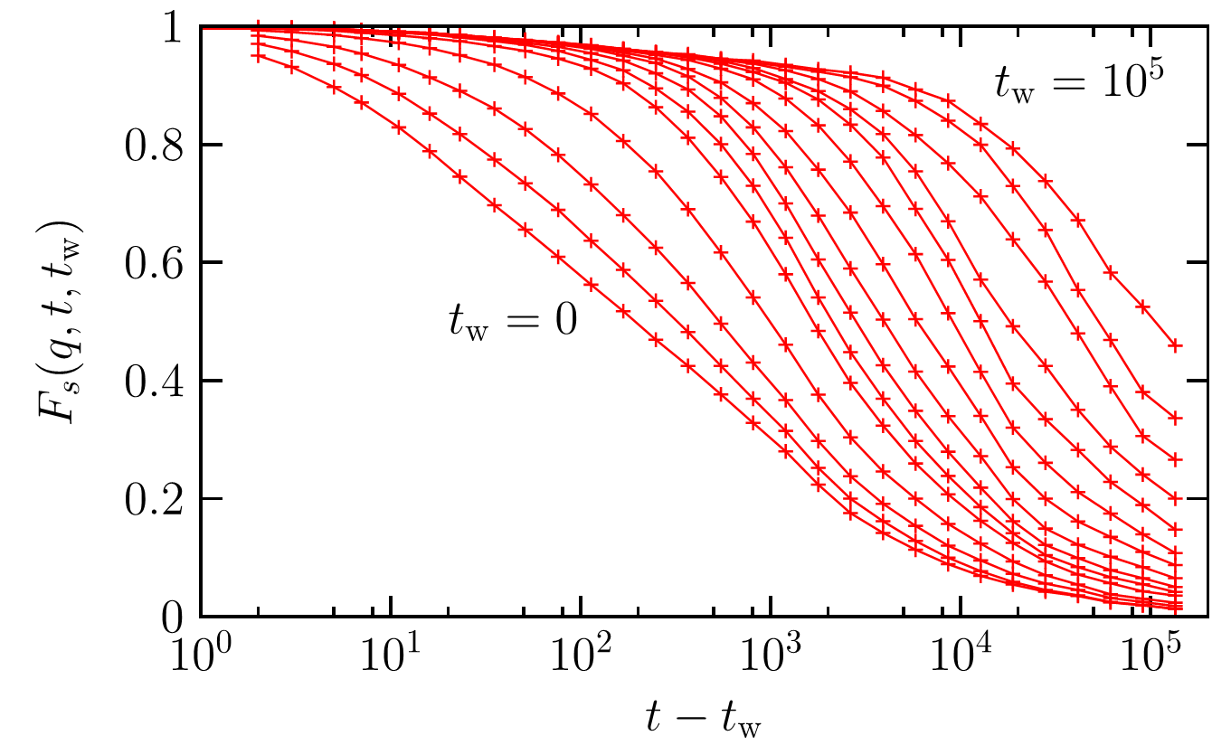
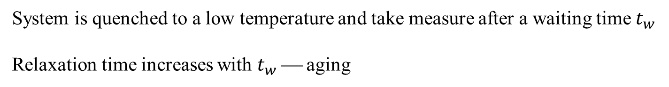
Aging of glasses
System is quenched to a low temperature and take measure after a waiting time $t_{w}$
Relaxation time increases with $t_{w}$ ⎯ aging

Slide 19
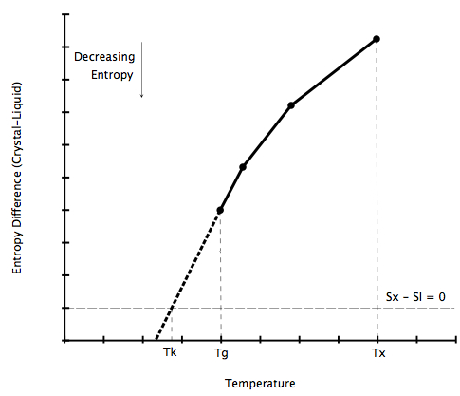
Kauzmann’s Paradox
Walter Kauzmann 1948
×
Entropy of liquid is lower than that of crystal below some temperature
Solution: ideal glass transition temperature

Slide 20
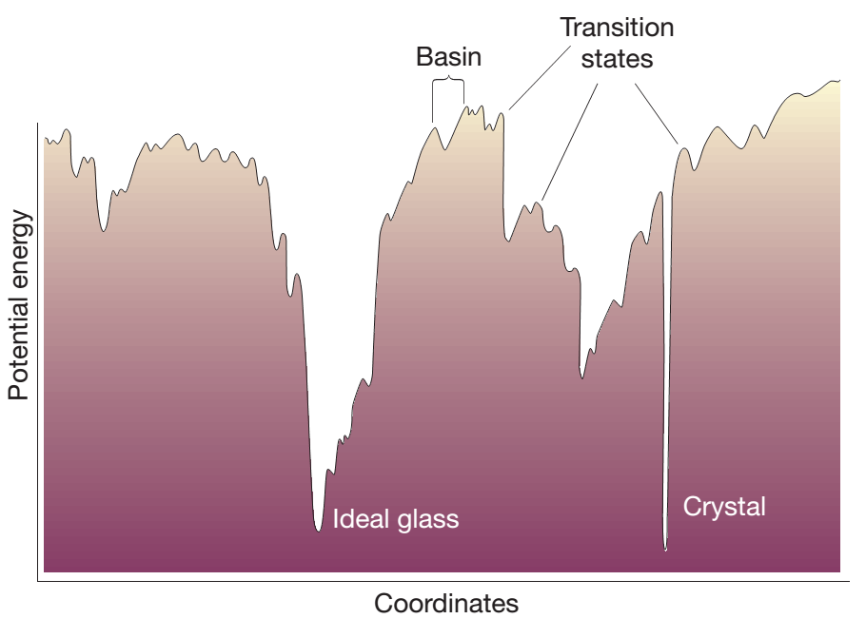
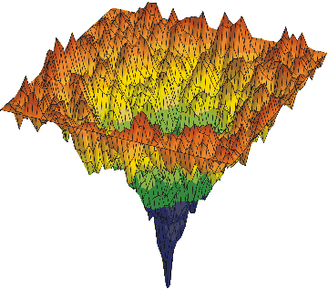
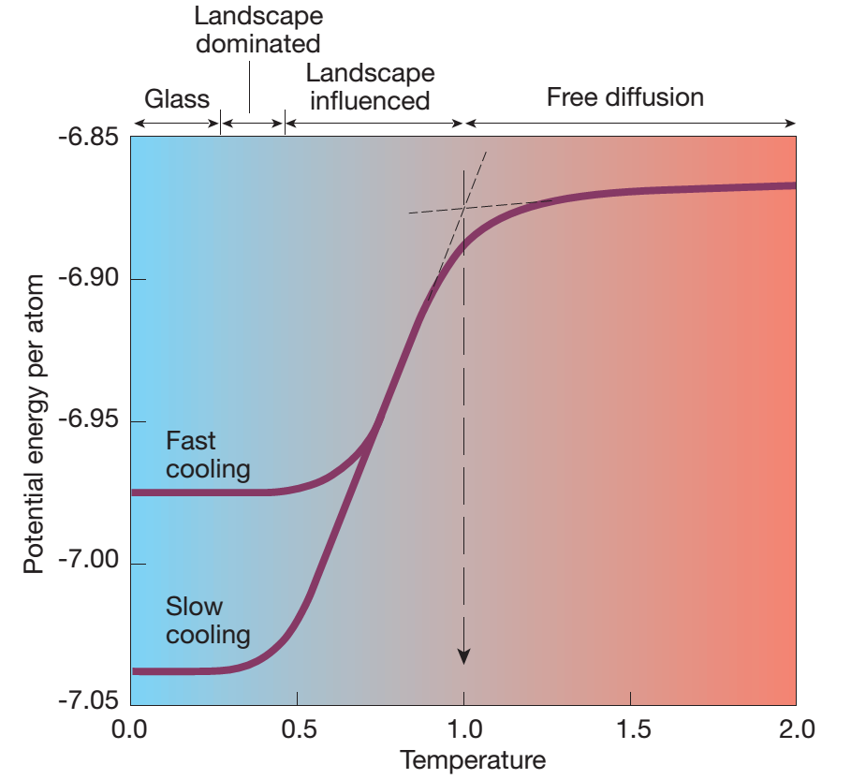
Potential energy landscape
PEL sampling depends on temperature
and cooling rate

Slide 21
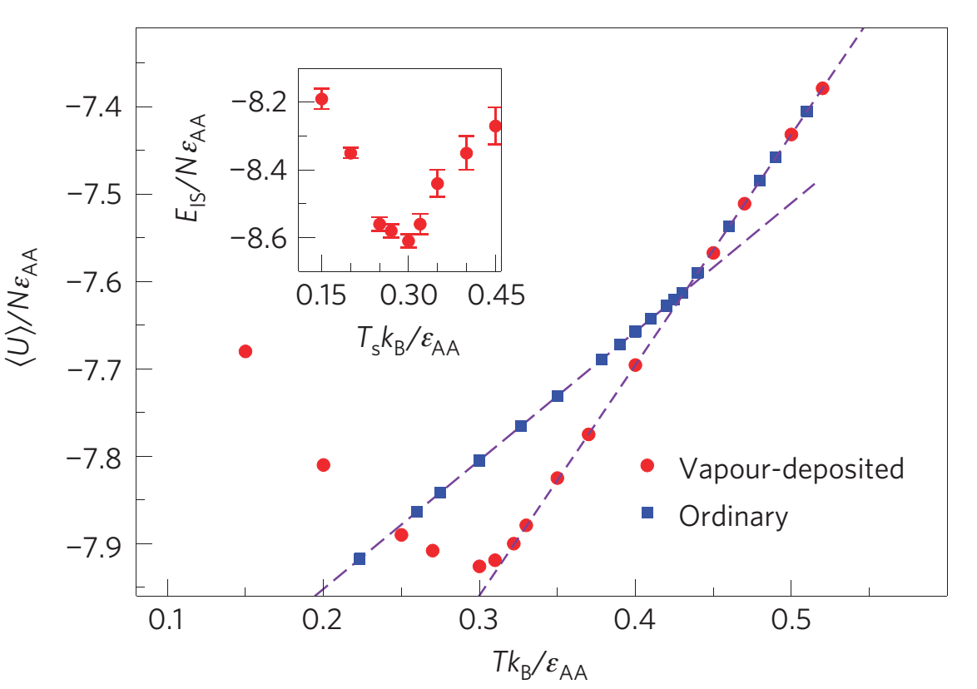
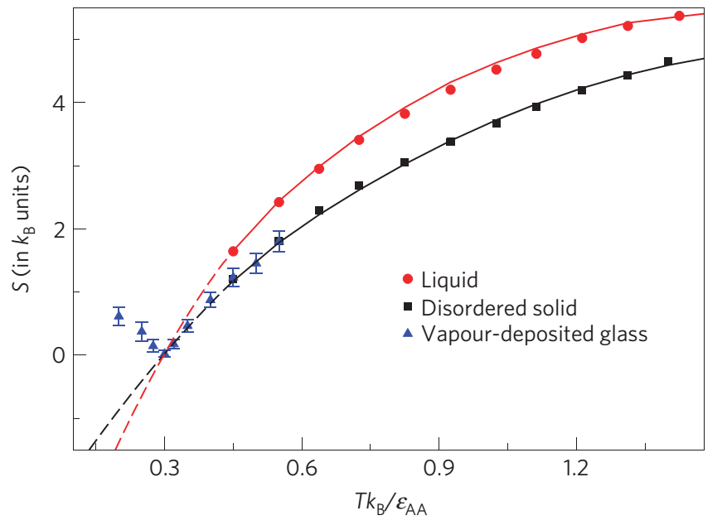
Ultrastable glasses
Method: vapor deposition on a substrate maintained at a temperature T
It is claimed that the glass is comparable to glasses aged over thousands of years; low energy; ultrastable; ideal glass transition
S. Singh et al. Nature Mater. 12, 139 (2013.)

Slide 22

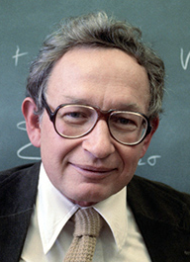

Glass transition is challenging
Free volume theory
Mode coupling theory
Thermodynamic theory
Kinetic theory
Random first order transition theory
More …
The deepest and most interesting unsolved problem in solid state theory is probably the theory of the nature of glass and the glass transition.
There are more theories of the glass transition than there are theorists who propose them.
Philip Anderson
David Weitz
K. Chang, The nature of glass remains anything but clear, The New York Times (2008).

Slide 23
Colloidal suspensions
Definition: A substance microscopically dispersed evenly throughout another one
Medium / Phases |  | Dispersed phase
 |  | Gas | Liquid | Solid
Dispersion medium | Gas | NONE (All gases are mutually miscible) | Liquid aerosol Examples: fog, hair sprays | Solid aerosol Examples: smoke, ice cloud, air particulates
 | Liquid | Foam Example: whipped cream, shaving cream | Emulsion Examples: milk, mayonnaise, hand cream | Sol Examples: pigmented ink, blood
 | Solid | Solid foam Examples: aerogel, styrofoam, pumice | Gel Examples: agar, gelatin, jelly | Solid sol Example: cranberry glass
Visible particle size (~1000nm)
Brownian motion (thermal systems)
Big size in space, slow in time, ideal experimental systems to simulate
molecular systems

Slide 24
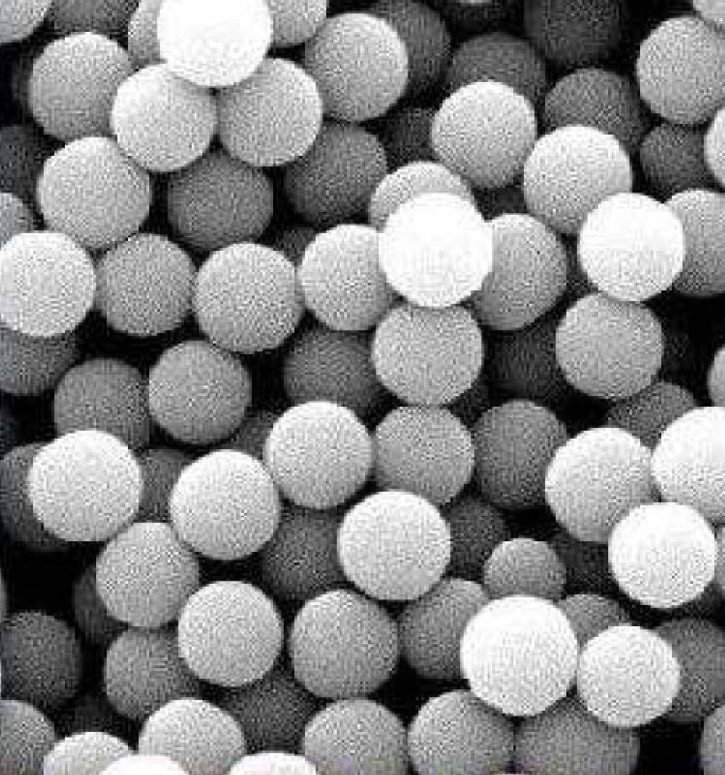
Interaction of colloidal suspensions
Excluded volume repulsion
Hard particle
Electrostatic interaction
Long-range, Debye screening
van der Waals forces
Short-range, attractive, dipole-dipole interaction
Entropic forces
Attractive depletion effect in bi-disperse systems
Steric forces
Polymer induced

Slide 25
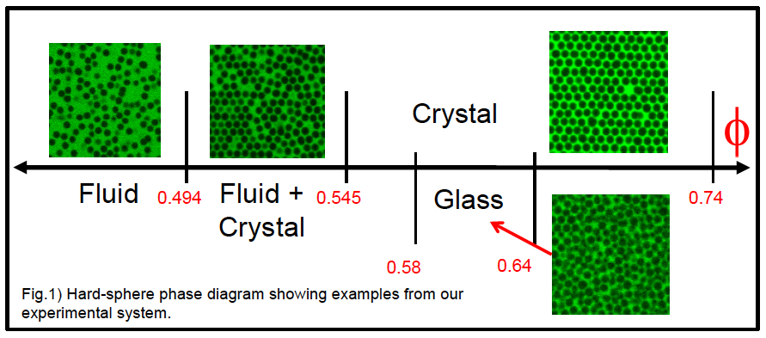
Phase diagram of hard colloids
Volume fraction (density) or entropy driven

Slide 26
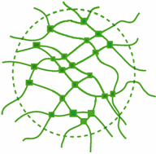
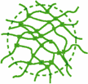
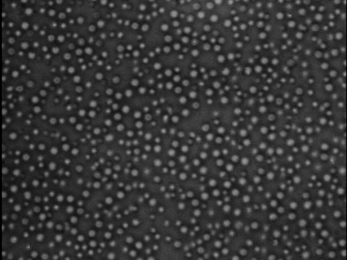
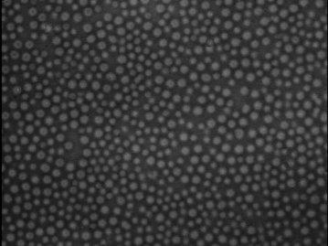
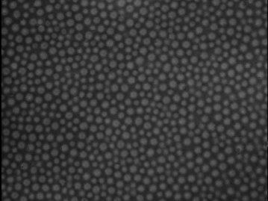
Soft colloids ⎯ PNIPAM
Poly(N-isopropyl acrylamide)
decrease temperature
increase size
lower temperature
increase density

Slide 27



Untrasoft colloids ⎯ star polymers, charged colloids
Charged colloid
Reentrant crystallization and glass transition
Star polymer

Slide 28

Granular materials
Athermal
For sand,
Dissipative
Static friction, inelastic collisions
Angle of repose
Maximum angle before grains flow driven by gravity
Height independent pressure
Pressure saturates after the height reaches a critical value
Contact forces, static frictions with container
H.M. Jaeger et al., Rev. Mod. Phys. 68, 1259 (1996)

Slide 29



Heterogeneous force chains
Possible cause of anomalous energy transport,
e.g. sound propagation in sand
Shear banding
Shear flow and static packing of grains coexist
Nonlinear velocity profile
Shear stress gradient
Phase separation
Grains with different sizes segregate
Brazil-nut effect, reverse Brazil-nut effect
http://www.phy.duke.edu/~bob/
http://jfi.uchicago.edu

Slide 30


Close packing of hard spheres
Kepler’s conjecture: No arrangement of equally sized spheres filling space has a greater average density than that of the cubic close packing (face-centered cubic) and hexagonal close packing arrangements. (Almost proved by T. Hales recently)
FCC
HCP
Volume fraction: Ratio of total particle volumes to volume of container

Slide 31

Random close packing of hard sphers
In 1960’s Bernal found experimentally that when equal-sized ball bearings
were randomly poured into a container the maximum volume fraction was
always around 64% ⎯ random close packing
In two dimensions, random close packing is around 84%
‘‘The figure for the occupied volume of random close packing— 0.64—must
be mathematically determinable, although so far as we know undetermined.’’
⎯ Bernal and Mason (1960)
J.D. Bernal, Nature 188, 910 (1960)

Slide 32
Possible connections between close packing and random close packing, crystallization and glass transition
Structure: Ordered Disordered
Maximum density: Close packing Random close packing
Phase transition: Crystallization Glass transition
First order (Random) first order ?
Phase separation: Liquid & crystal Liquid & glasses ?

Slide 33


Shear induced phase transition
Lee et al., Science 323, 231 (2009)
Weitz, Science 323, 214 (2009)
Grains flow when applied shear stress is larger than yield stress
Polymer glass melts when stretched

Slide 34




Shear rheology
Shear stress
Shear strain
Shear rate
Viscosity
Shear modulus
Complex shear modulus
Storage modulus
$$γ$$
$$σ_{xy}$$
Loss modulus
$$t$$

Slide 35






Shear thinning and shear thickening
Newtonian fluids:
viscosity
shear rate/stress
Non-Newtonian fluids:
Shear thinning
water
viscosity
shear rate/stress
Shear thickening
viscosity
cornstarch-water mixture
cornstarch swimming pool
shear rate/stress

Slide 36






Three ways to cause non-crystalline liquid-solid transition
Temperature driven
Density driven
Shear stress driven

Slide 37






Jamming everywhere
traffic jam
crowded people
packing of fruits
sand dunes
avalanches
shaving cream

Slide 38



Jamming phase diagram
Temperature
molecular glass
Liu and Nagel,
Nature 396, 21 (1998)
Jammed
colloidal glass
Shear stress
shear flow
random close packing
Unjammed
Density ⁻¹
Common features: 1. liquid−disordered solid transition
2. out of equilibrium: metastable, long relaxation times
3. viscoelastic: elastic at short time, viscous at long times

Slide 39


Point J ⎯ Jamming transition of packings of
frictionless spheres
unjammed
Point J
jammed
volume fraction
φ
pressure, shear modulus = 0
φ_{c}
pressure, shear modulus> 0
Correspond to random close packing

Slide 40
Simulation model
Periodic boundary conditions
Dimension of space d
Box side length L
Polydispersity or bidisperse  avoid crystallization
N/2 large and N/2 small frictionless spheres
with diameter ratio R = σ_{L} / σ ≥ 1
R = 1.4 is usually adopted
R = 1 (monodisperse) is good for 3D, not for 2D
y
x
z

Slide 41




Purely repulsive interaction of jammed systems
Spring-like repulsions
$$V\left(r_{ij}\right)=\frac{ε}{α}{\left(1−\frac{r_{ij}}{σ_{ij}}\right)}^{α}$$
harmonic
Hertzian
α = 2 : harmonic α = 5/2 : Hertzian

Slide 42





Lennard-Jones model of liquids and glasses
$$V\left(r_{ij}\right)=4ε_{ij}\left[{\left(\frac{σ_{ij}}{r_{ij}}\right)}^{12}−{\left(\frac{σ_{ij}}{r_{ij}}\right)}^{6}\right]+f(r_{ij})$$
Potential cutoff at $r_{ij}^{c}=εσ_{ij}$
Lennard-Jones (LJ, attractive):
$ε=2.5>2^{1/6}$
Weeks-Chandler-Andersen (WCA, repulsive):
$ε=2^{1/6}$
$f(r_{ij})$ guarantees $V^{′}=V^{′′}=0$ at potential cutoff
$$?$$
Liquid theory: Repulsion determines properties of dense liquids
Attraction acts as perturbation

Slide 43
Units
length : σ (small particle diameter)
energy : ε (interaction energy scale)
mass : m (particle mass)
time :
Boltzmann constant k_{B} = 1

Slide 44
Energy minimization methods
Why use it?
To quickly find local potential energy minima, i.e. solids at T = 0 with each particle force balanced
Total potential energy
Local energy minima means
Steepest descent
Start at a point P₀. As many times as needed, move from point P_{i} to the point P_{i+1} by minimizing along the line from P_{i} in the direction of the local downhill gradient −∇f(P_{i}).
⎯ Molecular dynamics simulation with damping force
Low efficiency!
Numerical Recipes online book
http://www.nrbook.com/a/bookfpdf.php

Slide 45


Conjugate gradient
http://www.nrbook.com/a/bookfpdf.php
CG
SD
L-BFGS
http://www.eecs.northwestern.edu/~nocedal/lbfgs.html
FIRE
E. Bitzek et al., PRL 97, 170201 (2006).

Slide 46
Molecular simulations
Molecular dynamics simulation
Numerically integrate equations of motion of all particles
Monte-Carlo simulation
Sample configuration space using trial moves satisfying thermodynamic laws
Reference books
M. P. Allen and D. J. Tildesley, Computer simulation of liquids (Oxford Science Publications, New York, 1987).
D. Frenkel and Berend Smit, Understanding molecular simulation, from algorithms to applications (Academic Press, 2002).

Slide 47

Historic dependence of random close packing
When jamming of hard spheres is approached by different rates, hard spheres
can jam over a range of volume fractions
Random close packing is mathematically ill-defined, which should be defined
as maximally random jammed (MRJ) state alternatively
Jamming density varies if quenching hard sphere states equilibrated at densities
higher than mode couple density
S. Torquato et al., PRL 84, 2064 (2000).
M. Ozawa et al. PRL 109,205701 (2012).

Slide 48

Random close packing is most probable
For finite size systems, spheres jam over a range of volume fraction, P(φ)
P(φ) narrows with increasing system size and approaches δ-function at
random close packing in thermodynamic limit
C.S. O’Hern et al., PRE 68, 011306 (2003).
C.S. O’Hern et al., PRL 88, 075507 (2002).
N. Xu et al., PRE 71, 061306 (2005).

Slide 49







Structural signatures of jamming transition
Second peak of g(r) splits
Liquid
$R=1.4$, large-large
$R=1.4$, small-small
$$R=1$$
Peak at $r=2$ splits into two sub-peaks at $r=\sqrt{3}$ and $r=2$
Occur as well in glass formation
Right hand side of the sub-peaks approach step function at Point J
 A structural signature of T = 0 jamming transition
N. Xu and E.S.C. Ching, Soft Matter 6, 2944 (2010).
L. E. Silbert et al., PRE 73, 041304 (2006) .

Slide 50


First peak of g(r) diverges
$$Δφ=φ−φ_{c}$$
Height of first peak $g\left(r_{peak}\right)\sim ∆φ^{−1}$
Width of first peak $w_{L}\sim Δφ$
L. E. Silbert et al., PRE 73, 041304 (2006).

Slide 51





Critical scaling relations of jamming
Potential energy $V$
$V=\sum_{ij}{V\left(r_{ij}\right)}=\sum_{ij}{\frac{ε}{α}{\left(1−\frac{r_{ij}}{σ_{ij}}\right)}^{α}}$
Pressure $P$
$P=\frac{Nk_{B}T}{L^{d}}−\frac{1}{dL^{d}}\sum_{ij}{r_{ij}V^{′}(r_{ij})}$
Bulk modulus $B$
$B=φ\frac{dP}{dφ}$
Shear modulus $G$
$G=\frac{dσ_{xy}}{dγ}$
Coordination number $z$
average number of interacting
neighbors per particle
φ_{d}
C. Zhao, K. Tian, and N. Xu, PRL 106, 125503 (2011).

Slide 52






Critical scaling of marginal jamming
Potential energy
$V\sim {\left(φ−φ_{c}\right)}^{α}$
Pressure
$P/φ^{2}\sim {\left(φ−φ_{c}\right)}^{α−1}$
Bulk modulus
$B\sim {\left(φ−φ_{c}\right)}^{α−2}$
Shear modulus
$G\sim {\left(φ−φ_{c}\right)}^{α−3/2}$
Marginally Jammed
Coordination number
$z−z_{c}\sim {\left(φ−φ_{c}\right)}^{1/2}$
φ_{d}
Marginal jamming: $φ−φ_{c}≪1$
C.S. O’Hern et al., PRE 68, 011306 (2003).
C. Zhao, K. Tian, and N. Xu, PRL 106, 125503 (2011).

Slide 53

Special features of jamming transition
Jamming transition at Point J has mixed continuous and discontinuous
phase transition behaviors
$G/B\sim {\left(φ−φ_{c}\right)}^{1/2}$, while for crystal it is not a function of density
Jamming transition at Point J is isostatic: $z=z_{c}=2d$
Is there an order parameter?
If any and if jamming transition is critical, I would guess it is the
coordination number ⎯ independent of potential

Slide 54

Isostaticity ⎯ Maxwell criterion
For d-dimensional system consisting of N frictionless
spheres, total number of unknowns (x₁,y₁,z₁,…,x_{N},y_{N},z_{N})
is dN; total number of constraints is zN/2
In order to determine all freedoms,
$\frac{zN}{2}≥dN⇒z≥z_{c}=2d$
Isostatic value $z_{c}=2d$ is minimum requirement of stability
Jamming transition at Point J is on verge of instability
i

Slide 55

Experimental study of marginal jamming
jammed
almost unjammed
T.S. Majmuder et al., PRL 98, 058001 (2007)

Slide 56





Critical scaling of deep jamming
Potential energy
$V−V(φ_{d})\sim {\left(φ−φ_{d}\right)}^{1}$
Pressure
$P−P(φ_{d})\sim {\left(φ−φ_{d}\right)}^{1.7}$
Bulk modulus
$B−B(φ_{d})\sim {\left(φ−φ_{d}\right)}^{1.7}$
Shear modulus
$G−G(φ_{d})\sim {\left(φ−φ_{d}\right)}^{1.2}$
Marginally Jammed
Coordination number
$z−z_{d}\sim {\left(φ−φ_{d}\right)}^{1}$
Deeply Jammed
φ_{d}
Do not depend on potential!
C. Zhao, K. Tian, and N. Xu, PRL 106, 125503 (2011).

Slide 57
Probing criticality of Point J
Response to point inflation in jammed solids
More particles show response to the point force approaching Point J from above
W. G. Ellenbroek et al. PRL 97, 258001 (2006).

Slide 58


Probing criticality of Point J
Response to drag below jamming
More particles response approaching jamming
with a length $ξ\sim {\left(φ_{c}−φ\right)}^{−ν}$, $ν\sim 0.6$ to 0.7
J. A. Drocco et al, PRL 95, 088001 (2005).

Slide 59






Probing criticality of Point J
Scaling collapse of viscosity in shear flow
P. Olsson and S. Teitel, PRL 99, 178001 (2007).

Slide 60

Probing criticality of Point J
Finite size scaling
$A={(φ−φ_{c})}^{n}f\left(\left(φ−φ_{c}\right)N^{1/3ν}\right)$ with $ν=0.81±0.05$
H. Liu, X. Xie, and N. Xu, to be submitted.

Slide 61
Normal modes of vibration (phonons)
If a potential energy minima is slightly perturbed by moving particles from
to , rise of potential energy is
0
Dynamical (Hessian) matrix H (dN × dN)
α,β: Cartesian coordinates
i,j: particle index
Diagonalization of dynamical matrix
Eigenvalues : frequency of normal mode of vibration l
Eigenvectors : polarization vectors of mode l

Slide 62
Why eigenvalues correspond to frequency of normal modes?
Fourier transform
Due to periodic boundary conditions, d out of dN modes are trivial
zero-frequency modes (identical translational moves of all particles)
Rattlers: particles with NO interactions
Each rattler contributes d trivial zero-frequency modes
If there are N_{f} rattlers, total number of non-trivial
normal modes is d(N − N_{f} − 1)
A State is mechanically unstable (unjammed) if any of the
d(N − N_{f} − 1) modes has imaginary frequency (λ < 0)
Apply ARPACK to numerically diagonalize large matrices
http://www.caam.rice.edu/software/ARPACK/

Slide 63


Density of vibrational states $D(ω)$ of jammed solids
Density of states: number of normal modes per unit frequency
For crystals, density of states obey Debye law, $D\left(ω\right)\sim ω^{d−1}$
Excess anomalous low-frequency modes beyond Debye prediction form a plateau
Onset frequency of plateau shifts to zero at Point J
$ω^{∗}\sim c_{t}{(z−z_{c} )}^{1/2}\sim {(φ−φ_{c})}^{(α−1)/2}$ $c_{t}$: speed of sound
Isostaticity determines special vibrational properties of jammed systems
L. E. Silbert et al., PRL 95, 098301 (2005).
N. Xu et al., PRL 98, 175502 (2007).

Slide 64


Boson peak and its connection to stability of disordered solids
D
Modes beyond Debye prediction form boson peak
Disordered solids like glasses are more stable with higher
boson peak frequency $ω_{BP}$
S. Singh et al., Nature Mater. 12, 139 (2013).

Slide 65



Picture of modes
low frequency
quasi-localized
intermediate frequency
extended
high frequency
localized

Slide 66



Participation ratio of modes $p(ω)$
$$p\left(ω\right)=\frac{{\left(\sum_{i=1}^{N}{{\left|{\overset{⃑}{e}}_{i,ω}\right|}^{2}}\right)}^{2}}{N\sum_{i=1}^{N}{{\left|{\overset{⃑}{e}}_{i,ω}\right|}^{4}}}$$
Modes are more localized with smaller $p(ω)$

Slide 67



Connection between quasi-localization and stability of disorder solids
$$V_{max}$$
Along more localized low-frequency modes, energy barrier $V_{max}$ are lower
Disorder solids like glasses are more stable if low-frequency quasi-localization
is weaker
N. Xu et al., EPL 90, 56001 (2010).

Slide 68




Why normal modes?
Normal modes of vibration (phonons) are basic element to understand unusual properties of disordered solids, e.g. energy transport, mechanical and dynamical heterogeneity upon excitations, …
Crystal
Glass
A. Widmer-Cooper et al., Nature Phys. 4, 711 (2008)
Structural relaxation of supercooled liquids shows strong correlation with low-frequency quasi-localization of T = 0 glasses
It is feasible to probe glass transition from the T = 0 glass perspective

Slide 69






Modified jamming phase diagram
$$T$$
$$σ_{xy}$$
$$1/φ$$
Glass transition at $T=0$ is at a volume fraction lower than Point J
Discontinuous change of yield stress at $T=0$
A. Ikeda et al., PRL 109, 018301 (2012).

Slide 70


Jamming of frictional spheres
Forbidden
Allowed
C. Song et al., Nature 453, 629 (2008).
Yellow region is theoretically allowed
jammed regime
D. Bi et al., Nature 480, 355 (2011).
Shear induced jamming

Slide 71

Jamming of non-spherical particles
A. Donev et al., Science 303, 990 (2004)
NYU P. Chaikin’s office
Z. Zeravcic, N. Xu et al., EPL 87, 26001 (2009).
M. Mailman et al., PRL 102, 255501 (2009).

Slide 72





Collective behaviors of active matter
A new field in soft matter physics.
Objects: Properties of assemblages of self-propelled particles
⎯ converting energy to movement.
Schools of fish
Flocks of birds
Swarms of bacteria
Schools of sheep
Crowded people

