Slide 1
应用于TOF-PET的高精度时间数字转换器ASIC设计
第四届半导体辐射探测器研讨会
张伟 （代表FPMROC设计组）
武汉纺织大学 电子与电气工程学院
2024年5月24日
wzhang@wtu.edu.cn

Slide 2
Outline
Background
TDC behavioral model
TDC design
Summary
wzhang@wtu.edu.cn

Slide 3
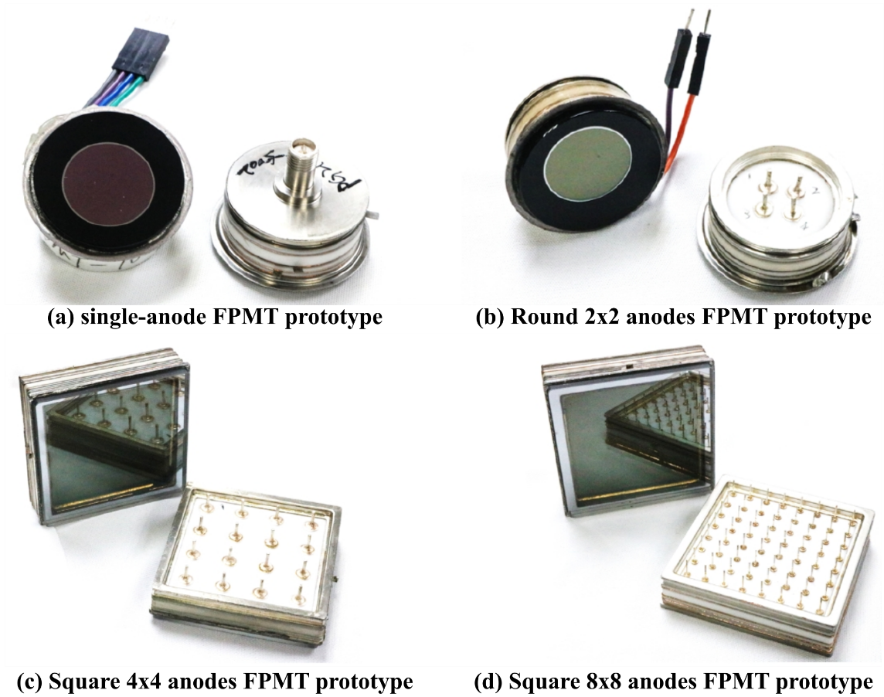
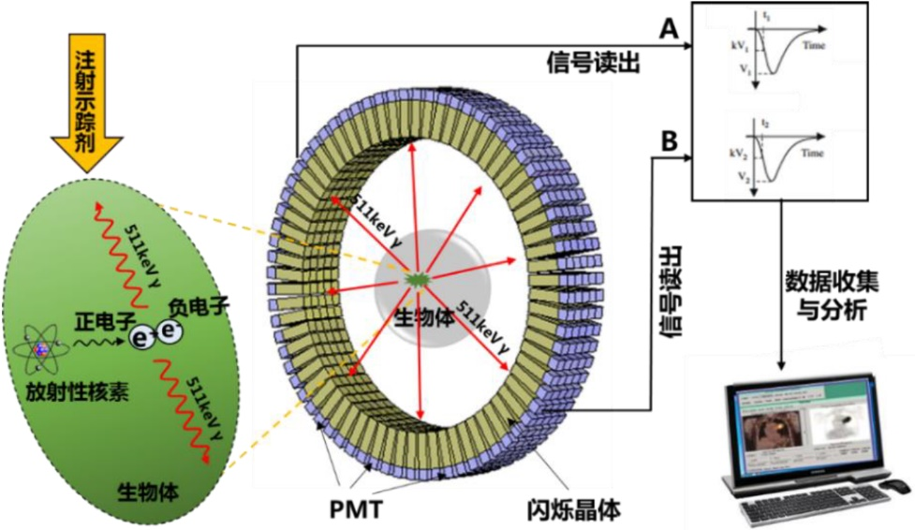
Background
Prototype of the FPMT (Designed by IHEP)
Structure of the TOF-PET system
The FPMT has single photon detection capability and great time resolution (76 ps for single photoelectron and 15 ps for multi photoelectrons).
The FPMROC (FPMT Readout Chip) is mainly composed by Pre-Amplifier, Discriminator, TDC and Serializer.
Block diagram of the FPMROC
wzhang@wtu.edu.cn

Slide 4
TDC Architecture
Parameter | Value
Process | SMIC 55 nm
TOA resolution | < 15 ps (LSB)
TOA range | 0.5 ns~24.5 ns
TOT resolution | < 15 ps
TOT range | 0.3~2 ns
TOA INL/DNL | < 1 LSB
TOT INL/DNL | < 1 LSB
Dead time | 25 ns
TOA/TOT precision | <8 ps
Power consumption | 30 mW/ch
Output data width | 32-bit
FPMROC TDC Architecture
The FPMROC TDC consists of Controller, Delay Line and Encoder.
The Controller receives the Pulse that comes from the discriminator and 40 MHz clock (CLK40M) then generates the control signals (latch_clk, tot_clk etc) for the Delay Line and Encoder.
The Delay Line is made up of fine time part and coarse time part. The fine time part is composed by 11 differential delay cells with interpolator and the coarse time part consists of the two ripple counters.
The Encoder converts the Delay Line raw data (fine time and coarse time) into binary code.
wzhang@wtu.edu.cn

Slide 5
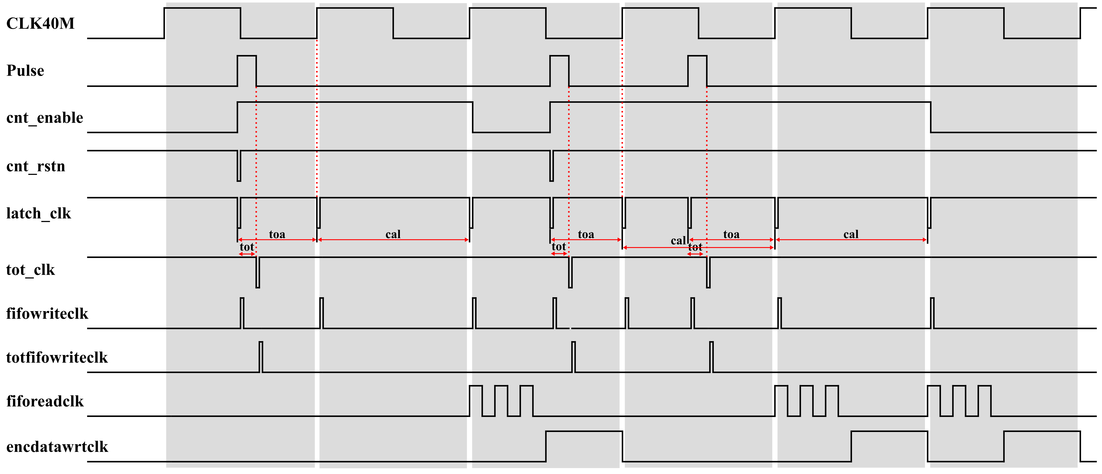
TDC Timing
FPMROC TDC timing
The gray area denotes the measurement window that is about 25 ns.
Using CLK40M system clock calibrates the delay line bin size due to the PVT variation.
wzhang@wtu.edu.cn

Slide 6
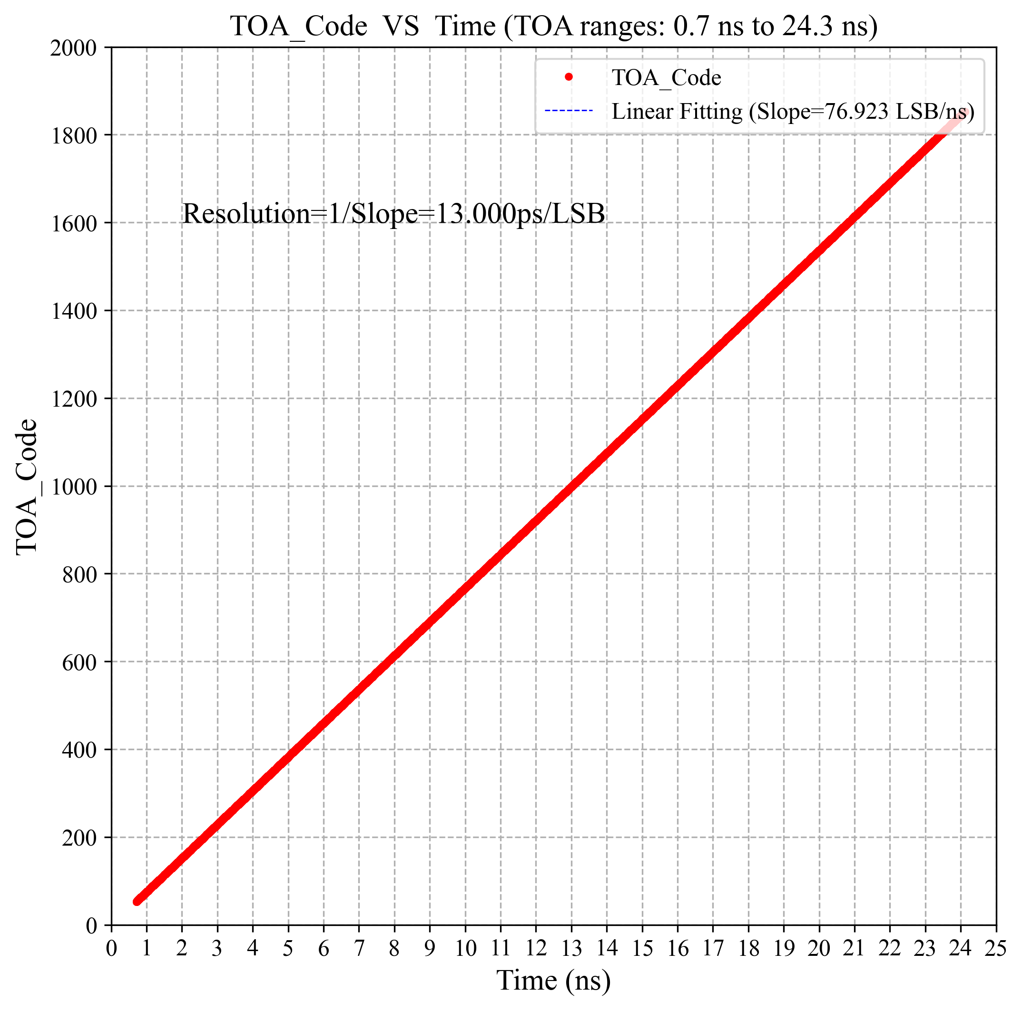
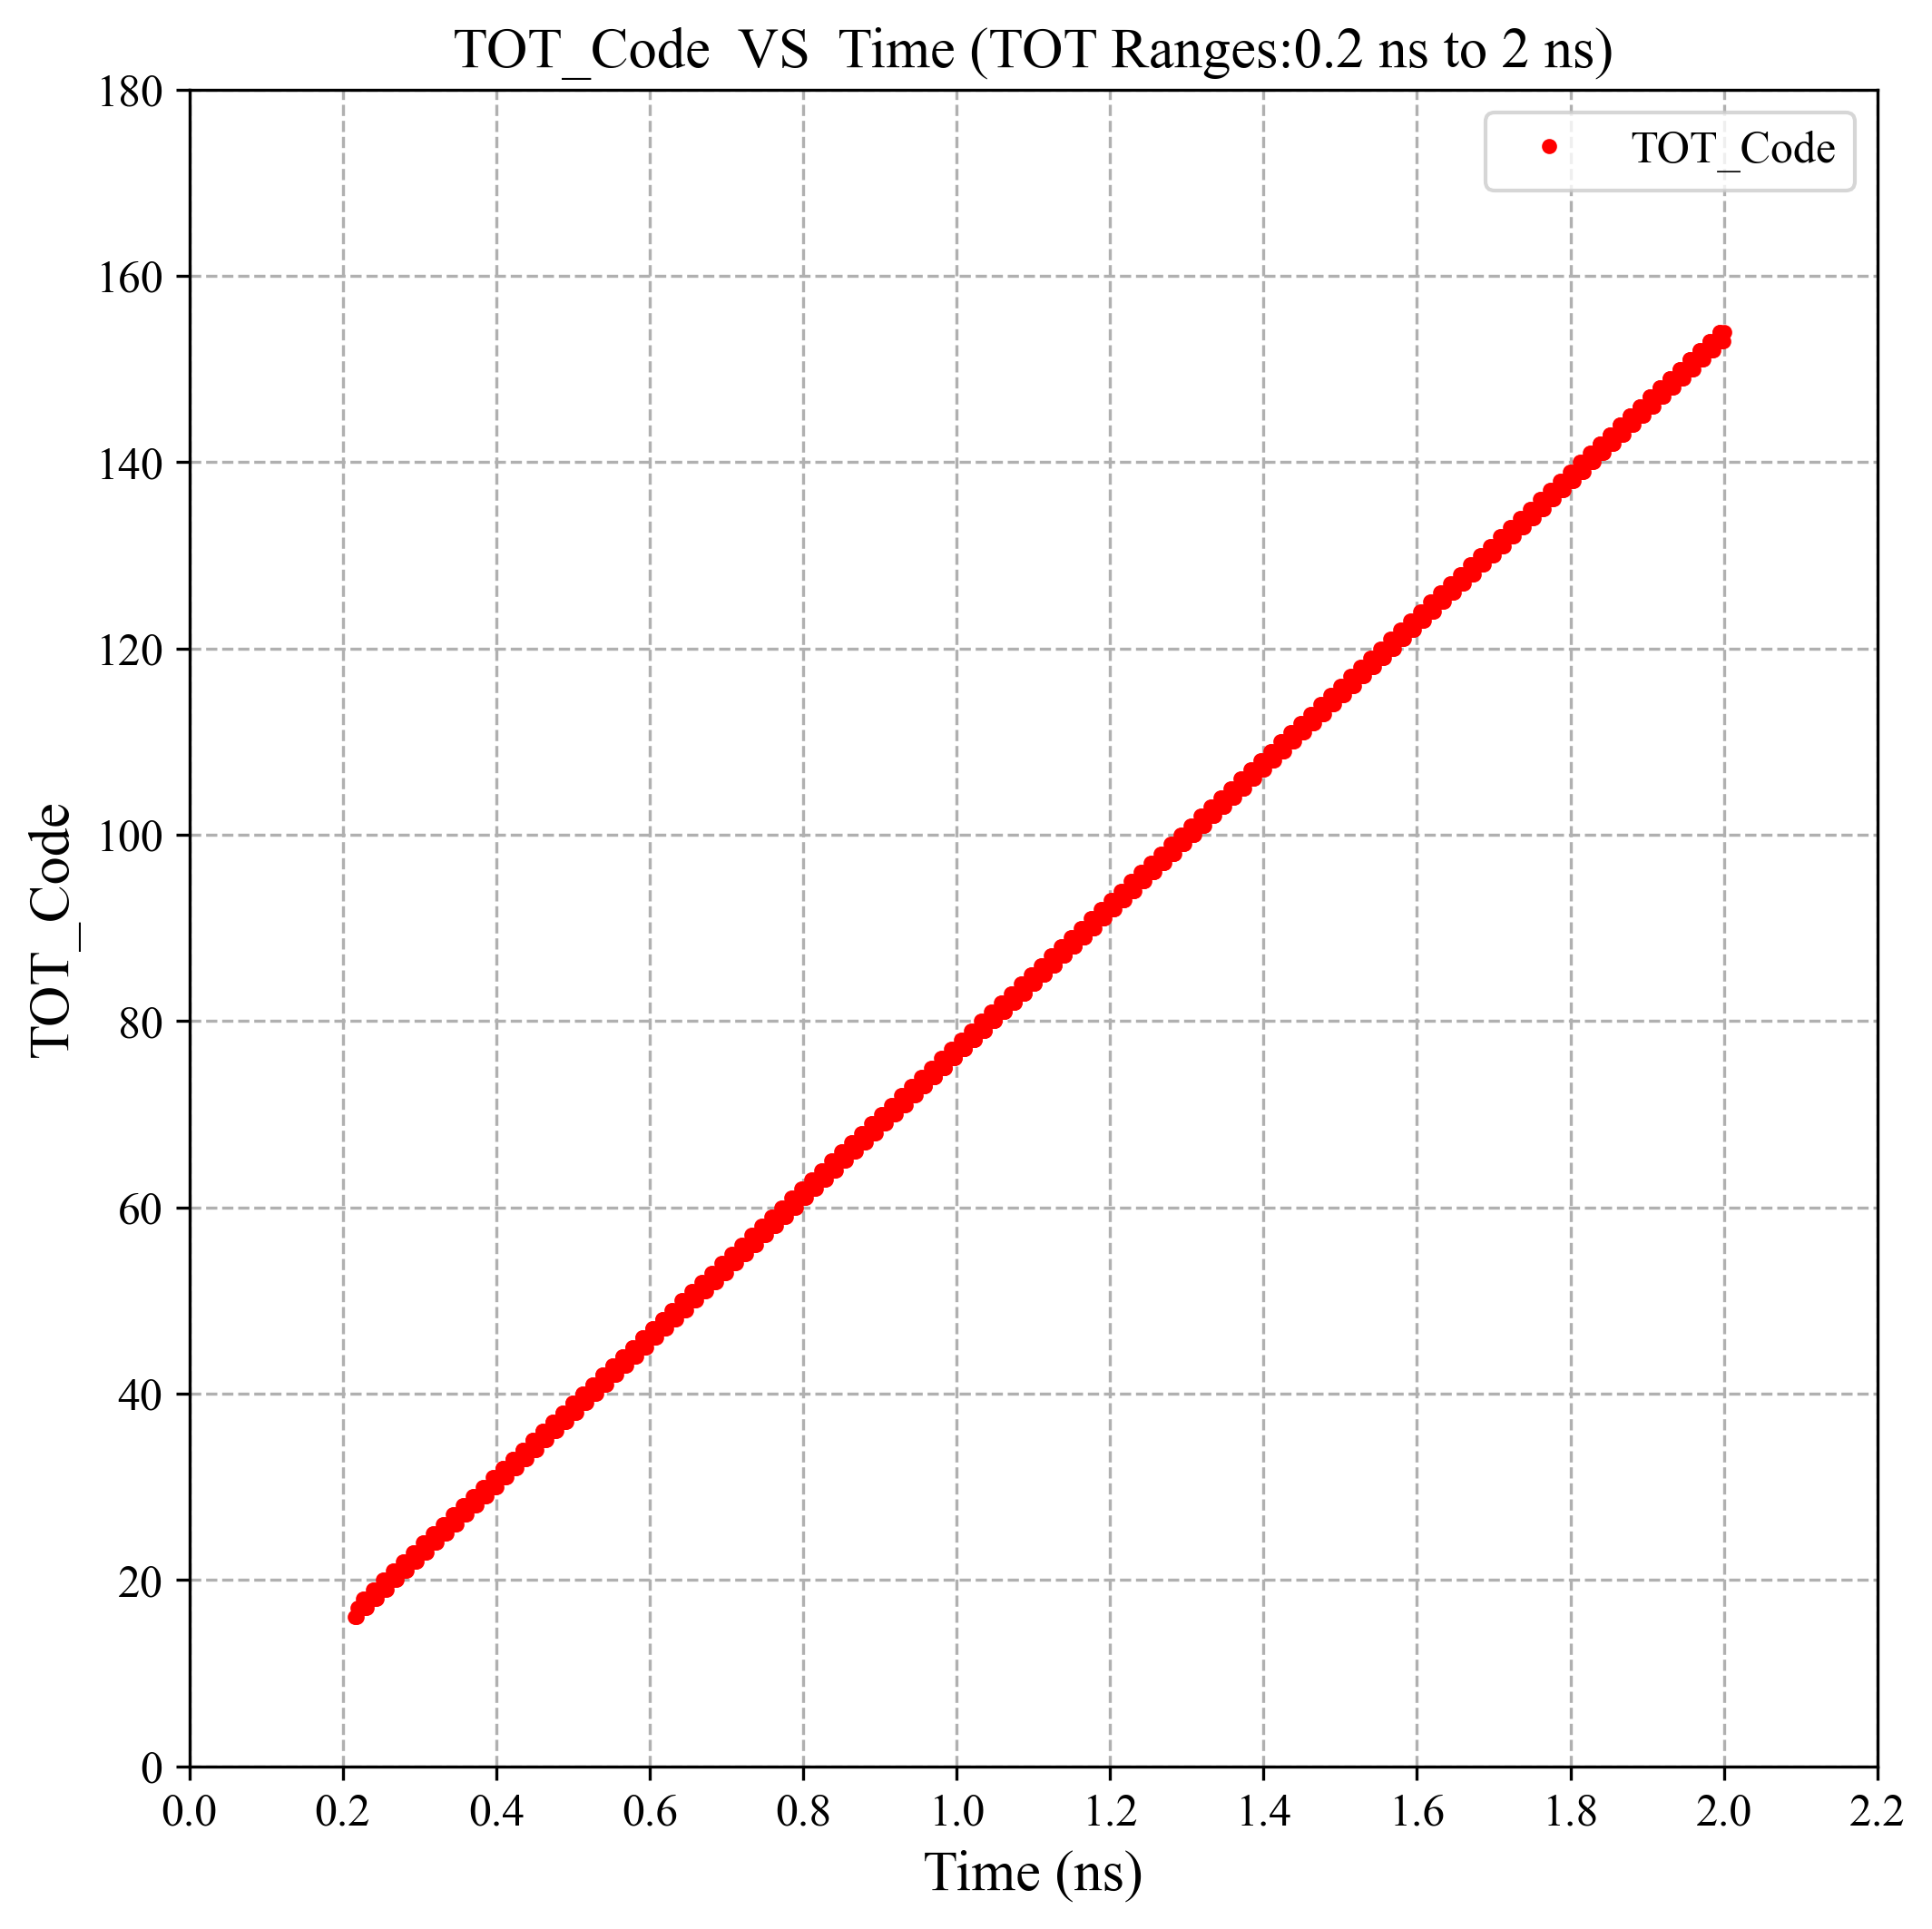
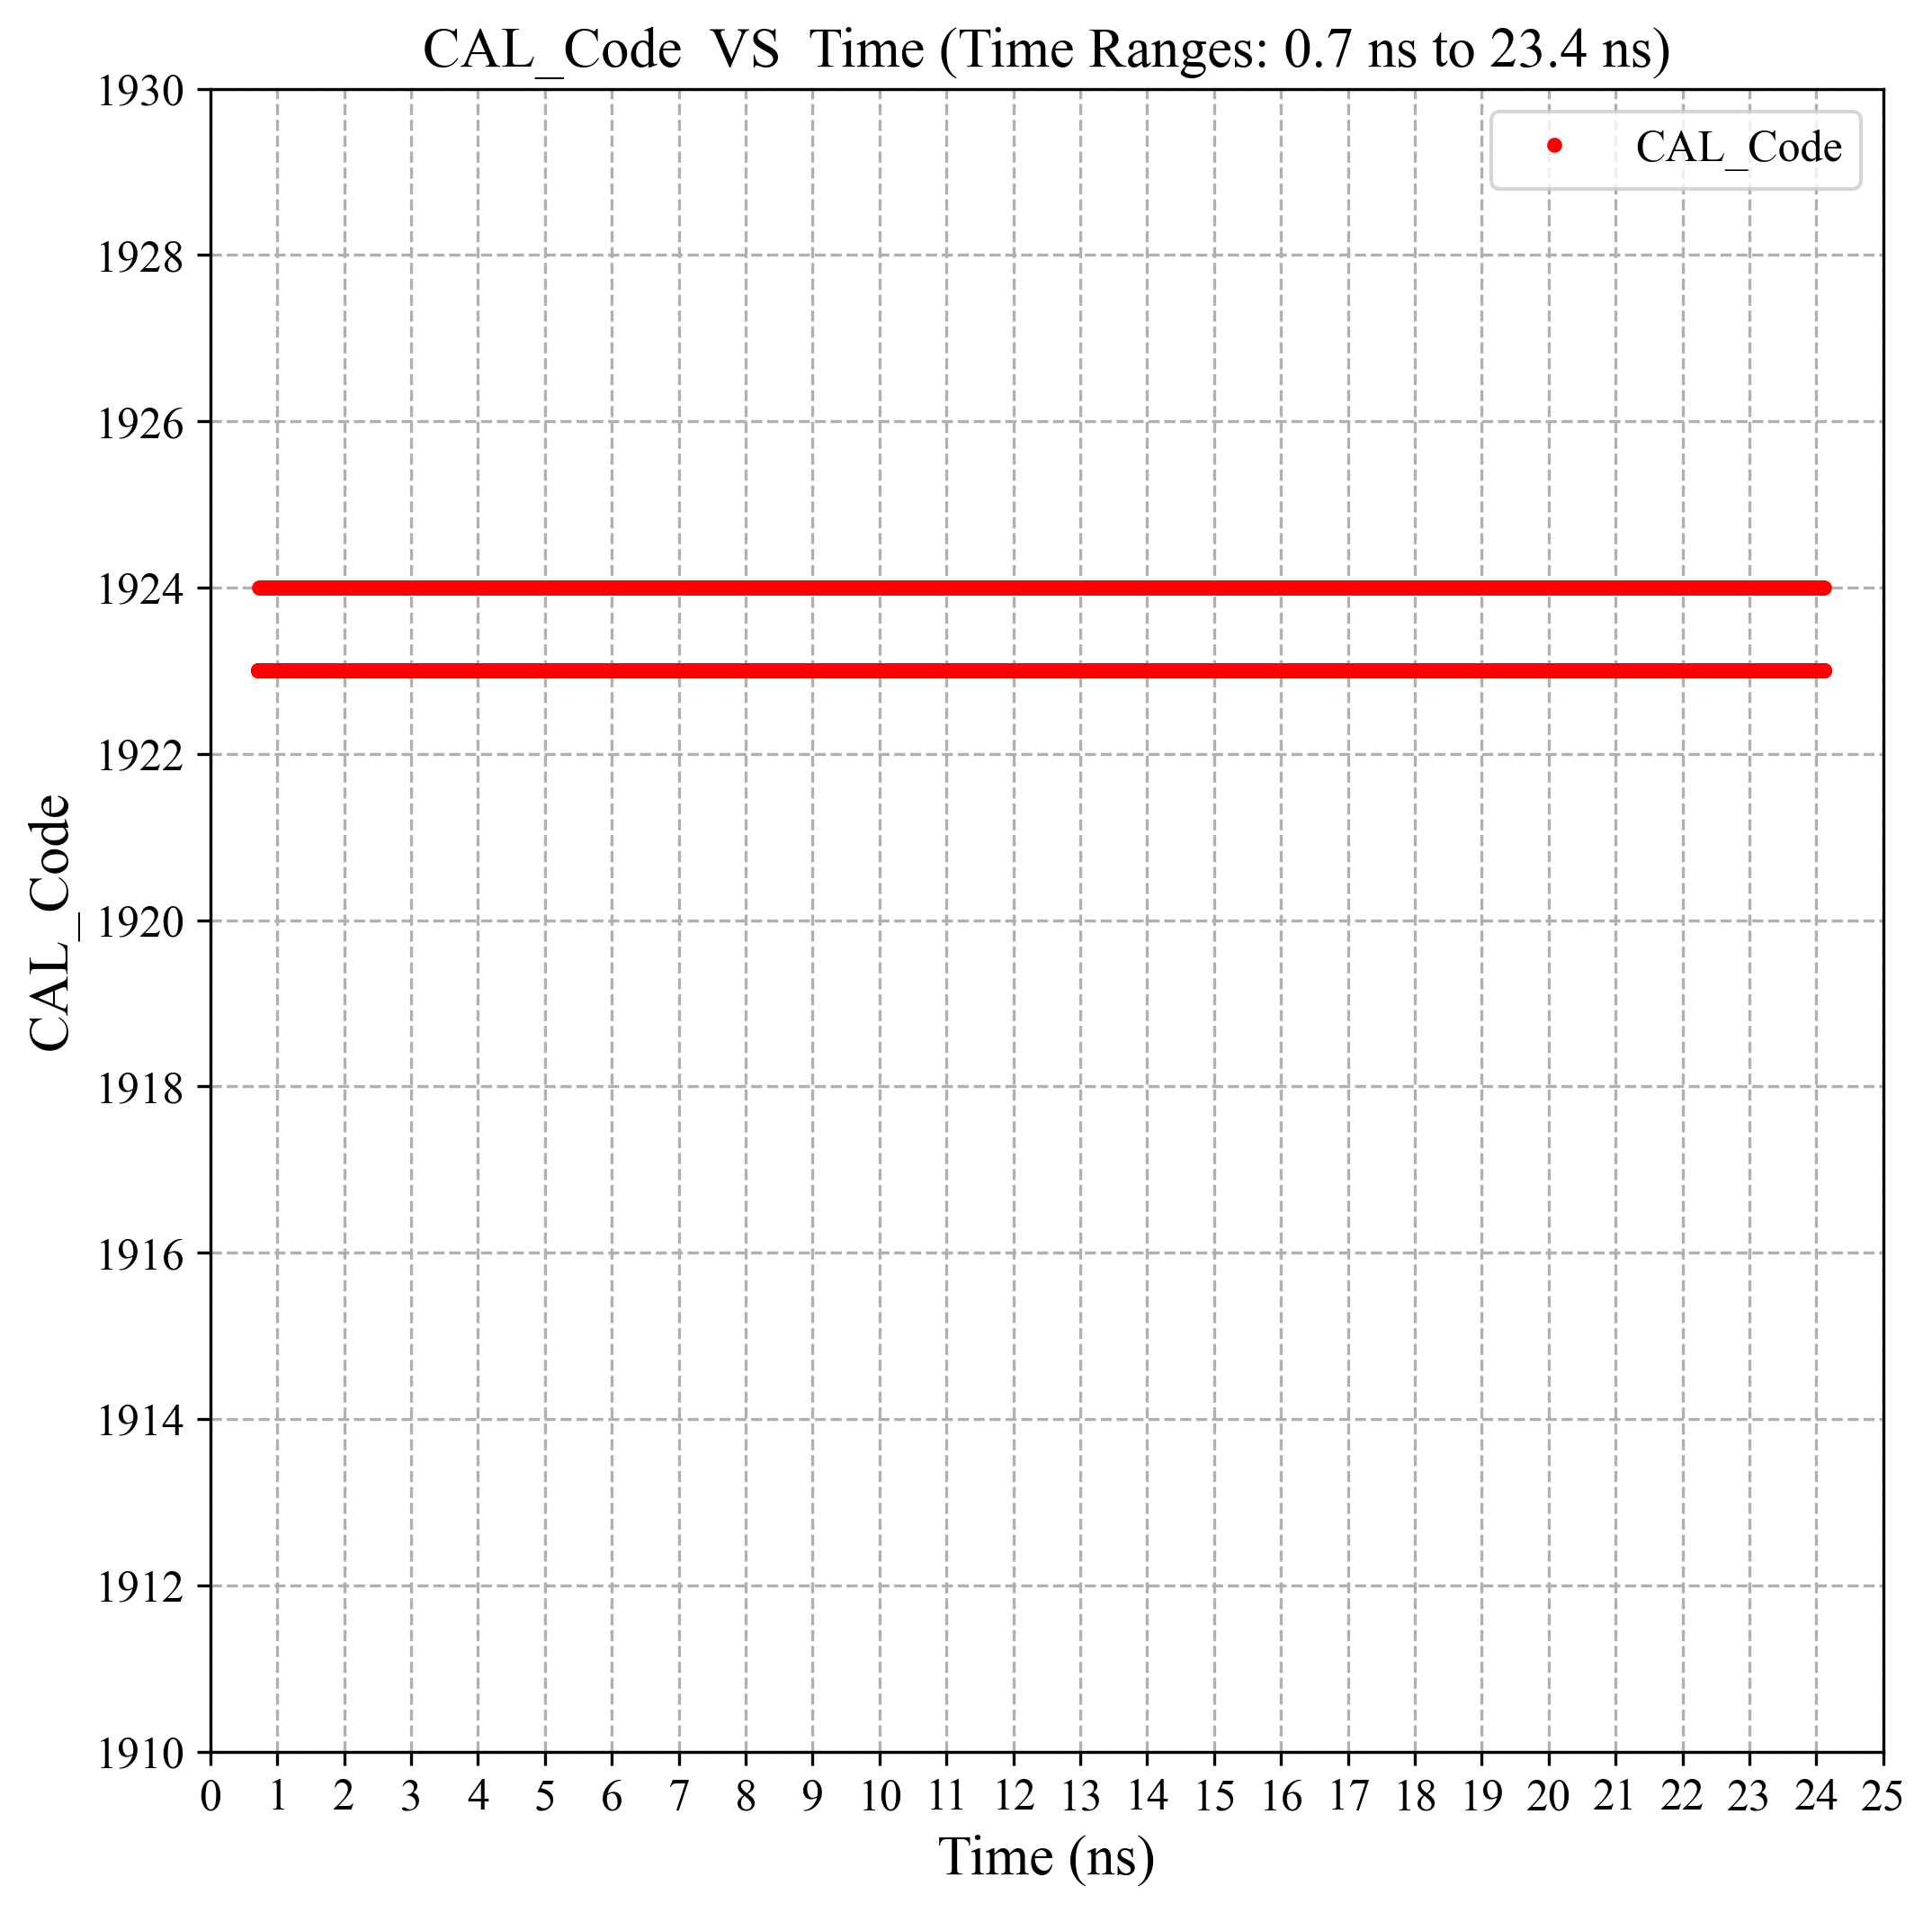
TDC Behavioral Model
TDC Behavioral model simulation results
TOA code vs Time
TOT code vs Time
CAL code vs Time
wzhang@wtu.edu.cn

Slide 7
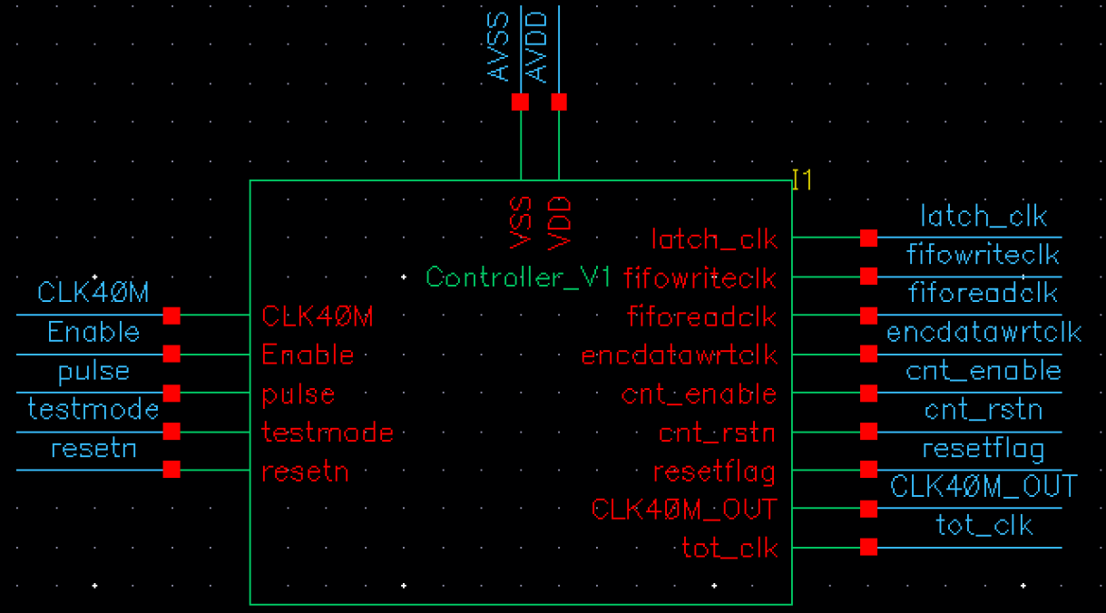
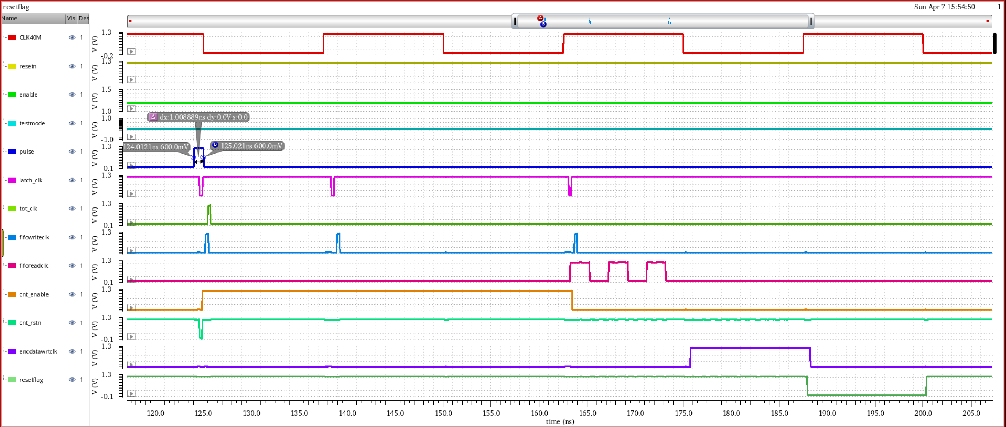
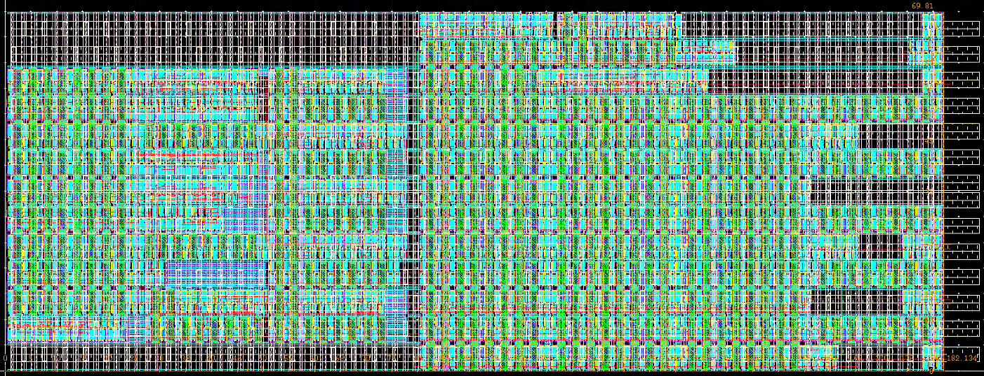
TDC Controller Design
Schematic of the TDC Controller
Layout of the TDC Controller
TDC Controller simulation results
Using basic logic components to realize the Controller via analog method.
The toa ranges from 0.7 ns to 24.3 ns under all corners (SS_1V08_0C, TT_1V20_27C and FF_1V32_85C) and the tot ranges from 0.2 ns to 2 ns.
The TDC Controller simulation results have demonstrated that the function and performance of the Controller meet the requirement.
wzhang@wtu.edu.cn

Slide 8
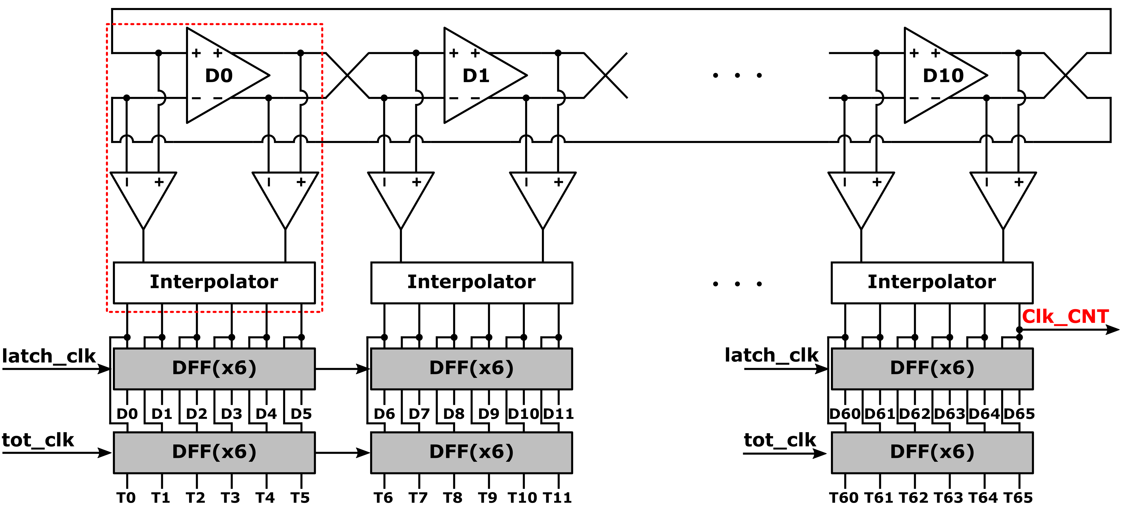
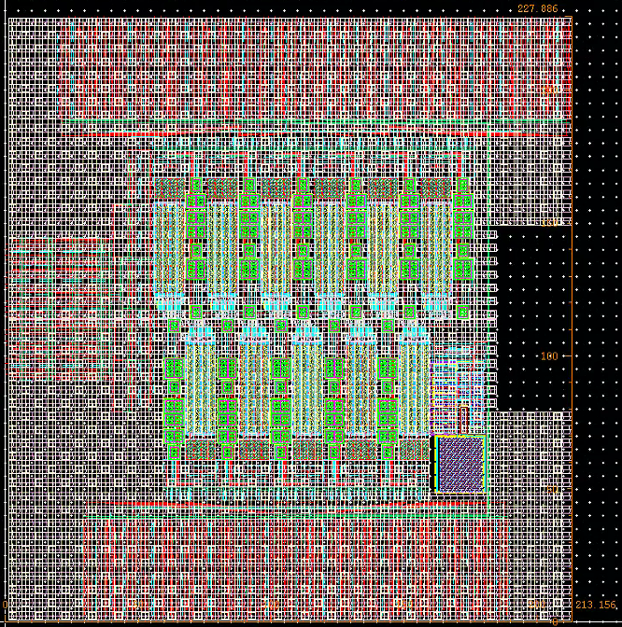
TDC Delay Line Design
Block diagram of the Differential Delay Line
Layout of the Delay Line
The bin size of the Delay Line with interpolator is about 12.4 ps at nominal corner.
Differential Delay Line simulation results
wzhang@wtu.edu.cn

Slide 9
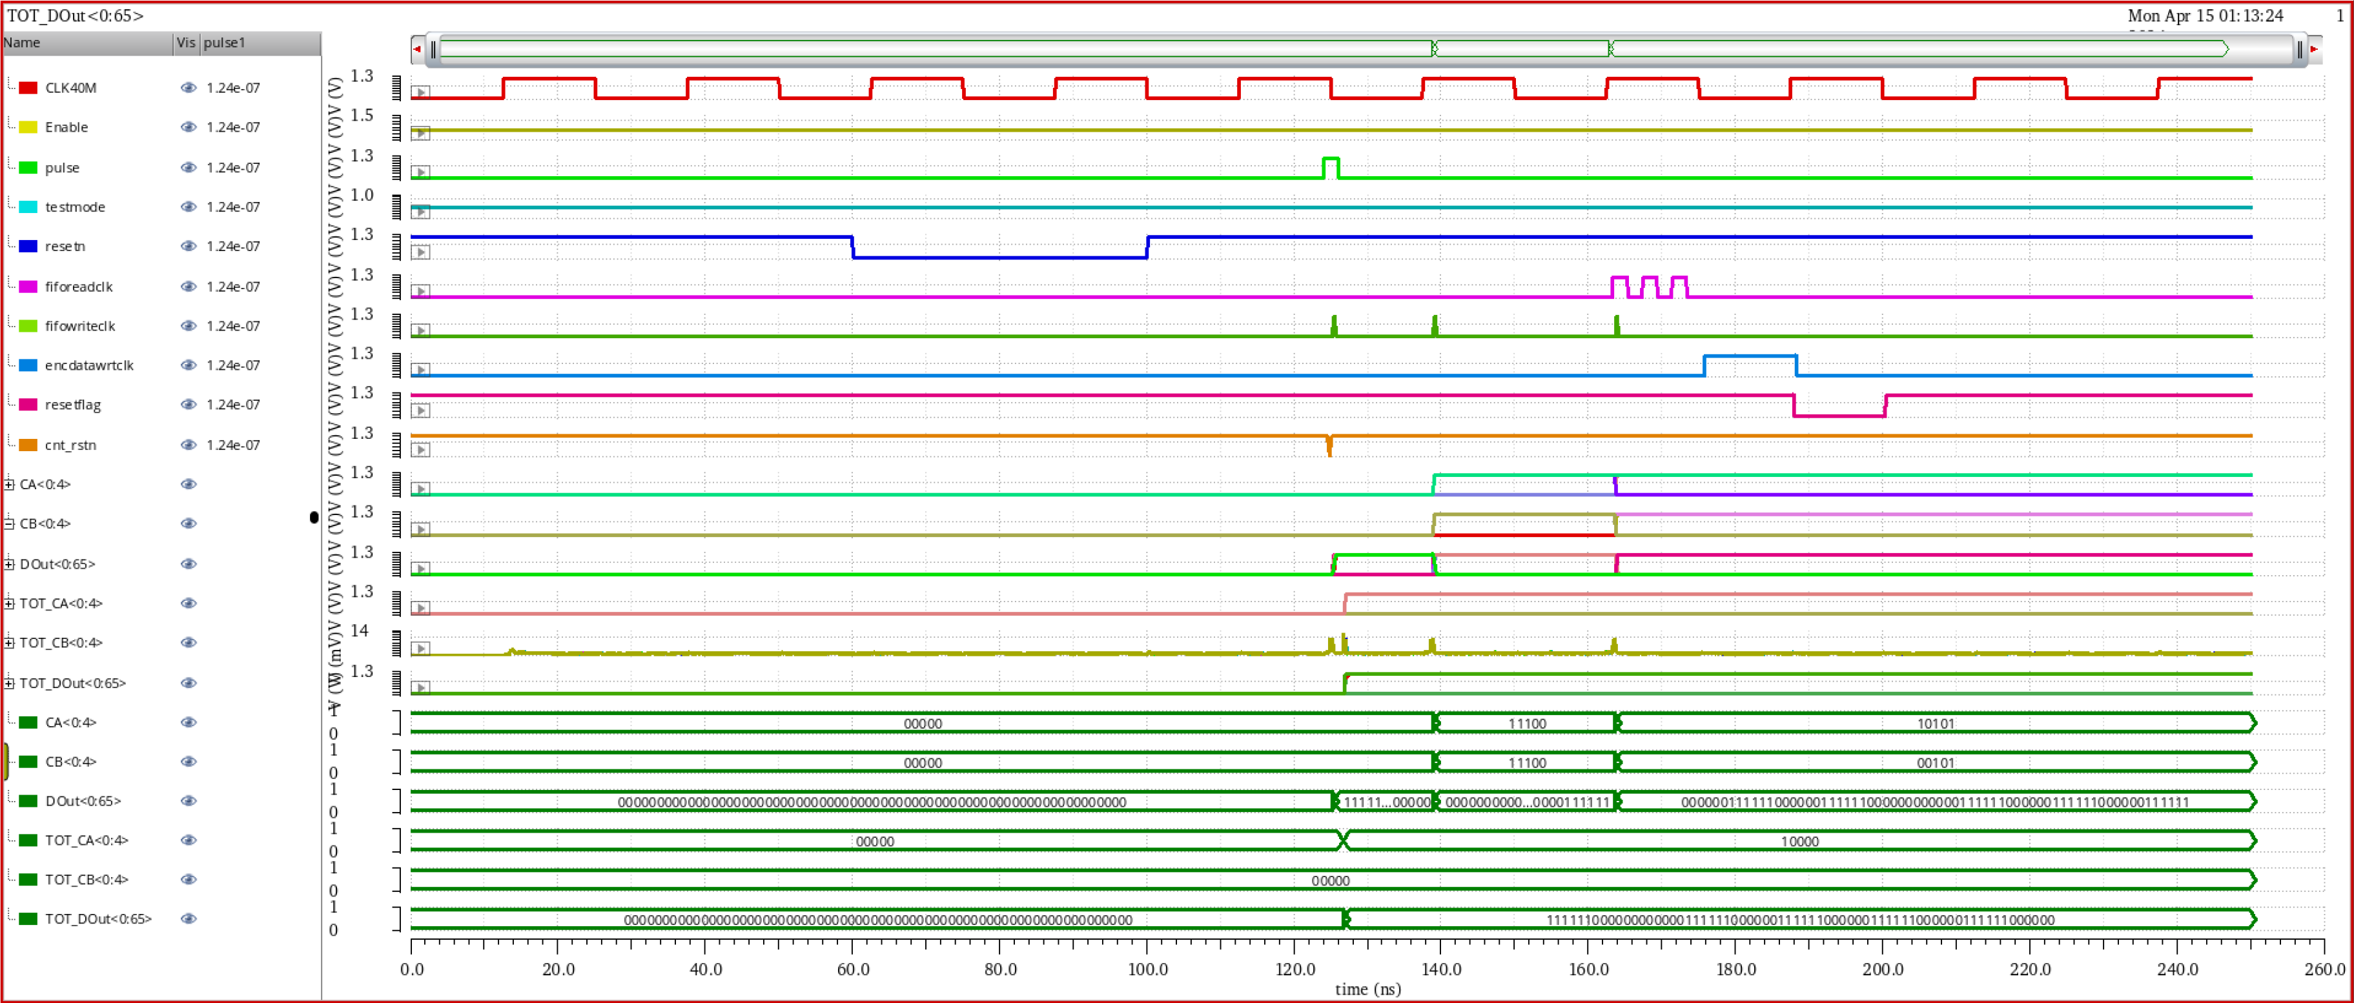
TDC Controller Delay Line Simulation results
TDC Controller and Delay Line Simulation results
wzhang@wtu.edu.cn

Slide 10
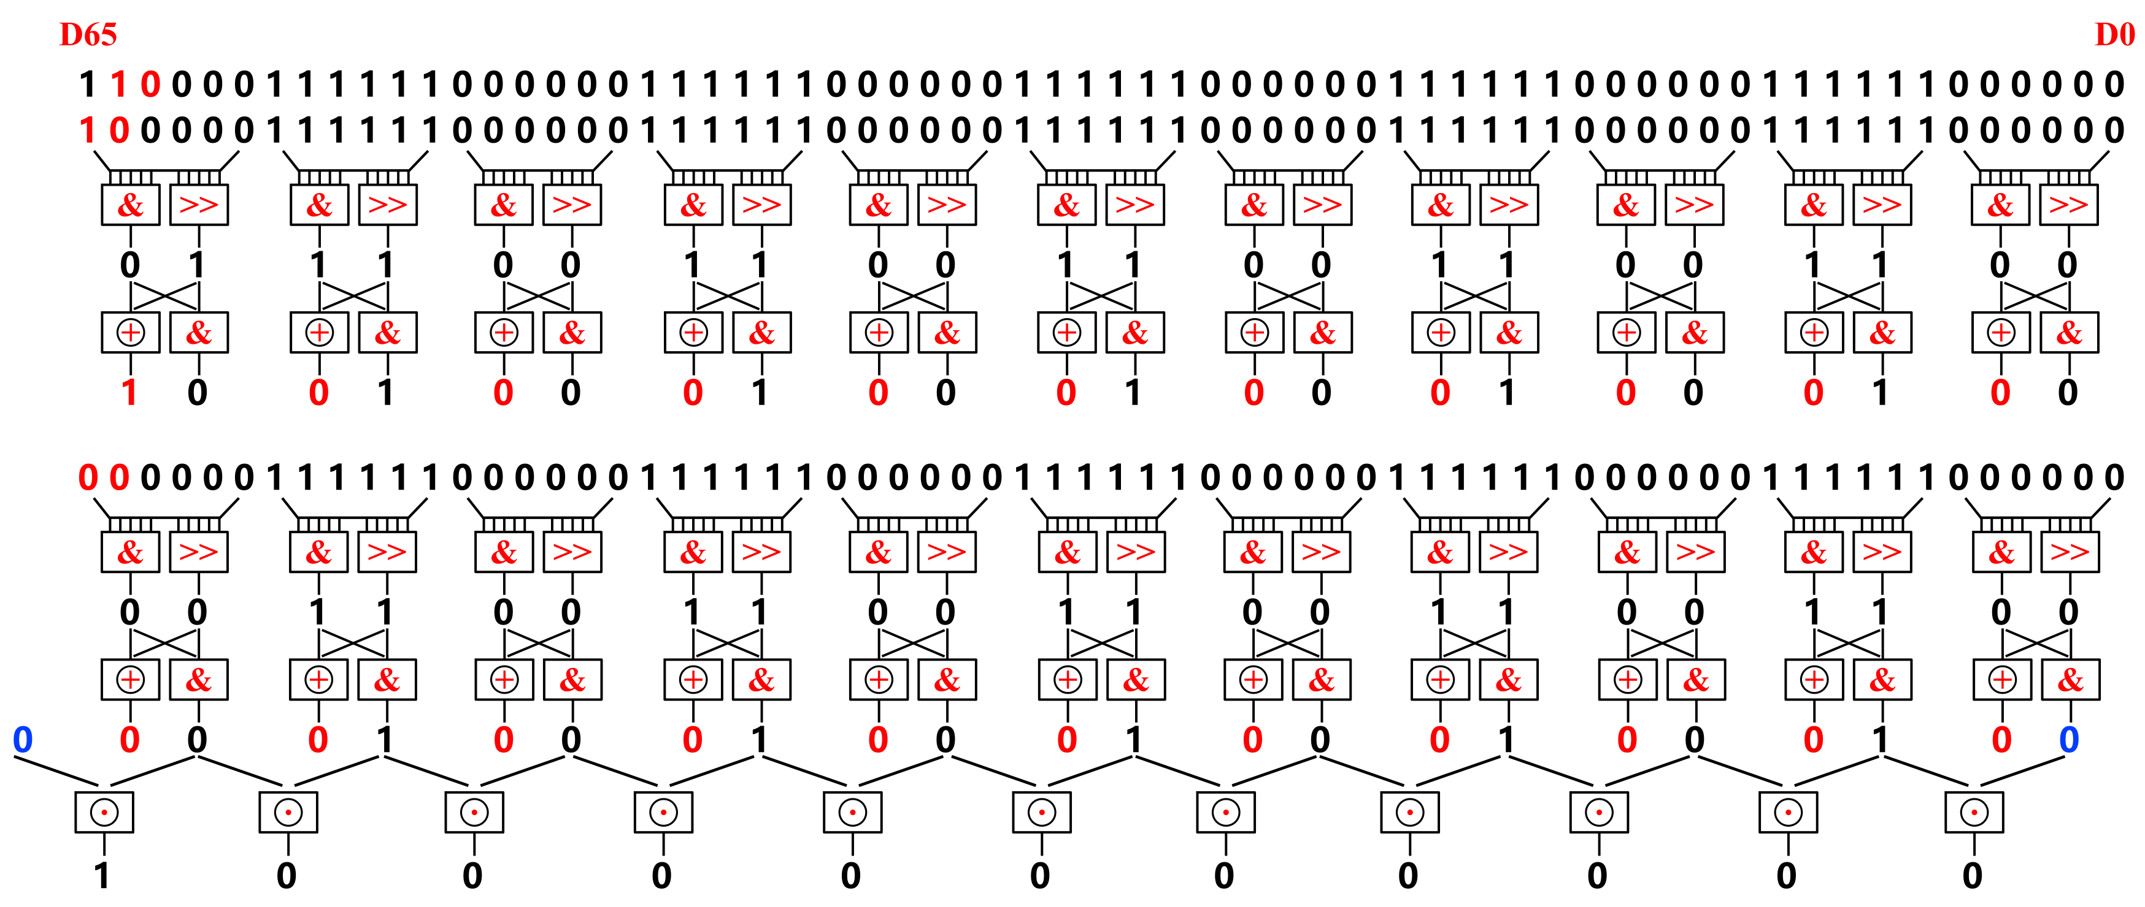
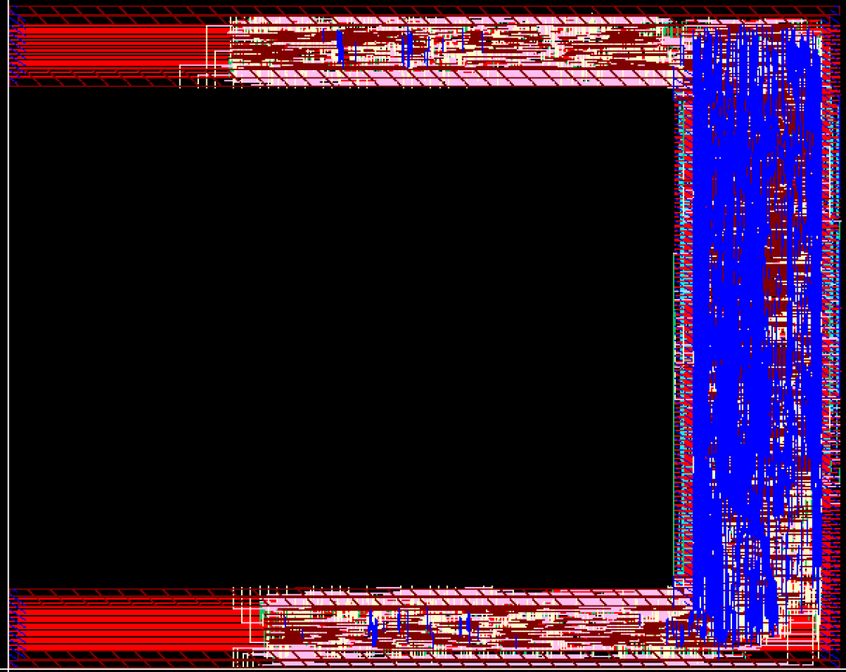
TDC Encoder Design
Schematic of the coarse time counter
Fine time encode logic
$$\begin{aligned}&TOA_code\left[11:0\right]=\left\{\begin{aligned}&CA\left[4:0\right]×132+Data_out\left[6:0\right]+D\left[0\right]×66 \left(D\left[0\right]=1\right) \\ &CB\left[4:0\right]×132+Data_out\left[6:0\right]+D[0]×66 \left(D\left[0\right]=0\right)\end{aligned}\right.\end{aligned}$$
The layout of the Encoder is a U-shape that was generated by digital flow.
The function of the Encoder logic has been fully verified using TDC behavioral model.
Layout of the Encoder
wzhang@wtu.edu.cn

Slide 11
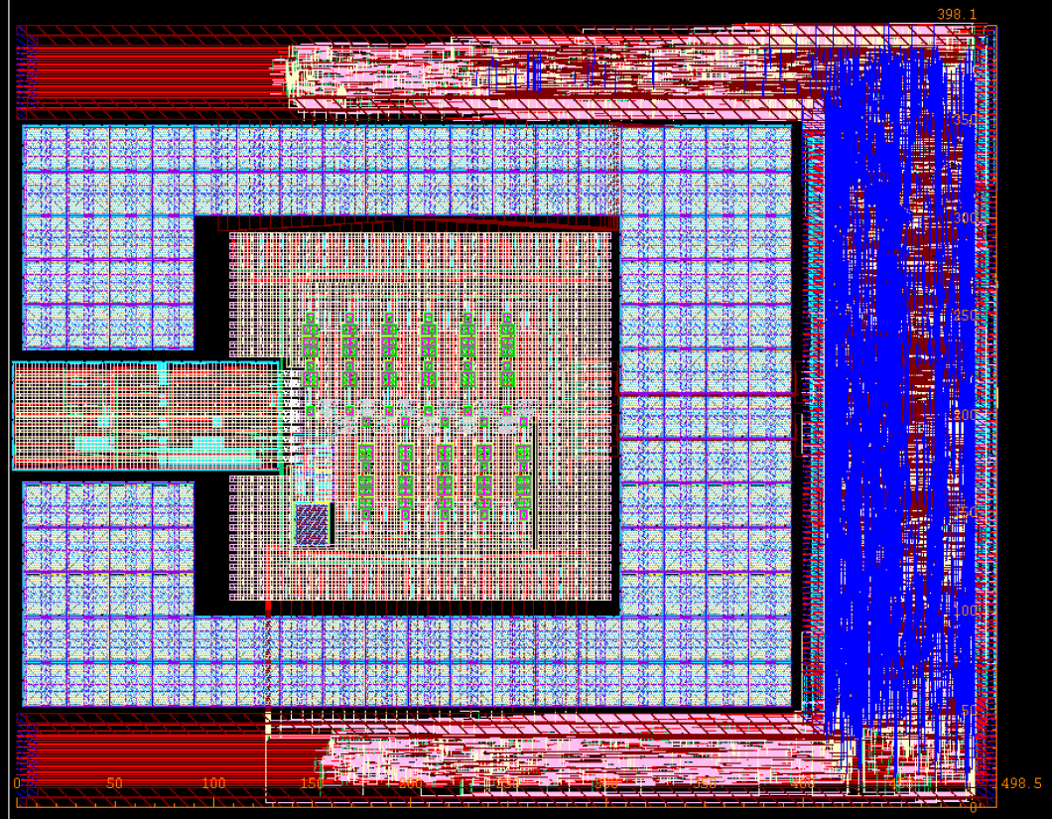
FPMROC TDC
Layout of FPMROC TDC
The power consumption of the FPMROC TDC is about 25.6 mW at nominal corner based on post-layout simulation.
In order to reduce interference between power supplies, we separate the analog and digital part for power supply.
wzhang@wtu.edu.cn

Slide 12
Summary
We have already finished the design of the TDC and further verification is ongoing.
The time resolution (bin size) is about 12.4 ps (post layout simulation).
The TOA ranges from 0.7 ns to 24.3 ns and the TOT ranges from 0.2 ns to 2 ns under all corners.
The FPMROC chip (eight full-function test channels ) and FPMROC TDC Chip (Front-end circuit and TDC test blocks) will be tapped out in July, 2024.
wzhang@wtu.edu.cn

