Slide 1
Introduction to VMM
Feng Li
State Key Laboratory of Particle Detection and Electronics
Depart of Modern Physics, University of Science & Technology of China
Acknowledgment
Gianluigi De Geronimo
DG Circuits Consulting, Stony Brook University, University of Michigan
Shanghai, CHEP2018

Slide 2
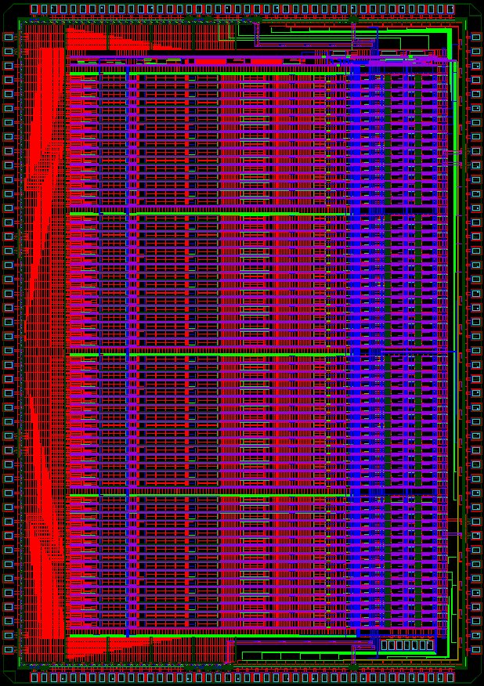
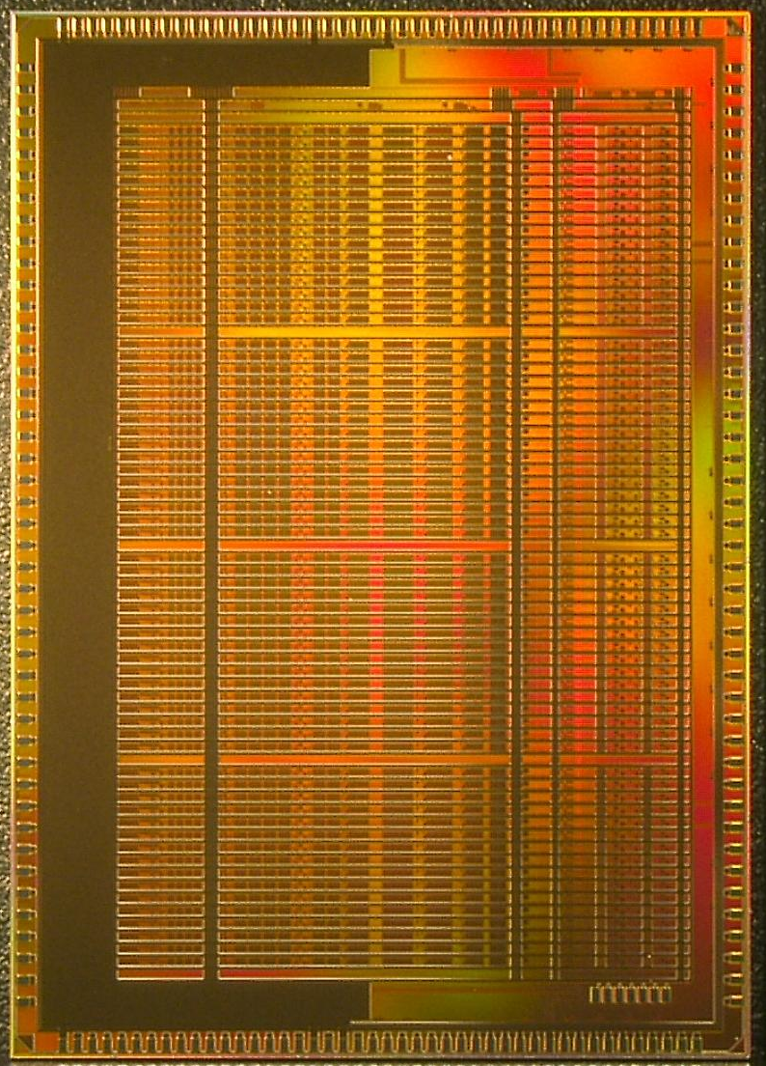
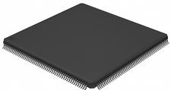
VMM ASIC family
VMM: ASIC family for ATLAS Muon Spectrometer upgrade (Micromegas and Thin Gap Chamber)
  VMM1
  VMM2
  VMM3
VMM1
AR

Slide 3



VMM1
An ASIC for Micropattern Detectors

Slide 4
Architecture of VMM1
neighbor
logic
direct timing (ToT or TtP)
or
real time address (ART)
CA
shaper
peak
mux
amplitude
time
mux
mux
timing
addr
mux
address
64 channels
logic
dual polarity, adj. gain (0.5, 1, 3, 9 mV/fC) (0.11 to 2 pC), adj. peaktime (25-200 ns)
discriminator with sub-hysteresis and neighboring (channel and chip)
address of first event in real time at dedicated output (ART)
direct timing outputs: time-over-threshold or time-to-peak
peak detector, time detector <1 ns
multiplexing with sparse readout and smart token passing (channel and chip)
threshold and pulse generators, analog monitors, channel mask, temperature sensor, 600mV BGR, 600mV LVDS
power 4.5 mW/ch, size 6 x 8.4 mm², process IBM CMOS 130nm 1.2V
CA

Slide 5
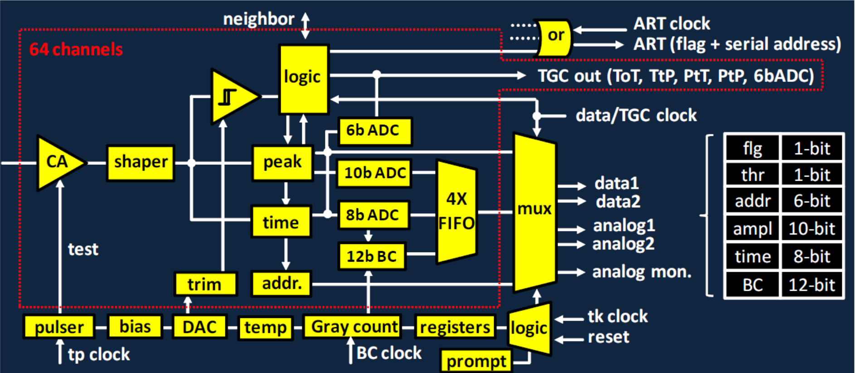
Architecture of VMM2

Slide 6
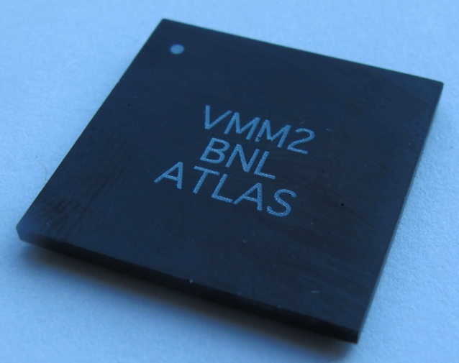
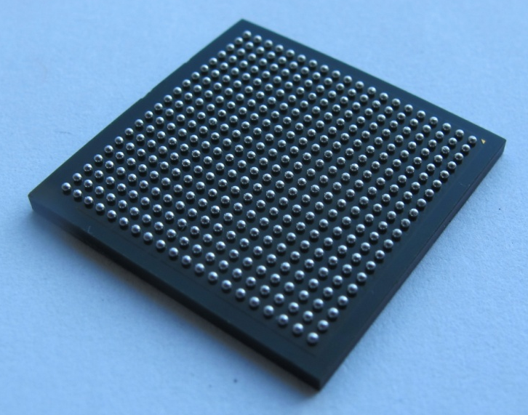

Packaging of VMM2
custom BGA package
21 x 21 mm², 400-pin, 1 mm pitch

Slide 7
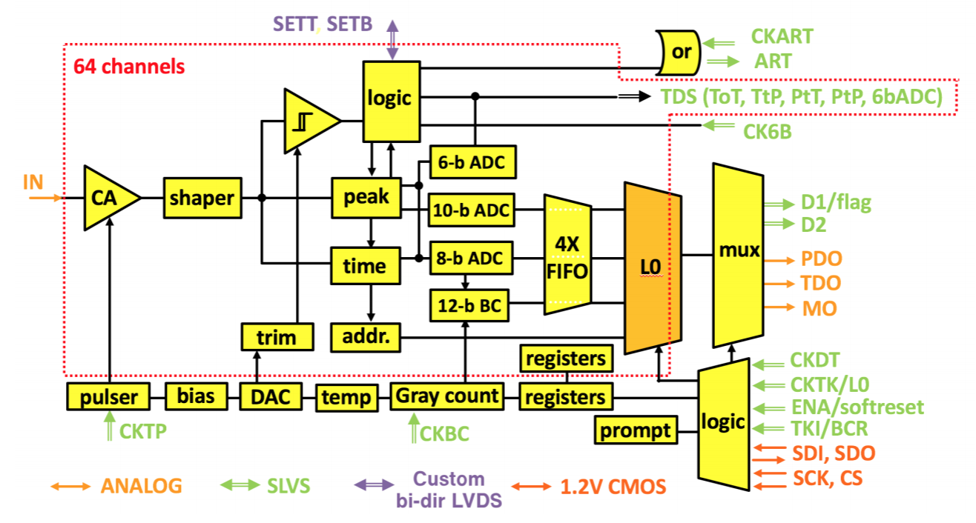
Architecture of VMM3

Slide 8
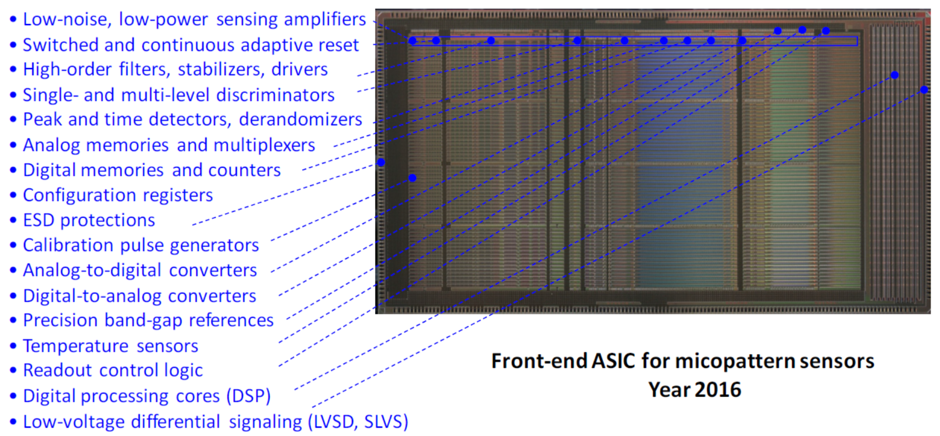

Slide 9
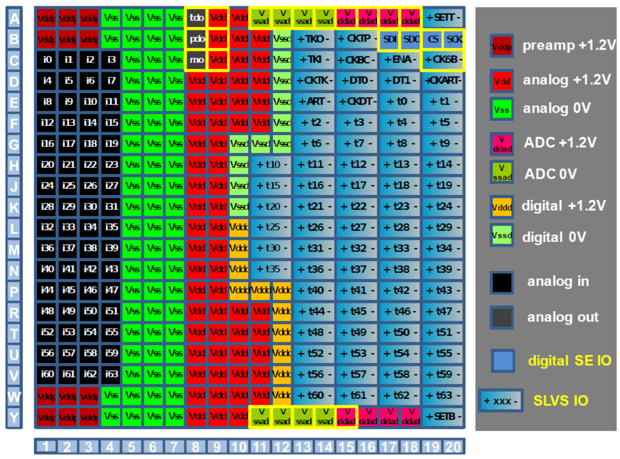
Packaging of VMM3

Slide 10
VMM3
Attenuation Networks (π-Networks)
V_{DDP}
V_{DDP}
bias
bias
R_{P1} ≈ 300 kΩ, R_{P2} ≈ 300 kΩ
C_{P} ≈ C_{PAD}/2 or 100pF 10V
Attenuation 1/3, can be adjusted
No attenuation → only R_{P1}=100kΩ
R_{P2}
R_{P1}
C_{P}
PAD
VMM3
attenuation C_{P}/(C_{P}+C_{PAD})
V_{DDP}
V_{DDP}
R_{S1} ≈ 300 kΩ, R_{S2} ≈ 300 kΩ
C_{S} > 100pF 10V
Small attenuation, or none
Beware of inter-strip coupling
No attenuation → only R_{S1}=100kΩ
R_{S2}
R_{S1}
C_{S}
STRIP
VMM3
C_{w}
R_{W1} ≈ 1 MΩ, R_{W2} ≈ 300 kΩ
C_{WG} ≈ 1nF 10V, C_{W} ≈ 200pF 10V
Attenuation 1/6, can be adjusted
C_{WG} keeps wire impedance low
Controlled termination possible
No attenuation → only R_{W1}=300kΩ
WIRES
(ac-coupled)
VMM3
C_{WG}
R_{W2}
R_{W1}
grounding
(& termination)
  G. De Geronimo

Slide 11
Problem on VMM3
Higher gain, higher baseline
Oscillation observed, probably caused by the π-Networks of FEB channels and the POWER Vddad of VMM3.

Slide 12
Thanks!

Slide 13

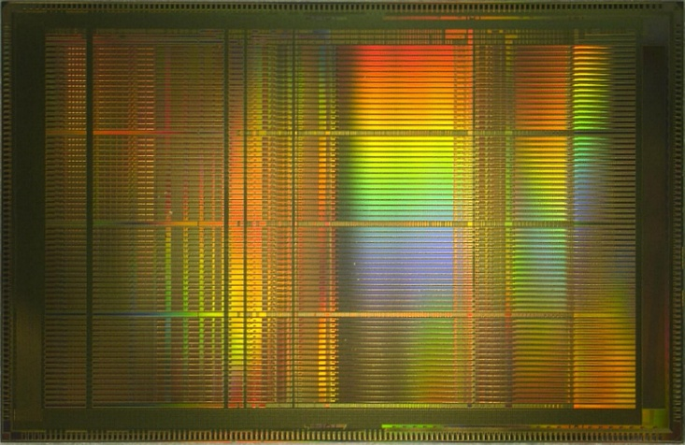
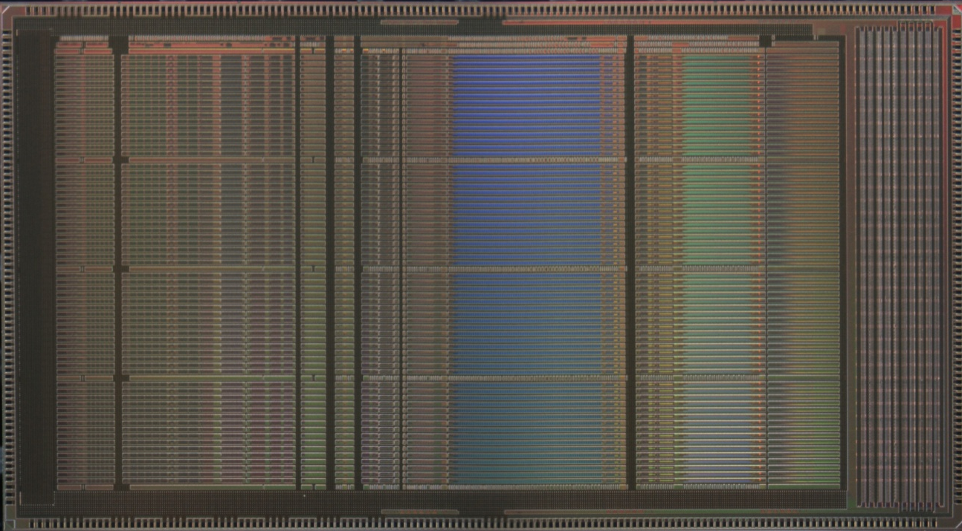
Path Towards VMM
VMM1
2011-12
50 mm²
500k FETs
(8k/ch.)
VMM2
2013-14
115 mm²
5M FETs
(80k/ch.)
VMM3
2015-16
130 mm²
10M FETs
(160k/ch.)
mixed-signal
2-phase readout
peak and timing
neighboring
sub-hysteresis
few timing outputs
mixed signal
continuous fully-digital readout
current-output peak detector
increased range of gains
three ADCs per channel
FIFOs, serialized data with DDR
serialized ART with DDR
additional timing modes
64 timing outputs
ITAR
additional functions and fixes
mixed signal + digital
continuous simultaneous readout
SEU-tolerant logic
deeply revised front-end for TGC
(2nF, 50pC, fast recovery, ...)
L0 handling digital core
SLVS and new config. interface
new reset control and fast reset
timing at threshold
timing ramp optimization
pulser range extension
ART synchronization
32-channel skip
additional functions and fixes

