Slide 1
MIP Calibration Parameter Check
2024/03/01
Jiaxuan Wang

Slide 2
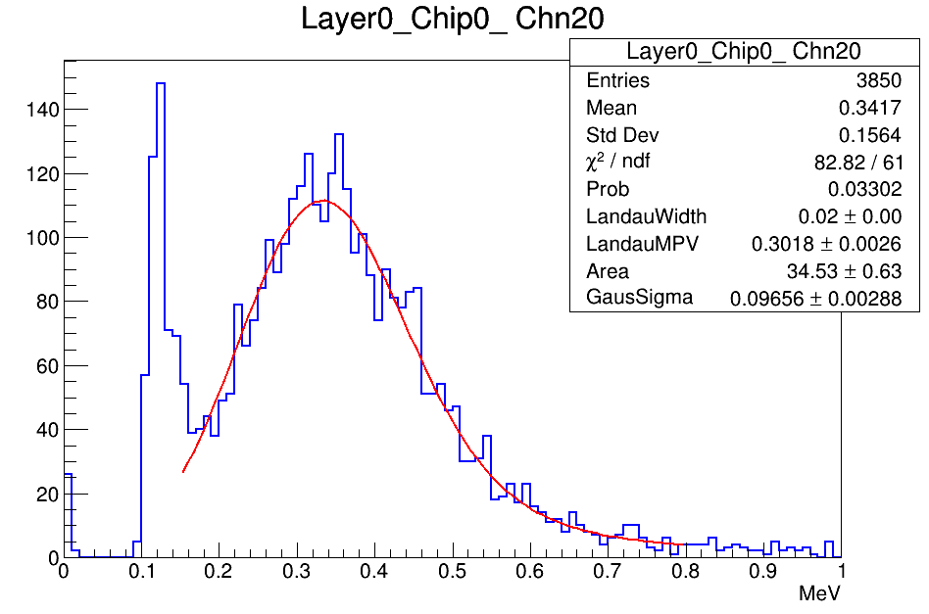
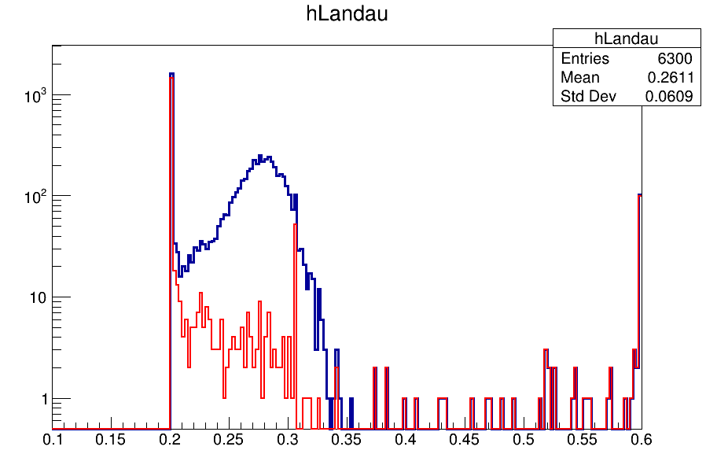
Muon Energy Reconstruction
Energy reconstruction
0.305MeV
Blue : All channels
Red : Dead Channels
Using calibrated results from muon data, the MPV of fitting function are not around 0.305MeV for muon files either

Slide 3
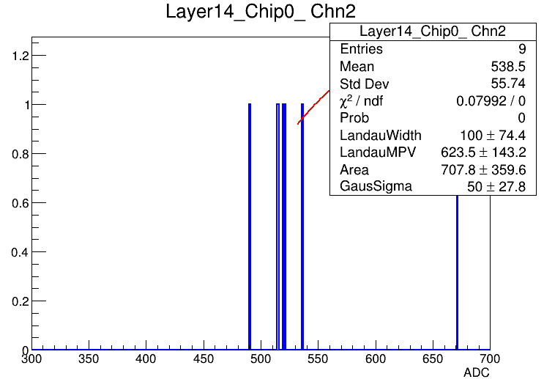
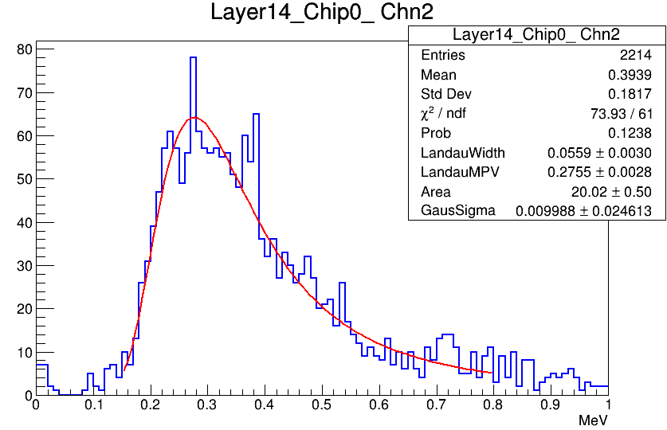
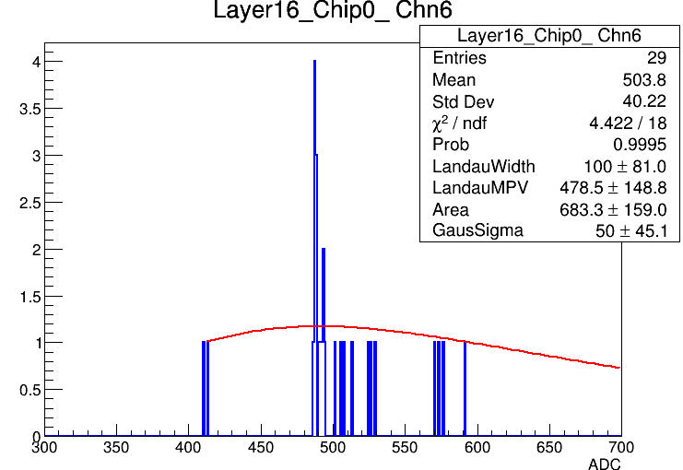
Abnormal channels check

Slide 4
Track fit method update
Old method: center of gravity method, and fit once
New method: fit multi times
Data selection : center of gravity method
To exclude the noise hit far away from real muon track(more than 10 strips far away)
First fitting:
To exclude the noise hit near the real muon track(2 strips far away)
Second fitting:
To exclude the noise not on the track
Third fitting:
Get the real track and real hits

Slide 5
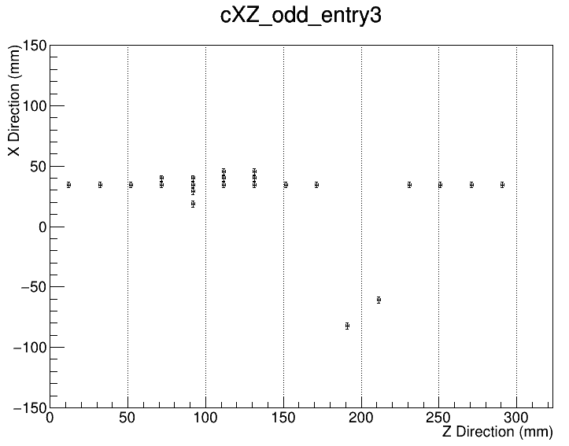
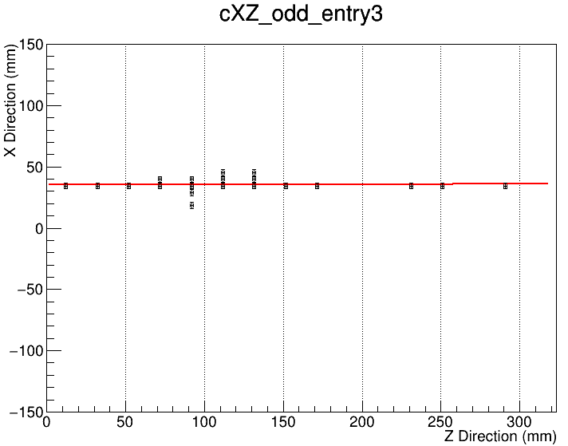
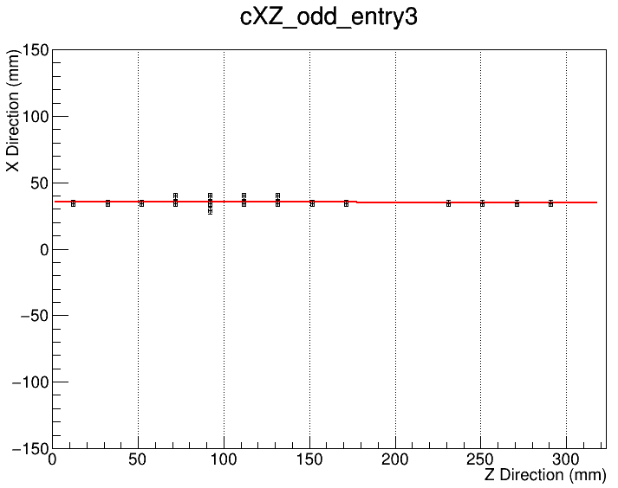
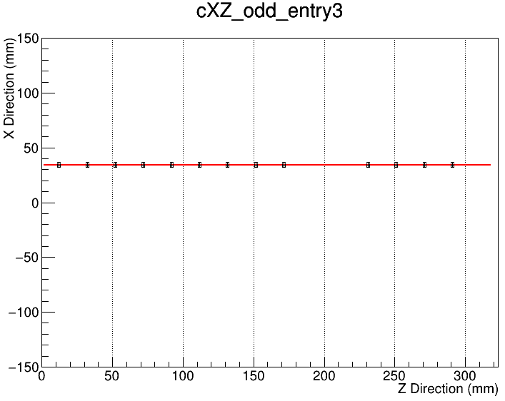
Track Fit - XZ
All hits
First fitting
Second fitting
Third fitting

Slide 6
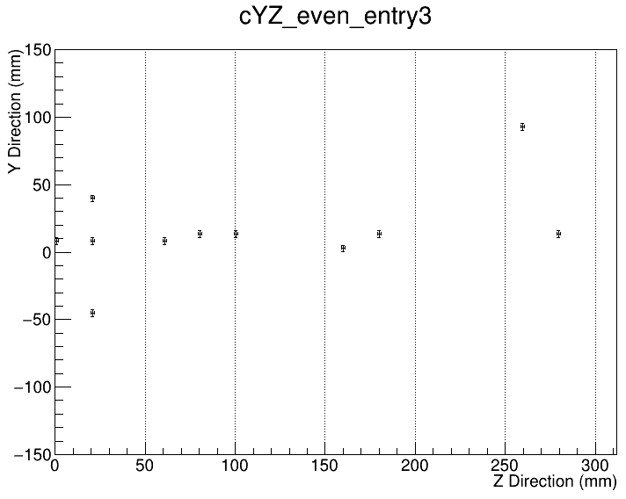
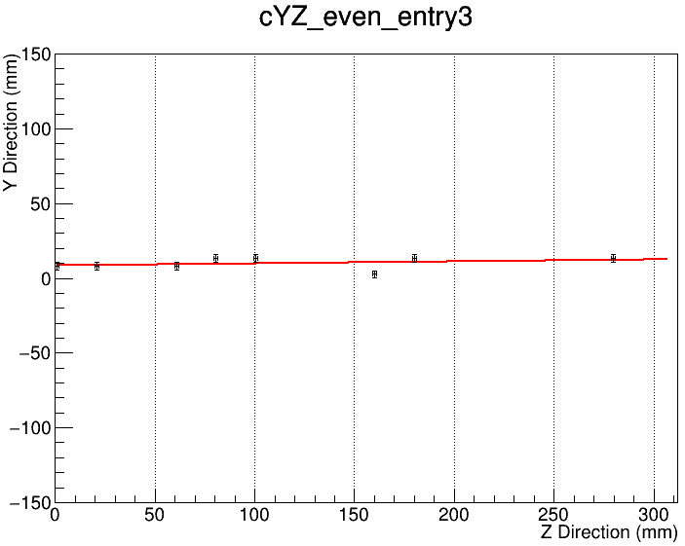
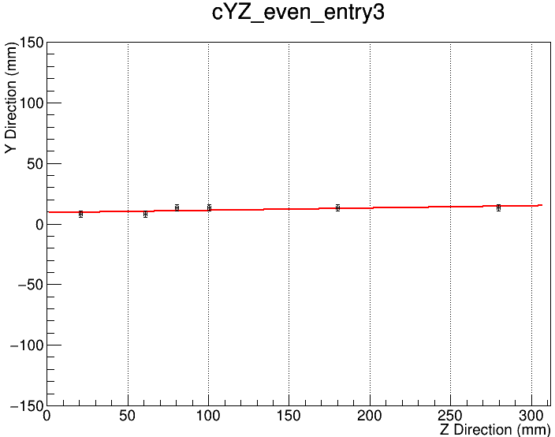
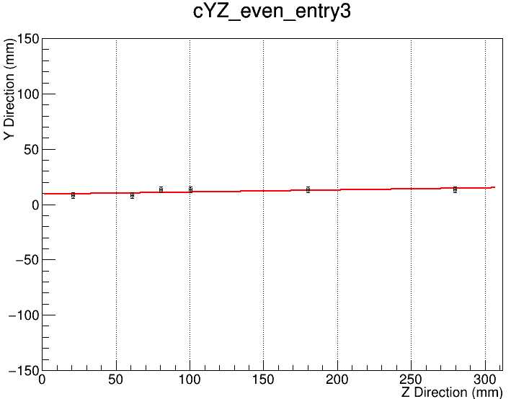
Track Fit - YZ
All hits
First fitting
Second fitting
Third fitting

Slide 7
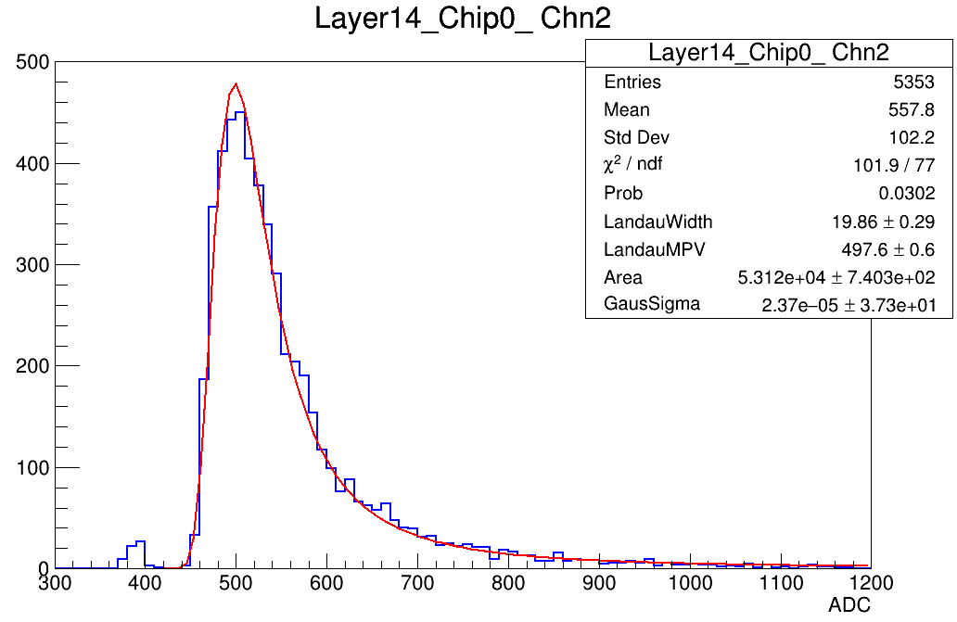
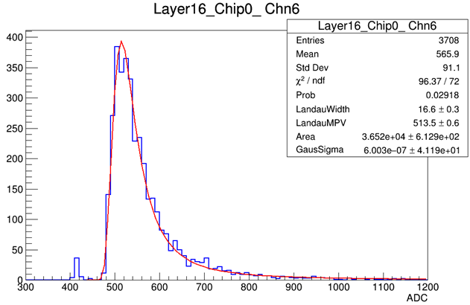
MIP Fit results comparison
before
after
before
after

Slide 8
Summary
After applying new fit method, the statistics problem in some channel get fixed
Increase efficiency of hits, 50% ->70%
New parameter for muon data check
New parameter for electron energy reconstruction

