Slide 1
MRPC 飞行时间谱仪技术研究进展
Yi Wang
Department of Engineering Physics
Tsinghua University

Slide 2
Outline
Introduction of MRPC -TOF system
Future requirement for MRPC-TOF:
-- High rate >20kHz/cm² (FAIR-CBM)
-- High time resolution <20ps (Jlab-SoLID)
-- Sealed MRPC to reduce gas consumption
Conceptual design MRPC for STCF endcap
Summary

Slide 3
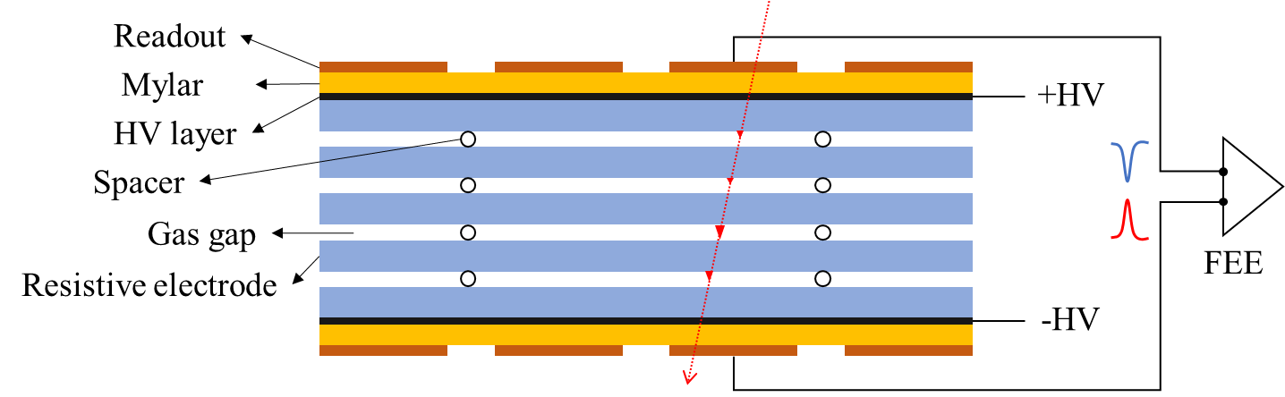
MRPC introduction
Working mechanism:
Electrode: glass, ~10¹²Ω.cm
HV layer: graphite, ~M Ω/
Narrow gap: 100-300 μm
High electric field: >10⁵ V/cm
Working gas should be very electro-negative:
90%R134a+ 5%Iso-butane+5%SF6
MRPC structure
Main performance:
Excellent time： ->20 ps
Efficiency：>98%
Spatial resolution: ~mm
Cost effective
Long time stability！
MRPC application：
Application in nuclear physics experiments
Application in industry（Muon tomography)
Application in medicine（TOF-PET）

Slide 4
MRPC in ToF system
MRPC has been widely adopted to construct the Time of Flight (TOF) systems in HEP experiments.
 | ALICE | STAR | FOPI | BESIII | CBM | SoLID
Active area per detector (cm) | 120 x 13 | 22 x 8.4 | 90 x 4.6 | 0.5x(9.2+14.8)x32.8 | 33 x 27.6 | --
Total active area (m²) | 141 | 50 | 5 | 1.33 | 120 | 10
Pad size (cm) | 3.7 x 2.5 | 6.3 x 3.1 | 90 x 0.3 | (9.1~14.1) x 2.4 | 27 x 1.0 | (16~28) x 2.5
Gap×thickness(mm) | 10 x 0.25 | 6 x 0.22 | 6 x 0.3 | 12 x 0.22 | 10 x 0.25 | 32 x 0.128
Gas mixtures (C₂H₂F₄/ C₄H₁₀/SF₆) | 90/5/5 | 95/5/0 | 85/5/10 | 90/5/5 | 90/5/5 | 90/5/5
Operating field (kV/cm) | 96 | 107 | 110 | 109 | 110 | 140
Efficiency | 99.9% | 95-97% | 97±3% | 99% | 97% | 98%
Time resolution(ps) | 40 | 60 | 73±5 | 60 | 60 | 20 ps
Max rate (Hz/cm²) | 50 | 10 | 50 | 50 | 30k | 20k
higher counting rate and time precision.

Slide 5
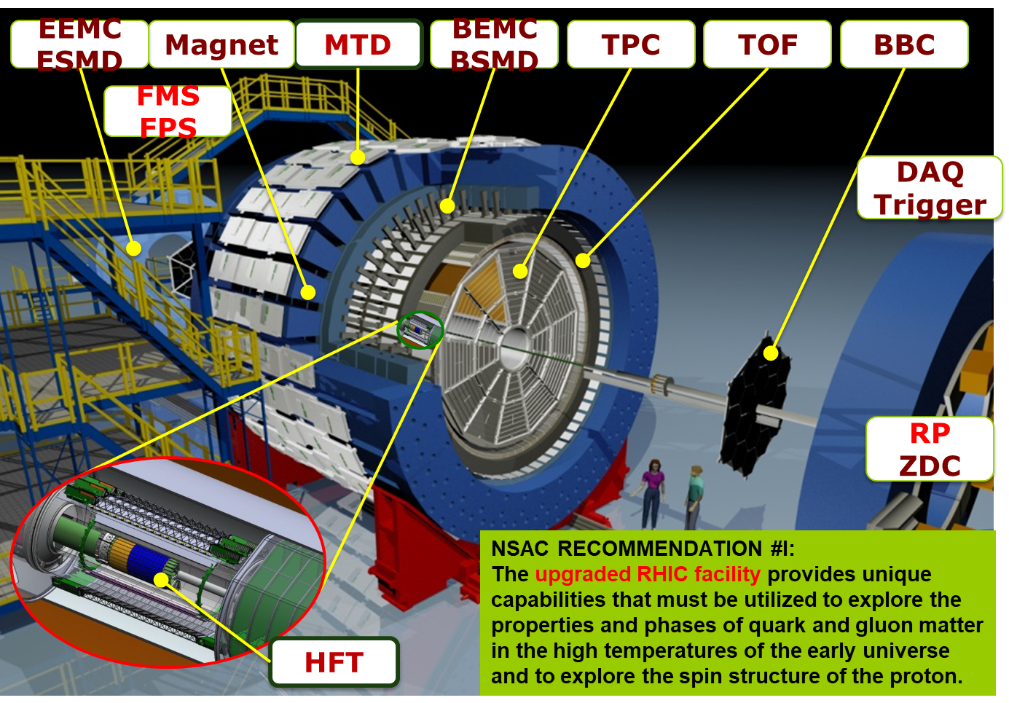
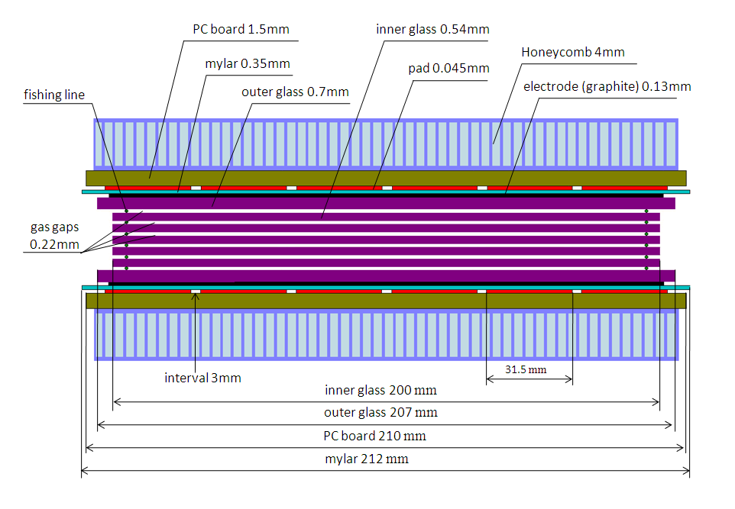
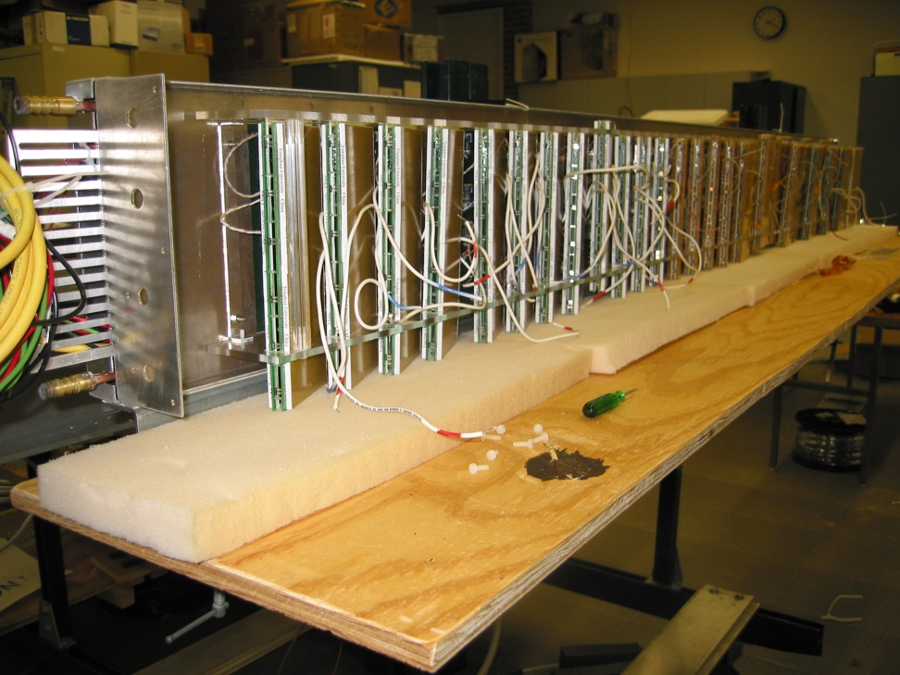
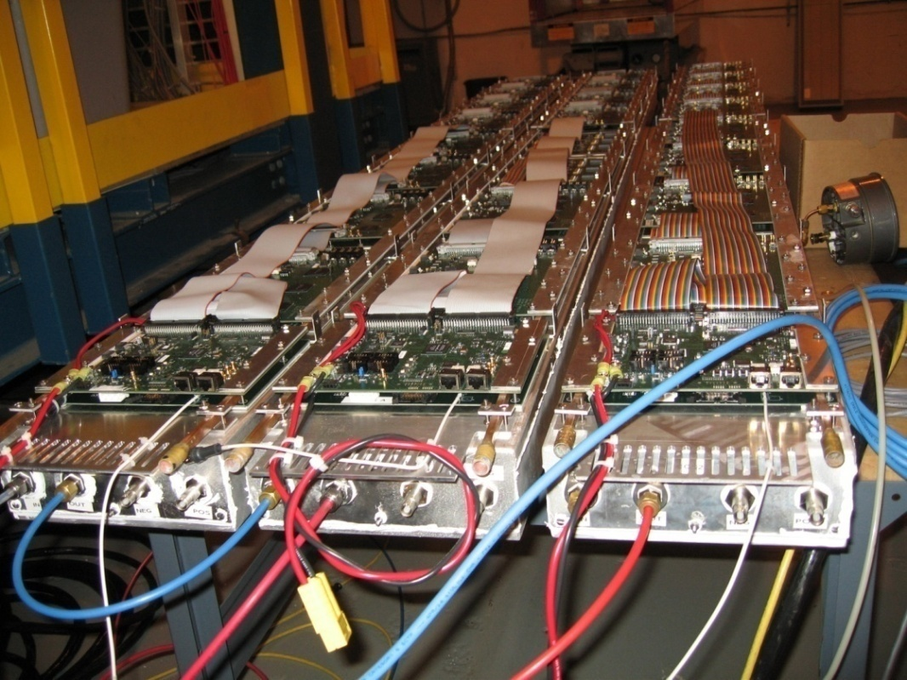
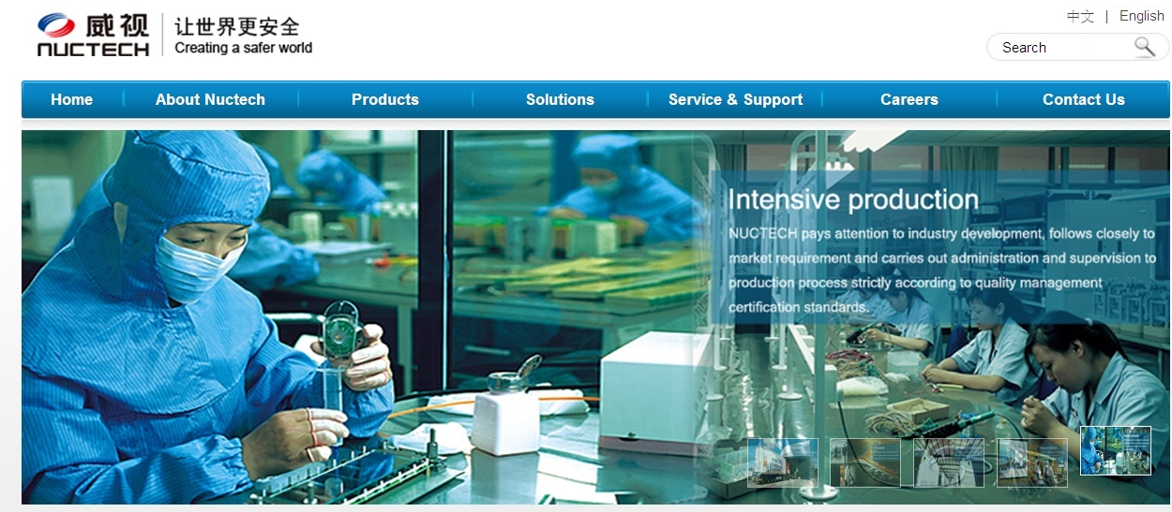
RHIC-STAR TOF system
STAR TOF-Tray

Slide 6
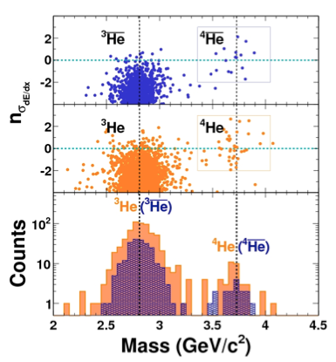
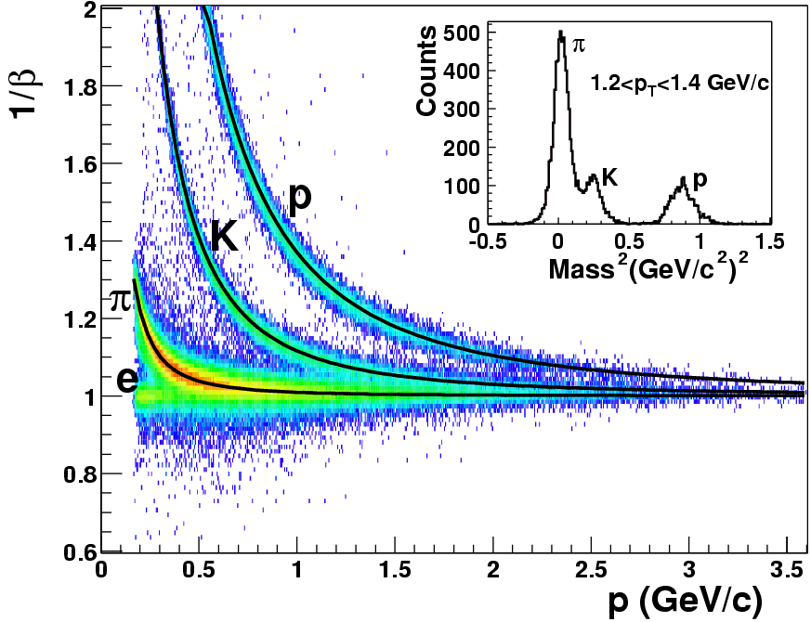

PID and physics success
TOF
TOF PID:
π /k ~1.6 GeV/c,
(π,k)/p ~ 3.0 GeV/c
Nature 473 (2011) 353

Slide 7
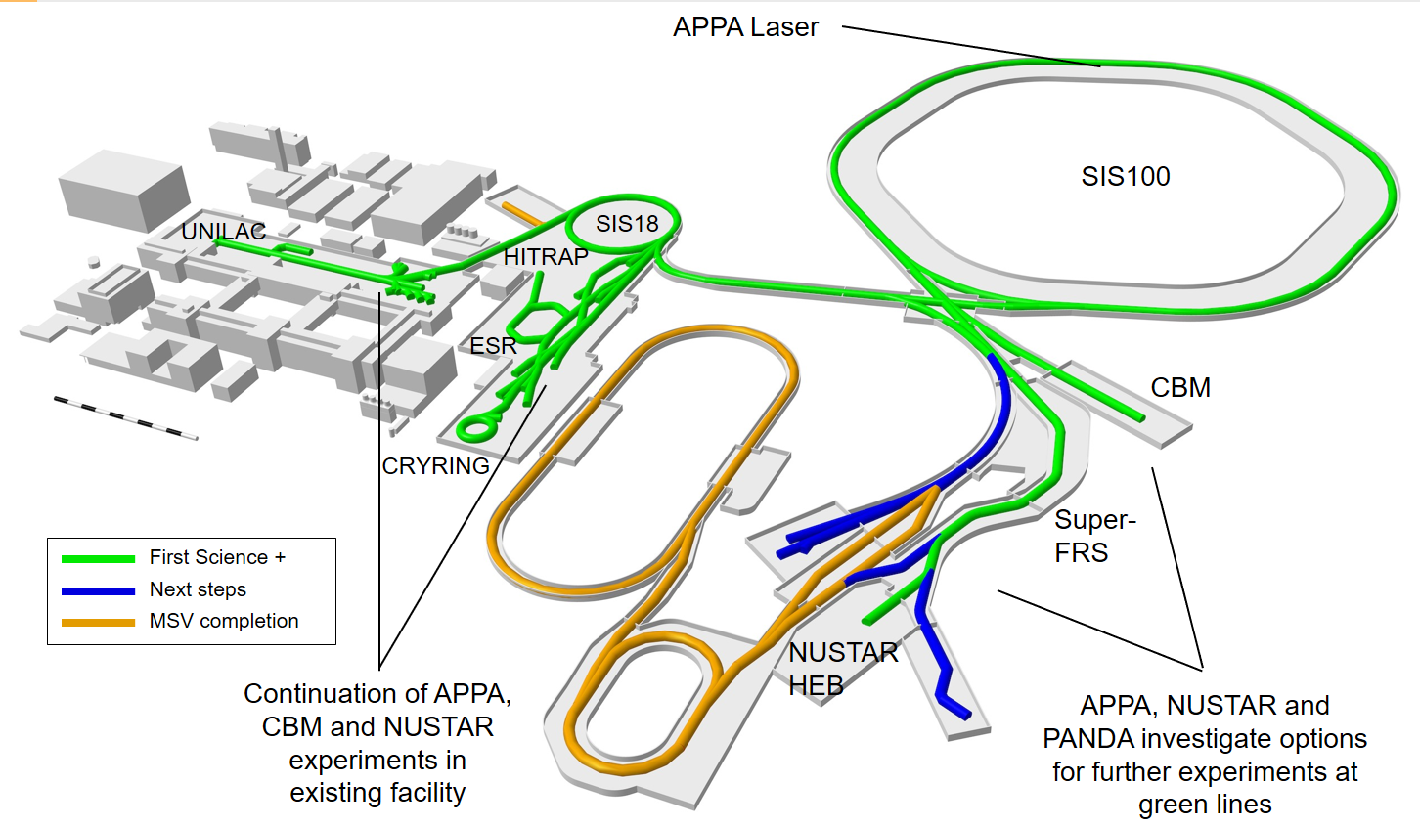
FAIR 2028
Primary Beams
10¹²/s; 1.5 GeV/u; ²³⁸U²⁸⁺
10¹⁰/s ²³⁸U⁷³⁺ up to 35 GeV/u
3x10¹³/s 30 GeV protons
The „FAIR 2028“ science program will include:
  CBM at the new cave with SIS100 beams, and HADES at SIS18
  APPA experiments at the low-energy rings, at SIS100, at the caves at SIS18 and UNILAC with and at PHELIX and a limited set of experiments which could be hosted at all the caves served by SIS100

Slide 8
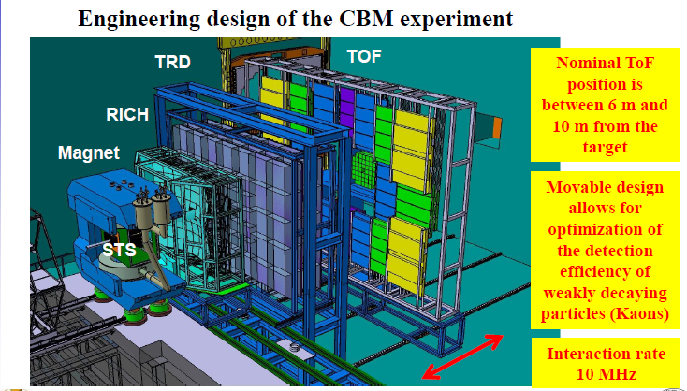
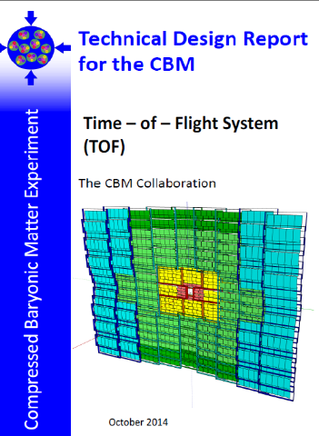
The structure of CBM-TOF wall
CBM-ToF Requirements
Full system time resolution σ_{T} ~ 80 ps
Efficiency > 95 %
Rate capability ≤ 25 kHz/cm²
Polar angular range 2.5°– 25°
Occupancy < 5 %
Low power electronics
(~100.000 channels)
Free streaming data acquisition
8
8

Slide 9
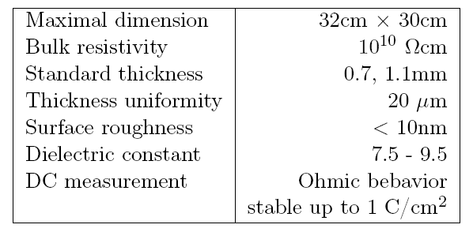


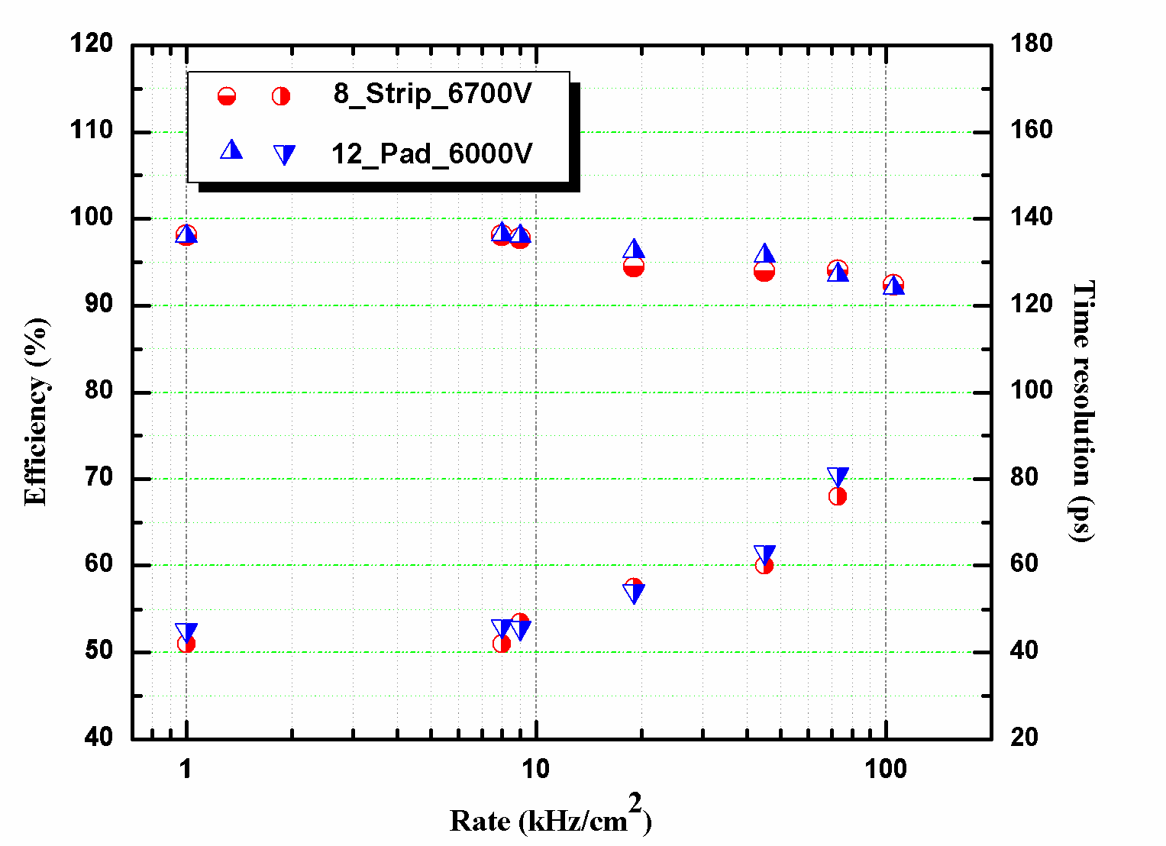
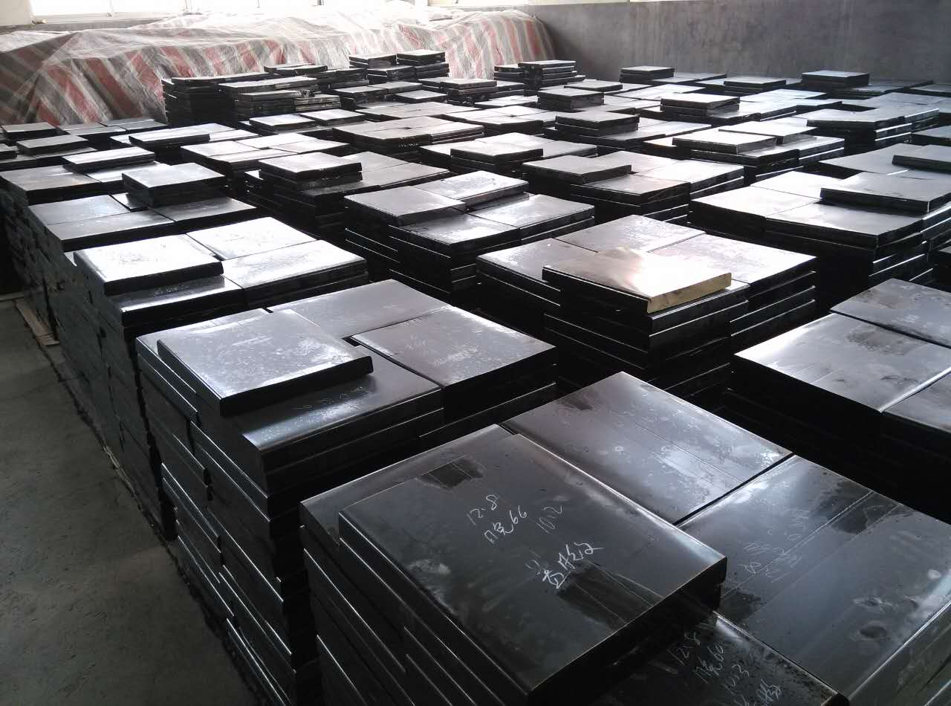
Higher counting rate: low-resistive glass
low-resistive glass control the voltage drop (efficiency loss) when incident flux goes up by Decrease the resistivity of the electrodes
Specifications of low resistive glass
Low-resistive glass has been operating at FAIR-Phase 0 programs like STAR-eTOF and mCBM
It has been applied in CBM-ToF Wall
Beam test result:
93%, 80ps ,70kHz/cm²
Notes:
在介绍为

Slide 10
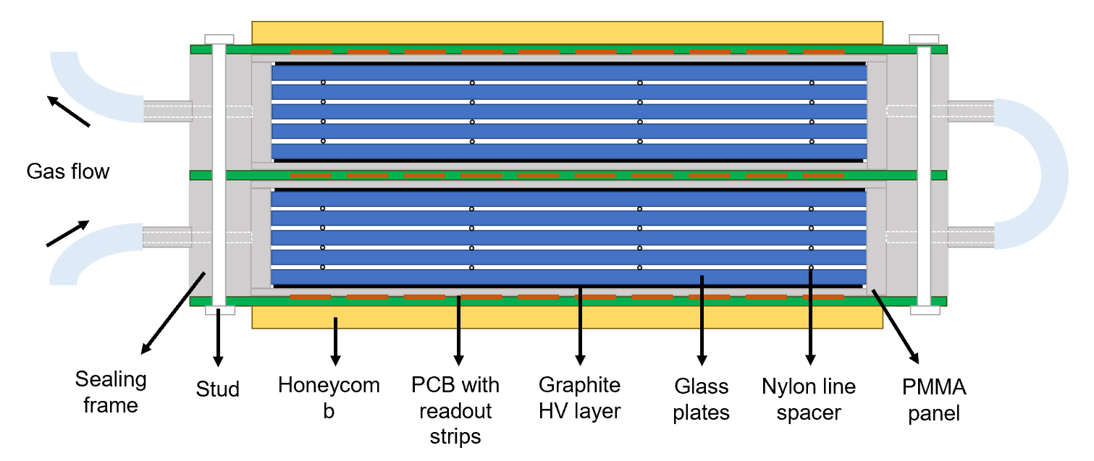
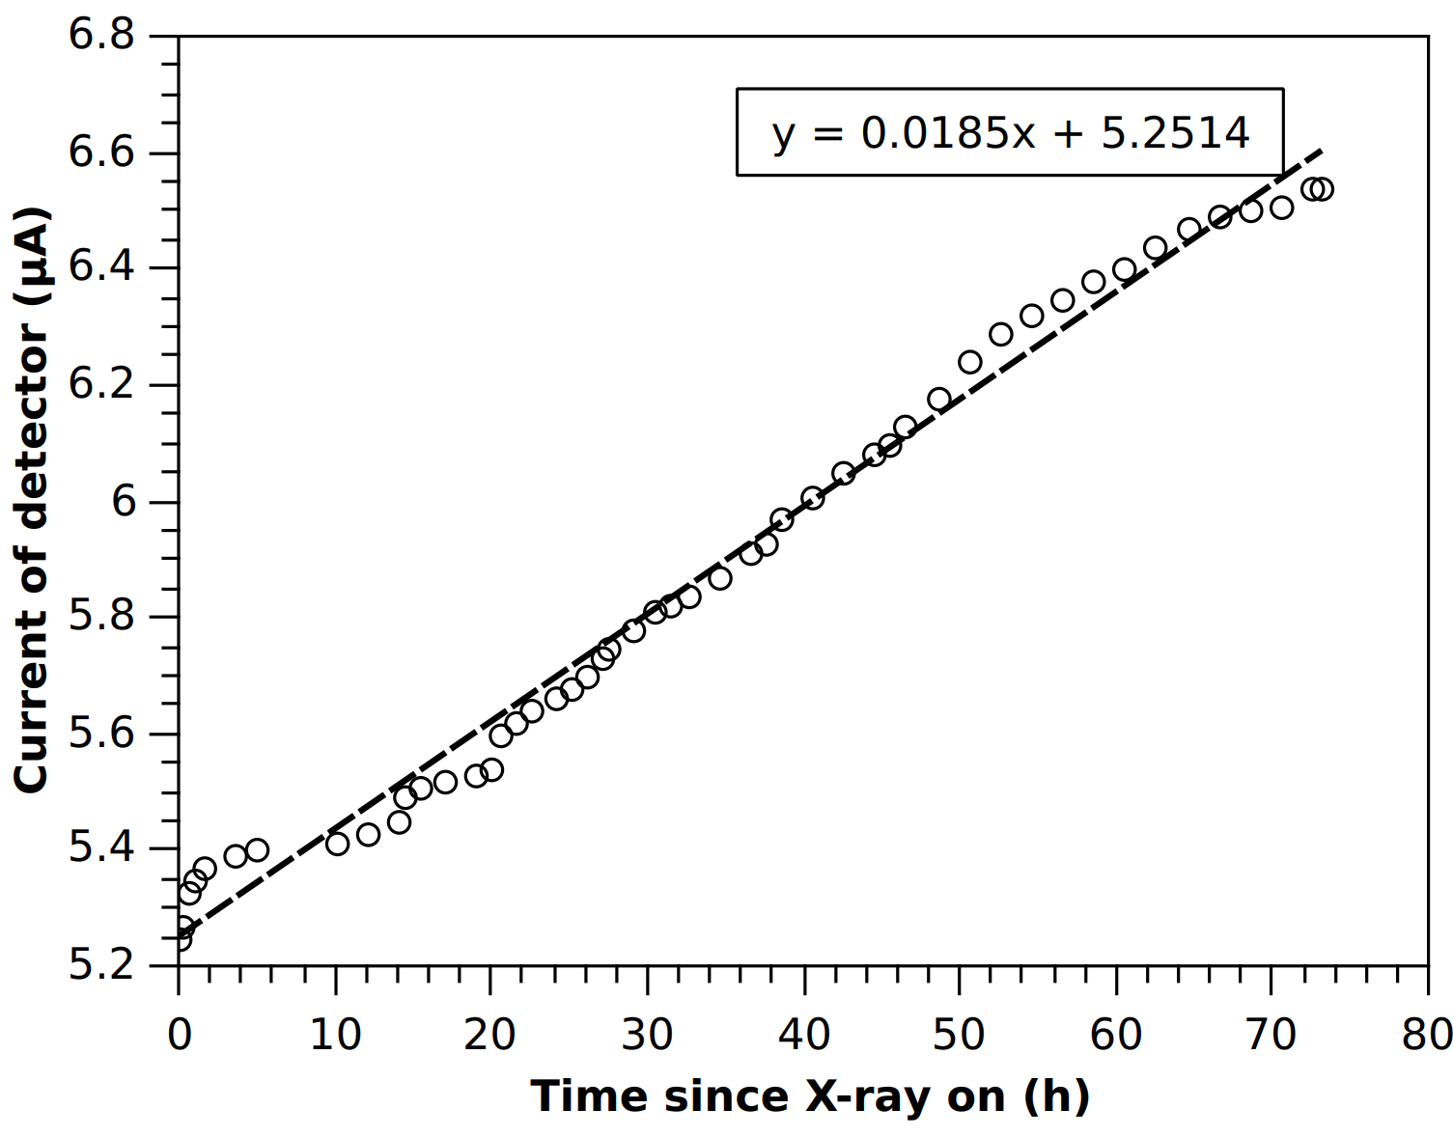
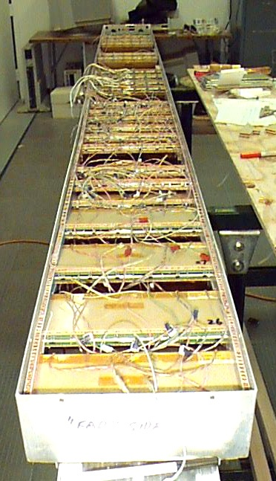
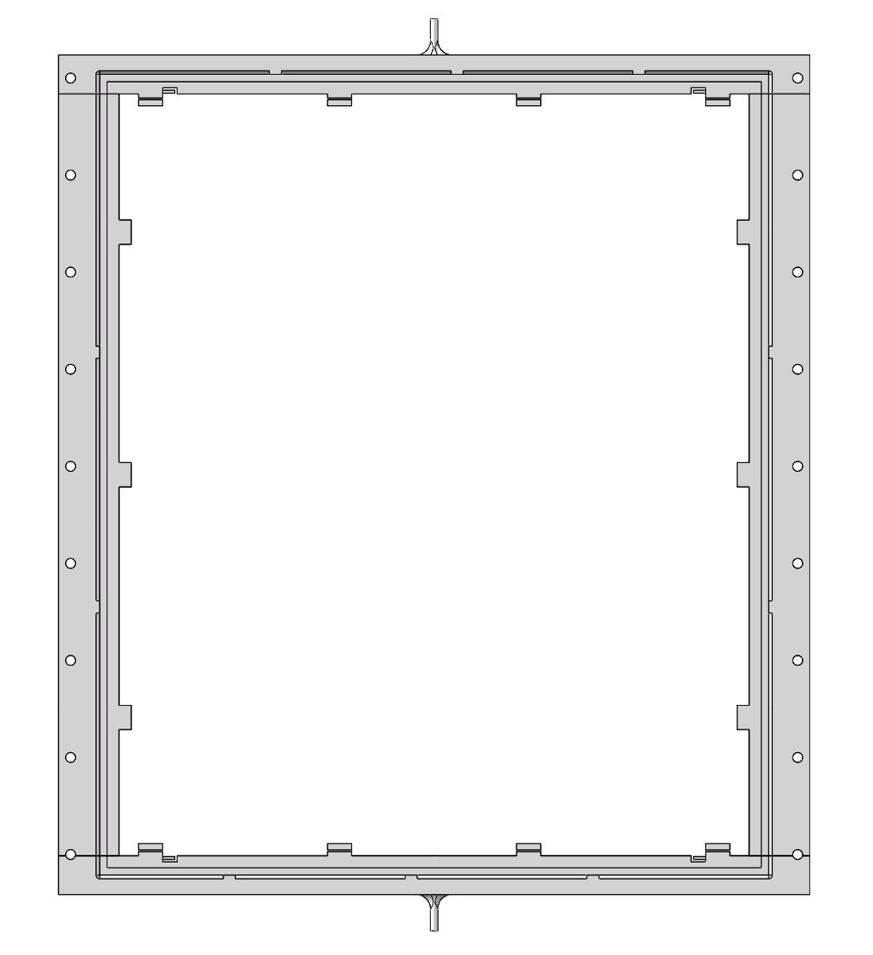
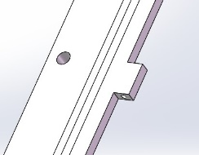
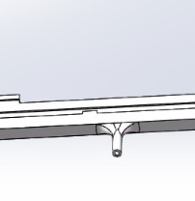
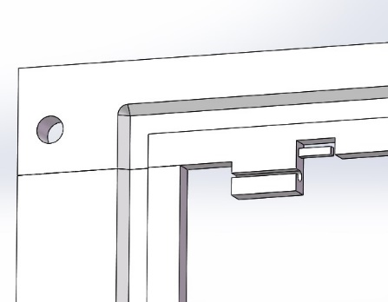
Higher counting rate : gas pollution
Constant rate condition of 1kHz/cm²
Gas tube
Inlet/outlet
The gas pollution in the gas gap caused the increase of current!
Fishline hook
3D printed sealing frame with Good strength, insulation and radiation persistency
Sealing MRPC speed up gas exchange and can reduce to 1sccm/m² flush rate at cosmic experiment!

Slide 11
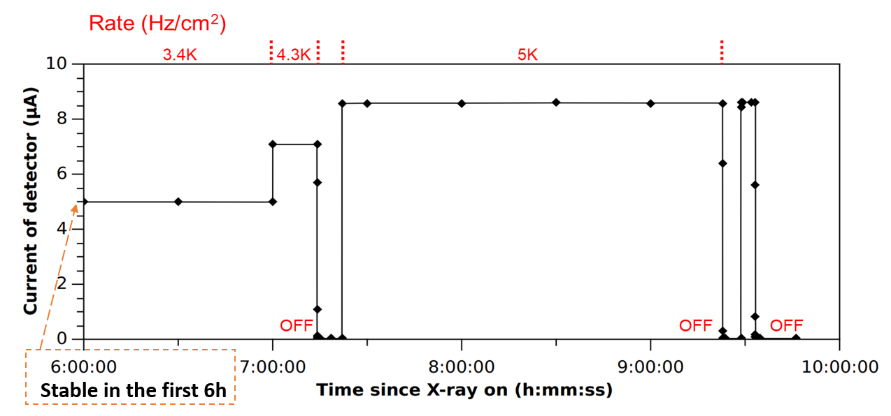
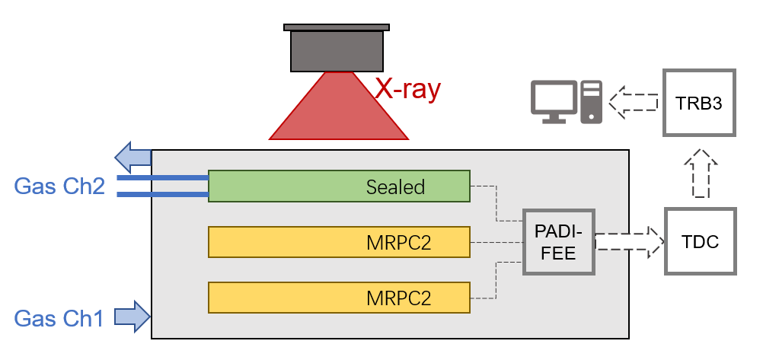
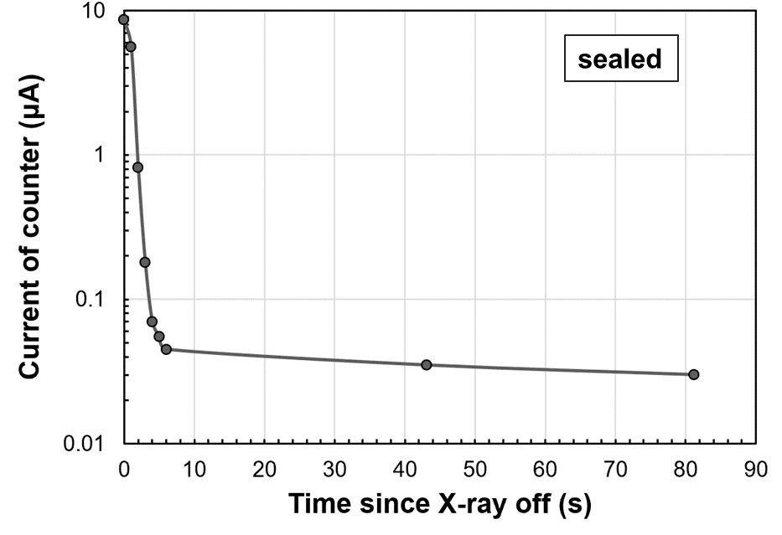
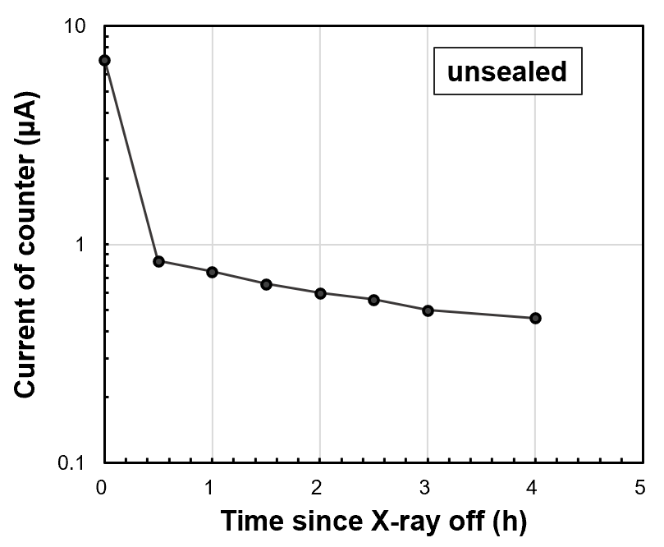
Excellent performance of sealed MRPC
Sealed MRPC promoted gas exchange
Decrease the wait time of gas purging:
Reach the working HV in 2h since flowing the gas
Excellent current behavior under high rate irradiation:
Stable current with constant rate condition.
Fast decay of dark current since when X-ray is off

Slide 12
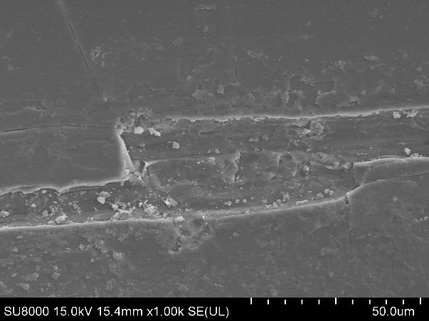
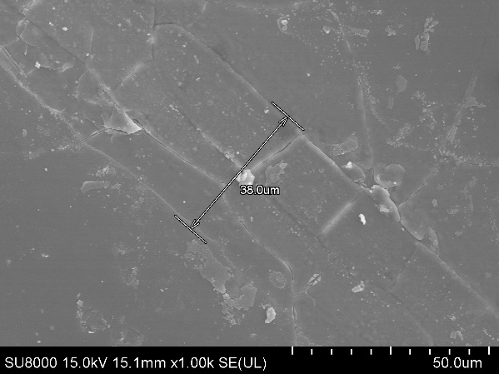
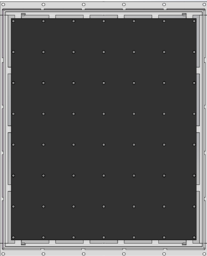
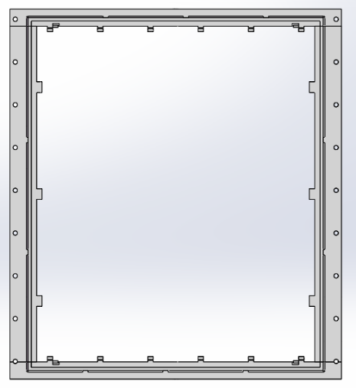
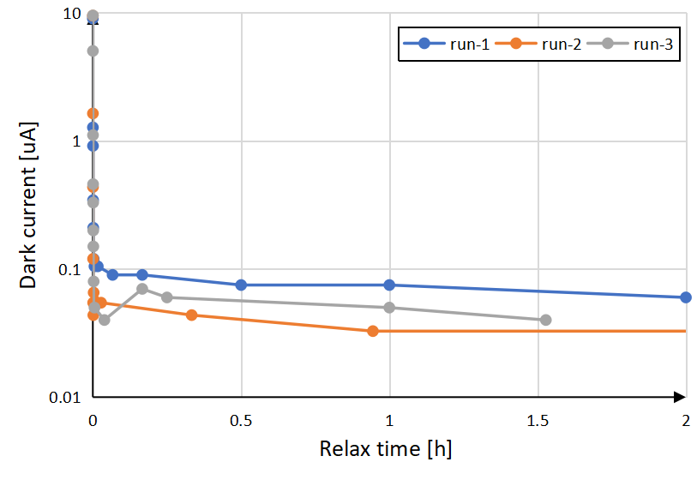
High counting rate (>7kHz/cm²): creepage on fishing line
35 um
fishline contact
The creepage on the fishing line caused the high current and deposition!
Gas outlet
Gas flow
Dark current decay after 10h
@7 kHz/cm² radiation
Kapton spacer: 3 x 3 x0.25mm
Gas inlet

Slide 13
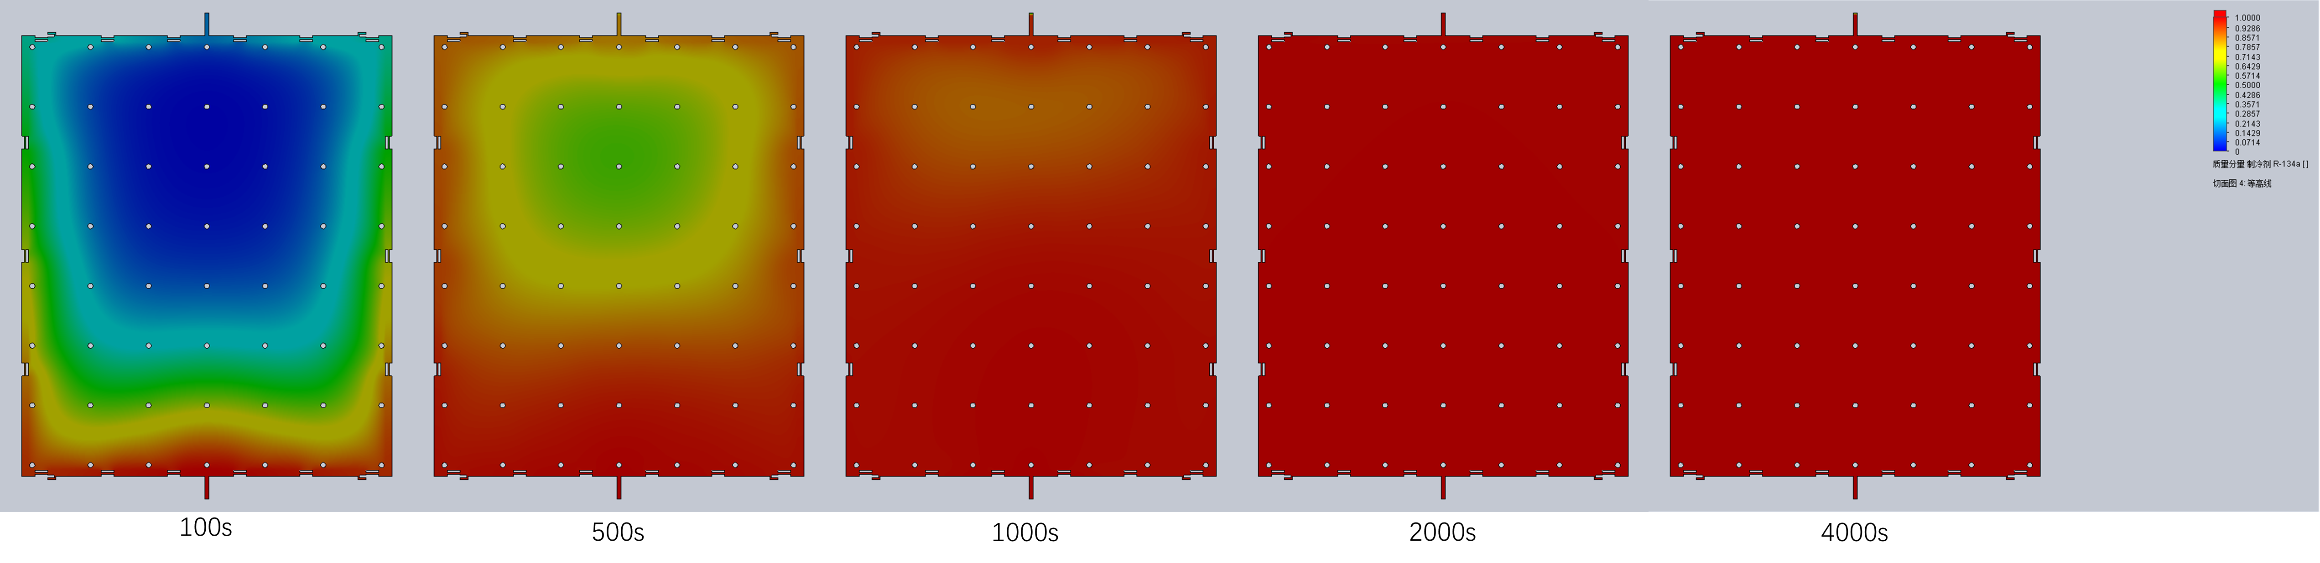
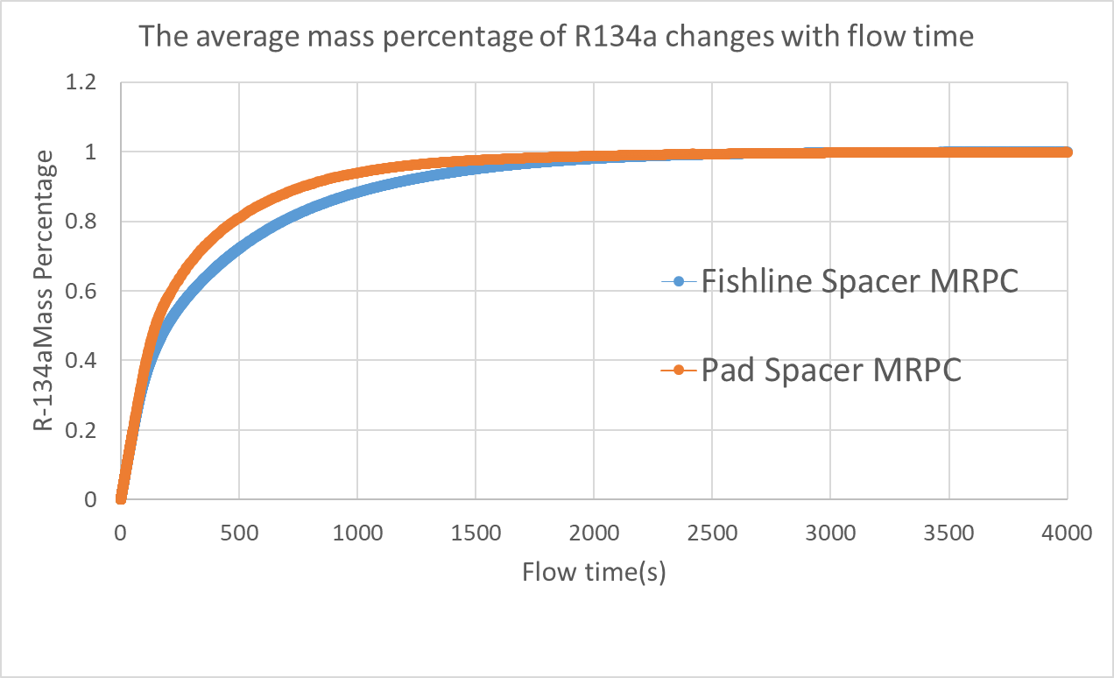
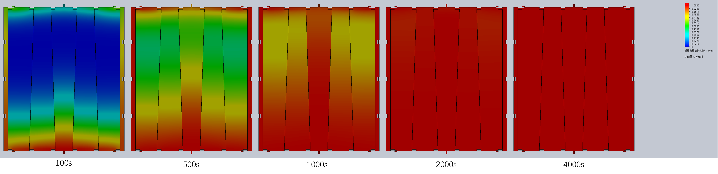
Gas flush simulation
Mass percentage of pad spacer MRPC
Mass percentage of fishing line spacer MRPC

Slide 14
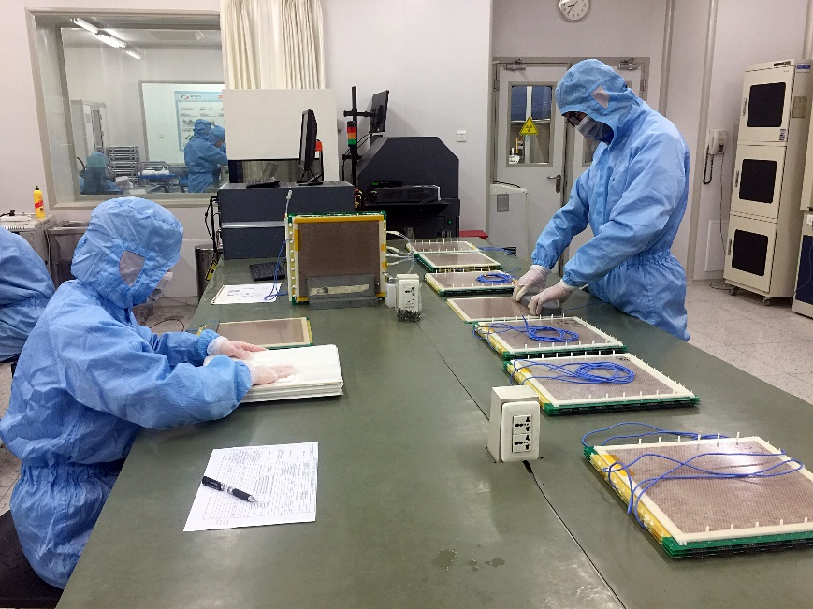
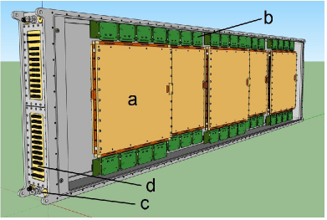
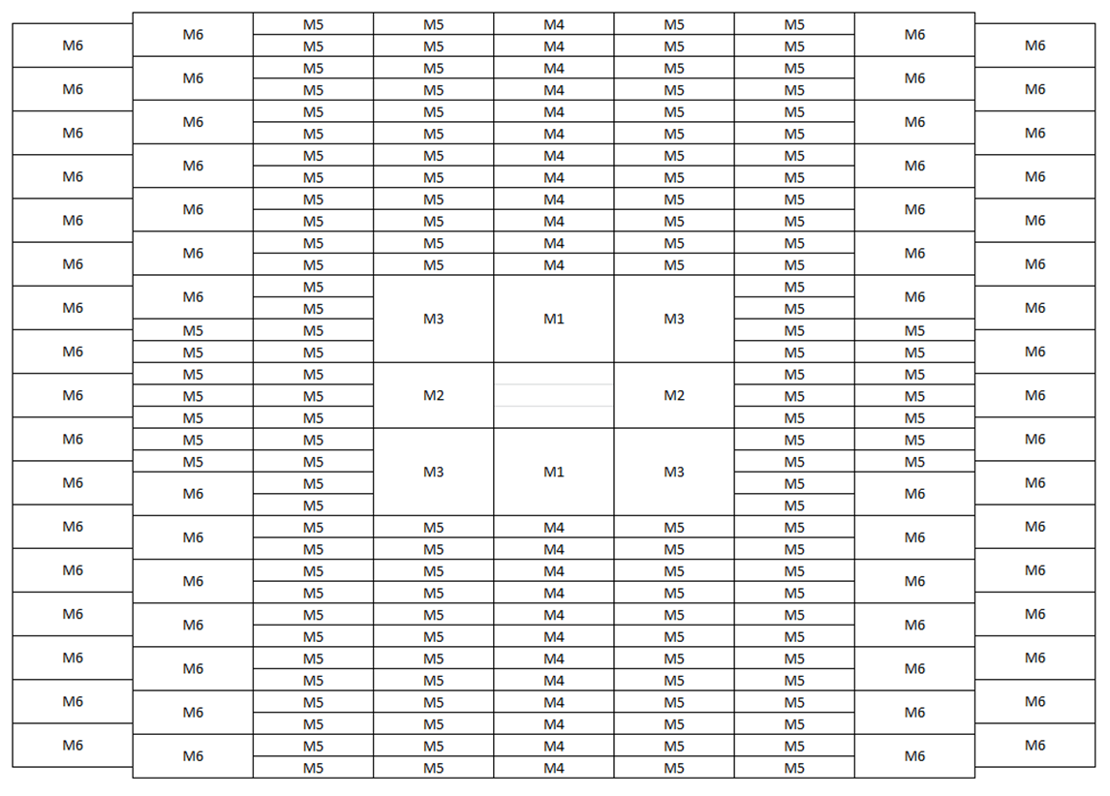
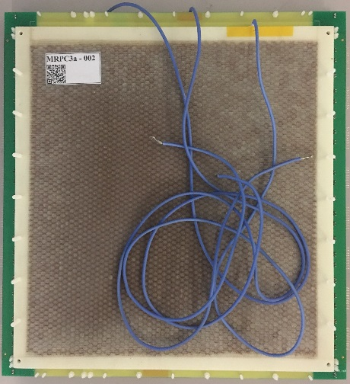
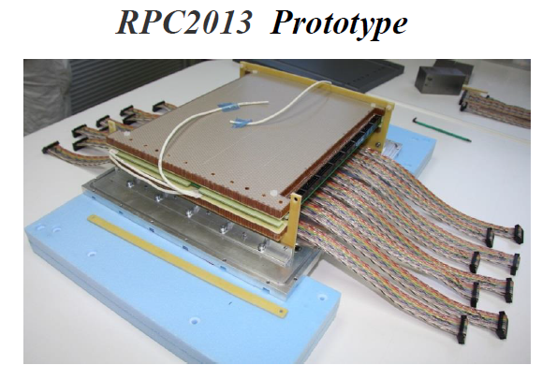

Prototype design for CBM-TOF
Strip-MRPC
Inner zone-MRPC
Two-dimensional code of MRPC

Slide 15
Now delayed to 2027!

Slide 16
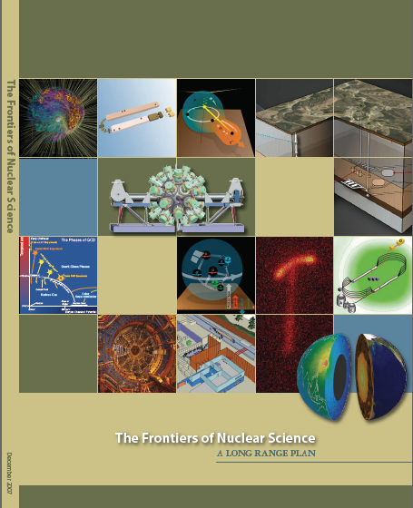
JLab 12Gev Upgrade
The completion of the 12 GeV Upgrade of CEBAF was ranked the highest priority in the 2007 NSAC Long Range Plan.
New Hall
Add 5
cryomodules
20 cryomodules
CHL-2
Add arc
20 cryomodules
Add 5
cryomodules
Enhanced capabilities in existing Halls
Increase of Luminosity 10³⁵ - ~10³⁹ cm⁻²s⁻¹
Maintain capability to deliver lower pass beam energies : 2.2, 4.4, 6.6,….

Slide 17
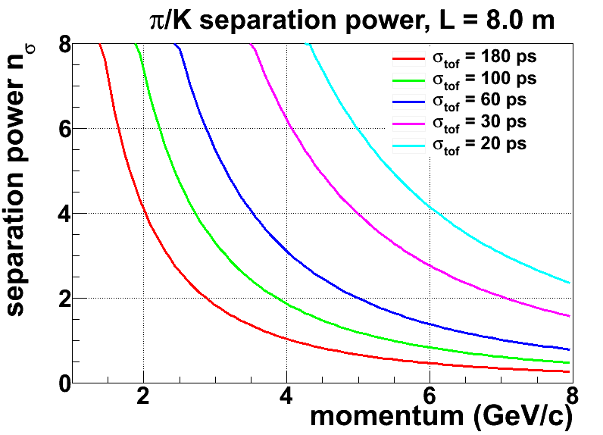
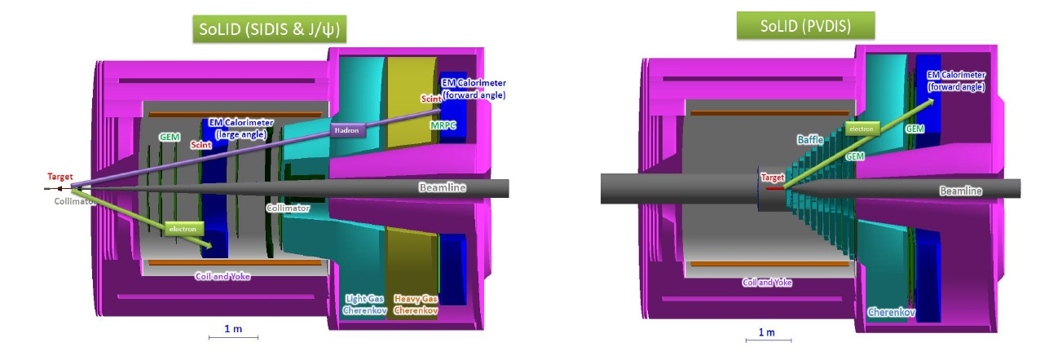
Overview of SoLID
Full exploitation of JLab 12 GeV Upgrade
→ A Large Acceptance Detector AND Can Handle High Luminosity (10³⁷-10³⁹)
Take advantage of latest development in detectors , data acquisitions and simulations
Reach ultimate precision for SIDIS (TMDs), PVDIS in high-x region and threshold J/ψ
5 highly rated experiments approved (+3)
Three SIDIS experiments, one PVDIS, one J/ψ production (+ three run group experiments)
Strong collaboration (250+ collaborators from 70+ institutes, 13 countries)
The MRPC is developed for the TOF of SoLID
Main Requirements for TOF:
  π/k separation up to 7GeV/c
  Time resolution < 20ps
  Rate capability > 20kHz/cm²

Slide 18
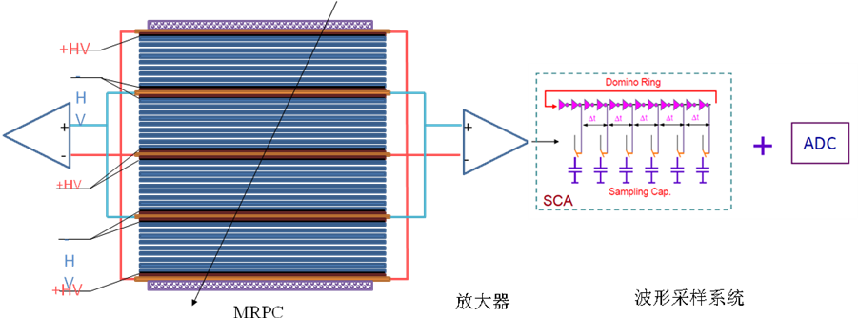
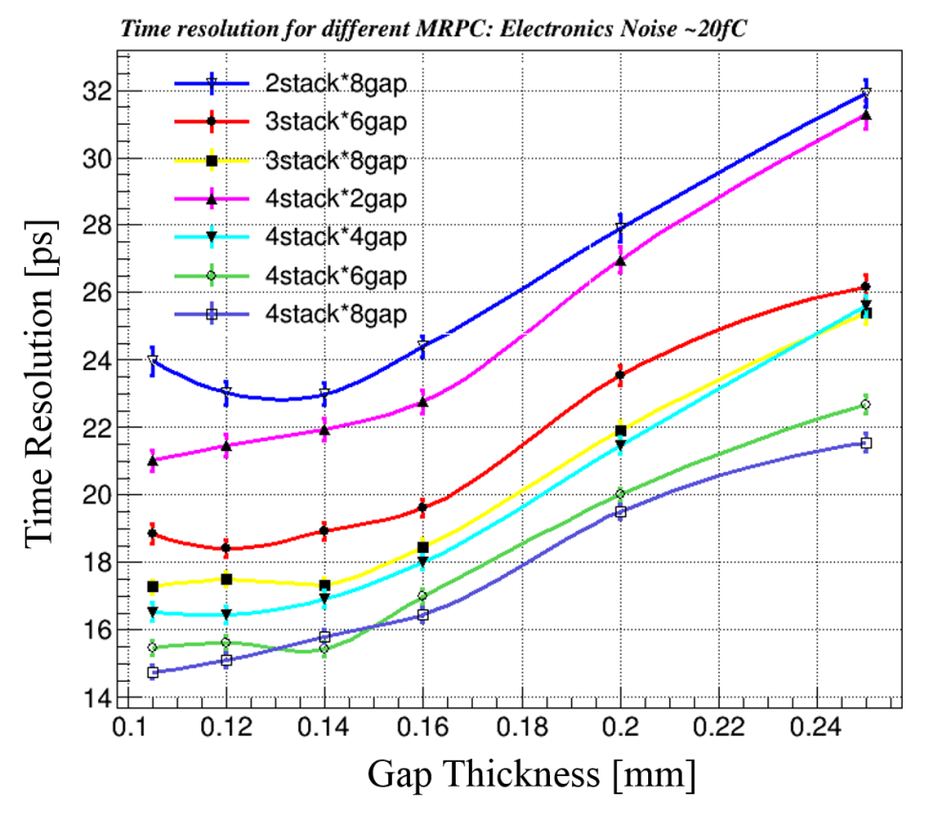
Toward 20ps resolution: narrow gap MRPC
Simulation indicates proper ways to design the gap thickness and arrange the stacks
Narrower gap thickness required
σ_{TOF} <20 ps， the intrinsic resolution of narrow gaps MRPC is around 15ps，so the time jitter of readout electronics <13~15 ps。
σ_{MRPC} <20 ps，the gas gap: <0.18mm
gap number: >16

Slide 19
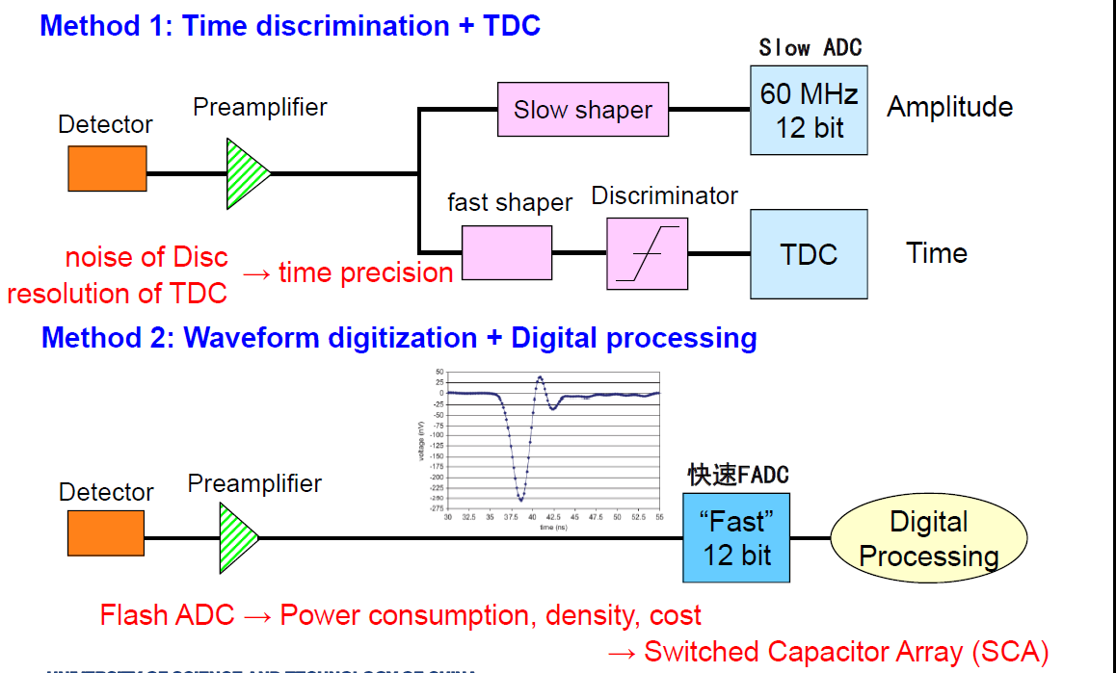
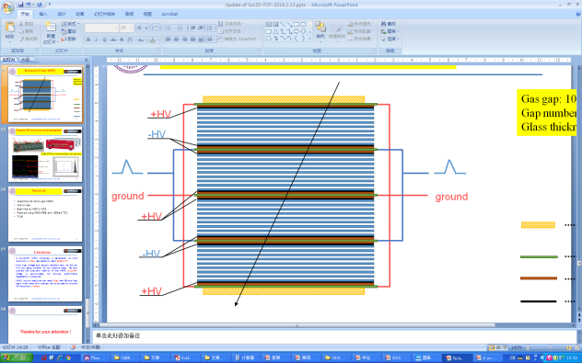
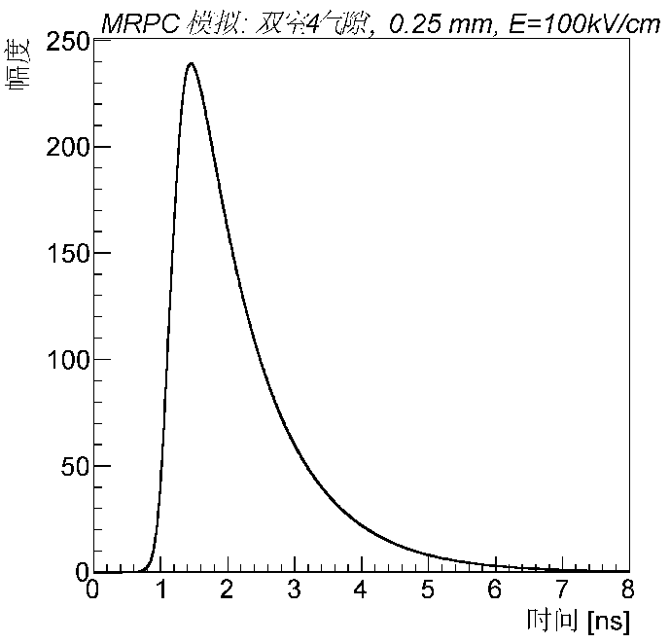
Toward 20ps resolution: fast readout electronics
low

Slide 20
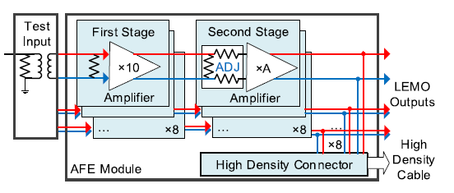
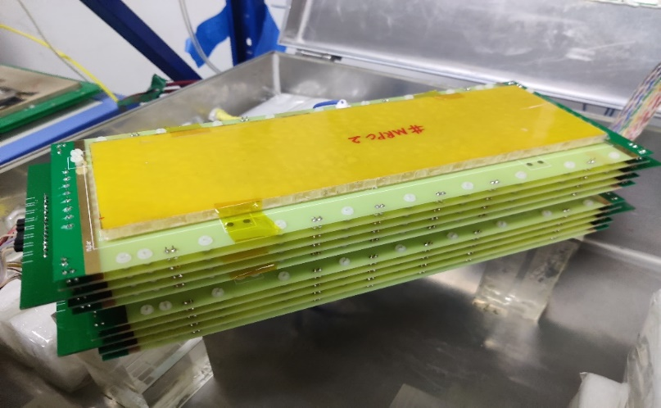
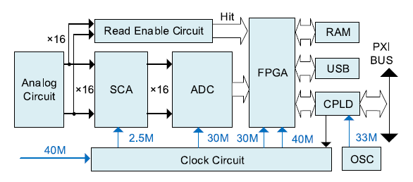
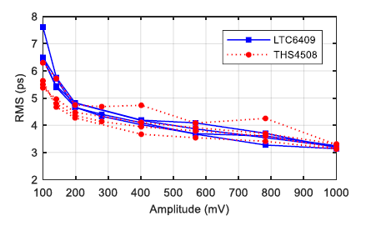
Toward 20ps resolution: fast readout electronics
Fast amplifier
Bandwidth=1.4GHz
 | MRPC prototype
gas gap thickness | 128 μm
number of gas gaps | 4 chambers × 8 gaps
glass material | low resistivity glass
glass thickness | 400
readout strips | 5 mm in width (2 mm clearance)
Waveform sampling
Based on DRS4
Sampling freq=5 GS/s
材料厚度：<0.1X₀
Fast amplifier & Waveform sampling
Electronic system time σ<7ps

Slide 21




Neural network can be used to analysis time
MRPC
Multilayer perceptron (MLP)
粒子源
Output
Input
Activation function: g and h —— tanh
Weights:
“Dropout”: avoid overfitting
The length of the leading edge t l
Time of the very first interaction:
Train/validate/test set: 20/10/10 k
Tensorflow & GPU: GTX 1080 Ti
~ 10 mins for training
固定阈值
Several uniformly distributed points along the leading edge

Slide 22

Another NN：LSTM
Recurrent neural networks(RNN): Long Short Term Memory network(LSTM)
Train/validate/test set: 20/10/10 k
Tensorflow & GPU: GTX 1080 Ti
The length of the leading edge t l
Several uniformly distributed points along the leading edge
f : forget gate: Whether to erase
I : Input gate, whether to write
g: gate gate, How much to write
o: output gate, How much to reveal
F
I
G
O
> 30 mins for training

Slide 23


Cosmic test
MRPC + fast amplifier + DRS4
Timing：CFD
Event choose：Vertical cosmic ray
E=140 KV/cm
Total time resolution
$$σ=\frac{23.24ps}{\sqrt{2}}=16.43ps$$

Slide 24

20ps,15kHz/cm² MRPC
detection efficiency
time resolution
detection efficiency
time resolution
rate
We are also trying with NINOs+ FPGA TDC to get good resolution!

Slide 25

PID of STCF
Physical Targets of STCF
the asymmetry of matter-antimatter
structure of hadrons and the nature of non-perturbative strong interactions
physics beyond the standard module
Parameters of STCF
Center-of-mass energy: 2-7GeV
Luminosity: ＞0.5*10³⁵cm⁻²s⁻¹
Physical requirements of STCF-PID
π/K misidentification rate < 2% at p < 2GeV/c
PID efficiency of hadrons >97% at p < 2GeV/c
Time resolution of eTOF：<44ps

Slide 26



Structure of STCF-eTOF
每个扇区由一个梯形MRPC组成
MRPC
242.4mm
222.4mm
405.8mm
425.8mm
读出条
470mm
Component | Dimensions(mm) | Quantity
Honeycomb | 470×(222.4-405.8)×6 | 2
PCB | 470×(226.4-409.8)×0.8 | 5
Mylar | 470×(222.4-405.8)×0.25 | 8
Float glass | 470×(224.4-407.8)×0.3 | 28
Gas gap | 0.14 | 24
Readout strip | 470×(222.4-405.8) | 24
密封型24气隙MRPC结构

Slide 27
STCF-eTOF主要指标
性能：
1、时间分辨：<44ps
2、PID of π/k: 2GeV @3σ
3、TOF面积：~2.362m²单面
4、电子学道数：1024
5、电子学功耗：17mW/道
6、造价估算：inexpensive
7、材料厚度：0.1X₀
8、读出电子学：TOT放大器+FPGA TDC

Slide 28
Summary
The rate capability of MRPC assembled with low resistive glass can reach 70kHz/cm²
Sealed MRPC was developed in our university:
-- Promote gas exchange in gas gap
-- Sealed MRPC (Kapton pad spacer) can solve creepage on the spacer at high
rate condition
-- Reduce gas consumption greatly
-- Has been used in CBM-TOF and CEE-eTOF
The time resolution of narrow gap MRPC with fast electronics can be better than 20ps
MRPC-TOF is a good choice for STCF-eTOF!!!

Slide 29
Thanks for your
attention !

