Slide 1
Micromegas R&D and Application
张志永, 黄涛 , 康 龙飞, 汪晓莲，安琪，苏弘，赵天池
核探测与核电子学国家重点实验室
中国科学技术大学近代物理系
E-mail: htao09@mail.ustc.edu.cn
2012.12.13

Slide 2

Outline
A 10cm*10cm chamber
1 . Structure and fabrication
2. Performance study (gain, uniformity, spatial
resolution , energy resolution)
Telescope system for Electro-Magnetic Calorimeter（DAMPE）
1. goals
2. performance of six chambers
Towards to larger area
Summary

Slide 3

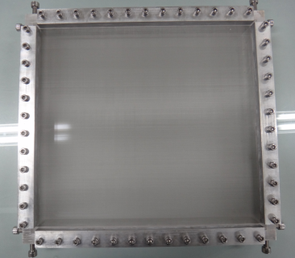
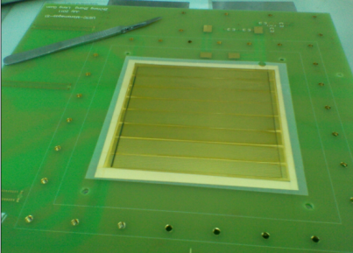
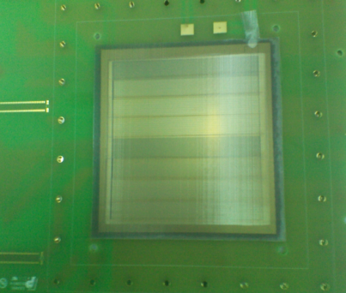
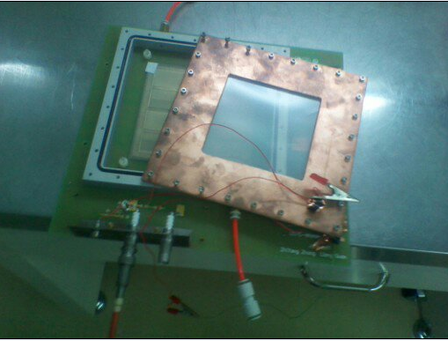
A 10cm*10cm chamber
Structure and Fabrication
350 LPI
-HV drift cathode
32cm*35cm
-HV avalanche cathode
Fishing line spacers
Thermal bonding film frame
Readout PCB
Honeycomb board
Readout PCB that has fishing line spacers bonded on its strips and thermal bonding film frame
MicroMesh: 350 LPI woven stainless steel mesh pintch /wire diameter 70/22 mm
Bonding by using a hot-press
Assemble
Notes:
热熔胶膜工艺？？？漂移区（转换区），雪崩区,漏斗形电场

Slide 4
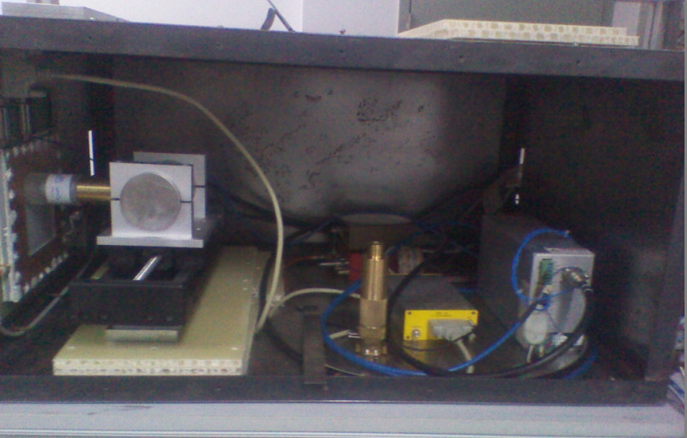
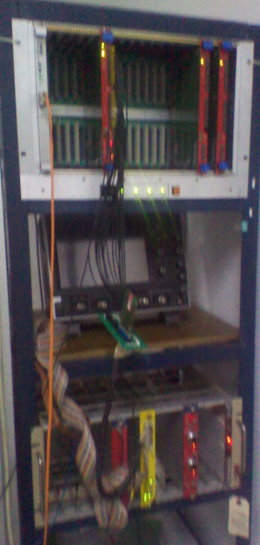
Setup
Micromegas
ADC: CAEN mod: V785N
Mobile device
Cu 8KeV X-rays tube
Preamplifier :mesytec MPR-16
Sharping : mesytec STM-16+
Fe55 5.9KeV x-rays source
Notes:
Fe放射源，Cu x光机，16路放大成型（没有配套电子学时）

Slide 5
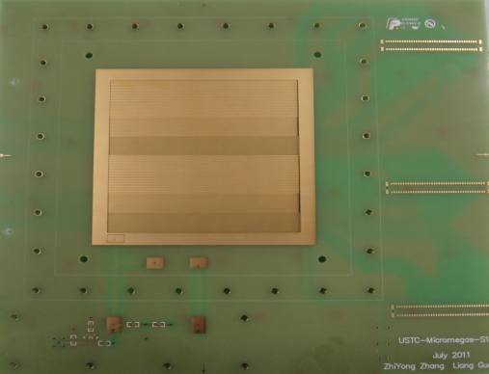
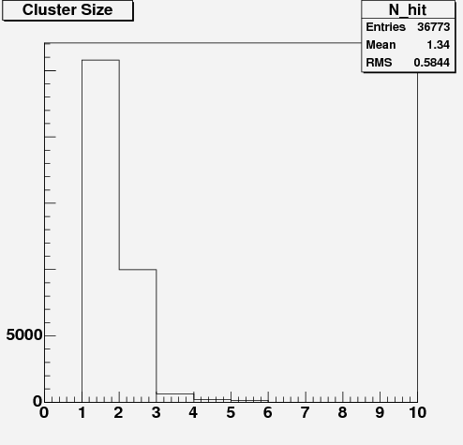
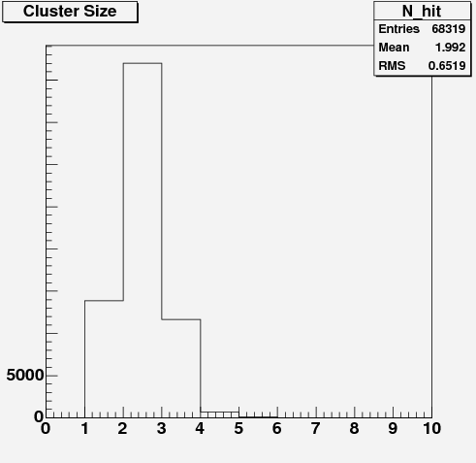
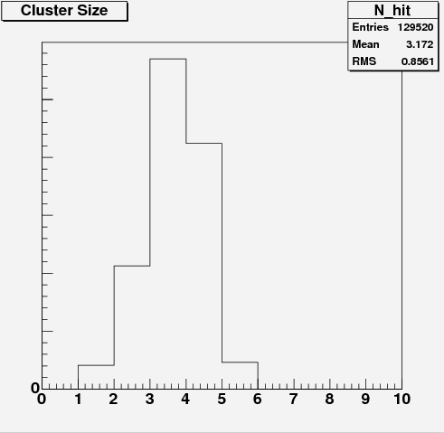
Hit multiplicity
Discrimination:
ADC-channel>pedestal-mean+3*pedestal-sigma
Pitch=1mm
Readout PCB with three types of strip-pitch
Pitch=0.5mm
Pitch=0.25mm
Test with a mesytec MPR-16 charge sensitive preamplifier and a mesytec STM-16+ which is a 16 fold spectroscopy Amplifier with Discriminators and Multiplicity Trigger
Notes:
什么是击中数，什么是cluster size，击中数与位置分辨相关

Slide 6
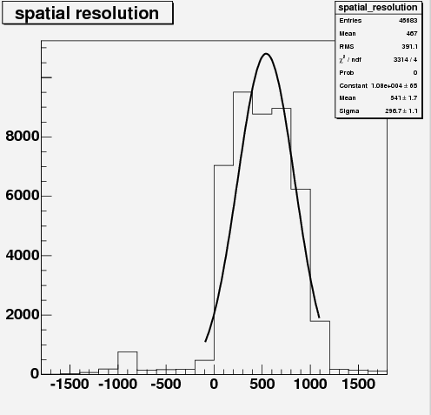
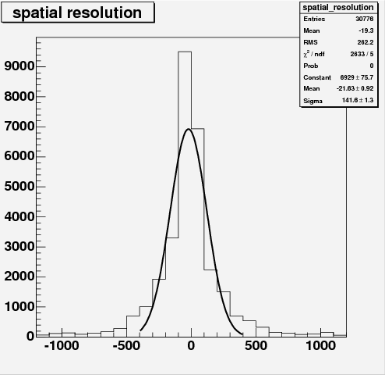
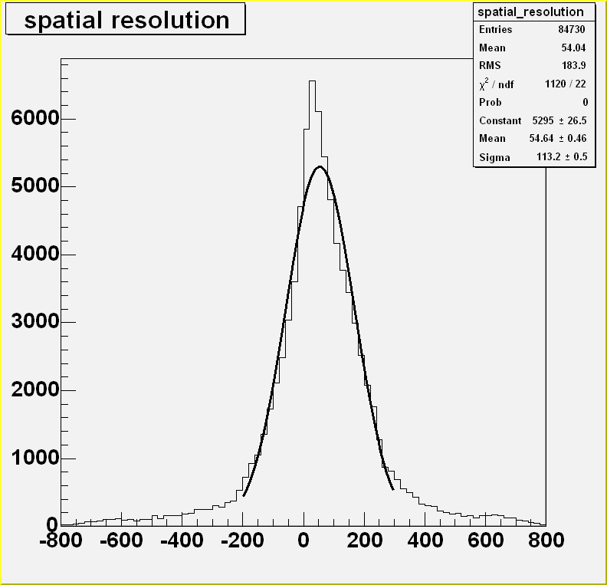
Spatial resolution
Cu X-rays tube(8KeV)
source
Pitch=0.25mm
~110μm
collimators
Pitch=1mm
Pitch=0.5mm
~140μm
Collimation
Strip pitch(mm) | 1 | 1 | 1 | 1 | 0.5 | 0.5 | 0.25 | 0.25 | 0.25
Cluster size (compared with pitch) | 1.934 | 1.927 | 1.34 | 1.497 | 2.119 | 1.992 | 3.172 | 3.052 | 3.227
SR(sigma :mm) | 0.297 | -- | 0.385 | -- | 0.142 | 0.119 | 0.115 | 0.113 | 0.116
Notes:
cluster size

Slide 7
Uniformity
Total_ADC =Σ(hit_ADC - pedestal_mean)
Uniformity = Total_ADC/{(maximum + minimum)/2}

Slide 8
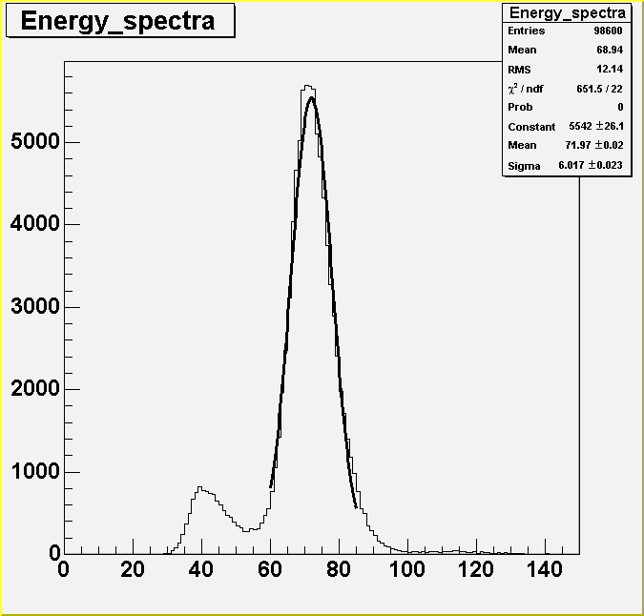
Typical Fe55 X-rays Energy spectrum
Gas mixture :Ar:CO2(93:7) Source : Fe55 5.9keV X-rays
Test: V-mesh=521V; V-drift=669V;
Charges：81.3fC
71.97mV*1.13pF
counts
Gain：2154
Charges/e/（5.9keV/ɛ）
FWHM=19.7%
Charges(mV)
Notes:
高斯拟合，能量与输出幅度（电荷量）

Slide 9
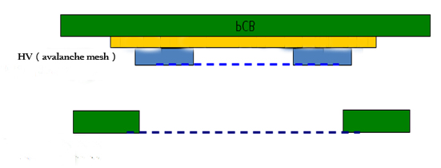
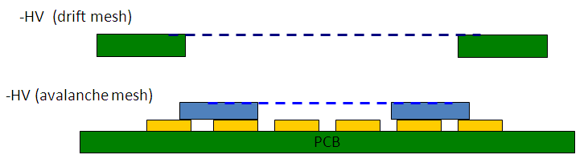
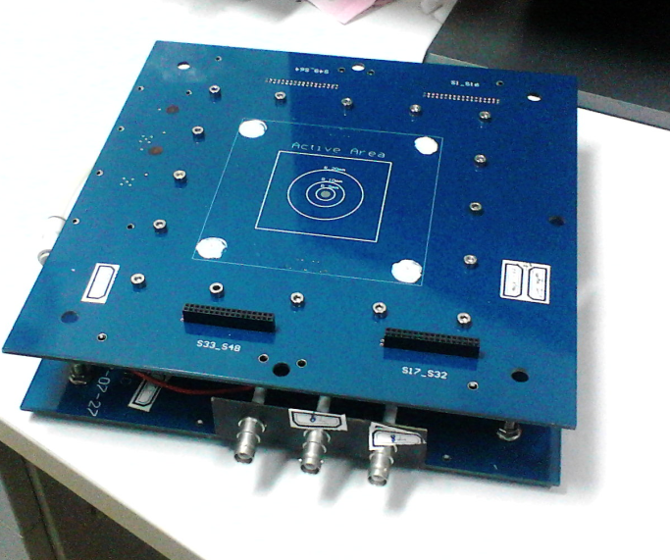
Telescope system for EMC
Motivation
Micromegas was proposed as telescope detectors for BGO EMC in Dark Matter Particle Explorer（DAMPE)
Experiment.
Design goals
1. Position of Particle hits(<1mm spatial resolution)
2. Angle of track (<0.5 degree resolution)
3 .Active area (>5cm*5cm)
e
e
e
e
A finished x-y chamber view
Basic principle
Notes:
Motivation and Goal。 每组两维读出，重建径迹

Slide 10
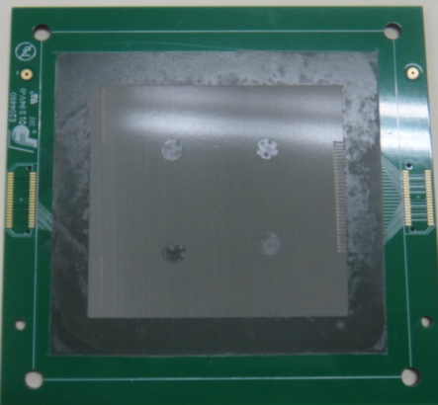
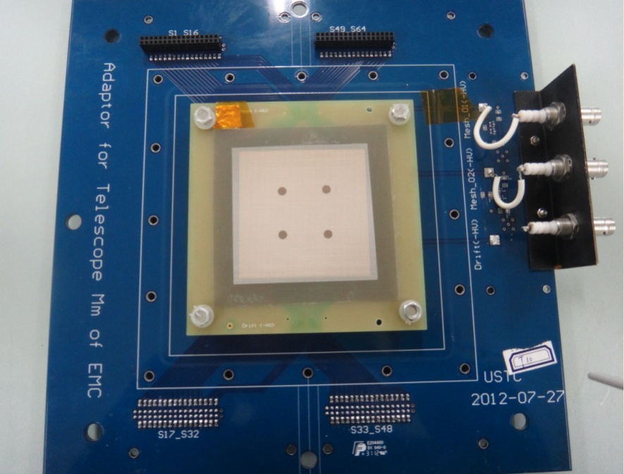
Telescope micromegas view
Top view of Mm and assemble
Bottom view of Mm(T12)
34-pin signal connectors
HV connectors
Another tension mesh was bonding on the bottom layer to avoid the Warp of readout PCB
Active area:64mm*64mm
64 readout strips （1mm strip-pitch and 0.1mm strip-gap）
Dead area :4*pi*(2mm*2mm) ~1.2%
Notes:
双面丝网，reason。

Slide 11
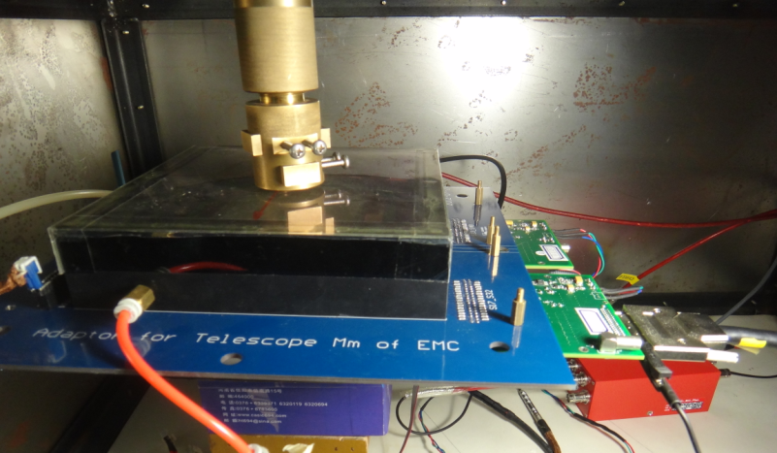
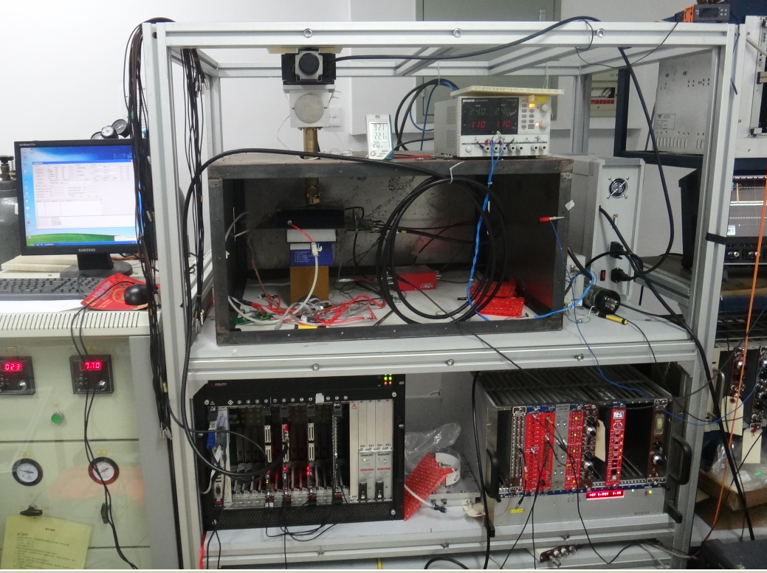
Setup
SFE16 amplifier and shaping （兰州近物所苏弘老师）
HPTDC time measurement （科大安琪老师）
SFE16 cards
Mmegas Detector
Cu X-ray tube
HPTDC and DAQ software
NIM crate
Notes:
SFE16 放大成型。 到TDC，TOT,TOT与电荷量有关，但不是线性

Slide 12
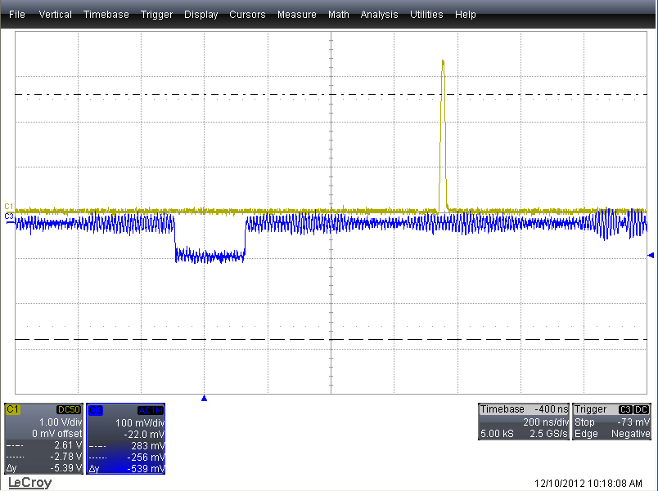
Logic circuit
Micromegas
Discriminator
NIM-TTL shifter
Mesh signal
Charge amplification and shaping
Anode strips signal
Attenuated to +3.3V for HPTDC trigger
one end signal of the
Differential output
SFE16
HPTDC
100mV ;200ns
PC
Notes:
自己使用时，丝网给触发，阳极信号到SFE16再到TDC，再到软件处理系统。调试过程采用示波器观察。

Slide 13
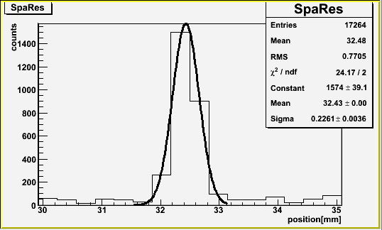
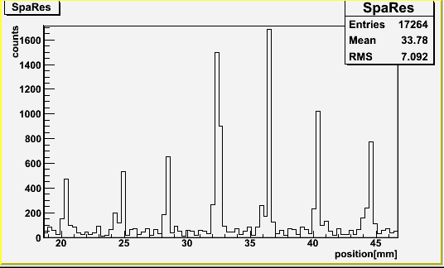
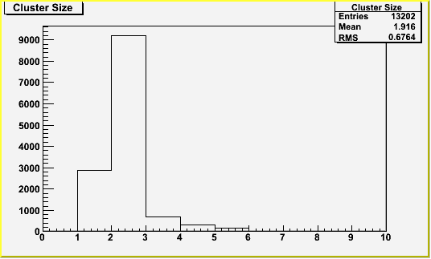
Cu-8KeV x-rays Scan for Spatial resolution
Micromegas(T12) : pitch =1mm
Sigma ：226um
Cluster Size ：1.92
The source moves from 20mm to 45mm
And we measure the spatial resolution with the interval = 5mm
Notes:
条宽1mm。从25mm到45mm，每个5mm。

Slide 14
Electron transparency and gas gain
Transparency
Gas Gain
Notes:
电子透过率，气体增益。（工艺不同gap不同）

Slide 15
Uniformity of gas gain
Scan area
1 2 3 4
5 6 7 8
9 10 11 12
3cm
4cm
The best Uniformity of several Micromegas is about 20%.
But the Uniformity of detector has a little influence on the spatial resolution

Slide 16
Towards to larger area
Equipped with the whole Electronic and DAQ
Solving the warp of readout PCB
Now we intend to step further
Drift electrode
Mesh
Readout PCB
Double Gain
Better spatial resolution with same readout channels
Better angle resolution
Solve the Warp of readout PCB
Notes:
Solve two problems

Slide 17
Summary
A telescope system with four layers Mm was finished and performance of each chamber was studied in the lab;
Some new methods were tried to make chamber and the good results have been obtained ;
A 10cm*10cm Chamber has been fabricated and studied , spatial resolution have been test with different strip-pitch s;
Larger chambers (20cm*20cm,30cm*30cm) with new structure will be tried soon.
Thank you!

Slide 18
Backup

Slide 19
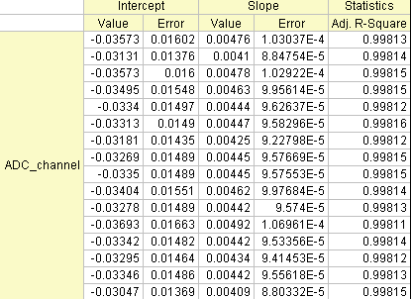
calibration
Linear fit X axis: Voltage of input square wave, Y : ADC channel
Slope intercept
0.02101 7.50445
0.02437 7.63179
0.02091 7.4693
0.02161 7.55227
0.02254 7.52714
0.02448 7.4582
0.02264 7.57712
0.02305 7.59579
0.02262 7.55911
0.02032 7.50482
0.0226 7.40858
0.02163 7.36096
0.02246 7.52531
0.02248 7.34903
0.0235 7.47674
0.02238 7.41296
Fitted parameters
Fitted curves Plot
Compute out the parameters cared
X : Voltage of input square wave(mV), Y : ADC channel (ADC units)
Calibrated through the pulser input with a square wave .
The pulser is internally distributed to individual charge termination capacity , tolerances:+-10%
Mesytec MPR-16 ：1.13pF

Slide 20
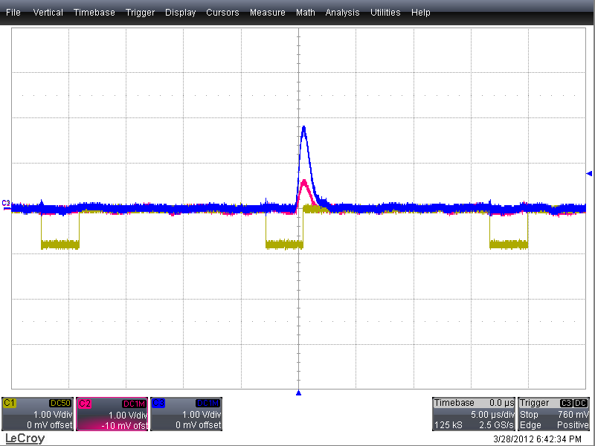
Problems
Triggers
STM-16+ Amplifier trigger：Accidental coincidence of multi-triggers and signals

Slide 21
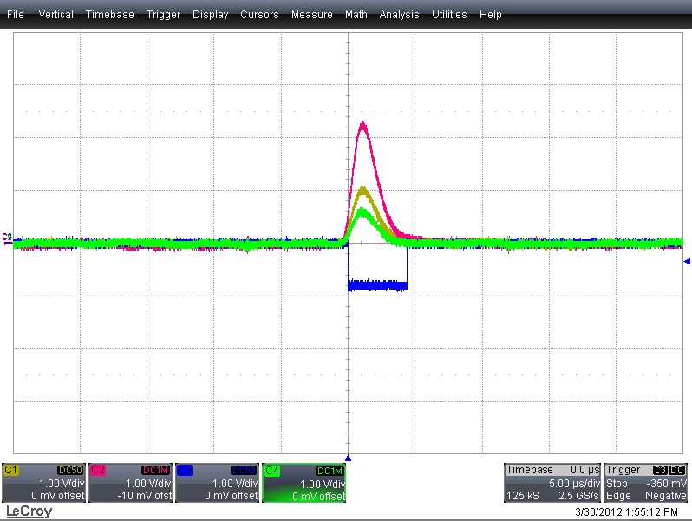
Mesh signals for trigger
Chose shaping time of main amplifiers for the signals and triggers as 0.5 μs and 1.0 μs

Slide 22
fabricated @ ~2012.01.15
a prototype with fishing line spacers and thermal bond-film frame achieved by using a hot-press machine;
Active area 10*10 square cm
Drift gap :4.7mm
Avalanche gap: 0.128mm achieved by fishing line 0.6#(diameter is of 0.128mm)
Bonding condition : temp 130;
pressure 140kg;
bonding time:28s;
thickness of separate paper ~44um
Readout channel 50 strips of 1mm pitch ,50 strips of 0.5mm pitch,100 strips of 0.25mm each strip was connected to ground through a 1M ohm resistor
the drift electrode is connected to -HV through a 10M ohm protective resistor
HV test in clear room (dry air exposure)~850V
performance study
test with a mesytec MPR-16 charge sensitive preamplifier and a mesytec STM-16+ which is a 16 fold spectroscopy Amplifier with Discriminators and Multiplicity Trigger
source
8keV Cu-X-rays supplied by a X-ray Tube

Slide 23
Micromegas 测试中的噪声问题
接地
探测器与前置放大器；探测器与HV；HV与前放大；外屏蔽箱与NIM机箱；
电磁干扰
屏蔽箱内不能放置强干扰器件，如温度监控器，电动平台电机（测试时断电），X光机光管（X光管测试需要放在屏蔽箱内，应尽量远离探测器）等；
NIM插件的干扰
尽可能把高压源，不同主要放大器分在不同NIM机箱上，其中主放大器，甄别器，电源相互干扰明显。

Slide 24
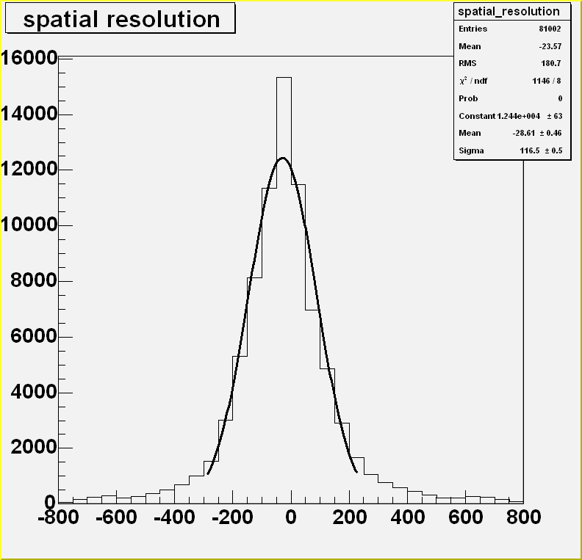
Strip 178(pitch:0.25mm)
σ=116.5μm
Strip 68(pitch:0.25mm)
σ=113.2μm
Spatial distribution is not a rigorous Gaussian ,may be caused by the width distribution of X-rays .

