Slide 1
Manufacture and performance of three 200×200mm² thermal-bonding Micromegas prototypes
Zhiyong Zhang（张志永）, Liang Guan（管亮）, Xiaolian Wang（汪晓莲）, Tianchi Zhao（赵天池）
核探测与核电子学国家重点实验室
中国科学技术大学近代物理系
E-mail: zhzhy@mail.ustc.edu.cn
2014/07/19-07/20

Slide 2
Outline
Basic principle
Manufacture
Test system
Performance
Summary

Slide 3
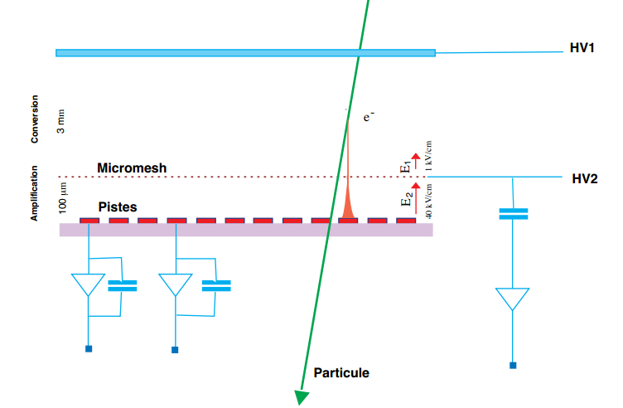
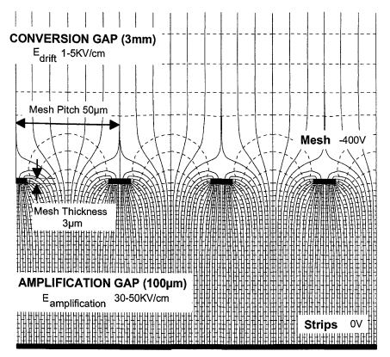
• Basic principle
Stainless steel
mesh
Y. Giomatnris, et al., MICROMEGAS: a high-granularity position-sensitive gaseous detector for high particle-flux environments, 1996 Nuclear Instruments and Methods in Physics Research A 376 29-35.
Y. Giomatnris, Development and prospects of the new gaseous detector “Micromegas”, 1998 Nuclear Instruments and Methods in Physics Research A 419 239-250

Slide 4
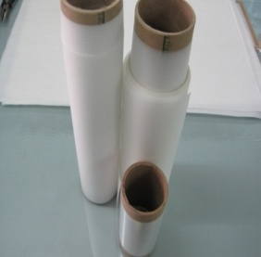
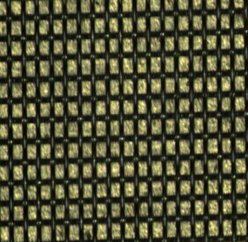
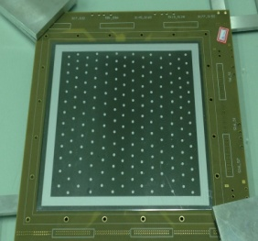
• Manufacture
» Structure
» Materials
Compressed air
Stretched mesh
Readout PCB
Spacers
Hot plane
MicroMesh: 350 LPI woven stainless steel mesh pitch/wire diameter 75/24 μm
The intrinsic volume resistivity of Ge (house temperature):59ohm.cm
tough polyester films with a permanent, dry (hot-melt type) adhesive on both sides
Germanium Plated PCB
The readout PCB with a Germanium plated layer (0.1-0.5μm thickness, ~2MΩ/口)
Thermal-bonding film spacers and frame are placed on the PCB.
Double avalanche gaps are achieved on both side of the readout PCB.

Slide 5
» Bonding condition
 | Mm01 | Mm02 | Mm_Ge
Active area (mm²) | 200×200 | 200×200 | 200×200
Number of spacers | 173 | 200 | ~200
Dimension of spacers (mm) | 4 | 3 | 3
Spacer area (%) | 5.43 | 3.53 | 3.85/3.34
Tension of mesh (N/cm) | 19/20 | 19.5/19.5 | 19/20
Bonding time | 70/70 | 69/69 | 65/65
Temperature (up) (ºC) | 116/118 | 116/115 | 120/117
Temperature (down) (ºC) | 138/132 | 130/130 | 144/139
Pressure (kg) | 125/110 | 124/120 | 119/127

Slide 6
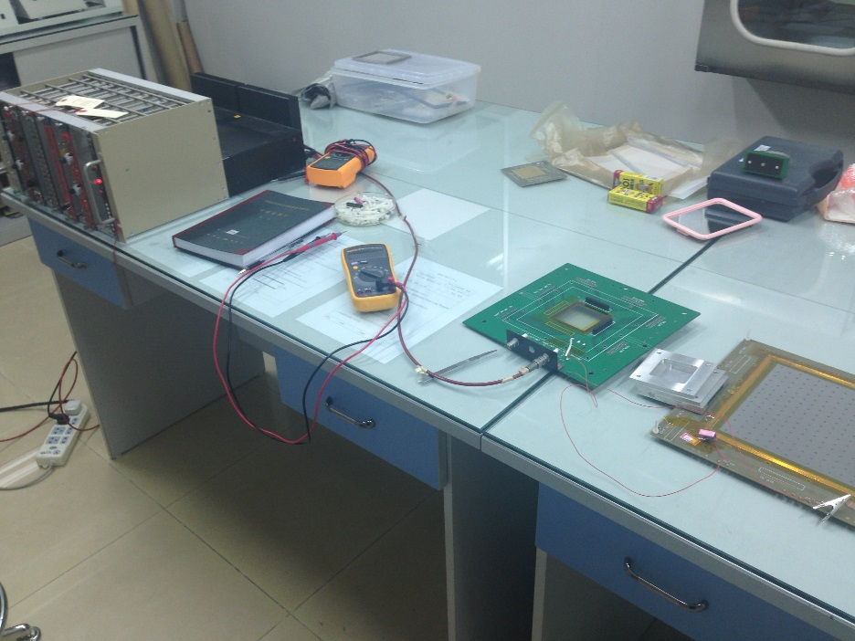
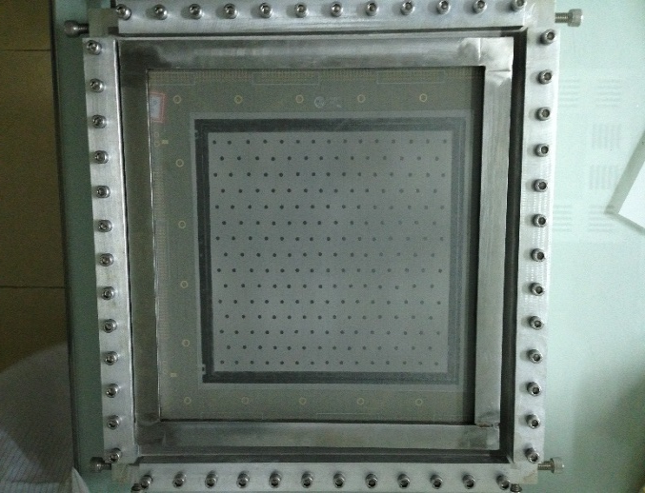
» Fabrication
After bonding
HV test in clean room

Slide 7
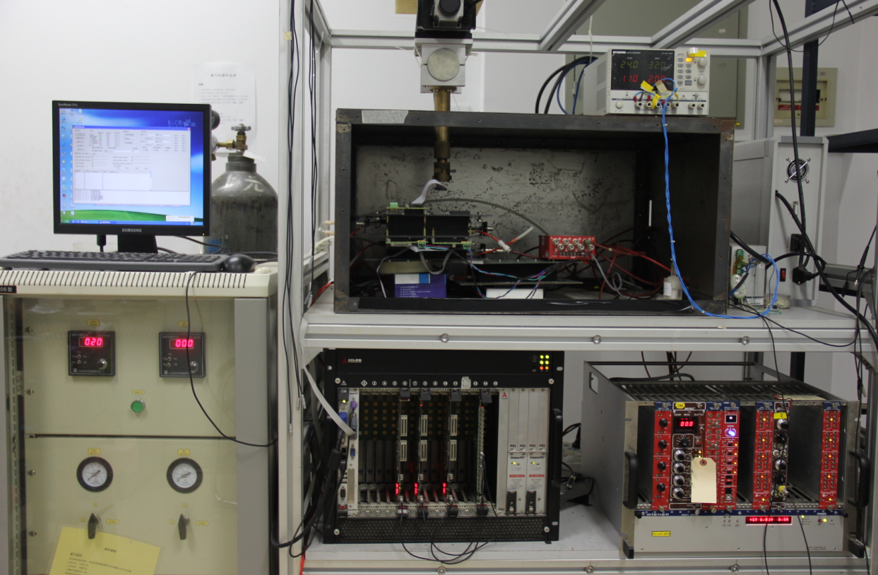
• Test system
Mobile scanning platform , x-ray gun, shielding box et.al..
Gas system
DAQ system
NIM crate and HV, logic plug-in board

Slide 8
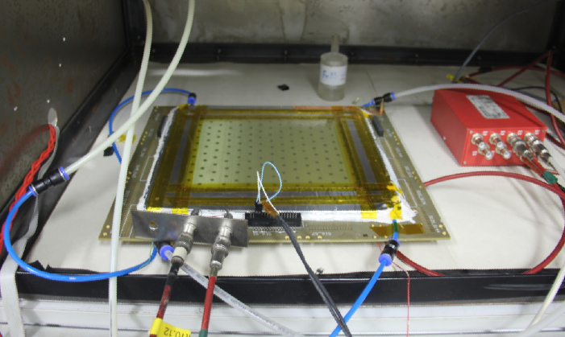
• Setup
Gas Mixture: Ar+CO2(93:7);
Flowing gas mode;
Scanning with a ⁵⁵Fe source and a Cu-target x-ray gun;

Slide 9
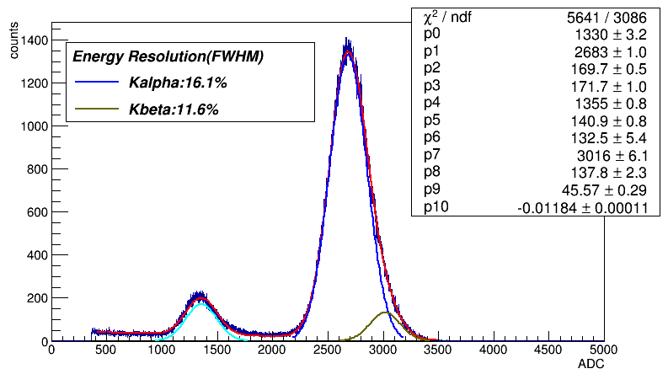
• Performance
» Spectrum of ⁵⁵Fe source (Mm01)
Gas Mixture: Ar+CO2(93:7);
Kalpha: 5.9keV; Kbeta: 6.5keV;
Fitted by triple gauss function + linear noise;

Slide 10
» Absolute gain (left)
» Energy resolution versus gas gain (⁵⁵Fe source 5.9keV x-rays) (right)

Slide 11
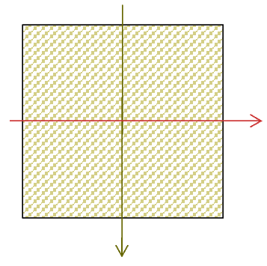
» Gain non-uniformity
⁵⁵Fe source Scan direction:
20cm×20cm active area
The gas gain is mainly depend on the avalanche gap，which is determined by the flatness of hot plate, heating time, and pressure etc.

Slide 12
» fine scan (Mm02)
Cu Kalpha x-rays source scanning (perpendicular to the strips):
20cm×20cm active area
Fine scan the active area with a Cu-target x-ray gun in a ~15mm range, about ± 5% non-uniformity is obtained, which will affect less for the spatial resolution, since the cluster size of avalanches is smaller than 1 mm.

Slide 13
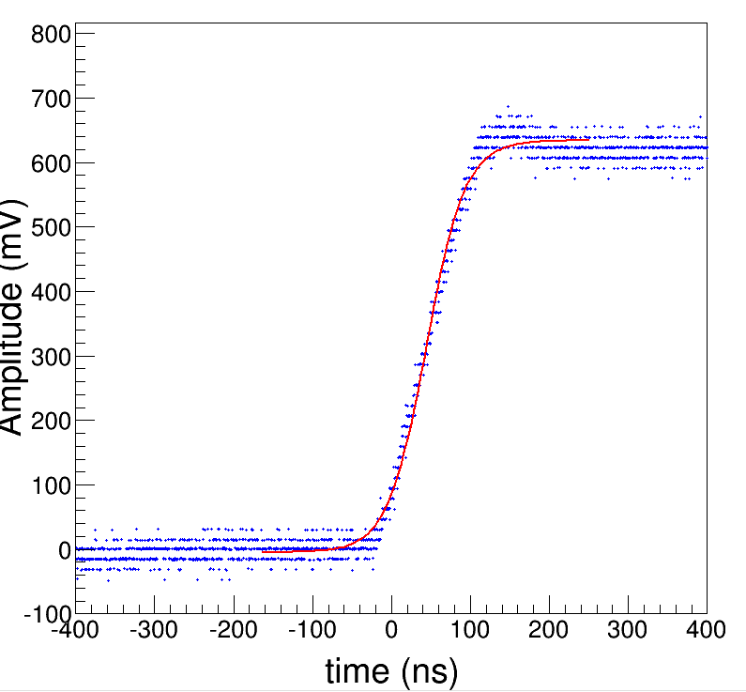
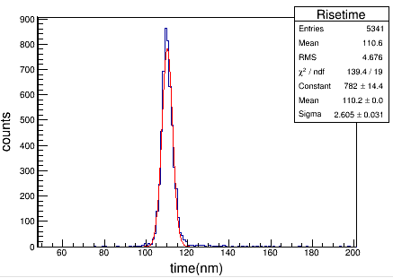
» Pulse analysis
Signals from preamplifier are digitized and recorded through Digital Oscilloscope for offline analysis
Pulse shapes are fitted (range: 2~3*rise time) with sigmoid function:
Signal Amplitude and Rise time are extracted from the fitted function.
Rise time:
$$A\left(t\right)=−\frac{p\left[0\right]}{1+e^{\frac{t−p\left[1\right]}{p\left[2\right]}}}+p[3]$$
Risetime:110ns
$$T_{10\%−90\%}=4.39∗p[2]$$

Slide 14
» Rate capability study
The Germanium layer is around
connected to the ground.
Cu X-rays tube(8KeV)
source
150-5000μm
collimator
100-5000μm
Micromegas

Slide 15
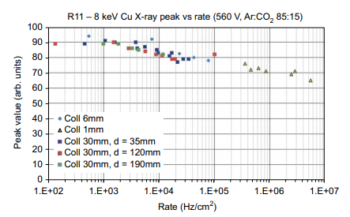
» Rate capability
The gain versus x-rays rate with different surface resistivity.
T. Alexopoulos, et.al., A spark-resistant bulk-micromegas chamber for high-rate applications, 2011 Nuclear Instruments and Methods in Physics Research A 640 110–118.

Slide 16
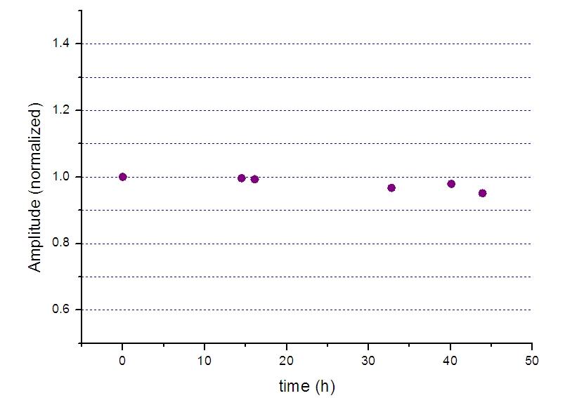
» Stability
Source: 5.9keV x-rays
Operated at a gain of ~9300;
Radiation rate:150Hz

Slide 17
• Summary
◊ The thermal-bonding method had been developed to manufacture the Micromegas, the manufacture and performance are presented.
◊ High gain and good energy resolution are obtained with the 200×200 mm² prototypes.
◊The rate capability and stability are also studied, further improvements need to be carried out.
Further plan：
■ Try to improve the uniformity efficiency and rate capability of resistant anode chamber.
■ Develop the new structures like PIM, Backplane.
■ Setup a telescope for cosmic test of BGO ECAL of DAMPE, if it is needed.
Thank you!

