Slide 1
山东大学 气体探测器研究
祝成光
代表山东大学粒子物理与粒子辐照教育部重点实验室的同仁们

Slide 2
Outline
TGC detector for ATLAS trigger
sTGC detector for ATLAS trigger upgrade
TPC detector for STAR upgrade
TPC advanced research for CEPC
Hodoscopes for detector testing

Slide 3
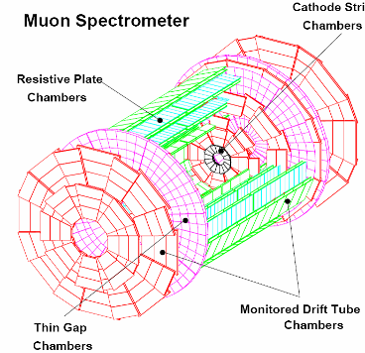
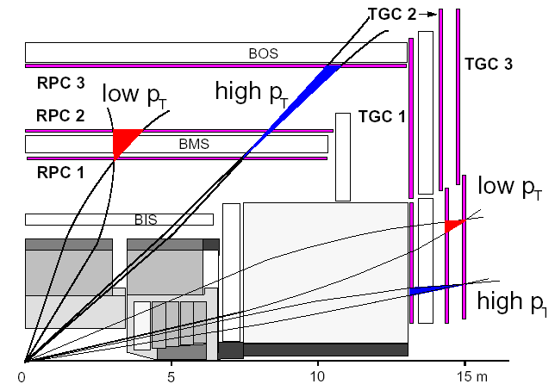
ATLAS实验TGC探测器
Start point of the detector study in SDU

Slide 4
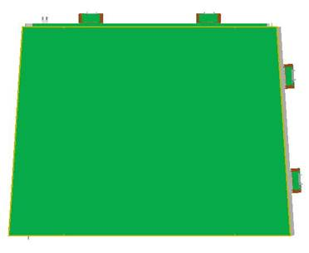
Principle of TGC detector
Quick response

Slide 5
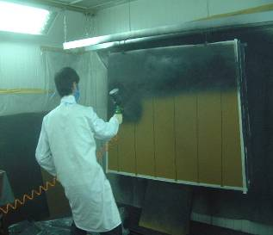
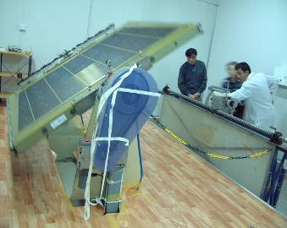
Anode and cathode plane

Slide 6
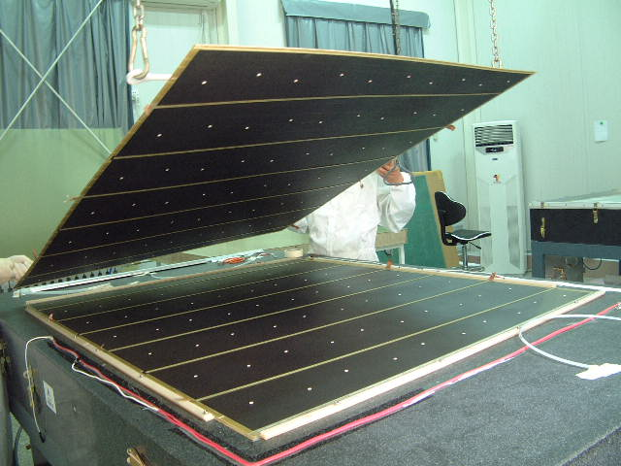
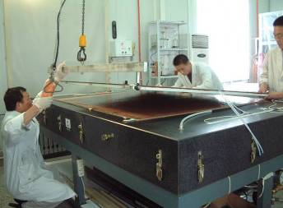
Detector into shape
A series of quality control

Slide 7
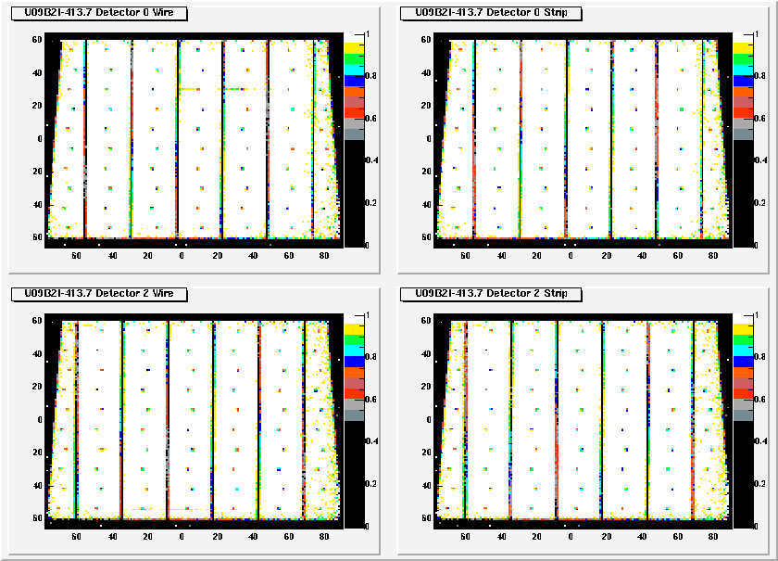
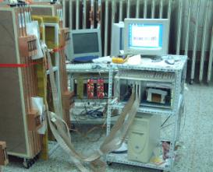
Testing of TGC
Uniformity/noise test and efficiency test
No one failed

Slide 8
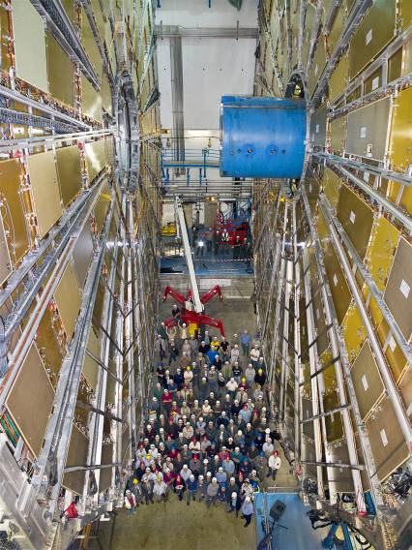
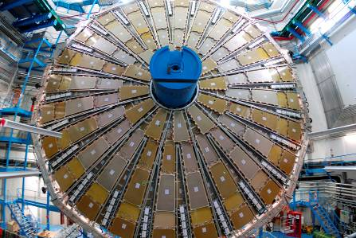
TGC installed in ATLAS cavern
One failed after 3 years of running, (fail: 1/400 < 1/50)

Slide 9
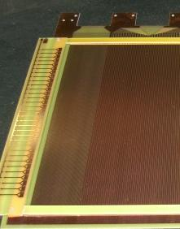
sTGC v1
感应信号拾取电极
Φ50μm镀金钨丝
2.8mm间距
Keep the performance of the fast response
Improve the position resolution and capable rate.
1mm strip pitch, 120micro achieved

Slide 10
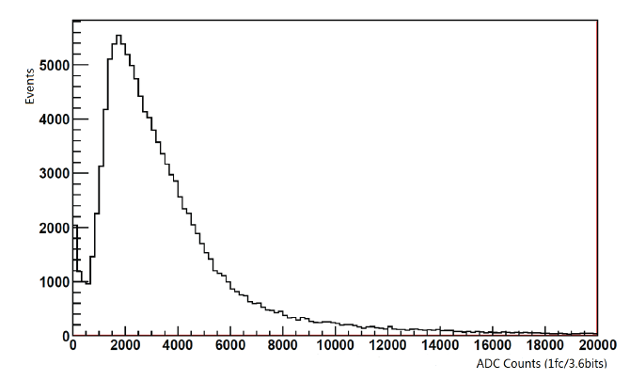
signals
Signals from strips
Charge distribution, on average 470fC, M around 10⁵

Slide 11
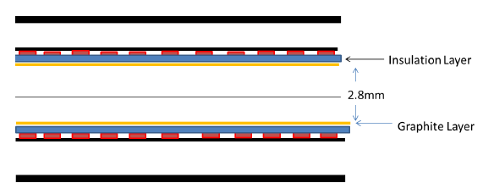
sTGC v2
4mm strip pitch, 233micro achieved.
Resistive layer for protection and enlarging charge dist

Slide 12
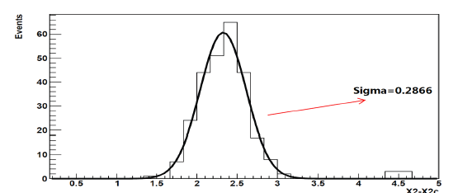
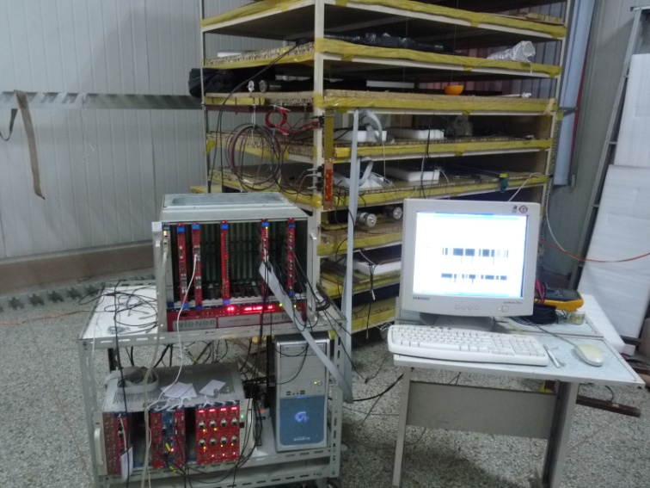
Position resolution around 233micro.

Slide 13
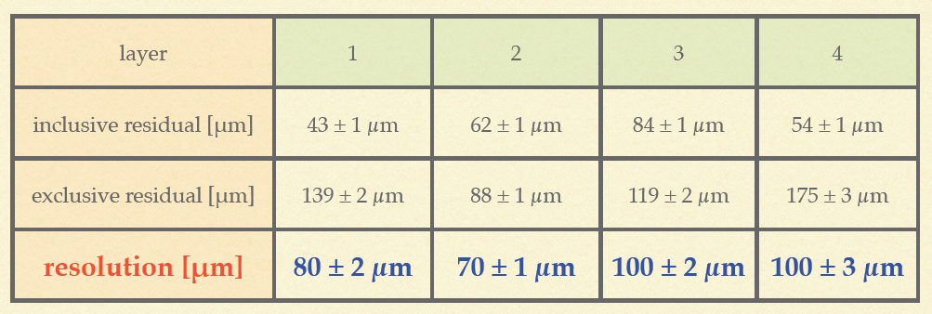
Beam test at Fermi

Slide 14
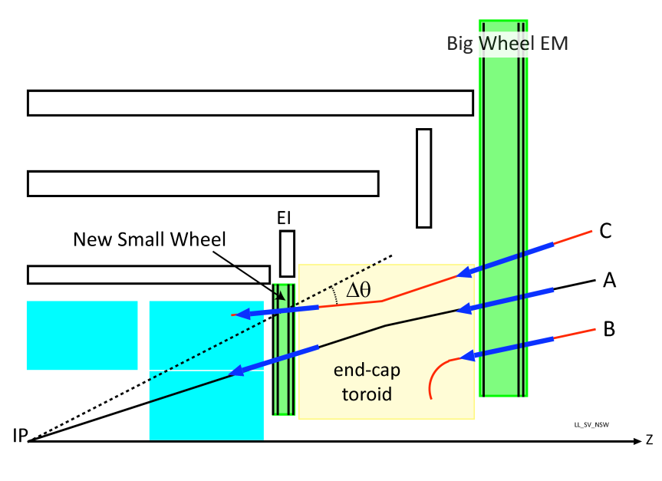
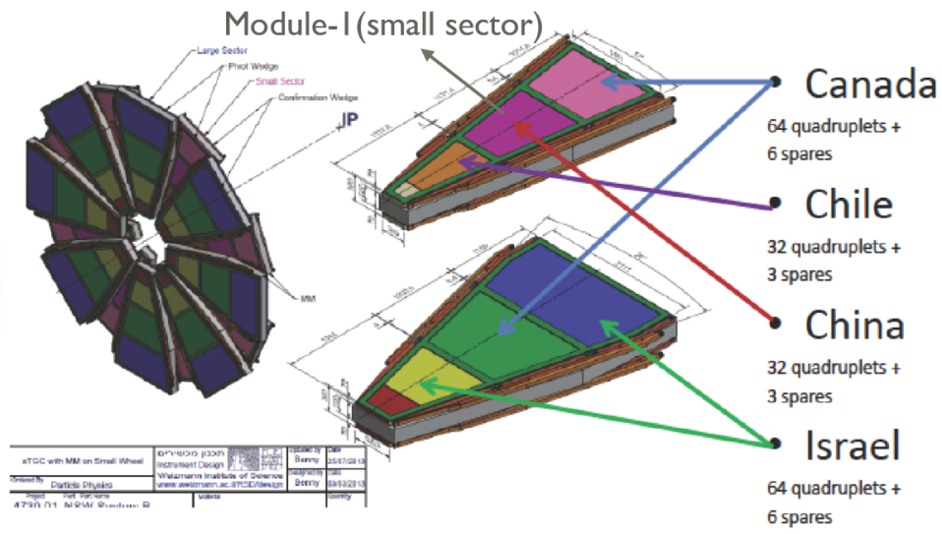
直径8.9米
8层sTGC
sTGC as the new trigger layer in ATLAS

Slide 15
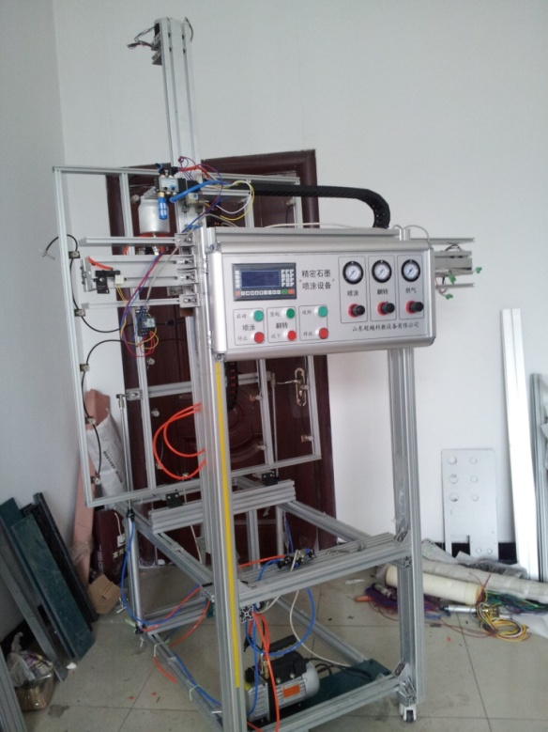
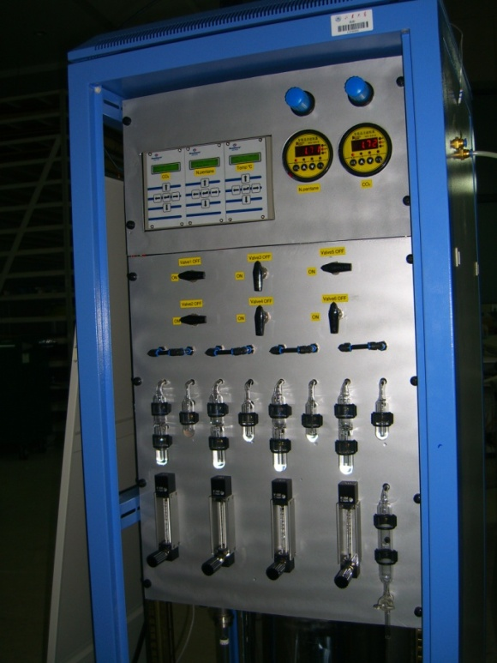
sTGC gas mixer
and automatic Spraying machine
15

Slide 16
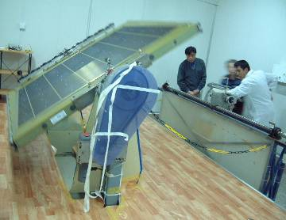
Upgraded wire machine

Slide 17
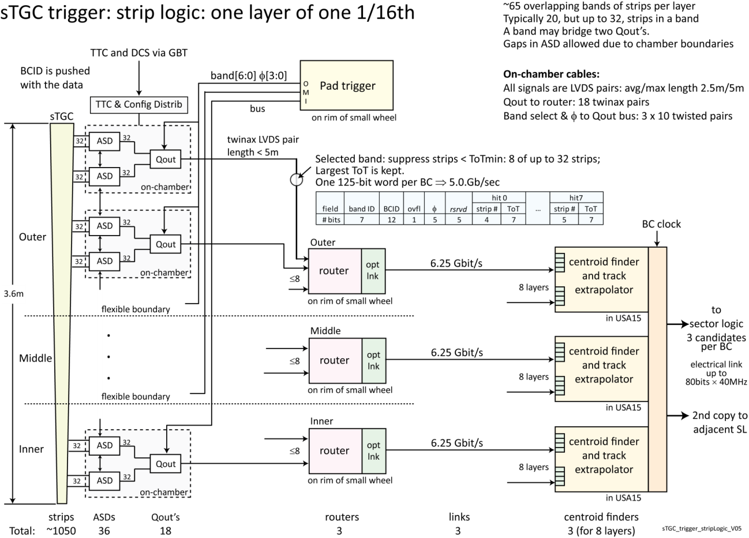
Front End lectronics
(USTC)
sTGC （SDU)
router
科大和山大在探测器和前端电子学合作是我们在粒子探测器的研究中走上更高的台阶。

Slide 18
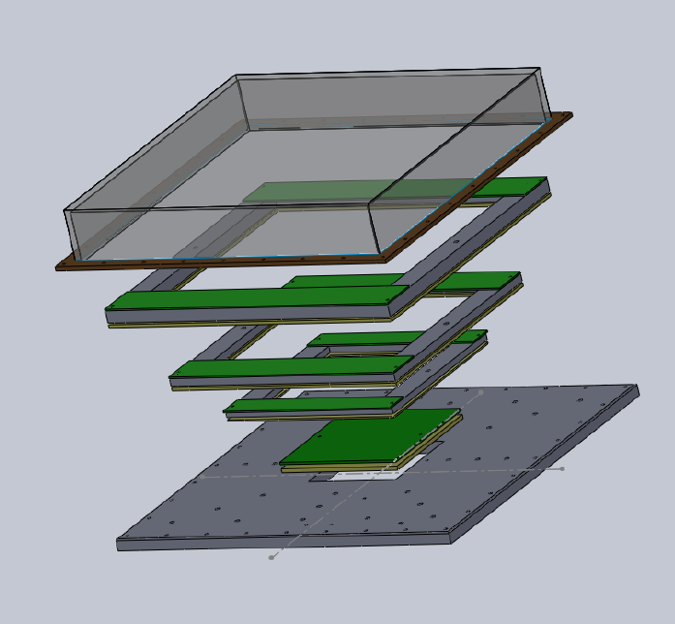
TPC for STAR experiment
20micro anode wire plus shielding and gating wires

Slide 19
Signal
200ns width

Slide 20
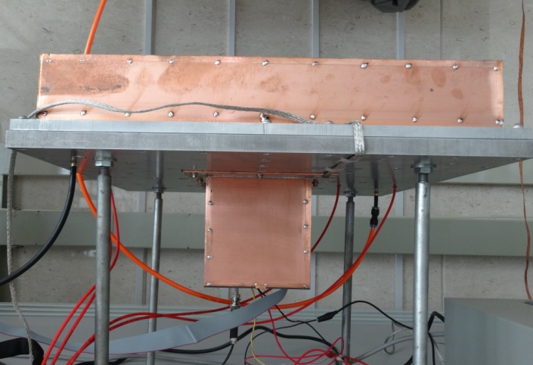
FE electronics
Gassiplex chip for FE

Slide 21
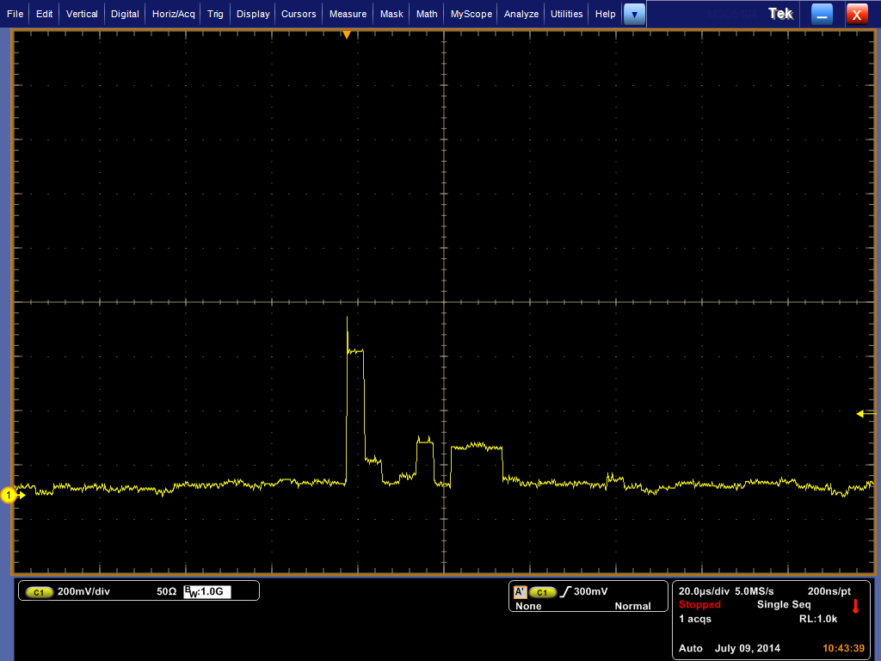
Integrated signal of each channel
88 pads readout in once

Slide 22
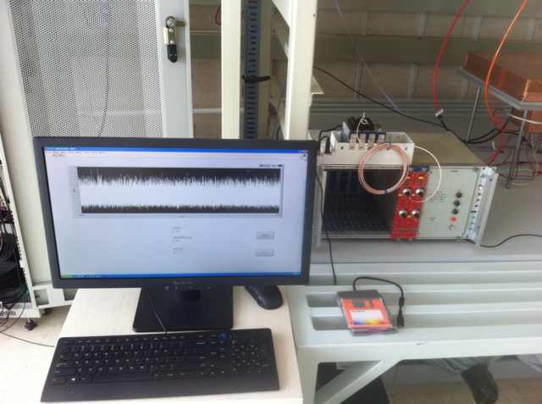
Leak current and noise
Noise and sparks are well under control

Slide 23
Plans
Test the performance for STAR requirements
Produce full size TPC
Extend the drift length to 1 meter
Test TGEM and GEM for TPC technique used for CEPC

Slide 24
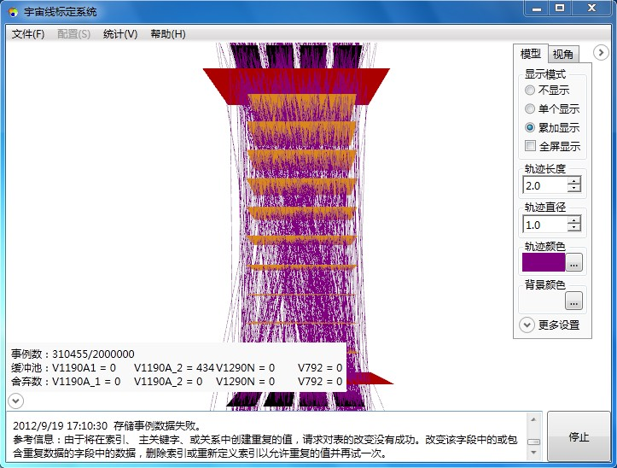
Cosmic test bed
For general detector testing

Slide 25
Full size

Slide 26
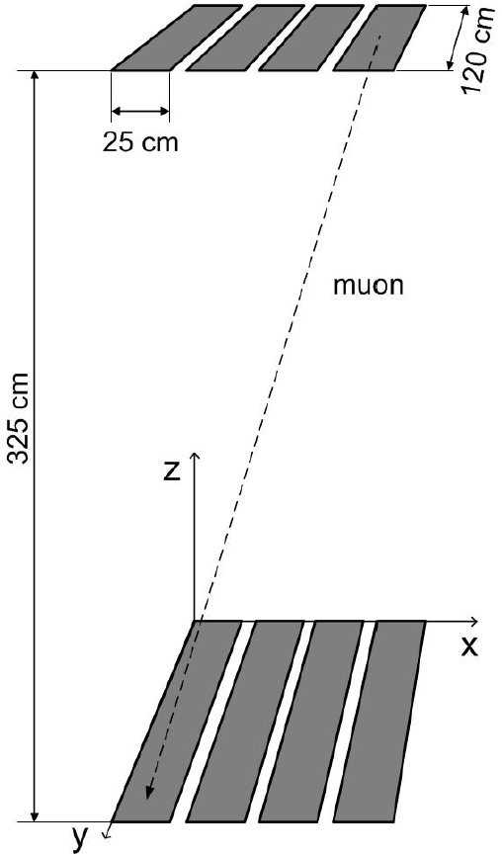
Cosmic rate
触发率模拟
总入射率
x、y 均匀分布
方位角均匀分布
天顶角
模拟结果：12.7/s

Slide 27
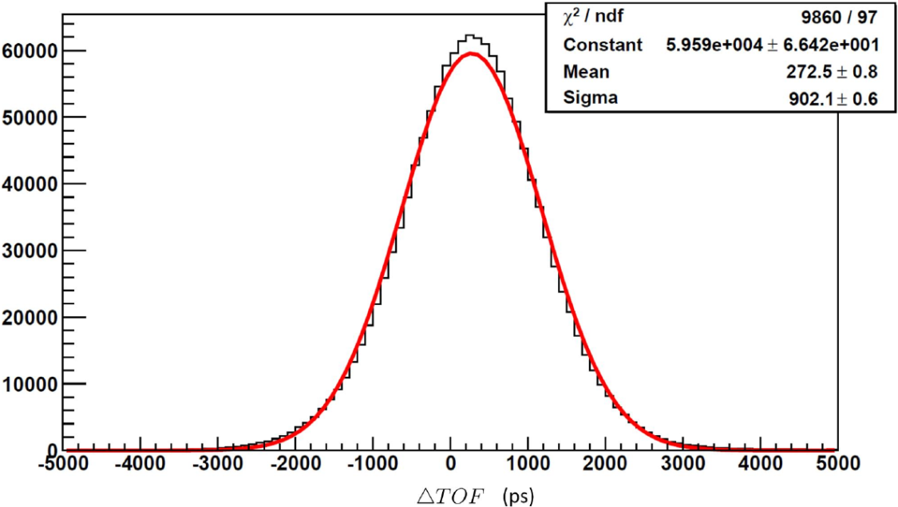
Time resolution
闪烁体时间刻度
系统时间分辨率
闪烁体的时间分辨率

Slide 28
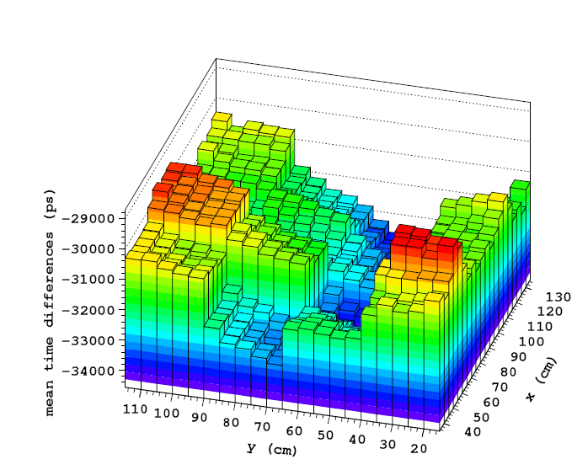
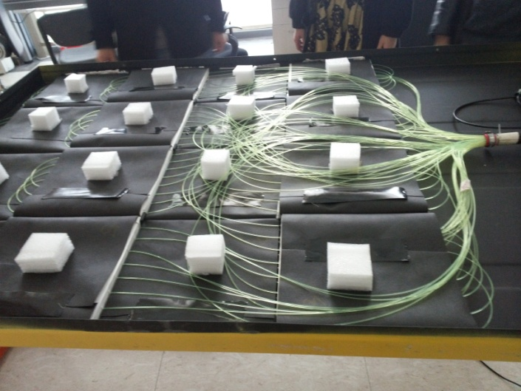
Tested EDs for LHAASO

Slide 29
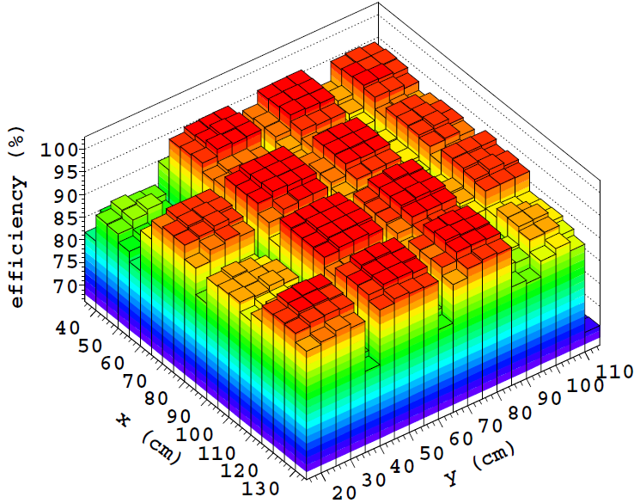
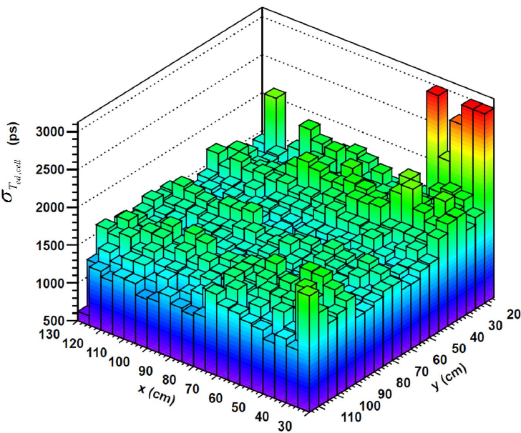
Efficiency and time reso scan

Slide 30
Q scan

Slide 31
Plan
Based on new sTGC technique, and new-build fast scintilators, build a new cosmic test bed with position resolution <100micro, time resolution <100ps.
Mainly for sTGC and TPC testing in near future.

Slide 32
总结
气体探测器研究在项目带动下得到长足发展，建设了基本的实验设备，积累了探测器研究经验，并蓬勃发展。
有望在中国建设的新一代粒子物理实验中发挥应有的作用

