Slide 1
MRPC飞行时间探测器研制进展
Wang Yi
Department of Engineering Physics, Tsinghua University
yiwang@mail.tsinghua.edu.cn

Slide 2
Abstract:
  Introduction of PID and MRPC
  Three generation of MRPC-TOF
  STAR-TOF
  CBM-TOF
  SoLID-TOF
Conclusion

Slide 3
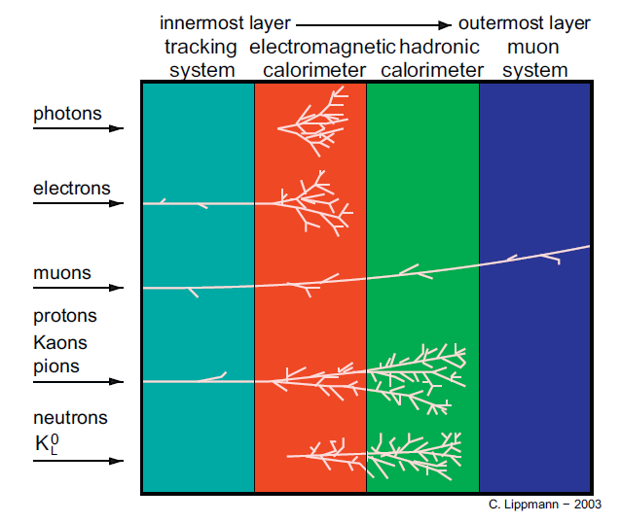
Particle identification
Particle identification by：
Velocity
- Flight time：
- Cherenkov velocity：
- TRD：
dE/dx
Energy -Calorimeter
Detection system of physics experiments
3

Slide 4
Typical TOF detector
Fast scintillator + PMT (SiPM)
Cherenkov scintillator + MCP
MRPC
MRPC has the advantage of good timing resolution, high detection efficiency and relatively low cost, and is widely used to construct TOF system in modern high energy nuclear physics experiments.

Slide 5
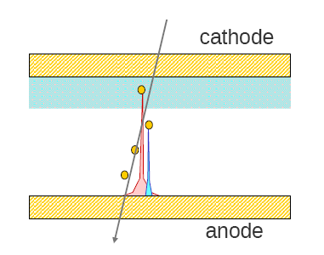
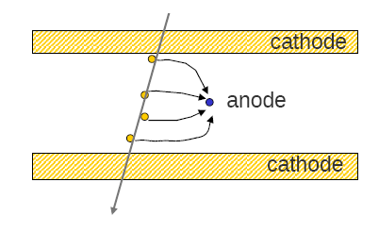
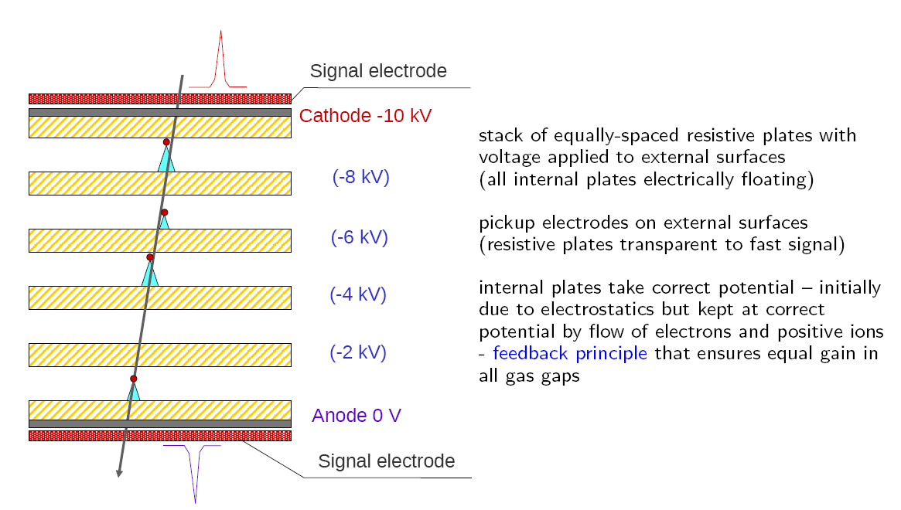
Evolution of timing gas detector
Drift chamber
Parallel plate
RPC
MRPC

Slide 6
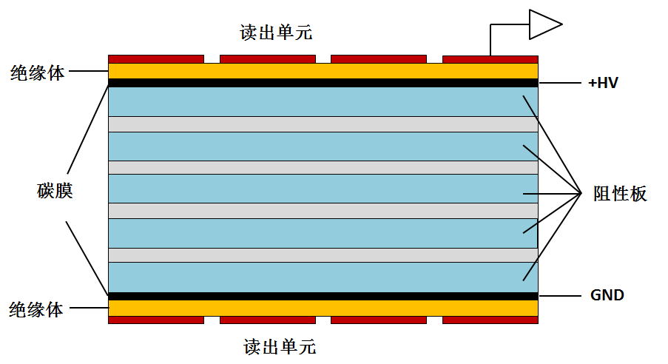
MRPC introduction
Read out
Standard parameters:
Resistivity of glass: ~10¹² Ω.cm
Working gas: 90%Freon+5%iso-butane+5% SF6
Time resolution <100ps
Efficiency >95%
Charge: a few PC
Dark current: a few nA
Noise ~1Hz/cm²
Rate <100 Hz/cm²
Large area, low cost
Insulator
Carbon
Resistive
plate
Insulator
Read out
MRPC structure
MRPC application：
Application in nuclear physics experiments
Application in industry（Muon tomography)
Application in medicine（TOF-PET）

Slide 7
MRPC performance
Efficiency：
efficiency of single gap：
Weighting field
threshold
Efficiency of N gaps：
Time resolution：

Slide 8
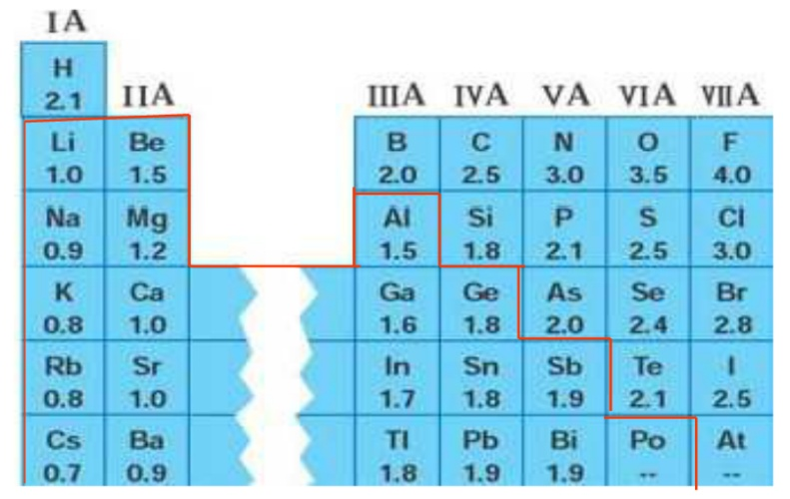
MRPC工作气体的选择
1）高电负性 （吸附系数>10⁻⁵）
2）在高电场下不易击穿
标准工作气体: C₂H₂F₄ (90%) i-C₄H₁₀ (5%) SF₆ (5%)
-C₂H₂F₄ (tetrafluorethane): 主要工作气体，电负性
-i-C₄H₁₀ (iso-butane): 吸收光子，减少流光
-SF₆(sulfur hexafluoride): SF6具备超强的吸附电子能力。吸附电子变成负离子，很容易与正离子结合，活动性变差。
元素的电负性表
8
8

Slide 9
How to increase rate of MRPC
The voltage drop in the gas gap:
The smaller the voltage drop, the higher efficiency and higher rate capability!
Two main ways to improve rate capability:
Reducing bulky resistivity of electrode glass (CBM)
Reducing the avalanche charge (ATLAS)
Other methods:
Reducing the thickness of glass
Warming the detector

Slide 10
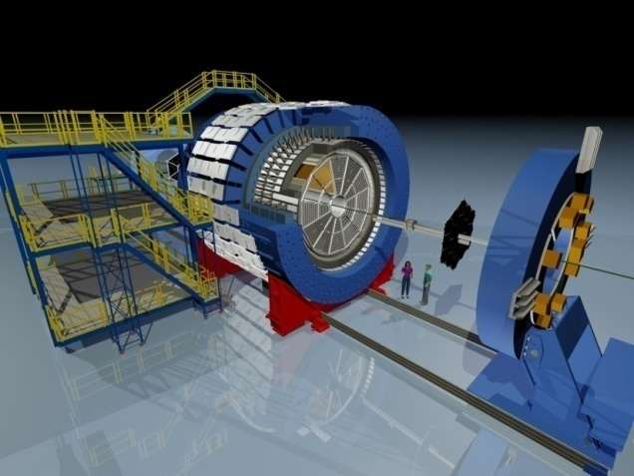
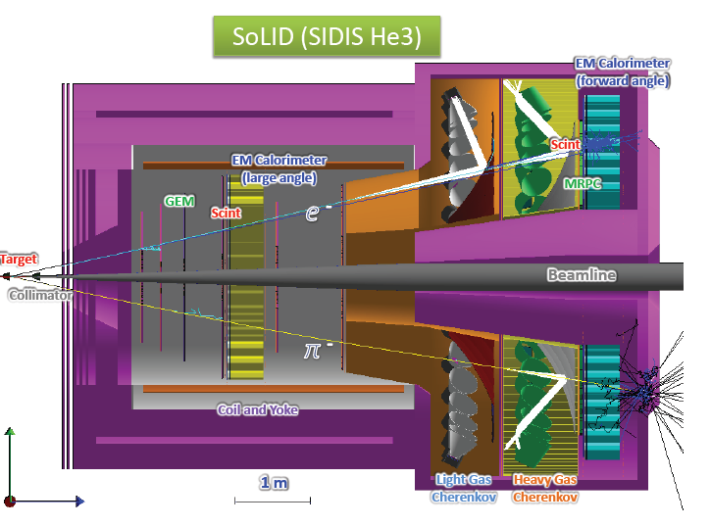
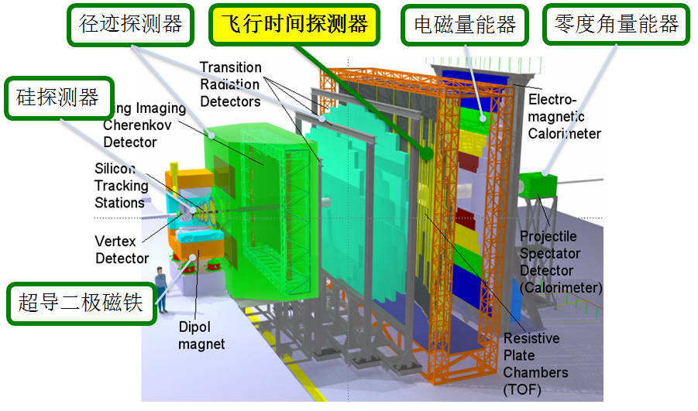
Typical MRPC TOF
RHIC-STAR TOF
Float glass
JLab-SoLID TOF
High rate and 20ps resolution
FAIR-CBM TOF
High rate- low resistive glass

Slide 11
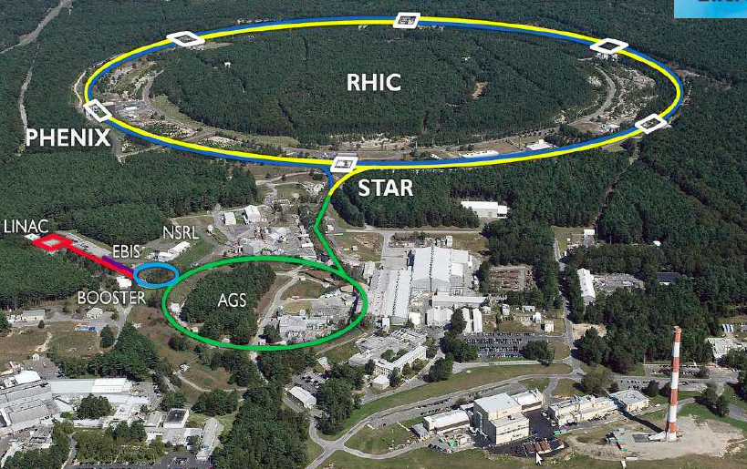
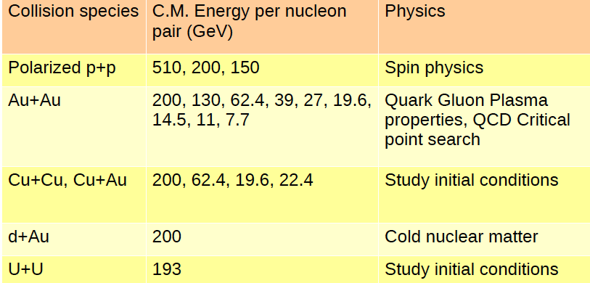
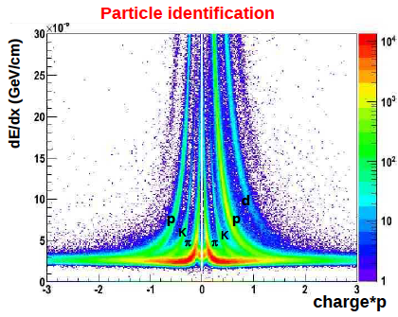
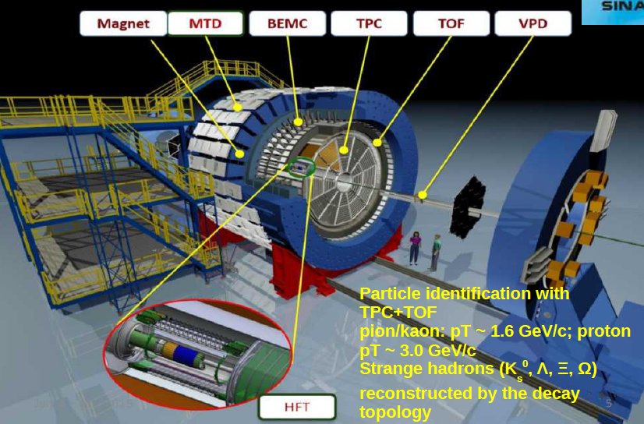
RHIC-STAR

Slide 12
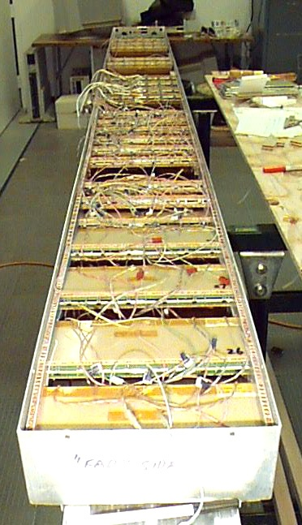
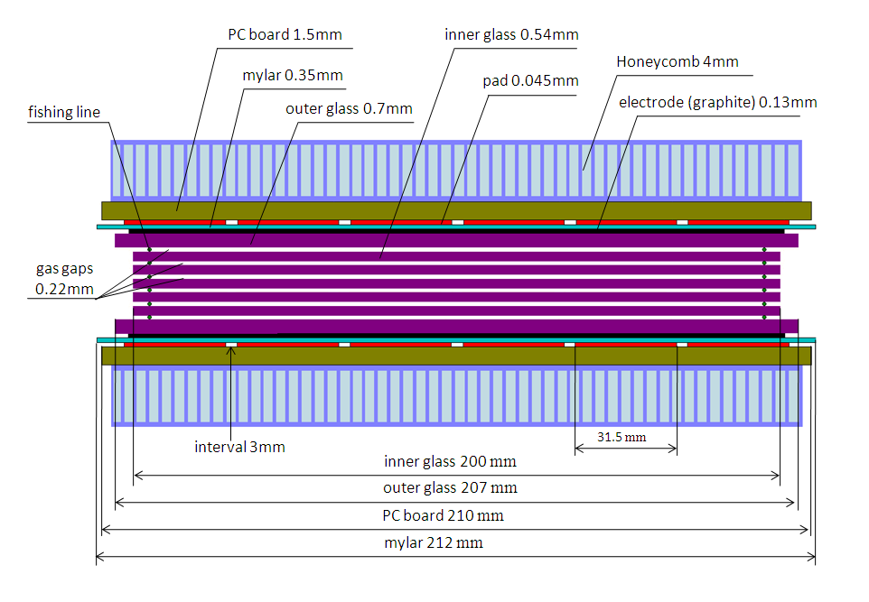
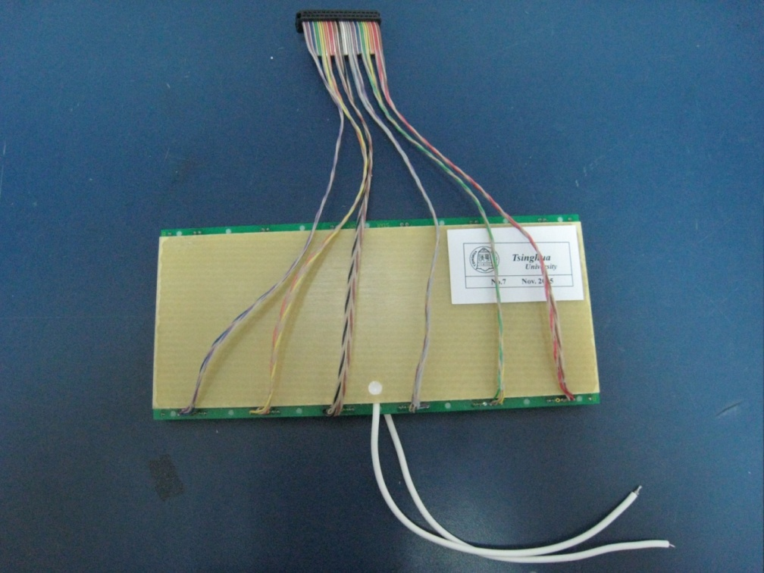
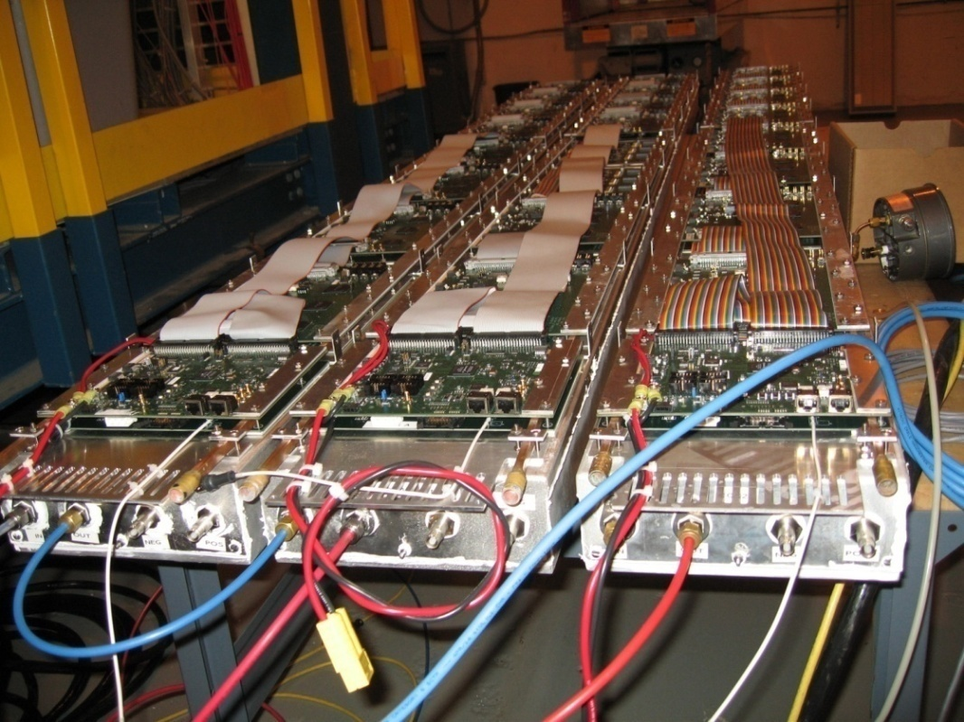
STAR-TOF MRPC
Long side view
12

Slide 13
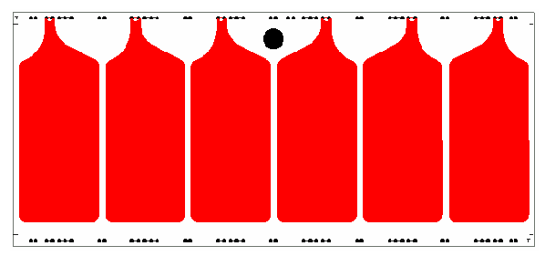
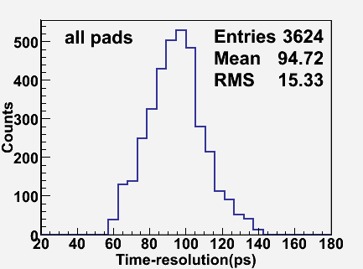
STAR MRPC performance
Readout pad
6cm
3cm
Glass: ～4×10¹²Ω.cm
Carbon tape: 500k Ω/
Gas gap: 6×0.22mm
Working gas: 95% F134a+5% iso-butane
Time resolution: 70ps
Efficiency >90%
Rates capability: <100Hz/cm² !
604个MRPC时间分辨统计图

Slide 14
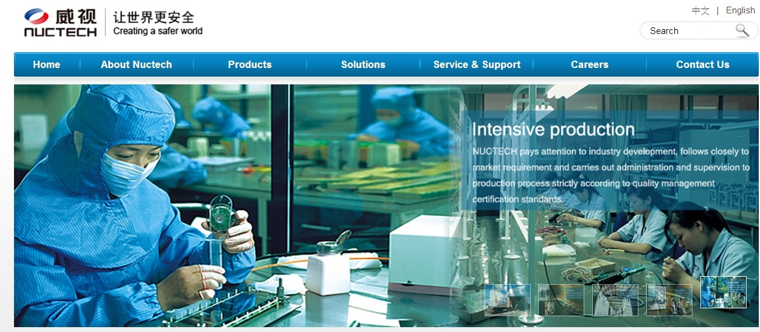
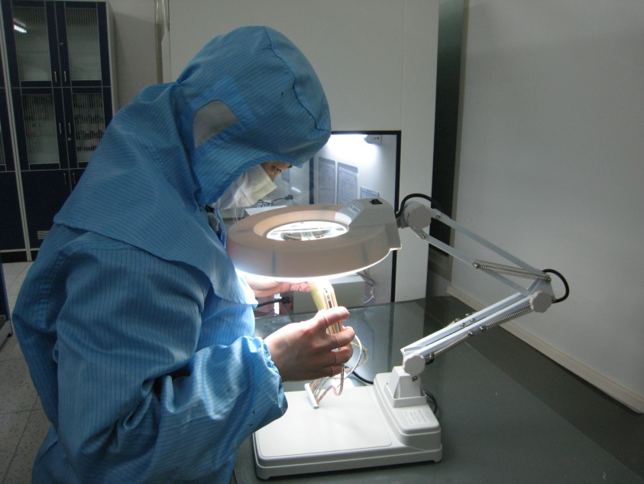
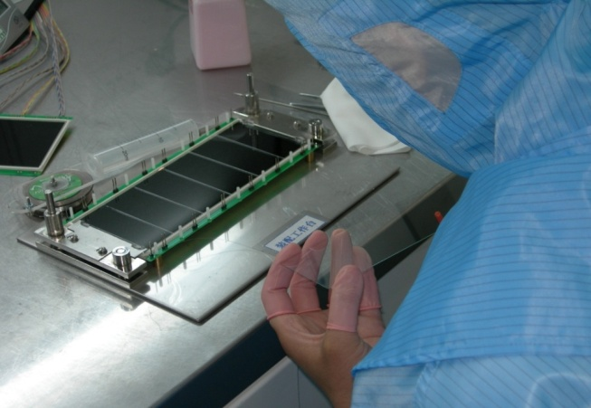
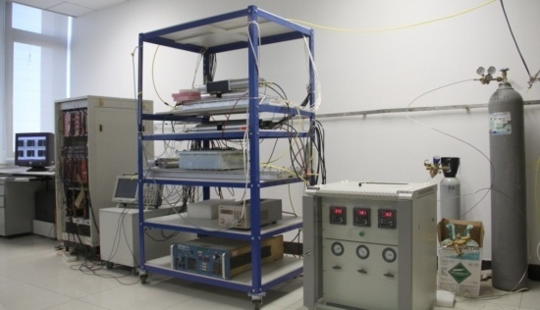
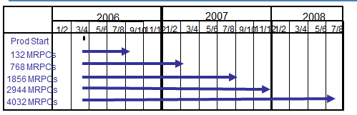
MRPC mass production
14
14

Slide 15
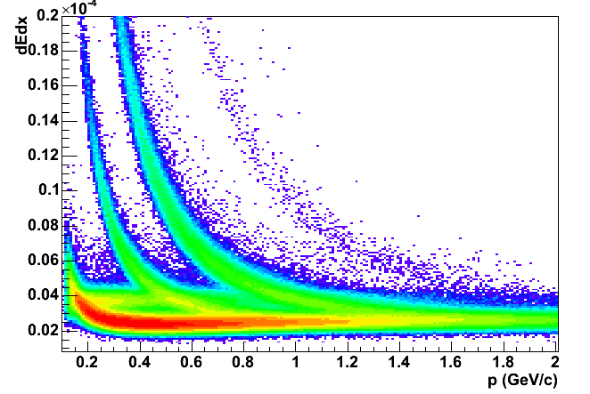
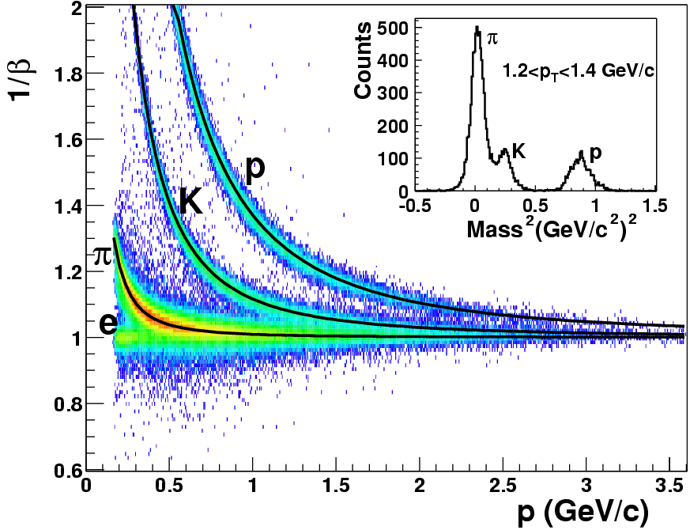
PID of STAR-TOF
TPC
Only TPC:
π/k ~0.7 GeV/c,
(π,k)/p ~1.1 GeV/c
p
π
K
TOF
e
Only TOF:
π /k ~1.6 GeV/c,
(π,k)/p ~ 3.0 GeV/c

Slide 16
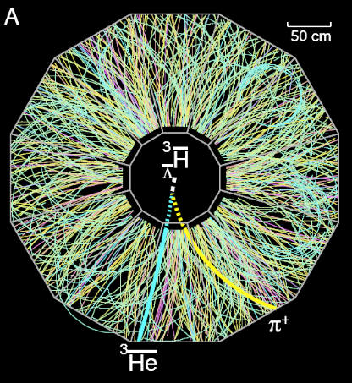
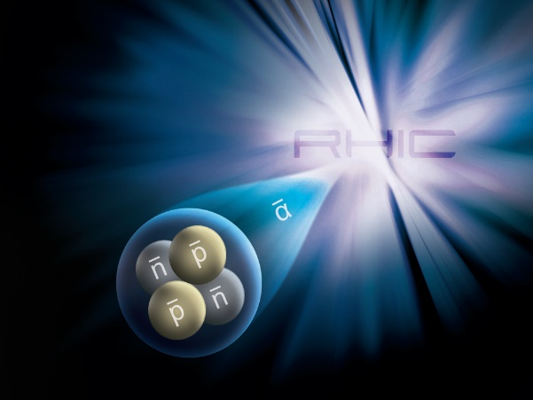



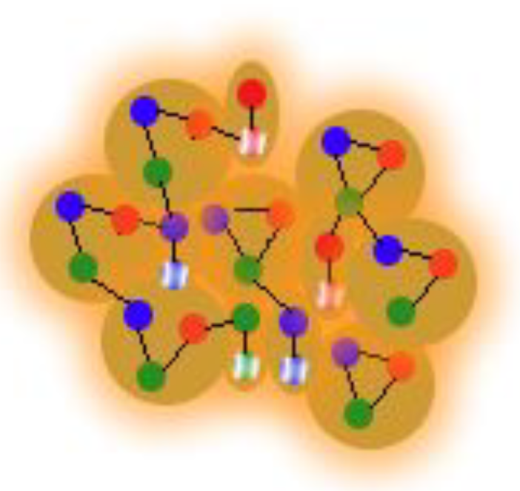
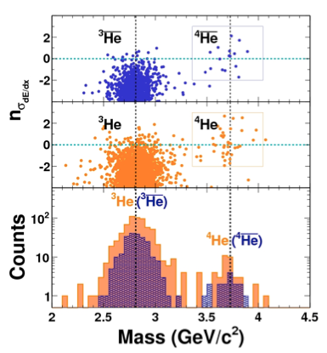

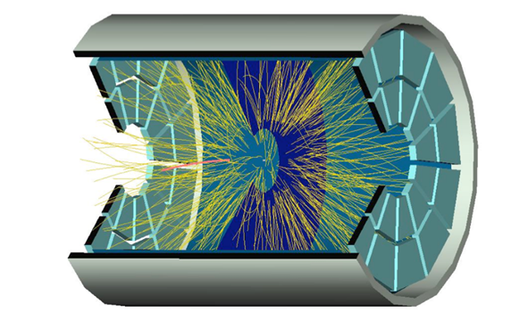
Physics results
TOF
QGP
Nature 473 (2011) 353

Slide 17
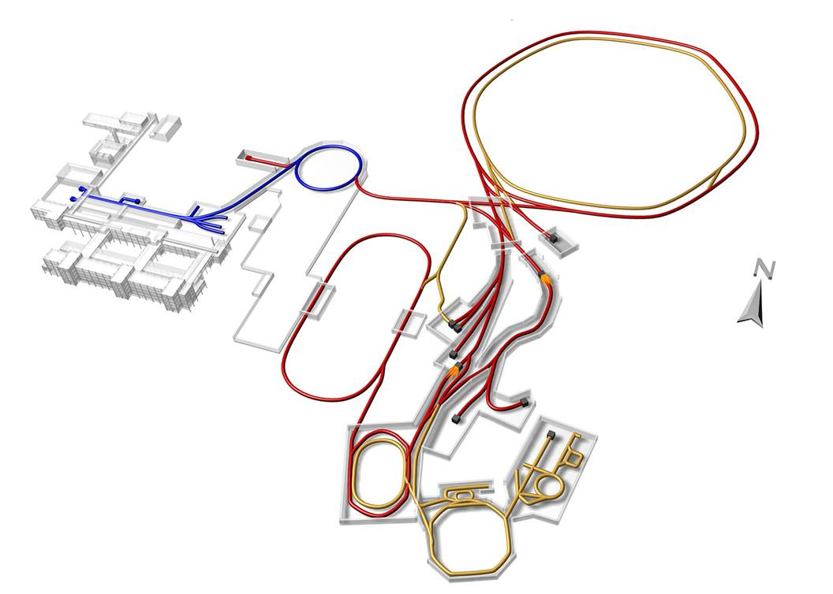
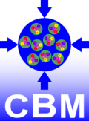
FAIR – Conceptual View
SIS18
SIS100/300
p-Linac
Atomic, Plasma, Applied Physics
Compressed Baryonic Matter
HESR
Anti-Proton Physics
Super Fragment-Separator:
Nuclear Structure and Astrophysics
Primary Beams
10¹²/s; 1.5 GeV/u; ²³⁸U²⁸⁺
10¹⁰/s ²³⁸U⁹²⁺ up to 11 (35) GeV/u
3x10¹³/s 30 (90) GeV protons
CR
Secondary Beams
FAIR phase 1
FAIR phase 2
radioactive beams up to 1.5 - 2 GeV/u;
10¹¹ antiprotons 1.5 - 15 GeV/c
100 m
17

Slide 18
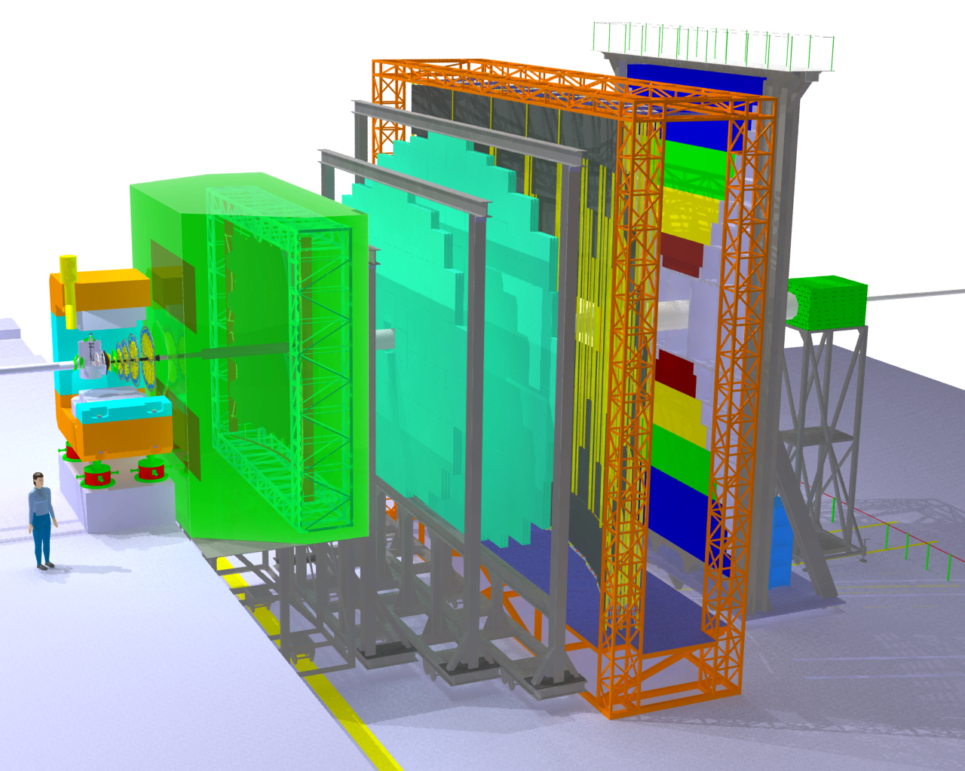
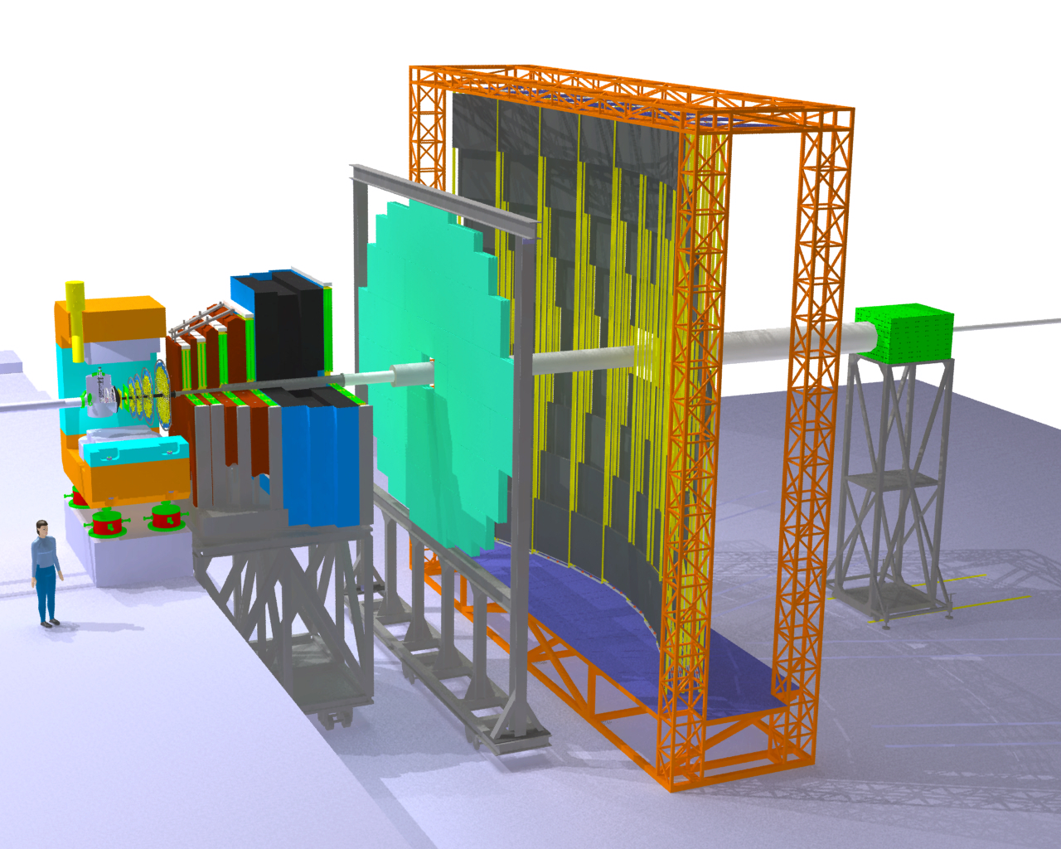
The Compressed Baryonic Matter Experiment
Transition
Radiation
Detectors
Tracking
Detector
Muon
detection
System
Electro-
magnetic
Calorimeter
Ring Imaging
Cherenkov
Detector
Silicon
Tracking
Stations
Vertex
Detector
Projectile
Spectator
Detector
(Calorimeter)
Dipol
magnet
Resistive
Plate
Chambers
(TOF)
18
18

Slide 19
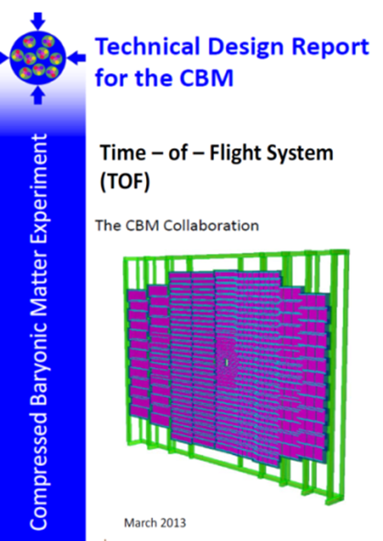
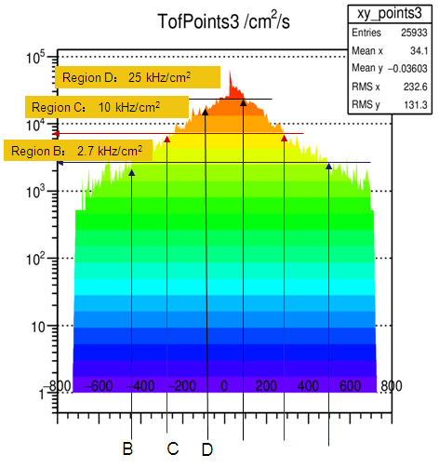
The structure of CBM-TOF wall
CBM-ToF Requirements
Full system time resolution σ_{T} ~ 80 ps
Efficiency > 95 %
Rate capability ≤ 30 kHz/cm²
Polar angular range 2.5°– 25°
Occupancy < 5 %
Low power electronics
(~100.000 channels)
Free streaming data acquisition
Au+Au, Center, 10AGeV
Simulated with CBM ROOT
19
19

Slide 20
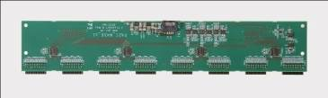
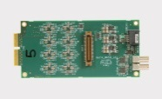
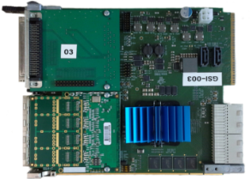

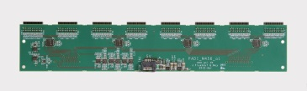

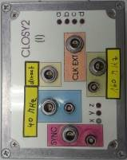
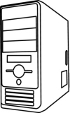
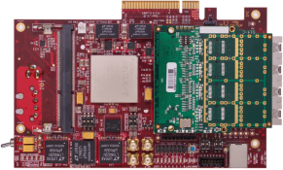
Electronics & Readout chain
MRPC
2
3
MRPC
MRPC
MRPC
PADI8
CAVE
GET4
CBM CLK (40MHz)
Example for 192 Channel
ToF CLK (160MHz)
Counting-Room
ToF SYNC Signal
Optic (~50m)
20

Slide 21
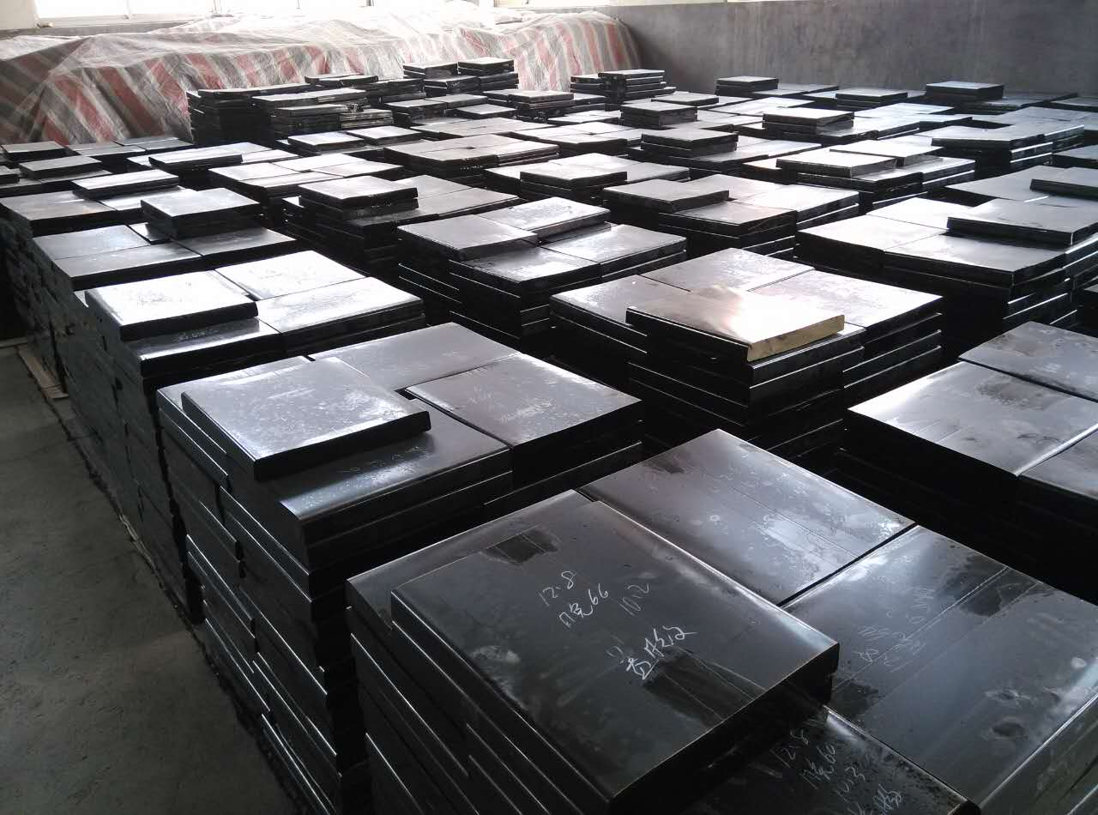
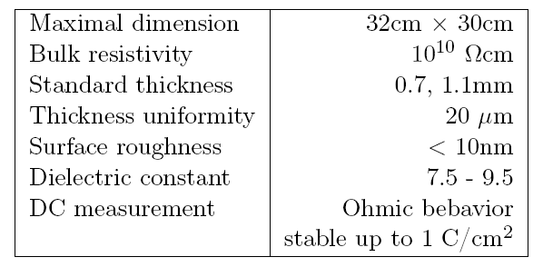
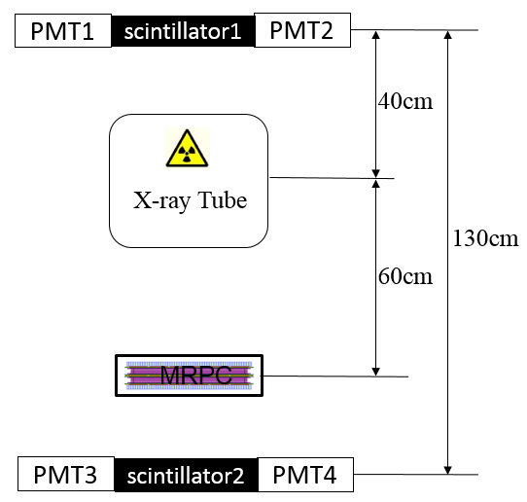
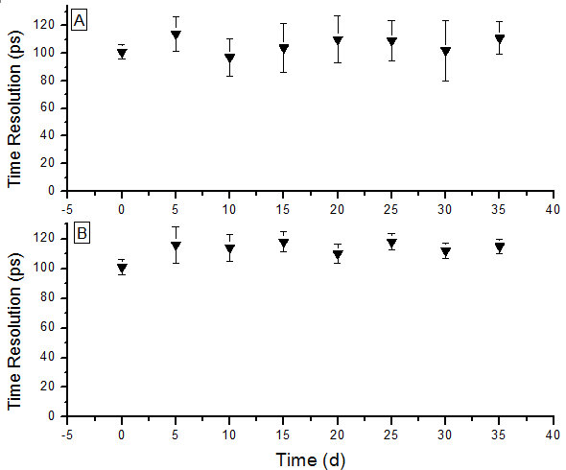
Development of low resistive glass
Performance of the glass
Glass mass production
Yield >100m²/month
Online test system. The efficiency and time resolution can be obtained by cosmic ray while irradiated by X-rays. 0.1C/cm² charge is accumulated in 35 days.
Aging test with X-ray source
21

Slide 22
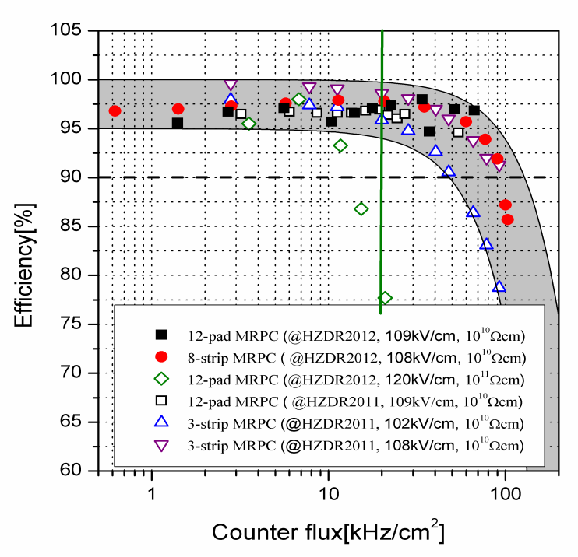
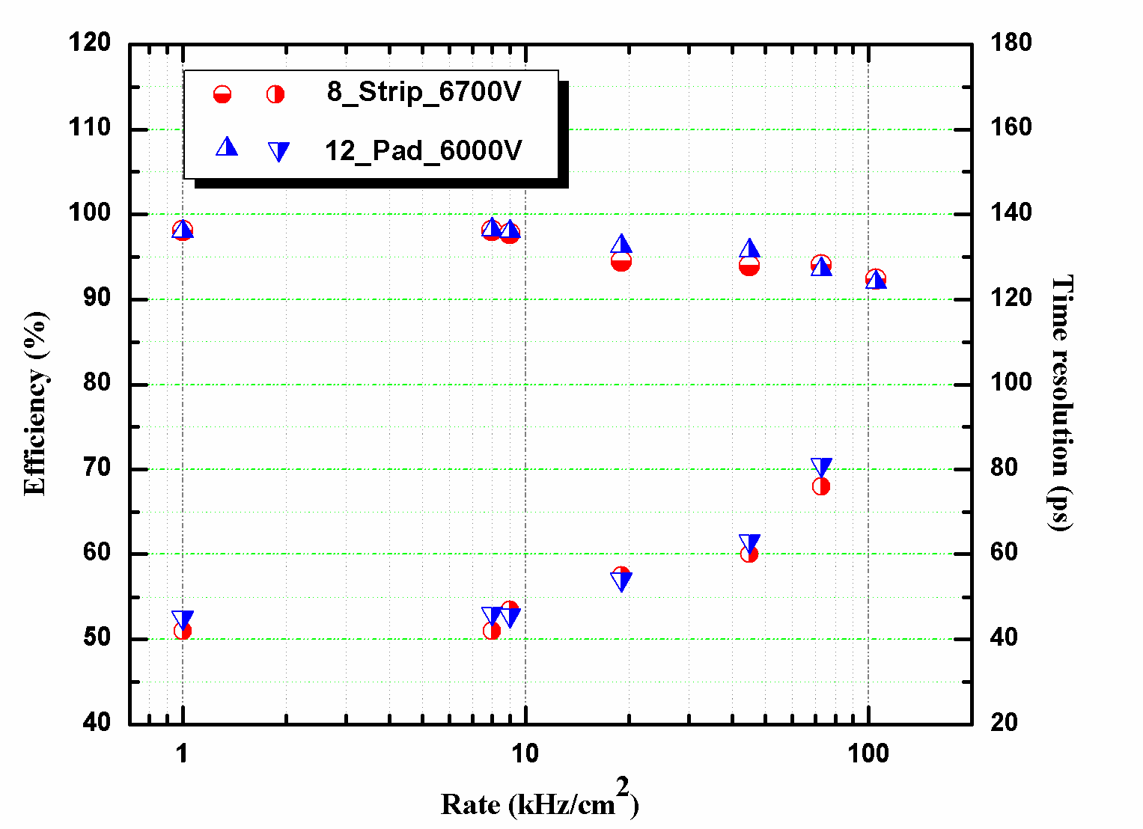

Rate capability of high rate MRPC
Test results at Nuclotron, Dubna，2013
Rate: 70kHz/cm²
Time resolution: 40 ps
Even though the rate is 70kHz/cm², the efficiency is still higher than 90% and the time resolution is about 80ps.

Slide 23



Prototype design for CBM-TOF
Strip-MRPC
Inner zone-MRPC

Slide 24


Design of strip-MRPC for high rate region
Glass: low resistive glass
0.7mm thick, 27cm x 25cm
Strip: 27cm x 0.7cm, 0.3cm interval, 24 strips
Gas gap: 8 x 0.25mm, two stacks
Gas box: 600mm x 500mm x 72mm
w
t
h
ground
Differential strip: 7mm wide+3mm interval
Feed trough: Micro-strip, 50Ω
24
24

Slide 25



CBM-TOF MRPC的批量生产
Quality assurance of each type of materials and the assembling procedure is recorded.
Detailed information can be found by scanning the QR code on it.
A website is developed to record all the QR information of each produced counter: http://hepd.ep.tsinghua.edu.cn/CBM_TOF/

Slide 26




Layout of cosmic test system
MRPC setup in the gas box.
MRPC3a - 003
Interface board
PADI output
MRPC3a - 002
PADI power cable
MRPC3a - 000
PADI power interface
PADI 10
HV connector

Slide 27
Noise rate around 1 Hz/cm²
Dut | Ref | BRef/ Sel2 | Eff | Time Resolution/ps | Clustersize Dut | Clustersize Ref | Event number | Calibration mode
009 | 010 | 011 | 0.984 | 92.3 | 1.8 | 1.8 | 6052 | 701001702
009 | 011 | 010 | 0.964 | 89.4 | 1.8 | 1.7 | 6280 | 701002701
010 | 009 | 011 | 0.989 | 100.2 | 1.7 | 1.8 | 3125 | 701701002
010 | 011 | 009 | 0.99 | 99.2 | 1.7 | 1.7 | 4671 | 701702700
011 | 009 | 010 | 0.973 | 91.8 | 1.7 | 1.8 | 5384 | 702701001
011 | 010 | 009 | 0.984 | 95 | 1.7 | 1.7 | 6121 | 702701700

Slide 28

Overview of SoLID
Solenoidal Large Intensity Device
Full exploitation of JLab 12 GeV Upgrade
→ A Large Acceptance Detector AND Can Handle High Luminosity (10³⁷-10³⁹)
Take advantage of latest development in detectors , data acquisitions and simulations
Reach ultimate precision for SIDIS (TMDs), PVDIS in high-x region and threshold J/ψ
5 highly rated experiments approved (+3)
Three SIDIS experiments, one PVDIS, one J/ψ production (+ three run group experiments)
Strong collaboration (250+ collaborators from 70+ institutes, 13 countries)
Significant international contributions (Chinese collaboration)
28

Slide 29


SoLID-TOF structure
The MRPC is developed for the TOF of SoLID
Main Requirements for TOF:
  π/k separation up to 7GeV/c
  Time resolution < 20ps
  Rate capability > 10kHz/cm²
MRPC3
28cm
MRPC2
16cmm
100cm
MRPC1
SoLID-TOF super module
SoLID-TOF structure

Slide 30


Two technologies
30

Slide 31


应用神经网络方法改进时间分辨

Slide 32
Next to do…
  Next to do: Development of high rate and high
  time resolution TOF
  Simulation to get : Width of gas gap→ time resolution
  Development of high rate 15ps resolution MRPC
  Development of 15ps jitter SCA, fast amplifier and TDC
  Impedance match
  Study “ecological” gas mixture for high rate MRPC

Slide 33

Welcome to RPC2018
http://fismat.ibero.mx/rpc2018/home

Slide 34
Conclusions
Time of flight system (TOF) based on MRPC technology is widely used and played an important role in modern high energy nuclear physics experiments.
With the increase of accelerator energy and luminosity, many experiments have increasingly demand on the TOF for particle identification to have high resolution TOF under high data rate environment.
New technology such as New material (low resistive glass), New electronics (switched capacitor array (SCA) and precision TDC ) will be used in TOF system.
New gas mixture (ECO-gas ) will also be a big issue in the future!

Slide 35
Thanks for your attention!

