Slide 1

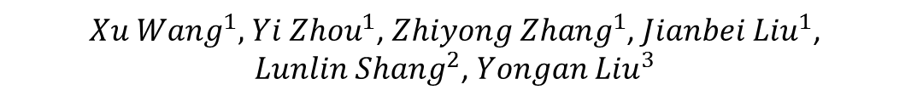
Study of DLC photocathode for PICOSEC detectors based on Micromegas
${Xu Wang}^{1},{ Yi Zhou}^{1}$, ${Zhiyong Zhang}^{1}$, ${Jianbei Liu}^{1}$, ${Lunlin Shang}^{2}$, ${Yongan Liu}^{3}$
State Key Laboratory of Particle Detection and Electronics, University of Science and Technology of China
State Key Laboratory of Solid Lubrication, Lanzhou Institute of Chemical Physics, Chinese Academy of Science
State Key Laboratory of Transient Optics and Photonics , Xi'an Institute of Optics and Precision Mechanics, Chinese Academy of Sciences

Slide 2

PICOSEC Collaboration
CEA Saclay(France):D. Desforge, I. Giomataris, T. Gustavsson, C. Guyot, F.J. Iguaz, M. Kebbiri, P. Legou, O. Maillard, T. Papaevangelou, M. Pomorski, P. Schwemling, L. Sohl.
CERN:J. Bortfeldt, F. Brunbauer, C. David, J. Frachi, M. Lupberger, H. Müller, E. Oliveri, F. Resnati, L. Ropelewski, T. Schneider, P. Thuiner, M. van Stenis, P. Thuiner, R. Veenhof, S. White2.
USTC (China):J. Liu, B. Qi, X. Wang, Z. Zhang, Y. Zhou.
AUTH (Greece):I. Manthos, V. Niaouris, K. Paraschou, D. Sampsonidis, S.E. Tzamarias.
NCSR:G. Fanourakis.
NTUA:Y. Tsipolitis.
LIP:M. Gallinaro.
HIP (FINLAND): F. García.
IGFAE: D. González-Díaz.

Slide 3
Outline
Introduction
  PICOSEC detector concept
  Results with CsI photocathode
Diamond-Like Carbon (DLC) Photocathode
  Manufacture
  Quantum Efficiency test with laser
  Beam test
Conclusion and Future work

Slide 4
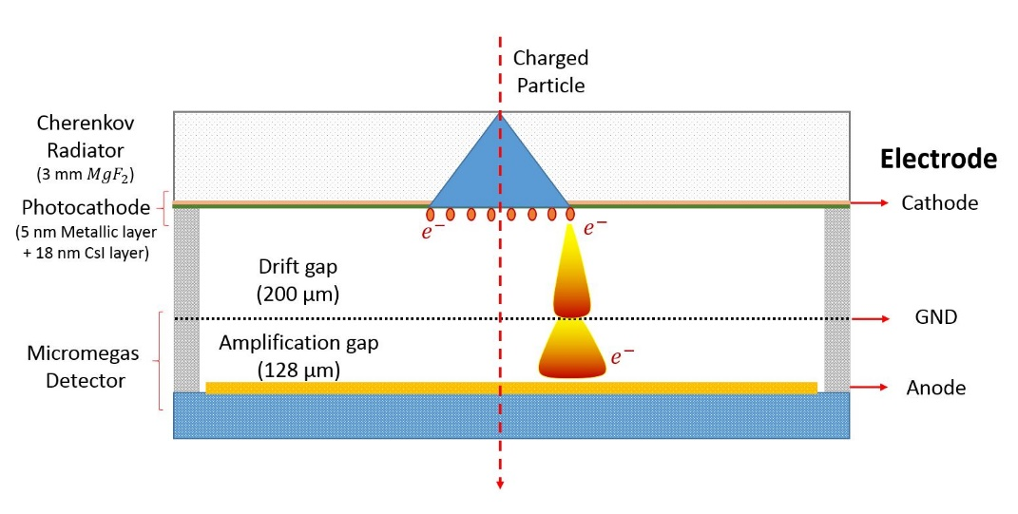
Detector Concept
Schematic of PICOSEC detector
A Novel fast timing Micromegas detector: Cherenkov Light Detection
Cherenkov Radiator & Photocathode
Smaller drift gap
Higher electric field

Slide 5
Collaboration
Started as an RD51 common fund project:
Fast Timing for High-Rate Environment: A Micormegas Solution
2014
2015
2016
2017
2018
Proposal
Submission
First Prototype and laser test
New Prototypes, laser tests and measurements with charged particles (CsI photocathode)
Resistive micromegas prototypes,
Multi-channel anode and larger area, photocathodes (CsI protection, Diamond, DLC),
Robust photocathode (DLC-based, pure metallic and nano diamond-based photocathodes), Double mesh structure, new detector prototypes… …
The crucial issue for a successful application of this concept is the robustness of photocathodes

Slide 6
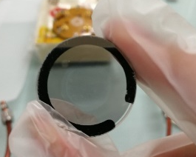
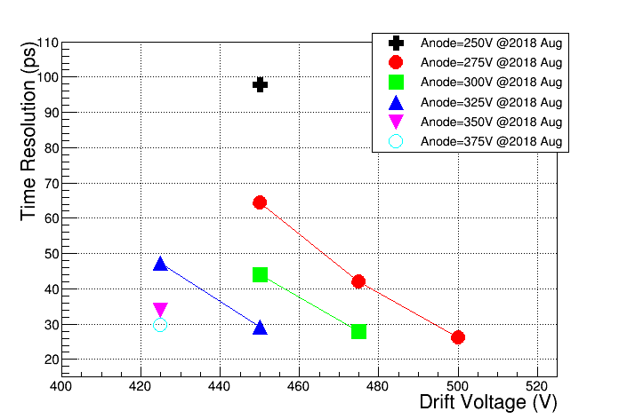
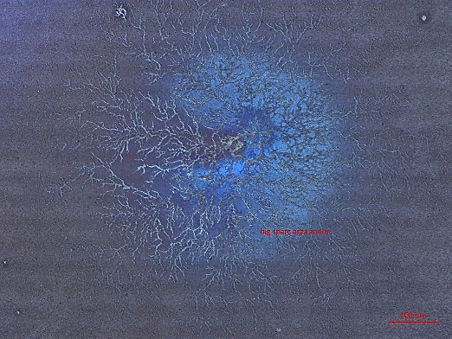
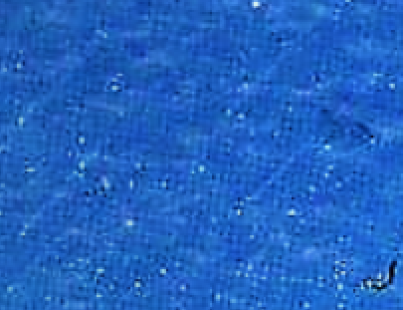
Results with CsI
CsI aging problem
USTC PICOSEC detector (18 nm CsI)
Sparks:
Crack on CsI layer
Time resolution reaches: 28 ps
Mean number of photoelectrons per muon: 7.4
Detection efficiency for muons: 100%
Ion back-flow (IBF) ratio: 42.7%
High IBF
mesh imprint on CsI layer
Cathode: -475V
Mesh: GND
Anode: +300V
Some alternative photocathodes need to be studied

Slide 7
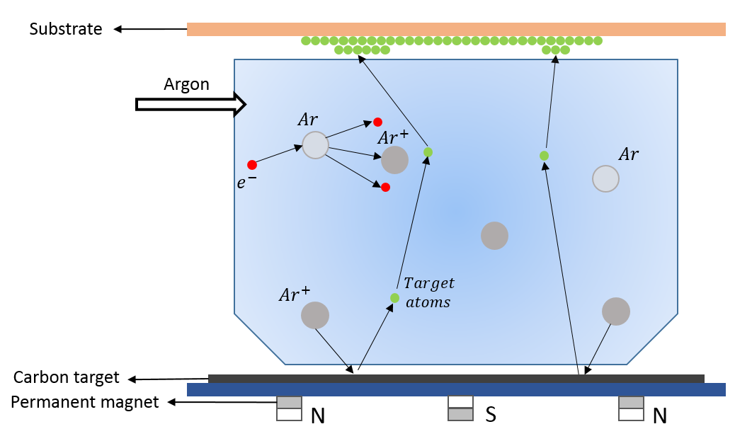
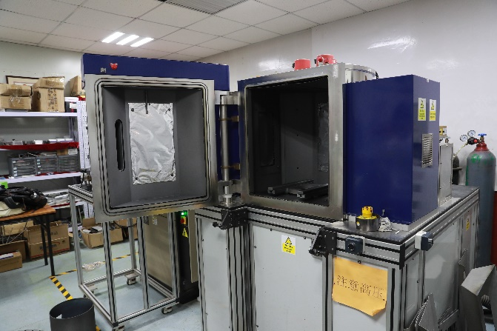
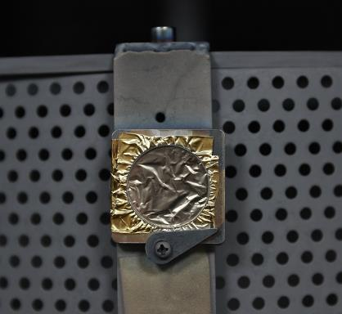
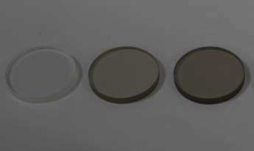
Diamond-Like Carbon (DLC)
More detailed in Lunlin Shang’s presentation
Schematic of DLC deposition by magnetron sputtering technology
State Key Laboratory of Solid Lubrication, Lanzhou Institute of Chemical Physics, Chinese Academy of Science
MgF₂
DLC photocathode samples
3 mm MgF₂ with DLC

Slide 8
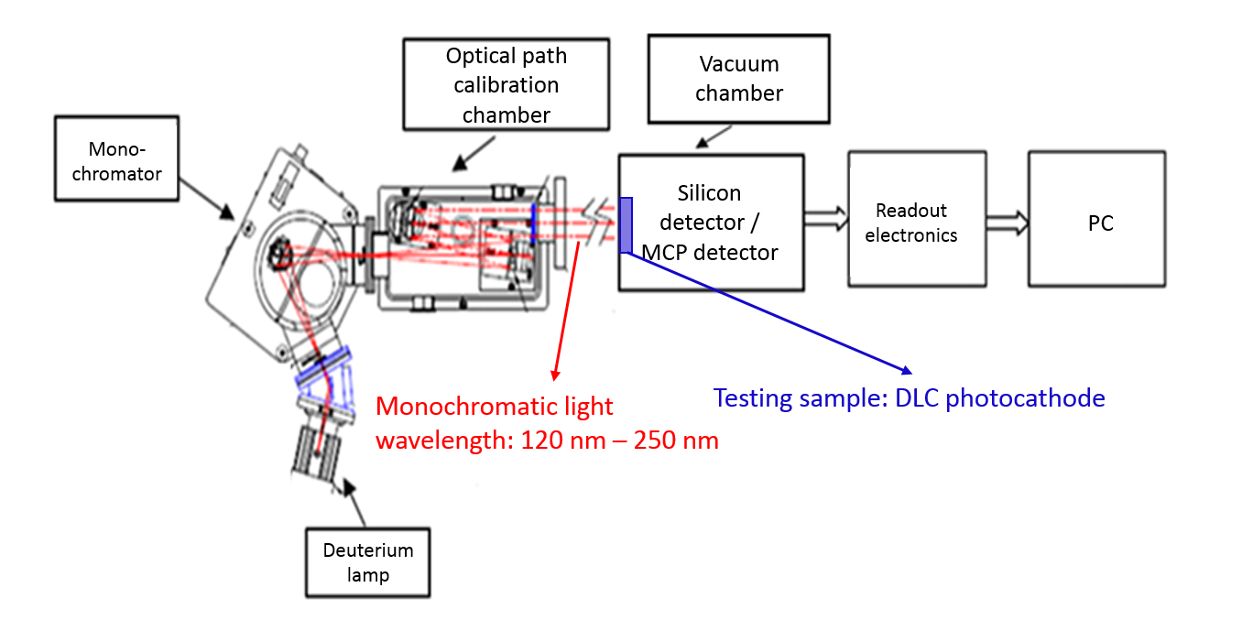
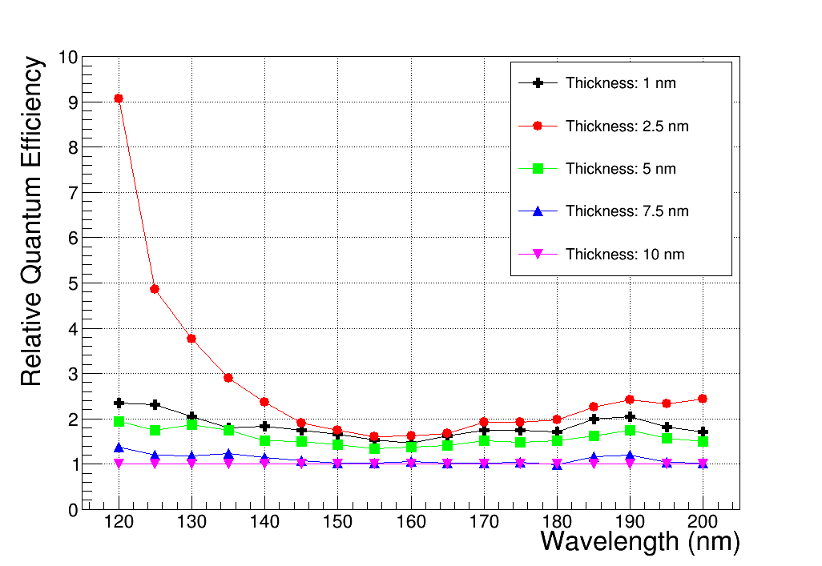
QE test with Laser
Quantum efficiency test system in laboratory
Relative QE of DLC with different thicknesses
State Key Laboratory of Transient Optics and Photonics , Xi'an Institute of Optics and Precision Mechanics, Chinese Academy of Sciences
Silicon detector (No DLC sample)
Incident photons flux
MCP detector (DLC sample)
Photoelectrons generation rate
Absolute QE is unpersuasive
Relative quantum efficiency of different samples are compared
The sample with thickness of 2.5 nm shows optimal performance

Slide 9
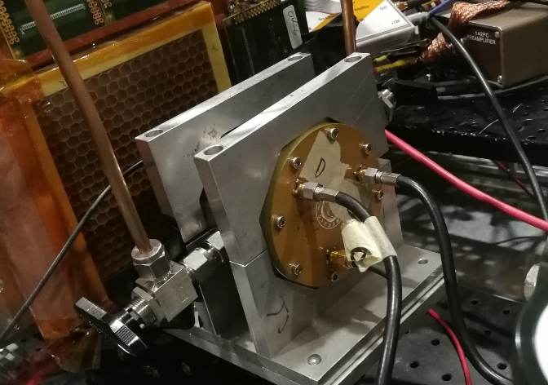
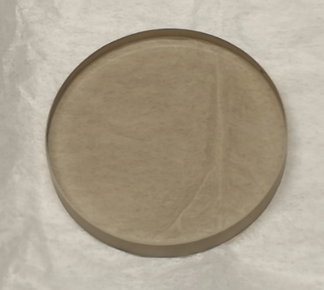
Beam test of PICOSEC Detector with DLC
5mm hole veto scintillator
10 cm * 10 cm scintillator
5 mm * 5 mm scintillator
Hamamatus MCP PMT
Scintillator
GEM Tracker
GEM Tracker
GEM Tracker
PICOSEC
PICOSEC
PICOSEC
DMM
Beam Line
DLC Photocathode
Time reference
USTC PICOSEC detector
Active area: Φ1 cm

Slide 10
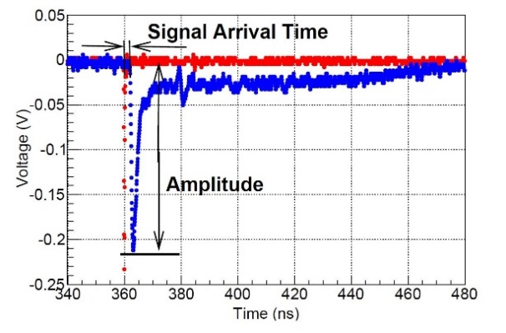
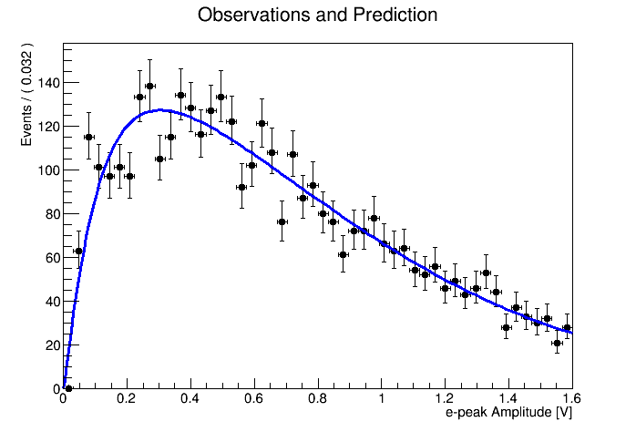
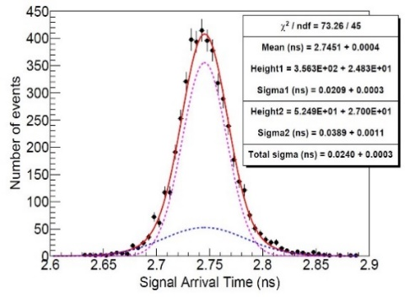
Data analysis
N_{pe}: mean number of photoelectrons generated by Cherenkov light on the surface of DLC layer
Time Response
Blue : Sample waveform of PICOSEC detector generated by 150 GeV muon
Red : Related MCP PMT signal
Signal Arrival Time: time difference between PICOSEC and MCP PMT (Timing with CFD)
Single photoelectron calibration: UV lamp
Fit function: Polya distribution
f = 1/(1+θ): relative gain variance$\overline{Q}$: mean

Slide 11
N_{pe} results of different DLC samples
Thickness of DLC film (nm) | N_{pe}/per muon | Detection efficiency for muons
1 | Bad | Bad
2.5 | 3.7 | 97%
2.5 | 3.5 | 95%
2.5 | 3.4 | 94%
5 | 3.4 | 94%
7.5 | 2.2 | 70%
10 | 1.7 | 68%
5 nm Cr + 18 nm CsI | 7.4 | 100%
Beam tests results confirm the laser results
2.5 nm sample is currently the optimal one , with 3.7 N_{pe} /per muon and 97% efficiency (the best results of several 2.5 nm samples)
These results are repeatable:

Slide 12
N_{pe} results of different photocathodes
Radiator MgF2 (mm) | Photocathode | N_{pe}
3 | Cr + CsI(2 nm LiF layer) | <1
3 | Cr + CsI(2 nm MgF₂ layer) | 3.55
3 | 20 nm Cr | 0.66
3 | 6 nm Al | 1.69
5 | 10 nm Cr | 2.15
5 | 10 nm Al | 2.20
3 | 2.5 nm DLC | 3.7
3 | 5 nm DLC | 3.4
Different photocathodes have been studied
DLC is promising compared with others

Slide 13
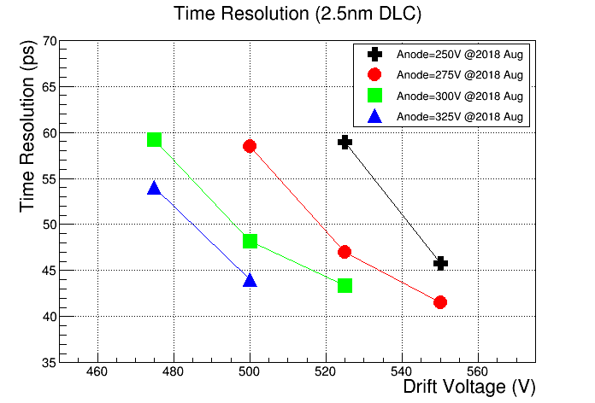
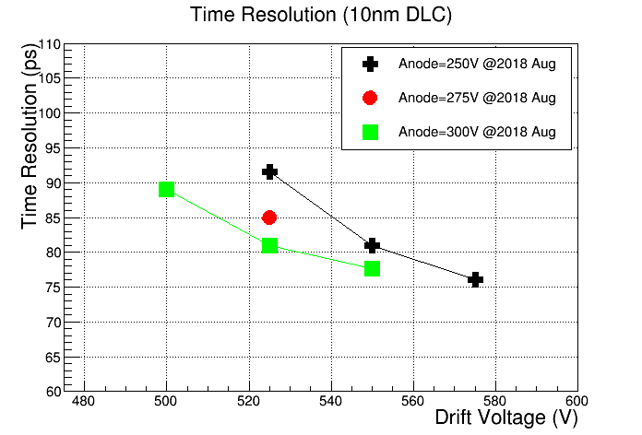
Time resolution with DLC photocathode
Time resolution reaches 42 ps with 2.5 nm DLC photocathode
Higher QE of photocathode, better time resolution of detector will be reached

Slide 14
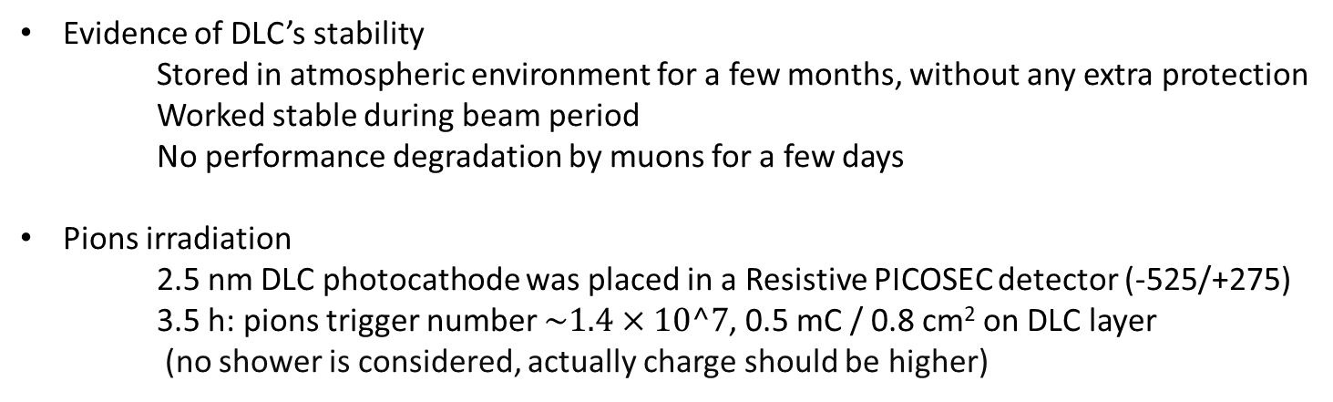
Robustness of DLC photocathode
Evidence of DLC’s stability
Stored in atmospheric environment for a few months, without any extra protection
Worked stable during beam period
No performance degradation by muons for a few days
Pions irradiation
2.5 nm DLC photocathode was placed in a Resistive PICOSEC detector (-525/+275)
3.5 h: pions trigger number $\sim 1.4×10^7$, 0.5 mC / 0.8 cm² on DLC layer
(no shower is considered, actually charge should be higher)
 | N_{pe}/per muon | Detection efficiency
Before pions | 3.5 | 95%
After pions | 3 | 94%

Slide 15
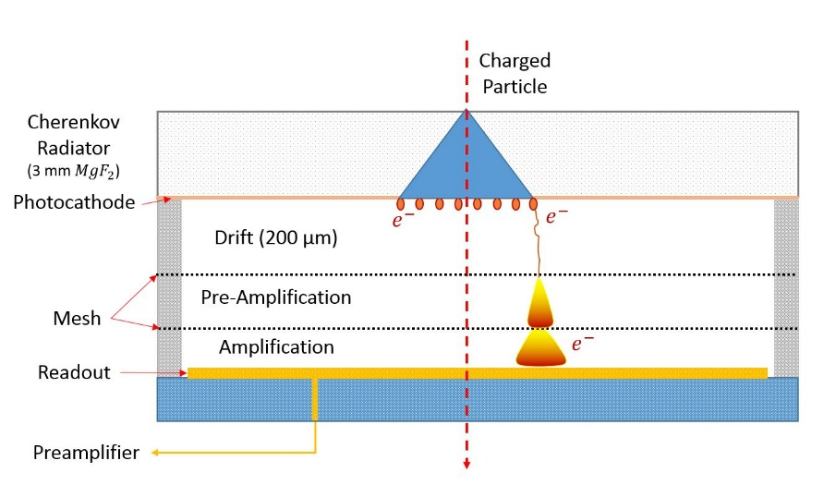
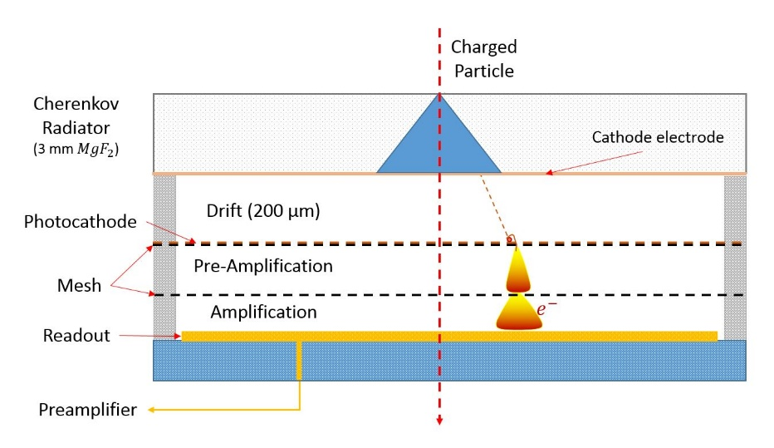
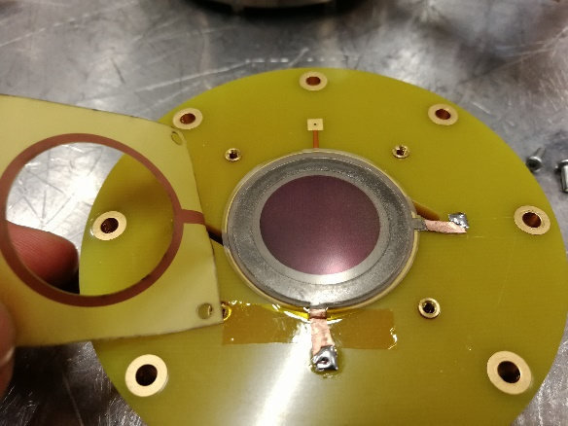
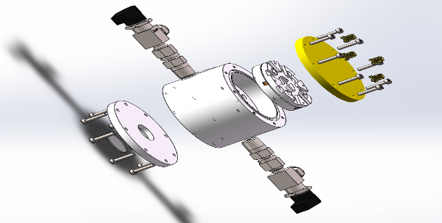
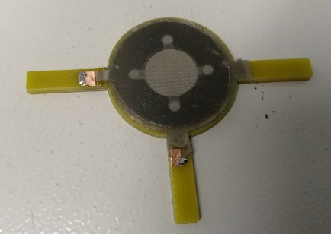
PICOSEC detector based on
Double Mesh Micromegas
Transmission Type
Reflection Type
Low IBF (180 ps @2 ‰ IBF ratio CsI photocathode)
Photocathode blind to IBF
Higher QE
CsI
Need more optimization
https://indico.ihep.ac.cn/event/7352/session/10/contribution/460

Slide 16
Conclusion
Laser test: 2.5 nm sample shows best performance
Beam test: 2.5 nm sample is also the best one
3.7 N_{pe} / per muon 97 % detection efficiency
time resolution reaches 42 ps
After pions irradiation, QE performance shows less decrease, more resistant to irradiation than CsI
For DLC’s resistive character, it acts as a resistive cathode that restrains sparks
DMM preliminary results:
    Transmission type: low IBF ratio(180 ps @2 ‰)
    Reflection type: no good results

Slide 17
Future Work
Find a suitable thickness of DLC layer which is robust enough, as well as suitable QE
Optimize the process of DLC deposition:
doping, heating… …
Study Secondary Electron Emission of DLC
Improve the QE test system
Aging research in lab with laser (213 nm):
    Figure out the impact of IBF
Continue working in DMM
… …

