Slide 1
A DLC μRWELL with
2-D Readout
You LV
On behalf of USTC MPGD Group
State Key Laboratory of Particle Detection and Electronics,
University of Science and Technology of China

Slide 2
Outline
Motivation
Preparation of the DLC resistive electrode
μRWELL design and fabrication
μRWELL performance
Conclusion and next step

Slide 3
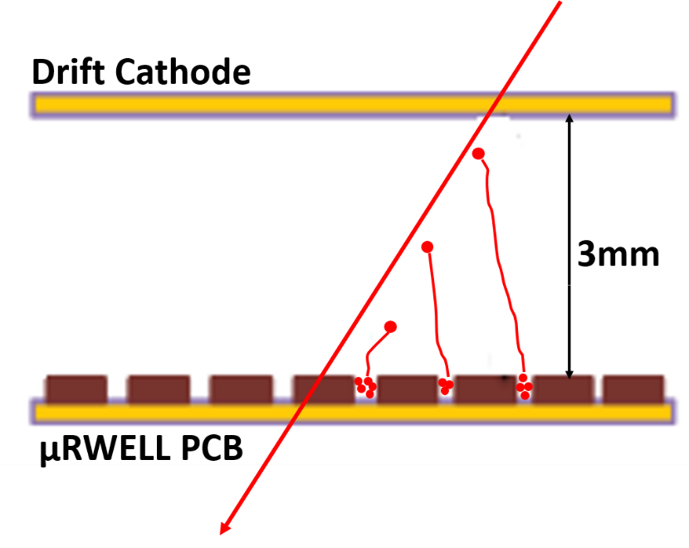
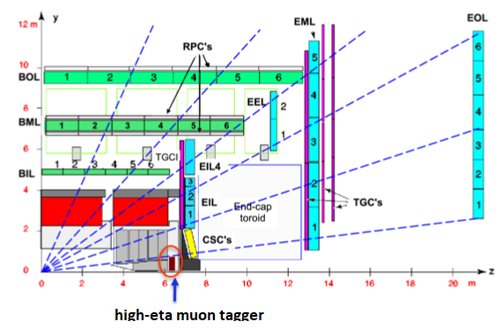
Motivation
ATLAS phase-2 upgrade: high-eta muon tagger
Micro-Resistive WELL detector
Phase-2 upgrade of the ATLAS Muon Spectrometer
μRWELL detector
Identify muons that penetrate the endcap calorimeter by reconstructing track segments in the tagger.
Novel MPGD combines features of MM and GEM
  Compact & high granularity
  Without gluing & stretching, assembling fast

Slide 4
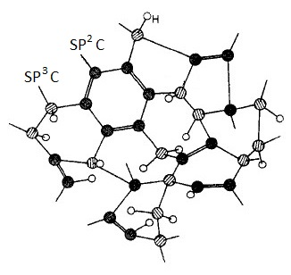
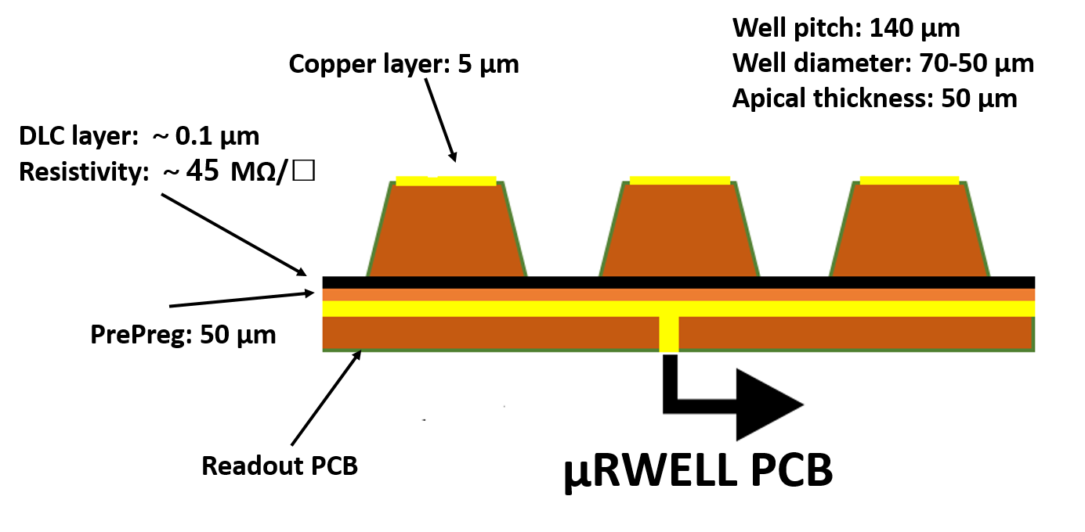
μRWELL PCB
μRWELL PCB
DLC: Diamond like Carbon
A stack of “readout printed circuit board (PCB) / insulating pre-preg / resistive DLC / well-type amplification structure”
A kind of “Metastable amorphous carbon material which contains both diamond-structure and graphite-structure”
Surface resistance stable
Resistant to discharge and radiation
Chemical stability and thermal stability
DLC resistive electrode to suppress discharge

Slide 5
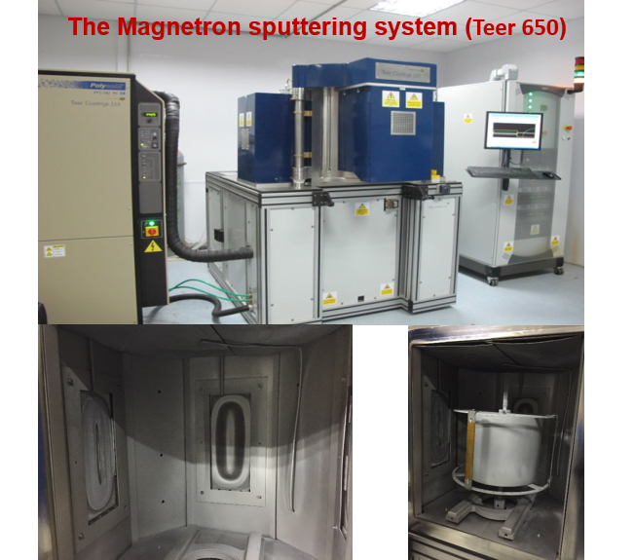
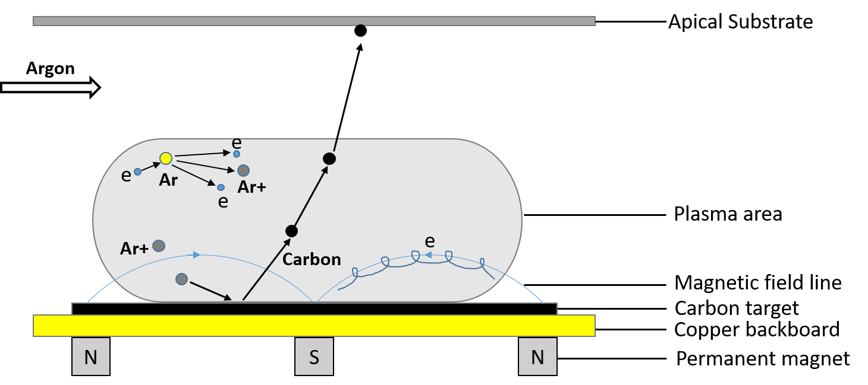
DLC Deposition Procedure
Magnetron sputtering deposition
Voltage between substrate and target ramps up
Glow discharges appear and produce primary electrons Ions
Ions hit targets and sputter carbons
Ejected atoms deposit on substrate
State Key Laboratory of Solid Lubrication, Lanzhou Institute of Chemical Physics, Chinese Academy of Sciences

Slide 6
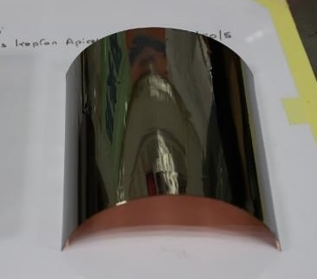
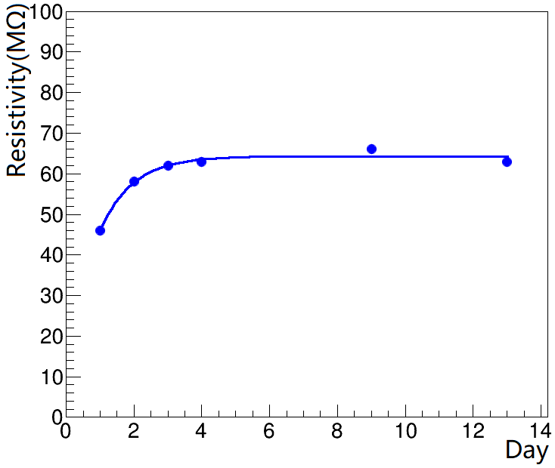
DLC Sample Performance
DLC sample parameters
15cm×15cm DLC Sample
Thickness: from tens to hundreds nanometers
Surface resistivity: from 1MΩ/□ to 500MΩ/□
Surface resistivity uniformity: 13% for 15cm×15cm size
Resistivity keep stable after 3~4 days
51 MΩ/□ | 52 MΩ/□ | 51 MΩ/□
41 MΩ/□ | 42 MΩ/□ | 42 MΩ/□
46 MΩ/□ | 45 MΩ/□ | 46 MΩ/□
Resistivity Uniformity: ~13%

Slide 7
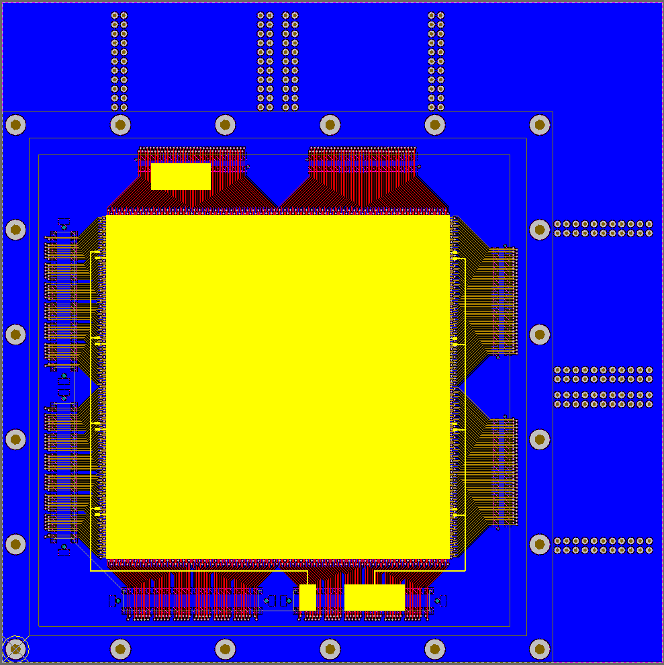
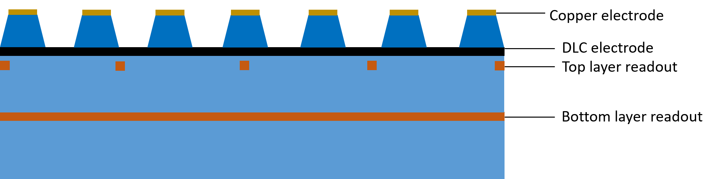
Design of the 2-D μRWELL PCB
μRWELL PCB with 2-D readout strip
Sensitive area: 10cm×10cm divided into 4 sectors
Readout strip pitch: 400 μm
Top layer: 80 μm
Bottom layer: 350 μm
Readout strip channel: 1024
μRWELL PCB
The thickness of APICAL between Top layer and Bottom layer is 50 μm.

Slide 8
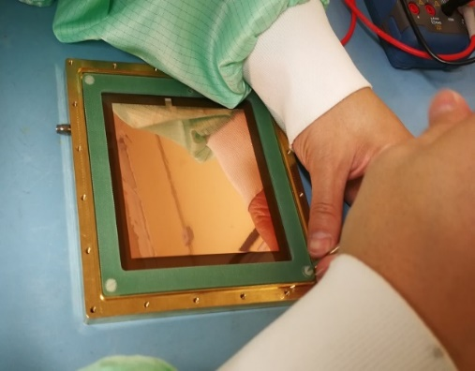
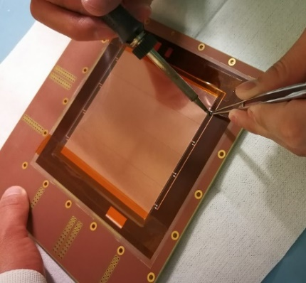
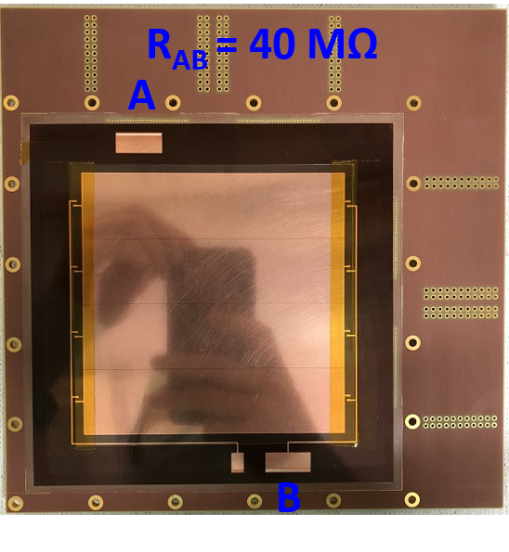
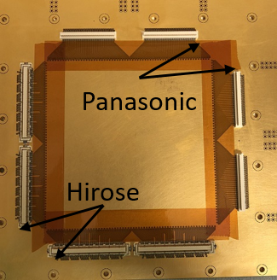
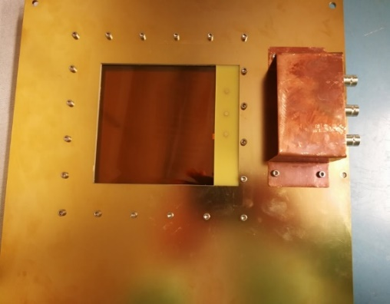
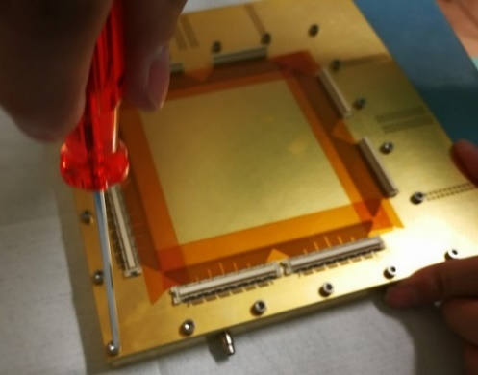
Fabrication of μRWELL detector
Detector fabrication
  Drift electrode: 50 μm APICAL with copper
  DLC Electrode resistivity：40MΩ
  Active area：10cm×10cm
  Drift region： 3mm
  4 Hirose connector + 4 Panasonic connector
Fix drift electrode
Solder HV Connector
μRWELL Detector
Fix μRWELL PCB
Special thanks to Antonio Teixeira, Rui De Oliveira for the technical support.

Slide 9
μRWELL Performance
Test with X-rays (Copper X-ray tube & Fe⁵⁵ X-ray)
  Gas gain
  Rate capability
Beam test (150GeV muon)
  Efficiency versus avalanche Voltage
  Position resolution

Slide 10
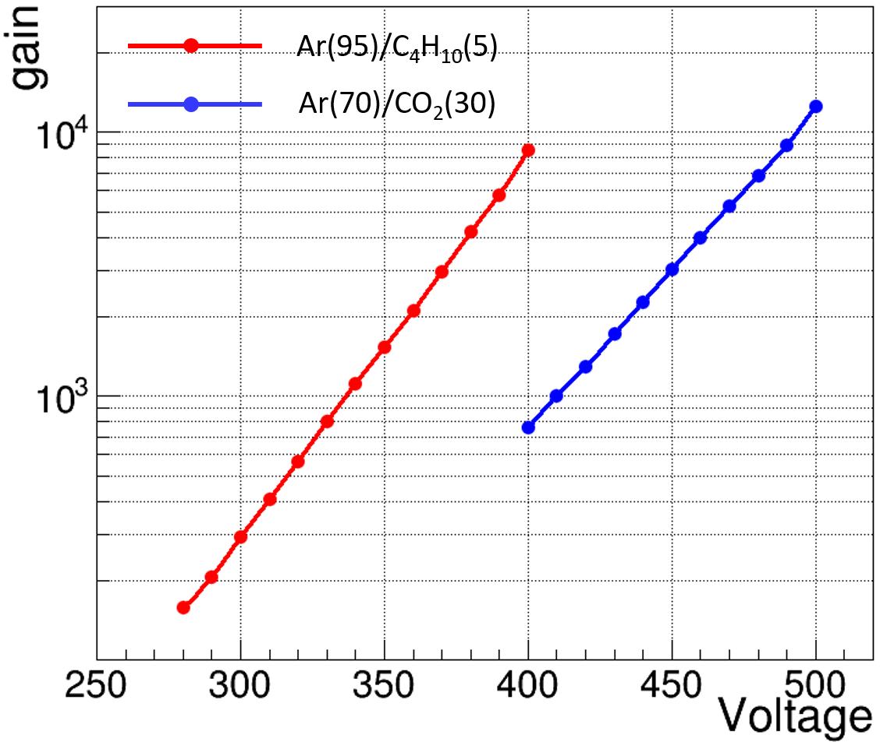
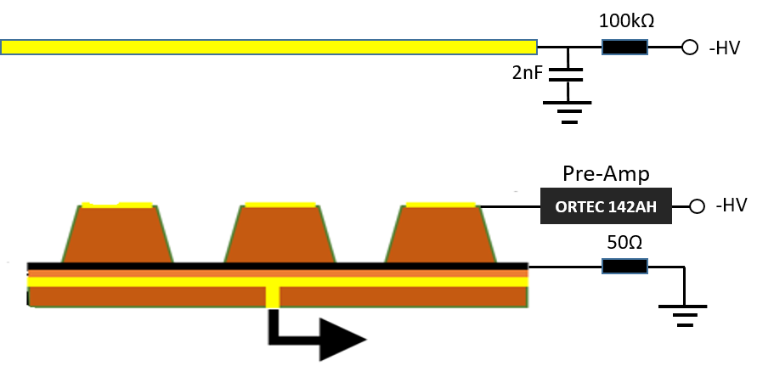
Detector gas gain
Detector test Setup
Ar(70)/CO₂(30) & Ar(95)/C₄H₁₀(5) gas mixture
Source: 8 keV Copper X_ray tube
DLC resistive electrode: grounded via a 50 Ω terminator
Top copper electrode: connected to a Pre-AMP, as a HV filter and amplify the signal
The maximum gain can reach 1.4×10⁴ in Ar(70)/CO₂(30) gas mixture.
Gain vs Voltage

Slide 11
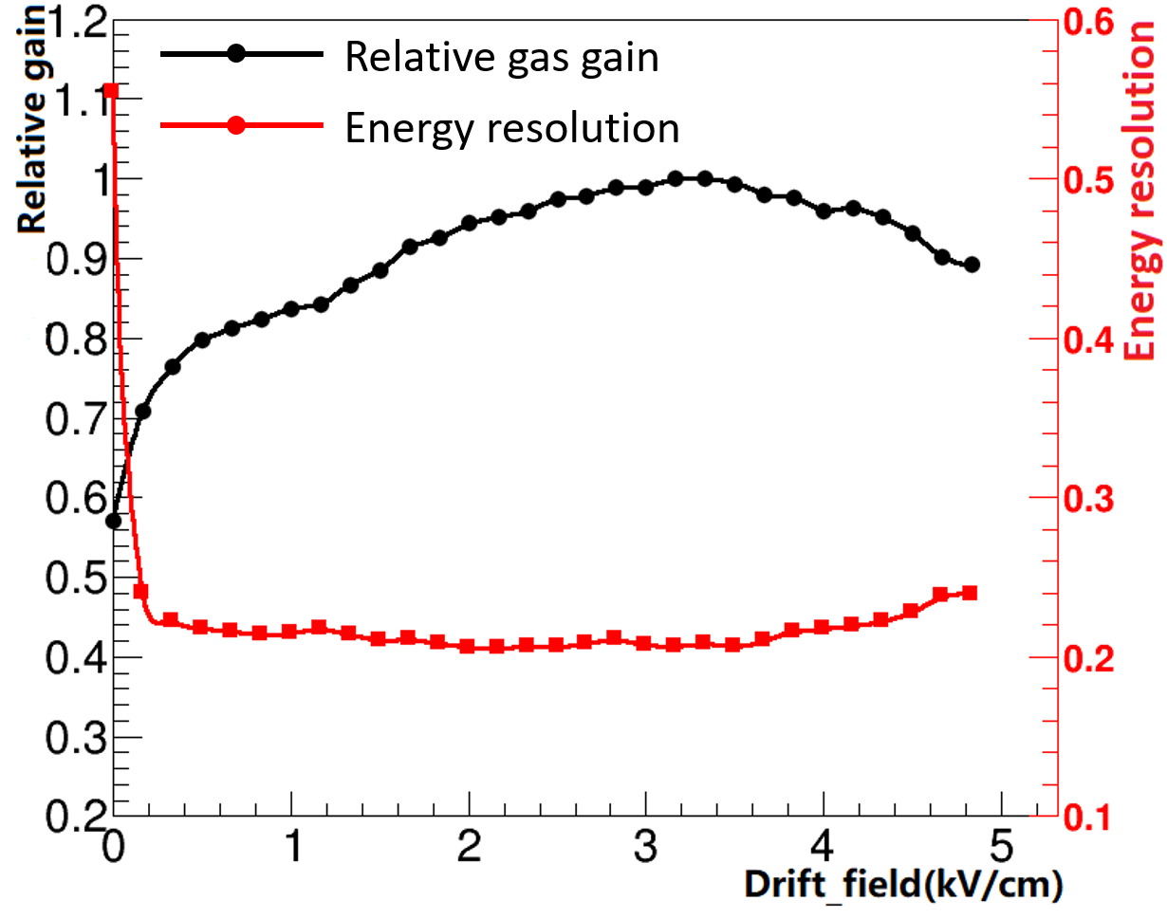
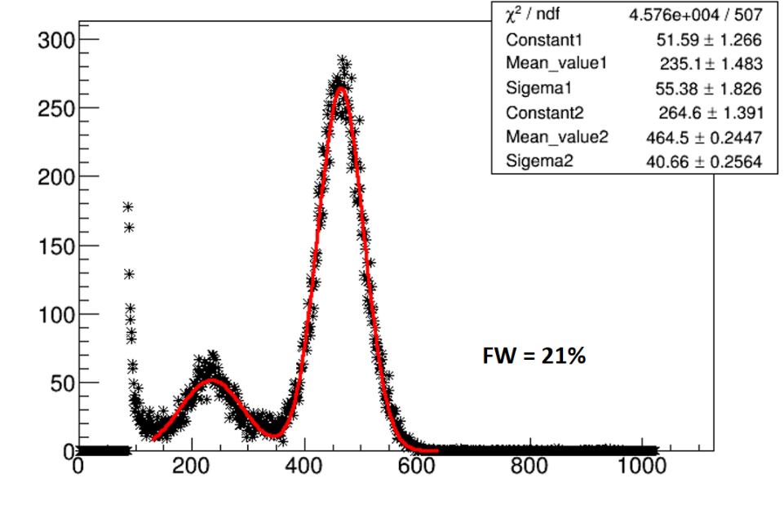
Detector relative gas gain
Relative gas gain: Normalizing the maximum full energy peak when the drift electric field was adjusted from 0 kV/cm to 4.8 kV/cm
Relative gas gain VS Drift electric field
0 - 0.3 kV/cm: Increases (decreasing recombination)
0.3 - 3.4 kV/cm: Increase (detector gain increase)
3.4 – 4.8 kV/cm: Decrease (collected by electrode )
Energy spectrum of Fe⁵⁵ X-rays

Slide 12
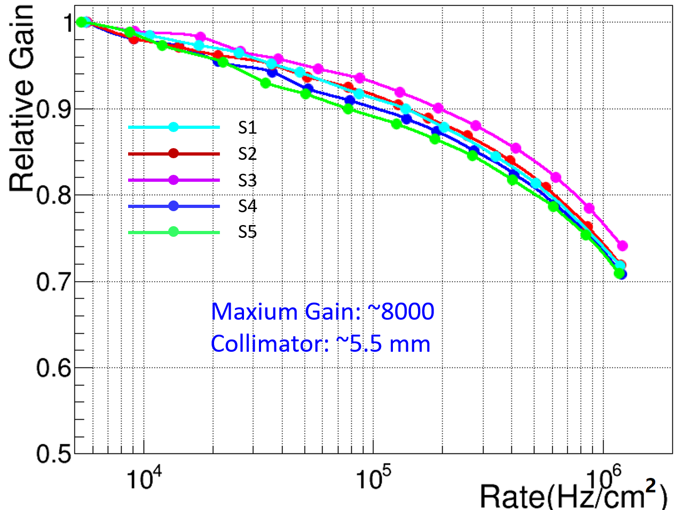
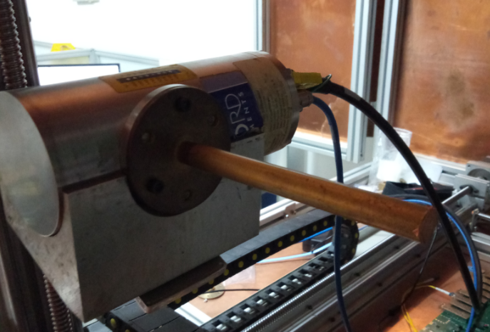
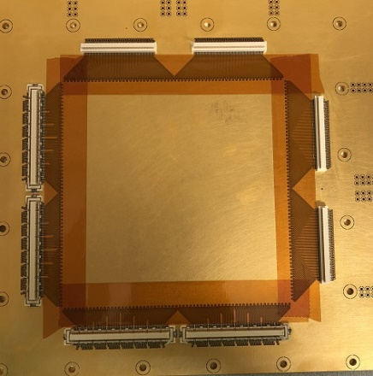
Detector Rate Capability
Gain vs Rate
Ar(70)/CO₂(30) gas mixture
Source: 8keV Copper X-rays
Collimator: 5.5mm-diameter
S2
S4
S1
S3
S5
The detector gas gain is 8000 at low rate, decrease about 10% at a rate 100 kHz/cm² in 5.5 mm diameter area.
Detector gain almost drop about 30% @1MHz/cm²
Gain vs Rate

Slide 13
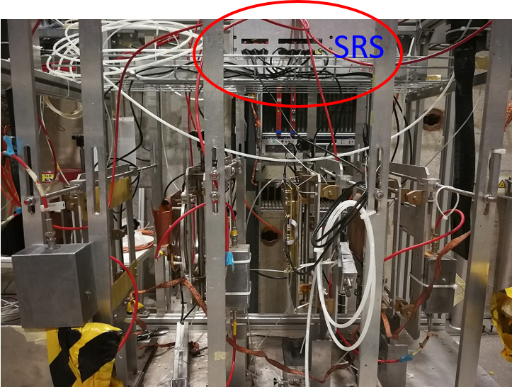
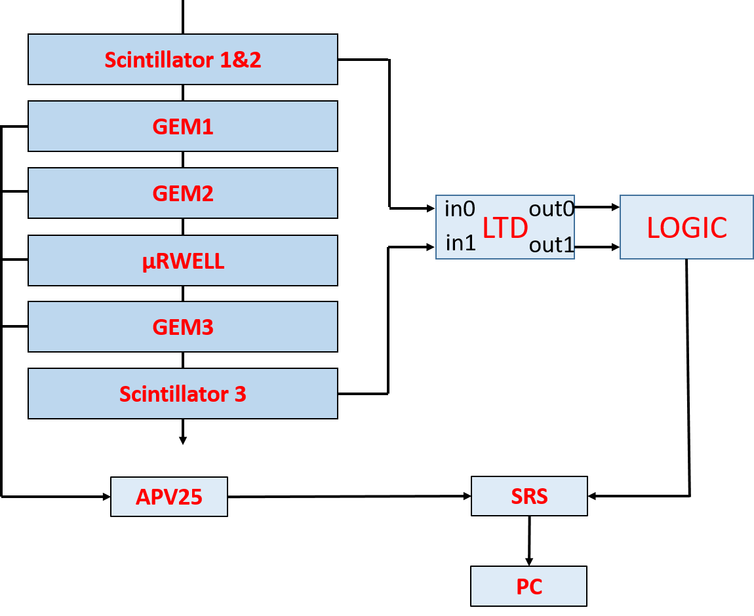
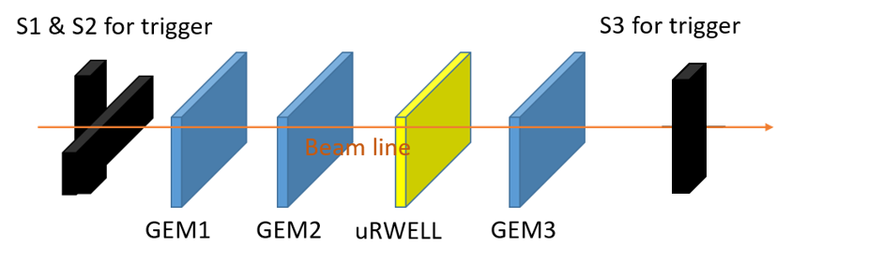
Beam Test Setup
Tracker system setup
CERN SPS-H4 beam area
Scintillator(S1, S2, S3) for trigger (10cm × 10cm)
RD51 GEM (10cm × 10cm) Tracker
RD51 SRS DAQ: 1024 channel (APV25 readout chip)
150GeV muon
μRWELL

Slide 14
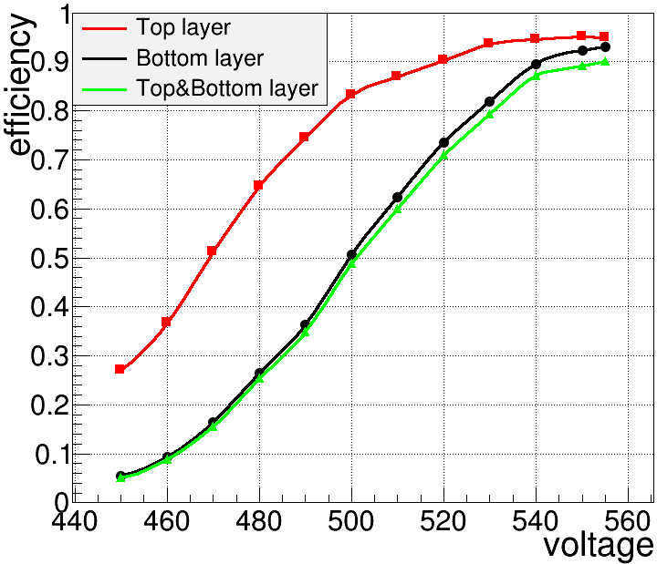
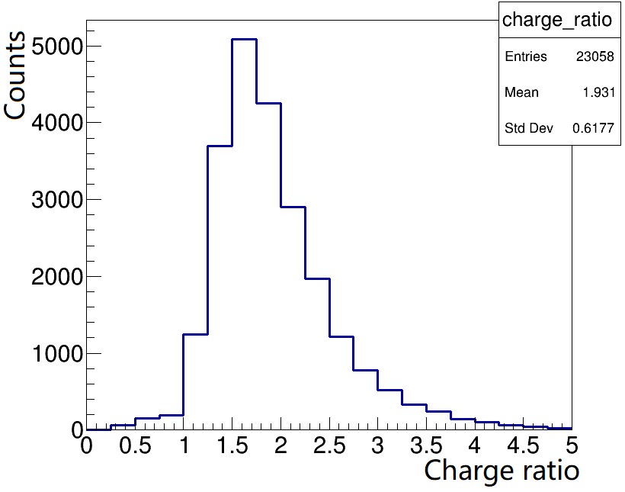
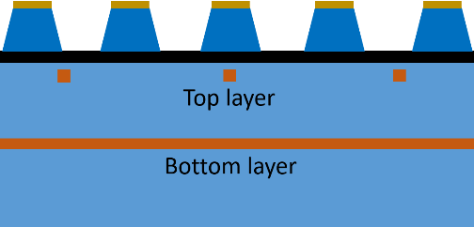
μRWELL detection efficiency
Detection efficiency VS Voltage
Top layer: ~95%, Bottom layer: ~92%
Top & Bottom efficiency: ~90%
Top layer induced charge is 1.9 times of Bottom layer
Top layer Charge/Bottom layer charge
Detection efficiency vs avalanche voltage

Slide 15
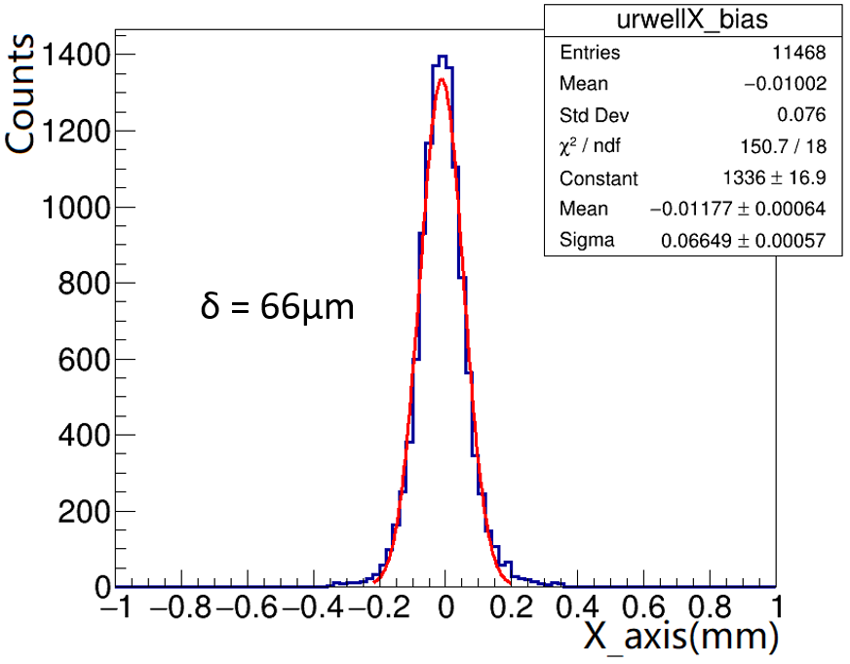
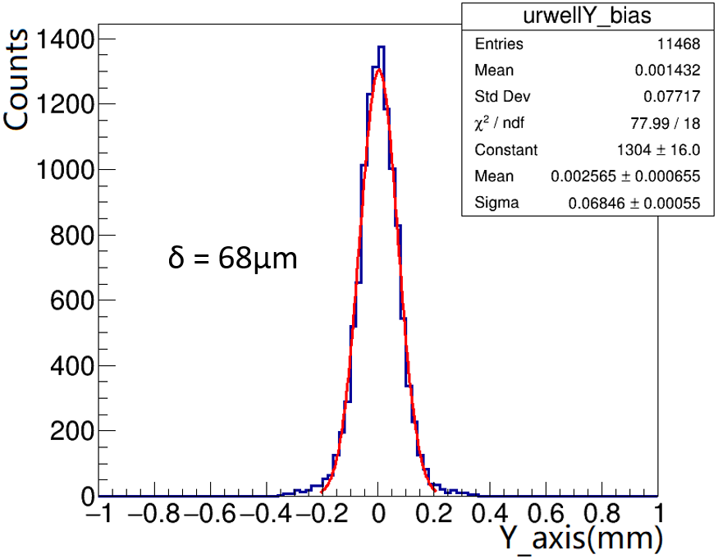
μRWELL position resolution
Position efficiency: Charge-weighted center of gravity (COG) method
Position resolutions better than 70 microns are achieved on both readout directions of the μRWELL prototype

Slide 16
Conclusion and next step
Conclusion
A 2-D readout μRWELL detector using DLC was designed, fabricated and tested.
Gas gain up to 10⁴, detection efficiency larger than 90%, position resolution better than 70um.
The good performance indicates the DLC is reliable and the 2-D track reconstruction could be achieved.
Next Steps
Optimize the 2-D readout strip.
R&D of the larger size DLC sample.
R&D of the large area μRWELL detector.
R&D of the high rate μRWELL detector.

Slide 17
THANKS

Slide 18
BACKUP

Slide 19
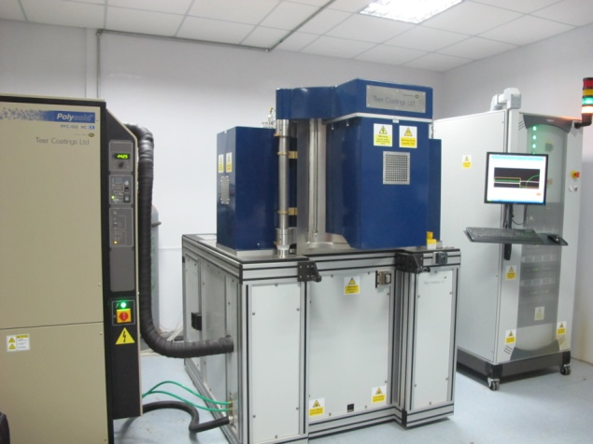
DLC Deposition Procedure
Baking the kapton sample at 70 degrees centigrade for 12 hours.
Vacuum pumping to remove the air from the chamber.
Start procedure to coat DLC on the pre-treated sample.
Cooling in vacuum to release the inner stress uniformly of the sample.
The Magnetron sputtering system (Teer 650)
Sample Baking
Sample Clamping
Vacuum Pumping
Cooling in Vacuum
Deposition
Sample Pre-treating
Sample
taking down

