Slide 1
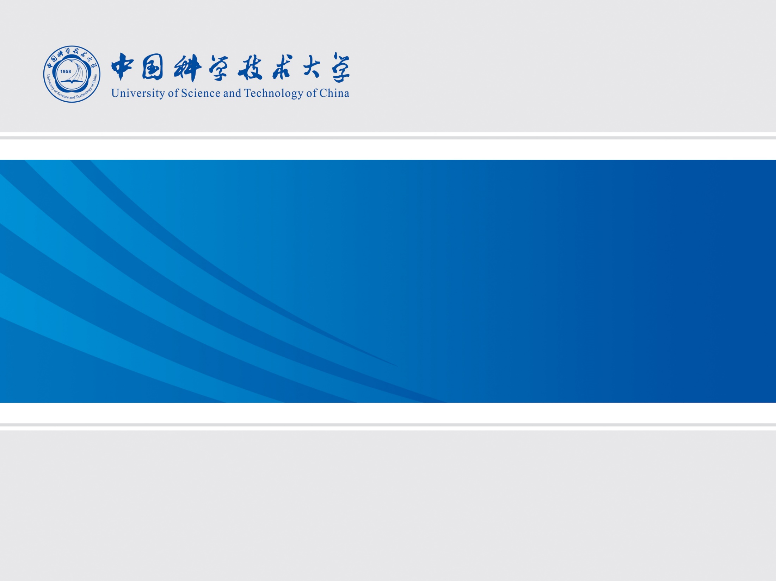
New Prototype MRPC with Diamond-Like-Carbon Coated Electrodes
Kaiyang Wang, Xinjian Wang, Yongjie Sun
State Key Laboratory of Particle Detection and Electronics
Department of Modern Physics, USTC

Slide 2

Outline
Research background
Introduction to DLC technology
MRPC prototype and cosmic ray test
Problems and improvement methods
Summary

Slide 3
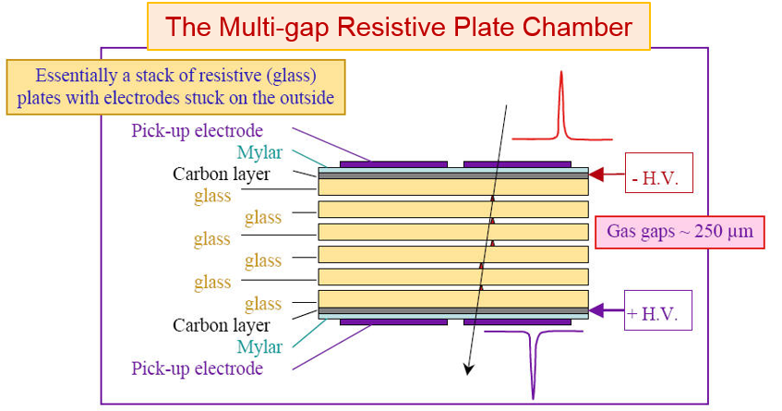
Background
The Multi-gap Resistive Plate Chamber (MRPC) has been successfully used in Alice TOF, STAR eTOF, STAR MTD, BESIII eTOF
High time resolution <50ps
High detect efficiency >95%(MIPs)
Low price
The Compressed Baryonic Matter(CBM) experiment will use MRPC technology in TOF
A rate capability between 0.5kHz/cm² ~25kHz/cm²
Normal MRPC can’t meet this demand, high rate capability MRPC is needed

Slide 4
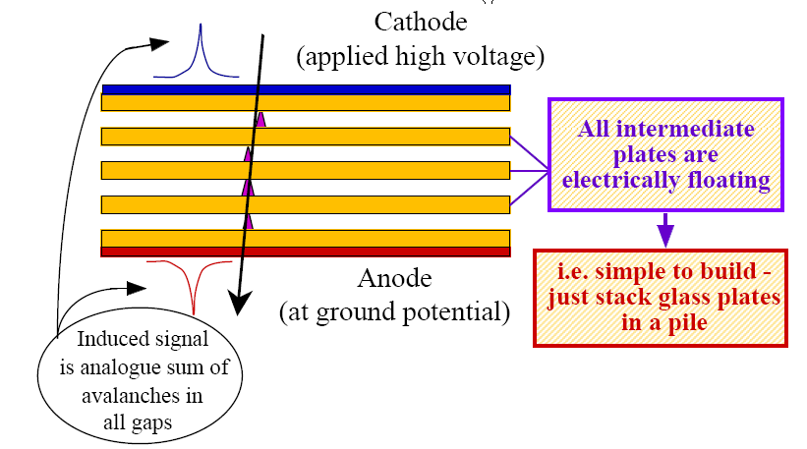

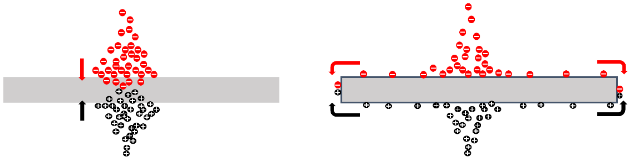
rate capability of MRPC
Vappl: Voltage apply to MRPC
Φ: particle flux
ρ: resistivity of glass
d: thickness of glass
<Q>: average electric charge
Normal way
Decrease thickness of glass: ultra-thin float glass
Decrease resistivity of glass : low resistive glass (Tsinghua University)
New way
Coat a Diamond-Like-Carbon (DLC) layer all over the entire surface of glass to change path for the neutralization of the avalanche charges

Slide 5
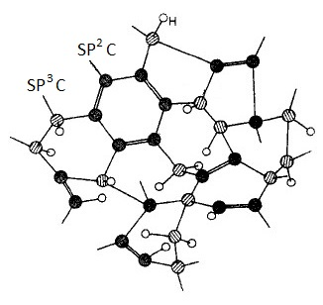
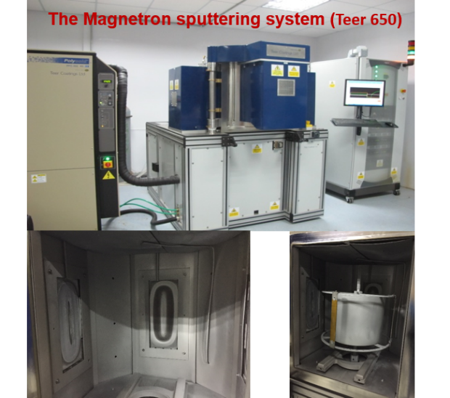
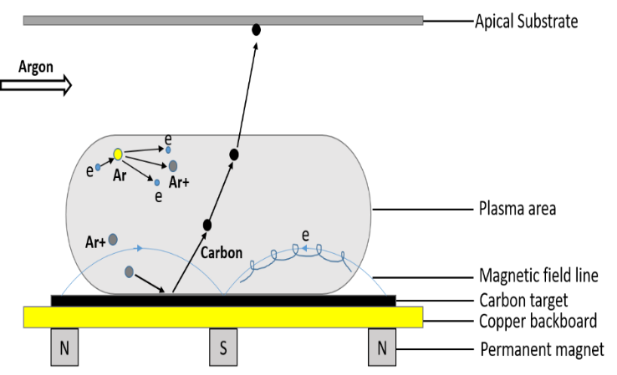
DLC: Diamond Like Carbon
A kind of “Metastable amorphous carbon material which contains both diamond-structure and graphite-structure”
Surface resistance stable and adjustable
Resistant to discharge and radiation
Chemical stability
Manufactured by Magnetron Sputtering deposition
Sample holder
Target
State Key Laboratory of Solid Lubrication, Lanzhou Institute of Chemical Physics, Chinese Academy of Sciences
Schematic of Magnetron Sputtering deposition

Slide 6
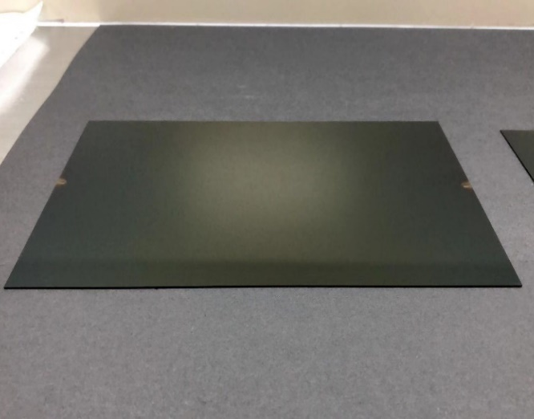
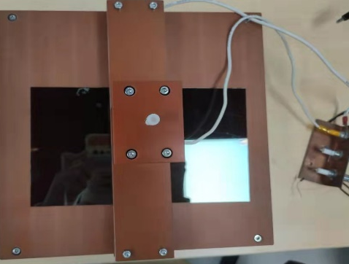
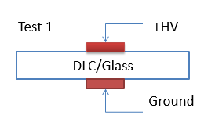
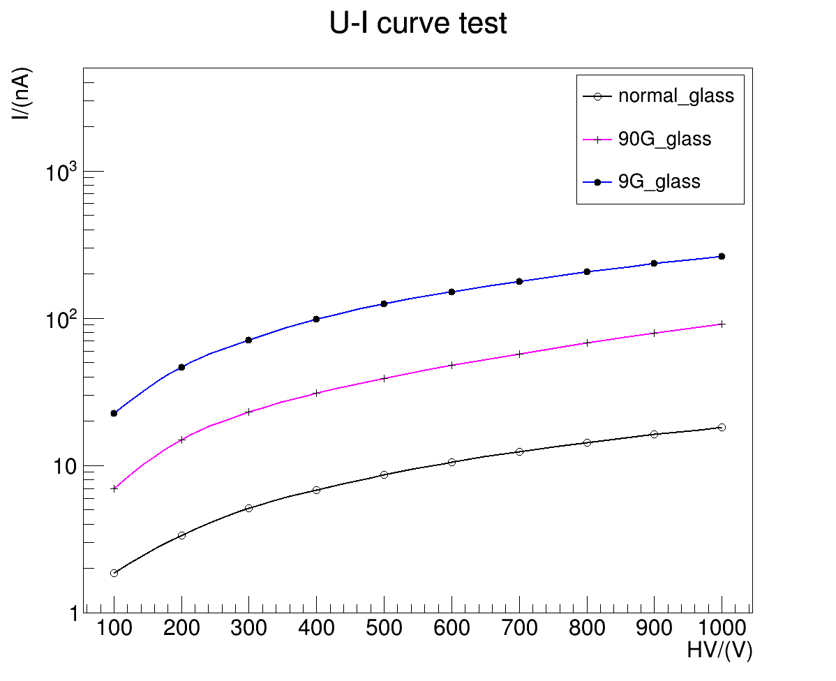
U-I curve
Made 2 DLC glass samples, surface resistivity are 9GΩ/□ and 90GΩ/□
12cm x 20cm
DLC glass sample
Electronic transmission speed is faster in DLC glass

Slide 7
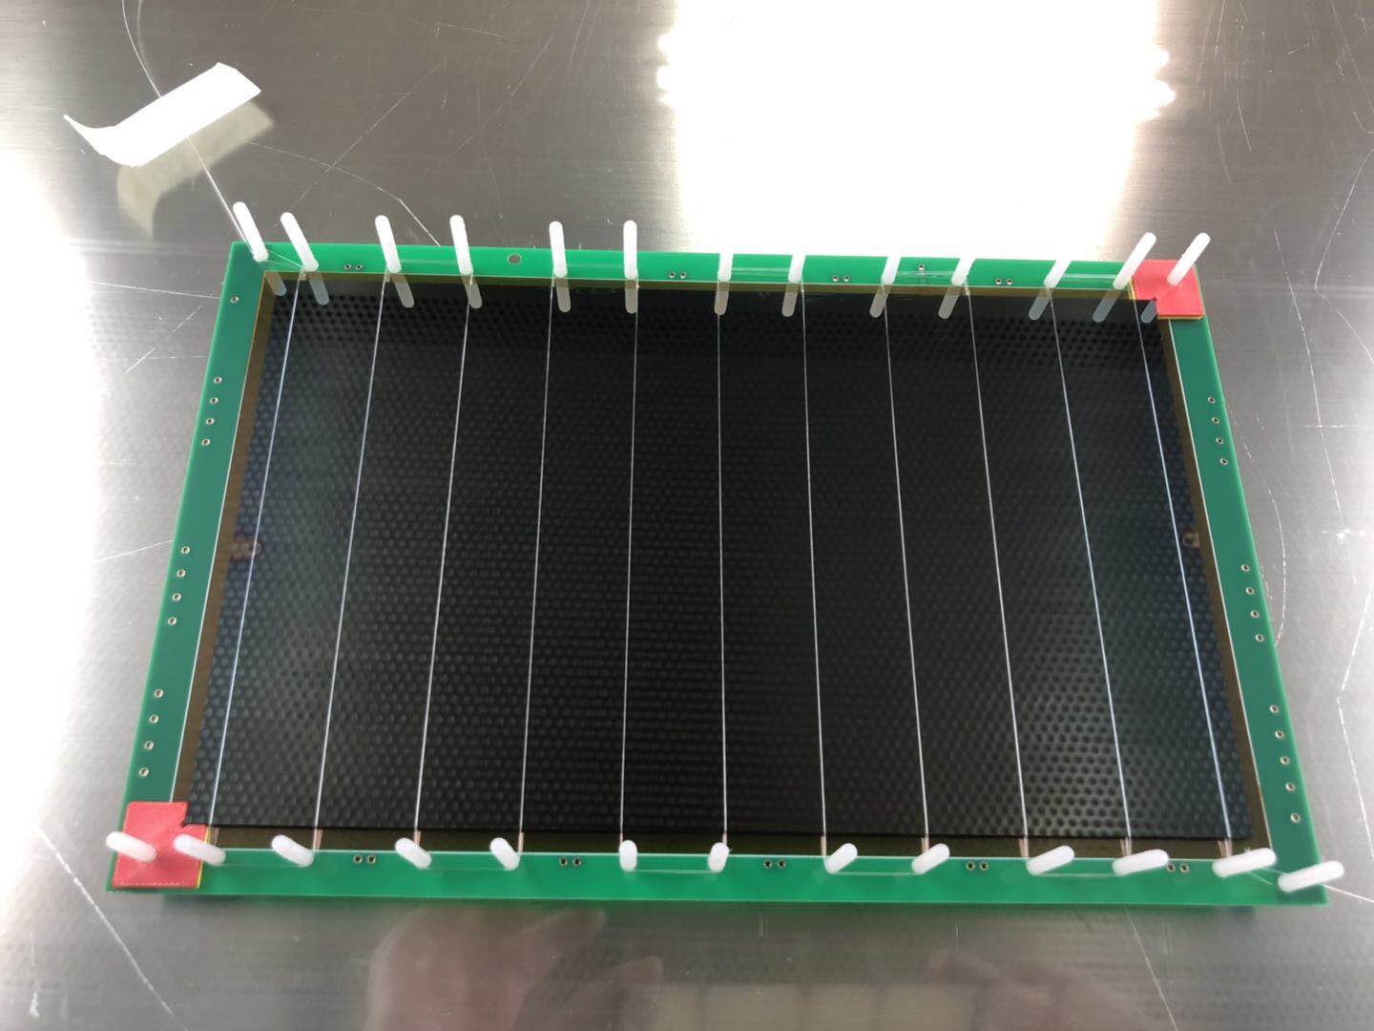
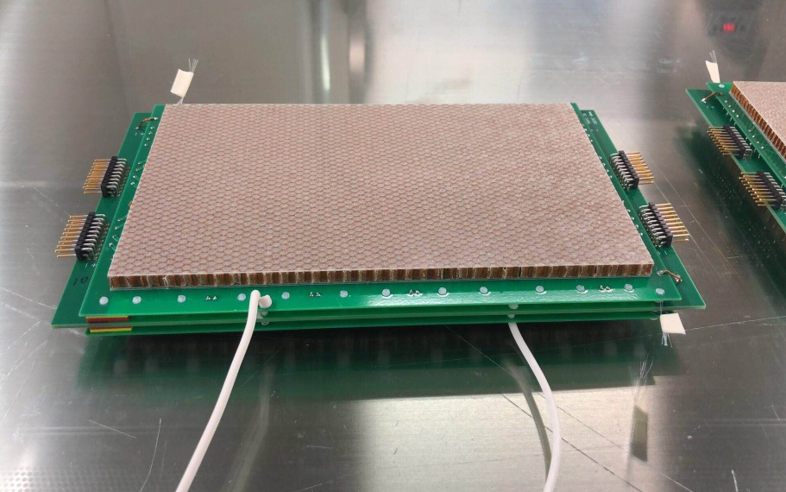
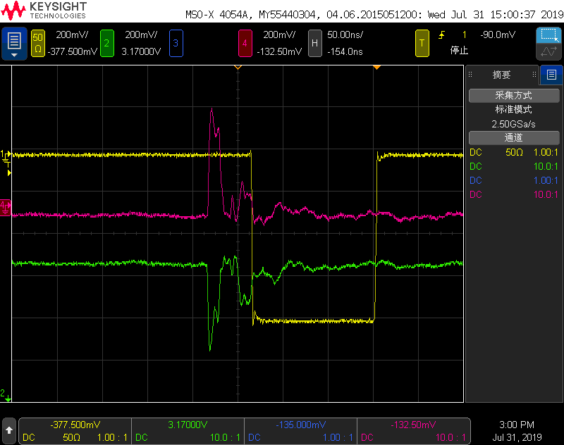
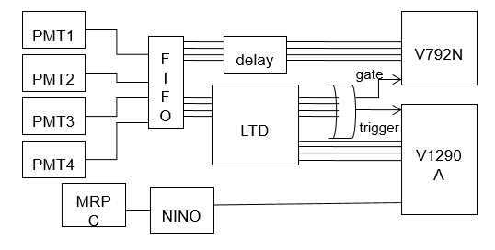
MRPC prototype
3 kinds of MRPC: one normal MRPC
two DLC MRPC 9GΩ/□&90GΩ/□
2x3 gaps
gap width 0.23mm
8 readout strips
Strip: 200mm x 7mm
For DLC MRPC, all resistive plates use DLC glass
Signal picked up after FEE
90GΩ/□ DLC MRPC@±3600V(~104kV/cm)
cosmic ray test system schematic

Slide 8
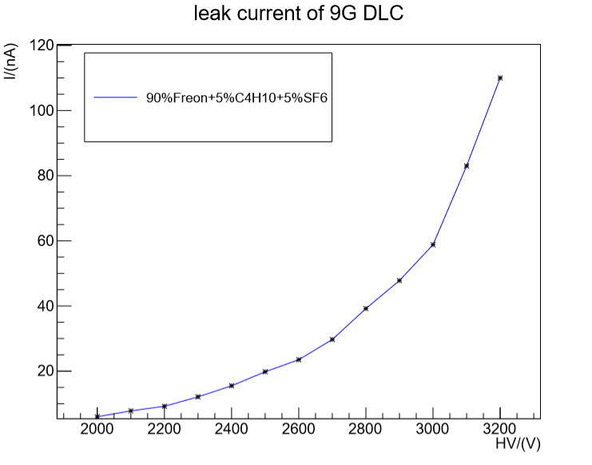
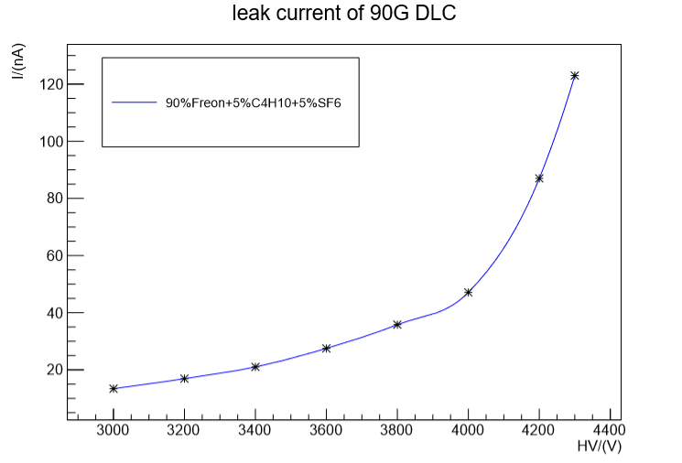
High voltage test
Leak current
Glass MRPC: <15nA@±4000V(~116kV/cm)
9GΩ/□ DLC MRPC: >100nA@±3200V(~93kV/cm)
90GΩ/□ DLC MRPC: <20nA @±4000V(After one month HV test, leak current increased)
after a month
Problem1:
high leak current

Slide 9
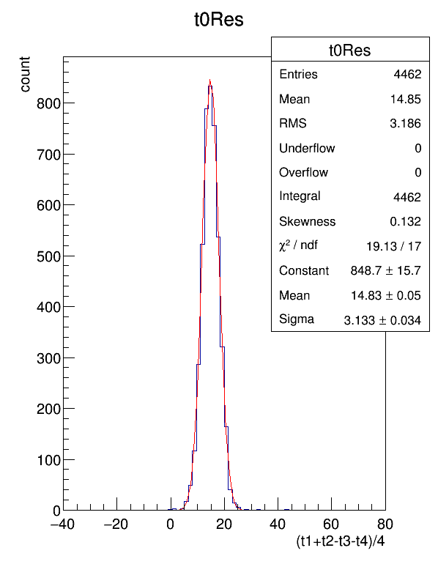
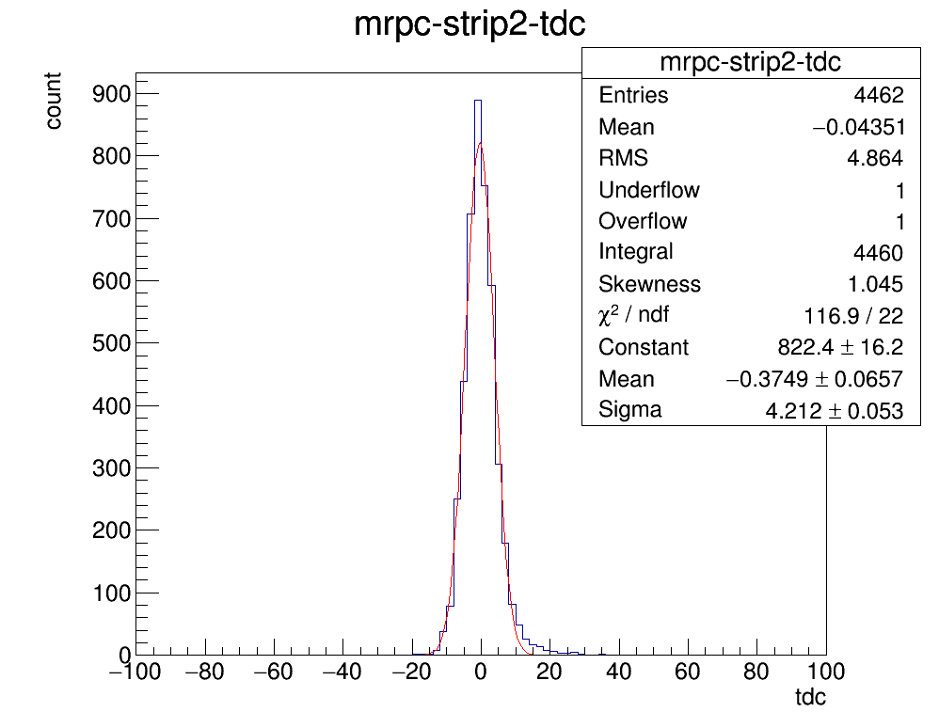

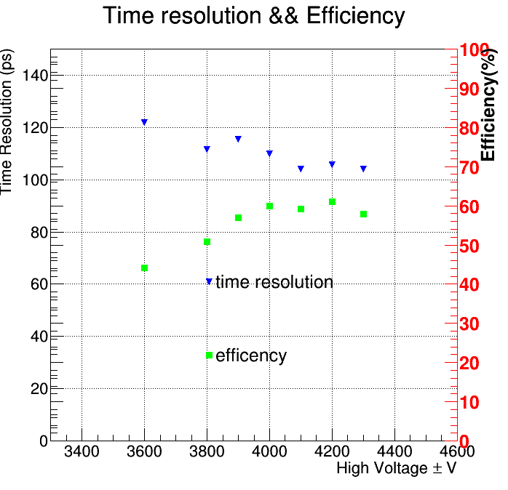


Time resolution && efficiency
Glass MRPC@±3600V
Efficiency ≈90%
Time resolution<80ps
$$σ=3.133$$
$$σ=4.212$$
Problem2:
low detect efficiency <60%
Time resolution and Efficiency plateau
of 90GΩ/□ DLC MRPC

Slide 10
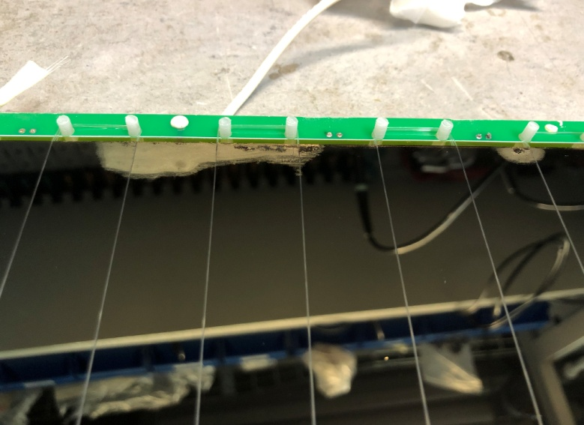
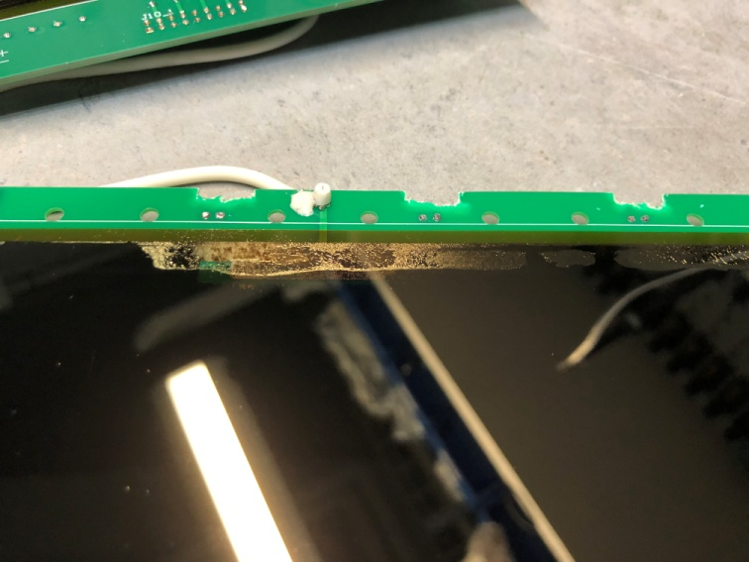
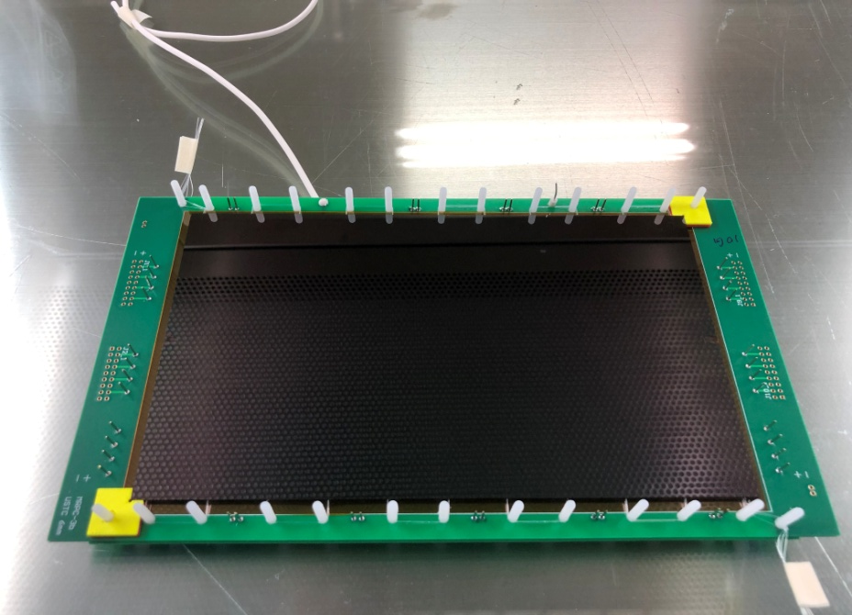
Inspection on DLC MRPC
DLC layers have fallen out
Fallen out
Ways to improve
Increase glass surface roughness
different electrode base

Slide 11
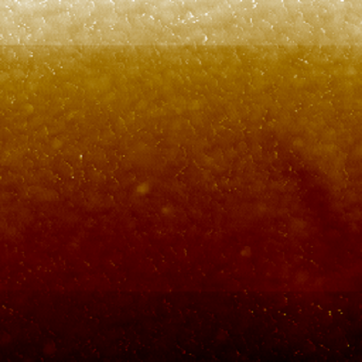

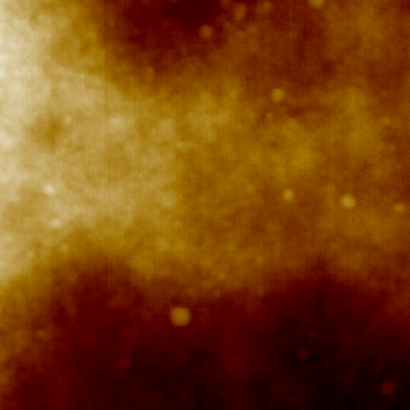
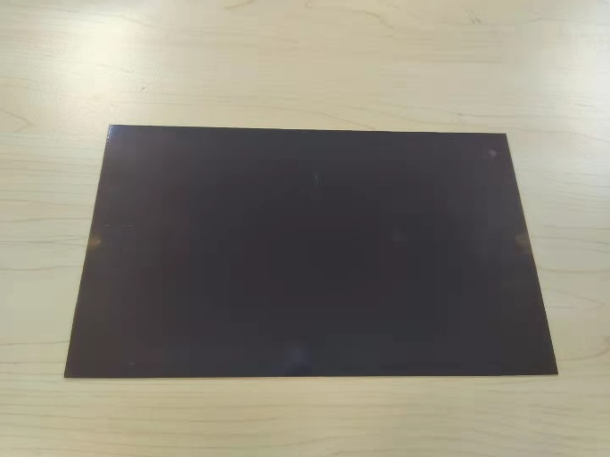
Erased Glass and Other Base
Erased glass: increase glass surface roughness
NaOH erased glass
Ra=1.79nm
HF erased glass
Ra=3.58nm
Normal float glass
Ra=0.37nm
Other base electrode: Kapton-PCB
DLC-Kapton-PCB
150GΩ/□
The problem of DLC shedding has not been solved so far
More test on other bases is ongoing

Slide 12
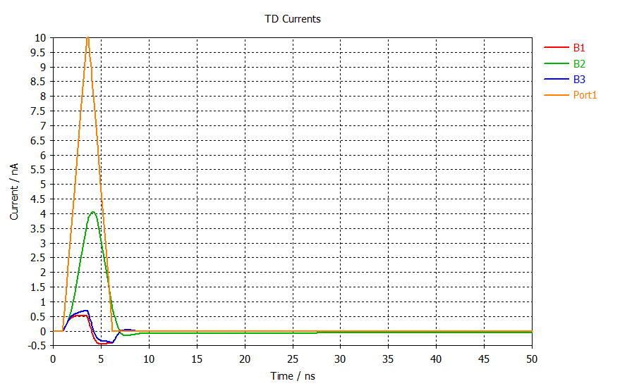
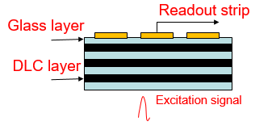
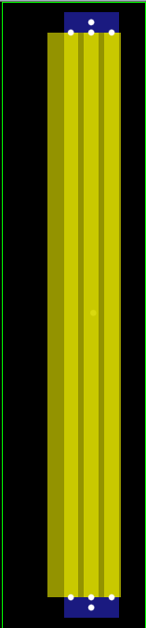
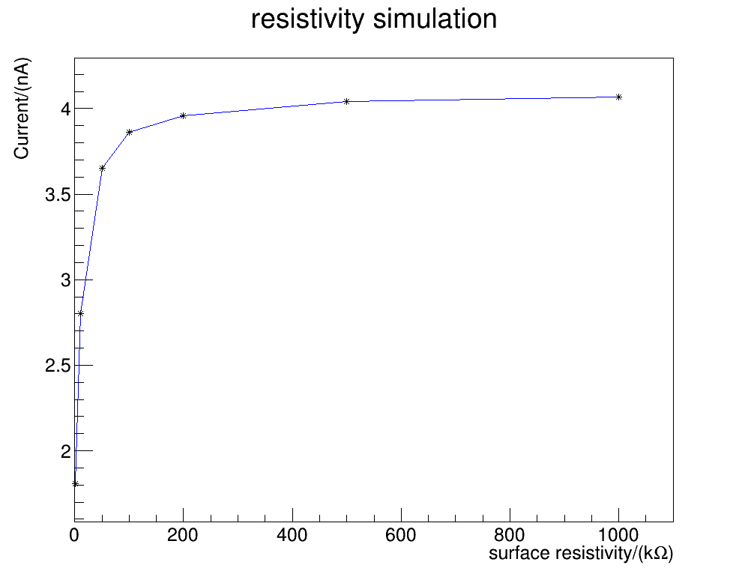
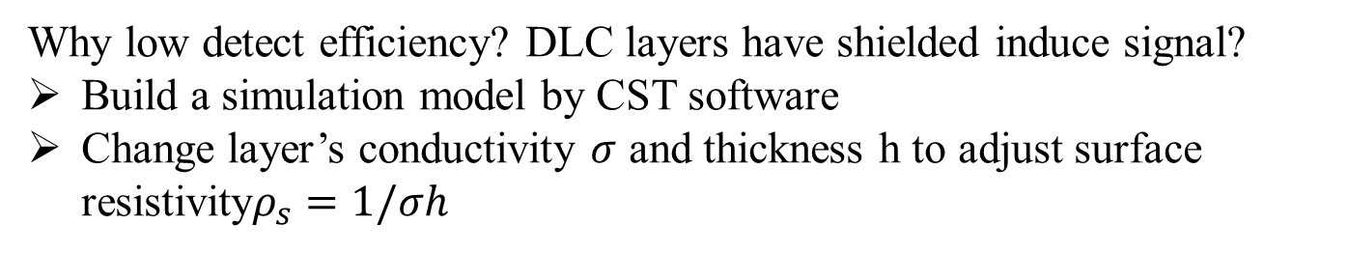
CST simulation
Why low detect efficiency? DLC layers have shielded induce signal?
Build a simulation model by CST software
Change layer’s conductivity $σ$ and thickness h to adjust surface resistivity$ρ_{s}=1/σh$
Excitation signal
induced signal
B1
T1
B2
Source
T2
B3
T3
induced signal varies surface resistivity
Simulation model

Slide 13



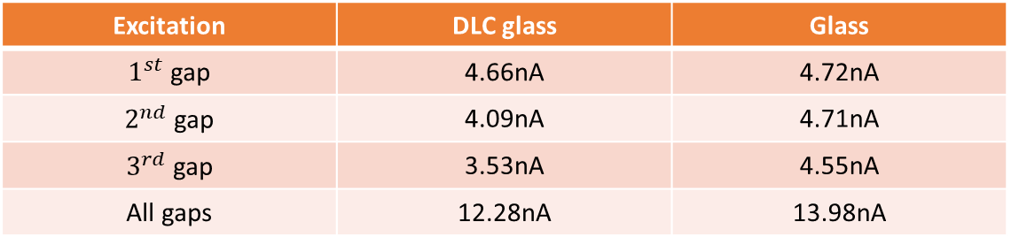
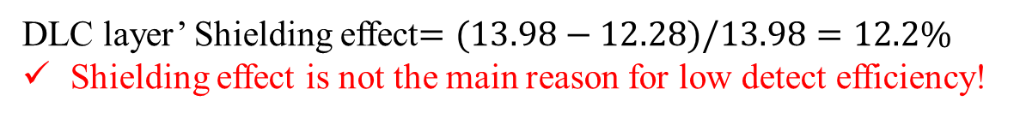
Simulation result
Build more detail simulation model refer to our MRPC structure
For DLC layers, set surface resistivity as maximum value 1MΩ/□
Induced signal
$1^{st}$ gap
$2^{nd}$ gap
Glass or DLC glass
$3^{rd}$ gap
Excitation signal
Amplitude of induced signal
Excitation | DLC glass | Glass
$1^{st}$ gap | 4.66nA | 4.72nA
$2^{nd}$ gap | 4.09nA | 4.71nA
$3^{rd}$ gap | 3.53nA | 4.55nA
All gaps | 12.28nA | 13.98nA
DLC layer’ Shielding effect$=(13.98−12.28)/13.98=12.2\%$
Shielding effect is not the main reason for low detect efficiency!

Slide 14
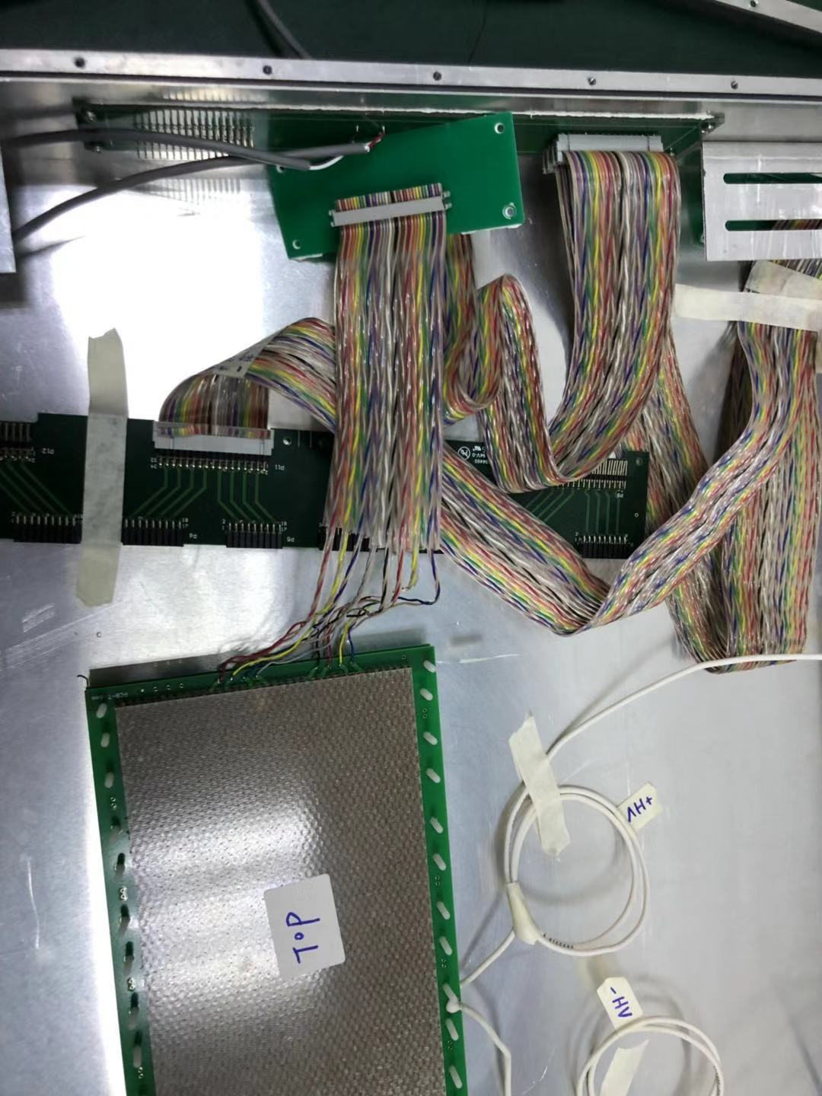
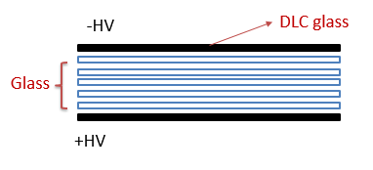
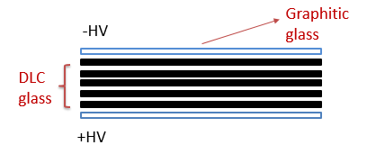
Investigation
two single stack MRPCs with 6 gas gaps
Different electrode and inner plates
MRPC1: DLC electrode + inner glass
MRPC2: Graphitic electrode + inner DLC(100G)
MRPC1:
MRPC2:
@±7200V(~104kV/cm)
Leak current: <40nA
Efficiency: 45.6%
Time resolution: ~100ps
@±7200V(~104kV/cm)
Leak current: <40nA
Efficiency: 86.7%
Time resolution: ~103ps
Detect efficiency is related to DLC electrode!
Need to test DLC coating + Graphitic glass

Slide 15
Summary
Put up with a new way to enhance rate capability of MRPC
by DLC coating in electrode
Made different kinds of MRPC prototype, test by cosmic ray
Encountered two main problems : large leak current and low efficiency
Find the reason and put forward ways to improve
Future work
Strengthen adhesion between DLC coating and glass
Test graphitic glass + DLC coating
Rate capability research
Thank you!

