Slide 1
Application of Micro-MEGAS on measuring X-ray activity of ⁷¹Ge
Kangkang Zhao
State Key Laboratory of Particle Detection and Electronics
University of Science and Technology of China
2021, 10. 22 XiAn, China

Slide 2
Outline
NTD-Ge thermistor
Ge-71 thermal neutron fluence monitor
Micro-MEGAS: X-ray detection
Geant4 simulation
Results
Summary

Slide 3
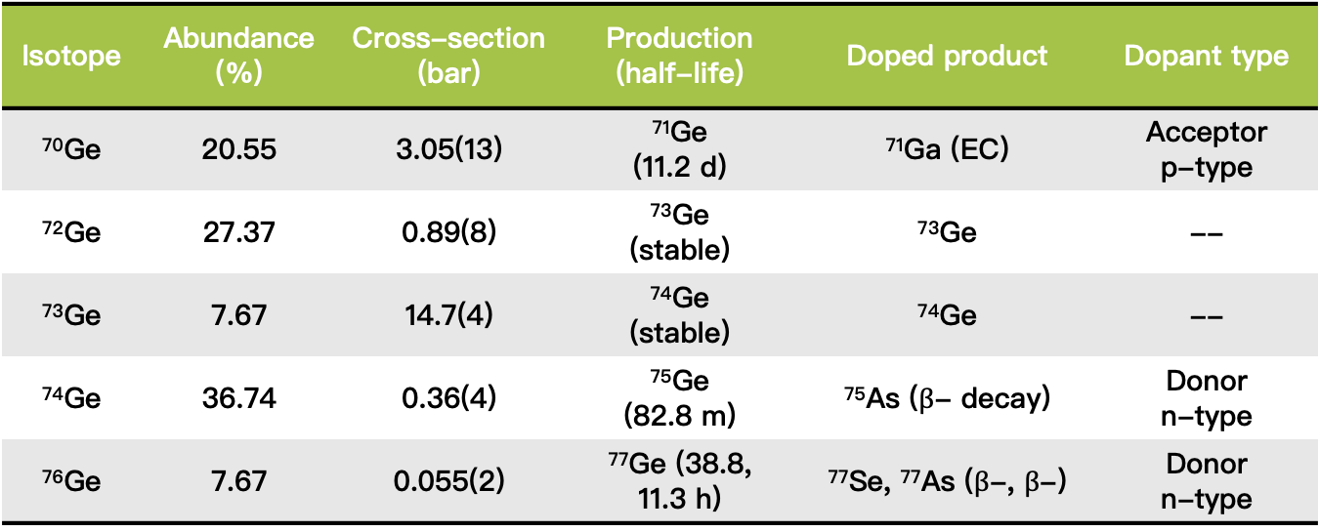

NTD-Ge thermistor
Neutron Transmutation Doped semi-conductor (Germanium)
The net carrier concentration is$:$
$$N_{A}−N_{D}=N_{{}_{31}^{71}{Ga}}−(N_{{}_{33}^{75}{As}}+2×N_{{}_{34}^{77}{Se}})$$
For a natural Ge, the neutron doping results in p-type due to its isotopic abundance and thermal neutron capture cross section
Isotope | Abundance (%) | Cross-section (bar) | Production (half-life) | Doped product | Dopant type
⁷⁰Ge | 20.55 | 3.05(13) | ⁷¹Ge (11.2 d) | ⁷¹Ga (EC) | Acceptor p-type
⁷²Ge | 27.37 | 0.89(8) | ⁷³Ge (stable) | ⁷³Ge | --
⁷³Ge | 7.67 | 14.7(4) | ⁷⁴Ge (stable) | ⁷⁴Ge | --
⁷⁴Ge | 36.74 | 0.36(4) | ⁷⁵Ge (82.8 m) | ⁷⁵As ($β$- decay) | Donor n-type
⁷⁶Ge | 7.67 | 0.055(2) | ⁷⁷Ge (38.8, 11.3 h) | ⁷⁷Se, ⁷⁷As ($β$-, $β$-) | Donor n-type

Slide 4
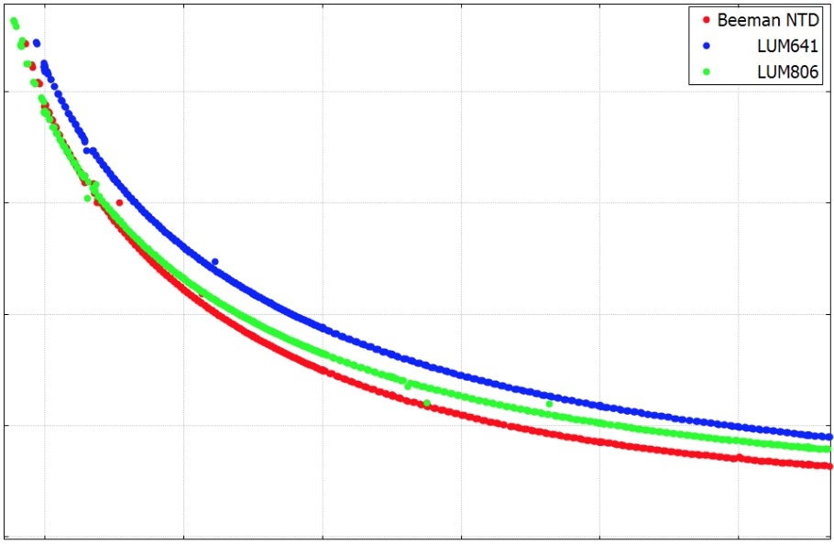
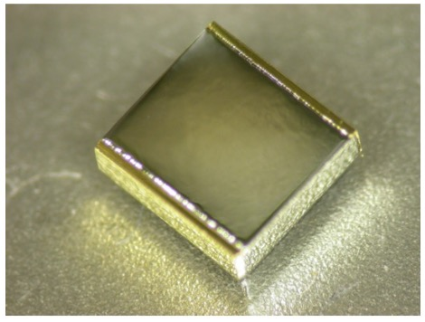
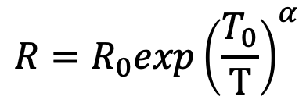

NTD-Ge thermistor
The resistivity of a NTD Ge is given by Mott’s law as,
In a Variable Hopping mechanism, the $α$ is predicted to be 0.5
neutron capture cross-section - homogenous doping
high temperature sensitivity, reproducibility, mass production, low specific heat, fast rise time and simple read out.
$$R=R_{0}exp{\left(\frac{T_{0}}{T}\right)}^{α}$$
Ge intrinsic property
Doping level
10⁶
0.2 mm
Resistance (Ω)
10⁵
0.9 mm
10⁴
2.9 mm
3.0 mm
10³
10²
0.02
0.04
0.06
0.08
0.10
0.12
Temperature (K)

Slide 5
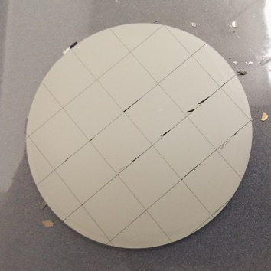
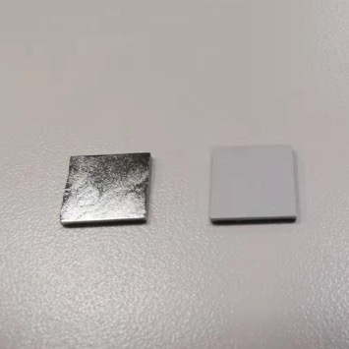
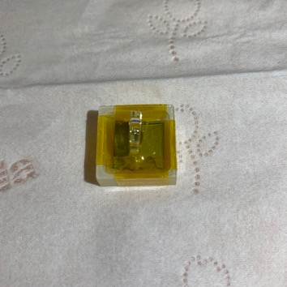
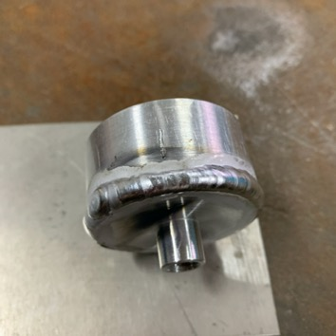
Neutron Irradiation of Ge
10Nine High-purity Ge, preparation and wrap
China Advanced Research reactor, CARR
2020.12.23, irradiation time 64 h 29 min
Thermal neutron percentage > 99%
No fluence monitor
Wafer dicing
HNO₃:HF=7:3
etching and de-oxide
Wrap in quartz box
Sealed in Al can
10*10*1 mm³

Slide 6
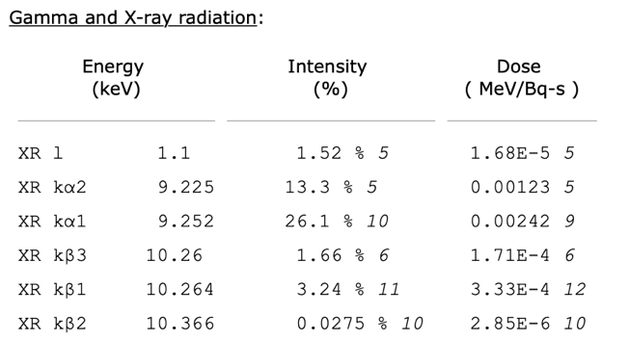

Thermal neutron fluence measurement
The thermal neutron fluence of HPGe received is related to the doping level of NTD-Ge, and the performance of thermistor
Using ⁷⁰Ge(n, $γ$) ⁷¹Ge reaction: 9.2 keV and 10.3 keV X-rays
Principle of measurement
The X-ray detection was carried out on MMD
⁷¹Ga

Slide 7
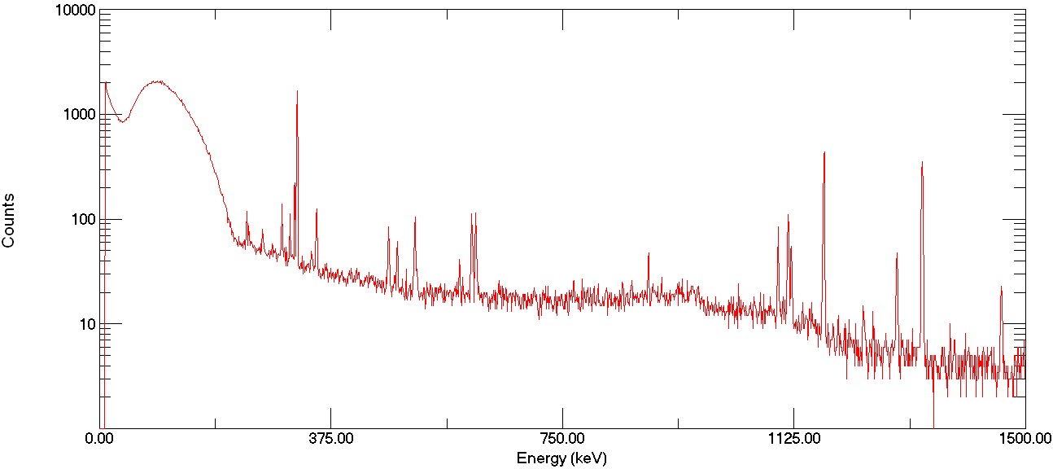

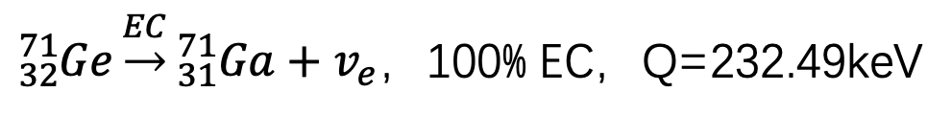
NTD-Ge Radioactivity
Low-background HPGe gamma spectrometer
EC内轫致连续$γ$
Cr-51
Co-60
Co-60
Sb-124
Zn-65
Fe-59
${}_{32}^{71}{Ge}\underset{→}{EC}{}_{31}^{71}{Ga}+v_{e}$，100% EC，Q=232.49keV

Slide 8
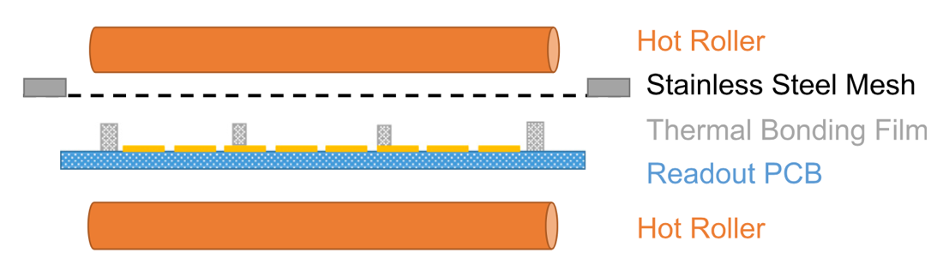
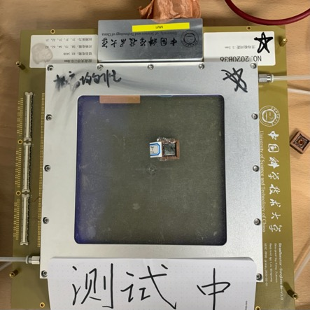
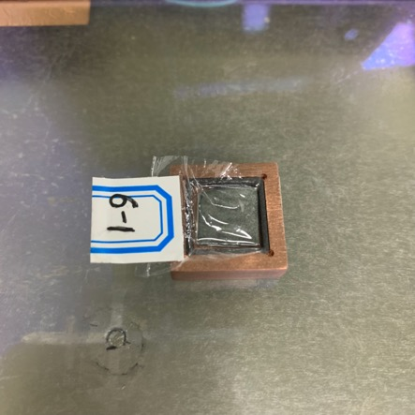
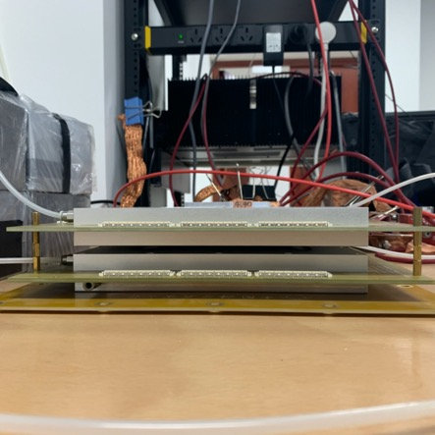
Micro-MEGAS
9.2 keV and 10.3 keV X-rays activities measurement
Clear structure: geant4 simulation to obtain efficiency
Thermal bonding method manufactured MMD
No etching, no pollution
Easy to handle at lab
Easy to make new structures
Cheap
Φ0.5mm- Φ1mm spacers, ~1cm pitch
➔easy to clean, especially for large area
➔less than 1% spacer area
Feng J, Zhang Z, Liu J, et al 2021, 989: 164958.
HPGe: 10*10*1mm3
Cu-collimator
PE film wrapping

Slide 9
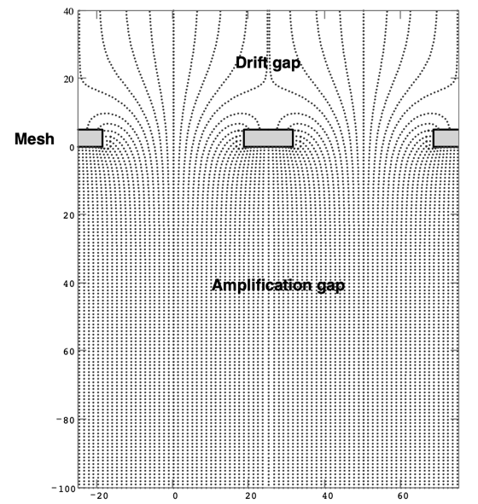
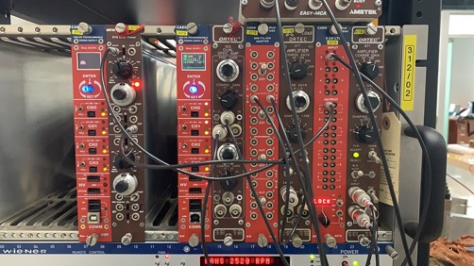
Experimental setup
Micro-Megas: Gas mixture 95% Ne, 5% iC₄H₁₀
Determine the optimal work points of MMD
  Electronic transparency
  Fixed the mesh voltage, adjust drift voltage, choose the point that have maximum peak position
  Energy resolution vs gain
  Fixed the field ratio, adjust voltage
  value, choose the gain that near 5000
∅6.45mm Cu collimator
Anticoincidence system to reduce bkg

Slide 10
⁷¹Ge X-ray spectrum
Energy resolution: ~9.1% FWHM@9.2 keV
Fit:
  Signal: 5 gaussian characteristic X-ray
  Background: Argus + Chebyshev polynomials
Prominent features: 5.4keV, 6.4keV, 8.0keV, which are NOT seen in Fe-55 spectrum
~11.4% FWHM@5.9 keV
Notes:
Penning effect

Slide 11
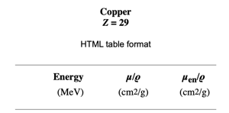
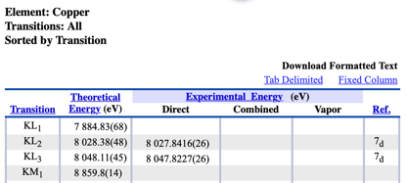

Peak sources
8.0 keV peak is from the Cu collimator excitation
With Cu-collimator
Without Cu-collimator

Slide 12
Half-life fit results
5.4 keV
6.4 keV
Energy (keV) | Half-life (day)
5.4 | 11.28
6.4 | 11.02
9.2 | 12.12
10.3 | 11.02
9.2 keV
10.3 keV
Half-life of ⁷¹Ge is 11.42 day, so the Prominent features: 5.4keV, 6.4keV are probably relative to ⁷¹Ge ( 9.2 keV $K_{α}$ , 10.3 keV $K_{β}$)

Slide 13
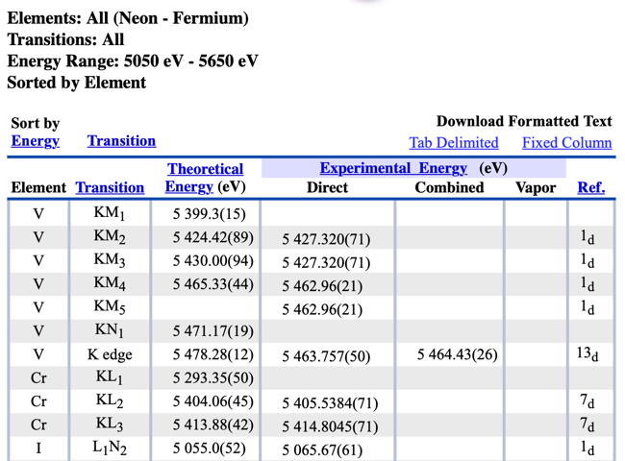
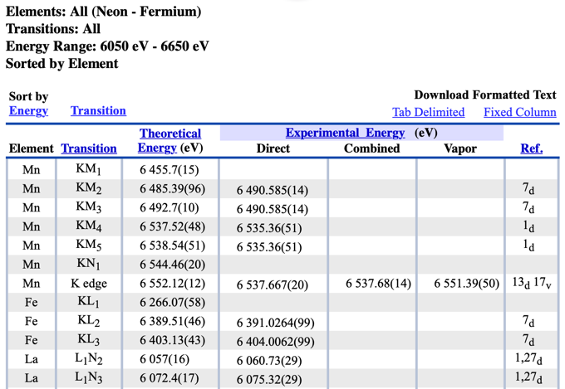
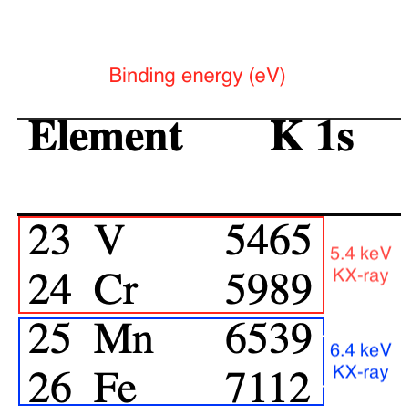
Mesh material excitation
Mesh material: stain-less mesh
Cr, Mn, Fe elements in stainless mesh are excited

Slide 14
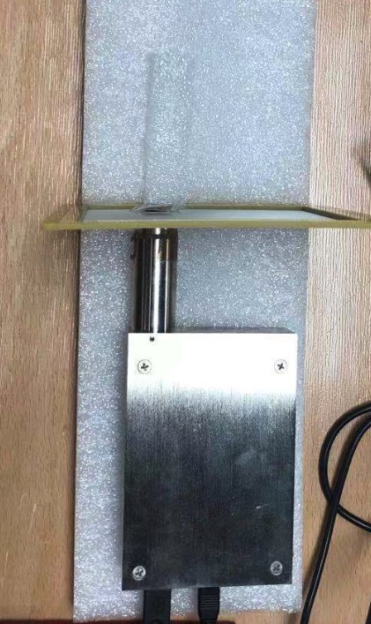
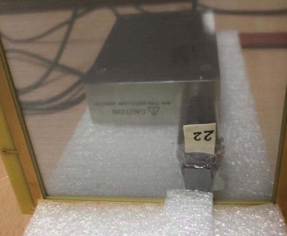
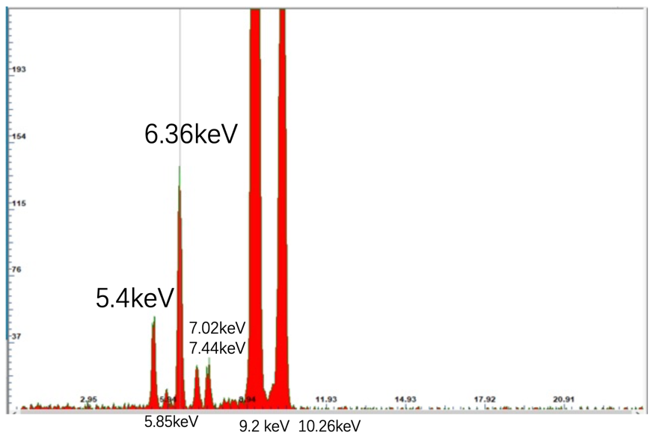
SDD measurement
Silicon Drift Detector
SDD Ge-71 spectrum
NTD-Ge
Mesh
SDD

Slide 15
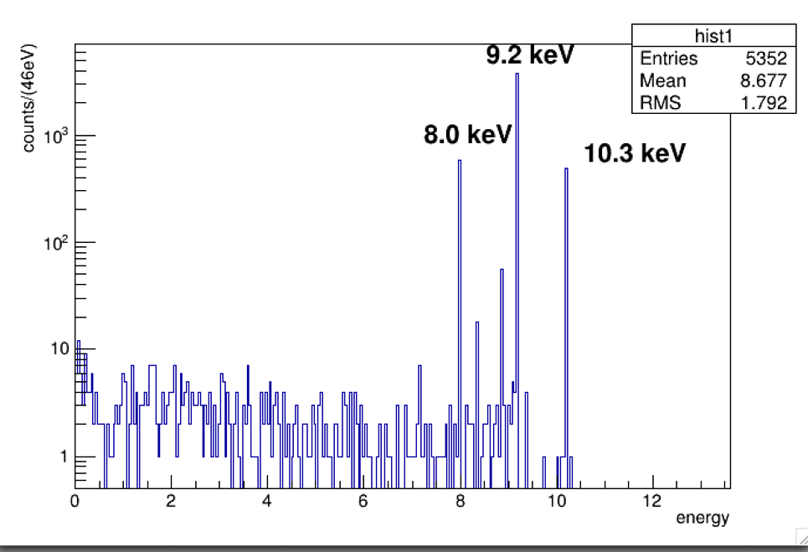
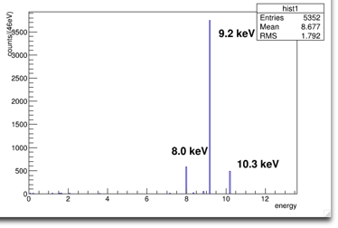
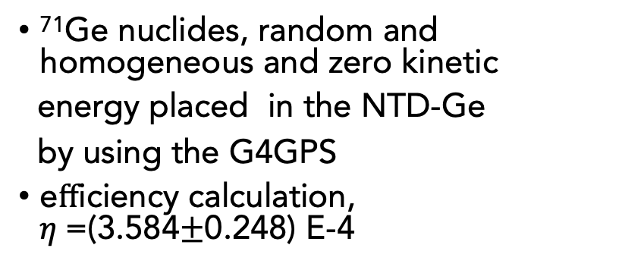
Geant4 simulation
PE Film
8um
NTD-Ge
10x10x1 mm³
Gas chamber
15x15 cm²x1.1cm
95%Ne+5%iC4H10
Efficiency contribution
Source distribution
NTD-Ge Self absorption
Cu collimator acceptance
Window absorption
Interaction with gas
Cu collimator
Thick 5mm
D:6.45mm
PET window
15x15 cm²x330um
⁷¹Ge nuclides, random and homogeneous and zero kinetic
energy placed in the NTD-Ge
by using the G4GPS
eﬀiciency calculation, $η$=(3.584$±$0.248) E-4

Slide 16
Thermal neutron fluence results
Fluence results and the uncertainty budget
The results of MMD and SDD measured are consistent
Dominant uncertainty of MMD comes from the uncertainty of thickness drift gas chamber
误差来源 | 相对误差 (%)
 | MMD | SDD
截面 | 1.5385 | 1.5385
探测器效率 | 7.0335 | 2.1203
输入参数 | 2.9267 | 2.9268
半衰期 | 2.9847 | 2.8612
合计 | 8.3253 | 4.8683
preliminary
preliminary

Slide 17
Summary
Using MMD to detect 9.2, 10.3 keV X-rays of ⁷¹Ge
Found the peaks from mesh material excitation, which are not seen by ⁵⁵Fe source
Using Neon gas reached a good energy resolution of ~9.1% FWHM@9.2 keV
Geant4 simulation give the detection-efficiency of MMD
Firstly using Ge and MMD to measure thermal neutron fluence
Future on-line reactor experiment
Thank you!
Notes:
高流强 大面积

Slide 18
Backup
MMD measured spectrum Fit results
With Cu-collimator
Without Cu-collimator

Slide 19
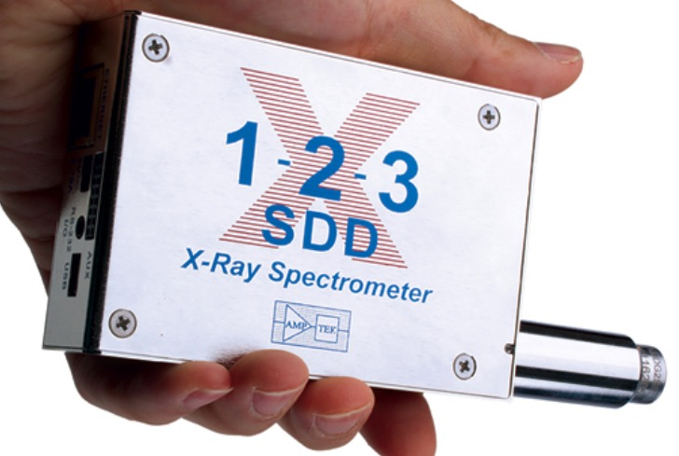

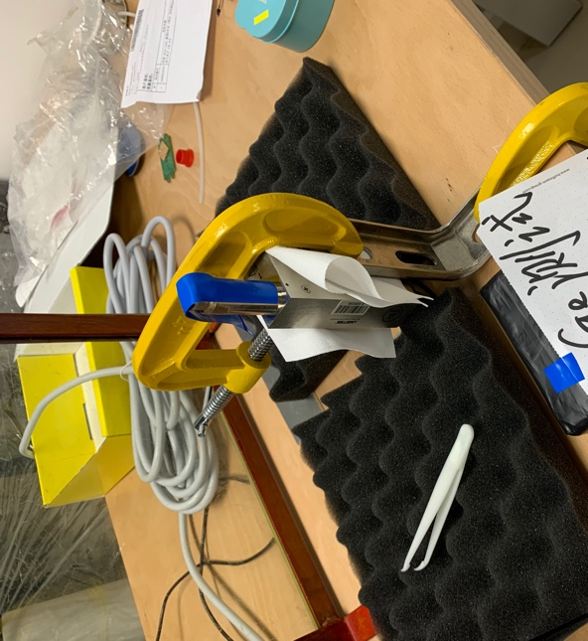
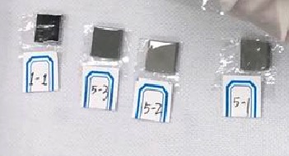
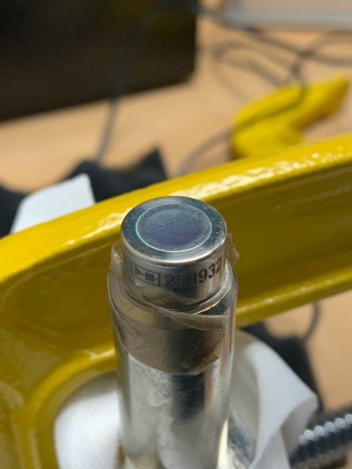

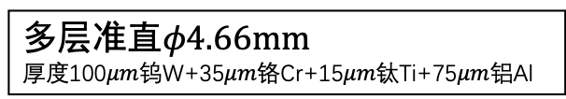

SDD info
Be窗$φ7mm×12.5μm$
多层准直$φ4.66mm$
厚度100$μm$钨W+35$μm$铬Cr+15$μm$钛Ti+75$μm$铝Al
硅晶体$5mm×5mm×500um$
测试能区2-30 keV
能量分辨率150 eV@5.9keV (Fe55)
实验室测试实物图
9.22keV
10.26 keV
⁷¹GeEC衰变kX-ray能谱

Slide 20
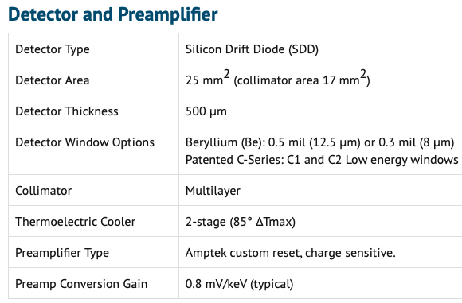
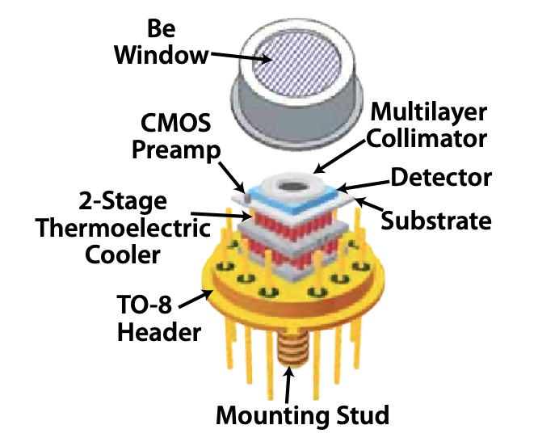

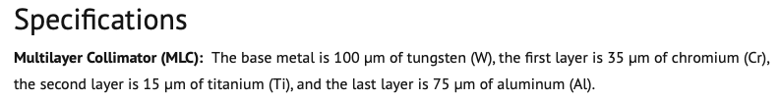
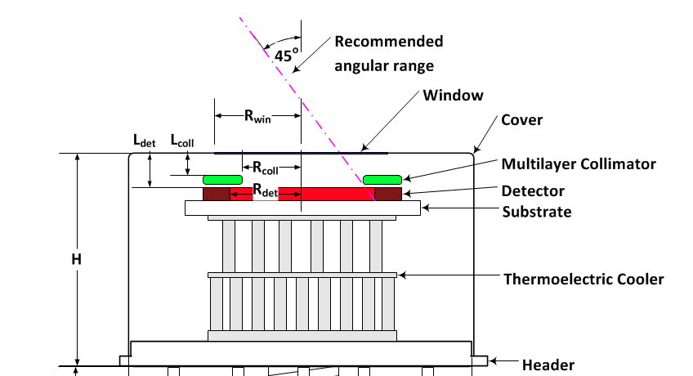
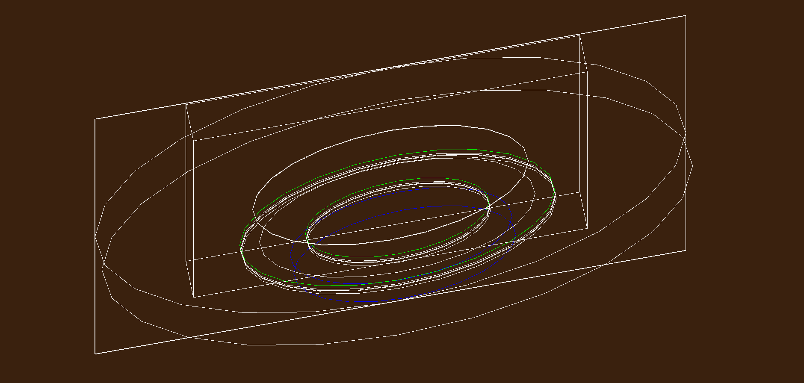
SDD geant4 simulation

