Slide 1
ECAL Muon Data analysis
2024/02/02
Jiaxuan Wang

Slide 2
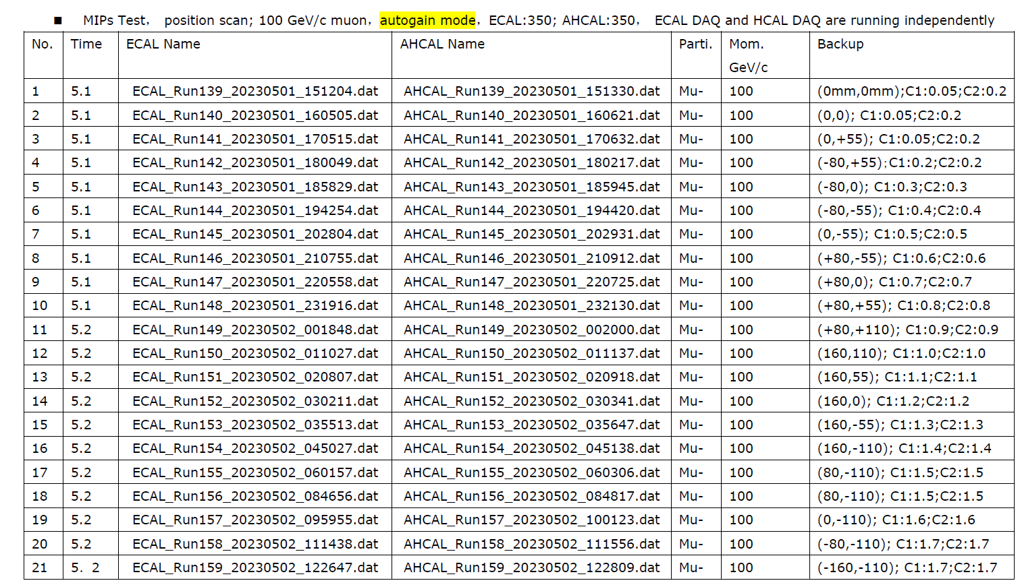
Muon Data
100GeV mu- data
Beam position
Beam condition
Sample and Test

Slide 3
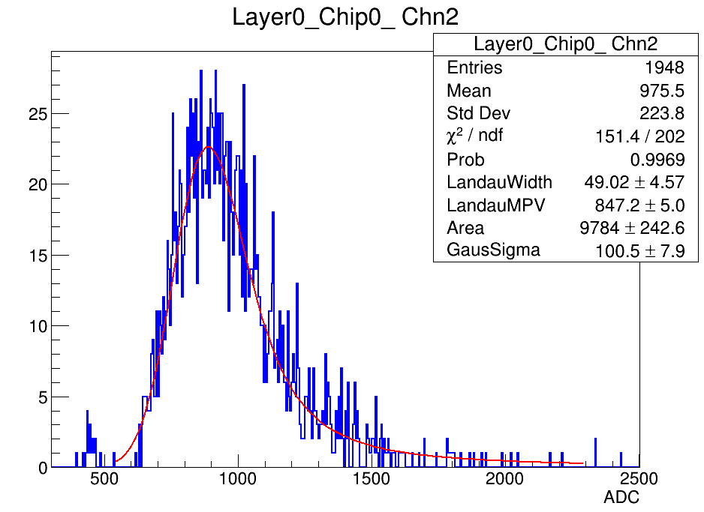
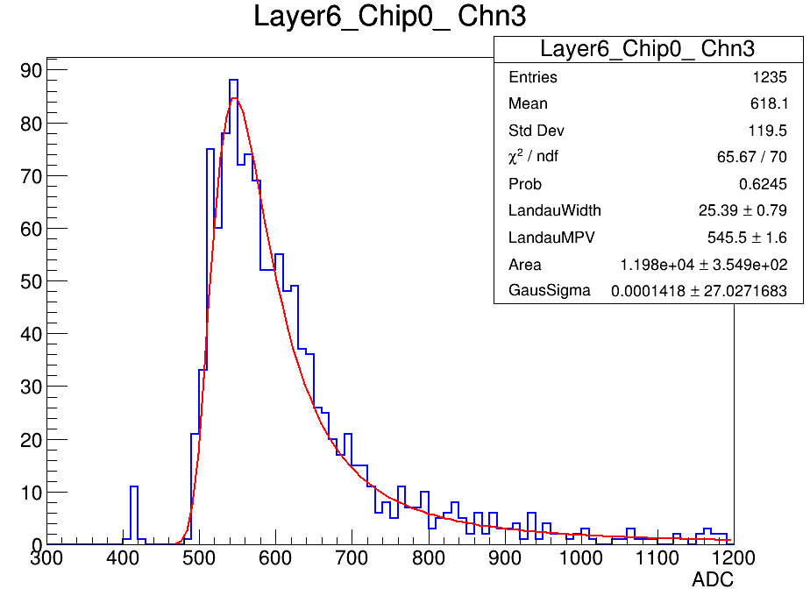
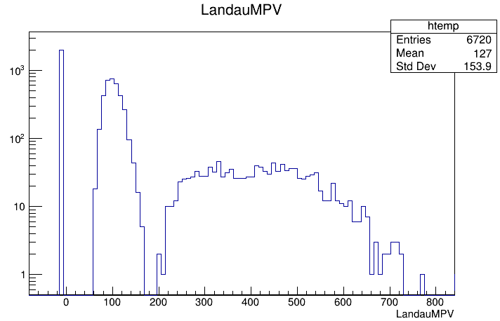
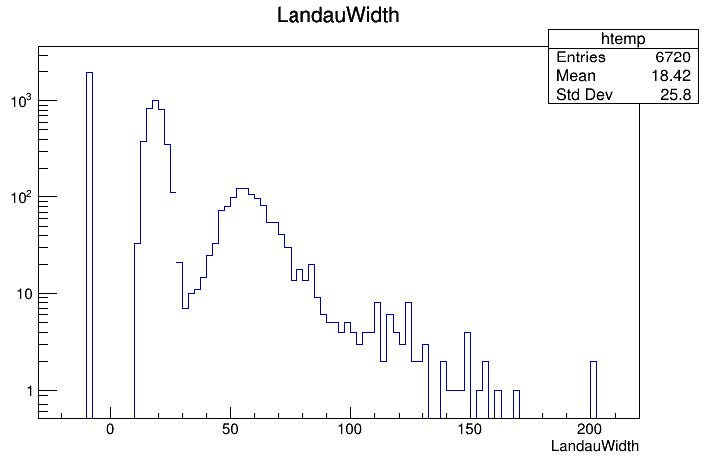
MIP calibration: sample
2/3 events from each file

Slide 4
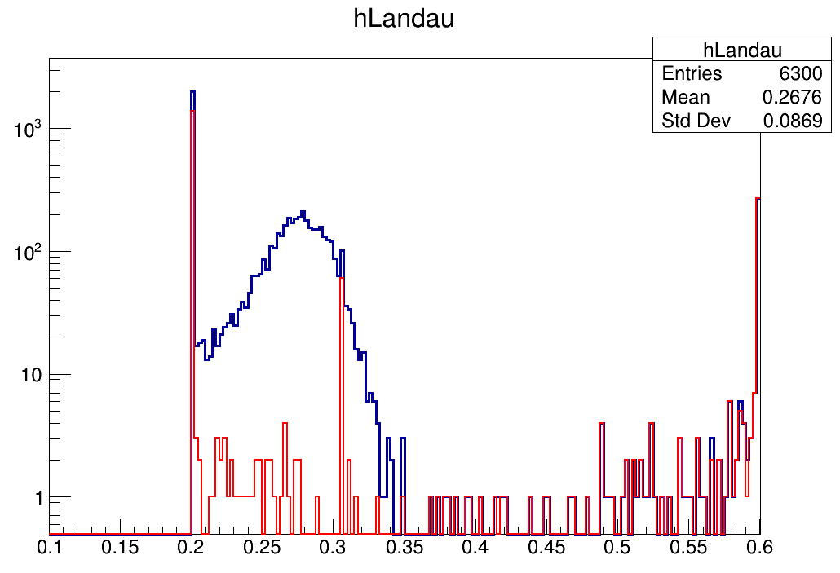
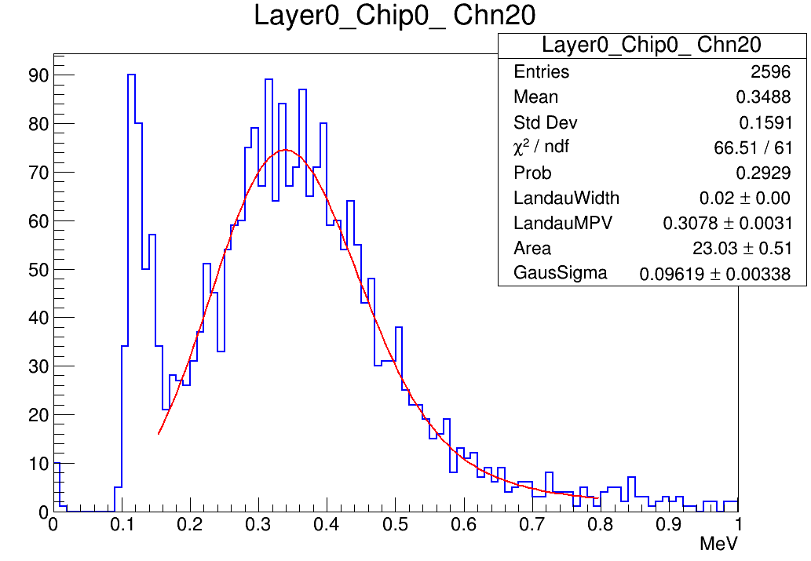
Muon Energy Reconstruction: test
1/3 events from each file
Energy reconstruction
0.305MeV
Blue : All channels
Red : Dead Channels
Using calibrated results from sample muon data, the MPV of fitting function are not around 0.305MeV for test muon files

Slide 5
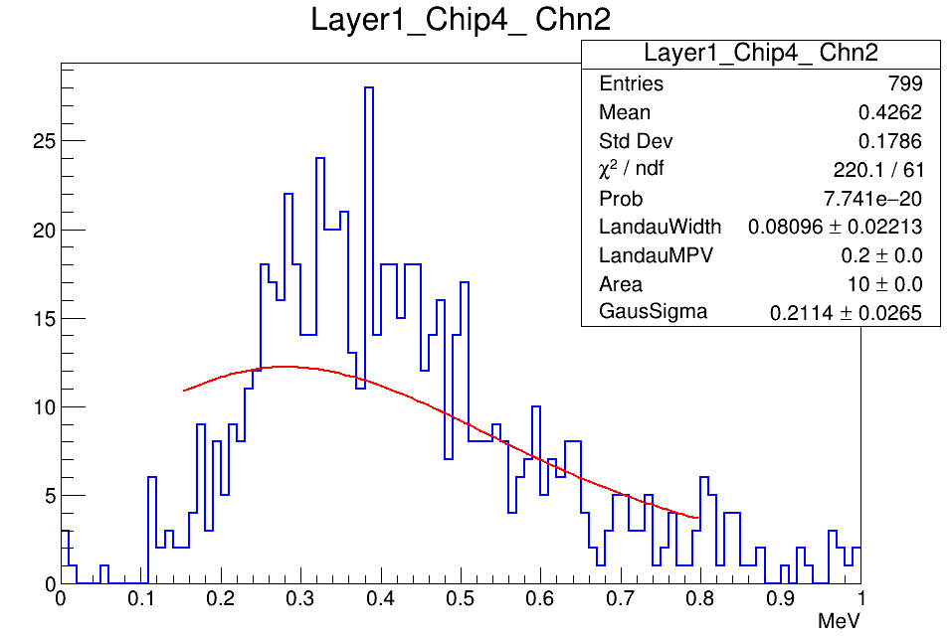
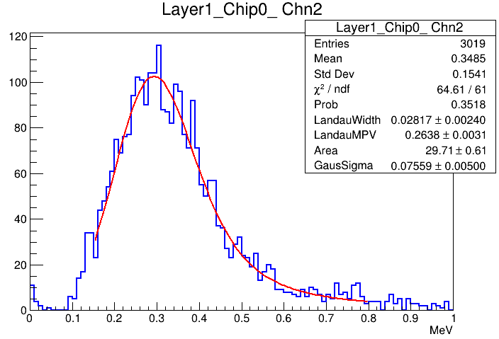
Muon Energy Reconstruction: test
Not fitted well good fit but with a low MPV

Slide 6
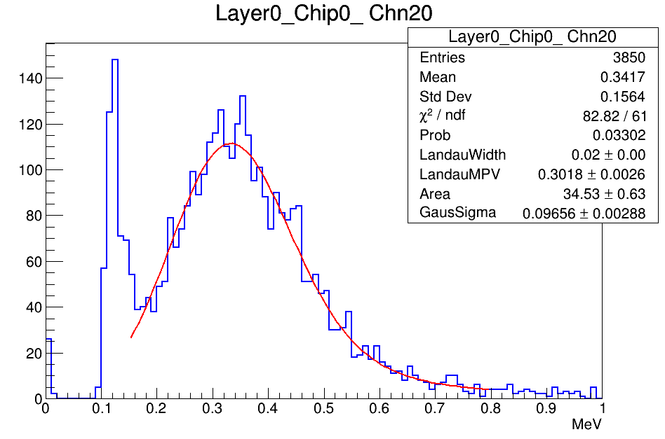
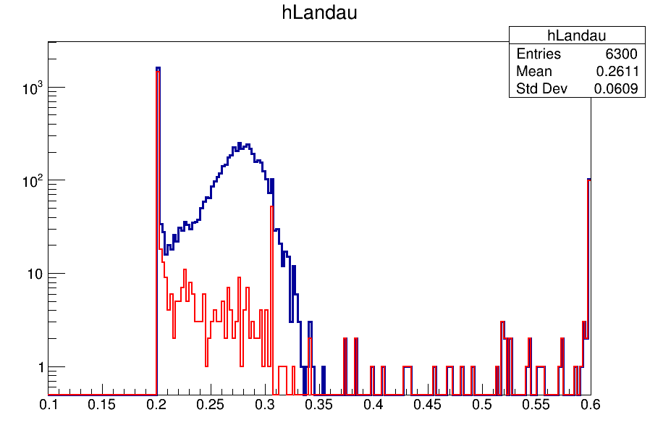
Muon Energy Reconstruction: sample
Energy reconstruction
0.305MeV
Blue : All channels
Red : Dead Channels
Using calibrated results from sample muon data, the MPV of fitting function are not around 0.305MeV for sample muon files either

Slide 7
Summary
Parameter calibrated from sample muon data
For muon energy reconstruction of each channel, plenty channels still have a low MPV which is smaller than 0.305MeV
Track fit method
SSA method
3D linear fit

