Slide 1
Holographic QCD and temperature density phase structure
Yuanxu Wang
Center for Theoretical Physics and College of Physics, Jilin University
@ The 1st edition of Spicy Gluons Workshop for Young Scientists
Rong-Gen Cai, He Song, Li Li, Yuan-Xu Wang, Phys.Rev.D 106 (2022) 12, L121902.
arXiv:2201.02004

Slide 2
Outline
Introduction & motivation
Holographic model
Predictions & QCD Phase diagram
Summary

Slide 3
PART 01
Introduction & motivation

Slide 4
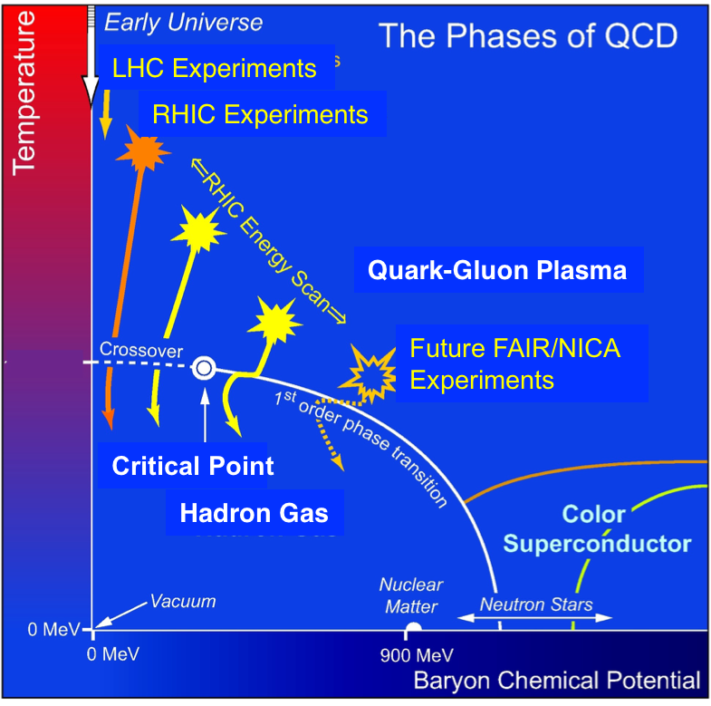
motivation
*[0809.3137]: Tribble R, Heinz U.

Slide 5
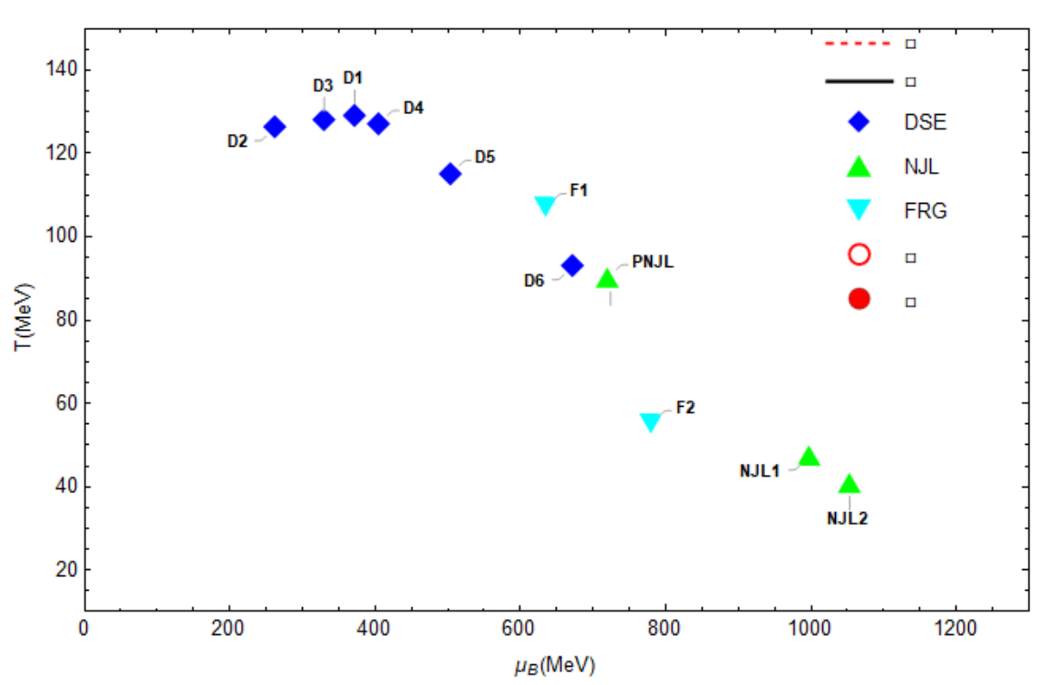
motivation
Schwinger–Dyson equation (DSE): 2109.09935, 1607.01675, 1011.2876, 1403.3797, 1405.4762, 2002.07500.
Nambu–Jona-Lasinio models (NJL, PNJL): 1801.09215, Nucl. Phys. A 504 (1989), 668-684.
Functional renormalization group (FRG): 1909.02991, 1709.05654.

Slide 6
hQCD
AdS/CFT
If
Non-Abelian gauge theory
gravity
Then
???
QCD

Slide 7
PART 02
Holographic model

Slide 8
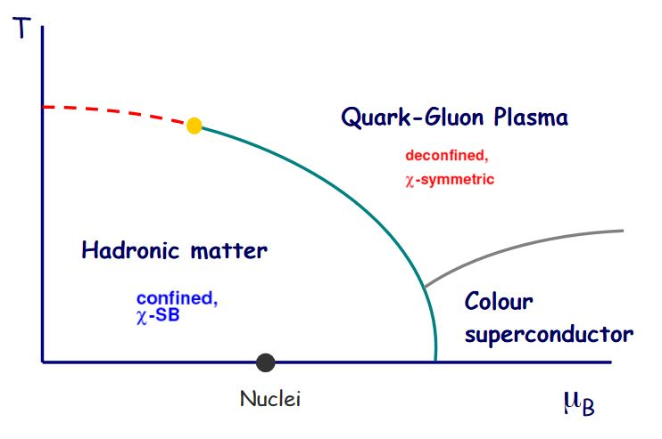
EMD Model
For 2+1 flavor system
Einstein-Maxwell-Dilaton(EMD) Model
Action
Φ ---- Breaking Conformal Symmetry
F ---- Baryon Chemical Potential
*[2201.02004]: Rong-Gen Cai, Song He, Li Li, Yuan-Xu Wang

Slide 9
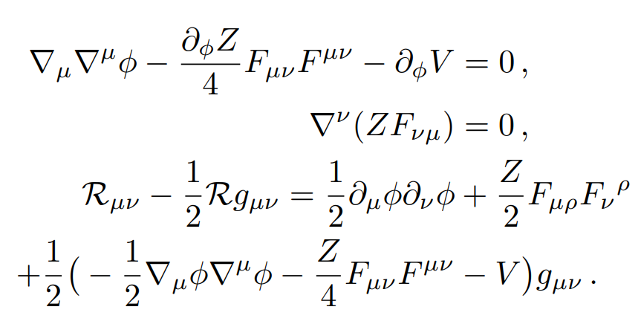
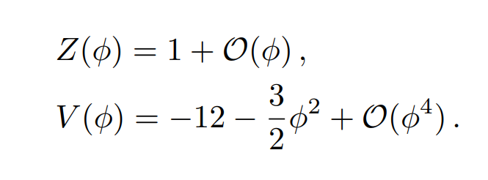
EMD Model
Ansatz
EOM
*[2201.02004]: Rong-Gen Cai, Song He, Li Li, Yuan-Xu Wang

Slide 10
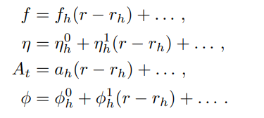
EMD Model
IR Expansion
UV Expansion
1
0
*[2201.02004]: Rong-Gen Cai, Song He, Li Li, Yuan-Xu Wang

Slide 11
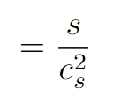
EMD Model
EOS
baryon susceptibility
*[2201.02004]: Rong-Gen Cai, Song He, Li Li, Yuan-Xu Wang

Slide 12
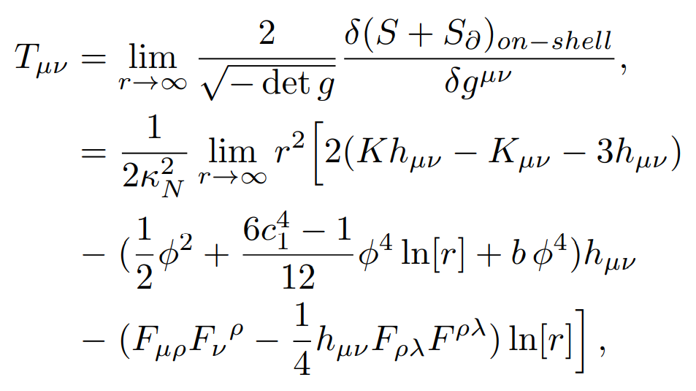
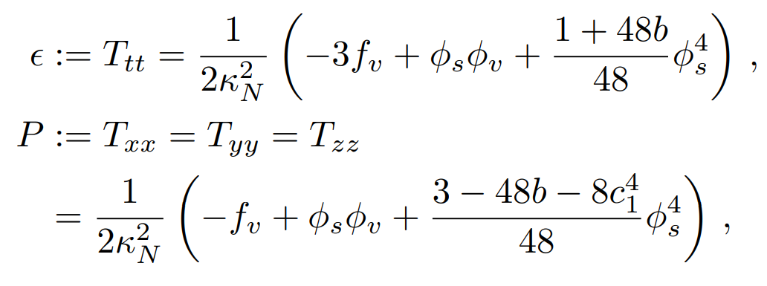
EMD Model
On-shell action
*[2201.02004]: Rong-Gen Cai, Song He, Li Li, Yuan-Xu Wang

Slide 13
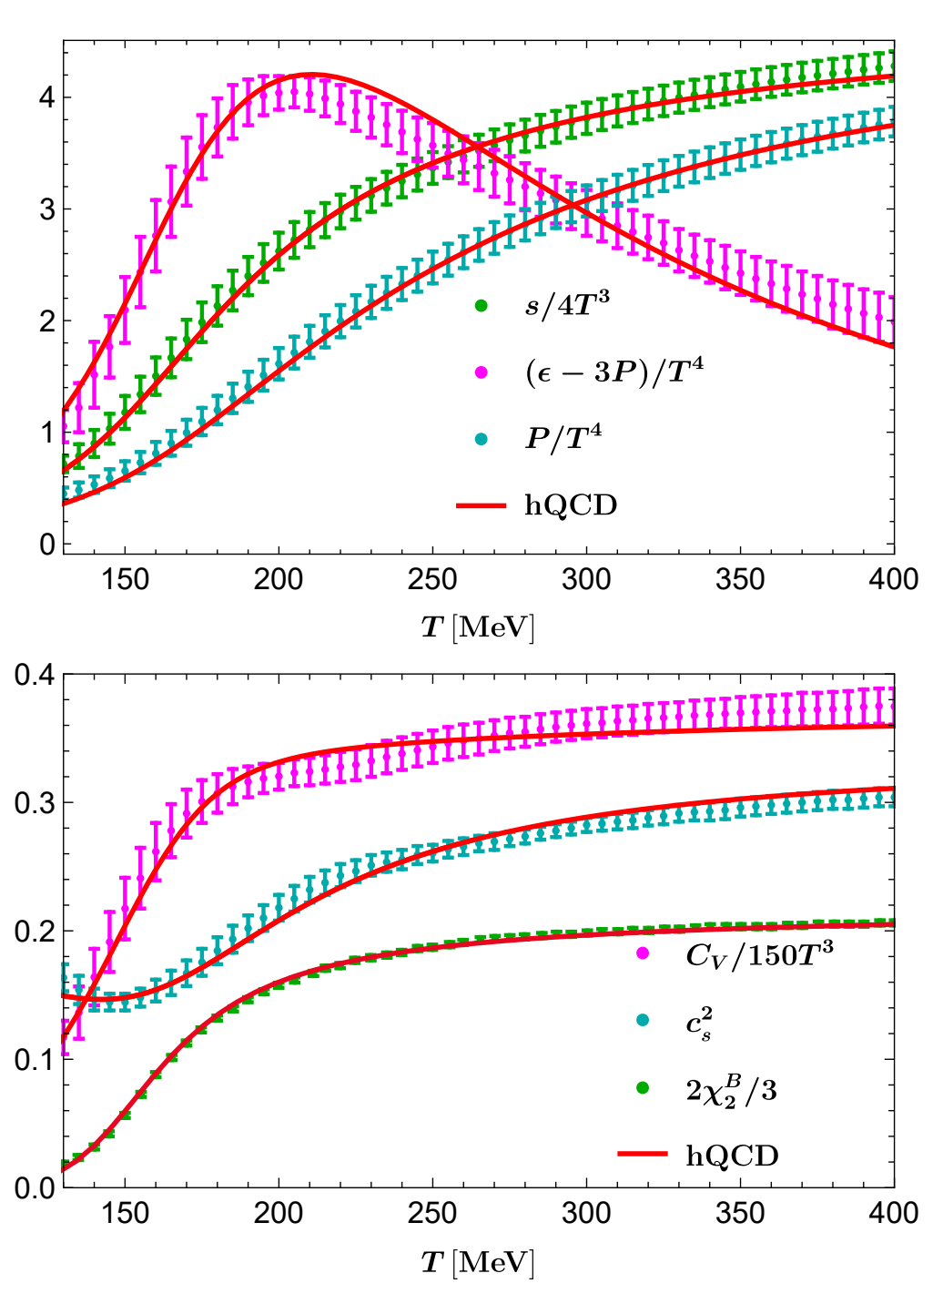
EMD Model
Parameters
Effective Newton constant
Scalar source
Renormalization constant
b
*[1407.6387]: A. Bazavov et al. [HotQCD],
*[2102.06660]: S. Bors´anyi, Z. Fodor et al.
*[2201.02004]: Rong-Gen Cai, Song He, Li Li, Yuan-Xu Wang

Slide 14
PART 03
Predictions & QCD Phase diagram

Slide 15
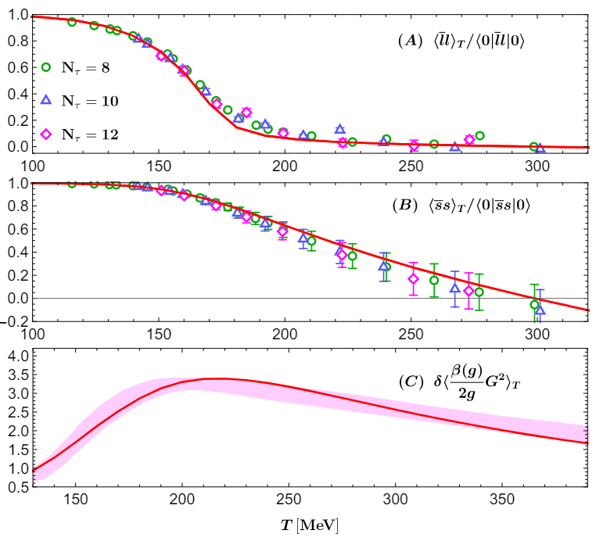
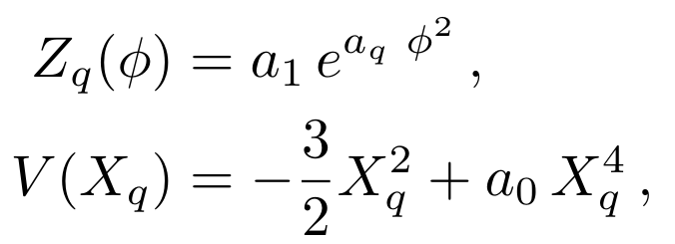
Condensation
*[1812.00385v2]: Gubler P, Satow D.
*[2201.02004]: Rong-Gen Cai, Song He, Li Li, Yuan-Xu Wang

Slide 16
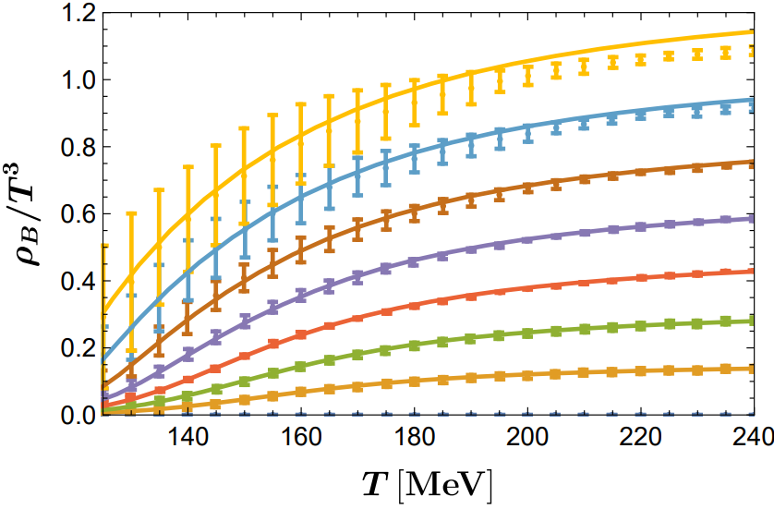
Finite chemical potential
*[2102.06660]:
S. Bors´anyi, Z. Fodor et al.
*[2201.02004]: Rong-Gen Cai, Song He, Li Li, Yuan-Xu Wang

Slide 17
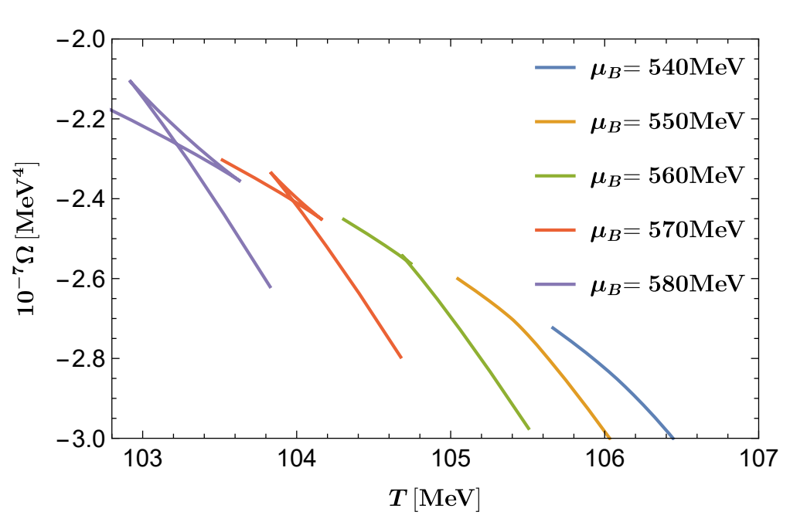
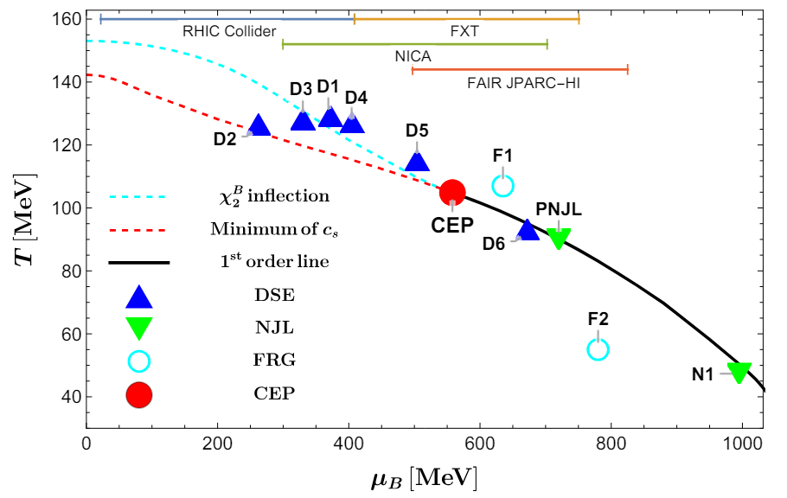
Phase diagram
*[2201.02004]: Rong-Gen Cai, Song He, Li Li, Yuan-Xu Wang

Slide 18
Phase diagram
*[2309.00579]: M.Hippert, J.Grefa, T.A.Manning, J.Noronha, etc.
*[2404.12109]: Qingxuan Fu, Song He, Li Li, Zhibin Li

Slide 19
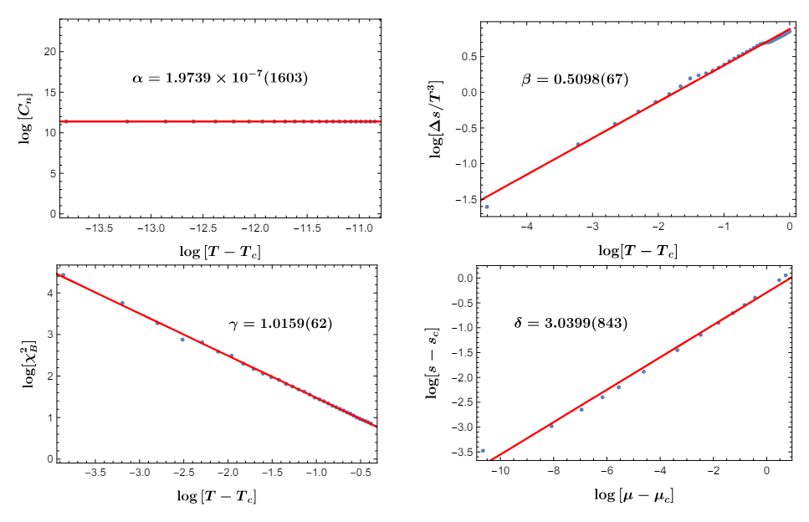
critical exponents
Closest to mean-field theory !
*[2404.12109]: Qingxuan Fu, Song He, Li Li, Zhibin Li

Slide 20
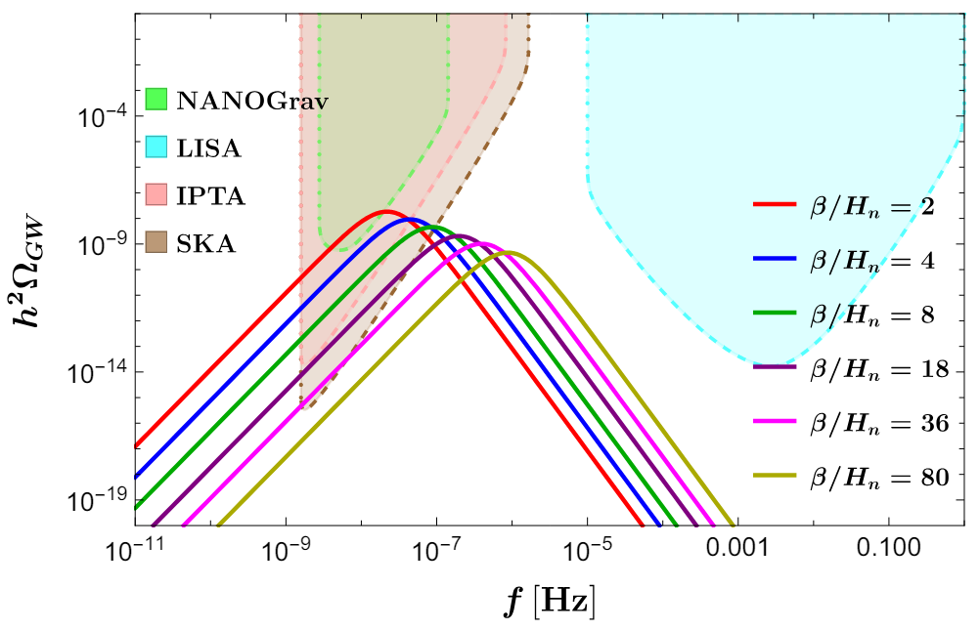
GWs
*[2103.06933]: Guo H K, Sinha K, Vagie D, et al.
*[2201.02004]: Rong-Gen Cai, Song He, Li Li, Yuan-Xu Wang

Slide 21
PART 04
Summary

Slide 22
Summary
Quantitatively, provid a hQCD model to describe QCD phase diagram, yielding:
1）EOS consistent with lattice simulations at zero/non-zero chemical potential.
2）Locate CEP, which agrees with effective field results and Bayesian analysis.
3）Critical behavier agree with mean-field theory
4）Predicted stochastic GW spectrum induced by SFOPT.

Slide 23
Thank you！

