Slide 1
（武汉）
Investigating non-prompt charm hadron production in high energy pp
collisions with the AMPT model
1th workshop on Spicy Gluons (胶麻) 2024
Zipeng Mountain, Hefei
2024.5.18
China University of Geosciences, Wuhan
School of Mathematics and Physics
JiaLin He （何佳林）

Slide 2
Outline
Why studying heavy flavor
A Multi-Phase Transport Model (AMPT)
Heavy flavor hadron production
The non-prompt / prompt ratio
Summary

Slide 3
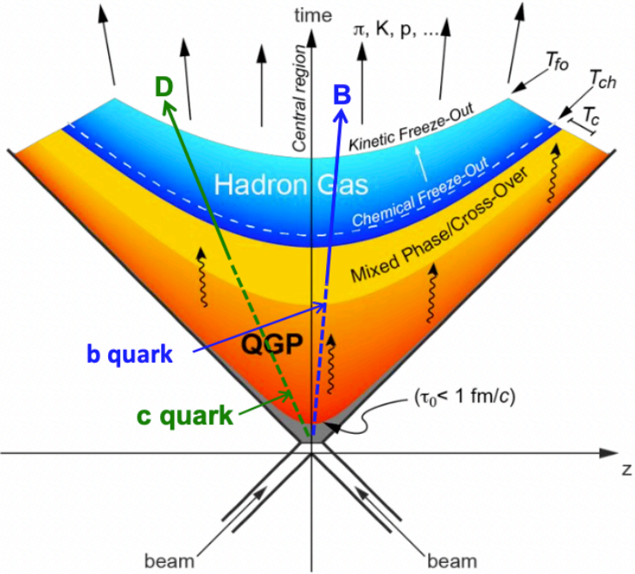
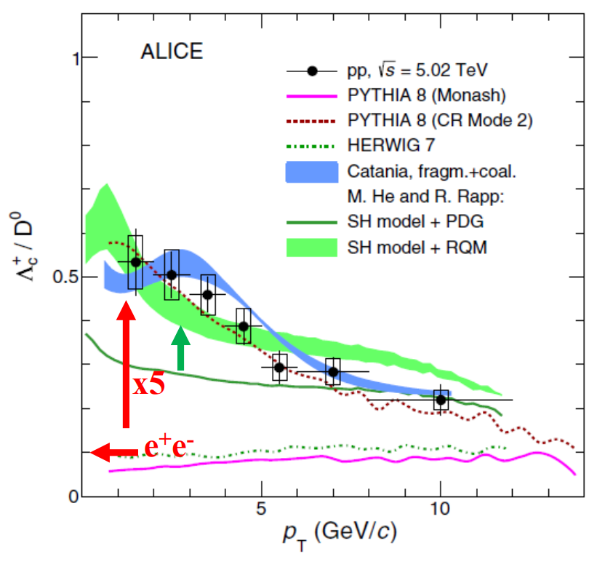
Why studying heavy flavor hadronization
m_{Q} >> ꓥ_{QCD} , applicable in pQCD framework for a wide p_{T} range
m_{Q} >> T_{QGP} , short formation time, thermalization time comparable to the fireball life time
arXiv:2105.06335v2
arXiv:2011.06078v3

Slide 4
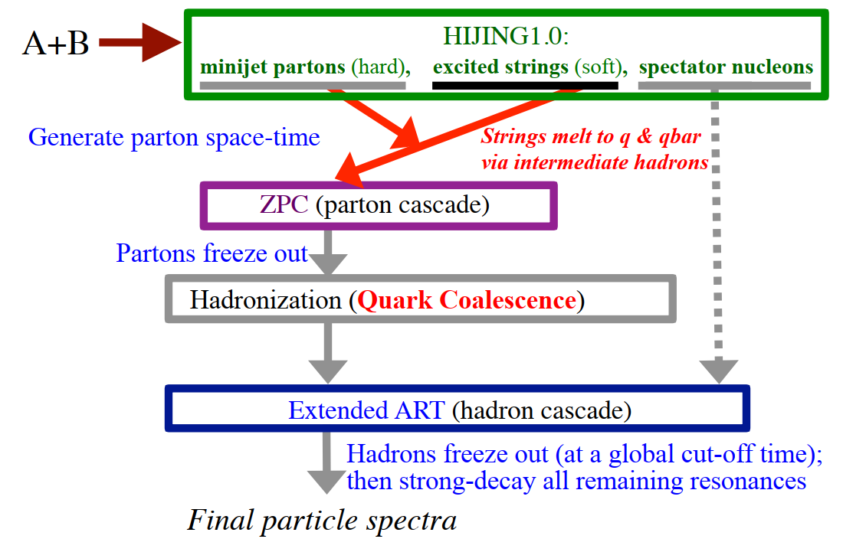
A Multi-Phase Transport Model (AMPT)
Z.W.Lin et.al., PRC 72 (2005) 064901
Initial condition
Partonic interaction
Coalescence
Hadron cascade

Slide 5
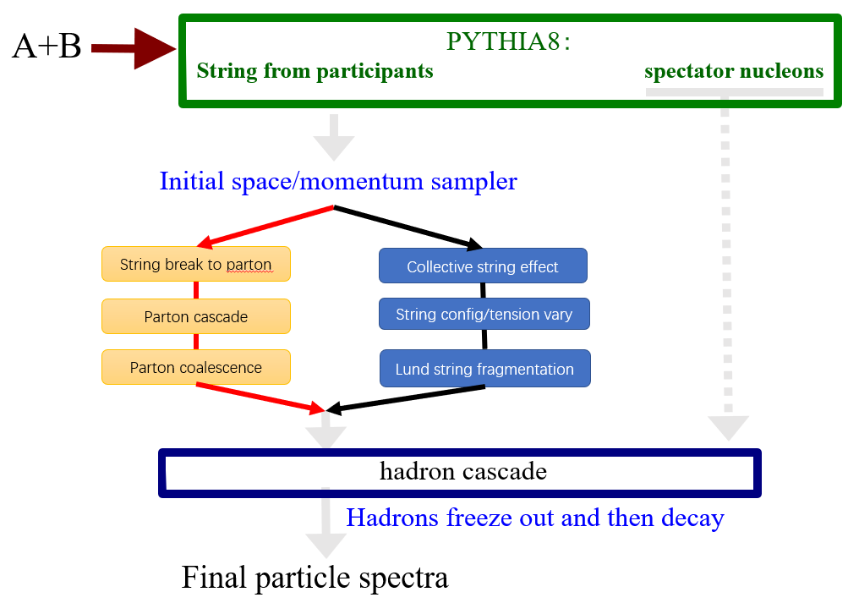
PYTHIA8 initial conditions of AMPT
To address the challenges in describing small systems and to improve the heavy flavor production, initial conditions from PYTHIA8 were incorporated.
Possible to compare parton/hadron transport effects and color reconnection effects on the same basis.
PRC 72 (2005) 064901
Nucl.Sci.Tech. 32 (2021) 113

Slide 6
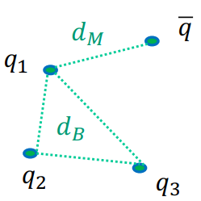
Key parameters of AMPT
Hadronization spatial coalescence
The final state quarks are hadronized through a naive spatial coalescence model.
A parton finds the closest partner in space to form a hadron.
d_{M}: closest anti-quark partner
d_{B}: average distance among 3 quark with closest q₂ & q₃
arXiv:1703.02673v2

Slide 7
Non-prompt charm hadron
charm
beauty
hadronization
hadronization
b-mesons
b-baryons
decay
decay
c-mesons
c-baryons
c-mesons
c-baryons
prompt c-hadron
non-prompt c-hadron
Because the fast decay of b-hadrons, experiments have limitations in directly detecting them. Therefore, the hadronization process of beauty is studied indirectly through non-prompt c-hadrons.

Slide 8
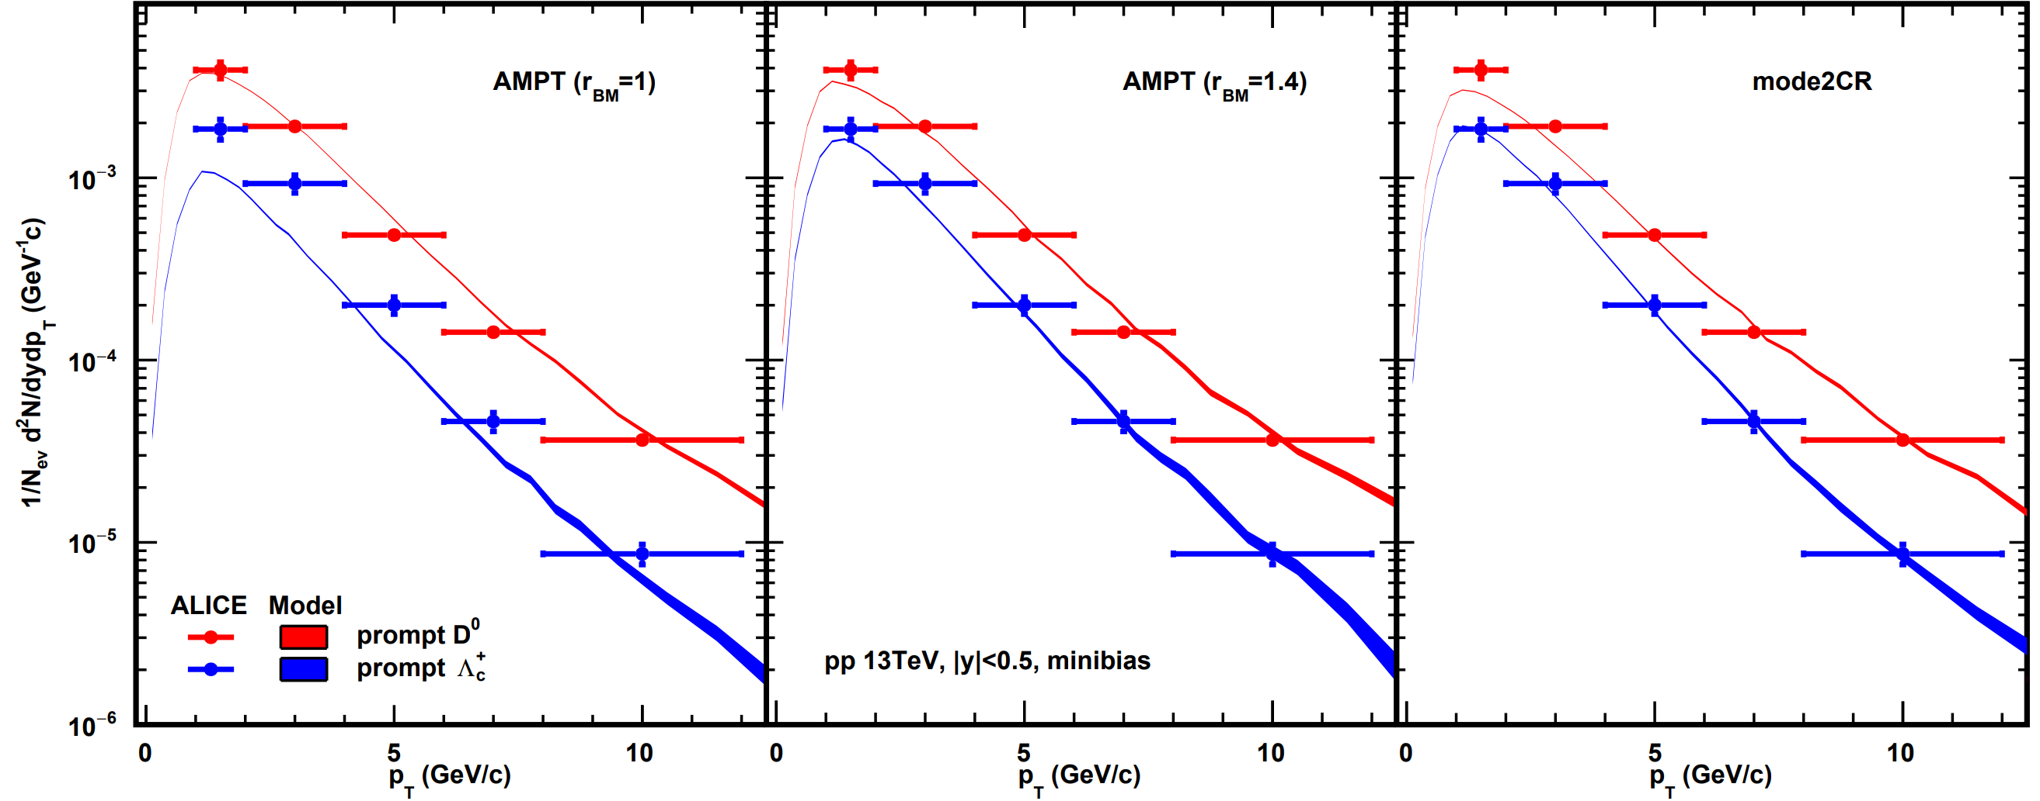
The $p_{T}$ spectra of prompt c-hadron
AMPT describes prompt $D^{0}$ overall quite well.
The $r_{BM}$ parameter enhances prompt $Λ_{c}^{+}$ yield effectively.
AMPT and CR are similar in describing prompt charm hadrons.
arXiv:2111.11948v2

Slide 9
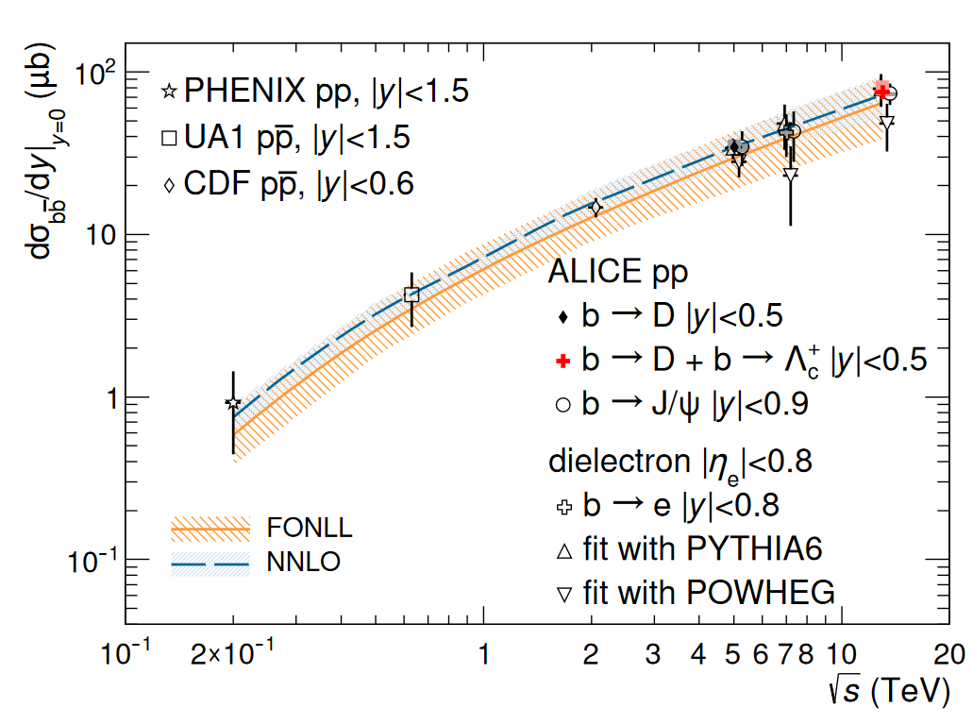
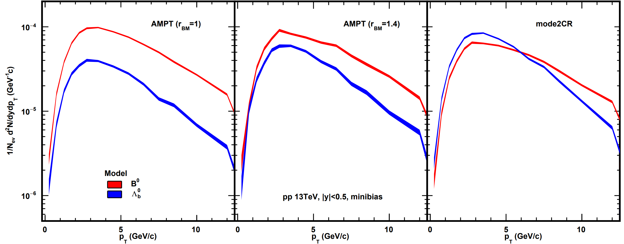
The $p_{T}$ spectra of b-hadron
The $r_{BM}$ parameter enhances prompt $Λ_{b}^{0}$ yield effectively.
In pythia initial conditions, the $b\overline{b}$ cross-section $dσ_{b\overline{b}}/dy|_{y=0}$ is 106$μb$, larger than the experimental measurement.
CR predicts much higher $Λ_{b}^{0}$/ $B^{0}$ ratio.
around 80 $μb$
arXiv:2102.13601v2

Slide 10
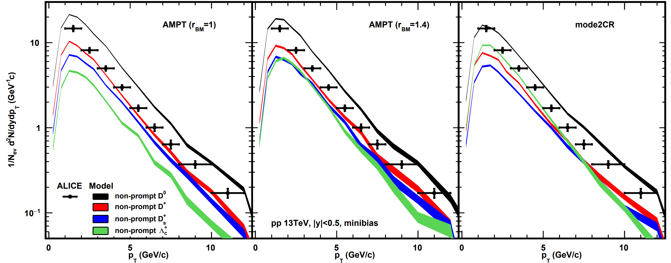
The $p_{T}$-differential production cross sections of non-prompt c-hadrons
AMPT can describe b-hadron decay.
AMPT predicts non-prompt D-mesons yields higher than experimental data, and $r_{BM}$ also enhances non-prompt $Λ_{c}^{+}$.
The yield of $Λ_{c}^{+}$ in CR is significantly higher than in AMPT.
arXiv:2402.16417

Slide 11
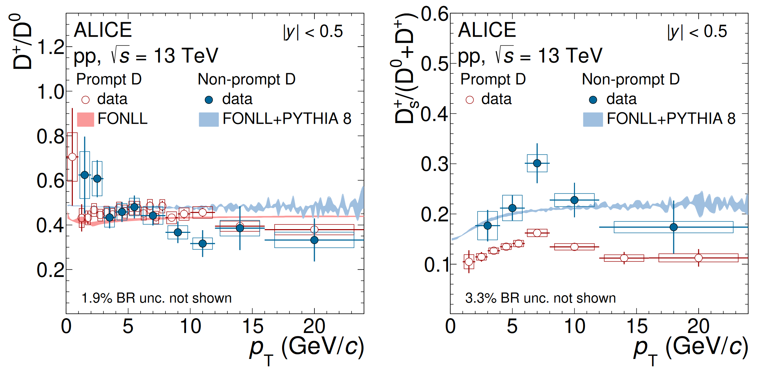
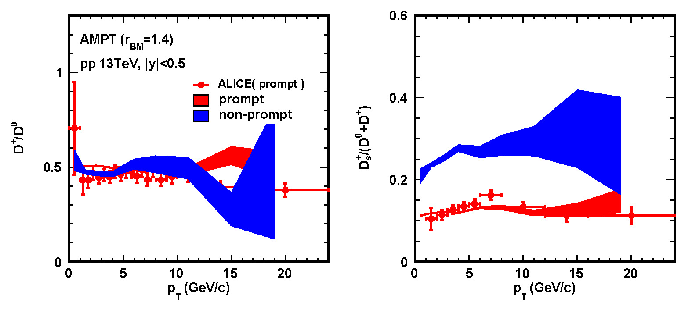
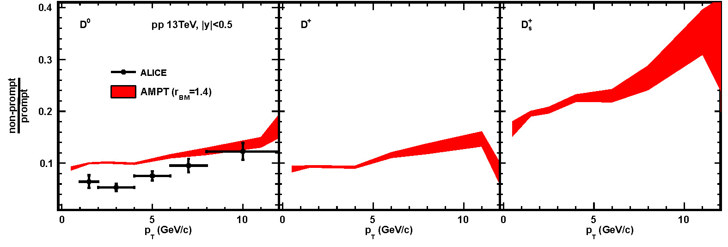
The $p_{T}$-dependence of non-prompt D-mesons production
arXiv:2402.16417
The relative productions among D-mesons are consistent with experimental data.
The non-prompt / prompt ratio have increasing behavior on AMPT and experimental data.
Experimental data have a dip around 3GeV/c.

Slide 12
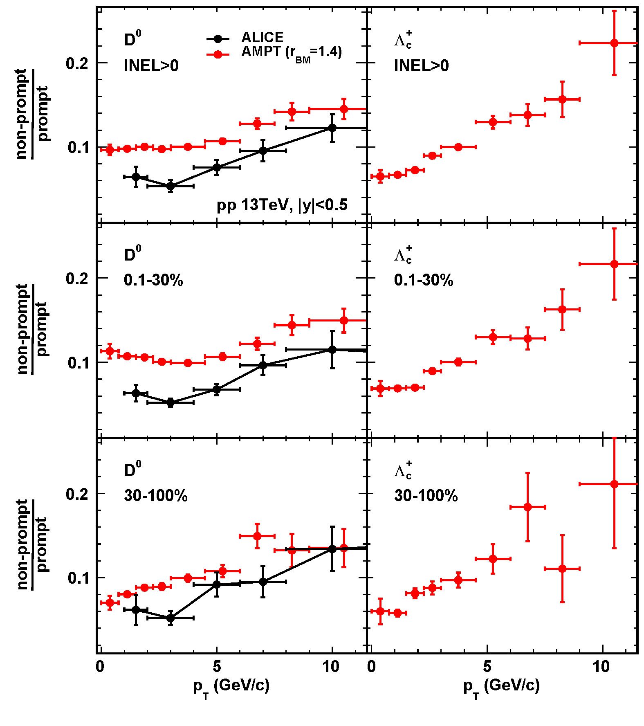
2.6 The multiplicity-dependence of non-prompt charm hadron production
arXiv:2302.07783v1
Experimental $D^{0}$ ratio shows no significant multiplicity-dependence.
AMPT $D^{0}$ ratio shows enhancement at low $p_{T}$ in more central event.
AMPT $Λ_{c}^{+}$ ratio has no significant multiplicity-dependence, but has stronger $p_{T}$-dependence compared to $D^{0}$ sector.

Slide 13
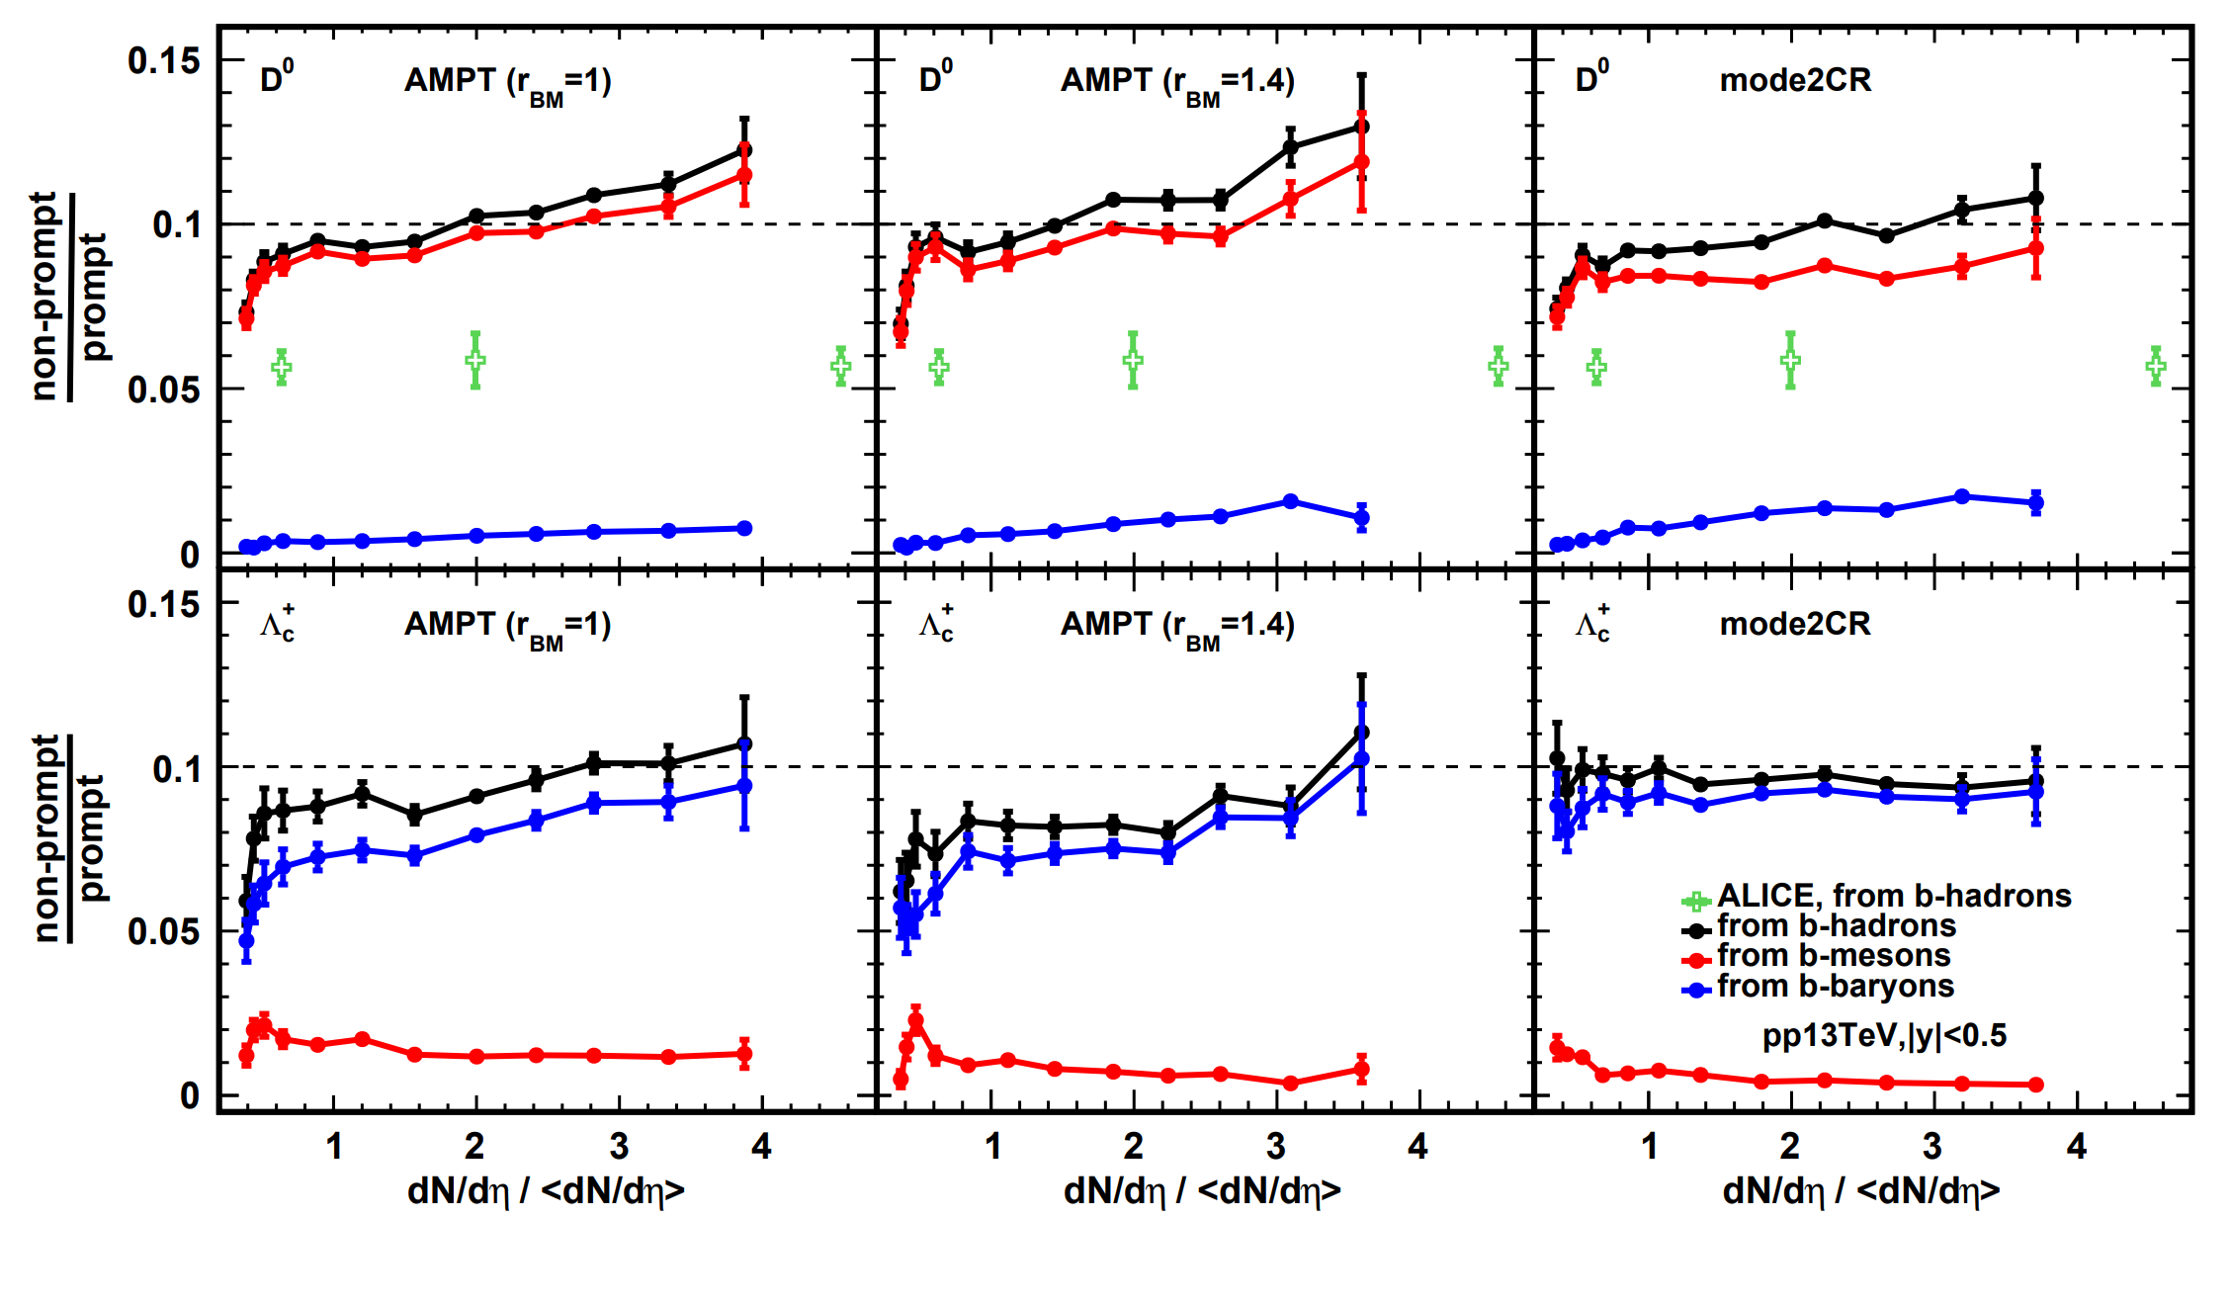
The multiplicity-dependence $p_{T}$-integrated non-prompt / prompt ratio
The model predice stronger incresement non-prompt/prompt $D^{0}$ ratio compare to data.
Non-prompt $D^{0}$ primarily come from b-meson decays, while non-prompt $Λ_{c}^{+}$ primarily come from b-baryon decays.
The rising of non-prompt $D^{0}$ ratio is sensitive to b-baryon decay.
arXiv:2302.07783v1

Slide 14
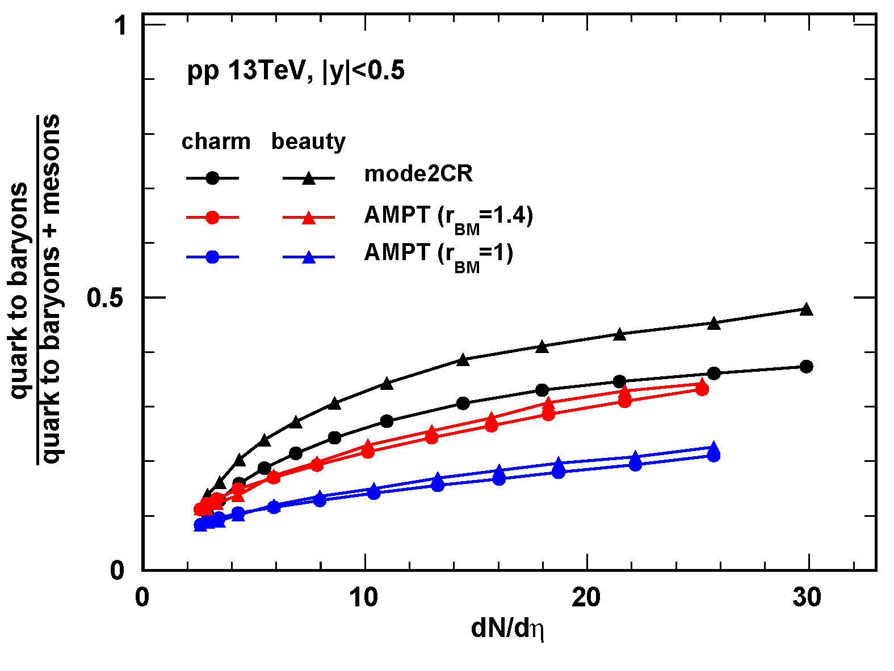
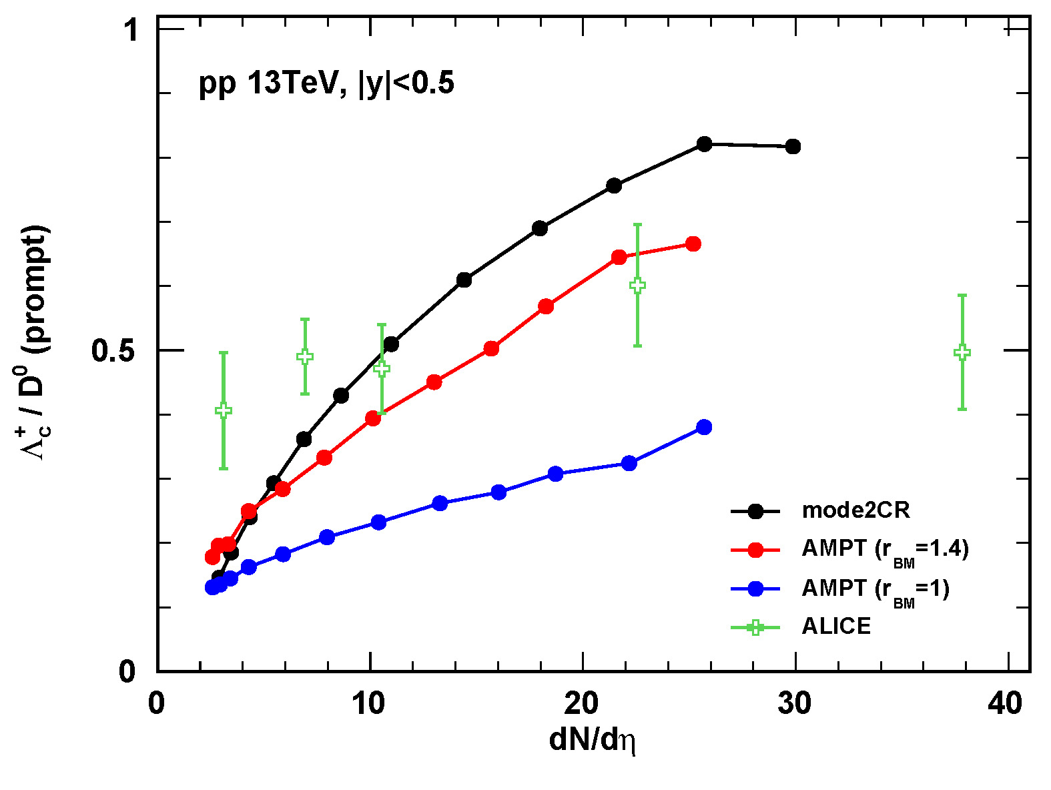
The multiplicity-dependence of baryon-to-meson ratio via hadronization
All models have increasement of the baryon-to-meson ratio in charm and beauty sector.
In CR the increasement of beauty is stronger than charm, in AMPT is similar.
The non-prompt / prompt increasement come from the rise of the baryon-to-meson fraction, rather than differences in the baryon-to-meson fraction of charm and beauty sector.
arXiv:2111.11948v2

Slide 15
Summary
Conclusions
AMPT describe the prompt charm-hadron reasonably by tuning $r_{BM}$ parameter.
The non-prompt charm production from b-hadron decay under multiplicity-dependence can be studied within the AMPT framework.
Both AMPT and CR predict a rising behavior of non-prompt / prompt ratio depend on the multiplicity, it conflicts with experimental data.
Prospects
Resolving the issue of the excessive $b\overline{b}$ production in pythia initial conditions.
Implement critical conditions to tame rapid growth of baryon-to-meson ratio dependent on the event multiplicity.
……
Thanks for your attention!

Slide 16
Backup

Slide 17
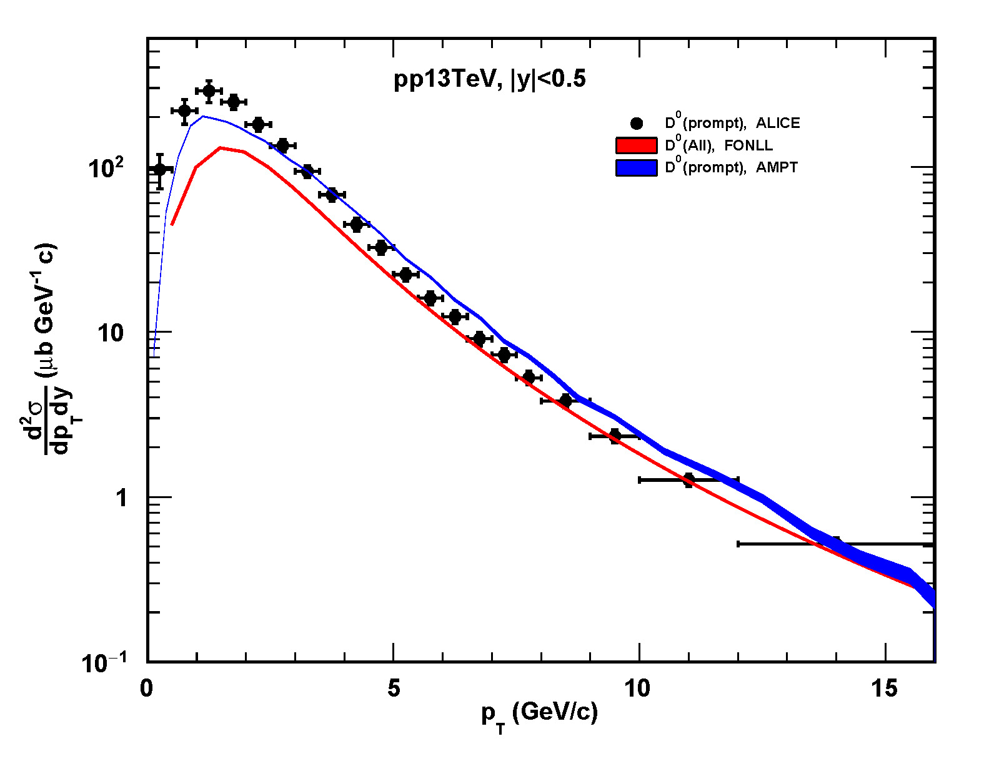
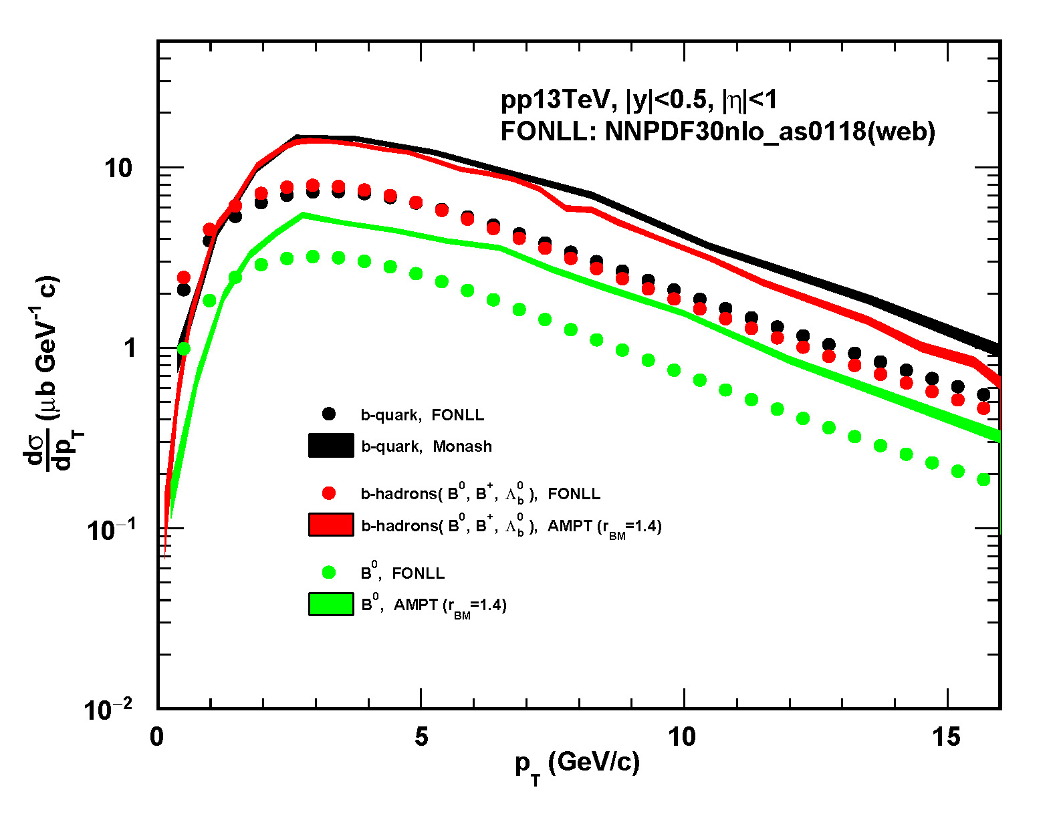
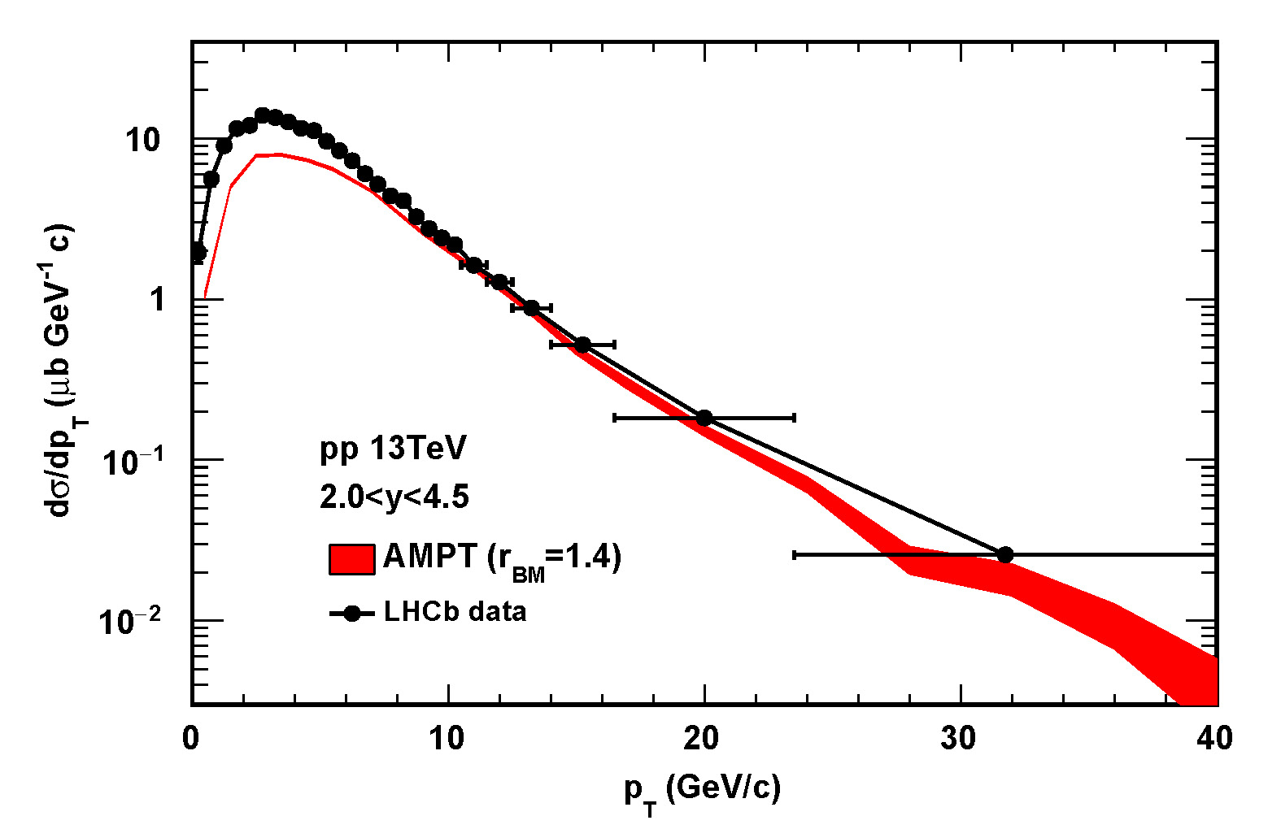
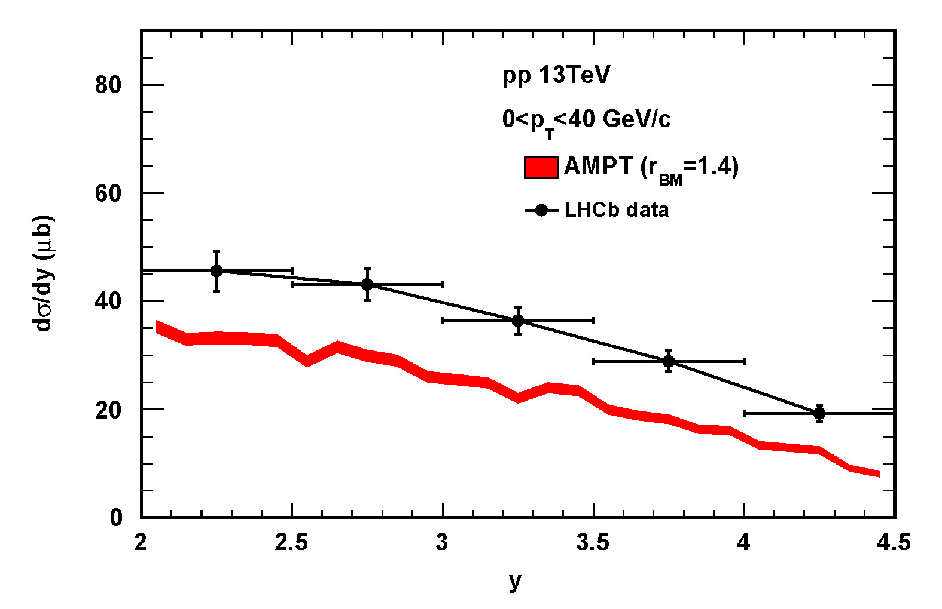
Transverse momentum spectra of b-quark on FONLL
pp13TeV Monash total $b\overline{b}$ cross-section value = 106.542860. (|eta|<0.8)
Compared with FONLL, AMPT shows approximately a 5-fold increase in b-quark, b-hadron, and $B^{0}$production.
Compared with experimental data, AMPT performs generally well for $B^{+}$production but slightly underestimates it.
Considering FONLL's good description of heavy flavor, it is believed that AMPT's $B^{0}$ production is overestimated.

Slide 18
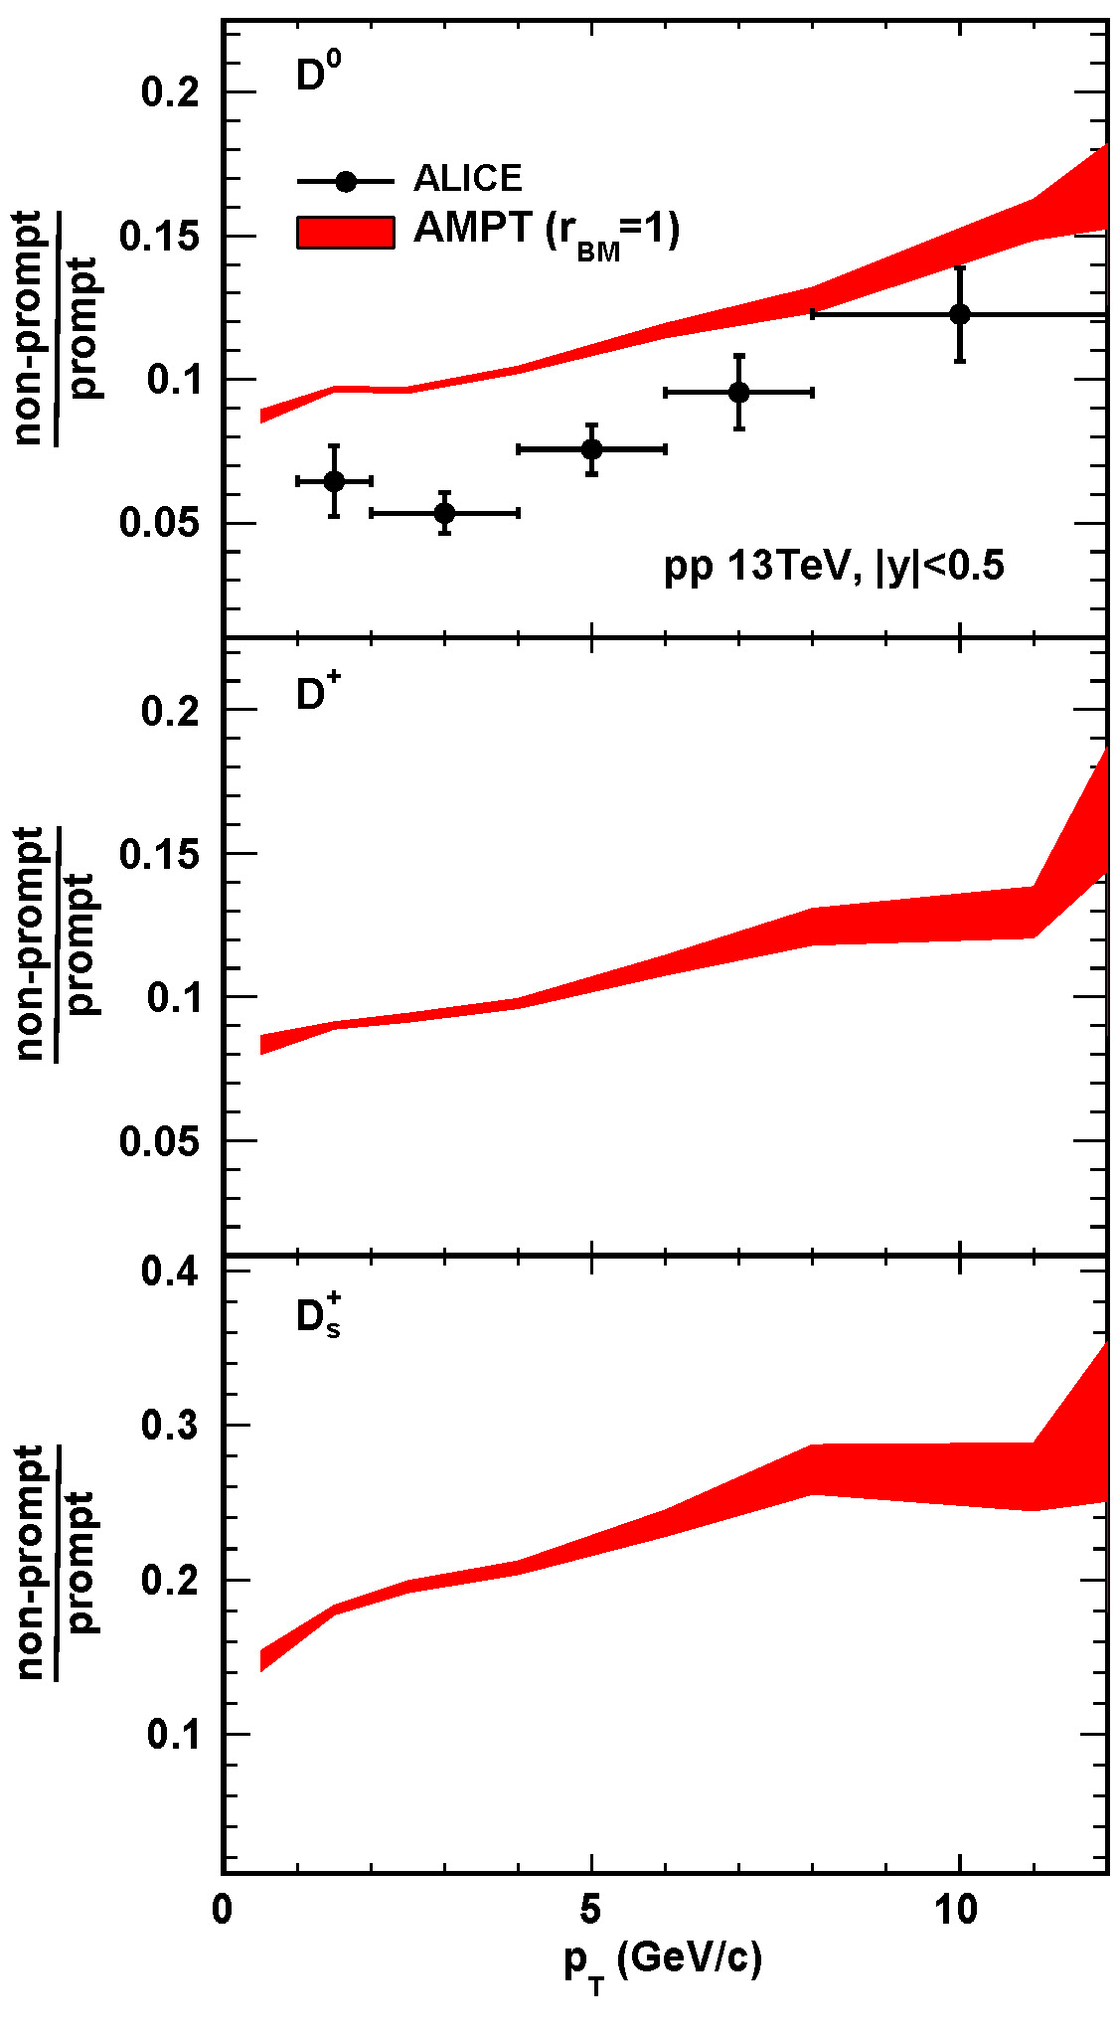
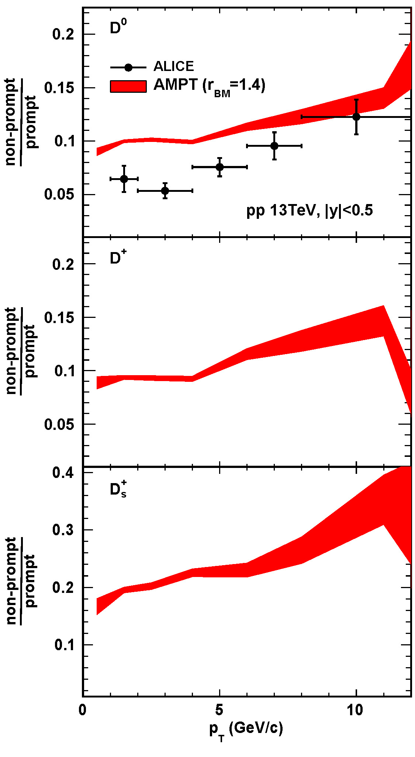
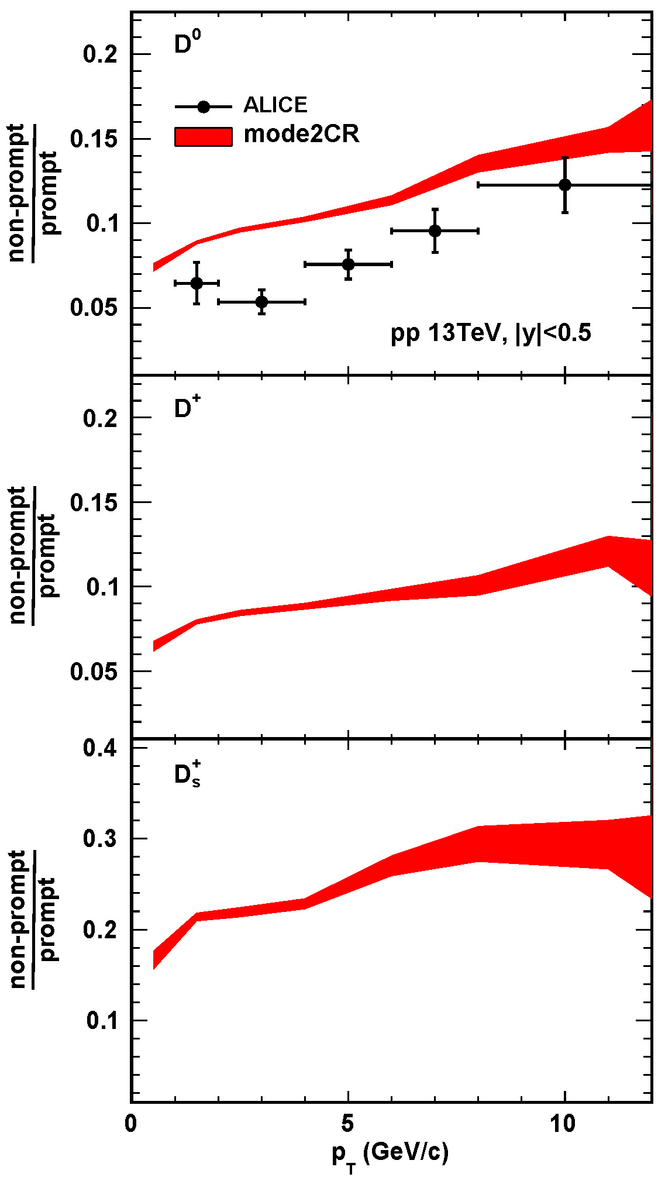
The $p_{T}$-dependence non-prompt D-mesons production
The ratio of both model and experiment shows $p_{T}$-dependence.
arXiv:2402.16417

Slide 19
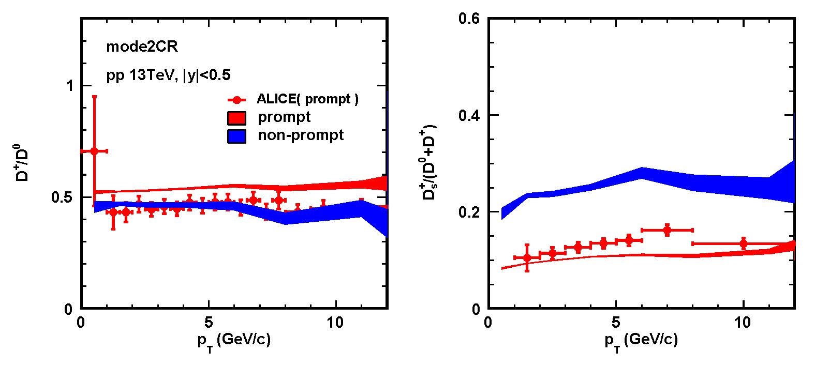
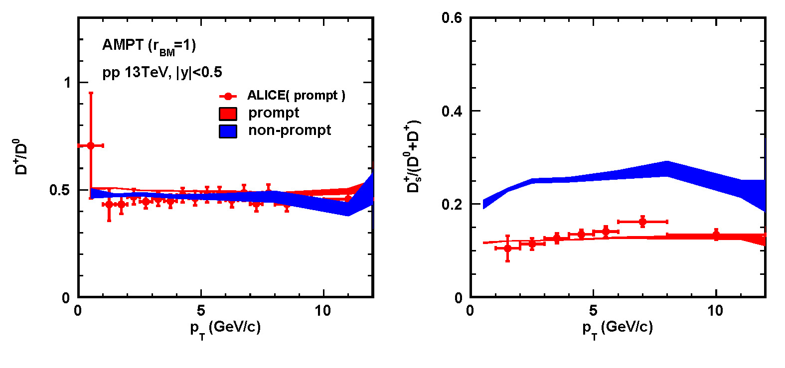
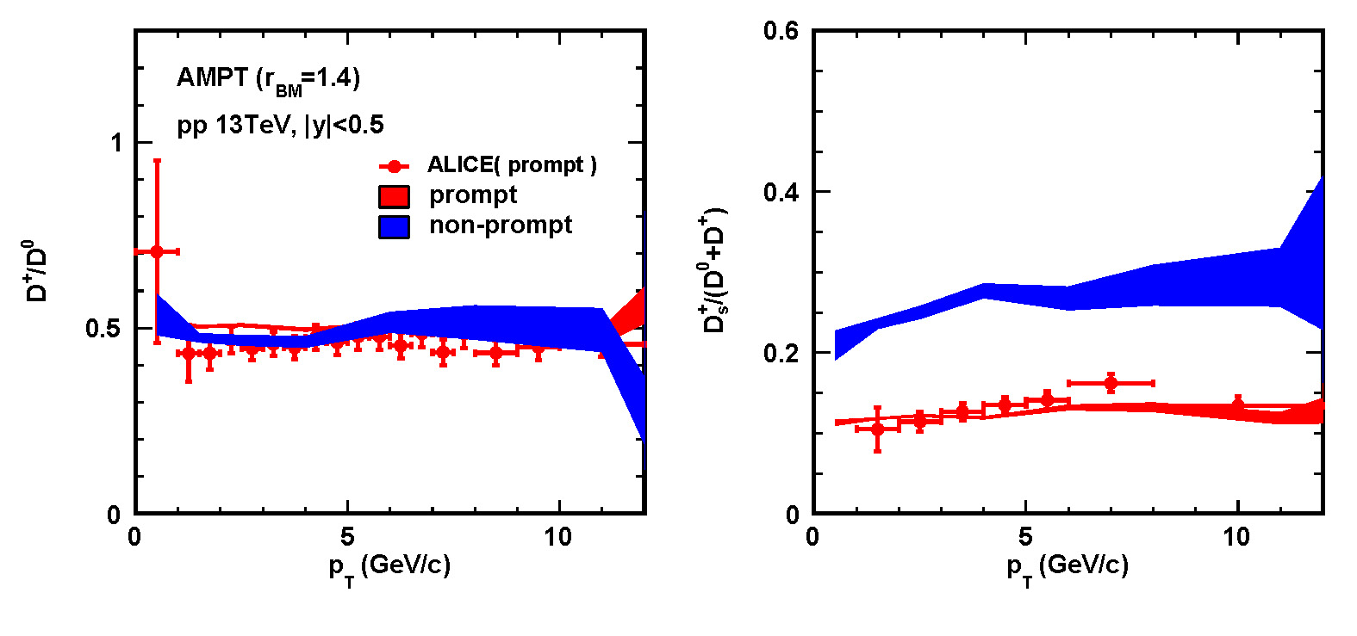
The ratios of $D^{+}/D^{0}$ and $D_{s}^{+}/(D^{0}+D^{+})$
The particle ratios reflect the differences in the number of u,d, and s quarks stripped away during the heavy flavor quark hadronization process.
The model's description of this process is consistent with experiment, regardless of whether the heavy flavor quark is c (prompt D) or b (non-prompt D).
// The excessive $B^{0}$ yield leads to synchronous increases in the production rates of non-prompt $D^{0}$, $D^{+}$, and $D_{s}^{+}$, without affecting their proportional relationships (in accordance with uds fragmentation fractions).
arXiv:2308.04877v2
arXiv:2402.16417

Slide 20
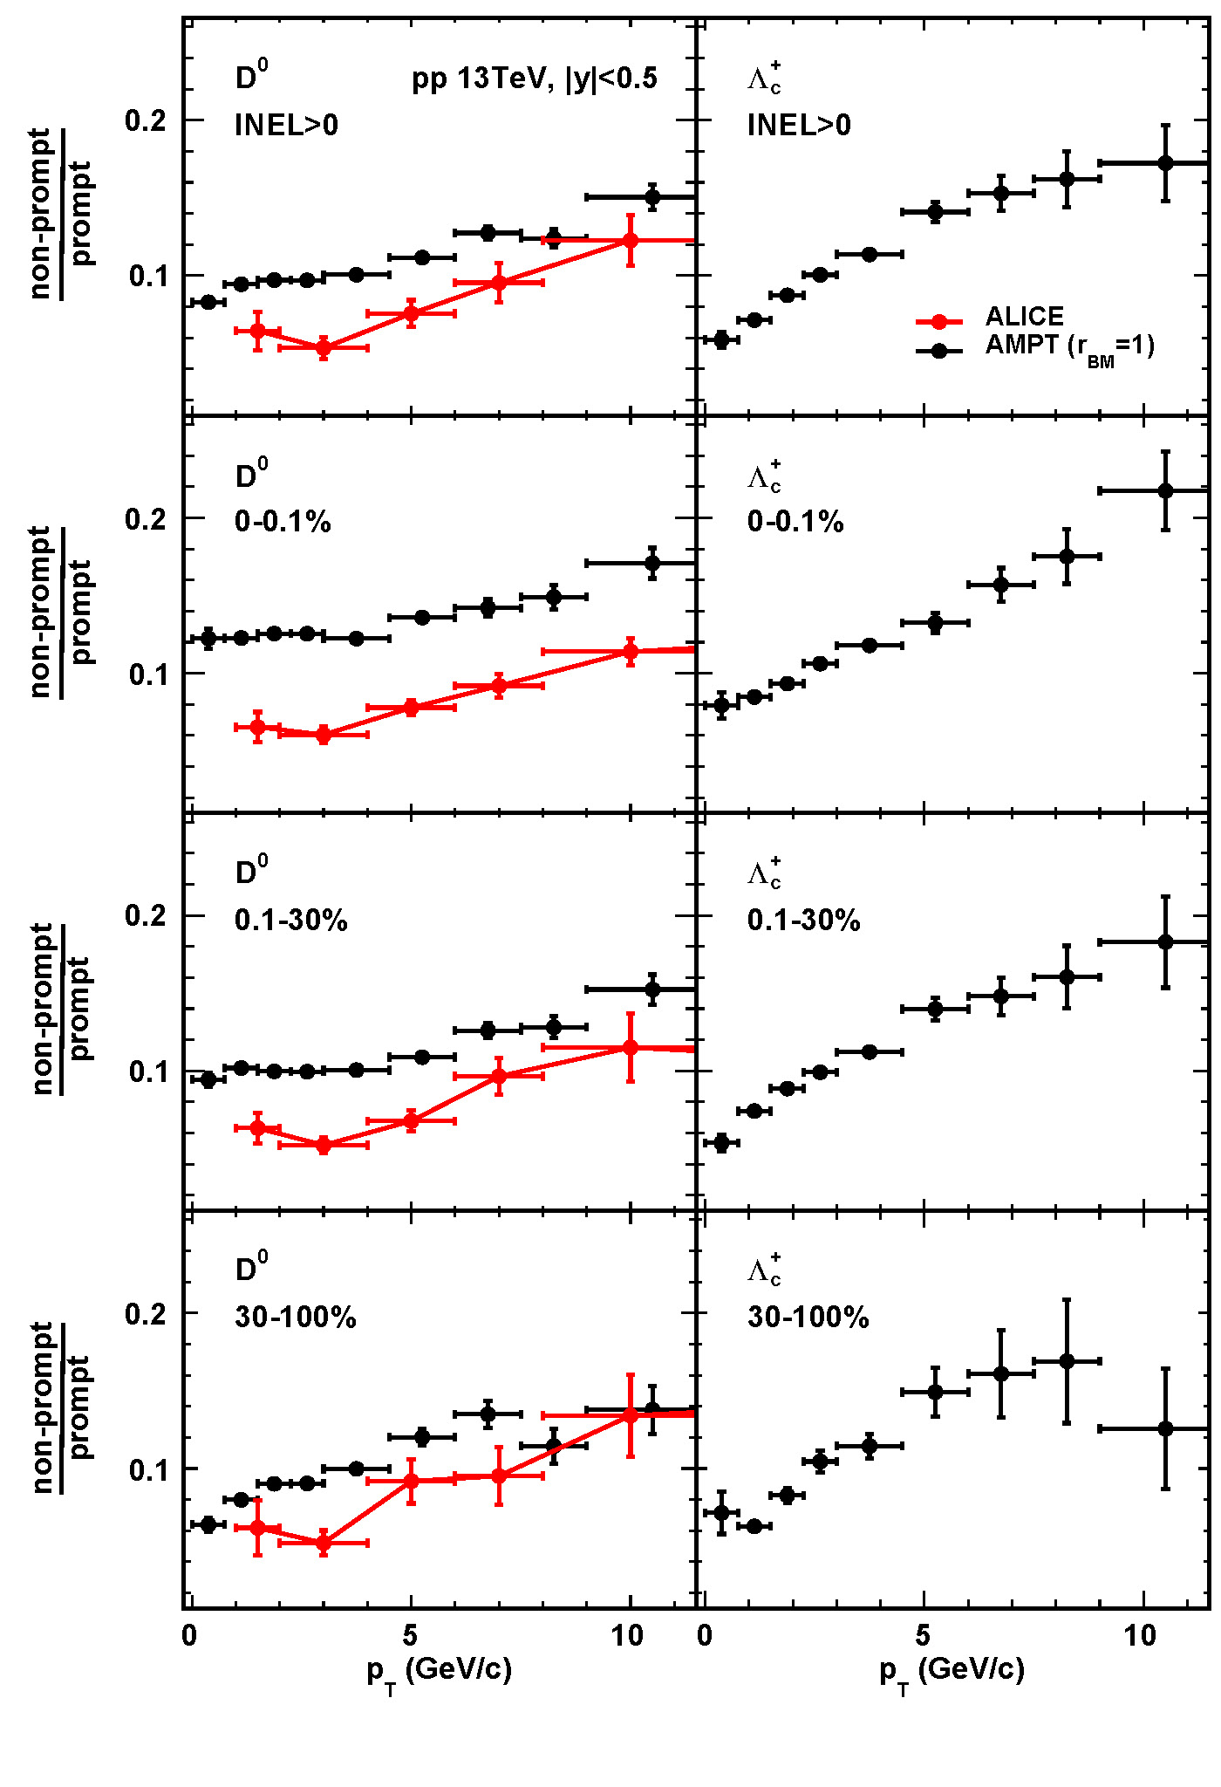
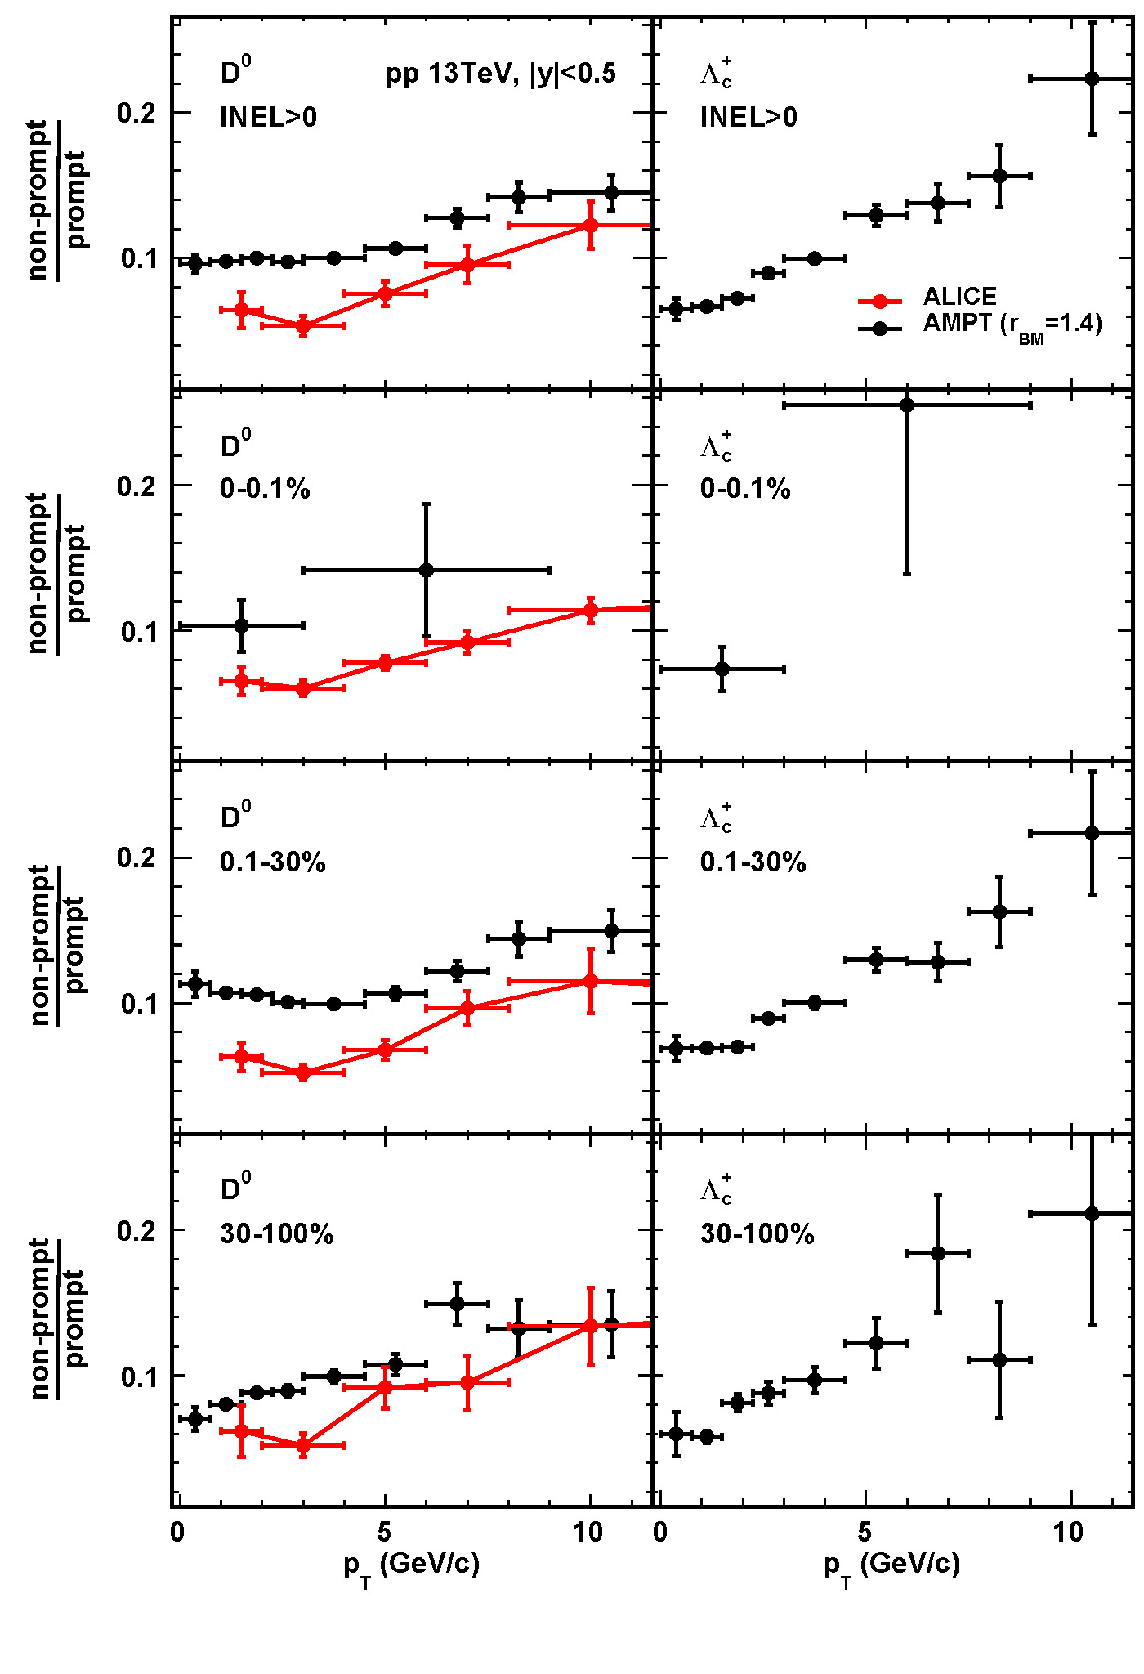
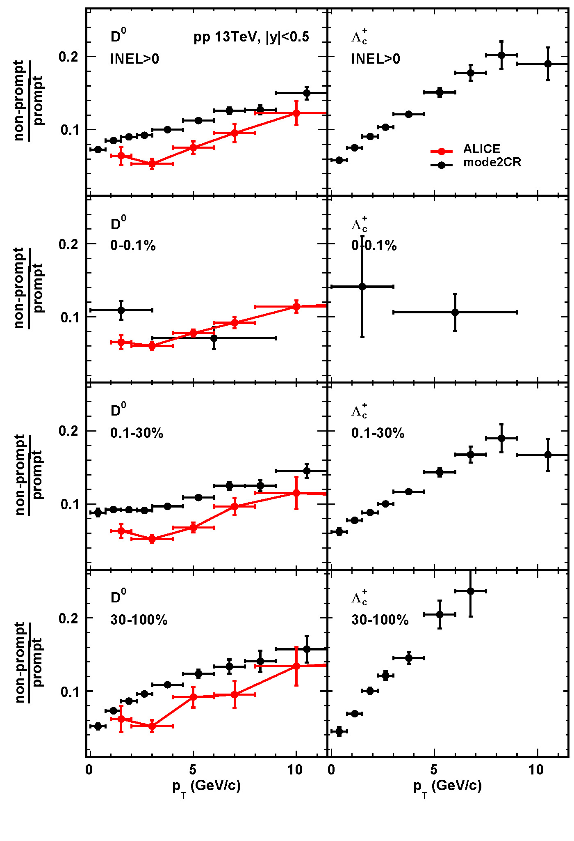
The $p_{T}$-differential non-prompt / prompt ratio of $D^{0}$、$Λ_{c}^{+}$
The $p_{T}$-dependence is present at each centrality.
Experimental $D^{0}$ exhibits a dip at low $p_{T}$, which the model either lacks or shows less prominently.
arXiv:2302.07783v1

Slide 21
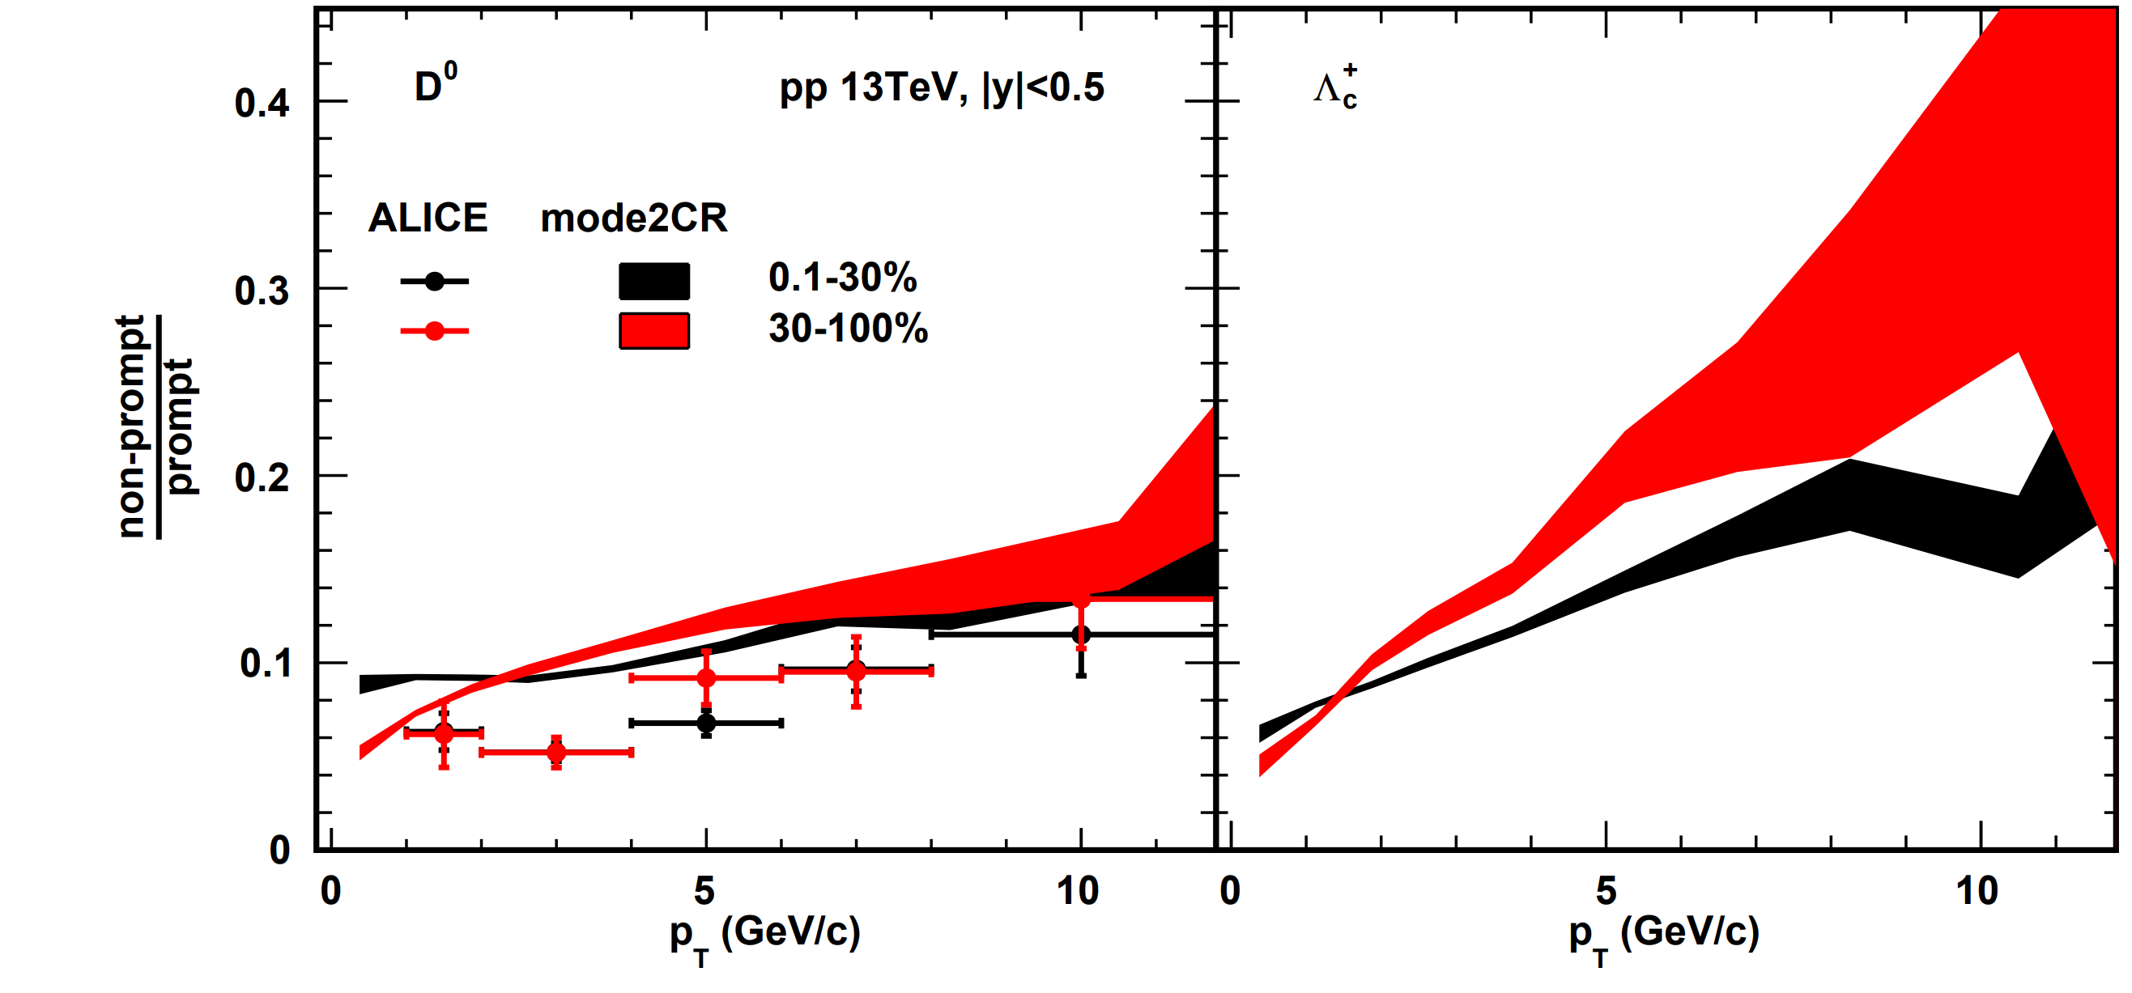
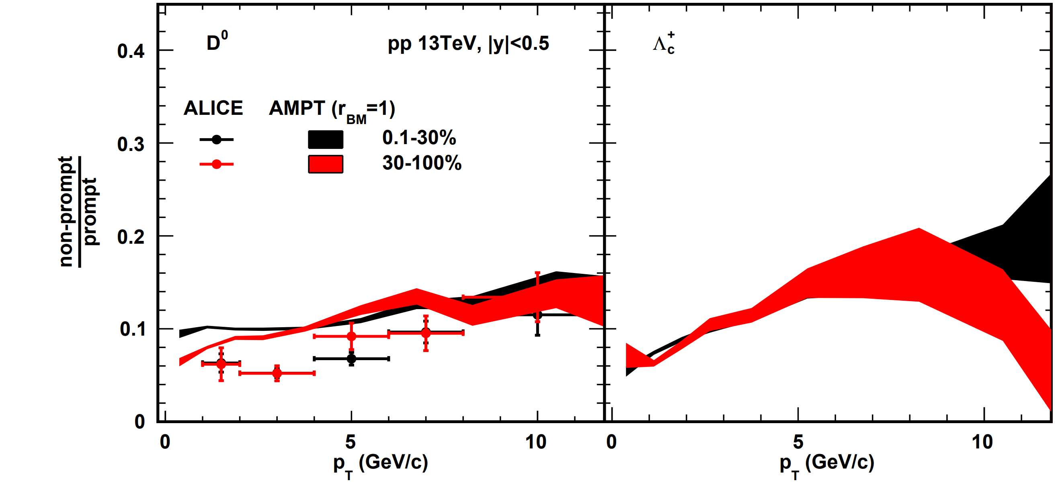
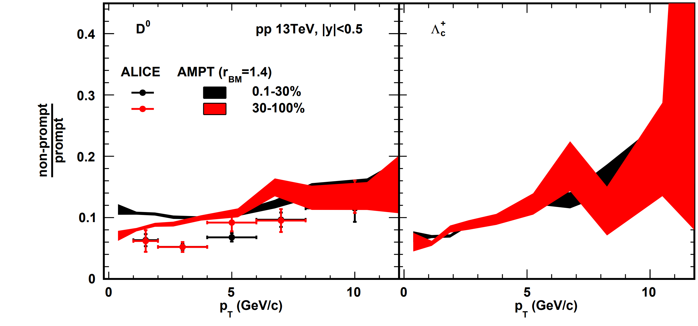
Comparison of two centrality about the non-prompt / prompt
When $p_{T}$<3 GeV/c, there is no significant difference between the two centralities in experimental $D^{0}$ production.
However, in the model, the production in the 30-100% centrality range is lower than in the 0.1-30% centrality range.
arXiv:2302.07783v1

Slide 22
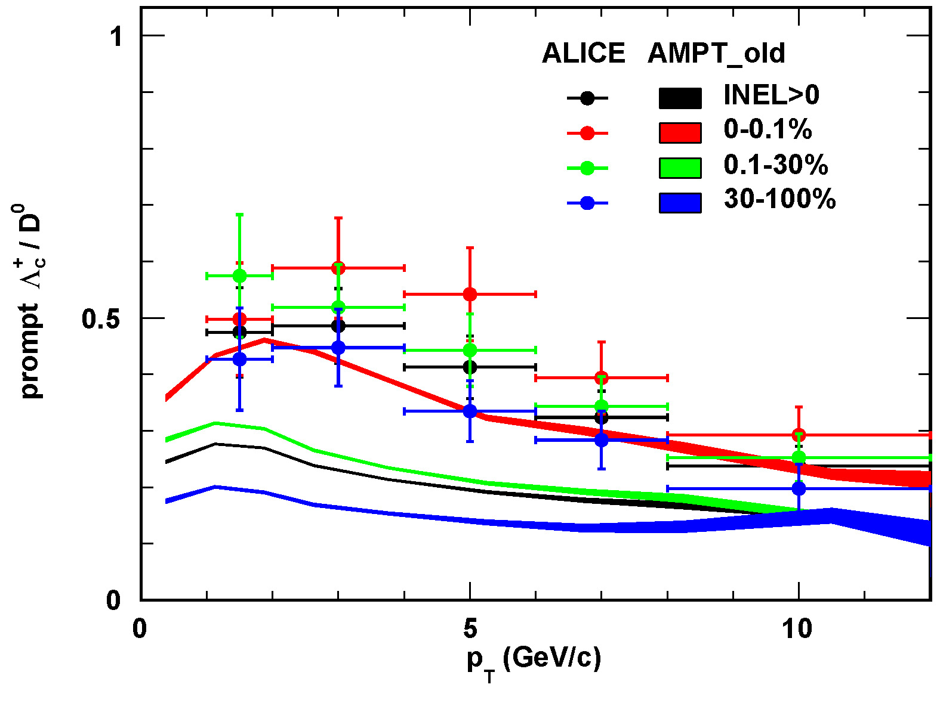
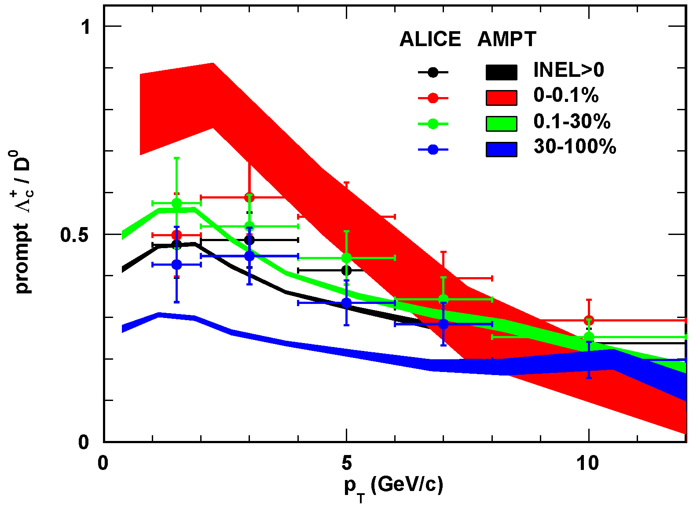
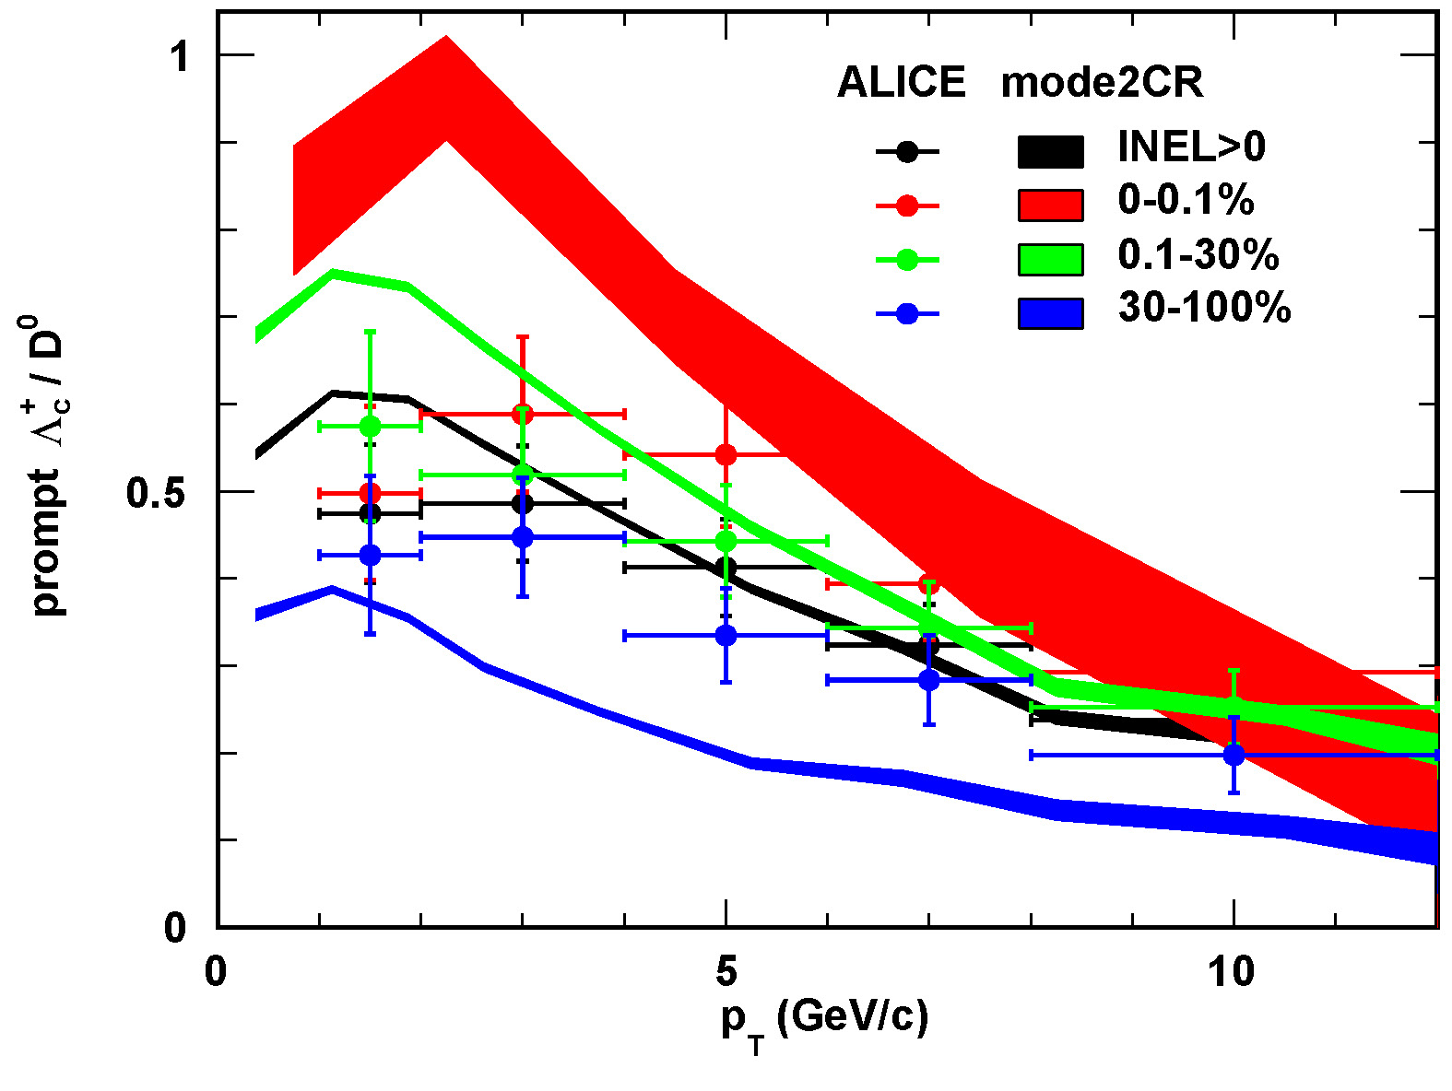
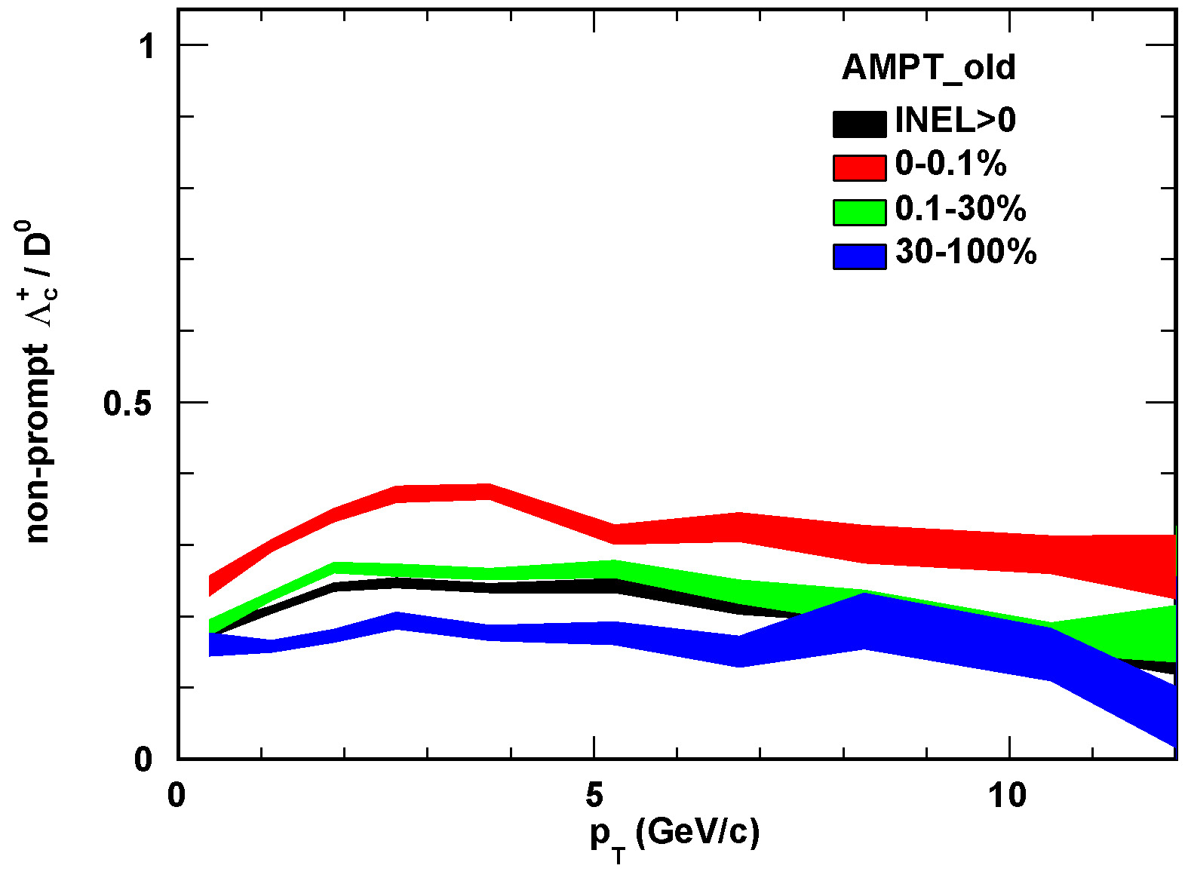
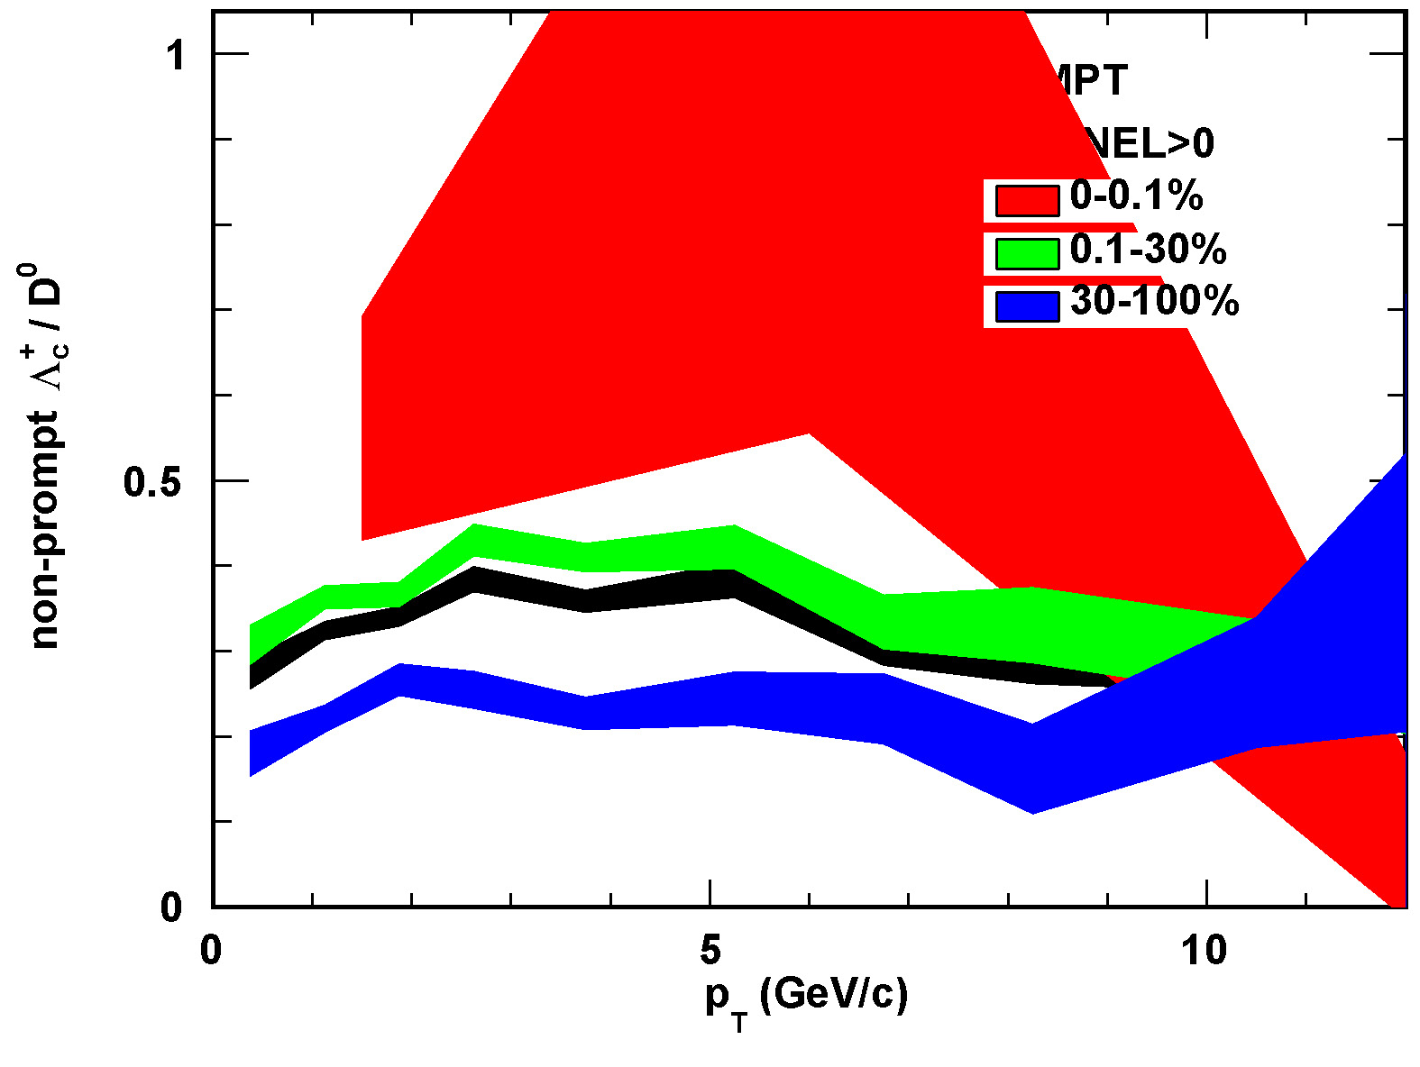
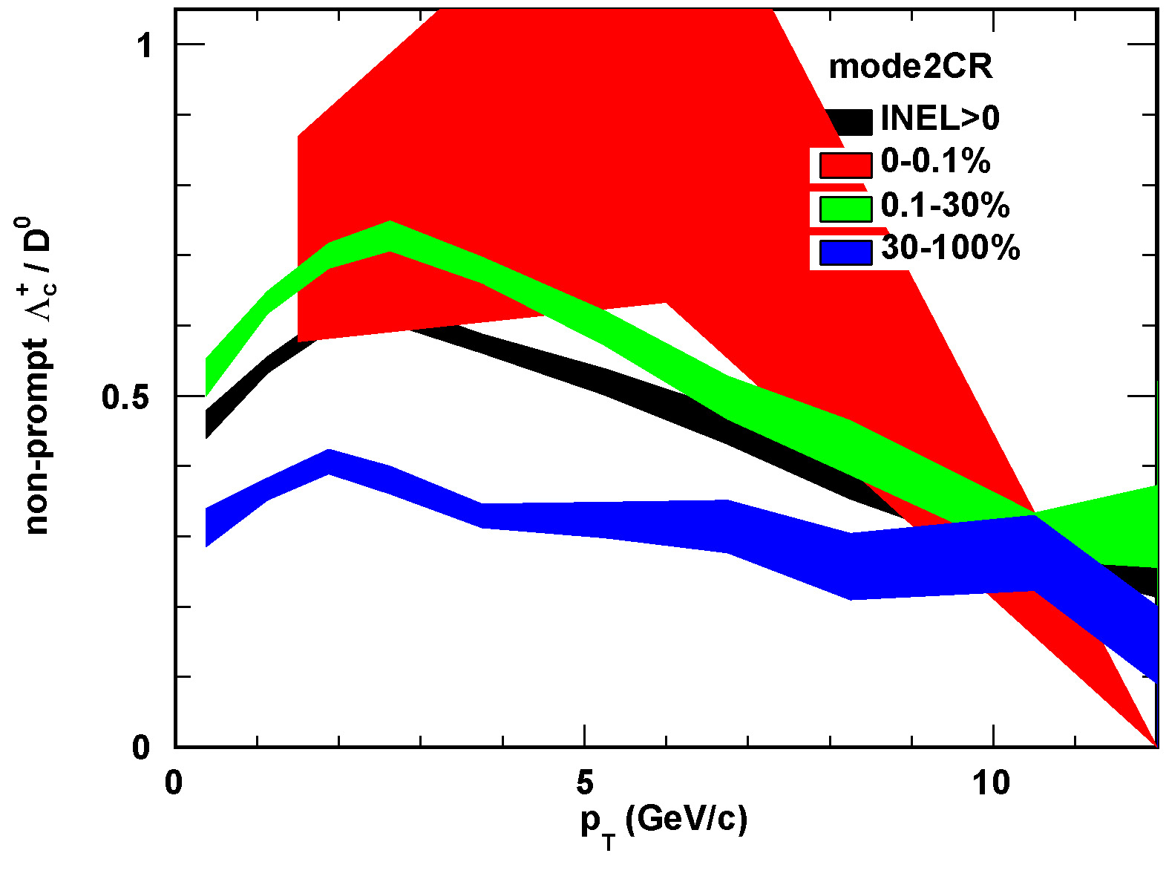
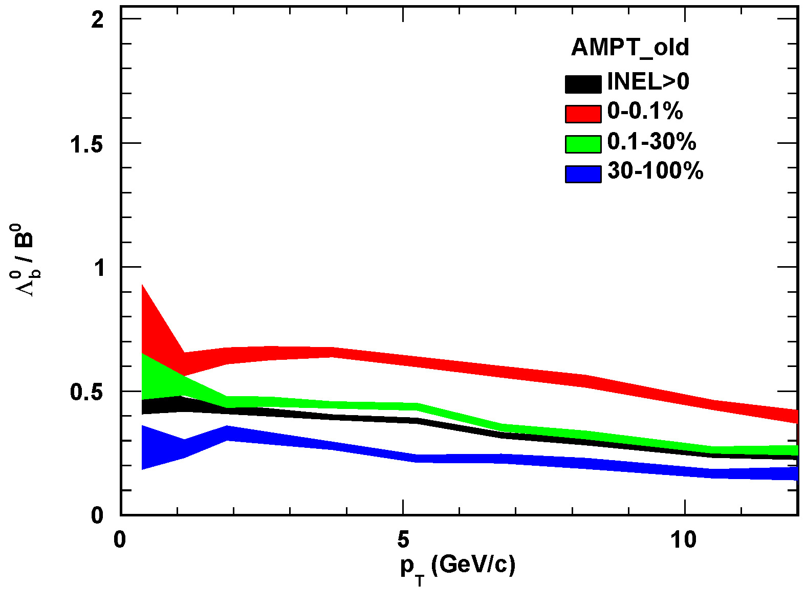
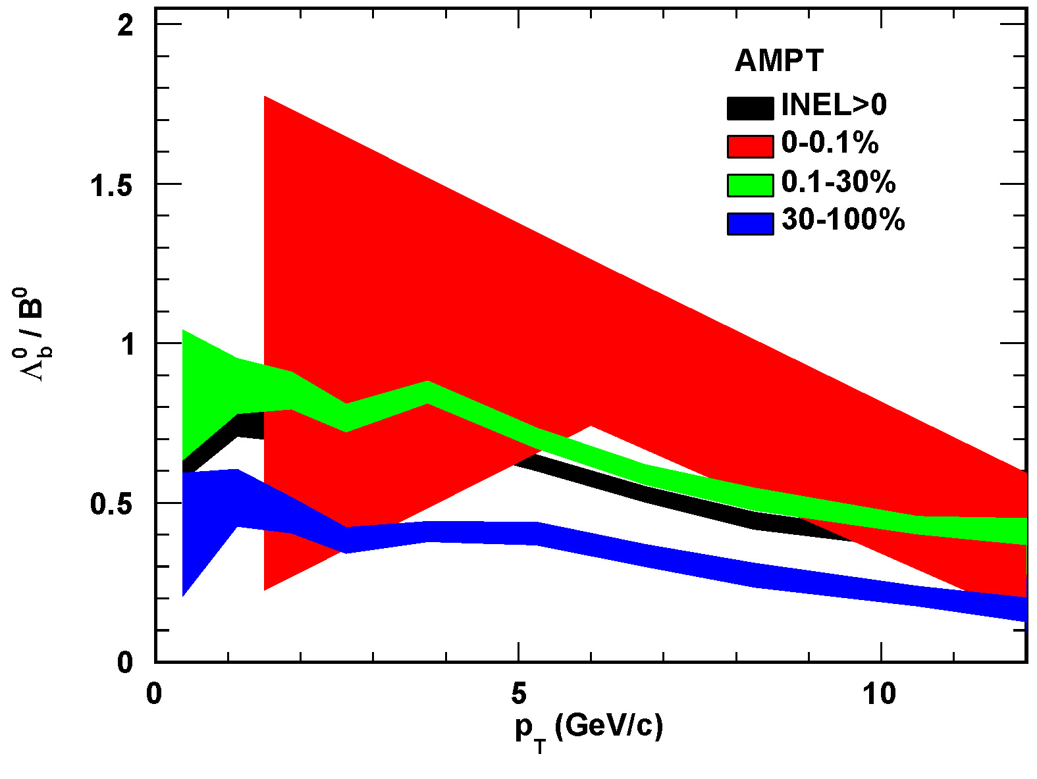
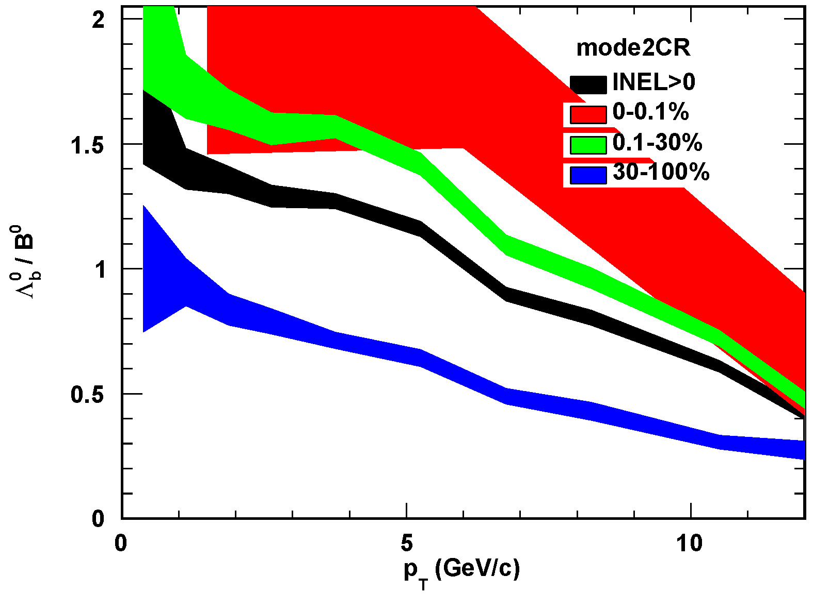
The $p_{T}$-differential baryon-to-meson ratio
The model's baryon-to-meson ratio is consistent with experimental behavior: it increases with centrality and decreases with increasing $p_{T}$ (for $p_{T}$ <GeV/c).
The enhancement of baryons due to $r_{BM}$ parameters is reflected across all centralities and in all $p_{T}$ranges.
arXiv:2111.11948v2

Slide 23
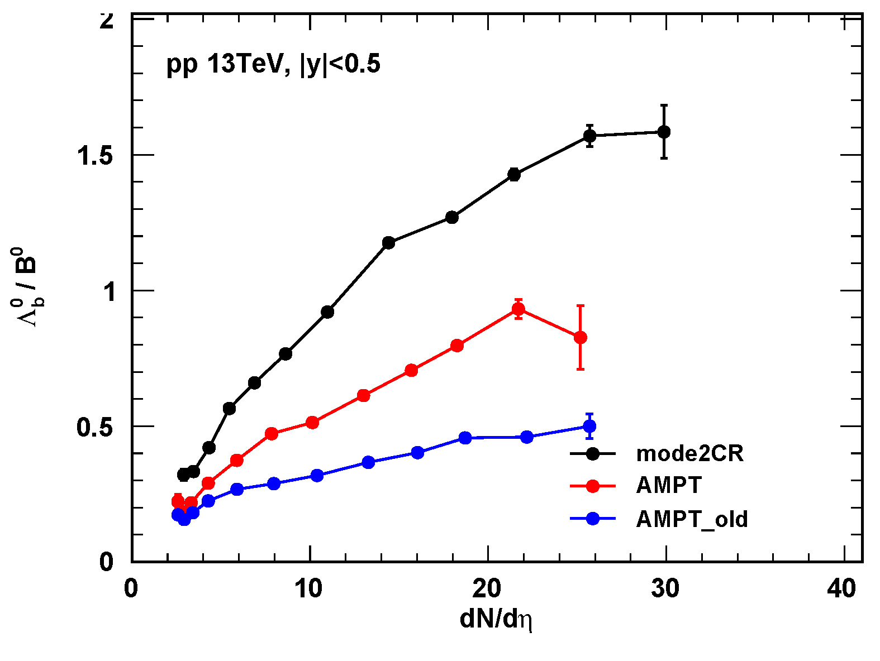
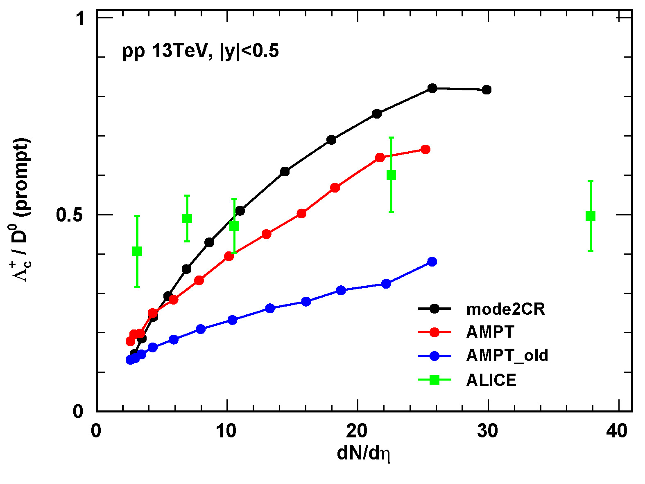
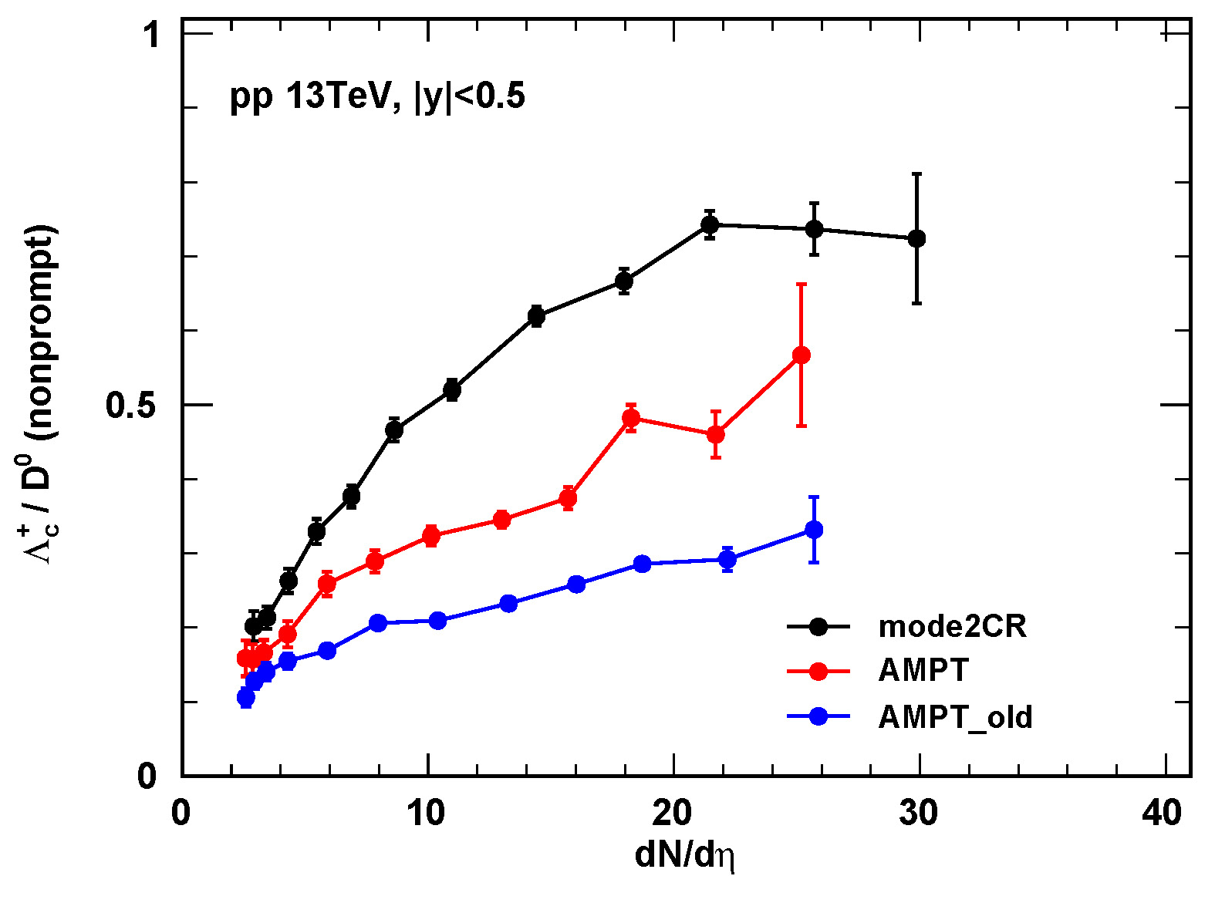
The $p_{T}$-integrated baryon-to-meson ratios
As the centrality increases, the $r_{BM}$ parameters in AMPT lead to a greater enhancement of baryons: high centrality events involve more secondary ZPC non-elastic collisions, resulting in more free quarks that undergo quark coalescence and hadronization.
Towards the periphery, the model becomes closer to and generally underestimates experimental data: AMPT and mode2CR use a unified Pythia string fragmentation description for peripheral events, which inadequately describes baryon production at the periphery.
mode2CR exhibits the highest slope: the purely string fragmentation mechanism is overly sensitive to centrality in baryon production.
arXiv:2111.11948v2

Slide 24
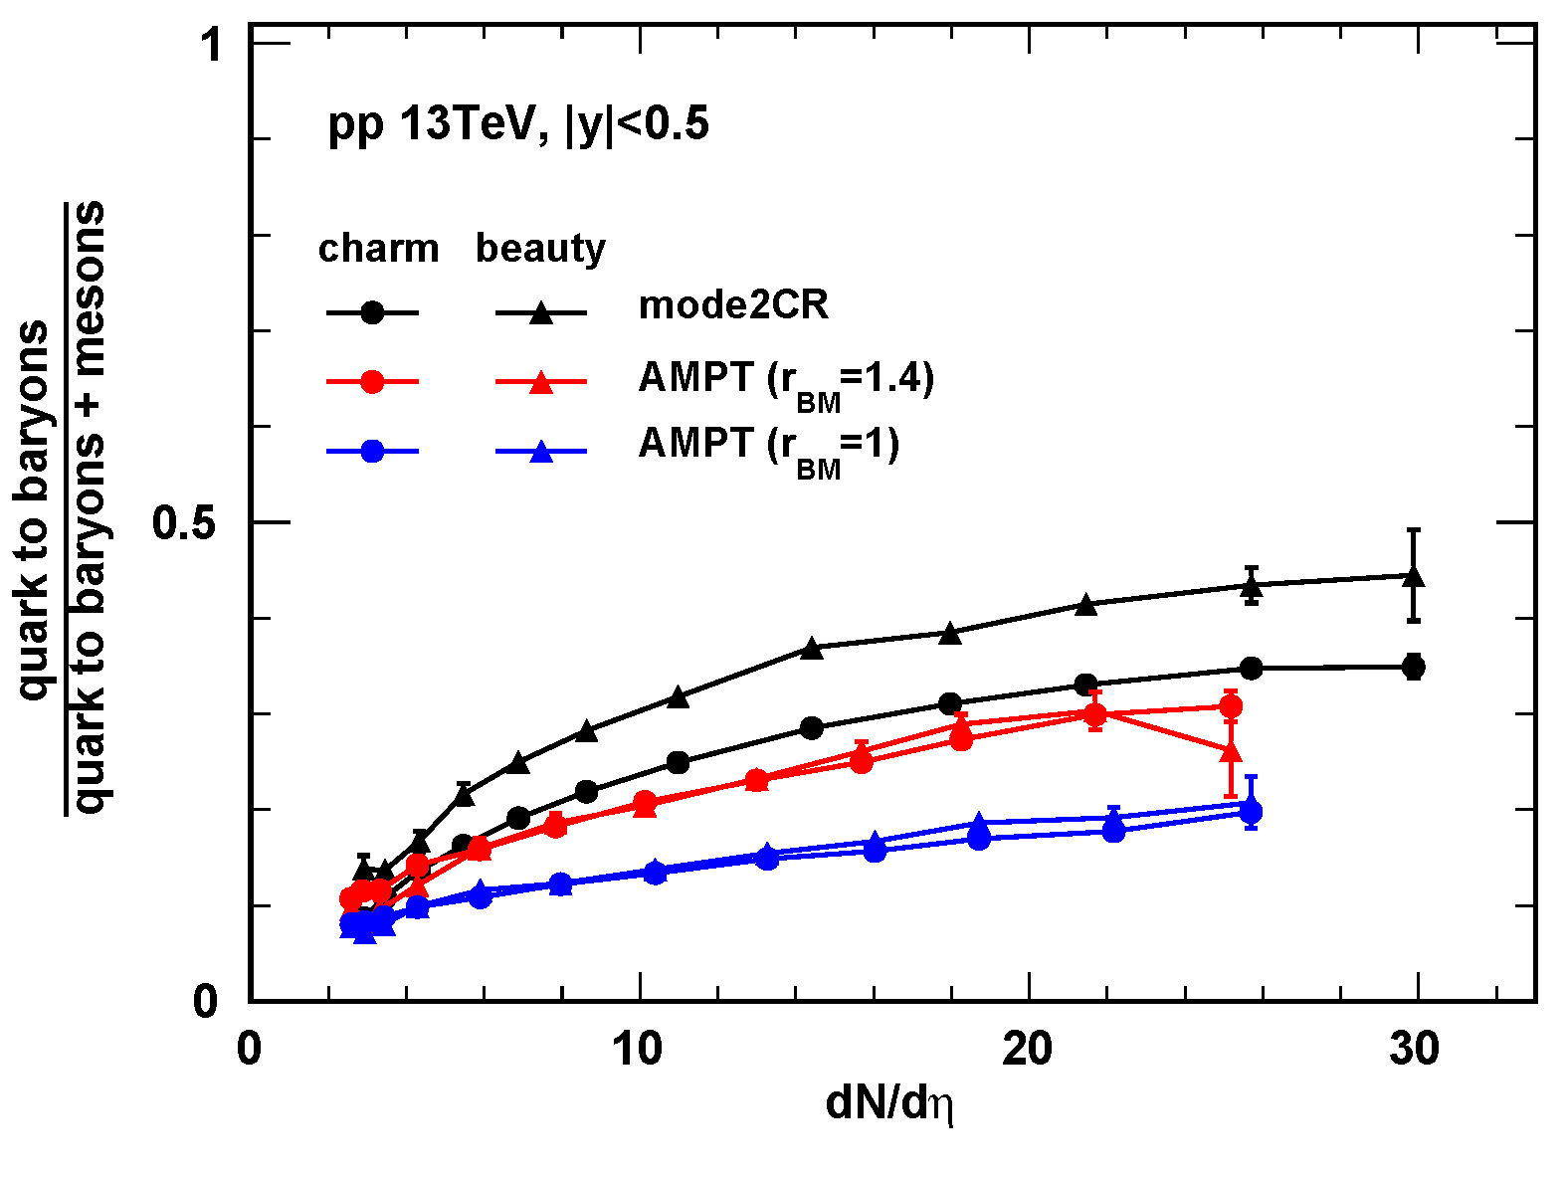
The multiplicity-dependence of baryon-to-meson ratio via hadronization
Statistical objects: all baryons and mesons produced through hadronization.
Statistical objects: ${ Λ}_{c}^{+}$、$Λ_{b}^{0}、D^{0}$、$D^{+}$、$B^{0}$、$B^{+}$produced through hadronization.
The proportion of baryons formed by hadronization of quarks increases with centrality;
$Λ_{c}^{+}$、$Λ_{b}^{0}$ reflect the overall baryon behavior, while $D^{0}$、$D^{+}$、$B^{0}$、$B^{+}$reflect the overall meson behavior.
The hadronization tendency of c-quarks and b-quarks in AMPT is consistent, with b-quarks more likely to form baryons than c-quarks in mode2CR.“

