Slide 1

2024 Spicy Gluons
Quantitative Analysis of Heavy Quark Diffusion Coefficient using Deep Learning Approach
Jiamin Liu(刘佳敏）
TianJin University
Advisor:Baoyi Chen
2024.5.18

Slide 2
Part I
Introduction
heavy ion collision
Research Probe
1

Slide 3
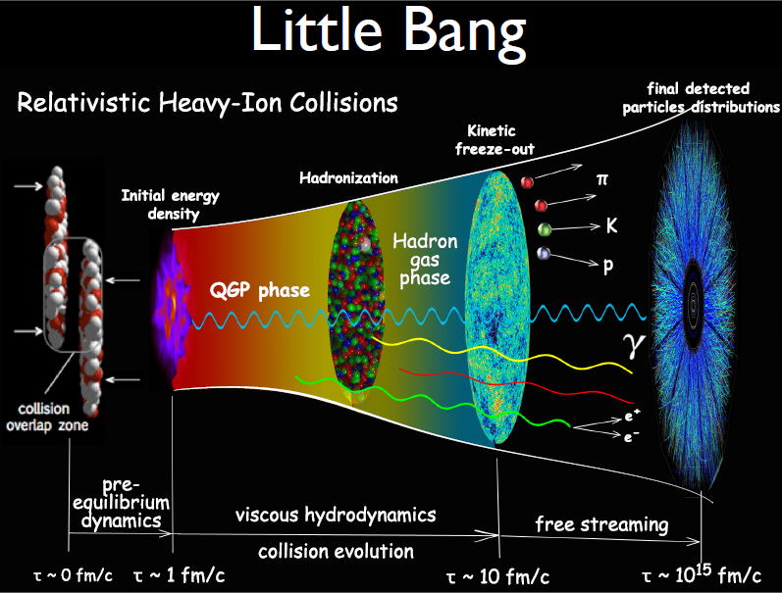
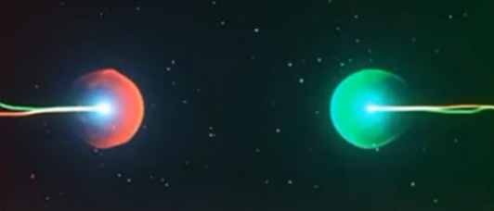
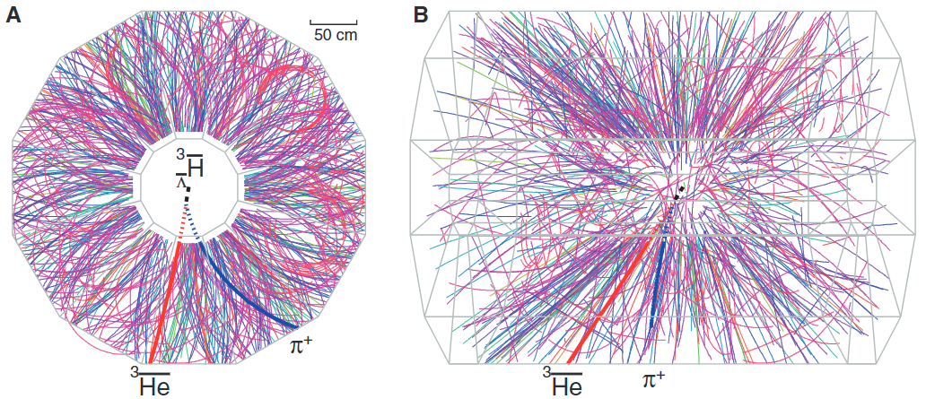

Heavy ion collisions
@ C. Shen
$$c+\overline{q}→D$$
From STAR
Different from pp collisions, AA collisions produce an extremely hot de-confined medium:
significant color screening + parton inelastic scatterings
Light hadrons: produced at the boundaries of QGP phase transition
Charmonium/bottomonium: primordial production + coalescence inside QGP (T>Tc)
2

Slide 4
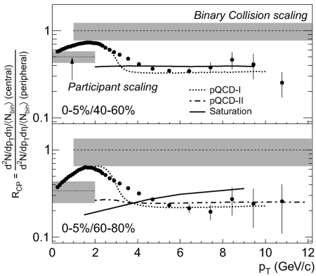
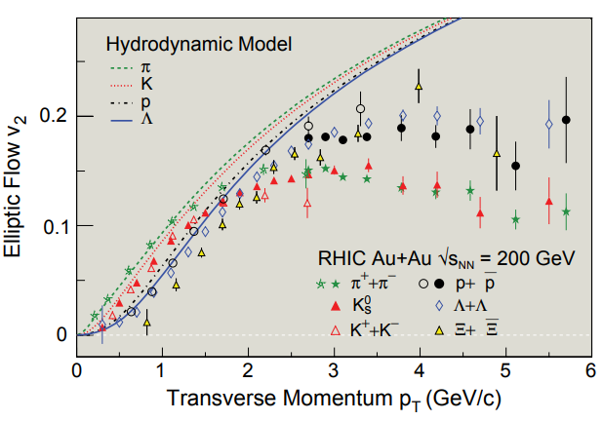
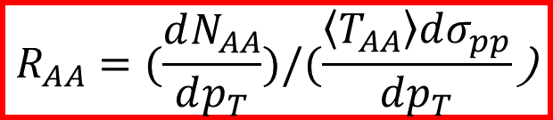


Research Probe
nuclear modification factors:
elliptic flow:
$$R_{AA}=(\frac{dN_{AA}}{dp_{T}})/(\frac{\left\langle T_{AA}\right\rangle dσ_{pp}}{dp_{T}}\text{)}$$
$$v_{2}=\left\langle \cos{2(φ−ψ_{2})}\right\rangle$$
Rcp
$$R_{CP}=\frac{\frac{d^{2}N}{dp_{T}dη\left\langle N_{bin}\right\rangle }(central)}{\frac{d^{2}N}{dp_{T}dη\left\langle N_{bin}\right\rangle }(peripheral)}$$
Adams, J. et al. Phys. Rev. Lett. 91, 172302 (2003).
Braun-Munzinger, Nature 448, 302–309 (2007).
3

Slide 5
Part Ⅱ
Calculations of coalescence model
Bulk medium evolutions
Charm diffusions in QGP (Classical Langevin equation)
coalescence via ICM model
4

Slide 6


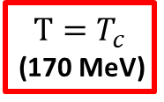


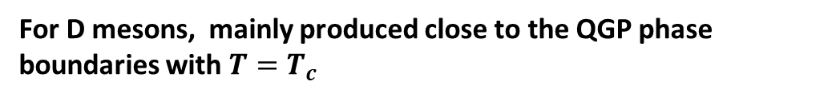
Calculations of coalescence model
5.02 TeV Pb-Pb collisions,
MUSIC hydro model is employed (crossover phase transition)
EoS:
QGP EoS is from Lattice QCD results
Hadron phase is treated as an ideal gas
At the center of the fireball (r=0) , its local temperature evolution is plotted:
Langevin + Instantaneous coalescence model (LICM)
(Langevin equation)
$$T_{0}(τ_{0})$$
charm
$c+\overline{q}→D$ + g
$$T_{freeze−out}$$
D meson diffusions
in hadronic medium
Charm diffusions
$$T_{c}$$
(ICM)
$$T=T_{c}$$
(170 MeV)
D meson
diffusions
For D mesons, mainly produced close to the QGP phase boundaries with $T=T_{c}$
Chen, B., Jiang, L Phys. Rev. C 105, 054901 (2022).
5

Slide 7
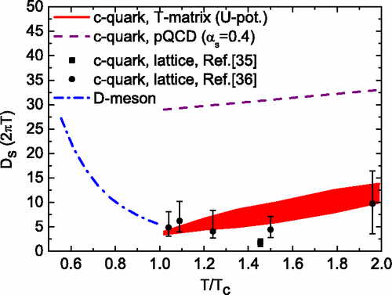
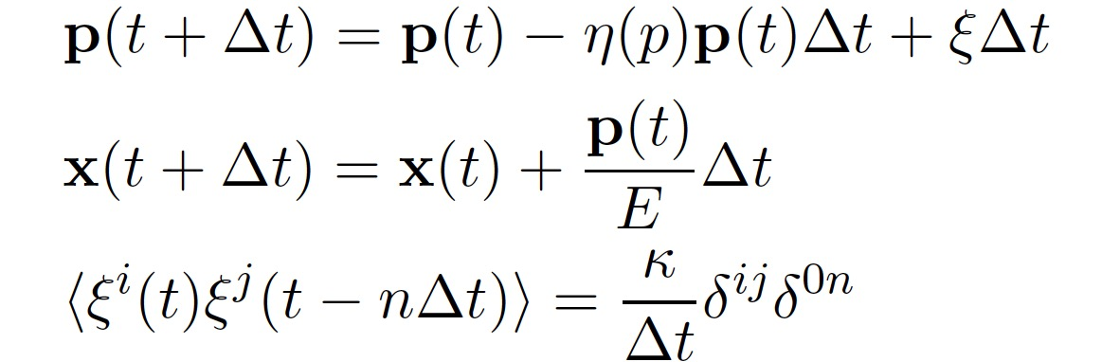
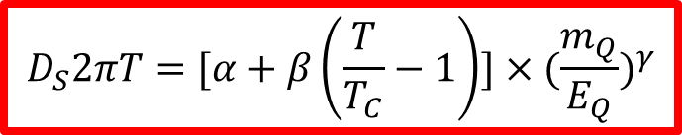



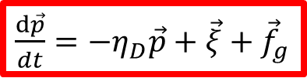


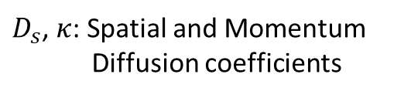

Charm diffusions in QGP
$$η_{D}=κ/(2TE_{C})$$
$$E_{C}=\sqrt{(m_{C}^{2}+p^{2}})$$
$\frac{d\vec{p}}{dt}=−η_{D}\vec{p}+\vec{ξ}+$ ${\vec{f}}_{g}$
$D_{s}$, $κ$: Spatial and Momentum
Diffusion coefficients
(1)
$$κD_{s}=2T^{2}$$
$${\vec{f}}_{g}=−d{\vec{p}}_{g}/dt$$
$$η_{D}$$
α,β,γ,S
$$D_{S}2πT=[α+β\left(\frac{T}{T_{C}}−1\right)]×{(\frac{m_{Q}}{E_{Q}})}^{γ}$$
Min He, Ralf Rapp, et al PRL 2012c
$$E_{Q}=\sqrt{({{{m_{Q}}^{2}+p}_{Q}}^{2}})$$
Test particle Monte Carlo method is used.
At each time step, the discretization of Equation (1) is performed.
6

Slide 8
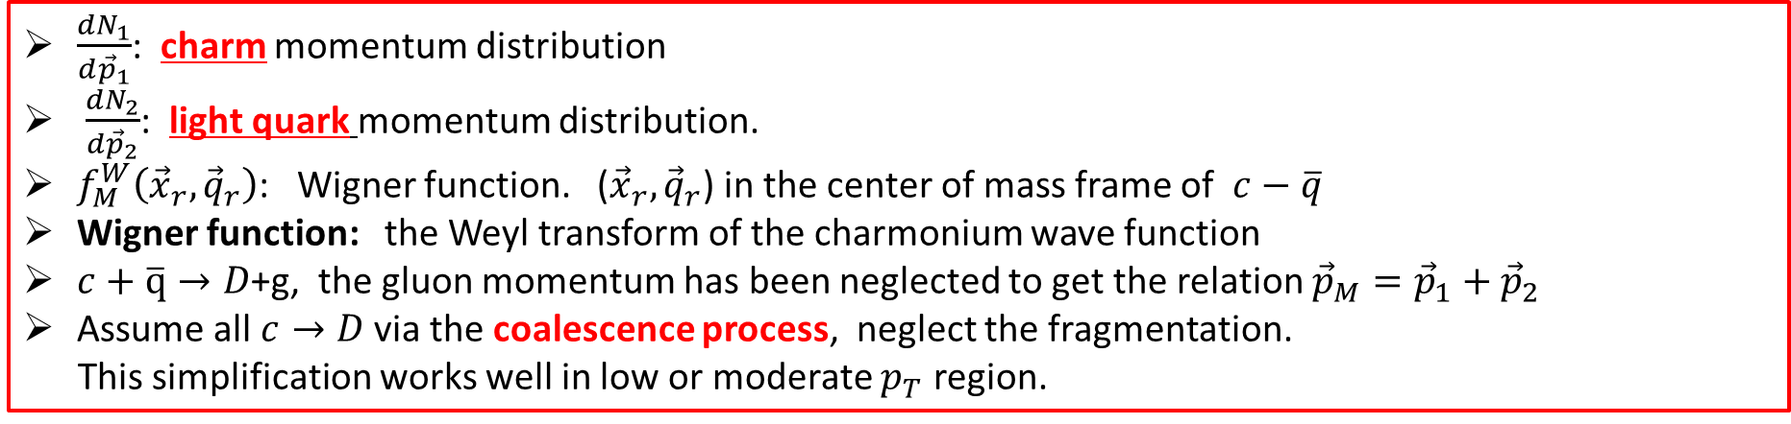

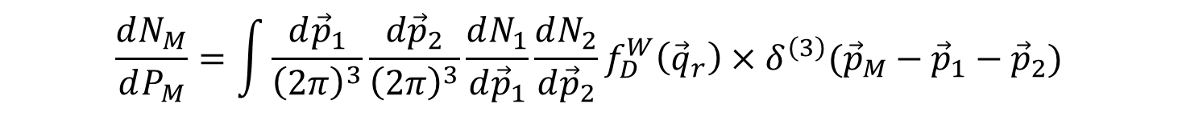

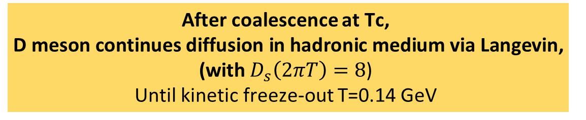
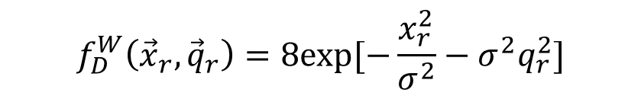
After coalescence at Tc,
D meson continues diffusion in hadronic medium via Langevin,
(with $D_{s}\left(2πT\right)=8$)
Until kinetic freeze-out T=0.14 GeV
Coalescence via ICM model
D meson coalescence
$$\frac{dN_{M}}{dP_{M}}=\int{\frac{d{\vec{p}}_{1}}{{\left(2π\right)}^{3}}}\frac{d{\vec{p}}_{2}}{{\left(2π\right)}^{3}}\frac{dN_{1}}{d{\vec{p}}_{1}}\frac{dN_{2}}{d{\vec{p}}_{2}}f_{D}^{W}\left({\vec{q}}_{r}\right)×δ^{\left(3\right)}({\vec{p}}_{M}−{\vec{p}}_{1}−{\vec{p}}_{2})$$
Wigner function:
The width $σ$ in the Wigner function
$$f_{D}^{W}\left({\vec{x}}_{r},{\vec{q}}_{r}\right)=8exp[−\frac{x_{r}^{2}}{σ^{2}}−σ^{2}q_{r}^{2}]$$
$$σ^{2}=\frac{4}{3}\frac{{(m_{1}+m_{2})}^{2}}{m_{1}^{2}+m_{2}^{2}}{<r^{2}>}_{M}$$
$\frac{{dN}_{1}}{d{\vec{p}}_{1}}$: charm momentum distribution
$\frac{{dN}_{2}}{d{\vec{p}}_{2}}$: light quark momentum distribution.
$f_{M}^{W}\left({\vec{x}}_{r},{\vec{q}}_{r}\right)$: Wigner function. (${\vec{x}}_{r},{\vec{q}}_{r}$) in the center of mass frame of $c−\overline{q}$
Wigner function: the Weyl transform of the charmonium wave function
$c+\overline{q}→D$+g, the gluon momentum has been neglected to get the relation ${\vec{p}}_{M}={\vec{p}}_{1}+{\vec{p}}_{2}$
Assume all $c→D$via the coalescence process, neglect the fragmentation.
This simplification works well in low or moderate $p_{T}$ region.
7

Slide 9
Part Ⅲ
ML and results in Heavy Ion Collisions
Applications of Machine Learning in High-Energy Domain
CNN for Identifying D Meson's RAA and v2 Data to Predict Diffusion Coefficient
Reinforcement Learning with DQN Model
9

Slide 10
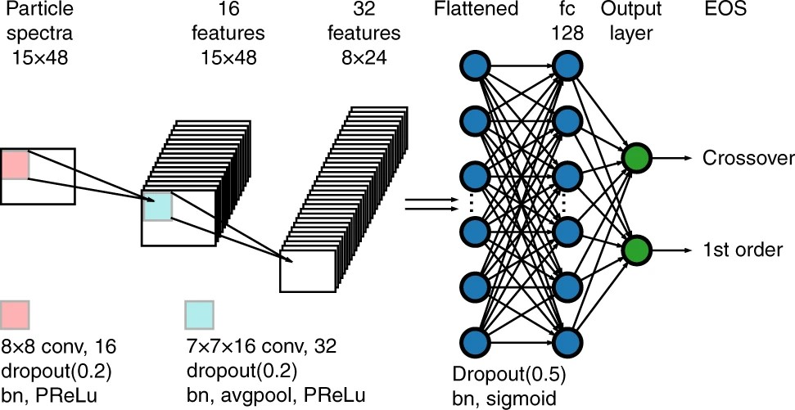
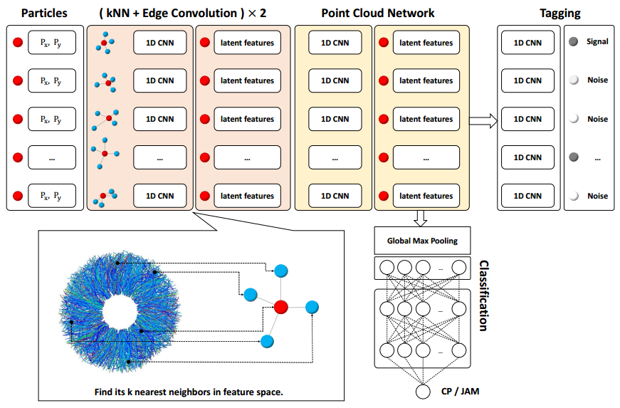
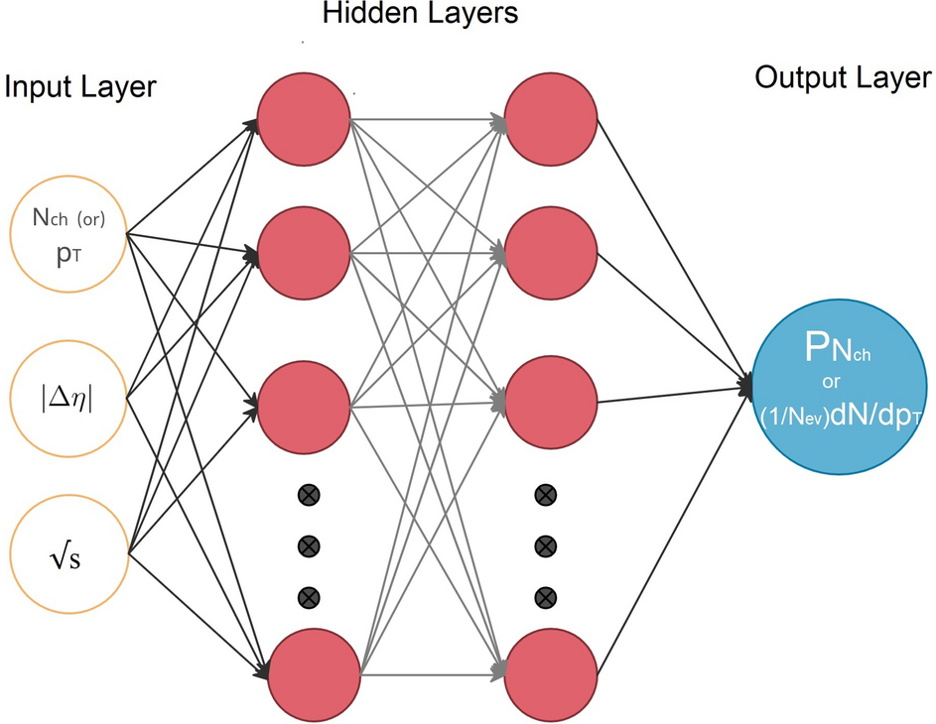
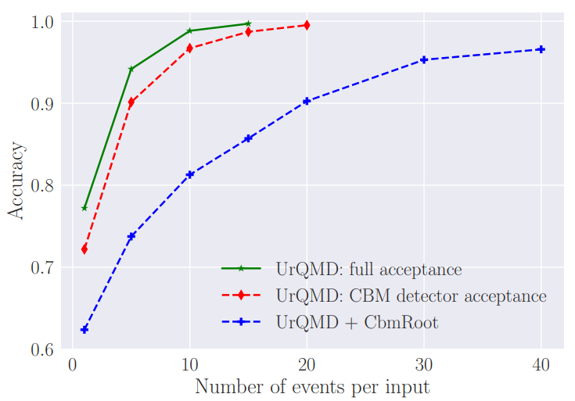
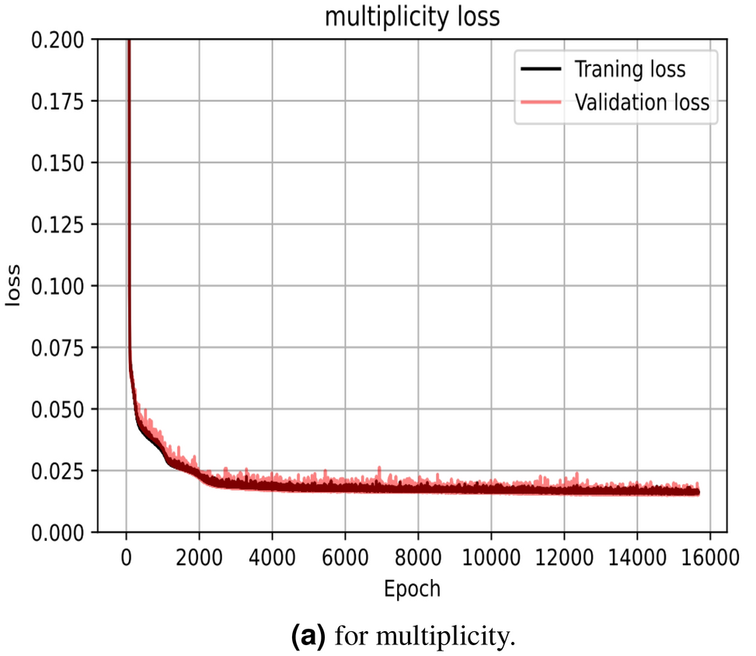
Applications of ML in High-Energy Domain
Fig1
Fig2
Pang, L.-G. et al. Nat Commun 9, 210 (2018).
Huang, YPhysics Letters B 827, 137001 (2022).
Fig3
Fig4
Fig5
Shokr, E.,. Sci Rep 12, 8449 (2022).
10

Slide 11
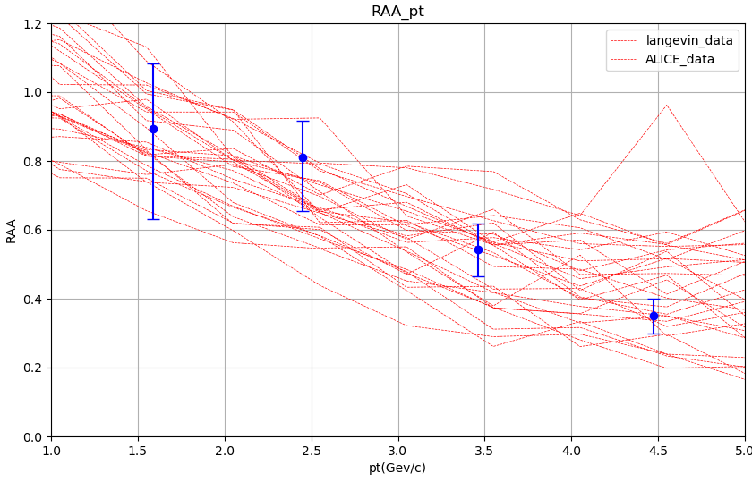
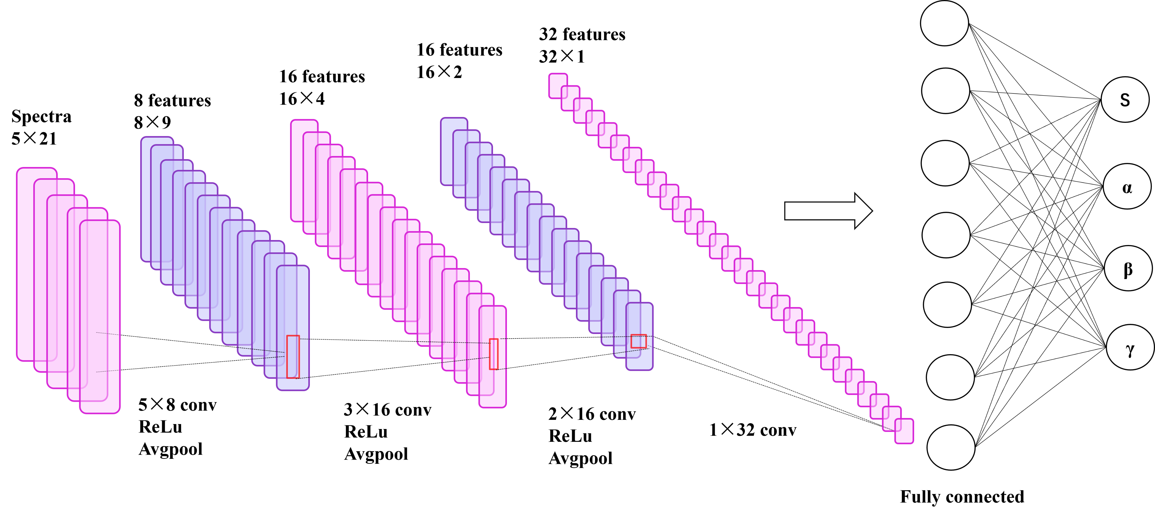
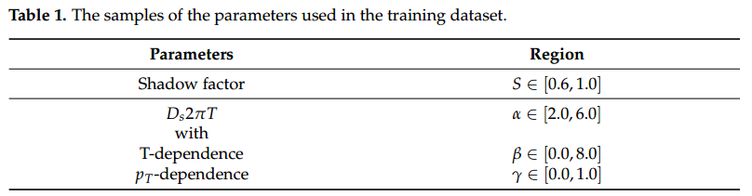
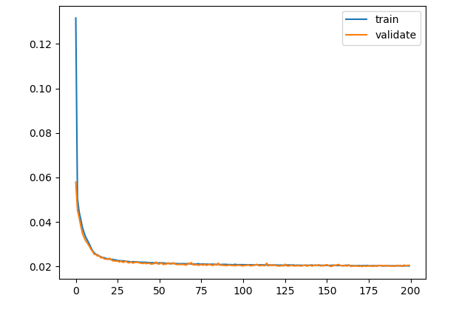
Results in heavy ion collision using CNN
Fig1
Fig2
Some events were randomly selected from one channel of the training dataset.
Fig3
(RAA and v2)----------------input
(S, α , β, γ) ---------------------output
three different centralities for the RAA data ----- three input channels
two distinct centralities for the V2 data ----------- two additional channels
20000 events,90%---train data,10%----valid data
CNN model’s loss-------about 2%
Chen B.Y., Entropy 25, 1563 (2023).
12
Notes:
在底夸克的动力学演化中，我们的理论模型通过改变方程中的遮蔽因子（表示为S）和三个参数（a，b，g），为5.02 TeV Pb–Pb碰撞中的非瞬发J/y产生了大范围的RAA和v2值。该数据集将作为CNN的训练数据。进行实验测量，以确定三种不同中心的非瞬发J/y的核修正因子RAA（pT），以及v2的椭圆流动系数。在我们的方法中，我们将RAA（pT）的三个中心视为单独的通道，而v2（pT)。CNN的输出层在扩散系数和阴影因子中包含相应的参数值，这被认为是输入数据的标签。基于LICM模型的理论计算建立了参数组合值（S，a，b，g）和实验可观测值（RAA，v2）之间的映射关系。图1提供了网络结构的图形表示，它由四个隐藏层组成，包括平均池化层和完全连接层。为这些层选择了ReLU激活函数。当使用Sigmoid函数时，与扩散系数参数相关的三个输出通道被投影为具有正值，而与阴影效应相关的通道被投影在0–1的范围内。
图2：通过改变模型中参数的值来生成CNN训练数据集的理论模型。我们绘制了（RAA（pT），v2（pT）），这些事件是从训练数据集的一个通道中随机选择的，如图2这些线可以覆盖实验数据，表明模型的训练范围包括实验数据的分布。该模型能够有效地应用于实验数据的分析。
由于关于RAA的实验数据点位于pT≥2 GeV/c，并且v2位于pT≤4 GeV/c中，
我们通过仅保留pT值高于4 GeV/c的数据来截断训练数据。这确保了训练数据的形状与实验数据尽可能紧密地对齐，从而更容易将它们合并到输入中。
图3：
总数据集的70%划分为训练数据，30%为验证数据。通过将（RAA，v2）作为CNN的输入，将参数值作为标签，我们可以计算训练和验证数据集的CNN损失。图3表明，在250个训练时期后，损失降至5%以下。值得注意的是，训练数据集的CNN损失与使用验证数据集时观察到的损失密切一致。这表明CNN模型没有表现出显著的过度拟合或拟合不足。

Slide 12
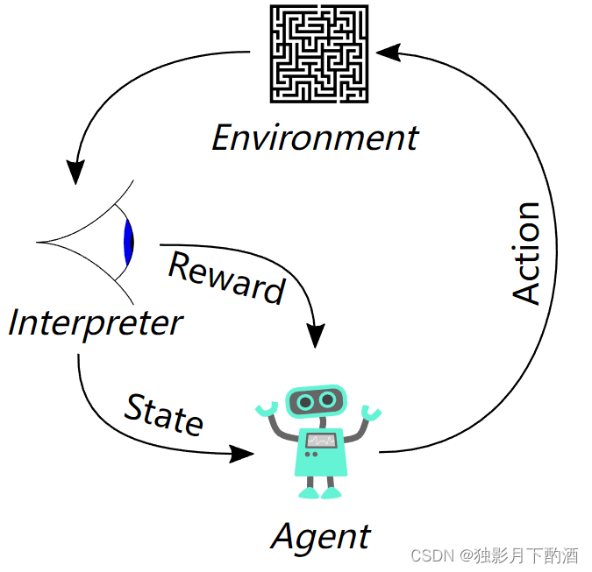
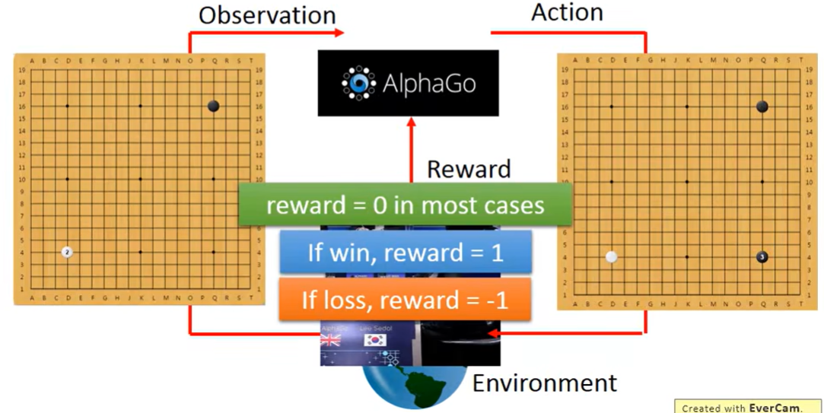
Reinforcement Learning（Q-Learning）
Supervised learning
Machine learning
unsupervised learning
Q-Learning
Reinforcement Learning
DQN model
Bellman equation:
……
$$Q\left(s,a\right)→Q\left(s,a\right)+α[r+maxQ\left(s^{′},a^{′}\right)−Q\left(s,a\right)]$$
$s^{′},a^{′}$:Next state and action,$α:decay$ value,$r$:reward
 | action1 | action2 | action3 | … | actionn
state1 | Q₁₁ | Q₁₂ | Q₁₃ | … | Q_{1n}
state2 | Q₂₁ | Q₂₂ | Q₂₃ | … | Q_{2n}
… | … | … | … | … | …
staten | Q_{n1} | Q_{n2} | Q_{n3} | … | Q_{nn}
Agent--machine Environment--people experience
Action--up,down,left,right State----chessbord
13

Slide 13
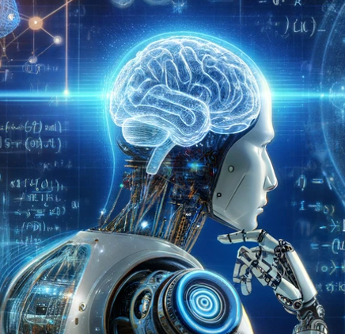
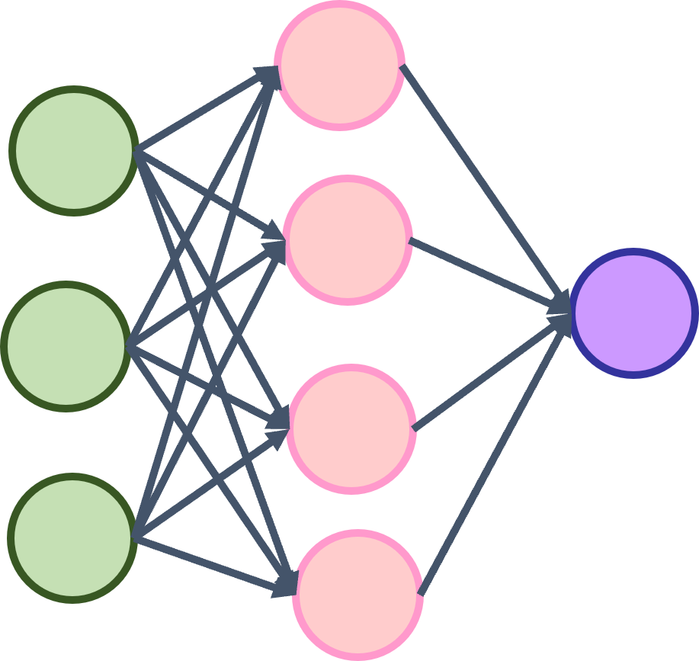


Deep Q-Learning(DQN model)
Agent
Action
Langevin model
Environment
Next state
Experiment data
state
Rewards
Input and output: S, α , β, γ
Target: Find suitable S, α , β, γ
S
S’
α
a’
State
Next state
β
$$Q\left(s^{′},a^{′}\right)$$
$$Q(s^{′′},a^{′}′)$$
b’
γ
γ'
Eval network
Target network
MSELoss
Parameters in diffusion coefficient
$$Loss={(Rewards+γmaxQ\left(s^{′}\right)−Q\left(s\right))}^{2}$$
optimize
14

Slide 14
Summary
We develop Langevin + Instantaneous Coalescence Model (LICM) to study the realistic diffusions of charm quarks in the hot medium.-----(RAA and v2)
We input D meson data into a Convolutional Neural Network (CNN) for training; however, the parameter selection was overly arbitrary and requires further optimization.
We opted for the Deep Q-Network (DQN) reinforcement learning model to optimize parameter selection, with the aim of enhancing the agreement between the theoretical calculations based on the Langevin equation and experimental data.
15

Slide 15


Thanks for your listening!
Jiamin Liu(刘佳敏）
2024.5.18

