Slide 1



Search for the Chiral Magnetic Effect with Forced Match of Multiplicity and Elliptic Flow in Isobar Collisions at STAR
Yufu Lin,
Guangxi Normal University, Guilin
In collaborate with: Diyu Shen, Aihong Tang, Gang Wang
Spicy Gluons (胶麻) 2024: Workshop for Young Scientists on the quark-gluon matter in extreme conditions, May 15-18, 2024, Hefei
Notes:
Good afternoon everyone,
¹Guangxi Normal University
²Central China Normal University
³Fudan University
⁴Brookhaven National Laboratory
⁵University of California, Los Angeles

Slide 2
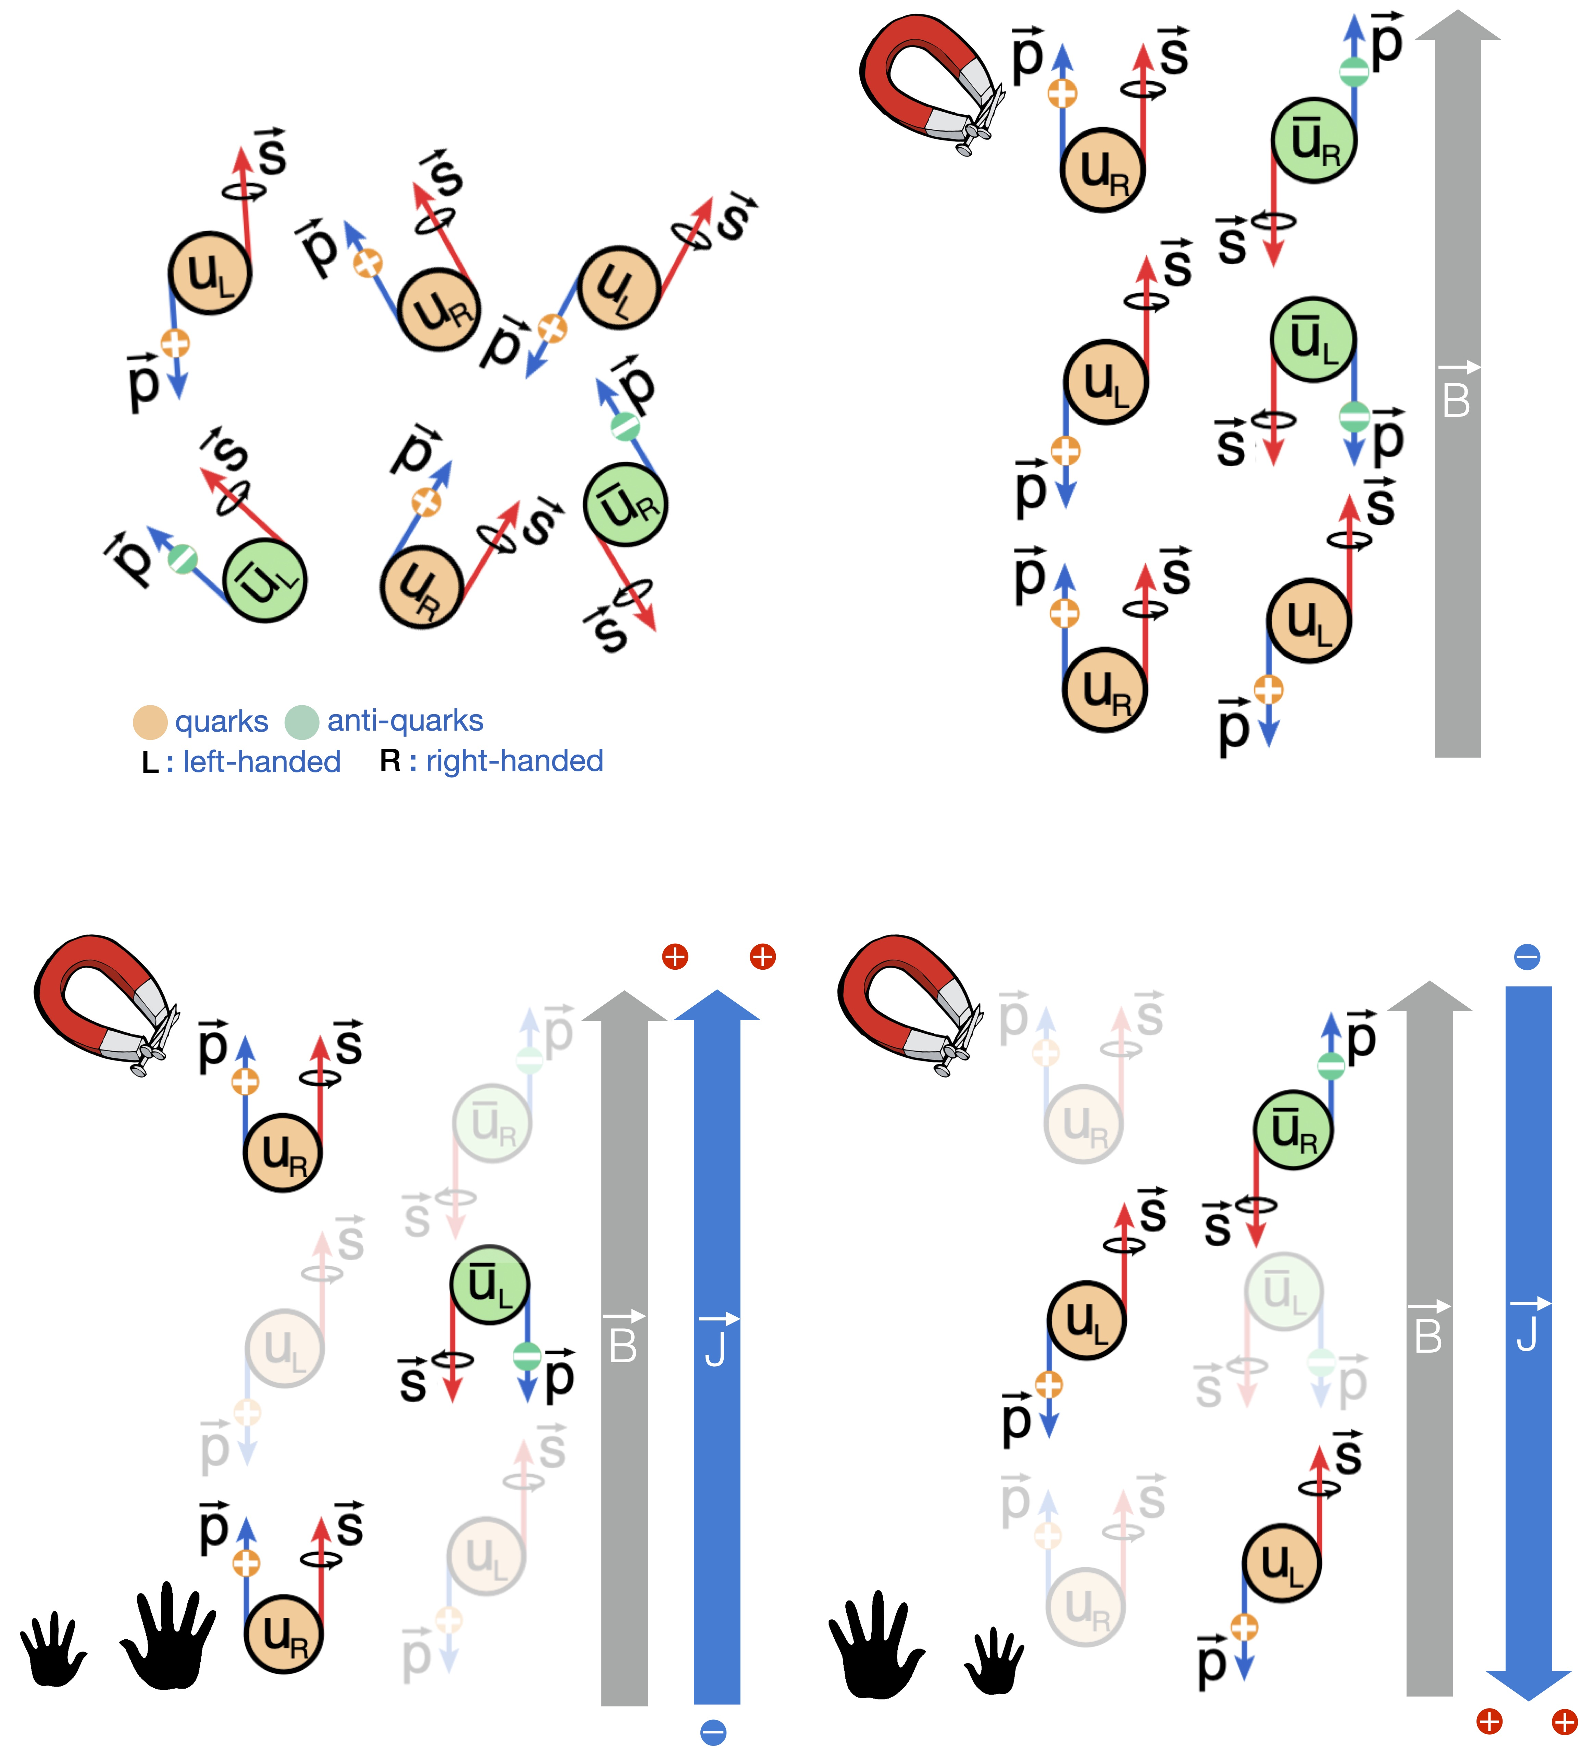
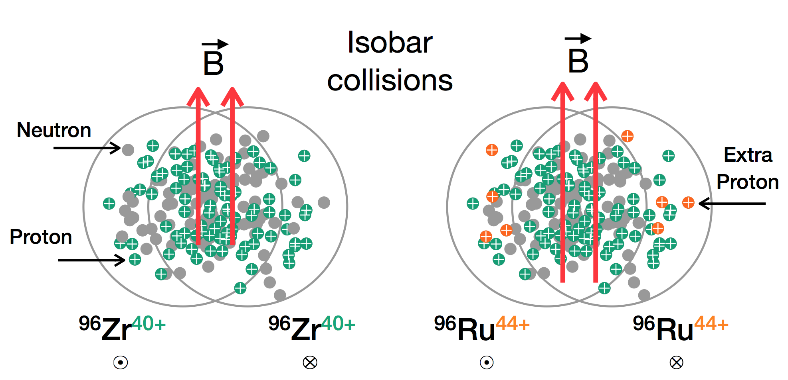
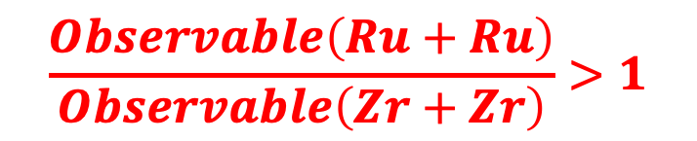
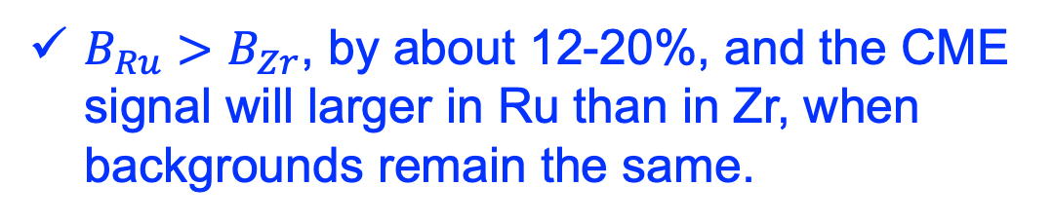
Chiral magnetic effect(CME) and isobar collisions
CME: Charge seperation along the B due to strong magnetic effect and local CP violation.
$B_{Ru}>B_{Zr}$, by about 12-20%, and the CME signal will larger in Ru than in Zr, when backgrounds remain the same.
$$\frac{Observable\left(Ru+Ru\right)}{Observable\left(Zr+Zr\right)}>1$$
Notes:
The basic idea is to contrast the CME-sensitive observables in two different colliding systems,
the RuRu and the ZrZr, where the Ru and Zr are a pair of isobars with the same nucleon numbers (A = 96) but different nuclear charges (Z = 44 and Z = 40 respectively).
left) Four types of chiral fermions are produced in the system: left and right handed quarks (with positive electric charge) and anti-quarks (with negative electric charge). Their spins are randomly oriented, as are their momentum directions. This does not lead to any observable effect. (Upper right) The presence of an external electromagnetic field (B⃗) aligns the spin of the quarks due to polarization, where positive quarks are aligned along B⃗ and the anti-quarks are anti-aligned. Still, nothing noticeable happens that can be detected by known experiments. (Lower left) In a situation where more right handed quarks are produced, a vector current (J⃗) will be generated along B⃗. (Lower right) In a situation where more left handed quarks are produced, a vector current (J⃗) will be generated anti-parallel to B⃗ . This phenomenon of generation of J⃗||B⃗ or J⃗|| − B⃗ is called the CME. This will lead to an observable effect of charge separation along B⃗ .
The expectation is that the two systems will have the same background contributions,
while quite different CME signals due to the difference proton numbers and thus magnetic field strength.
The Isobar collision can provided a unique opportunity to detect CME.
CME difference about 10%
CME-induced charge separation shifts pos. and neg. particles in opposite directions.
Backgrounds issue: resonances’ $v_{2}$, local charge conservation and momentum conservation etc.
Key idea: constrasting two systems with identical buld, caried magnetic field.
W.-T. Deng, X.-G. Huang, G.-L. Ma, and G. Wang, Phys. Rev. C 94, 041901 (2016)
L. Huang, M.-W. Nie, and G.-L. Ma, Phys. Rev. C 101, 024916 (2020).
Sergei A. Voloshin, Phys. Rev. Lett. 105, 172301 (2010)

Slide 3
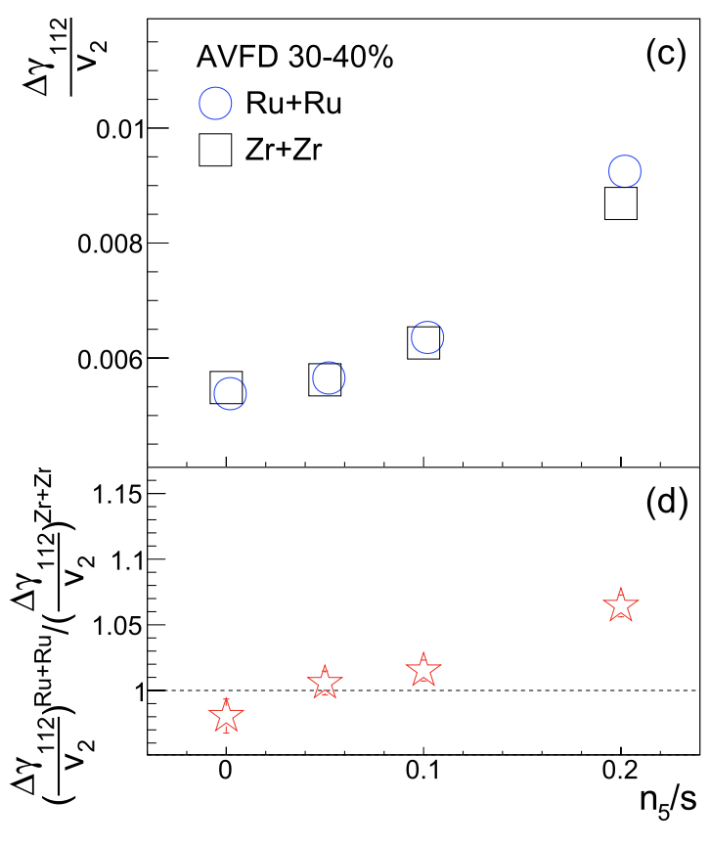
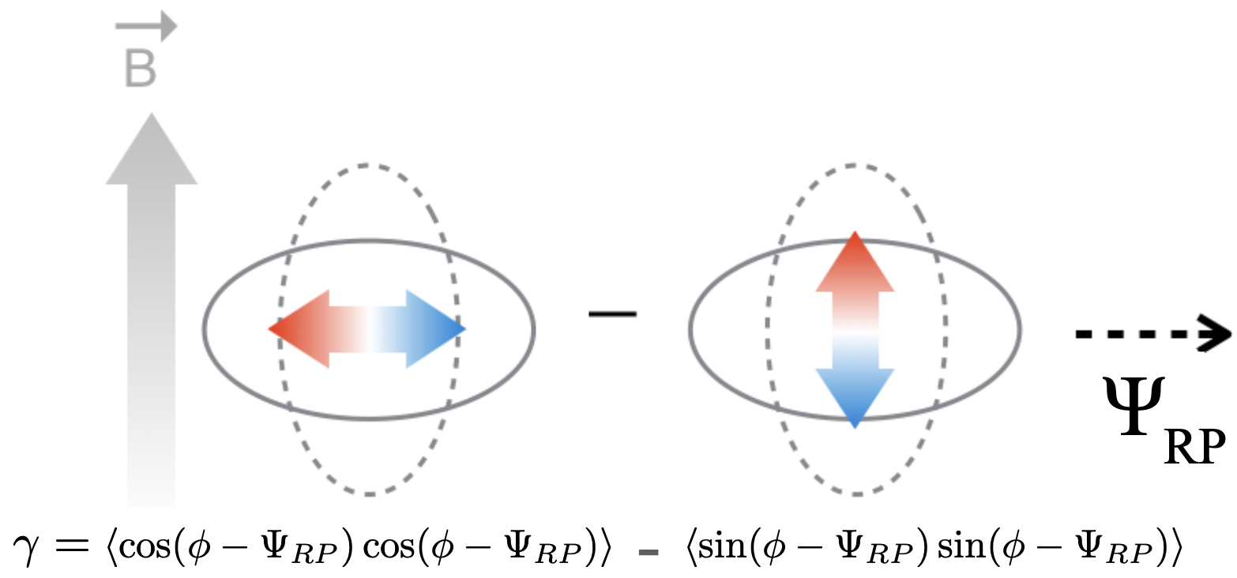

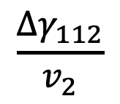
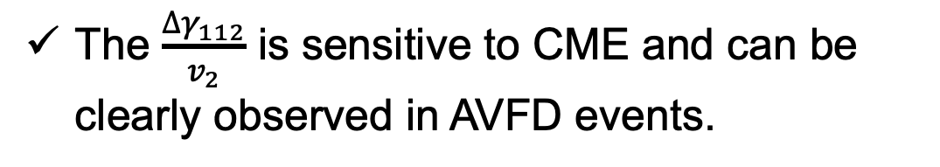

Analysis method: 𝛄-correlator
By utilizing the azimuthal correlation:
$$γ_{112}=\left\langle cos\left(φ_{α}{−φ}_{β}−{2Ψ}_{RP}\right)\right\rangle$$
$${∆γ}_{112}=γ_{112}^{OS}{−γ}_{112}^{SS}$$
The normalized quantity:
The $\frac{{∆γ}_{112}}{v_{2}}$ is sensitive to CME and can be clearly observed in AVFD events.
$$\frac{{∆γ}_{112}}{v_{2}}$$
Notes:
Firstly, let me remind you the methods can be used to searching CME signal.
The first method, is 𝛄-correlator, which by utilizing the azimuthal correlation, delta gamma 112,
And. The normalized quantity delta gamma 112 over v2 to account for the tribial scaling from the v2 contribution,
The $\frac{{∆γ}_{112}}{v_{2}}$ is sensitive to CME and can be clearly observed in AVFD events.

Slide 4
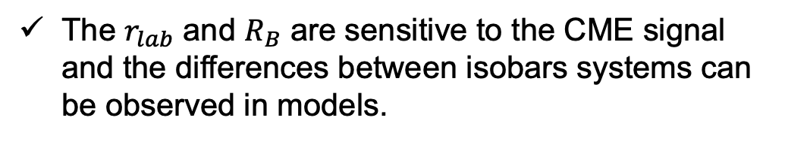
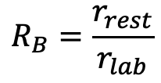
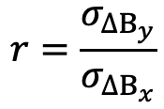
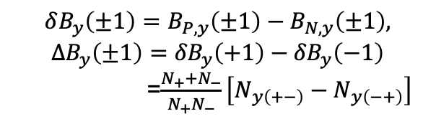
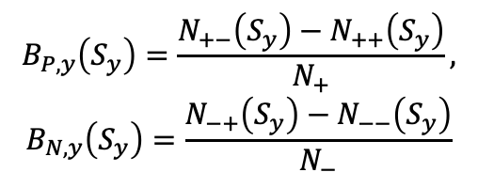

Analysis method: Signed Balance Function(SBF)
By accounting momentum ordering:
1) Count pair’s momentum ordering along y direction in py :
$$B_{P,y}\left(S_{y}\right)=\frac{N_{+−}\left(S_{y}\right)−N_{++}\left(S_{y}\right)}{N_{+}},$$
$$B_{N,y}\left(S_{y}\right)=\frac{N_{−+}\left(S_{y}\right)−N_{−−}\left(S_{y}\right)}{N_{−}}$$
y
B
2) Count net-ordering (e.g. excess of pos. leading neg. ) for each event :
x
A.H. Tang, Chin. Phys. C 44, 054101 (2020)
S. Choudhury, et al., Chin. Phys. C 46, 014101 (2022)
$$δB_{y}\left(±1\right)=B_{P,y}\left(±1\right)−B_{N,y}\left(±1\right),$$
$$∆B_{y}\left(±1\right)={δB}_{y}\left(+1\right)−{δB}_{y}\left(−1\right)$$
=$\frac{N_{+}+N_{−}}{N_{+}N_{−}}\left[N_{y\left(+−\right)}−N_{y\left(−+\right)}\right]$
3) Look for enhanced event-by-event fluctuation of net ordering in y direction.
Observable:
$$r=\frac{σ_{∆B_{y}}}{σ_{∆B_{x}}}$$
$$R_{B}=\frac{r_{rest}}{r_{lab}}$$
The $r_{lab}$ and $R_{B}$ are sensitive to the CME signal and the differences between isobars systems can be observed in models.
Where Nαβ denotes the number of positive -negative pairs with a sign of Sy in an event. Sy is labeled as +1 if p^{α}y > p^{β}y, and -1 if vice versa, $r_{lab}$and $r_{rest}$ are $r$ calculate in the laboratory frame and pair rest frame separatly.
Notes:
The other method is signed balance function,
Which by accounting the momentum ordering with balance function,
The observable is $r_{lab}$ and $R_{B}$ are have been test and they are sensitive to the CME signal and the differences between isobars system two systems can observed in models.

Slide 5
Isobar blind analysis at STAR
STAR Isobar blind analysis, PRC 105, 014901 (2022)
Pre-defined signature of CME is not observed.
Notes:
After several years efforts, the Isobar blind analysis was posted by STAR.
This plots shows the blind analysis results, as we can see, the ratio of Ru to Zr from all 5 STAR analysis groups are consistent and less than 1,
Indicating that no pre-defined signature of CME is observed.
So, the question come out, What’s happen to the Isobar collision?

Slide 6
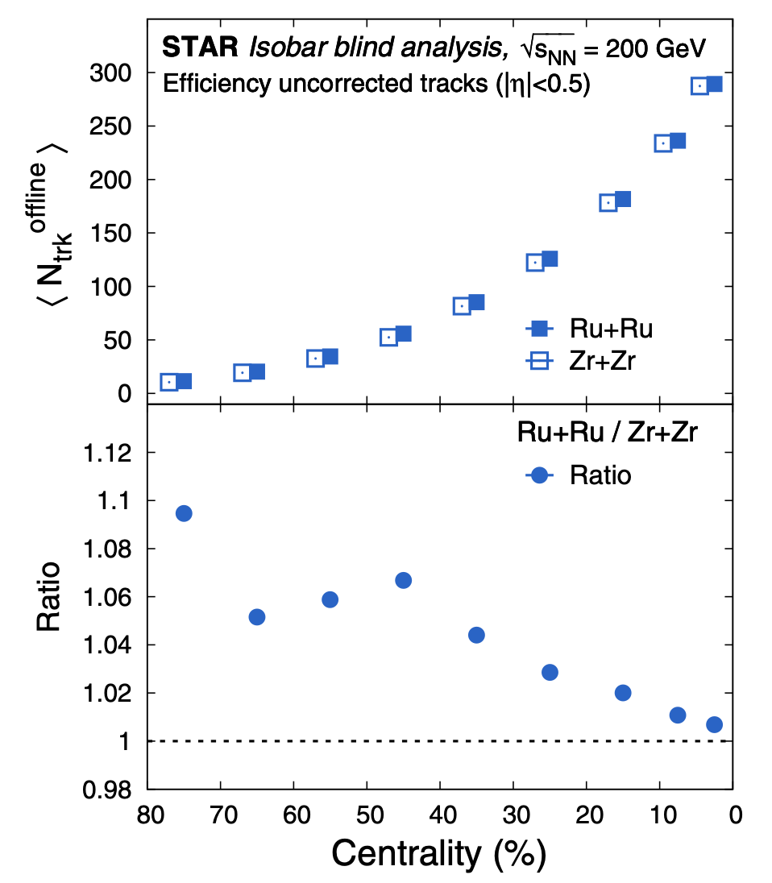
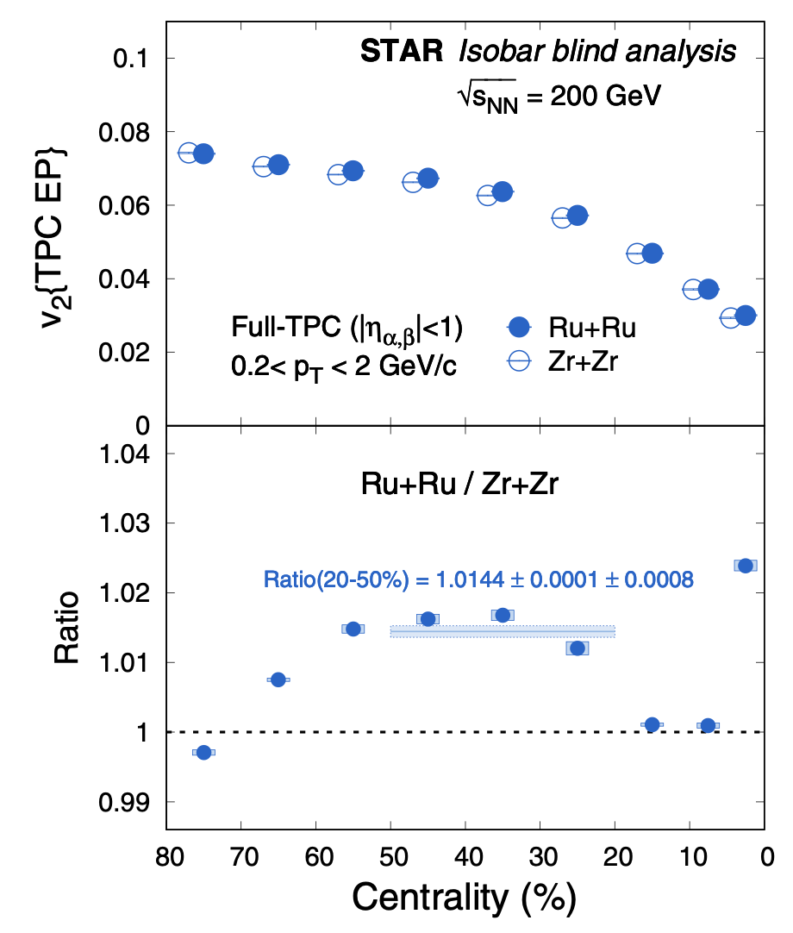
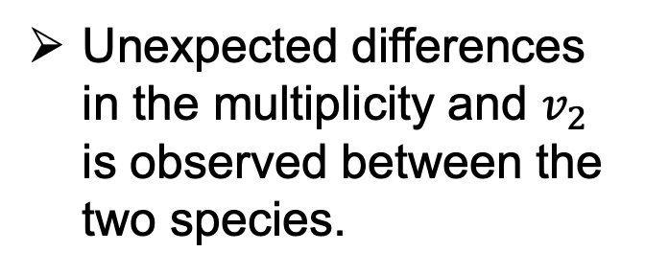
Isobar blind analysis at STAR
STAR Isobar blind analysis, PRC 105, 014901 (2022)
Unexpected differences in the multiplicity and $v_{2}$ is observed between the two species.
Notes:
It’s due to an unexpected the multiplicity and v2 defference,
Differences in the multiplicity and 𝑣_2 is observed between the two species.
If we want to figure out whether there is CME signal difference, the differences should be cancel,
So, an force match is employed to remove these differences
When we moved to the multiplicity and v2, the ratio of the Ru to Zr are clearly not equit to1,
The first blind analysis results from this important experiment were recently released by the STAR Collaboration.
Under the pre-defined assumption of identical background in RuRu and ZrZr, the results are inconsistent with the presence of CME, as well as with all existing theoretical models (whether including CME or not).

Slide 7
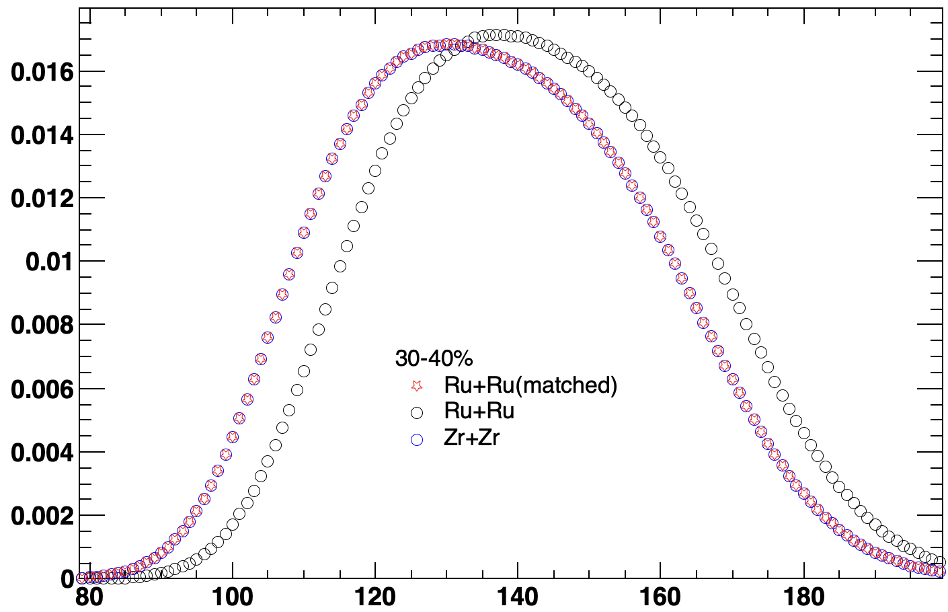


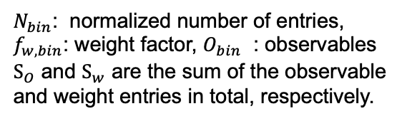



Forced match to remove the backgrounds difference
Keep the Zr+Zr original and then match the Ru+Ru Distribution to Zr+Zr.
$$f_{w, bin}=N_{bin\left(Zr\right)}∕N_{bin\left(Ru\right)}$$
$${\text{S}}_{O}+=O_{bin\left(Ru\right)}∙N_{bin\left(Ru\right)}∙f_{w,bin}$$
$${\text{S}}_{w}+=N_{bin\left(Ru\right)}∙f_{w,bin}$$
$${\text{O}}_{Ru\left(matched\right)}=S_{O}∕S_{w}$$
$N_{bin}$: normalized number of entries,
$f_{w, bin}$: weight factor, $O_{bin}$ : observables
${\text{S}}_{O}$ and ${\text{S}}_{w}$ are the sum of the observable and weight entries in total, respectively.
$$N_{POI}$$
The CME related backgrounds are tuned to be exactly the same with matched.
Notes:
For an distribution can be obtained in two system, for example, the particles of intrrest (POI), their distribution are different as show, Blue and black circle, then an weights can be apply to Ru in corresponding bin, finally we have the red star, which are exactly the identical with the blue circle.
In order to remove the backgrounds difference in two system, a forced matched method is proposal.
, making the interpretation on the ratio between isobar systems straightforward

Slide 8
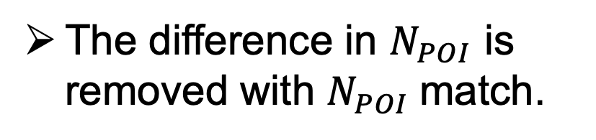
Matching check
The difference in $N_{POI}$ is removed with $N_{POI}$match.
Notes:
open diamond, open square, open circle

Slide 9
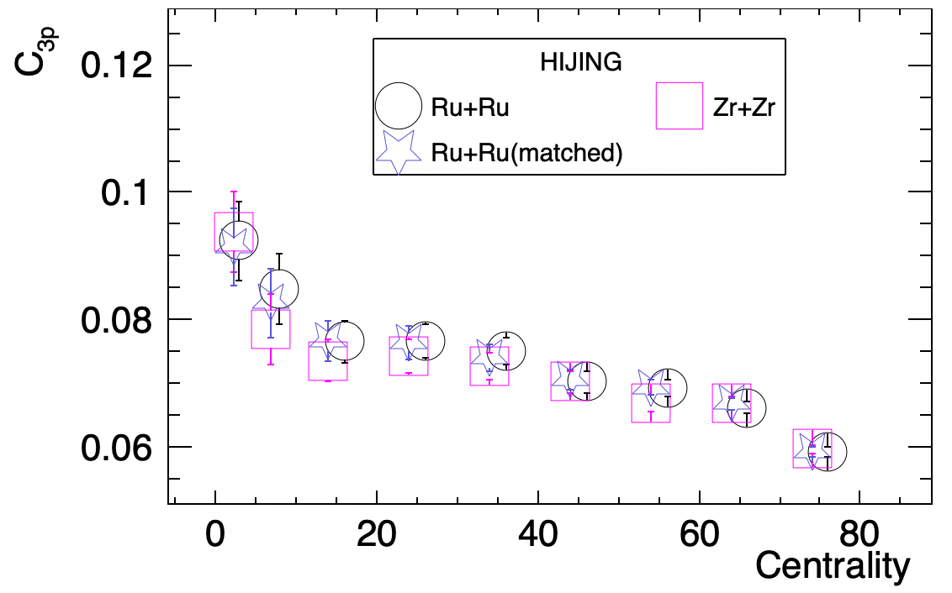
3-particles nonflow effect in forced match with HIJING
$$C_{3p}=N^{2}\left({\left\langle cos\left(φ_{α}+φ_{β}−2φ_{c}\right)\right\rangle }_{3p,OS}−{\left\langle cos\left(φ_{α}+φ_{β}−2φ_{c}\right)\right\rangle }_{3p,SS}\right)$$
Nonflow effect has been cancel with matched.
Yicheng feng, et al. Phys. Rev. C 105, 024913(2022)
The STAR collaboration, arXiv:2310.13096v
Notes:
Heavy Ion Jet INteraction Generator:
which simulates parton-parton hard scatterings based on perturbative QCD and gives a reasonable description of partonic energy loss in the QGP medium (jet quenching).

Slide 10
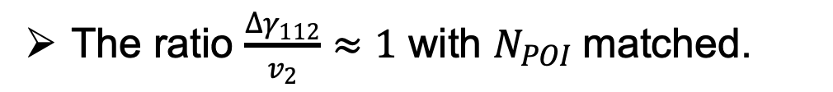
Analysis results: $γ$
𝛄-correlator： Only the $N_{POI}$ as the matching dimension.
The ratio $\frac{{∆γ}_{112}}{v_{2}}≈1$ with $N_{POI}$matched.
Notes:
open diamond, open square, open circle

Slide 11
Analysis results: SBF
SBF: $N_{POI}$, $v_{2}\left(observe\right)$ and $cos\left[2\left(Ψ_{E}−Ψ_{W}\right)\right]$ all as the matching dimensions.
The difference in $N_{POI}$, $v_{2}\left(observe\right)$ and $cos\left[2\left(Ψ_{E}−Ψ_{W}\right)\right]$ are removed.
Notes:
Both POI, v₂(observe) and resolution are applied the same weight factor (bin-by-bin difference between Ru+Ru and Zr+Zr), and the final observables will apply the same factor as well.

Slide 12
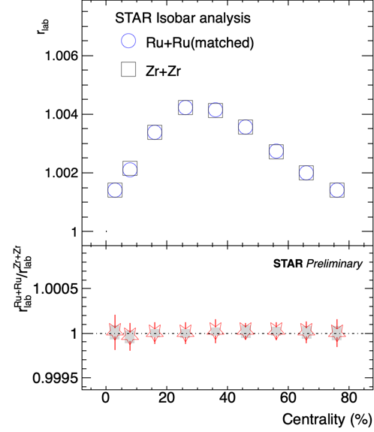
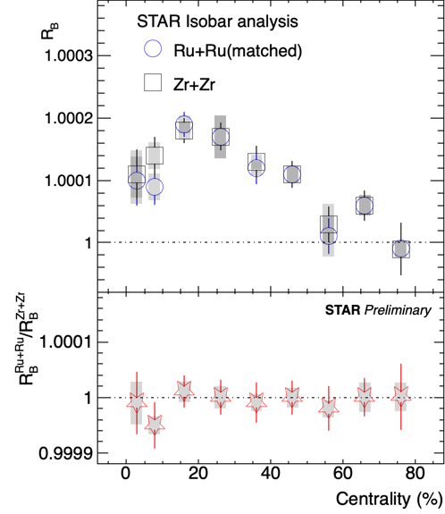
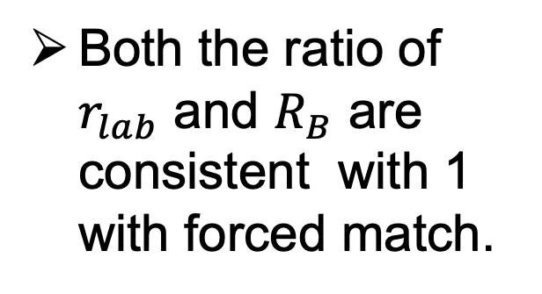
Analysis results: SBF
Both the ratio of $r_{lab}$ and $R_{B}$ are consistent with 1 with forced match.

Slide 13
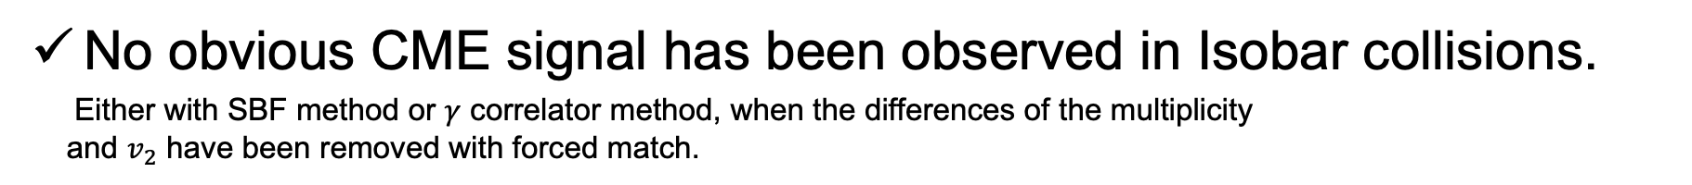
Summary
No obvious CME signal has been observed in Isobar collisions.
Either with SBF method or $γ$ correlator method, when the differences of the multiplicity
and $v_{2}$ have been removed with forced match.
Notes:
No obvious CME signal has been observed in Isobar collisions, either with the SBF method or the 𝛾 correlator method, when the differences in multiplicity and 𝑣_2 have been removed using forced matching.

Slide 14
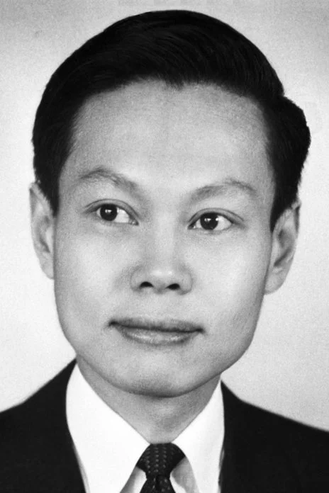

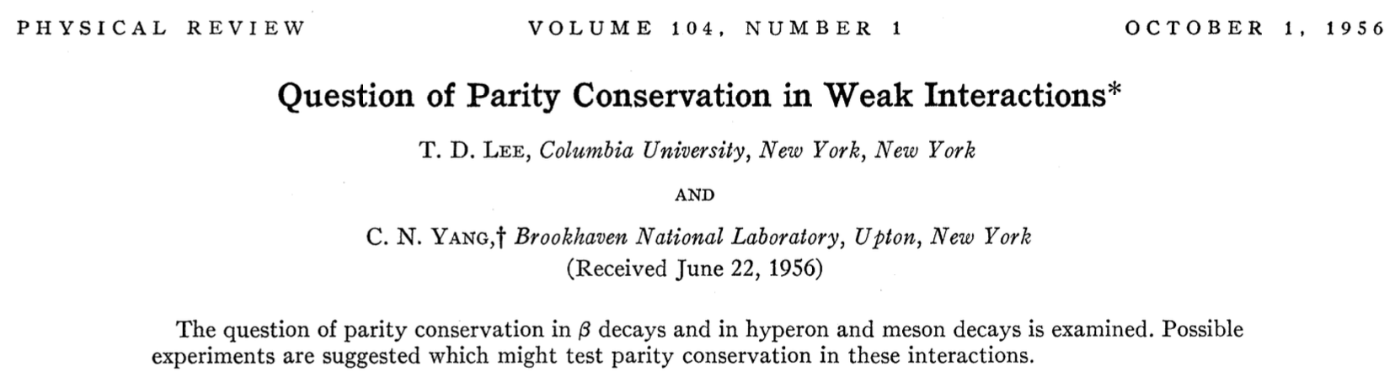
Outlook and good news
RHIC Au+Au: Upcoming large data set 2023~2025, pushing measurements toward high sigma level for a decisive conclusion.
Beam energy scan: Mapping the full range beam energy dependence of CME phenomenon from BES energies.
The Nobel Prize in Physics 1957
Good news: A possible Nobel prize is still there waitting for you.
Notes:
After several years efforts, the Isobar blind analysis was posted by STAR.
This plots shows the blind analysis results, as we can see, the ratio of Ru to Zr from all 5 STAR analysis groups are consistent and less than 1,
Indicating that no pre-defined signature of CME is observed.
So, the question come out, What’s happen to the Isobar collision?
突破性思维。

Slide 15




Scenery of Guilin
The longji yao and zhuang ethnic terrace
龙脊梯田
Sun and Moon Twin Towers
日月双塔
The Peak of Unique Beauty
独秀峰
Elephant Trunk Hill
象鼻山
China Yanrong Geological Museum
七星岩

Slide 16

Scenery of Guilin：Lijiang River and Yangshuo
Discover Guilin!

Slide 17
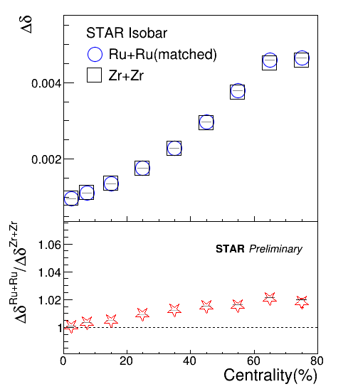
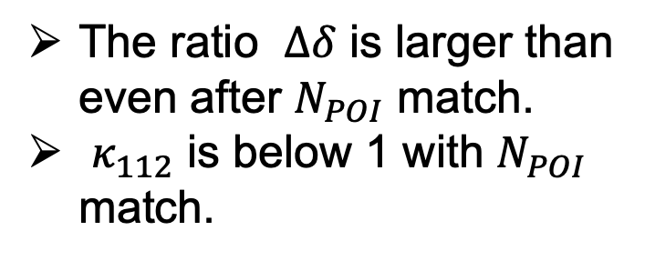
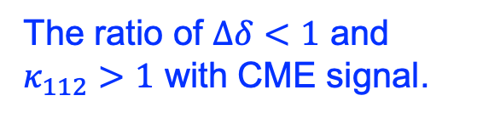
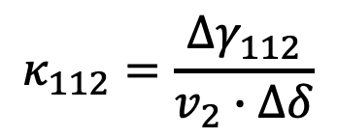
Backup: Analysis results
$$κ_{112}=\frac{{∆γ}_{112}}{v_{2}∙∆δ}$$
The ratio of $∆δ<1$ and $κ_{112}>1$ with CME signal.
The ratio $∆δ$ is larger than even after $N_{POI}$ match.
$κ_{112}$ is below 1 with $N_{POI}$ match.
Notes:
That indicate the fluctuation of POI and v2 have been removed successfully.
So, the POI and v2 fluctuation have been removed.

Slide 18
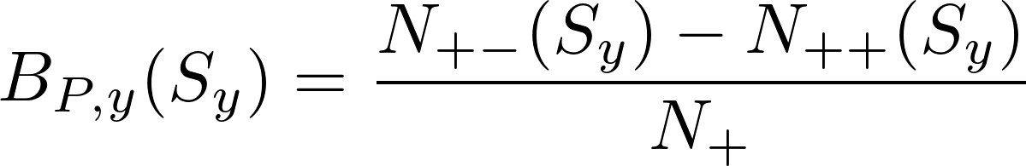
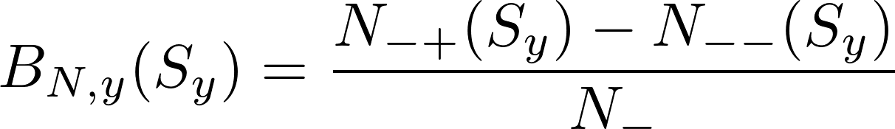
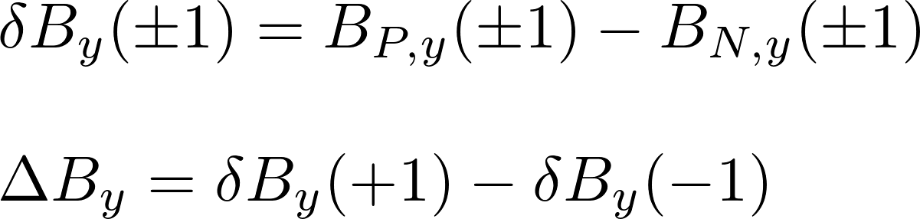
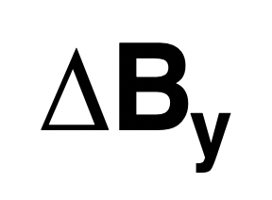
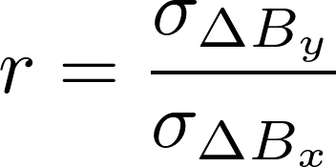
Backup: SBF(1)
1) Count pair’s momentum ordering
in py :
3) Look for enhanced event-by-event fluctuation of net ordering in y direction.
2) Count net-ordering (e.g. excess of pos. leading neg. ) for each event :
Toy model
30-40%
where Nαβ denotes the number of positive -negative pairs with a sign of Sy in an event. Sy is labeled as +1 if p^{α}y > p^{β}y, and -1 if vice versa.
Observable:
(>1 with CME)
Notes:
And then the last steps: Look for enhanced event-by-event fluctuation of net-ordering in y direction.
This picture shows the simulation result of delta B_{y},
Here is the simulation of net-ordering in y delta By, the red color is with CME, with CME the width of the distribution is widen, and blue color without CME,

Slide 19
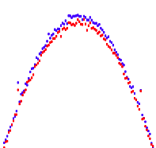
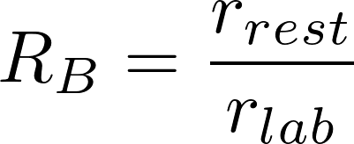
Backup: SBF(2)
y
y
Toy model
P_{α}
P_{β}
30-40%
P_{α}
x
x
P_{β}
Lab frame view
( p_{y}^{α} = p_{y}^{β} )
Rest frame view
( p_{y}^{α} > p_{y}^{β} )
Rest frame has the best sensitivity to momentum ordering.
(>1 with CME)
Observable:
Observable:
Notes:
For the pair of the particles,
if examined with the consideration of azimuthal angle only in lab frame, α is leading β, because α being closer to y-axis than β.
But the reality is the opposite when the same pair is viewed in the pair rest frame.
Due to the signed balance function method need to count the pairs of the particles, rest frame holds the right answer to it.
At this point, r can be calculated in both lab. and pair’s rest frame and the r_{rest} has the best sensitivity for real charge separation. (but not guaranteed so for background)
It's will be useful to calculate their ratio, and the Capital R_{B} should be large than Unity with CME

Slide 20
Backup: Isobar Blind Analysis
Program Advisory Committee Recommendation:
  The PAC strongly recommends that any STAR publication regarding CME observables should contain the result after unblinding and without any additional corrections applied after unblinding that are deemed necessary by STAR. If such additional corrections are needed, then a paper containing both the unblinded and post-unblinded results should be published for reference in papers reporting the isobar data.
NUCL SCI TECH 32, 48 (2021)
Establish all procedures
Act "blindly” on all procedures
Cartoon : P. Tribedy, WWND 2020
STAR implementation: “Rules” for blind analysis
Notes:
For the pair of the particles,
if examined with the consideration of azimuthal angle only in lab frame, α is leading β, because α being closer to y-axis than β.
But the reality is the opposite when the same pair is viewed in the pair rest frame.
Due to the signed balance function method need to count the pairs of the particles, rest frame holds the right answer to it.
At this point, r can be calculated in both lab. and pair’s rest frame and the r_{rest} has the best sensitivity for real charge separation. (but not guaranteed so for background)
It's will be useful to calculate their ratio, and the Capital R_{B} should be large than Unity with CME

Slide 21
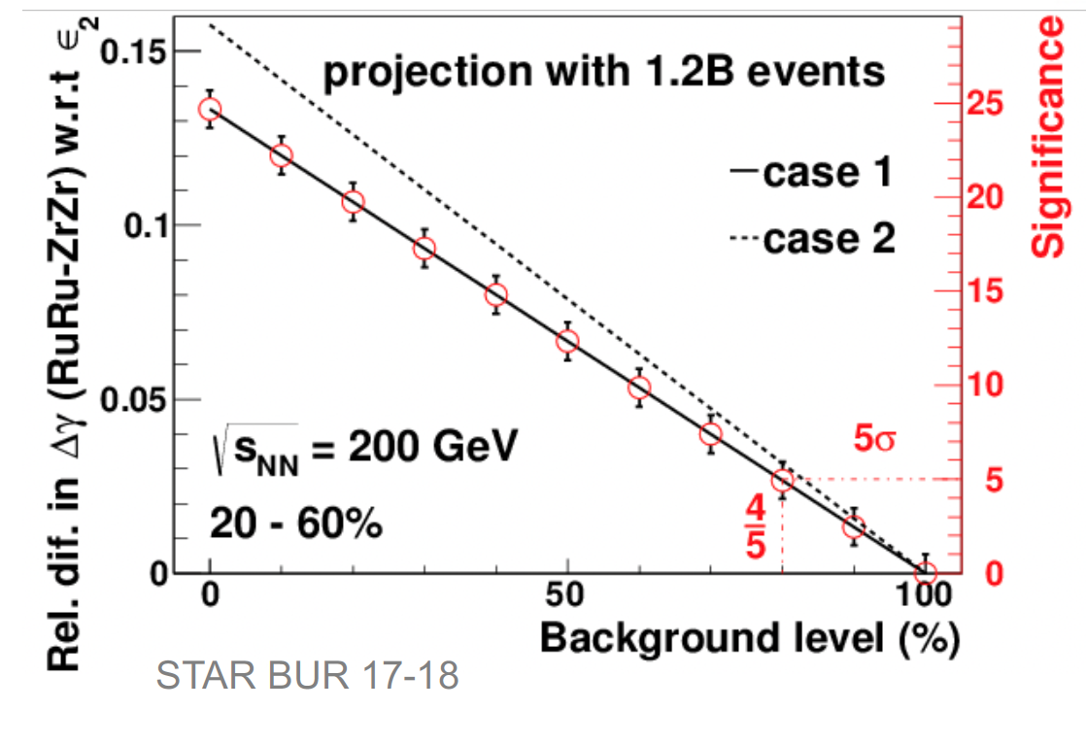
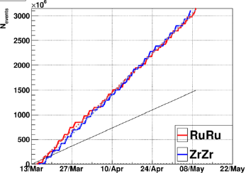

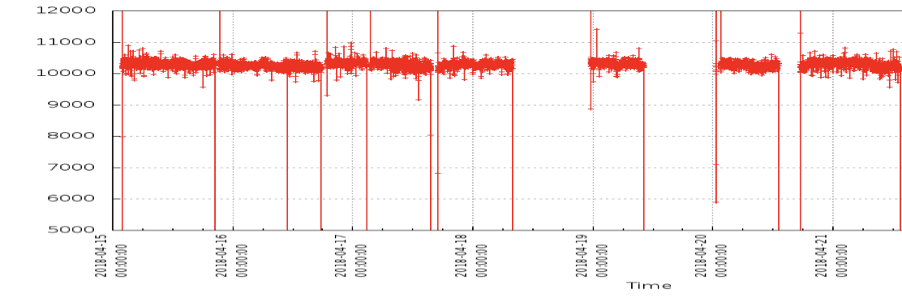
Backup: SBF
Data collected in 2018 RHIC run
Collected (3.1B each)
Requested
J-H Lee for STAR, RHIC/AGS Mtg 2018
Interleaved fills for isobar species to minimize systematic differences
between two species..
Zr
Ru
Zr
Ru
Zr
Ru
Zr
Notes:
For the pair of the particles,
if examined with the consideration of azimuthal angle only in lab frame, α is leading β, because α being closer to y-axis than β.
But the reality is the opposite when the same pair is viewed in the pair rest frame.
Due to the signed balance function method need to count the pairs of the particles, rest frame holds the right answer to it.
At this point, r can be calculated in both lab. and pair’s rest frame and the r_{rest} has the best sensitivity for real charge separation. (but not guaranteed so for background)
It's will be useful to calculate their ratio, and the Capital R_{B} should be large than Unity with CME

