Slide 1
Solutions for the Linear Waves in First-Order Spin Magneto-Hydrodynamics
Reporter: Zhe Fang
Collaborators: Koichi Hattori, Jin Hu
Zhe, Koichi, Jin, arXiv:2402.18601 (2024)
12345071@zju.edu.cn

Slide 2
Outline
Background
Perturbation Method in MHD
Solutions for MHD
Solutions for Spin-MHD
Conclusion

Slide 3
Background

Slide 4
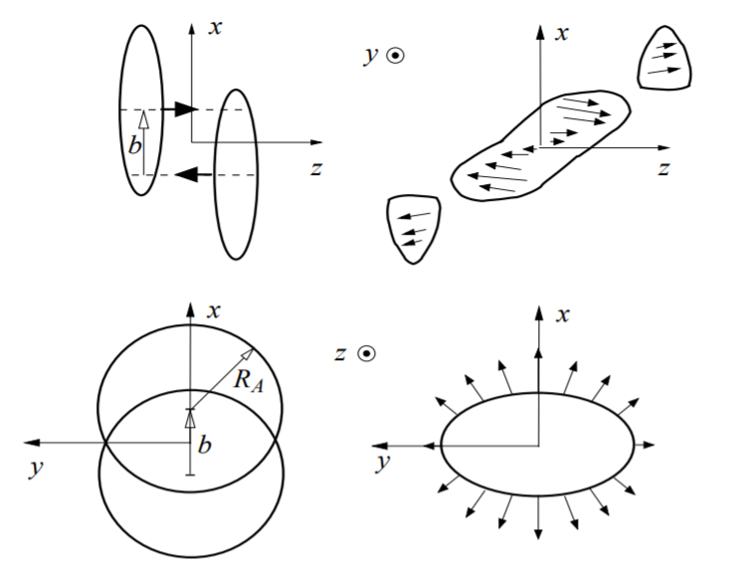
Background
Magnetic field and spin in Quark gluon plasma
QGP is created in the heavy-ion collision in experiment. If the collision is non-central, there will be a large vorticity in the QGP.
The vorticity may result in a magnetic field in non-central collision, which inspired the investigation of relativistic magnetic hydrodynamics (MHD) in high energy physics.
Armas, et al. arXiv:2201.06847 (2022)
Grozdanov, et al. arXiv:1610.07392 (2016)
Hongo, et al. arXiv:2107.14231 (2021)
Figure 1: non-central collision of heavy ion
Liang-Wang, et al. arXiv:0410079 (2004)

Slide 5
Background
Previous works
The solution for leading order MHD at arbitrary angle is already obtained. (where angle means the angle between the orient of magnetic field and the wave vector. )
The solution for first order MHD at two specific angle 𝜃=0 and 𝜋/2 have already been calculated. However, the solution at 𝜋/2 are inconsistent.
Biswas, et al. arXiv:2007.05431 (2020)
Grozdanov, et al. arXiv:1610.07392 (2017)
Armas, et al. arXiv:2201.06847 (2022)
Kovtun, et al. arxiv:1703.08757(2017)

Slide 6
Perturbation Method in MHD

Slide 7
Result of MHD
Conservation laws and Constitutive equation
The MHD stems from the conservation law for the energy-momentum tensor and magnetic flux
Conserved current can be expressed with conserved charges and thermodynamic variable
By expanding the conserved current to certain order and using linear mode analysis, one obtain the equations for the system.

Slide 8
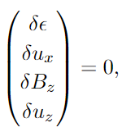
Result of MHD
Linear mode analysis
We consider a perturbation around the equilibrium state, so the thermodynamic variables have a small shift from the value at equilibrium state:
equilibrium state:
The equations for leading order MHD reads

Slide 9
Result of MHD
First order MHD
To derive the equations up to $k^{2}$ order, we need to write down the expansion of $Θ_{(1)}^{μν}$ and $F_{(1)}^{μν}$:
The second order terms in the coefficient matrix read:
The form becomes a little complex for first order MHD, but it can still be diagonalized into a 2*2 matrix and a 4*4 matrix.

Slide 10
Solution for First-order MHD

Slide 11
Result of MHD
Algorithm for Solution Search
The solution for the 2*2 equations is already obtained as
As for the 4*4 part, the solution should be propagating at leading order, and damping at next to leading order, so we get another form of the solution as
By comparing the terms of order $ω^{i}k^{j}$ with $\det\left(M_{0}^{\left(4\right)}+M_{1}^{\left(4\right)}\right)$, we can get the coefficient $w_{i}$, which is just the coefficient for $k^{2}$ order.

Slide 12
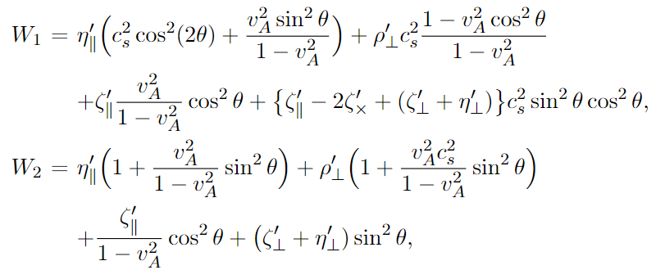
Result of MHD
Solutions for the Quartic Equation
This result is consistent with Kovtun’s work (arXiv: 1703.08757) at 𝜋/2 limit , but is inconsistent with Armas’s work (2201.06847)

Slide 13
Result of MHD
Solution at $θ=\frac{π}{2}$
Equations at $\frac{π}{2}$ limit:

Slide 14
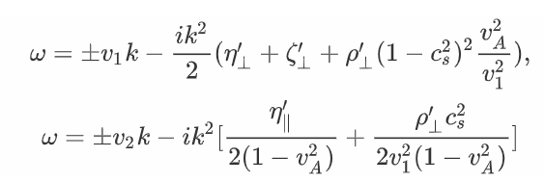
Result of MHD
Comparing the Solution with previous one
Solution for$θ=\frac{π}{2}$:
(Take $θ⟶\frac{π}{2}$ before expand the solution)
(Take limit $θ⟶\frac{π}{2}$ for solution up to $k^{2}$ order)

Slide 15
An issue in MHD
Explaining for the non-commutable
The limit $\frac{π}{2}$ is different from previous works. We conclude that the difference stems from the non-analytical point near the point $k=0,cos=0$.
At $k=0, cos=0$, dispersion relation is non-analytical.
If we assume that $k$ is much smaller than $cos θ⁡$, we can obtain the dispersion relation as
The cos appear in the denominator in the higher order. Thus if we take cos to 0, we will suffer from an infinity in higher order.

Slide 16
An issue in MHD
Valid Expansion at $\frac{π}{2}$ limit
Since we are consider the limit $cos θ⟶0$, we assume that $k$ is non-zero and use a cos expansion. The leading order should be the result we got at $θ=\frac{π}{2}$. The expansion reads
The $k$ will appear in the denominator in higher order expansion, but if cos is much smaller than $k$, the effective of the higher order will be depressed. On the other hand, this expansion is valid only when cos is smaller than $k$.

Slide 17
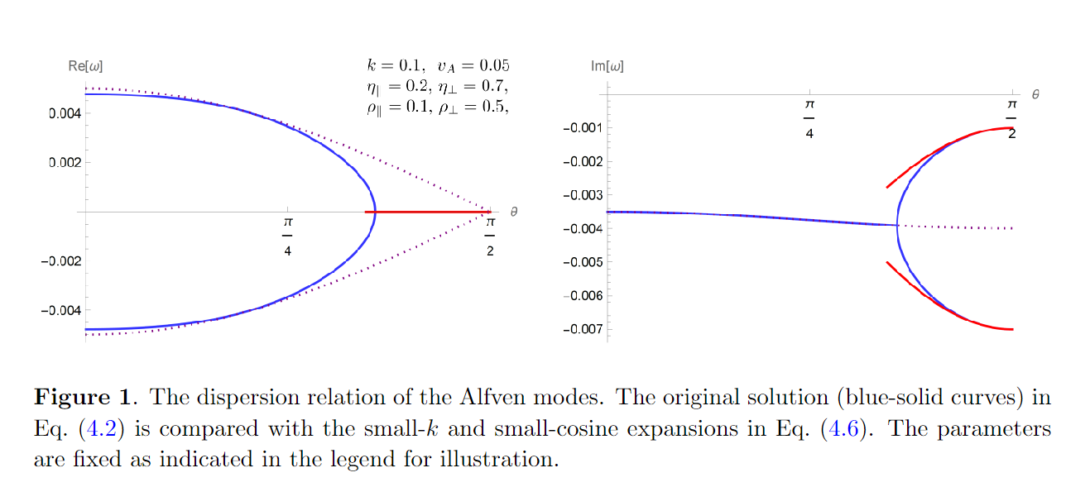
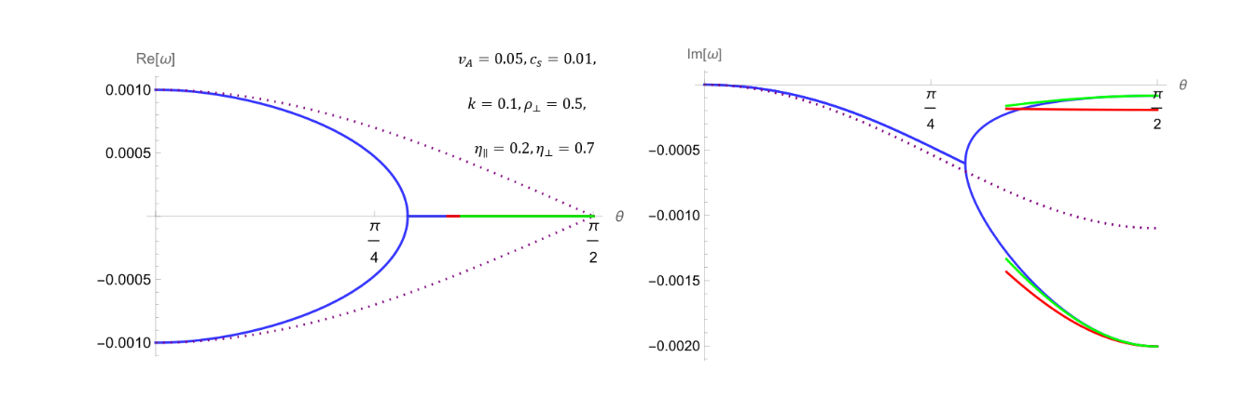
An issue in MHD
Illustration for Different Expansion
Let’s compare these expansions with the analytic result
One can notice that the k expansion correspond well with the analytic solution before the critical point.

Slide 18
Stability
Stability of the solution
We noticed that the solution is always damping in the second order. The stability at the two boundary are easy to check. For the general solution, we use the following restrictions for the transport coefficient and check the stability term by term.
Zhe, Koichi, Jin, arXiv:2402.18601 (2024)

Slide 19
Solution for spin-MHD
12345071@zju.edu.cn

Slide 20
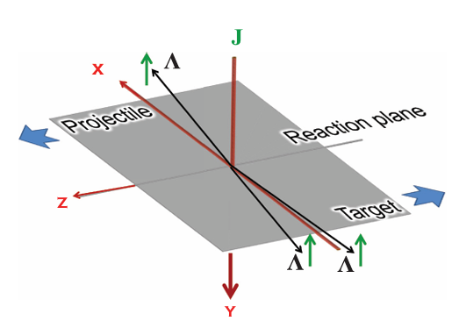
Background
Spin polarization in QGP
The obit angular momentum in QGP can exchange with spin and cause the spin polarization. Recently, it draw a lot of interest to study the QGP system with both magnetic field and spin.
Experimentally, $Λ$ hyperons is a typical probe to detect the polarization in QGP
Kiamari, et al. arXiv:2310.01874 (2023)
Bhadury, et al. arXiv:2204.01357 (2022)
F. Becattini, et al. PHYSICAL REVIEWC88,034905 (2013)

Slide 21
Result of spin-MHD
Constitutive equation for spin-MHD
In the last part, we reviewed the basic approaches for hydro and derived the dispersion relation for the first order MHD, and we discussed when the $k$ expansion is valid. Then let’s step forward to the spin-MHD.
In spin-MHD, the total angular momentum is to be considered
or it can be cast into another form
This equation indicates there is no symmetry that guarantees the conservation of spin in relativistic systems.

Slide 22
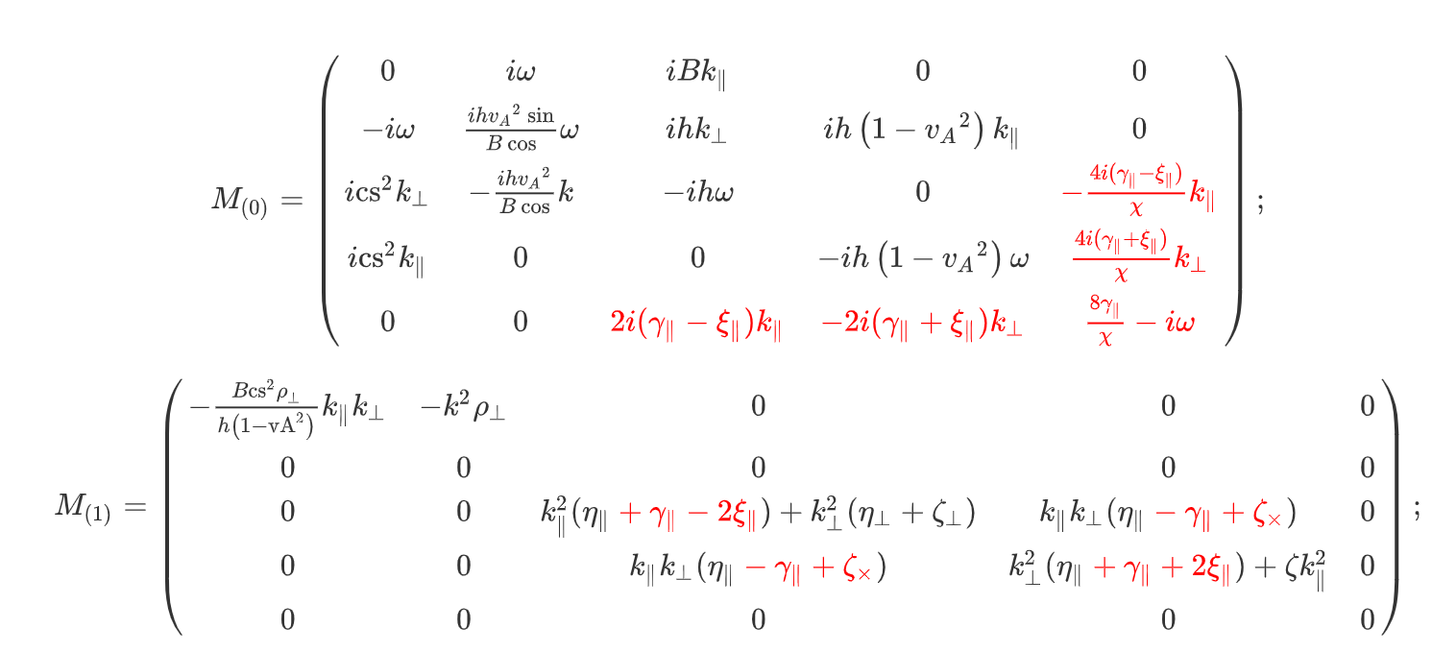
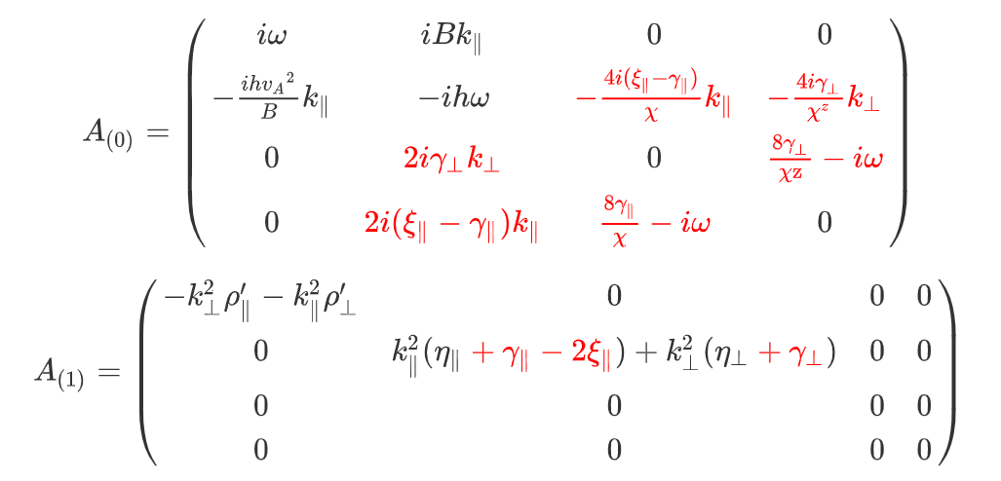
Result of spin-MHD
Equations for spin-MHD
We will have an quartic equation and a quantic equation in spin-MHD, but the method is almost the same with MHD. The coefficient matrix for spin-MHD is obtained as

Slide 23
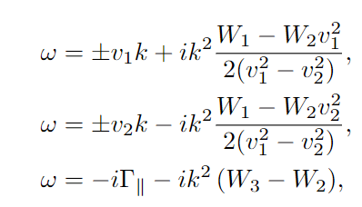
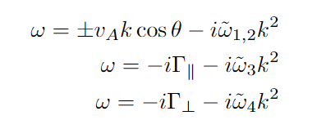
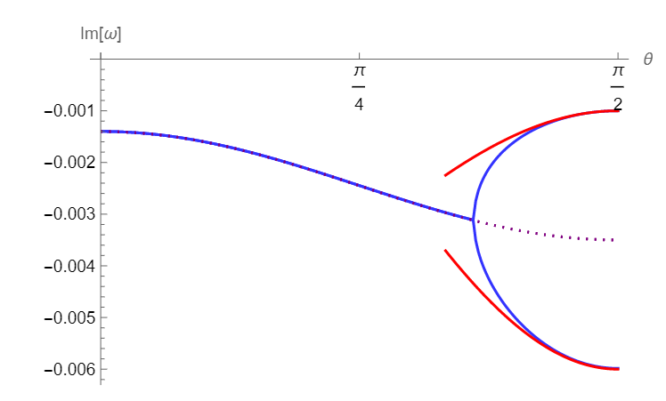
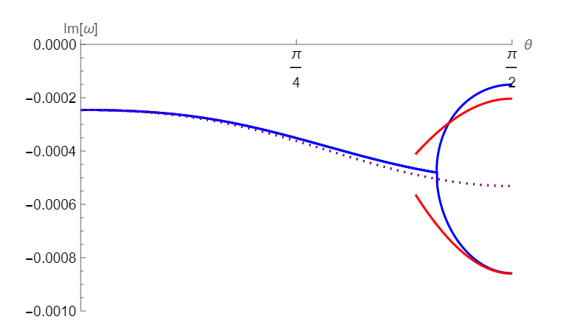
Result of spin-MHD
Solution for first order Spin-MHD
The solutions we obtained are
The same issue arise when we consider the $θ⟶\frac{π}{2}$ limit. So the result of k expansion is valid only when $cos θ⁡$ is not too small

Slide 24
Result of spin-MHD
Stability in Spin-MHD
If we compare the six propagating modes with MHD, we noticed that the only difference is that $η_{∥}$ is replaced with $η_{∥}−\frac{ξ_{∥}^{2}}{γ_{∥}}$. Since we have got $η_{∥}−\frac{ξ_{∥}^{2}}{γ_{∥}}>0$ with entropy current method and have proved that the solution of MHD is stable, it is easy to conclude that the spin-MHD is also stable.

Slide 25
Summary
Summary:
We have got the formulation for first order spin magneto- hydrodynamics
We got the solution for first order MHD and spin-MHD for an anisotropic case.
We faced a challenge when we take the limit to $\frac{π}{2}$, and we realized it stems from the expansion at an inappropriate point.

Slide 26
Thanks

Slide 27
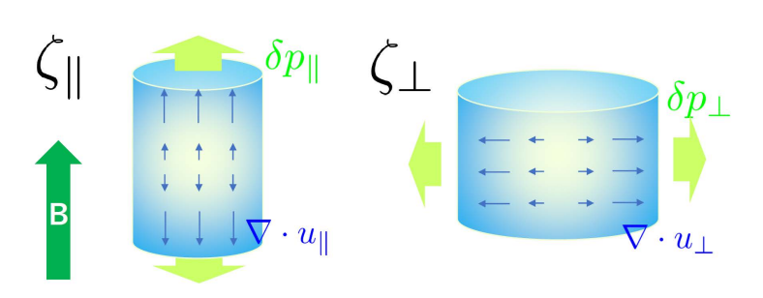
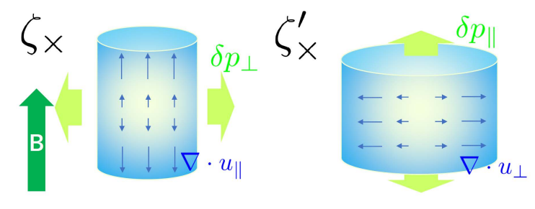
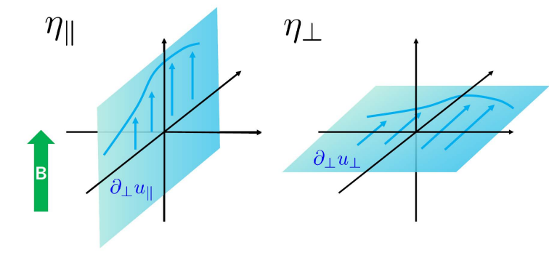
Back up
Transport coefficient

Slide 28
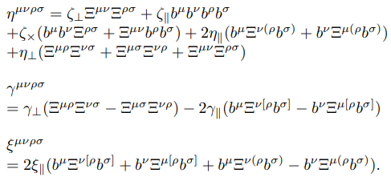
Back up
General form for spin-MHD in first order
These are the general form of the first order. One can found the similar term in the paper [10,Cao,2022].

Slide 29
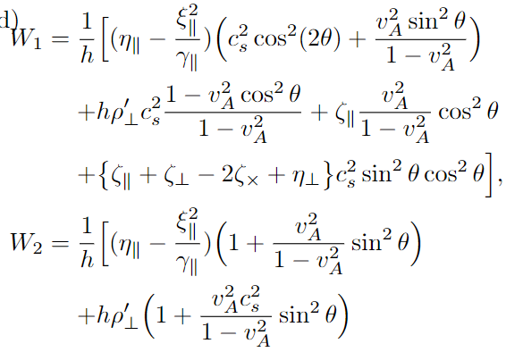
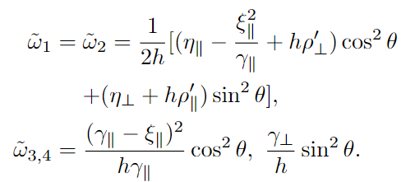
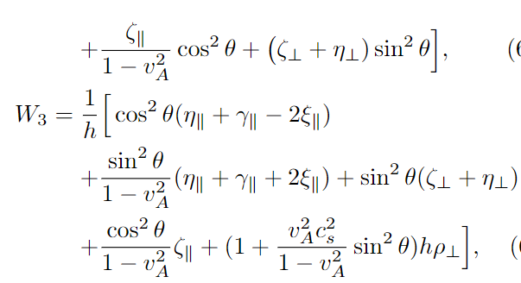
Back up
The solutions we obtained are

