Slide 1



Spicy Gluons@HeFei May 16, 2024
Dilepton Enhancement with First-order Chiral Phase Transition
Wen-Hao Zhou (周文豪)
Email: zhouwenhao@xaau.edu.cn

Slide 2
Spicy Gluons@HeFei May 16, 2024
Outline
1. Backgrounds and Motivation
2. Transport approach to the first order chiral phase transition
3. Enhanced dilepton productions
4. Summary and outlook

Slide 3
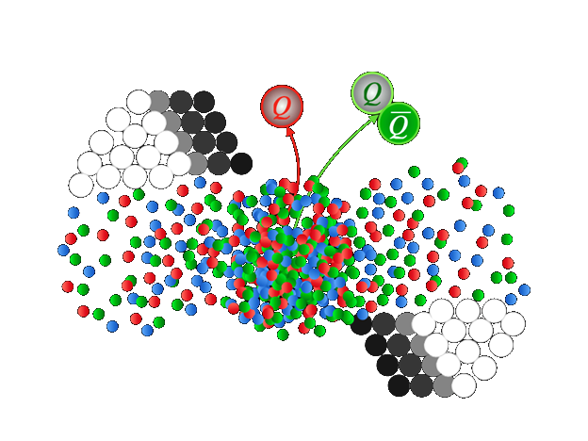
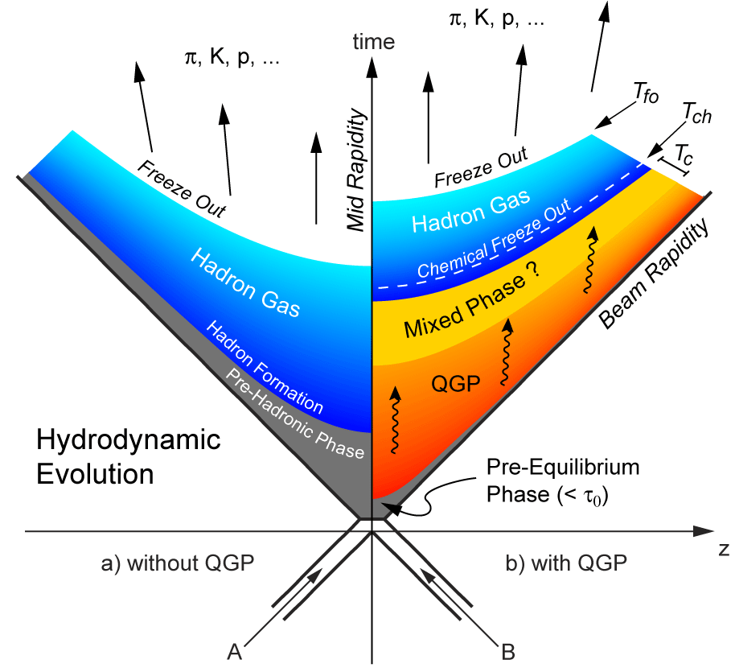
Spicy Gluons@HeFei May 16, 2024
Backgrounds
Phase diagram
1

Slide 4
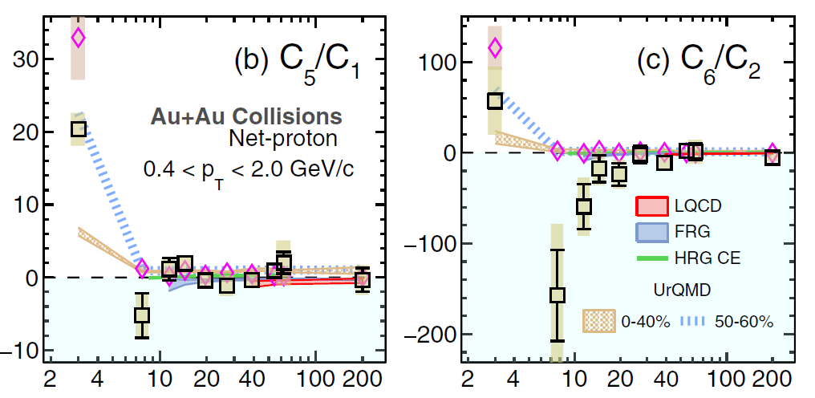
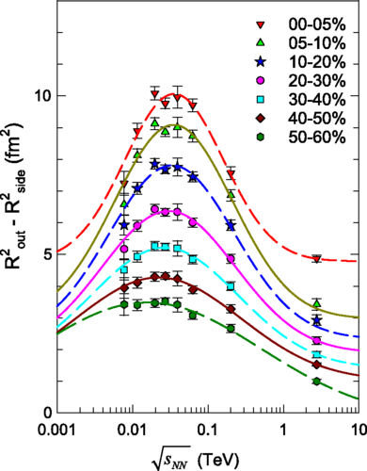
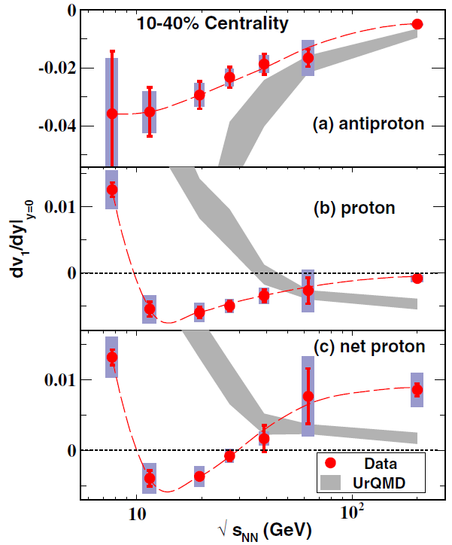

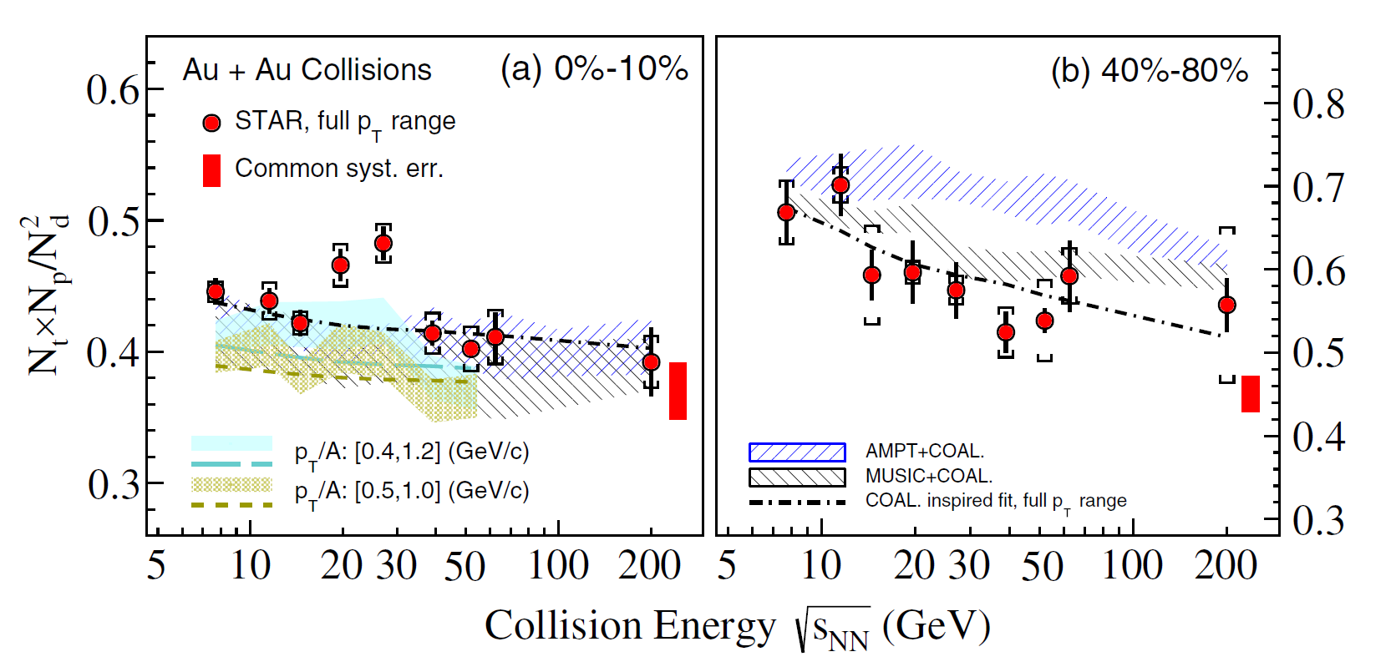
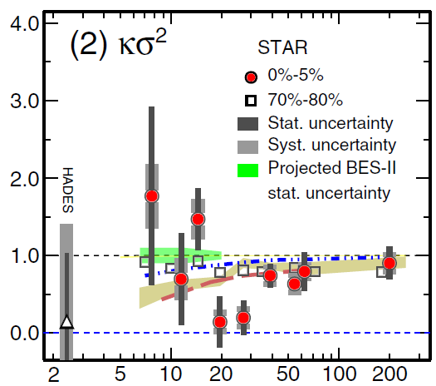
Spicy Gluons@HeFei May 16, 2024
Backgrounds
R. A. Lacey, PRL 114, 142301 (2015).
STAR, PRL 130, 082301 (2023).
STAR, PRL 112, 162301 (2014).
Non-monotonic behaviors as function of beam energies.
STAR, PRL 130, 202301 (2023).
STAR, PRL 126, 092301 (2021).
2

Slide 5
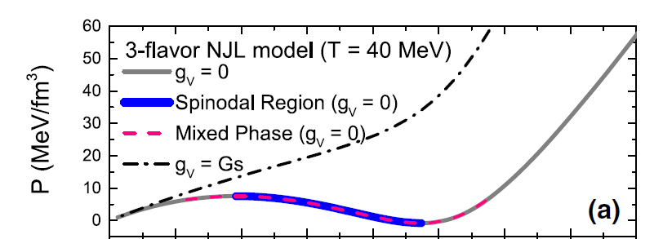
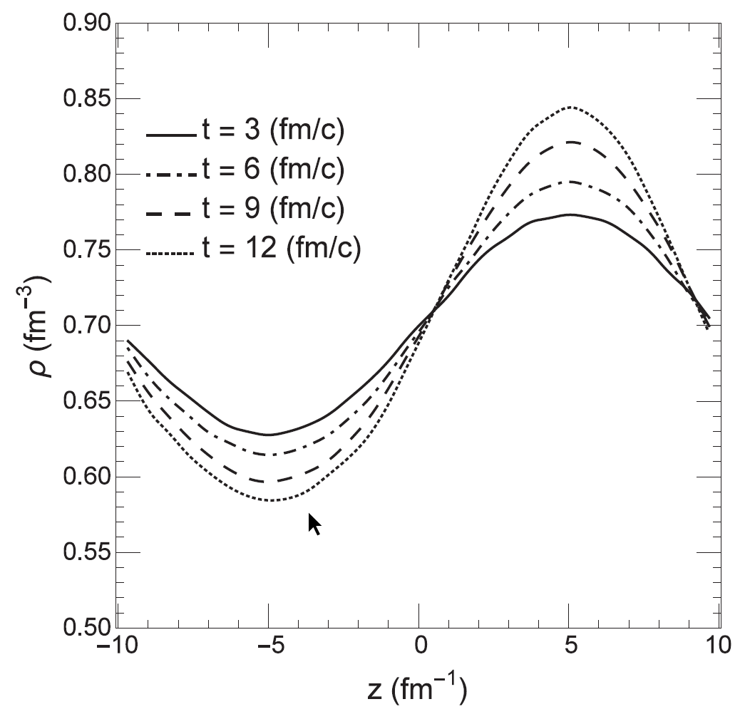
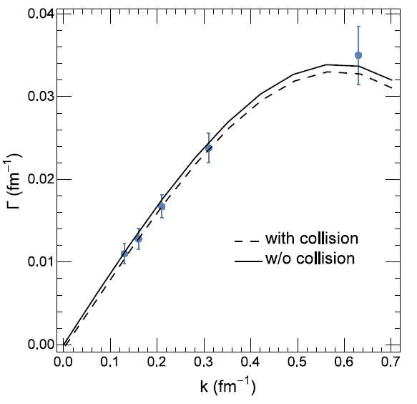
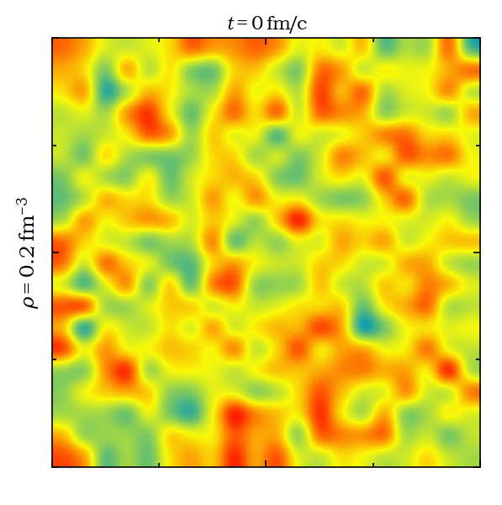

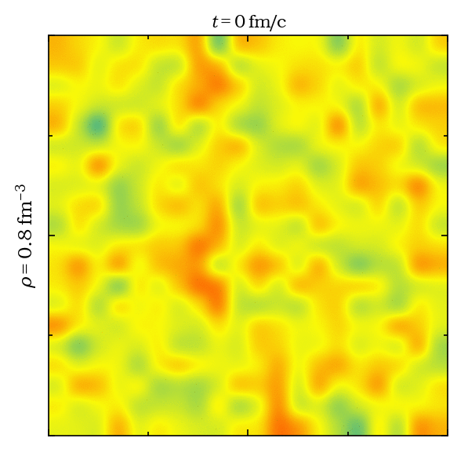
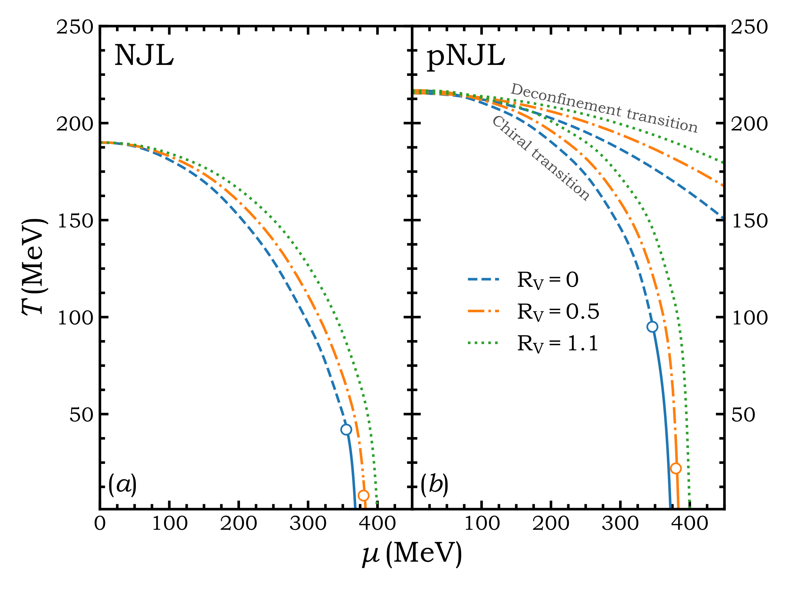
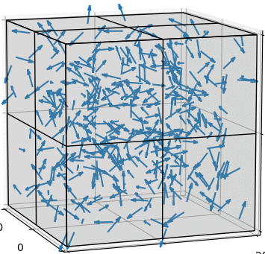
Spicy Gluons@HeFei May 16, 2024
Spinodal instability
Density fluctuation is enhanced in spinodal region.
Out of Spinodal
1
In Spinodal
F. Li and C. M. Ko, Phys. Rev. C 95, 055203 (2017).
Low
Initial
High
2
1
2
The phase separation in the phase diagram.
K.-J Sun, C. M. Ko, J. Xu, F. Li, C.-L. Chen, Eur. Phys. J. A 57, 313 (2021).
W.-H Zhou and J. Xu, Phys. Rev. C 104. 044901 (2021).
3

Slide 6
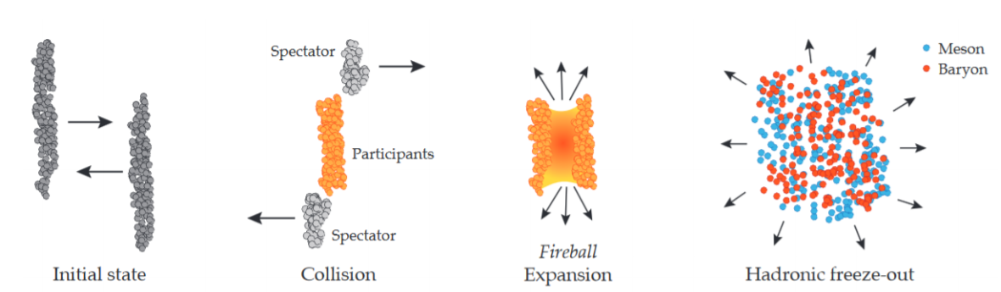
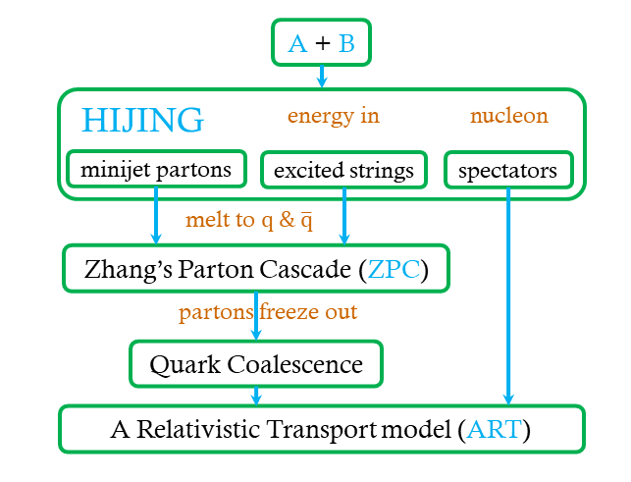
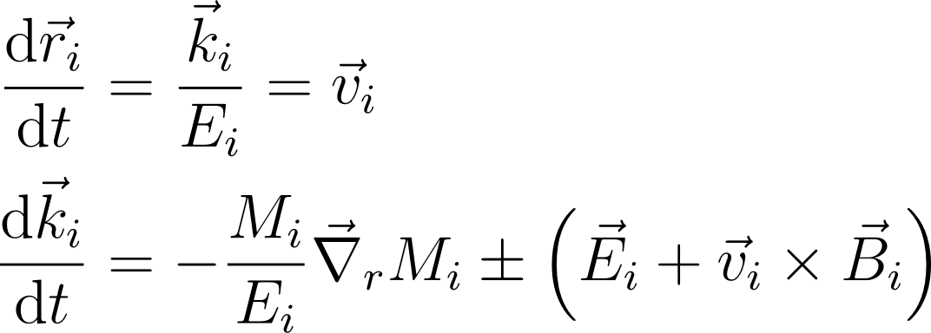
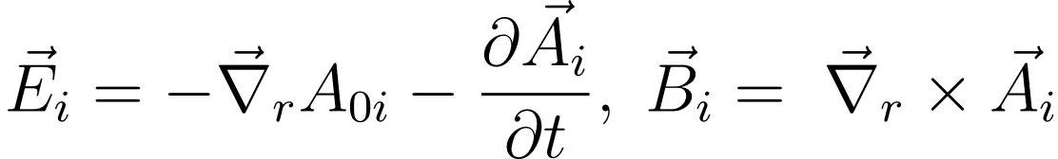

Spicy Gluons@HeFei May 16, 2024
Extended AMPT model
EOMs
Parton Transport with Nambu-Jona-Lasinio (NJL) model
Nucleon Coalescence
String Melting-AMPT
To replace ZPC model with NJL model.
Z.-W. Lin, C. M. Ko, B.-A. Li, B. Zhang, S. Pal, Phys. Rev. C 72, 064901 (2005).
4

Slide 7
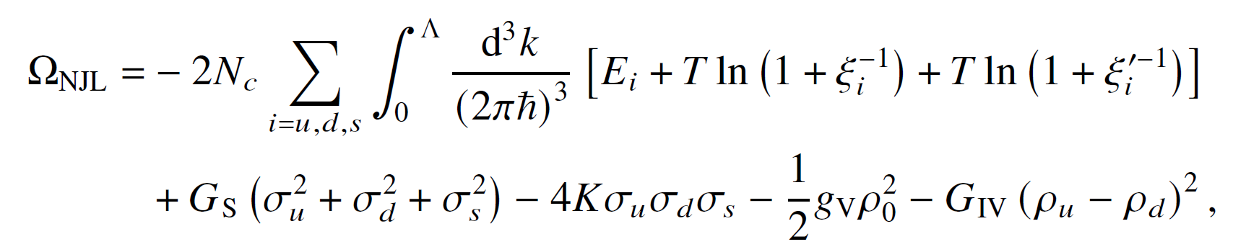
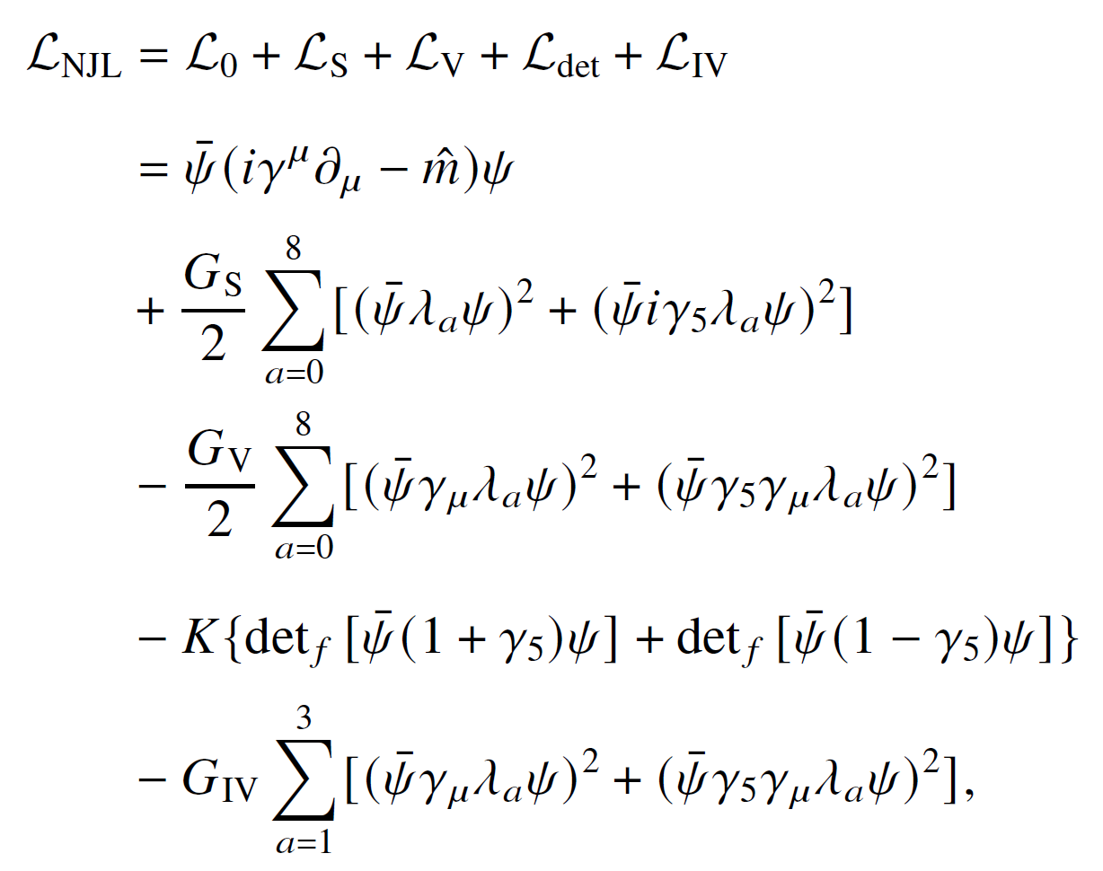
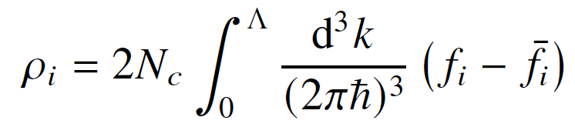
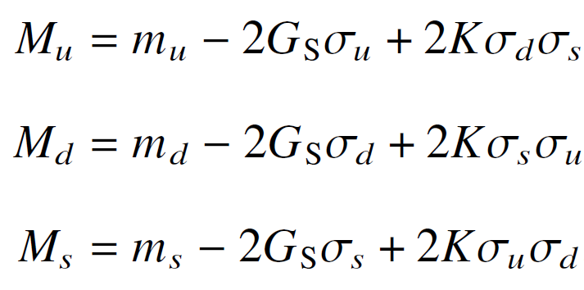
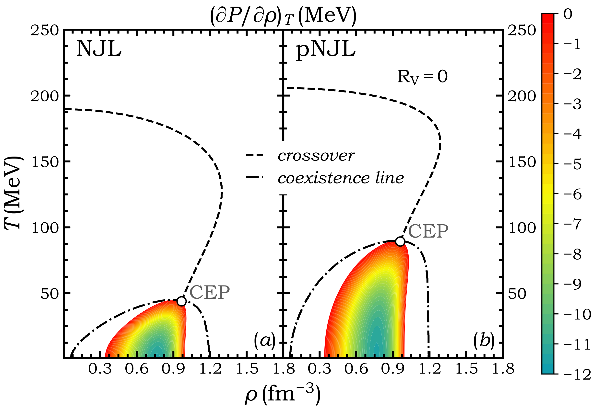
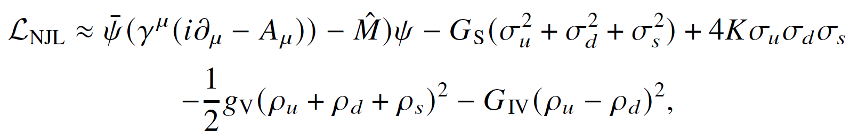
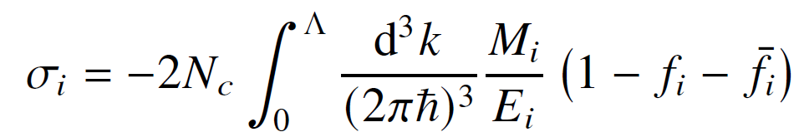
Spicy Gluons@HeFei May 16, 2024
NJL model
Thermodynamics
Quark densities
FTFT
scalar
pseudo-scalar
Quark masses
vector
pseudo-vector
KMT interaction
Mean field approximation
Quark condensates
Y. Nambu and G. Jona-Lasinio, Rhys. Rep. 122, 235 (1961); 124, 246 (1961).
5

Slide 8
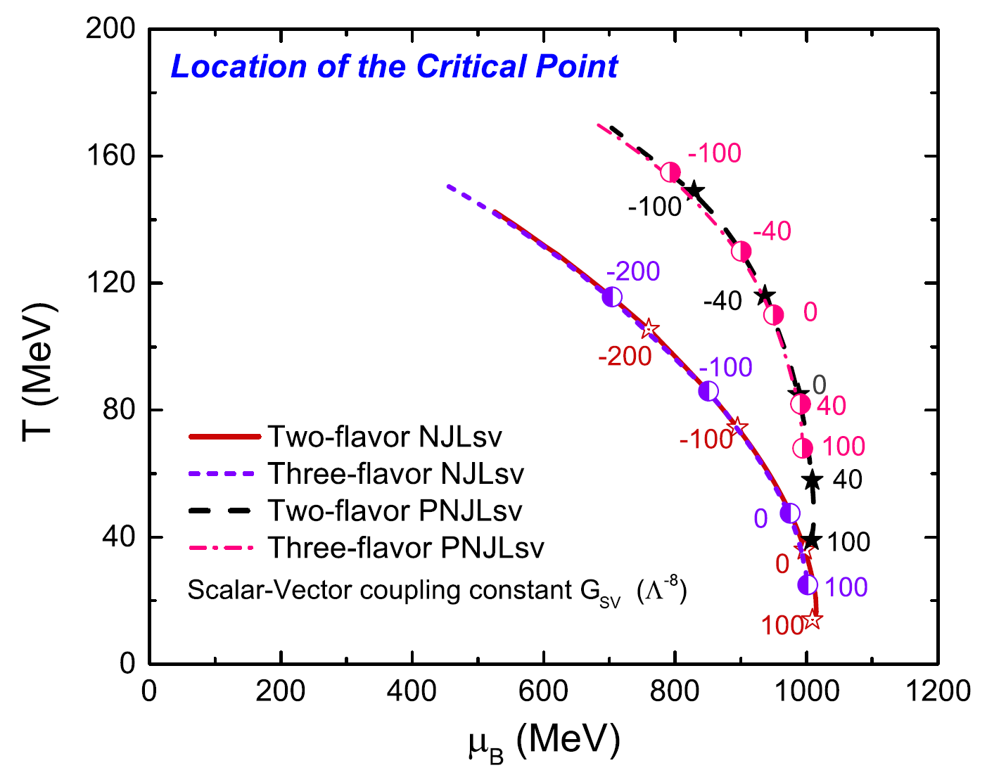
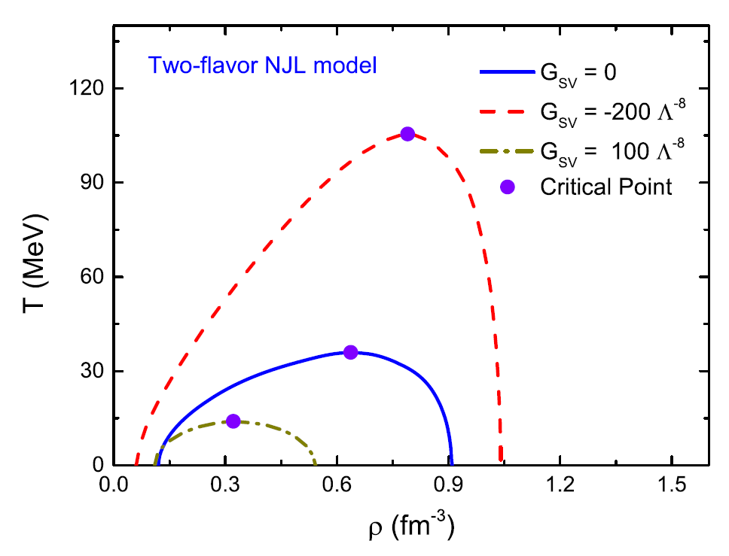
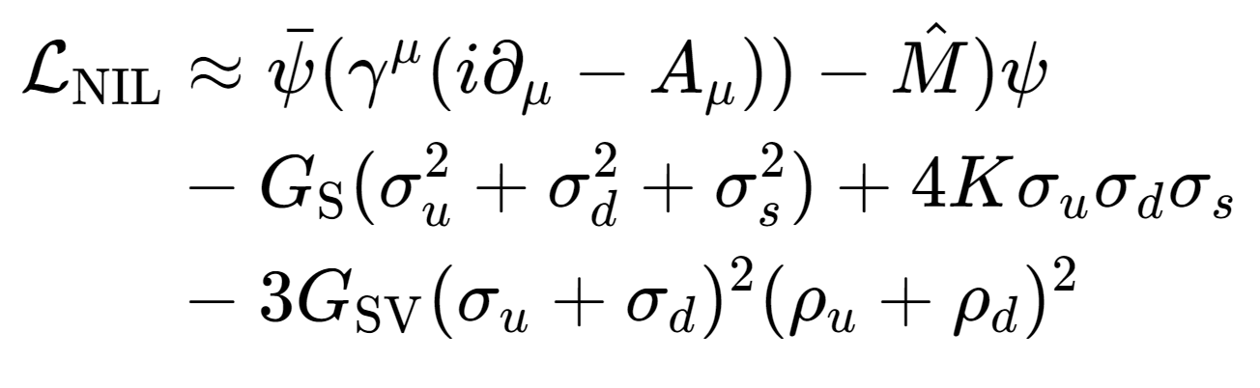
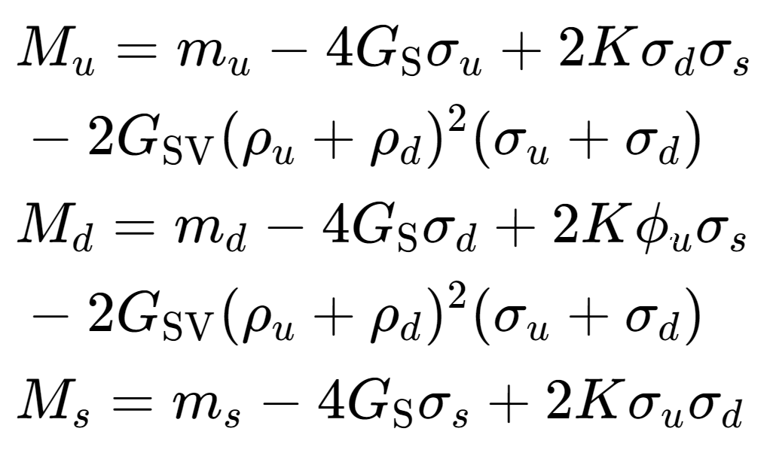
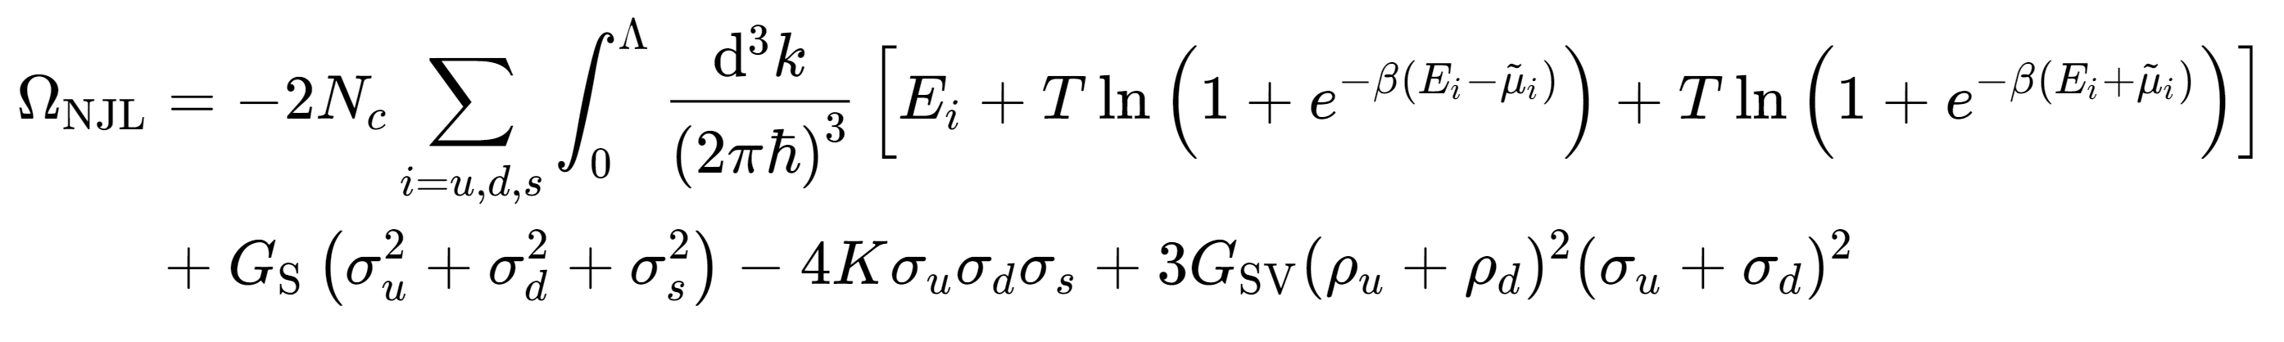
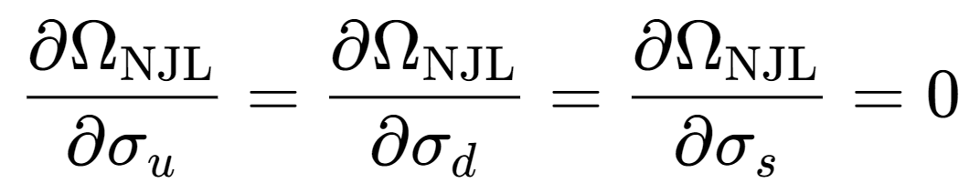
Spicy Gluons@HeFei May 16, 2024
Equation of state
K.-J. Sun, C. M. Ko, S. S. Cao, F. Li, Phys. Rev. D 103, 014006 (2021).
Finite negative $G_{SV}$ term can obtain higher critical point temperature and bigger area of spinodal region.
6

Slide 9
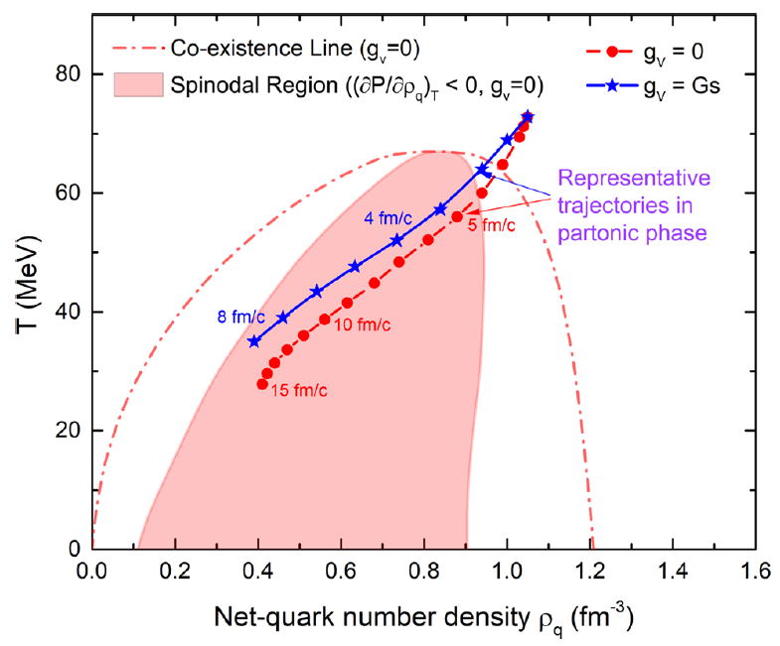
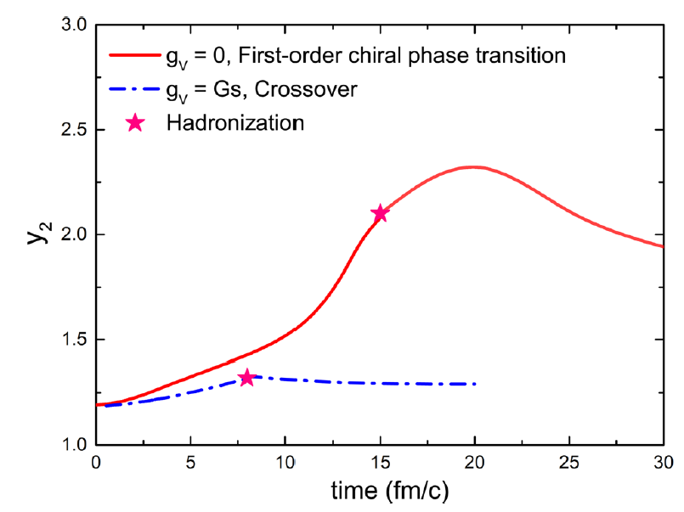
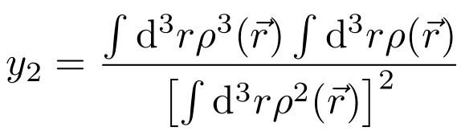
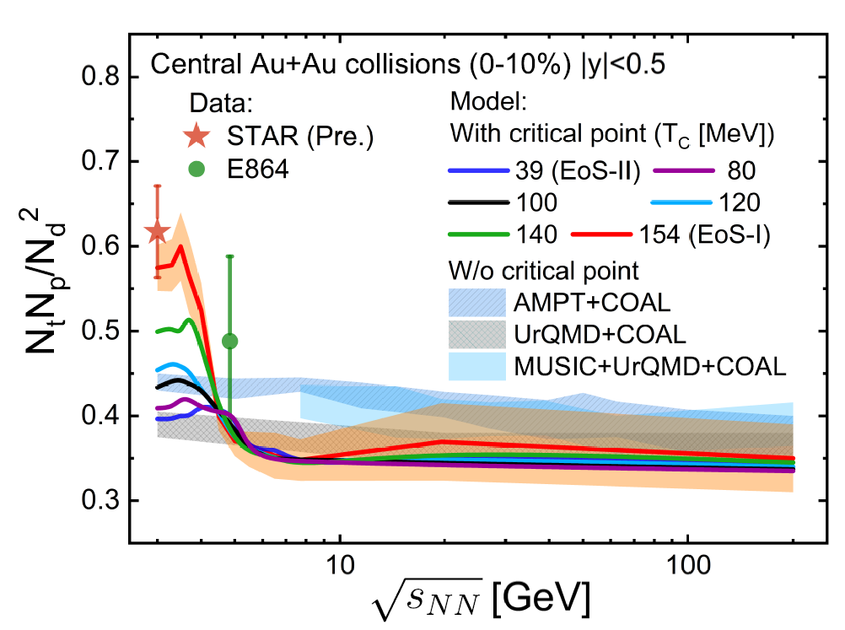

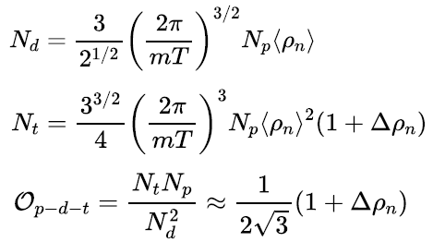


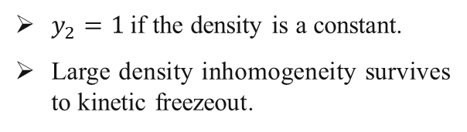
Spicy Gluons@HeFei May 16, 2024
Light nuclei yield ratio
Second-order scaled density moment
$y_{2}=1$if the density is a constant.
Large density inhomogeneity survives to kinetic freezeout.
K.-J Sun, C. M. Ko, J. Xu, F. Li, C.-L. Chen, Eur. Phys. J. A 57, 313 (2021).
The longer system stay in spinodal region, the bigger the fluctuations system can get.
The light nuclei yield is enhanced in EoS-I.
K.-J. Sun, L. W. Chen, C. M. Ko, Z. Xu, Phys. Lett. B 774, 103 (2017).
arXiv:2205.11010.
7

Slide 10
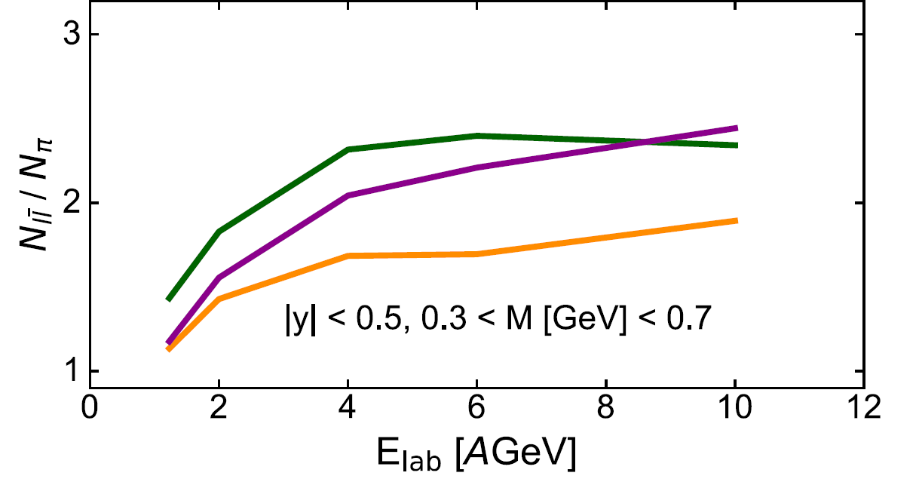
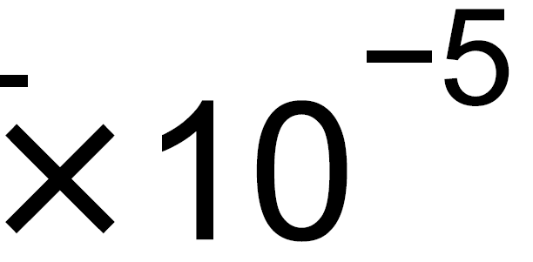
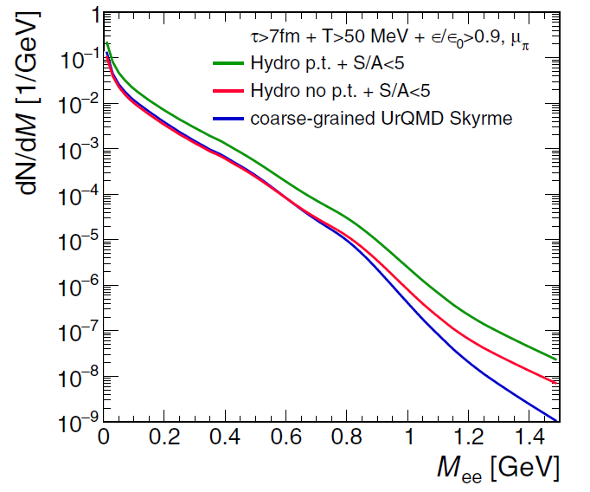
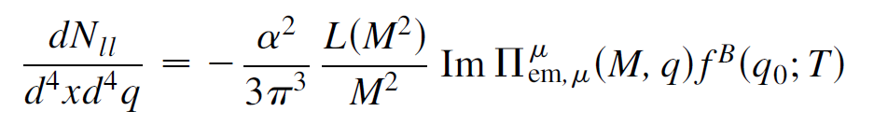
Spicy Gluons@HeFei May 16, 2024
Dilepton production
Why dilepton?
first-order
Dilepton and photon productions are not affected by strong force and emitted continuously at all stages of evolution.
Hadronic rescatterings tend to wash out the information from the EoS-driven expansion i.e. spinodal decomposition.
EM radiation may be sensitive to a local density clumping and a longer lifetime of the fireball when the medium undergoes a first-order phase transition.
The dilepton production rate is proportional to the square of parton density, more dileptons are produced when the density fluctuation is large.
crossover
O. Savchuk, et. al., J. Phys. G: Nucl. Part. Phys. 50, 125104 (2023).
F. Seck et. al., Phys. Rev. C 106, 014904 (2022).
R. Rapp and H. van Hees, Phys. Lett. B 753, 586 (2016).
crossover
first-order
F. Li and C. M. Ko, Phys. Rev. C 95, 055203 (2017).
F. Seck et. al., Phys. Rev. C 106, 014904 (2022).
8

Slide 11
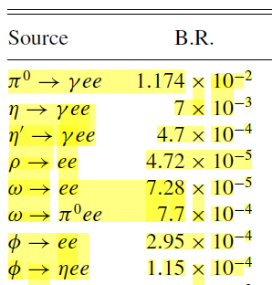

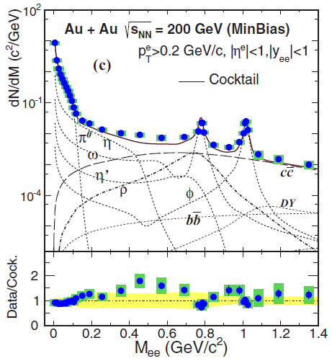


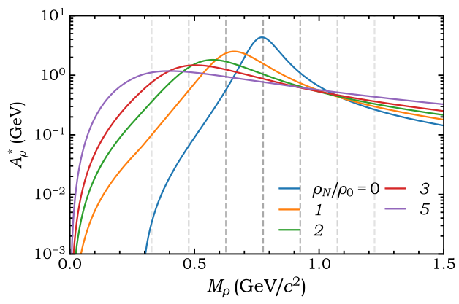


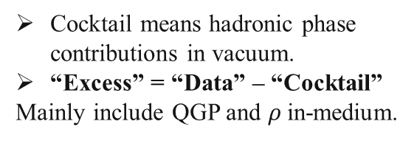
Spicy Gluons@HeFei May 16, 2024
Dilepton production
dilepton sources
QGP:
$ρ$:
Dileptons are perturbatively produced both in partonic and hadronic phases.
Cocktail means hadronic phase contributions in vacuum.
“Excess” = “Data” – “Cocktail”
Mainly include QGP and $ρ$in-medium.
STAR, Phys. Rev. C 92, 024912 (2015).
O. Linnyk, E. L. Bratkovskaya, W. Cassing, PPNP 87, 50 (2016).
9

Slide 12
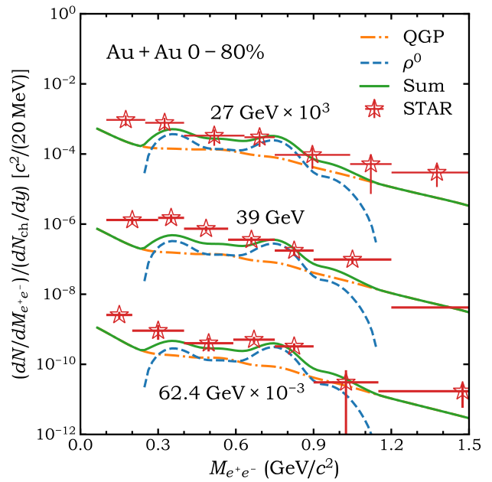
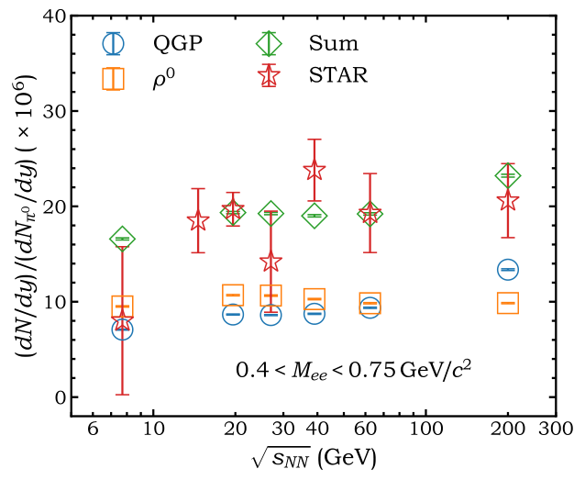
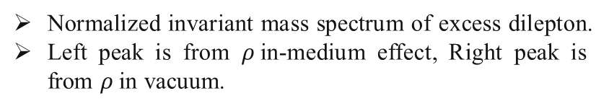
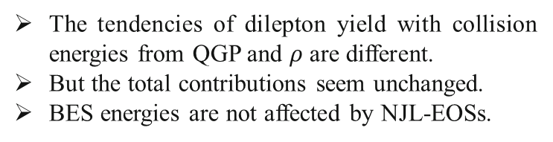
Spicy Gluons@HeFei May 16, 2024
Dilepton production at BES-I
The tendencies of dilepton yield with collision energies from QGP and $ρ$ are different.
But the total contributions seem unchanged.
BES energies are not affected by NJL-EOSs.
Normalized invariant mass spectrum of excess dilepton.
Left peak is from $ρ$in-medium effect, Right peak is from $ρ$in vacuum.
10

Slide 13
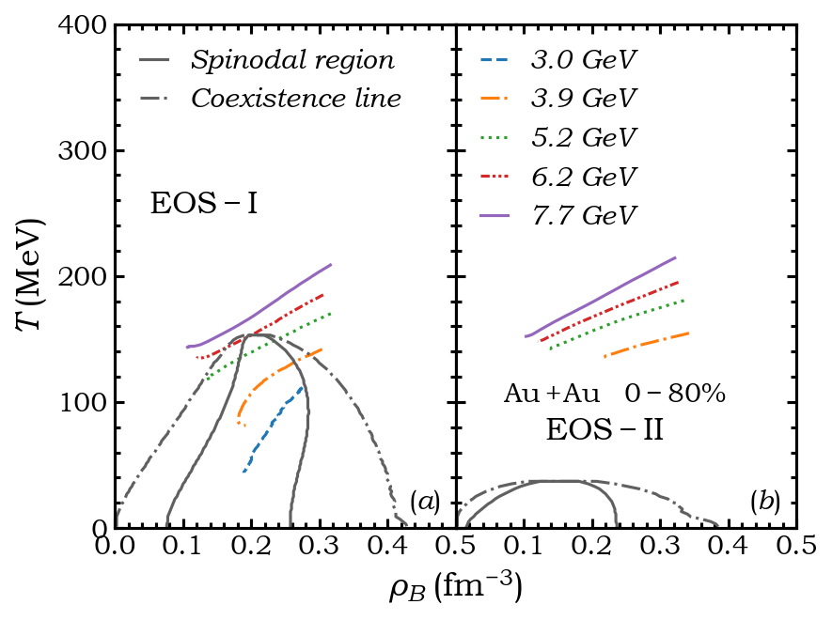





Spicy Gluons@HeFei May 16, 2024
Dilepton production at FXT
The trajectories are more deeper in spinodal can have more larger densities fluctuations.
Phase trajectories seem unchanged at collision energies $\sqrt{s_{NN}}≥5.2 GeV.$
The time of evolution could be extended when system enter spinodal.
If assume particles are massless.
Smaller $δ$ mean larger density fluctuations.
11

Slide 14



Spicy Gluons@HeFei May 16, 2024
Dilepton production at FXT
Time evolution of dilepton yields in partonic phase.
Dilepton production enhanced at all time periods.
Invariant mass spectrum of dilepton.
Dilepton production radio is proportional to quark density.
Structures of $ρ$ decay are the same at all collision energies.
12

Slide 15




Spicy Gluons@HeFei May 16, 2024
Dilepton production at FXT
Preliminary
The trajectories are more deeper in spinodal, dilepton yield enhancement more larger.
Dileptons from $ρ$ decay not affected by NJL-EOSs.
Enhancement at QGP is from spinodal instability and long lifetime of partonic phase.
Combine with$ρ$ decay contribution, the yield difference between two EOSs with energies increasing is non-monotonic.
13

Slide 16

Spicy Gluons@HeFei May 16, 2024
Summary and outlook
Main points:
Large density inhomogeneities can be generated by the spinodal instability during the first-order chiral phase transition at $\sqrt{s_{NN}}=$ 3.0 ~ 5.2 GeV.
Dilepton emissions during the QGP phase are enhanced when the first order chiral phase transition occurs.
Future plan:
Other observables like HBT correlation, high order moments of conserved charges, etc.
Initial density fluctuation from nucleus structures.
14

Slide 17
Thanks for your attention!

Slide 18
Backup

Slide 19





