Slide 1
Elastic hadron-hadron scattering in holographic QCD
Zhibo Liu （刘志博）
College of Science,
China Three Gorges University
Advisor：Akira Watanabe（渡边 晓）

Slide 2
Motivation
1. High energy hadron-hadron scattering has been one of the most important research topics in high energy physics over several decades, since its cross sections reflect the internal structure of the involved hadrons.
2. It is particularly difficult to perform the theoretical analysis on the high energy forward scattering, since the underlying partonic dynamics is highly nonperturbative.
3. It is required to build a model, which appropriately approximates such a nonperturbative interaction and enables one to predict the cross sections in wide kinematic regions.

Slide 3
AdS/CFT correspondence
A conjectured correspondence between a weak coupling superstring theory in the higher dimensional anti-de Sitter space (AdS) and a strong coupling conformal field theory (CFT) in the ordinary 4D space proposed by J. M. Maldacena in 1997.
Actually, we consider QCD, not CFT, in the real world, and then break the conformal symmetry (basically by hand), which is called the holographic QCD or AdS/QCD.

Slide 4
Holographic QCD
Top-down approach
(e.g. Sakai-Sugimoto model)
Bottom-up approach
(e.g. a model by
Erlich-Katz-Son-Stephanov)
from 10D superstring theory to 4D QCD
configurations of D-branes to take out 4D QCD
• from 4D QCD to 5D model in AdS space
• based on phenomenology of QCD,
constructing 5D action by hand
• Both are according to the field/operator correspondence provided by the original AdS/CFT correspondence
• Both can (basically) treat only color singlet objects (in these frameworks, the color confinement is trivial!)

Slide 5
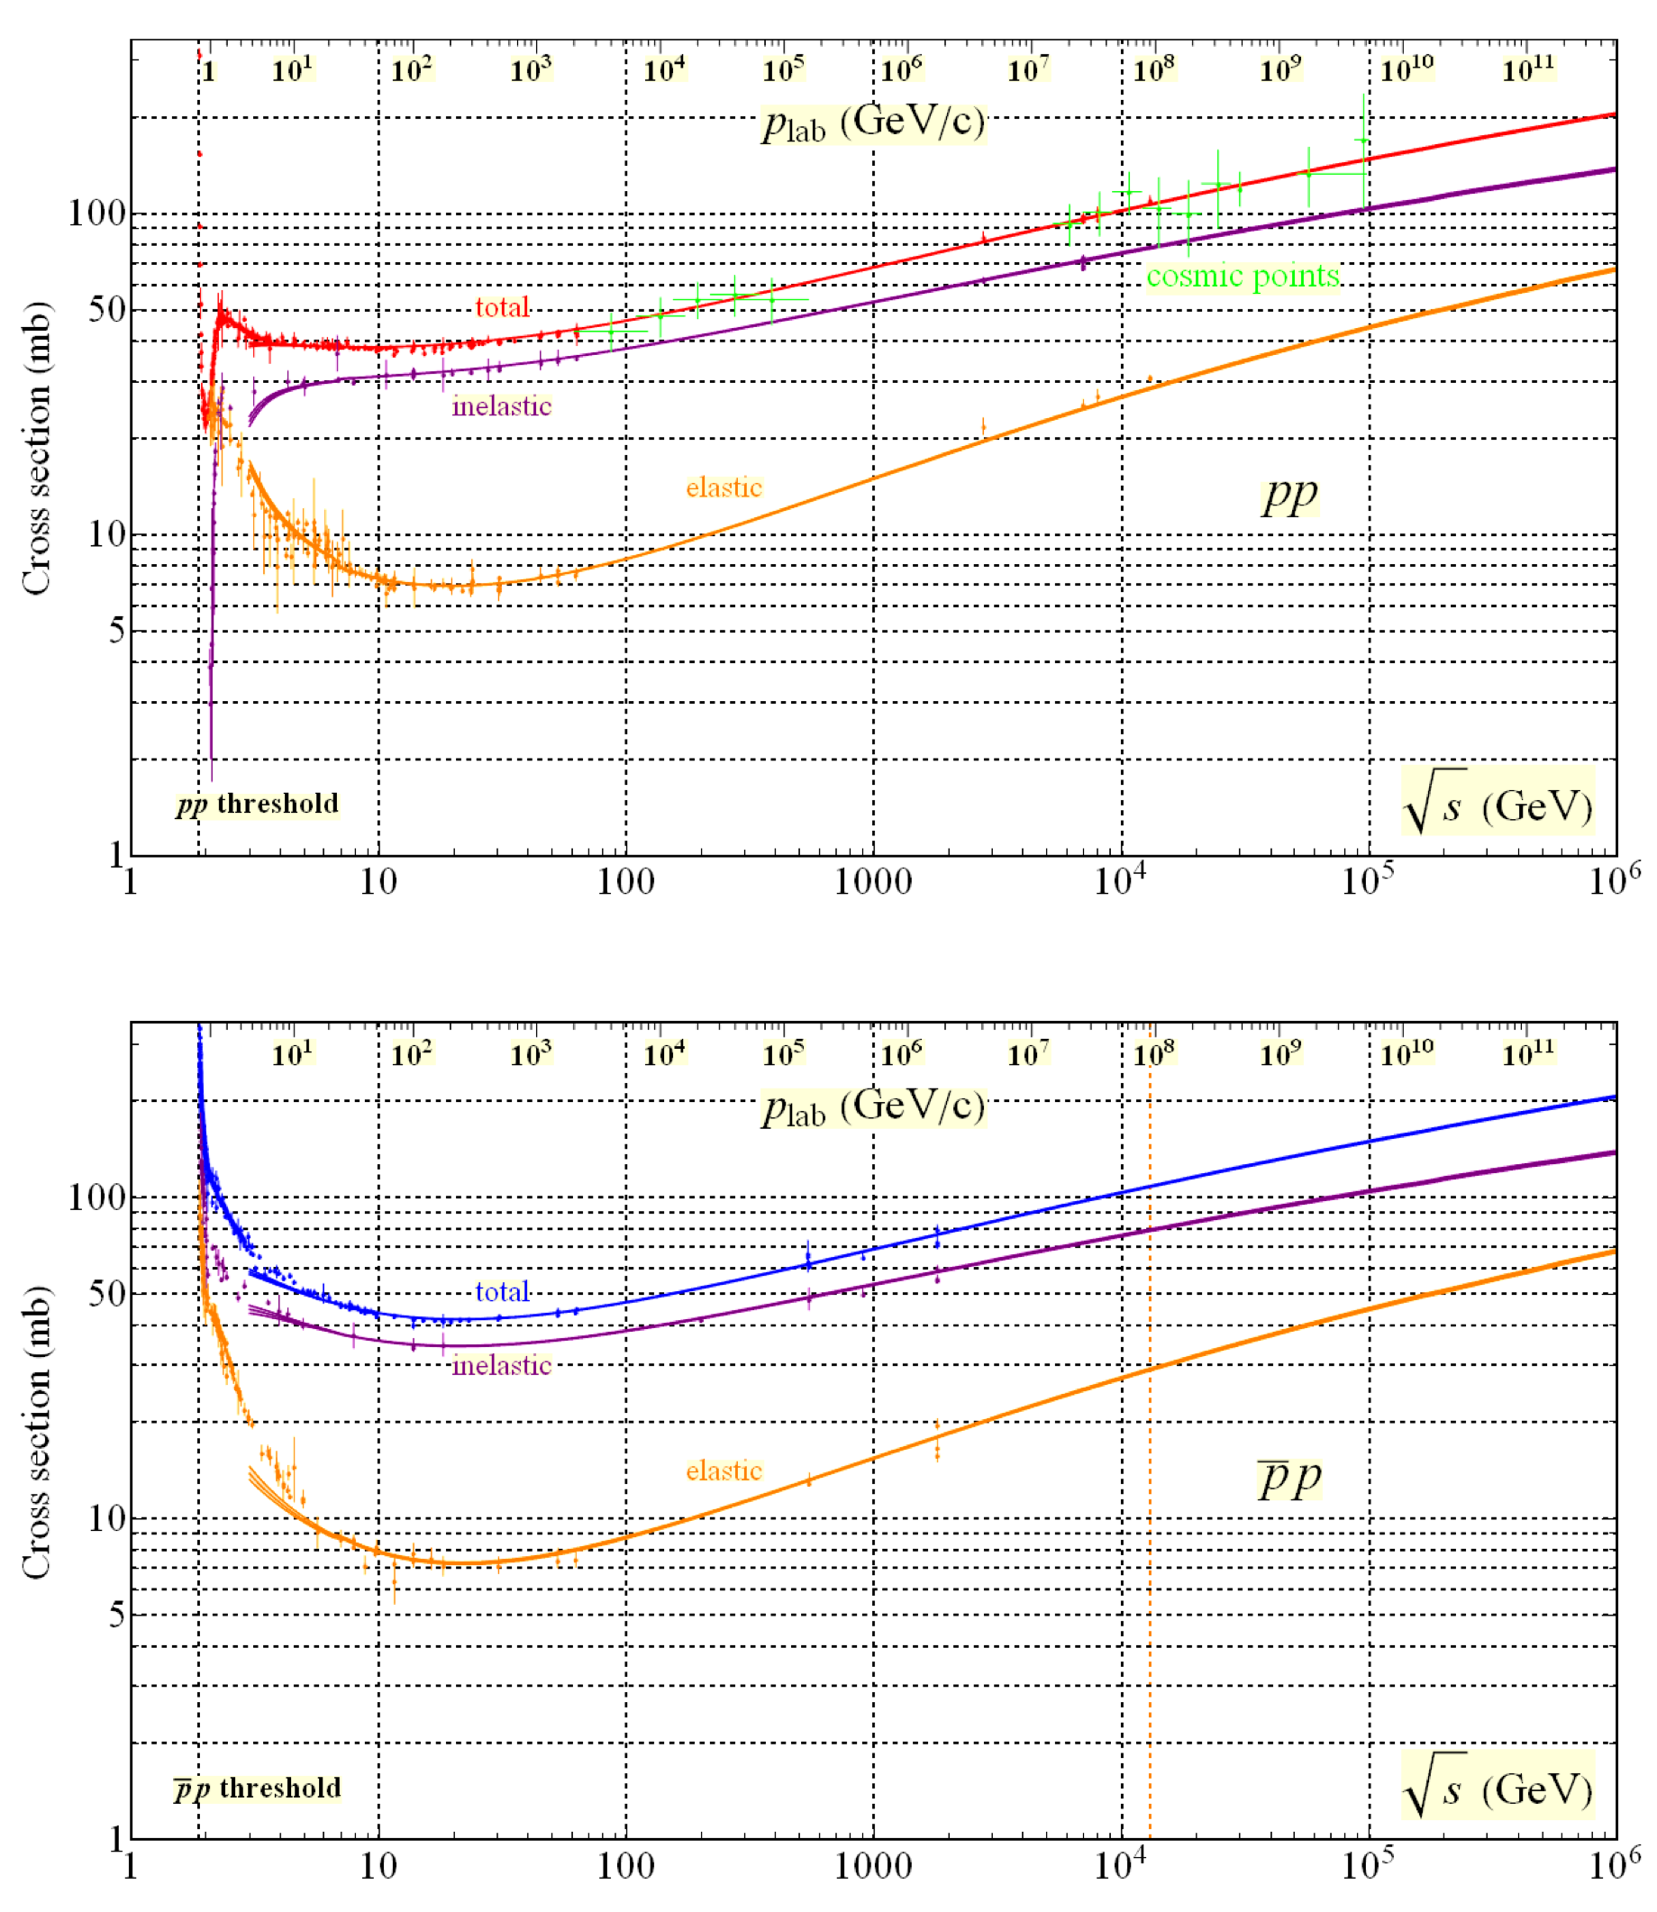
Reggeon exchange
$$J=α(0)+α^{′}m^{2}$$

Slide 6
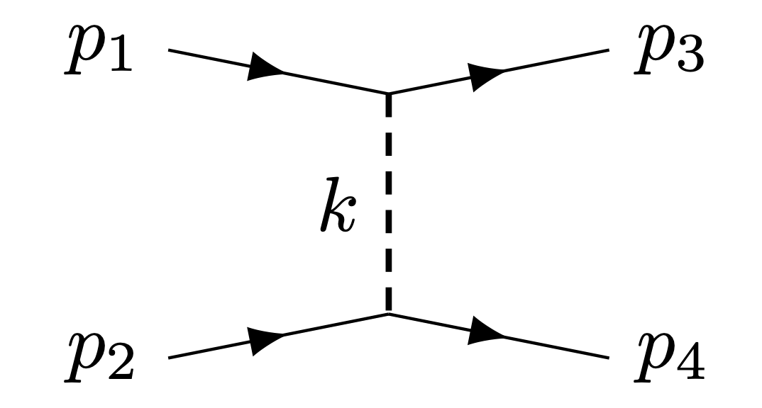
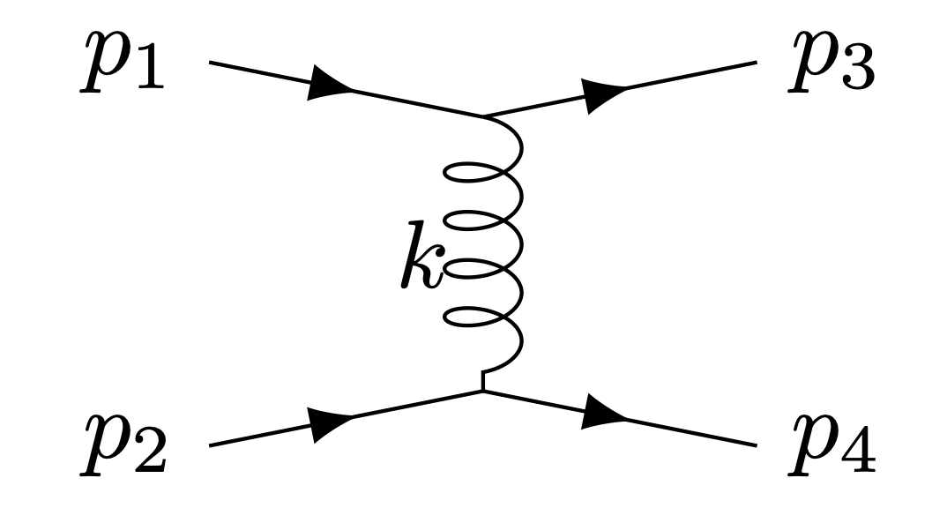
Considered Feynman diagrams
To take into account the both contributions
90
Reggeized spin-1 and spin-2 particle propagators
Reggeon exchange
Pomeron exchange
$$J=α(0)+α^{′}m^{2}$$
In hQCD, meson states are dual to open bosonic strings and glueball states to closed bosonic strings.
Domokos-Harvey-Mann Phys.Rev.D 80 (2009) 126015
Anderson-Donmokos-Harvey-Mann Phys.Rev.D 96 (2017) , 046002

Slide 7
Vertices and propagators in $pp(p\overline{p})$ scattering
The vertex of glueball-proton-proton in the Regge limit is $Γ_{g}^{μν}=\frac{λ_{g}A(t)}{2}(γ^{μ}(p_{1}+p_{3})^{ν}/2+γ^{ν}(p_{1}+p_{3})^{μ}/2).$
The massive spin-2 glueball propagator is $D_{αβγδ}^{g}(k)=\frac{id_{αβγδ}}{t-m_{g}^{2}}.$
$$σ_{tot}=\frac{1}{s}ImA(s,t=0)$$
The vector meson propagator can be written as $D_{μν}^{v}(k)=\frac{-i}{t-m_{v}}η_{μν}.$
The vector-proton-proton vertex is $Γ_{v}^{μ}=-iλ_{v}γ^{μ}.$
$$\frac{dσ}{dt}=\frac{1}{16πs^{2}}|A_{tot}|^{2}$$
The propagator of the vector meson needs to be Reggeized as
$$\frac{1}{t-m_{v}^{2}}→α_{v}^{′}e^{-\frac{iπα_{v}(t)}{2}}sin\left[\frac{πα_{v}(t)}{2}\right]{\left(α_{v}^{′}s\right)}^{α_{v}(t)-1}Γ[-α_{v}(t)].$$
The propagator of the massive spin-2 glueball needs to be Reggeized as
$$\frac{1}{t-m_{g}^{2}}→\frac{α_{g}^{′}}{2}e^{-\frac{iπα_{g}(t)}{2}}{\left(\frac{α_{g}^{′}s}{2}\right)}^{α_{g}(t)-2}\frac{Γ\left[3-\frac{χ_{g}}{2}\right]Γ\left[1-\frac{α_{g}(t)}{2}\right]}{Γ\left[2-\frac{χ_{g}}{2}+\frac{α_{g}(t)}{2}\right]}$$
where $χ_{g}≡α_{g}(s)+α_{g}(u)+α_{g}(t).$
Domokos-Harvey-Mann Phys.Rev.D 80 (2009) 126015

Slide 8
Elastic proton-(anti)proton scattering
Pomeron exchange
Reggeon exchange
5 adjustable parameters are determined with experiment data
$λ_{g}$: the (anti)proton-glueball-(anti)proton coupling constant
$α_{g}(0)$: the intercept of Pomeron trajectory
$α_{g}^{′}$: the slope of Pomeron trajectory
$λ_{v}$: the (anti)proton-vector-(anti)proton coupling constant
$α_{v}(0)$: the intercept of Reggeon trajectory
$$\}$$
Xie-Watanabe-Huang JHEP 10 (2019) 053
Gravitational form factor
$$\}$$
Liu-Xie-Watanabe
Phys.Rev.D 107 (2023), 014018

Slide 9
Gravitational form factors in hQCD
It is the standard prescription that is the correspondence between the 4D currents and their corresponding 5D field as
90
3-points function
90
J. Erlich, E. Katz, D. T. Son, and M. A. Stephanov ,Phys. Rev. Lett. 95, 261602 (2005)

Slide 10
Gravitational form factors in hQCD
90
3-points function
90
Deog Ki Hong, Takeo Inami, Ho-Ung Yee,Phys. Phys.Lett.B 646 (2007) 165-171

Slide 11
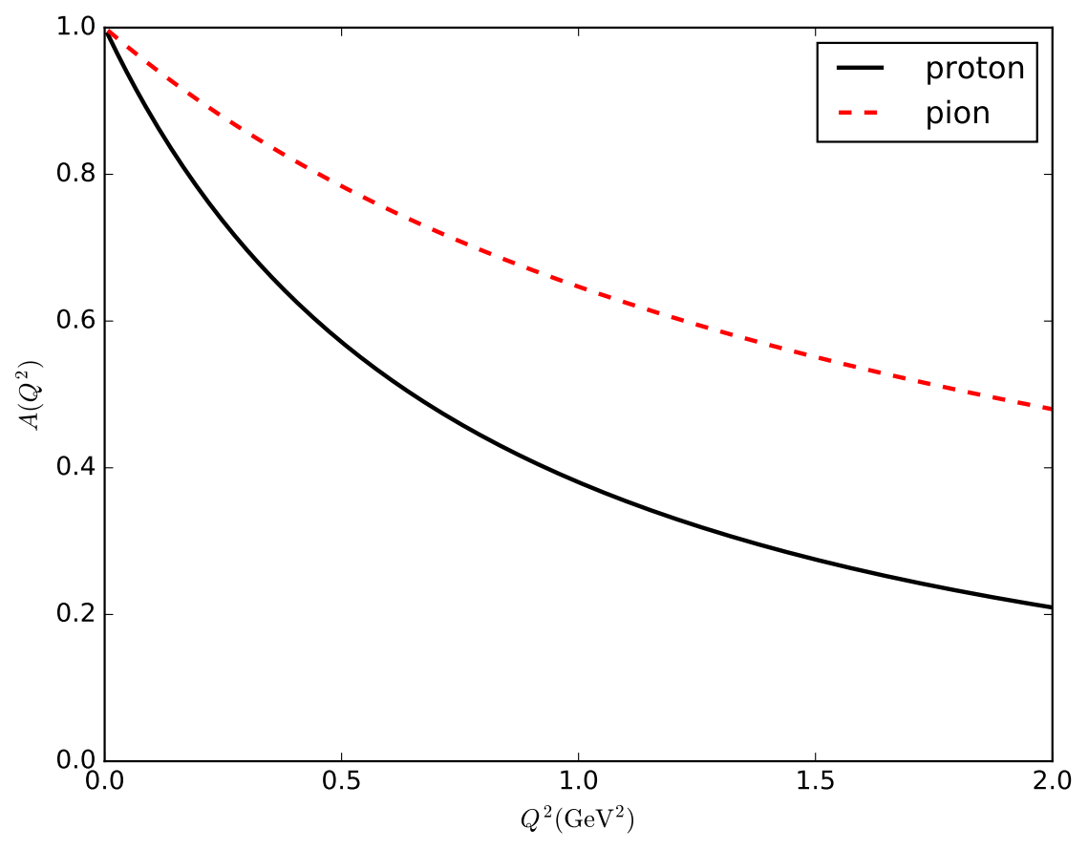
Gravitational form factors in hQCD

Slide 12
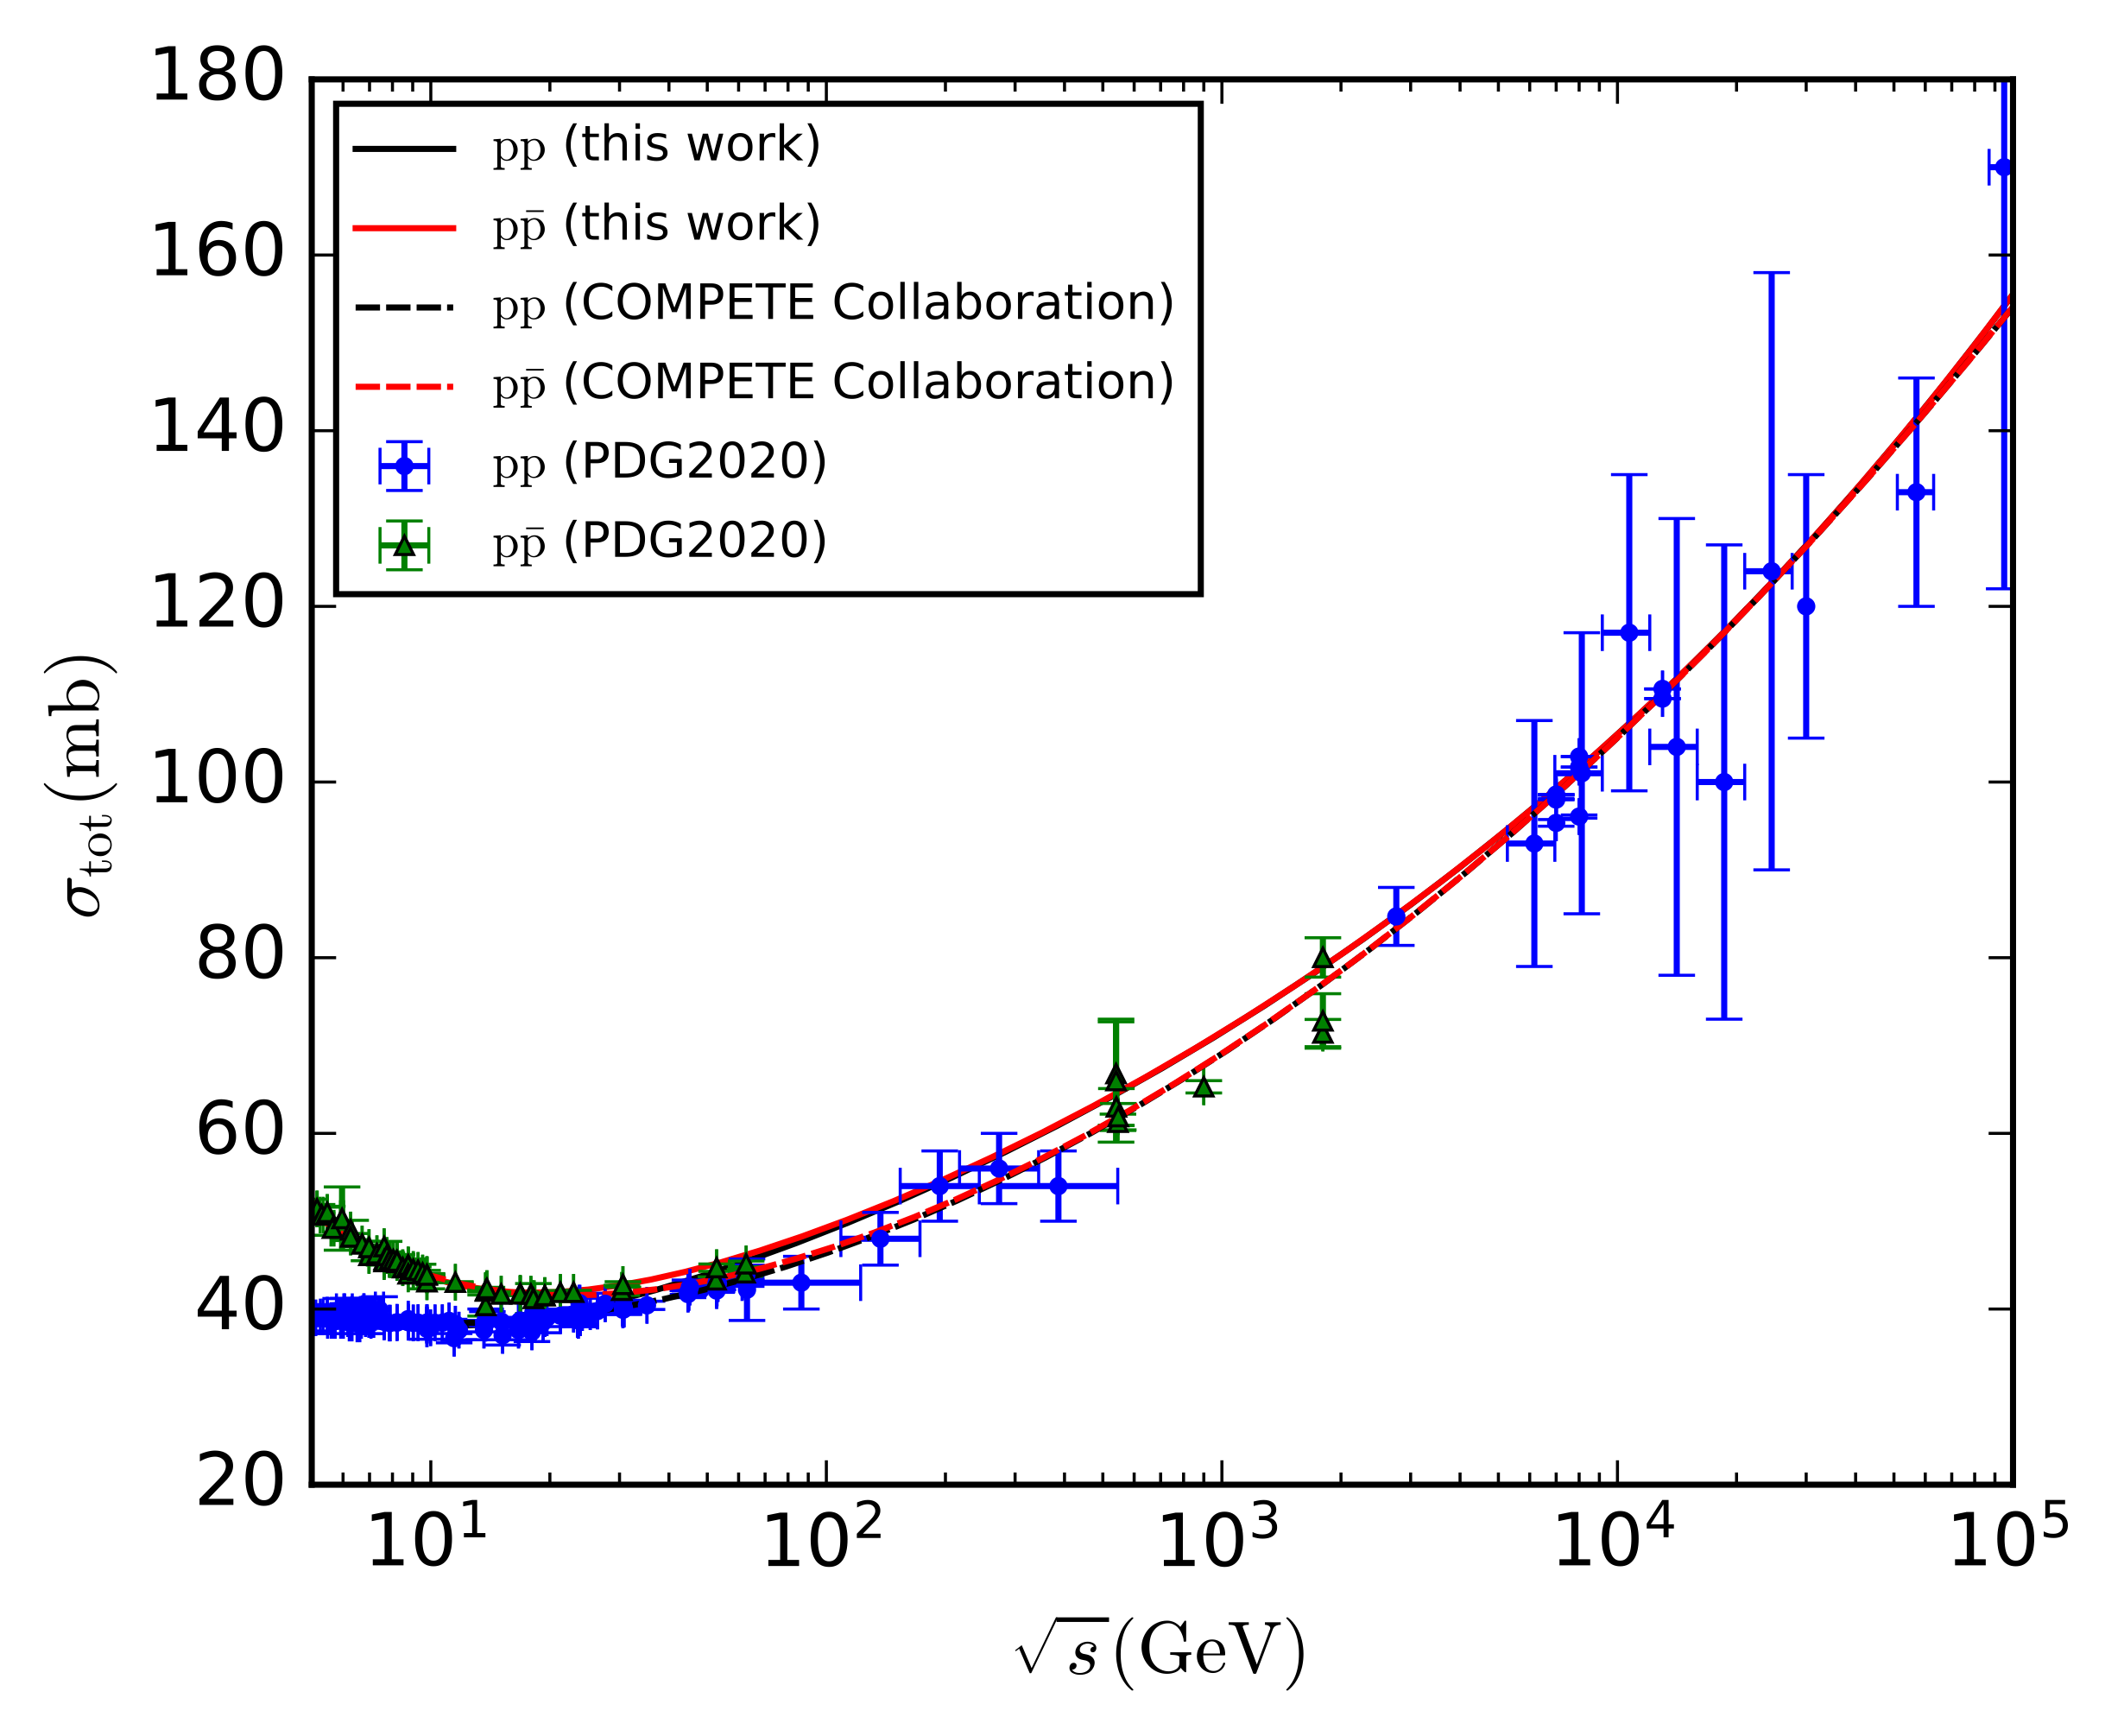
Our results for TCS

Slide 13
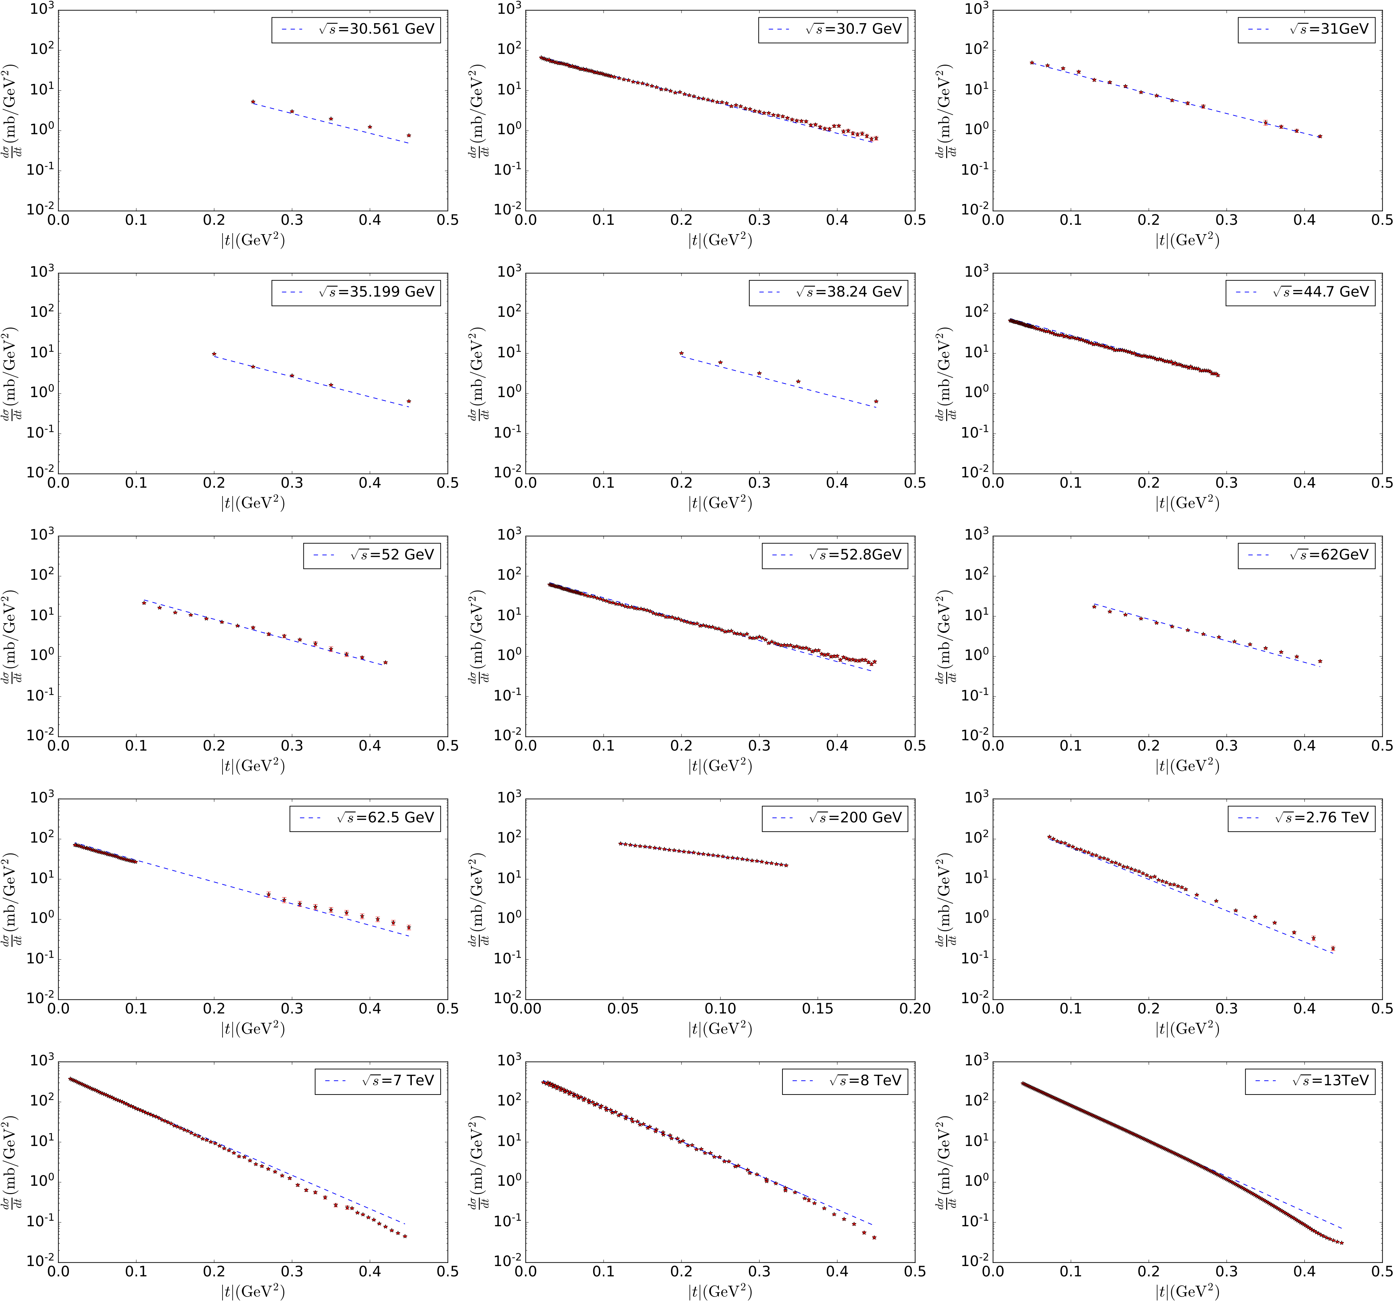
Our results for DCS of pp scattering

Slide 14
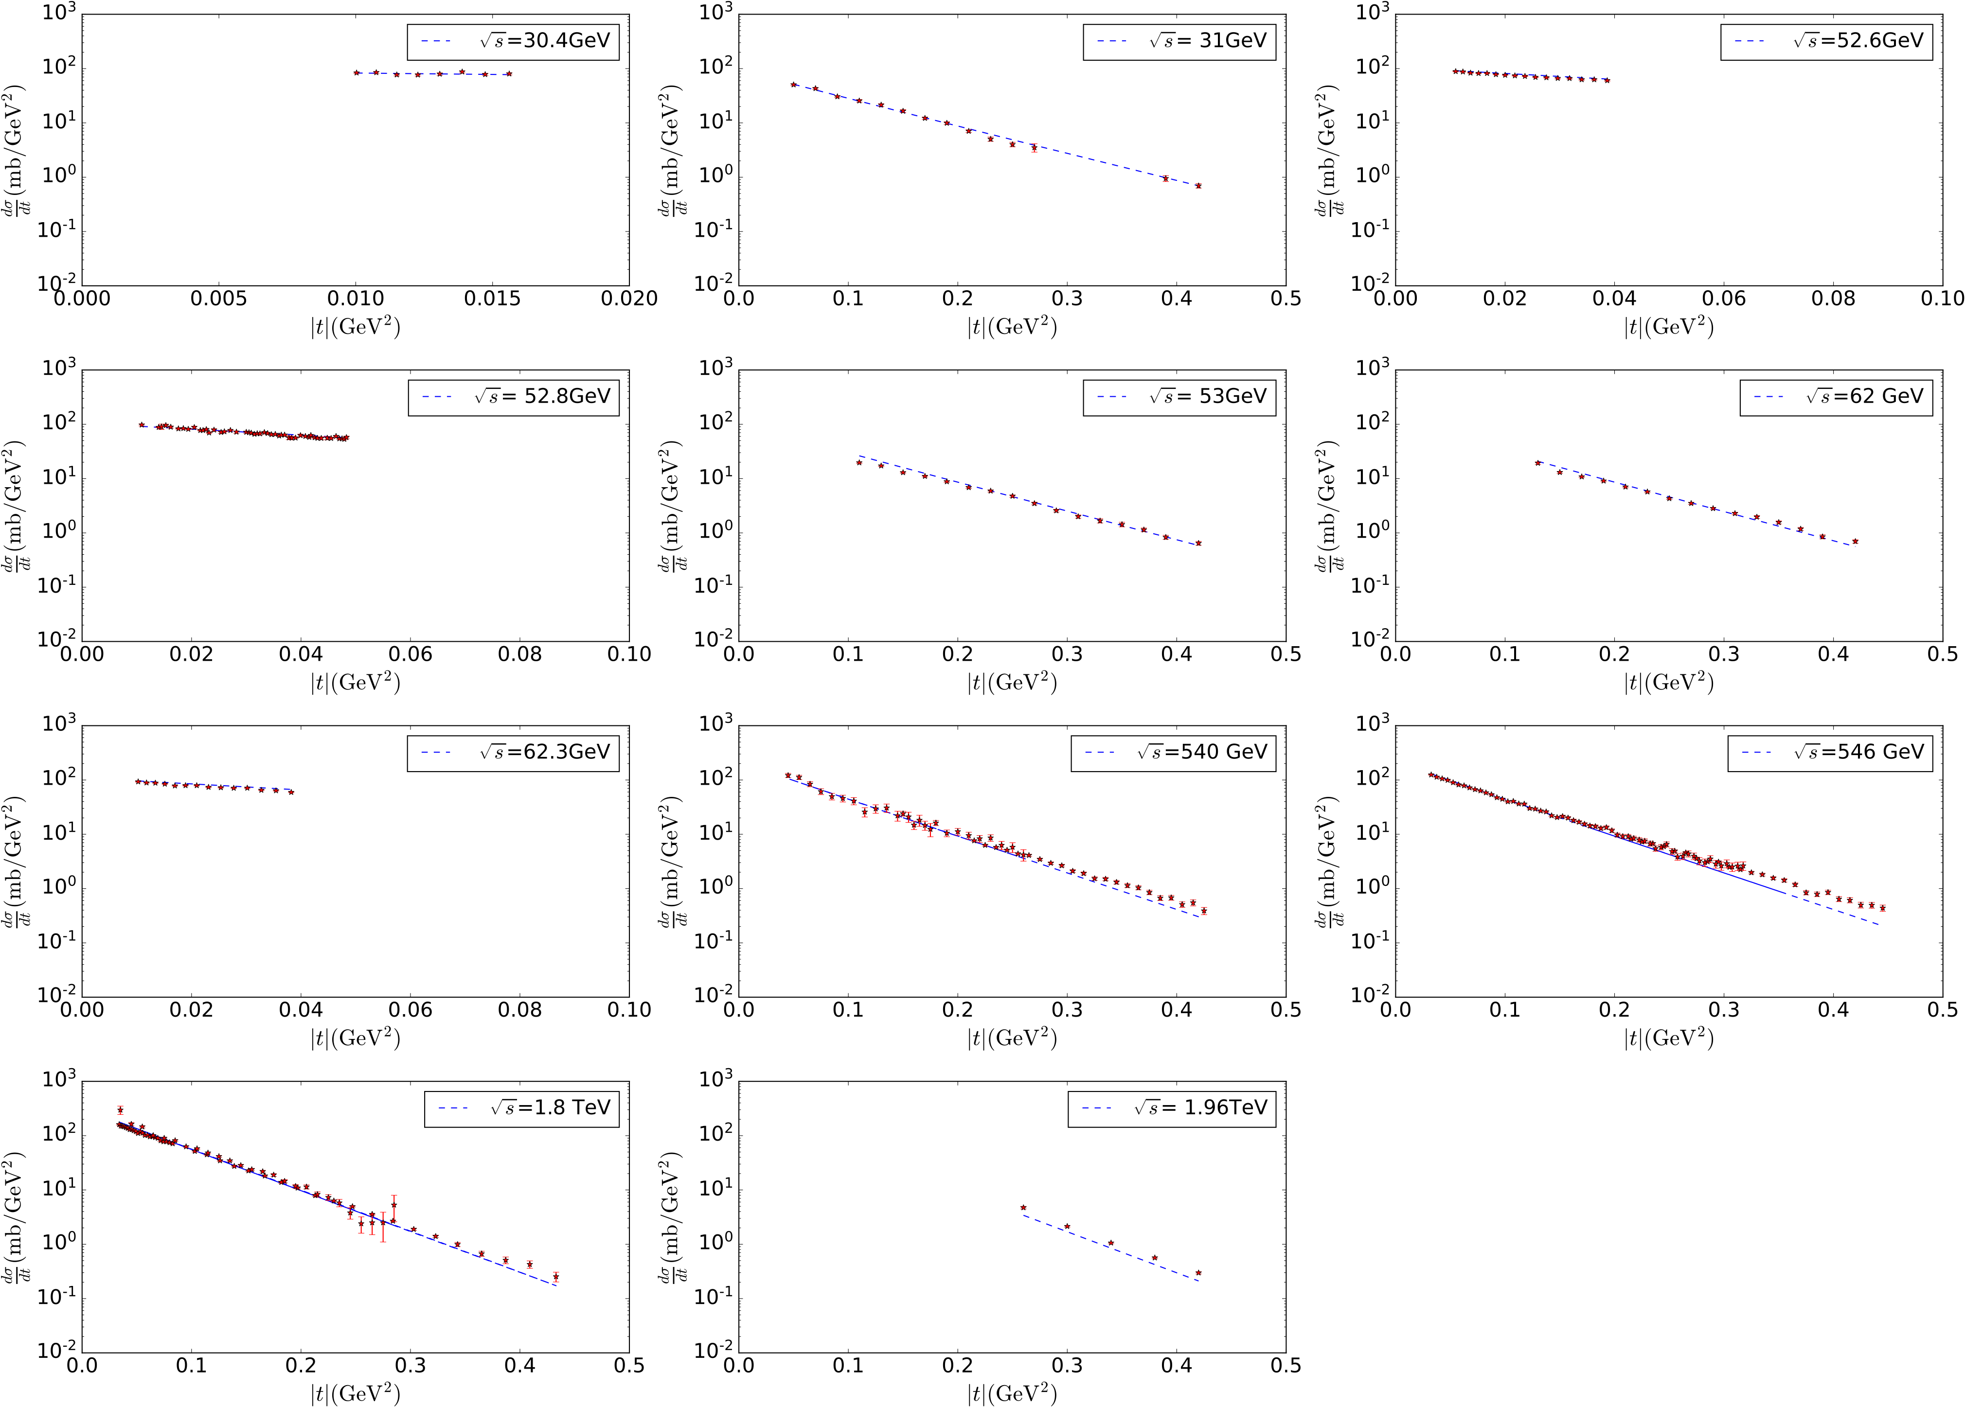
Our results for DCS of $p\overline{p}$ scattering

Slide 15
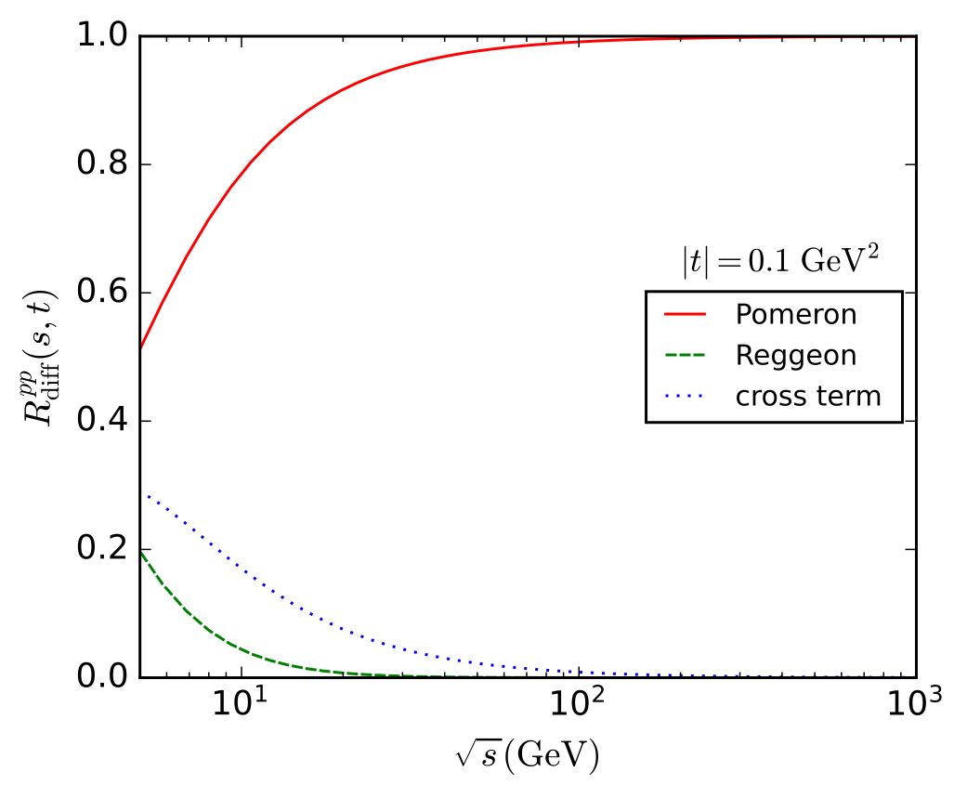
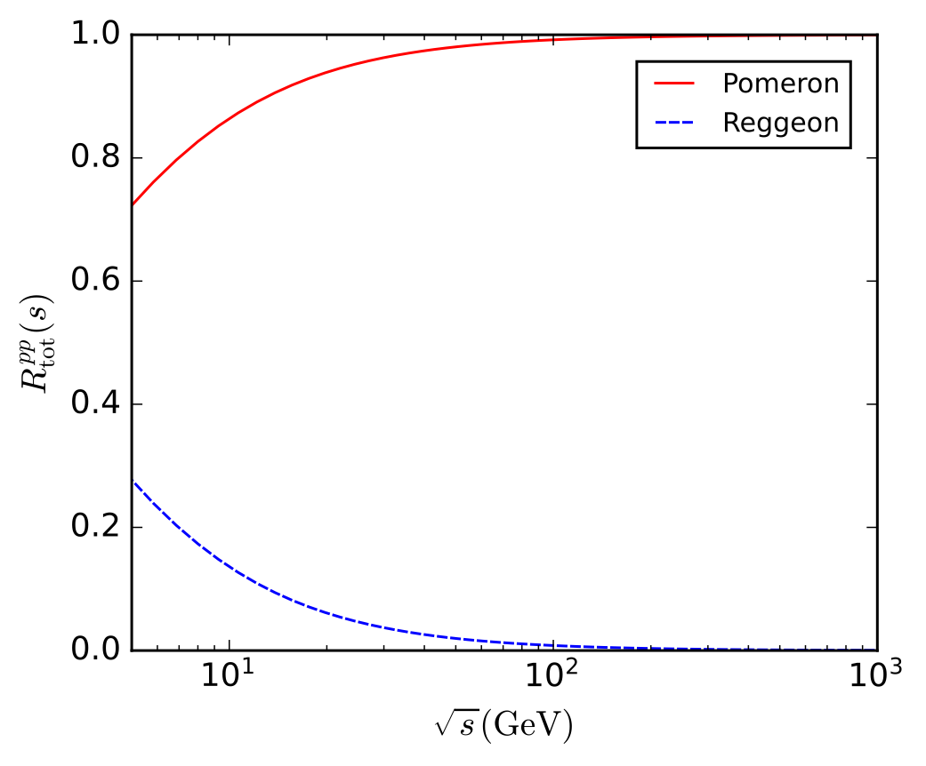
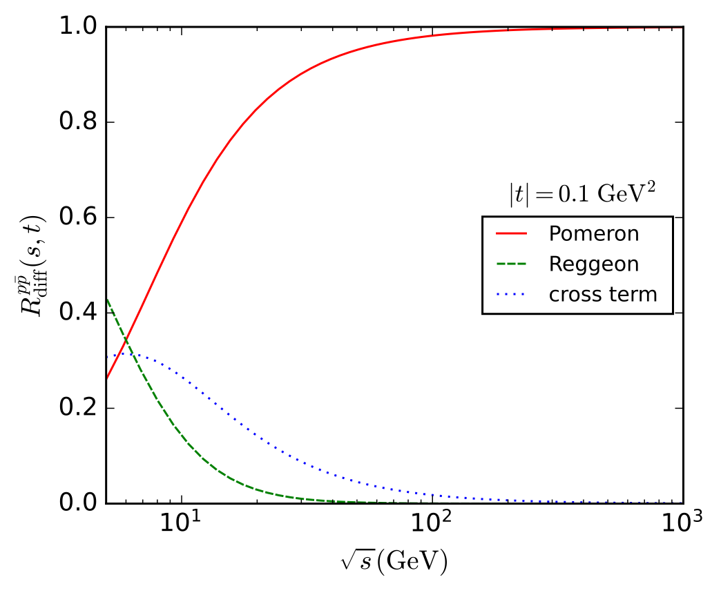
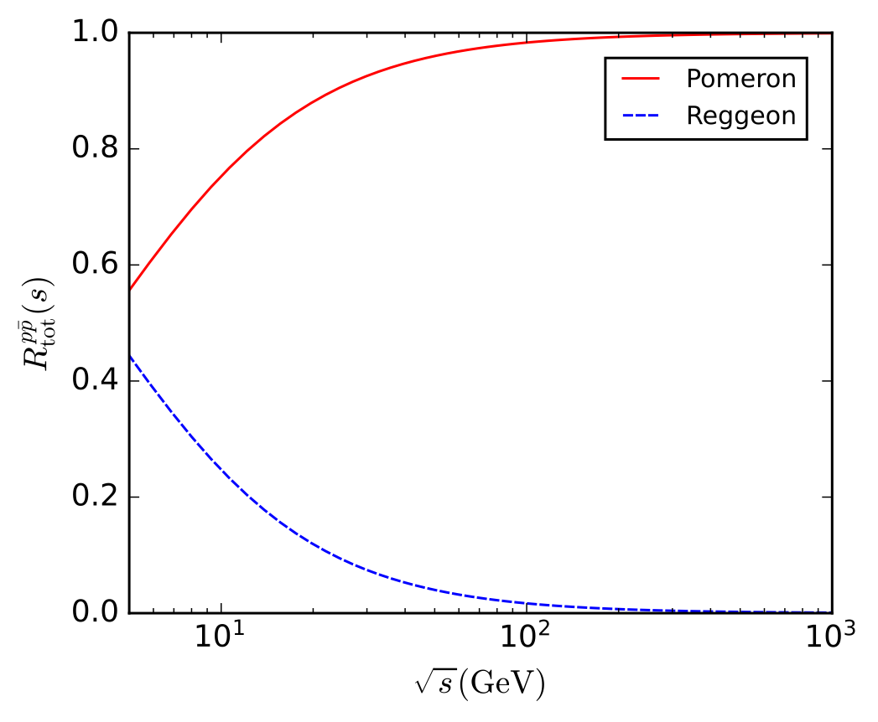
Our results for contribution ratios
DCS
TCS
$$pp$$
$$p\overline{p}$$

Slide 16
Elastic pion-proton and pion-pion scattering
The glueball-pion-pion vertex is $Γ_{gππ}^{μν}=2iλ_{gππ}A_{π}(t)p_{π}^{μ}p_{π}^{ν}$
The vertex of vector-pion-pion can be expressed as $Γ_{vππ}^{ν}=-2iλ_{vππ}p_{π}^{ν}$
3 adjustable parameters are determined with experiment data of total cross section
$λ_{gππ}$: the pion-glueball-pion coupling constant
$λ_{vπ^{+}π^{+}}$: the positive pion-vector-positive pion coupling constant
$λ_{vπ^{-}π^{-}}$: the negative pion-vector-negative pion coupling constant
Liu-Xie-Sun-Li-Watanabe Phys.Rev.D 106 (2022) 5, 054025
Liu-Watanabe Phys.Rev.D 108 (2023) 3, 034010

Slide 17
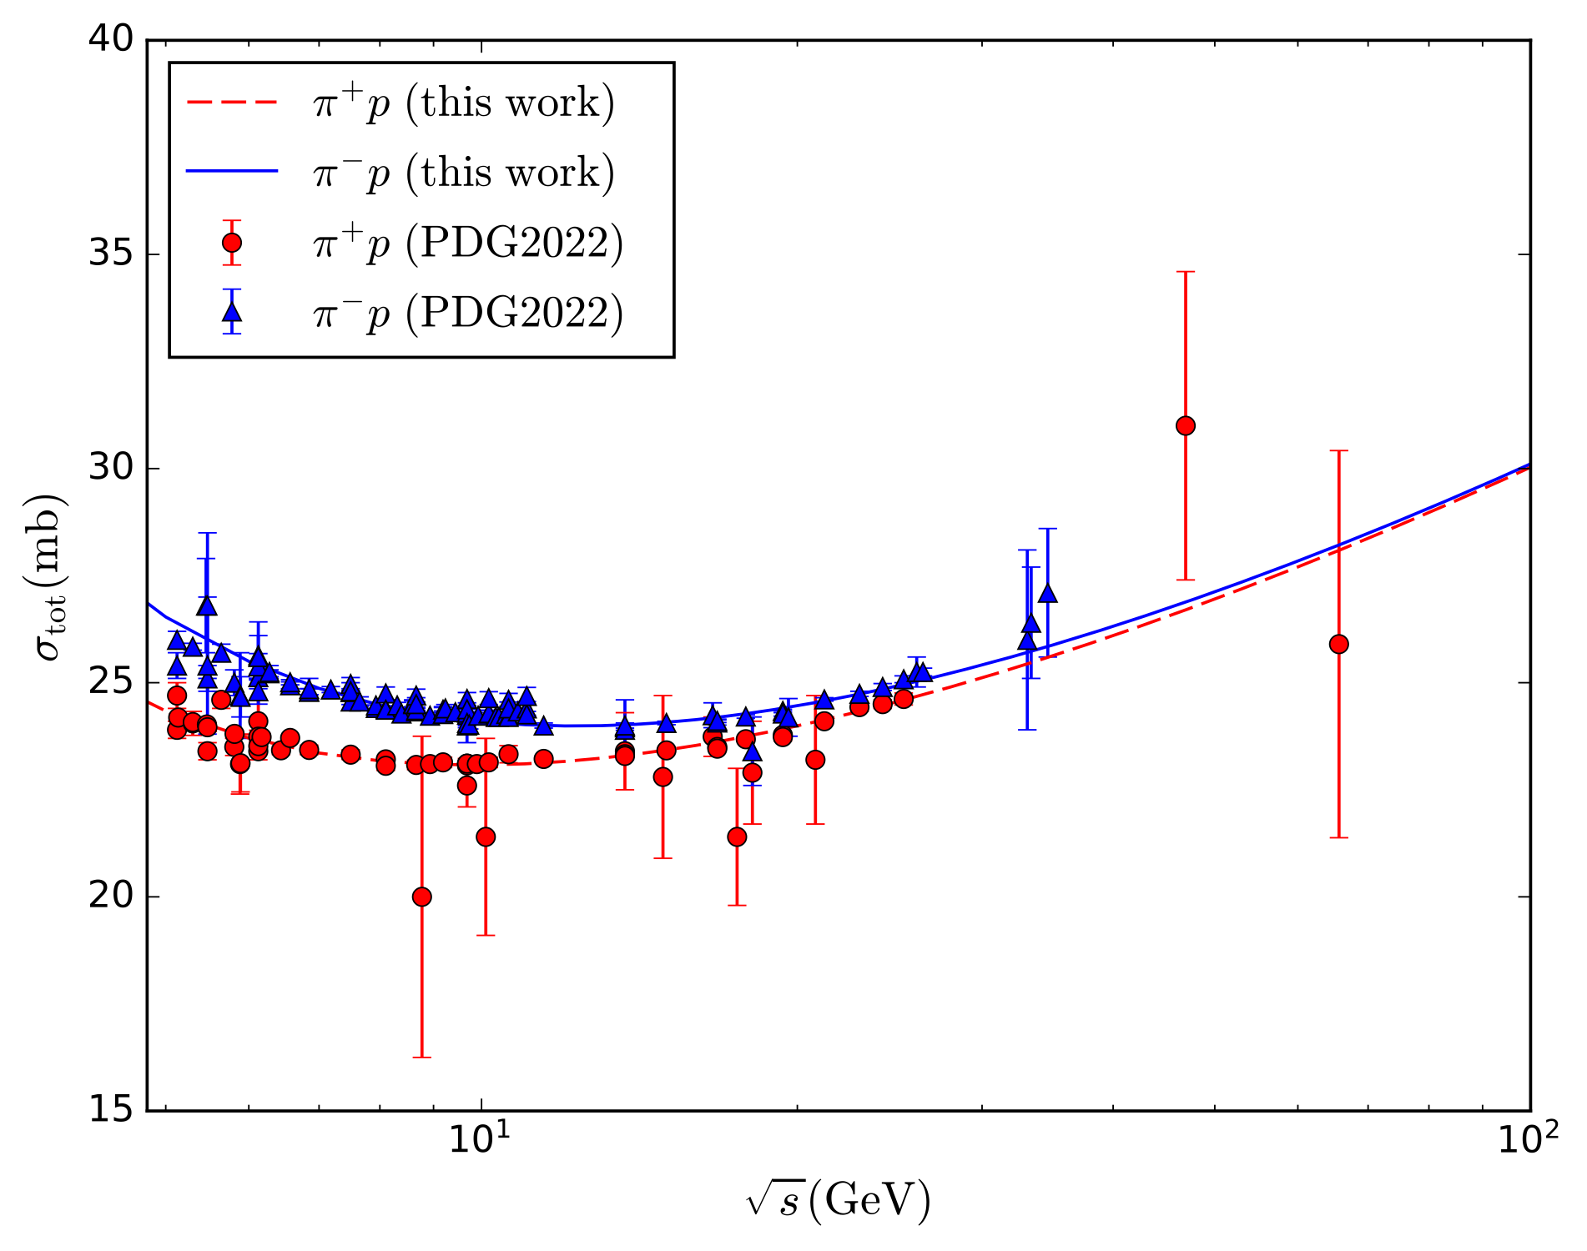
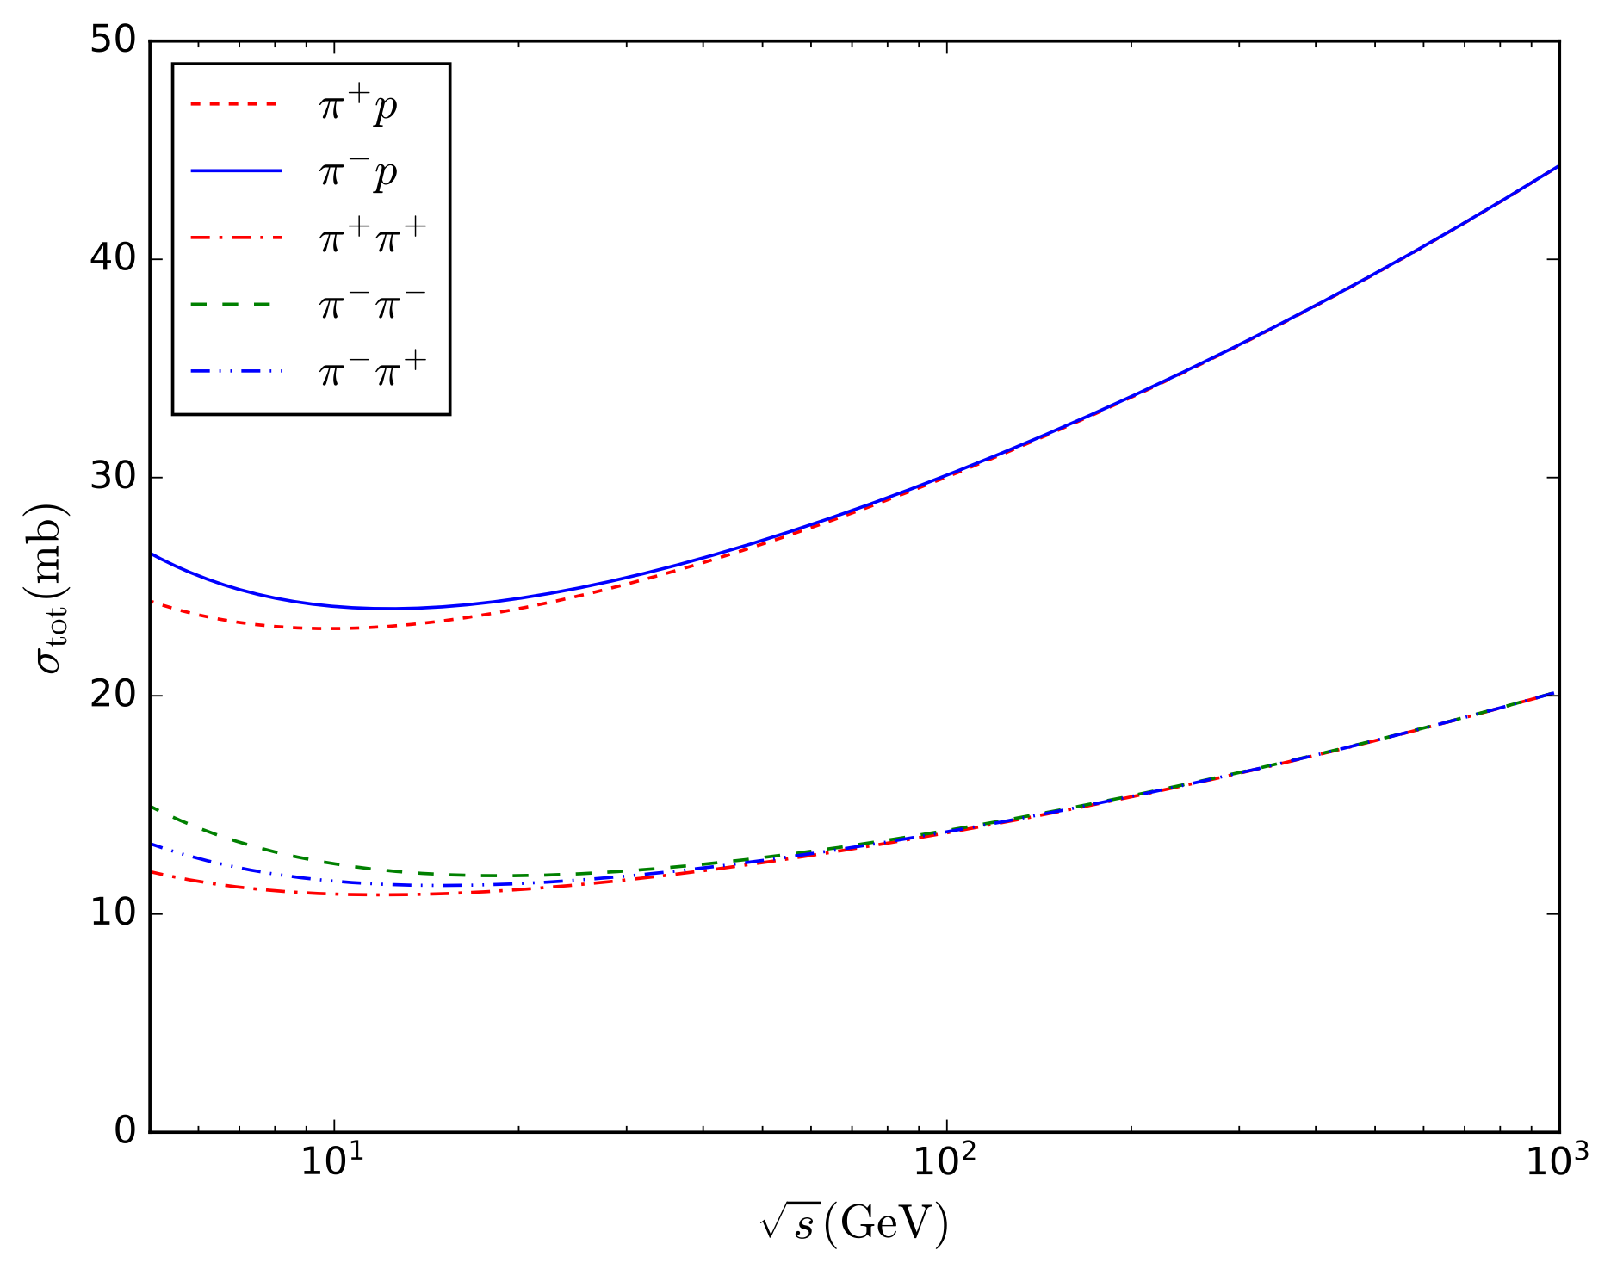
Our results for TCS

Slide 18
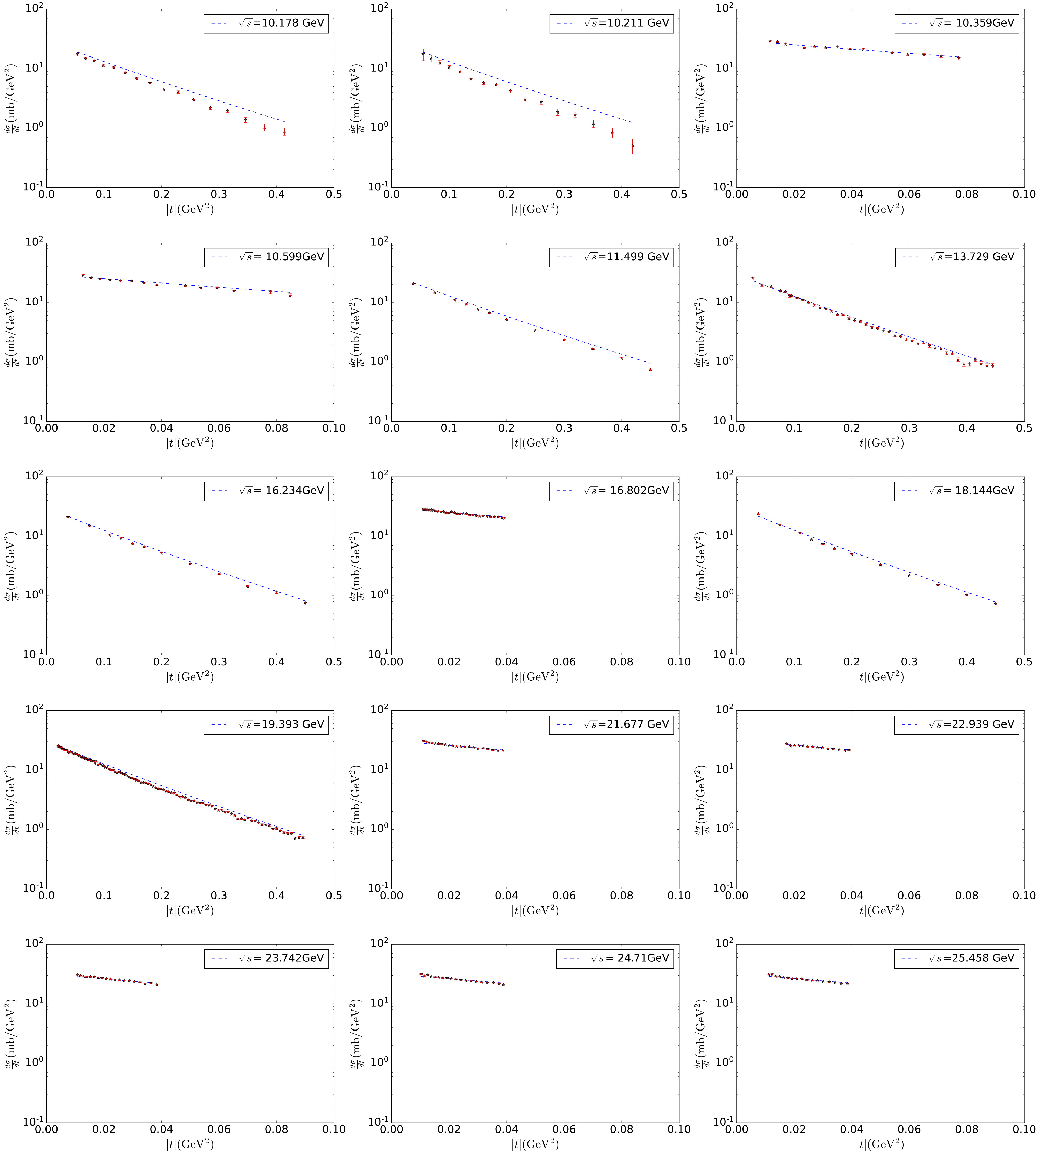
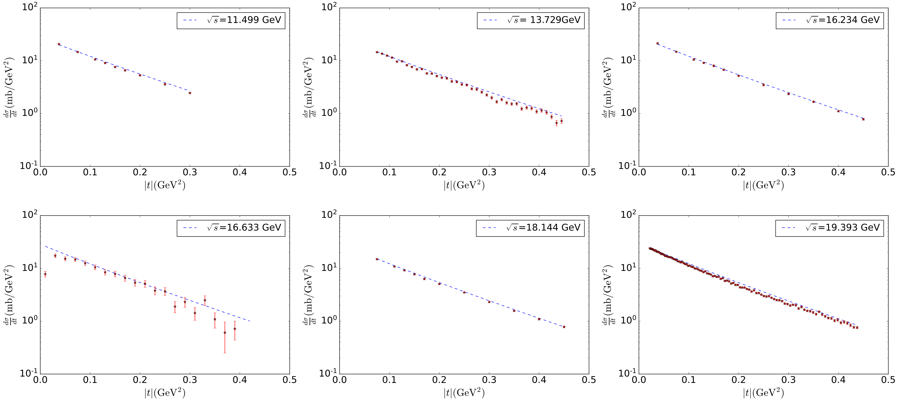
Our results for DCS
$$π^{-}p$$
$$π^{+}p$$

Slide 19
Summary
The preceding work only considered the contribution of Pomeron exchange in proton-proton elastic scattering, which cannot describe cross sections in the lower energy region.
We have added the contribution of Reggeon exchange and expanded the kinematic region that this model can describe. All additional parameters were determined by fitting the experimental data of TCS, and the predicted DCS are consistent with the experiment data. Then, considering the exchange of Pomeron and Reggeon in $πp$ and $ππ$ scattering, it was found that our results are consistent with the data.
These results imply that the present model may be useful for studying other high energy forward scattering processes.

