Slide 1
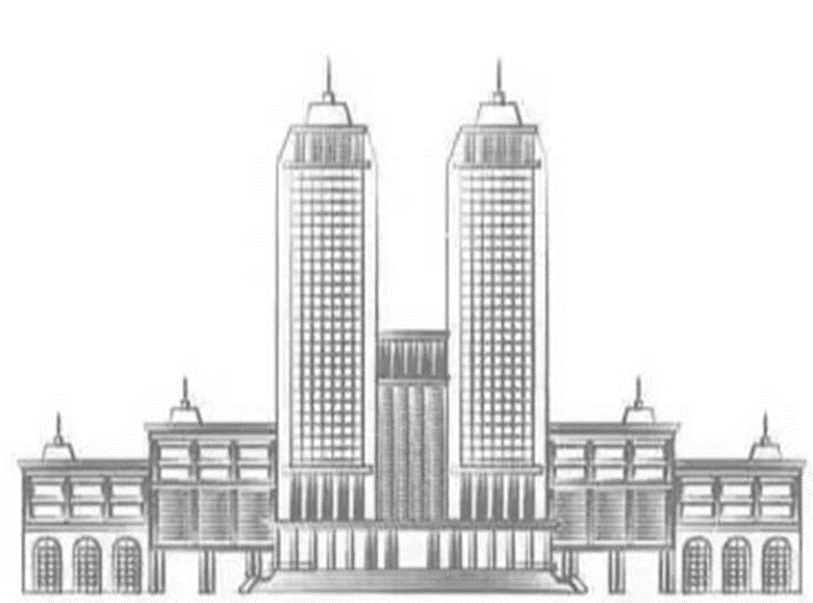
A machine learning study to identify collective flow in small and large colliding systems
Shuang Guo,^{1, 2} Han-Sheng Wang,^{1, 2} Kai Zhou,^{3, ∗} and Guo-Liang Ma ^{1, 2, †}
¹Institute of Modern Physics, Fudan University, Shanghai 200433, China ²Shanghai Research Center for Theoretical Nuclear Physics,Shanghai 200438, China ³Frankfurt Institute for Advanced Studies, Ruth-Moufang-Str. 1, 60438 Frankfurt am Main, Germany

Slide 2
Outline:
Background & Motivation
Relativistic heavy ion collision & Collective flow
Model
A multi-phase transport model & Point cloud neural network
Result
Train result of collective flow discrepancy
Summary & Outlook
Notes:
3维的结果放不放，逻辑漏洞？
讨论亮点是否正确
pz与pt的关联这一特征

Slide 3
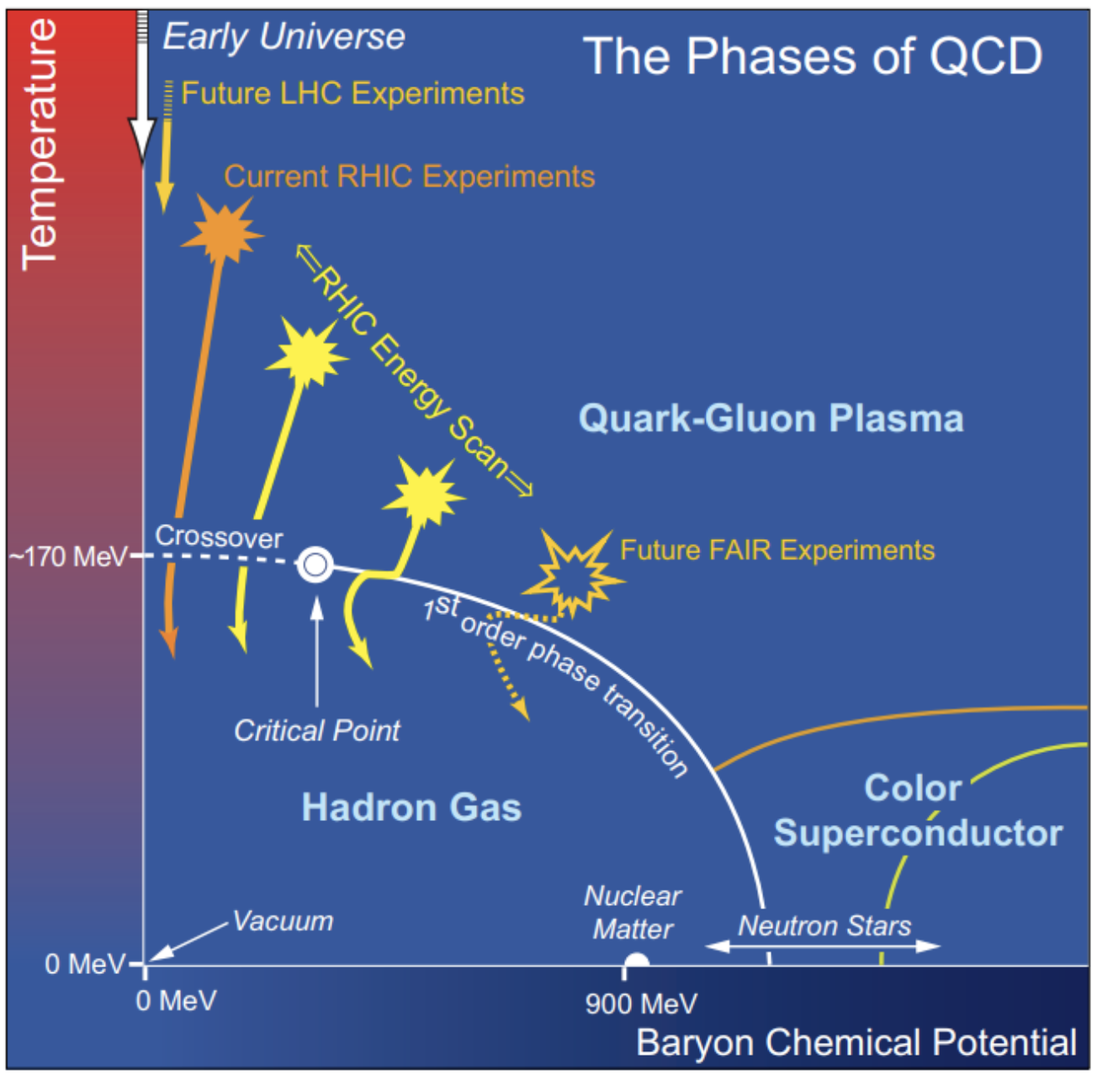
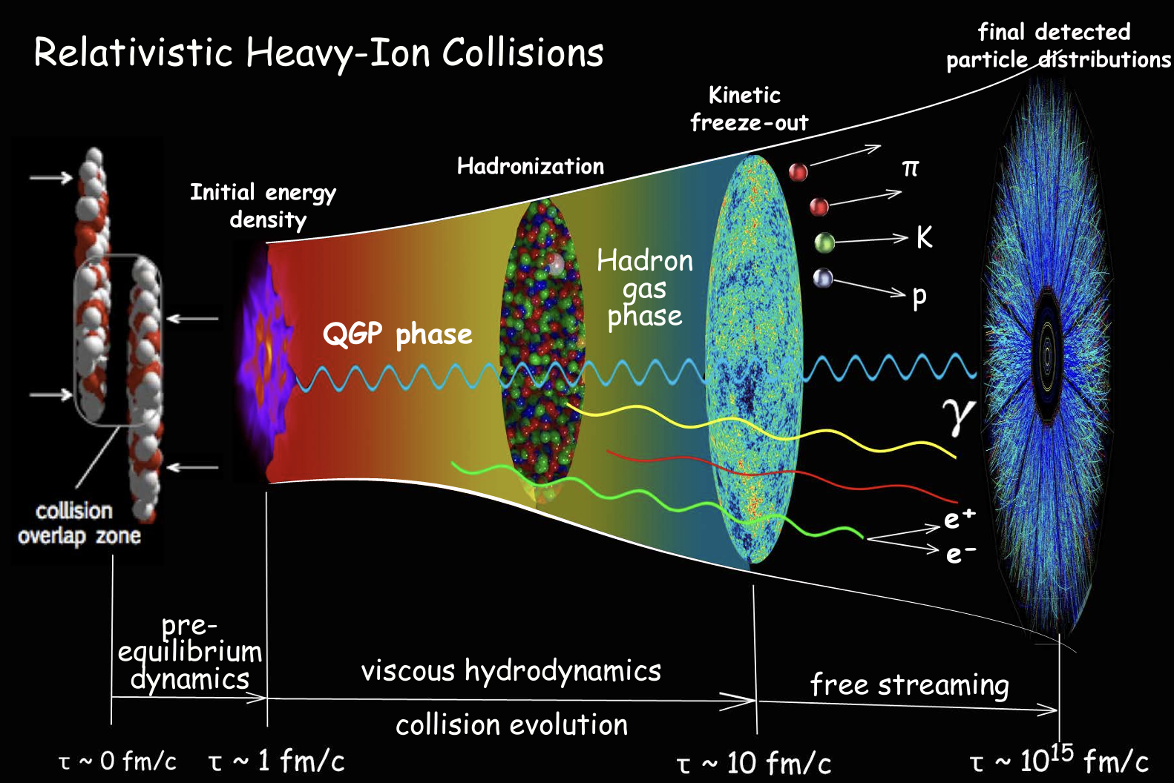
Background & Motivation
https://doi.org/10.48550/arXiv.1304.2073
https://doi.org/10.48550/arXiv.1507.01558
A deconfinement phase transition from the hadron phase to the quark-gluon plasma phase.
Relativistic heavy ion collisions can produce QGP and study QCD phase transitions.
Shuang Guo

Slide 4
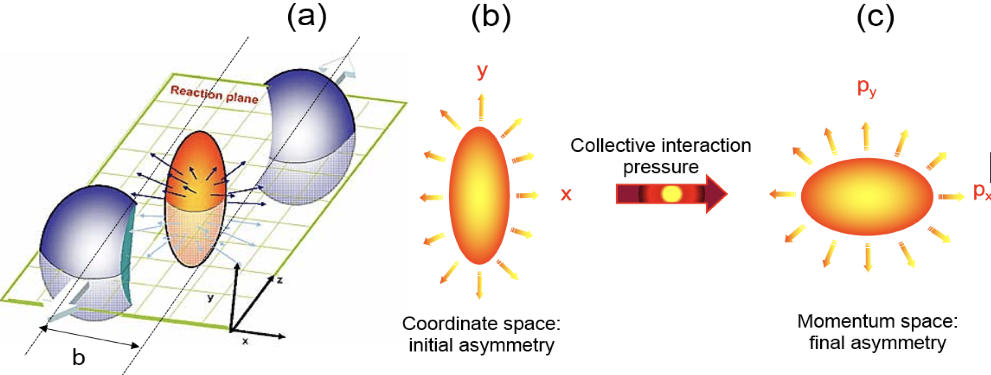
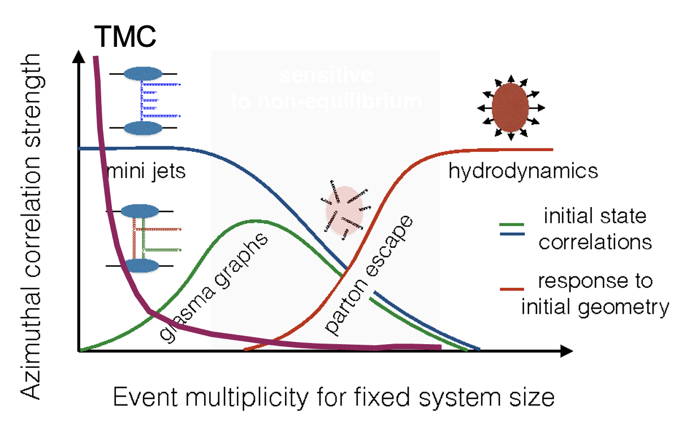
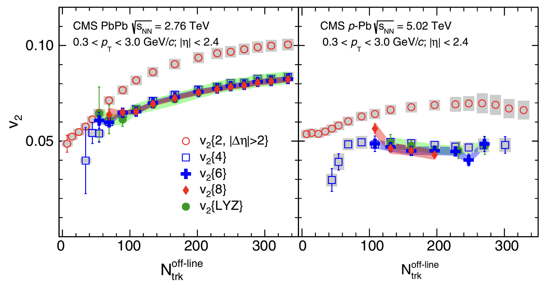
collective flow
https://doi.org/10.1140/epjp/i2016-16070-2
Fourier decomposition of the azimuthal angle $φ$ distribution of measured particles:
$$\frac{dN}{dφ}=\frac{1}{2π}\left[1+\sum_{n=1}^{∞}{2v_{n}\cos\left(n\left(φ−ψ_{n}\right)\right)}\right]$$
Can ML serves as a mechanism identifier?
Find event by event discrepancy
Heavy ion collision && Machine learning:
Exploring QCD matter in extreme conditions with Machine Learning, Kai Zhou, Lingxiao Wang, Long-Gang Pang, Shuzhe Shi arXiv:2303.15136
Phase Transition Study Meets Machine Learning, Yu-Gang Ma , Long-Gang Pang , Rui Wang and Kai Zhou 2023 Chinese Phys. Lett. 40 122101
Shuang Guo
CMS Phys. Rev. Lett. 115, 012301
Notes:
产生机制具体有什么不同 ：小：部分子逃逸 大：流体
Knudsen 数 小，不符合流体力学的使用范围
实验上如何看出similar behabior?：也有集体流
事件平均 𝑣𝑛 值主要反映了流体力学对初始状态 下产生的物质的平均碰撞几何的响应。更多的信息，例如重叠区域核子位置的 涨落[112] ，可以通过测量带电强子的逐事件 (EbyE) 分布 𝑃 (𝑣𝑛) 来获得，ATLAS 合作组在 √𝑠NN =2.76 TeV 的 Pb + Pb 碰撞中使用展开 (unfolding) 法测量了该分 布 [11]
通过大量的逐事件对比不同条件下大碰撞系统和小系统末态粒子 状态，或许也可以发现它们之间的不同之处，进而理解小系统集体流产生之谜 的原因。

Slide 5
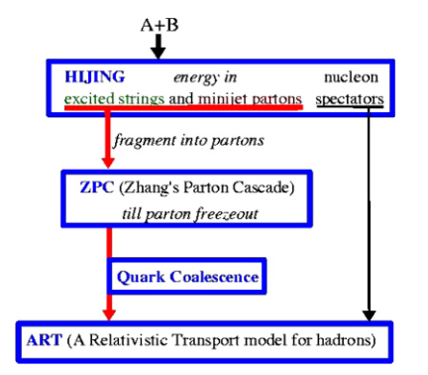
Model--AMPT
Four processes: Initial state, Parton cascade, Hadronization, Hadronic rescatterings.
Well describe collective flow in both large and small colliding systems.
In ZPC : parton cross section → collection flow
After ART : Outputs of final state particles: (px, py, pz ,x, y, z, id, mass, …)
PHYSICAL REVIEW C 72, 064901 (2005)
Shuang Guo
Notes:
部分子截面产生的集体流，这对应着哪个产生机制:不同的相互作用
ampt可以很好描述集体流的图

Slide 6
Model--PCN
In heavy ion collision
A track
N attributes
in an event
In point net cloud
A point
N dimensional space
in the point cloud
PCN in high energy nuclear physics:
Reconstruct the impact parameter¹
Classify equation of state ²
Identify weak intermittency signal³…
A dimension-raising operation through one-dimensional convolution
An invariant rearrangement operation to realize the correlation in high-dimensional sapce
https://doi.org/10.48550/arXiv.1612.00593
M. Omana Kuttan, J. Steinheimer, K. Zhou, A. Redel-bach, and H..Stoecker, Particles 4, 47 (2021).
M. Omana Kuttan, K. Zhou, J. Steinheimer, A. Re- delbach, and H. Stoecker, JHEP 21, 184 (2020),arXiv:2107.05590 [hep-ph].
Y. Huang, L.-G. Pang, X. Luo, and X.-N. Wang, Phys. Lett. B 827, 137001 (2022), arXiv:2107.11828 [nucl-th].
Shuang Guo
Notes:
input transform and feature transform的作用
The T-net aims to learn an affine transformation matrix by its own mini
network. The T-net is used twice. The first time to transform the input features (n, NUM_DIMENSION)
into a canonical representation. The second is an affine transformation for alignment in
feature space (n, NUM_DIMENSION). As per the original paper we constrain the transformation to be
close to an orthogonal matrix
T-net 首次用于将输入特征（n, NUM_DIMENSION）转换为标准表示。这意味着，它将输入点云中的每个点的特征变换到一个标准化的坐标系中，使点云在进行后续处理时具有一致性。
第二次使用：在特征空间中，T-net 进行第二次仿射变换，对已经提取的特征进行对齐。这一步确保了在特征空间中，各点的特征是对齐的，从而便于后续的特征聚合和处理。
通过一维卷积对粒子进行升维操作，然后对所
有粒子做重排不变操作，实现粒子在高维空间的关联

Slide 7
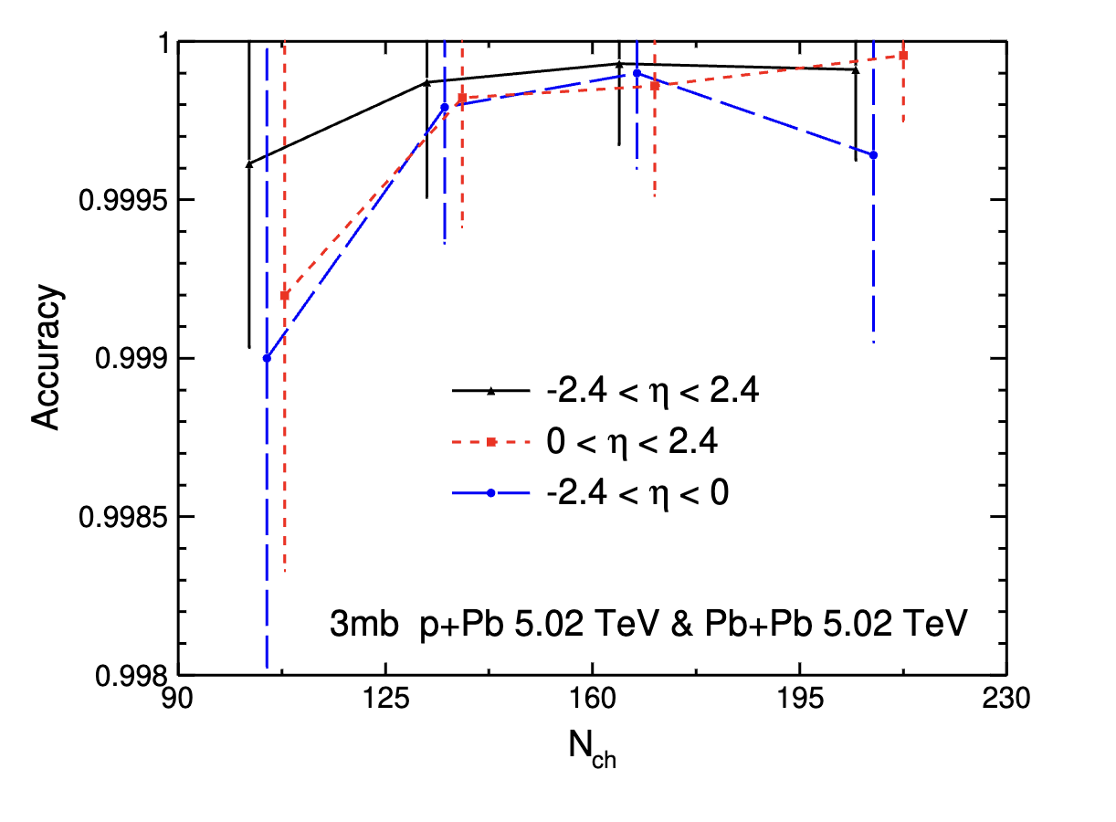
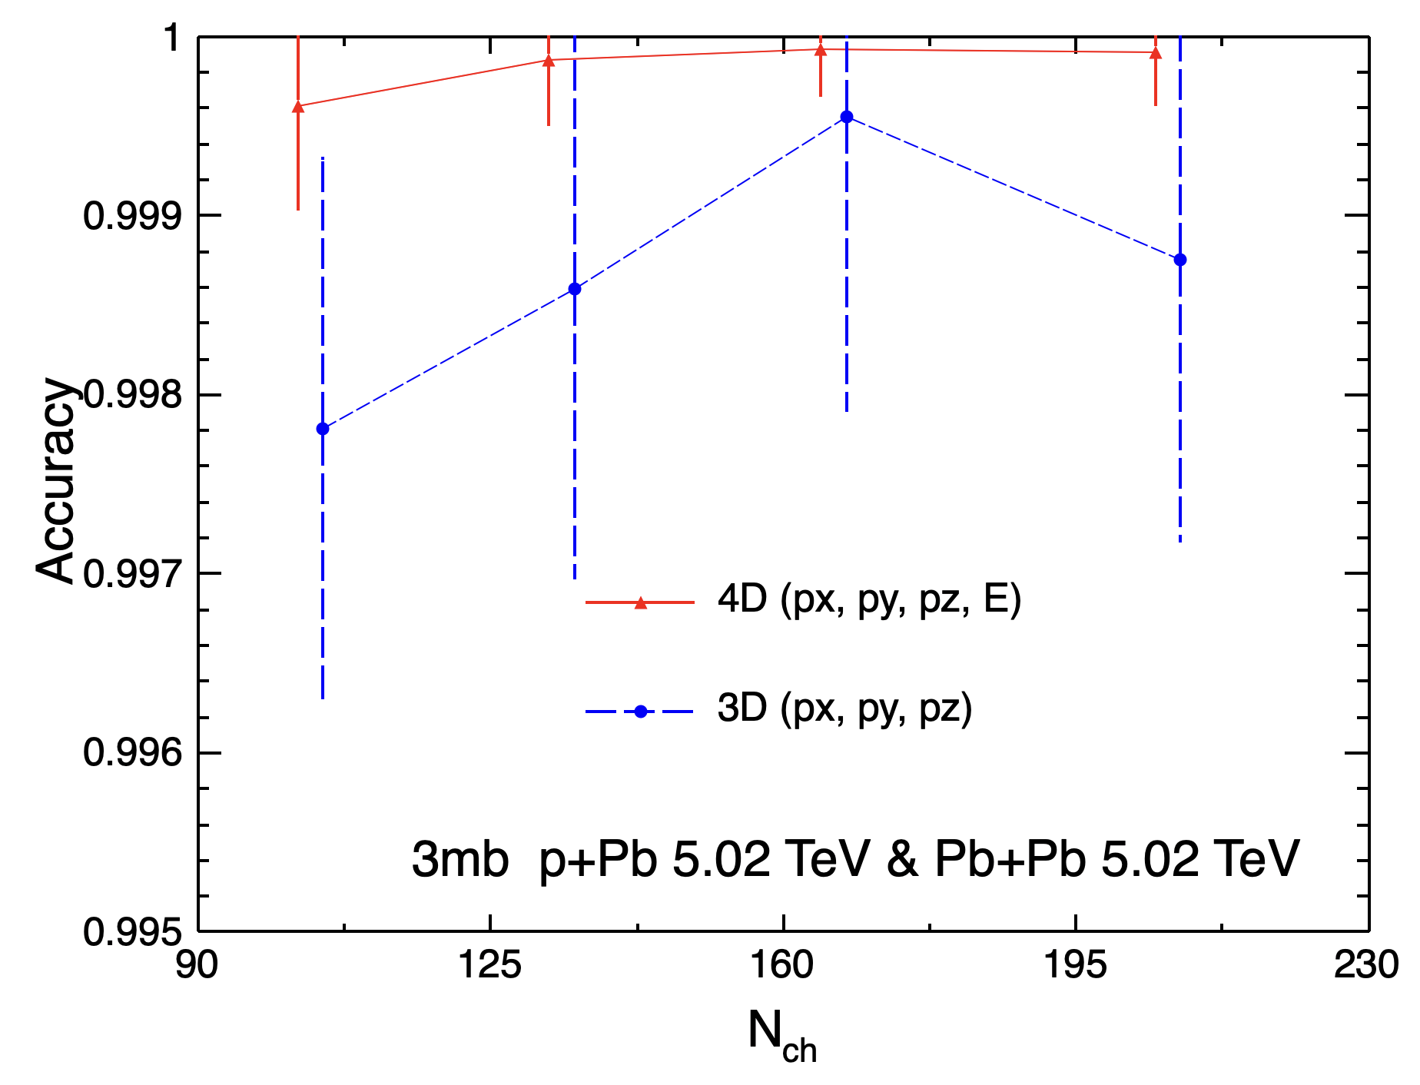
Method & Result
$p_{x}, p_{y}, p_{z}, E$ as input
PCN can identify two systems
From what features?
Change different inputs
Remove or reduce some known features
Observe changes in accuracy
Infer which features the model has learned
$p_{x}, p_{y}, p_{z}$ as input
Shuang Guo
Notes:
cut pt 和哪个实验相符:
pz的物理，pz和eta的关系

Slide 8
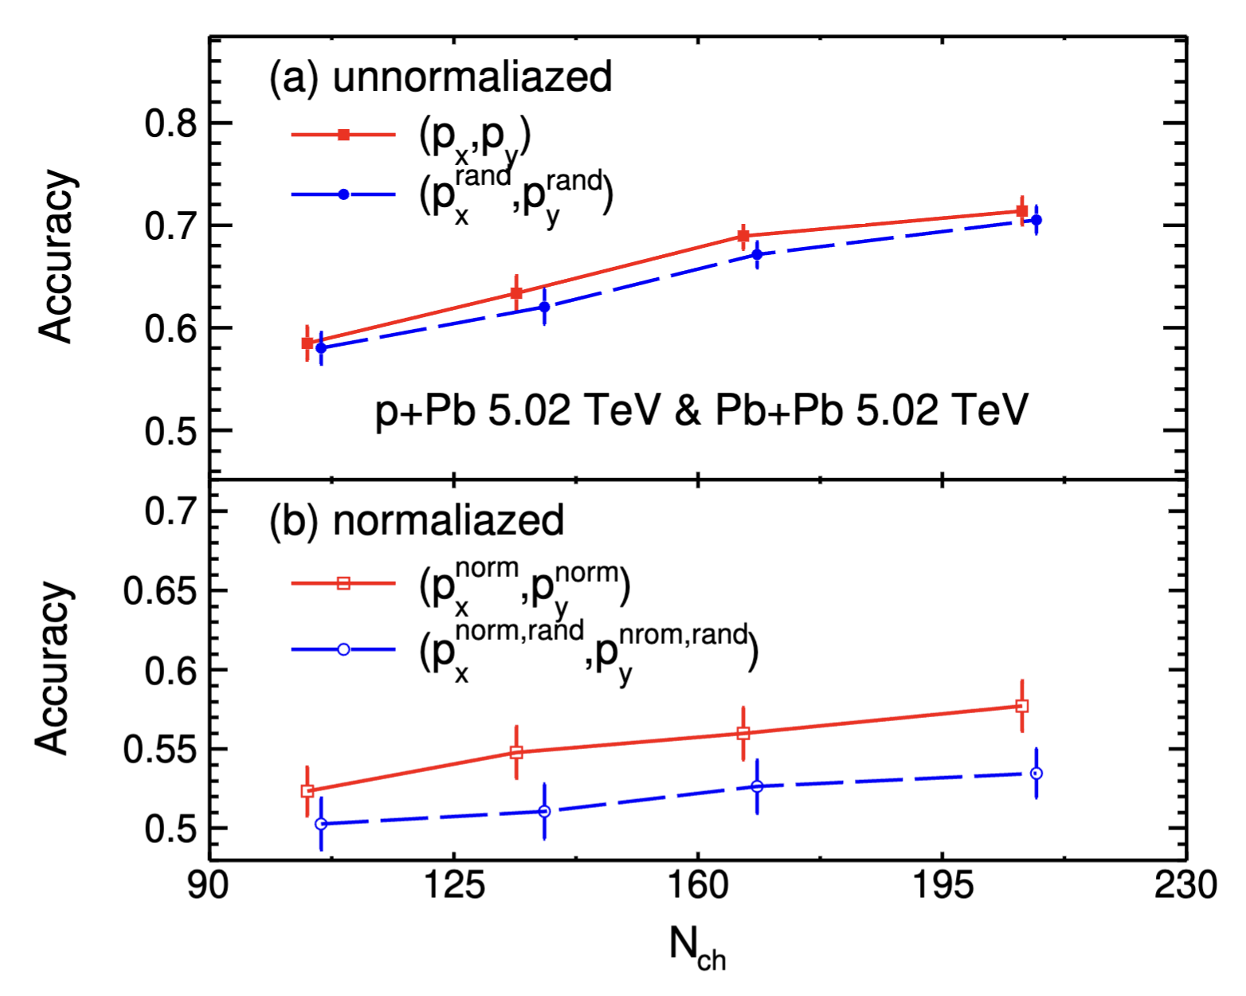
Method & Result
Eliminate the $p_{t}$value:
$$p_{x}^{norm}=\frac{p_{x}}{p_{T}}$$
$$p_{y}^{norm}=\frac{p_{y}}{p_{T}}$$
Eliminate azimuthal angle distribution:
$$p_{x}^{rand}=p_{x} ×cosφ_{rand}−p_{y}×sinφ_{rand}$$
$$p_{y}^{rand}=p_{x} ×sinφ_{rand}−p_{y}×cosφ_{rand}$$
$$p_{x}^{rand,norm}=\frac{\left(p_{x} ×cosφ_{rand}−p_{y}×sinφ_{rand}\right)}{p_{T}}$$
$$p_{y}^{rand,norm}=\frac{\left(p_{z} ×sinφ_{rand}−p_{y}×cosφ_{rand}\right)}{p_{T}}$$
Decrease from 3D to 2D: $p_{z}$ matters!
No Decrease after random rotation: $p_{t}$ > $φ$
Decrease after rand. with norm.: Collective Flow !!
Notes:
mean pt 和pt distribution? ? we follow CMS method Multiplicity and transverse-momentum dependence of two- and four-particle correlations in pPb and PbPb collisions
看一下毕业论文，
集体流的来源
随机旋转是怎么加的

Slide 9
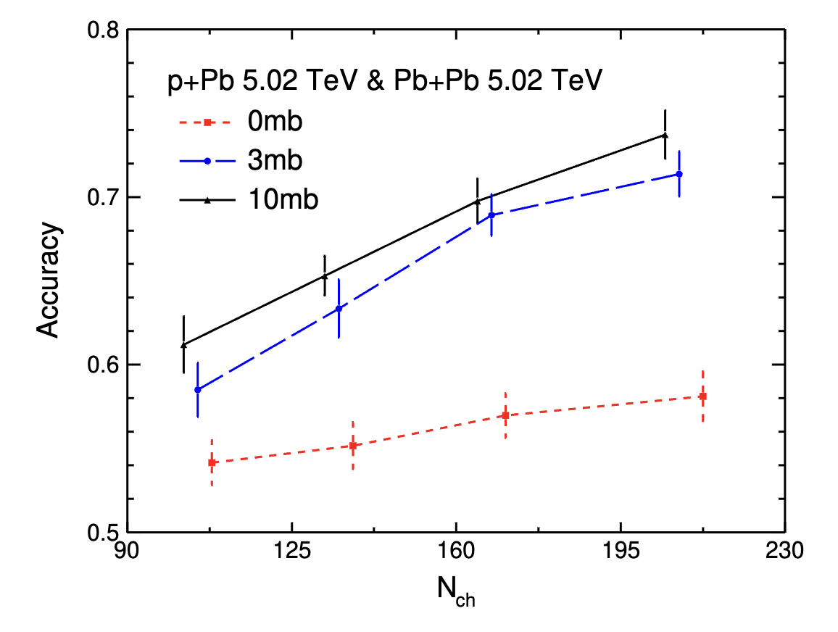
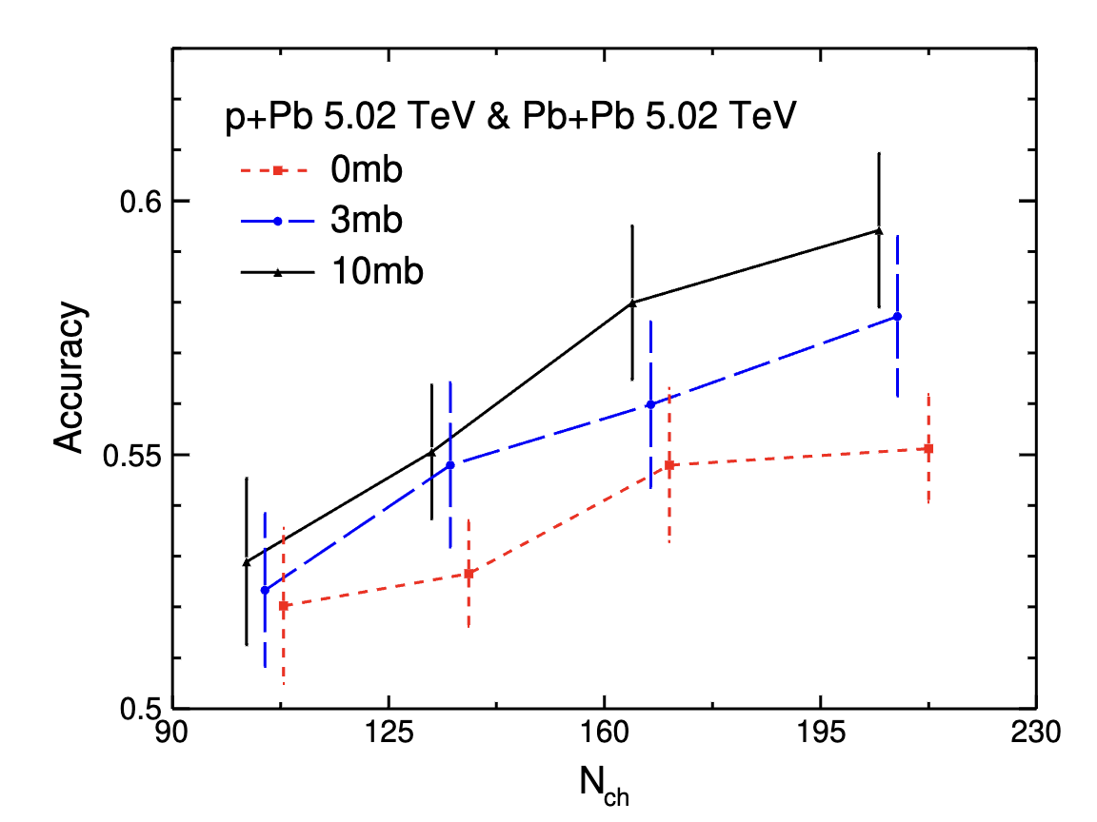
Method & Result
cross section of parton interaction → collective flow in different intensities
$p_{x}, p_{y}$ as input
$p_{x}^{norm}, p_{y}^{norm}$ as input
Higher accuracy for non-zero cross section → Collective flow helps!
more partons participating in scattering → Larger collective flow difference!
Shuang Guo

Slide 10
Summary & Outlook
Employ the PCN to identify the events of p+Pb and peripheral Pb+Pb collisions from AMPT model.
$p_{z}$distribution, $p_{T}$ spectra, and anisotropic flow are learned and captured by PCN.
The collective flow between p+Pb and Pb+Pb collisions are more different with a larger parton scattering cross section.
Serve as a preliminary analysis and set the groundwork for future data analysis
Use PCN to identity CME signal.
Use PCN to identity deformed and neutron-rich nuclear structures.

Slide 11
BACK UP

Slide 12
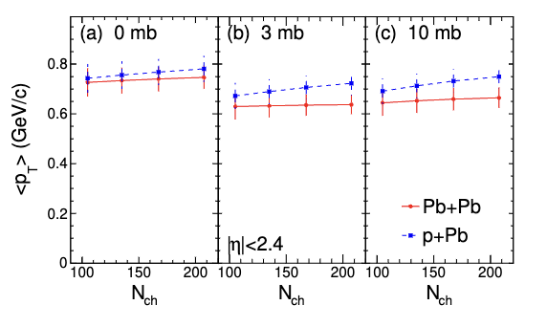
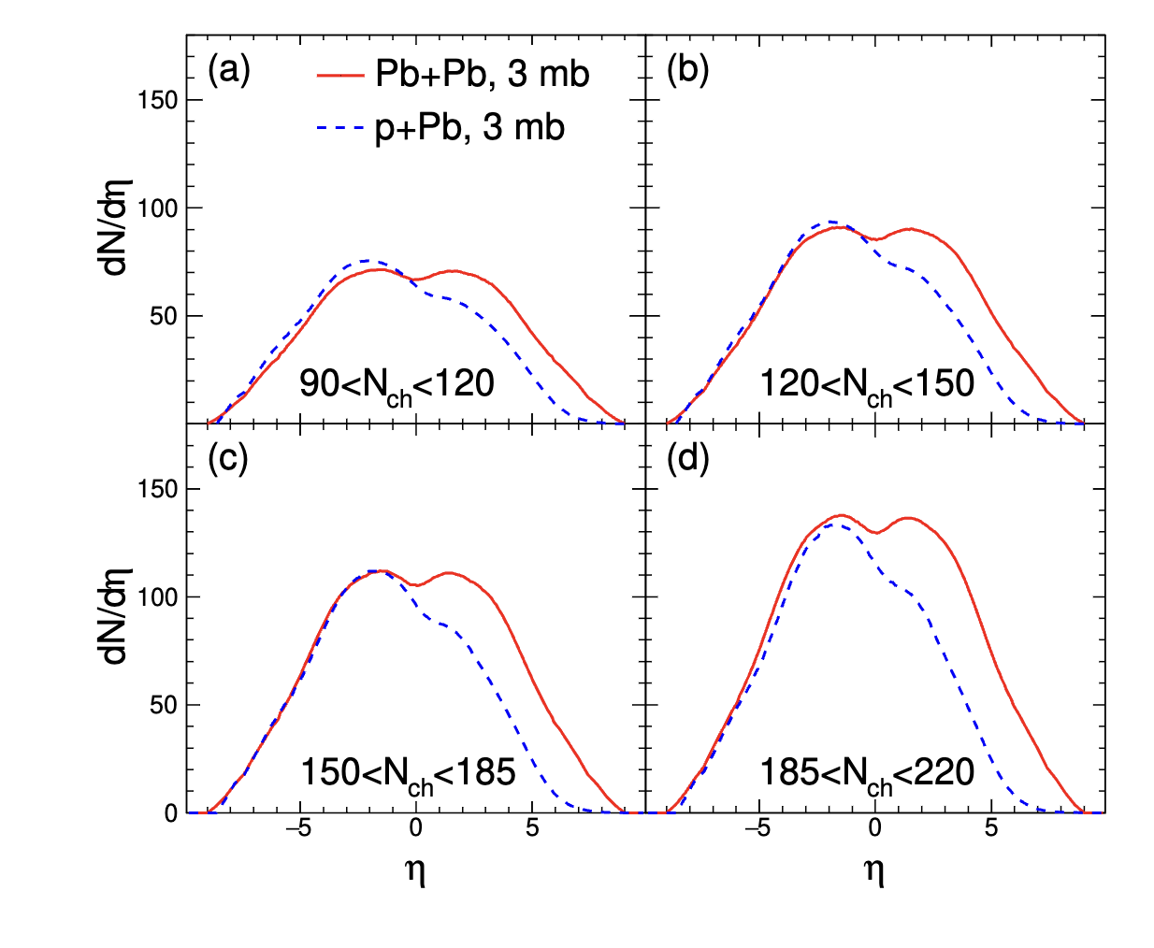
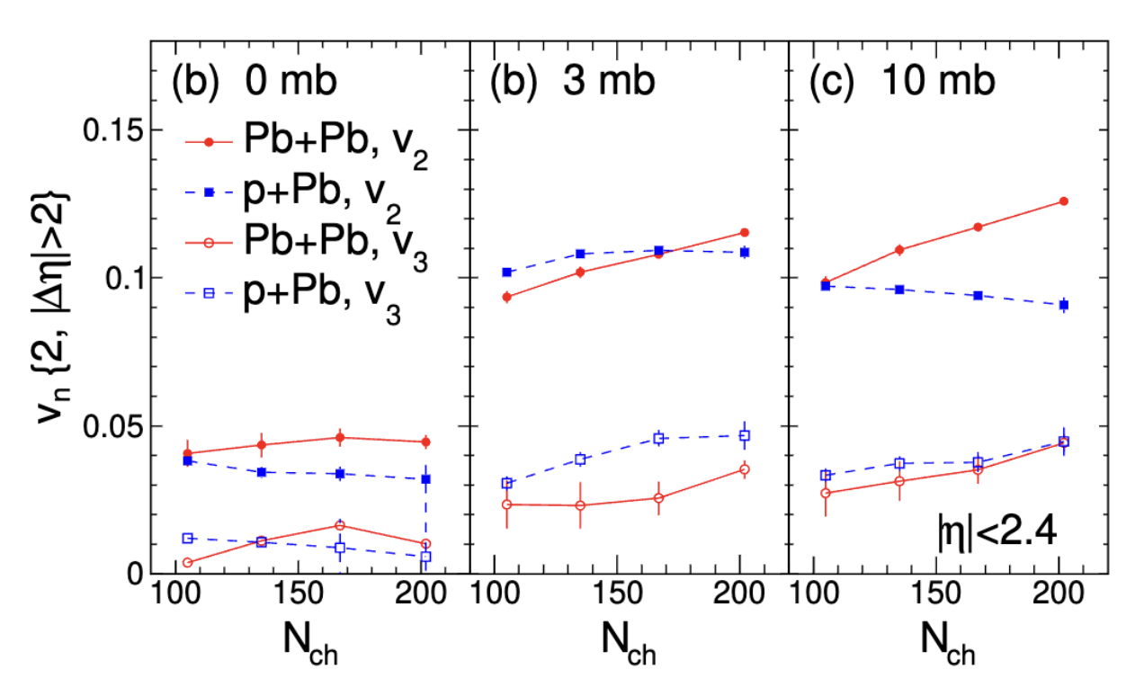

Slide 13
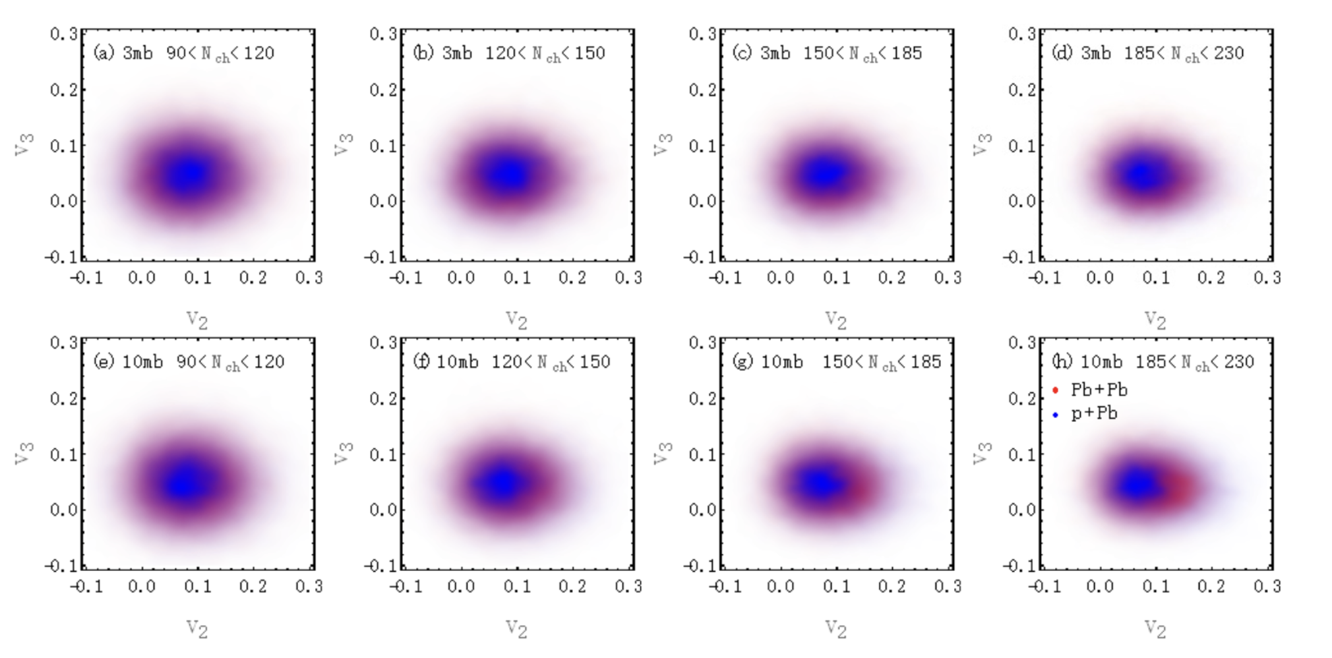
Method

Slide 14
An MLP is a type of feedforward neural network composed of multiple layers of nodes in a directed graph. Here in our model the pointwise MLP refers to an MLP that processes each point from the input independently.
1D CNNs are a type of neural network that uses 1D convolution operations to process and transform their input data.
A feature map, in the context of convolutional neural network in particular, is the output of one convolutional kernel (i.e., filter) applied to the previous layer, which can capture specific patterns or features from the input data, highlighting areas that match the convolutional kernel’s pattern.
A global max pooling operation is retrieving the maximum values of each feature across all particles, summarizing them as a singular global feature representative of the entire particle cloud.
A fully connected DNN is a neural network architecture where each node(i.e.,neuron) in a layer is connected to every nodes in the subsequent layer, facilitating complex pattern recognition through multiple layers of computation.
Batch normalization is a technique in deep learning that normalizes the inputs of each layer, to improve training stabilityand performance by reducing internal covariate shift The LeakyReLU activation function is defined as f (x) = x ifx > 0 and f (x) = αx otherwise, where α is a small, positive parameter.

