Slide 1

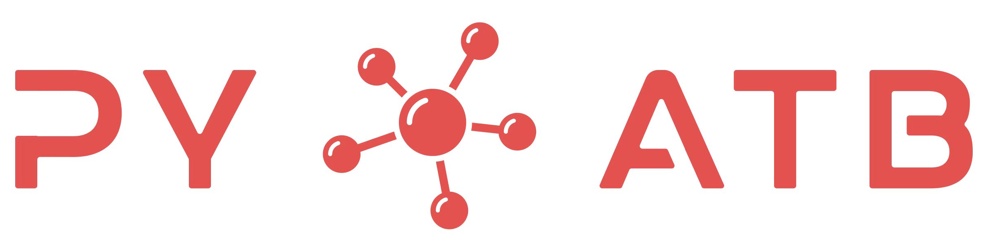
Recent development of ABACUS codes
Lixin He
Key laboratory of quantum information, University of Science and Technology of china

Slide 2
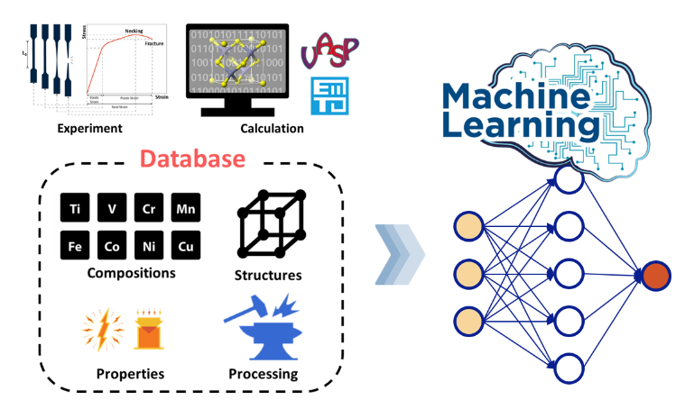
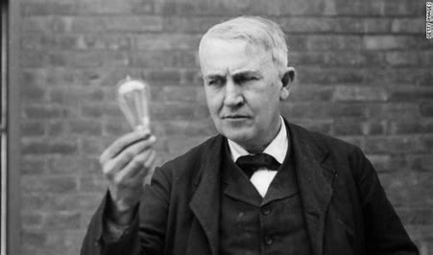
第一性原理方法促进了材料科学研究范式的转变：
传统的试错法走向智能设计
试错法
第一性原理计算
+
大数据、人工智能
需要大量高质量的数据！
拓扑材料、高压材料、极端条件 …

Slide 3
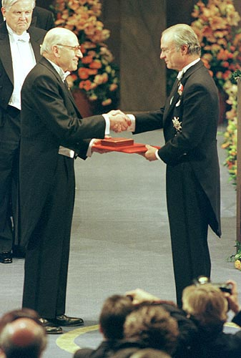
第一性原理方法
不依赖实验结果，直接从量子力学出发，在原子尺度，计算材料的物理性质！
地学
生物
凝聚态
第一性原理方法
能源、环境
材料
化学
W. Kohn 教授，1998 诺贝尔化学奖（密度泛函理论， DFT）

Slide 4
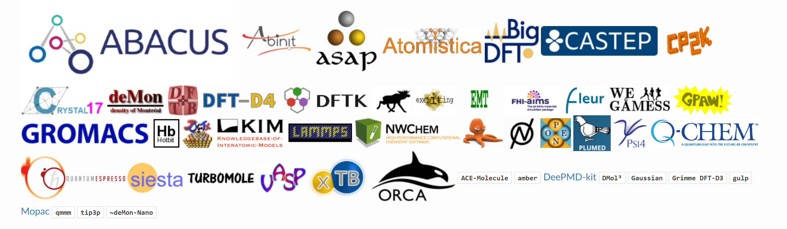
第一性原理计算软件“动物园”
国产第一性原理计算软件逐渐得到了国际认可

Slide 5

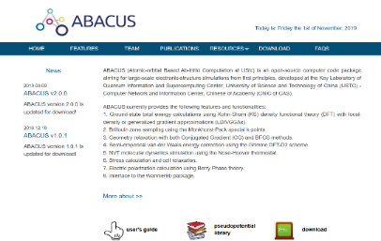
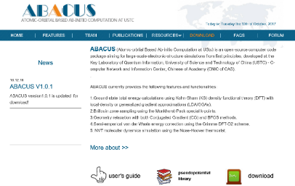
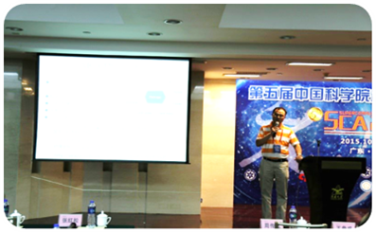
Atomic-orbital Based Ab-initio Computation at UStc
http://abacus.ustc.edu.cn/
2022年10月发布v3.0版本
2006、2007年，ABACUS项目启动
2015年10月，发布v1.0.0版本
2020年12月，发布v2.1.0版本
2019年6月，发布v2.0.0版本
2016年12月，发布v1.0.1版本
2021年获基金委重点项目支持！
2016年获科技部重点研发计划支持！

Slide 6



ABACUS项目发展情况
2023年ABACUS软件发展
2023.12.29
优化，重构，提升计算效率！
ABACUS 3.5.0
2023.10.07
建立自动测试工作流，提升单元测试覆盖率；
完成代码框架以及基础数据结构的重构；
优化输入参数，加强用户体验；
优化安装方式，便于多平台推广；
优化代码，大幅提高了整体计算效率。
ABACUS 3.4.0
2023.07.13
ABACUS 3.3.0
2023.04.01
ABACUS 3.2.0
2023.01.02
ABACUS 3.1.0
2023年度一共发布了22个软件新版本！

Slide 7
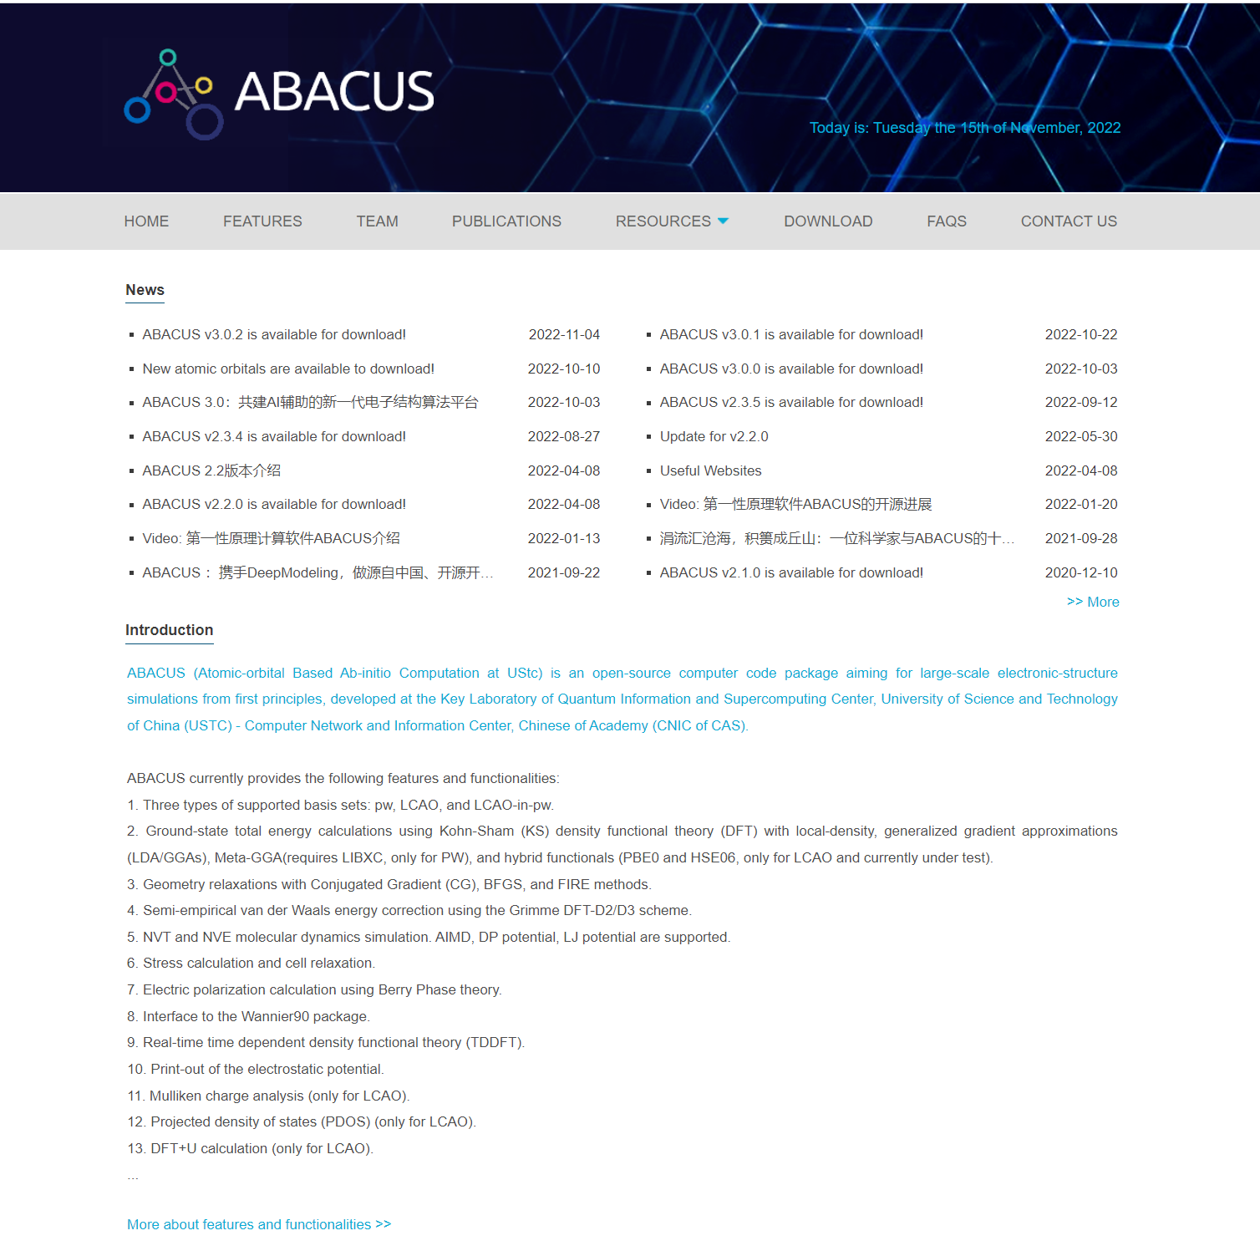

Main features
License: LGPL3.0
Norm-conserving pseudopotential（& PAW pseudopotential)
Support both numerical atomic orbital (NAO) and plane wave (PW) bases
Provide high-precision NAO basis sets.
Feature-rich and user-friendly.
Capable of efficiently computing systems with thousands of atoms
https://abacus.ustc.edu.cn

Slide 8
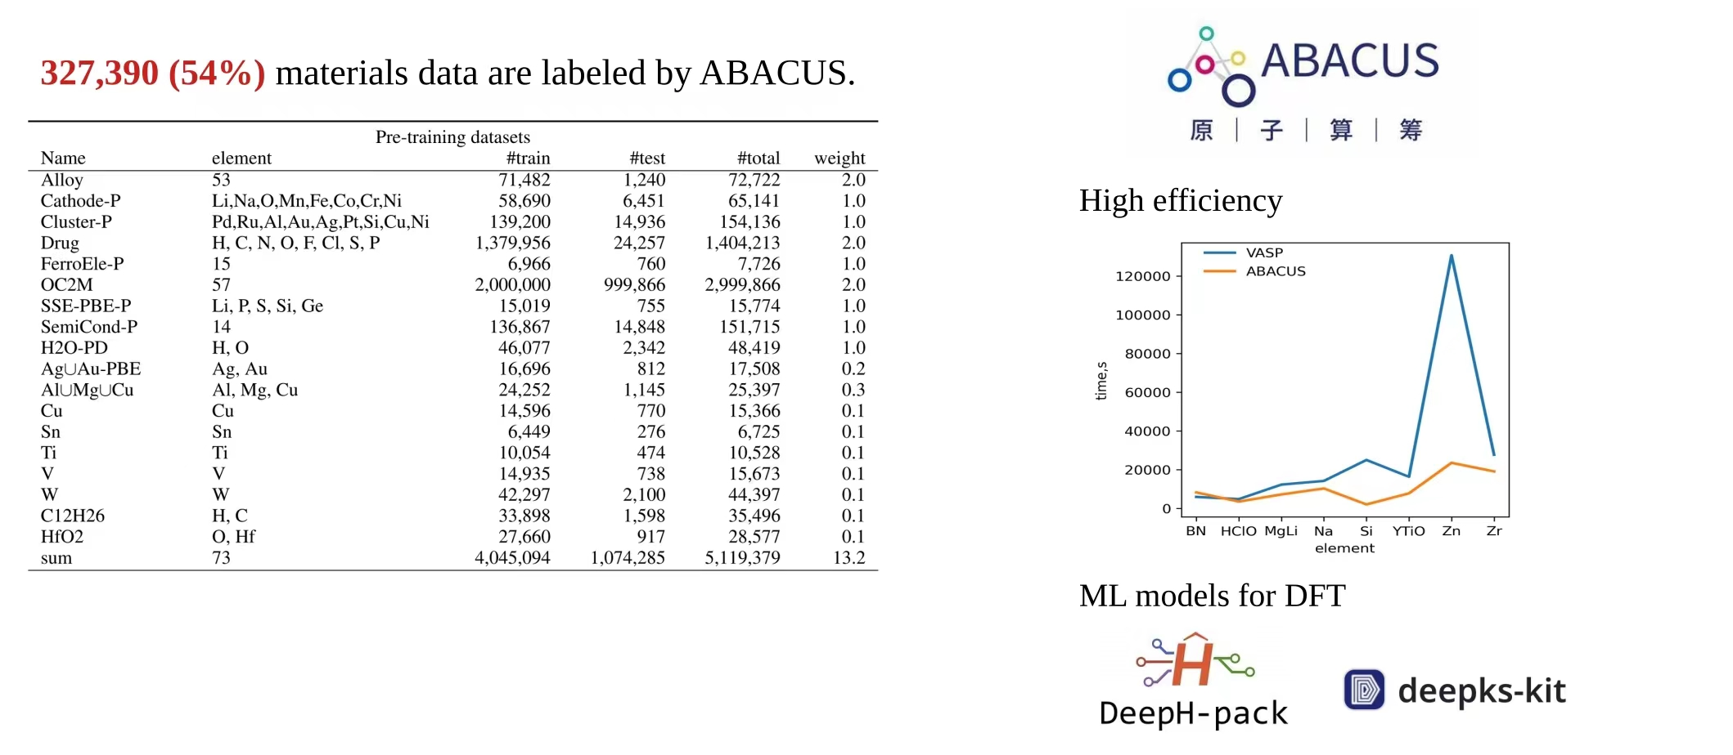
“大原子模型”训练
Arxiv: 2312.15492
王涵研究员 北京应用物理与计算数学研究所

Slide 9

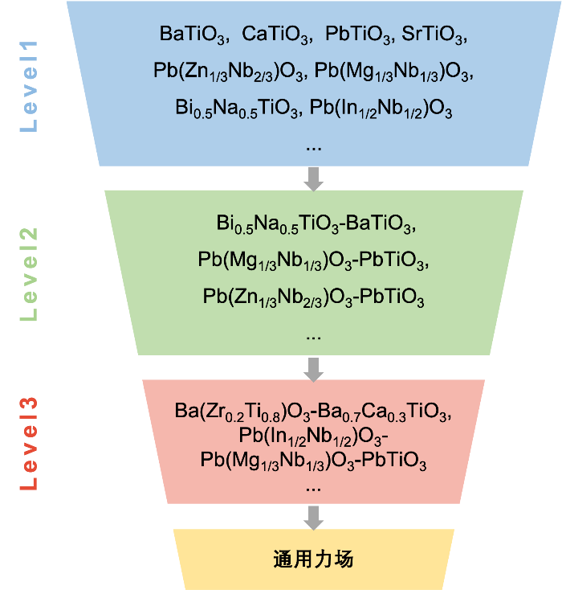
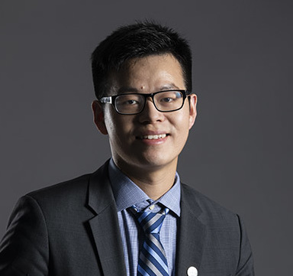
科研攻关成果-应用情况
通用力场
能够描述一系列ABO3类型固溶体的通用力场：19个体系、180组分
基于DAP1+ABACUS
西湖大学 刘仕教授
成本：CPU 核时<20万
Jing Wu, Jiyuan Yang, Yuzhi Zhang, Yudi Yang, Linfeng Zhang, Shi Liu, 在 PRB 发表

Slide 10
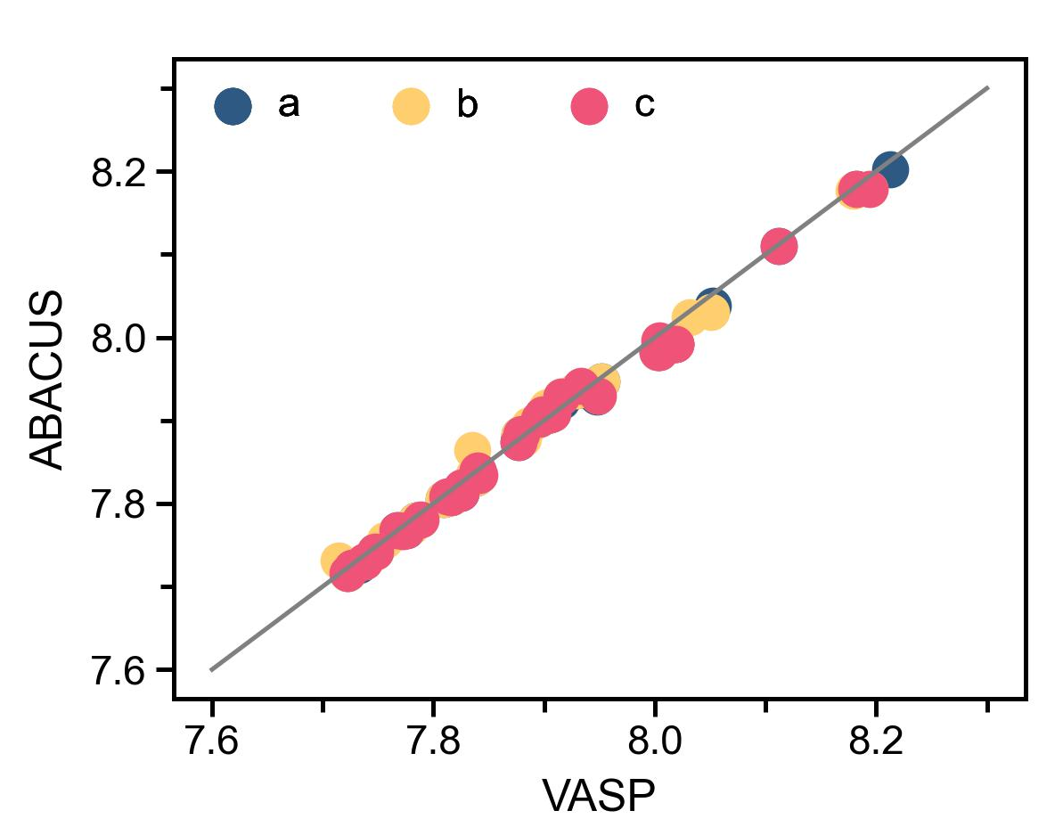
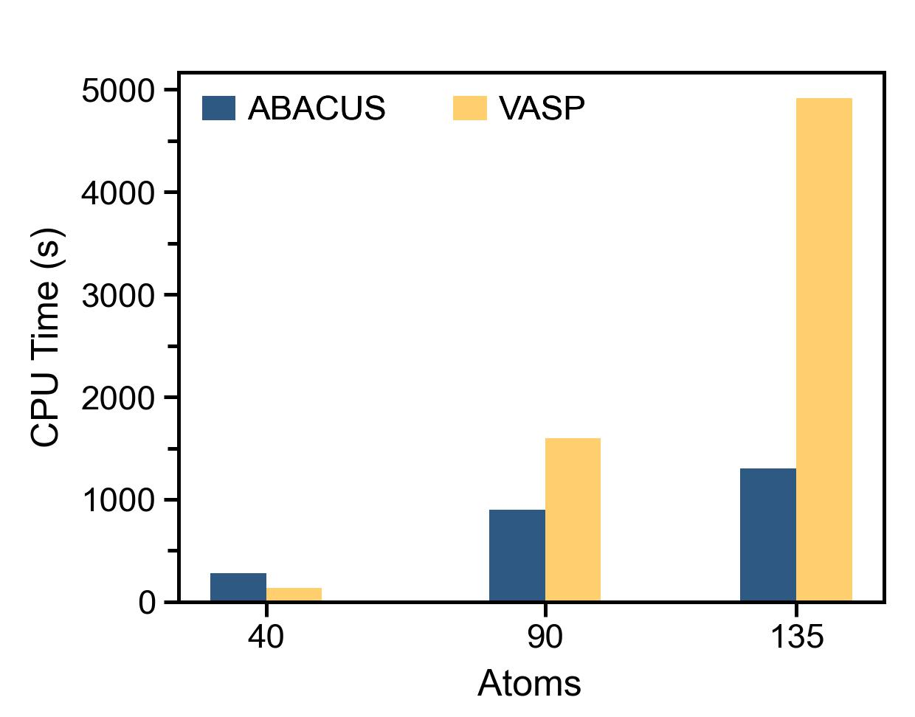
科研攻关成果-应用情况
ABACUS解决计算成本问题
ABACUS计算精度与VASP相同，成本更低
精度
计算时间
Lattice constants
Ba_{x}Ca_{1-x}TiO₃, Ba_{x}Pb_{1-x}TiO₃, Ba_{x}Sr_{1-x}TiO₃,Ca_{x}Sr_{1-x}TiO₃,
K_{0.5}Na_{0.5}NbO₃, Pb(In_{1/2}Nb_{1/2})O₃, Pb(Zr_{1-x}Ti_{x})O₃,
Bi_{0.5}Na_{0.5}TiO₃, Bi_{0.5}Na_{0.5}TiO₃-BaTiO₃
Ba(Hf_{0.2}Ti_{0.8})O₃-Ba_{0.7}Ca_{0.3}TiO_{3,} Ba(Zr_{0.2}Ti_{0.8})O₃-Ba_{0.7}Ca_{0.3}TiO₃

Slide 11
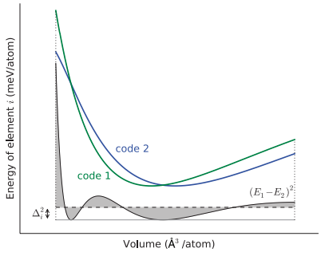
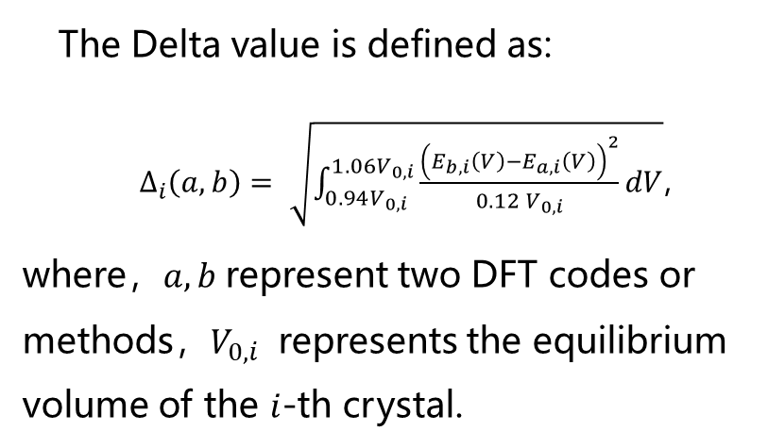
Delta test for ABACUS code
The Delta value is defined as:
$∆_{i}\left(a,b\right)= \sqrt{\int_{0.94V_{0,i}}^{1.06V_{0,i}}{\frac{{\left(E_{b,i}\left(V\right)−E_{a,i}\left(V\right)\right)}^{2}}{0.12 V_{0,i}}dV}}$,
where，$a,b$ represent two DFT codes or methods，$V_{0,i}$ represents the equilibrium volume of the $i$-th crystal.
[ Lejaeghere K, Bihlmayer G, Björkman T, et al. Science, 351，6280 (2016) ]

Slide 12
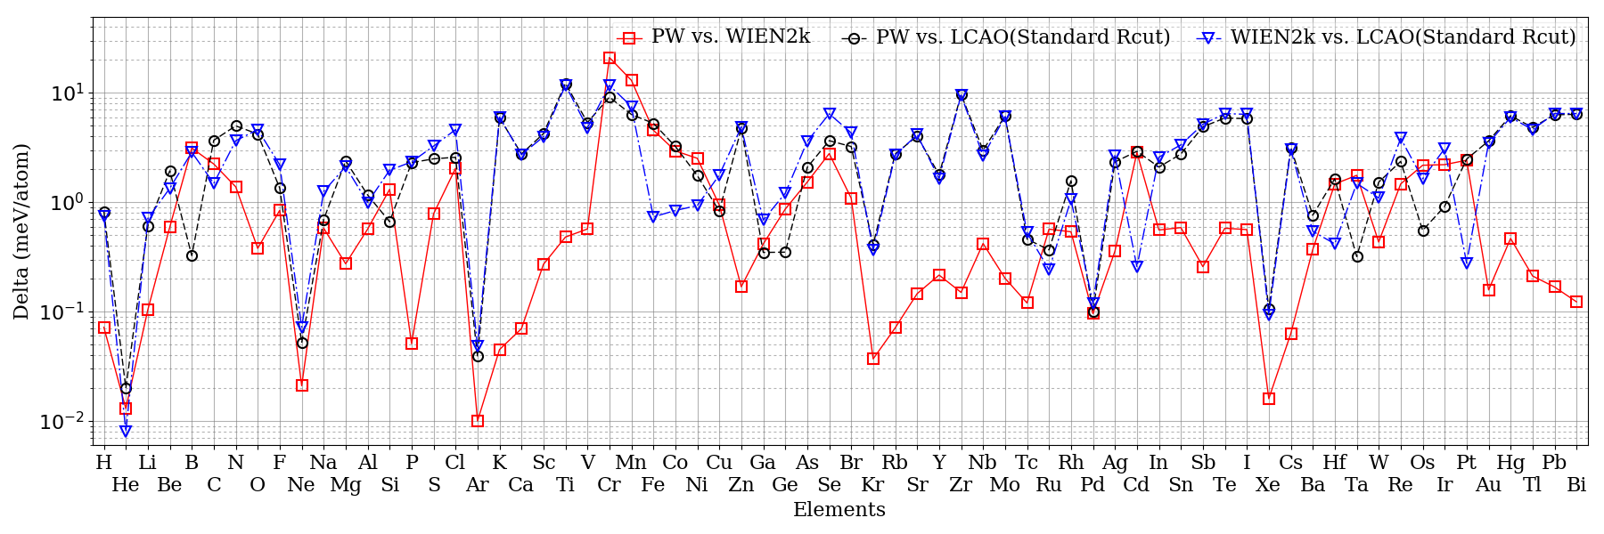
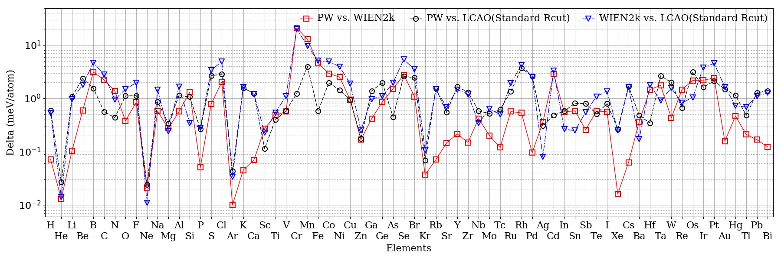
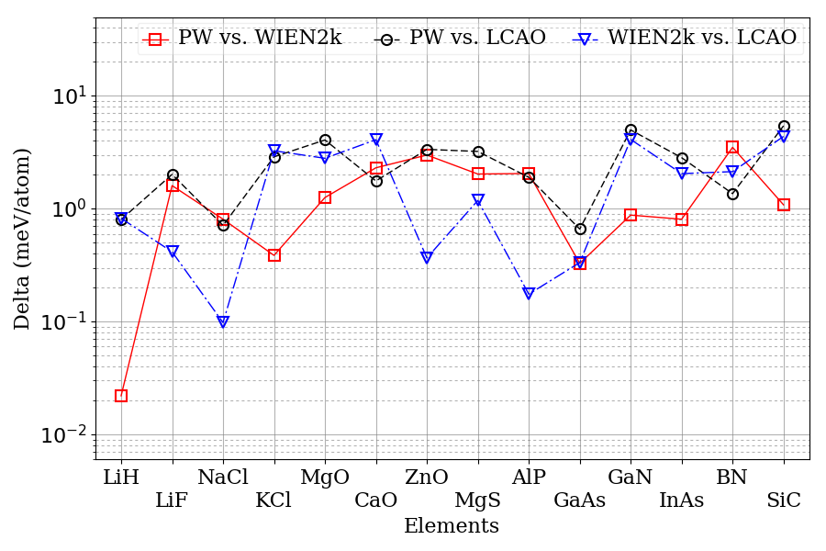
Delta test for ABACUS LCAO methods
DZP & ECut 100Ry
DFT code | Delta
PW - WIEN2k | 1.3 meV/Atom
PW - LCAO | 2.9 meV/Atom
WINE2k - LCAO | 3.0 meV/Atom
TZDP & ECut 100Ry
DFT codes | Delta
PW - WIEN2k | 1.3 meV/Atom
PW - LCAO | 1.1 meV/Atom
WINE2k - LCAO | 1.9 meV/Atom
DZP (compounds)
DFT code | Delta
PW - WIEN2k | 1.4 meV/Atom
PW - LCAO | 2.6 meV/Atom
WINE2k - LCAO | 1.9 meV/Atom

Slide 13
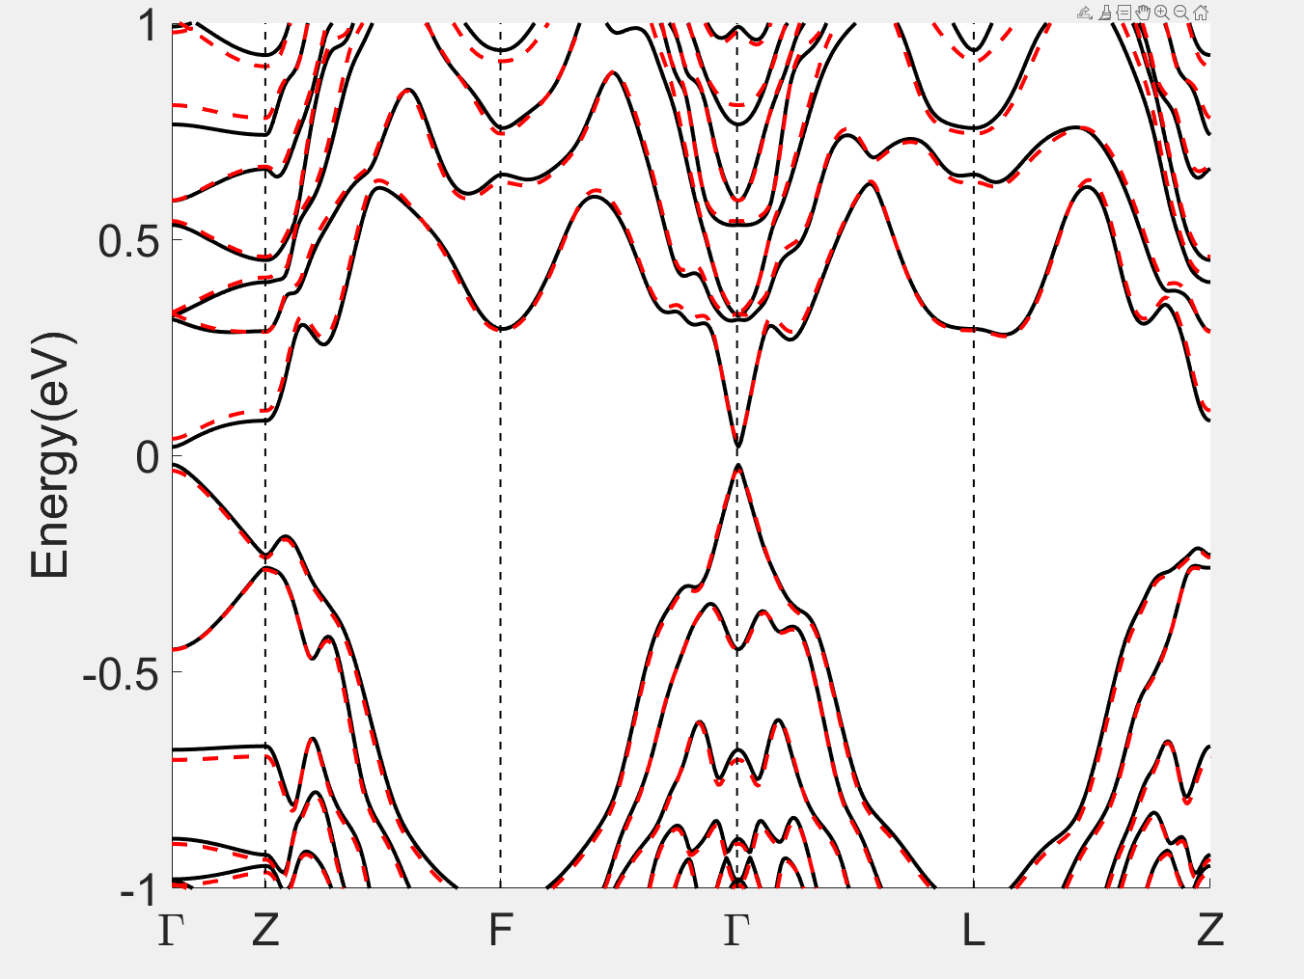
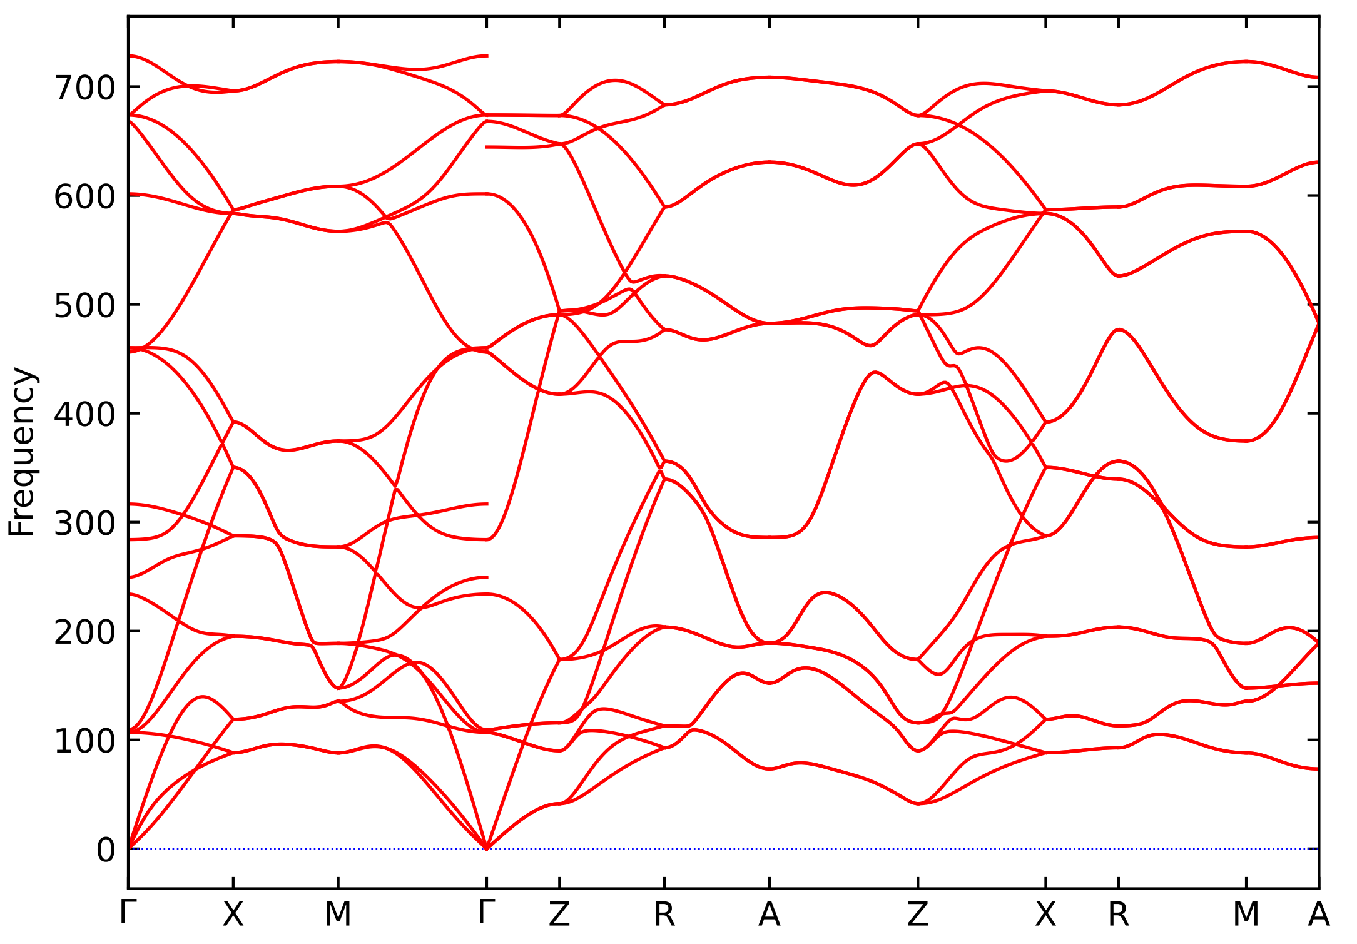
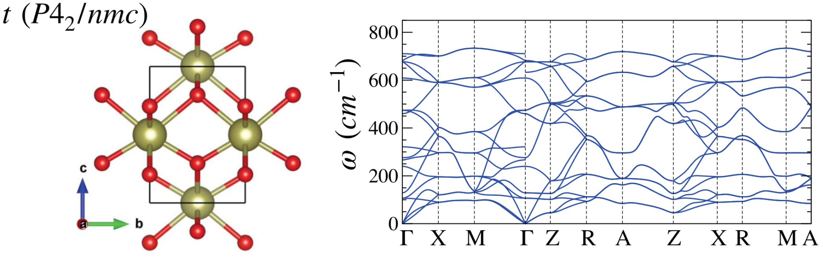
black：abacus
red：vasp
Phonon spectra of t-HfO2
MnSbTe band structure AFM+SOC
Blue：VASP
Red：ABACUS

Slide 14
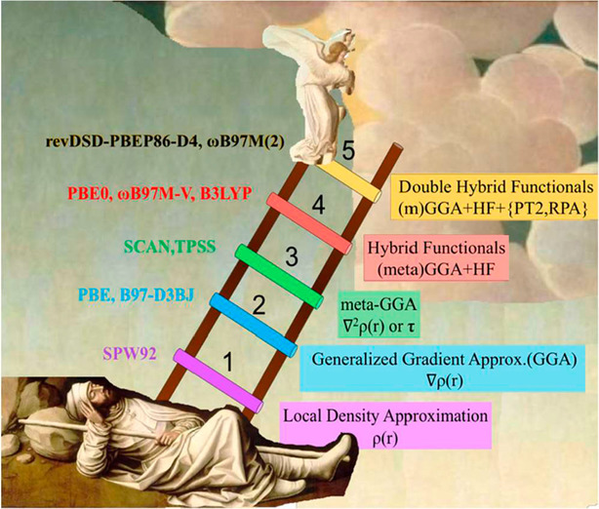
Jacob’s ladder for DFT
Implemented:
LDA GGA, SCAN, hybrid, +U, +DMFT, rt-TDDFT
Work in progress:
RPA, GW …
John Perdew, 2001
Notes:
密度泛函理论计算的精度由其交换关联泛函所采用的近似控制。

Slide 15
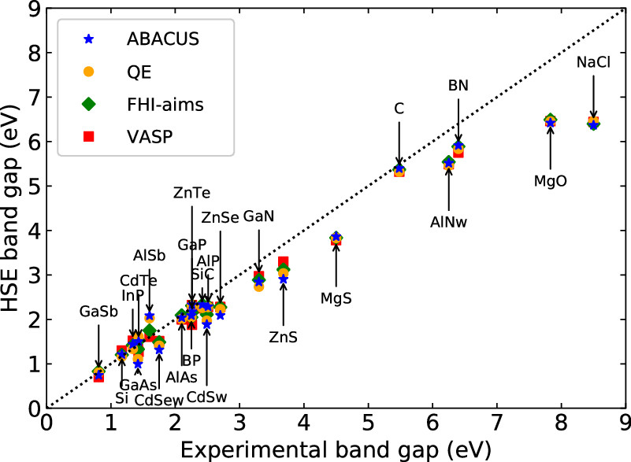
computation time vs. number of atoms $O(N)$
Si diamond structure
Time per each Hxx calculation
Efficient hybrid functional calculations for thousands of atoms

Slide 16
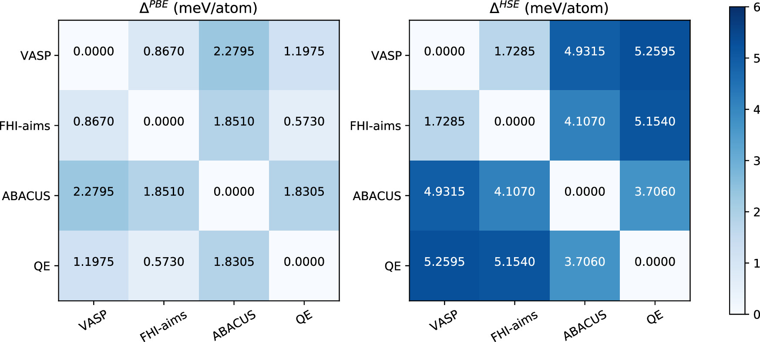
J. Phys. Chem. A 2022, 126, 5924−5931

Slide 17
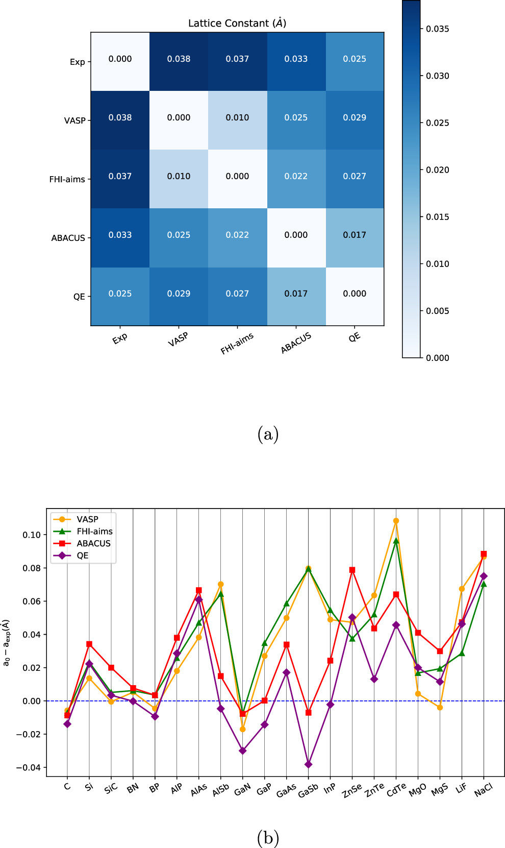
Comparison of the lattice constants
HSE calculated lattice constants
J. Phys. Chem. A 2022, 126, 5924−5931

Slide 18
HSE calculated bulk moduli (in GPa)
HSE calculated band gaps (in eV)
J. Phys. Chem. A 2022, 126, 5924−5931

Slide 19

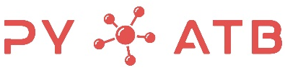
phonopy, Wannier90，ASE, Hefei-NAMD
ShengBTE …
DFPT
(linear response)
Quantum chemistry
band topology`
linear optics
Others…
Non-linear optics
Quantum transport
DeepKS
DeepMD
DeepH
Advanced DFT and beyond DFT
Machine Learning

Slide 20

PY-ATB: A Python package for band structure and related properties using ab initio tight-binding Hamiltonian
Jin, Pang, Ji Dai, and He, Comput Phys Commun 291, 108844 (2023)

Slide 21




Why
After self-consistent calculations, we need to calculate band structure and related properties: e.g. band structure, DOS, PDOS, band geometries and topological properties, optical properties, etc.
The construction of MLWFs can be quite cumbersome, especially for complex systems, and may not necessarily maintain desired symmetry.
Wannier functions is not complete as a basis set. When calculating physical properties, additional correction terms are often required.

Slide 22
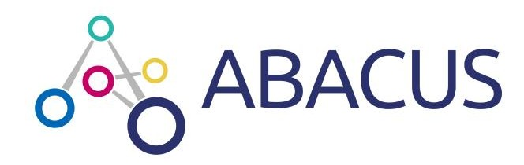
Why
One can obtain the tight binding Hamiltonian directly after self-consistent calculations using ABACUS.
NAO bases, which have spherical symmetry, can be used for any crystal symmetry.
The NAO basis set exhibits greater completeness and lower base set error than Wannier functions.

Slide 23
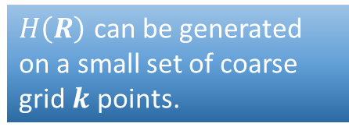
Ab initio tight-binding Hamiltonian
Kohn-Sham equation:
Bloch wave function on NAO basis (LCAO):
Obtained by self-consistent calculations
$H\left(R\right)$ can be generated on a small set of coarse grid $k$ points.

Slide 24

Perform ABACUS scf calculation
NAOs-based DFT software or Wannier function
Get H(R), S(R), r(R), structure, NAO files, etc.
Execute PYATB as an independent code
Use PYATB as a module to build python scripts
Option 1
Option 2

Slide 25
Capabilities of PYATB
V1.0
Band structure
Band unfolding
Fermi energy
Fermi surface
Find nodes
JDOS
PDOS
Fat bands
Spin texture
Polarization
Wilson loop
Berry curvature
AHC
Chern number
Chirality
optical conductivity
Shift current
Berry curvature dipole
CPGE
Berry phase
Geometric
Energy band and wave functions
Berry curvature
optics

Slide 26
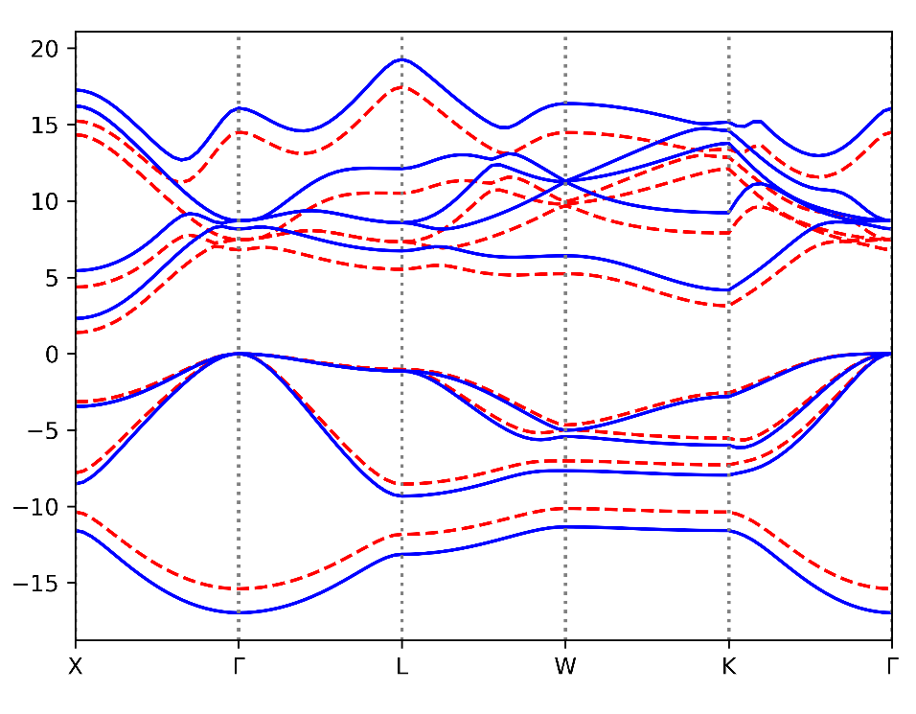
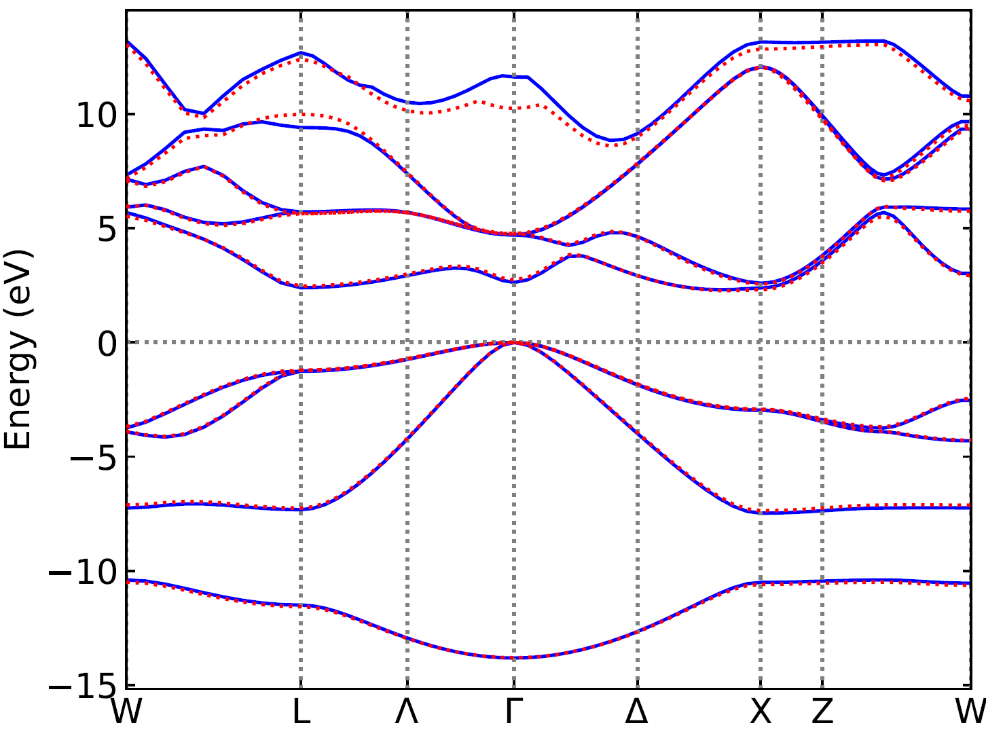
Band structure calculations
SiC (HSE vs PBE)
GaP (ABACUS vs FHI-aims)
HSE
$H\left(R\right)$ can be generated on a small set of coarse $8×8×8$grid $k$ points.
Can efficiently calculate band structure at arbitrary $k$ point, even for hybrid functionals!

Slide 27
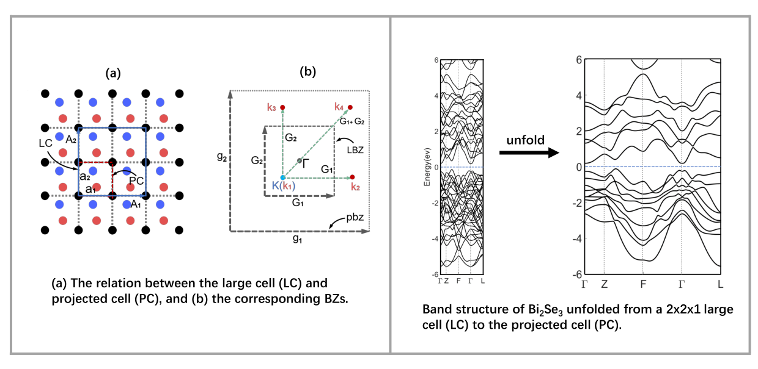
Band unfolding

Slide 28
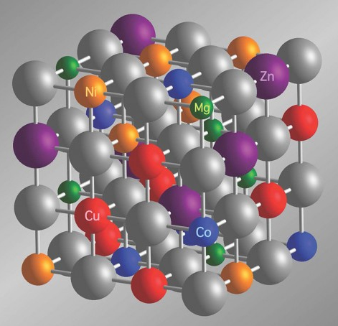
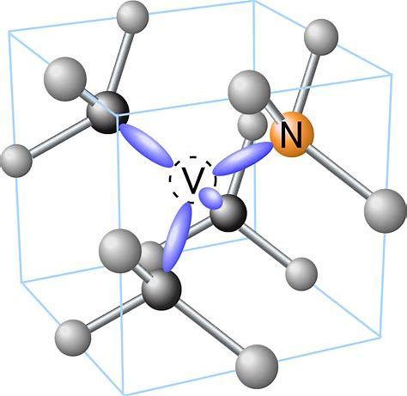
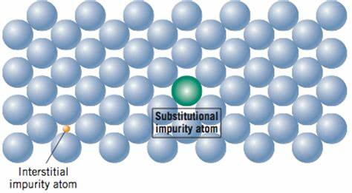
Supercell approaches in DFT calculations
Extremely complicate band structures!

Slide 29
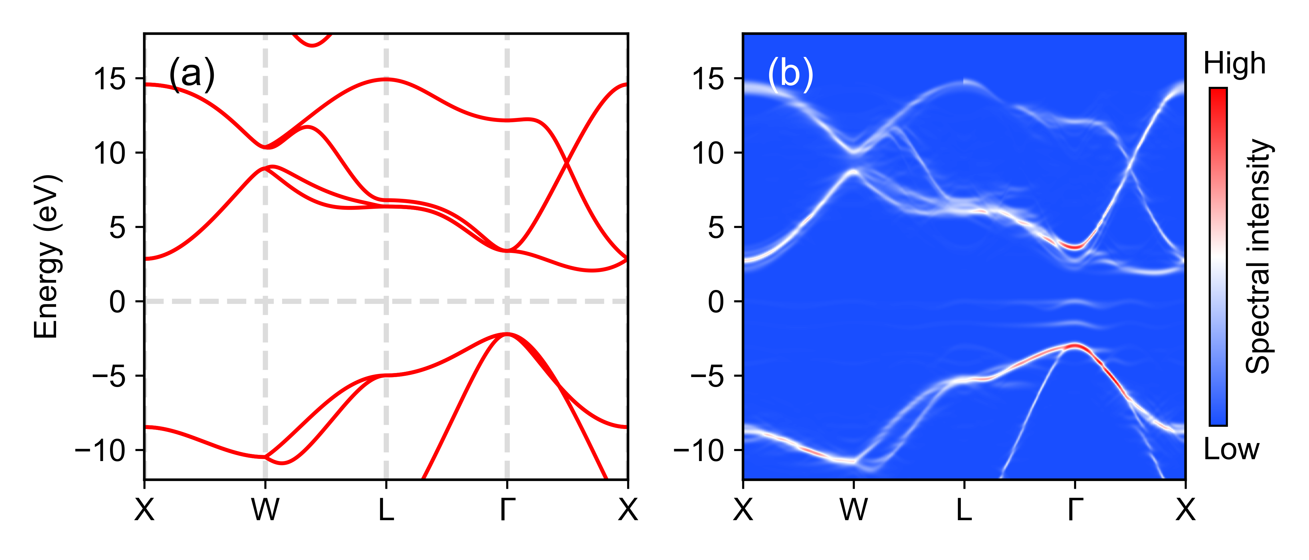
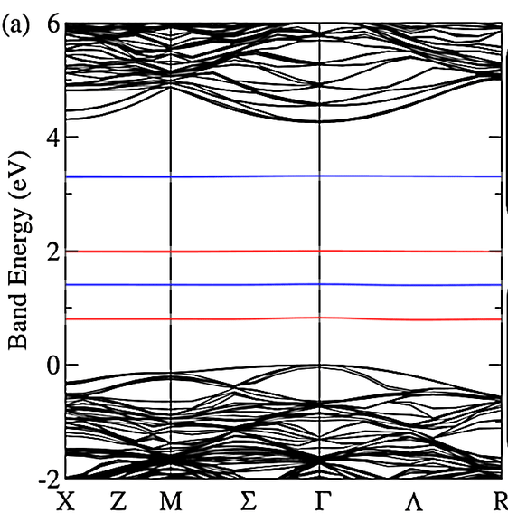
Band unfolding for NV center
Folded energy bands of NV center
energy bands of primary unit cell
unfolded energy bands of NV center

Slide 30
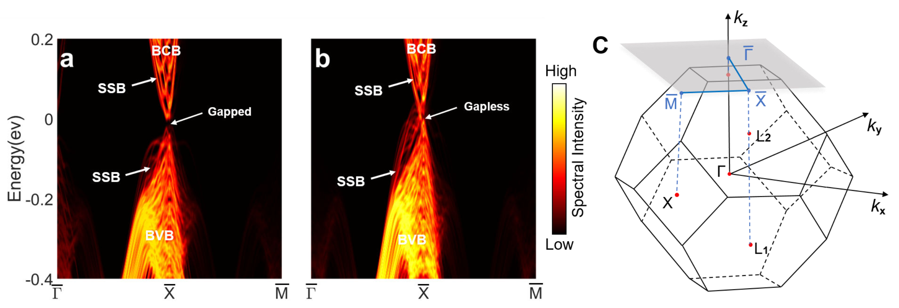
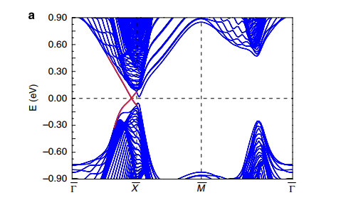
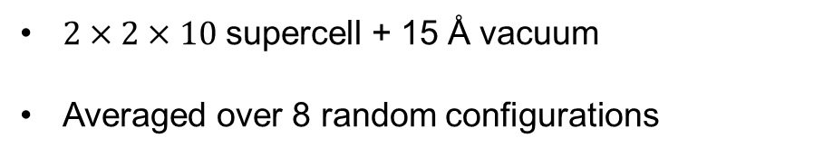
Unfold band structures Pb_{1−𝑥}Sn_{𝑥}Te
x=0.2
x=0.4
$2×2×10$ supercell + 15 Å vacuum
Averaged over 8 random configurations

Slide 31
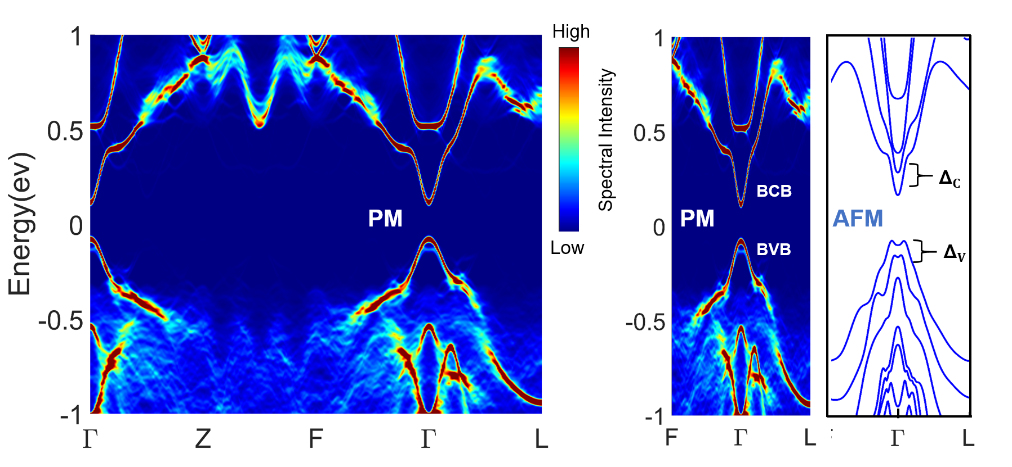
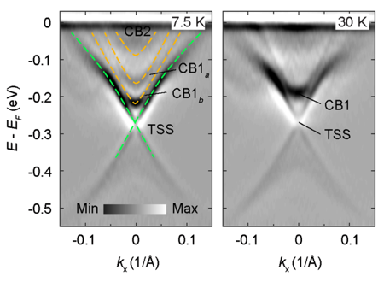
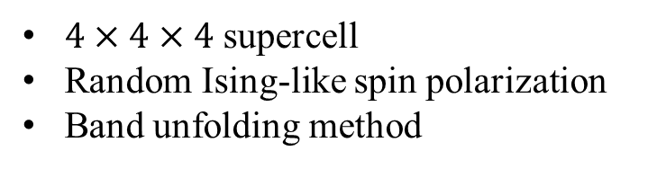
Band structure of paramagnetic (PM) state
$4×4×4$ supercell
Random Ising-like spin polarization
Band unfolding method
Band blurred away from Γ point
No BCB and BVB splitting
Dai, Jin and He, PRB 108, 085112 (2023)

Slide 32
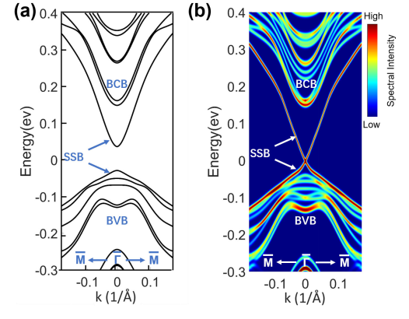
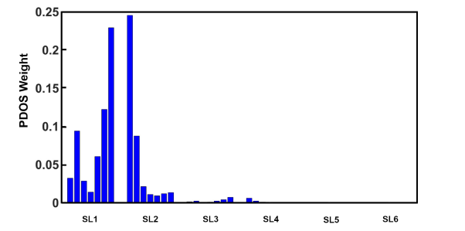
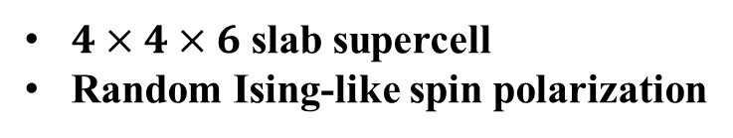
Topological SS: A-AFM vs. PM
$4×4×6$ slab supercell
Random Ising-like spin polarization
PM slab show gapless TSS
Surface states mostly localized on the outermost two SLs
A-AFM
PM
Dai, Jin and He, PRB 108, 085112 (2023)

Slide 33

TSS vs magnetic order on the surface
Gap of TSS is small when |M₂|> |M₁|
The magnetization of the first SL is weakened by dangling bonds or defects (|M₂|> |M₁| region)
Have a large net FM magnetization when gap is small
Dai, Jin and He, PRB 108, 085112 (2023)
Notes:
介绍两种不同的磁构型构建方式，M1,M2
按照逻辑介绍每一种构型
m1,m2更加一般情况，利用插值计算每一层不同极化率的
(m1,m2) = (0,-1) 存在能隙，说明第二层FM层Mn磁性对于能带有很大贡献
(m1,m2) = (0,0) 基本无能隙，说明对于能带贡献的磁性主要是由于最表面两层贡献
说明模型可靠性：1.第一层磁化收到影响，比第二层更加弱；和实验结果不冲突，有一个净的磁化，（并且有准的三次对称性？）

Slide 34
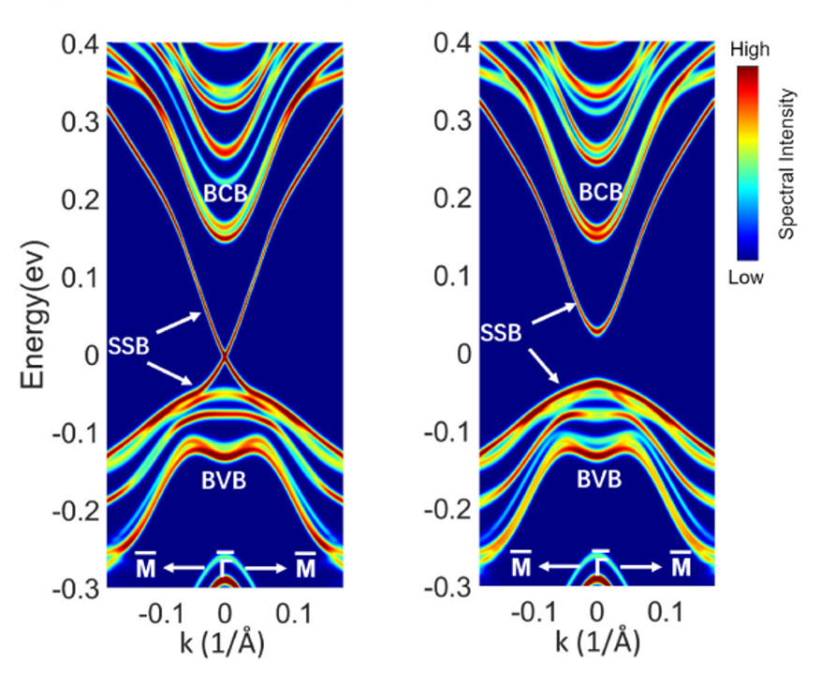
TSS vs magnetic order on the surface
(M₁,M₂) = (0,-1), gapped (38mev);
(M₁,M₂) = (0,0), nearly gapless (0.6mev）;
(M₁,M₂) = (1,-1), A-type AFM(65mev）;
|M₂|> |M₁|, tend to have small gaps;
|M₂|< |M₁|, tend to have large gaps;
M₁ ≈ -1/3M₂ nearly gapless;
(M₁,M₂) = (0.8,-0.45), gap size is approximately 69mev, slightly larger than that of the perfect A-type AFM slab
(0.25, -0.625)
(0.75, -0.5)
“gapless” TSS can coexist with the magnetic order at surface
Simple effective models are not enough
Dai, Jin and He, PRB 108, 085112 (2023)
Notes:
介绍两种不同的磁构型构建方式，M1,M2
按照逻辑介绍每一种构型
m1,m2更加一般情况，利用插值计算每一层不同极化率的
(m1,m2) = (0,-1) 存在能隙，说明第二层FM层Mn磁性对于能带有很大贡献
(m1,m2) = (0,0) 基本无能隙，说明对于能带贡献的磁性主要是由于最表面两层贡献
说明模型可靠性：1.第一层磁化收到影响，比第二层更加弱；和实验结果不冲突，有一个净的磁化，（并且有准的三次对称性？）

Slide 35
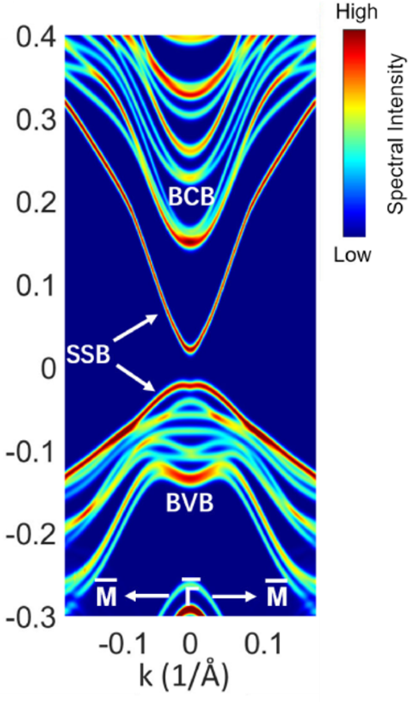
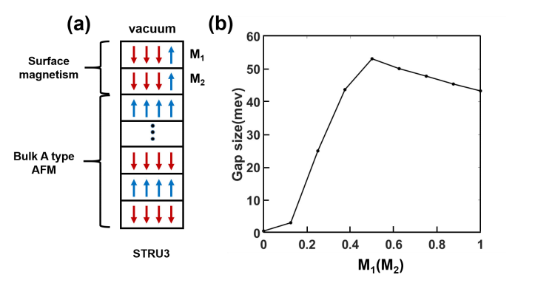
Open a considerable gap via proximity effect
M₁=M₂ >0
（0.375, 0.375）
Gap first increases with increasing M₁ and saturates at M₁=0.5
Tend to Weyl semimetal
(SSB is not Dirac like)
Proximity effect
Heterojunction technique
Nano Lett. 19, 2472 (2019)
Sci. Adv. 5, eaax9989 (2019)
Sci. Adv. 6, eaaz0948 (2020)
Phys. Rev. B 101, 121401(R) (2020)
Phys. Rev. B 103, 195308 (2021)

Slide 36
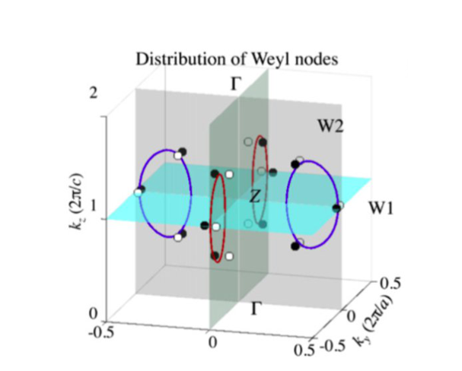

Find nodes
PY-ATB
Nodal structure of TaAs
RevModPhys.90.015001
Useful for finding Dirac and Weyl points

Slide 37

Spin texture
spin texture of Bi₂Se₃ at $kz=0$ plane

Slide 38




Electric polarization
PbTiO₃
$$P=\frac{−e}{{2π}^{3}}\sum_{n}{\int_{BZ}{dk^{3}<u_{nk}\left|i∇_{k}\right|u_{nk}>}}$$

Slide 39







Wilson loop
Bi₂Se₃ 6个时间反演不变面的Wilson loop，确定Z₂为（1，000）

Slide 40

Berry curvature：BCC Fe

Slide 41

MnBi₂Te₄
in FM states
Weyl points
Chirality
Chern number of $\left(k_{x},k_{y}\right)$ plane as function of $k_{z}$

Slide 42


Optical conductivity and dielectric function
$$30×30×30$$
$k$ points.

Slide 43

Shift-current conductivity of WS₂
$300×300$ k-points
fat bands: W 5d orbitals
Second order optical effects

Slide 44

Background: the bulk photovoltaic effect (BPVE)
DC current generation under linearly polarized light in non-centrosymmetric materials
Compared with traditional PN-based PV devices:
Homogeneous, the manufacturing is more simple.
Above-bandgap photovoltage
Surpass Shockley-Quiesser limit.
Dai & Rappe. Chem. Phys. Rev. 4, 011303 (2023).

Slide 45



History of the BPVE:
In 1956, reports about BPVE emerged. In the 1970s, numerous experiments found the BPVE in ferroelectric materials, such as BaTiO₃ and LiNbO₃. (very weak in bulk)
Tip-enhanced photovoltaic effects in BiFeO3 (2011)
PV voltage far above band gap (2010)
BiFeO3: $E_{g}\sim 2.67eV$, $V_{oc}\sim$18 eV$≫E_{g}$
nature communications | 2:256
Greatly enhanced in nanostructures!
NATURE NANOTECHNOLOGY | VOL 5 | FEBRUARY 2010 |
Notes:
Young 和 Rappe 使用第一性原理计算了BaTiO3的shift current，并于实验数据进行比较，理论计算比较符合实验的结果。

Slide 46



2016: claim PCE of BTO exceeds S-Q limit for that band gap
Notes:
Young 和 Rappe 使用第一性原理计算了BaTiO3的shift current，并于实验数据进行比较，理论计算比较符合实验的结果。

Slide 47

Mechanisms for BPVE:
Extrinsic: asymmetric scattering
Intrinsic: shift-current
Theory:
In 1981, von Baltz and Kraut proposed shift current as an explanation for the BPVE in BaTiO₃.
In 2000, Sipe and Shkrebtii derived the formulism for shift current conductivity
In 2012, Young and Rappe showed for the first time the comparison of the shift current predicted by DFT with the experiment.
Young, Rappe, Phys. Rev. Lett. 109, 116601 (2012).
Notes:
Young 和 Rappe 使用第一性原理计算了BaTiO3的shift current，并于实验数据进行比较，理论计算比较符合实验的结果。

Slide 48



In 2016, Morimoto and Nagaosa showed that nonlinear optical effects can be described by topological quantities (Berry connection, Berry curvature) using the Floquet formalism.
In 2022, Ahn et al., Riemannian geometry of resonant optical responses
Sci. Adv. 2016; 2 : e1501524 20 May 2016
Nature Physics | VOL 18 | March 2022 | 290–295 |
Notes:
Young 和 Rappe 使用第一性原理计算了BaTiO3的shift current，并于实验数据进行比较，理论计算比较符合实验的结果。

Slide 49


Inter-band dipole matrix
the generalized derivative of the dipole matrix
Berry connection
Sipe & Shkrebtii. Phys. Rev. B 61, 5337 (2000).

Slide 50





When $b= c$:
Shift vector:
characterizes the displacement of electrons
in real space during the inter-band transition
Jiang, et al. Nat. Nanotechnol. 16, 894–901 (2021)
Notes:
价带的电子云通过光激发到导带上，在实空间产生一段位移，由shift vector来表征。BPVE产生的电流由shift current和ballistic current组成。
在不考虑额外的电子散射条件下Ballistic current在非磁性材料（即存在时间反演）线偏振光下为0，对应于injection current。

Slide 51




1 UC T_{c} = 270 K
2~4 UC T_{c} > 300 K
Bulk T_{c} = 98 K
Chang, et al. Science 353, 274–278 (2016).

Slide 52

Computational details
Self-consistent calculations:
  ABACUS first-principles code
  Heyd-Scuseria-Ernzerhof (HSE) hybrid functional
  Optimized norm-conserving Vanderbilt (ONCV) pseudopotential
  Numerical Atomic Orbitals: Sn, Te: 2s2p2d1f
  k-points: $16×16$
Shift-current calculations:
  Pyatb code
  k-points: $1000×1000$
Notes:
2016年Chang等人实验上合成了原子层厚度的SnTe，存在robust的面内铁电性。
SnTe的bulk态为镜面对称保护的拓扑晶格绝缘体。
有一个镜面对称M_xz。

Slide 53





Pmn2₁ space group
4 valley points:
$M_{xz}$ symmetry
Polarization along $x$ direction
$k_{0}, −k_{0}$, $k_{1}, −k_{1}$
arXiv:2301.13391
$$k0=(0.416, 0.0), k1=(0.0, 0.415)$$
Notes:
2016年Chang等人实验上合成了原子层厚度的SnTe，存在robust的面内铁电性。
SnTe的bulk态为镜面对称保护的拓扑晶格绝缘体。
有一个镜面对称M_xz。

Slide 54



Symmetry analysis
$M_{xz}$ symmetry:
Shift-current:
When $y→−y$, we have:
Only ${ σ}^{xxx}$， $σ^{xyy}$, $σ^{yxy}=σ^{yyx}$ are non-zero
Notes:
JDOS反映了允许光学跃迁电子态的数目，吸收系数、介电函数、shift current均与JDOS相关，一般来说大的shift current效应需要大的JDOS。

Slide 55






$M_{xz}$ symmetry:
Only ${ σ}^{xxx}$， $σ^{xyy}$, $σ^{yxy}=σ^{yyx}$ are non-zero
GeS ~ 150 $μA/V^{2}$
$$ℏω$$
To experimentally explore this effect, we could apply light with an electric field polarized along the [110] direction
$$E_{[110]}$$
Notes:
JDOS反映了允许光学跃迁电子态的数目，吸收系数、介电函数、shift current均与JDOS相关，一般来说大的shift current效应需要大的JDOS。

Slide 56





$$σ^{xyy}$$
Joint density of states (JDOS)
$M_{xz}$ symmetry
absorption coefficient
$$α^{[110]}≪1$$
$α^{yy}$=0
$$g^{yxy}=\frac{σ^{xyy}}{α^{[110]}}=1.8×{10}^{−5}cm⋅V^{−1}$$
Glass coefficient
A sharp peak appears at 1.2 eV.
Notes:
JDOS反映了允许光学跃迁电子态的数目，吸收系数、介电函数、shift current均与JDOS相关，一般来说大的shift current效应需要大的JDOS。

Slide 57

open-circuit voltage

Slide 58



The contribution of the shift current of single k-point in the BZ

Slide 59




$$\left.r_{vc}^{y}(k_{0}\right)=0$$
Three-bands model (VBM, CBM, CBM+1)
（v = 1，c = 2,3）
1st and 2nd bands does not couple, but both bands couple strongly with the 3rd band !
Notes:
1,2能带之间的光学跃迁在y方向是禁止的。

Slide 60







Let’s change an angle to look at the problem:
Change of the phase dipole matrix
Shift current from shift-vector
Shift vector has a singularity at $k_{0}$.
is finite and very large even when $r_{12}^{y}→0$
$${(r}_{12}^{y}=0)$$
Notes:
f4和f5是常数参数。

Slide 61


Potential in the Riemannian space
Monopole at $k_{0}$
analogous to the Weyl point of energy band
Nature Physics | VOL 18 | March 2022 | 290–295 |
Notes:
Young 和 Rappe 使用第一性原理计算了BaTiO3的shift current，并于实验数据进行比较，理论计算比较符合实验的结果。

Slide 62



Relation to the quantum metric tensor
band-resolved quantum metric tensor
band-resolved Berry curvature
arXiv:2301.13391 npj comp. mater. (in press)
Notes:
从图a中Berry curvature的变化可以推测单层SnTe存在巨大的Berry curvature dipole。

Slide 63
MX family share the same feature of shift-current effects!

Slide 64
Summary
Giant shift current effects found in SnTe monolayer
These effects are related to the diverging shift vector
The diverging shift vector is a monopole of a potential in the transition Riemannian space that is analogous to the Weyl point of energy band.

Slide 65







Acknowledgement
Gan Jin
Hongsheng Pang
Zujian Dai
Yuyang Ji
https://github.com/pyatb/pyatb

Slide 66
PC wave function
LC wave function
Large cell (LC) lattice vectors
Projected cell (PC) lattice vector
The break of translational symmetry introduce coupling between different k points in the PC！

Slide 67


MX (M = Ge, Sn; X = S, Se, Te)
Monolayer MX:
2D ferroelectric vdW materials
large band edge responsivities
high carrier mobility
broad optical absorption coverage
Green: M Yellow: X
Shift-current spectra of monolayer GeS
Xu, Yang, Wang, and Feng, Phys. Rev. B 95, 235434 (2017).
Rangel, et al. Phys. Rev. Lett. 119, 067402 (2017).
Notes:
寻找具有巨大shift current效应的材料：1. 破坏中心对称，铁电材料。2.低维材料的光吸收增强。 3.具有拓扑性质的材料，例如Weyl半金属。
4族单硫族化合物，单层结构，带隙合适，处于近红外和可见光波段内。
MX家族的单层材料已经可以通过实验合成。

Slide 68


Optimizing NAOs via spillage minimization
        “Spillage”:
Reference states
Local orbital space
Cup: Hilbert Space spanned by
reference states (plane wave).
Hilbert Space spanned by
Local orbitals
Hilbert space left ：spillage
Ice Block：atomic orbitals
Mohan Chen, G-C Guo, and Lixin He, J. Phys.: Cond. Matt. 22 445501 (2010)

Slide 69




Spherical Bessel functions:
Radial functions
Very flexible!
To ensure continuity, multiply f by a smooth function:
Mohan Chen, G-C Guo, and Lixin He, J. Phys.: Cond. Matt. 22 445501 (2010)

Slide 70



Reference system: dimers
Molecule made of two identical atoms: “dimer”
No bias!
Choose a set of dimers with different bond lengths.
Calculate the energies and wave functions
4~5 dimers are enough to get good orbitals

Slide 71
Systematically generation of NAOs
Choose reference system
Self-consistent calculations
Choose the angular momentum you want to use.
Choose the radii of the orbitals
Get wave functions in plane wave basis
Input parameters of the atomic orbitals
Minimize spillage
(simulated annealing, GD)
Atomic orbitals
Mohan Chen, G-C Guo, and Lixin He,
J. Phys.: Cond. Matt. 22 445501 (2010)

Slide 72
Methods of band unfolding
Plane waves:
  simple to implement;
  hard to treat large systems
Wannier functions:
  may treat large systems;
  hard to construct,
  can not teat system with large distortions
Numerical Atomic Orbitals (NAOs)
  may treat large systems;
  can not teat system with large distortions
have to assume the bases of
projected cell

Slide 73
PC wave function
LC wave function
Large cell (LC) lattice vectors
Projected cell (PC) lattice vector
The break of translational symmetry introduce coupling between different k points in the PC！

Slide 74
Methods of band unfolding
Plane waves:
  simple to implement;
  hard to treat large systems
Wannier functions:
  may treat large systems;
  hard to construct,
  can not teat system with large distortions
Numerical Atomic Orbitals (NAOs)
  may treat large systems;
  can not teat system with large distortions
have to assume the bases of
projected cell

Slide 75
Band unfolding on the atomic bases
LCAO Bloch wavefunctions
with
Projector function (Plane wave)
Zujian Dai, Gan Jin, Lixin He, Comput. Mat. Sci. 213, 111656 (2022)

Slide 76
Form factor
“structure factor”
spectra
Number of $g$ vectors is determined by the PC
Energy cutoff can be much lower than that for scf calculations!

Slide 77
Calculation of the form factors for a NAO

Slide 78




Intrinsic magnetic TI: MnBi₂Te₄
Molecular beam epitaxy (MBE)
Ke He et al.
CrystEngComm 15, 5532–5538 (2013)
E. V. Chulkov et al.
Chin. Phys. Lett. 36, 076801 (2019)
Sci. Adv. 5, eaaw5685 (2019)
Nature 576, 416 (2019)
Phys. Rev. Mater. 3, 064202 (2019)
2D Mater. 4, 025082 (2017)
Notes:
2013年，实验合成了MBT的亚稳态相，但是2017年之前该材料单晶样品的制备还存在很大困难，所以MBT并没有引起大家关注。
2017年，西班牙 E. V. Chulkov’s group 在第一性原理计算层面计算了一个MnTe 层插入Bi2Te3 层的构型，发现其打开一个很大的磁性能隙
远远比磁性掺杂的拓扑绝缘体打开的能隙大。
一段时间之后，最先由清华大学何珂和薛其坤课题组
利用分子束外延生在技术合成高质量薄膜（film）样品，并且测定了基本的电子性质，2019年之后很多课题组陆续可以合成高质量MBT的多晶单晶样品。
不同于磁性掺杂拓扑绝缘体，这种由内禀磁性构成的范德瓦尔斯层结构被理论证明为反铁磁拓扑绝缘体，
并且成为实现高温度高霍尔平台的量子反常霍尔效应，轴子绝缘体的理想候选材料，这个引起大家广泛的关注。

Slide 79




Magnetic topological insulator
Inversion symmetry
S symmetry $s= θτ_{1/2}$
Intrinsic A-type AFM topological insulator
  Intra layer FM
  Inter layer AFM
Phys. Rev. Lett. 122, 206401 (2019).
Phys. Rev. Lett. 122, 107202 (2019).
Sci. Adv. 5, eaaw5685 (2019)
Nature 576, 416 (2019)
Science 367, 895 (2020)
Nat. Mater. 19, 522 (2020)
……
septuple layer (SL)
Notes:
介绍磁构型，基本结构，一些重要工作相关文献

Slide 80



Gapped topological surface states for idea surface
Nature 576,416 (2019)
Chem.Mater.2019,31,2795-2806
65mev
Early experimental and theoretical works suggest that the TSS have considerable gap!
Phys. Rev. B 100, 121104(R) (2019)
Phys. rev. res. 1, 012011(R) (2019)

Slide 81





Gapless TSS
10K
15K
Topological insulators
More recent experiments suggest that the TSS is gapless!
Phys. Rev. X 9, 041038 (2019)
Phys. Rev. X 9, 041039 (2019)
Phys. Rev. X 9, 041040 (2019)
Yulin Chen et al.
Chang Liu et al.
Hong Ding et al.

Slide 82
Origin of the gapless TSS: Magnetic reconstruction?
Disordered moment
A-type AFM(x)
G-type AFM
No surface magnetization
Phys. Rev. X 9, 041038 (2019)

Slide 83

circular dichroism (CD)
Robust out-of-plane ferromagnetic order on the surface!

Slide 84

Computational details
Software：ABACUS (Atomic orbital Based Ab-initio Computation at UStc)
Basis：NAOs
Exchange-correlation functional ：PBE+SOC
Pseudopotentials ：Dojo ONCV fully relativistic pseudopotentials
Corrections:：DFT-D3, L(S)DA+U(U=4.0 eV for Mn 3d orbitals)
Energy cutoff ：120 Ry
Lattice parameters ： experimental
Atomic positions: fully relaxed ($F<0.01$ eV/Å)

Slide 85


$300×300$ k-points
$$ℏω$$
$$E_{[110]}$$
Giant shift-current effects in SnTe monolayer
arXiv:2301.13391
Notes:
JDOS反映了允许光学跃迁电子态的数目，吸收系数、介电函数、shift current均与JDOS相关，一般来说大的shift current效应需要大的JDOS。

