Slide 1

基于光学人工维度的模拟与调控
Zhengwei Zhou（周正威）
Key lab of Quantum Information, USTC
Jan. 25, 2024

Slide 2
Outline
Synthetic dimension in the photonic systems
Topological matters in photonic synthetic dimensions
All-optical devices based on degenerate cavities
Outlook & Summary

Slide 3
Outline
Synthetic dimension in the photonic systems
Topological matters in photonic synthetic dimensions
All-optical devices based on degenerate cavities
Outlook & Summary

Slide 4
光学人工维度概念的建立
X. W. Luo, X. Zhou, C. F. Li, J. S. Xu, G. C. Guo, Z. W. Zhou, Nat. Commun. 6, 7704 (2015)
动机：通过建立光学人工维度的概念，试图解决光子量子模拟器中的关键困难：
1）模拟系统规模的可扩展性
2）模拟系统的调控复杂性

Slide 5
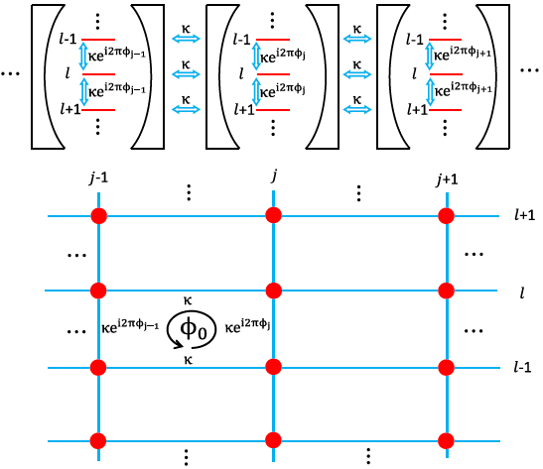
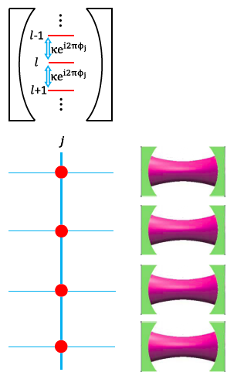
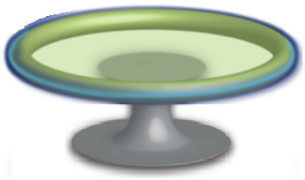

Slide 6
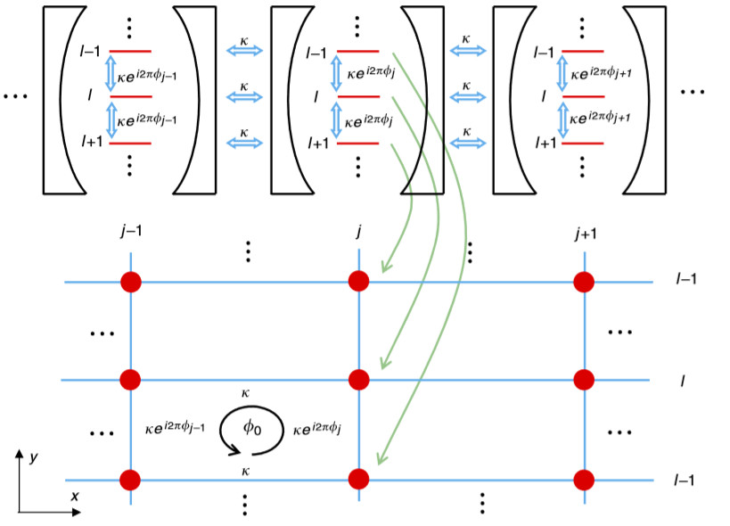
优点：同时解决了对光学模拟器规模和可扩展性问题，以及调控的复杂性问题！
1）模拟器的物理规模被大大缩小；
2）调控难度也被大大降低。
Nature Communications 6:7704 (2015)

Slide 7
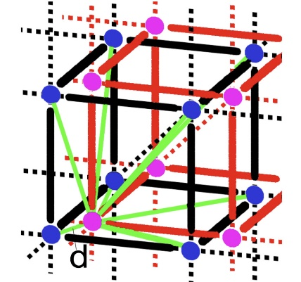
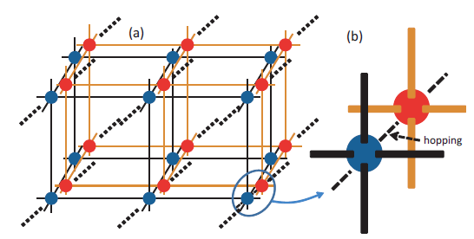
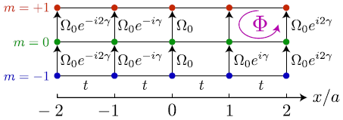
Introduction
State-dependent lattices
Photonic lattice with waveguides
O. Boada, et al., Phys. Rev. Lett. 108, 133001 (2012)
D. Jukić and H. Buljan, Phys. Rev. A 87, 013814 (2013).
Atomic states with Raman transitions
A. Celi, et. al., Phys. Rev. Lett. 112, 043001 (2014).

Slide 8
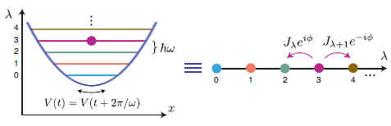
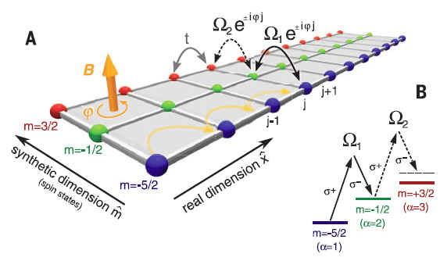
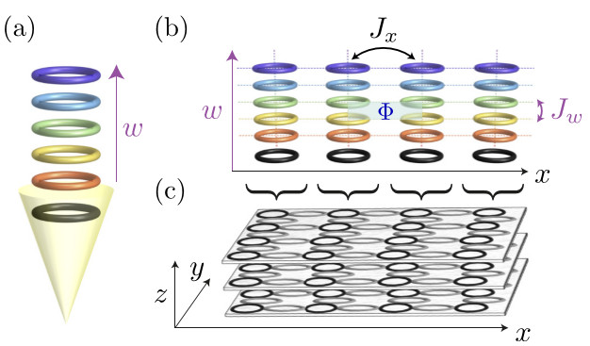
Introduction
  Quantum simulation by utilizing synthetic dimensions
Phys. Rev. A 95, 023607 (2017)
PRL 108, 133001 (2012);
PRL 112, 043001 (2014);
Science 349, 1510 (2015);
Science 349, 1514 (2015).
Phys. Rev. A 93, 043827 (2016)

Slide 9
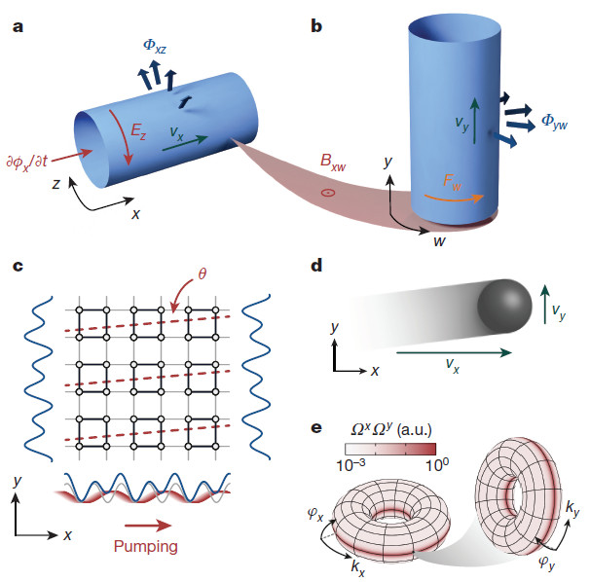
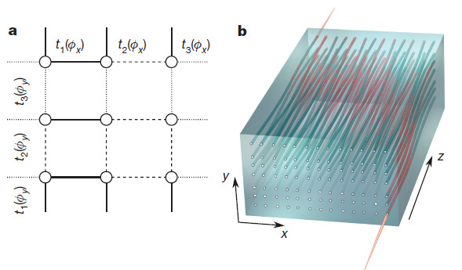
Introduction
研究人工维度物理的动机：
1）通过引入额外维度来统一相互作用
2）通过引入高维能带模型来统一刻画低维材料
Nature 553，55（2018）
Nature 553，59（2018）

Slide 10

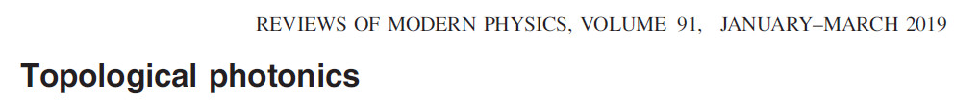
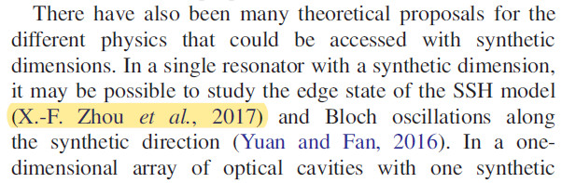

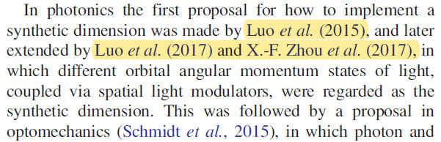
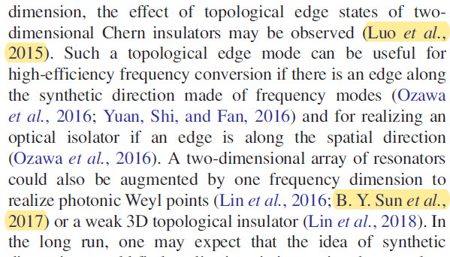
Introduction
Rev. Mod. Phys. 91.015006（2019）
在Rev. Mod. Phys.文章中的“人工维度”专门章节中，强调我们的工作是“光子学领域第一个实现人工维度的方案”，并综述了我们4篇工作的结果。

Slide 11
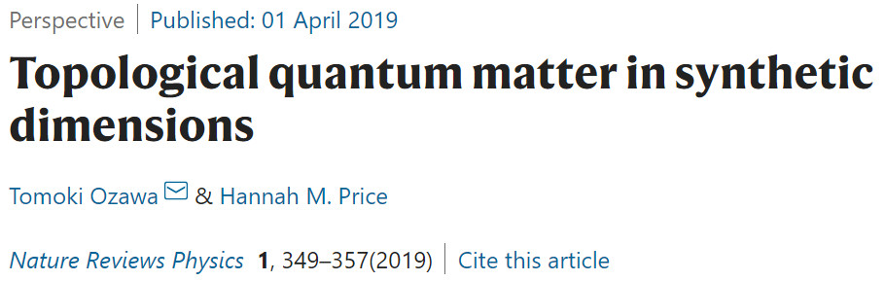
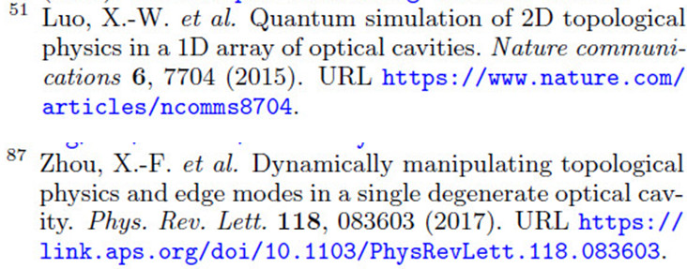
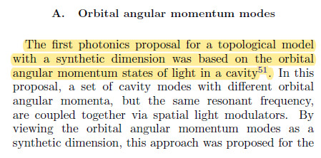
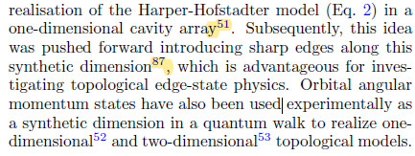
Introduction
日本学者在Nature Reviews Physics的综述文章中，以“Orbital angular momentum modes”为题，用一专门章节综述我们的工作。他们在文章中强调了我们工作的首创性：在用人工维度模拟拓扑模型的第一个光子学方案是基于光腔中的轨道角动量态……

Slide 12
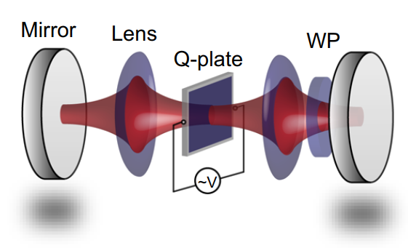
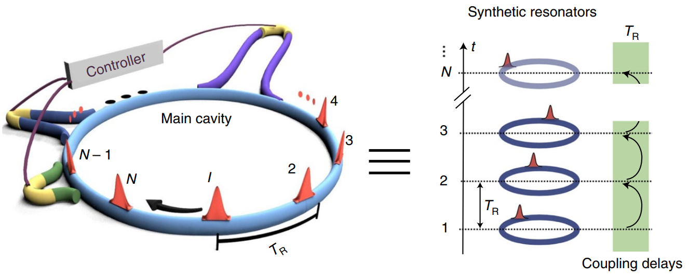
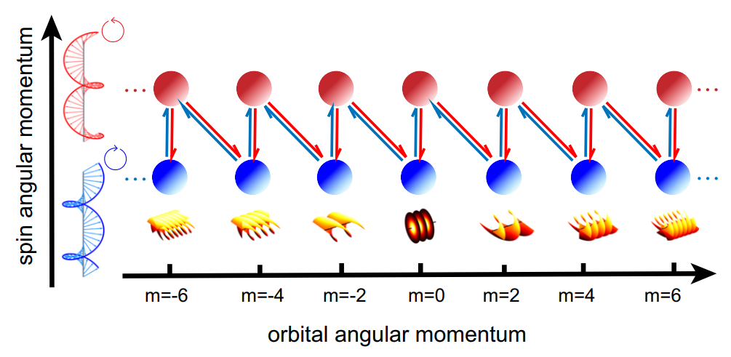
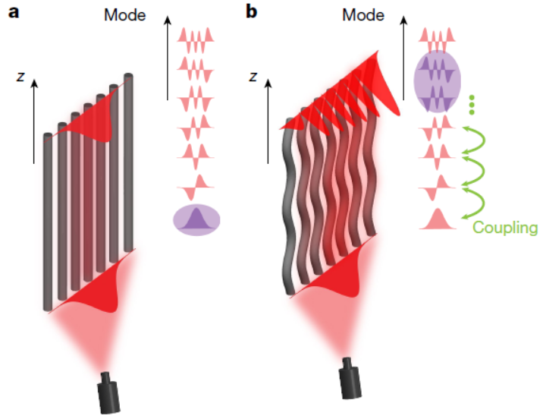
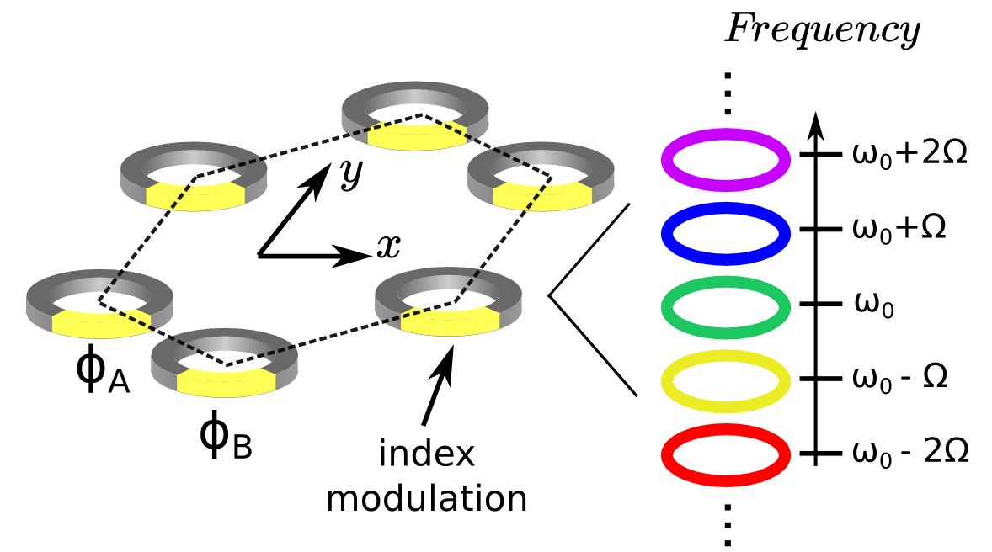
Introduction
Using time-multiplexed network
Using OAM modes
S. Weidemann et. al., Science 368, 311 (2020).
C. Leefmans, et. al., Nat. Phys. 18, 442 (2022).
M. Muniz et. al., Science 379, 1019 (2023).
X.-W. Luo, et. al., Nat. Commun. 6, 7704 (2015).
M. Yang, et. al., Nat. Commun. 13, 2040 (2022).
M. Yang, et. al., Sci. Adv. 9, eabp8943 (2023).
Using modal states
Using frequency resonances
E. Lustig, et. al., Nature 567, 356 (2019).
L. Yuan, et. al., Opt. Lett. 41, 741 (2016).
T. Ozawa, et. al., Phys. Rev. A 93, 043827 (2016).

Slide 13
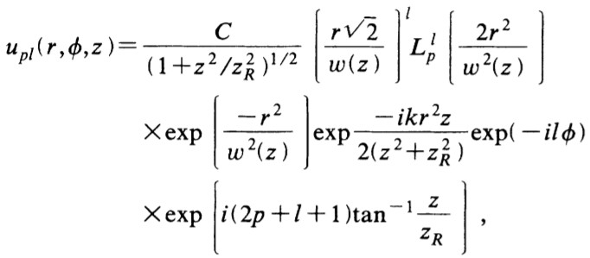

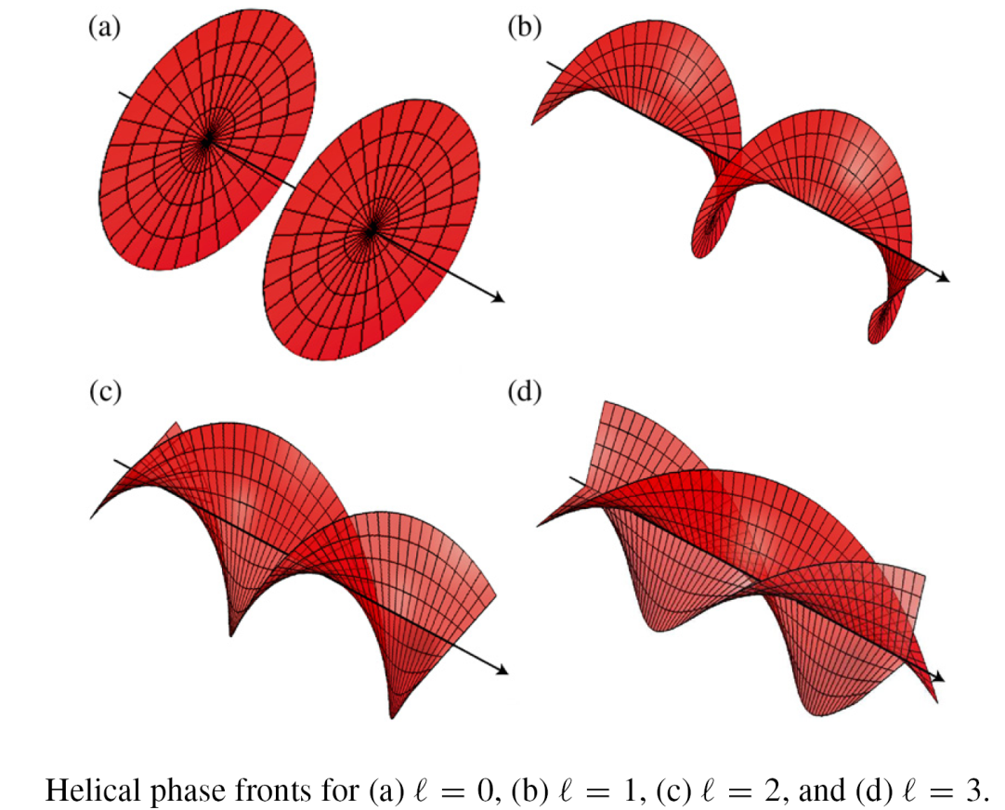
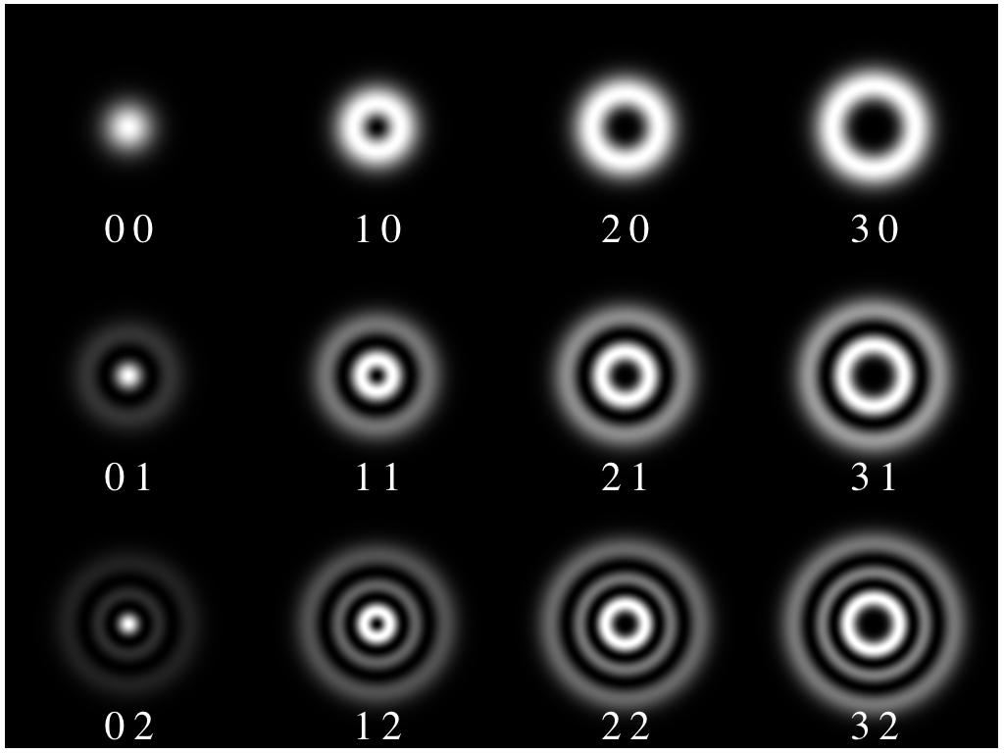
Orbital angular momentum
LG Mode :
l : azimuthal mode index
p: radial mode index
(l p)
Phase fronts for helical beams

Slide 14
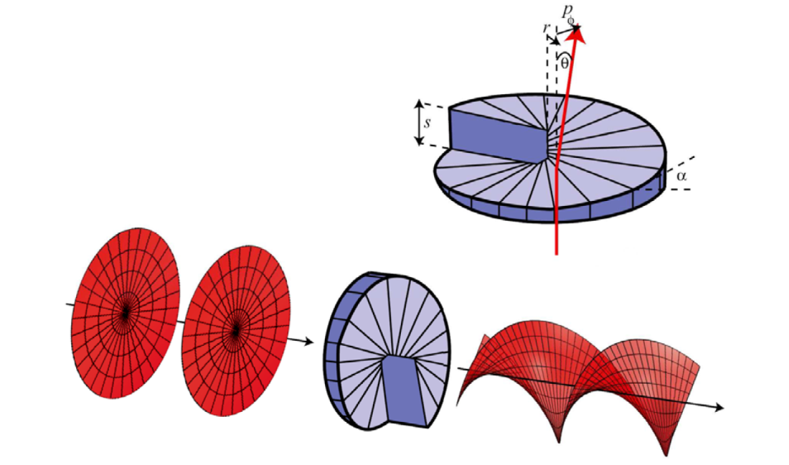
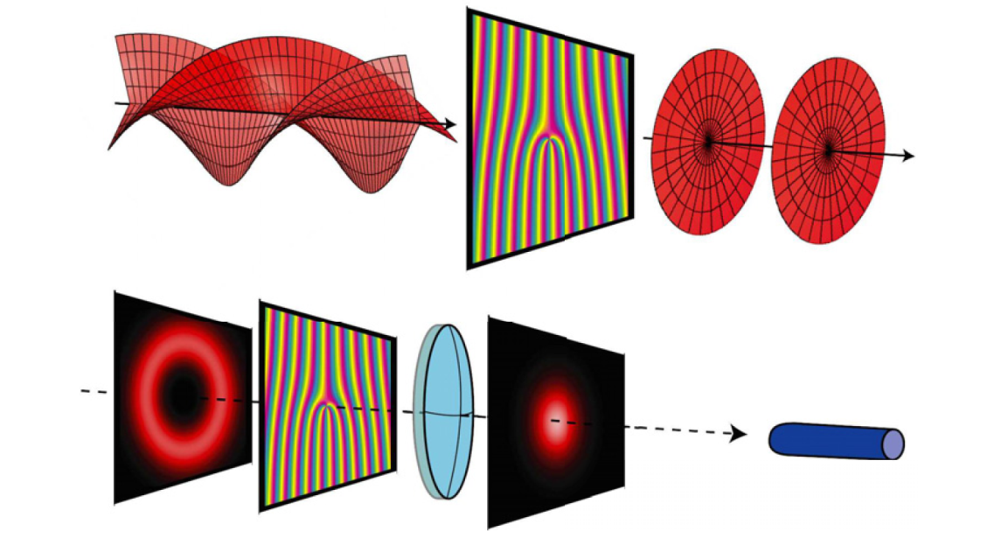
Orbital angular momentum
OAM generation:
Spatial light modulator (SLM)
Step index: M
l → l + M
OAM detection:
SLM &
Single mode fiber

Slide 15
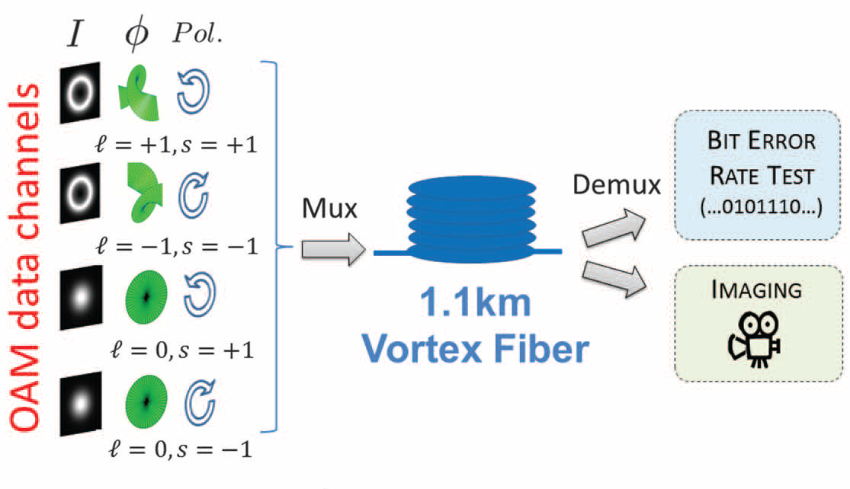
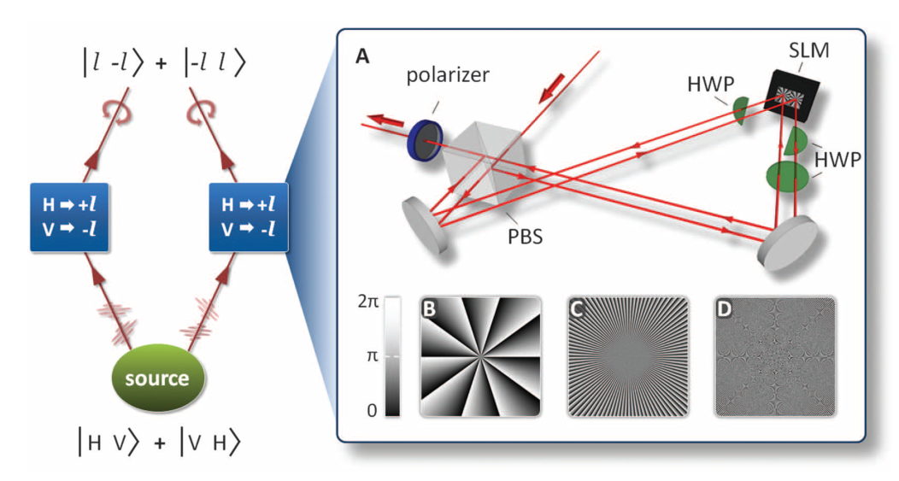
Orbital angular momentum
Science 340, 28 (2013)
High capacity communication
High dimensional quantum entanglement
Science 338, 2 (2012)

Slide 16
Degenerate cavity
Degenerate condition: Unit ray matrix
G: depends on ray matrix [A,B;C,D]
G=Delta function: Unit ray matrix
Resonance condition:
Applied optics, 8(1):189 (1969); Nature Communications 6:7704 (2015)

Slide 17
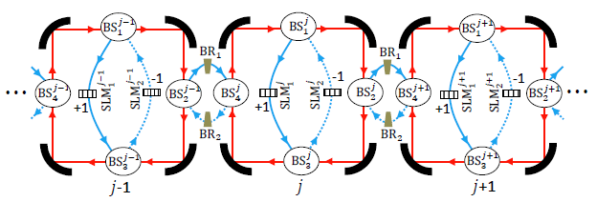

Simulating photonic lattices
X-W Luo, X. Zhou, C. F. Li, J. S. Xu, G. C. Guo, Z. W. Zhou, Nat. Commun. 6, 7704 (2015)

Slide 18
Outline
Synthetic dimension in the photonic systems
Topological matters in photonic synthetic dimensions
All-optical devices based on degenerate cavities
Outlook & Summary

Slide 19
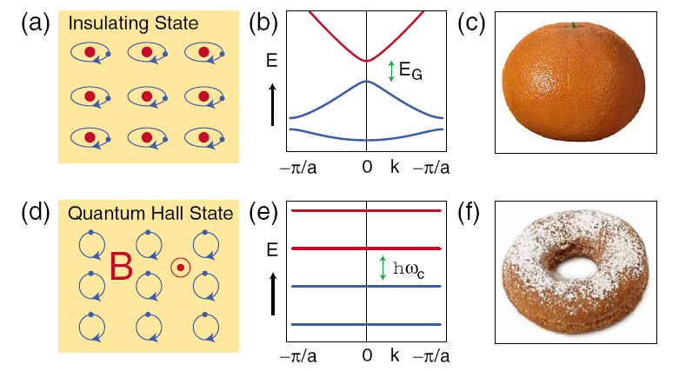
Introduction
I）Introduction on topological physics
Rev. Mod. Phys. 82, 3045(2010)

Slide 20
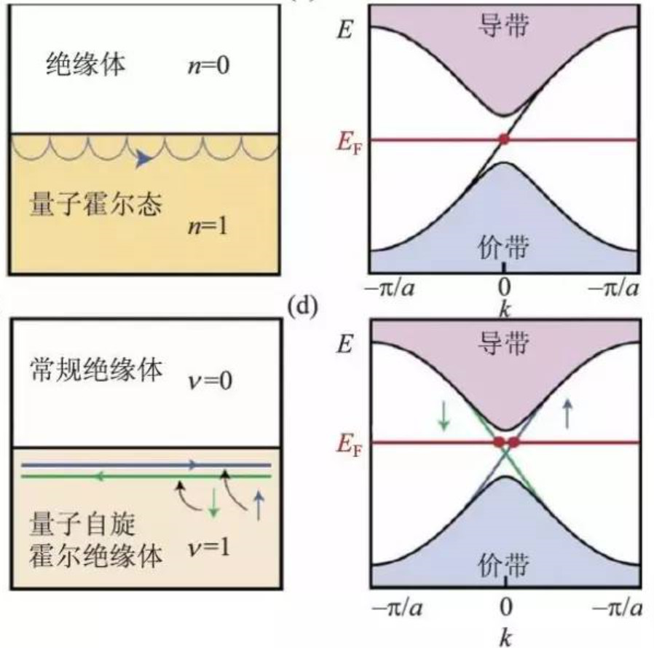
Introduction

Slide 21
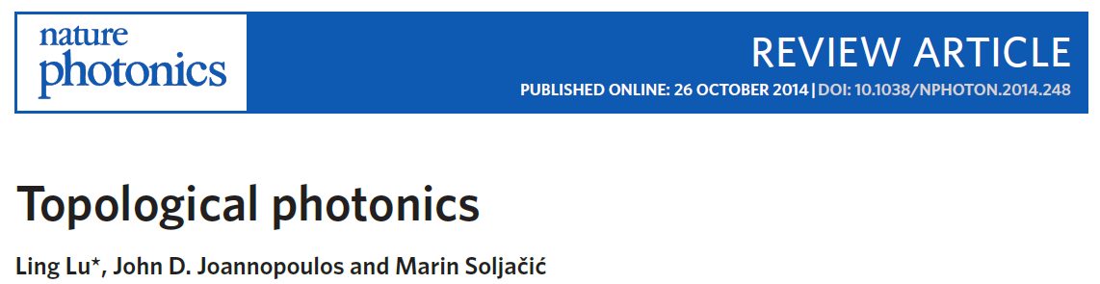
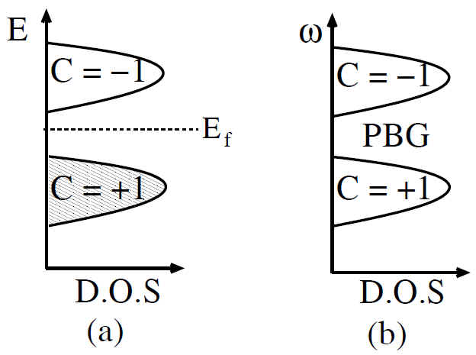
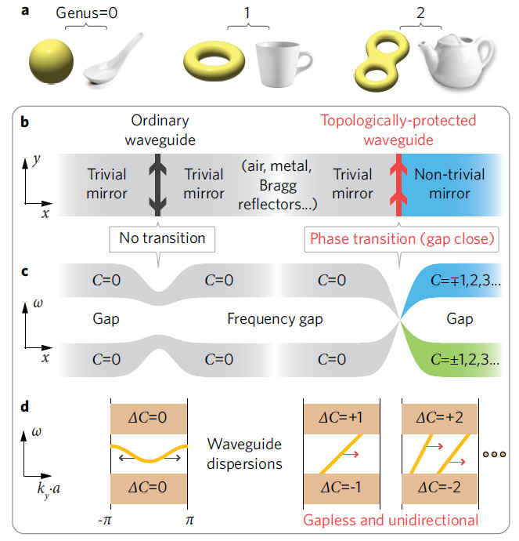
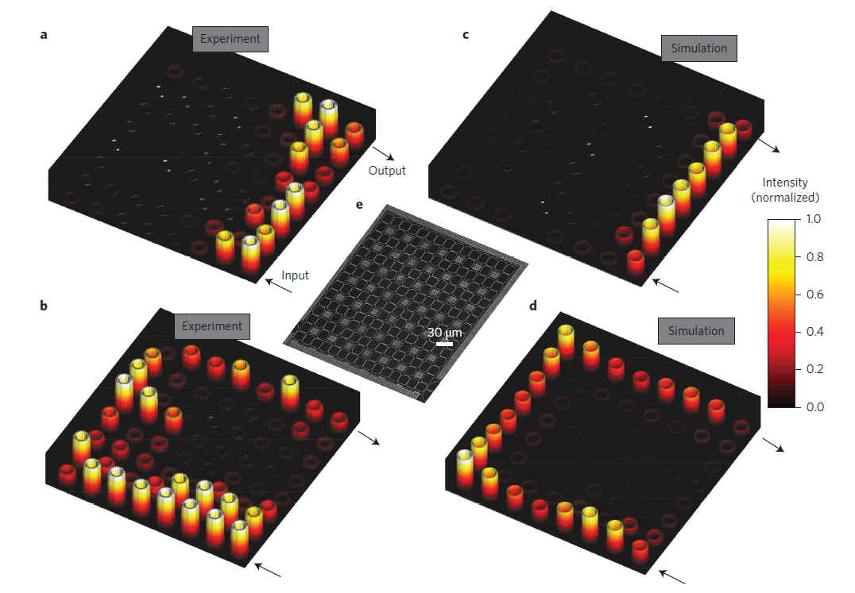
Nature Photonics (2014)
F. Haldane and S. Raghu, PRL. 100 , 013904 (2008); S. Raghu and F. Haldane, PRA 78 , 033834 (2008).
Nature Photonics (2013)

Slide 22
Simulating photonic lattices
X-W Luo, X. Zhou, C. F. Li, J. S. Xu, G. C. Guo, Z. W. Zhou, Nat. Commun. 6, 7704 (2015)

Slide 23
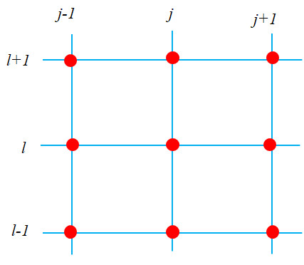
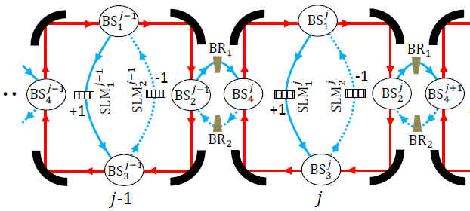

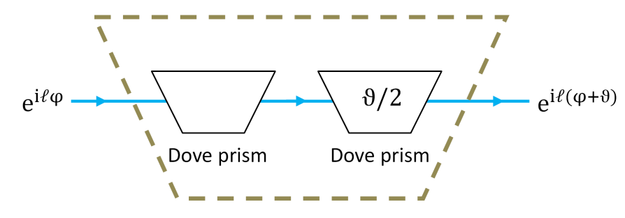



规范场模拟
Abelian gauge field

Slide 24
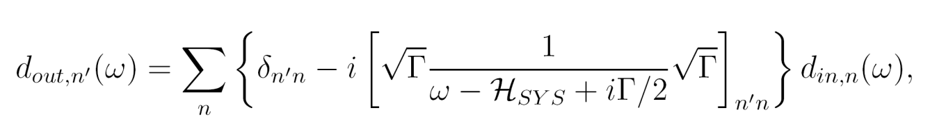


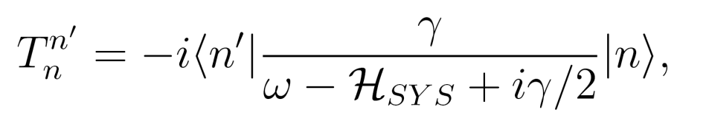
Detection
Input-output relation
Bound states in cavity

Slide 25


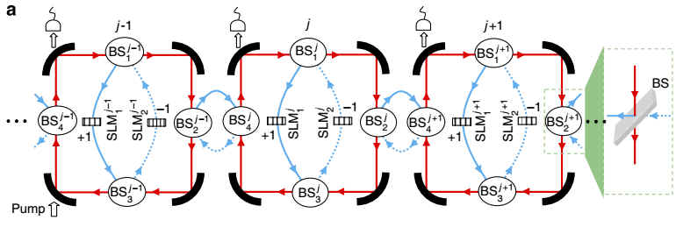
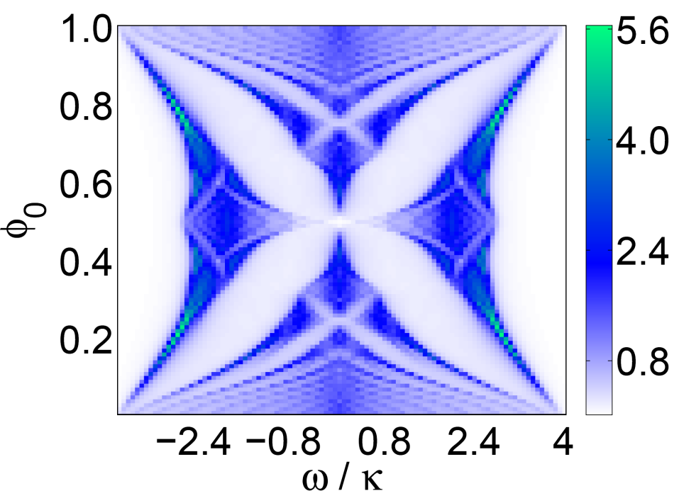



规范场模拟
transmission spectroscopy

Slide 26

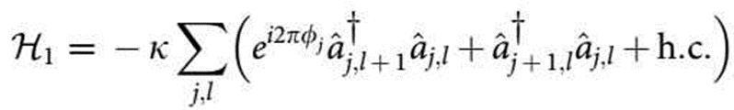
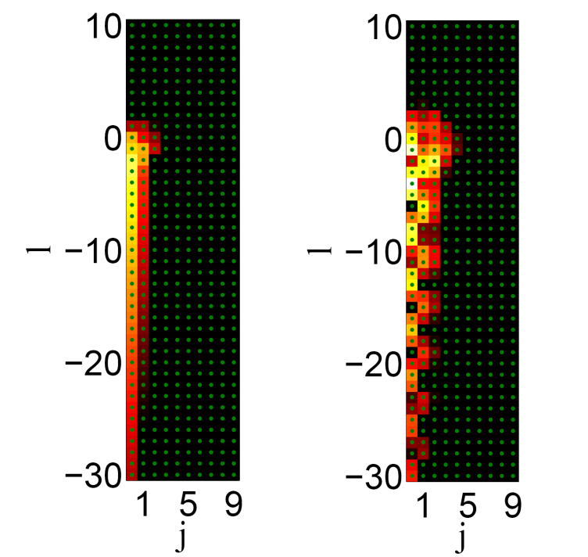
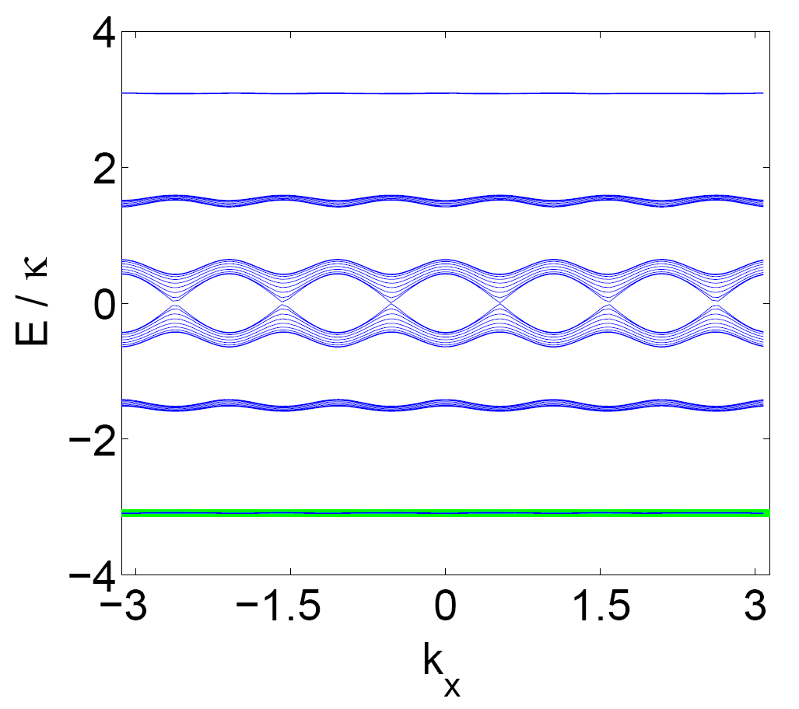


规范场模拟
Detecting topological invariants
Simulation of edge-state transport
  unidirectionality & robustness
  Energy band

Slide 27
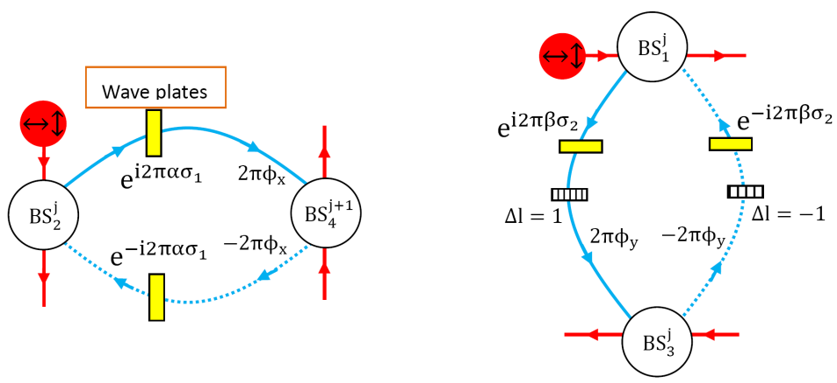





规范场模拟
NonAbelian gauge field

Slide 28








规范场模拟
Simulating Topological QPT

Slide 29




Soft boundary
X. F. Zhou, X. W. Luo, S. Wang, G. C. Guo, X. Zhou, H. Pu, Z. W. Zhou, PRL, 118, 083603(2017)
l : azimuthal mode index
p: radial mode index

Slide 30





Boundary construction using composite mode
l
l
l
l-Lm

Slide 31



Example: SSH model inside single cavity

Slide 32




Example: SSH model inside single cavity

Slide 33

Arbitrary lattice models based on single main cavity
1
2
3
4
5
6
7
8
9
S Wang, X-F Zhou, G-C Guo, H Pu, and Z-W Zhou, PRA 100, 043817 (2019).

Slide 34



Simulating arbitrary lattices
边界的特殊性：

Slide 35




Step 1: Mapping lattice sites to 1D
We define a vector to characterize the d-dimensional lattice system. So, a particular site in the lattice can be denoted by the vector: .
Here, .
Thus, each lattice site can then be mapped to the OAM mode with
where

Slide 36




Step 2: Mapping the hopping steps
The hopping terms in the lattice model with hopping step
the coupling between two cavity modes whose OAMs differ by the amount

Slide 37




Step 3: Controlling the hopping amptitudes
For a translation-invariant lattice model with N0 internal
states, each type of hopping with fixed steps δL can possess
N0 different hopping amplitudes at most.
As those optical circuits are all connected in the main cavity and have the same hopping step, they can interfere to give a total amplitude:

Slide 38






Step 3: Controlling the hopping amptitudes
For example:
By virtue of the OAM-dependent phase shift

Slide 39



Arbitrary lattice models based on single main cavity
For example: 1) Haldane’s model

Slide 40




Arbitrary lattice models based on single main cavity
For example: 2) Qi-Hughes-Zhang’s model

Slide 41

Arbitrary lattice models based on single main cavity
It totally needs 60 auxiliary circuits to realize all the hopping terms!

Slide 42



Detecting the 2nd Chern number
Berry curvature can be calculated approximately:

Slide 43





Detecting the Chirality of Weyl points
S Wang, X-F Zhou, G-C Guo, H Pu, and Z-W Zhou, PRA 100, 043817 (2019).

Slide 44
Outline
Synthetic dimension in the photonic systems
Topological matters in photonic synthetic dimensions
All-optical devices based on degenerate cavities
Outlook & Summary

Slide 45

X. W. Luo, X. Zhou, J. S. Xu, C. F. Li, G. C. Guo, C. Zhang, Z. W. Zhou, Nat. Commun. 8, 16097 (2017).

Slide 46



Quantum memory
Degenerate cavity
Site index: j
Step index: M
OAM index: l=j*M
j-1
j
j+1
…
…
…
…
Optical design
Input/output:
Pinhole couples
l = 0 mode in/out
X. W. Luo, X. Zhou, J. S. Xu, C. F. Li, G. C. Guo, C. Zhang, Z. W. Zhou, Nat. Commun. 8:16097 (2017)

Slide 47

Quantum memory
Effective circuit & band structure
Phase imbalance , Electro-optical modulator
Spectrum engineering → propagation control
Phase modulation speed:
Slow compared with gap
Typically, the bandwidth is about 100MHz

Slide 48








Quantum memory

Slide 49


Quantum memory
Storage time :

Slide 50


Quantum memory
Pulse propagation:
Storage time :
Not on-demand

Slide 51

Quantum memory
On-demand Quantum Memory
Interference between 2 auxiliary cavities
Bandwidth reversibly compressed
No distortion during storage

Slide 52

Filter
OAM based filter
Better performance with fewer cavities
Stop bandwidth: 40MHz
Shape factor: 0.85
Skirt slope: 20dB/MHz
B+C
Maximum absorption frequency determined by
Design the reflectivity of the pinhole such that
or or

Slide 53



Topological OAM Switch
X. W. Luo, C. Zhang, G. C. Guo, Z. W. Zhou, Phys.Rev.A 97,043841(2018).

Slide 54




Topological Pumping of single photon

Slide 55




Topological Pumping of single photon

Slide 56



Topological Pumping of single photon
Multistage setup:
～ μs

Slide 57


All optical devices based on nonlinear effects
C.-X. Zhu, X.-F. Zhou, Z.-W. Zhou, Phys. Rev. A 106, 043718 (2022).

Slide 58


All optical devices based on nonlinear effects

Slide 59


All optical devices based on nonlinear effects

Slide 60






All optical devices based on nonlinear effects

Slide 61
Outline
Synthetic dimension in the photonic systems
Topological matters in photonic synthetic dimensions
All-optical devices based on degenerate cavities
Outlook & Summary

Slide 62




后续实验工作的开展
中科院量子信息重点实验室李传锋、许金时组，先后实现了31个模式和46个模式的简并光腔。
Opt.Lett. 42,2042(2017)
Appl.Phys.Lett.112,201104(2018)

Slide 63




研究方向和成果概述

Slide 64




Slide 65
summary
About Synthetic Dimension based on Degenerate Cavity
Simulating Photonics Topological Matter
Quantum Memory
Optical Filter
Topological OAM Switch
New Applications…

Slide 66
In collaboration with
Univ. of Sci. & Tech. of China
X. -W. Luo (罗希望) X.-F. Zhou (周祥发)
S. Wang (王 塑) X.-X. Zhou (周幸祥)
B. -Y. Sun (孙伯业) C. X. Zhu (朱晨曦)
J. -S. Xu (许金时) M. Gong (龚明)
C. -F. Li (李传锋) G.-C. Guo (郭光灿)
Rice Univ.
Han Pu (浦晗)
UT Dallas
Chuanwei Zhang (张传伟)

Slide 67
References
Simulating Topological matter of Photons:
X. W. Luo, X. Zhou, C. F. Li, J. S. Xu, G. C. Guo, Z. W. Zhou, Nat. Commun. 6, 7704 (2015)
X. F. Zhou, X. W. Luo, S. Wang, G. C. Guo, X. Zhou, H. Pu, Z. W. Zhou, Phys. Rev. Lett. 118, 083603 (2017)
B. Y. Sun, X. W. Luo, M. Gong, G. C. Guo, Z. W. Zhou, Phys. Rev. A 96, 013857 (2017).
S. Wang, X. F. Zhou, G. C. Guo, H. Pu, Z. W. Zhou, Phys. Rev. A 100, 043817 (2019).
All-optical devices by manipulating photonic synthetic dimension
X. W. Luo, X. Zhou, J. S. Xu, C. F. Li, G. C. Guo, C. Zhang, Z. W. Zhou, Nat. Commun. 8, 16097 (2017).
X. W. Luo, C. Zhang, G. C. Guo, Z. W. Zhou, Phys. Rev. A 97, 043841(2018).
C. X. Zhu, X. Zhou, G. C. Guo, Z. W. Zhou, Opt. Express 30 (2) 972 (2022).
C. X. Zhu, X. F. Zhou, Z. W. Zhou, Phys. Rev. A 106, 043718 (2022).
C. X. Zhu, X. Zhou, G. C. Guo, Z. W. Zhou, Phys. Rev. A 108, 043507 (2023).
Experiment:
Z.-D. Cheng, Z.-D. Liu, X.-W. Luo, Z.-W. Zhou, J. Wang, Q. Li, Y.-T. Wang, J.-S. Tang, J.-S. Xu, C.-F. Li, G.-C. Guo, Opt. Lett. 42, 2042 (2017).
Z.-D. Cheng, Q. Li, Z.-H. Liu, F.-F. Yan, S. Yu, J.-S. Tang, Z.-W. Zhou, J.-S. Xu, C.-F. Li, G.-C. Guo, Appl. Phys. Lett. 112, 201104 (2018).
M. Yang, H.-Q. Zhang, Y.-W. Liao, Z.-H. Liu, Z.-W. Zhou, X. Zhou, J.-S. Xu, Y.-J. Han, C.-F. Li & G.-C. Guo, Nat. Commun. 13, 2040 (2022).
M. Yang, H.-Q. Zhang, Y.-W. Liao, Z.-H. Liu, Z.-W. Zhou, X. Zhou, J.-S. Xu, Y.-J. Han, C.-F. Li & G.-C. Guo, Sci. Adv. 9, eabp8943 (2023).

Slide 68
Thanks for your attention !

