Slide 1


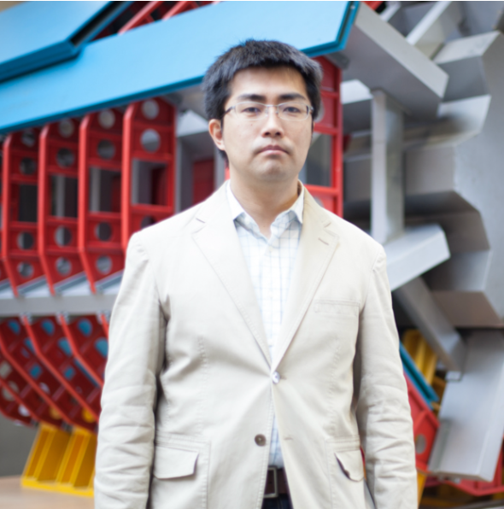

学术报告
Recent measurement of Higgs boson decaying into $b\overline{b}$/$c\overline{c}$ pair
会议地址：会议室（腾讯：）
会议时间：2023年12月05日 17:00 – 18:00
腾讯会二维码
报告人：增渕达也 教授 (东京大学)
摘要：
LHC ATLAS experiment has measured Higgs boson properties precisely since its discovery in 2012. All particles predicted by the Standard Model (SM) are discovered, however many mysteries to be solved remain in our Universe. It is indicated that the Higgs boson properties are connected to these mysteries, and as a result the measured Higgs boson properties may deviate from the SM prediction. In particular, the signature of the Higgs boson decaying into a bottom quark or charm quark pair provides important measurement. In this seminar, the important milestone of Higgs boson measurement in Run-2 and the latest Higgs boson property measurements with these fermionic final states in Run-2 are presented.
报告人简介：
增渕达也（Tatsuya Masubuchi）教授来自东京大学粒子物理国际研究中心（ICEPP），2008年起在ATLAS实验工作。在LHC一期运行期间，他在H→WW道对希格斯玻色子的发现做出贡献，并随后担任HWW工作组负责人。在LHC二期运行期间，他领导Hbb工作组确立了希格斯玻色子到底夸克对衰变道以及VH产生过程的发现。这是希格斯物理研究的重要里程碑。增渕教授于2021至2023年间担任ATLAS实验希格斯工作组负责人，领导工作组取得诸多重要研究成果。

