Slide 2
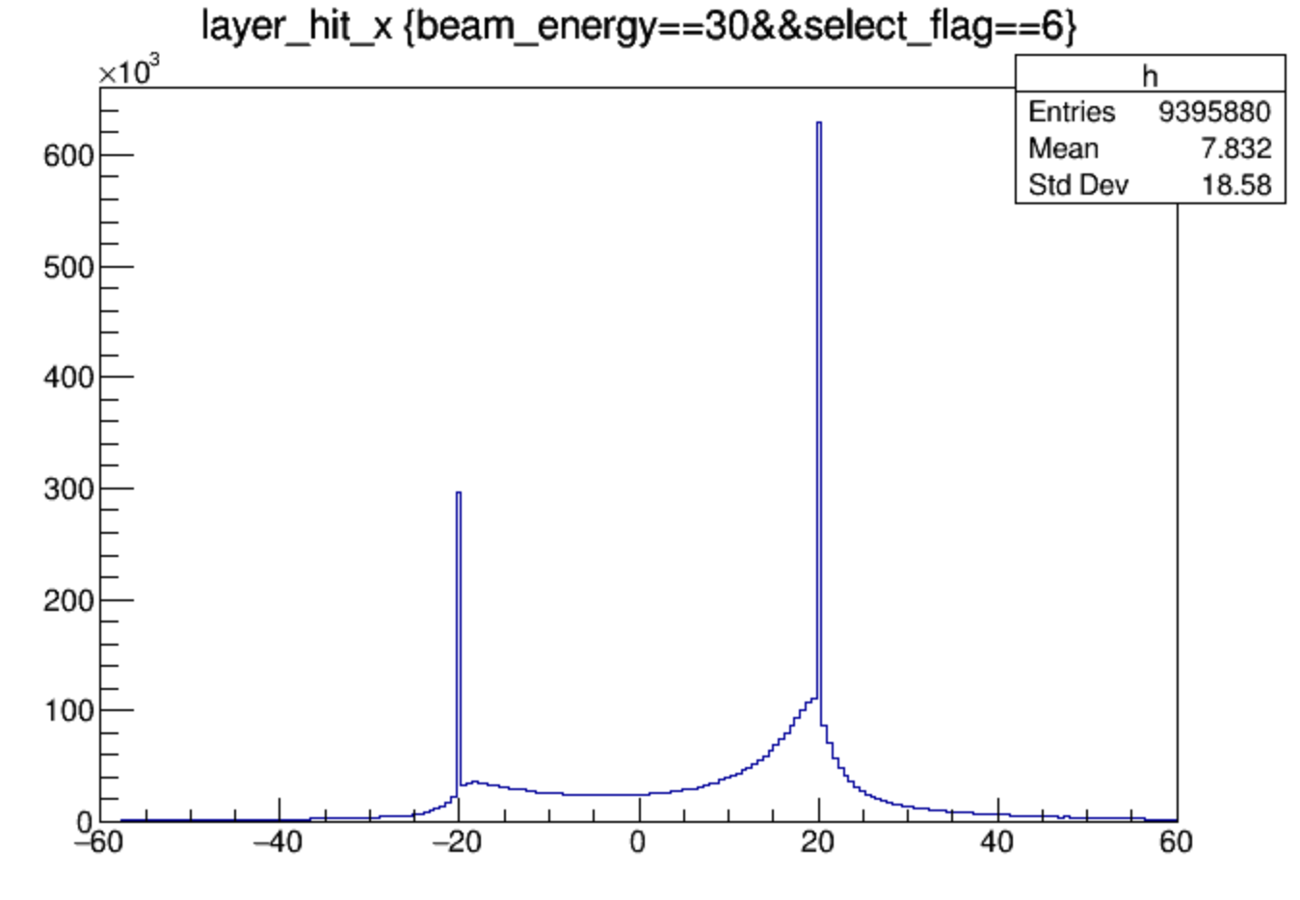
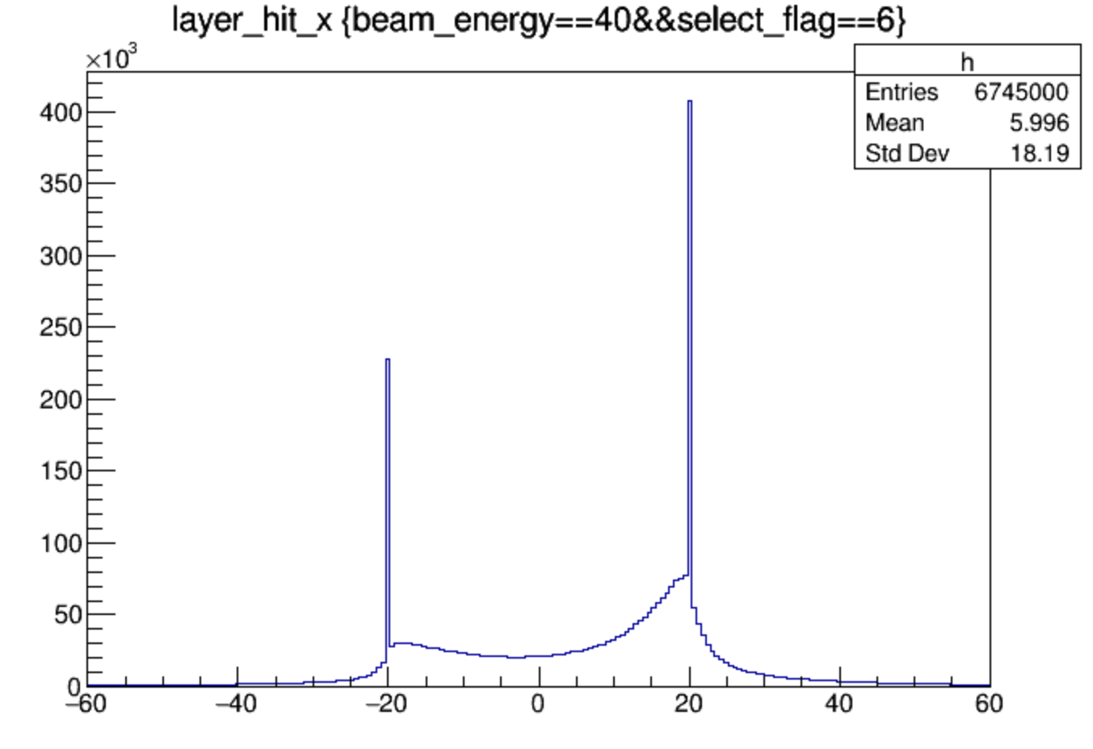
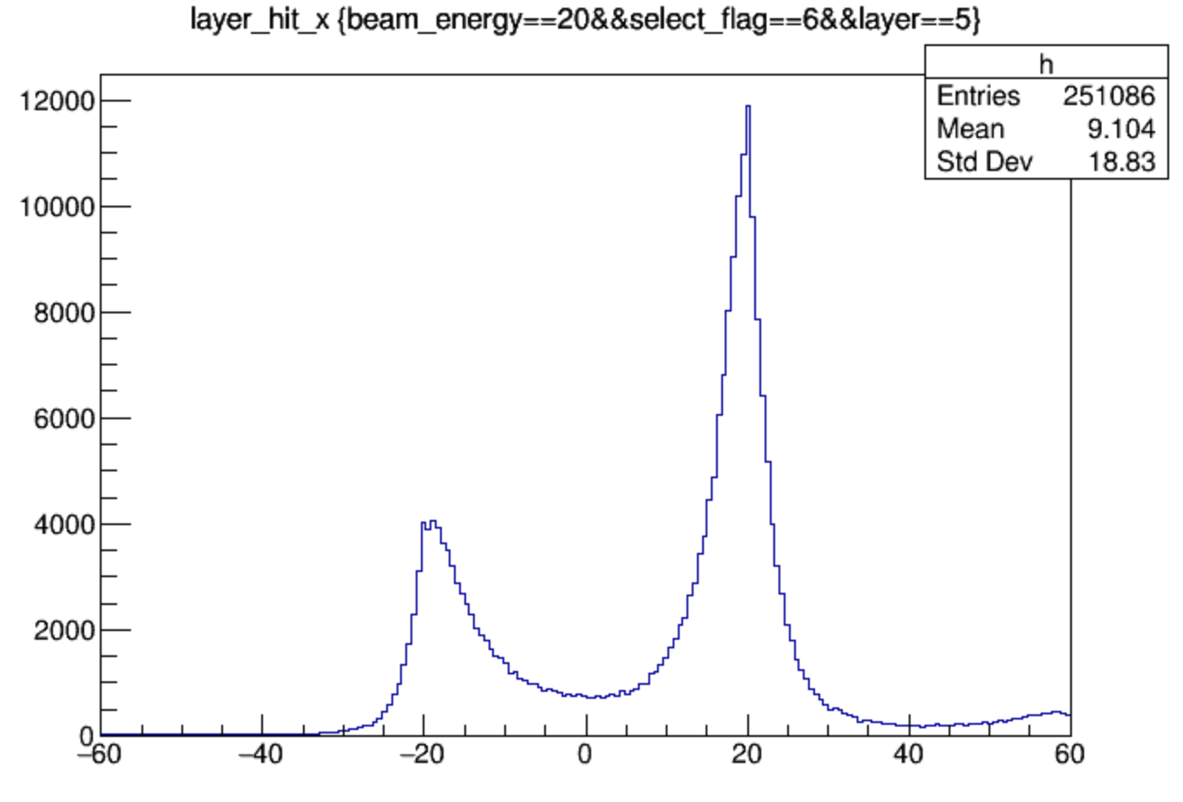
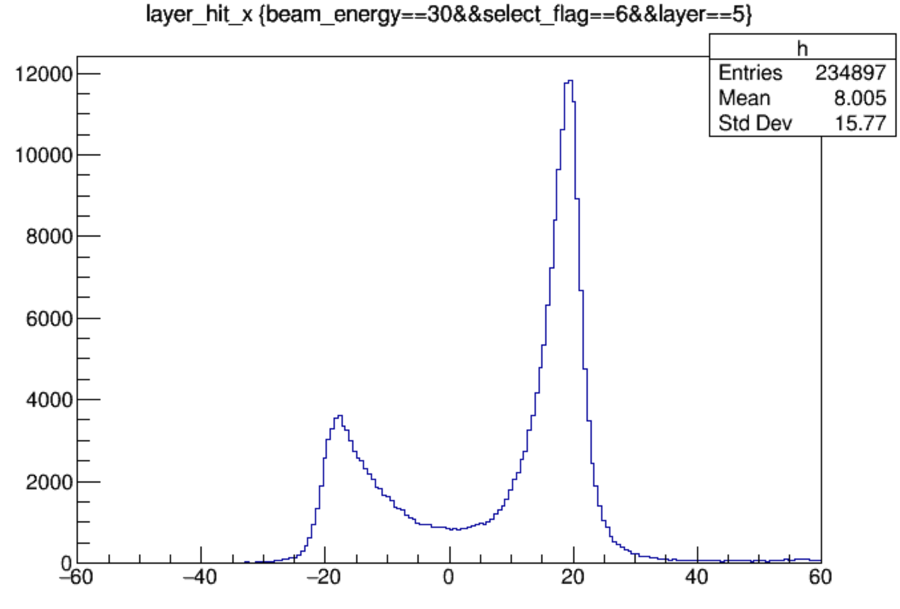
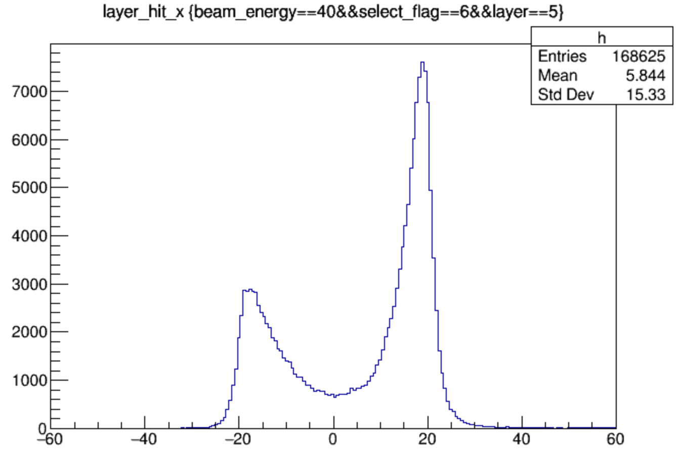
data energy center along x
all layers
layer 5

Slide 3
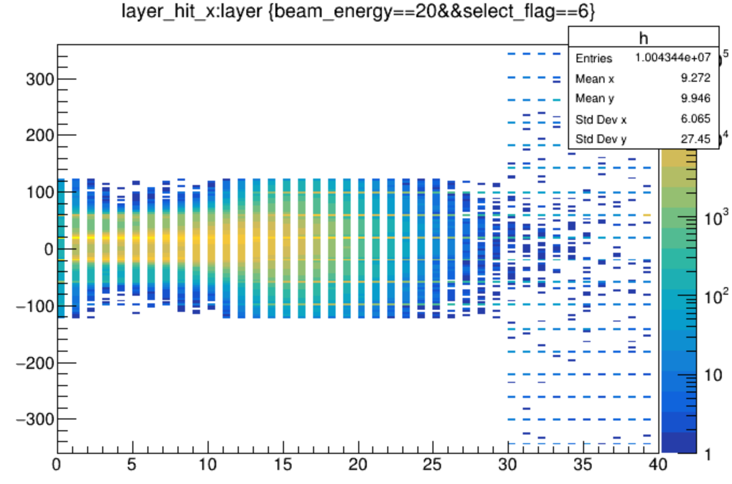
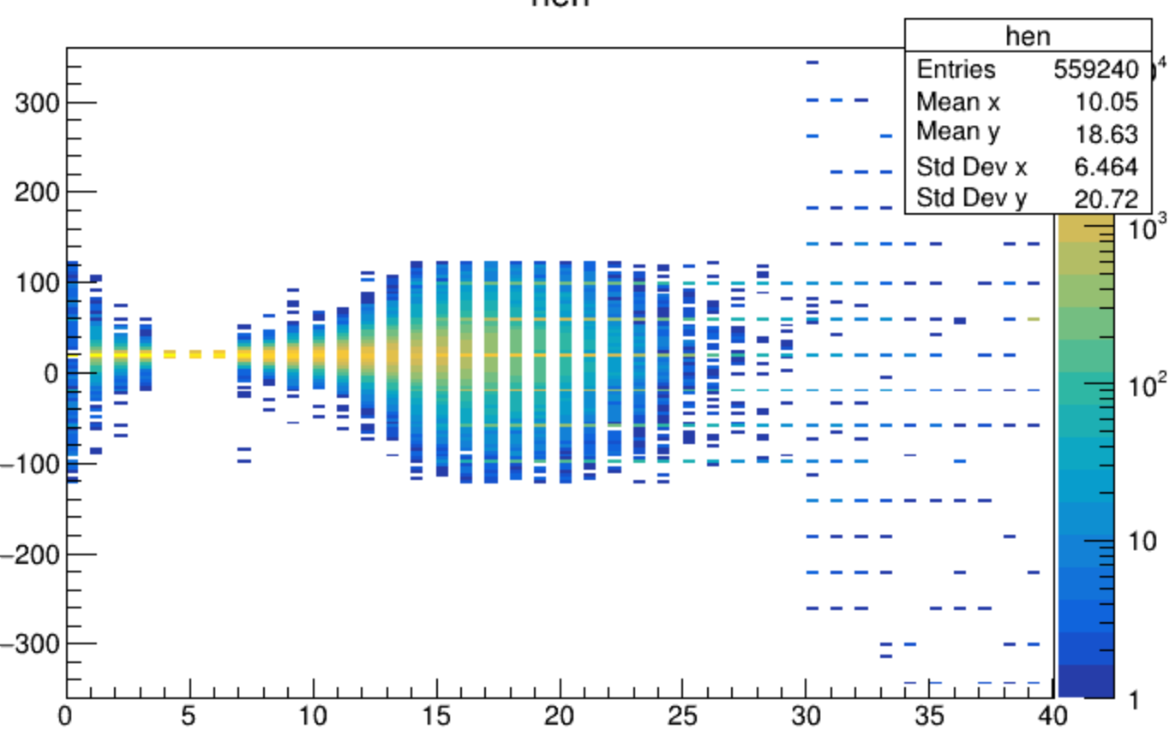
add select criterion
energy center of all layers are in the central chip, that is in (-120,120)mm
energy center of layer4 to layer6 are in (15,25)mm

Slide 4
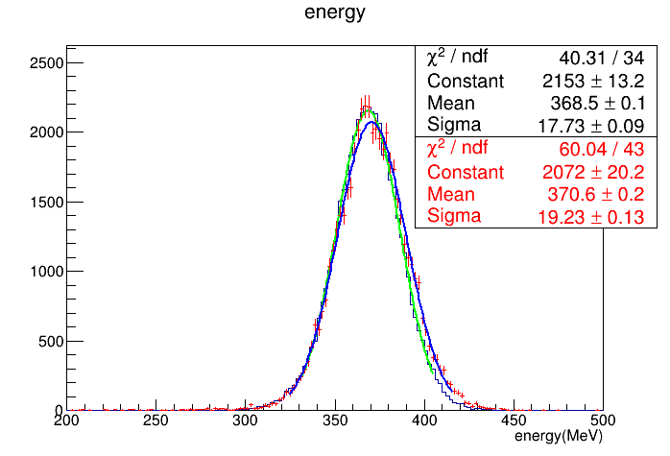
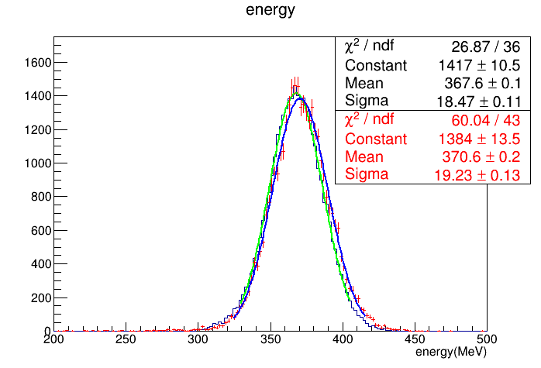
20GeV electron
red: data black: MC
before
add 100mm front trigger detector

Slide 5
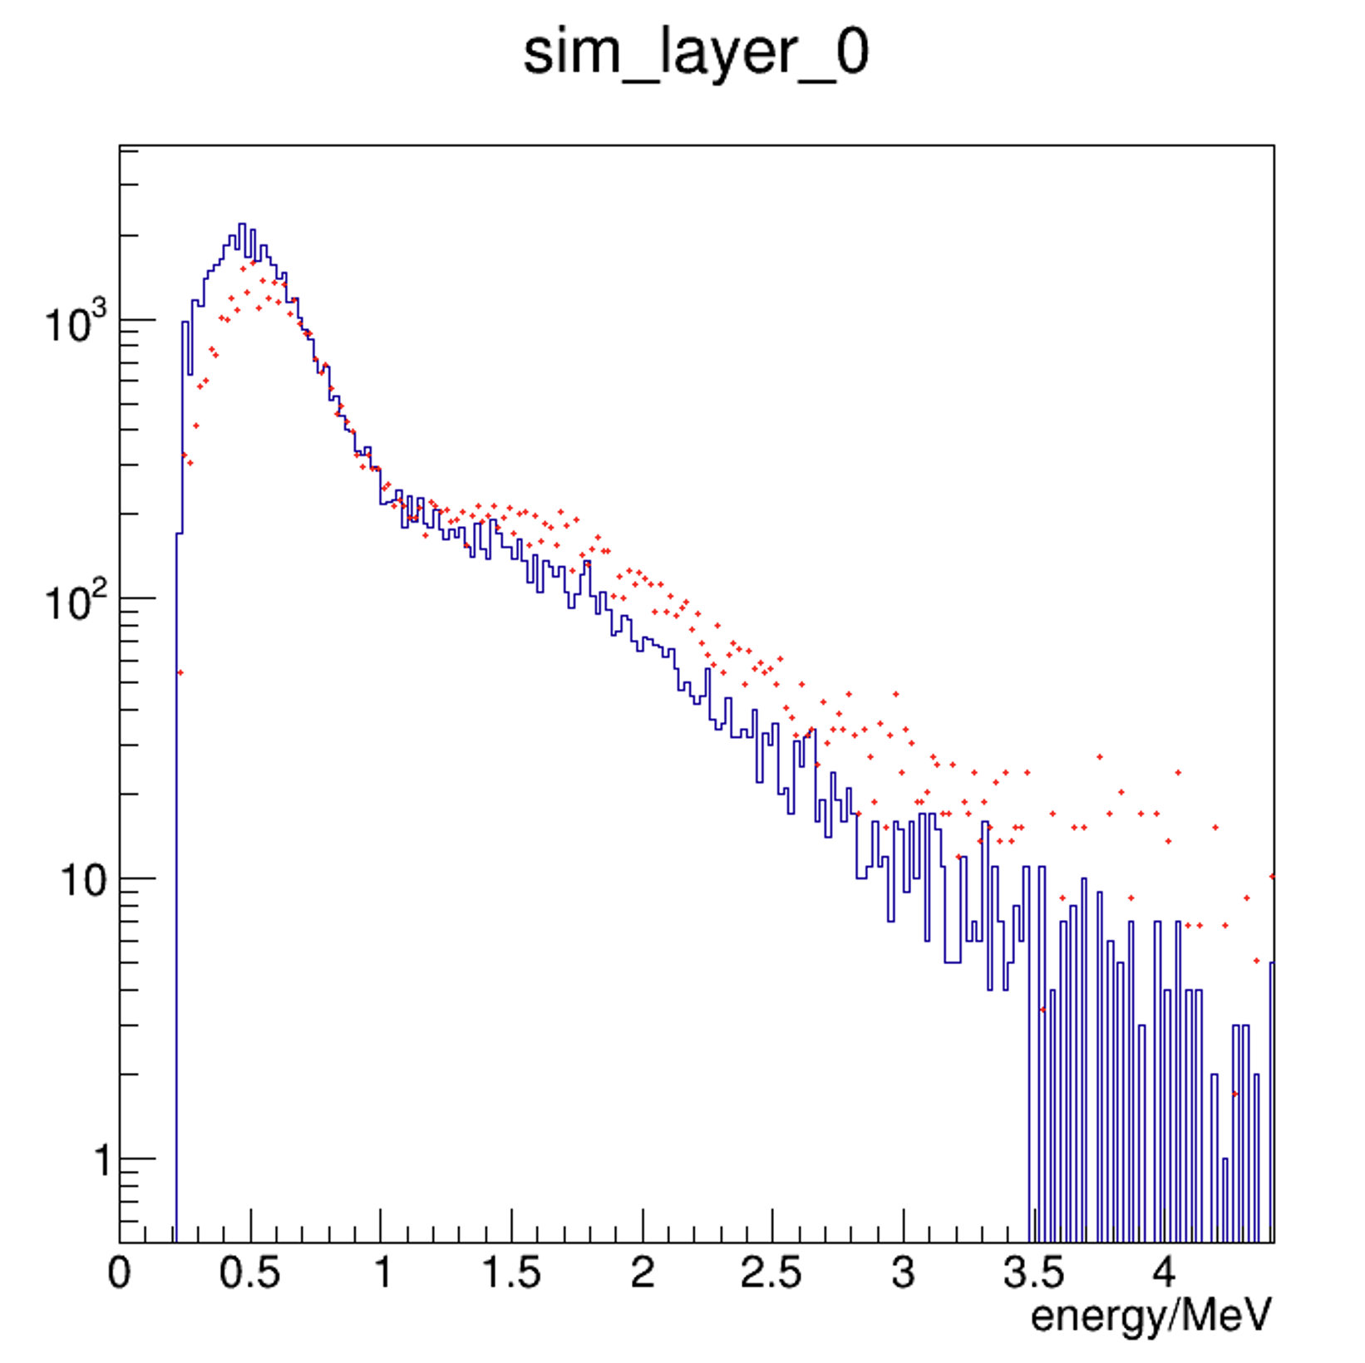
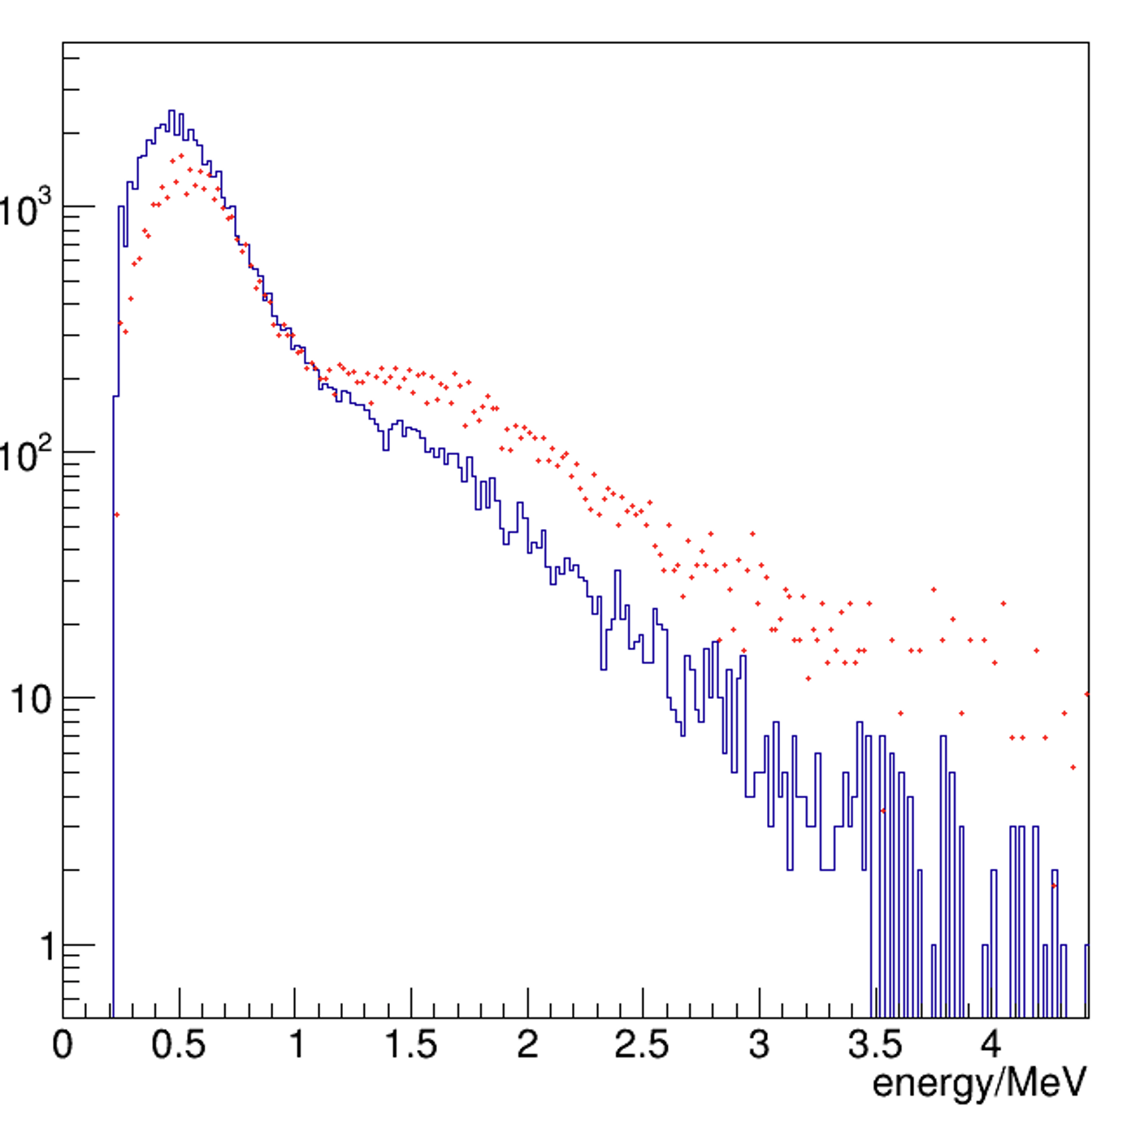
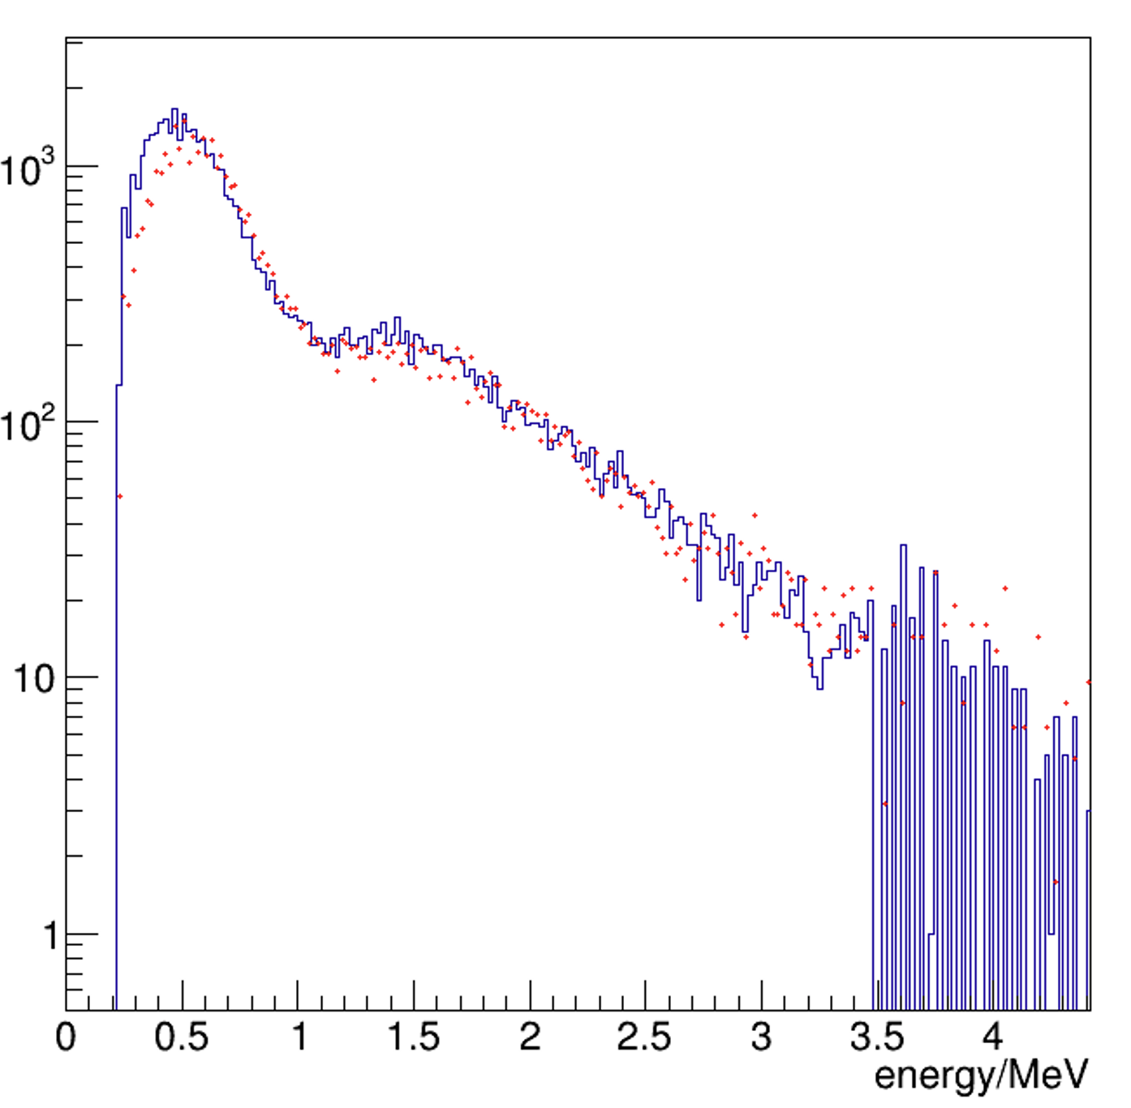
different thickness of front detector
layer 0 energy
red: data blue: MC
0
10mm
40mm
100mm

Slide 6
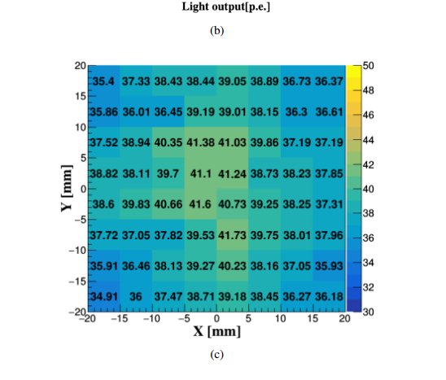
add non-uniformity of scintillators
1.836/38.37 = 4.8%

Slide 7
digitize
4.8% gassian smear
energy to photon (poisson distribution)
photon to phoelectron (binomial distribution, PDE=0.32)
SiPM model
gaussian smear
phoelectron to adc
gaussian smear (sigma of single phoelectron peak sqrt(n)*3)
adc to highgain and lowgain

Slide 8
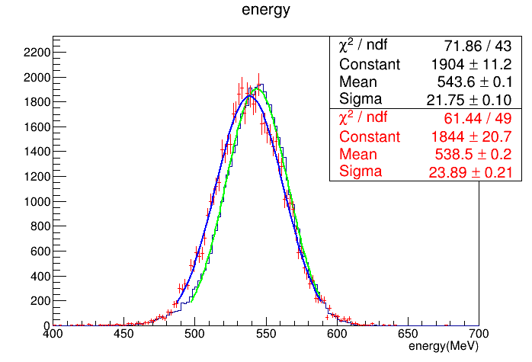
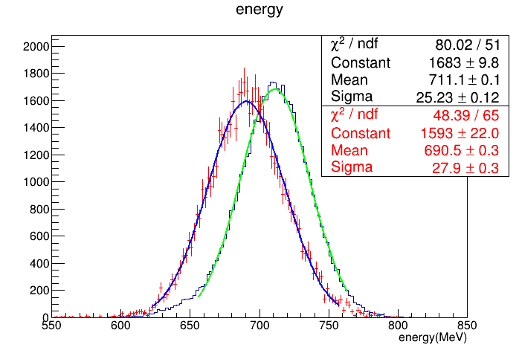
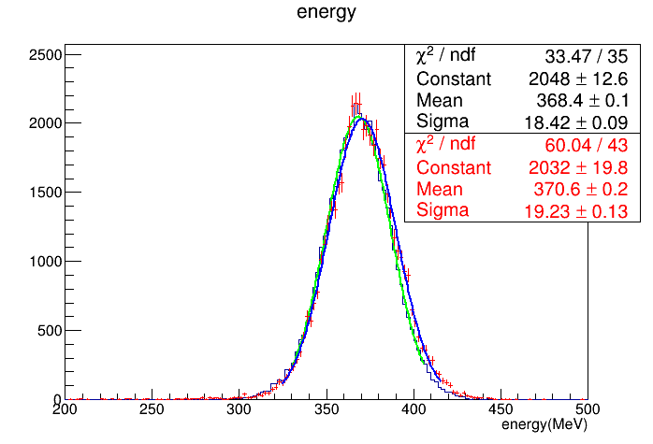
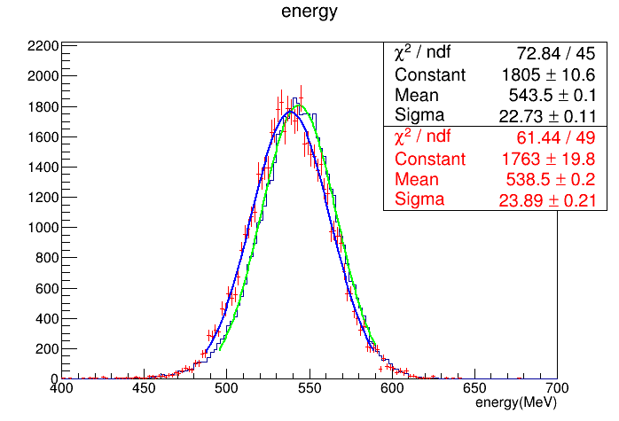
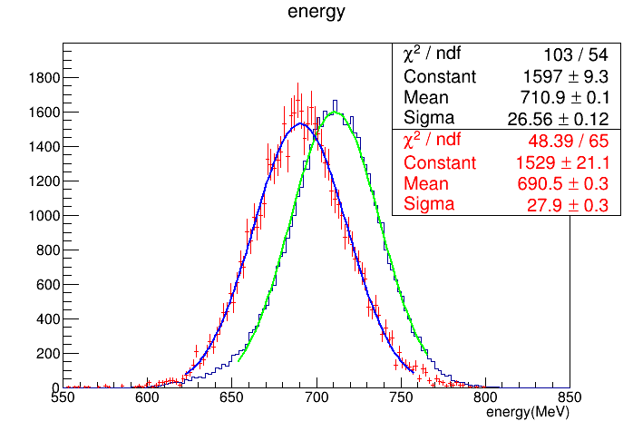
add non-uniformity of scintillators
20GeV
before
30GeV
40GeV
20GeV
after
30GeV
40GeV

Slide 9
backup

Slide 10
no position select 20GeV

Slide 11
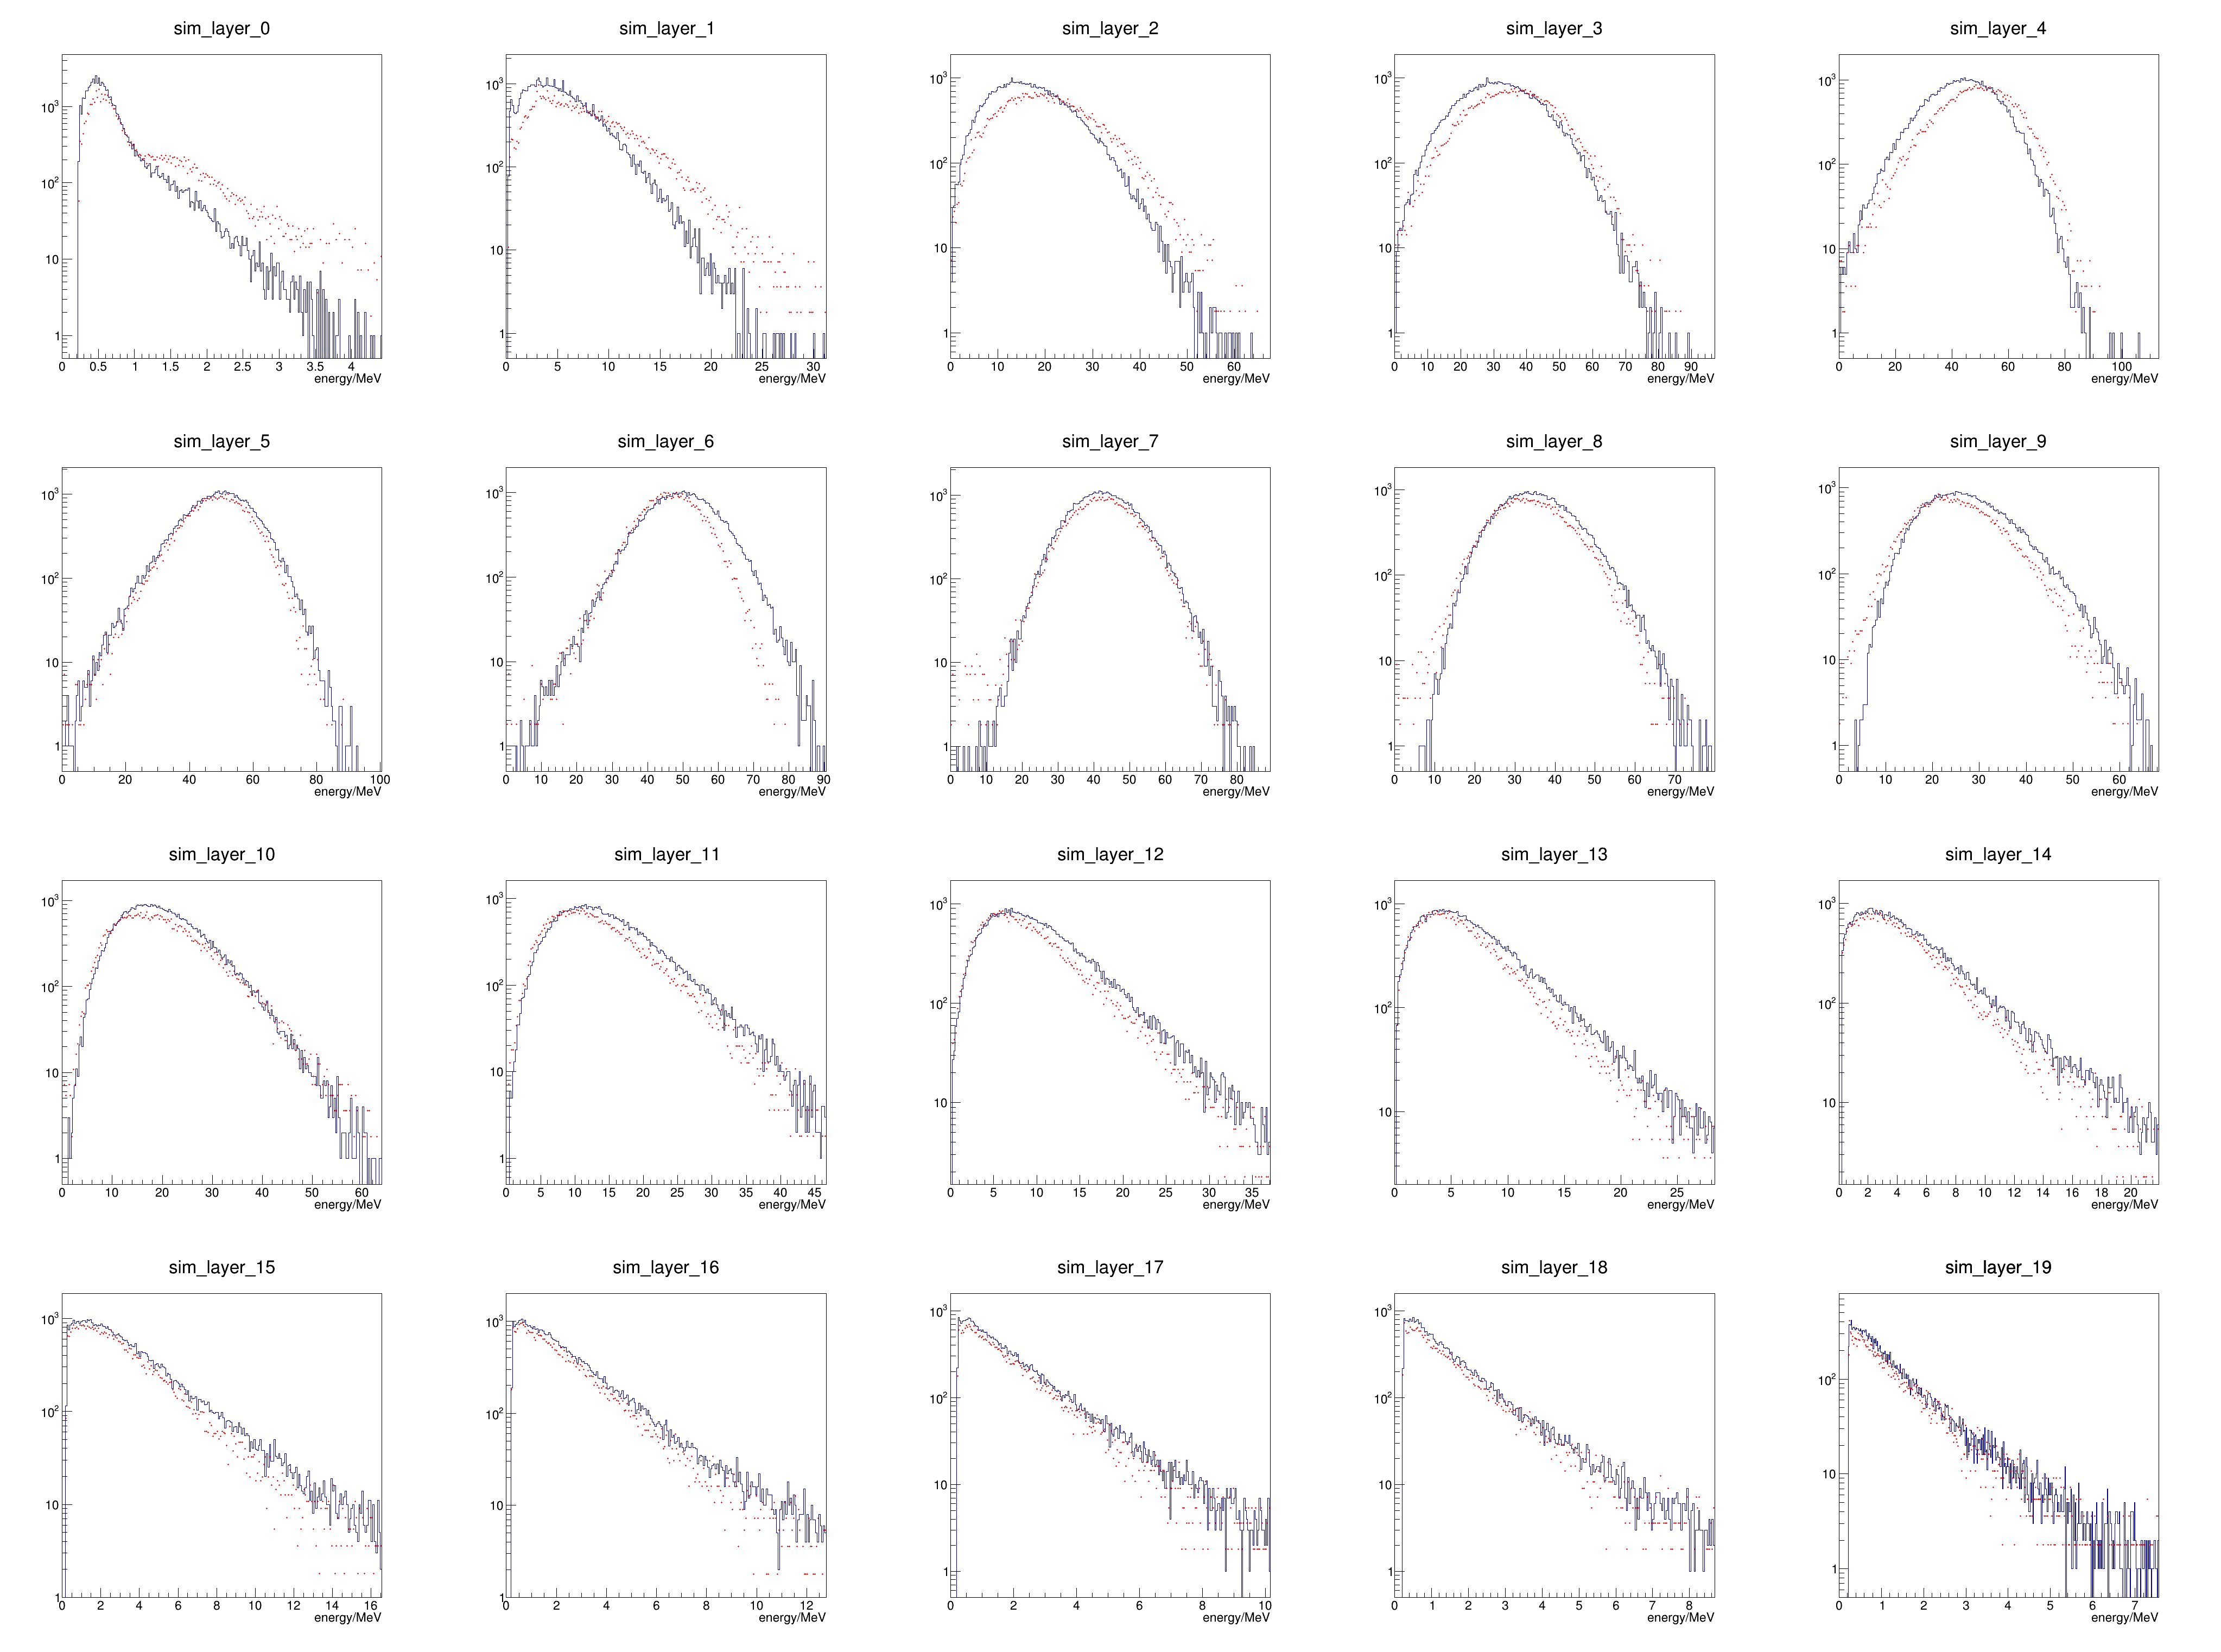
layer profile 20GeV, 0mm

Slide 12
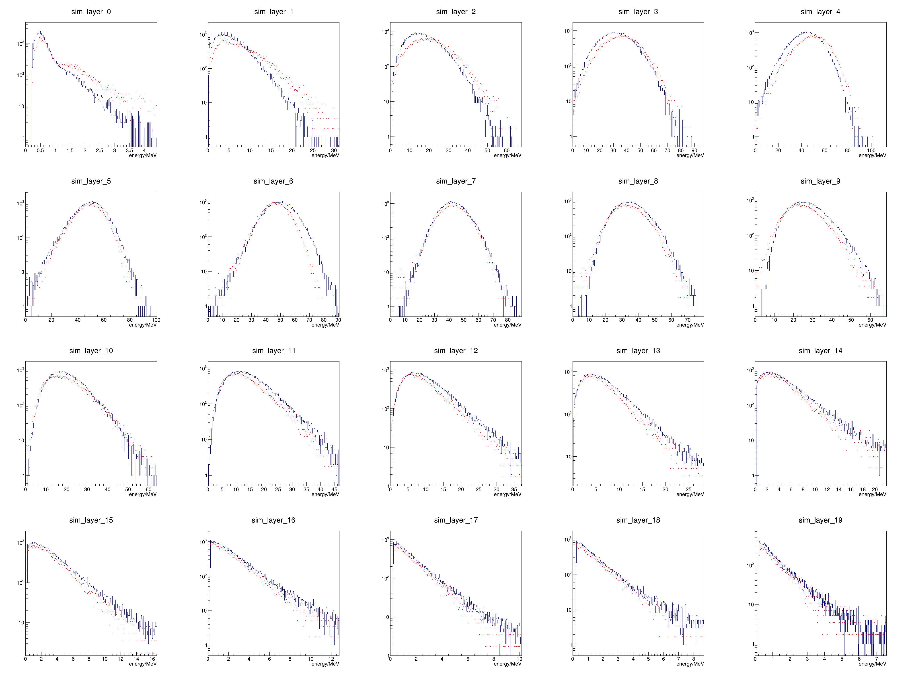
layer profile 20GeV, 10mm

Slide 13
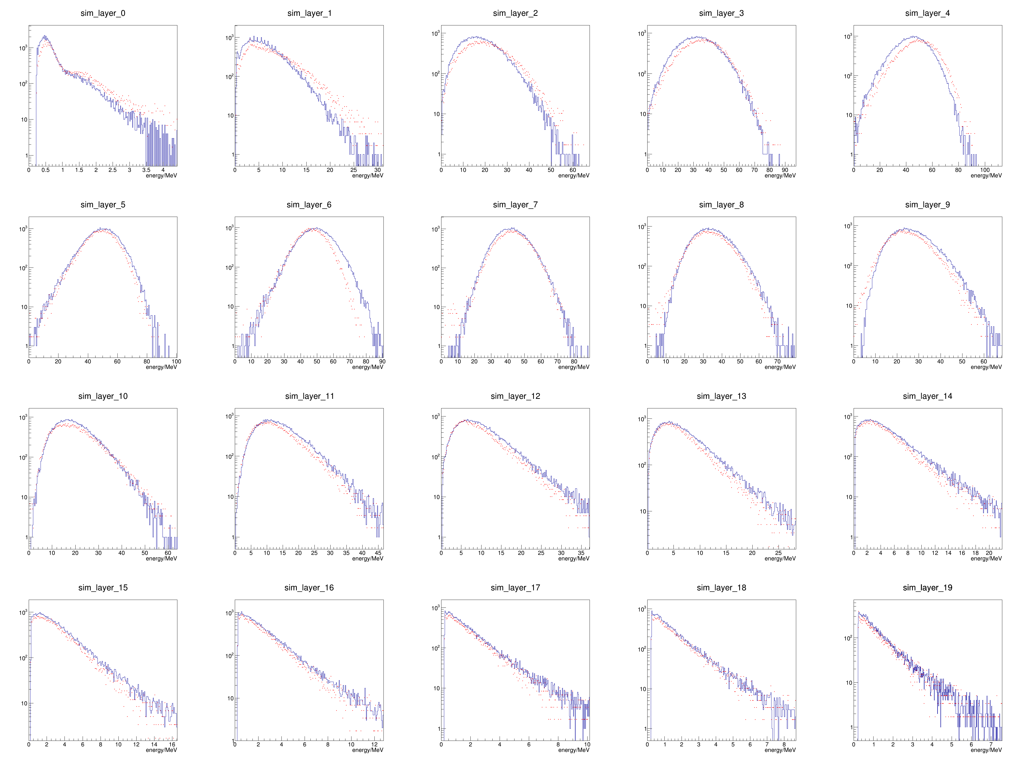
layer profile 20GeV, 40mm

Slide 14
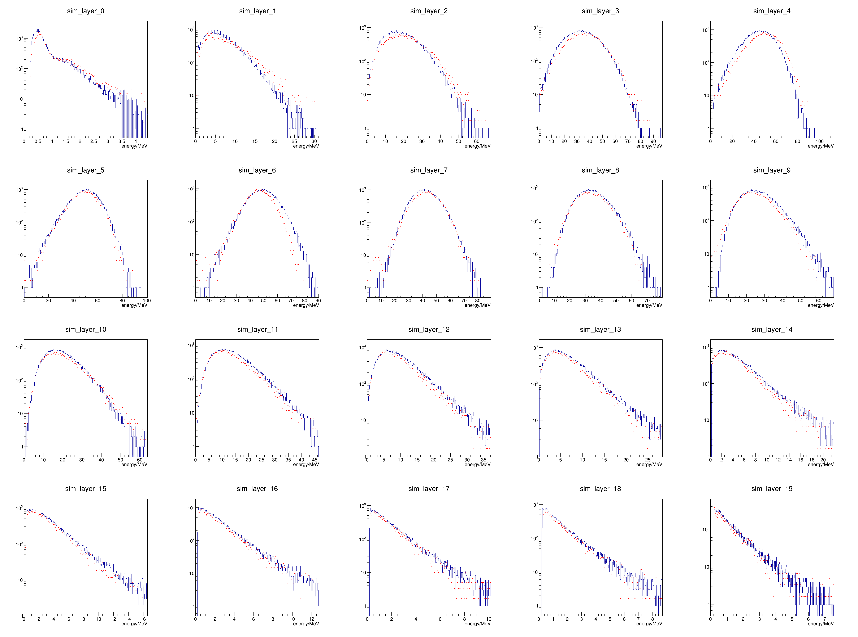
layer profile 20GeV, 60mm

Slide 15
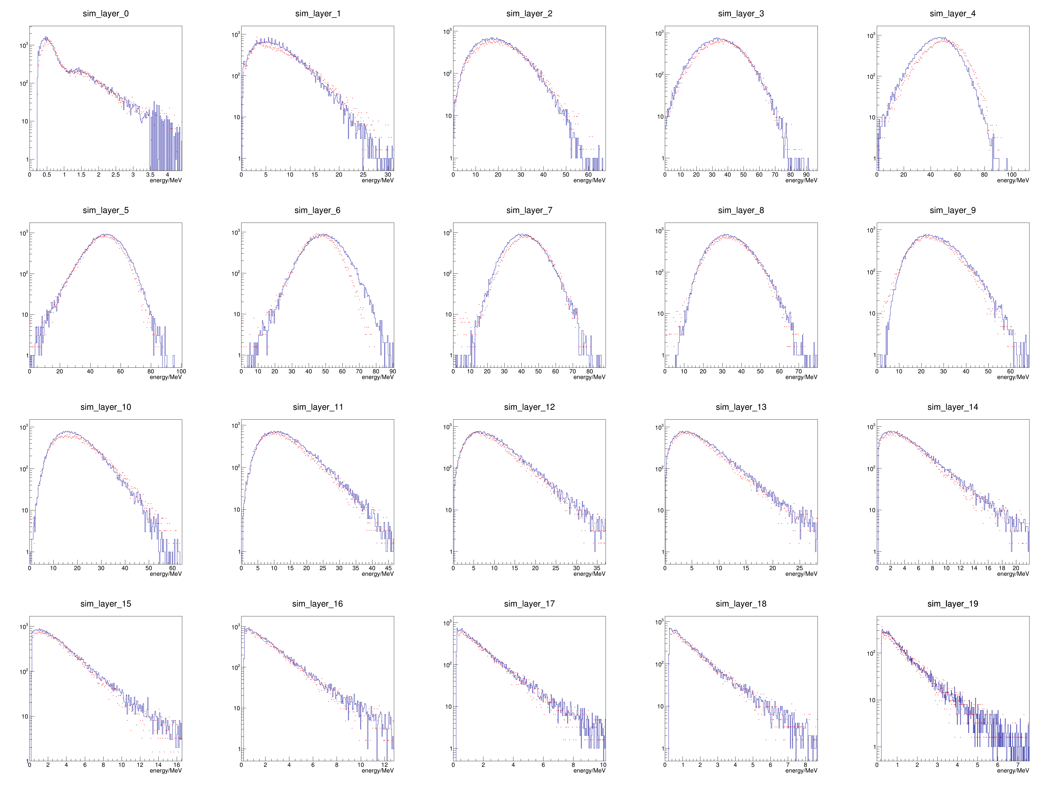
layer profile 20GeV, 100mm

Slide 16
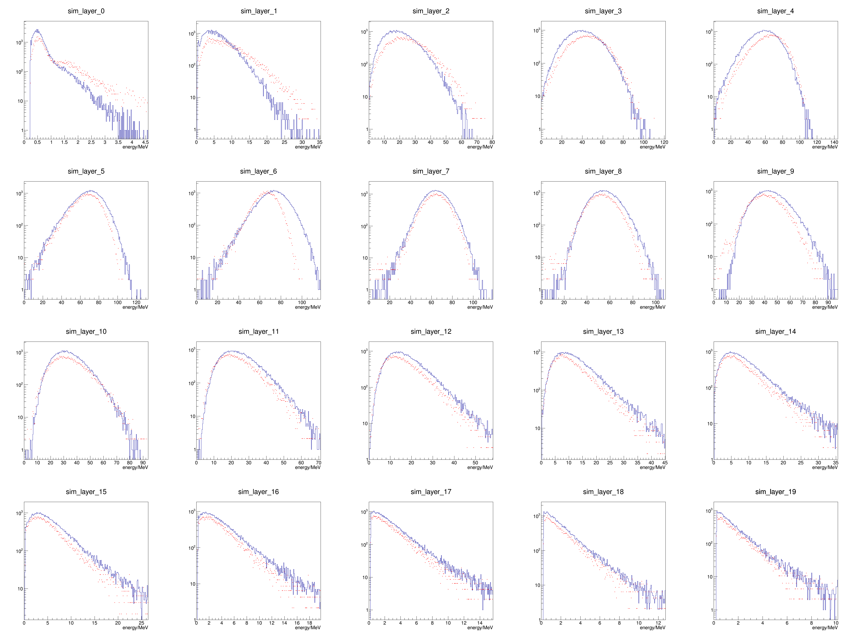
layer profile 30GeV, 0mm

Slide 17
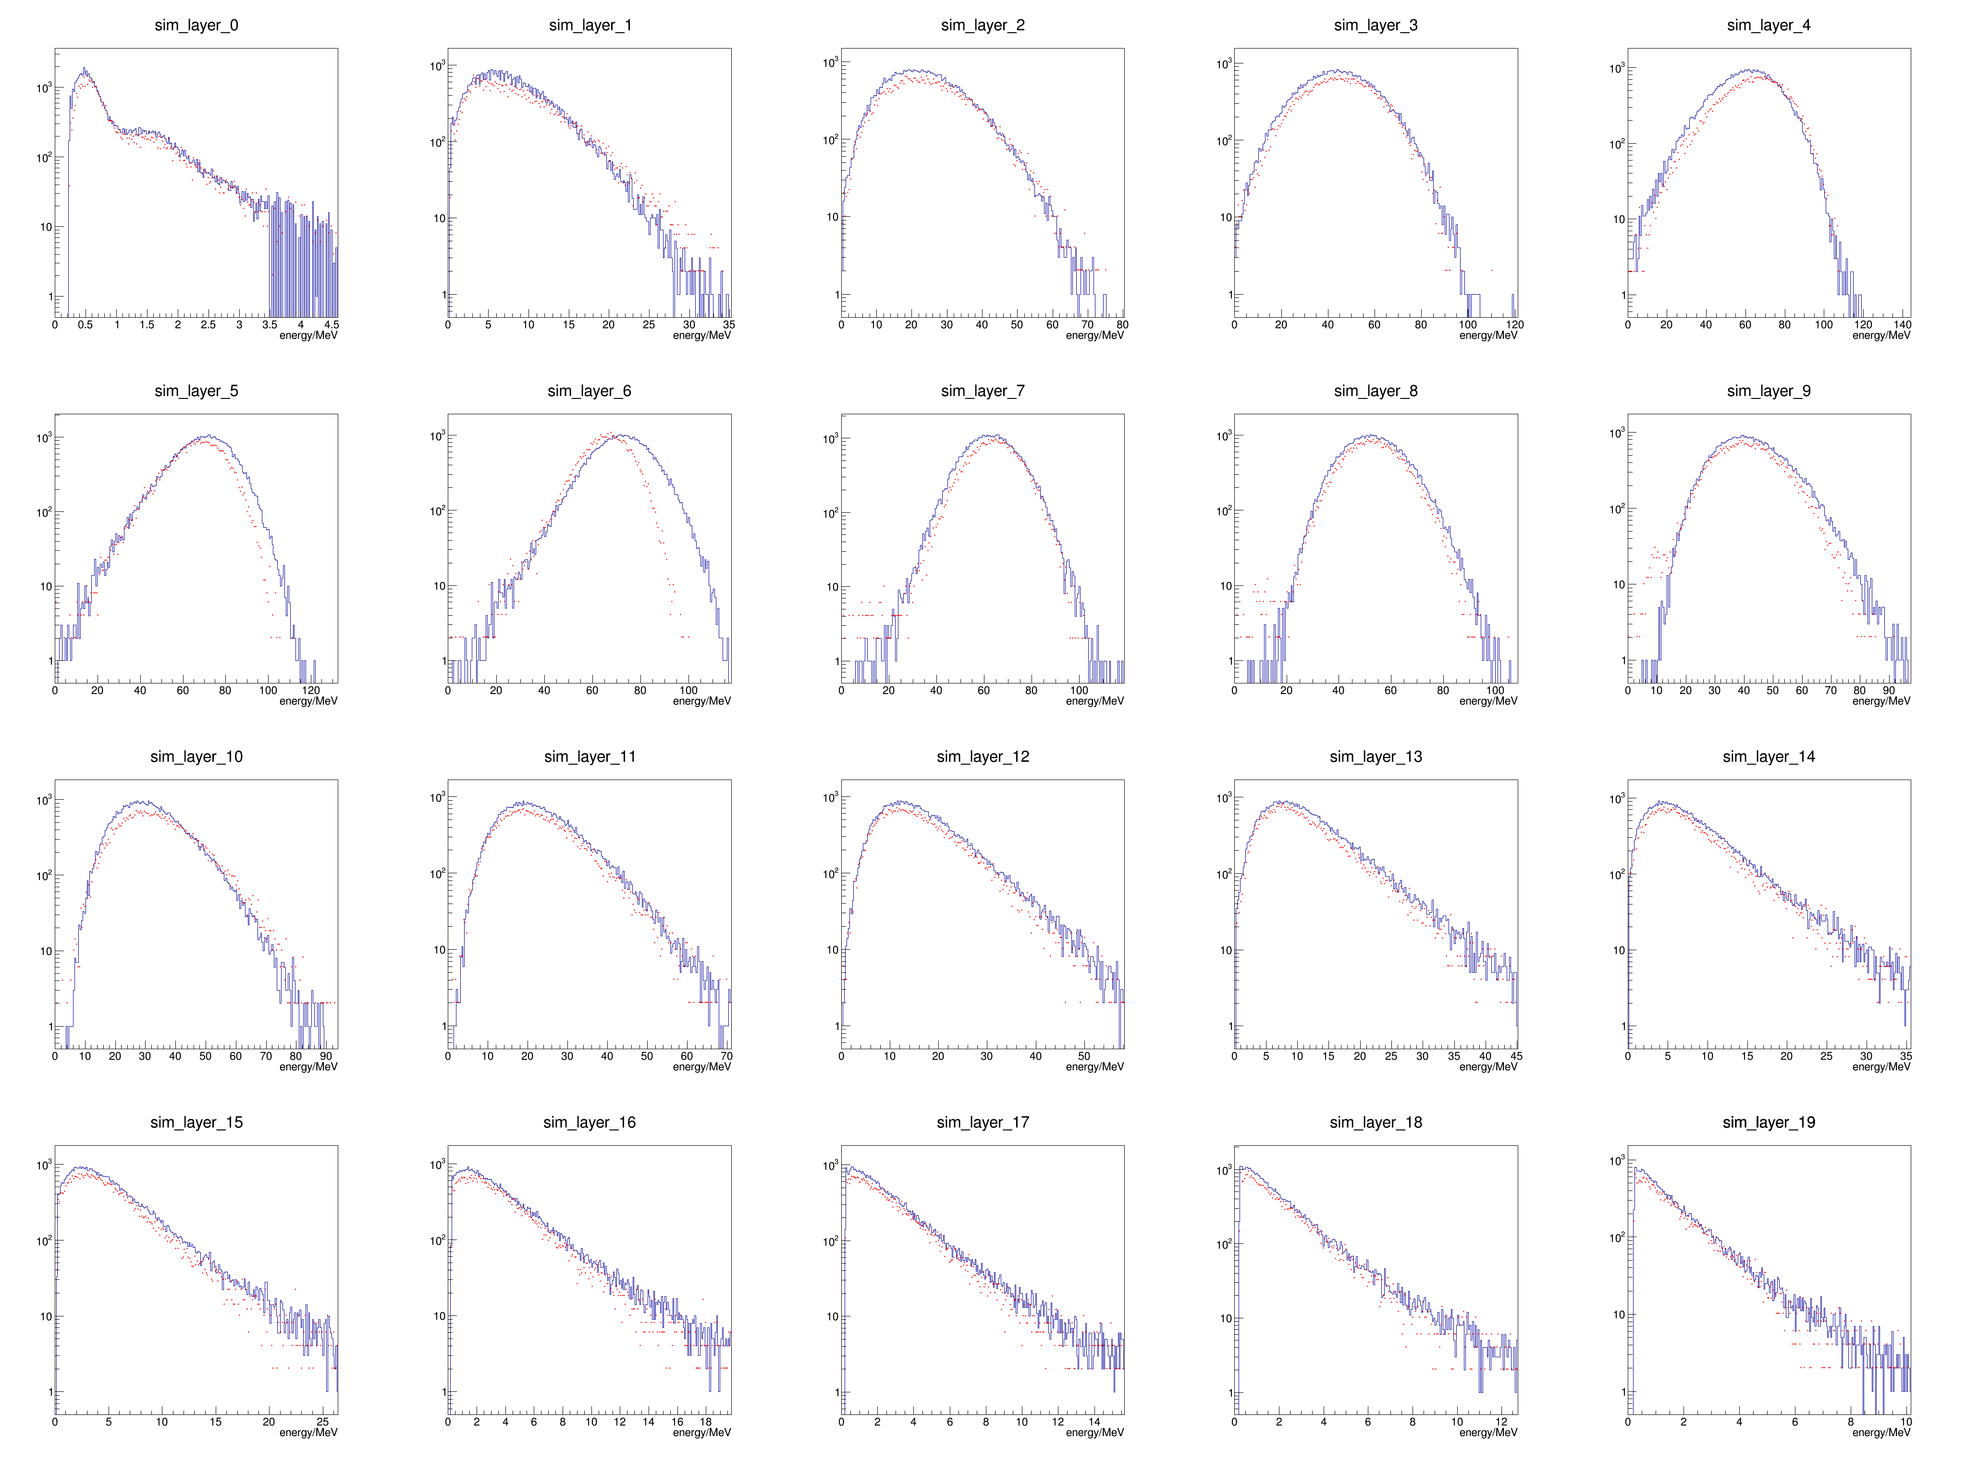
layer profile 30GeV, 100mm

Slide 18
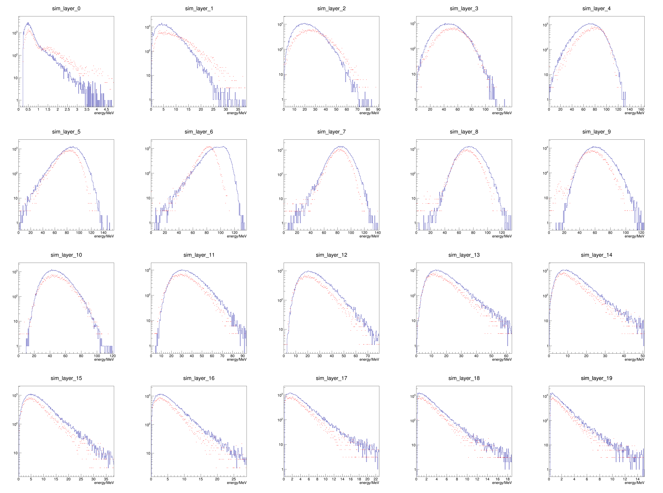
layer profile 40GeV, 0mm

Slide 19
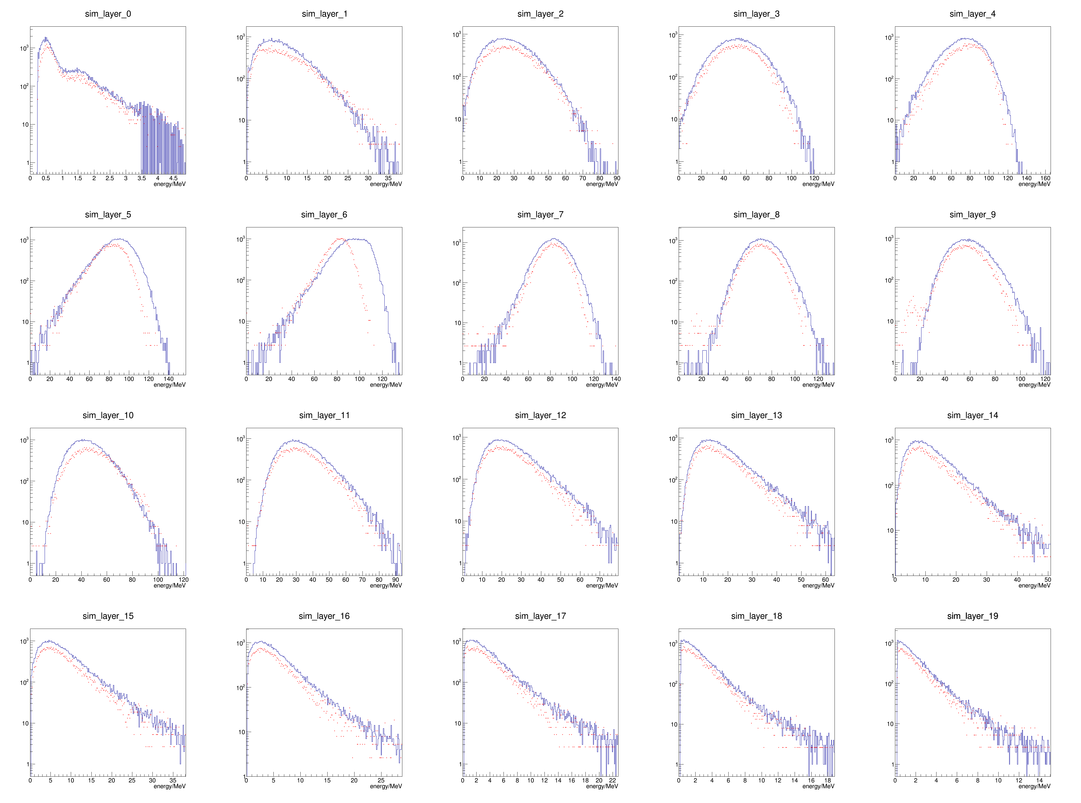
layer profile 40GeV, 100mm

