Slide 1
Digitization and Comparison
diao hongbin
State key laboratory of particle detection and electronics
USTC

Slide 2
digitize
energy to photon (poisson distribution)
photon to phoelectron (binomial distribution, PDE=0.32)
SiPM model
sample
gaussian smear
phoelectron to adc
gaussian smear (sigma of single phoelectron peak sqrt(n)*3)
adc to highgain and lowgain

Slide 3
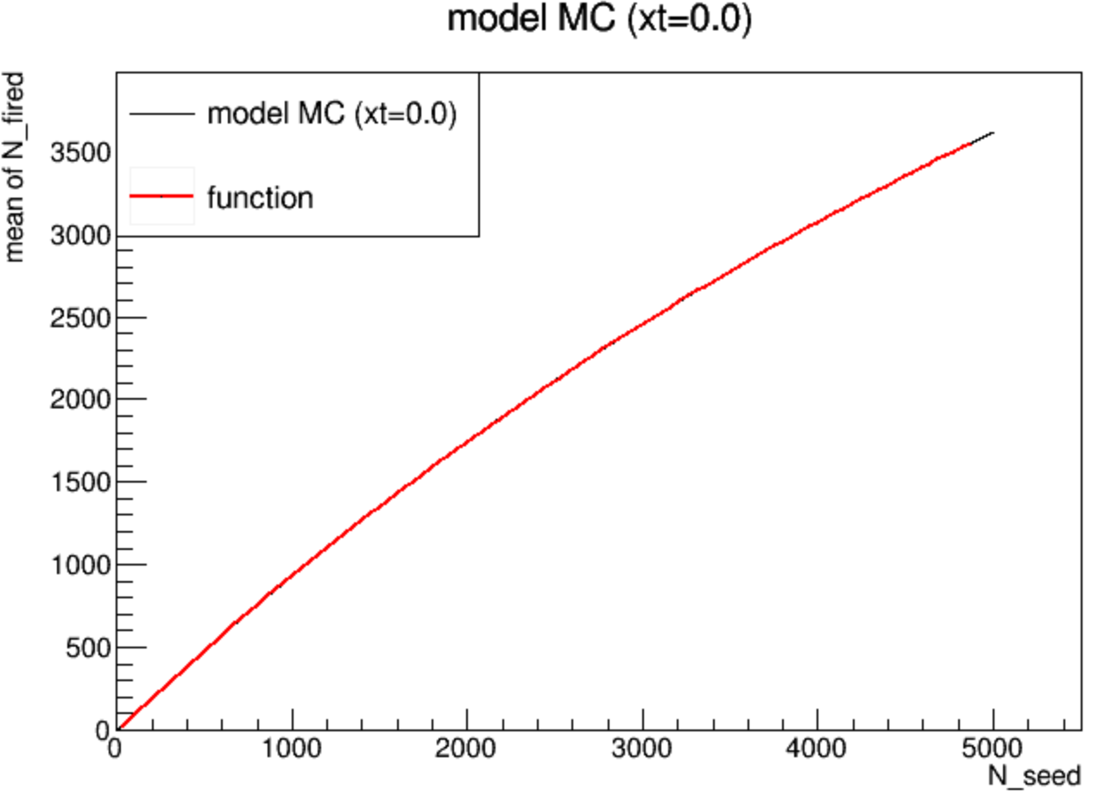
SiPM model
N_pixel=7284, P_crosstalk=0.00

Slide 4
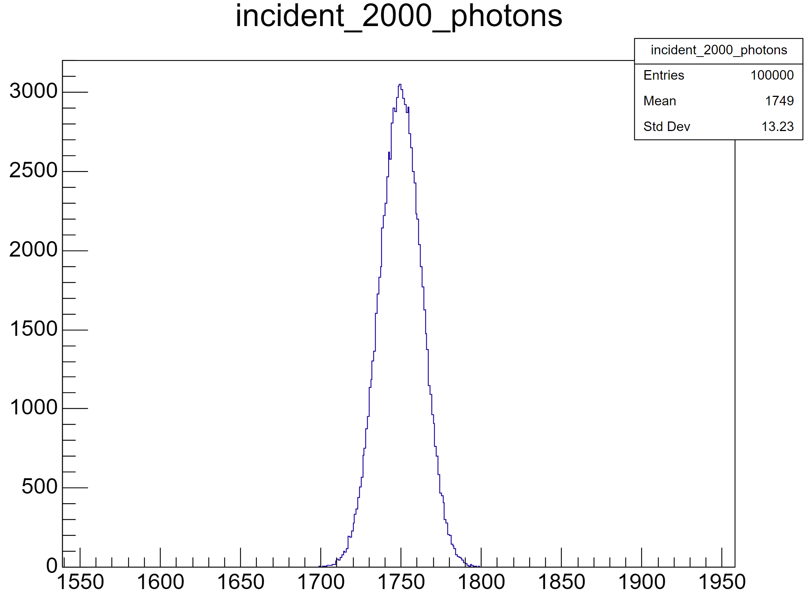
N_fired distribution (P_crosstalk=0)

Slide 5
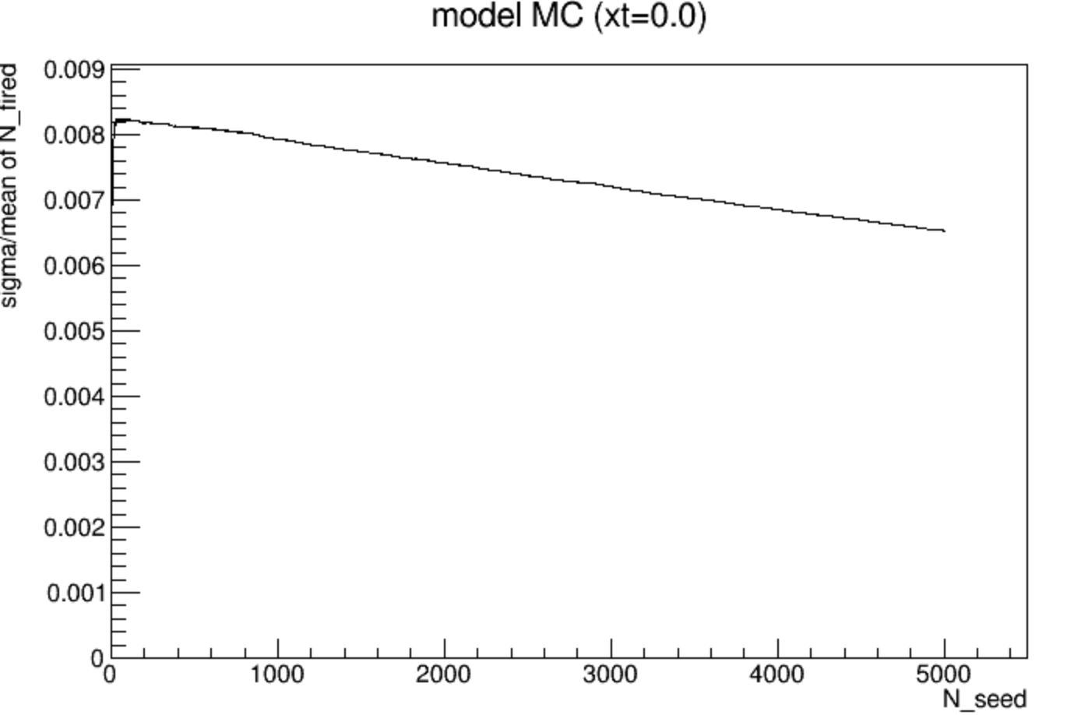
sigma and resolution

Slide 6
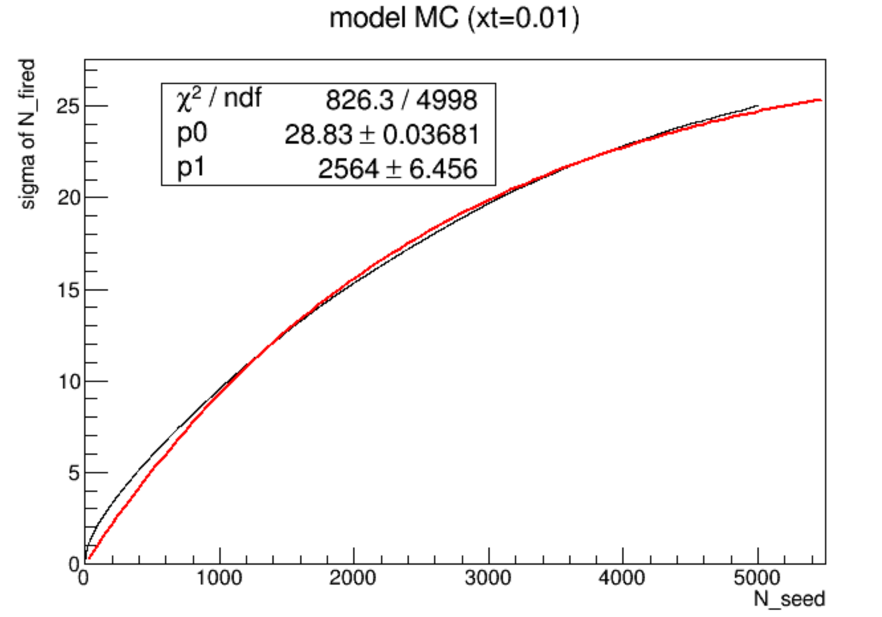
P_crosstalk=0.01
exponential function is not ok
N_pixel=7284, P_crosstalk=0.01

Slide 7
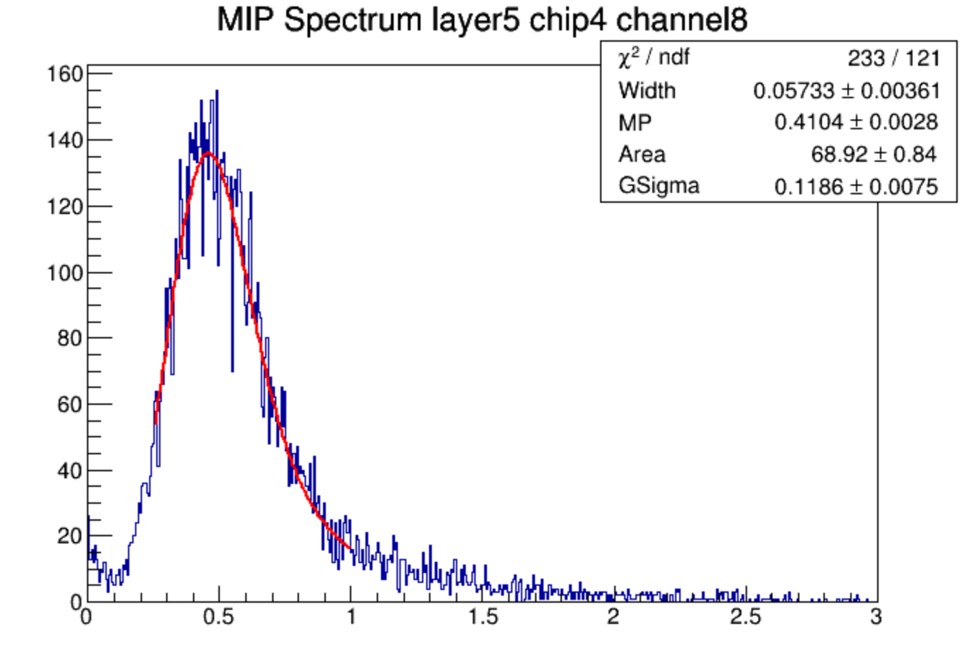
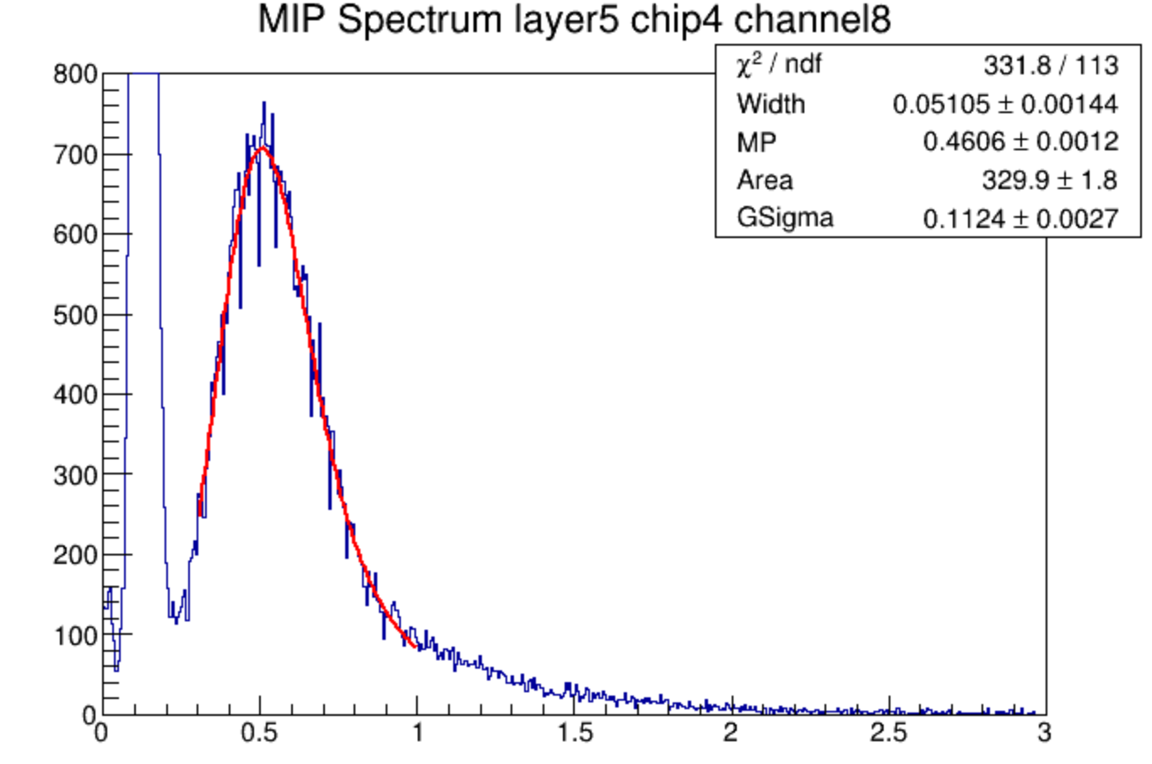
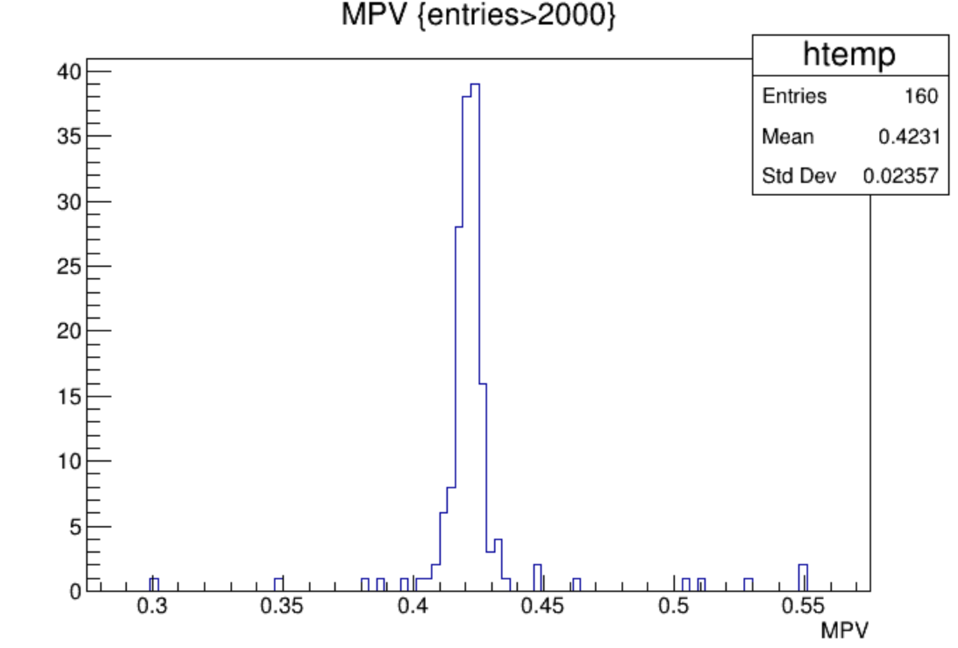
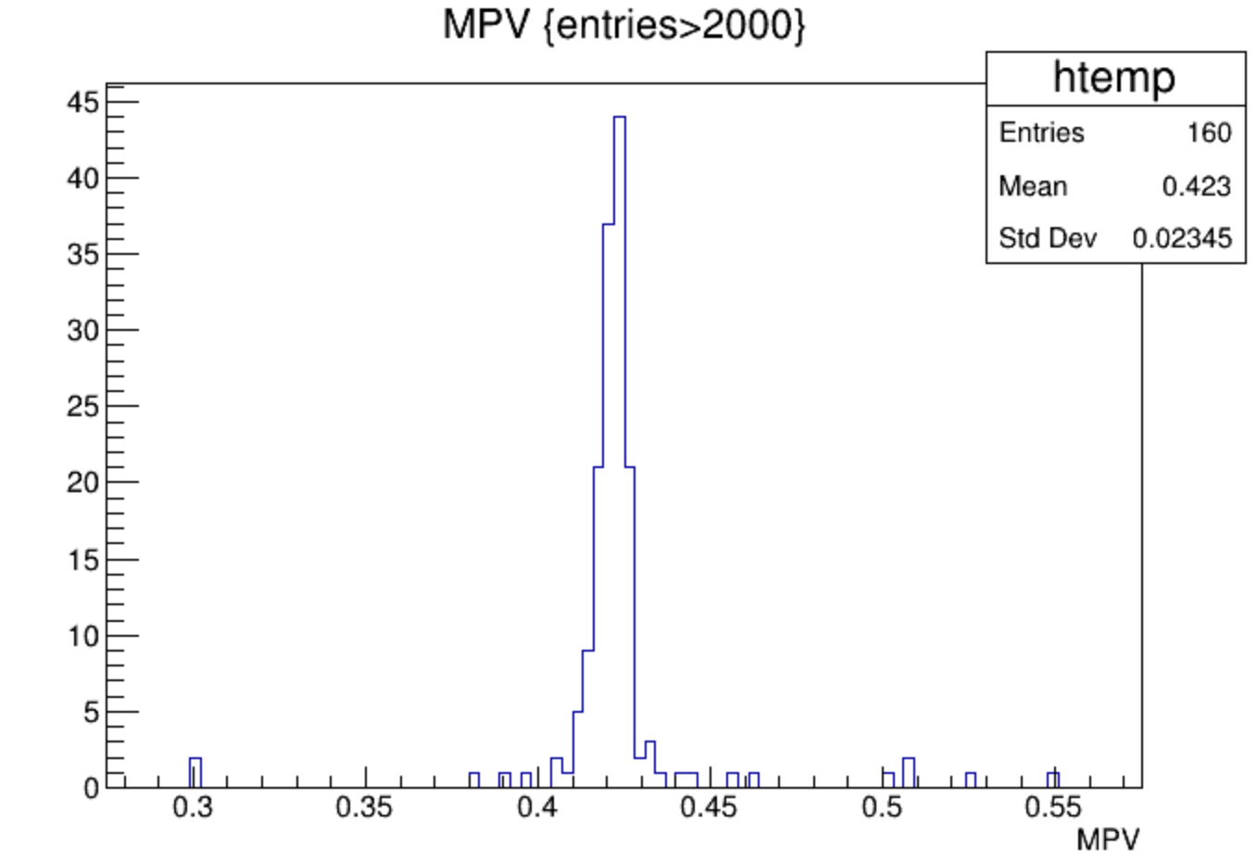
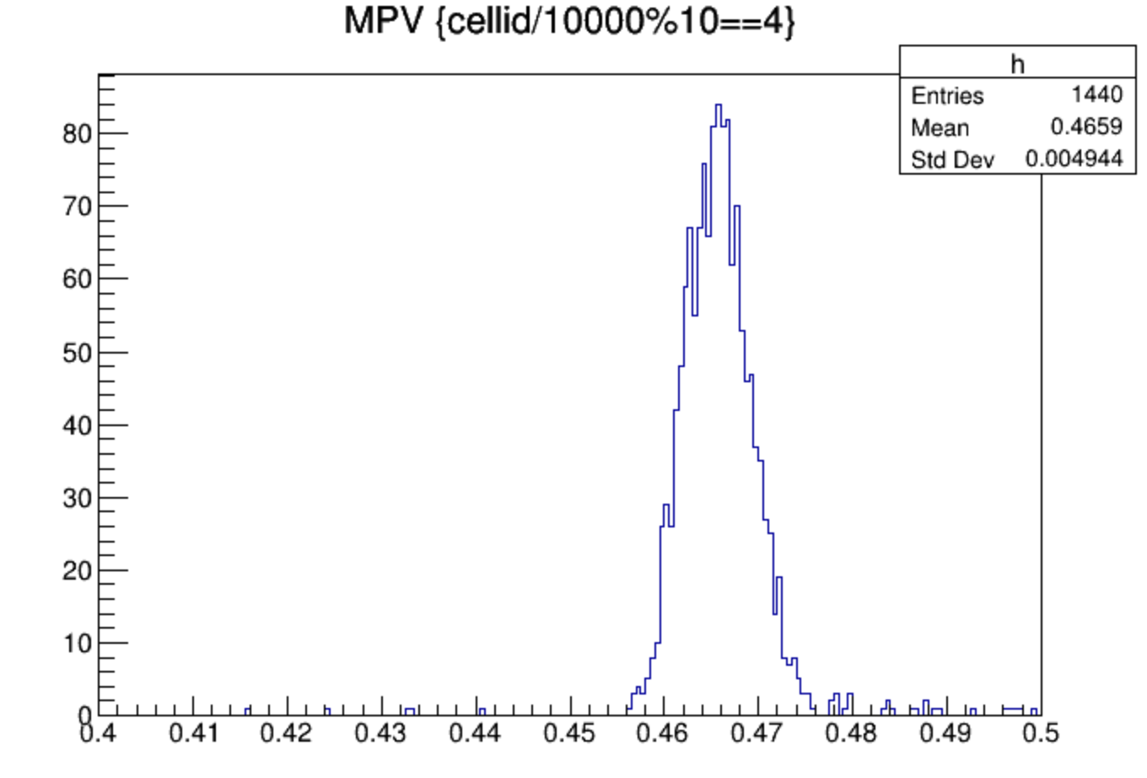
muon comparison
sample
model
data
data

Slide 8
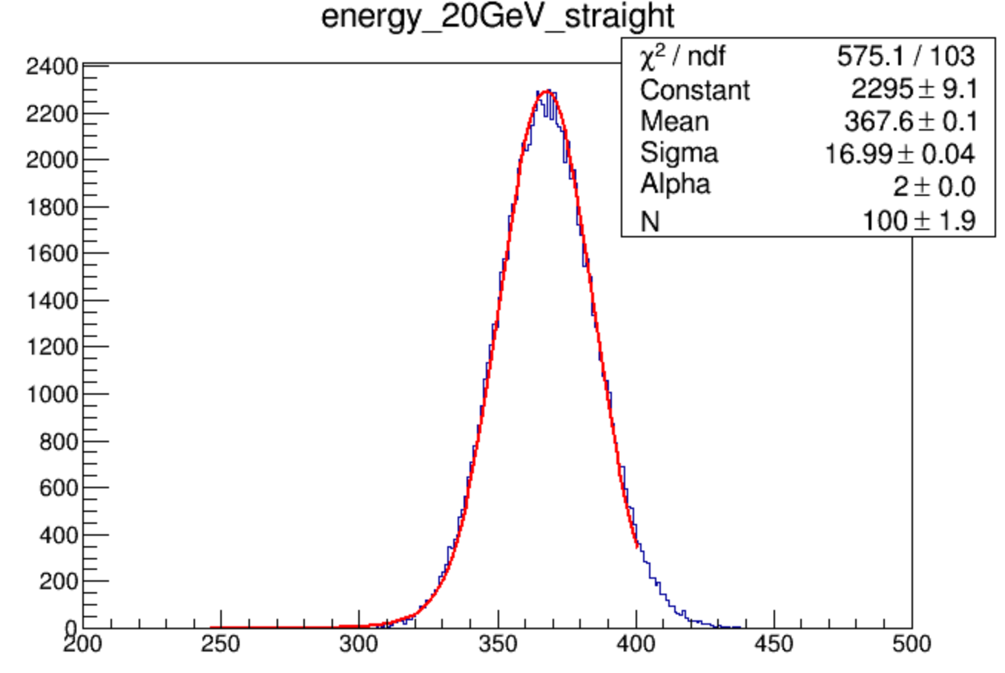
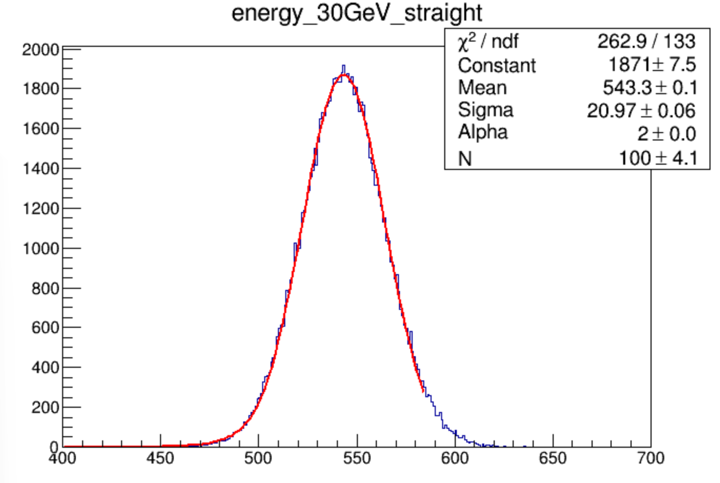
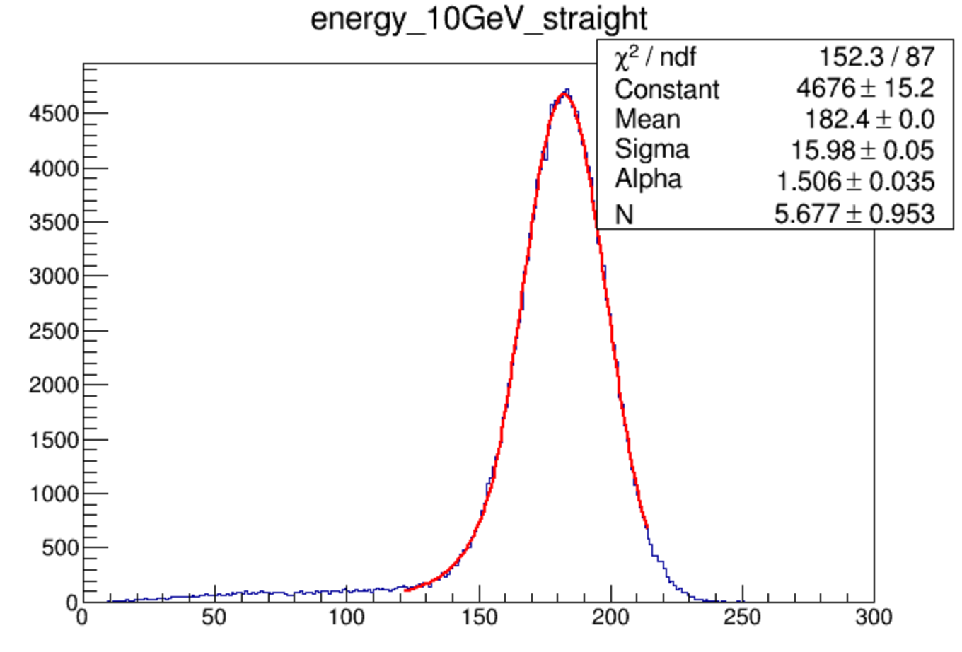
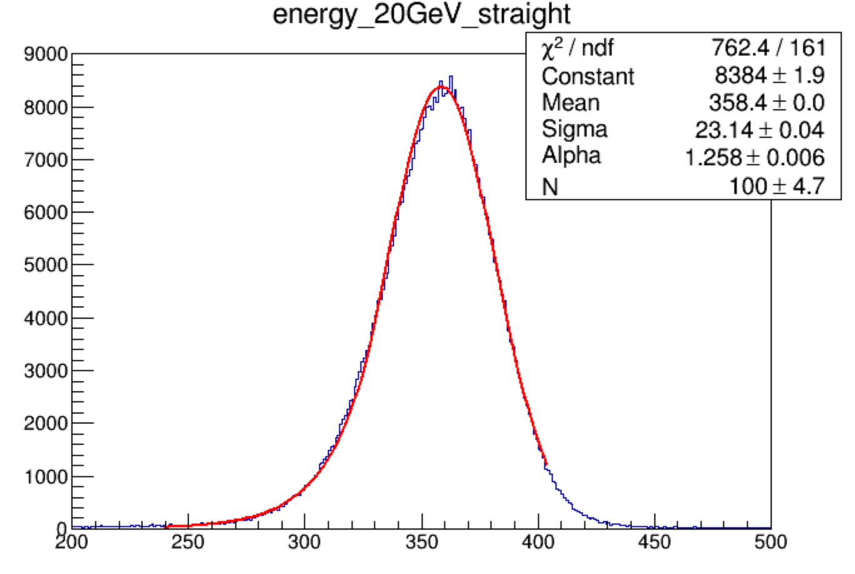
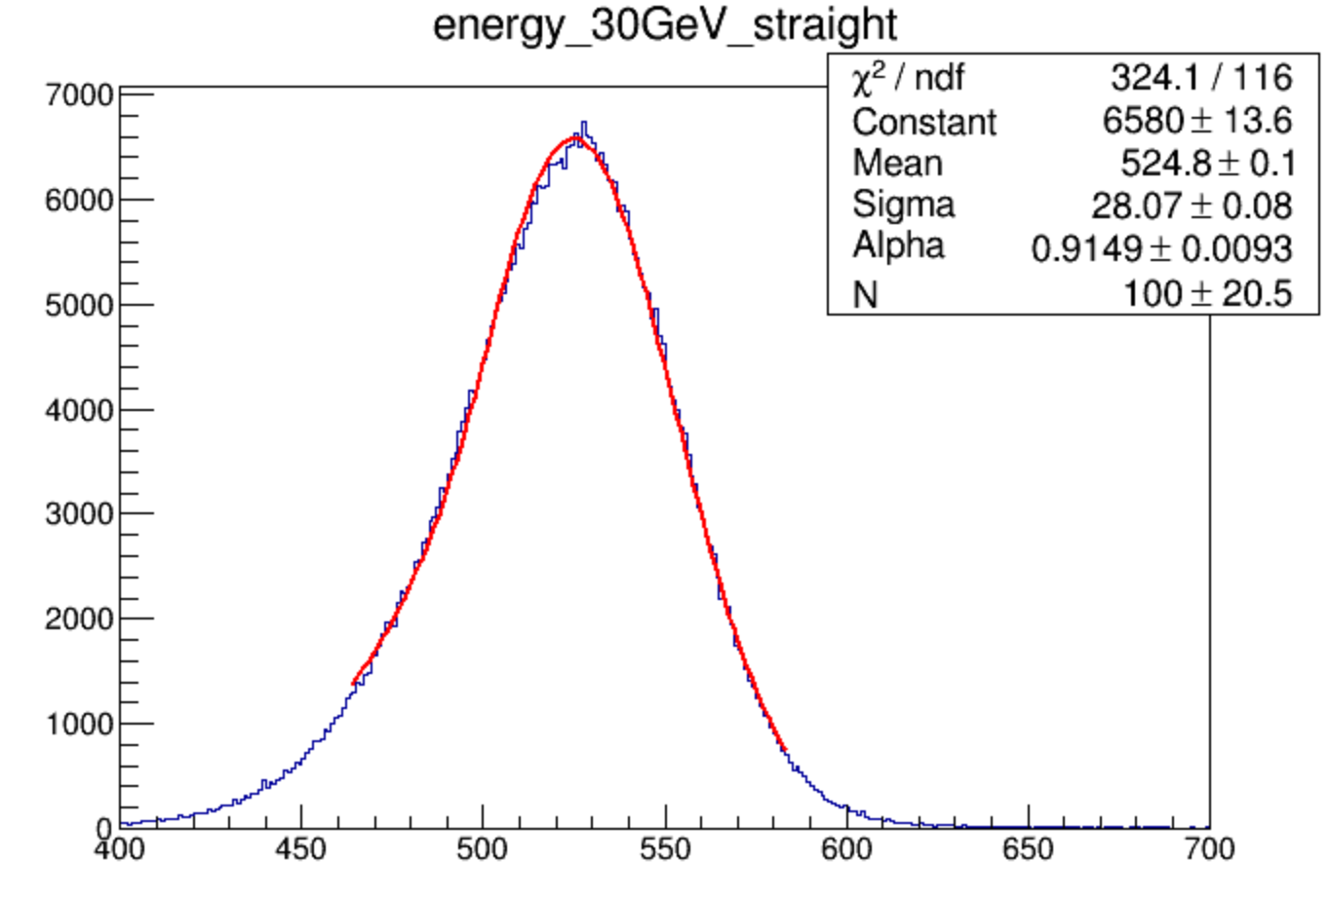
electron comparison
MC
digi
data

Slide 9
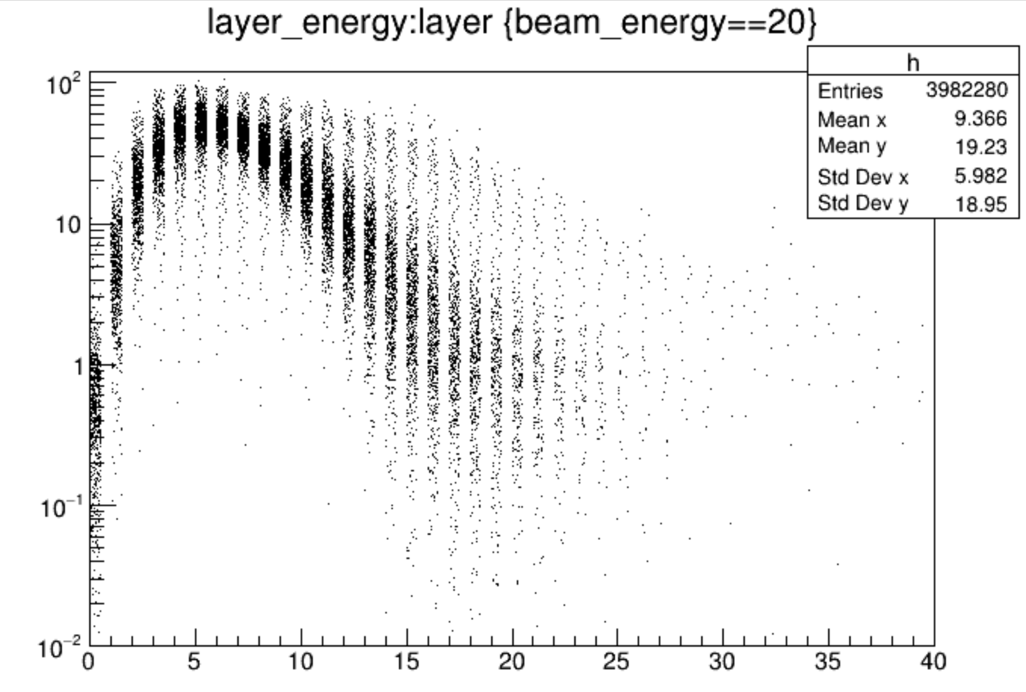

Slide 10
backup

Slide 11
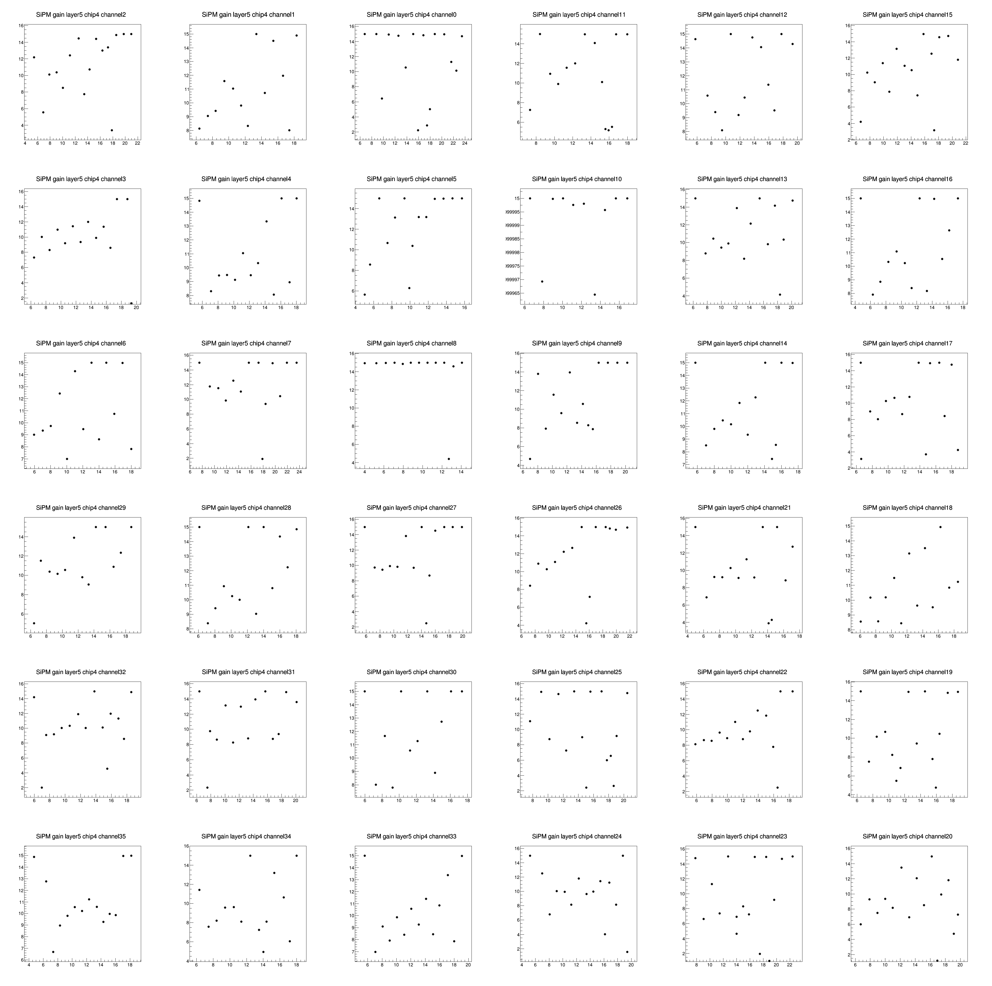
single phoelectron peak sigma
fitted peak sigma
number of peak
=(mean-pedesta)/gap of peaks

Slide 12
single phoelectron peak sigma

Slide 13
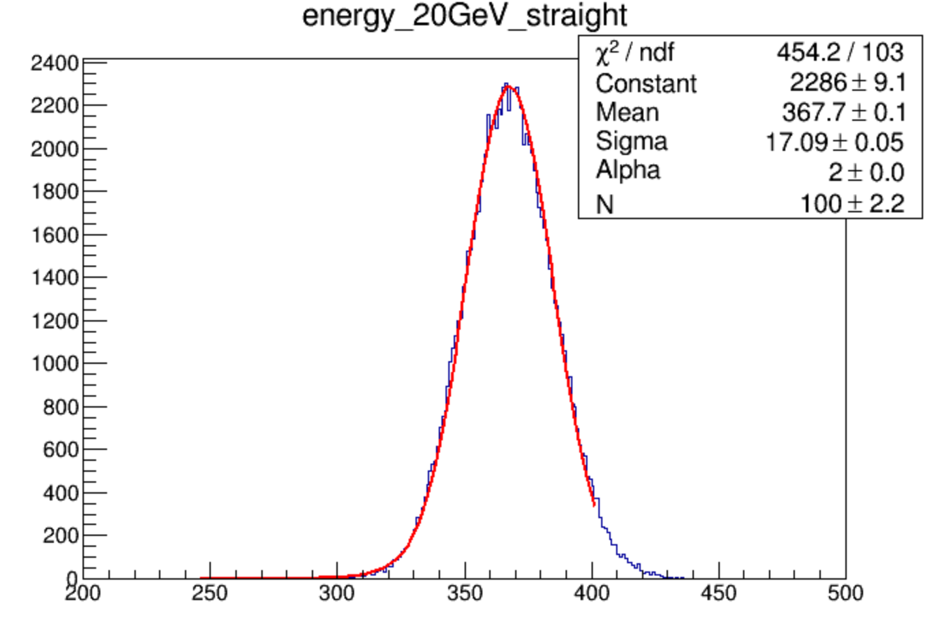
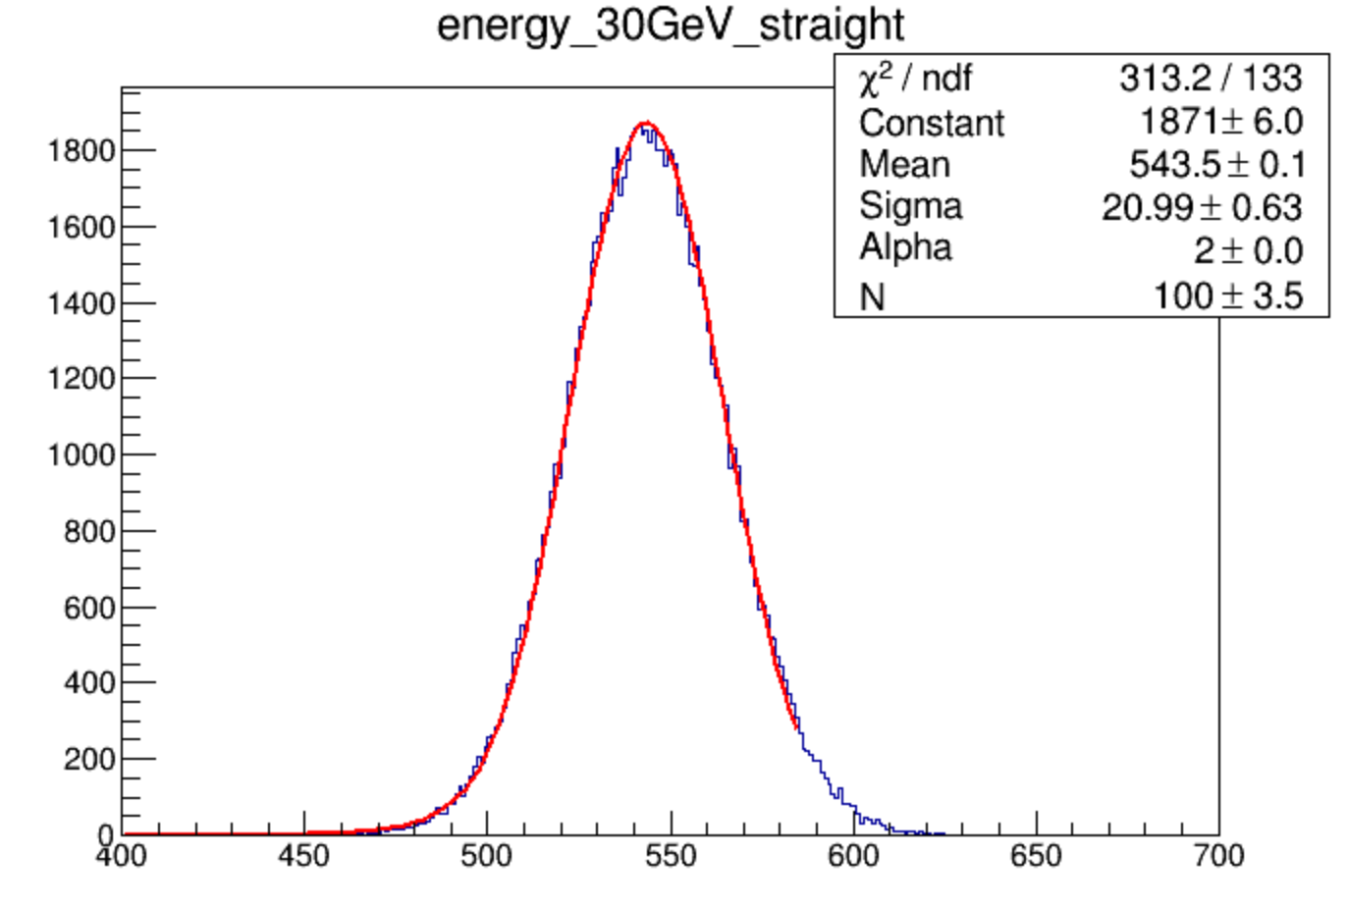
electron
MC model

Slide 14
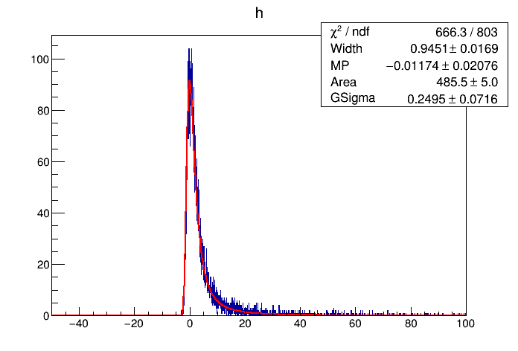
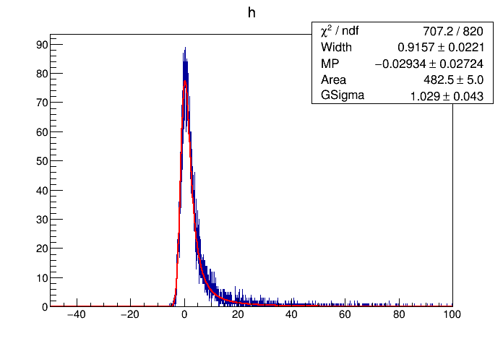
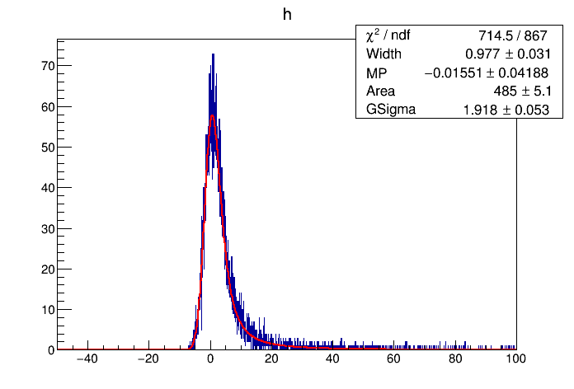
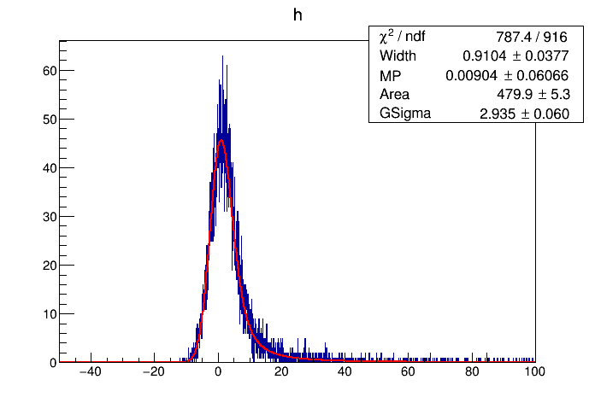
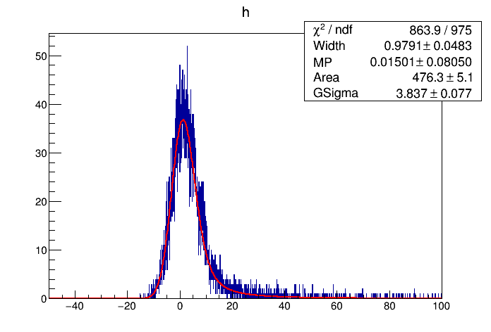
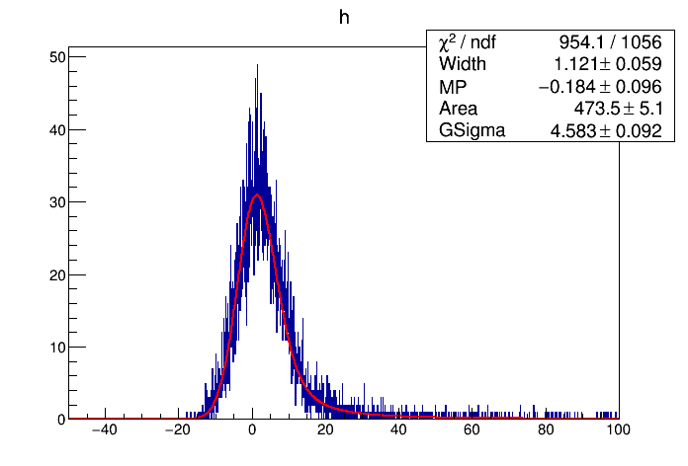
Fit change sigma
h->FillRandom(f,10000)
1,0,1,0.001
1,0,1,1
1,0,1,2
1,0,1,3
1,0,1,4
1,0,1,5

Slide 15
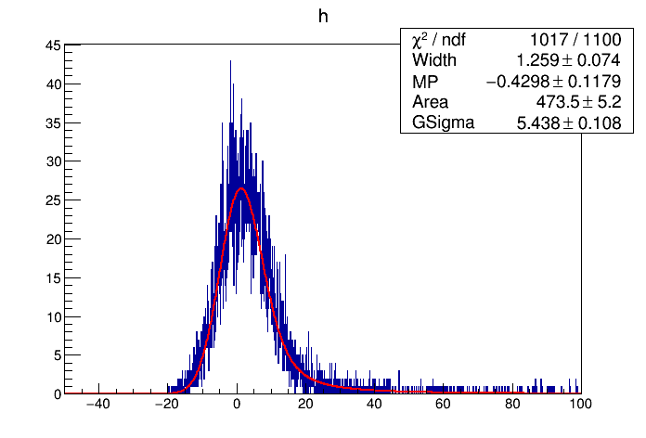
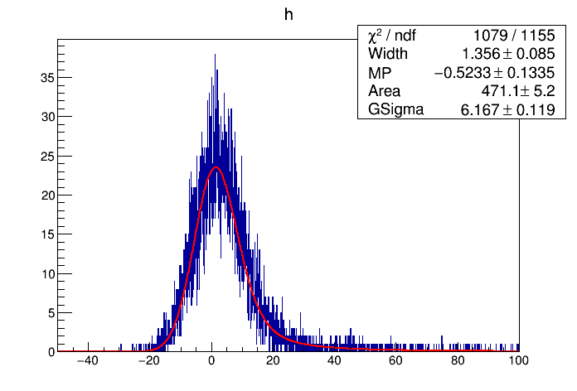
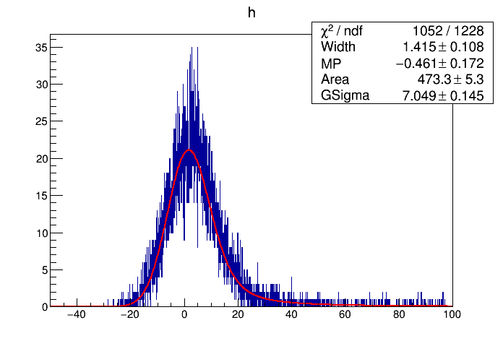
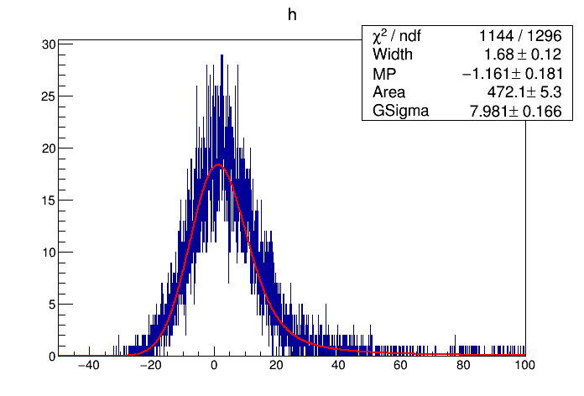
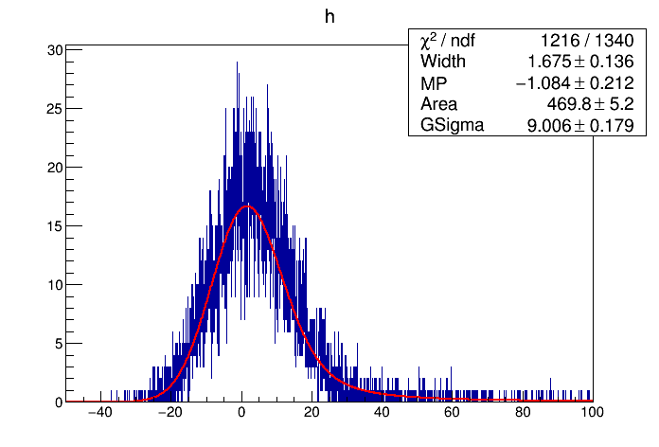
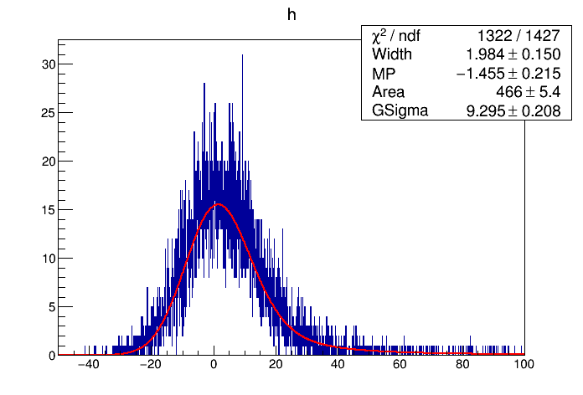
Fit change sigma
1,0,1,6
1,0,1,7
1,0,1,8
1,0,1,9
1,0,1,10
1,0,1,11

Slide 16
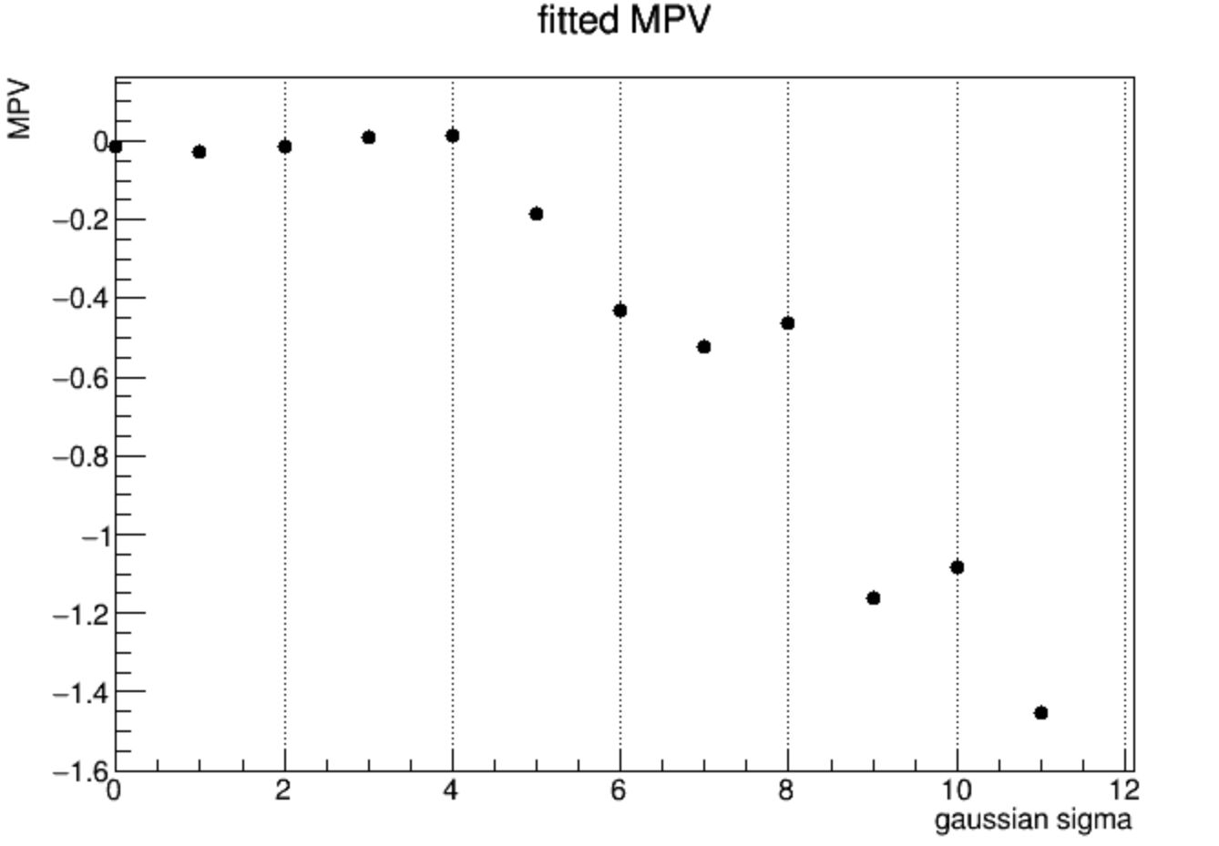
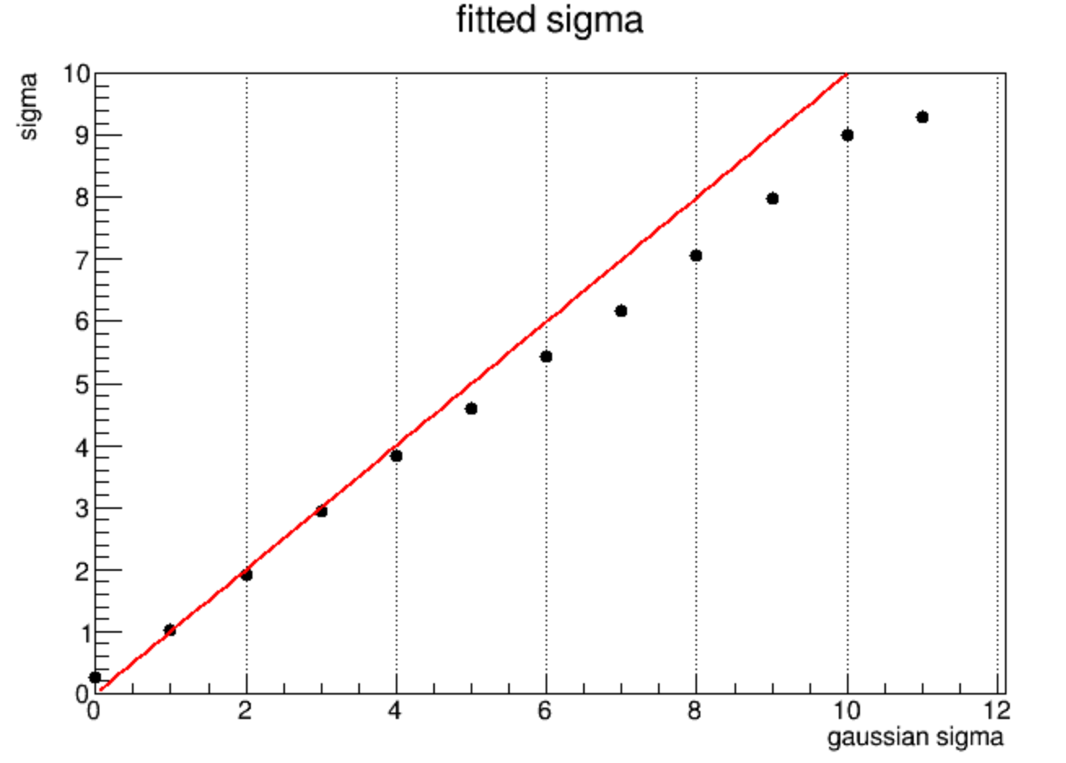
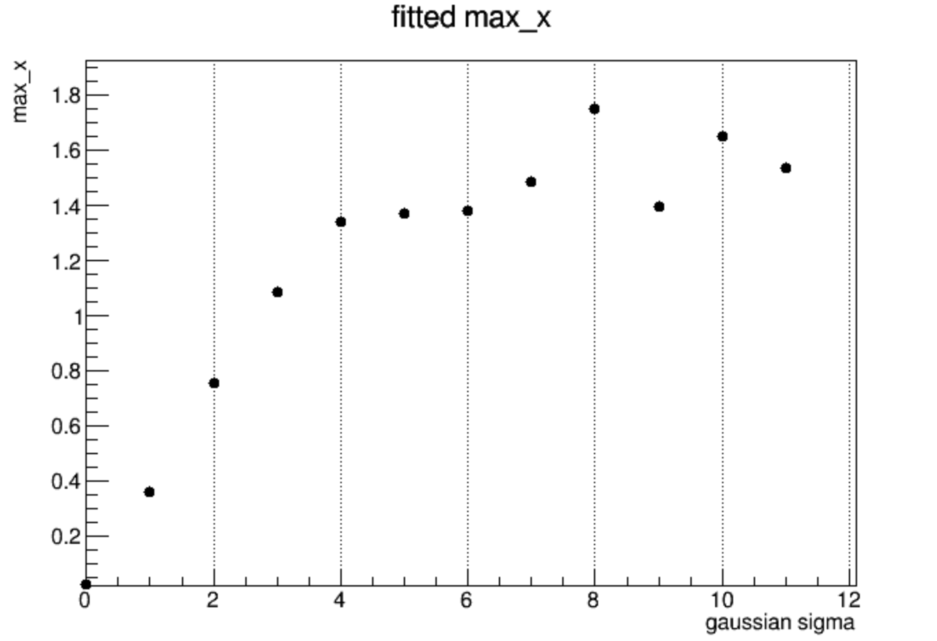
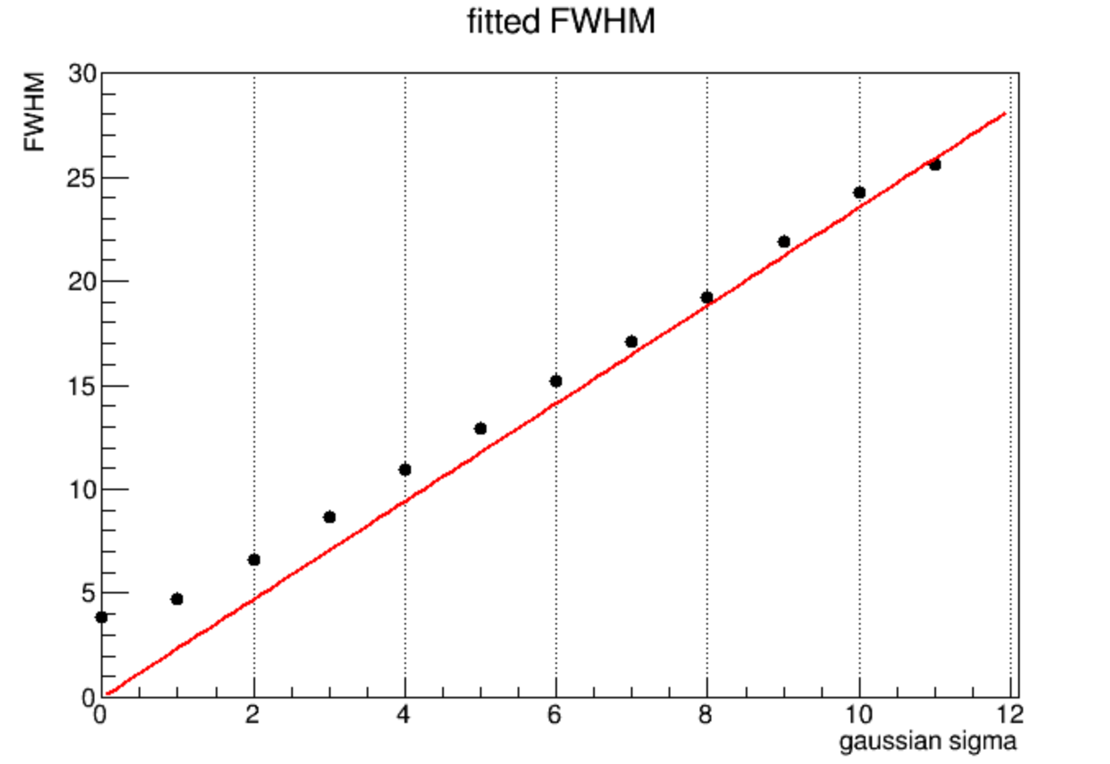
fitted result
y=x
y=2.355*x

