Slide 1
12-22 ECAL digitalization update
2023/12/22
Jiaxuan Wang

Slide 2
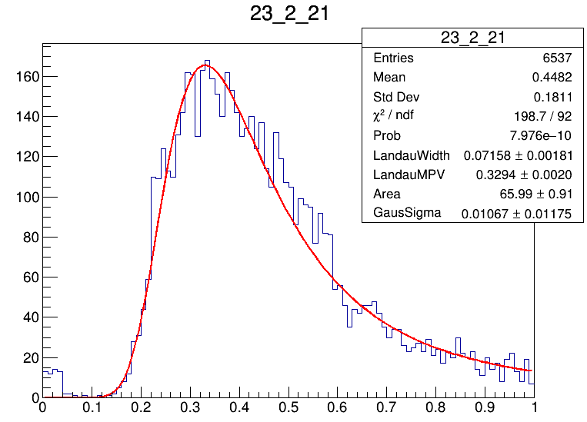
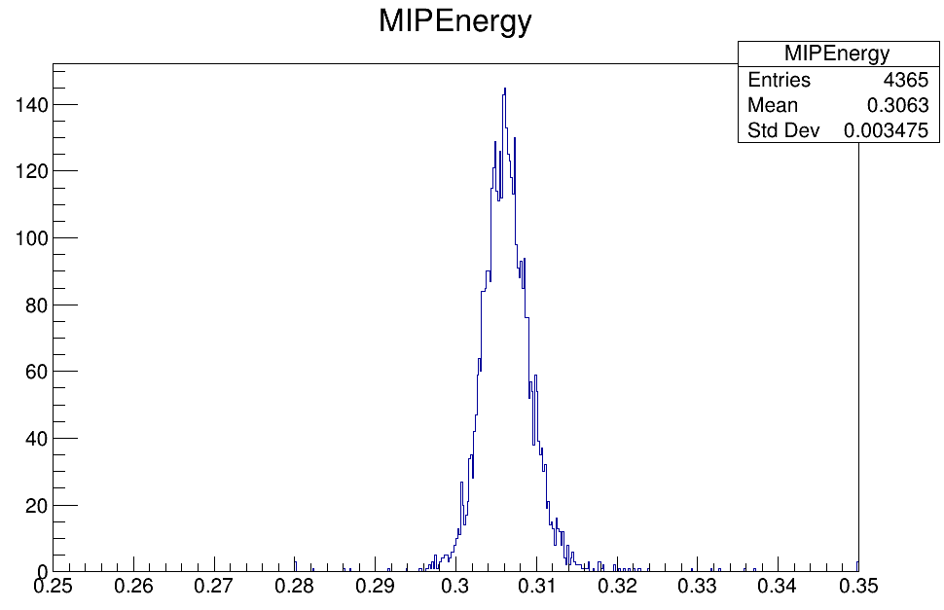
Muon data self-check
Sample muon data: ECAL Run 139 – Run 148
Test muon data: ECAL Run 149 – Run 153
Entries>1000

Slide 3
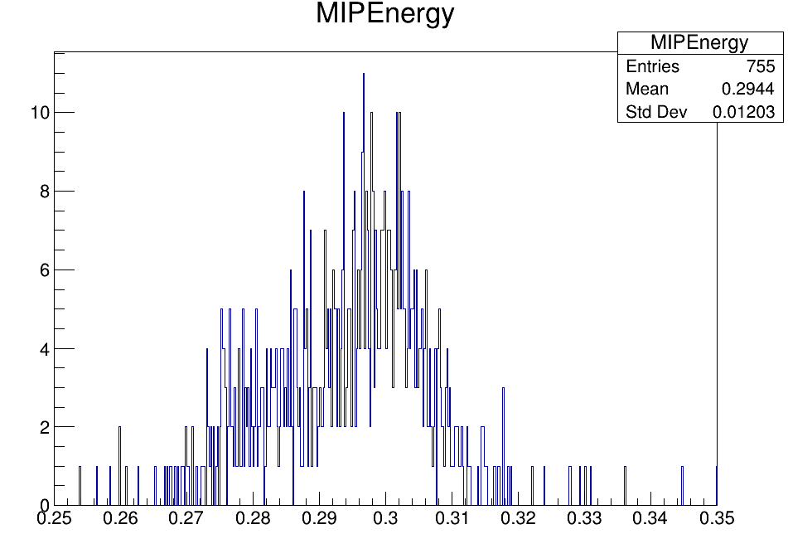
Muon data self-check : test
Sample muon data: ECAL Run 139 – Run 148
Test muon data: ECAL Run 149 – Run 153
Entries>1000
Entries>1000

Slide 4
Digitization
Energy Deposition E_Dep
Incident photons N_Photon
SiPM response N_PE
SiPM saturation correction N_PE_Saturation
ADC HL_ADC
Dead channel cut
0.5 MIP cut

Slide 5
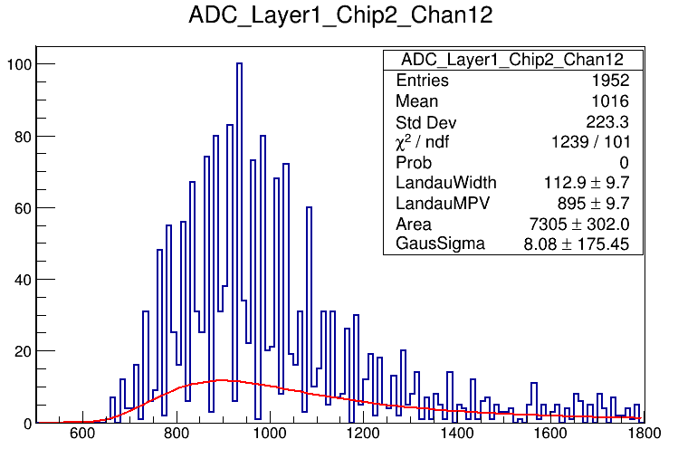
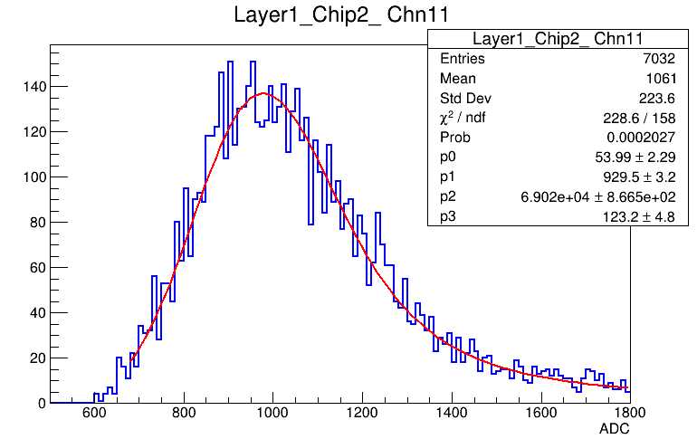
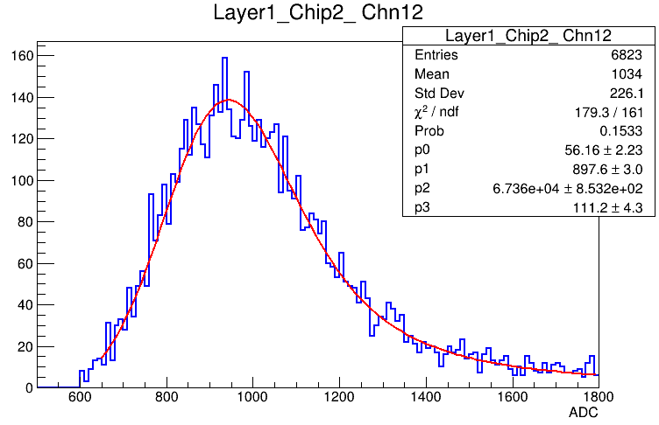
Digi & Data : Layer 1 (15um)

Slide 6
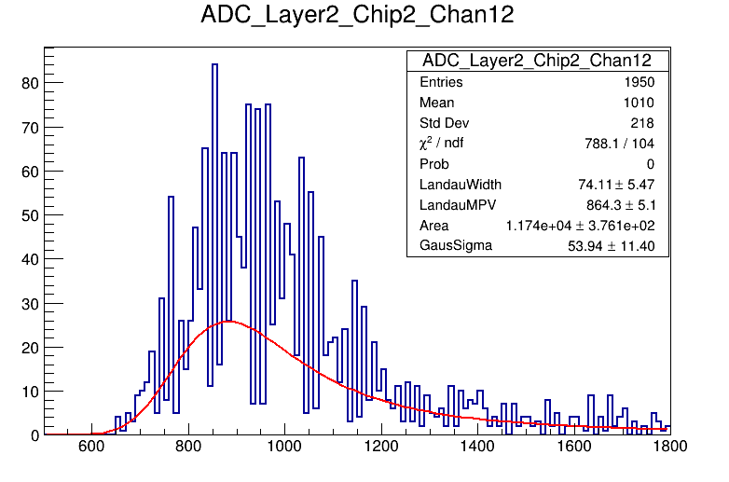
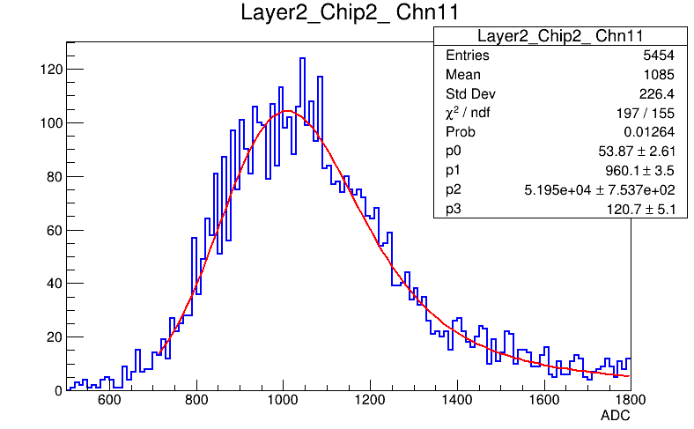
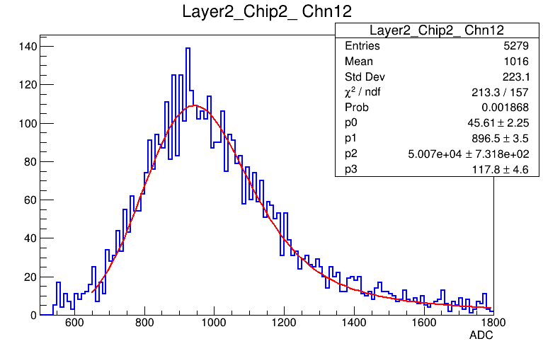
Digi & Data : Layer 2 (15um)

Slide 7
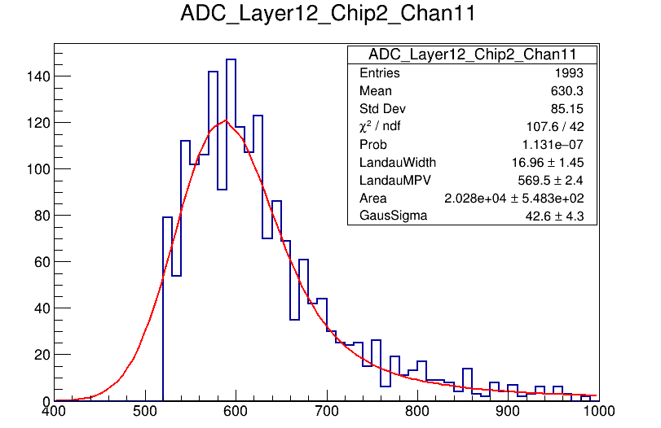
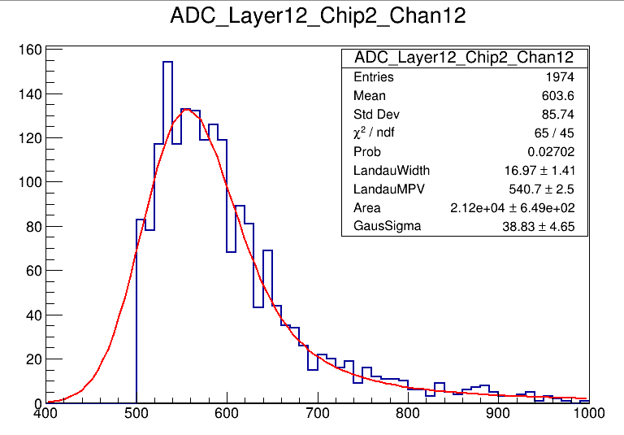
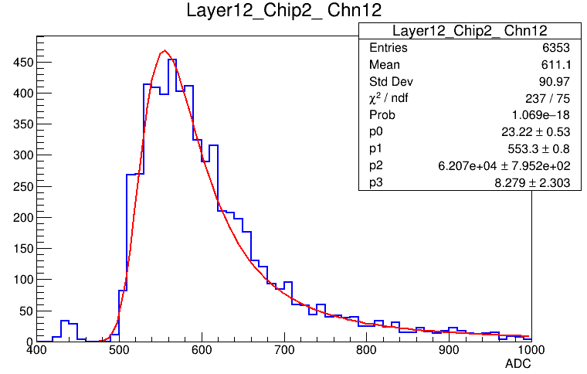
Digi & Data : Layer 12 (10um)

Slide 8
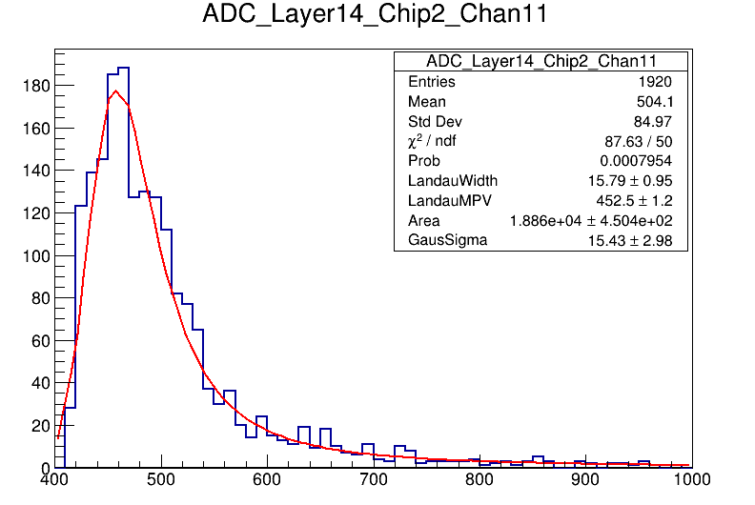
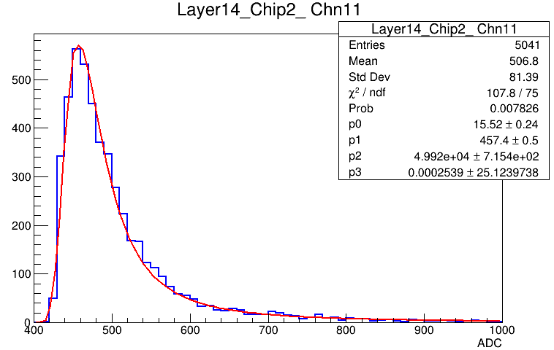
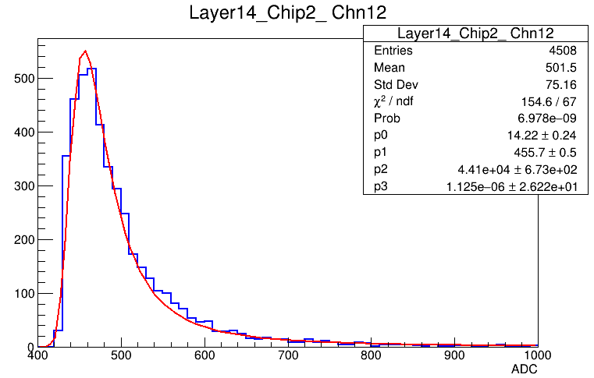
Digi & Data : Layer 14 (15um)

