Slide 2
digitize
energy to photon (poisson distribution)
photon to phoelectron (binomial distribution, PDE=0.32)
SiPM saturation
phoelectron to adc
gaussian smear (sigma of single phoelectron peak)
adc to highgain and lowgain
reconstruct energy

Slide 3
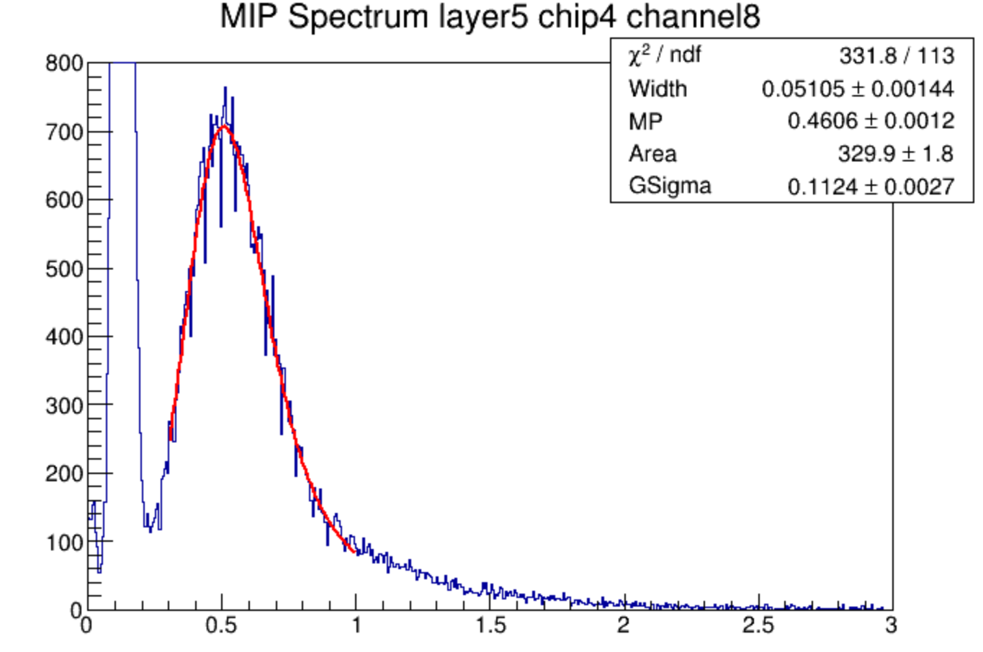
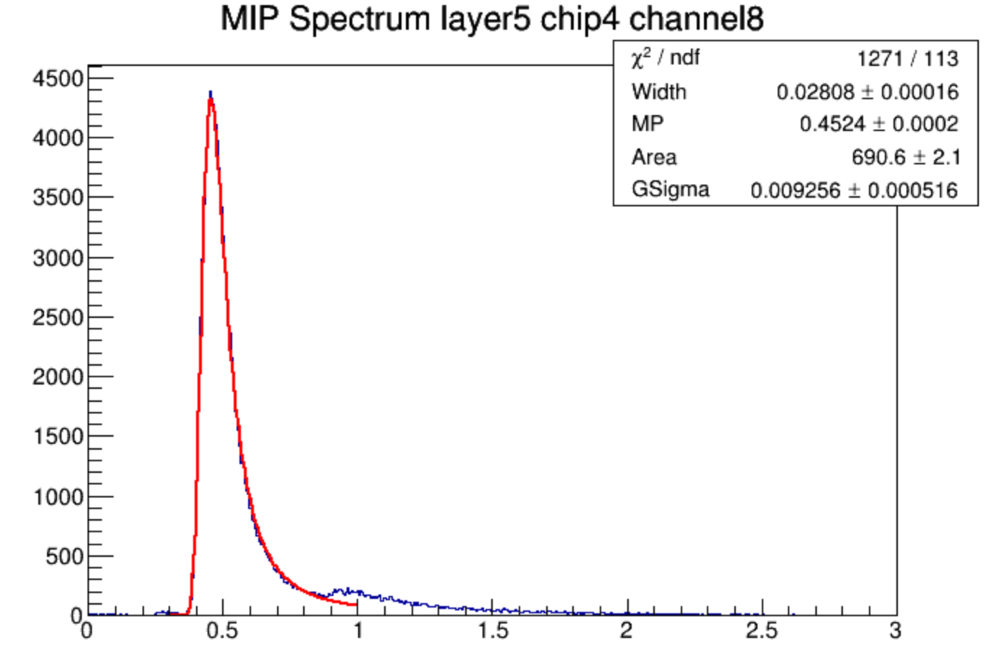
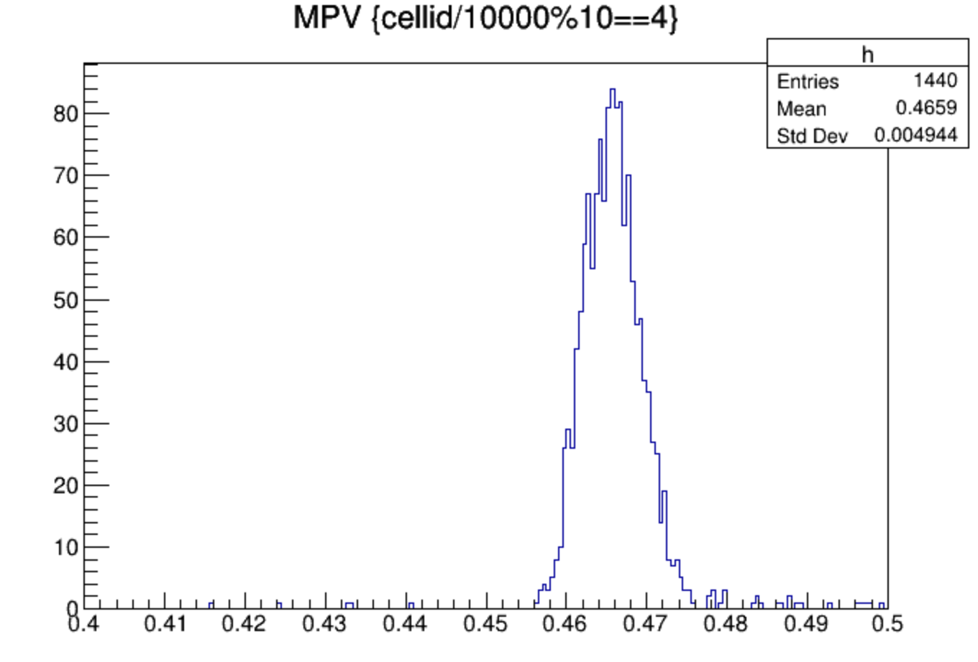
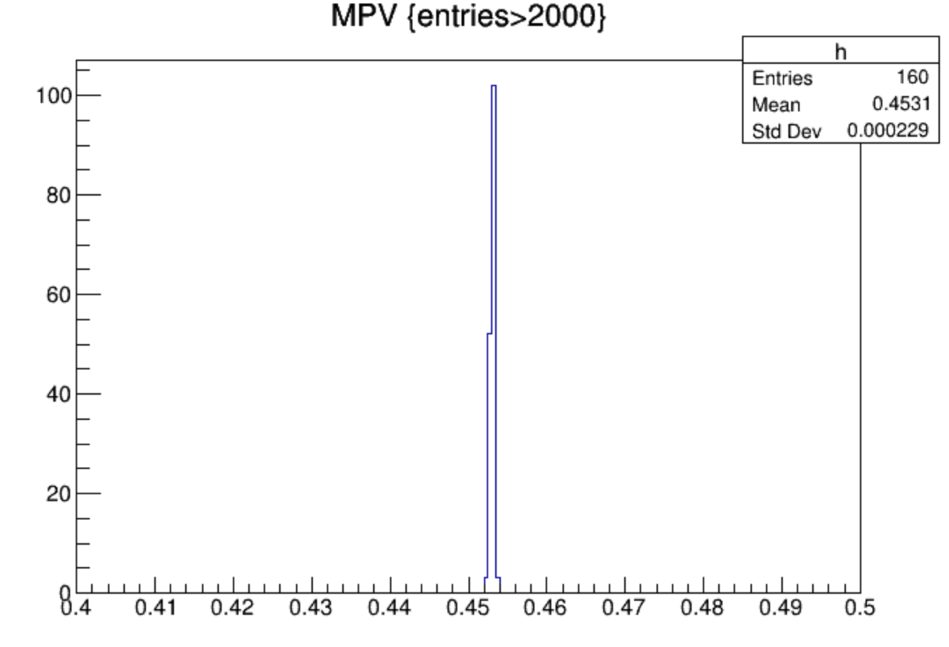
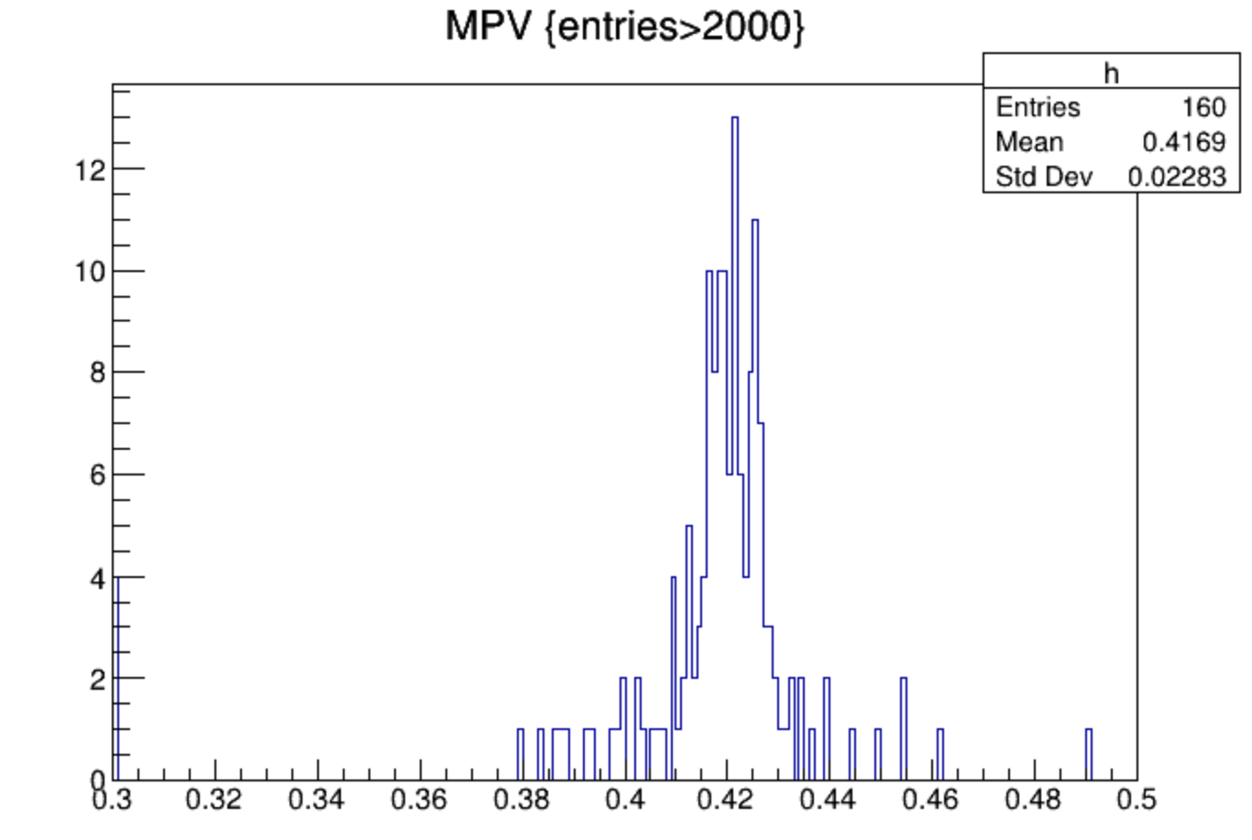
MIP Spectrum
data
MC
MC after digitized
MC after digitize
data
MC

Slide 4
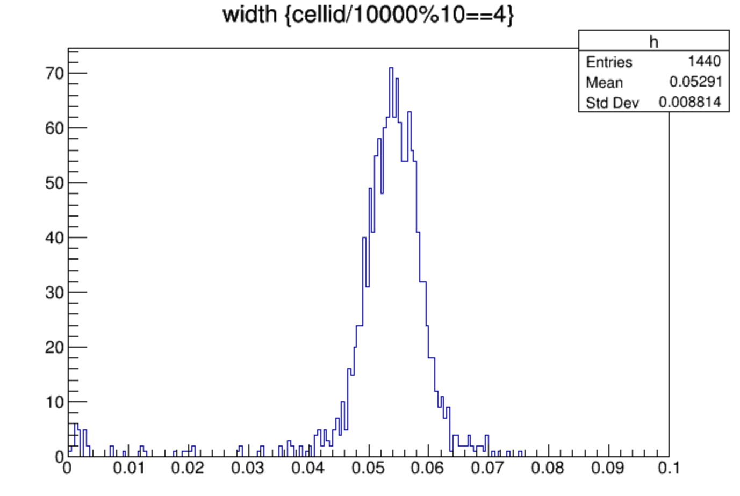
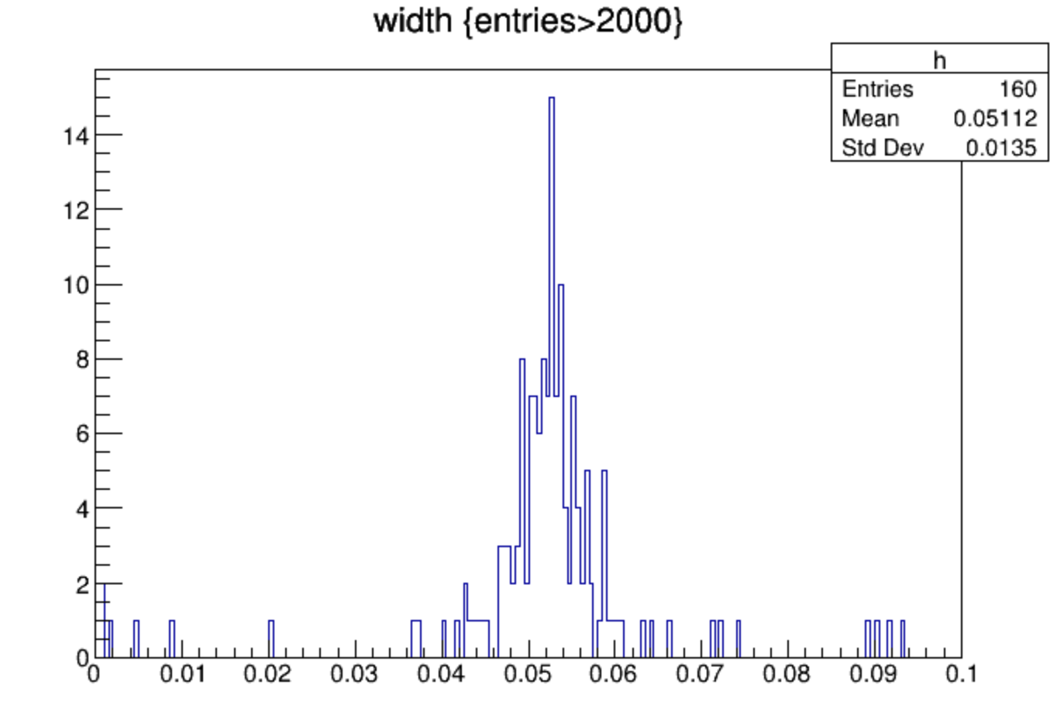
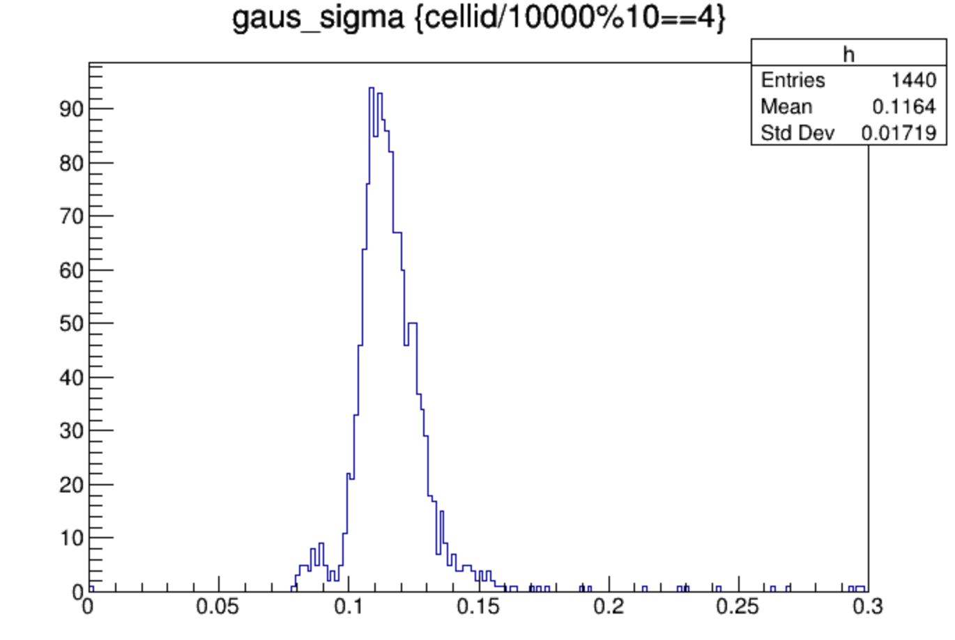
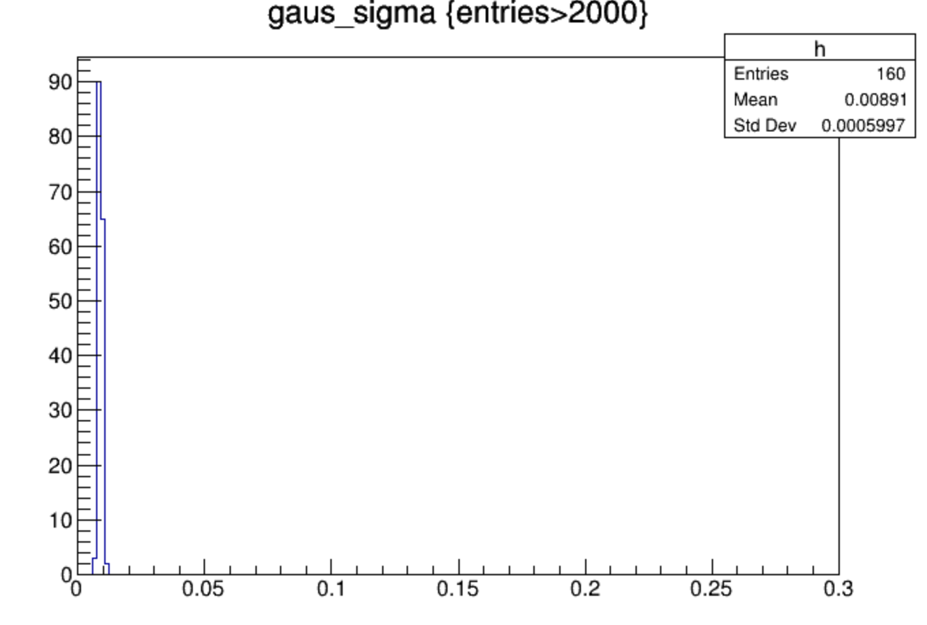
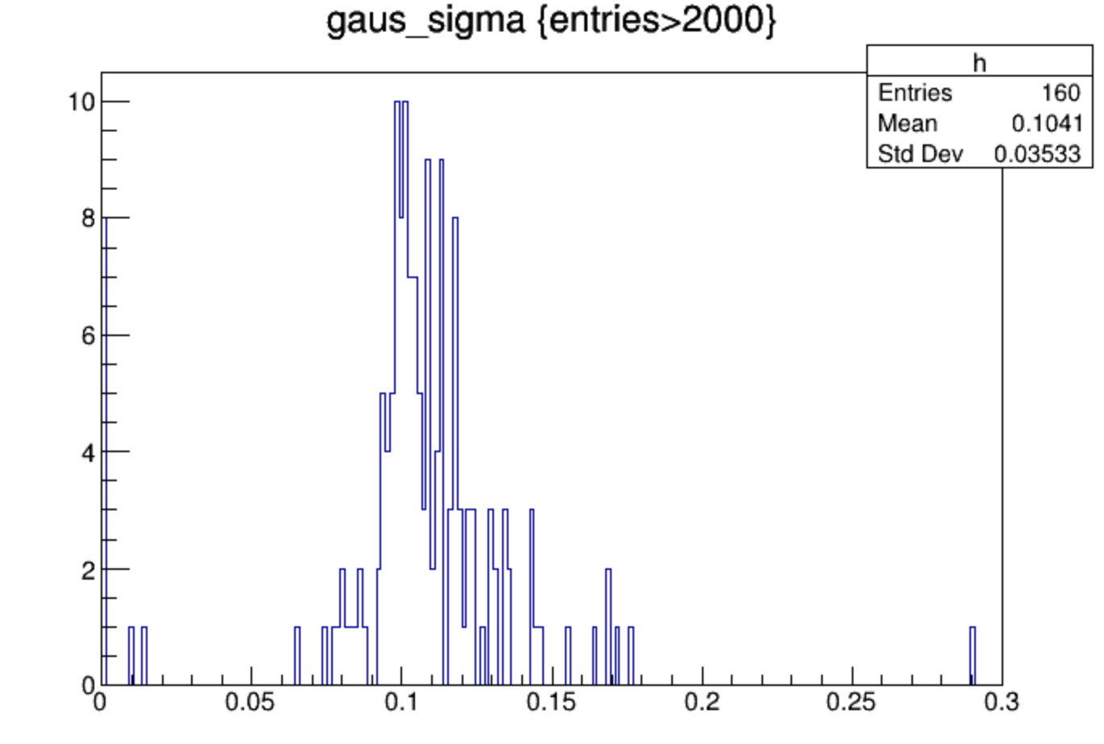
width and sigma
MC after digitize
data
MC truth

Slide 5
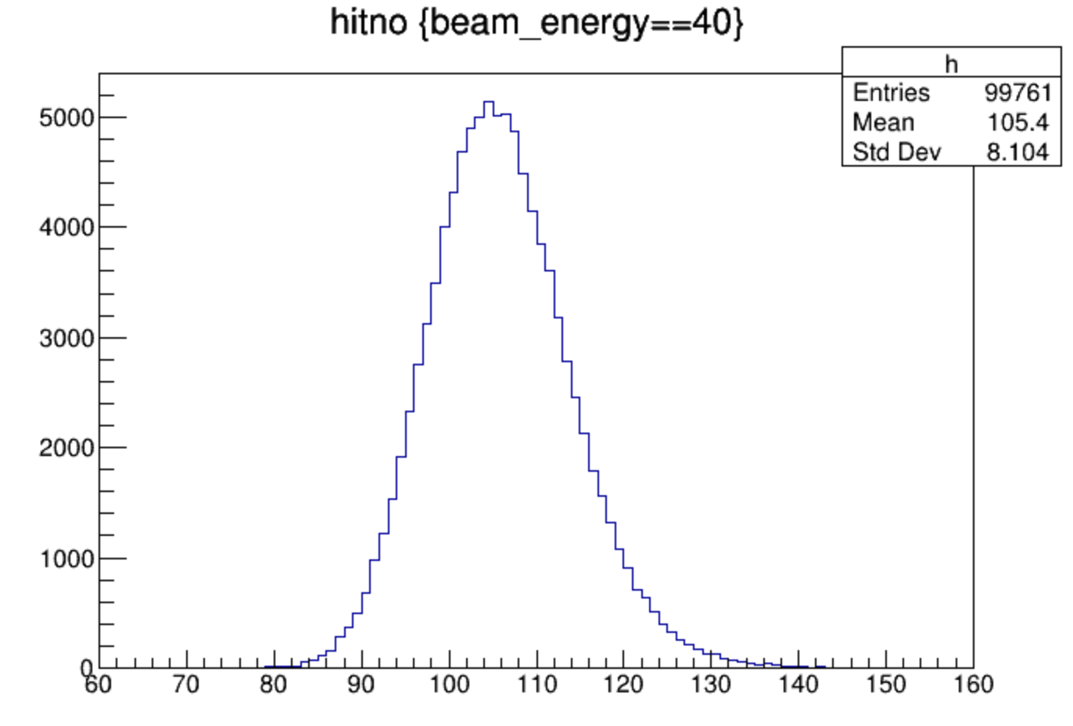
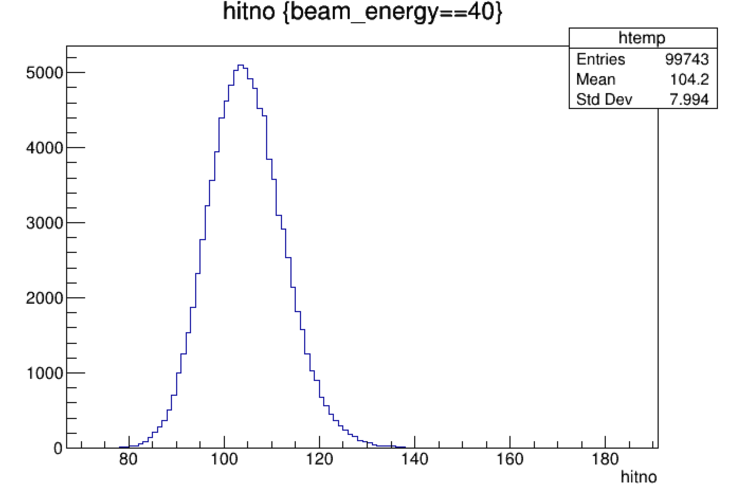
hitno --change position of incident particle
1,1mm
10,10mm
20,20mm

Slide 6
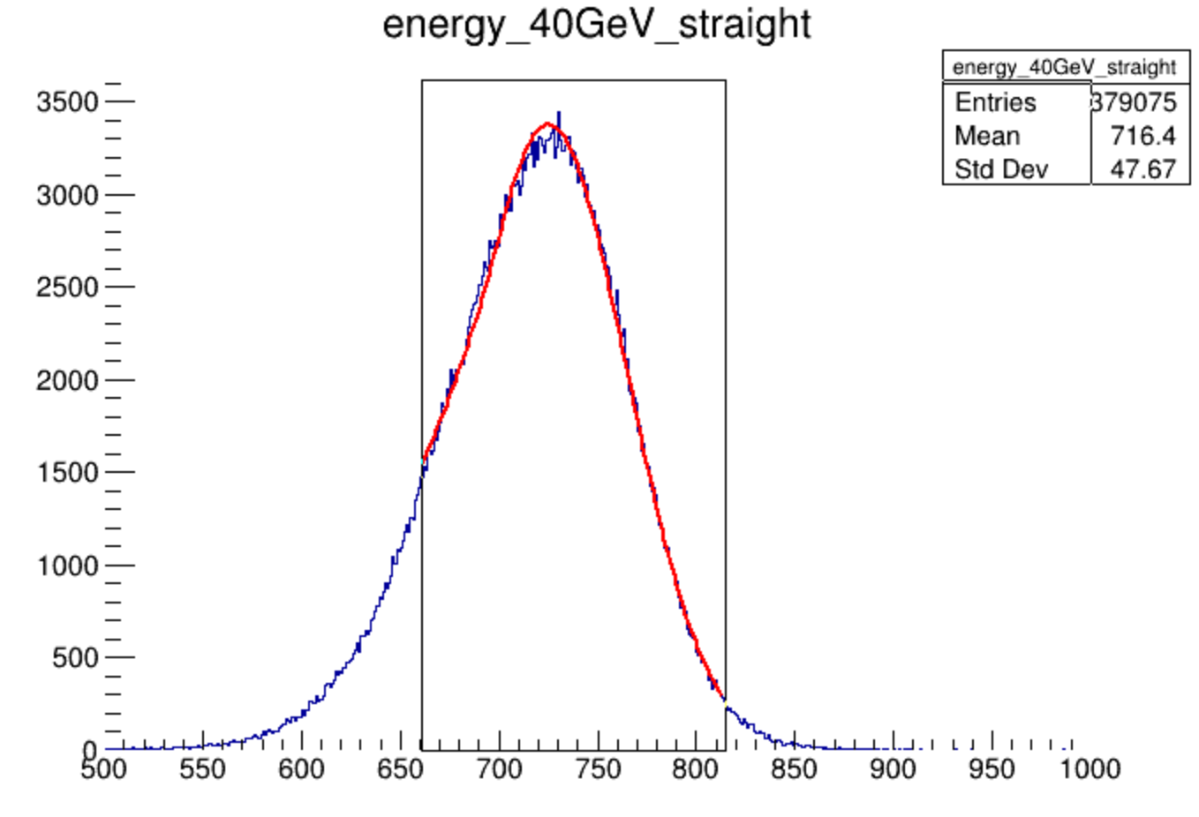
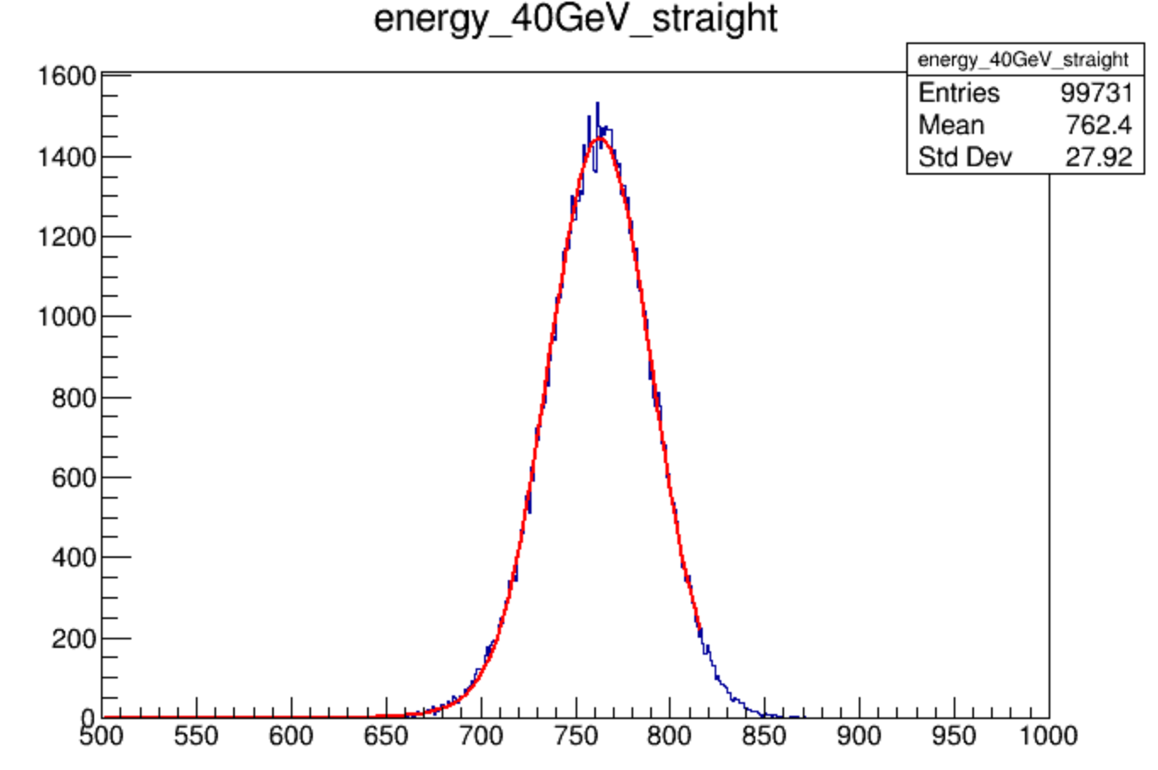
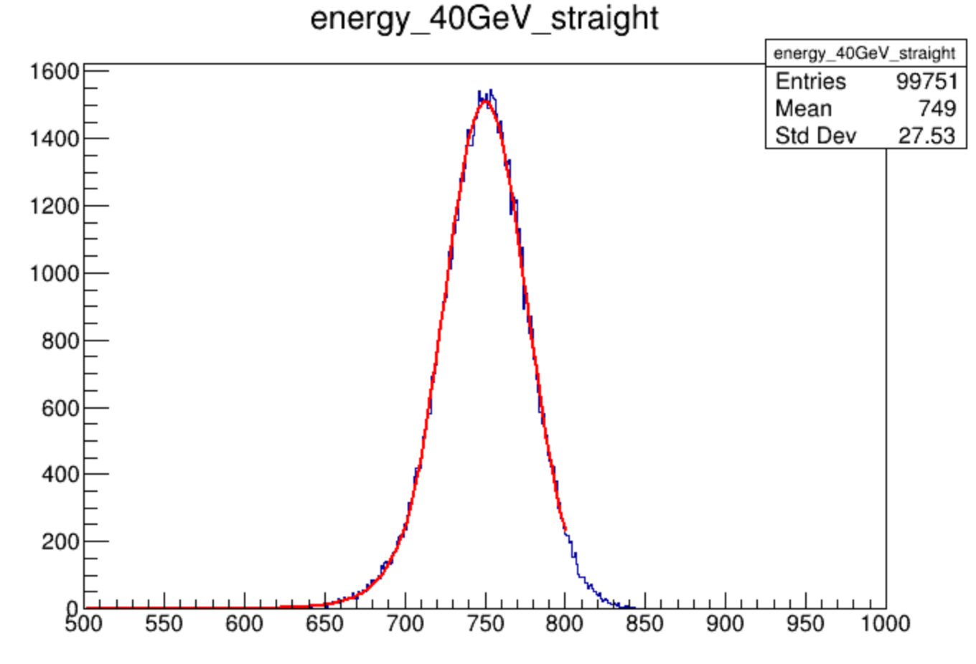
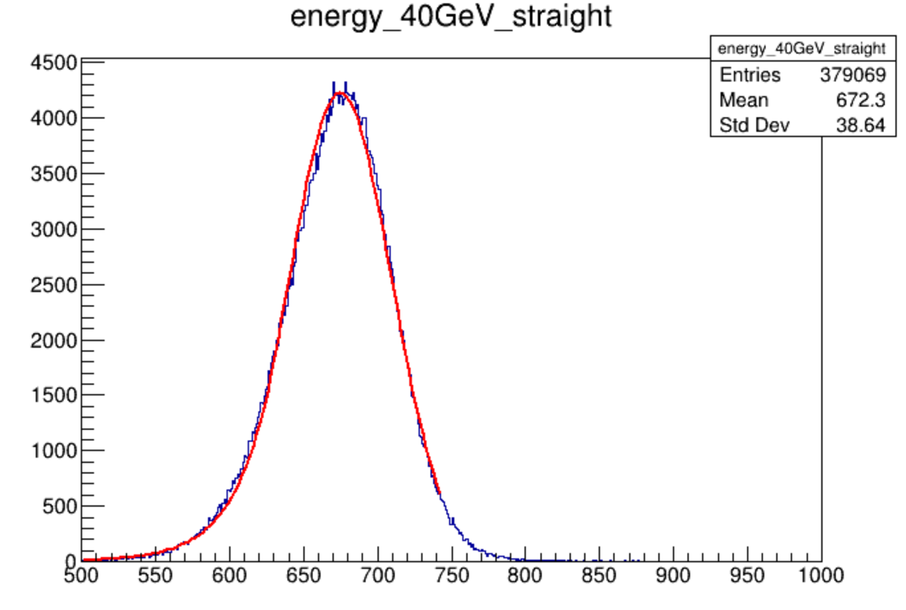
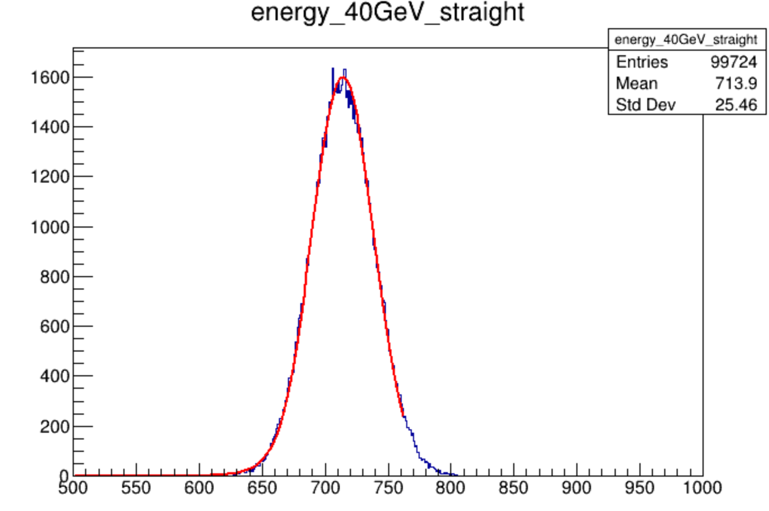
total energy
MC(1,1)
truth
MC(10,10)
truth
data after correction
data
MC(1,1)
digitized
MC(10,10)
digitized

Slide 7
backup

Slide 8
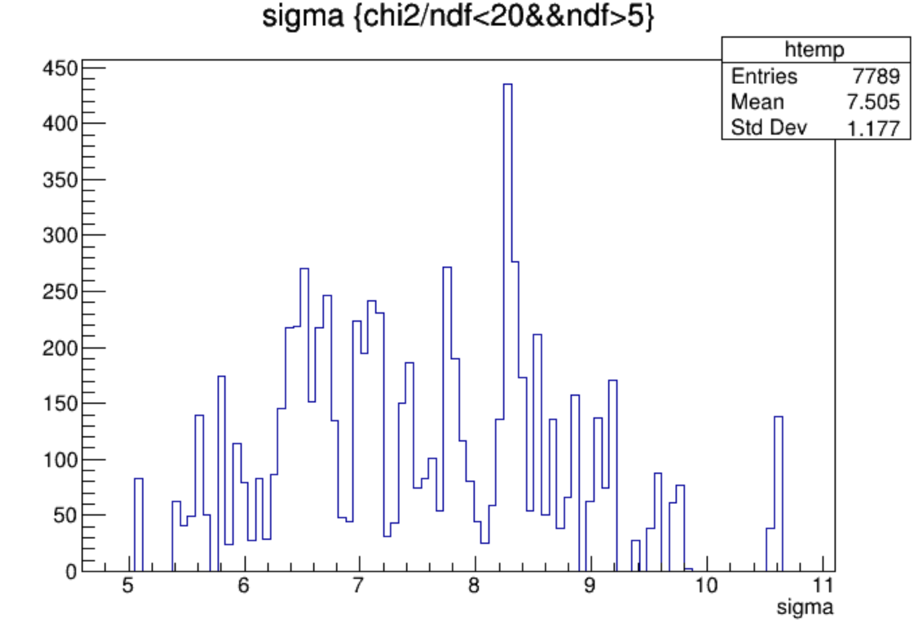
single phoelectron sigma

Slide 9
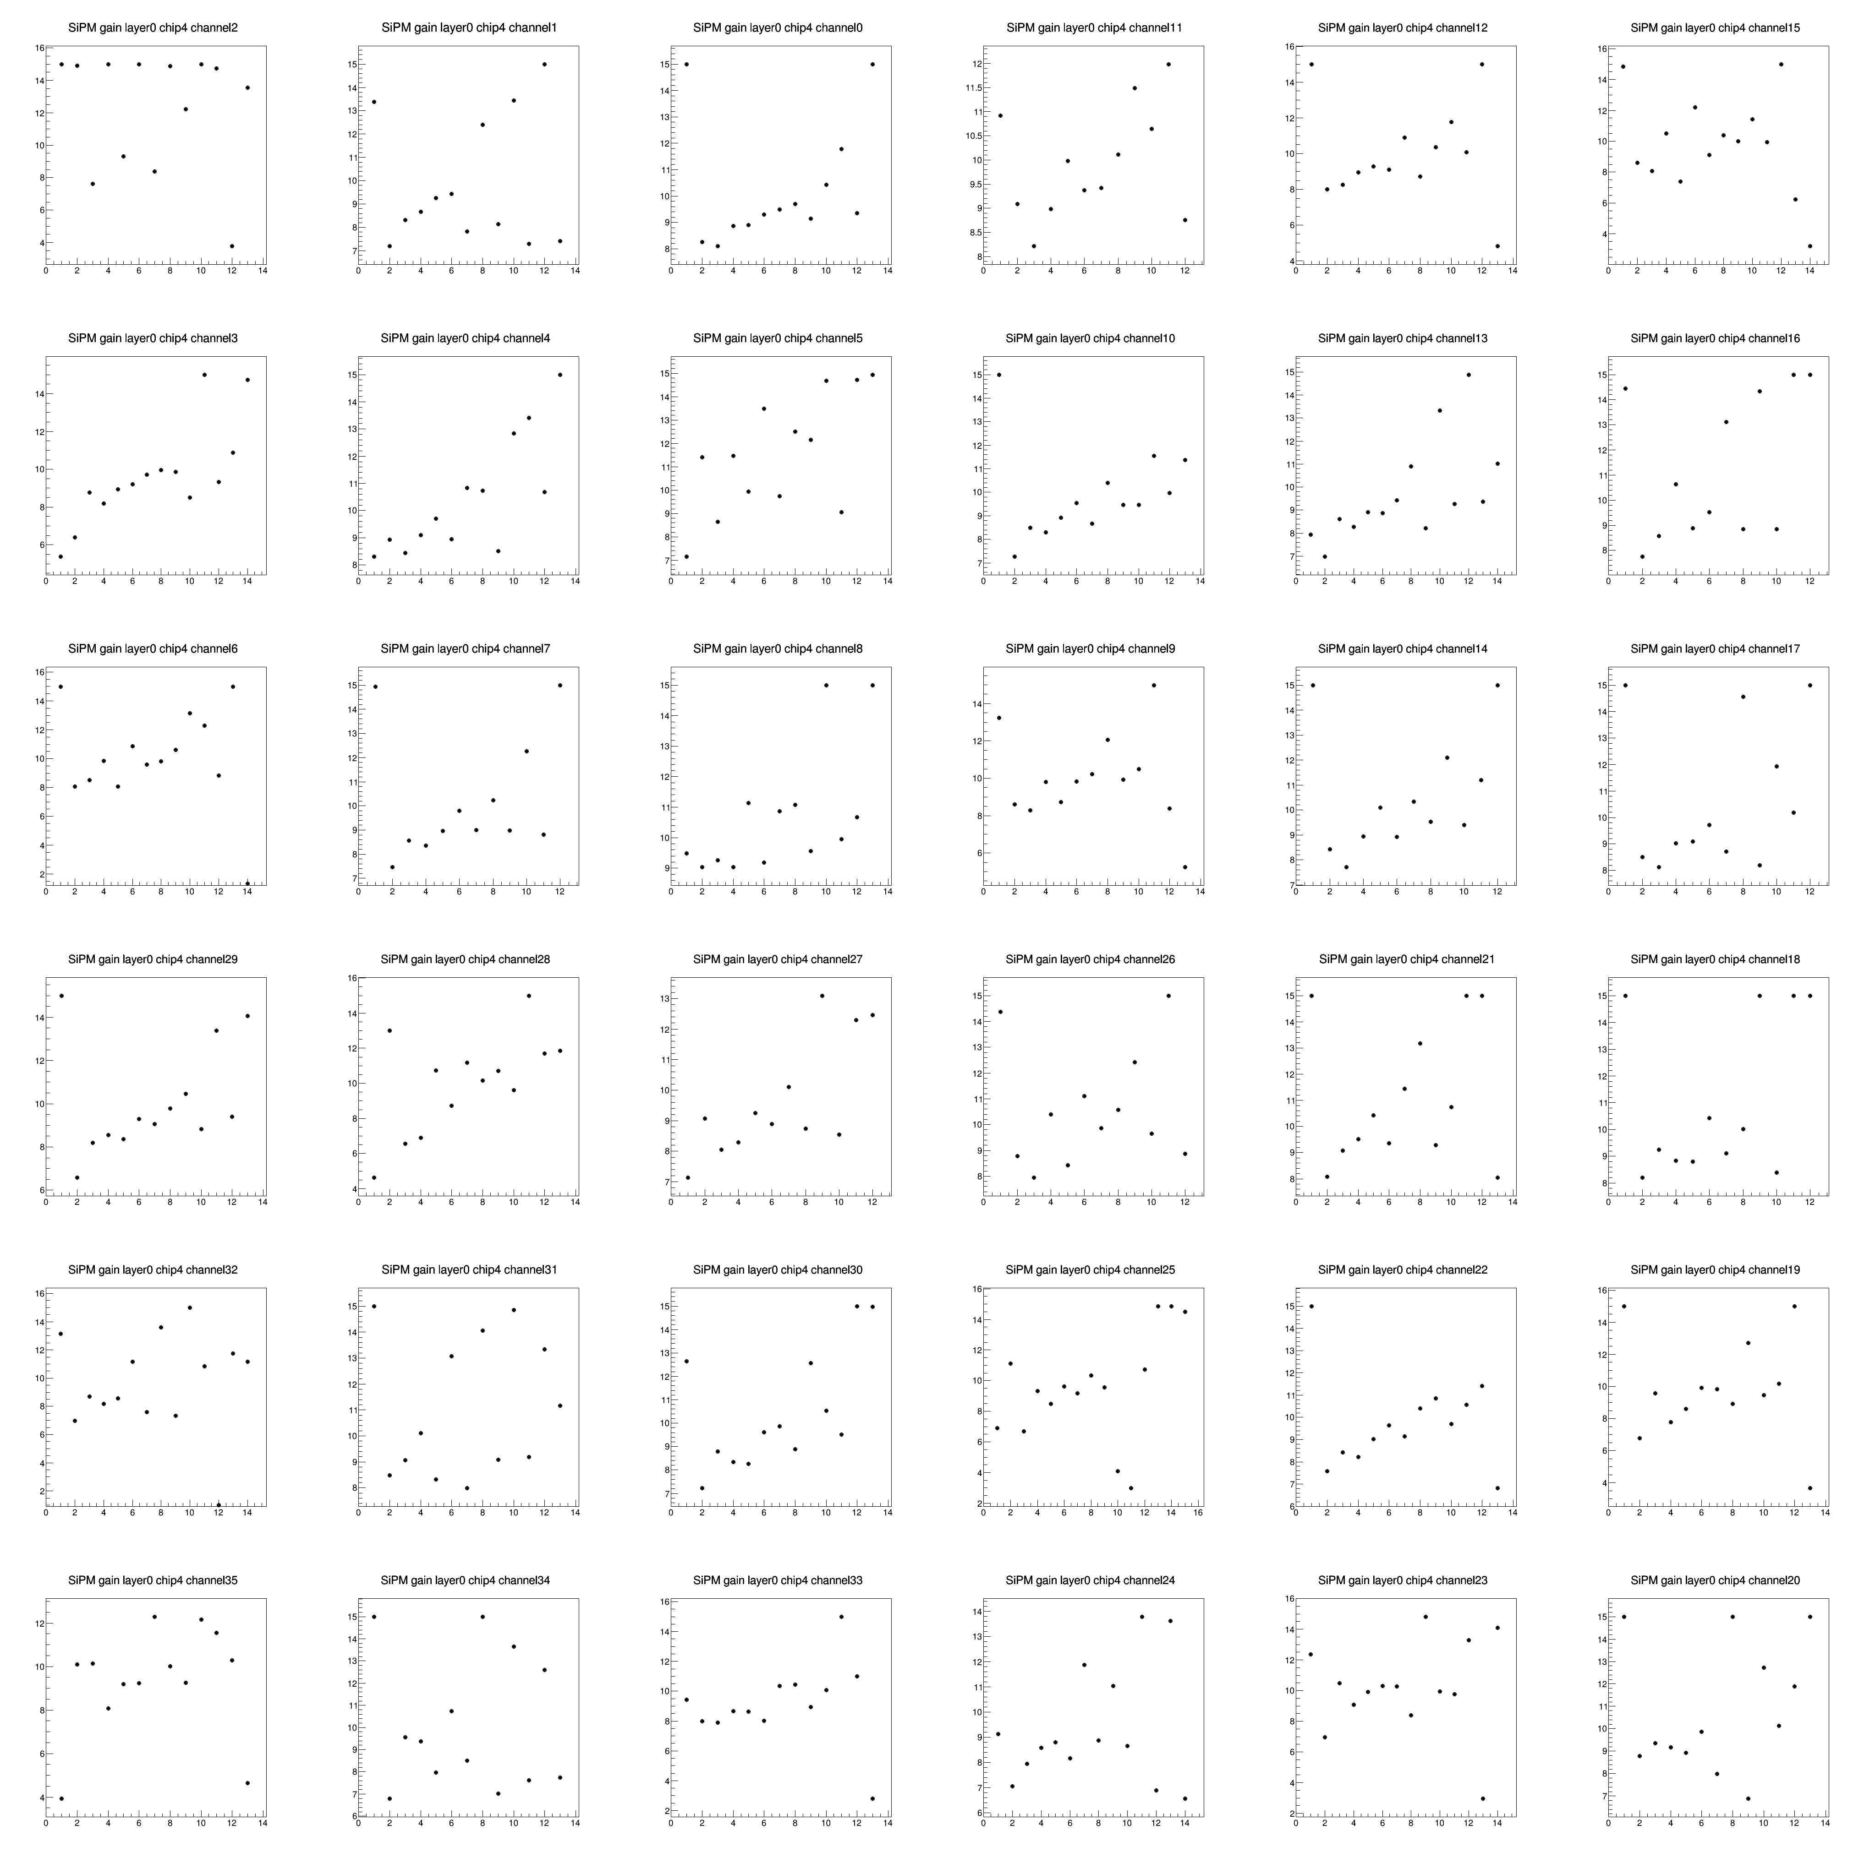
single phoelectron sigma

Slide 10
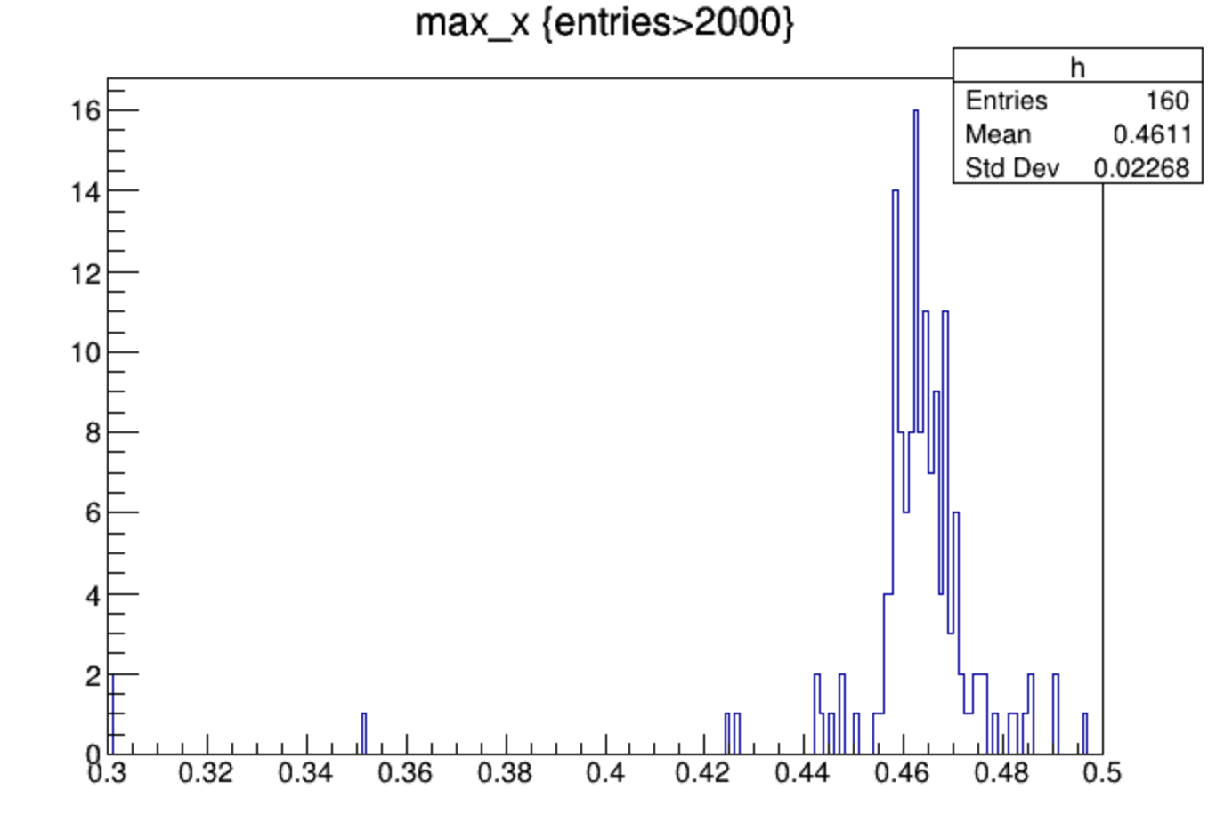
MC after digitize

Slide 11
hitno
MC 10,10mm 2.5,0.0,0.126, digitized

Slide 12
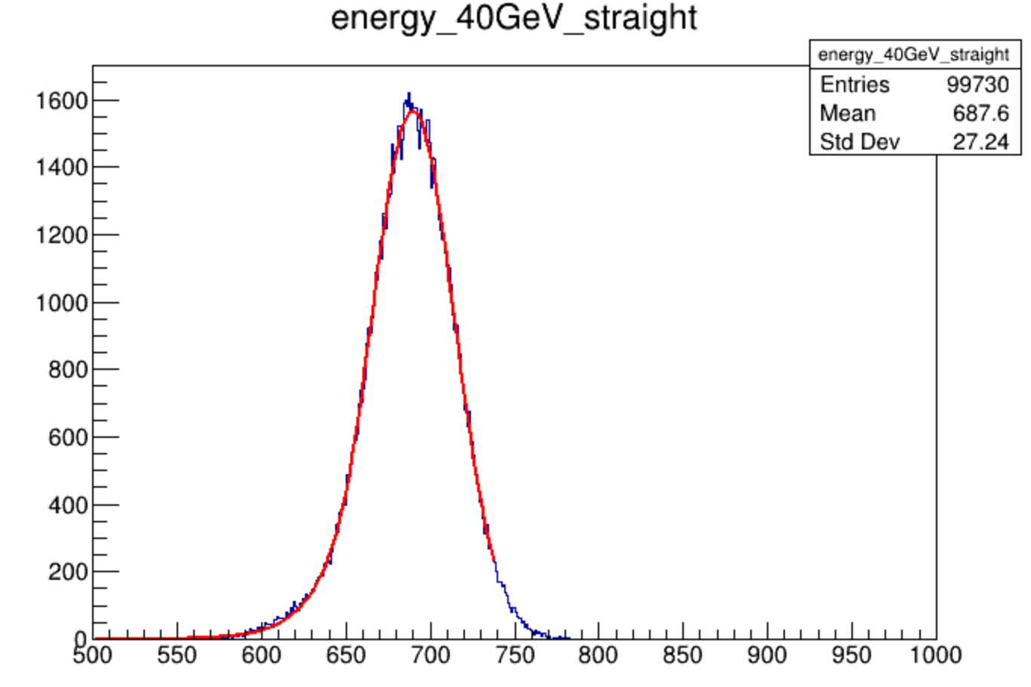
total energy MC 2500/0126/2020
MC(20,20)
digitized

