Slide 1
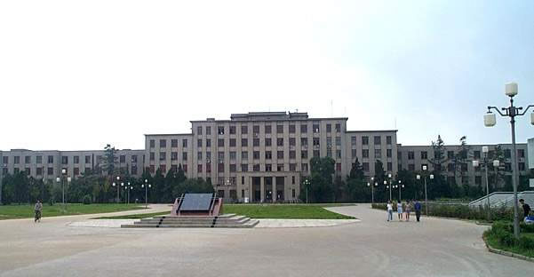

原子核中的相对论对称性研究
郭建友
Jian-You Guo
安徽大学 物理与光电工程学院
School of Physical and Optoelectronic Engineering, Anhui University

Slide 2
Contents
1
Discovery of relativistic symmetry
2
Progress on relativistic symmetry
3
There exist problems
4
SRG for relativistic symmetry
5
Summary and perspective

Slide 3
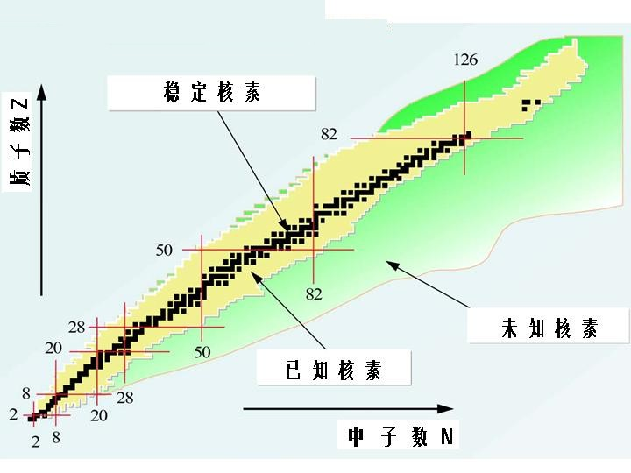
1
Discovery of relativistic symmetry
There exist the magic numbers
Mayer, Haxel etal.,1949;1950
N, Z = 2, 8, 20, 28, 50, 82, N=126,184
Spin-orbit coupling:

Slide 4
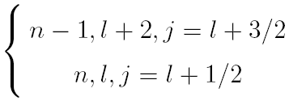



Discovery of pseudospin symmetry
Hecht & Adler, NPA137 (1969) 129;
Arima, Harvey & Shimizu, PLB30 (1969) 517
Pseudospin doublets
Re-definite the quantum numbers of states
Here
Pseudospin doublets:
Similar to the spin doublets
The splitting of both spin and pseudospin doublets play critical roles in the shell structure evolutions. It is a fundamental task to explore the origin of SS and PSS, as well as the mechanism of their breaking.

Slide 5
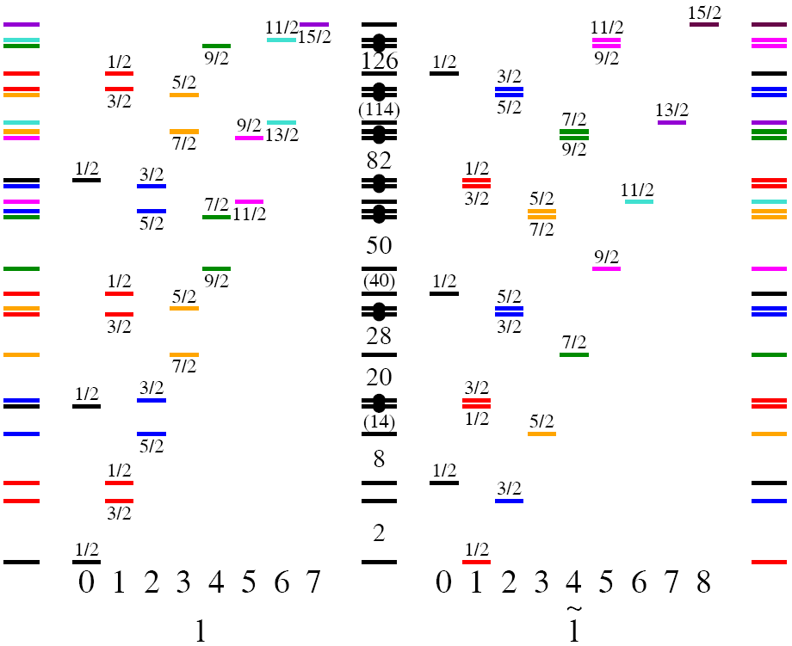


Analogy of spin doublets and pseudospin doublets
Typel, NPA 806 (2008) 156
The single particle levels in the conventional shell model description for the spin–orbit partners and the pseudospin partners
Left column
The exist the spin singlet with
Large energy splitting in spin doublet
Right column
The exist pseudospin singlet with
Small energy splitting in pseudospin doublet
The exist the intruding states in the most right side

Slide 6
The introduction of PSS explains a large number of nuclear physical phenomena
Nuclear deformation and superdeformation configurations,
Bohr, Phys.Scr.26, 267(1982); Dudek, PRL59,1405(1987).
Identical bands in ¹⁵¹Tb and ¹⁵²Dy and in ¹⁵⁰Gd and ¹⁵¹Tb,
Nazarewicz, PRL64, 1654(1990); Zeng, PRC44, R1745(1991).
Absence of quark spin-orbit splitting in heavy-quark meson,
Page, PRL86, 204 (2001).
M1 transitions in ³⁹K and ³⁹Ca, which should be forbidden in 1d_{3/2} (g) and 2s_{1/2}(e),
Ginocchio, PR414, 165(2005).
N = 28 shell closure disappears due to the quenching of spin-orbit splitting for the spin doublets,
Gaudefroy, PRL97, 092501(2006).
Spin symmetry in anti-nucleon spectrum,
Zhou, Meng, Ring, PRL91,262501(2003).
Structure of halo and super heavy nuclei,
Long, PRC81, 031302R(2010); Li, PLB732,169(2014).
Tensor force obviously affect the pseudospin energy splitting of the spin-unsaturated nuclei,
J.M.Dong,W.Zuo etal PRC84, 014303 (2011).
Existence of exact conservation in resonant states,
Lu, Zhao, Zhou, PRL109,072501(2012).
Spin symmetry in the Dirac sea derived from the bare nucleon–nucleon interaction,
Shen, Liang, Meng, etal., PLB781, 227 (2018).

Slide 7
Pseudospin partner bands have been experimentally observed
Identification of pseudospin partner bands in ¹⁰⁸Tc
(2)
(1)
Q. Xu, S. J. Zhu, J. H. Hamilton, etal., Phys. Rev. C 78, 064301 (2008)
The configuratuions of the band head levels of bands (1) and (2) in ¹⁰⁸Tc is
Pseudospin doublet of nuetron
namely

Slide 8
The configurations of the bands (2) and (3) are
Bandheads of the bands (2) and (3) form neutron pseudospin doublet

Slide 9
Pseudospin partner bands in ¹⁸⁹Pt
Pseudospin partner bands in ¹³⁰Ba

Slide 10
PSS in shape coexistence in the ⁷⁸Ni region

Slide 11
2
Progress on relativistic symmetry
Early attempts
To transformations from the normal scheme to pseudospin scheme
special ratio for the strength of the spin-orbit and orbit-orbit interactions
To explain such special ratio with RMF theory

Slide 12


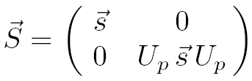

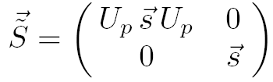

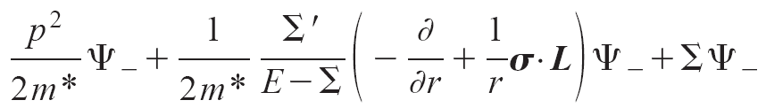

Explanations on origin of this symmetry
Dirac Hamiltonian has SU(2) symmetry in the SS and PSS limits.
Exact SS:
Exact PSS:
Alberto etal. investigated the breaking mechanism of PSS by transforming the Dirac equation into a Schrödinger-like form for the lower component.
Alberto, PRL86, 5015(2001)
They indicates the PSS has a dynamical character.
Dirac Hamiltonian may possess the supersymmetry in the SS and PSS limits.
Leviatan, PRL92, 202501(2004);PRL103, 042502(2009)
The spin symmetry breaking can be treated as a perturbation of SS Hamiltonian in a realistic system. The pseudospin symmetry breaking can not be treated as a perturbation of PSS Hamiltonian.
Liang, Zhao, Zhang, Meng, etaI., PRC83, 041301(R) (2011)
Origin and breaking mechanism of this PSS are still ambiguous !

Slide 13
Relativistic explanations
In 1997, Ginocchio indicated that PSS in nuclei arises from nucleons moving in a relativistic mean field which has an attractive scalar and repulsive vector potential nearly equal in magnitude.
Ginocchio, PRL78,436 (1997)
Relativistic mean field
Lagrangian density:
meson | J^{π} | T
π | 0⁻ | 1
σ | 0⁺ | 0
ω | 1⁻ | 0
ρ | 1⁻ | 1
Equations of motion for nucleon:
Where the vector and scalar potentials

Slide 14
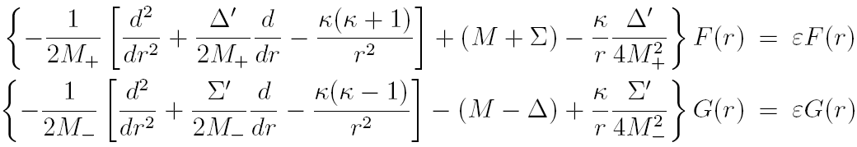




Relativistic explanations
For spherical system, the Dirac spinor
Dirac equation becomes
The Dirac equation can be written as the Schrödinger-like equations
Where
and
For the upper spinor equation, the centrifugal barrier (CB) and the spin-orbital potential (SOP)
For the lower spinor equation, the pseudo-centrifugal barrier (PCB) and the pseudo spin-orbital potential (PSOP)

Slide 15
Relativistic explanations
Based on relativistic mean field theory, Meng etal. show that the quality of the PS approximation is connected to the competition between the PCB and the PSOP
J.Meng etal., PRC58, R628 (1998), PRC59,154 (1999)
For the spherical case
Dirac equation
to the form
where
Pseudospin approximation is good
Pseudo spin-orbital potential (PSOP)
Pseudocentrifugal barrier (PCB)

Slide 16
Perturbative interpretation of relativistic symmetry
Following the idea of Rayleigh-Schrodinger perturbation theory, the Dirac Hamiltonian H is split as
Liang, etal., PRC83, 041301(R) (2011)
The realistic system can be treated as a perturbation of SS Hamiltonian, but can not be treated as a perturbation of PSS Hamiltonian.
The energy splitting of the PS doublets can be regarded as a result of small perturbation around the Hamiltonian with RHO potentials.
The perturbation method removes from the singularities.
We hope to obtain a Schrödinger-like equation in which the SS and PSS breaking terms can be shown explicitly.

Slide 17
Reviews on relativistic symmetry
Since PSS is recognized as a relativistic symmetry, there are a number of studies on the origin and its breaking mechanism, as well as the application in nuclei and other fields.
References 170
Physical Reports 570 (2015) 1-84
References 334

Slide 18
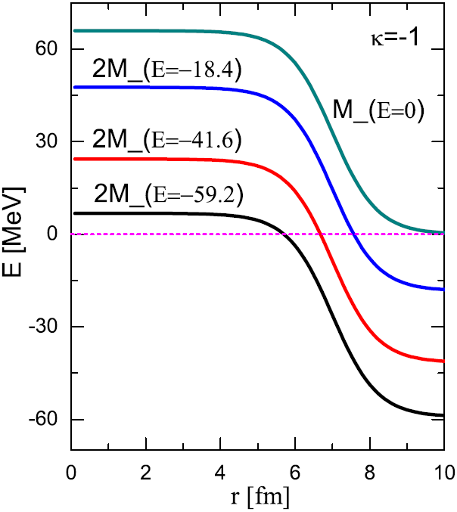



3
There exist problems
For spherical system, Dirac equation becomes
where
There are not bound solutions within .
M_ = 0 at finite r₀ , thus there exist singularities in V_{PCB} and V_{PSOP} .
Effective Hamiltonian is not Hermitian.
There exists the coupling between energy and operator.

Slide 19
4
SRG for relativistic symmetry
Theoretical formalism of similarity renormalization group (SRG)
Jian-You Guo, PRC85, 021302® (2012)
The initial Hamiltonian
By introducing a unitary transformation
where l is a continuous flow parameter. Differentiation of above equation yields flow equation as
with the anti-Hermitian generator
η(l) should be chosen in such a way so that the off-diagonal matrix H(l) elements decay. In Wegner scenario, η(l) is often chosen as
where Hdiag (l) is the diagonal part of H(l).

Slide 20
For the Dirac Hamiltonian
We choose the generator in the form
The Hamiltonian H(l) is presented as a sum of an even operator ε(l) and odd operator o(l)
Then our ansatz for the transformation matrix η(l) becomes
By using the relations
and the fallowing equations

Slide 21
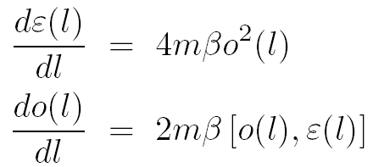
Considering the commutation relations of even and odd operators, we obtain
Above equations can be solved perturbatively in 1/m . It is convenient to introduce a dimensionless flow parameter .
Since , the expansion of in a series in 1/m contains terms starting with the zeroth order term

Slide 22
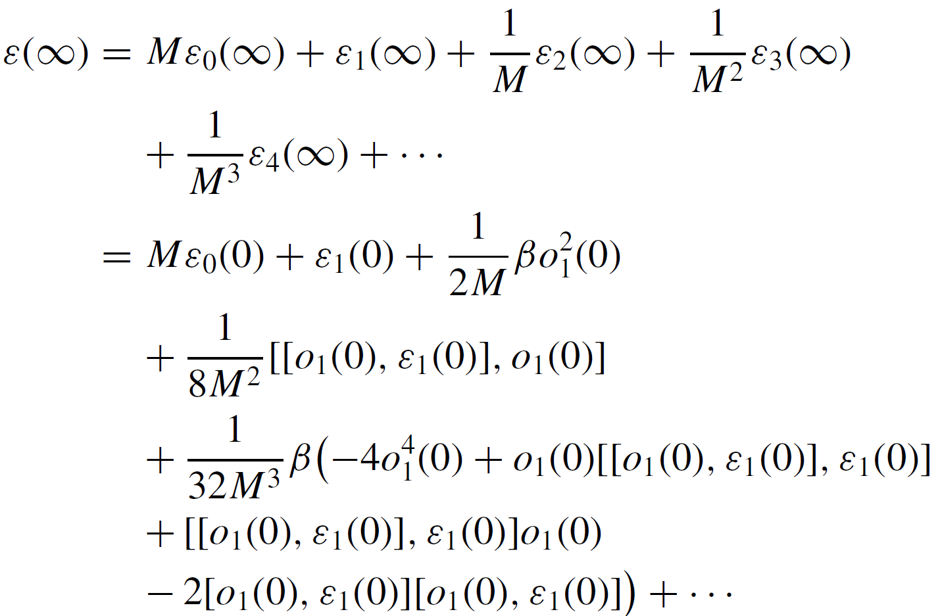
To collect all the terms together, we obtain

Slide 23
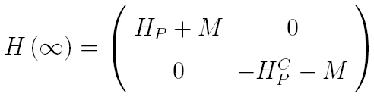

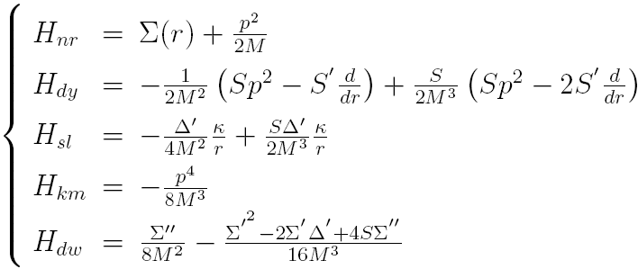
For spherical nuclei, the diagonalized Dirac operator
Jian-You Guo, PRC85, 021302® (2012)
The singularity disappears in every component.
Every component is Hermitian.
There is no the coupling between the energy ε and the operator H_{p} .
Here, is an operator describing Dirac particle,
is the charge-conjugation of , which describes Dirac anti-particle.
where
nonrelati
For Dirac particle, when Δ’ = 0, the spin-orbit coupling disappear, the spin symmetry is exact.
For Dirac antiparticle, when Σ’ =0, the pseudo spin-orbit coupling disappears, the pseudo spin symmetry is exact.
dynamical
spin-orbit
other

Slide 24


Numerical results and comparisons
Comparison with the exact solutions
The energy spectrum of H_{p} for the six pseudo spin partners. The first column in each subfigure indicates that H_{p} is approximated to the non-relativistic limit. The second and third columns in each subfigure indicate that Hp is approximated to the orders and , respectively. The fourth column in each subfigure indicates the exact relativistic spectra.

Slide 25

Spin symmetry in anti-nucleon spectra
The energy spectra of for Dirac antiparticle
For Dirac anti-nucleon spectra, there exists good spin symmetry.
The spin symmetry in anti-nucleon spectra is better than the pseudospin symmetry in nucleon spectra.
Conclusions
The Dirac Hamiltonian is transformed into a diagonal form.
The diagonal element H_{p} is decomposed to the five Hermitian components with clear physical meaning.
The spectra of H_{p} approximated to the order well agree the exact results for nucleon and anti-nucleon spectra.

Slide 26
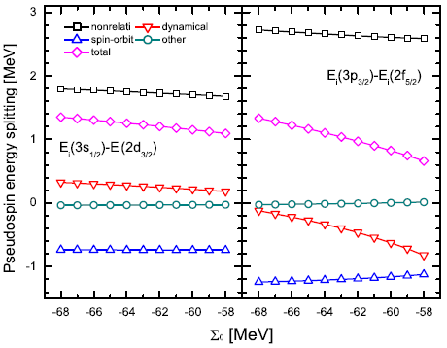
Pseudospin symmetry and its dependence on the shape of potential
Li, Chen, Guo,
PRC 87, 044311(2013)
PSS is a relativistic symmetry.
Spin symmetry in anti-nucleon is better than PSS in nucleon.
The non-relativistic pseudospin splitting is very large.
The PSS is improved, which comes mainly from the spin-orbit term.
The dynamical term destroys PSS for the deeply bound states, and improves PSS for the loosely bound states.
The pseudospin symmetry is sensitive to the shape of potential.

Slide 27

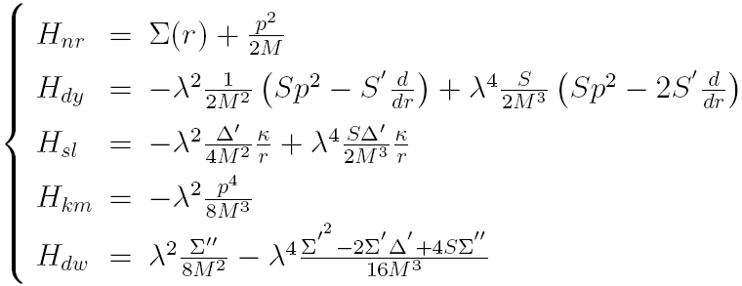

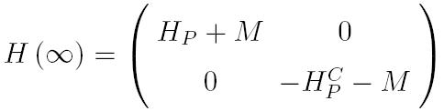
Relativistic effect of SS and PSS
Dirac Hamiltonian
Shou-Wan Chen and Jian-You Guo, PRC 85, 054312 (2012)
Where
The atomic units ћ = M = 1 are adopted instead of the conventional relativistic units ћ = c = 1 in the present system. The Compton wavelength λ = ћ /Mc = 1/c .
The Dirac Hamiltonian is written as
By the SRG transformation, the diagonal Hamiltonian is obtained as
In this units, the result in the non-relativistic limit can be obtained in a very simple, intuitive, and straightforward manner by taking the speed of light c → ∞ or the Compton wavelength λ → 0, which is not possible in the latter units since c = 1.

Slide 28
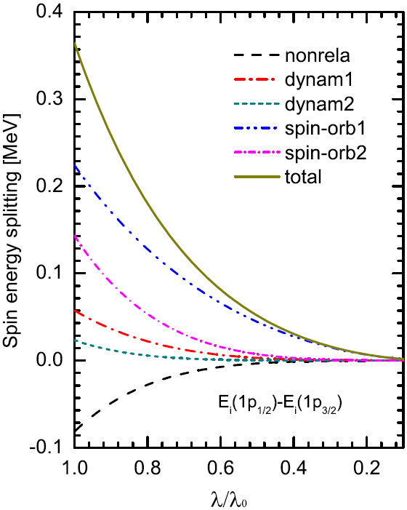
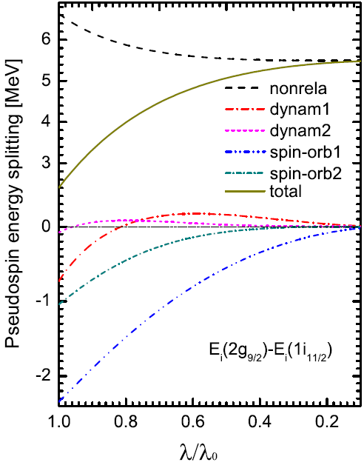

The energy splitting behavior of each term with λ for the SS and PSS doublets
The non-relativistic PS splitting is large.
PSS is improved by the relativistic effect which origin the spin-orbit and dynamical terms.
With the relativistic effect becomes weak, the PSS becomes worse.
PSS is a relativistic symmetry.
The relativistic spin-orbit splitting is large, which origins mainly from the dynamical and spin-orbit terms.
With the relativistic effect becomes weak, the spin-orbit splitting goes to zero.
Relativistic
Non-relativistic limit
The spin-orbit splitting comes from relativistic effect.
Relativistic
Non-relativistic limit

Slide 29


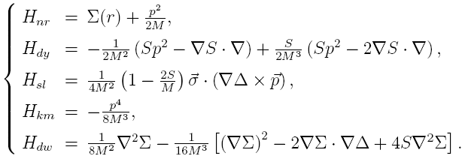

Relativistic symmetry in deformed nuclei
Guo, Chen, Niu, Li and Liu, PRL 112, 062502 (2014)
The details of theoretical formalism are referenced to the literature
The diagonal Dirac Hamiltonian
For the axially deformed nuclei, the potentials are adopted as
The singularity disappears in every component.
Every component in H_{p} is Hermitian.
There is no the coupling between the energy E and the operator H_{p} .

Slide 30
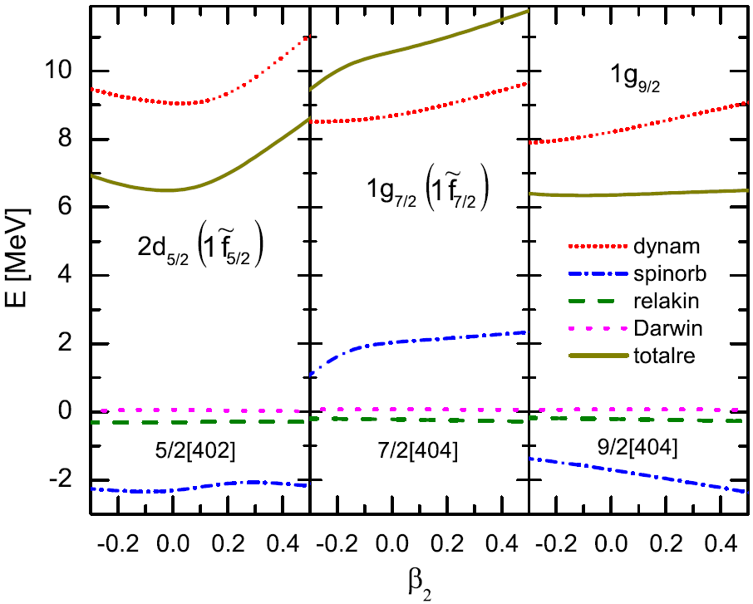
“totalre”represents the sum of all the relativistic modifications.
Contributions of every term and correlations with deformation
The spin-orbit term and dynamical term play a dominant role in the relativistic modifications of the energies.
The relativistic modification from the spin-orbit interaction and dynamical term are remarkably associated with deformation.
The energies from the spin-orbit term are negative for the spin aligned states and positive for the spin unaligned states, while those by the dynamic term are always positive.

Slide 31
The spin and pseudospin energy splitting contributed by every term and their dependences on the deformation
The quality of PSS relates to the nonrelativistic, spin-orbit, and dynamic terms.
Their contributions to the pseudospin splitting are correlated with deformation.
The spin-orbit term always improves PSS, while the dynamical effect depends on the particular states.
The total spin-orbit splitting comes mainly from the contribution of the spin-orbit term.
The spin-orbit splitting increases with the increasing deformation in the prolate side.

Slide 32
Isospin dependence of SS and PSS
Huang, Guo, and Chen, Phys. Rev. C 105, 054313 (2022)
Pseudospin splitting from the non-relalativistic is large.
The spin-orbit coupling improves PSS,
The dynamical term also play important role at PSS.
With the increase of orbital angular momentum, the spin splitting increases.
PSS is isospin-dependent.
Spin orbit interactions dominate spin splitting.
The contributions of the non-relativistic and dynamical term to the spin splitting almost cancel each other out.
With the increase of orbital angular momentum, the spin splitting increases.
As the mass increases, the spin splitting increases overall.

Slide 33
Prediction of novel effects in rotational nuclei at high speed
Jian-You Guo, Phys. Lett. B 850, 138532 (2024)
The Dirac Hamiltonian describing a rotating nucleus
SRG

Slide 34
  The signature splitting caused by the Zeeman effect operator is three orders of magnitude larger than the splitting caused by the spin rotation operator
  Signature splitting depends on the strength magnetic field-like.
  The dependence of signature splitting on the strength of the magnetic field-like is mainly due to the Zeeman effect operator

Slide 35
PSS in resonant states
Exploration of resonant states in nuclei
Liu, shi, Guo, Niu, Liang,
PRL117, 062502 (2016)
  CMR describes the bound states, resonant states, and continuum on an equal footing
  The bound states populate on the imaginary axis in the complex momentum plane
  The resonant states locate at the fourth quadrant
  The continuum follows the contour
  The bound states and resonant states are independent on the contour.

Slide 36
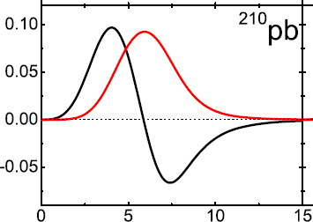
Pseudospin symmetry in wavefunctions-bound
The upper components of Dirac spinors for the bound pseudospin doublet in ²¹⁰Pb
lower
component
upper component
The lower components of Dirac spinors for the bound pseudospin doublet in ²¹⁰Pb

Slide 37
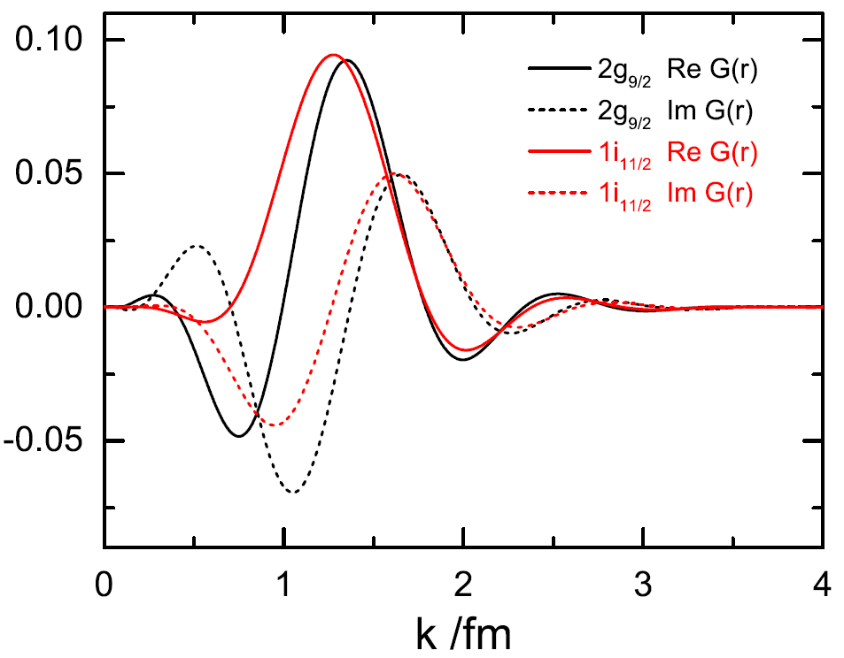
Pseudospin symmetry in wavefunctions-resonant
The upper components of Dirac spinors for the resonant pseudospin doublet in ²¹⁰Pb
lower
component
upper component
The lower components of Dirac spinors for the resonant pseudospin doublet in ²¹⁰Pb

Slide 39
5
Summary and perspective
Summary
The discovery of PSS is introduced
Some explanations on PSS are sketched
SRG formalism for PSS is presented
Perspective
The origin of PSS ?
A Hamiltonian operator with PSS ?
The new observables possessing PSS ?
Thank you！

Slide 40
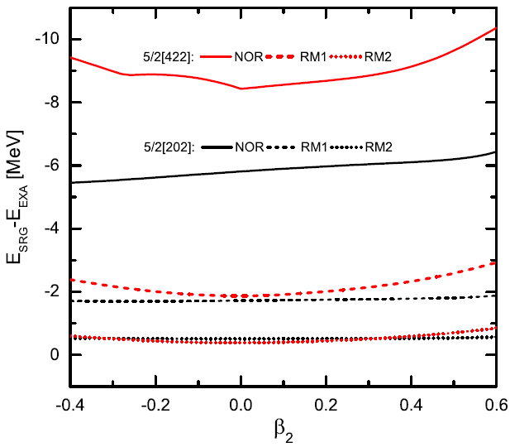
Comparisons with the exact solutions
As an example, we calculate the single particle levels.
EXA RM2 RM1 NOR
The parameters in the potentials are adopted from the RMF calculations for ¹⁵⁴Dy

Slide 41
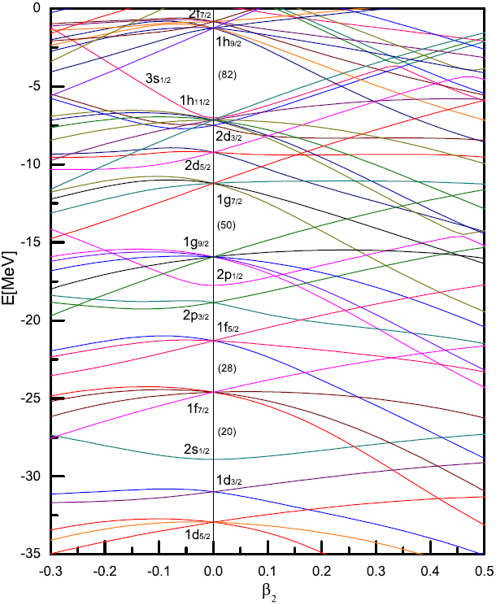
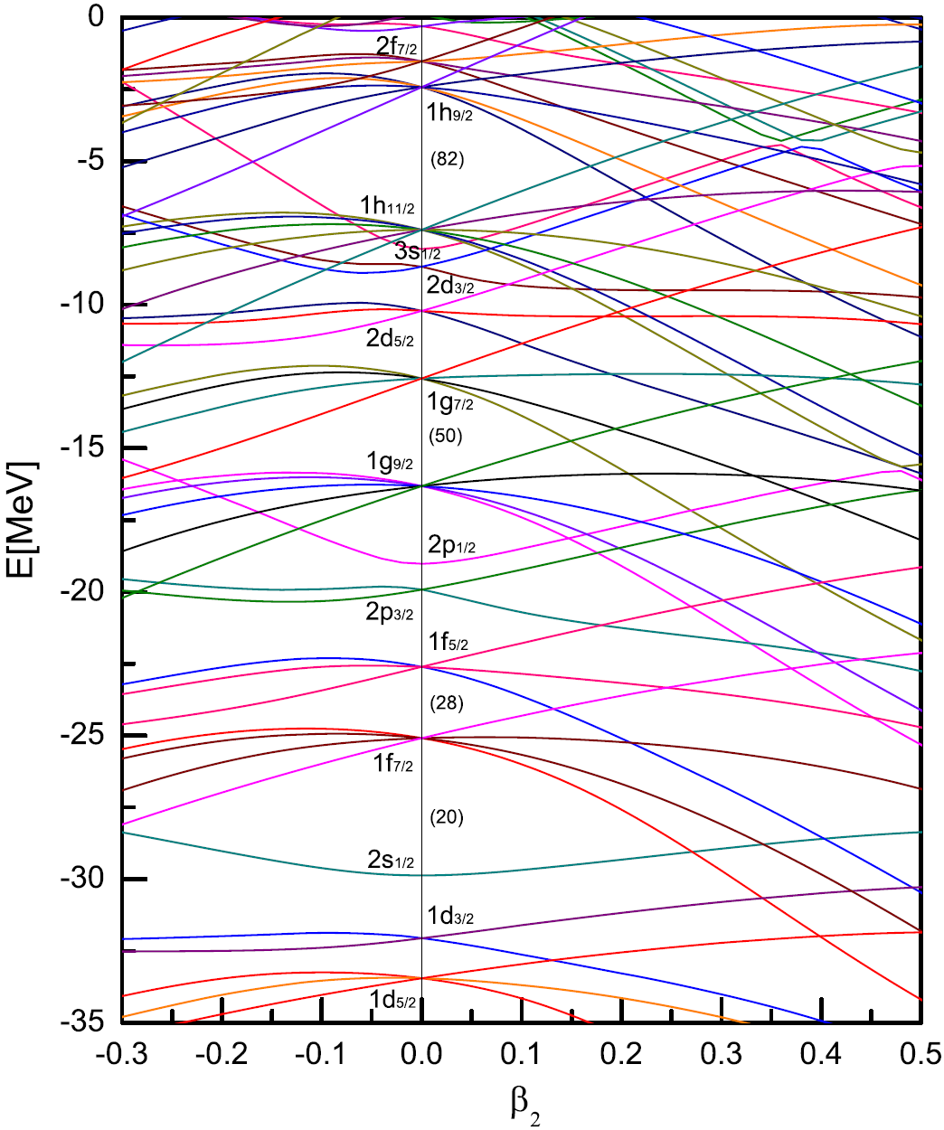
The single particle levels obtained from the diagonalized Hp for ¹⁵⁴Dy
Exact Results
SRG Results

